Slide 1
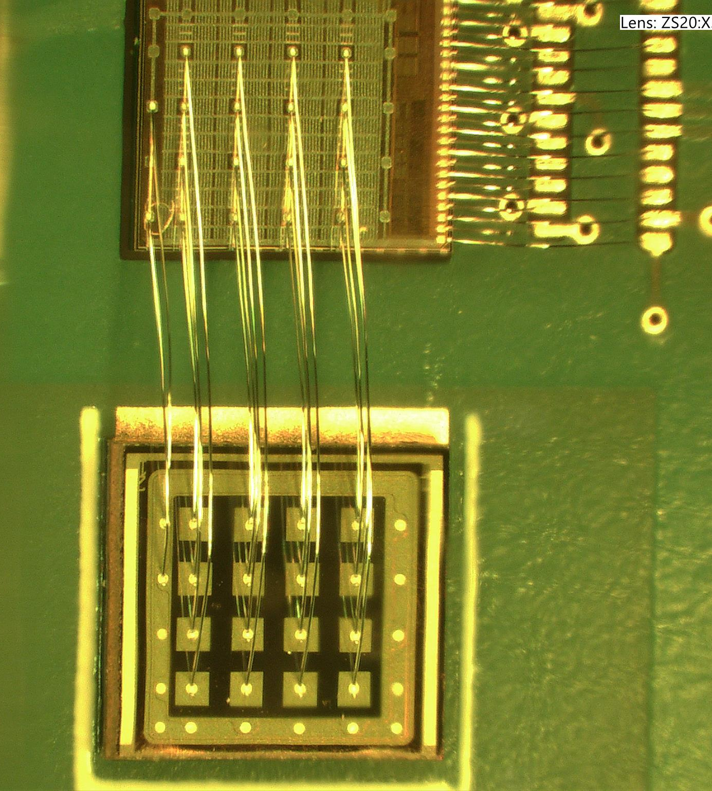
IR Laser test bench status
O. Brand-Foissac, V. Chaumat, T. Cornet, D. Marchand, A. Sharma, L. Serin, A. Torrentó

Slide 2
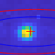
Progress
DAQ with AC-LGAD + EICROC0 (see Dominique’s talk)
Diffraction problem on the spot (not on focal point, but before and after), solved with a fiber collimator after laser fiber output
  The incident angle on the first lens was too high, so we had non-paraxial effects. With the collimator, we reduce this angle to paraxial levels and diffraction and other aberrations have disappeared.
  PRELIMINARY : the spot diameter measures ∼ 2 – 3 pixels < 10 μm to be verified
  With new initial spot size (collimator output), now we have to rearrange
  optical elements (distances)
DAQ software development ongoing (state machine to launch a measurement sequence and store data)

