Slide 1
Tribute to Sydney Gales
15th of December 2025

Slide 2
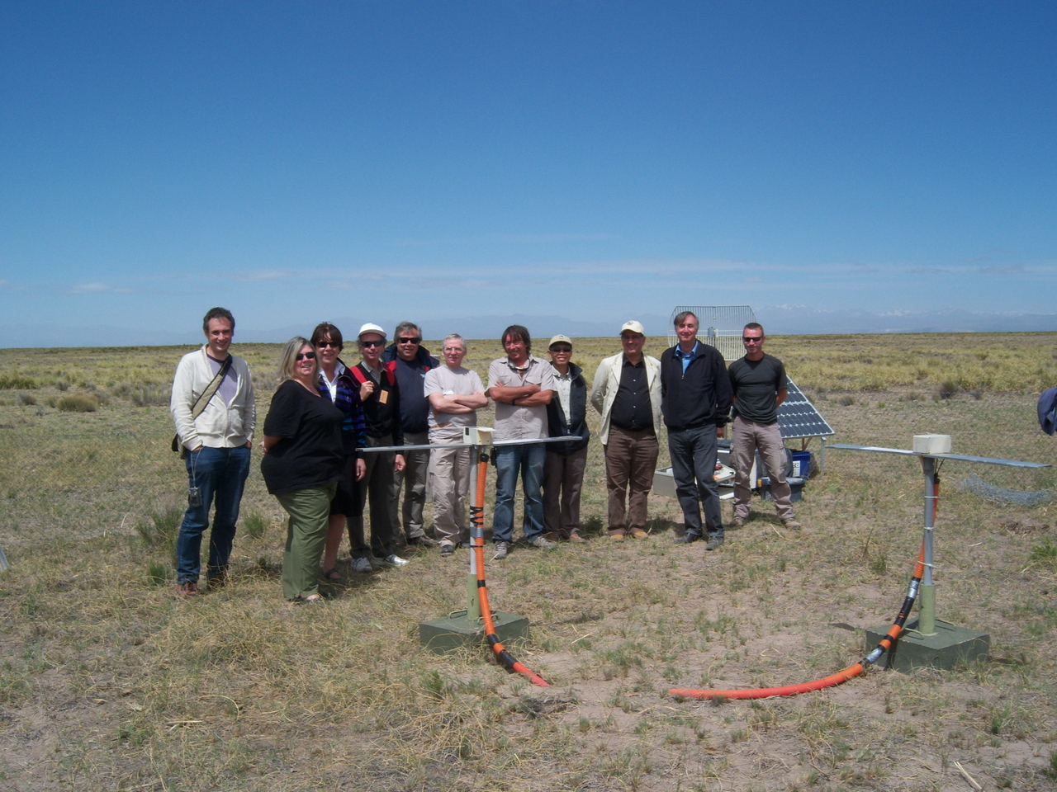
SYDNEY AND THE CNRS VIP’s IN THE PAMPA
AUGER CELEBRATION, NOVEMBER 2008

Slide 3
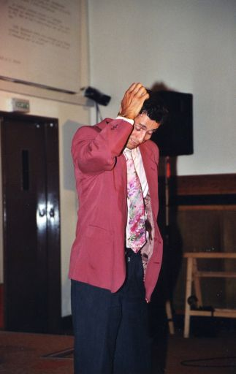
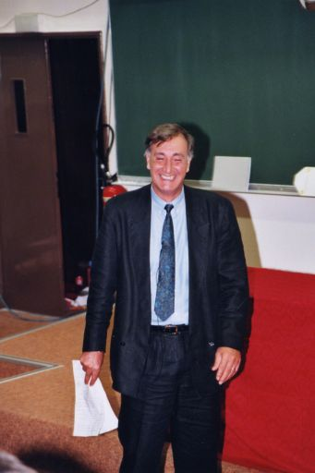
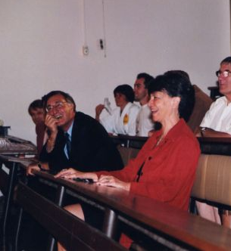
Fête de l’IPN , Septembre 2000

