Slide 1
The AGOR-KVI initiative
Sydney Galès
A Long Journey of Research, Innovation, Collaboration, Leadership and Friendship
Muhsin N. Harakeh
University of Groningen
15 December 2025

Slide 2
Sydney Galès the Leader
Sydney has contributed a lot to the national (French) and international nuclear physics communities through his research, innovative ideas, his dedication and initiating collaborations with others, with his leadership and service to the community. Some of the important positions and contributions:
He has spent time abroad at Université Montreal 1970-1972 and MSU East Lansing 1978-1980
He has been Physics group leader at Orsay 1974-1984 and AGOR project leader 1986-1994. Because of his contributions to the scientific future of KVI/RUG, he was appointed extra-ordinary professor at Univ. of Groningen 1992-2008.
Director of IPN Orsay 1994-2002
Chair of NuPECC 1996-2000 (LRP 1997)
Chair of GANIL Scientific council 1998-2001
Chair of IN2P3/CNRS Scientific council 2003-2005
Chair of STI (Scientific and Technical Issues) FAIR 2004-2006
Chair of the LRP for the French particle, Astroparticle and nuclear physics 2004-2005

Slide 3
Deputy Director IN2P3-CNRS 2004
Director of GANIL 2005-2011
Chair or member of scientific and/or Review committees of KVI, Dubna, Lanzhou, RIKEN, Cracow, MICINN(Spain)
Chair/member International Conference Advisory Committees (More than 50)
Scientific coordinator of EU FP7 Programme ERANET-NUPNET 2008...
Member of IUPAP C12 and OECD Nuclear Physics working group 2005...
Member of Int’l Jury “webby awards, New York, 1995...
President of the “Normandie Incubateur “ (nurture new start-ups) 2009-2011
Scientific Director of ELI-NP
…and many, many more…
For all his contributions he has received several distinctions:
Medal of CNRS - 1974
Knight in the order of Oranje-Nassau, the Netherlands - 1996
Ordre National du Mérite, France - 1997
Flerov Prize, JINR Dubna - 2009

Slide 4
GEPL (Groupe d'Etudes de Projet du Laboratoire)
1979-1983 was proposing a project to implement a novel accelerator at IPN, Orsay. The studies were very advanced and the project ready to be implemented. GEPL was hoping for financing.
However, the new projects at the time: MIMAS, Saclay Booster, Vivitron and the National Laboratories SATURNE and GANIL were in competition in the same period.
This led to a priority ranking of the IPN project in 1983, which did not leave much hope for its realisation.

Slide 5
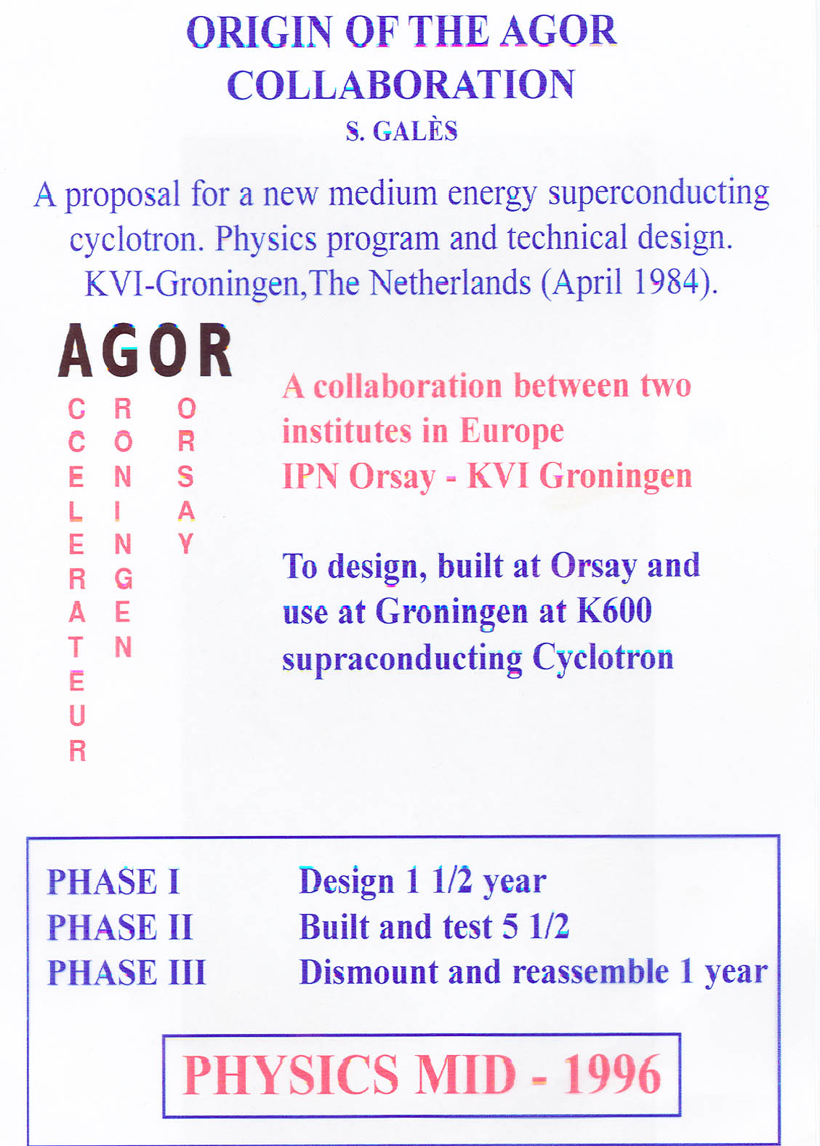
Project Leaders AGOR
(Sydney Galés & Hans Schreuder)

Slide 6
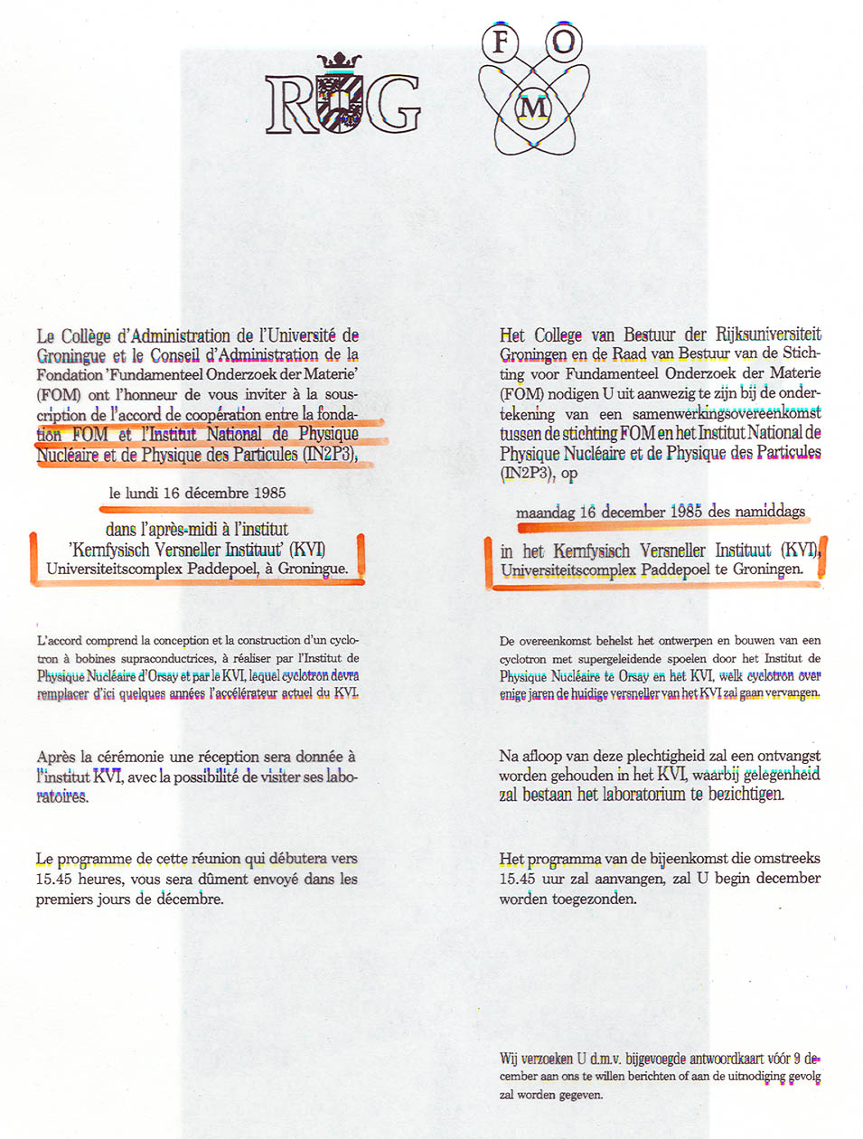
It takes about one year to sign the official start of AGOR in Groningen; December 16, 1985

Slide 7
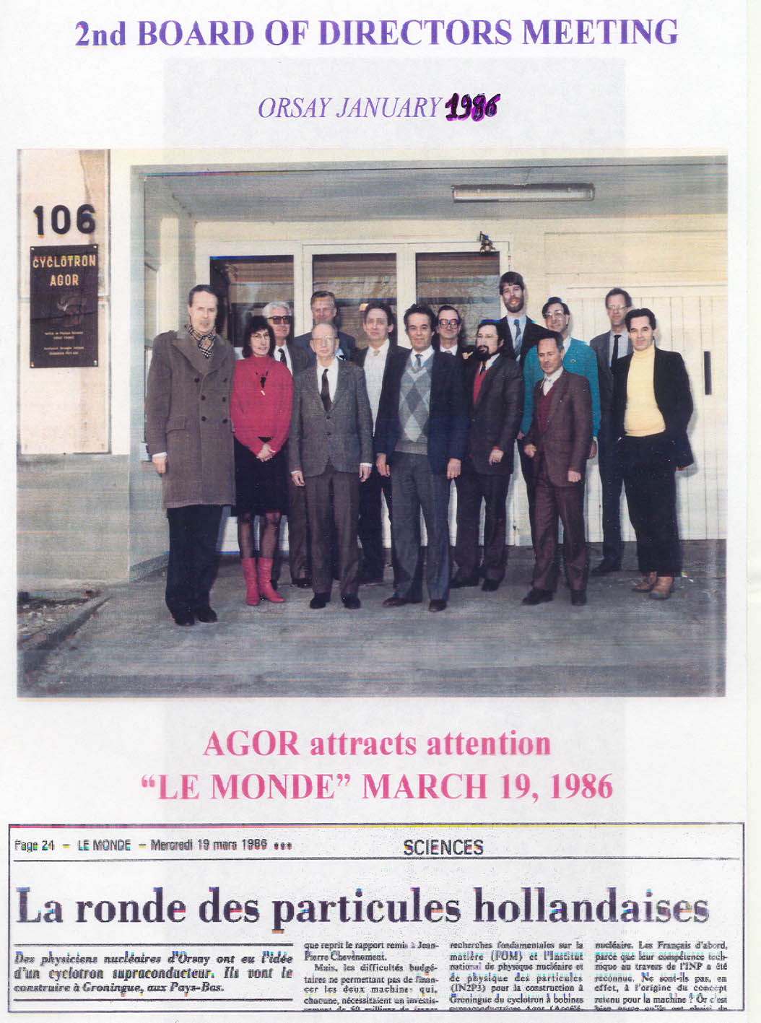

Slide 8
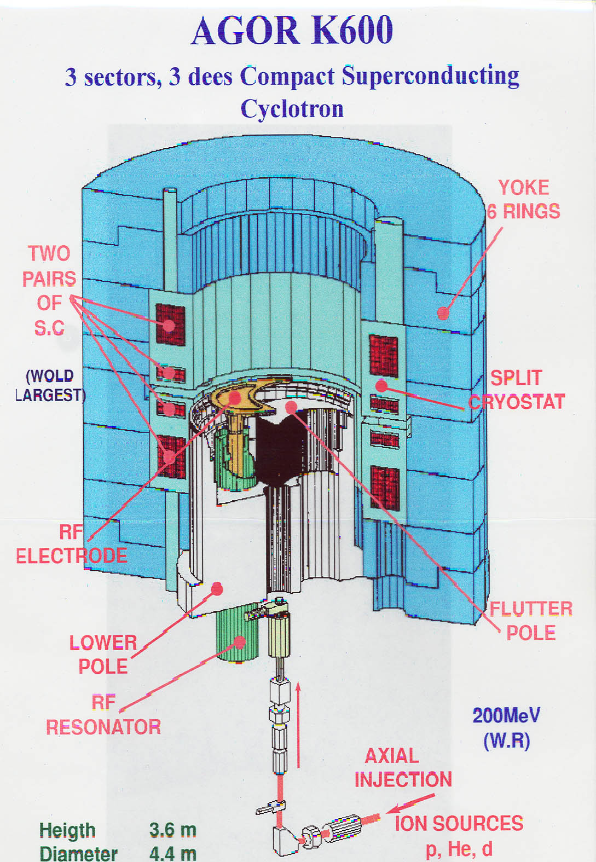
AGOR Cyclotron
Compact Cyclotron with superconducting coils.
Broadly deployable accelerator for nuclear physics and applied research (including medical research).
Accelerates elements from hydrogen to lead.

Slide 9
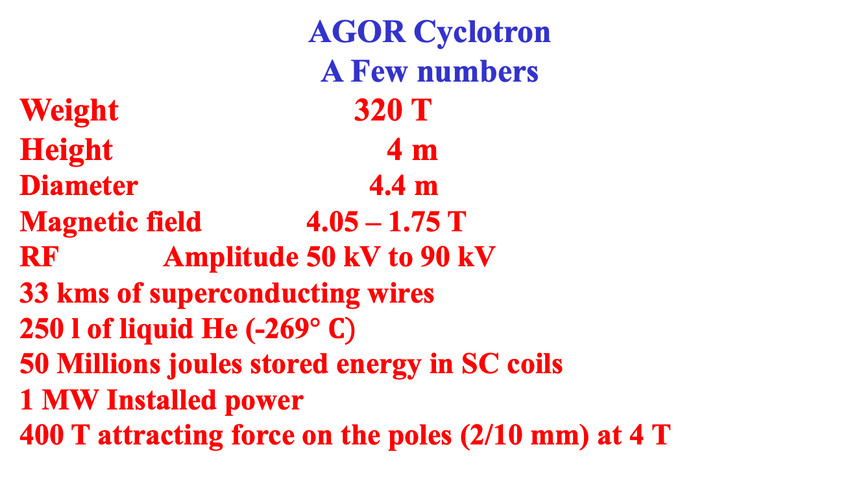
Basic design: All ions
200 MeV pol p and d; 100 MeV/n Z/A = 0.5; 10 MeV/n Z/A = 0.1
AGOR Cyclotron
A Few numbers
Weight 320 T
Height 4 m
Diameter 4.4 m
Magnetic field 4.05 – 1.75 T
RF Amplitude 50 kV to 90 kV
33 kms of superconducting wires
250 l of liquid He (-269$° C)$
50 Millions joules stored energy in SC coils
1 MW Installed power
400 T attracting force on the poles (2/10 mm) at 4 T

Slide 10
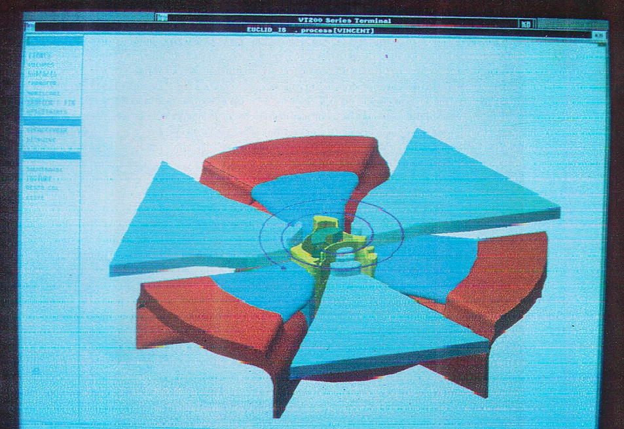
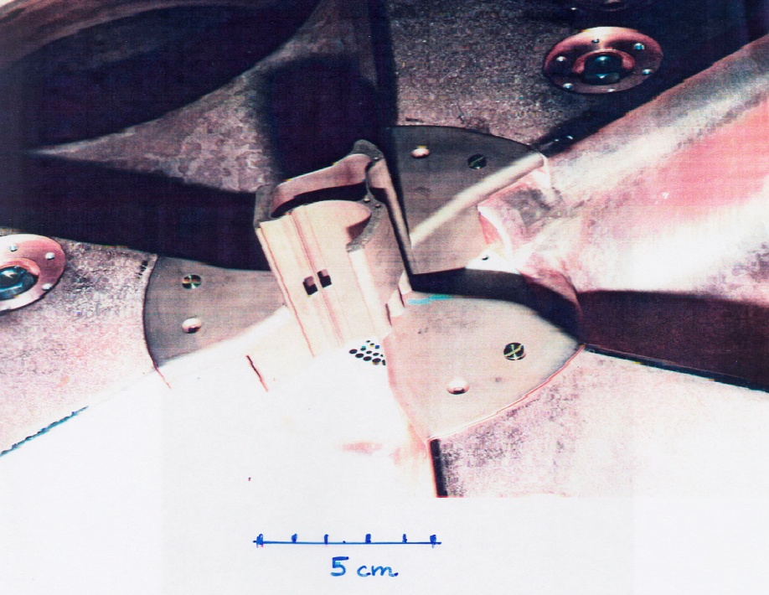
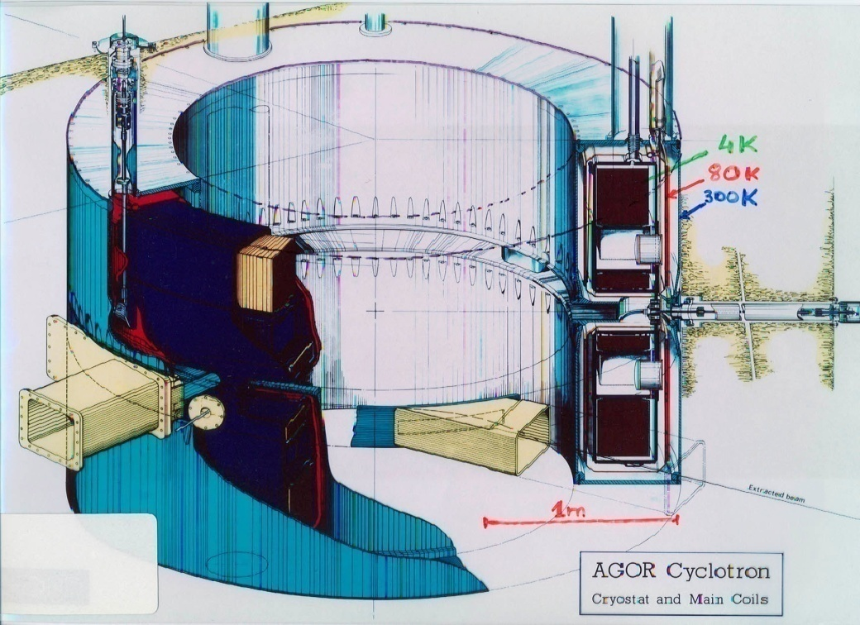
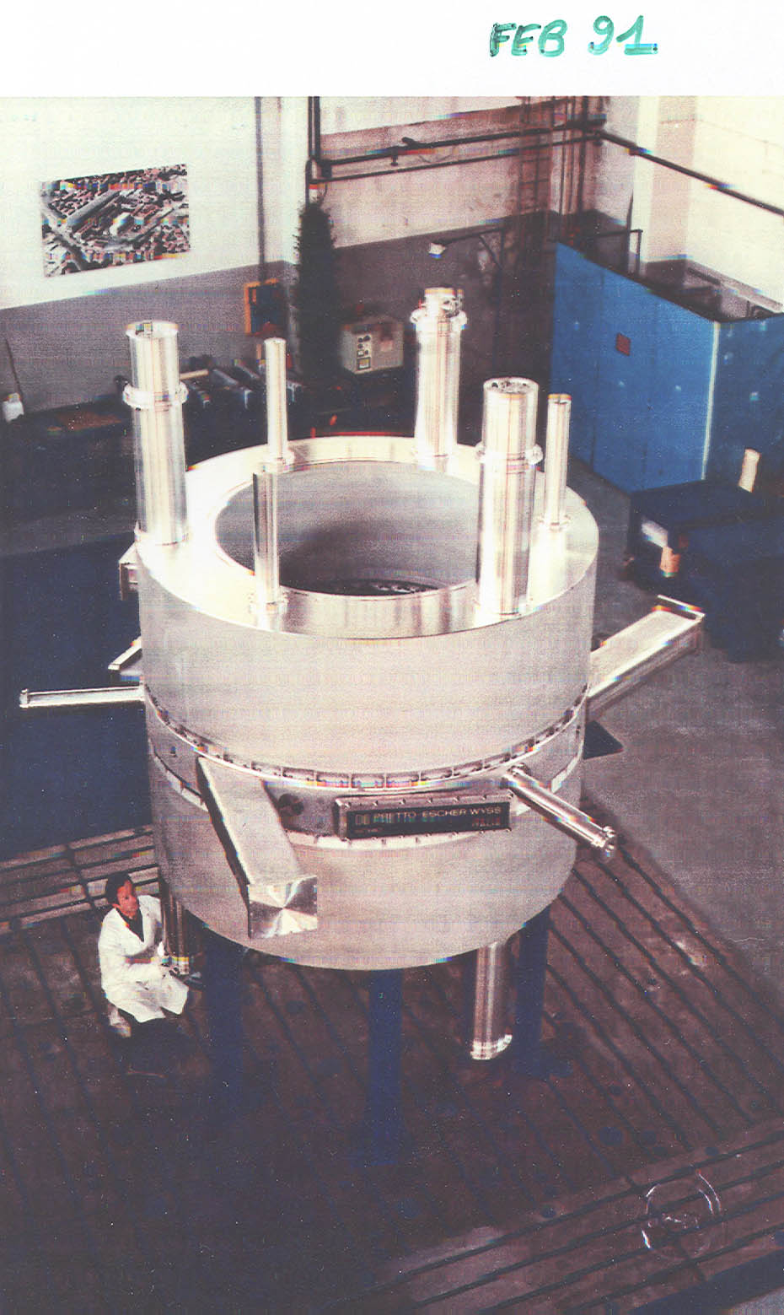
One of the first accelerator designs with
high level of computer-aided design (CAD)

Slide 11
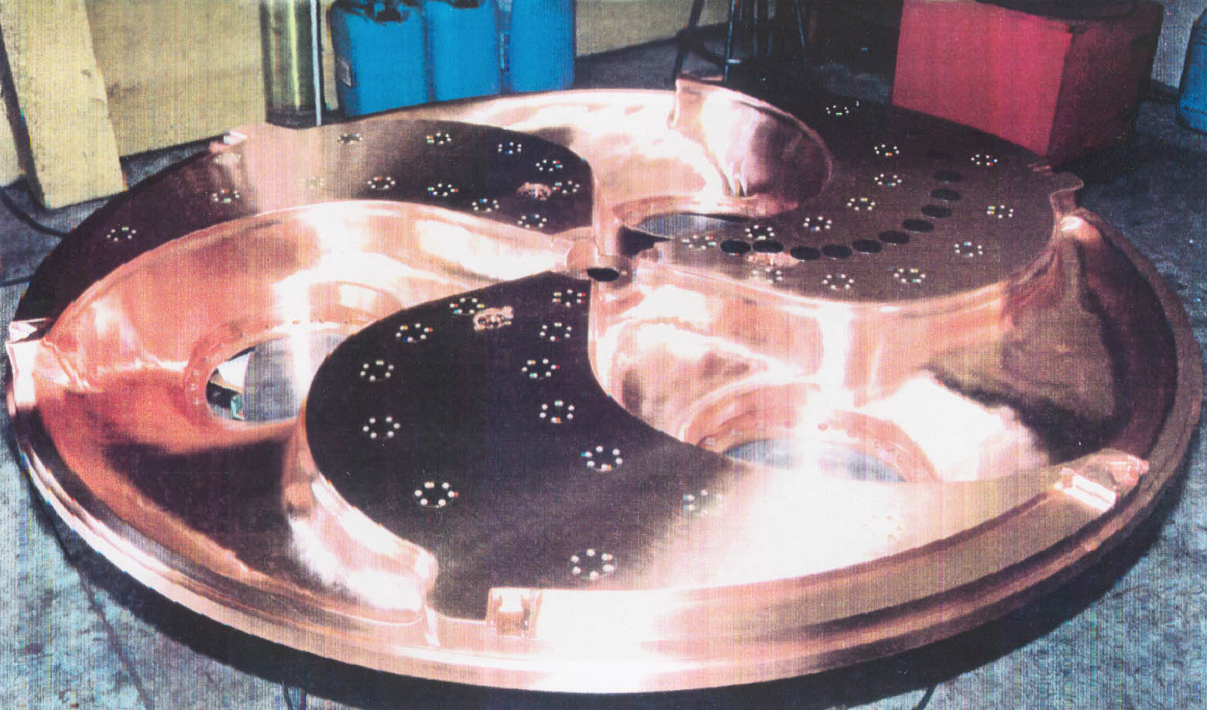
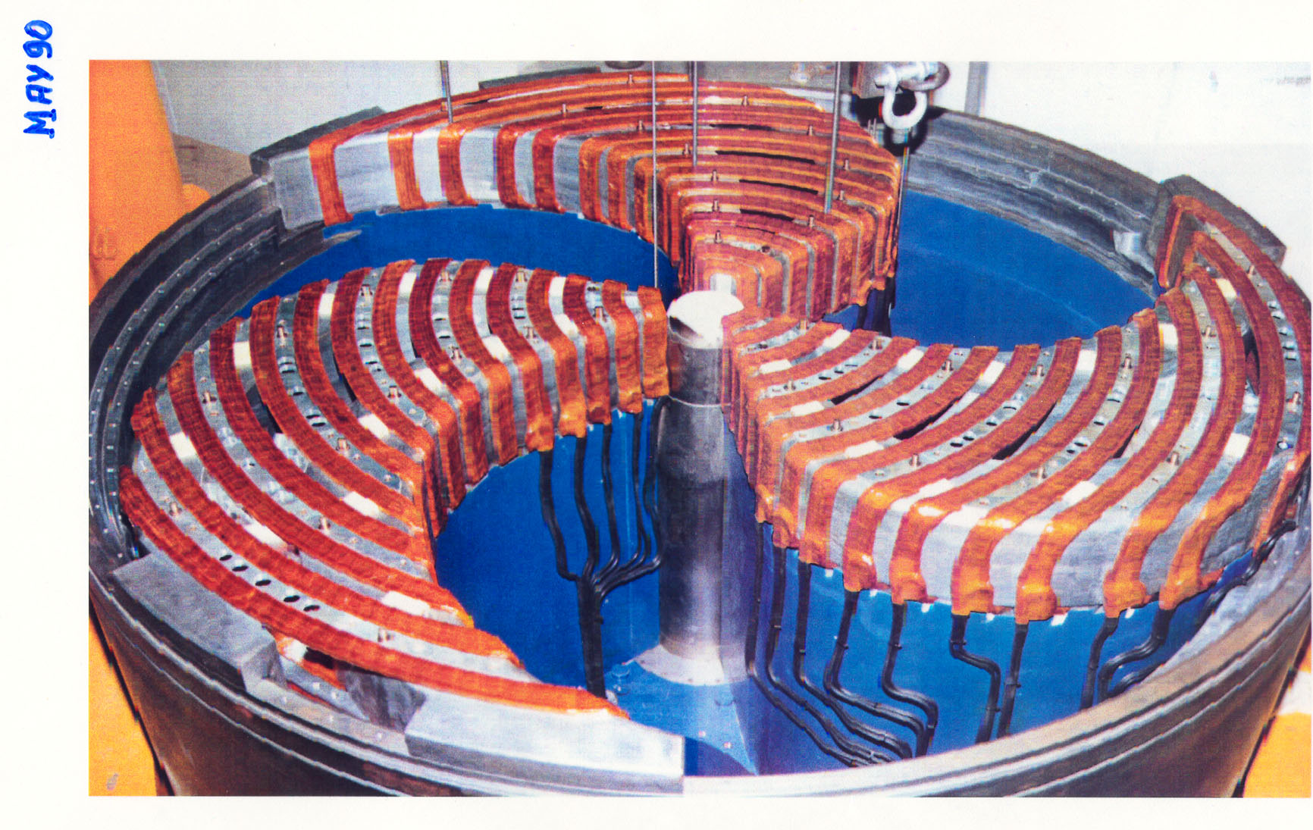
And beautiful to look at!

Slide 12
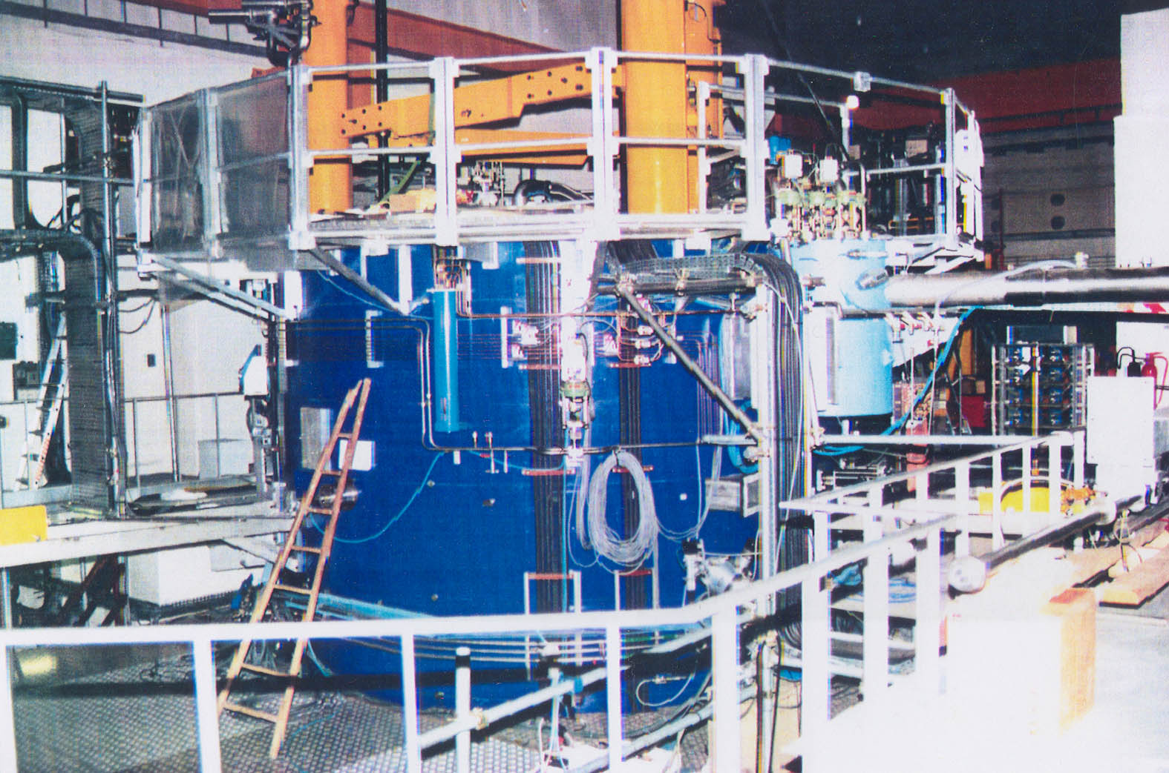
It took many years of hard work to reach the point where AGOR is ready for beam test.
Starting with FOM-IN2P3 Agreement in December 1985.
Approval of budget in May 1987.
From that moment up to February 1994 construction, preparation and montage of all components of AGOR.
3 March 1994 Acceleration of the first intern beam
12 April 1994 Extraction of the first beam of 200 MeV He²⁺
2-9 May 1994Acceleration and extraction of the first beam of 150 MeV protons

Slide 13
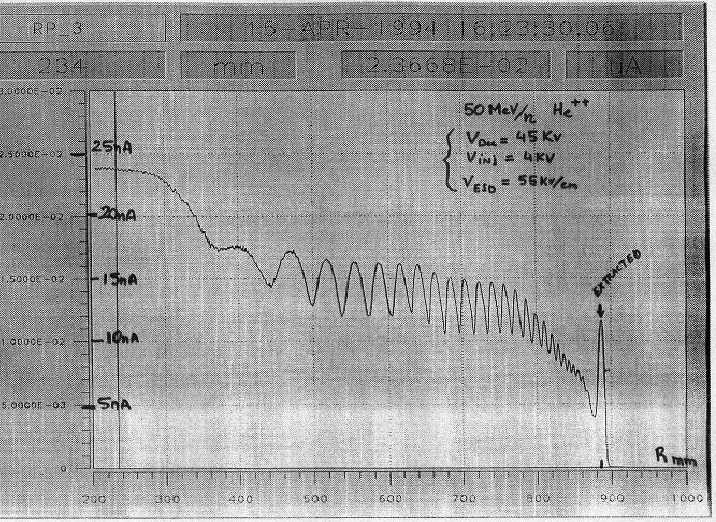
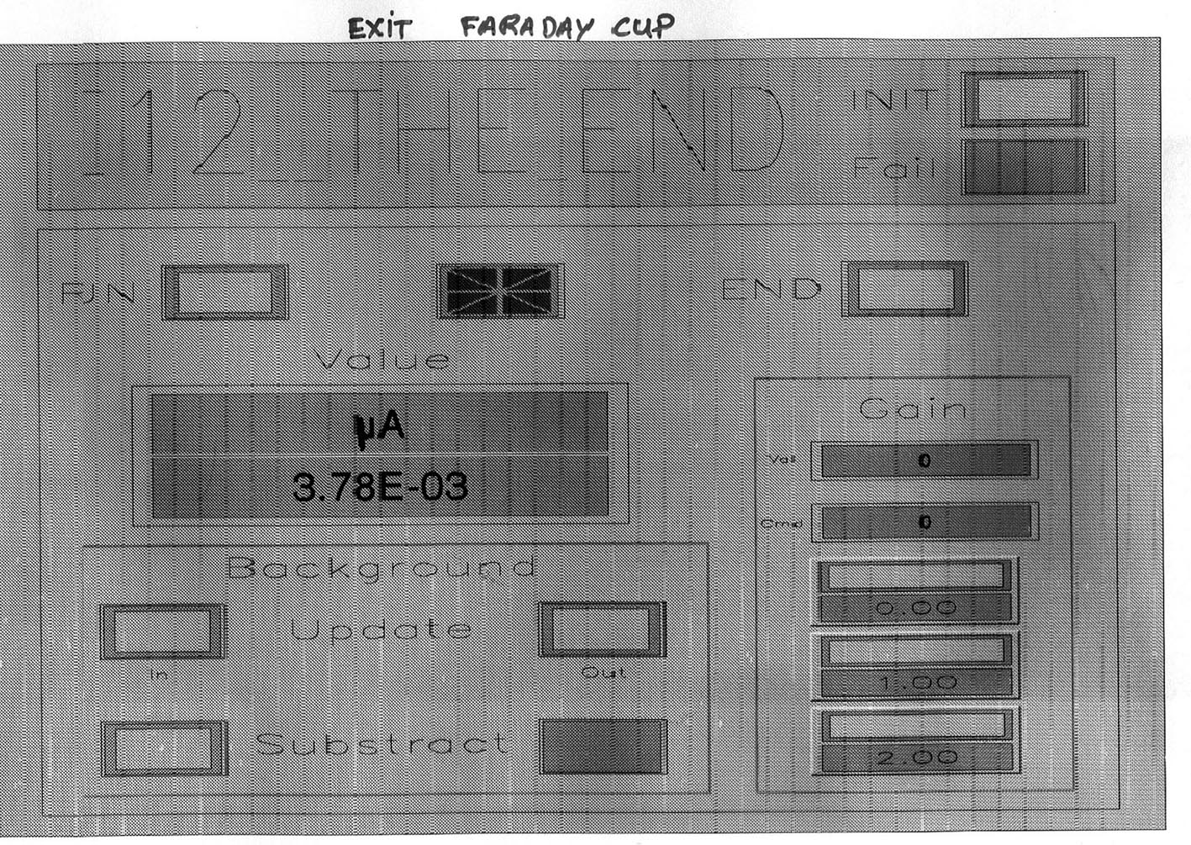
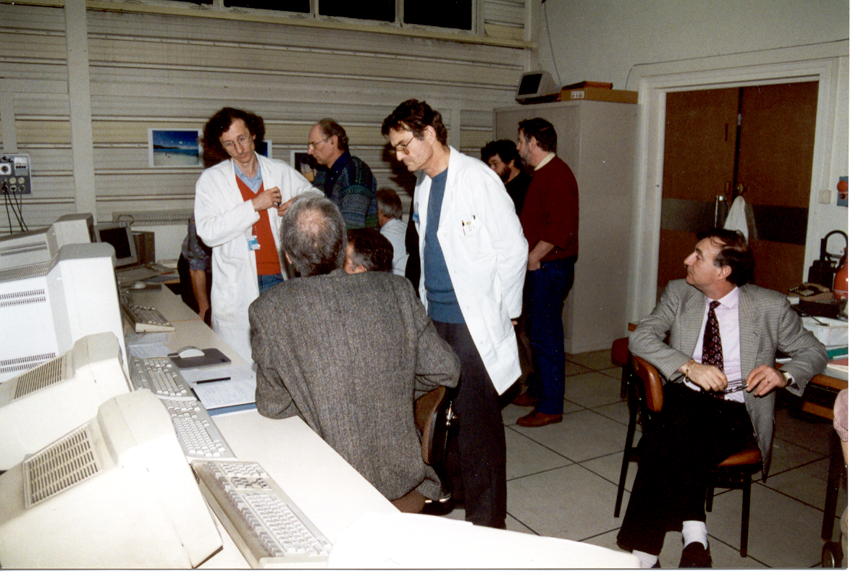
200 MeV ⁴He⁺⁺
Beam Out!!
12 April 1994

Slide 14
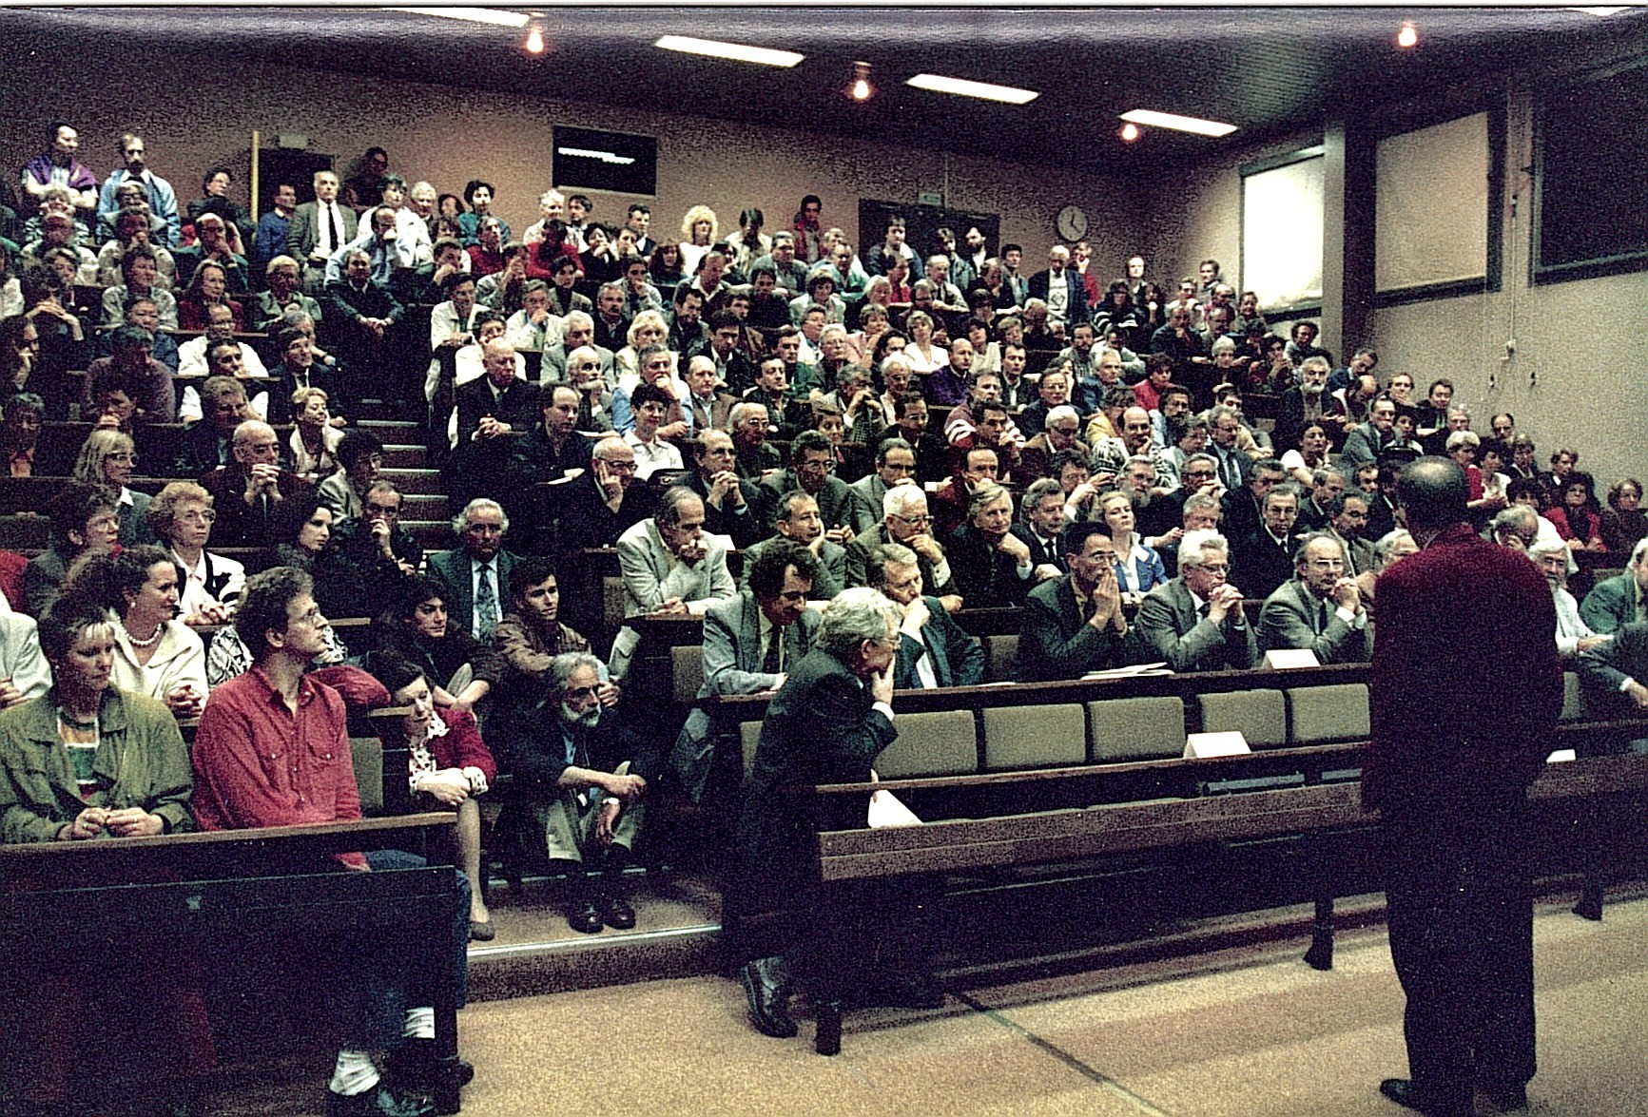
Official celebration at IPN Orsay
May 1994

Slide 15
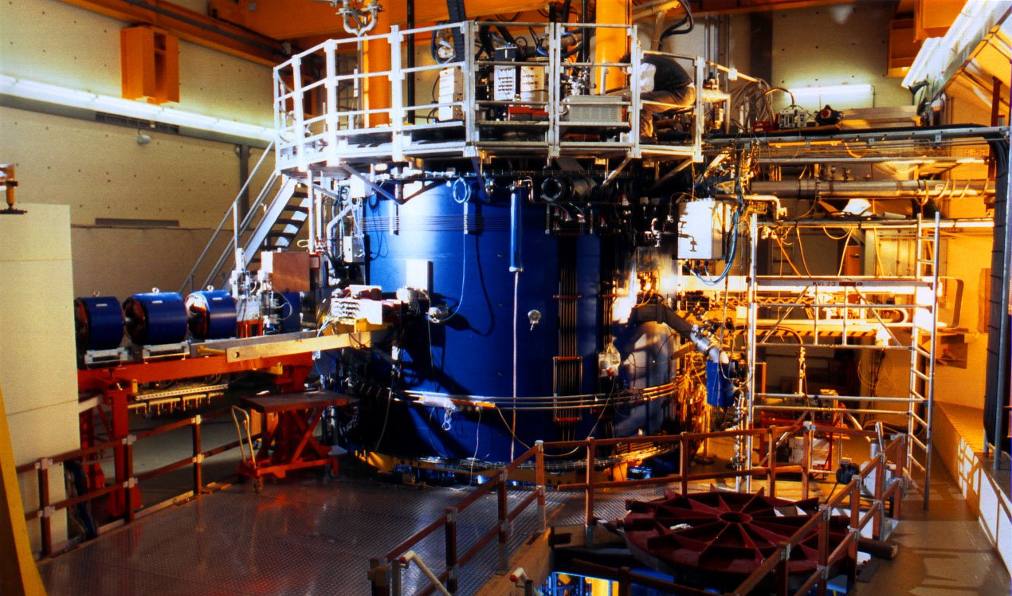

Mid 1994-1996 Installation at KVI
AGOR
Cyclotron@KVI
1996

Slide 16
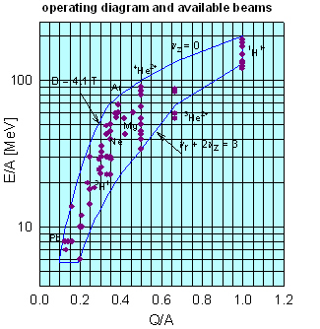
Within less than 1.5 years of operation at KVI most of the predicted possible beams with AGOR were accelerated and extracted from polarised ¹H & ²H
to ²⁰⁸Pb^{~30+}
A success story

Slide 17
Project Leaders AGOR (S.G. + H.S.)
Ceremony in RuG Aula and later KVI
Inauguration of the scientific programme with the AGOR cyclotron
16 January 1997
Opening through:
Dr.ir. J.M.M. (Jo) Ritzen
Minister of Education, Culture and Sciences
and
Mr. François d’Aubert
State Secretary in charge of research

Slide 18
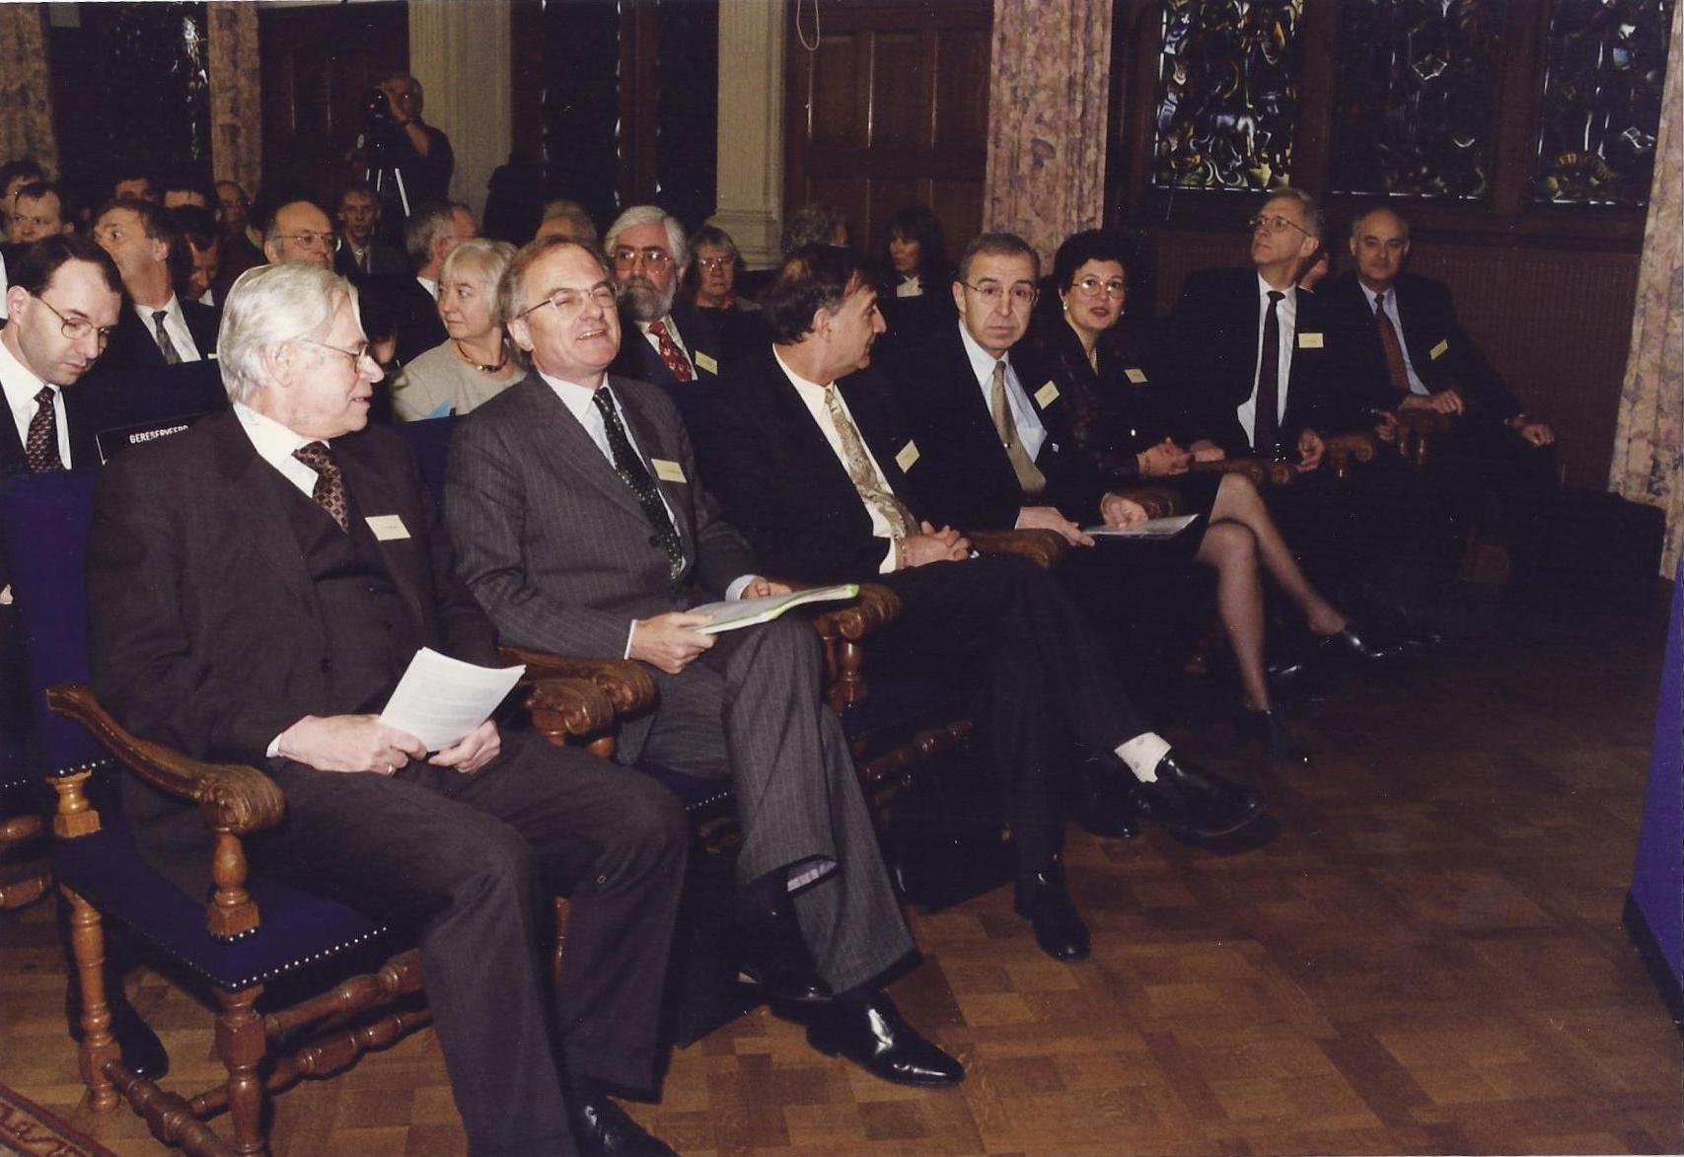
F. van der Woude, Rector Sydney Gales / M.N.H. / E. Dassoum/ Hans Schreuder

Slide 19
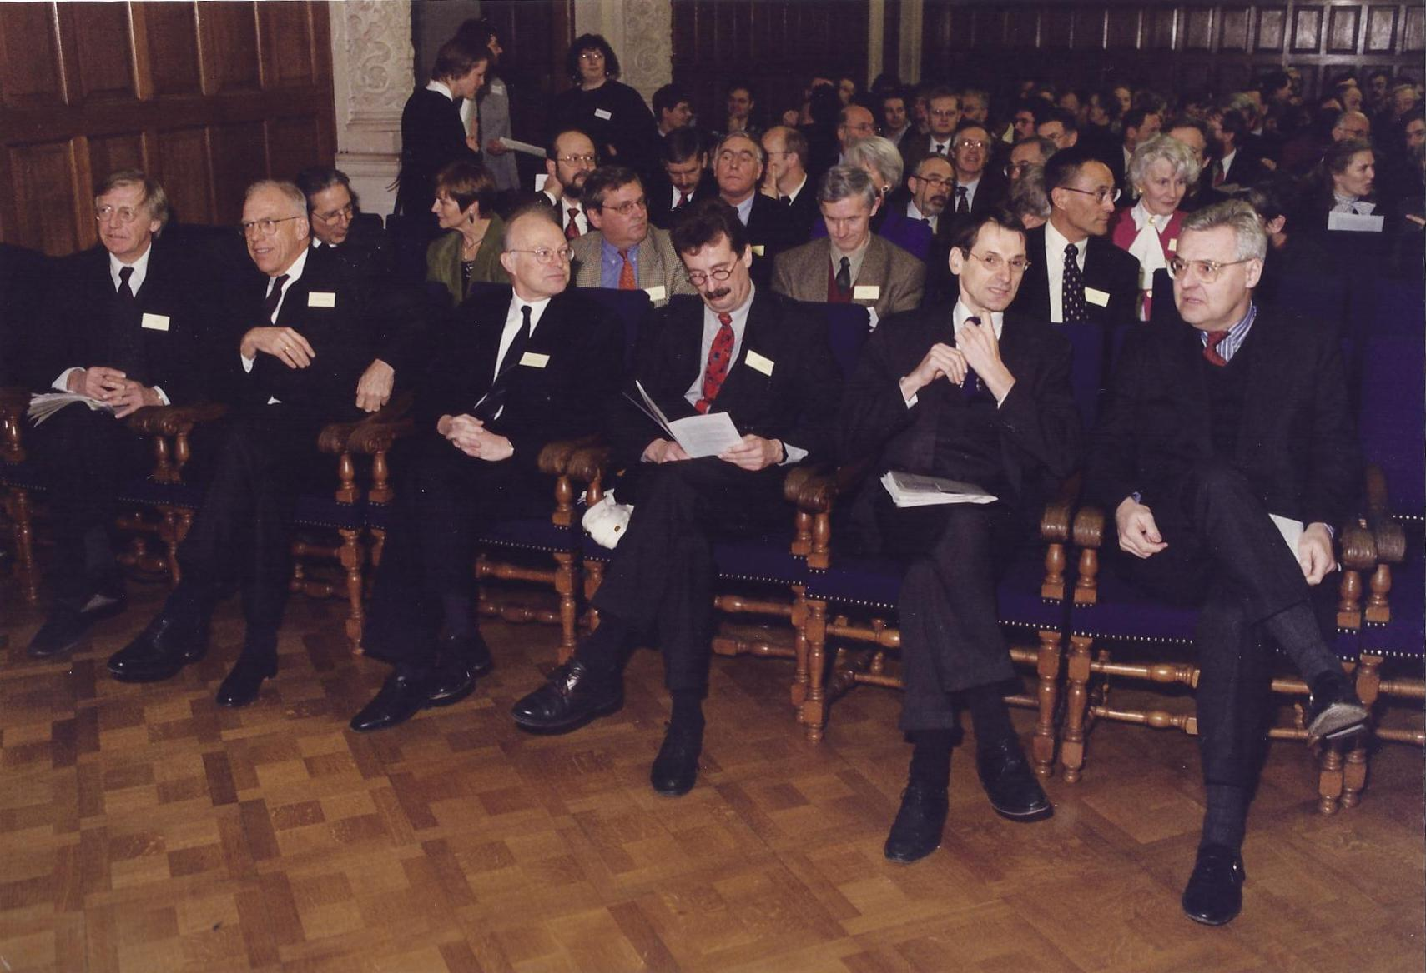
M. Kooiman RuG Executive Board, Hans Alders (commissioner), Ritzen, d’Aubert

Slide 20
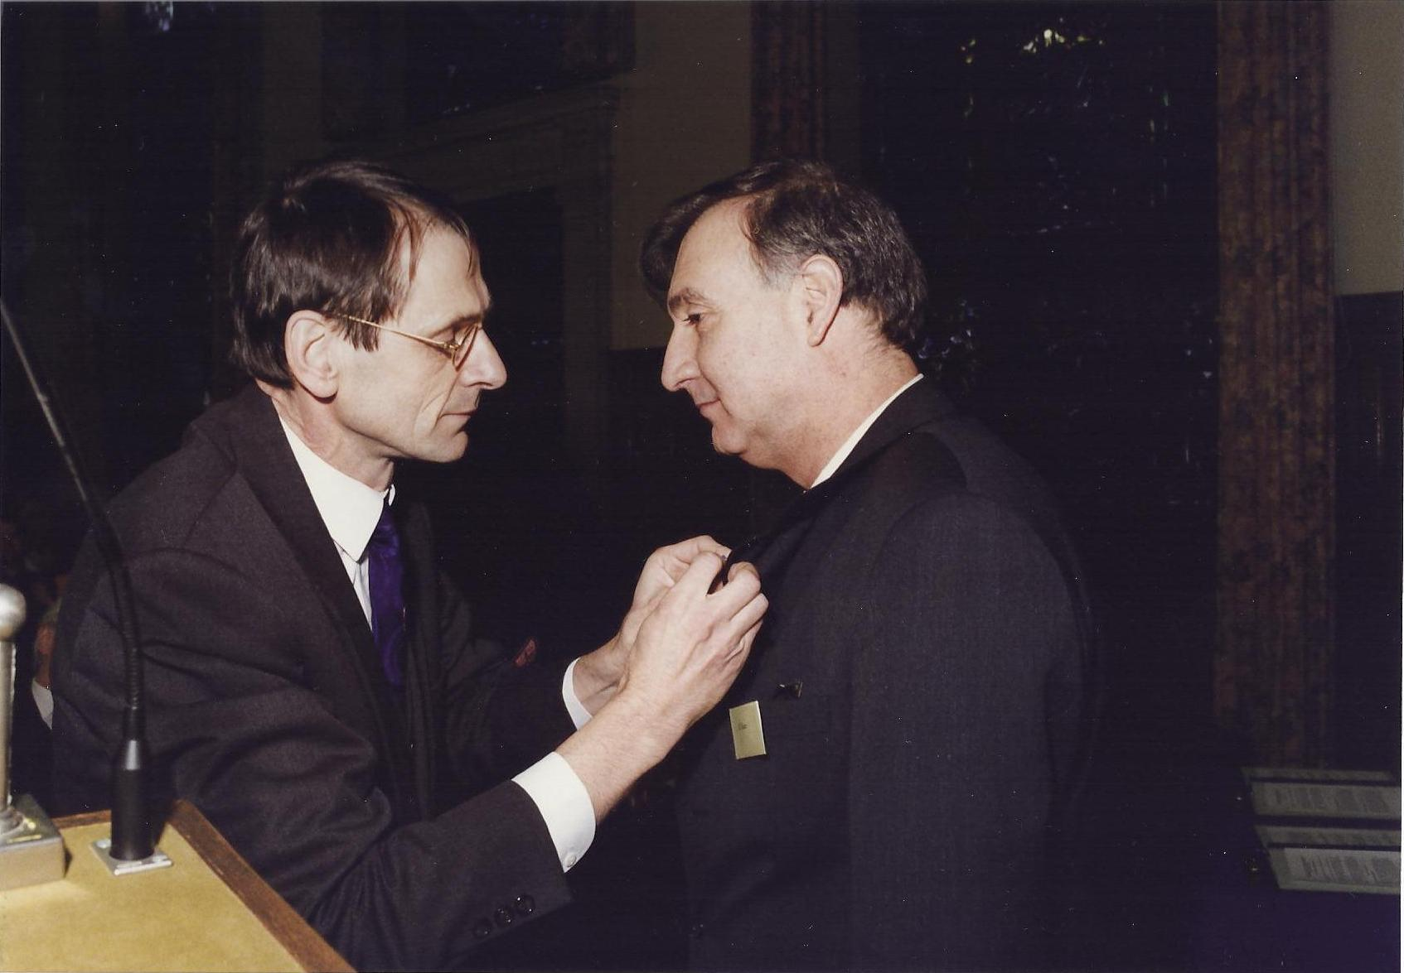
Ritzen decorates Sydney as Knight in the order of Oranje-Nassau

Slide 21
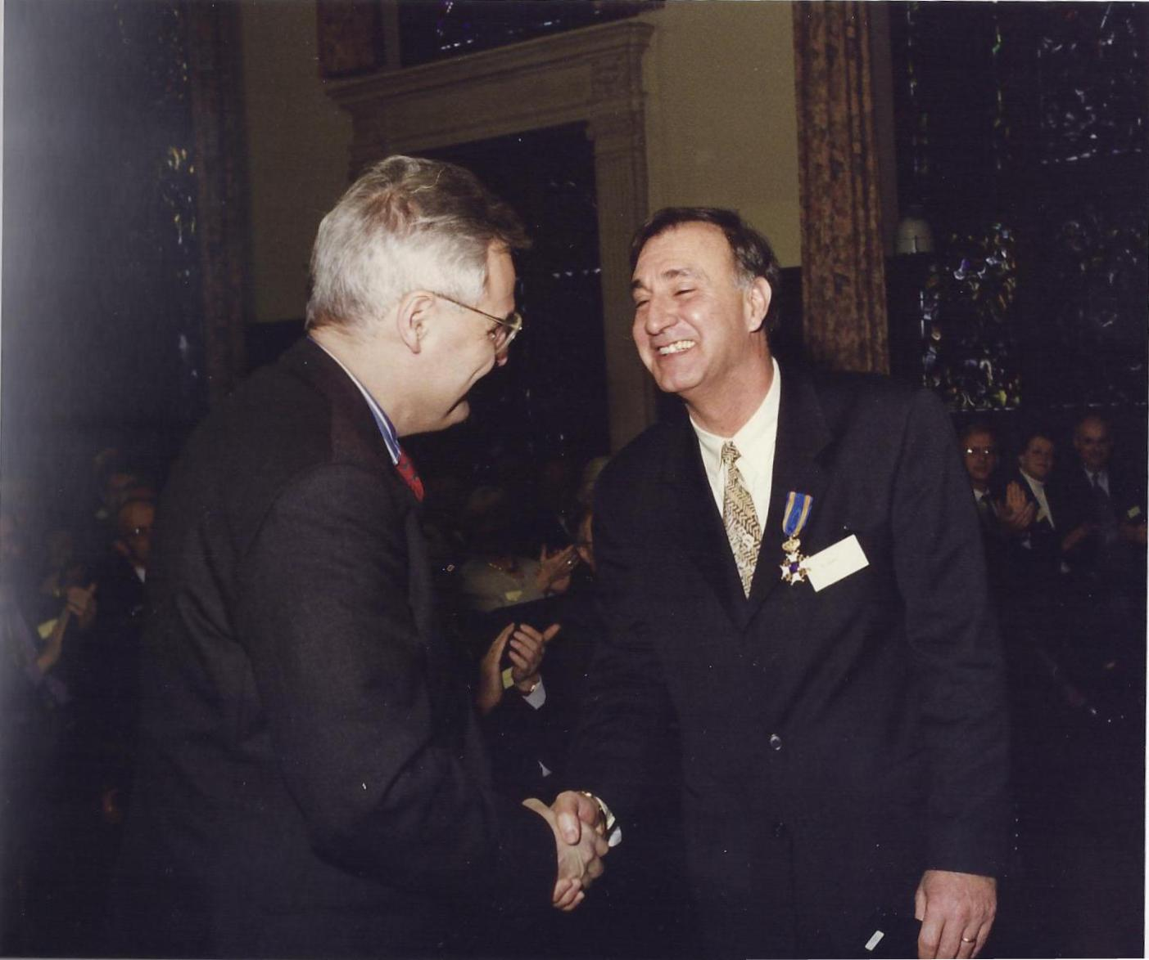

Slide 22
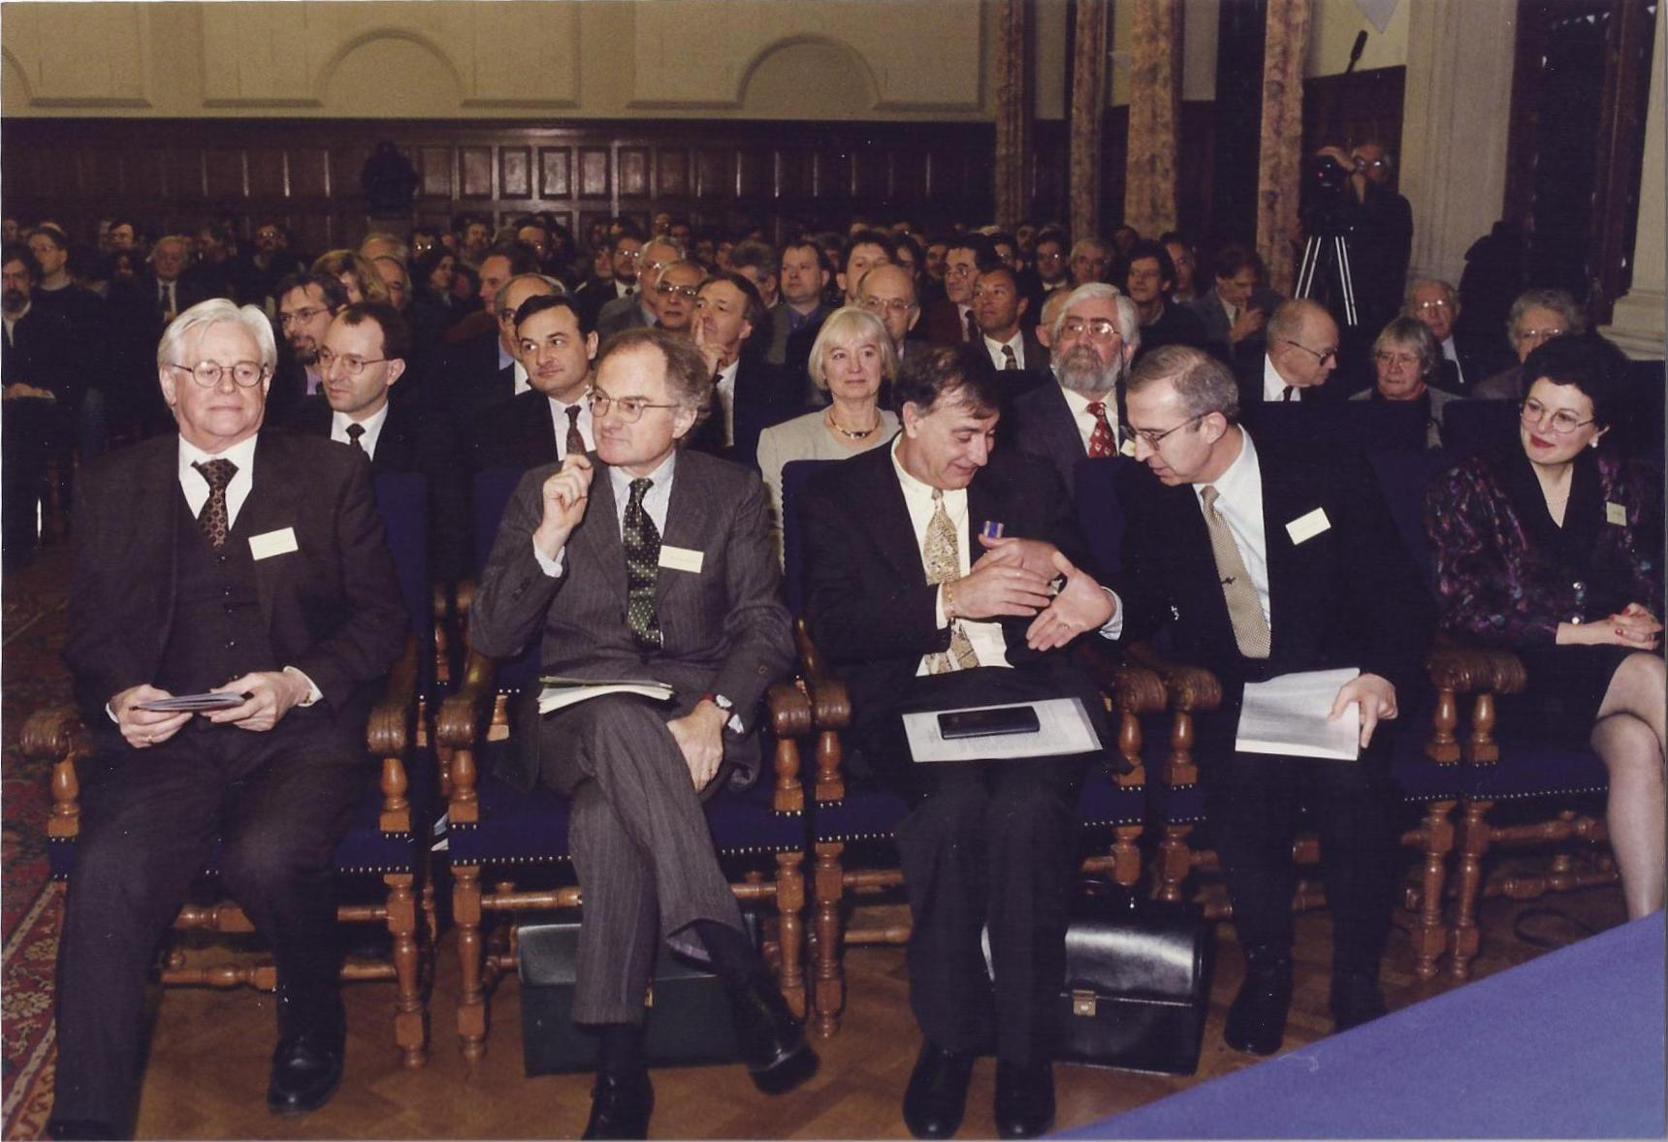
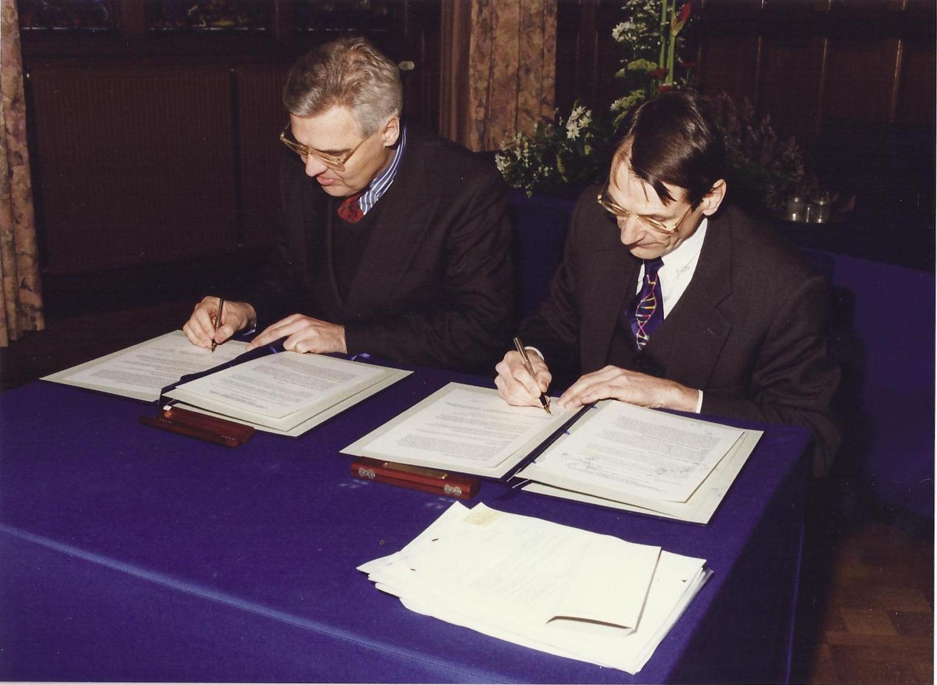

Slide 23
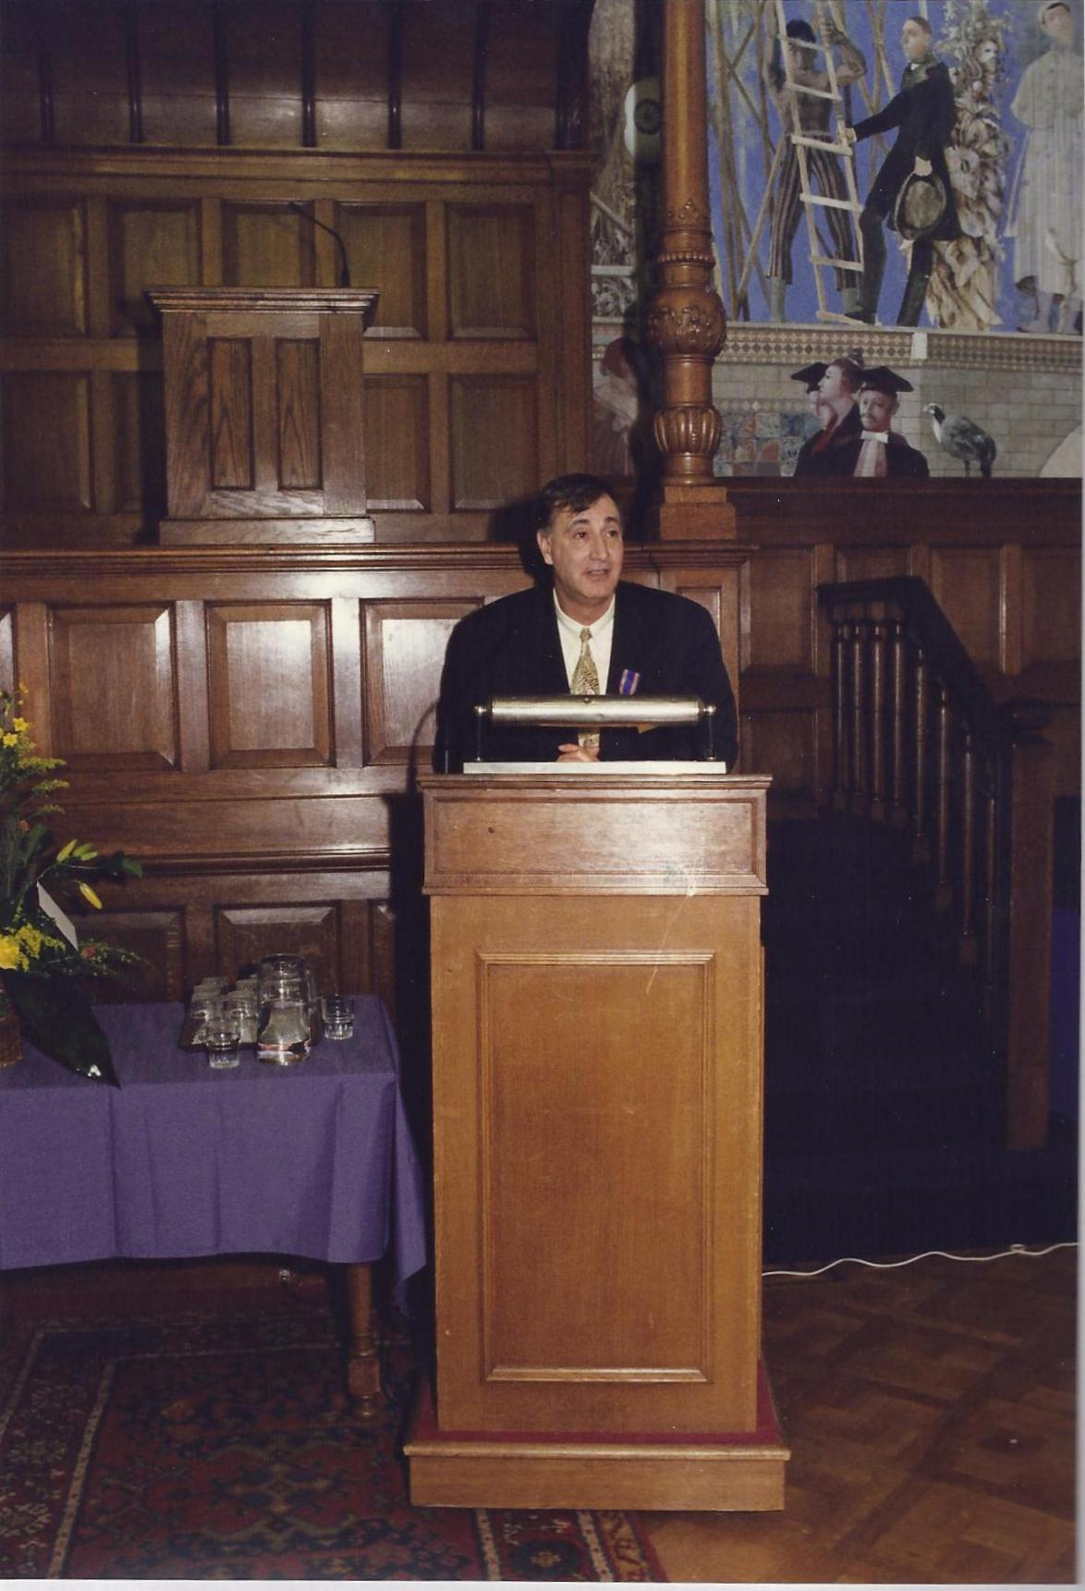

Slide 24
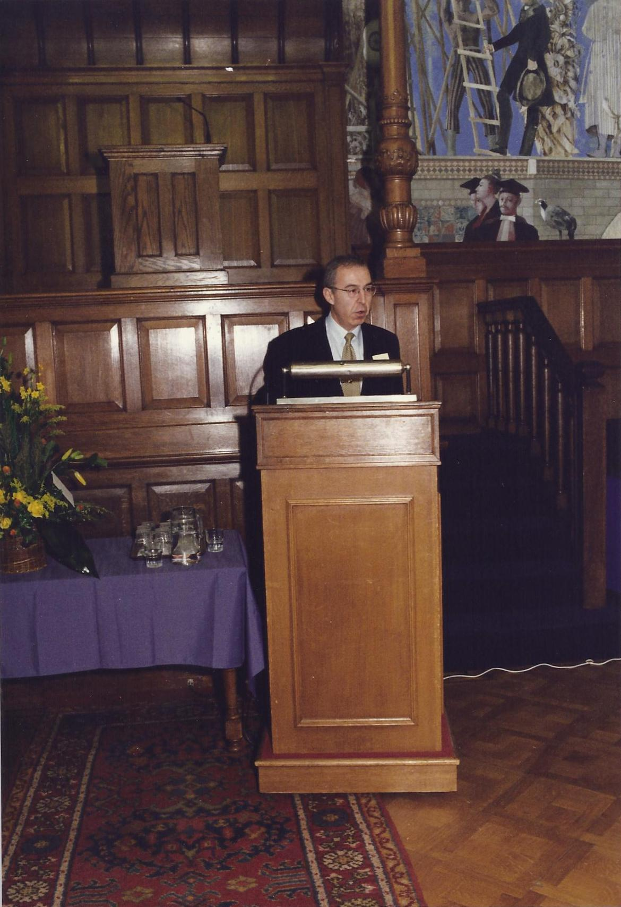

Slide 25
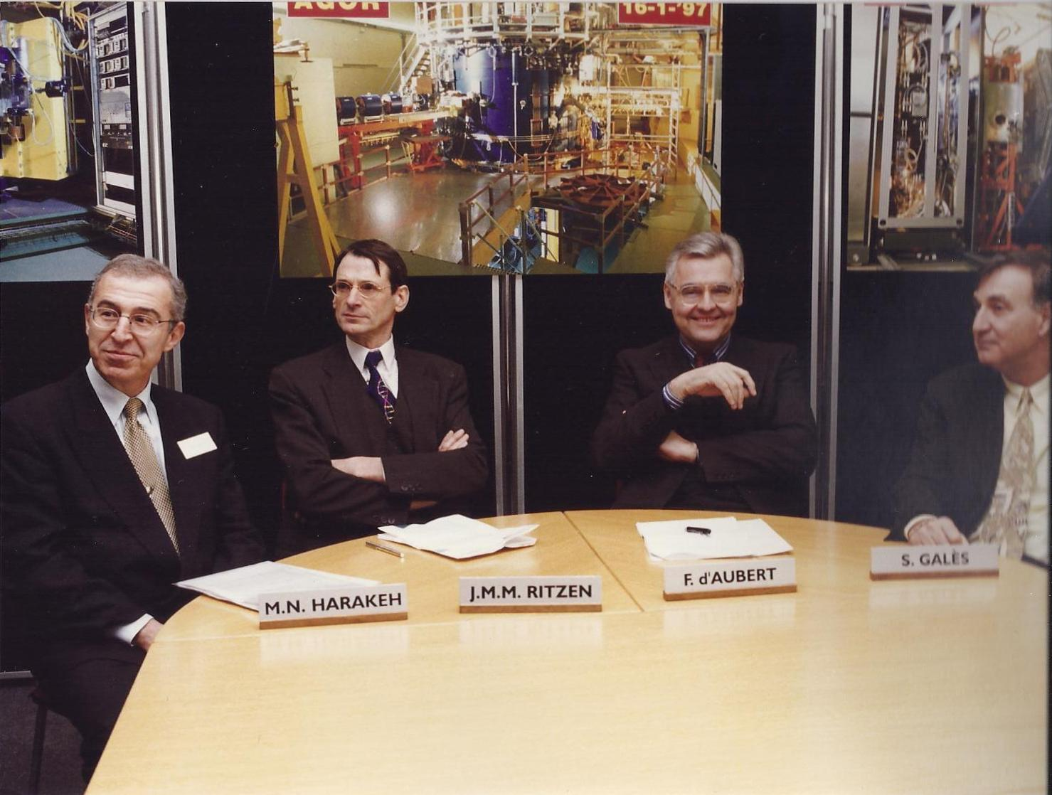
Press conference initiated by Minister Ritzen

Slide 26
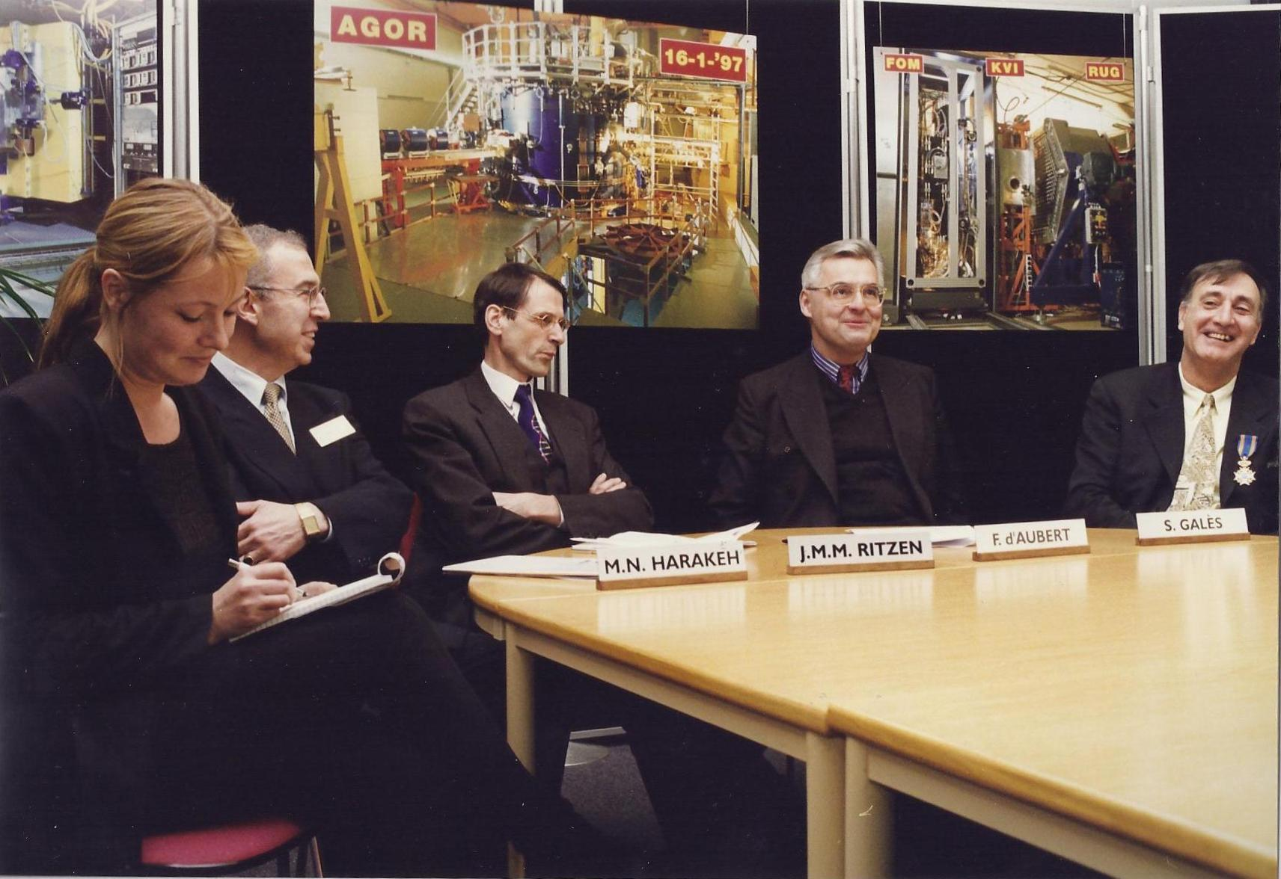

Slide 27
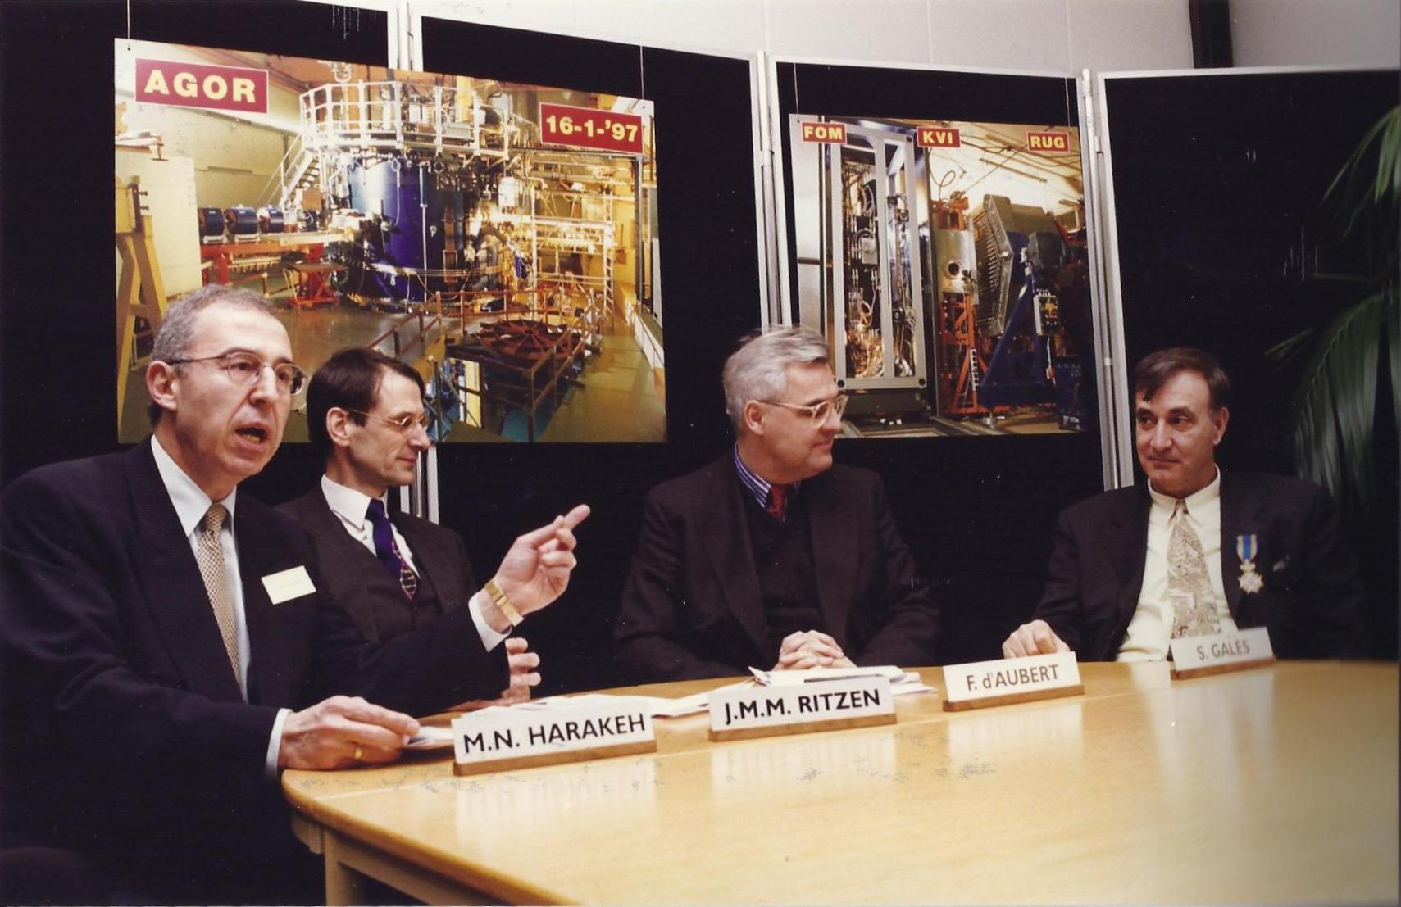

Slide 28
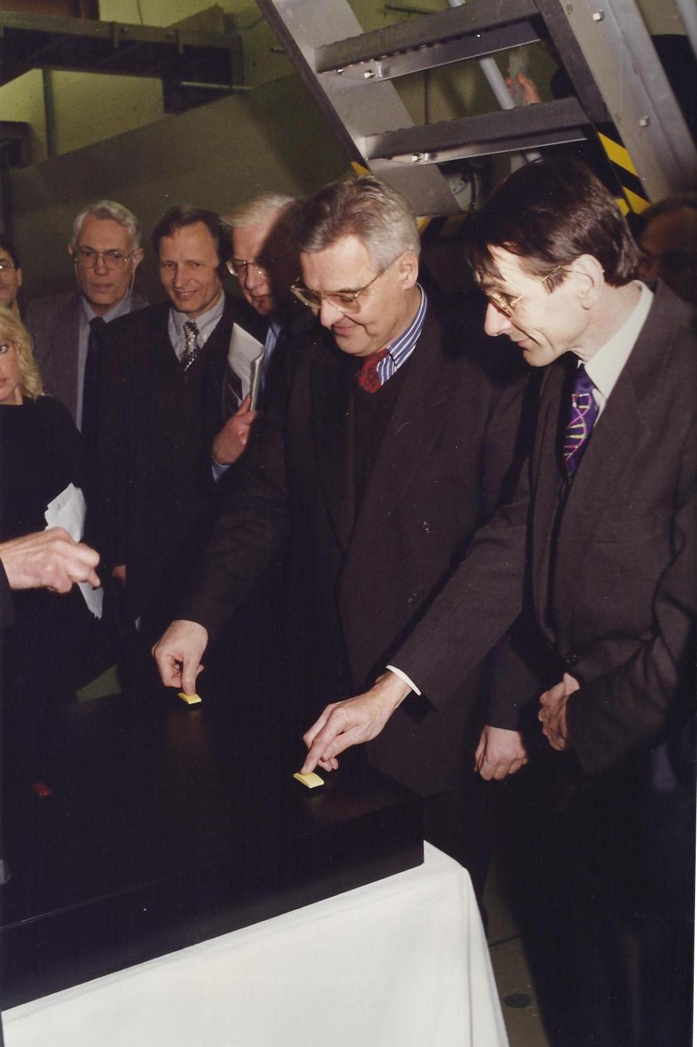

Slide 29
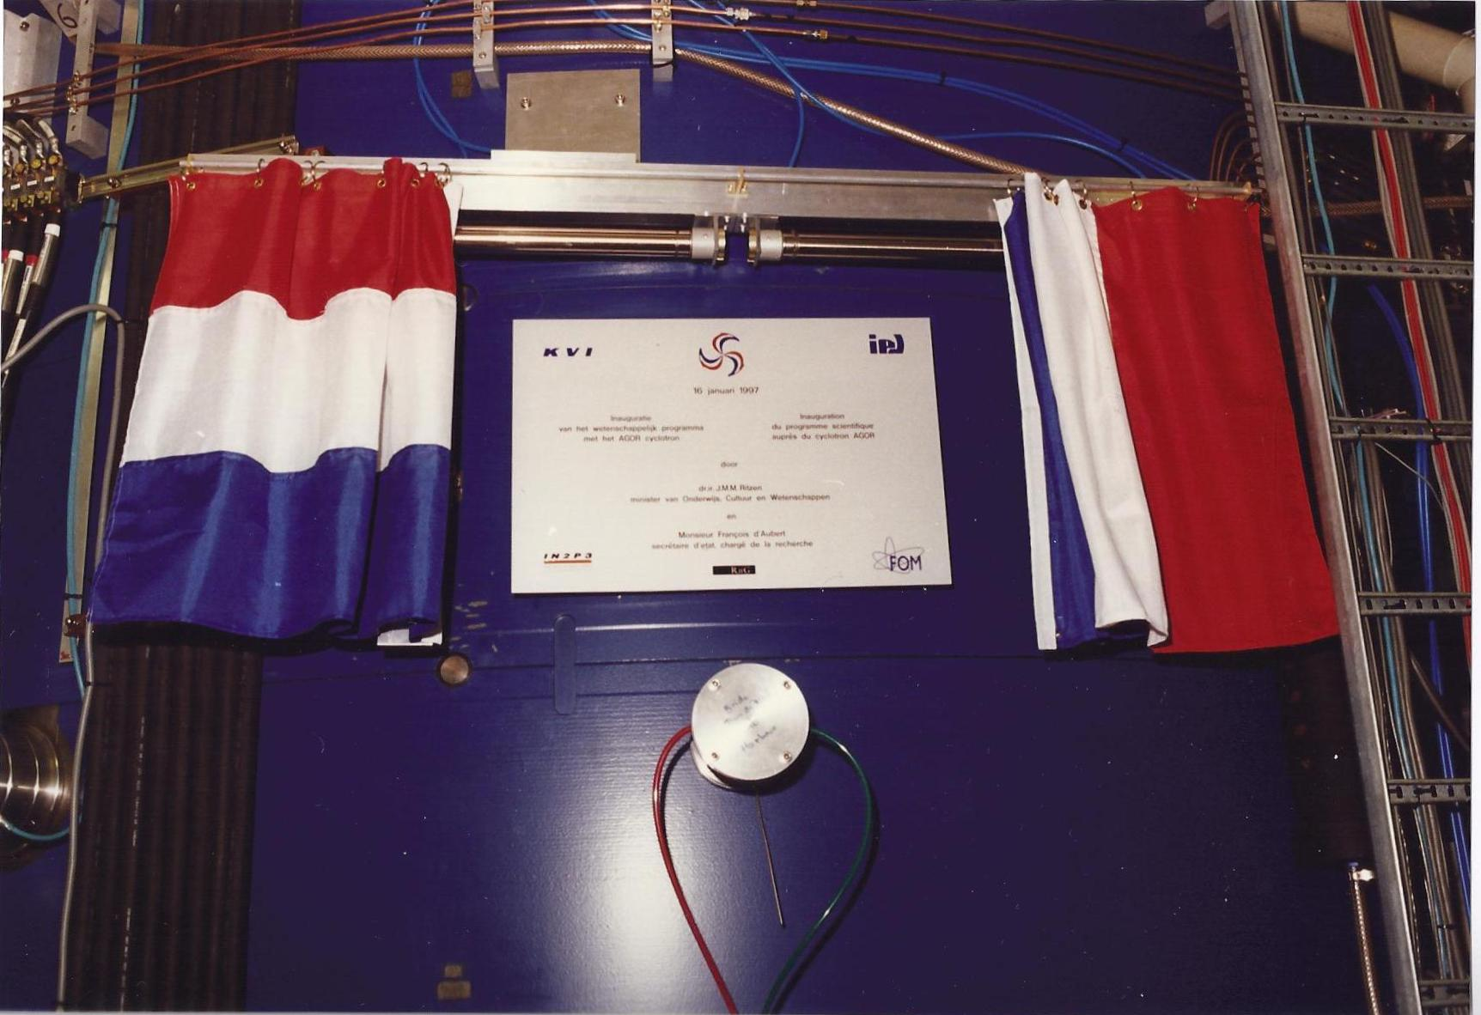

Slide 30
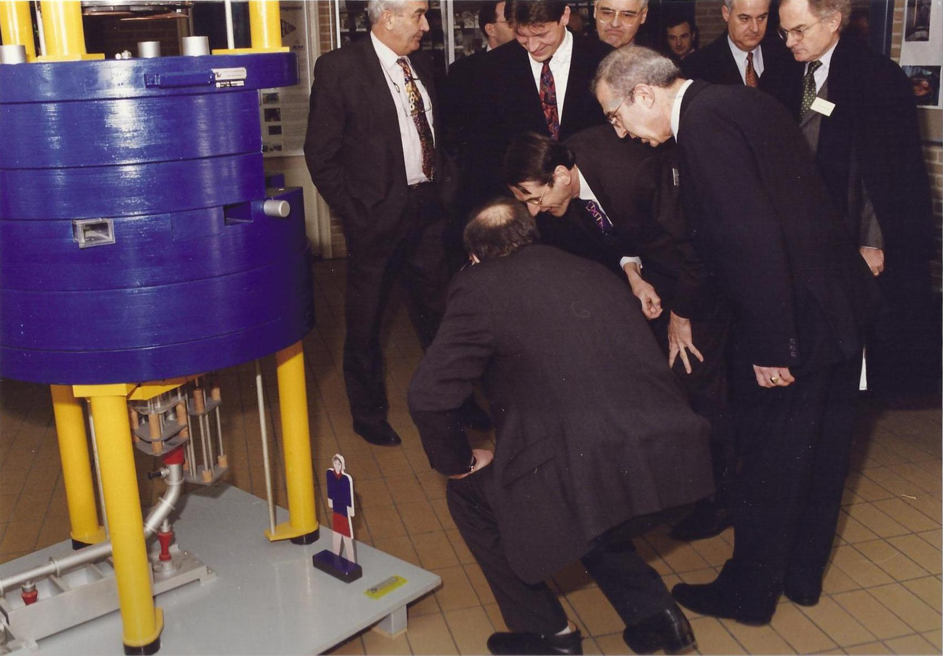

Slide 31
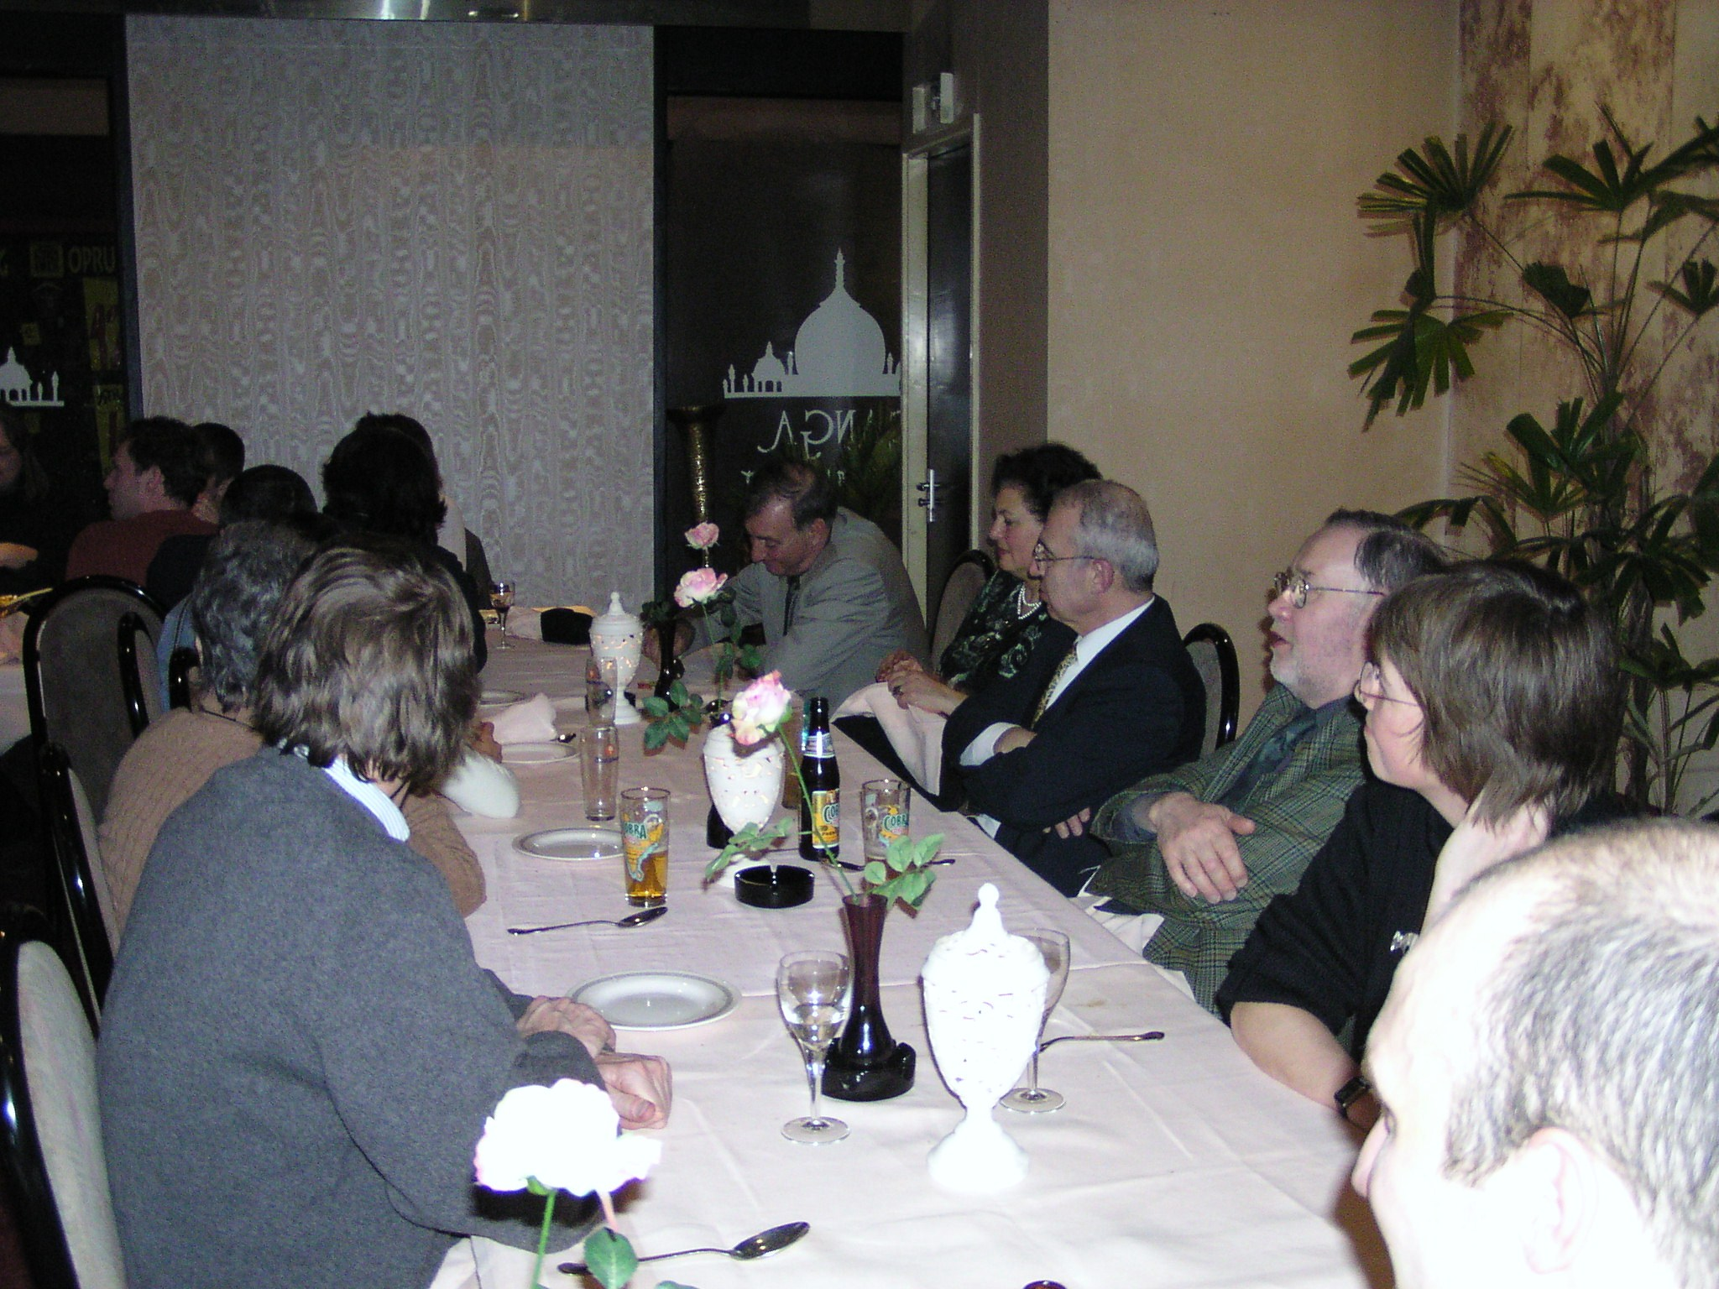

International Research School for Fundamental and Applied Nuclear and aTOMic physics (FANTOM) - 1994
Groningen, Gent, Leuven, Münster, Orsay

Slide 32
Thank you for your attention

