Slide 1
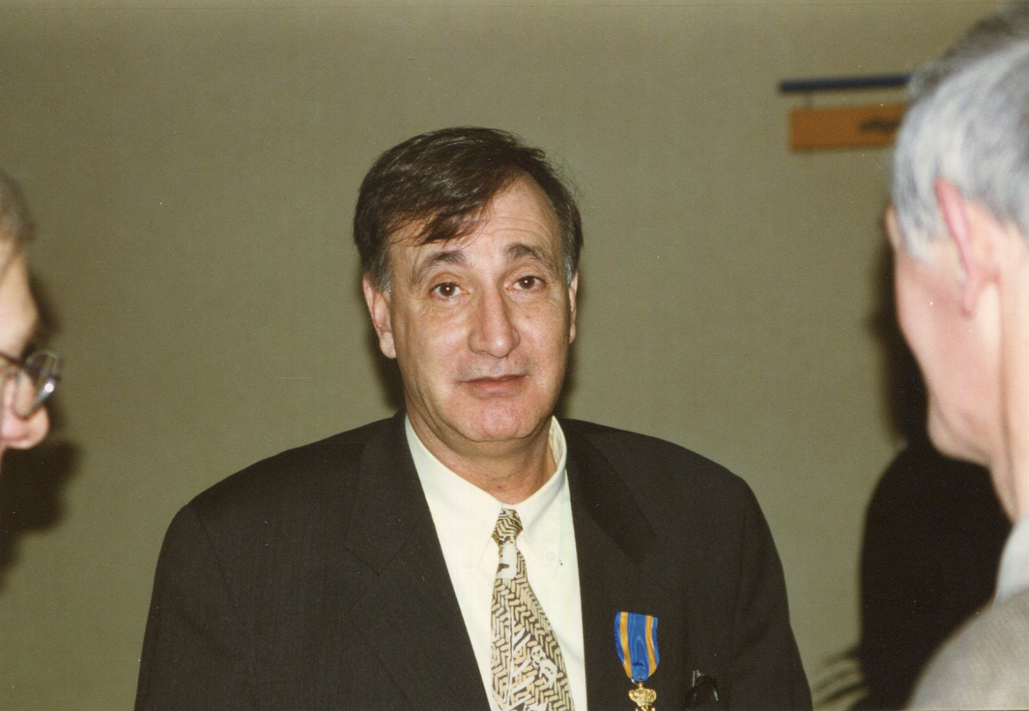
Sydney as AGOR project “boss”

Slide 2

Sydney’s “Rucksack”
very good physicist
strong commitment
ambition
in a hurry
strong opinions
direct communication style

Slide 3
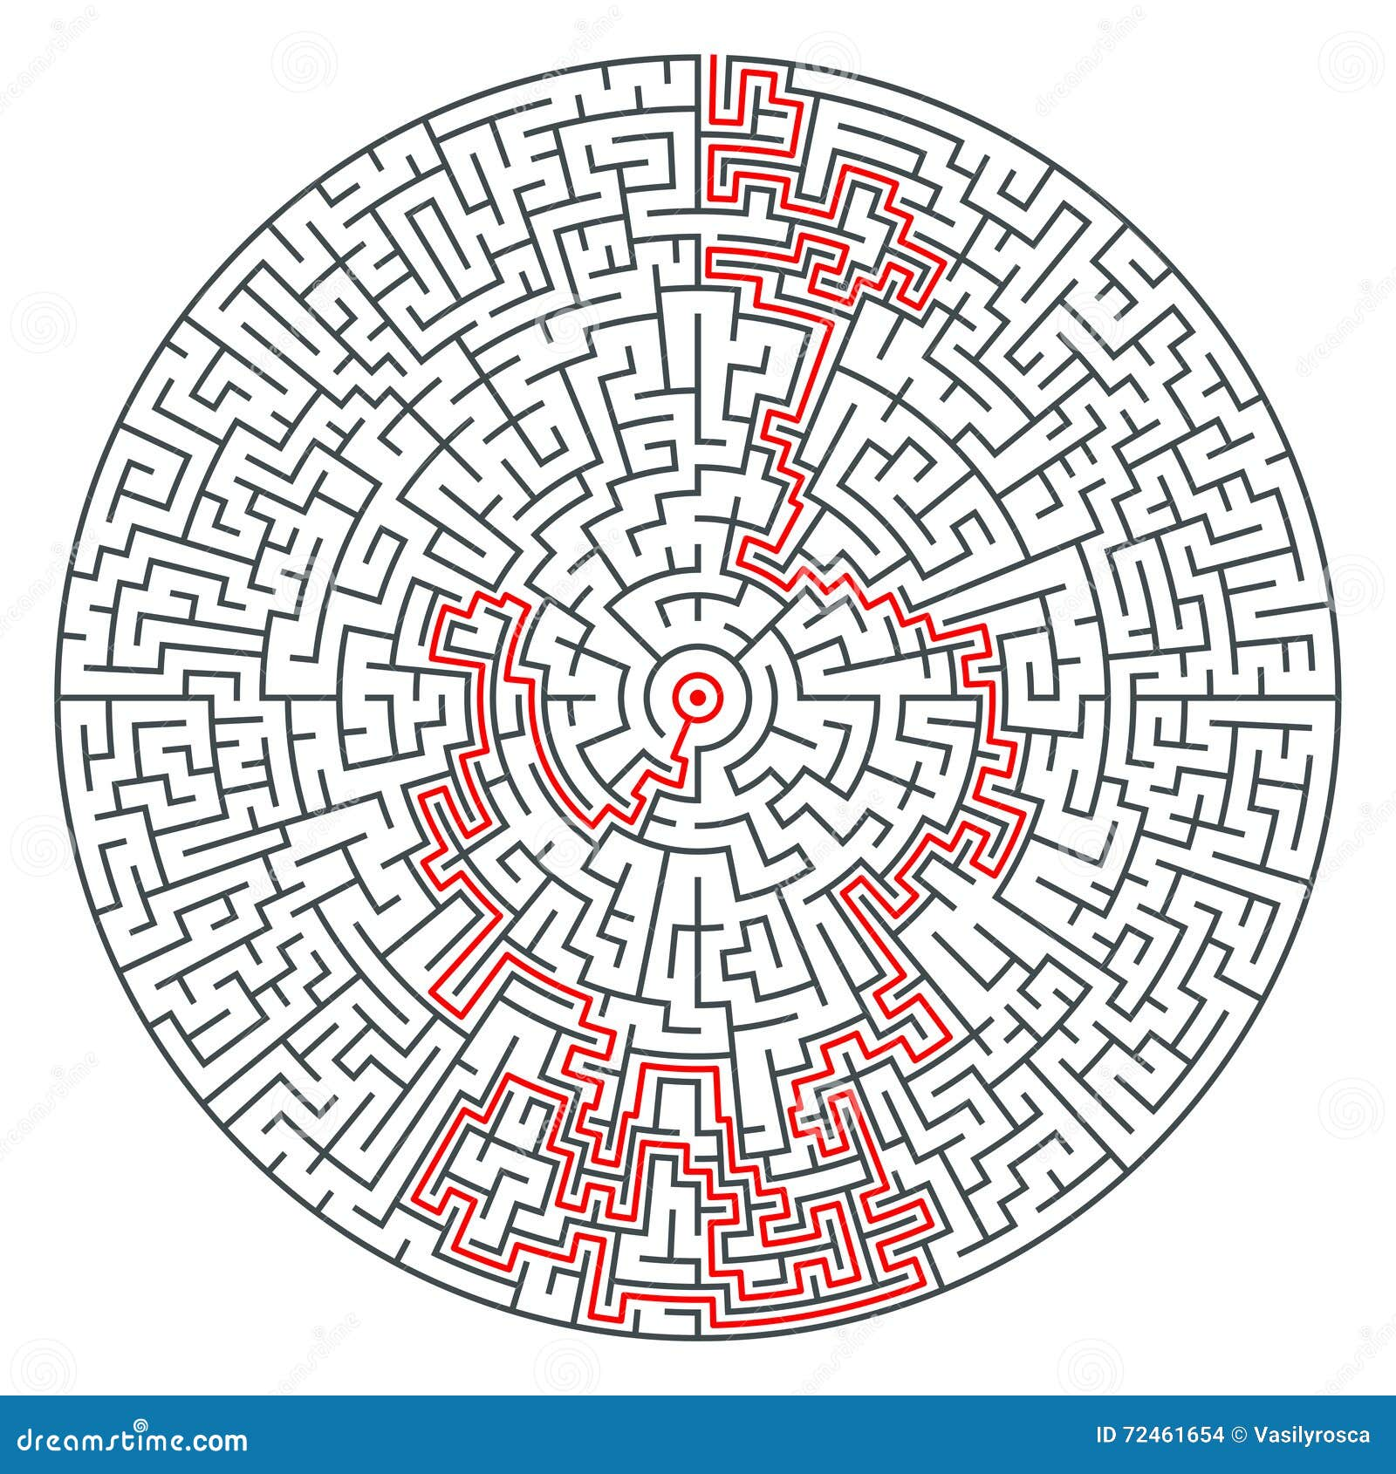
the AGOR project: complex environment to manage
Dutch and French funding agencies
IPN and KVI directors
strong financial constraints
scientists in the project group
technological challenges
a rough ride but overall successful

Slide 4
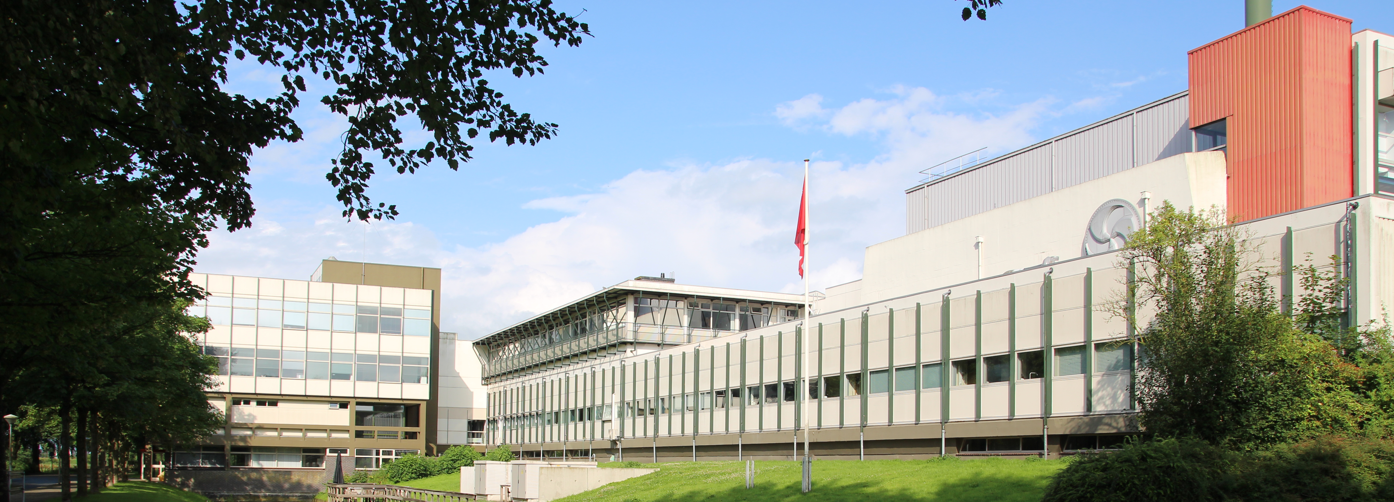
AGOR today

Slide 5
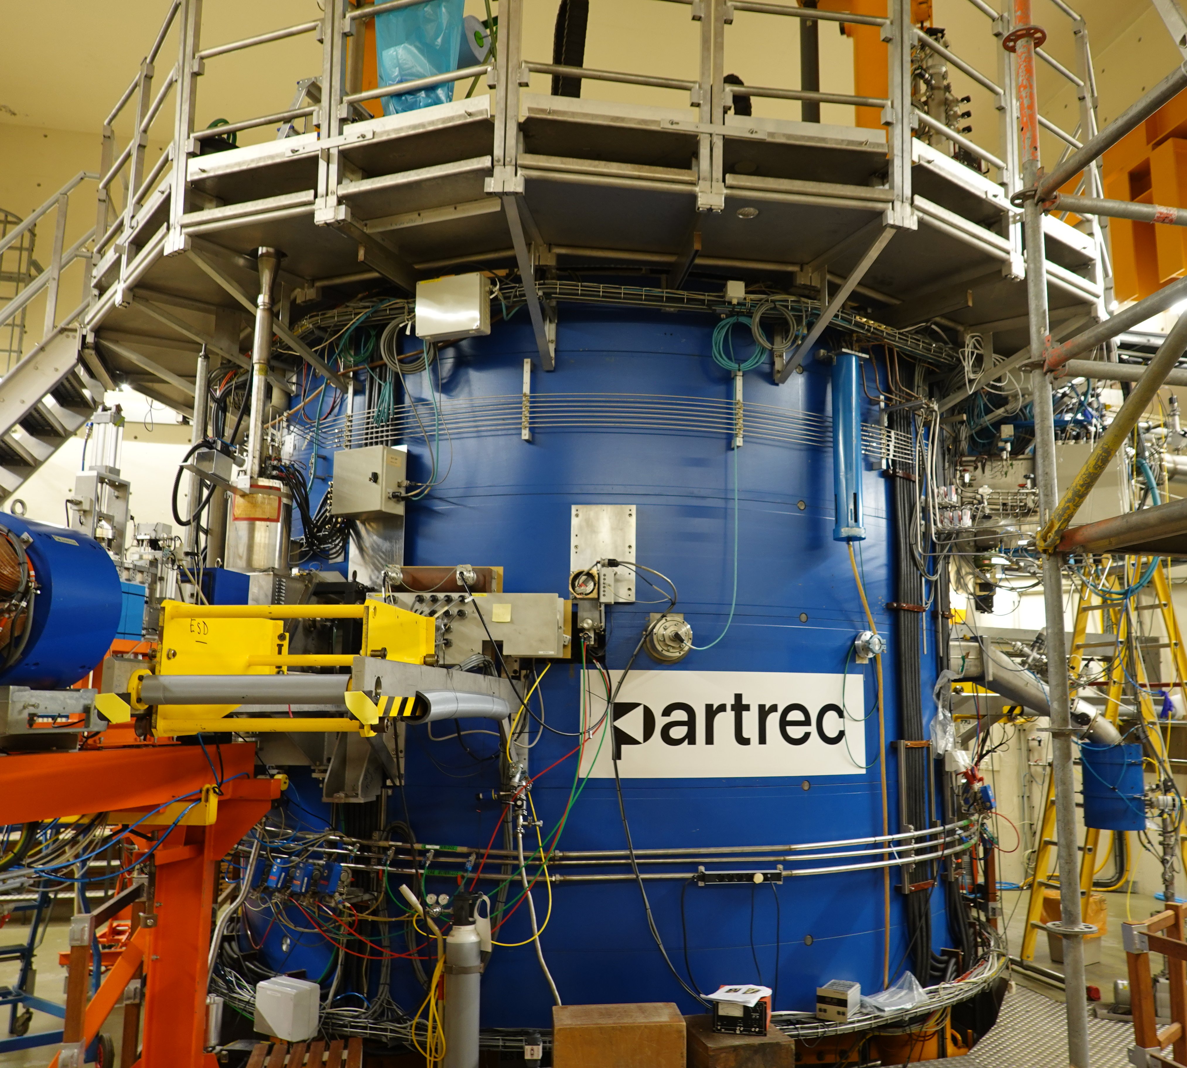
operational for 30 years now
current research activities
radiation biology
radiation hardness
nuclear science
beams
protons, helium, carbon
protons, heavy ion cocktails
heavy ions

Slide 6
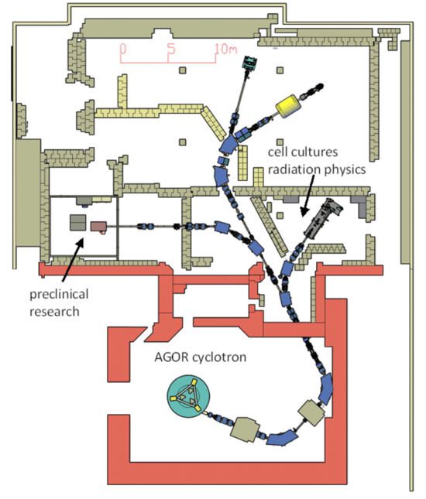
2025: new experimental facilities completed
IMPACT: image guided preclinical research funded by Dutch cancer foundation KWF
NEXT: very heavy nuclei funded by ERC and NWO
commissioning on-going
first experiments 2026
NWO Large-Scale Research Infrastructure

Slide 7
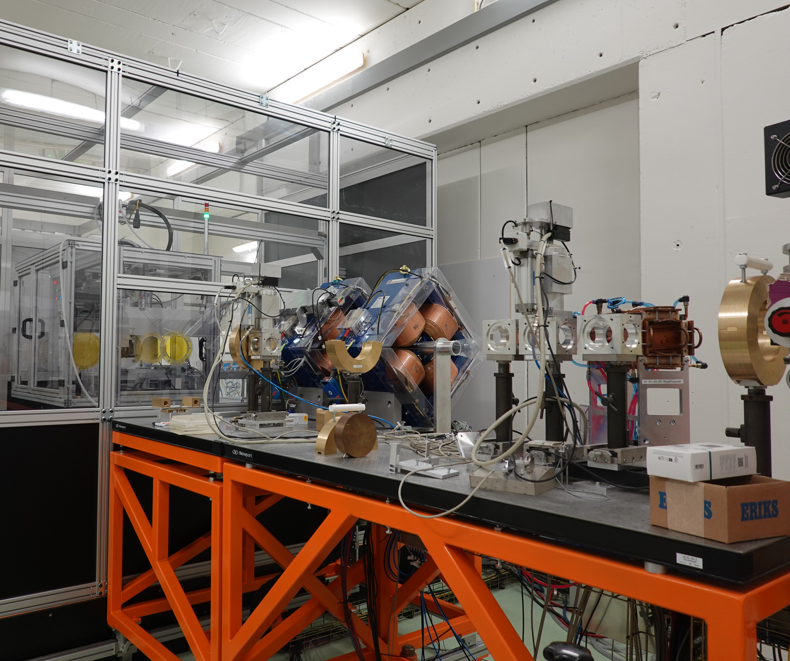
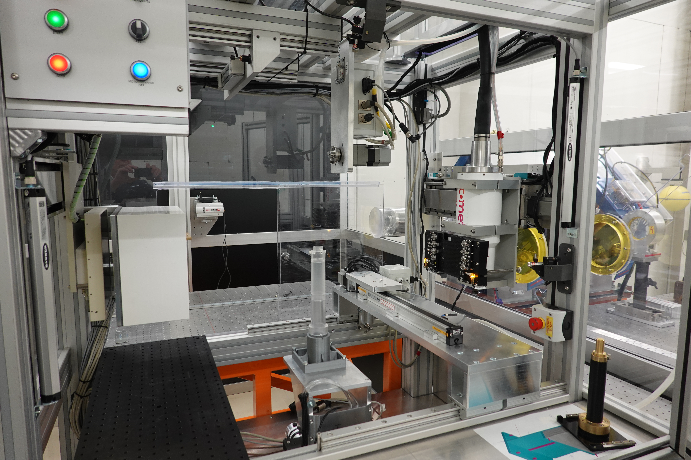
IMPACT
on-line 3D X-ray imager
MC irradiation planning μRayStation
X-ray and particle irradiations
scattered and scanned beams
FLASH (very high dose rate)
spatial fractionation (mini beam)

Slide 8
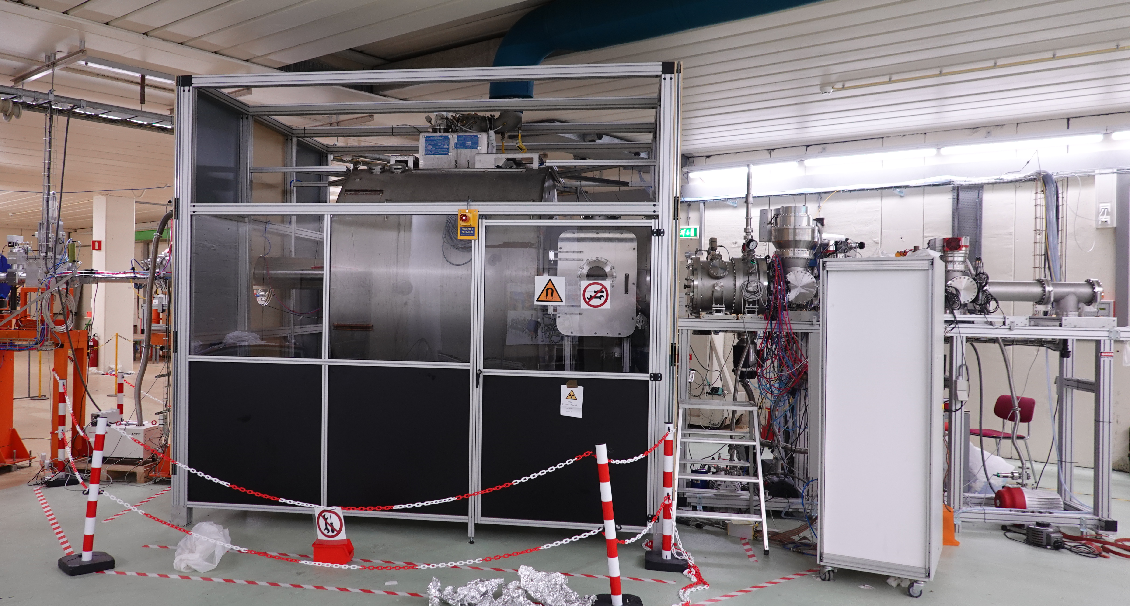
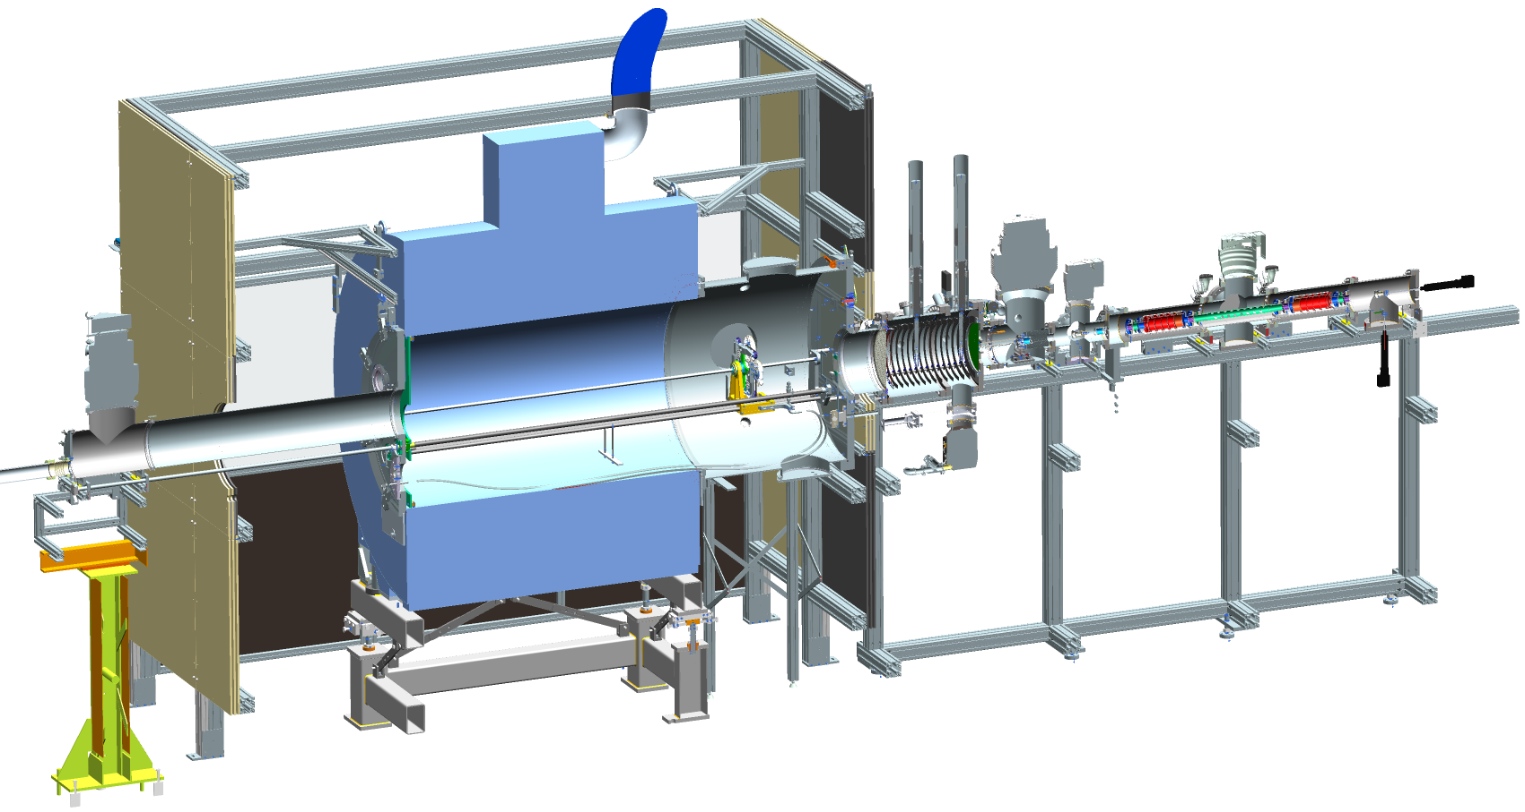
NEXT
superconducting solenoid separator
MR ToF mass spectrometer

