Slide 1
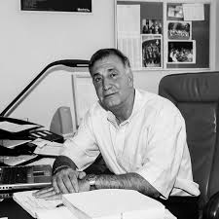
Tribute to Sydney Galès
By Michel Spiro

Slide 2
Sydney, a fellow and a friend
I had the honour of leading, with Sydney's help, IN2P3, the National Institute for Nuclear and Particle Physics, of CNRS, a very large Institute envied worldwide, from the beginning of 2003 to the end of 2010. It was an incredible opportunity and a chance to be accompanied so closely in this task by Sydney.

Slide 3
Key dates and facts
2003–2004 Sydney chaired the IN2P3 Scientific Council.
From 2003 to 2005, he represented IN2P3 in developing, with the CEA/DSM, the French roadmap for particle physics (high-energy physics) and nuclear physics.
From 2004 to 2010, Sydney was my Deputy Director for Nuclear Physics, a position he held until 2012.
From 2005 to 2010, he also directed GANIL, the Grand National Heavy Ion Accelerator, with the SPIRAL2 project, demonstrating that GANIL and this project were IN2P3's priority in nuclear physics, and giving a long-term vision to GANIL.

Slide 4
Impact and recognition
His impact on the community was considerable. He was visionary and a builder of nuclear science, both nationally and internationally, which earned him numerous honours and recognitions.
From 2004 to 2011, he represented France on the Nuclear Physics Commission of the International Union of Pure and Applied Physics.
We participated together until very recently on the Scientific Council of the JINR in Dubna.
I had the honour of presenting him with the Robin Prize in 2014 at the IPN Orsay, one of the major prizes of the French Physical Society, for an exemplary career.

Slide 5
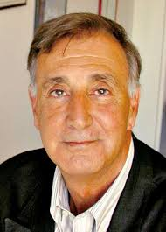
Sydney Wales, winner of the Félix Robin Grand Prix of the SFP (IPN Orsay public statement)
Sydney Galès, research director at the IPN in Orsay and scientific director of the ELI-NP project at IFIN-HH in Bucharest, has just been awarded the Félix Robin Grand Prize by the French Physical Society (SFP) in recognition of his internationally acclaimed scientific work. Sydney Galès thus receives one of the highest distinctions awarded annually by the SFP, marking the excellence of researchers and projects in the field of physics.

Slide 6
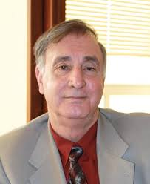
Personal touch
We formed a close-knit team, in understanding each other, in our interactions, a memory I will always cherish. Sydney was an exceptional scientist, an internationally renowned figure, an outstanding personality in every respect: his natural authority, his foresight, his charisma, his leadership, and at the same time, his generosity and humanism, these were the hallmarks of his character!!
I was fortunate enough to know him, to work closely with him,
and to appreciate his consistently relevant, insightful,
and compassionate opinions and advice! I consulted him and
listened to him on every subject. Sydney was more than
a colleague to me. He was a friend, a companion on many
journeys, an inspiration to me on countless occasions,
and I owe him a great deal!

