Slide 1
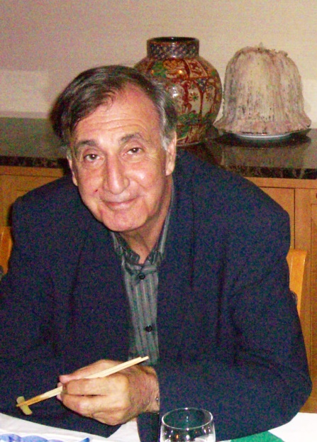
ORSAY
15 December, 2025
Memories of Sydney Gales
Hide Sakai (RIKEN Nishina Center)
Three keywords overlapping our interests
(1943-2024)
Deeply bound hole state study (∼1980)
Accelerator (AGOR) (∼1990)
IUPAP C12 (2006-2011)

Slide 2
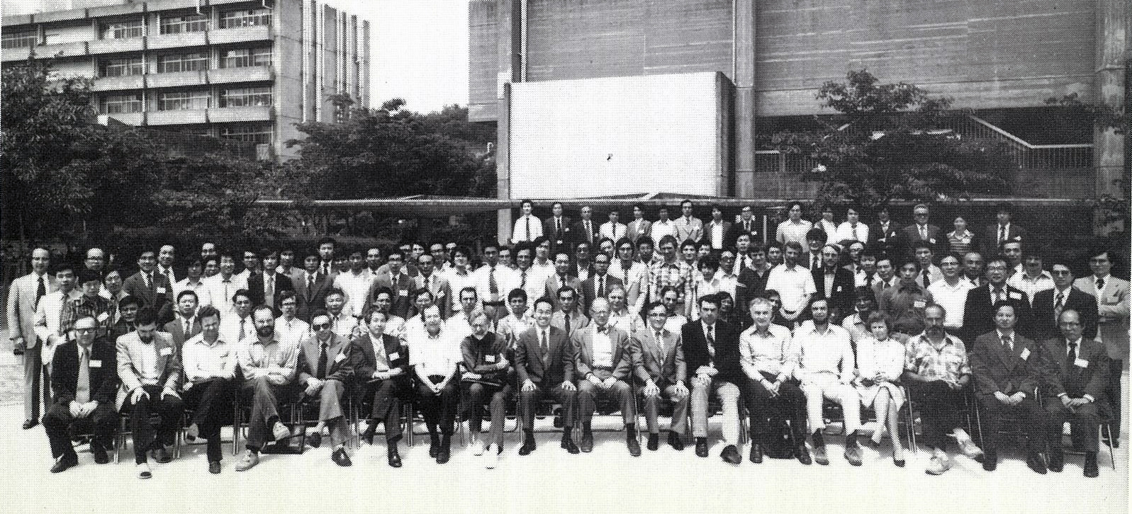
First encounter
1980 RCNP Int. Symposium on ‘Highly excited states in nuclear reactions’
12-16 May, 1980
Sydney was one of our first guests from abroad to join us for dinner.
Hide
Muhsin
Sydney

Slide 3
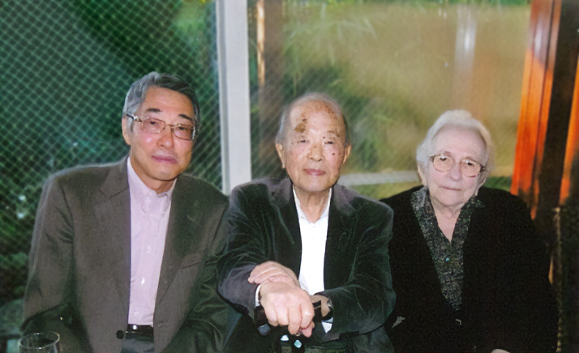
Deeply bound hole state study (∼30s)
Sydney and Sakai² (坂井光夫、酒井英行) Connections
Expert of deeply bound hole state research in his early (∼30 y) career
1977-1985 publishes >12 first author papers!
Mutsuo Sakai (坂井光夫) (1921—2015)
1951 Researcher under Joliot Curie
1972 Deeply bound hole state by (p,d) reaction
Nucl. Phys. A185 (1972) 217.
1984 Ordre national de la Légion d'honneur
Hide Sakai (酒井英行)
γ-decay from deeply bound hole state measured at KVI (1982)
Phys. Lett. 103B (1981) 309.
Mitsuo & Francoise Sakai

Slide 4
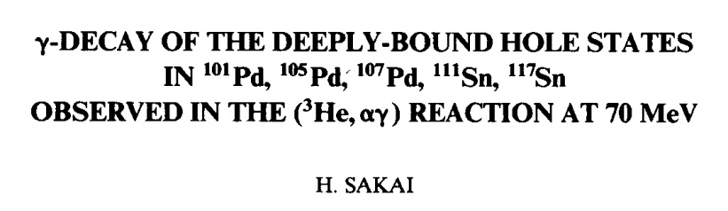
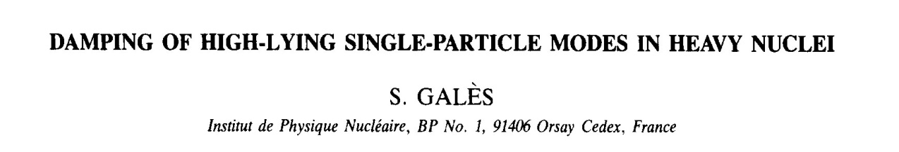
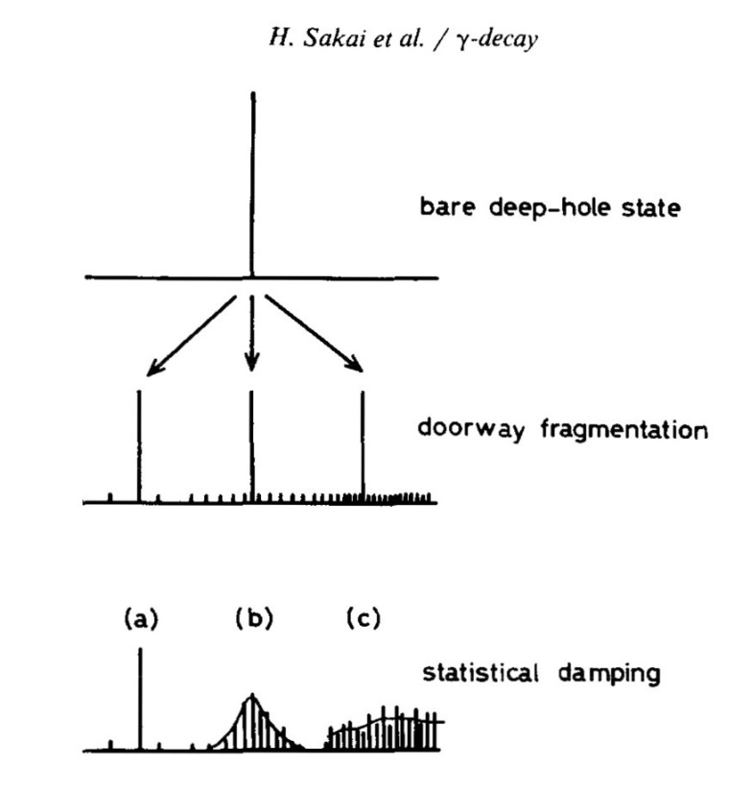
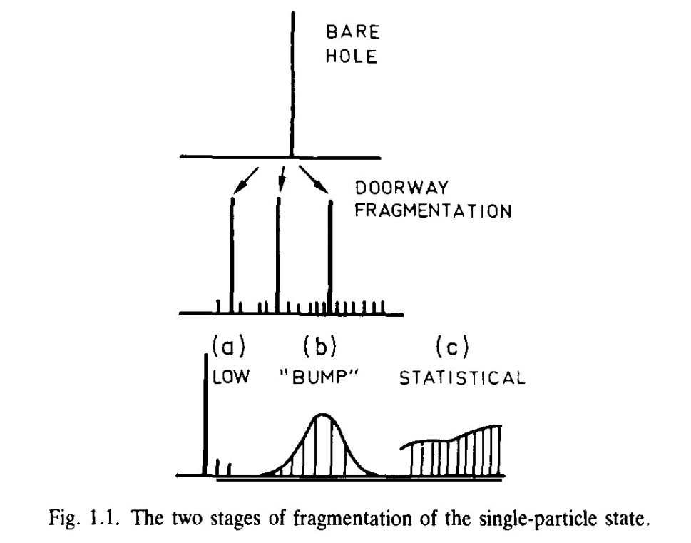
Seminal review paper of deeply bound states by Sydney
Sakai et al.
Nuclear Physics A441 (1985) 640
Gales, Stoyanov and Vdovin
Physics Report 166, (1988) 125-193
So happy
recognized by the experts.
Schematic diagram of spreading mechanism
Adopted
152 cited!

Slide 5
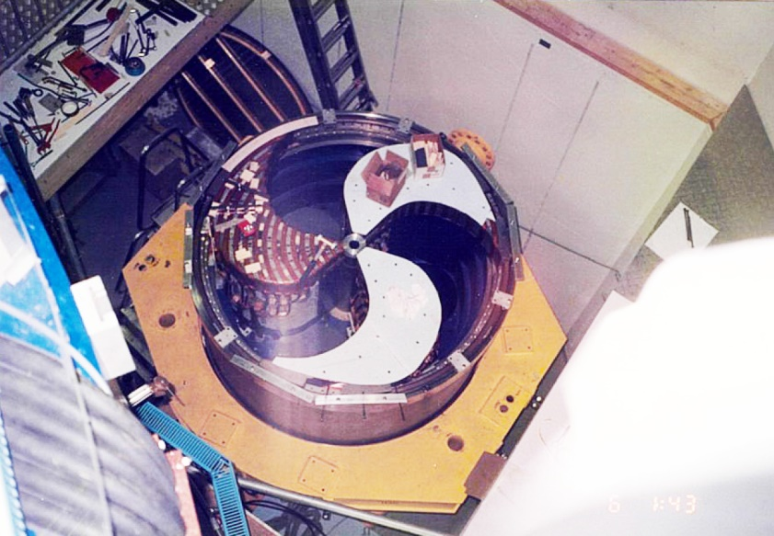
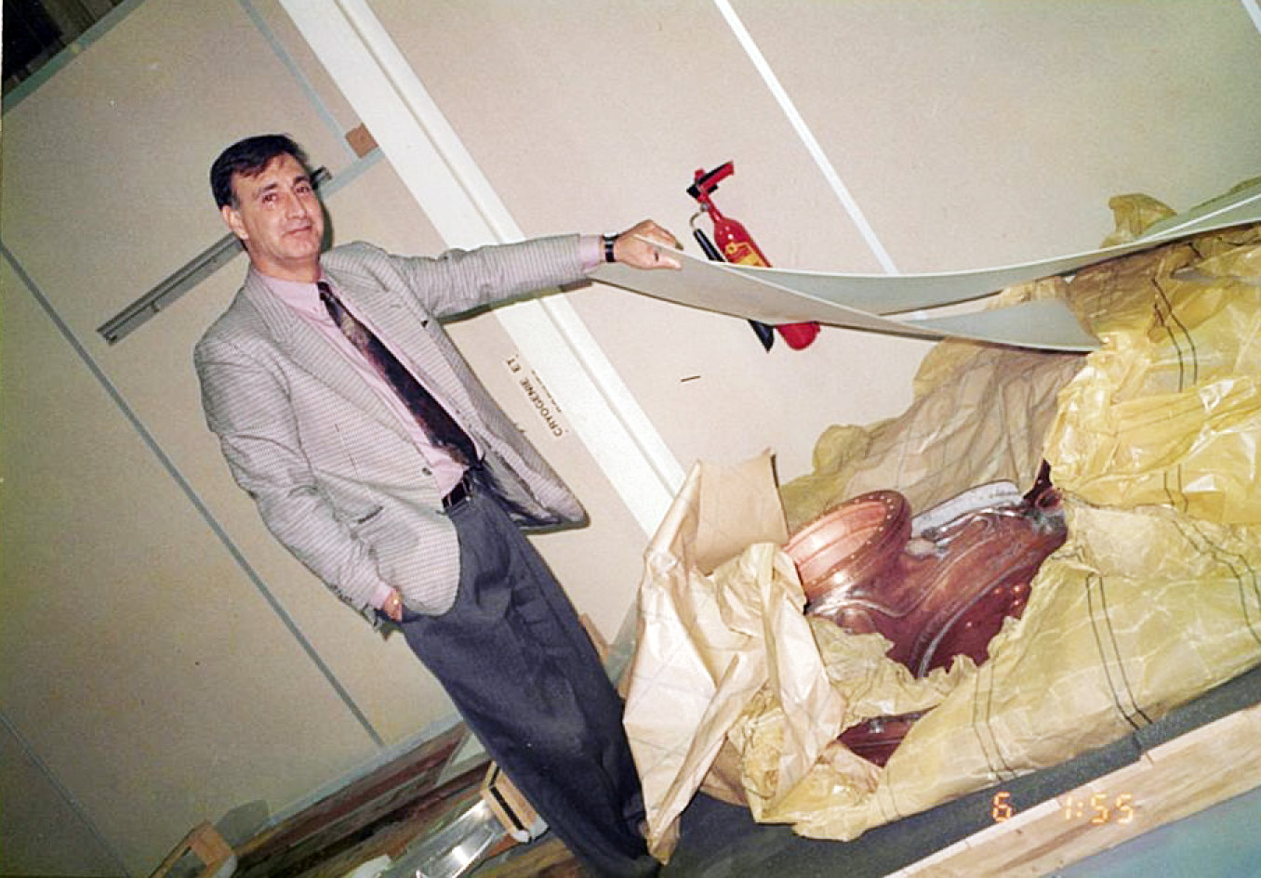
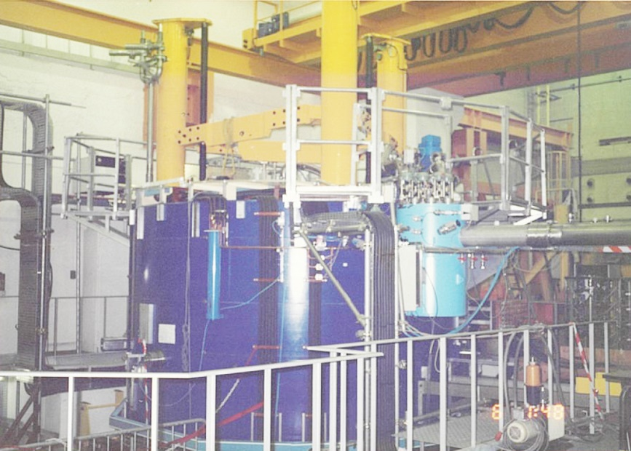
Accelerator (AGOR) (∼40s)
6 October 1992 Orsay visit
Since I started my research career as an accelerator engineer (1972-77), so I felt a sense of affinity with him.
152 cited!

Slide 6
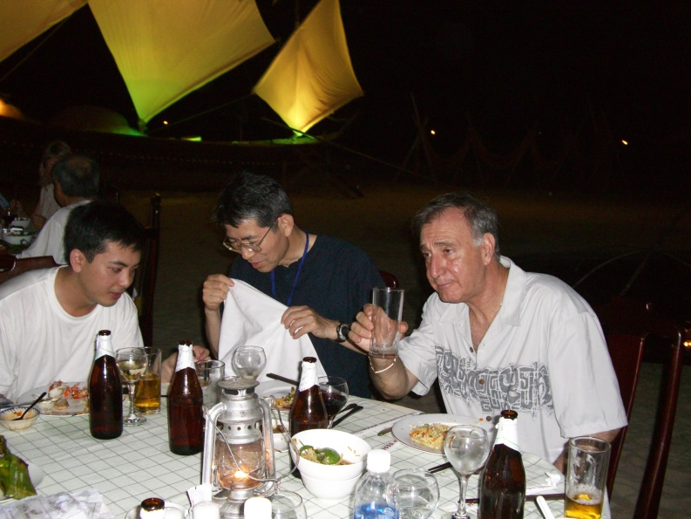

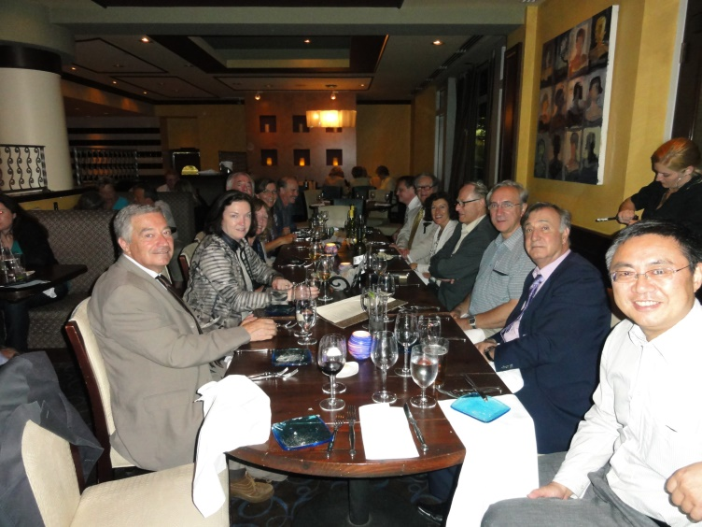
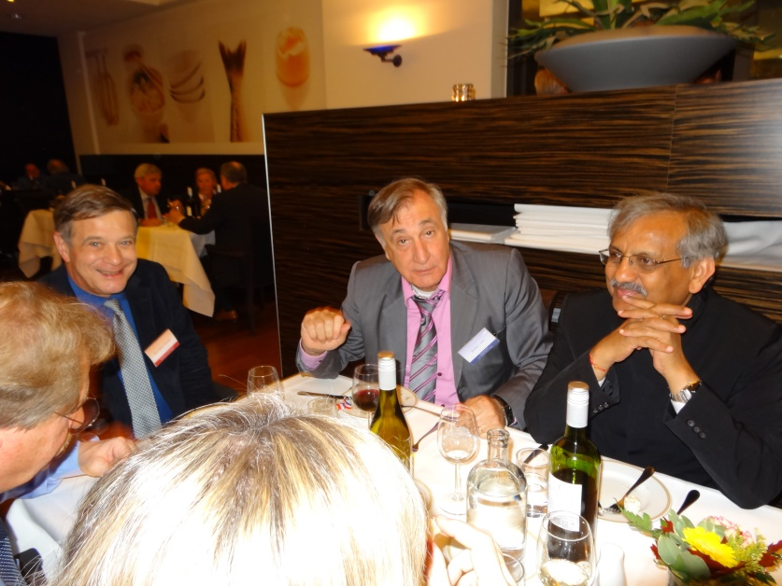
IUPAP C12 (2006-2011) and …
IUPAP Nuclear Physics Commission (C12)
We were both members 2006-2011
Helped at C12 young scientist prize.
2002 July, ISPUN02, Halong Bay, Vietnam
2012 December, Groningen. Harakeh’s retirement symposium dinner
2011 July, Boston, C12 dinner
2007 June, INPC Tokyo, C12 dinner

Slide 7
Gratitude
Sydney always called me ‘hide’(hàid). Never pronounced correctly ‘Hide’yuki.
(The pronunciation of “h” is a real challenge for French people.)
I miss hearing Hyde's pronunciation and wish I could hear it again.
I am grateful for long-standing friendship with Sydney.

