Slide 1
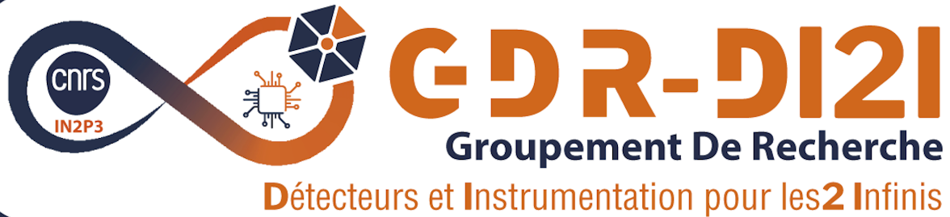

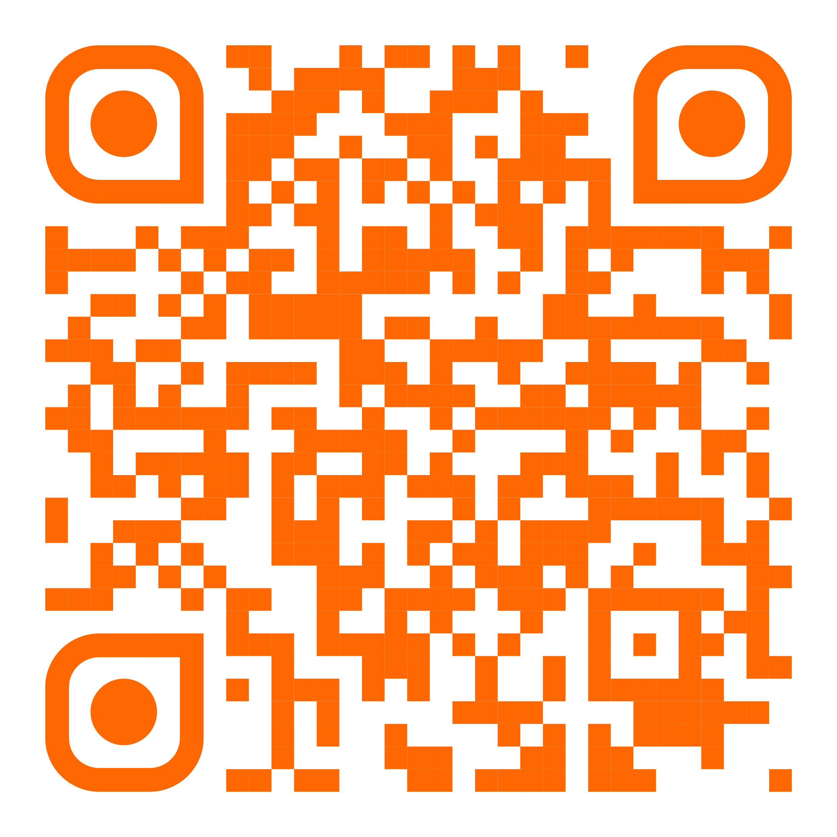
Radiation Detection and Imaging for Nuclear Materials Characterization
Prof. Sara Pozzi
University of Michigan
Friday October 10th 2025, 10h00
Auditorium Joliot-Curie IJCLab –Bât. 100
Nuclear fission is a complex and not yet fully understood phenomenon. Advancing our theoretical understanding and modeling of the nuclear fission process—including both individual fission events and fission chains—requires the development of new detection systems and analyses. This research is crucial for enhancing our knowledge and predictive capabilities pertaining to the physics of fragment de-excitation. The work has application in fundamental science, nuclear safeguards, and nuclear security.
In this presentation, I will explore recent advancements in radiation detection methods aimed at improving our understanding of nuclear fission and fission chains. I will provide examples of detection arrays utilizing organic and inorganic scintillator detectors for neutron and gamma ray multiplicity measurements and radiation imaging. Specifically, detection systems for neutron correlation and multiplicity counting will be highlighted. Additionally, I will discuss the integration of machine learning techniques to enhance the accuracy and precision of these measurements, including the use of augmented reality to provide a more intuitive understanding of the data. This work significantly advances our current understanding of nuclear fission and the de-excitation processes.
Furthermore, I will present case studies demonstrating the effectiveness of these advanced detection systems in practical applications, including experiments performed on kg-quantities of special nuclear materials (highly enriched uranium and plutonium). By leveraging these cutting-edge technologies, we aim not only to improve our understanding of nuclear fission, but also to pave the way for new methodologies in the monitoring and safeguarding of nuclear materials.
https://indico.ijclab.in2p3.fr/event/12140

