Slide 1
EICROC0 Test follow-up
08/09/2025
Adrien VERPLANCKE, Christophe de LA TAILLE, Kinann GUILLOSSOU-JNAID

Slide 2
Summary - Code
Changed GitLab to work on new code for all EICROC ASICs : https://gitlab.in2p3.fr/verplancke/eicroc
Changes to the code on the new Git :
Command line functions / parameters rather than menus as used before (testing and plotting script)
Optimized data treatment in the plotting script, RAM use lowered drastically
Structure of code is different, more abstraction used
Data treatment for plots changed, fixed the old TDC plots that did not make sense
Modified the plots for a new look
The code on the new Git aims to function well for all new ASICs when they are received
Documentation (Code guide, Userguide) updated for the new code

Slide 3
Summary - Testing
Using the new code, testing resumed on cards at Omega
Only cards with ASIC alone are available at the lab
TDC Slow control parameters changed, much improved performance
Tested multiple cards in the last weeks :
EIC1.3B and EIC2.2 (ASIC alone)
EIC Flipchip (@ IJCLab)
EIC HPK Wirebonded (@ IJCLab)
Results in the following slides

Slide 4
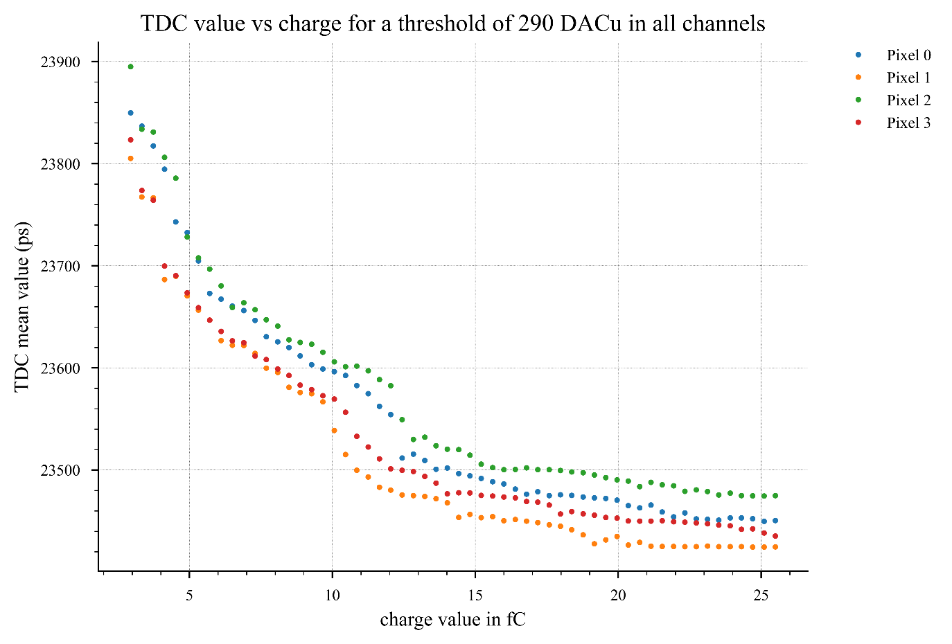
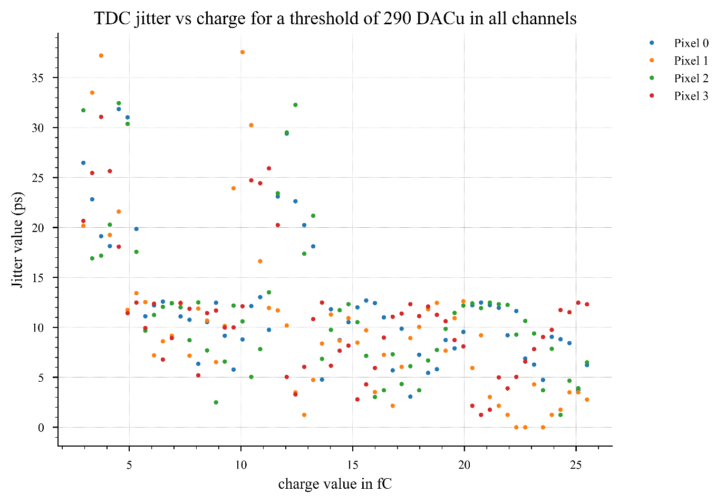
EIC1.3B – 31/07/2025 Complete test
TDC ToA
Jitter
c_{D} = 00 for all pixels

Slide 5
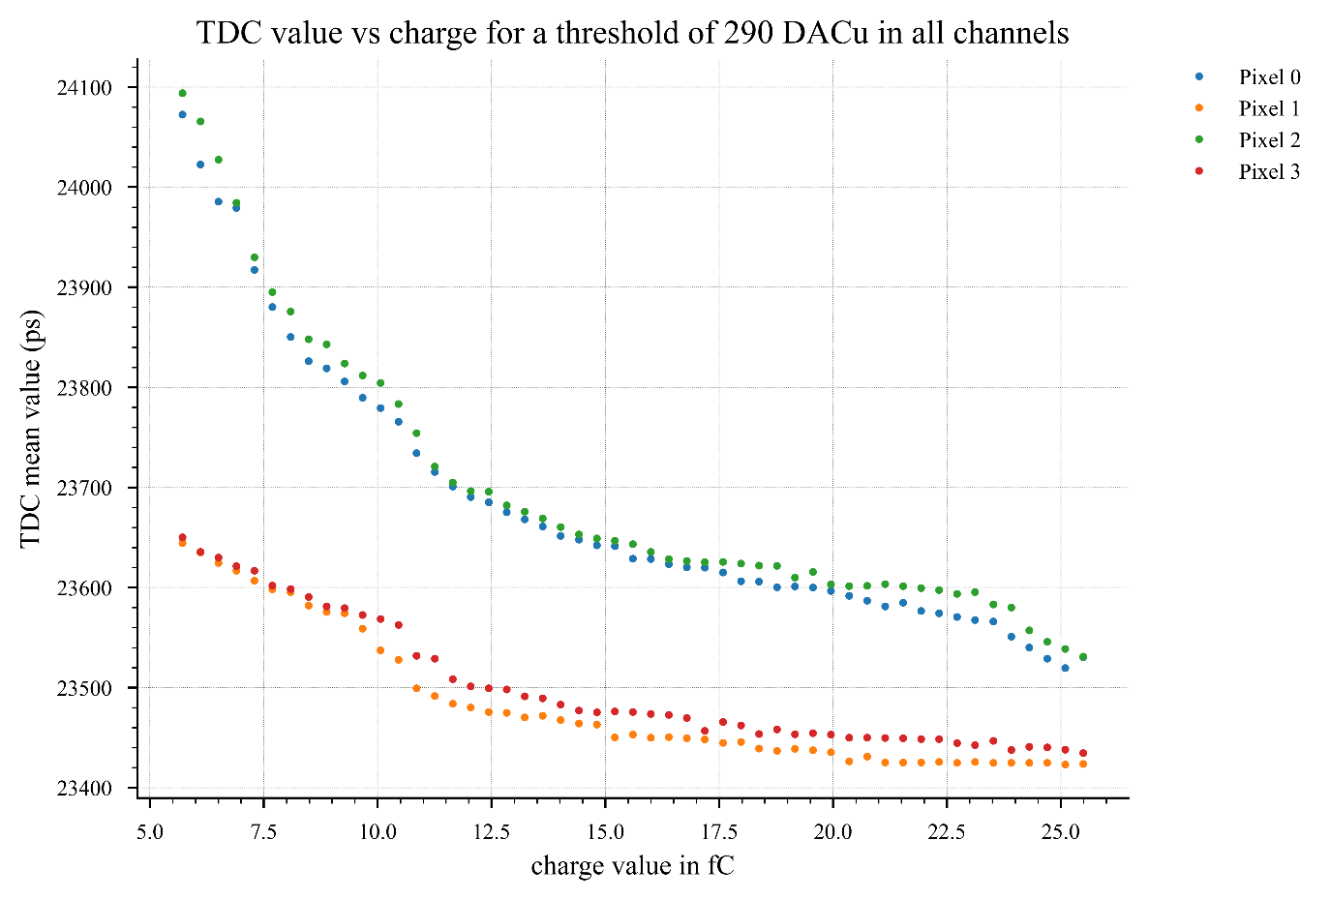
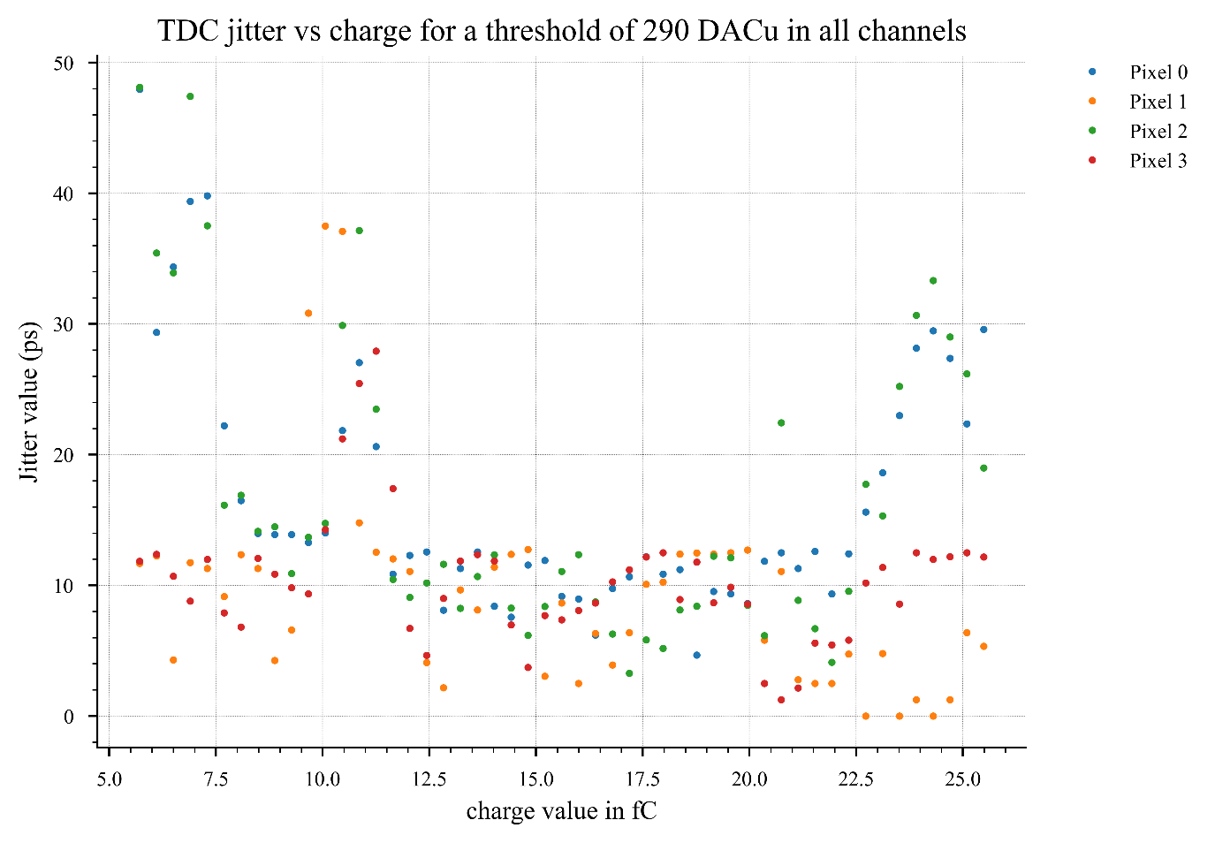
EIC1.3B – 31/07/2025 Complete test
TDC ToA
Jitter
c_{D} = 11 for pixels 0 & 2
(additional 750 fF @ preamp input)

Slide 6
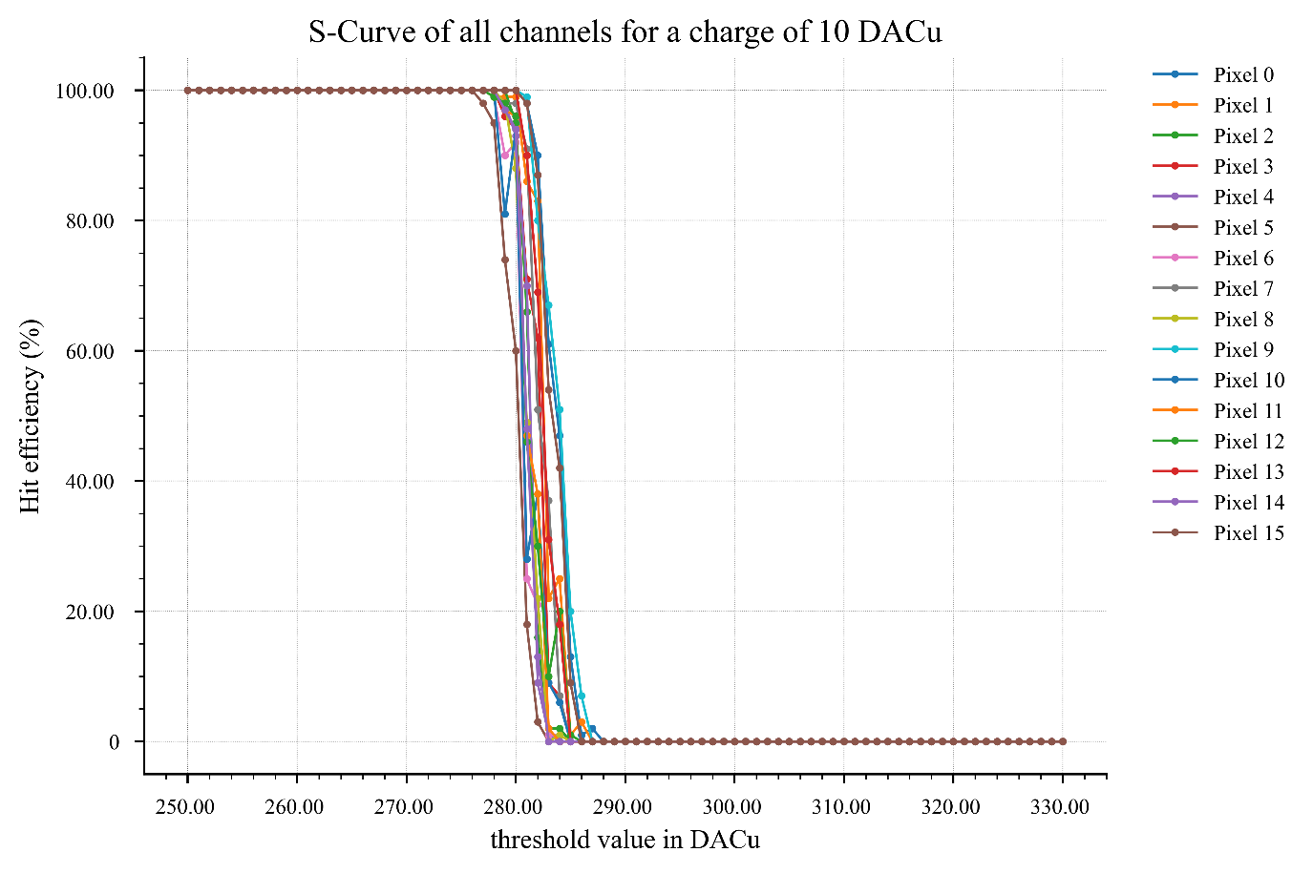
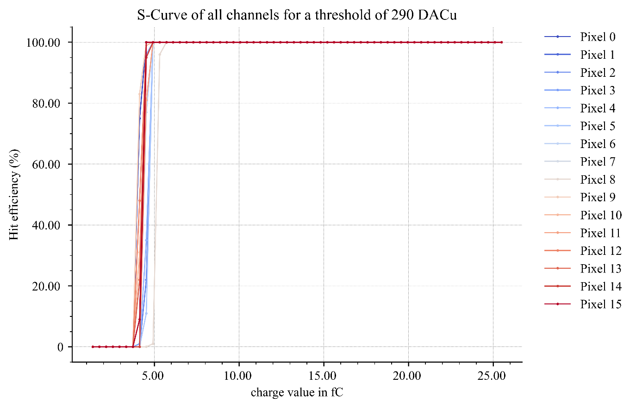
EIC2.2 – 01/09/2025 Complete test : c_{D} = 11 (+ 750fF input cap)
S-Curves aligned @ 4.6 fC
Charge S-Curves for correction threshold

Slide 7
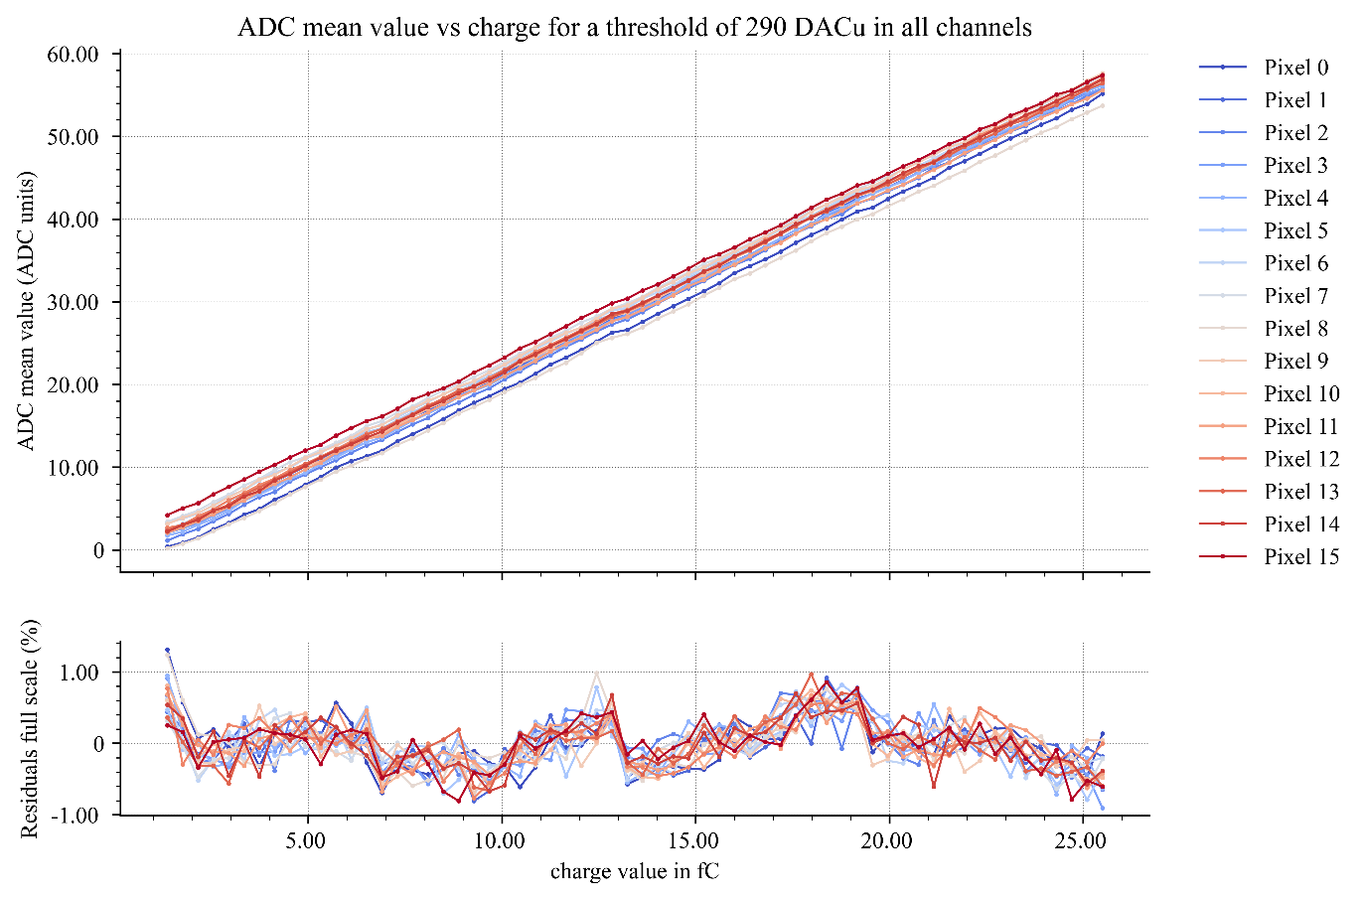
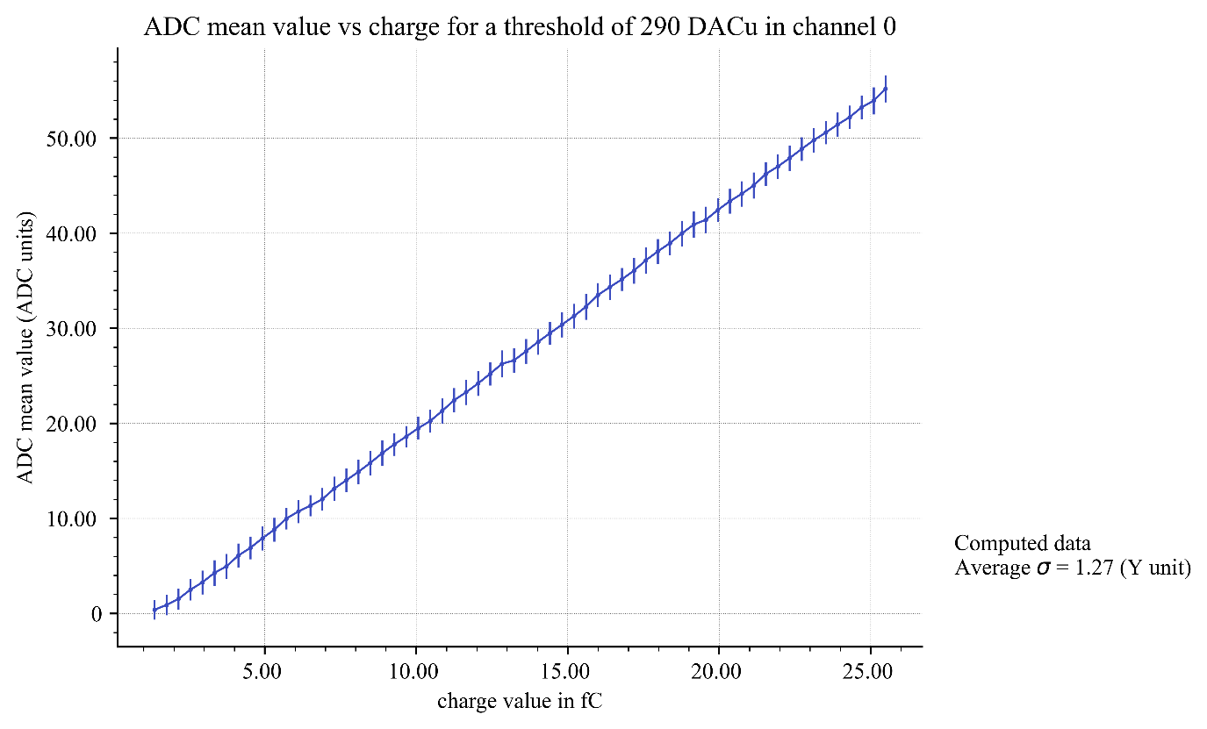
EIC2.2 – 01/09/2025 Complete test : c_{D} = 11 (+ 750fF input cap)
ADC with errorbar (std)
ADC Linearity

Slide 8
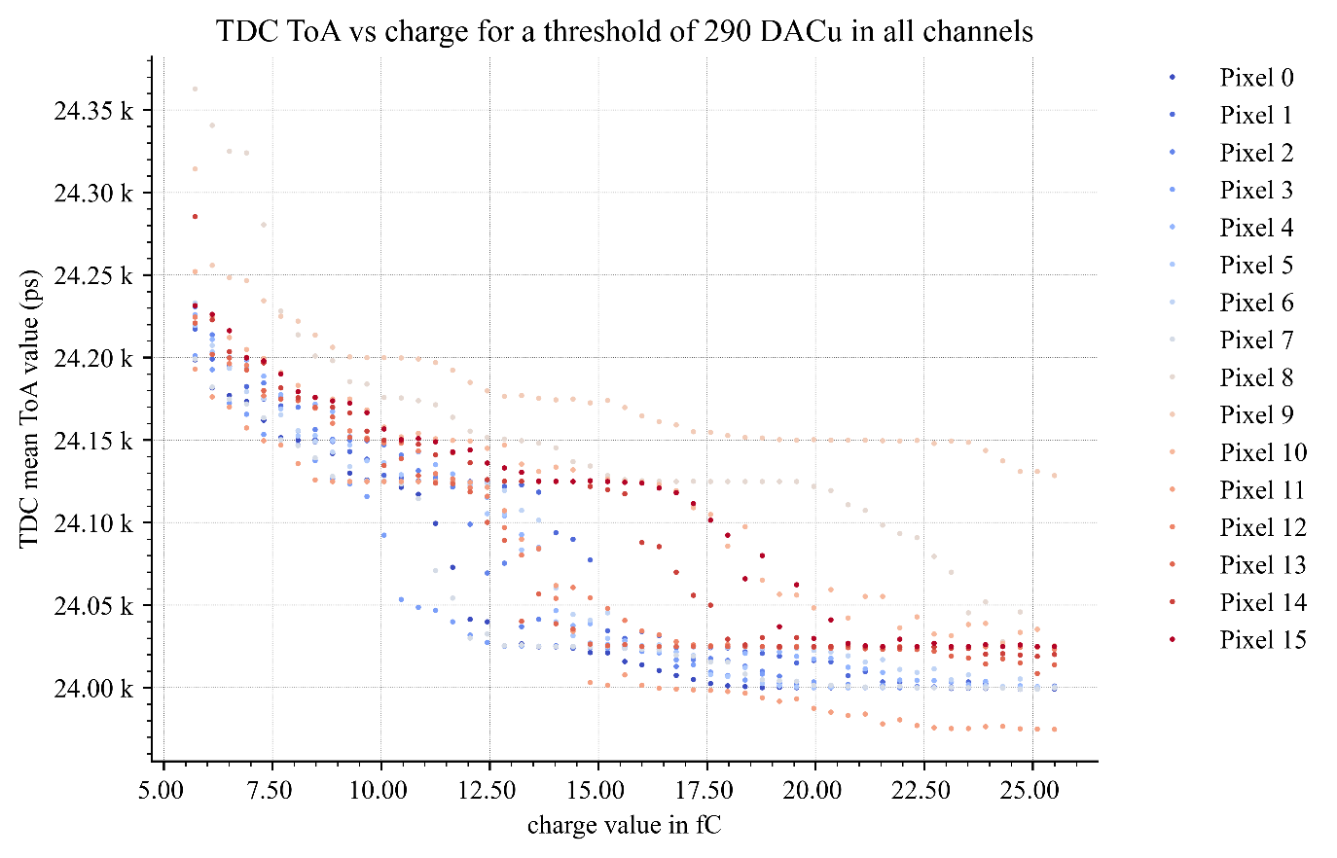
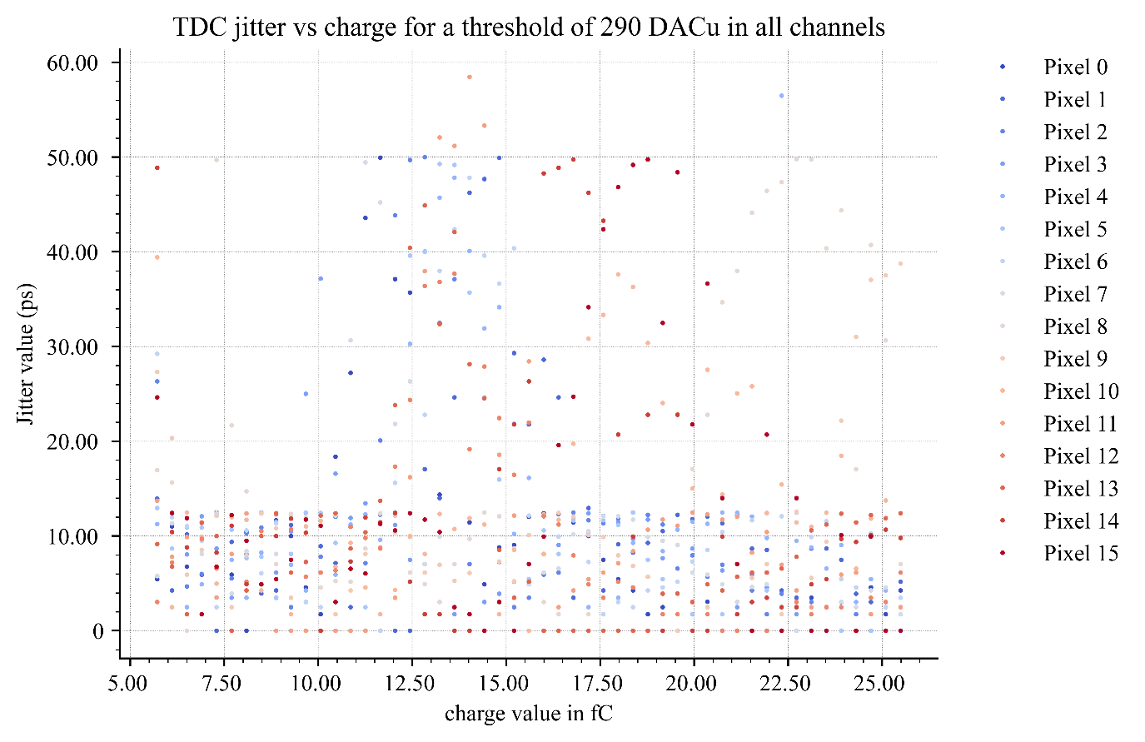
EIC2.2 – 01/09/2025 Complete test : c_{D} = 11 (+ 750fF input cap)
TDC ToA
Jitter

Slide 9
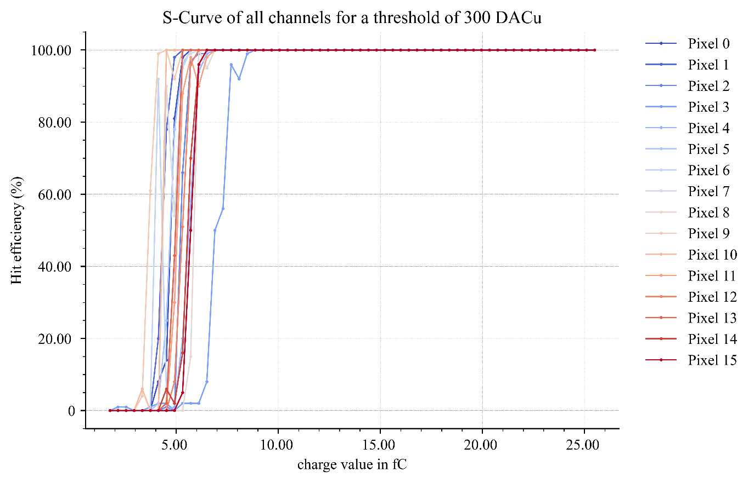
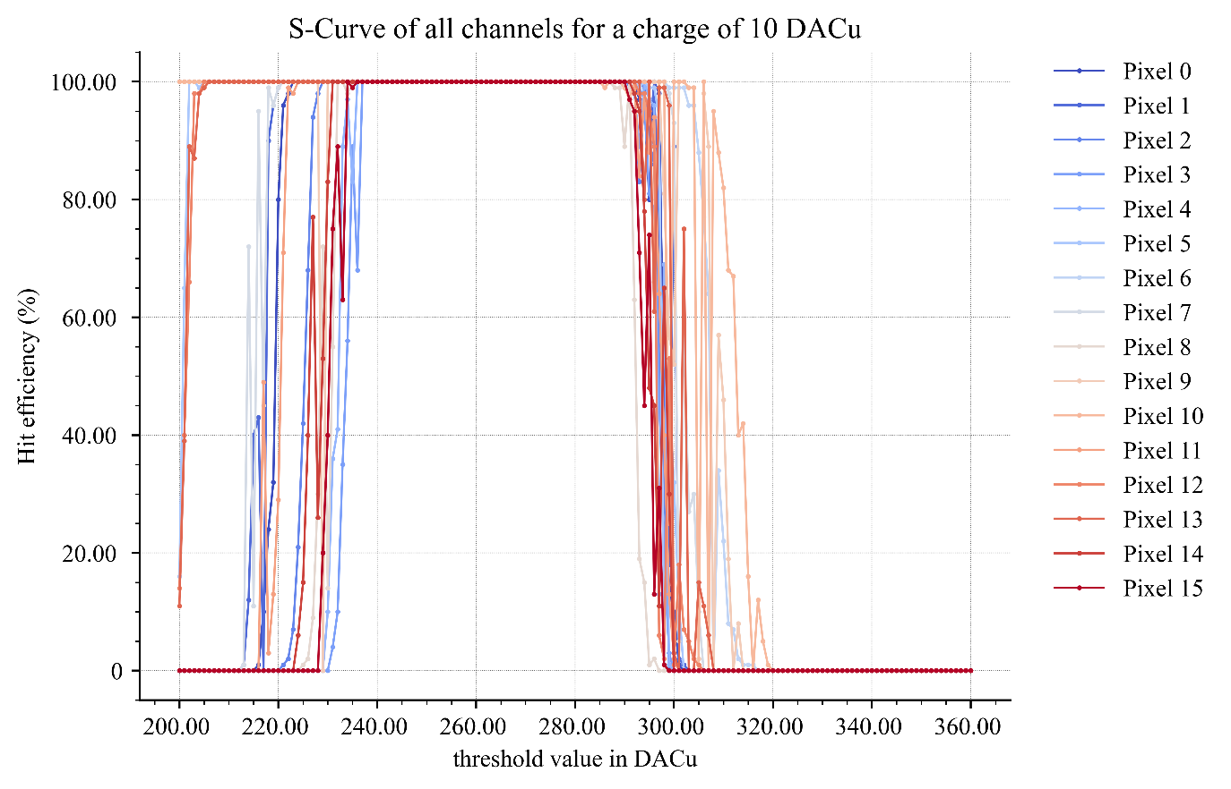
EIC FLIPCHIP – 04/09/2025 Complete test @ IJCLab
Sensor biased @ -190 V
Charge S-Curves for correction threshold
S-Curves aligned @ 4.6 fC

Slide 10
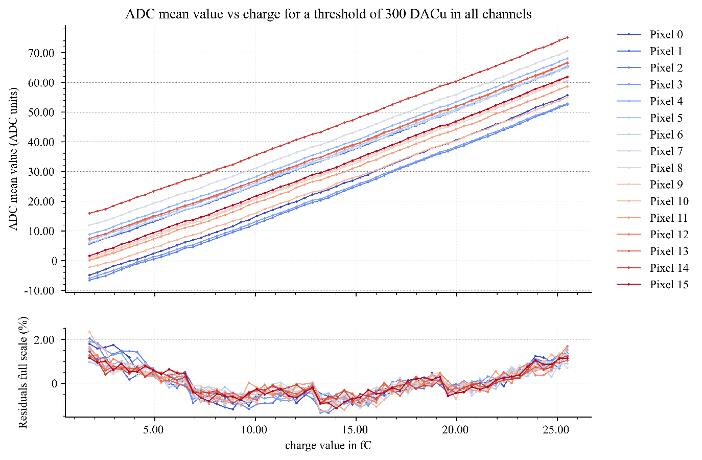
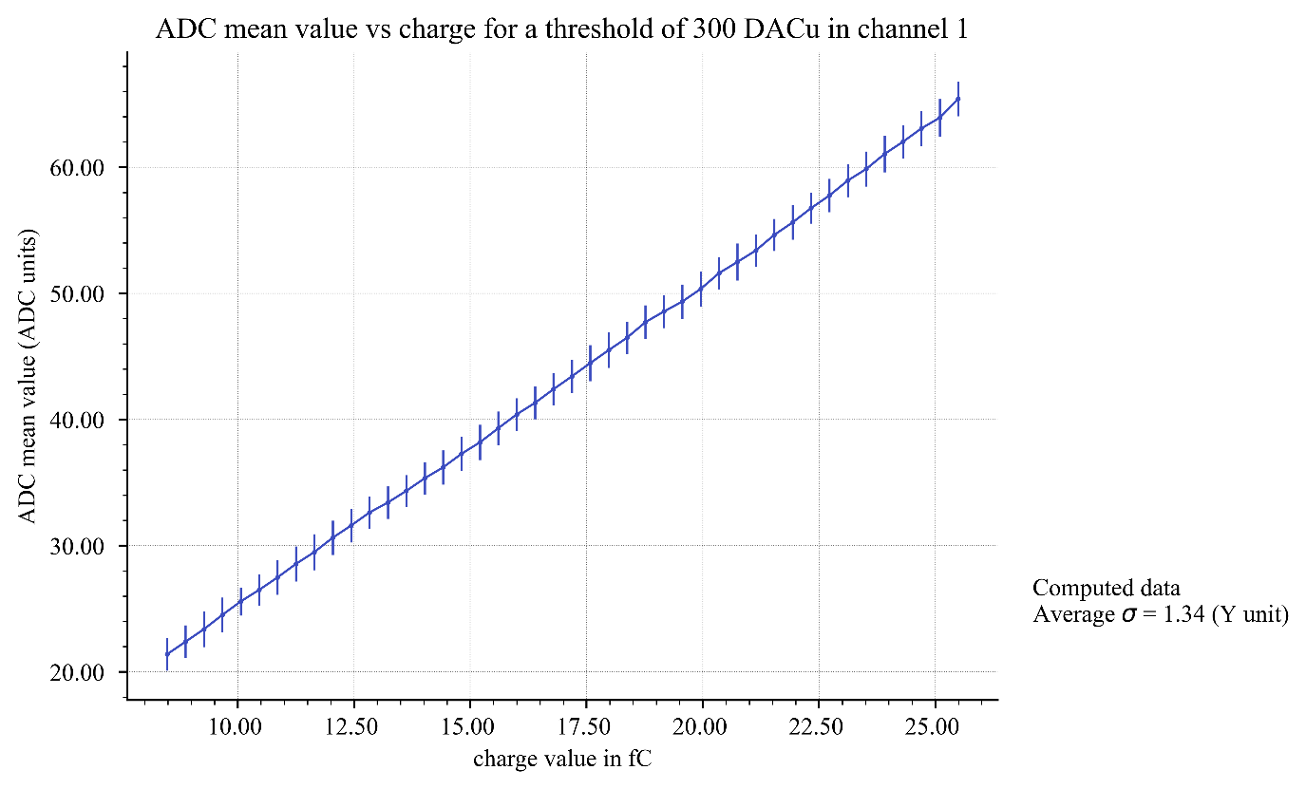
EIC FLIPCHIP – 04/09/2025 Complete test @ IJCLab
ADC with errorbar (std)
ADC Linearity

Slide 11
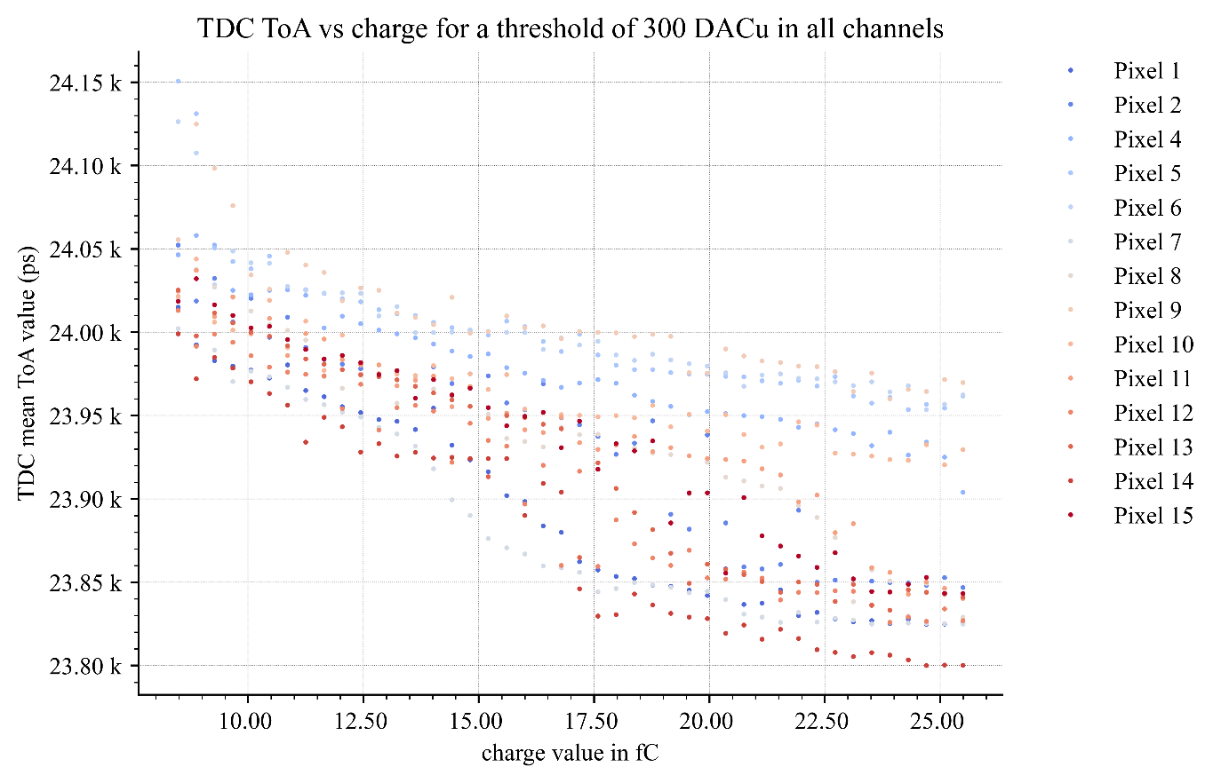
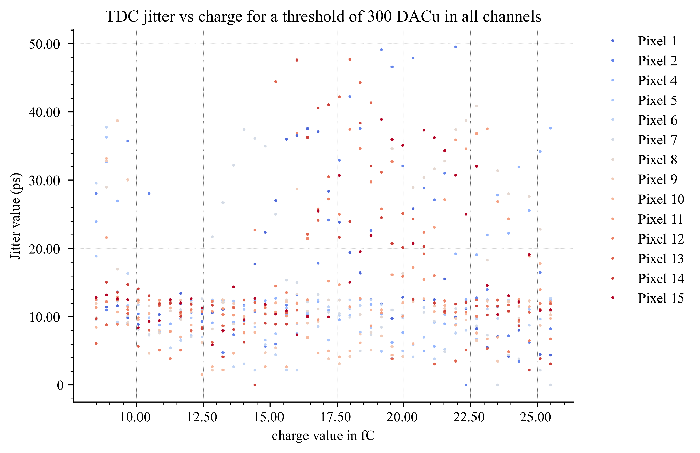
EIC FLIPCHIP – 04/09/2025 Complete test @ IJCLab
TDC ToA
Jitter
Pixel 3 was an outlier and is absent from data. Pixel 0 was removed from the data because of this

Slide 12
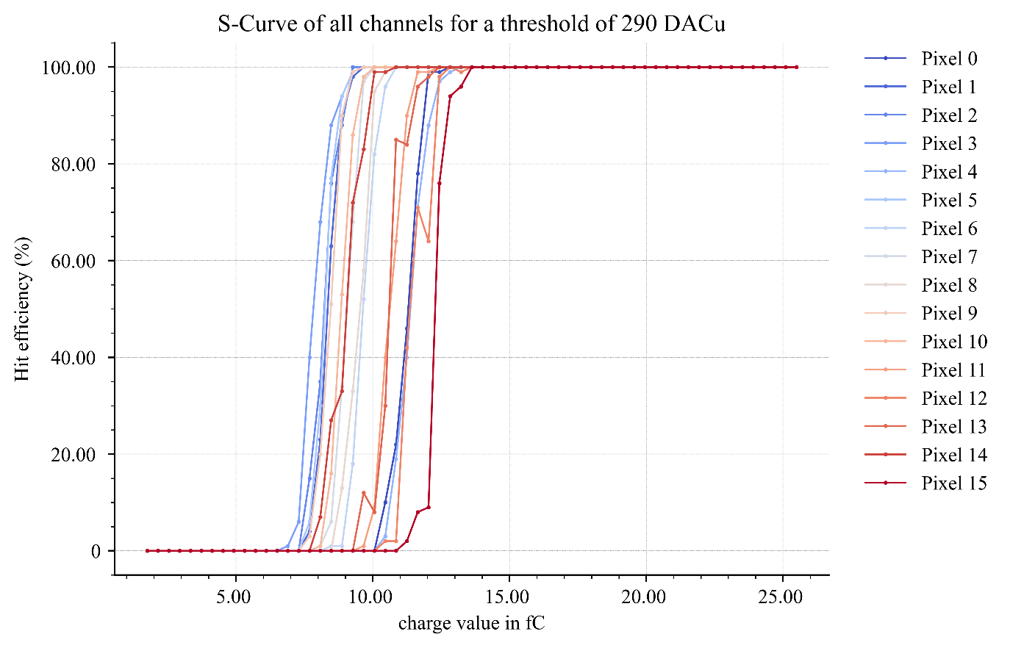
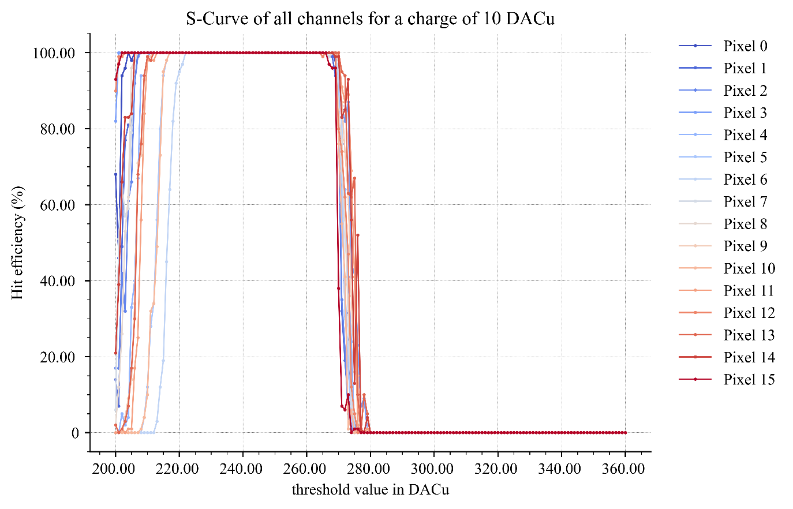
EIC HPK WB – 04/09/2025 Complete test @ IJCLab
Sensor biased @ -190 V
Charge S-Curves for correction threshold
S-Curves aligned @ 4.6 fC

Slide 13
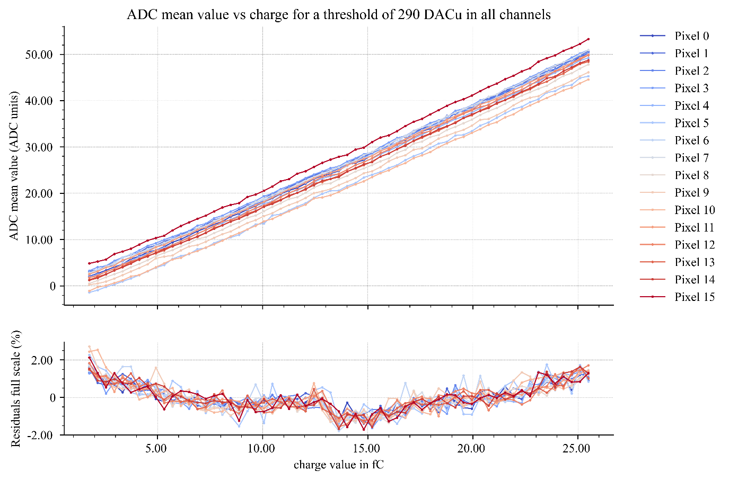

EIC HPK WB – 04/09/2025 Complete test @ IJCLab
ADC with errorbar (std)
ADC Linearity

Slide 14
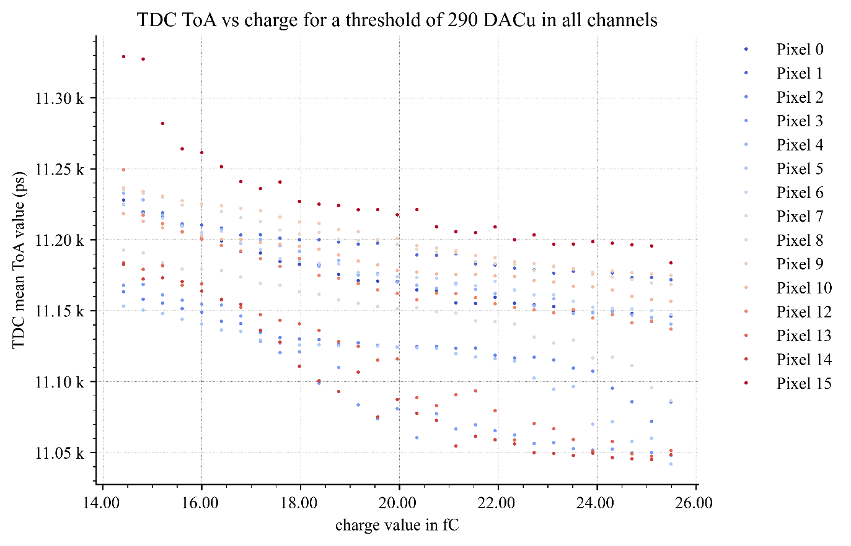
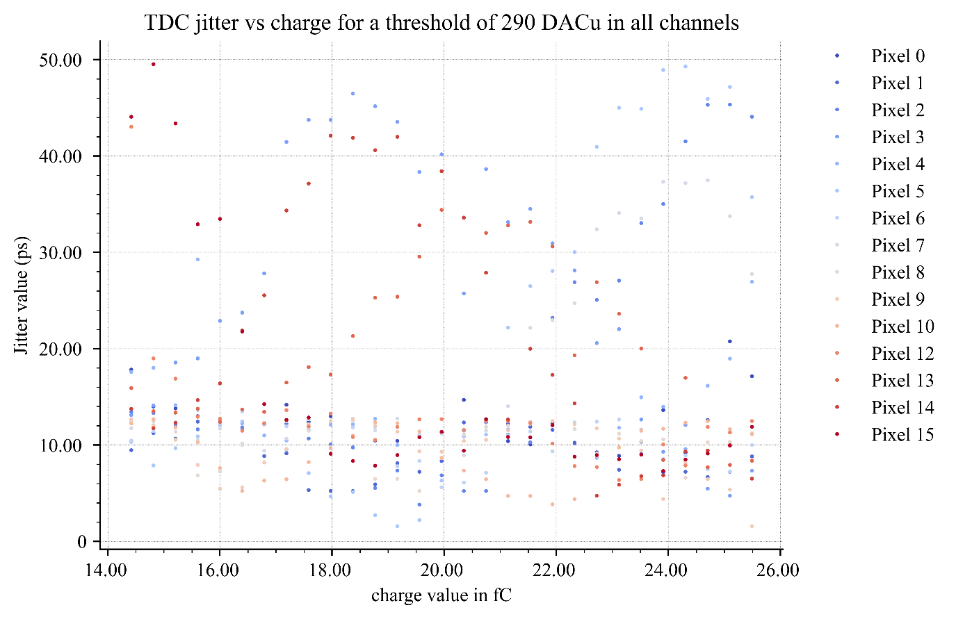
EIC HPK WB – 04/09/2025 Complete test @ IJCLab
TDC ToA
Jitter

Slide 15
Backup

Slide 16
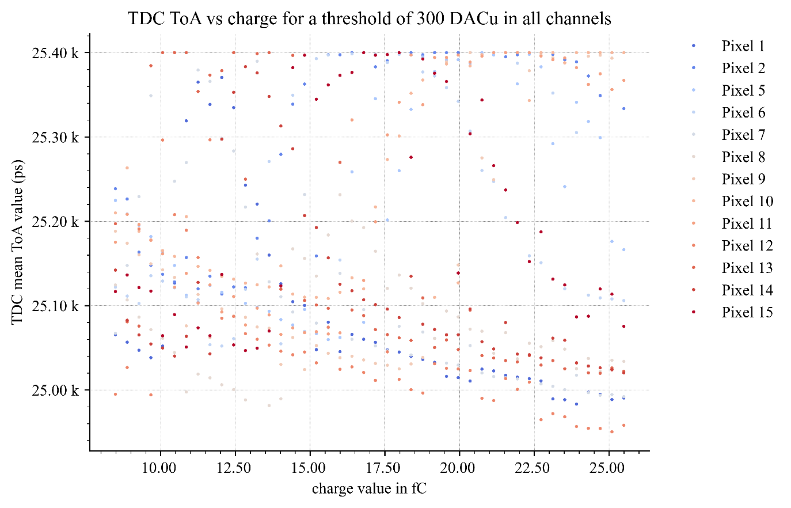
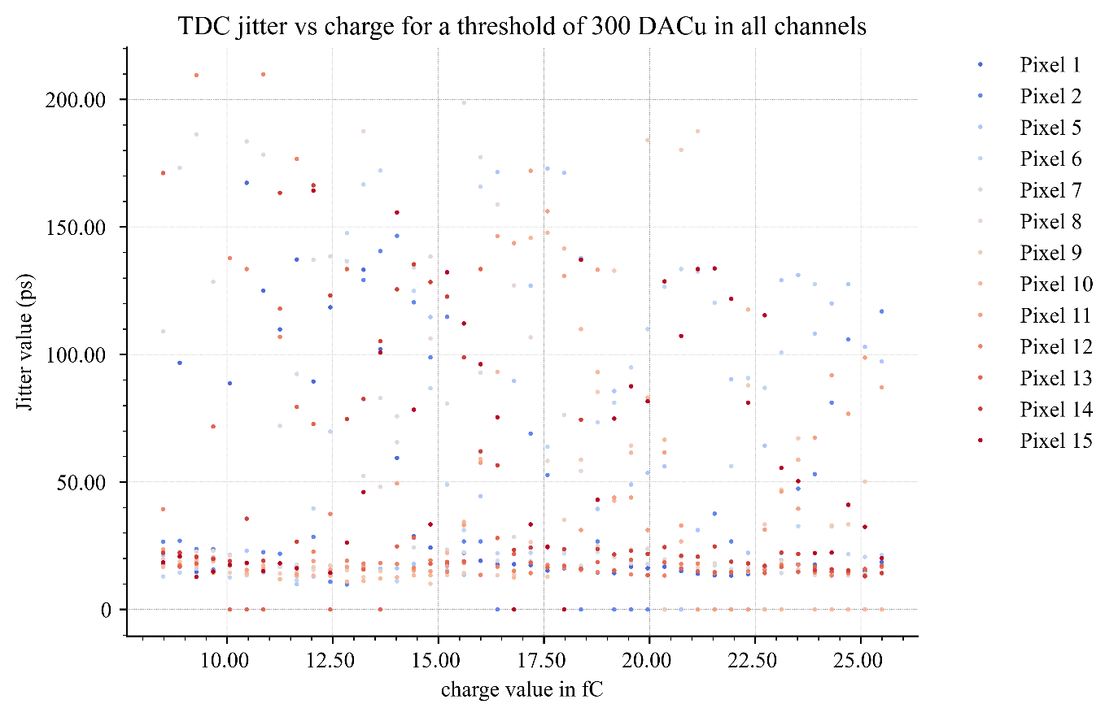
EIC FLIPCHIP – 04/09/2025 Complete test @ IJCLab
TDC ToA
Jitter
TDC Configuration bits back to old code. 4x on the jitter, with worse ToA performance and distribution with the old slow control configuration. Needs to be optimized further.
Pixel 3 and 4 were outliers and are absent from data. Pixel 0 was removed from the data because of this.

