Slide 1

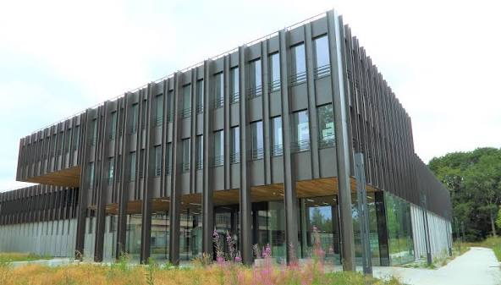
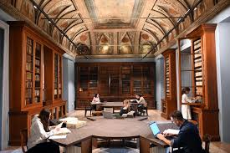

The Two-dimensional and Disordered Superconductors
Universitè Paris-Saclay, Institut PASCAL
July 9, 2026
Superconducting Fluctuations: From Ginzburg–Landau Theory to Fluctuation Spectroscopy II
Andrey Varlamov
CNR-SPIN, Rome, Italy
Academy of Science and Letters, Milan, Italy

Slide 2
Lecture II. Superconducting fluctuations in Ginzburg Landau formalism and beyond
Accounting for superconducting fluctuations in the framework of the GL formalism
0D case
3D case (evaluation)
Ginzburg-Levanyuk criterion
Time-dependent GL equation and its applications for description of the effect of fluctuations on the transport properties
2. The ideas of microscopic description of fluctuation phenomena
3. Fluctuation Spectroscopy: results

Slide 3
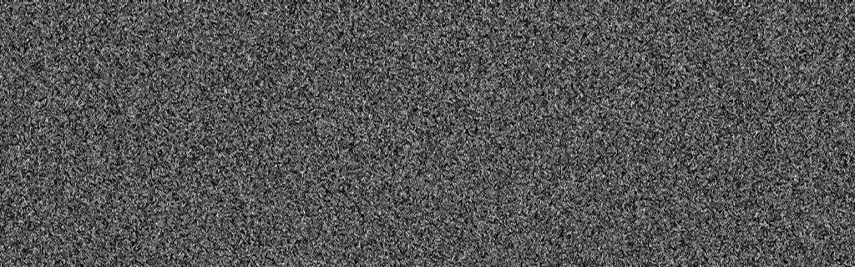
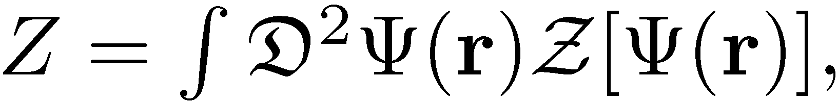
Beyond mean field: accounting for fluctuations
The complete description of its thermodynamic properties can be done through the calculation of the partition function

Slide 4
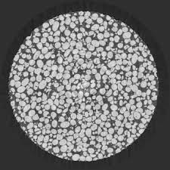
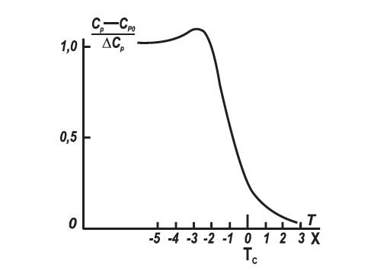
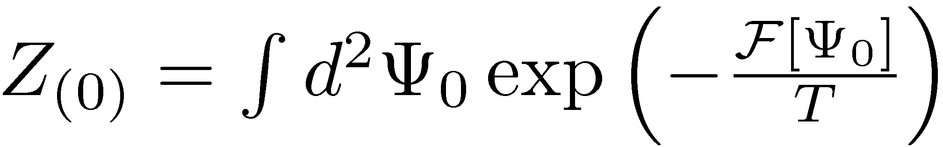
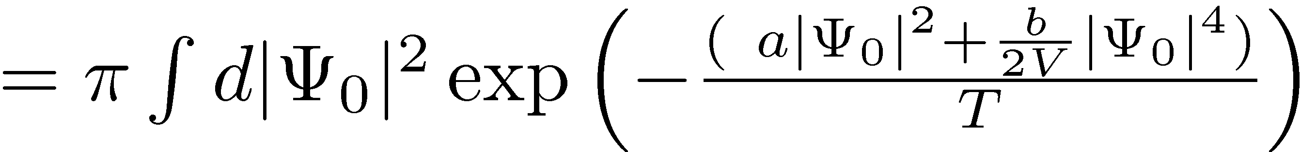
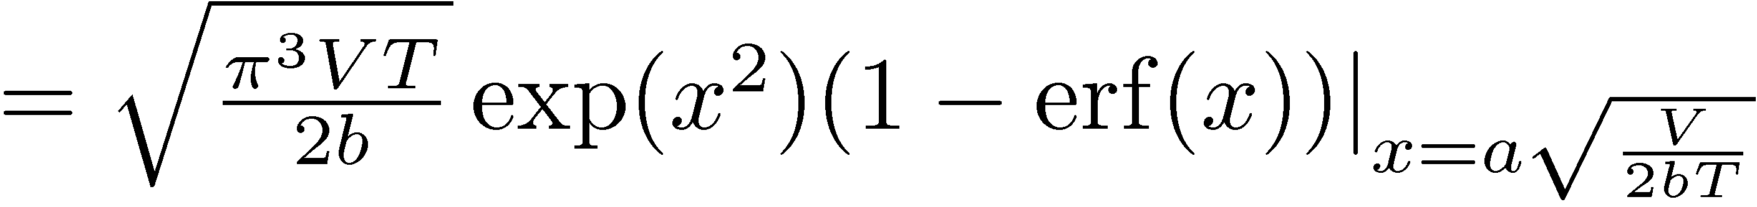
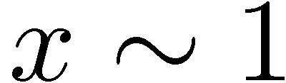
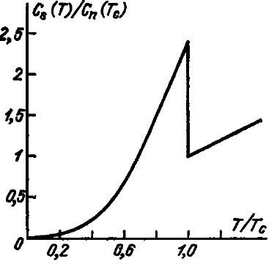
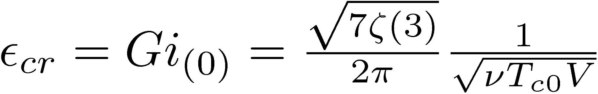
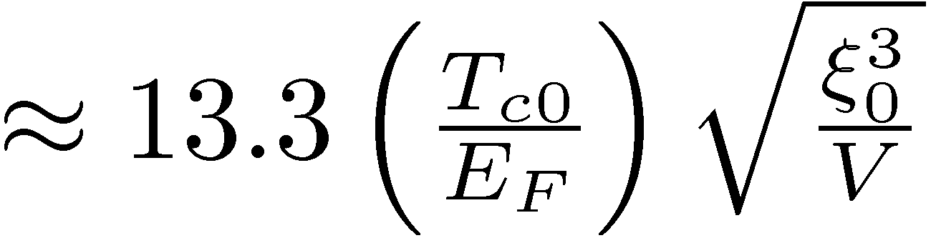


The limits of applicability of the Ginzburg–Landau theory.
0-dimensional case: exact solution:
$$d≤ξ\left(T\right)$$
One can see that this function is analytic in temperature, therefore fluctuations remove phase transition in the 0D system. The smearing of the heat capacity jump takes place in the region of temperatures in the vicinity of T_{c0} where x ∼ 1, i.e.
$$ΔC=1.43Ce$$
x>>1

Slide 5
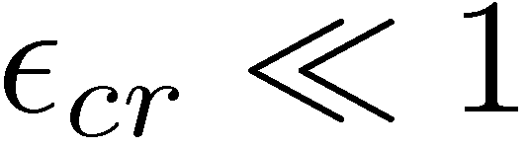
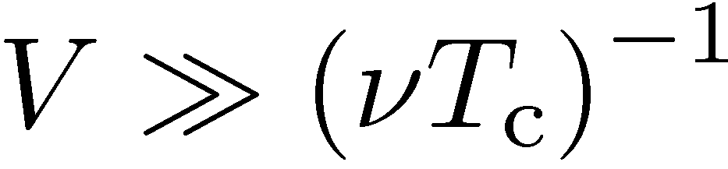
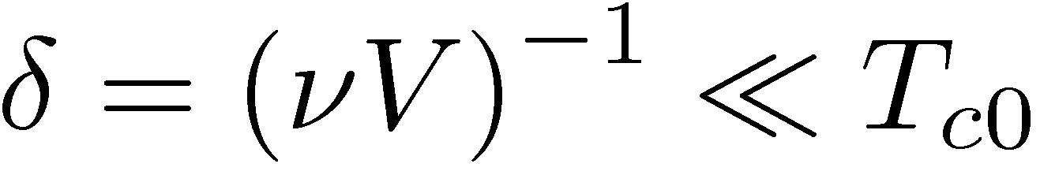
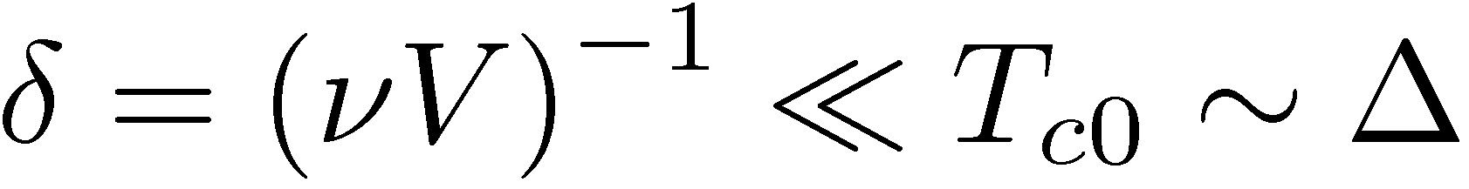
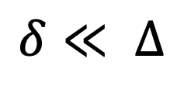
The transition remains narrow as long as
$δ$ is spacing – average distance between quantum levels in the grain
E
$$δ≪ Δ$$
BCS theory holds as long as the spacing remains small in comparison to $Δ$

Slide 6
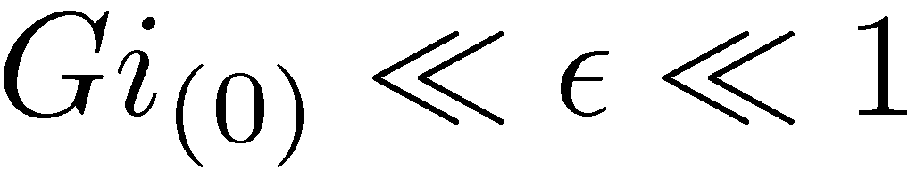
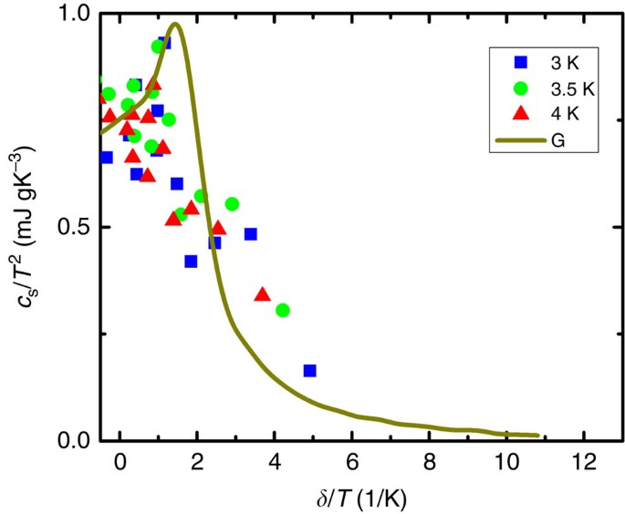
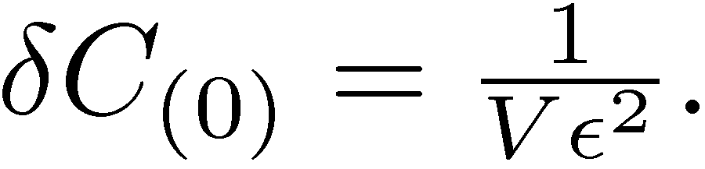
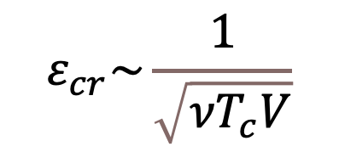
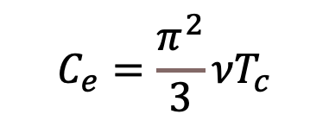
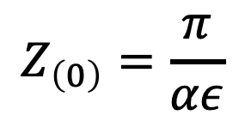


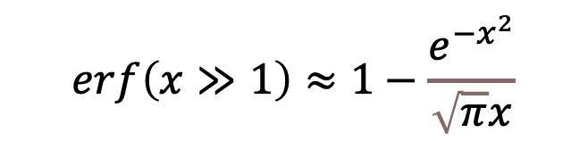
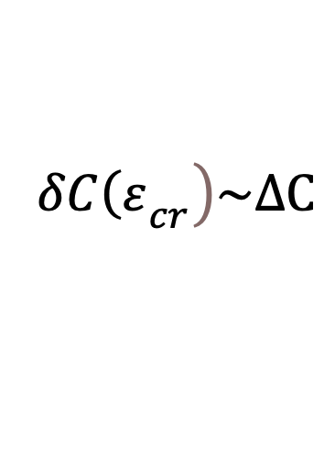
Outside the critical region
$$Z_{\left(0\right)}$$
$$erf\left(x≫1\right)≈1−\frac{e^{−x^{2}}}{\sqrt{π}x}$$
$$Z_{\left(0\right)}=\frac{π}{αε}$$
$$C_{e}=\frac{π^{2}}{3}{νT}_{c}$$
$$ΔC=1.43Ce$$
$$\left.{δC\left(ε\right.}_{cr}\right)\sim ΔC$$
$$ε_{cr}\sim \frac{1}{\sqrt{{νT}_{c}V}}$$
S. Poran, A. Auerbach, T. Nguyen-Duc, N. Dupuis, A. Frydman & Olivier Bourgeois
Nature Communications 8, 14464 (2017)

Slide 7
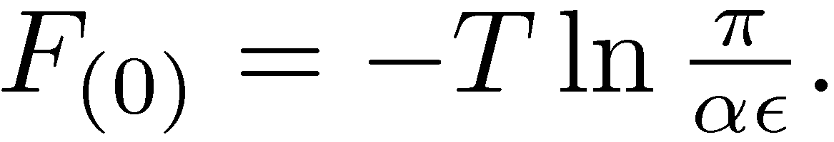
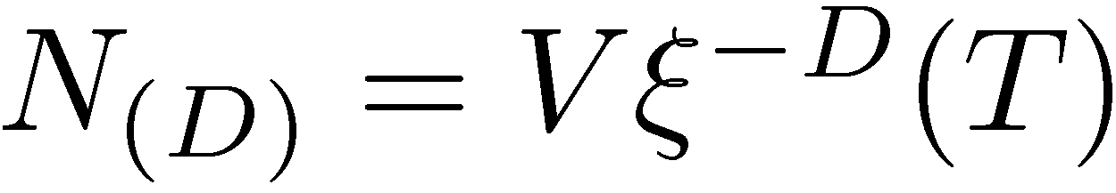
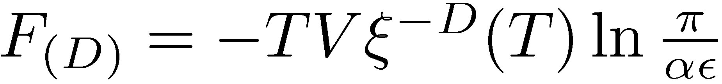
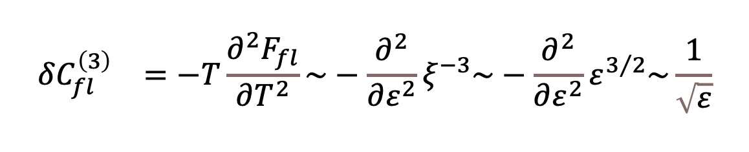
Beyond the immediate vicinity of transition: Qualitative evaluation
The volume of the specimen may be divided into regions of size ξ(T), which are weakly correlated to each other. Then the whole free energy can be estimated as the free energy of one such 0D specimen
ξ(T)
multiplied by their number
This formula gives the correct temperature dependence of the free energy not too close to T_{c} for the specimens of the even dimensionalities. Example:
3-dimensional case:
$${δC_{fl}^{\left(3\right)}}_{}=−T\frac{∂^{2}F_{fl}}{∂T^{2}}\sim −\frac{∂^{2}}{∂ε^{2}}ξ^{−3}\sim −\frac{∂^{2}}{∂ε^{2}}ε^{3/2}\sim \frac{1}{\sqrt{ε}}$$

Slide 8
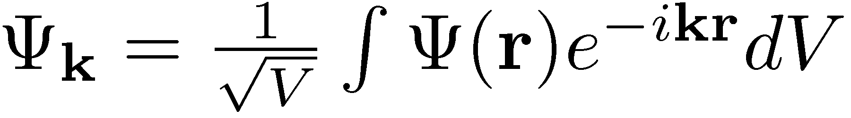
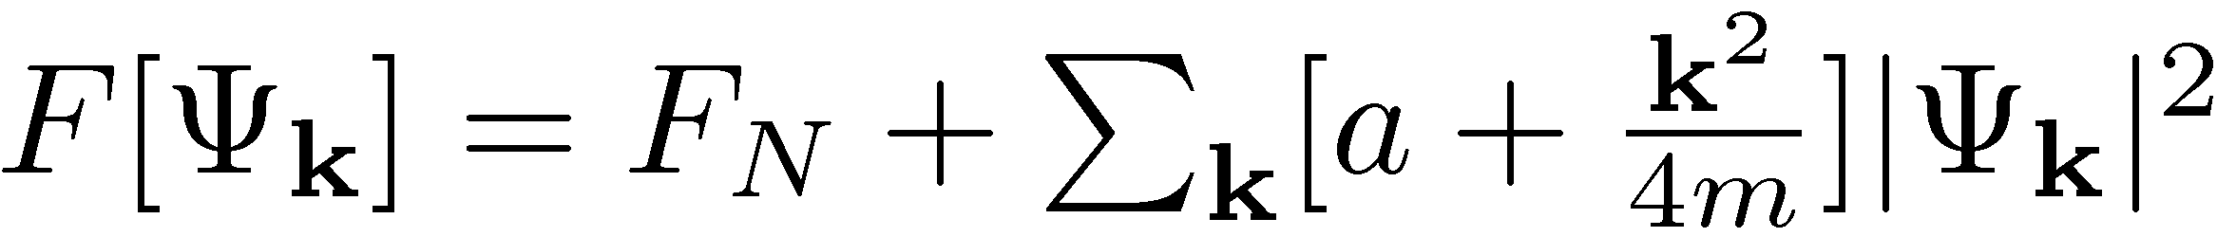
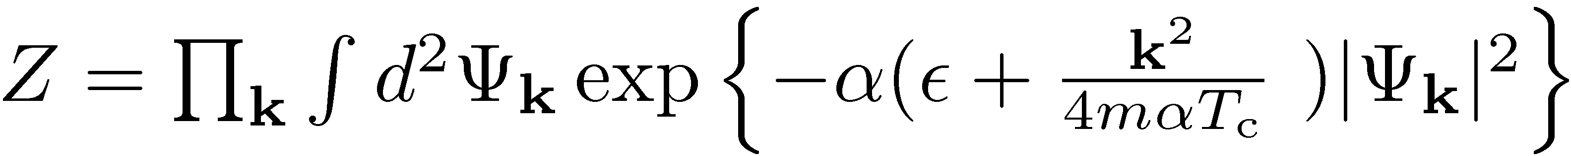
Beyond the immediate vicinity of transition: Perturbation approach
Fourier transform
Partition function

Slide 9
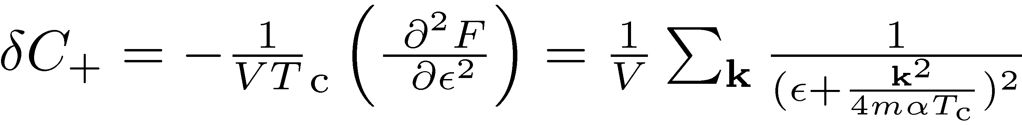
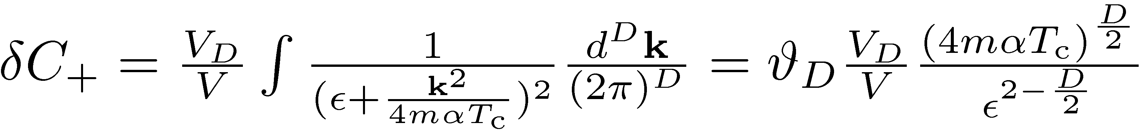
Fluctuation contribution to the heat capacity:

Slide 10
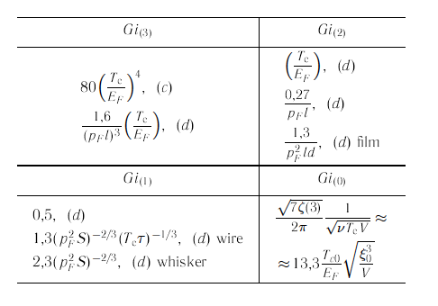
The Ginzburg–Levanyuk number

Slide 11


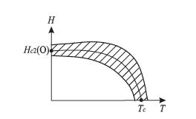
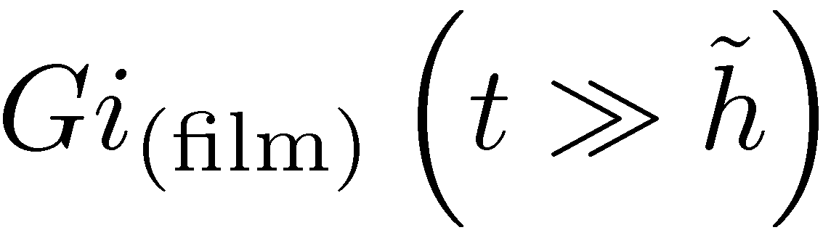
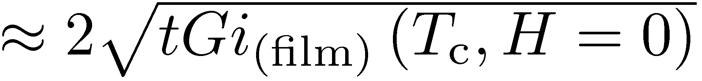
Broadening of the critical region: dependence of the Ginzburg–Levanyuk number on the magnetic field

Slide 12
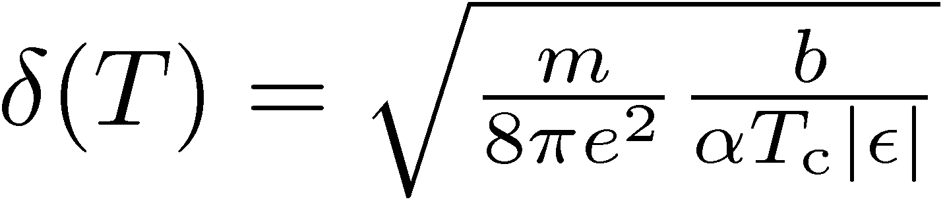
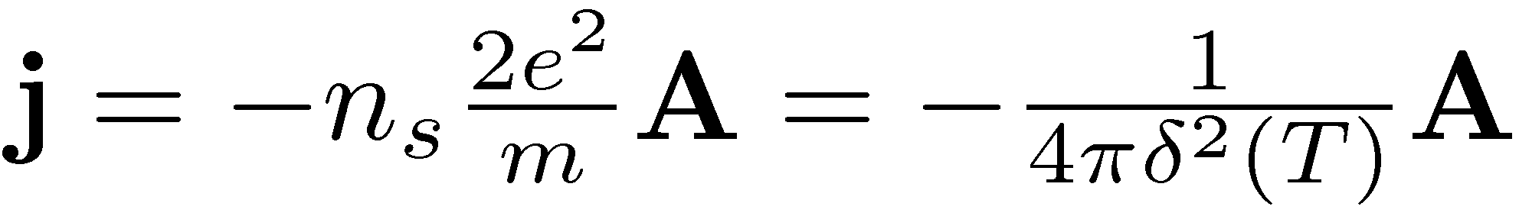
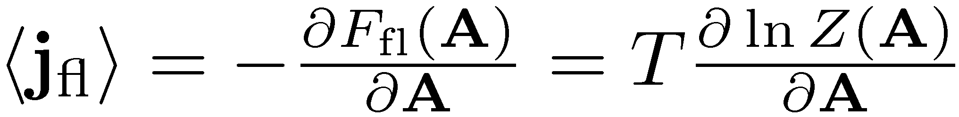

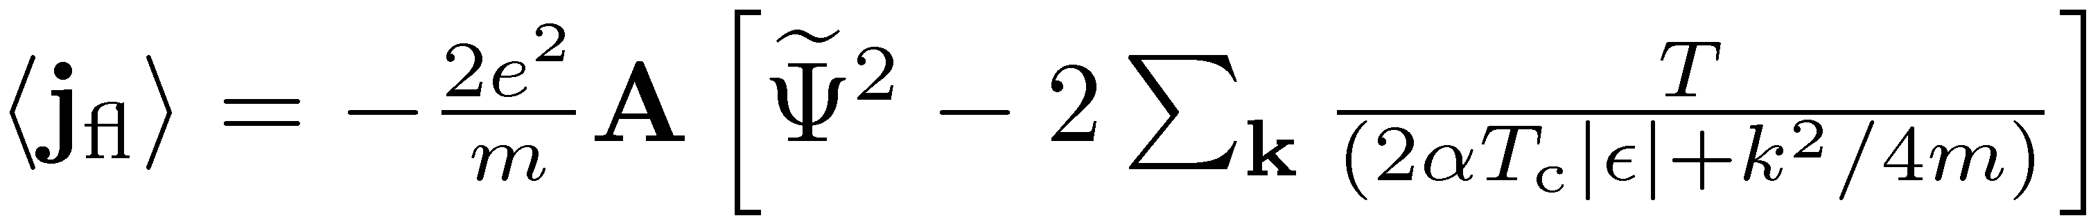
Fluctuation-induced shift of the critical temperature
Ginzburg-Landau penetration length

Slide 13
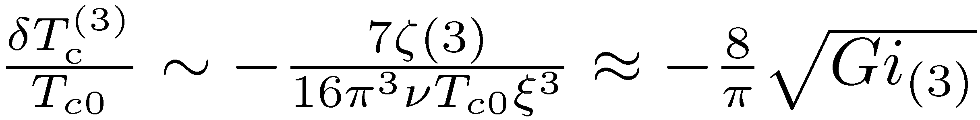
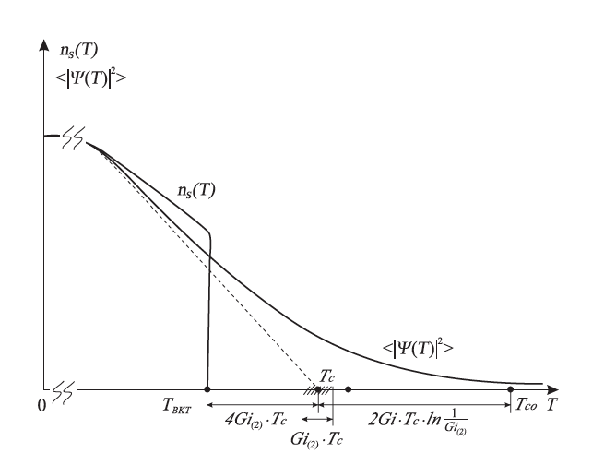
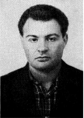
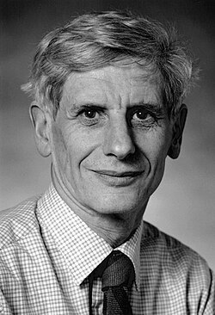

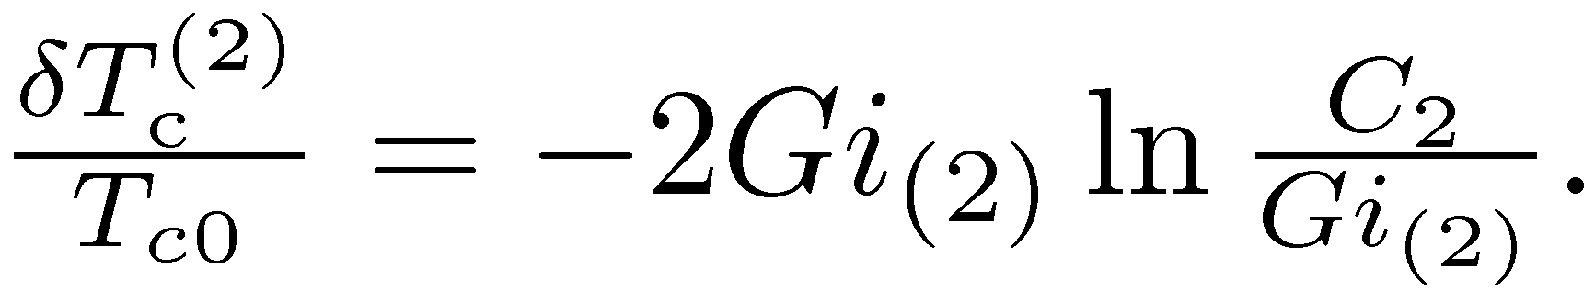
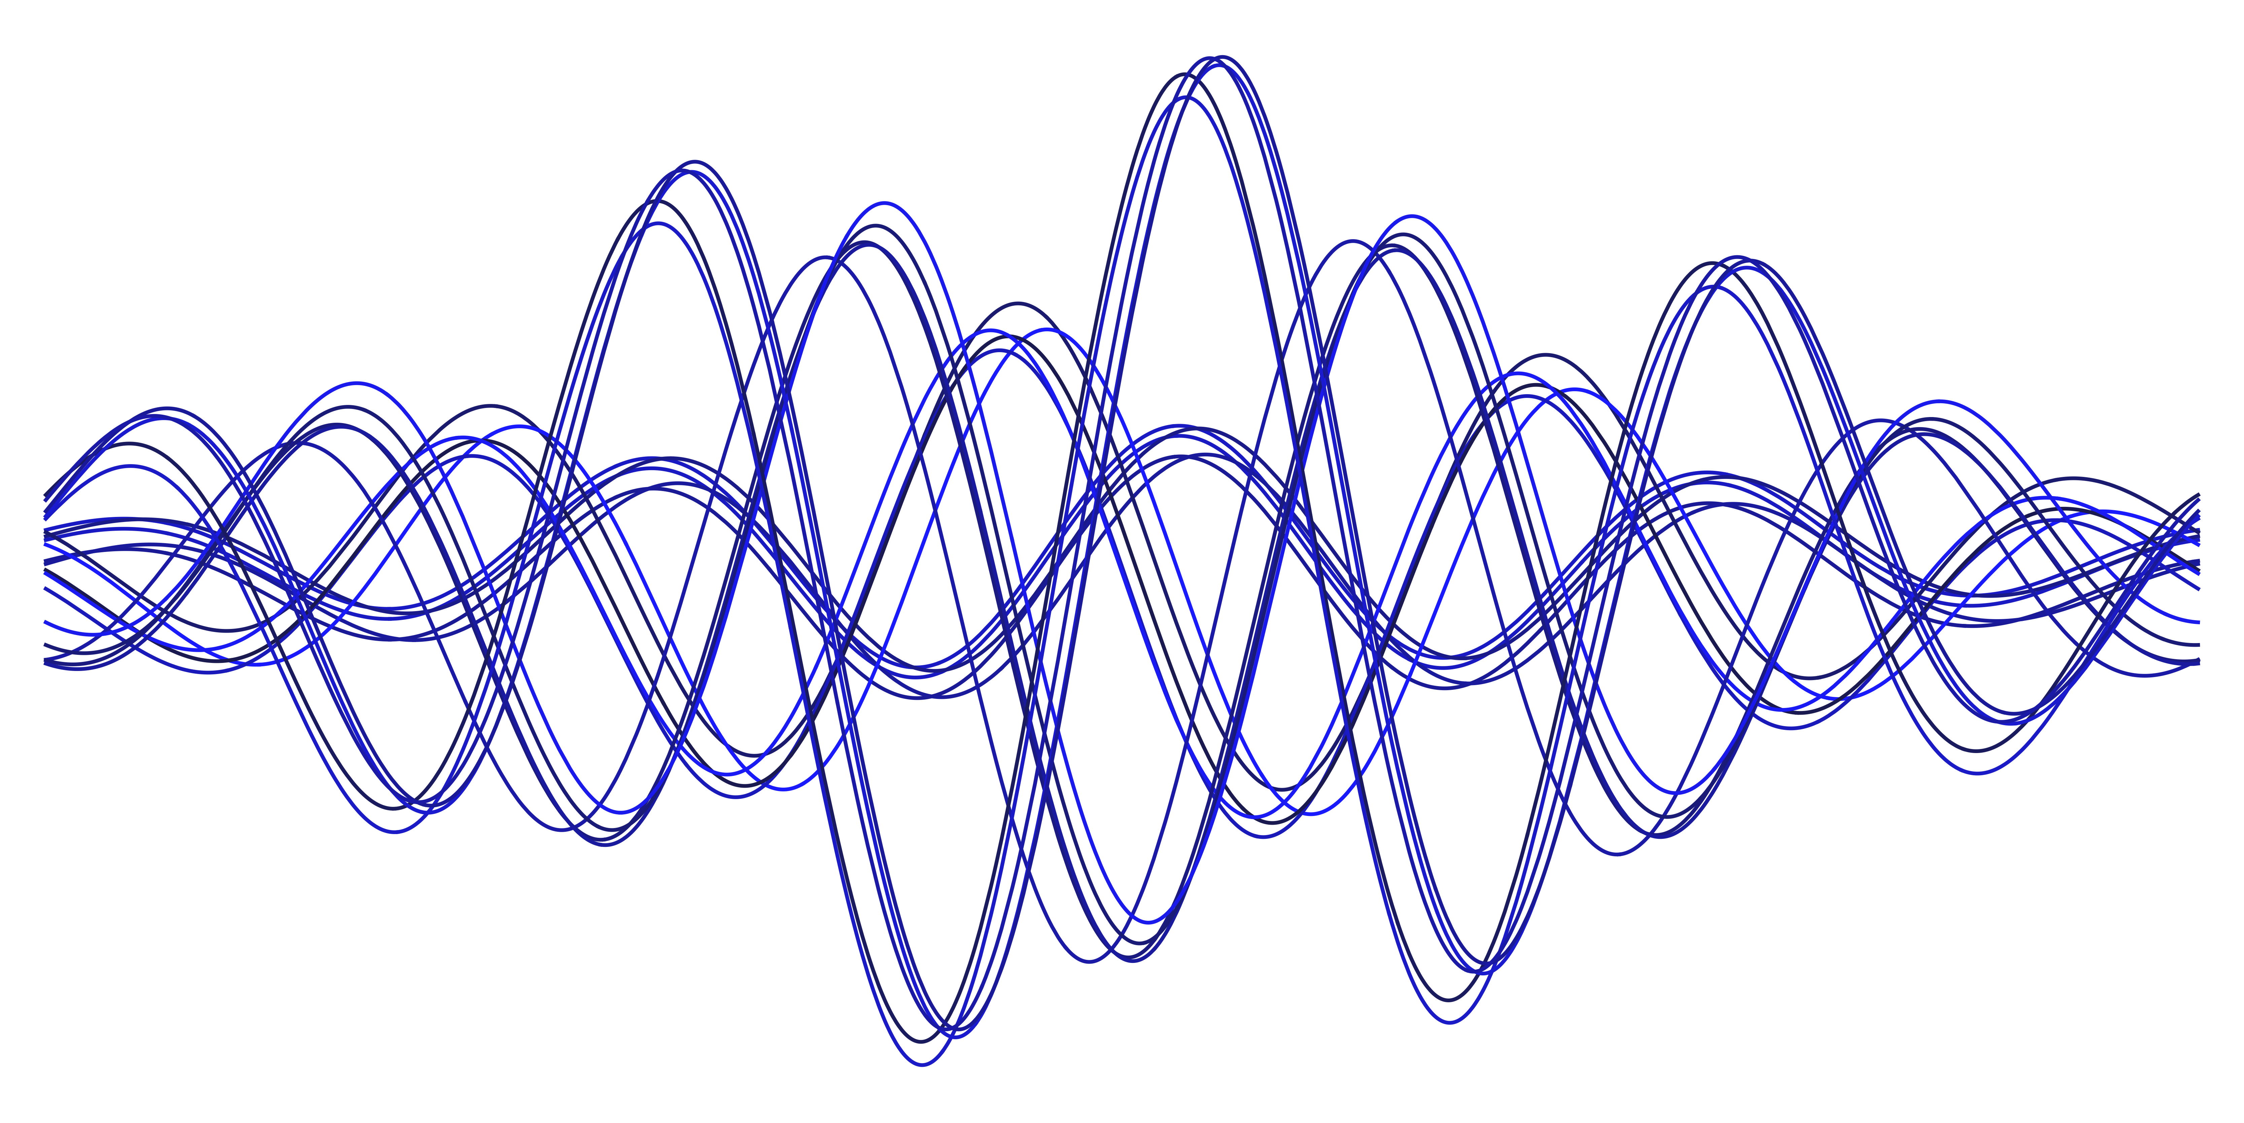

Fluctuation-induced shift of the critical temperature

Slide 14
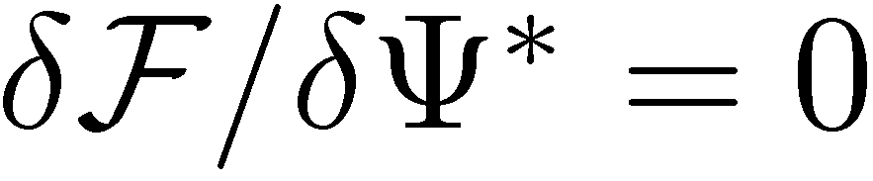




Fluctuation transport in the Ginzburg–Landau formalism
Time-dependent Ginzburg–Landau equation
Gauge invariance requires
The relaxation of the order parameter is described by the equation
Langevin forces
Accounting for interaction with thermostat

Slide 15

Neglecting the fourth-order term in the GL functional, this equation can be rewritten
in operator form as
with the TDGL operator and Hamiltonian defined as
In the absence of an electric field one can write the formal solution of this equation as
The correlator of the Langevin forces introduced above must satisfy the fluctuation–dissipation theorem. This requirement is fulfilled if the Langevin forces are correlated by the Gaussian white-noise law

Slide 16





Paraconductivity

Slide 17


The quantum mechanical expression for the current
After some algebra which we can discuss during Q&A session one can obtain
Where is the spectrum of the GL Hamiltonian

Slide 18


The isotropic case

Slide 19
Diagrammatic description of fluctuation phenomena

Slide 20

$σ_{AL}$($ε$ )=

Slide 21
Fluctuoscopy: arbitrary temperatures and fields
a) AL
b) MT
1
2
c) DOS
d) DcR
3
9
4
10
5
7
6
8

Slide 22



Fluctuation propagator in magnetic field and arbitrary temperatures
=

Slide 23

Fluctuation conductivity at arbitrary temperatures and magnetic fields

Slide 24

General picture of fluctuation conductivity
(A.Glatz,A.Varlamov, V.Vinolur, 2011)

Slide 25

How is T_{c} obtained?
→T_{c} is assigned, not determined

Slide 26


Fluctuoscopy of thin TiN films (II)
T. Baturina et al (2011)
S03: T_{c}=1.260K
S04: T_{c}=2.538K
Traditional definition of T_{c}
The determination of T_{c} as the temperature where R(T) drops to 0.9, 0.5 R_{N} significantly overestimates T_{c}.

Slide 27
Electric field control of fluctuations in a two-dimensional superconductor
Graham Kimbell, Ulderico Filippozzi, Stefano Gariglio, Marc Gabay, Andreas Glatz, Andrey Varlamov, and Andrea Caviglia (2026)
(a) Superconducting transition at −2 V, comparing the best fit from Aslamazov-Larkin and the full fluctuation conductivity model. (b) Superconducting transition at different gate voltages (colored lines), fit to the full fluctuation conductivity model (black lines).

Slide 28


Microwave Signature of the Emerging Abrikosov Lattice Above H_{c2}
(Hang Zhou, Zhanghai Chen, A. A. Varlamov, Andreas Glatz, and Yuriy Yerin, PRL 2026)

Slide 29


Frequency dependence of conductivity
Normal impure metal (Drude)
$$ω_{0}\sim 1/τ$$

Slide 30


Absorption in low-Tc superconductor.
Superconductor at T=0 (Abrikosov, Gor’kov, Khalatnikov, 1958)
The characteristic frequency 𝑓_{𝑐}, which is proportional to the strength of the pinning force acting on fluxons and that marks the crossover between the low-frequency, low
dissipation regime and the high-frequency, high dissipation regime. J. I. Gittleman and B. Rosenblum, “Radio-frequency resistance in the mixed state for
subcritical currents”, Phys. Rev. Lett., vol. 16, no. 17, pp. 734-736, 1966.
$$ω_{0}\sim 2∆\sim 3.52T_{c}≪1/τ$$

Slide 31






Quantum fluctuations in a weak electromagnetic field
For $T=0, ω<∆\frac{H−H_{c2}}{H_{c2}}$
${\left({π^{2}}/{e^{2}}\right)Δσ}_{AL} \left(H,ω\right)$=$\frac{16}{9}\frac{H−H_{c2}}{H_{c2}}∙\ln{\frac{H_{c2}}{H−H_{c2}}+\frac{2iω}{3Δ}}\left(\frac{H_{c2}}{H−H_{c2}}\right)$
$${\left({π^{2}}/{e^{2}}\right)Δσ}_{MT}\left(H,ω\right)\text{=}−2∙\ln{\frac{H_{c2}}{H−H_{c2}}+\frac{iω}{Δ}}\left(\frac{H_{c2}}{H−H_{c2}}\right)$$
${\left({π^{2}}/{e^{2}}\right)Δσ}_{(3−4)}\left(H,ω\right)=−4∙{\ln{\frac{H_{c2}}{H−H_{c2}}+O(\frac{iω}{Δ}}}$)
${\left({π^{2}}/{e^{2}}\right)Δσ}_{DOS}\left(H,ω\right)$ =$0$
${\left({π^{2}}/{e^{2}}\right)Δσ}_{tot}$=$−6∙\ln{\frac{H_{c2}}{H−H_{c2}}+\frac{5iω}{3Δ}}\left(\frac{H_{c2}}{H−H_{c2}}\right)$

Slide 32






Microwave Signature of the Emerging Abrikosov Lattice Above H_{c2}
$${\left({π^{2}}/{e^{2}}\right)Im Δσ}_{tot}$$
$${\left({π^{2}}/{e^{2}}\right)Im Δσ}_{tot}$$
$$ω_{0}\sim \frac{H−H_{c2}}{H_{c2}}∆≪∆≪1/τ$$
$$ω_{0}\sim 1/τ$$
$$ω_{0}=2∆$$

Slide 33



Giant Nernst effect above the transition line
Hc2(T): vortices or fluctuating Cooper pairs?
Nernst effect in cuprates: the experiments of Ong’s group

Slide 34









Nernst effect in conventional superconductor

Slide 35









Qualitative explanation of the Giant Nernst effect due to fluctuating Cooper pairs
(A. V. Kavokin and A. A. Varlamov, 2009)
Nernst effect & chemical potential
$ν=\frac{σ}{ne^{2}c}\left(\frac{∂μ}{∂T}\right)$

Slide 36

Giant Nernst effect due to fluctuation Cooper pairs
M.Serbyn et al (2009): A. Kavokin, A. Varlamov (2009); A. Glatz, A. Varlamov (2018)
=T_{c}-T

Slide 38

Comparison of the theory and experiments

Slide 39



Tunnel Fluctuoscopy: pseudogap opening and low bias anomaly (A.Glatz,A.Varlamov, V.Vinokour, 2011)
Tunnel Current Giaver and Mengerle, 1961)
Fluctuation renormalization of the DOS (Abrahams et al, 1970)
Fluctuation pseudogap (Varlamov, Dorin, 1983)

Slide 41


Slide 42


Tunneling conductance at H=0, near T_{c0} : theory
Temperature and voltage dependence of the tunneling conductance due to superconducting fluctuations. The overall behavior of both terms of the tunnel current results in a pronounce pseudo-gap structure of the conductance near the superconducting region.
The non-linear behavior of the second term of the tunnel current is responsible for the fine structure (local maximum) at the center of the gap.

Slide 43

Observation of the pseudogap structure in experiments
(B. Sacepe et. al., Nature Comm.. 140, 1 (2010))
.
Tunneling conductance STM measurements on 3.6nm (a) 5nm (b) thick TiN films (»¼10nm), T_{c}=1.27K (a) or 0.98K (b)

