Slide 1
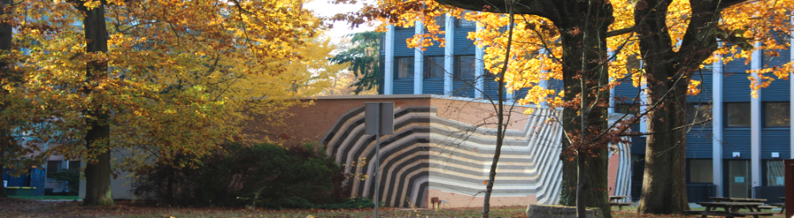



Inhomogeneities in superconductors
Pascal Simon
Laboratorie de Physique des Solides (LPS)
University Paris Saclay & CNRS
TIDES 2026, Institut Pascal

Slide 2
Anderson’s theorem
P. W. Anderson, J.Phys. Chem. Solids 11, 26 (1959)
In the presence of dirt one can still pair time-reversed members of Kramer’s doublet:
thermodynamics (Tc, gap, sp. ht., …) are not affected by nonmagnetic impurities
In the presence of dirt one can still pair time-reversed members of Kramer’s doublet:
thermodynamics (Tc, gap, …) are not affected by nonmagnetic impurities

Slide 3
Abrikosov-Gor’kov theory

Slide 4
Abrikosov-Gor’kov theory (consequences)
Skalski et al, Phys Rev. 136, A1500 (1964)

Slide 5
Results about non-magnetic impurities

Slide 6
Magnetic impurity in a superconductor
Yu Lu, Acta Physica Sinica 21, 75 (1965)
see also
H. Shiba, Prog. Theor. Phys. 40, 435 (1968).
A. I., Rusinov, 1969, Zh. Eksp. i Teor. Fiz. 56, 2047, [Sov.
Phys. JETP 29, 1101 (1969)].

Slide 7
A more direct approach to YSR bound states
From F. Pientka, L. Glazman, F. von Oppen, Phys. Rev. B 88, 155420 (2013)
In this Nambu basis, the Hamiltonian is bloc diagonal in spin space!
Solve the Schoedinger equation in the spin bloc space :
Take
Fourier transform:

Slide 8
A more direct approach to YSR bound states
F. Pientka, L. Glazman, F. von Oppen, Phys. Rev. B 88, 155420 (2013)

Slide 9

A more direct approach to YSR bound states
Normalization

Slide 10

Rusinov’s parametrization (JETP 68’)
Phase shift:
Full wave function:
Spatial dependence governed by:
;

Slide 11
Rusinov’s parametrization (JETP 68’)
In 3D:
;
In 2D:
A. I. Rusinov, Zh. Eksp. Teor. Fiz. Pisma Red. 9, 146 (1968) [JETP Lett. 9, 85 (1969)]
;
G. Ménard et al., Nature Physics 2015

Slide 12
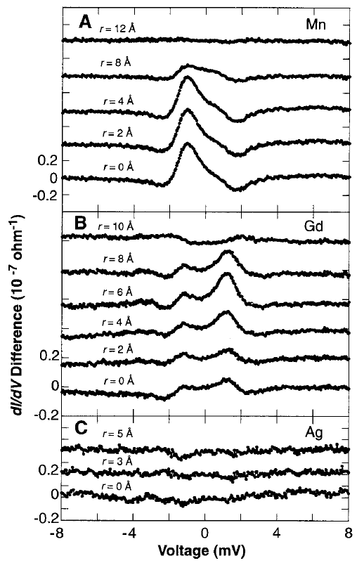
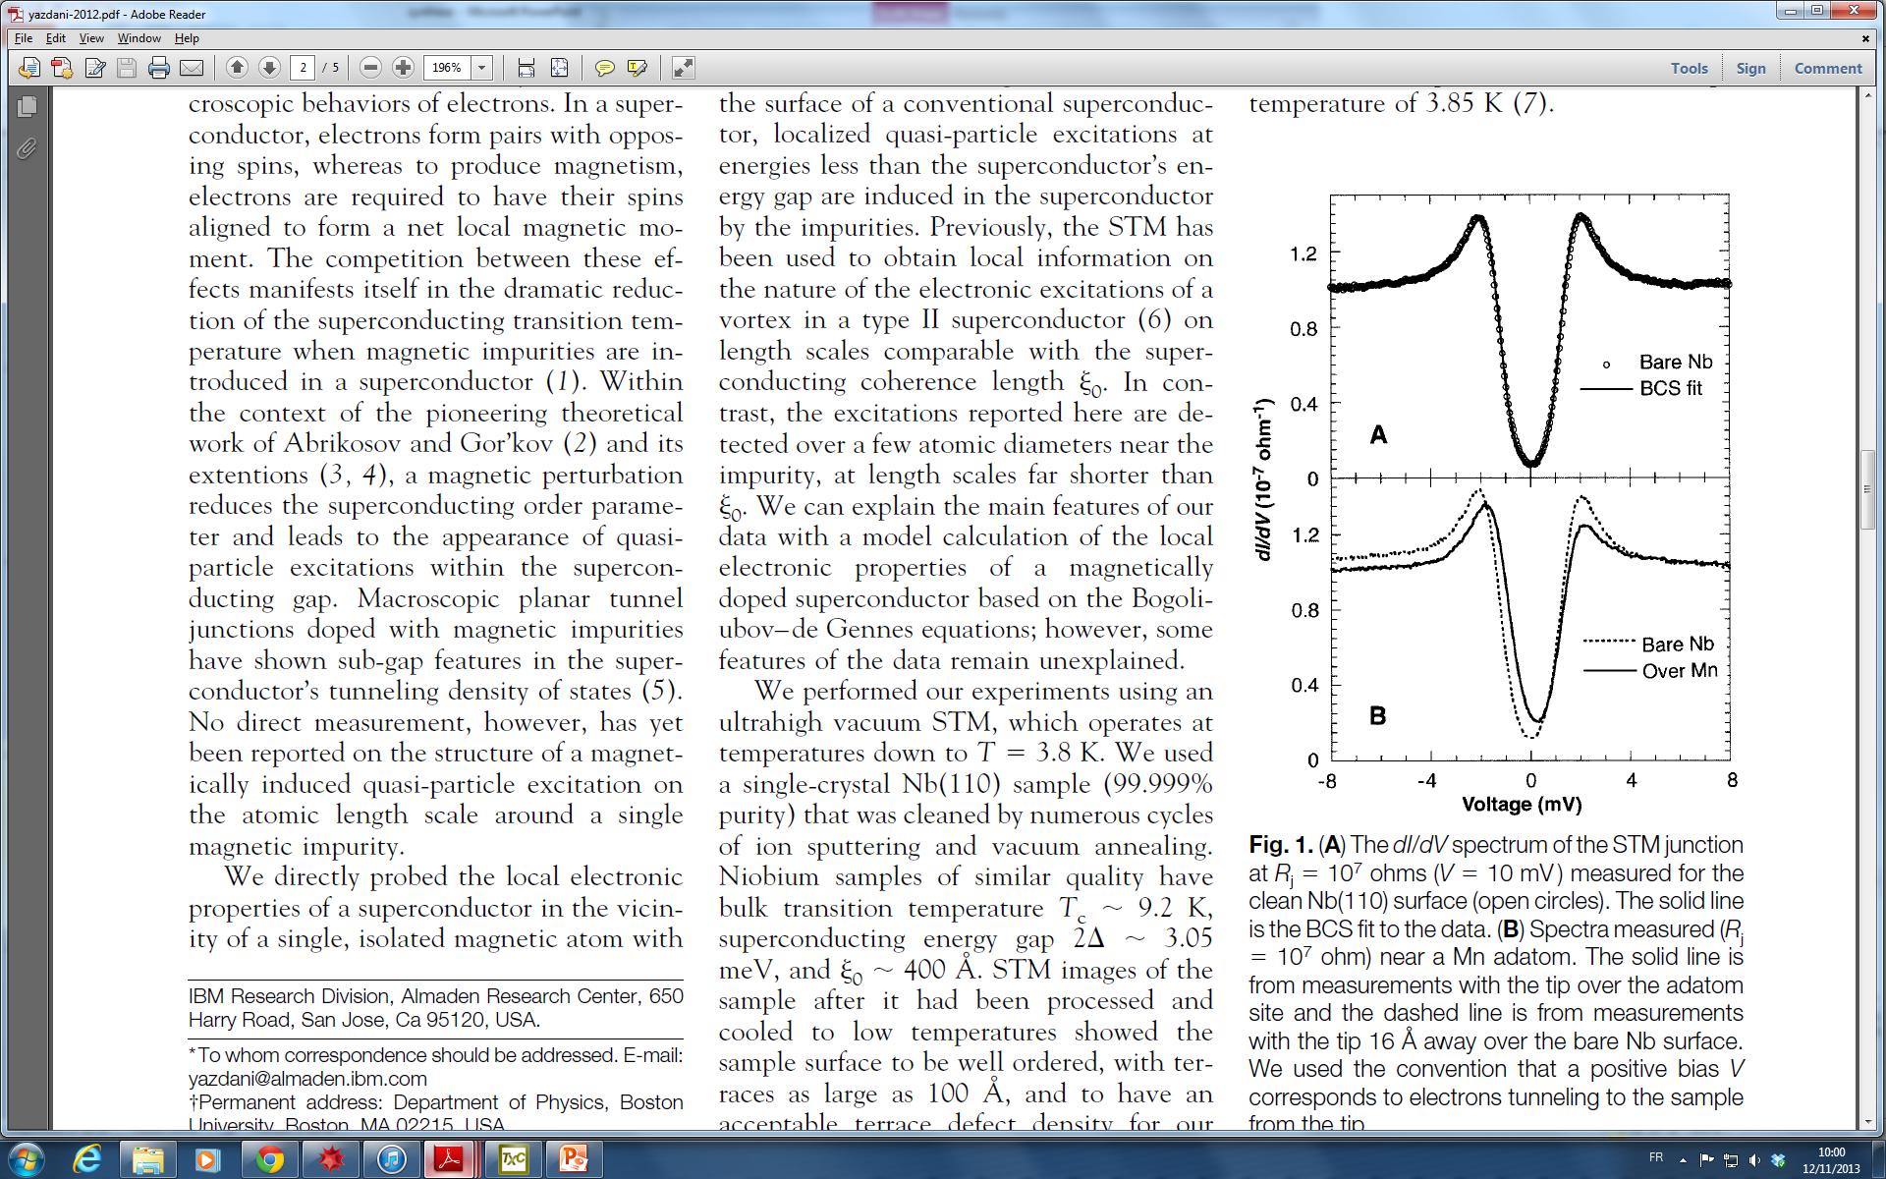
Single magnetic impurities observed by STM
Bound states for magnetic impurities (Mn & Gd) on Nb
No bound states for non magnetic Ag adatoms on Nb
STM tip
Mn & Gd atoms
Nb
The wave function of the
bound states is localized at less
than 10 Å from the impurities
Yazdani et al. Science 275, 1767 (1997)

Slide 13
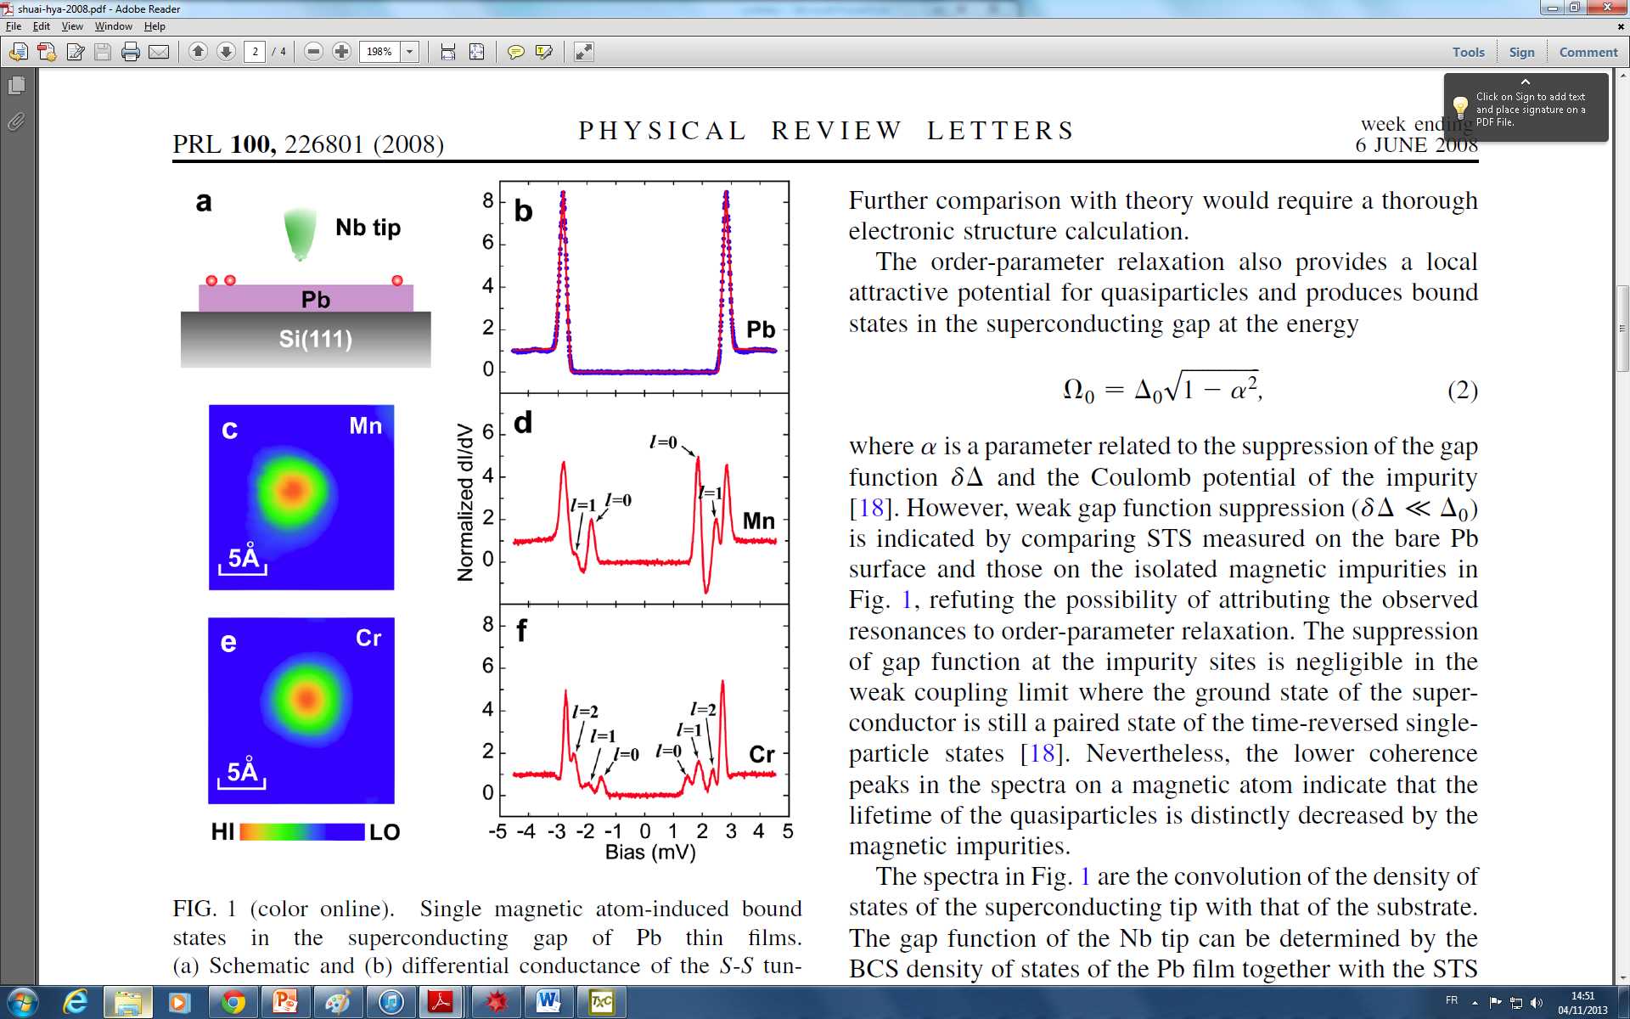
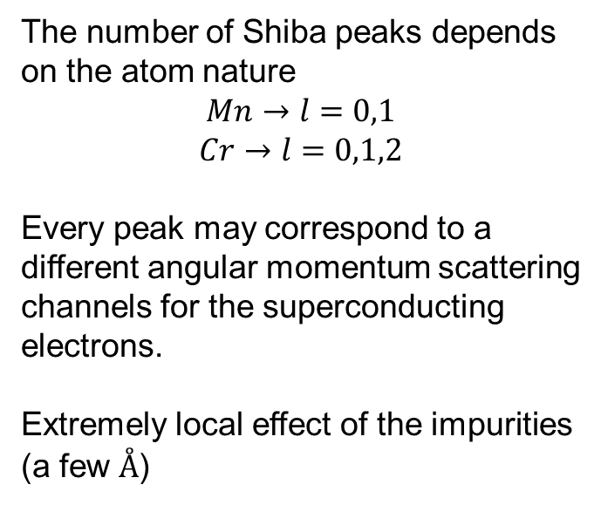
Single magnetic impurities observed by STM:
Angular momentum dependence
The number of Shiba peaks depends on the atom nature
$$Mn→l=0,1$$
$$Cr→l=0,1,2$$
Every peak may correspond to a different angular momentum scattering channels for the superconducting electrons.
Extremely local effect of the impurities (a few $Å$)
Shuai-Hua Ji et al. PRL 100, 226801 (2008)
See also N. Hatter et al., Nature Commun. (2015)

Slide 14
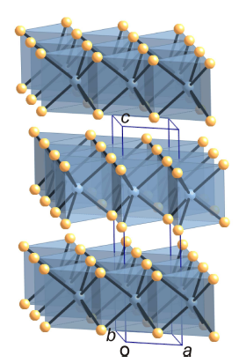
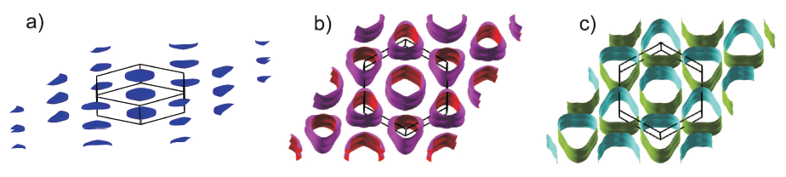
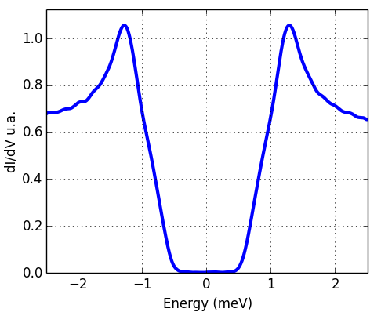
2H-NbSe₂ as a two-dimensional superconductor
Band 1
Band 2
Two-dimensional like bands structure due to the weak Van der Waals interlayer coupling.
Superconducting gap measured at 320 mK
(multigap superconductor)

Slide 15
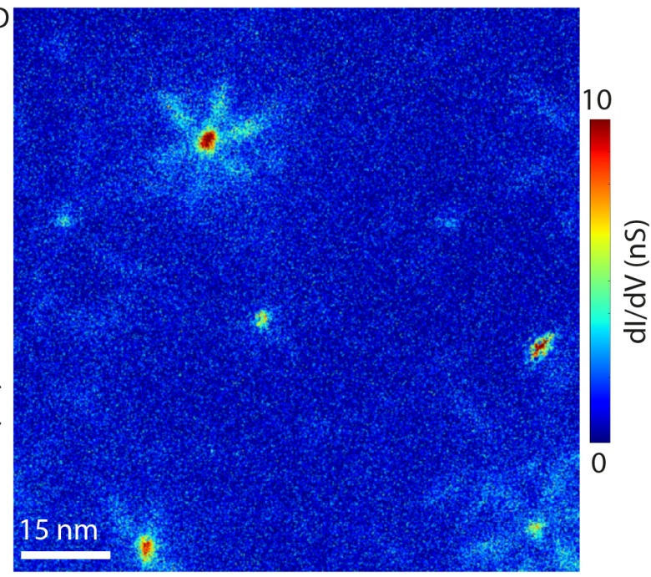
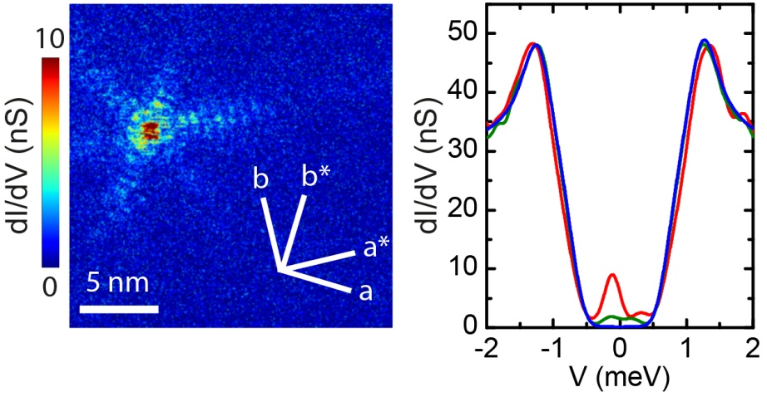
Observation of bound states around magnetic impurities in 2H-NbSe₂
The Nb used for the crystal growth contains magnetic impurities :
  175 ppm of Fe
  54 ppm of Cr
  22 ppm of Mn
dI/dV maps at -0.13 mV (320 mK)
G. Ménard et al., Nature Physics 2015

Slide 16
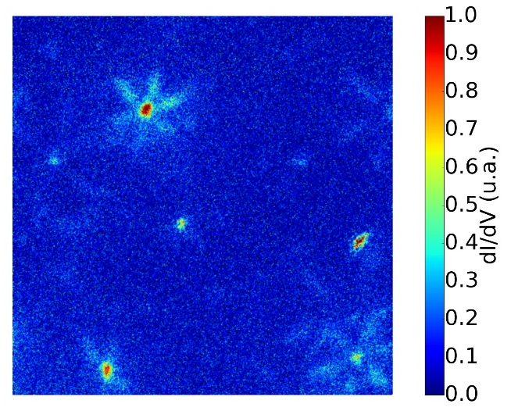
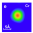
Observation of bound states around magnetic impurities in 2H-NbSe₂
Shiba bound states observed over scales of the order of 10nm
20 nm
G. Ménard et al., Nature Physics 2015

Slide 17
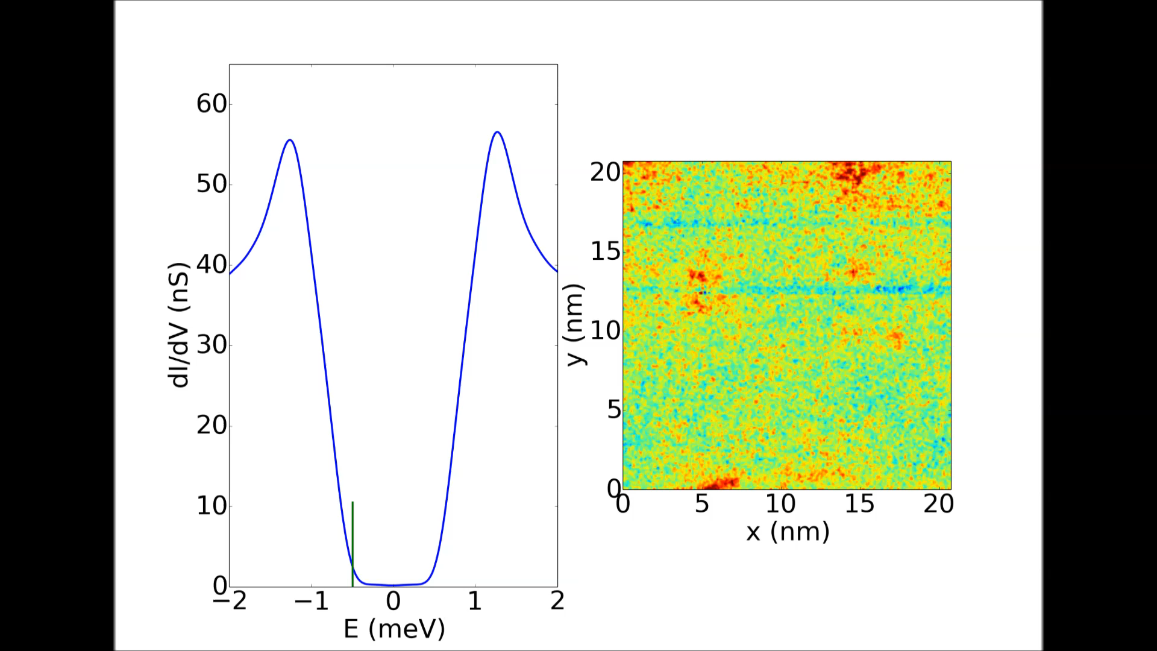
Observation of bound states around magnetic impurities in 2H-NbSe₂

Slide 18
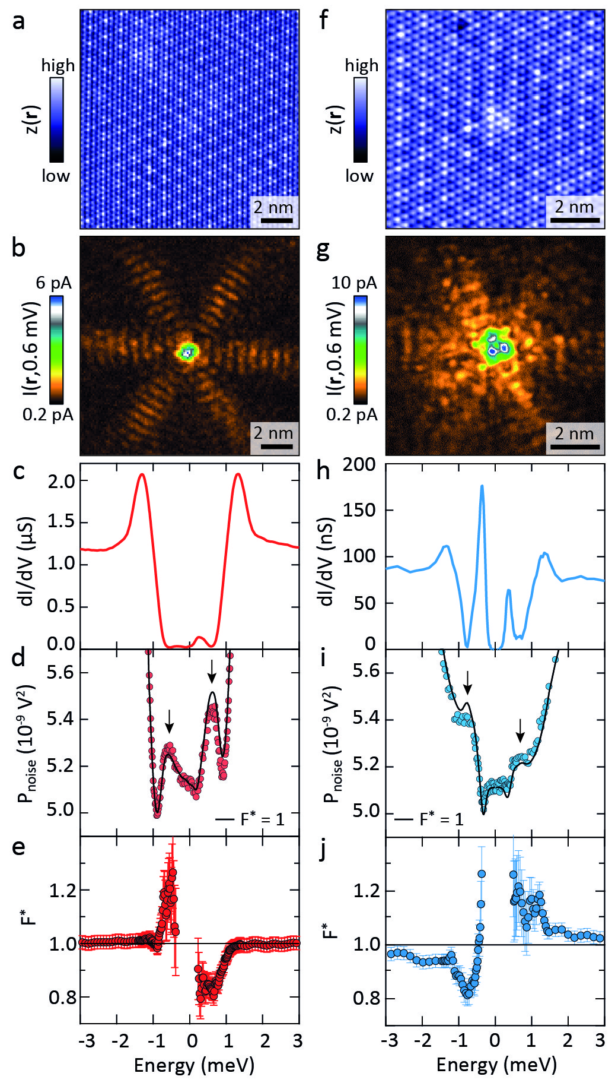
YSR in 2H-NbSe₂ (F. Massee’s STM in LPS)
YSR in 2H-NbSe₂
U. Thupakula et al., PRL (2022)

Slide 19

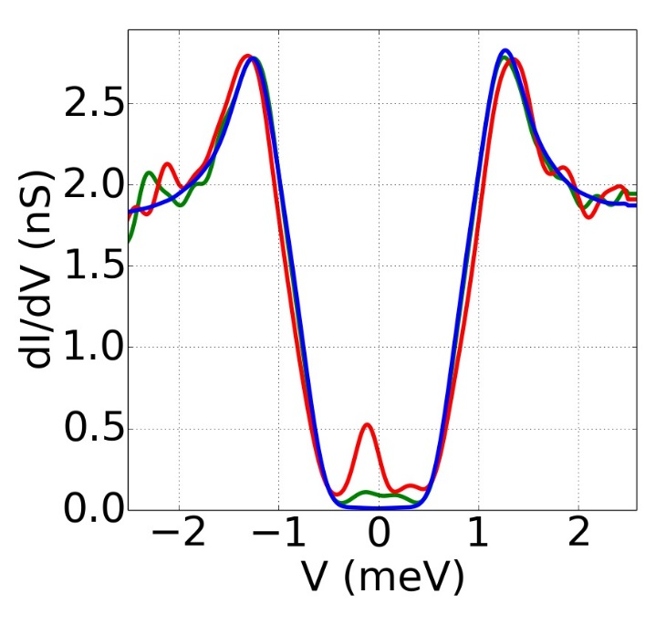
Spatial oscillation of Shiba bound states
Electron-hole asymmetry
Oscillations of the local density of states with a phase opposition between positive and negative energy states
Decrease of the Shiba bound states on a size of the order of the coherence length ξ
Distance (nm)
G. Ménard et al., Nature Physics 2015

Slide 20

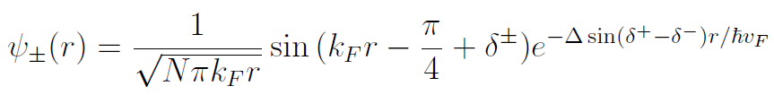


Spatial oscillations and electron-hole asymmetry
Good agreement with theoretical calculations for Shiba state in a 2D SC
in the asymptotic limit.
The Shiba peaks position relatively to the gap is directly related to the phase shift.
G. Ménard et al., Nature Physics 2015

Slide 21
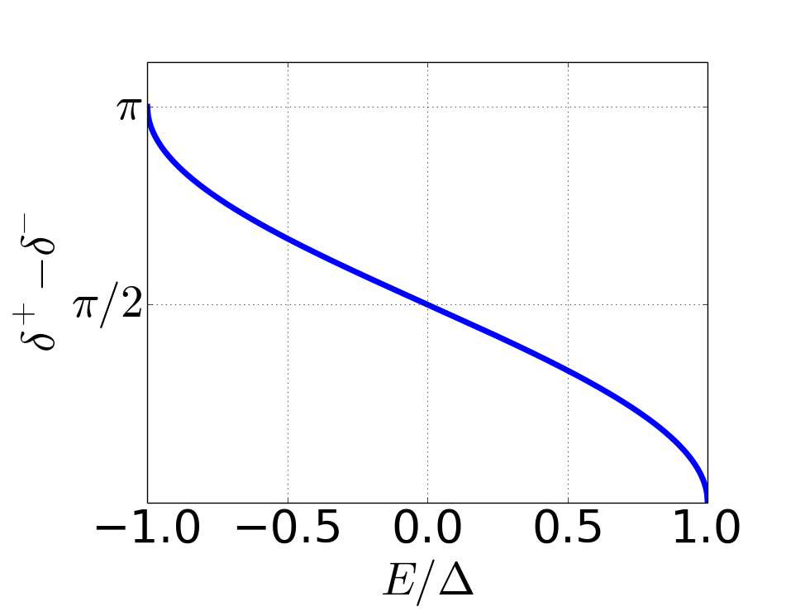
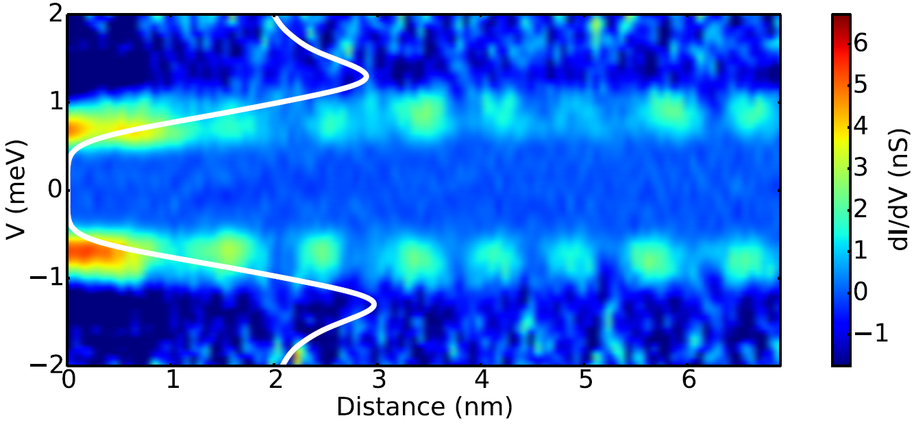
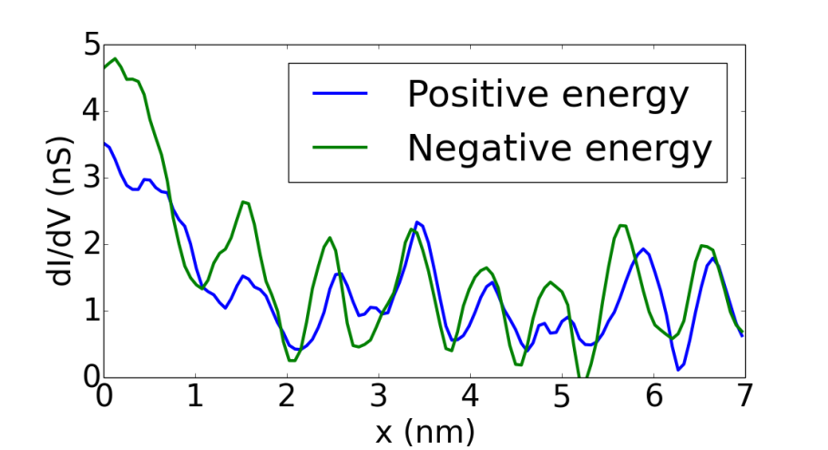

Impurity with bound states at gap edge:
in phase electron-hole oscillations
Cr or Mn impurity
1st Case
2nd Case
$$E=Δ\cos\left(δ^{+}−δ^{−}\right)$$
We observe the energy dependence of the phase
23
G. Ménard et al., Nature Physics, 11 1013 (2015)

Slide 22


Quantum parity phase transition
Excitation spectrum in the YSR impurity model
Δ
Excited state
Screened spin: S*=0
Excited state
Free spin: S*=1/2
$$±E_{0}=∆\frac{1−α^{2}}{1+α^{2}}$$
0
Ground state
Free spin: S=1/2
Ground state
Screened spin: S=0
0
J_{c}
J
$$α=JSπρ$$
Adapted from Franke group : PRL 121, 196803 (2018) and Prog. Surf. Sci. 93, 1-19 (2018)

Slide 23
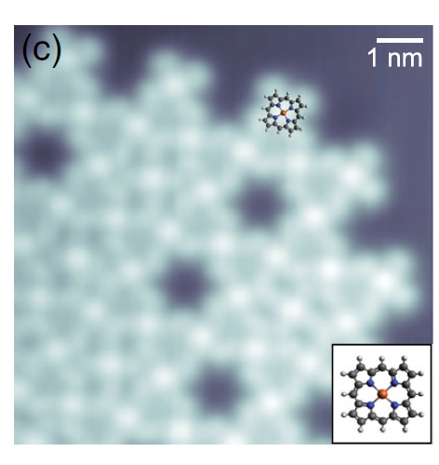
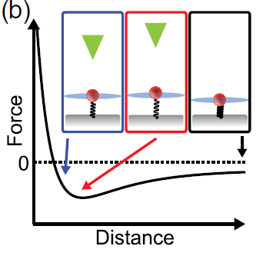
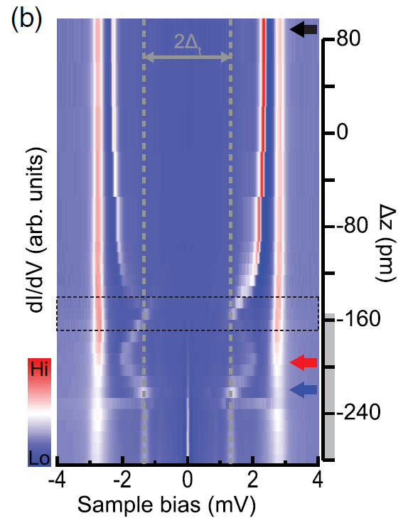
Quantum phase transition
Exchange coupling (J) modified with tip-sample distance
What if there are multiple channels?
Franke group: PRL 121, 196803 (2018)

Slide 24
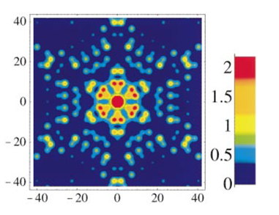
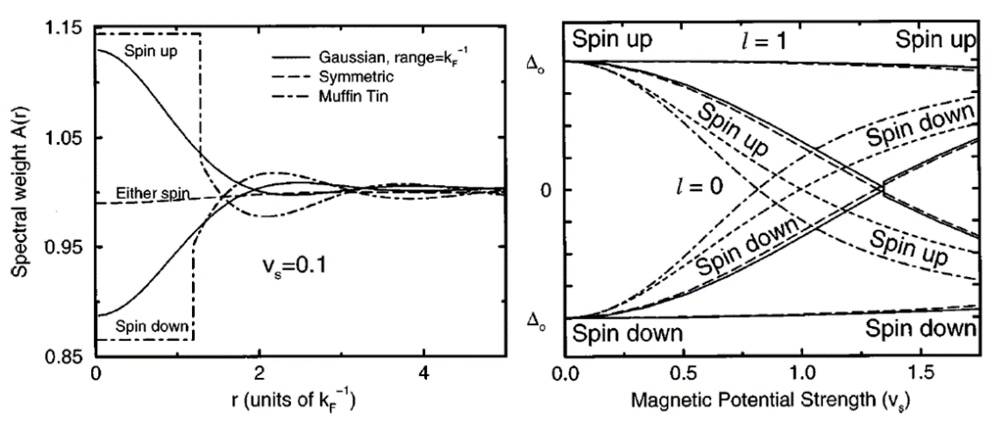
Shape of the YSR wave function ?
A classical spin in NbSe₂
may give rise to a bound state
with a star shaped pattern
M.E. Flatté and D. E. Reynolds, PRB (2000)
M.E. Flatté and J. M. Byers, PRL78, 3761 (1997)

Slide 25
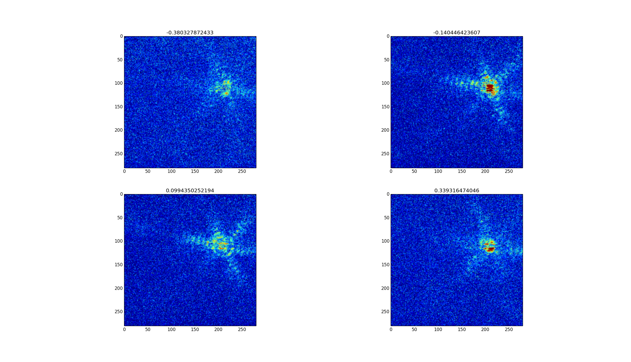
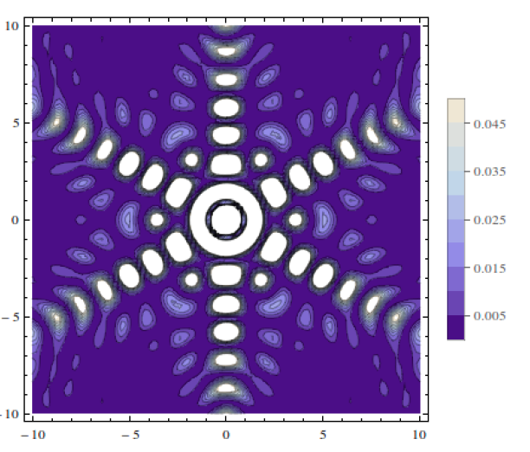
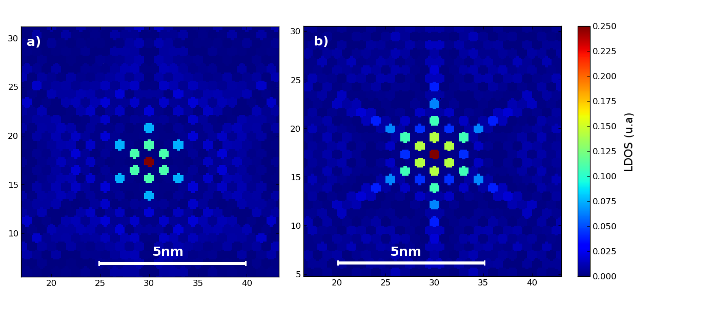
Shape of the YSR wave function ?
Direct numerical resolution of the Shiba equation using a
a Bogoliubov-de Gennes tight-binding model extracted from ARPES
Continuous asymptotic model
The star shape comes the anisotropy of the Fermi surface
Tight binding model
G. Ménard et al., Nature Physics, 11 1013 (2015)

Slide 26
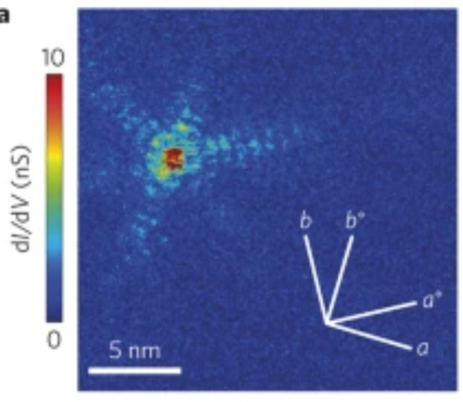
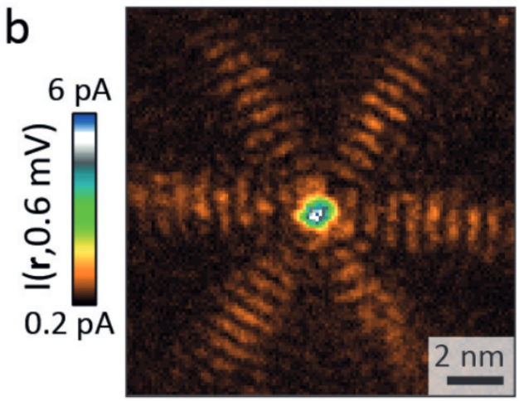
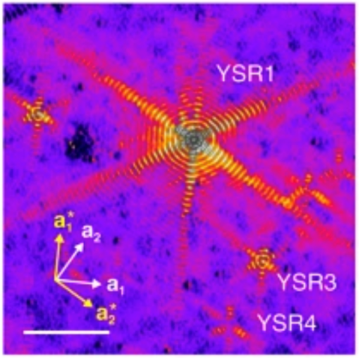
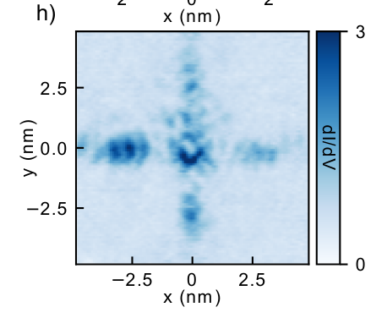
Quasi-particle focusing of YSR states
Long-range 2D YSR bound states
NbSe2
NbSe2
La(0001)
β−Bi₂Pd
Zaldivar et al. (2020)
G.Menard et al.
Nat.Phys. 11, 1013 (2015)
U.Thupakula et al.,
Phys. Rev. Lett (2022)
H.Kim et al.
Nat.Comm. 11, 4573(2020)
Need the real-space form of YSR for any dispersion
(anisotropy, decay&oscillations, symmetry)
Analytical approximation and interpretation
Quantitative match with tight-binding for NbSe2
STM data analysis: an approach

Slide 27
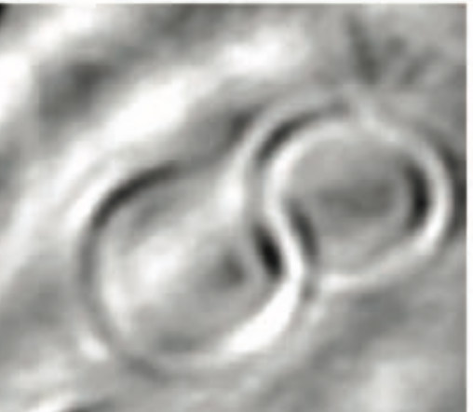
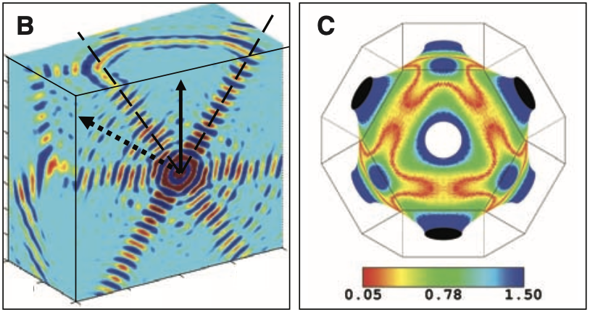
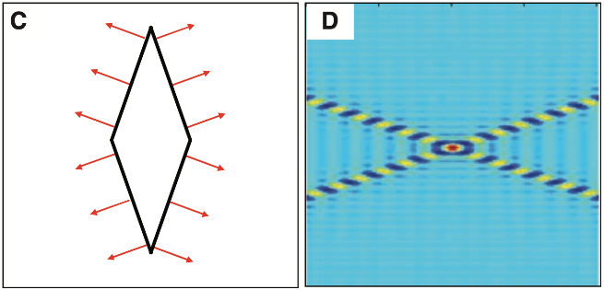
Quasiparticle focusing in a normal metal
Seeing Fermi surface in real-space
Real-space
Fermi surface
Cu(111) surface
Cu[111]
Co impurity
Focusing from
flatter segments
6nm
A.Weismann et al. Science 323, 1190(2009)
Theory:
Saddle point approximation of normal metal propagator
S.Lounis et al. PRB 83, 035427(2011)
Our work: Generalize to YSR
See also alternative approach by Ortuzar et al., Phys. Rev. B 105, 245403 (2022)

Slide 28
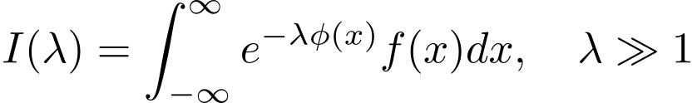

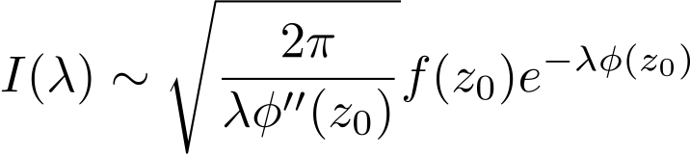
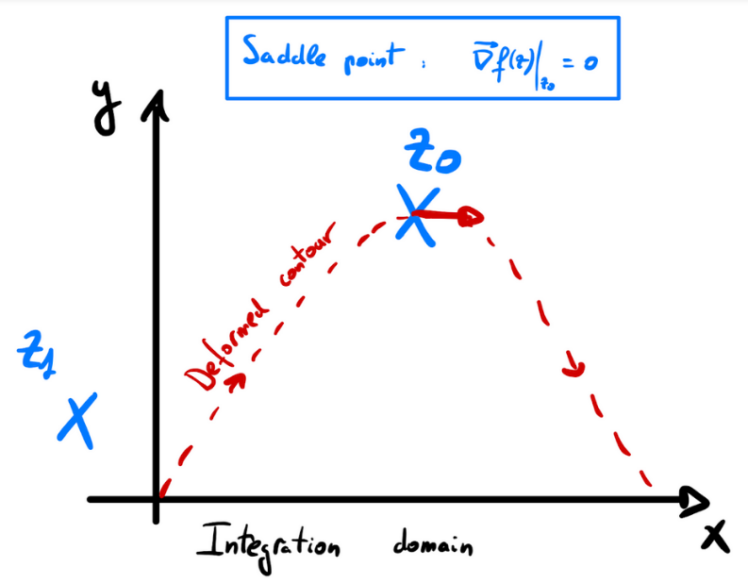
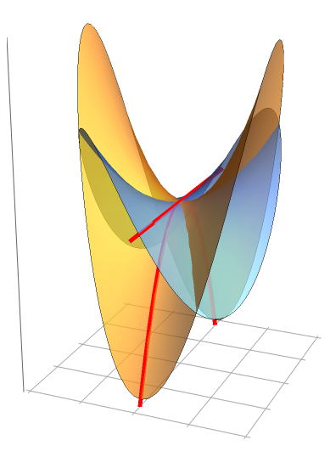



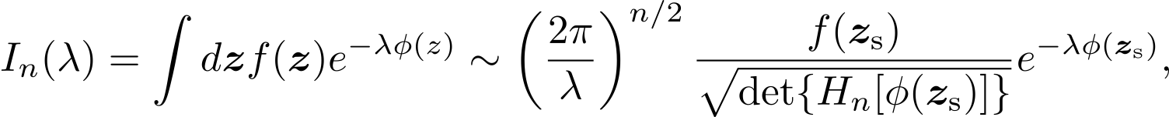
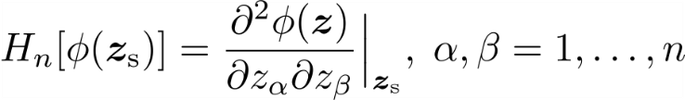
Complex saddle point
Deform integration path through a saddle point:
Standard Laplace method along deformed contour:
Generalization to n dimensions (Bleinstein 2016)
with

Slide 29
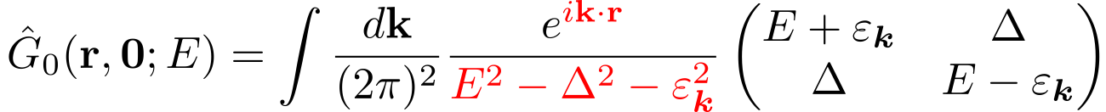
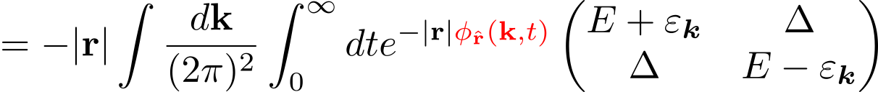

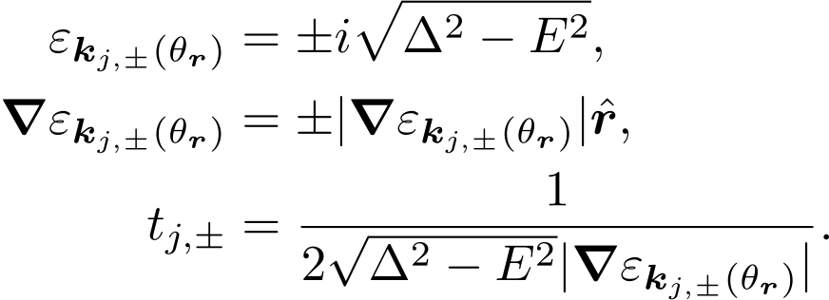
Complex saddle point
with
t
Critical points are given by
yielding the saddle point equations:
If critical points must fall
on the Fermi surface
Discard spurious solutions!

Slide 30
Theory: Quasiparticle focusing in superconductors
Perform a complex saddle point approximation

Slide 31
Theory: Quasiparticle focusing in superconductors
Quasiparticle focusing in superconductor

Slide 32
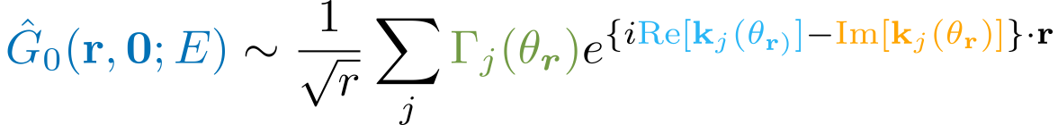

How is the anisotropy encoded?
Friedel-like oscillations
Exponential decay
Geometrical prefactor
In the perturbative limit :
Saddle pt eq. → Two solutions: , solving

Slide 33
How is the anisotropy encoded?
Friedel-like oscillations
Exponential decay
Geometrical prefactor
In the perturbative limit :
Saddle pt eq. → Two solutions: , solving

Slide 34
How is the anisotropy encoded?
Friedel-like oscillations
Exponential decay
Geometrical prefactor
In the perturbative limit :
Saddle pt eq. → Two solutions: , solving

Slide 35
How is the anisotropy encoded?
Friedel-like oscillations
Exponential decay
Geometrical prefactor
In the perturbative limit :
Saddle pt eq. → Two solutions: , solving

Slide 36
Prefactors and decay length are aligned

Slide 37
How is the anisotropy encoded?
Friedel-like oscillations
Exponential decay
Geometrical prefactor
General implications:
1. Focusing survives in 2D SC
2. Decay length and prefactor are in phase (reasonable FS)
3. Critical point doubling affects oscillations (no SOC)

Slide 38
Single Fermi pocket
Example: Tight-binding toy model
Fermi surface
LDOS

Slide 39
Single Fermi pocket
Single Fermi pocket
Example: Tight-binding toy model
Fermi surface

Slide 40
NbSe2 tight binding (multi-pocket)
Spinless three-pocket
Fermi surface
(lowest Nb 4d-band)
Analytical model:
Tight-binding fit:
Tight-binding and analytical model
match perfectly!
D.J. Rahn et al., Phys. Rev. B 85, 224532 (2012)

Slide 41
NbSe2 tight binding (multi-pocket)
Analytical model:
Tight-binding fit:
Tight-binding and analytical model
match perfectly!

Slide 42
NbSe2 tight binding (multi-pocket)
Analytical model:
Tight-binding fit:
Tight-binding and analytical model
match perfectly!

Slide 43
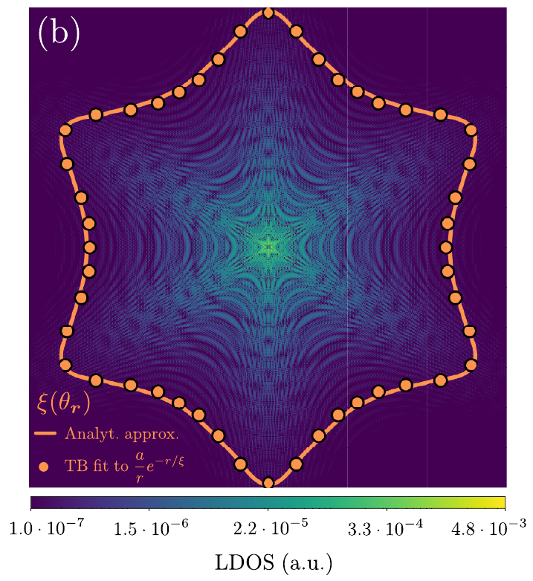

NbSe2: Quantitative test against
tight-binding
Analytical model:
Tight-binding fit:
Tight-binding fit and analytical model
match perfectly!
See M. Uldemolins, A. Mesaros, PS, PRB 105, 144503 (2022)

Slide 44
Analyzing STM data on NbSe2: challenge
STM
Tight-binding models
Small gap (1meV) and ARPES fit bands
G.C. Menard et al., Nat. Phys. 11, 1013 (2015)
L.M. Rütten et al., arXiv:2404.16513 (2024)
First principles
D. Sticlet and C. Morari, Phys. Rev. B 100, 075420 (2019)
Matches estimate from Hc2 and vortex core
H. F. Hess, R. B. Robinson, and J. V. Waszczak, PRL 64, 2711 (1990)
Nader and Monceau. SpringerPlus 3:16 (2014)
Abandon the radial fit of and consider the prefactor only

Slide 45
Analyzing STM data: angular dependence
Analytical model:
Tight-binding fit:
Tight-binding and analytical model
match perfectly!

Slide 46
Angular dependence results
Analytical model:
Tight-binding fit:
Tight-binding and analytical model
match perfectly!
M. Uldemolins, F. Massee, T. Cren, A. Mesaros, PS, arXiv:2406.14323

Slide 47
Angular dependence results
Analytical model:
Tight-binding fit:
Tight-binding and analytical model
match perfectly!
M. Uldemolins, F. Massee, T. Cren, A. Mesaros, PS, arXiv:2406.14323

Slide 48
Prefactor in momentum space
STM data
M. Uldemolins, F. Massee, T. Cren, A. Mesaros, PS, arXiv:2406.14323

Slide 49
Limiting approximations
of the YSR solution

Slide 50
Self-consistent SC gap calculation
Due to impurities, the SC gap becomes inhomogeneous
Expectation value depends
on the impurity spin
where
Self-consistent calculation is thus required
For
One can obtain an analytical expression:
In the α << 1 limit,
Quadratic suppression of the gap
Meng, Klinovaja, Hoffman, PS, Loss, PRB (2015)

Slide 51
Self-consistent SC gap calculation
Self-consistent SC gap calculation
SC gap BELOW the impurity
Pi-shift of the SC gap
Energy of the Shiba state
Meng, Klinovaja, Hoffman, PS, Loss, PRB (2015)

Slide 52
Sub-gap Shiba BS to Supra-gap Andreev BS
Sub-gap Shiba state turns into a
supra-gap state
Meng, Klinovaja,Hoffman, PS, Loss, PRB (2015)

Slide 53
Spectroscopic signature ?
Meng, Klinovaja,Hoffman, PS, Loss, PRB (2015)

Slide 54
Beyond the
YSR model

Slide 55
Competition between Kondo-screened and free spin ground state
Local exchange interaction:
In a metal, this interaction gives rise to the Kondo effect with a formation of a
Kondo singlet at T << (the Kondo temperature)
In a superconductor, competition between the screening with pairing
>> Δ
The magnetic impurity is screened (singlet) and no in-gap bound state
<< Δ
Kondo effet cannot develop and the GS is a doublet → Back to YSR physics
When
Competition between these two GS
T. Matsuura, Progress of theoretical physics 57, 1823 (1977)

Slide 56
Relation between YSR and Kondo energy scales
for MnPc molecules
K. J. Franke, G. Schulze, and J. I. Pascual, Science 332, 940 (2011)

Slide 57
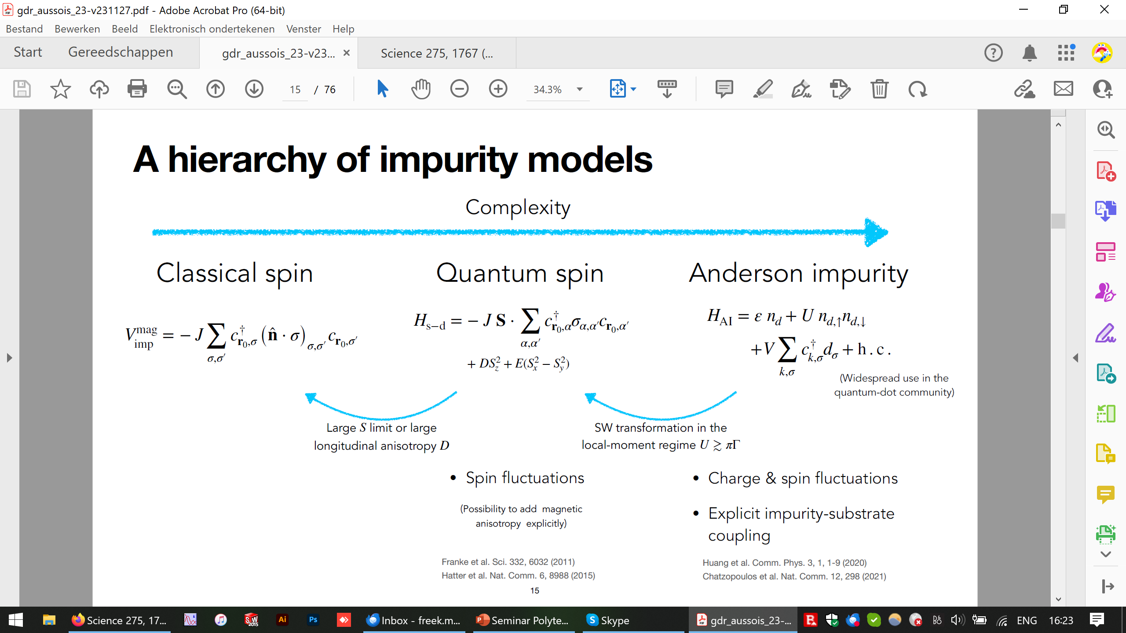
Impurity models
Complexity
Classical spin
Quantum spin
Anderson impurity
Large S limit or large longitudinal anisotropy D
SW transformation in the local-moment regime U≥πΓ
Spin fluctuations
Charge and spin fluctuations
Explicit impurity-substrate coupling
Science 332, 6032 (2011)
Nature Commun. 6, 8988 (2015)
Comm. Phys. 3, 1-9 (2020)
Nature Commun. 12, 298 (2021)

Slide 58
Impurity models
Impurity models
Complexity
Classical spin
Quantum spin
Anderson impurity
Captures most observations
Widely used to describe YSR states
Multiple YSR states are simply added up
Large S limit or large longitudinal anisotropy D
SW transformation in the local-moment regime U≥πΓ
Spin fluctuations
Charge and spin fluctuations
Explicit impurity-substrate coupling
Science 332, 6032 (2011)
Nature Commun. 6, 8988 (2015)
Comm. Phys. 3, 1-9 (2020)
Nature Commun. 12, 298 (2021)

Slide 59
Impurity models
Impurity models
Complexity
Classical spin
Captures most observations
Widely used to describe YSR states
Multiple YSR states are simply added up
Question: are there experiments for which the classical model does not work ?

Slide 60
FeTe_{0.55}Se_{0.45}: an exotic superconductor in vogue

Slide 62
Experimental observations
T=0.3 K
Assumption: Tip acts as a local gate electrode

Slide 63
Experimental observations
Two key features:
1) Concurrent switch of in-gap states from
hole-like to electron-like
Independent classical YSR
channels
1

Slide 64
Experimental observations
Two key features:
1) Concurrent switch of in-gap states from
hole-like to electron-like
2
Independent classical YSR
channels
2) Appearance of negative differential conductance (NDC)
Multiple impurity states and Coulomb interaction

Slide 65
Previous related experiment
Magnetic iron-porphyrin on Pb(111)
Interpreted as two YSR channels, caused by two frontier molecular orbitals strongly coupled by Hund coupling.
See Rubio-Verdiu et al., Phys Rev. Lett. 2021

Slide 66
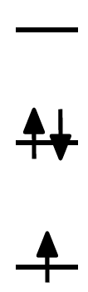

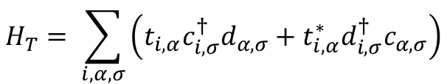

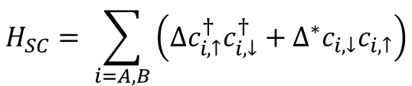








Multi-channel
Anderson impurity model
Orbital a
Orbital b
Energy levels
$$H= H_{SC}+H_{T}+H_{imp}$$
$$0$$
$$H_{SC}= \sum_{i=A, B}{\left(∆c_{i,↑}^{†}c_{i,↓}^{†}+∆^{∗}c_{i,↓}c_{i,↑}\right)}$$
$$2ε_{b}+U$$
$$Γ_{A, a}$$
$$Γ_{B, b}$$
$$H_{T}= \sum_{i, α,σ}{\left(t_{i,α}c_{i,σ}^{†}d_{α,σ}+t_{i,α}^{∗}d_{i,σ}^{†}c_{α,σ}\right)}$$
$$ε_{b}$$
$$∆$$
$$∆$$
$$H_{imp}= \sum_{α,σ}{ε_{α}d_{α,σ}^{†}d_{α,σ}}+\sum_{α}{\left(U_{α}d_{α,↑}^{†}d_{α,↑}d_{α,↓}^{†}d_{α,↓}\right)}$$
$$Γ_{i,α}=πt_{i,α}^{2}$$

Slide 67



Multi-channel
Anderson impurity model
Orbital a
Orbital b
Energy levels
$$H= H_{SC}+H_{T}+H_{imp}$$
$$0$$
$$H_{SC}= \sum_{i=A, B}{\left(∆c_{i,↑}^{†}c_{i,↓}^{†}+∆^{∗}c_{i,↓}c_{i,↑}\right)}$$
$$2ε_{b}+U$$
$$Γ_{A, a}$$
$$Γ_{B, b}$$
$$H_{T}= \sum_{i, α,σ}{\left(t_{i,α}c_{i,σ}^{†}d_{α,σ}+t_{i,α}^{∗}d_{i,σ}^{†}c_{α,σ}\right)}$$
$$ε_{b}$$
$$∆$$
$$∆$$
$$H_{imp}= \sum_{α,σ}{ε_{α}d_{α,σ}^{†}d_{α,σ}}+\sum_{α}{\left(U_{α}d_{α,↑}^{†}d_{α,↑}d_{α,↓}^{†}d_{α,↓}\right)}$$
$$Γ_{i,α}=πt_{i,α}^{2}$$
$$\overline{ε}=\frac{ε_{a}+ε_{b}}{2}$$
‘crystal field’ splitting$δε=ε_{a}−ε_{b}=C$
$\overline{ε}$ varies linearly with tip-sample distance

Slide 68






Multi-channel
Anderson impurity model
Orbital a
Orbital b
Energy levels
$$J_{H}$$
$$H= H_{SC}+H_{T}+H_{imp}$$
$$0$$
$$H_{SC}= \sum_{i=A, B}{\left(∆c_{i,↑}^{†}c_{i,↓}^{†}+∆^{∗}c_{i,↓}c_{i,↑}\right)}$$
$$2ε_{b}+U$$
$$Γ_{A, a}$$
$$Γ_{B, b}$$
$$H_{T}= \sum_{i, α,σ}{\left(t_{i,α}c_{i,σ}^{†}d_{α,σ}+t_{i,α}^{∗}d_{i,σ}^{†}c_{α,σ}\right)}$$
$$ε_{b}$$
$$∆$$
$$∆$$
$$H_{imp}= \sum_{α,σ}{ε_{α}d_{α,σ}^{†}d_{α,σ}}+\sum_{α}{\left(U_{α}d_{α,↑}^{†}d_{α,↑}d_{α,↓}^{†}d_{α,↓}\right.}$$
$$Γ_{i,α}=πt_{i,α}^{2}$$
$$− \left.J_{H}{\hat{S}}_{a}∙{\hat{S}}_{b}\right)$$
$$U∼\left|\overline{ε}\right|>\left|J_{H}|>|δε\right|≳\sqrt{Γ_{i,α}}>Δ$$
$$\overline{ε}=\frac{ε_{a}+ε_{b}}{2}$$
‘crystal field’ splitting$δε=ε_{a}−ε_{b}=C$
Hund’s coupling
$$J_{H}>0$$
$\overline{ε}$ varies linearly with tip-sample distance

Slide 69


Multi-channel Anderson impurity model:
many-body spectrum
Orbital a
Orbital b
Energy levels
$$J_{H}$$
$$0$$
$$2ε_{b}+U$$
$$Γ_{A, a}$$
$$Γ_{B, b}$$
$$ε_{b}$$
$$∆$$
$$∆$$
$$Γ_{i,α}=πt_{i,α}^{2}$$
$$U∼\left|\overline{ε}\right|>\left|J_{H}|>|δε\right|≳\sqrt{Γ_{i,α}}>Δ$$
‘crystal field’ splitting$δε=ε_{a}−ε_{b}=C$
$\overline{ε}$ varies linearly with tip-sample distance

Slide 70
Multi-channel Anderson impurity model:
many-body spectrum
M. Uldemolins et al., Nature Comm 15, 8526 (2024)

Slide 71
Multi-channel
Quantum phase transition
Multi-channel quantum phase transition: large change in occupation
Orbital energy cost compensated by gain of Hund’s energy

Slide 72
Multi-channel
Quantum phase transition
Calculated LDOS captures STM experiment
M. Uldemolins et al., Nature Comm 15, 8526 (2024)

Slide 73

Slope changes upon crossing E=0
Discontinuous slope at E = 0

Slide 74

Slope changes upon crossing E=0
Discontinuous slope at E = 0
M. Uldemolins et al., Nature Comm 15, 8526 (2024)

Slide 75
Switching off the Hund coupling
Comparison to J_{H} = 0:
orbitals decoupled, similar to independent YSR or Kondo channels
J_{H} = 0 does not match the experiment
M. Uldemolins et al., Nature Comm 15, 8526 (2024)

Slide 76
Multi-channel quantum phase transition (MCQPT)
Independent YSR channels not always suitable
High spin impurities (Hund’s coupling)
Large change in ground state occupation at MCQPT
Discontinuity of both the slope and intensities at the transition

Slide 77



Motivation 1: Local defects as probing tools

Slide 78

Motivation 2: Engineering exotic states
S. Nadj-Perge et al., Science 346, 6209 (2014)
Kim et al. Sci. Adv., 2 eaar5251 (2018)

Slide 79
1D effective topological superconductors
using RKKY systems

Slide 80

Where to look for Majorana excitations ?

Slide 81

Majorana fermions: in short:
Certain Hamiltonians can support solutions with isolated localized Majorana fermions
They also encode one complex fermion but in a way robust
to any local perturbation
Ideal for quantum bit

Slide 82

Band structure of a quantum wire

Slide 83



Equivalent system: Rashba nanowire in B-field :
Turn on the B-field
μ
Reduce
μ
μ
Effective Pairing:
Effective Pairing:
TRIPLET
Sau et al., PRL 104, (2010).
Oreg et al., PRL 105, (2010).
Notes:
note: there is a subtlety for CNT: there are 4 helical modes from K and K’ each two. Need to assume that there is no valley
scattering. Flensberg et al. claim that there is substantial valley scattering…If it is a problem, go into valley tuned regime with B field, which suprresses one valley.
Magnetic field:: s-wave

Slide 84







Majorana fermions in 1D : Quantum wires
1-Dimensional Semiconducting quantum-wires
Topological phase
Spin-orbit interaction :
Magnetic field :
s-wave superconductivity :
Sato et al., PRB (2009)
Sau et al., PRL 104, (2010).
Oreg et al., PRL 105, (2010).
Majorana:

Slide 85

Can we find other equivalent realization ?
Change of frame: Gauge transform
Equivalent to a spiral magnetic field
B. Braunecker, G. Japaridze, J. Klinovaja, D. Loss, PRB 82, 045127 (2010)

Slide 86




The spin selective Peirls transition
external periodic potential: spiral magnetic field B(r)
backscattering on B(r): gap Δ for one-half
of the conducting modes with opposite spin
by forming a helical spin/charge density wave
2Δ
  one-half of the system becomes insulating
  one-half remains conducting and forms a spin-filter
B. Braunecker, G. Japaridze, J. Klinovaja, D. Loss, PRB 82, 045127 (2010)

Slide 87

Where to find a magnetic spiral field ?
A first option: quantum wires with nuclear spins
Basic
Hamiltonian
Below some critical temperature T*, electrons and nuclear spins
can be tightly bound into an new ordered phase in 1D
B. Braunecker, PS, D. Loss, PRL 2009, PRB 2009

Slide 88


How does it work ?
- Integrate out electrons (separation of time-scales)
RKKY interaction long ranged
Interaction Jq
static electron spin susceptibility
minimum at 2k_{F}
B. Braunecker, PS, D. Loss, PRL 2009, PRB 2009

Slide 89





Self-consistent mean field approach
effective electron Hamiltonian
mutual
dependence
effective nuclear spin Hamiltonian
self-consistency
novel physics

Slide 90


Effect of nuclear helical field
Helical order of nuclear spins :
Nuclear helimagnet
Nuclear order generates a spiral Overhauser field:
Nuclear magnetization
This Overhauser field drives the spin-Peierls instability
and gaps half of electronic degrees of freedom
B. Braunecker, PS, D. Loss, PRL 2009, PRB 2009

Slide 91
Combined electron / nuclear spin order
nuclear helimagnet
pinned electron density wave
(electron spin helix)
Below T* the ordered phases depend on each other:
Phase of tightly bound electron & nuclear spin degrees of freedom
- independent of system size for realistic samples
- huge renormalization due to electron-electron interactions
- experimentally (challenging but) accessible temperatures
B. Braunecker, PS, D. Loss, PRL 2009, PRB 2009

Slide 92





Experimental consequences
1. Reduction of conductance
R ↑
Through feedback: Pinning of channels
L ↓
Blocking of ½ of the conducting channels
Universal reduction of conductance by factor 2
Remaining channels are spin-filtered
Example: Luttinger liquid adiabatically connected to metallic leads
Conductance:
number of conducting channels
reduced to n → n / 2
helical phase
lead
lead
Maslov & Stone, Ponomarenko,
Safi & Schulz (all in PRB 1995)
B. Braunecker, PS, D. Loss, PRL 2009, PRB 2009

Slide 93


In proximity of a superconductor
Superconductivity induced by proximity effect is of p-wave type
(projection onto spin-filtered conducting modes)
proximity induced
superconductivity
s-wave superconductor
for nanotubes cf. Le Hur, Vishveshvara, Bena
PRB (2008)

Slide 94
Expect Majorana edge states ?
Superconductivity induced by proximity effect is of p-wave type
(projection onto spin-filtered conducting modes)
s-wave superconductor
Do we expect Majorana zero modes ?
S Gangadharaih, B Braunecker, PS, Loss, PRL 2011

Slide 95


How does SC modify the whole locking scenario ?
Same as before but now Hel contains the
proximity induced SC gap
Mean field decoupling
as before
How is the susceptibility/RKKY modified in a 1D SC?
minimum at 2k_{F}
Therefore helical magnetic structure survives
Majorana zero modes expected !
Braunecker, PS, PRL (2013)
Klinovaja et al., PRL (2013)
Vazifeh, Franz, PRL (2013)

Slide 96

Minimal ingredients and robustness
Recipe ingredients: - Magnetic moments interacting via RKKY interactions
- 1D-like electronic band
- s-wave superconductor
One can include also take electron-electron interactions into account:
This enhances T* but reduces the proximity induced gap (compromise)
This whole locking scenario is also robust versus point-like
non-magnetic disorder !
B. Braunecker, PS, PRL (2013)

Slide 97

A natural platform: magnetic adatoms on a SC substrate
Recipe ingredients: - Magnetic moments interacting via RKKY interactions
- 1D-like electronic band
- s-wave superconductor
Proposal: magnetic atoms with some
pre-existing spin texture on a SC surface
S. Nadj-Perge, I. Drozdov, A. Bernevig, A. Yazdani PRB (2013)
See also T.-P. Choy, J. M. Edge, A. R. Akhmerov, C. W. J. Beenakker,
Phys. Rev. B (2011)

Slide 98

How about the 1D band ?
a
Two limiting cases:
1) The dense limit :
The adatoms wave functions overlap and hybridize and form a 1D electronic band on top of the SC substrate
All the conditions are met for our model and we expect our locking scenario to apply!

Slide 99






How about the 1D band ?
2) The dilute limit :
First solve the single spin case
Shiba in-gap bound state:
Yu Lu (1965), Shiba (1968), Rusinov (1968)

Slide 100
How about the 1D band ?
Several diluted classical spins impurity band in the SC gap : Shiba band
Shiba (1968)
Shiba band
Results obtained from a tight-binding description for a given magnetic texture
I. Reis, D. Marchand, and M. Franz, arXiv:14065222
For a chain of dilute magnetic impurities of given orientations, an effective more complicated tight binding Kitaev-like Hamiltonian can be actually derived which supports Majorana fermions under certain conditions
F. Pientka, L. Glazman, F. vonOppen, PRB (2013)

Slide 101
Experimental predictions?
Helical magnetic phase is the ground state: self-sustained helical phase
1) Semi-conducting wires with nuclear spins
GaAs wire:
Forget it !

Slide 102
Experimental predictions?
Helical magnetic phase is the ground state: self-sustained helical phase
1) Semi-conducting wires with nuclear spins
GaAs wire:
Forget it !
InAs wire:
Maybe !

Slide 103
Experimental predictions?
Helical magnetic phase is the ground state: self-sustained helical phase
1) Semi-conducting wires with nuclear spins
GaAs wire:
Forget it !
InAs wire:
2) Magnetic Co atoms on a Nb surface
Maybe !
provides a constraint on A0:
reasonable !

Slide 104

Conclusion of this first part
New platform for Majorana fermions: RKKY systems
- Wires with nuclear spins (however only at very low T= 0(10mK)
- Magnetic atoms on a SC surface
Advantage: self-sustained Majorana phase
(no fine-tuning)
B. Braunecker, PS, PRL (2013)

