Slide 1
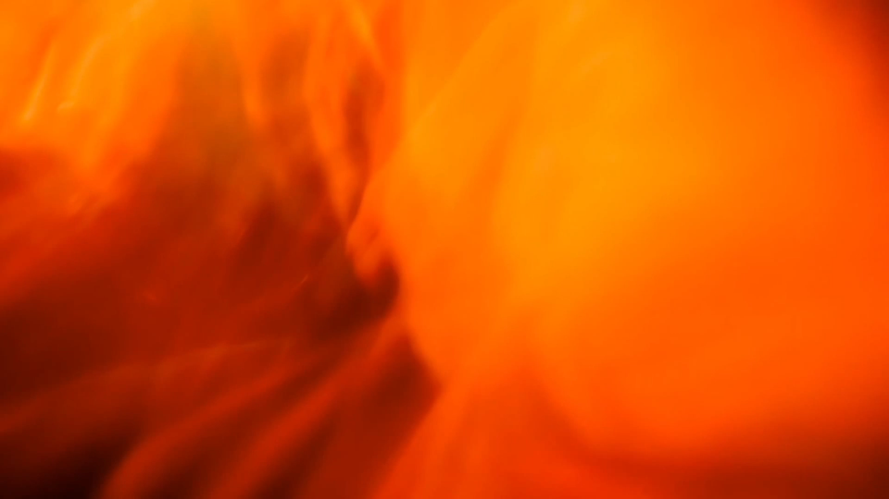
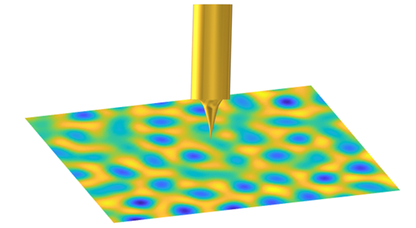
Classical and Quantum effects on the vortex lattice in superconducting thin films
Pratap Raychaudhuri
Tata Institute of Fundamental Research Mumbai, India.

Slide 2
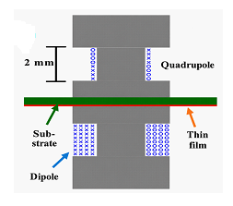
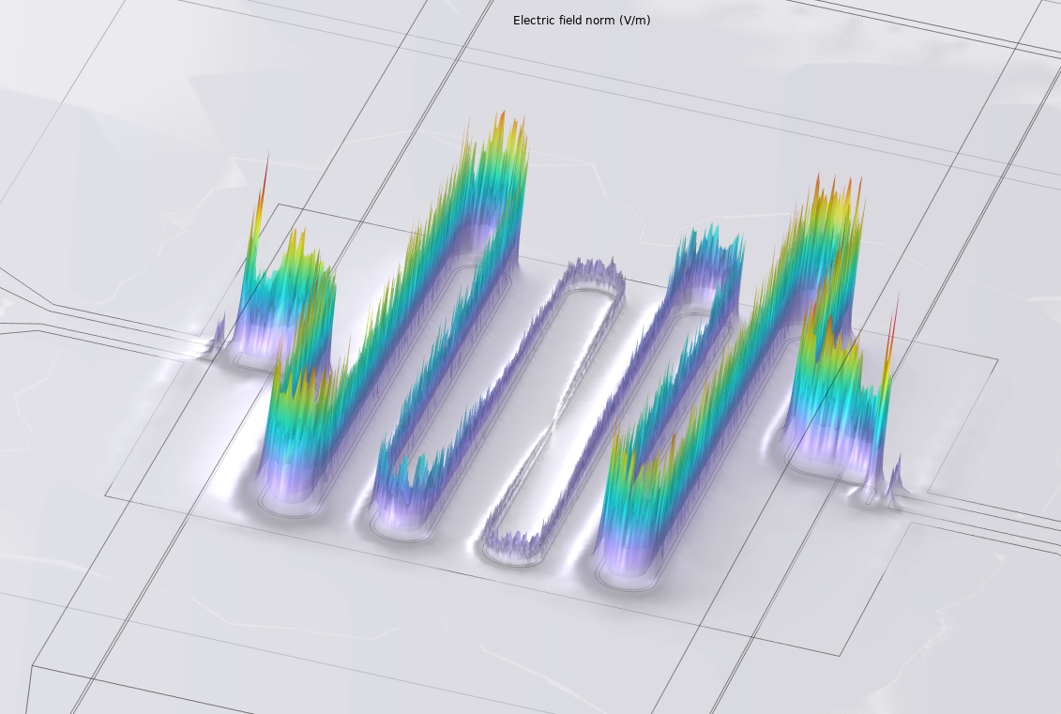
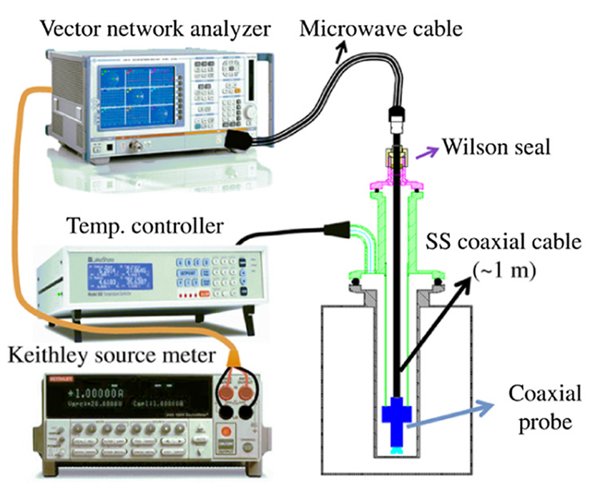
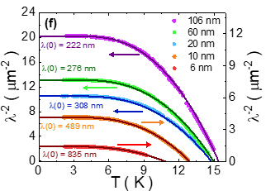
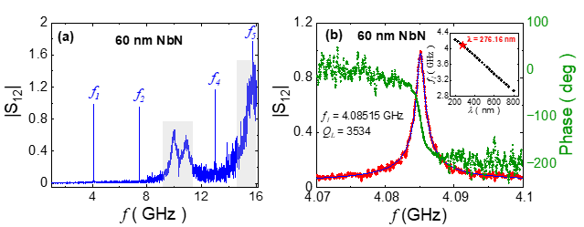
Poster
Measurement of absolute value of Superfluid Stiffness (penetration depth)
Complex conductivity measurements (kHz-GHz)
2-coil technique
Microwave techniques
[2605.28759] Absolute measurement of penetration depth of superconducting thin films using microwave stripline resonators

Slide 3
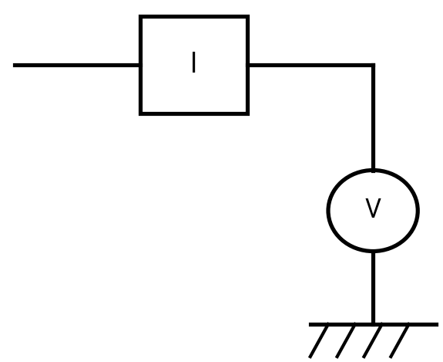
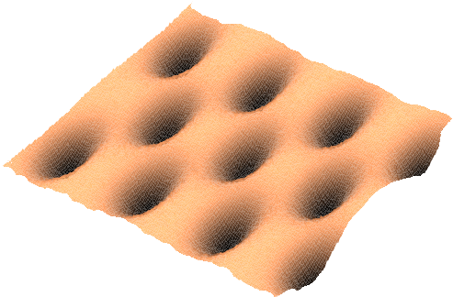
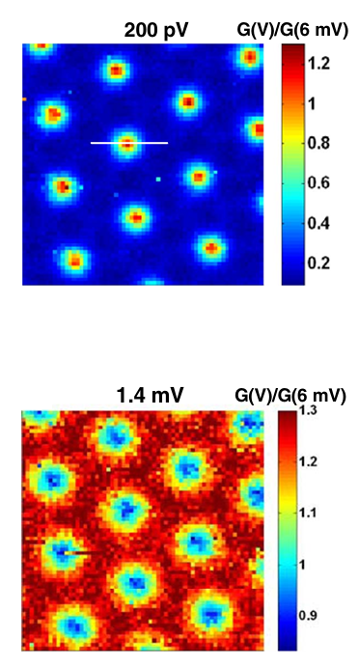
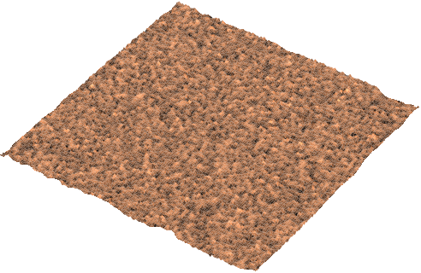
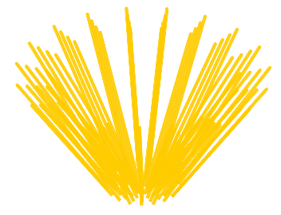

Imaging the vortex lattice using a Scanning Tunnelling Microscope
H
G(V) map at coherence peak bias
G(V) maps

Slide 4
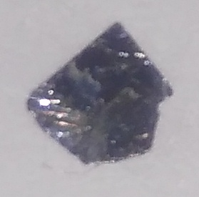
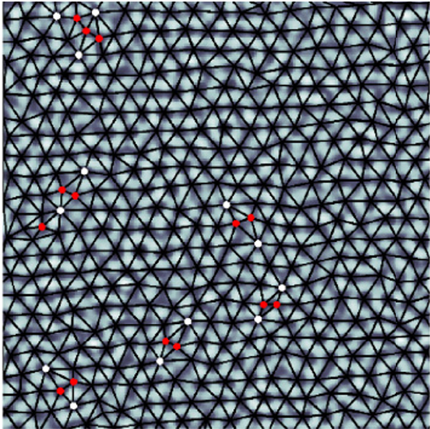
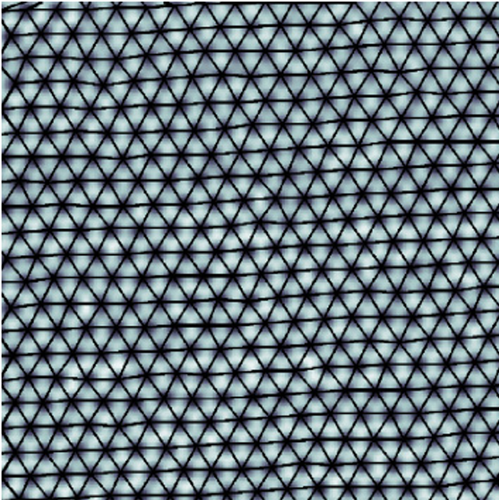
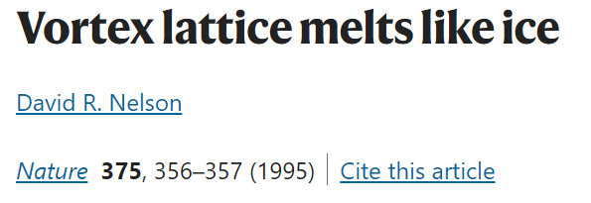
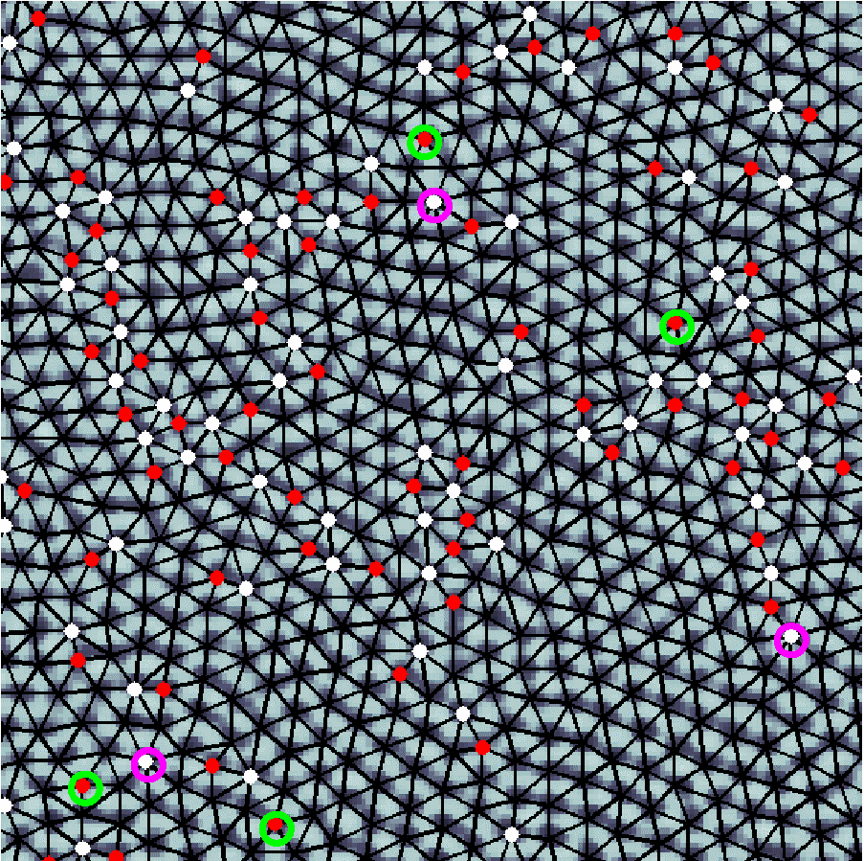

A very soft solid
NbSe₂
4.14 K, 8 kOe
460 mK, 8 kOe
T
H
25 kOe, 460 mK
$$\frac{B}{Φ_{0}}$$
Areal vortex density :
Caveat:
No Temporal Dynamics → Amorphous glass
Magnetic field Pressure

Slide 5
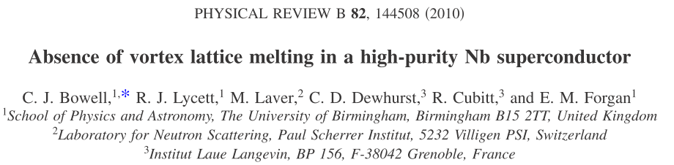
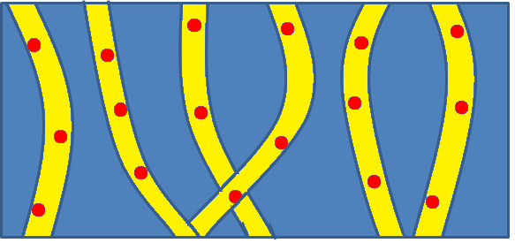
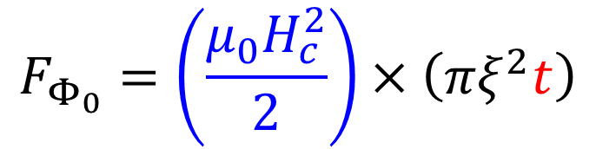
Energy scales of the problem
Intervortex
interactions
Thermal Energy
k_{B}T
Random Pinning
energy
Promotes order
Favors disorder
Bulk Crystal
Condensation energy reduces by 4-5 orders of magnitude
Long vortices →
Large condensation energy
Thin film
t ~ 0.1 – 2 mm
$$F_{Φ_{0}}=\left(\frac{μ_{0}H_{c}^{2}}{2}\right)×\left(πξ^{2}t\right)$$
t ~ 4 – 100 nm
H

Slide 6
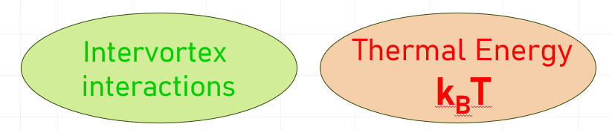
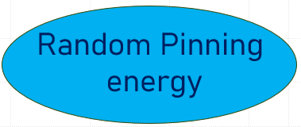
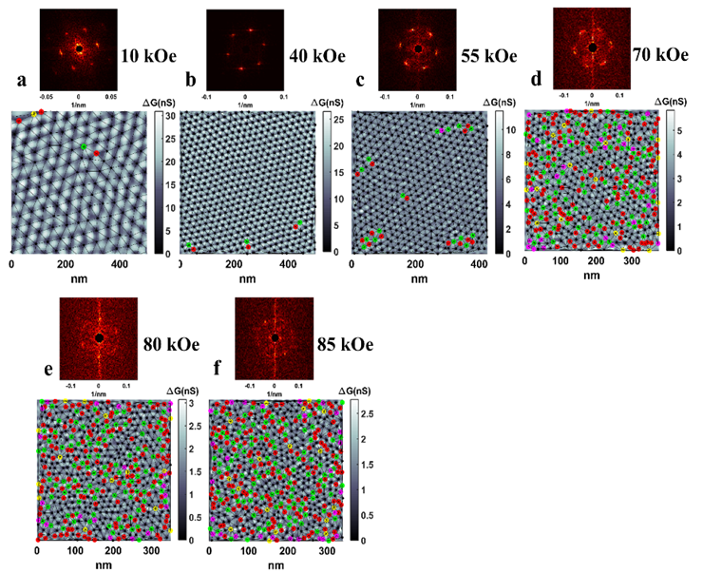
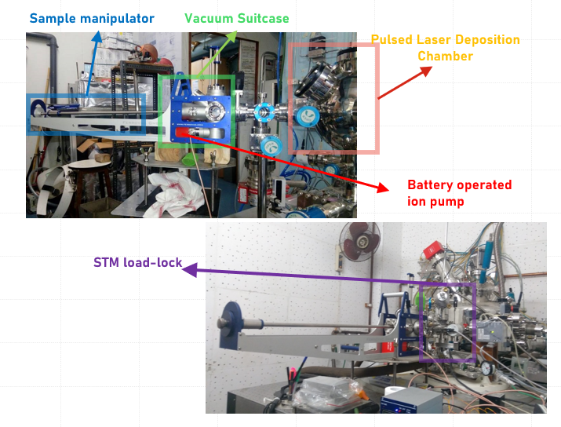
Amorphous MoGe thin film
Films grown through pulsed laser deposition using arc-melted target Thickness: 20 nm
Pinning 5 orders of magnitude smaller than Nb films

Slide 7
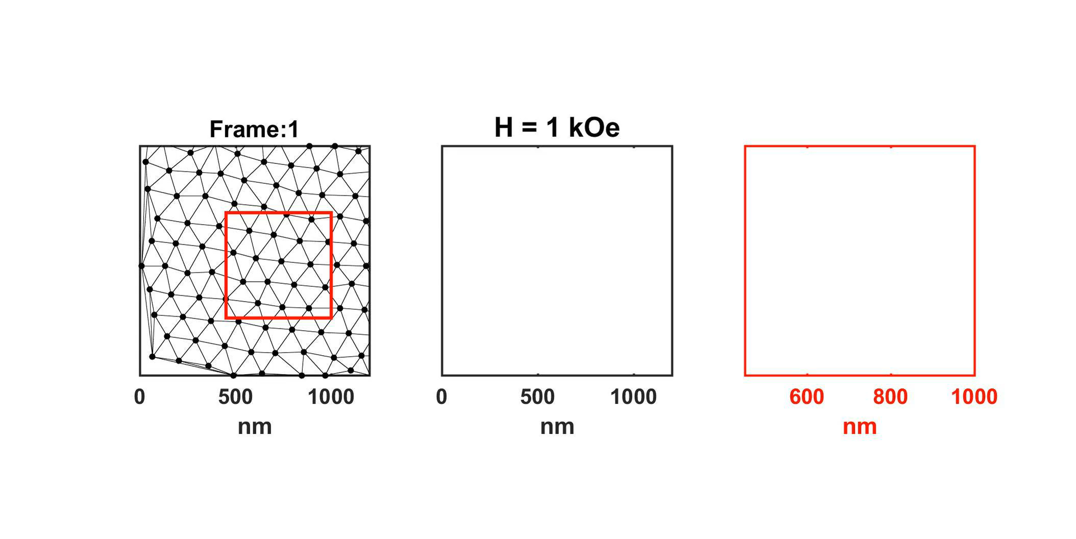
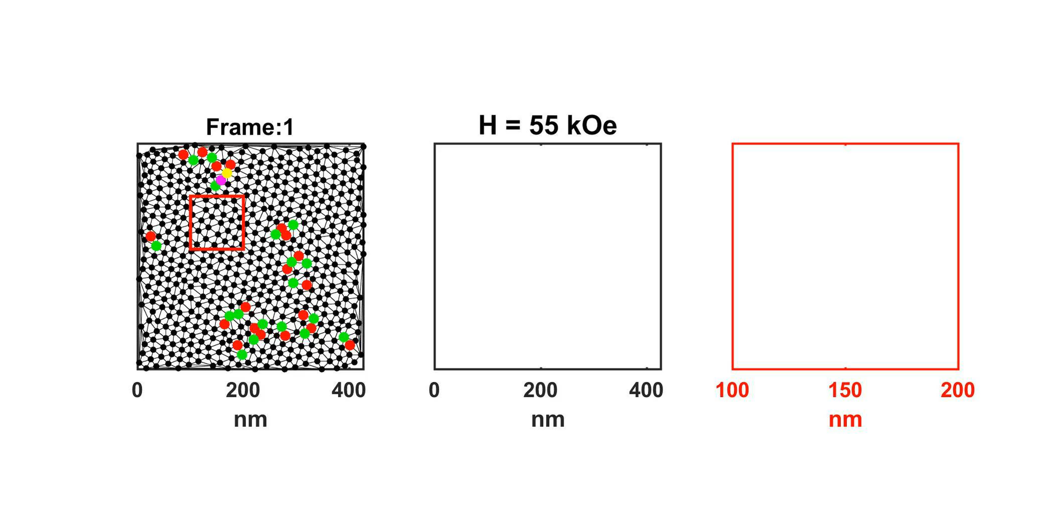
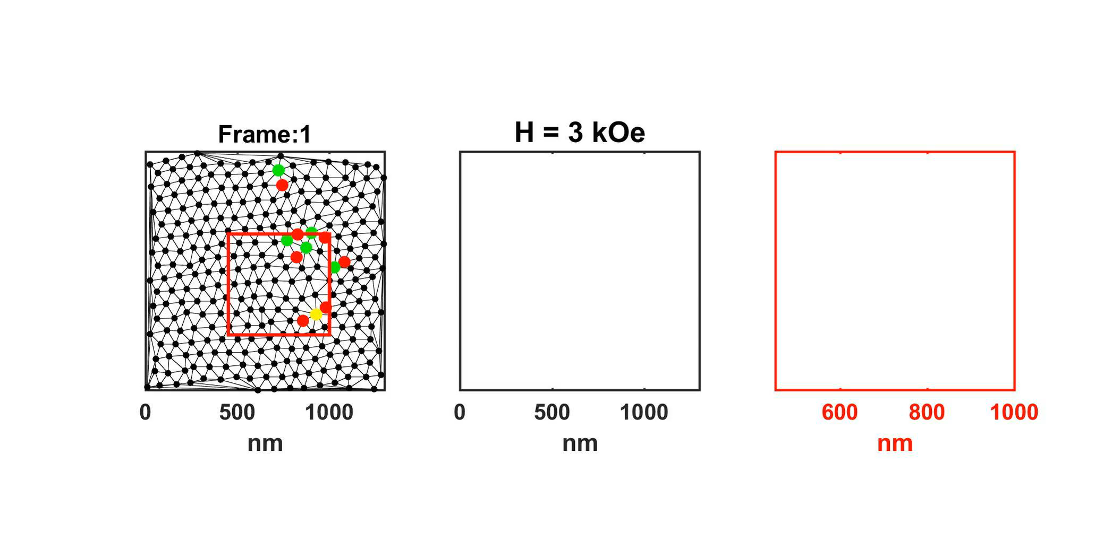
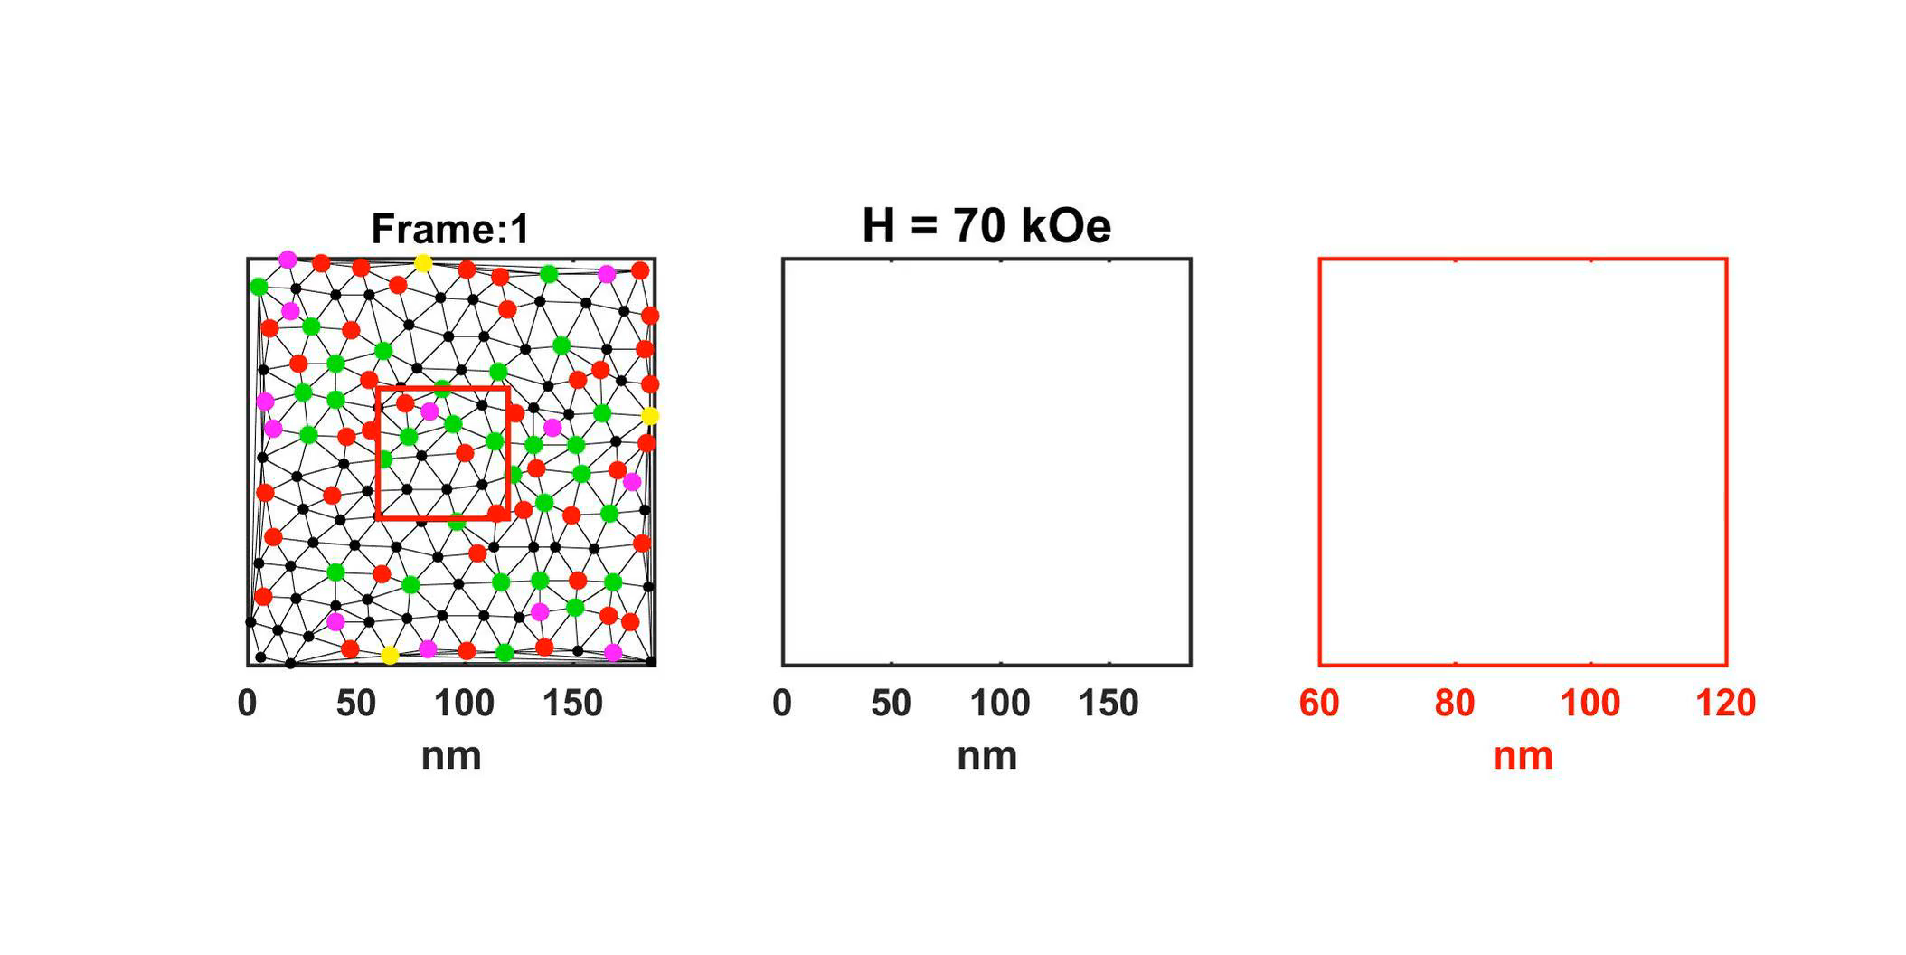
Vortex Creep in the Solid, Hexatic fluid and Isotropic liquid
Hexatic Fluid
Solid
The Hexatic Fluid
A fluid that maintains orientational order. First predicted by Berezinski, Kosterlitz and Thouless followed by Halperin Nelson and Young in the 1970s.
Hexatic Fluid
Isotropic Liquid
Only possible when vortex motion is very slow.
Estimated $ρ_{dc}\sim \text{10}\text{−19} \text{Ohm}\text{−}\text{m}$

Slide 8
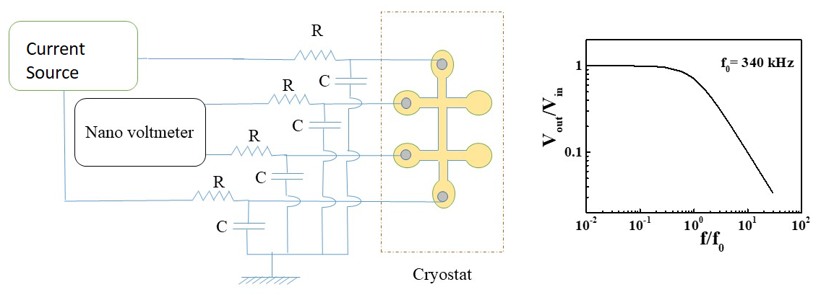
Extreme sensitivity of the Hexatic State
Solid to liquid transition: Hexatic Marked by Extreme sensitivity
Hexatic fluid to isotropic liquid
Special thanks: Mumbai B Ashmita Vahini
Transmission frequency:: 500 kHz
Surajit Dutta et al., Phys. Rev. B 100, 214518 (2019)

Slide 9
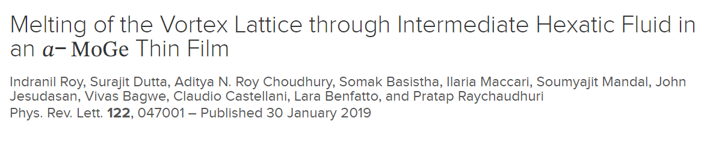
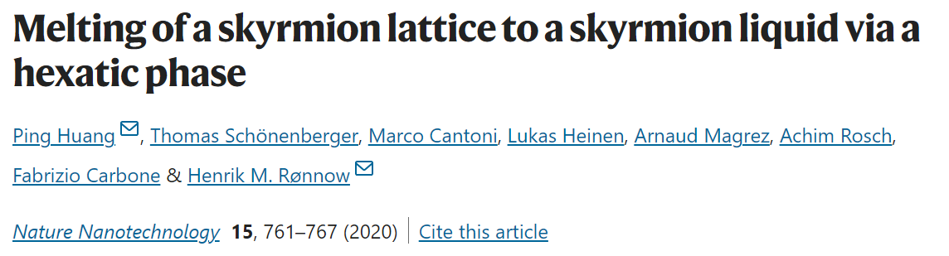
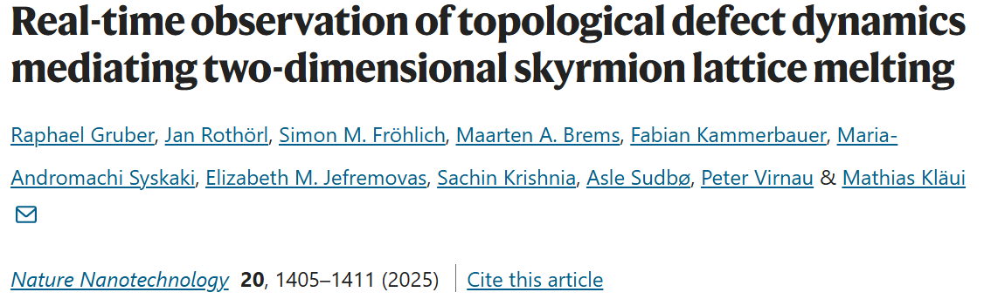
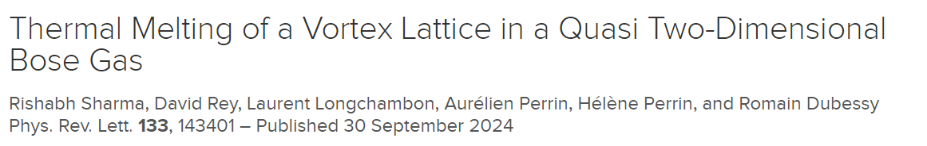
Vortex Phase Diagram in 20 nm a-MoGe thin film
the lamps are different, but the Light is the same; it comes from beyond - Rumi

Slide 10
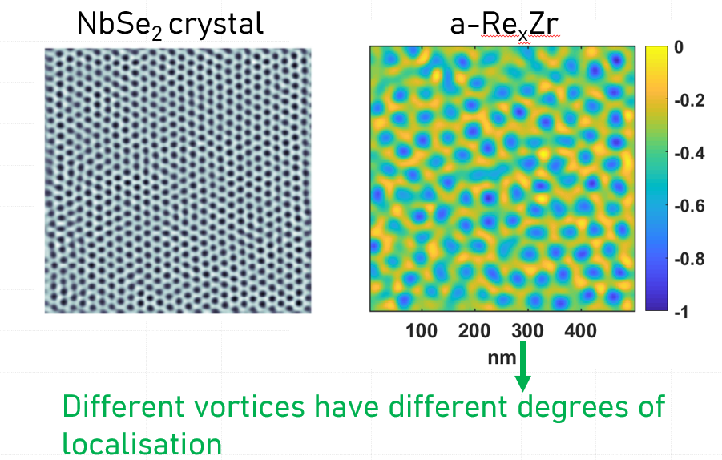
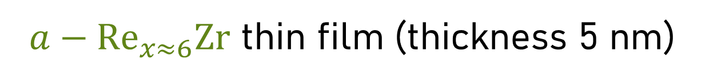
${a−Re}_{x≈6}Zr$ thin film (thickness 5 nm)
Stronger vortex pinning than a-MoGe
Pinning further increased by reducing thickness
Surajit Dutta, Vivas Bagwe, Gorakhnath Chaurasiya, et al, Journal of Alloys and Compounds 877, 160258 (2021)
400 mK, 10 kOe

Slide 11
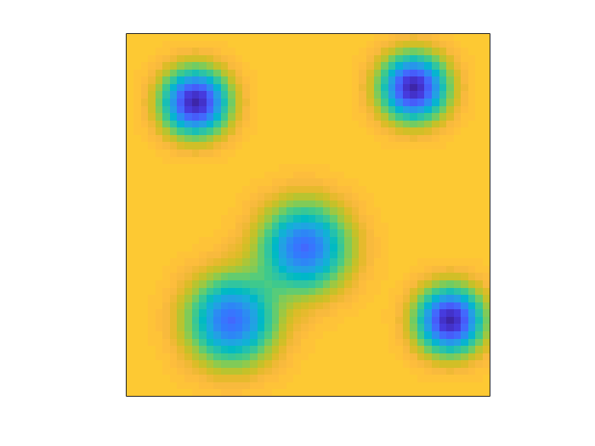
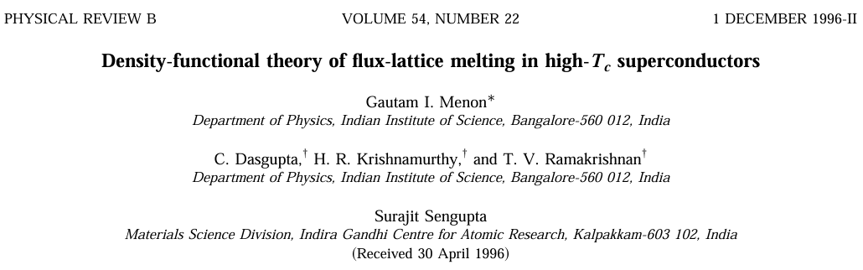
STS measurement in a pinned vortex liquid
No Vortex
The intensity of the conductance minimum reflects the amount of time a vortex spends at that location.
Locally Fluctuating Vortex
Surajit Dutta et al.,
Phys. Rev. B 103, 214512 (2021)
Vortex hopping between sites

Slide 12
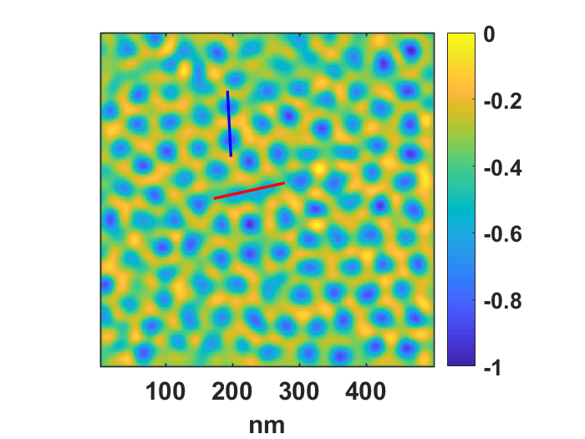
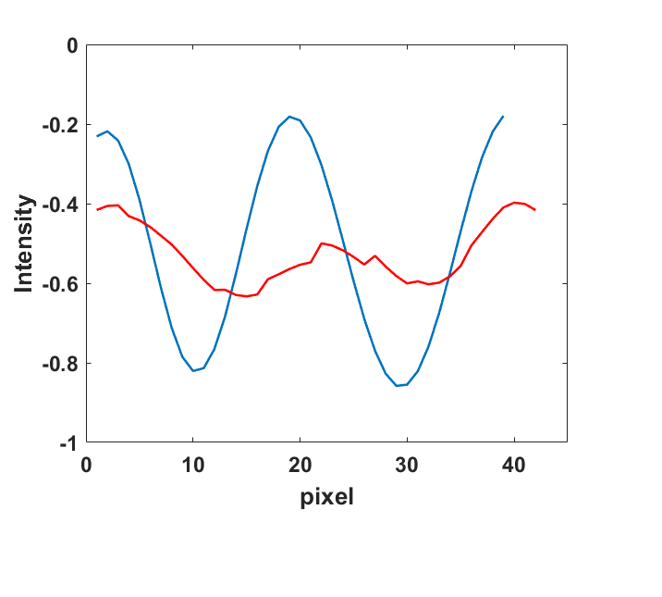
Vortices with different degree of localisation
Deep minima corresponding to strongly localized vortices
Shallow minima corresponding to weakly localized vortices

Slide 13
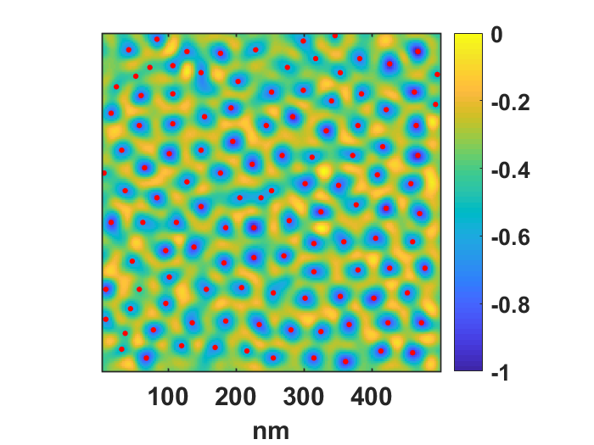
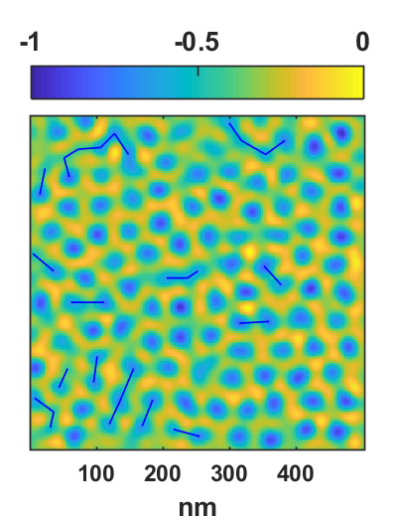
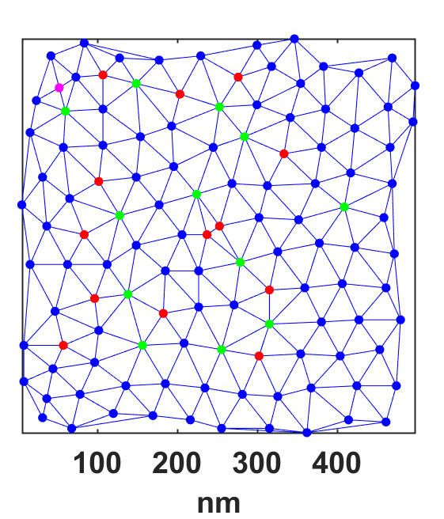
How to calculate the motion paths
Step 2
Step 1
Join any two neighbouring minima for which,
The value of G_{N} > -0.8
and
(ii) The value of G_{N} along the line joining the minima is < -0.4
Delaunay Triangulate

Slide 14
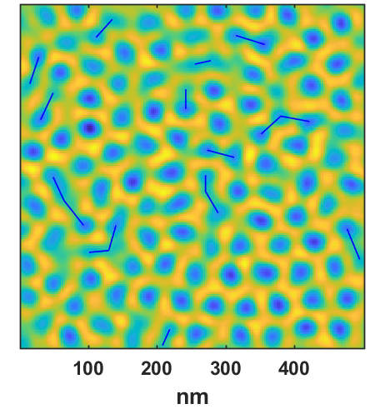
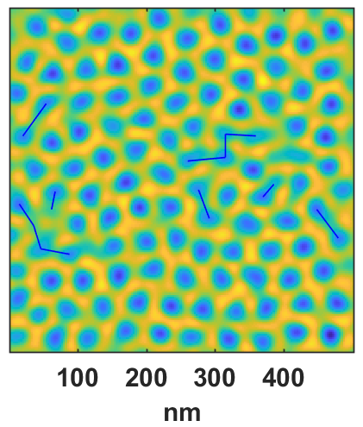
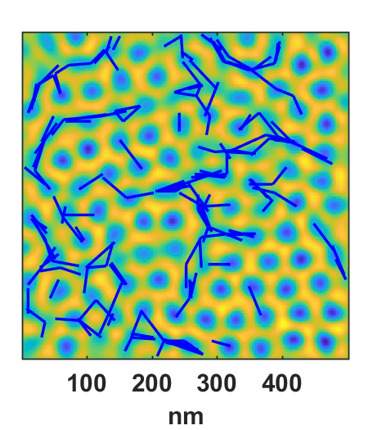
Motion paths over long time-scales
+
+
+ . . . =
Not the complete story

Slide 15
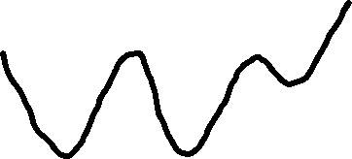
Sequence of 10 images at 410 mK, 10 kOe
1
3
7
Incomplete hop
Complete hop
Modified landscape
(Pinning + Interactions)

Slide 16

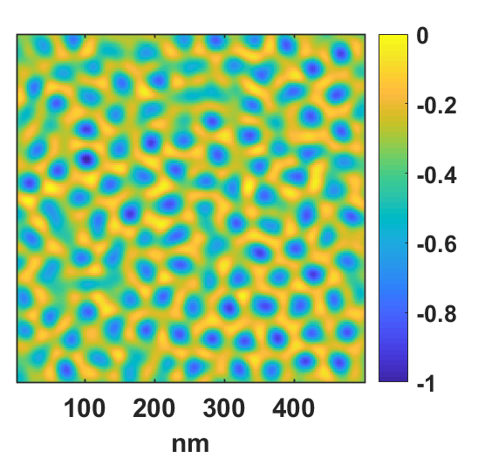
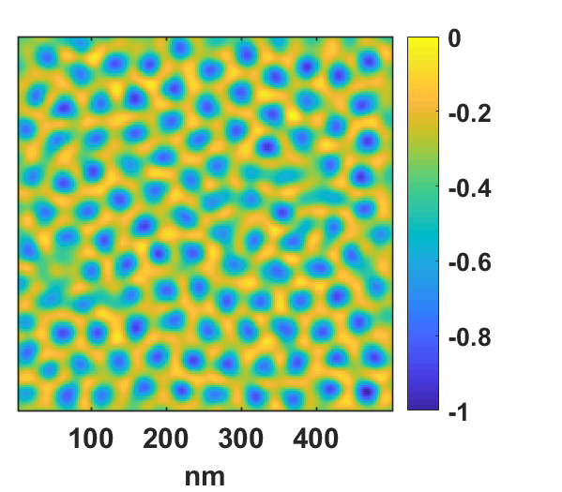
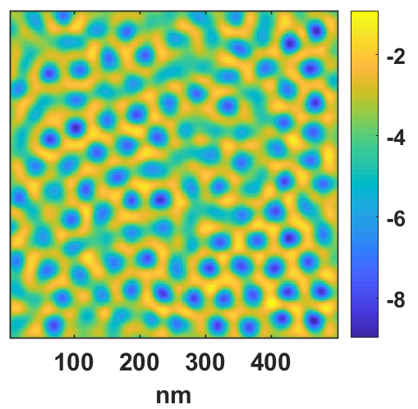
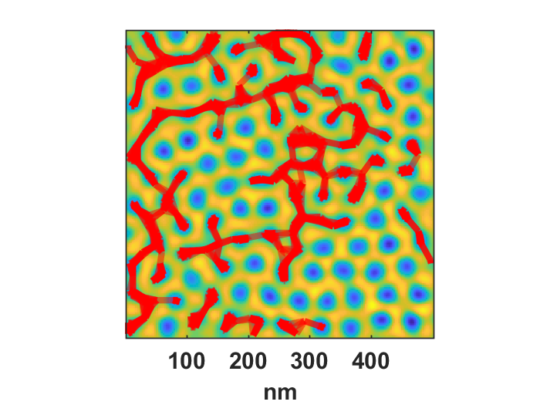

Motion due to incomplete hops
+
+
+
. . . =
Superimposed image
Global Motion Paths
(in an inhomogeneous liquid)
+

Slide 17






Magnetic field evolution at 410 mK
a-ReZr 5 nm
Temperature evolution at 10 kOe
T = 0.41 K
T = 1.2 K
T = 2 K
T = 2.5 K
T = 2.8 K
No Signature of vortex solid (crystalline or amorphous)!
Rishabh Duhan et al., Phys. Rev. B 108, L180503 (2023).

Slide 18


${a−Re}_{x≈6}Zr$ thin film (thickness 20 nm)
Moderate Pinning
Strong Pinning: 5 nm a-ReZr
Moderate Pinning: 20 nm a-ReZr
Very Weak Pinning: 20 nm a-MoGe

Slide 19

460 mK

Slide 20

3 kOe: “Inverse melting” in the range 0.46K →3 K. Regular melting between 3K → 4 K.
20 kOe: Vortex lattice disorders slowly with temperature
30 kOe: Vortex lattice disorders rapidly with temperature

Slide 21

For the agnostic: Direct visualization from raw data
Nature Communications 16, 2100 (2025)

Slide 22




Inverse melting
Predicted also for vortices
Most well known in liquid ³He
Rev. Mod. Phys. 66, 1125 (1994)
Earlier evidence only in layered high T_{c} superconductor BSCCO from thermodynamic measurements under shaking:
Nature 411, 451–454 (2001)

Slide 23

Construction of phase diagram
The peak effect(s)
Inverse Melting of the vortex lattice
Melting of the vortex lattice

Slide 24
Inverse Melting
No Inverse Melting
Liq.
5 nm
Normal
State
50 nm
Liquid
20 nm
Solid
Liquid
Inverse Melting
20 nm
Normal State
Liquid
Solid
Liquid
Solid
Liquid
[2605.23567] Phase diagram of the vortex state in an amorphous Re6Zr thin film exhibiting inverse melting

Slide 25


Quantum Nature of vortices: “Zero-point” fluctuation
Spectroscopy of the vortex core
NbSe₂
A
C
B
Very clean crystal
Moderate clean crystal

Slide 26






A-MoGe thin films: Soft gap inside vortex vortex core
5 kOe, 450 mK
$$G_{N}(V)$$
$$ΔG(nS)$$
$$nm$$
$$nm$$

Slide 27




Simulating a conductance map
Single vortex
Simulating the vortex Lattice
$${\tilde{G}}_{N}\left(V,r\right)=\frac{\sum_{i}{G_{N}\left(V,r−r_{i}\right)}}{{〈\sum_{i}{G_{N}\left(V=0,r−r_{i}\right)}〉}_{max}}$$
Zero bias conductance
Coh. Pk. bias conductance
$$w\left(r\right)$$
G (V,r)=w(r)G_{A}(V)+(1- w(r)) G_{B}(V)
FWHM
$$2×ξ_{GL}$$
Assumptions:
Spectra inside core is flat: G_{A}(V)
Spectra far away from core is same as the zero-field spectrum: G_{B}(V)

Slide 28





Validation of this scheme on NbSe₂
$$G_{N}(0)$$
$$ΔG(nS)$$
5 kOe
$$nm$$
$$nm$$
H_{c2} ~ 42 kOe
ξ ∼ 8.9 nm

Slide 29






Simulating fluctuating vortices
Each vortex is randomly displaced by $|\vec{δ}|<α<a_{Δ}$
Zero Bias
Displace each vortex by a random vector r
Coh. peak
$$\overline{r}=\hat{i} r cos\left(θ\right)+\hat{j} r sin\left(θ\right)$$
$$r →0−Δa$$
$$θ→0−2π$$
Sum over 200 such replica

Slide 30


Matching with experimental results: a-MoGe
Zero Bias
450 mK, 30 kOe
Coh. peak
$Δa/a$ = 0.275

Slide 31

Extracting the Amplitude of Fluctuations
Origin: Classical or Quantum?

Slide 32












Calculations: Surajit Dutta
Theory: Amplitude and frequency of fluctuation
$$\tan\left(θ\right)≈θ=\frac{δ}{a}$$
$$ε=\frac{1}{2} C_{66}{\left(\frac{δ}{a}\right)}^{2}$$
Harmonic Approximation
$$E^{el}=\frac{{∅_{0}}^{2}d}{32πμ_{0}λ^{2}}{\left(\frac{δ}{a}\right)}^{2}=\frac{1}{2}\left(\frac{{∅_{0}}^{2}d}{16πμ_{0}λ^{2}a^{2}}\right)δ^{2}$$
$$=\frac{1}{2}m_{v}ω^{2}δ^{2}$$
a
$$ω=\sqrt{\frac{{∅_{0}}^{2}d}{16πμ_{0}λ^{2}a^{2}m_{v}}}={\left(\frac{K}{m_{v}}\right)}^{1/2}\frac{1}{a}=ω_{0}{\left(\frac{H}{H_{c2}}\right)}^{1/2}$$
$${Total Energy of Oscillator=m}_{v}ω^{2}{\left(∆a\right)}^{2}$$
Amplitude of thermal motion $m_{v}ω^{2}{\left(∆a\right)}^{2} \sim k_{B}T$
Zero Point Fluctuation: ${ℏω=m}_{v}ω^{2}{\left(∆a\right)}^{2}$
$$\frac{∆a}{a}=\left(\frac{ℏ^{\frac{1}{2}}}{{\left(Km_{v}\right)}^{1/4}}\right){\left(\frac{1}{a}\right)}^{1/2}∝H^{1/4}$$
Difference with our result is a pre-factor of 0.7.
$$\frac{∆a}{a}\sim {\left(\frac{k_{B}T}{K}\right)}^{1/2}$$

Slide 33





Zero point motion of vortices
$$\frac{∆a}{a}=\left(\frac{ℏ^{\frac{1}{2}}}{{1.036\left(Km_{v}\right)}^{1/4}}\right){\left(\frac{μ_{0}}{Φ_{0}}\right)}^{1/2}H^{1/4}$$
Theoretical Estimate of vortex mass:
Suhl, PRL 14, 266 (1965)
$$m_{v}=\frac{2}{π^{3}}m^{∗}k_{F}d=32m_{e}$$
$$m_{v}\sim 36 m_{e}$$
$$ω_{0}\sim 0.86 THz$$
$$ω=ω_{0}{\left(\frac{H}{H_{c2}}\right)}^{1/2}$$
Phys. Rev. B 103, 214512 (2021)

Slide 34





Slide 35

2 K

Slide 36

Summary
In nanometer-thick superconducting thin films, vortex liquid phases span a very large region of the H-T parameter space.
The phase diagram shows novel phase resulting from the interplay of fluctuations, pinning and intervortex interactions: Formation of the hexatic, smectic vortex fluid and Inverse melting.
Vortices are quantum in nature: Undergo zero-point fluctuations.
Can there be a quantum vortex liquid?

Slide 37


Collaborators
Inverse melting
Rishabh Duhan (now in Weizmann)
Subhamita Sengupta (now in Harvard)
Somak Basistha (now at IIT Bombay)
Pritam Das, Anjan Jana, Sulagna Dutta
Hexatic vortex fluid
Indranil Roy (now at Rutgers)
Surajit Dutta (now at Weizmann)
Vortex State in NbSe₂
Somesh Ganguly (now at University of Jyväskylä)
STM Instrumentation
Anand Kamlapure (now at QuTech, The Netherlands)
Theory Collaborators
Lara Benfatto & group (Sapienza, Rome)
Chandan Dasgupta (IISc, Bangalore)
Vadim Geshkenbein (ETH)
Amit Ghosal (IISER, Kolkata)
…and special thanks for technical support
Vivas Bagwe
John Jesudasan
Funding Support: Department of Atomic Energy, Govt of India

Slide 38

Different degree of localization

Slide 39

Overall Motion paths: Red Network + Blue Network

Slide 40





Order-disorder transition of the vortex lattice
In conventional superconductors the VL does not melt in 3D!
In bulk crystals vortex liquids have been only observed in High Temperature superconductors at temperature > 0.4 T_{c}
Nature 375, 373–376 (1995)
Nature 406, 282–287 (2000)
Scientific Reports 5, 10613 (2015); Phys. Rev. B 93, 144503 (2016).

Slide 41





Development of TIFR-Qmet Cryogenic Nanopositioners (NP)
Point Contact Spec Insert
Example of LabView interface
Customisable for specific requirements
Fully computer controlled electronics
Operating Temperature: 300 K – 1.6 K
Customizable for different applications.
Also Available commercially through Excel Instruments, Mumbai
Review of Scientific Instruments, 95, 113708 (2024)

