Slide 1
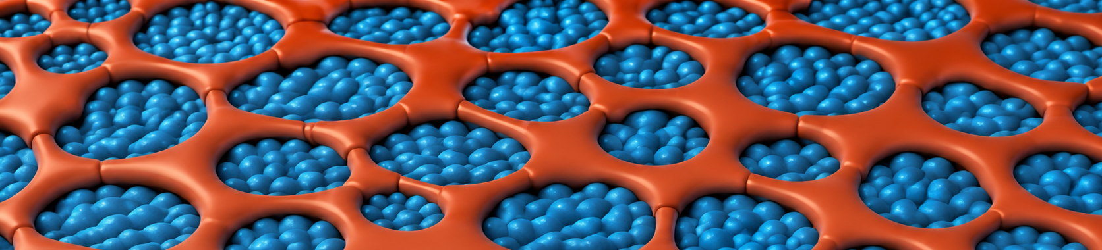
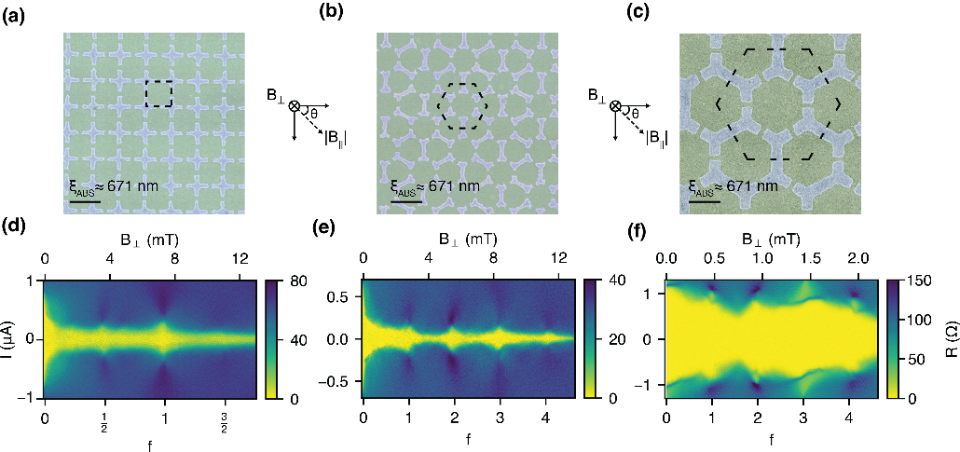
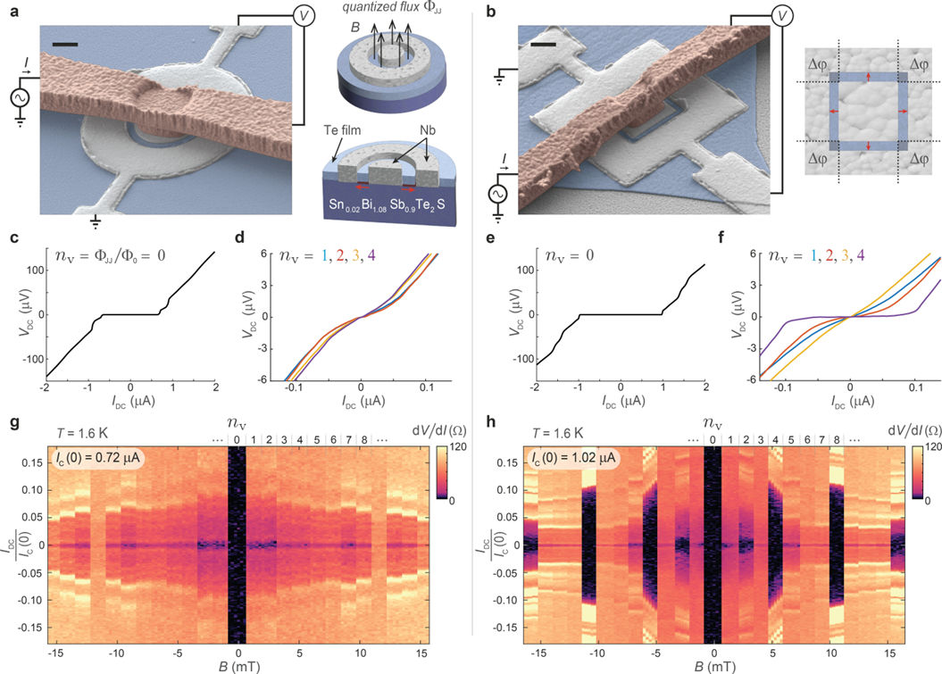

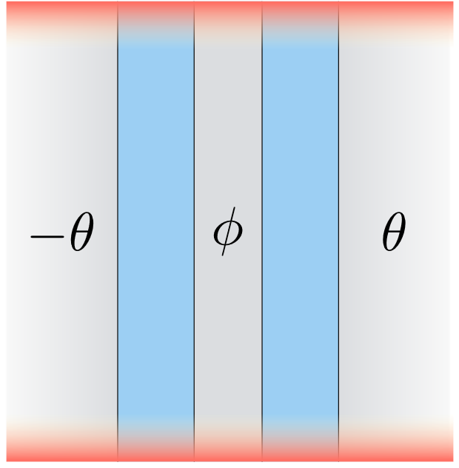

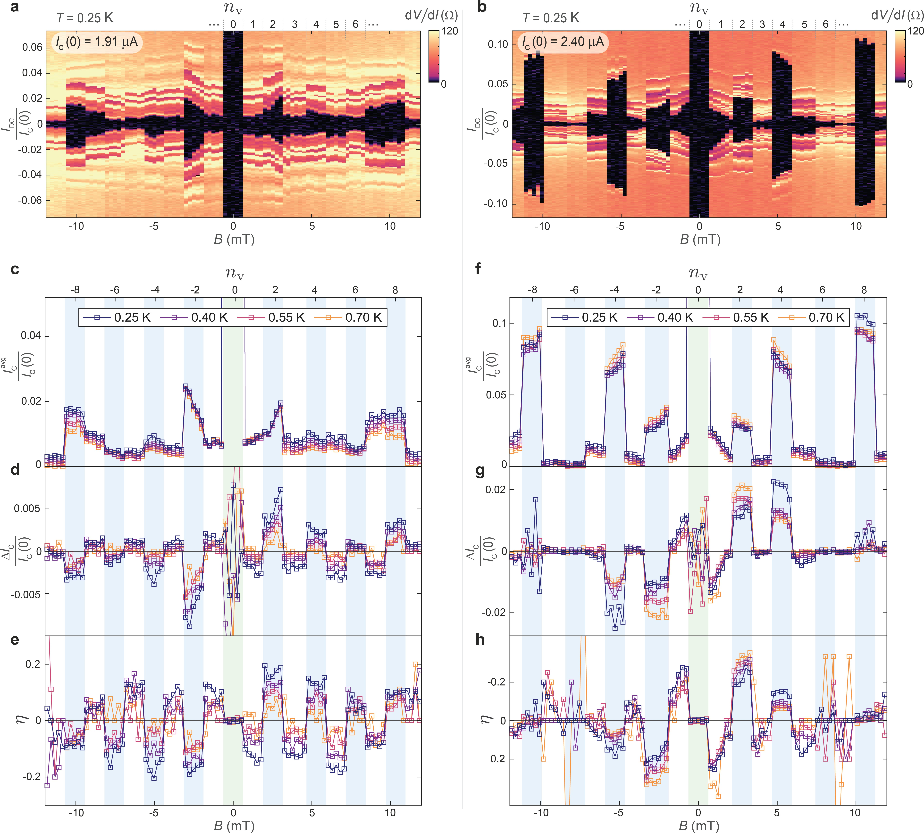

Topological Superconductivity with a tiny magnetic field
Two-dimensional and Disordered Superconductors (TIDES)
יובל אורג
Yuval Oreg
July 2026

Slide 2

A Trailer

Slide 3
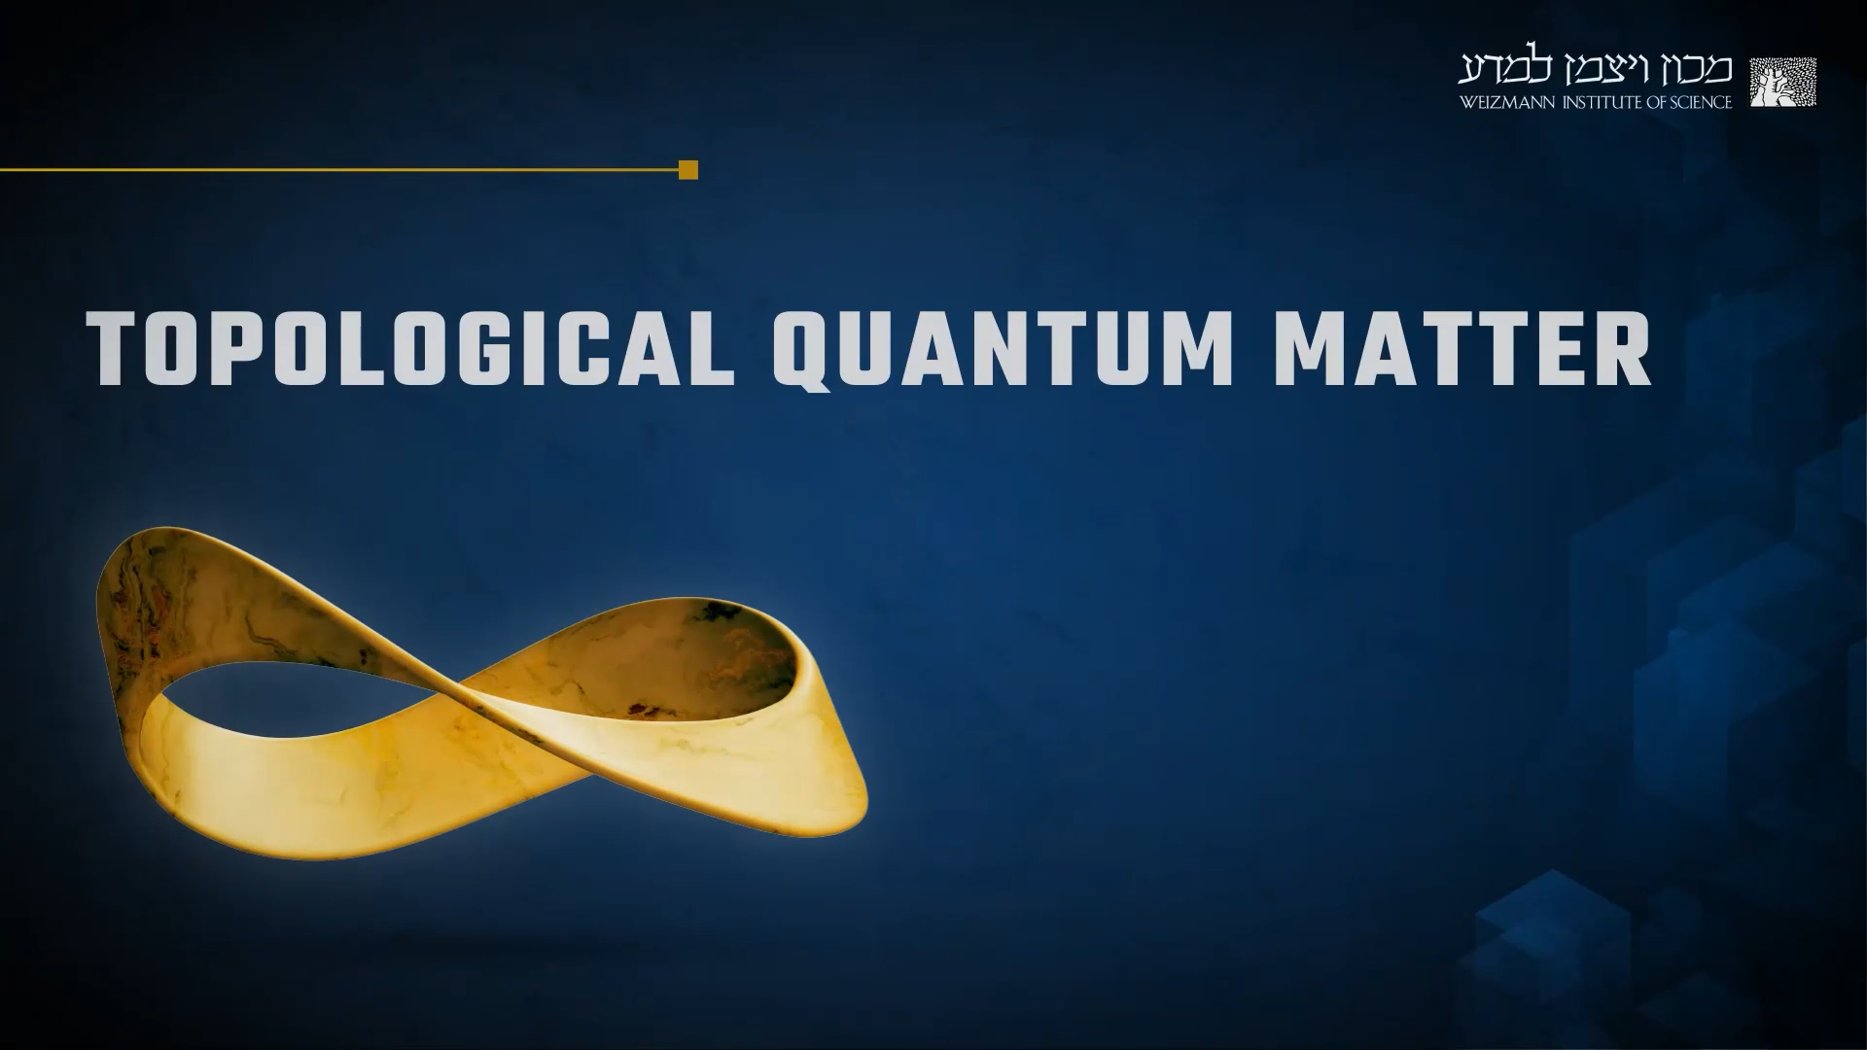

Slide 4
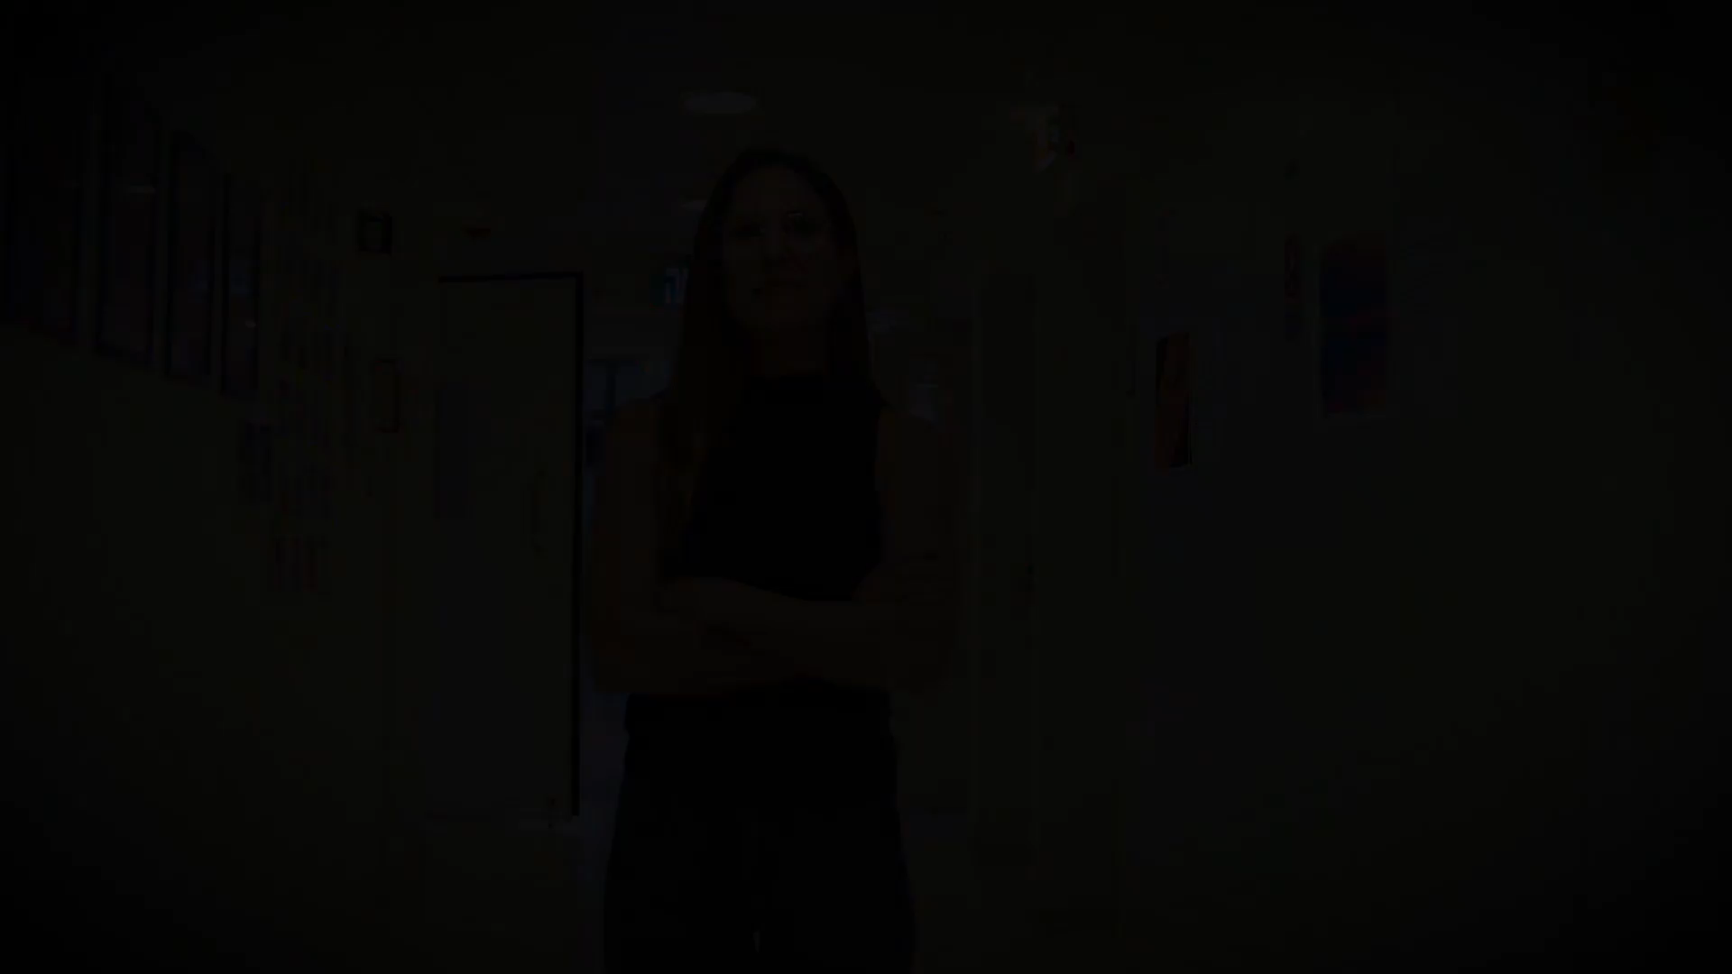
1. The Quantum Hall effect
2. Topological superconductivity
3. Topological universe on graphene
4. Topological insulators
5. Topological classification
6. Gapless topological phases
7. Material prediction
8. States of topological Order
9. Experimental tools

Slide 5
Free on:
Youtube
EdX
Campus IL
Registration!

Slide 6
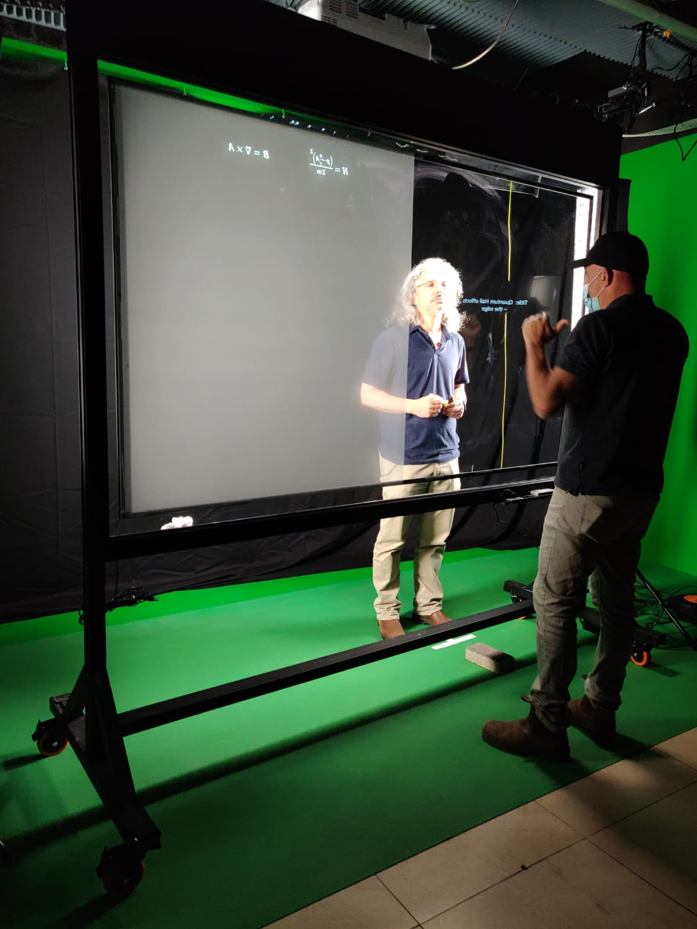
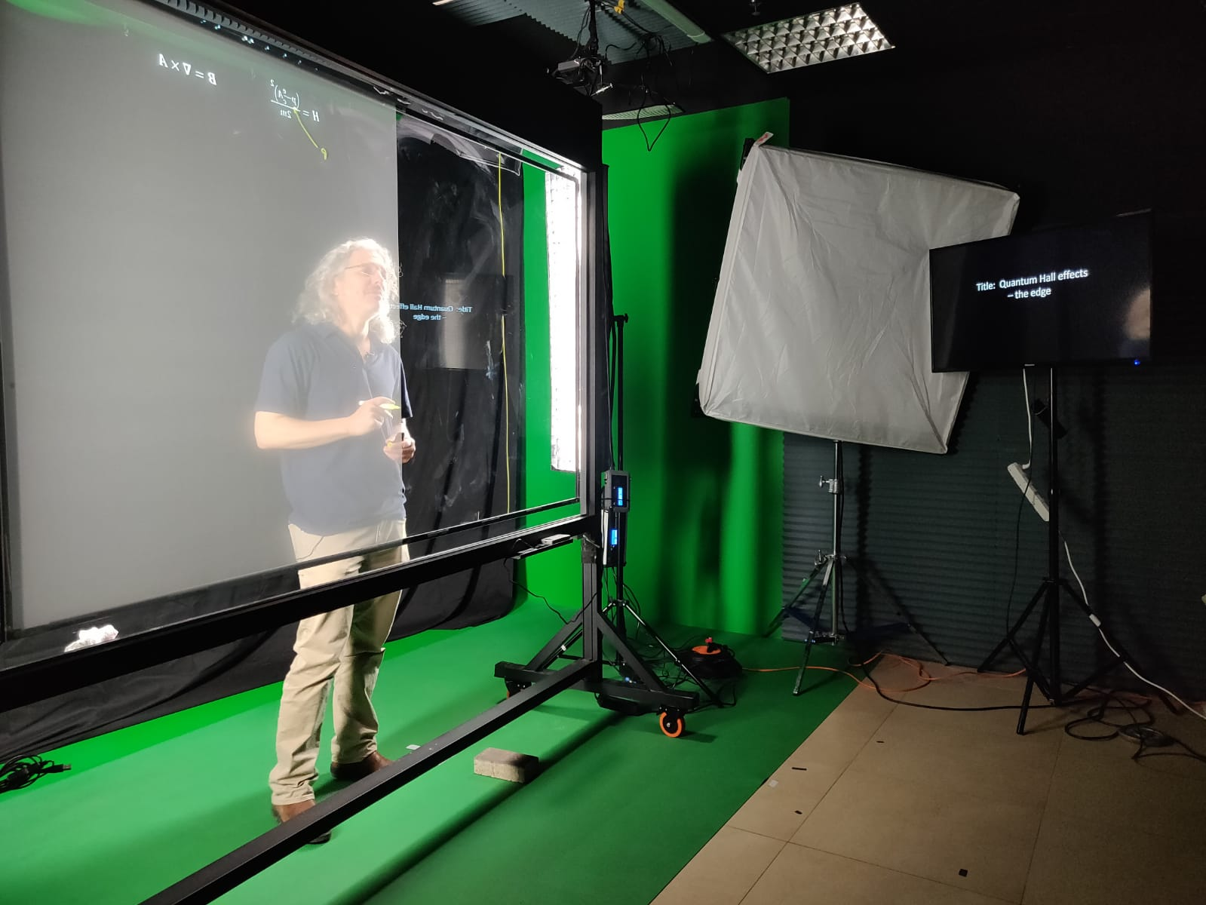
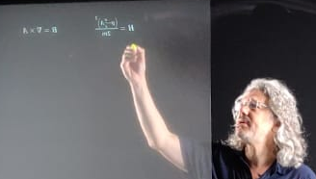

Slide 7
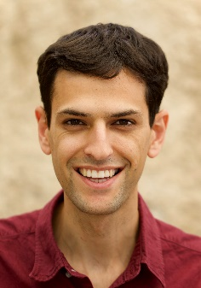
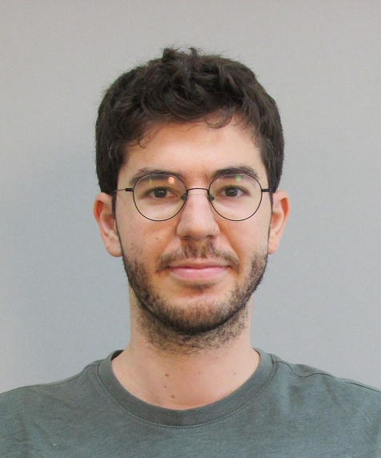

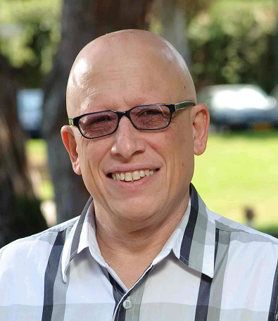

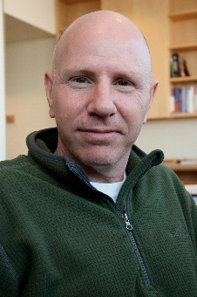


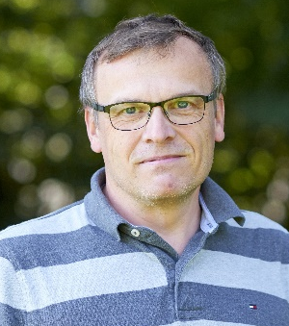
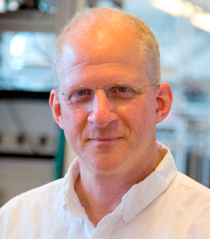

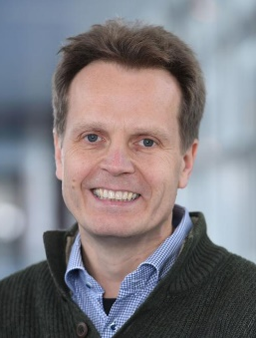
Collaborators
Weizmann Institute of Science
Harvard University
Omri
Lesser
Nadav
Drechsler
Samuel D.
Escribano
Ady
Stern
Daniil
Skliannyi
Amir
Yacoby
Andrew
Saydjari
Marie
Wesson
Niels Bohr Institute
Freie University Berlin
Karsten
Flensberg
Charles M.
Marcus
Anders E E
Dahl
Felix
von Oppen

Slide 8
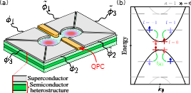
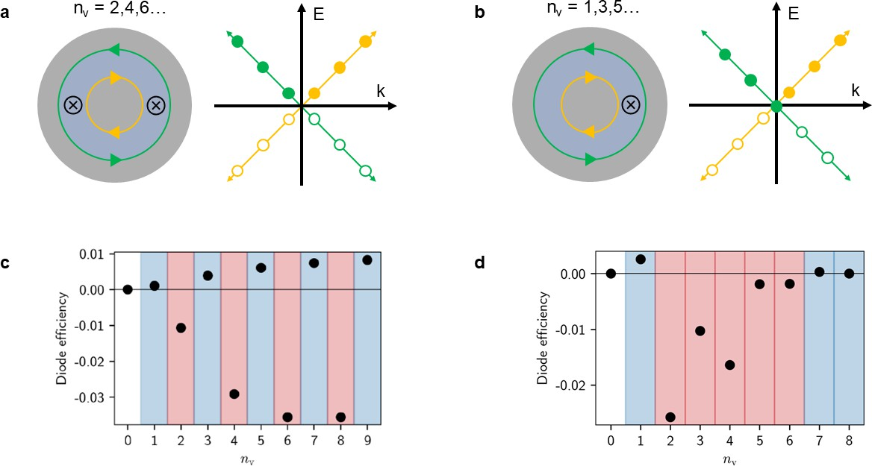
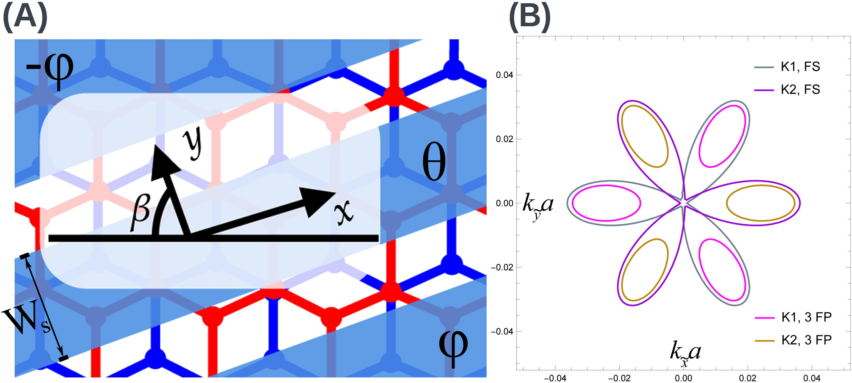
Topological superconductivity
Phase-induced Majorana zero modes
O. Lesser., K. Flensberg, F. von Oppen, Y.O., Phys. Rev. B, 2021
O. Lesser, A. Saydjari, M. Wesson, A. Yacoby, Y.O., PNAS, 2021
O. Lesser, Y.O., J. Phys. D, 2022
O. Lesser, Y.O., A. Stern, Phys. Rev. B, 2022
D. Escribano, A.E. Dahl, K Flensberg, Y.O.
PRB (2025) (Poor’s man w phases)
D. Skliannyi, Y.O., A. Stern
PRB (2025)
Chiral two-dimensional topological superconductivity
In Arrays
O.Lesser, A. Stern, Y.O, PRB (2024)
Vortex-parity-controlled diode effect in Corbino topological Josephson junctions
D. Skliannyi, Y.O., A. Stern
PRB (2025)

Slide 9
Topological superconductivity
Phase-induced Majorana zero modes
O. Lesser.,… et al. (2021-2024 5 publications)!!
Vortex-parity-controlled diode effect in Corbino topological Josephson junctions
Park,… Kim (2026) arXiv:2601.14384
Theory of reentrant superconductivity in Corbino Josephson junctions
Lesser,…,YO (2026), arXiv:2601.14364
D. Escribano, A.E. Dahl, K Flensberg, Y.O.
PRB (2025) (Poor’s man w phases)
D. Skliannyi, Y.O., A. Stern
PRB (2025)

Slide 10




Majorana Zero Mode – Mile stones
Relevant for the discussion today
2001 Basic theory – toy models (Kitaev)
2008 TI+ SC (Kane and Fu)
2010 2D Proximity (Sau et al, Alicea)
2010 Lutchyn et al YO et al (Wires)
2012 Exp. Delft (Also Weizmann Lund and Haravrad)
2012 Quantum dots and SC (Sau et al, Leijnse Flensberg)
2012 Fulga quantum dots no charging energy
2017 Josephson junctions (Pientka et al Hell et al. Exp (Copenhagen, Harvard)
2020 Full shell nano wire (S. Vaitiekenas et al.)
2022…2025 Exp Poor Man scaling (Delft)

Slide 11
We suggest a way to overcome the obstacles that disorder and high density of states pose to the creation of unpaired Majorana fermions in one-dimensional systems. This is achieved by splitting the system into a chain of quantum dots, which are then tuned to the conditions under which the chain can be viewed as an effective Kitaev model, so that it is in a robust topological phase with well-localized Majorana states in the outermost dots.

Slide 12
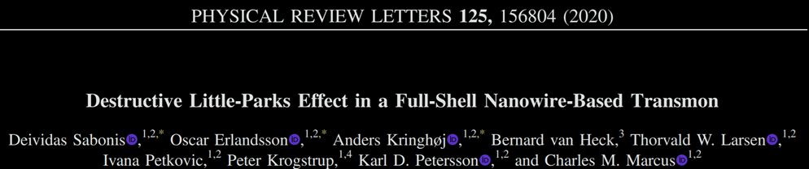
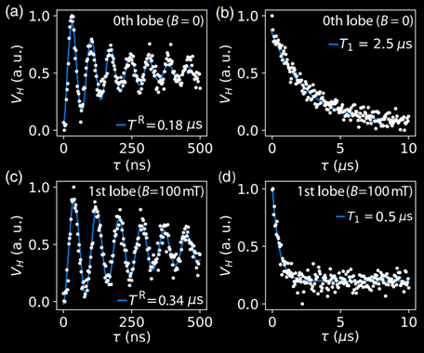
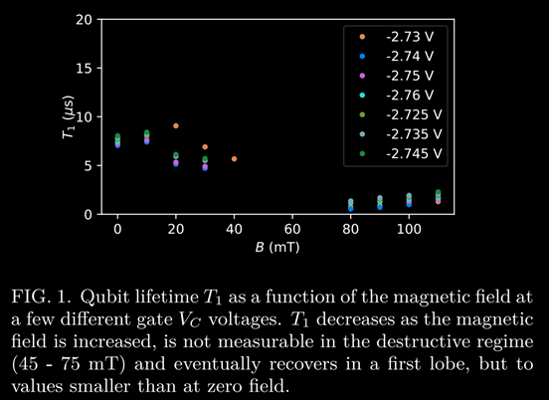
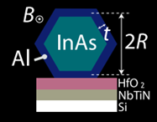
Negative effects of magnetic fields
Notes:
So what’s the problem with a magnetic field? Here’s an example that shows how qubit lifetime is greatly diminished already at tens of microTeslas.
Dephasing
Sub-gap states
Magnetic impurity states
Deteriorating the superconductor

Slide 13
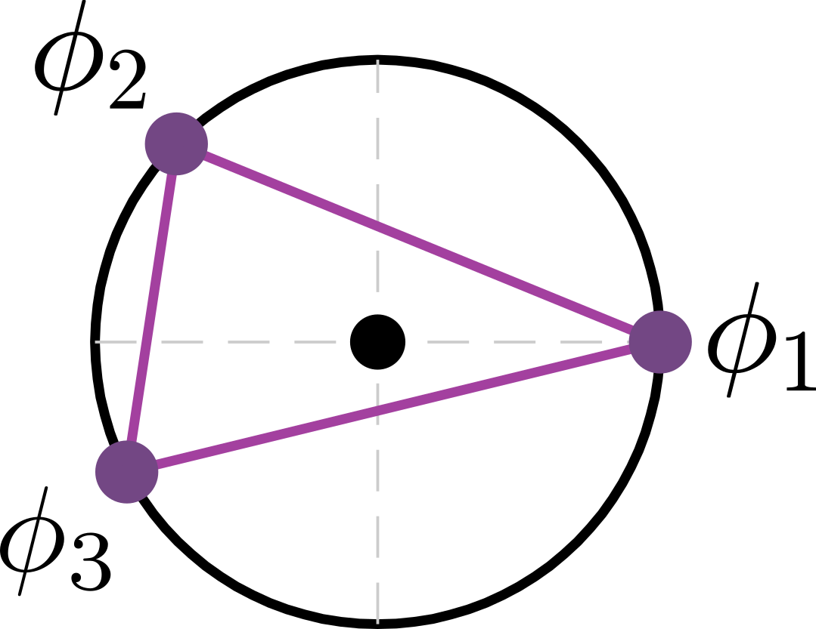

Replacing $B$ with SC phase control
Why is a (Zeeman) magnetic field needed?
To break time-reversal symmetry
Replace with superconducting phase winding
SC phase + Aharonov-Casher phase interference
Advantages:
  Phases are easy to control with a tiny field
  No undesired in-gap states, magnetic impurities, etc.

Slide 14
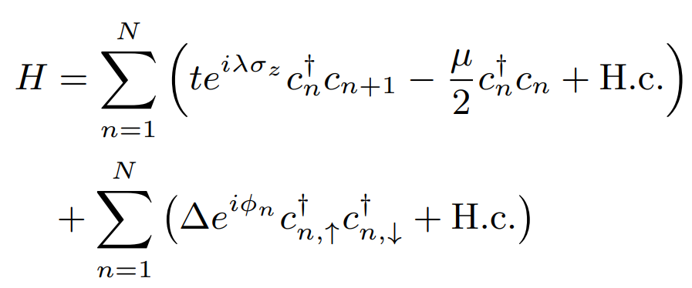
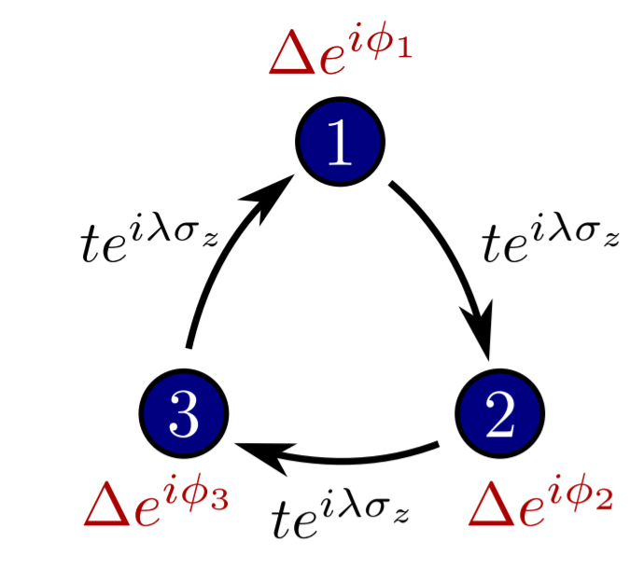
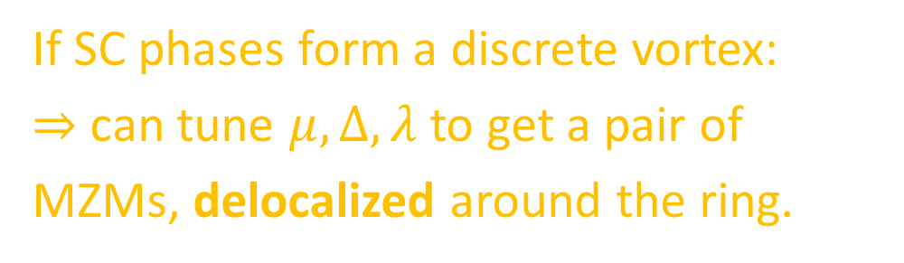
Basic building block
If SC phases form a discrete vortex:
$⇒$ can tune $μ, Δ, λ$ to get a pair of MZMs, delocalized around the ring.
B. van Heck, S. Mi, A. R. Akhmerov, PRB, 2014
Omri Lesser et al, Phys. Rev. B, 2021; Omri Lesser et al, PNAS 2021

Slide 15
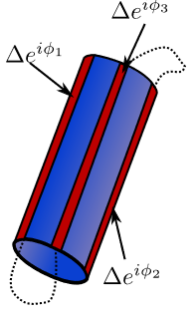
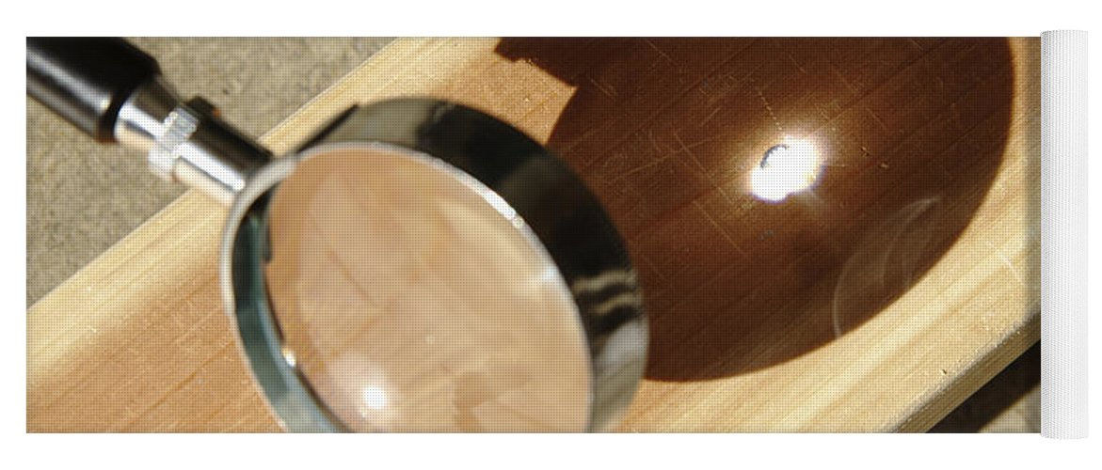
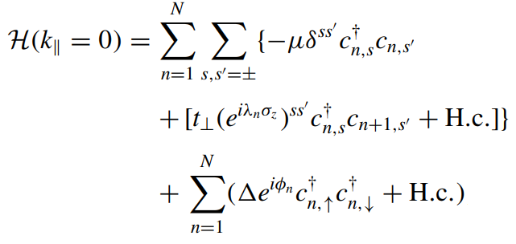
Cylinder model
Gap Closure → Topological phase transition

Slide 16
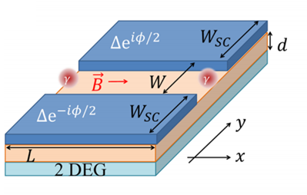
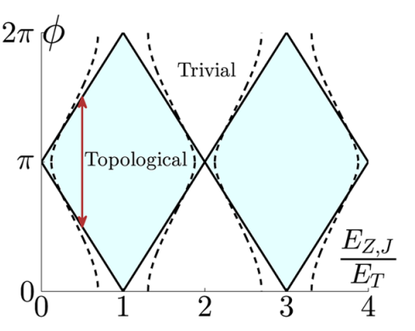
Phase bias as a time-reversal-symmetry breaker
Hell et al, Phys. Rev. Lett., 2017;
Pientka et al, Phys. Rev. X, 2017

Slide 17
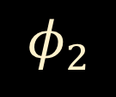
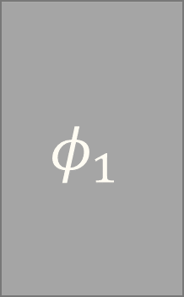
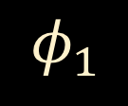
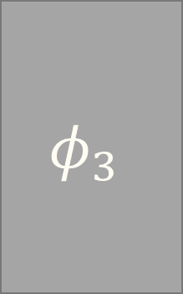

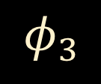
Can phase bias replace Zeeman altogether?
Two superconductors are not enough
$$φ_{1}$$
$$φ_{1}$$
$$φ_{2}$$
$$φ_{3}$$
$$φ_{2}$$
$$φ_{3}$$
B. van Heck, S. Mi, A. R. Akhmerov, PRB, 2014
Notes:
Unidirectional current

Slide 18
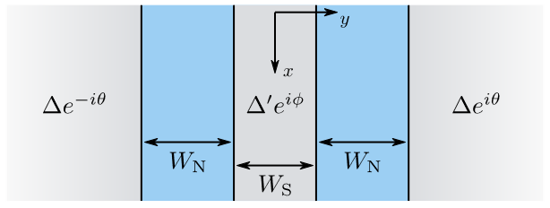
SNSNS junction
O. Lesser, YO, A. Stern, Phys. Rev. B, 2022

Slide 19
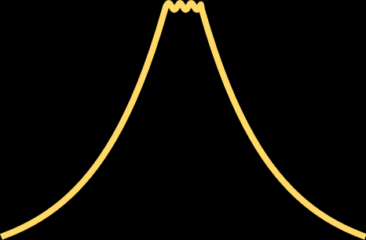




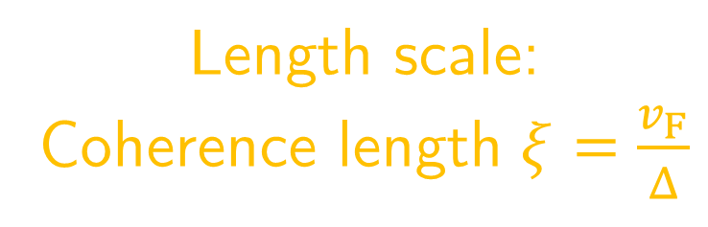


SNSNS junction
$$Δe^{−iθ}$$
$$Δ′e^{iφ}$$
$$Δe^{iθ}$$
$$Δ′e^{iφ}$$
Length scale:
Coherence length $ξ=\frac{v_{F}}{Δ}$
$$Δe^{−iθ}$$
$$Δe^{iθ}$$
O. Lesser, Y.O., A. Stern, Phys. Rev. B, 2022

Slide 20
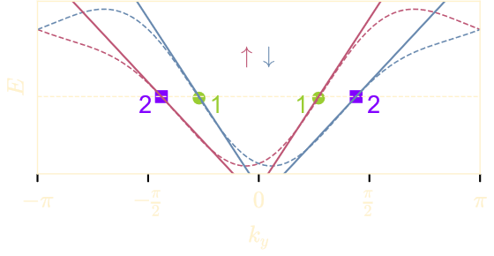

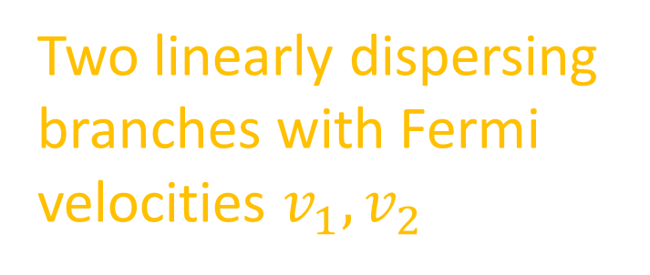
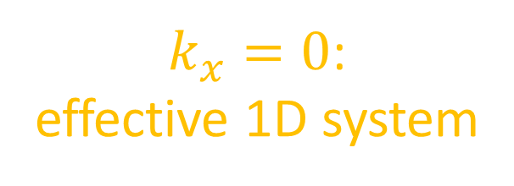
SNSNS junction: 1D description
$k_{x}=0$:
effective 1D system
Two linearly dispersing branches with Fermi velocities $v_{1},v_{2}$
$v_{}=(k−A_{so}σ_{x})/m$

Slide 21
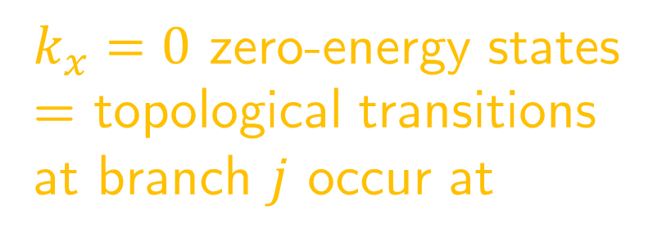
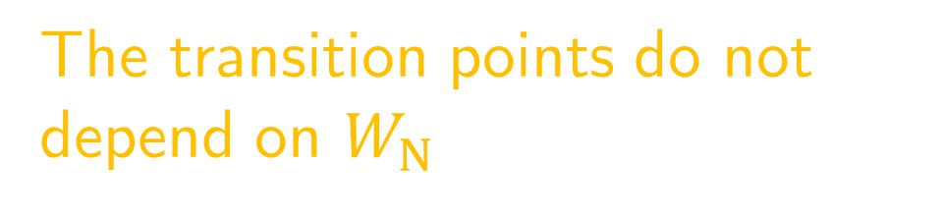
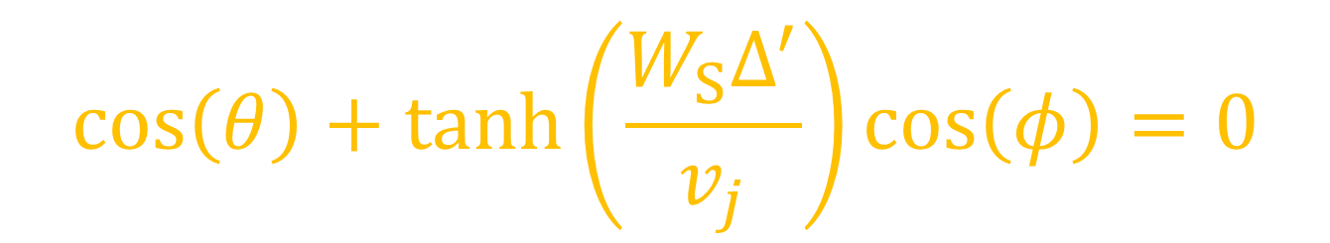
SNSNS junction: gap closings
$k_{x}=0$ zero-energy states = topological transitions at branch $j$ occur at
$$\cos\left(θ\right)+\tanh\left(\frac{W_{S}Δ^{′}}{v_{j}}\right)\cos\left(φ\right)=0$$
The transition points do not depend on $W_{N}$

Slide 22
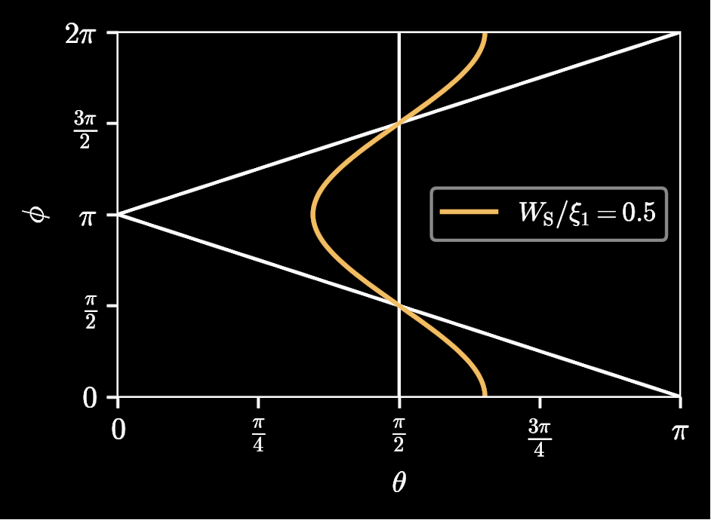
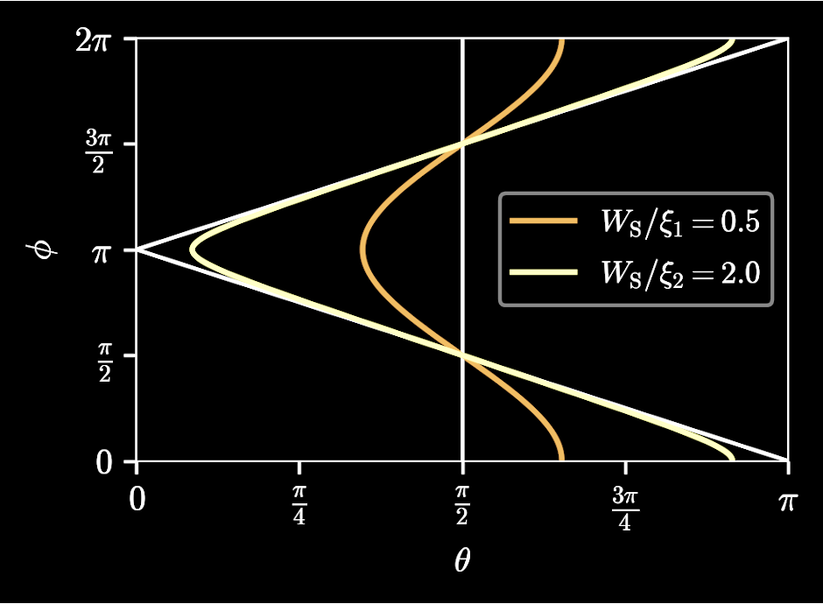
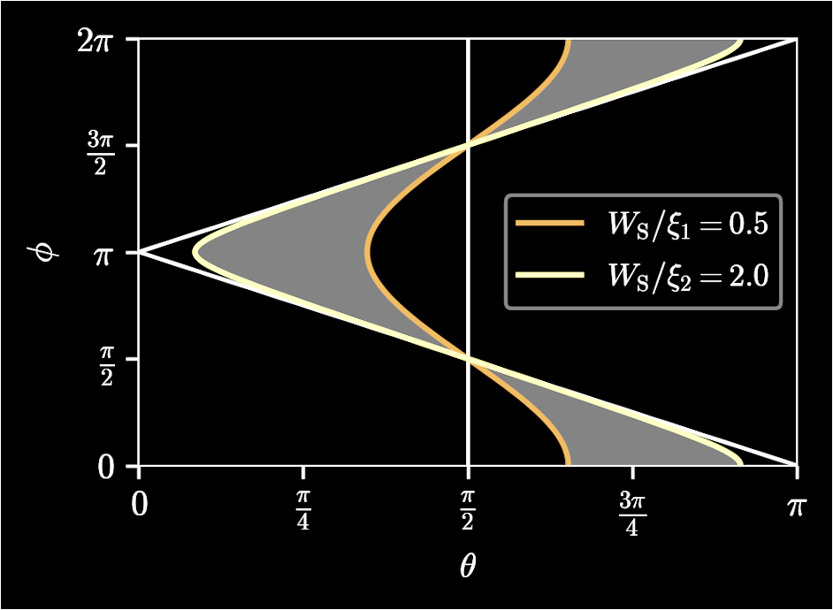






Topological phase diagram
$$\cos\left(θ\right)+\tanh\left(\frac{W_{S}}{ξ_{j}}\right)\cos\left(φ\right)=0$$
Topological
$$v_{1}$$
$$v_{2}$$
Phase winding
No phase winding
O.Lesser, YO, A. Stern, Phys. Rev. B, 2022

Slide 23



1
3
$$θ$$
$$φ$$
$$−θ$$
0
2

Slide 24





1
3
Opposite-sides non-local
conductances
$$θ$$
$$φ$$
$$−θ$$
0
2

Slide 25


1
3
Same-side non-local
conductances
$$θ$$
$$φ$$
$$−θ$$
0
2

Slide 26





General considerations for unequal Fermi velocities
At $k_{x}=0$: 1D ring
Nearest-neighbor hopping only:
Shifted spectra $E_{±}\left(k\right)=E\left(k±k_{SO}\right)$ (Meir et al, PRL, 1989)
$⇒$ equal Fermi velocities!
Must go beyond simple 1D nearest-neighbor models
$$⇒$$
Notes:
Unequal v_F– sounds not a big deal; because usually people look at simple n.n. models with SOC, that’s not enough
Mention Aharonov Casher and Berry phase

Slide 27


Material platforms with a velocity imbalance
Transition metal dichalcogenides
MoS₂, MoSe₂, MoTe₂, WS₂, WSe₂, WTe₂, TaS₂, …
Gate-defined wires
in HgTe
quantum wells
J. Reuther et al, PRX, 2013
Holes in
Germanium, small g factor large rashba

Slide 28

Periodic potentials make the Fermi velocities unequal
O. Lesser, A. Saydjari, M. Wesson, A. Yacoby, Y.O., PNAS, 2021

Slide 29

Experimental signature: periodic phase diagram

Slide 30
Phase-controlled minimal Kitaev chain in multiterminal Josephson junctions
SD Escribano, AE Dahl, K Flensberg, and YO (2025)

Slide 31



Gapfull and gapless 1D Topological Superconductivity in Spin-Orbit Coupled Bilayer Graphene
D. Skliannyi, YO, Ady Stern arXiv:2504.16176 (2025)
Ising term only – spin symmetry → topological gapless superconduting phase (analogous to Weyl semi-metal) +Rashba → opens a gap.

Slide 32


Subgap spectrum of four phase-controlled islands
Notes:
Non degenerare due to SOC – unlike CdGM

Slide 33

Phase-controlled Josephson junction arrays
Strong
Weak
Notes:
As a backup slide - how to connect the islands with bridges
Consider presenting also the 3-island unit cell

Slide 34



Phase-controlled JJ array: phase diagram

Slide 35



Fu and Kane 2009

Slide 36


Corbino Geometry
300 nm

Slide 37












Fraunhofer Pattern
$$I_{c}\left(Φ\right)=I_{c}\max_{φ_{0}}\int_{0}^{L}{sin(φ\left(y\right)dy}$$
$$φ=0$$
$$φ(y)=2π\frac{Φ}{Φ_{0}}\left(\frac{y}{L}\right)$$
$$I_{c}\left(0\right)\left|\frac{sin πΦ/Φ_{0}}{πΦ/Φ_{0}}\right|$$
$$Φ_{0}=\frac{h}{2e}$$
$$Δφ(y)$$
$$+φ_{0}$$
$$y$$
$$x$$
$$η=\frac{\left|I_{c}^{+}\right|−\left|I_{c}^{−}\right|}{\left|I_{c}^{+}\right|+\left|I_{c}^{−}\right|}$$
$$\vec{B}$$

Slide 38

$$n_{v}=\left\lfloor \frac{Φ}{Φ_{0}}\right\rfloor$$
Number of corners

Slide 41
Trivial and Topo
Trivial
Topo

Slide 47

Extending to two dimensions
Notes:
Analogy: QHE, make it 1D – instead of just gap we get localized modes.
What is this “parent” 2D state? p+ip superconductor.
The bulk is gapped for single electrons and not for pairs.
The edge has chiral mode which are combinations of particles and holes; PHS is since we are looking below the gap.

Slide 48
Extending to two dimensions
Notes:
Analogy: QHE, make it 1D – instead of just gap we get localized modes.
What is this “parent” 2D state? p+ip superconductor.
The bulk is gapped for single electrons and not for pairs.
The edge has chiral mode which are combinations of particles and holes; PHS is since we are looking below the gap.

Slide 49
With Zeeman

Slide 50

Extending to two dimensions
Notes:
Analogy: QHE, make it 1D – instead of just gap we get localized modes.
What is this “parent” 2D state? p+ip superconductor.
The bulk is gapped for single electrons and not for pairs.
The edge has chiral mode which are combinations of particles and holes; PHS is since we are looking below the gap.

Slide 51


Zeeman JJ arrays: from 1D to 2D
O. Lesser, A. Stern, YO 2024

Slide 52

Exchange-biased JJ arrays: from 1D to 2D

Slide 53





Josephson junction arrays
Bøttcher et al, Nat. Phys., 2018; arXiv:2210.00318; arXiv:2212.08651

Slide 54




Phase-controlled Josephson junction arrays
$$0$$
$$0$$
$$φ_{1}$$
$$φ_{1}$$
$$φ_{2}$$
$$φ_{2}$$
2DEG with
spin-orbit coupling
$$φ_{3}$$
Superconductor
O. Lesser, A. Stern, YO, in preparation

Slide 55
Subgap spectrum of four phase-controlled islands
Notes:
Non degenerare due to SOC – unlike CdGM

Slide 56
Phase-controlled Josephson junction arrays
Strong
Weak
Notes:
As a backup slide - how to connect the islands with bridges
Consider presenting also the 3-island unit cell

Slide 57
Phase-controlled JJ array: phase diagram

Slide 58



Controlling the phase with flux
$f=\frac{1}{2}$ flux quantum per plaquette:
Checkerboard vortex lattice
T. Halsey, PRB, 1984
O.Lesser., A. Stern, YO, in preparation

Slide 59

Controlling the phase with flux
$f=\frac{1}{2}$ flux quantum per plaquette:
Checkerboard vortex lattice
T. Halsey, PRB, 1984

Slide 60

Controlling the phase with flux
$f=\frac{1}{2}$ flux quantum per plaquette:
Checkerboard vortex lattice
T. Halsey, PRB, 1984

Slide 61


Controlling the phase with flux
$f=\frac{1}{2}$ flux quantum per plaquette:
Checkerboard vortex lattice
T. Halsey, PRB, 1984
O.L., A. Stern, Y. Oreg, in preparation

Slide 62

Flux-biased JJ array: phase diagram

Slide 63





Exchange-biased super-semi heterostructures
2DEG + SC + out-of-plane field
(Sau et al, PRL, 2010)
$$\vec{B}$$
Single Fermi surface
$$k_{x}$$
$$k_{y}$$
But the large perpendicular field hinders superconductivity
and gating is hard
(Levine YO et al, Phys. Rev. B, 2017)
Notes:
Problems with Sau proposal: cannot gate (cite Levine et al), magnetization is in plane

Slide 64
More Lattices

Slide 65



More Lattices
$$2π/3$$
$$0$$
$$4π/3$$

Slide 66
More Lattices
$$2π/3$$
$$0$$
$$4π/3$$

Slide 67

More Lattices
$$2π/3$$
$$0$$
$$4π/3$$
Kekulé

Slide 68


How to detect
$$eΔ\sim 2nA$$
Tunneling
Tunneling, q
Doppler

Slide 69


Outlook: charging effects
Chiral
spin liquid?
Chiral topological
superconductor
Time-reversal
breaker
$$\left(B,φ,…\right)$$
Localized pairs
insulator
Non-topological
superconductor
$$\frac{E_{J}}{E_{C}} \left(\frac{Josephson energy}{Charging energy}\right)$$
~1
Notes:
Other directions:
* Time dependence – creation of entangled states
* Non equilibrium

Slide 70
Summary
One-dimensional topological superconductivity can be achieved with only phase biasing and no external Zeeman fields. Materials selections.
2D Chiral topological superconductivity can be realized in spin-orbit coupled Josephson junction arrays, with phase control / external flux / exchange bias
If experience SC-Insulator transition we get a Chiral Spin Liquid
Indication for Topo SC in TI

Slide 71


