Slide 1
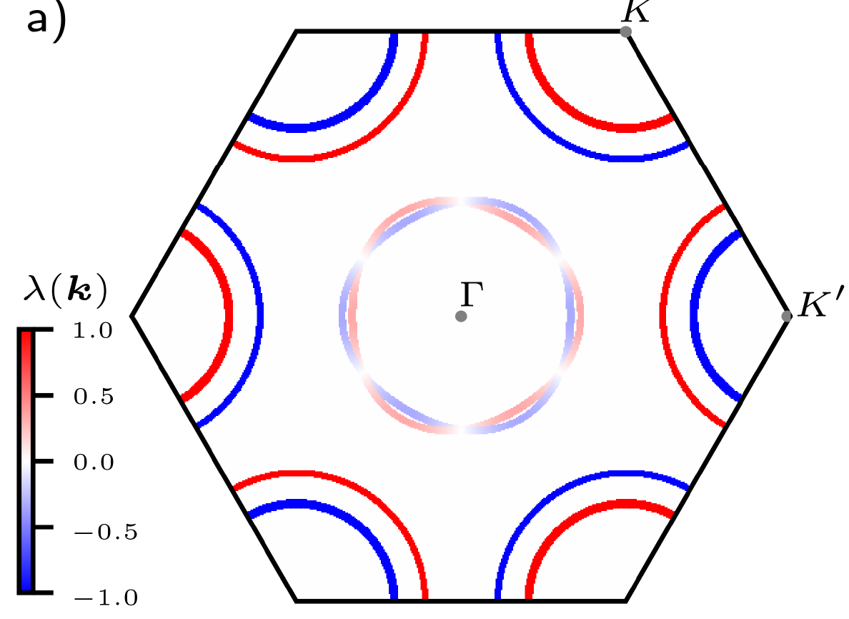



Upper critical field and pairing symmetry in 2D Ising superconducting materials
TIDES, 16 July 2026
Lena Engström
LPS Orsay, Université Paris-Saclay
L. Engström, L. Zullo, T. Cren, A. Mesaros, and P. Simon, Upper critical field and pairing symmetry of Ising superconductors, 2025, Physical Review Letters 135, 236004
L. Engström, A. Mesaros, and P. Simon, Upper critical field in few-layer Ising superconductors, 2026, arXiv: 2602.14210

Slide 2
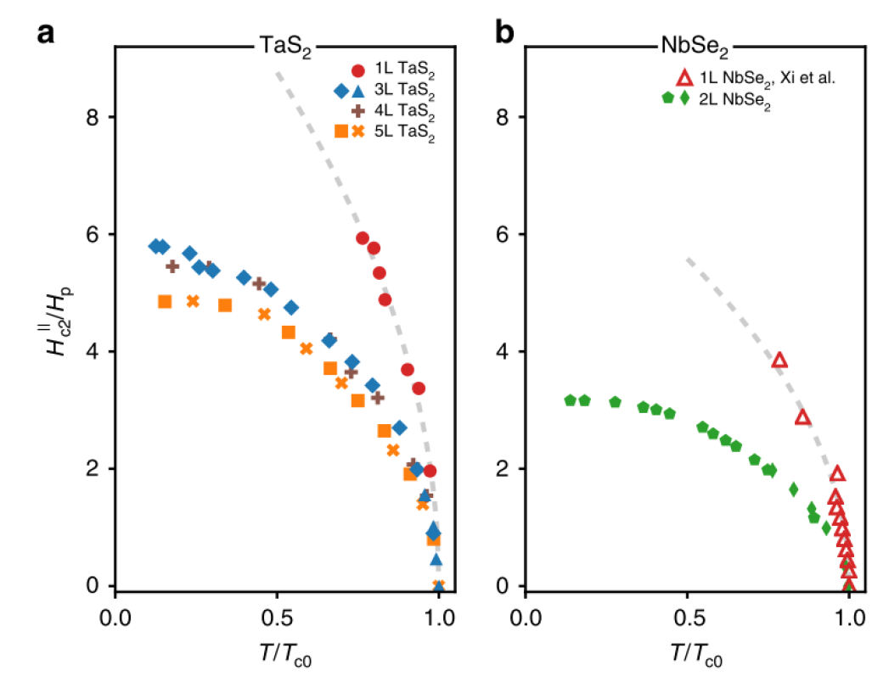
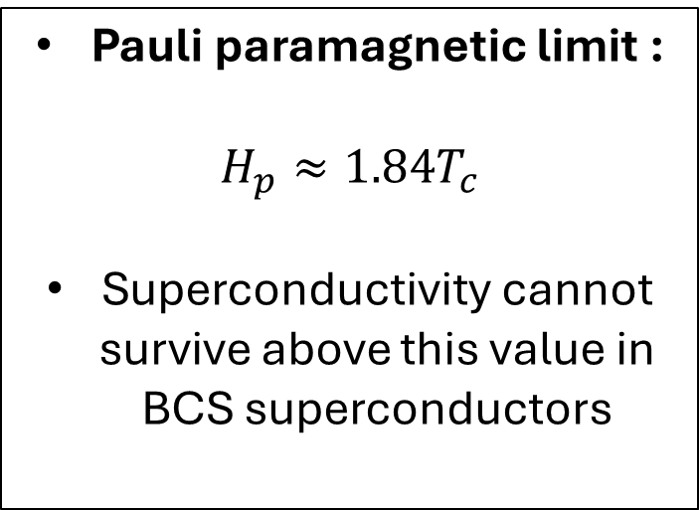

Upper critical field of a superconductor
BCS superconductor
Pauli paramagnetic limit :
$$H_{p}≈1.84T_{c}$$
Superconductivity cannot survive above this value in BCS superconductors
$${\vec{H}}_{ext}$$
Cooper pair breaking
de la Barrera et al., 2018, Nature Comm.
Upper critical magnetic field

Slide 3

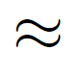
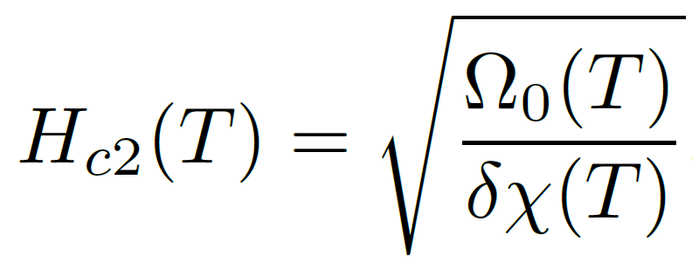
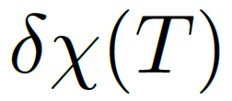

Upper critical field
Where Ω is the thermodynamic potential
At the critical field H_{c2}:
Near T=T_{c,} H_{c2} is small enough to expand Ω :
Condensation energy:
Susceptibility difference:
Clogston, 1962
Chandrasekhar, 1962
Frigeri, Agterberg & Sigrist, 2004
Sigrist, Avella & Mancini, 2009

Slide 4
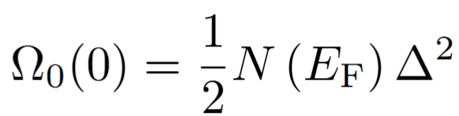
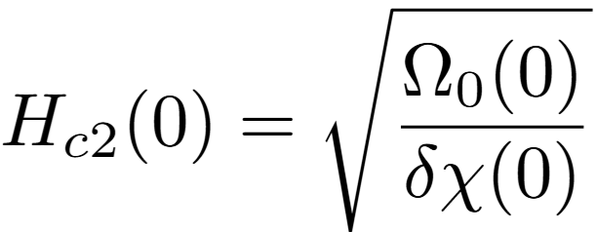

Upper critical field of a s-wave superconductor
Paramagnetic limit: Clogstone Chandrasekar
Condensation energy:
Δ = superconducting gap
Ν(Ε) = density of states
Susceptibility difference:
Pauli susceptibility of the normal state
Pauli limit
Clogston, 1962
Chandrasekhar, 1962
$$H_{c2}=\sqrt{\frac{n\left(E_{F}\right)Δ^{2}}{2δχ}}$$
More generally:

Slide 5
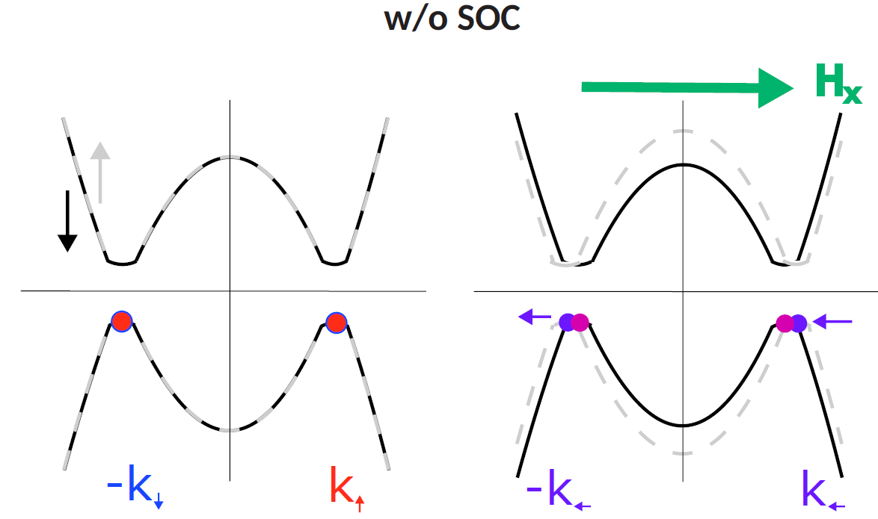
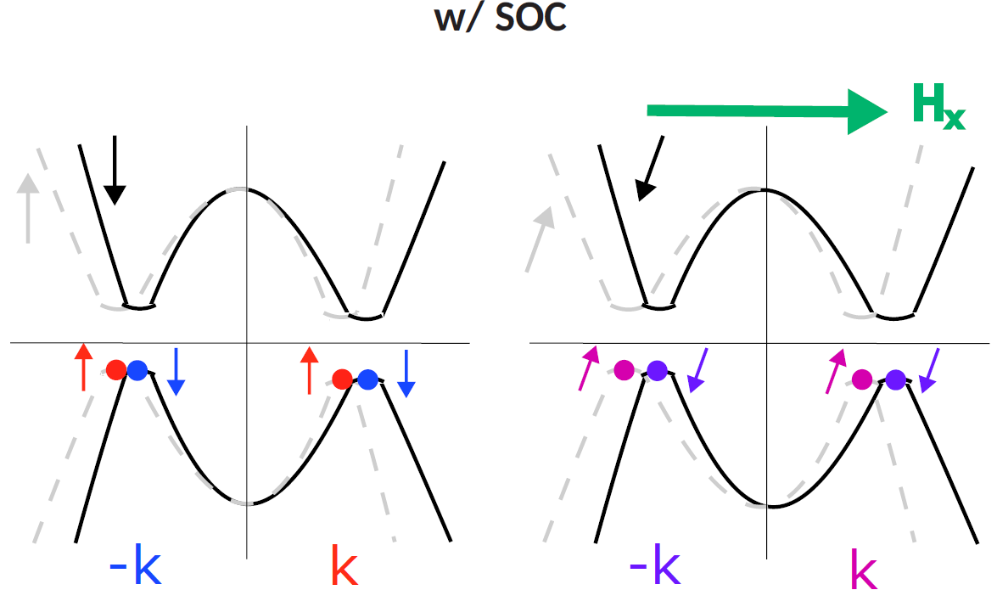
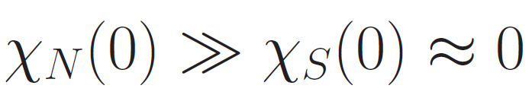
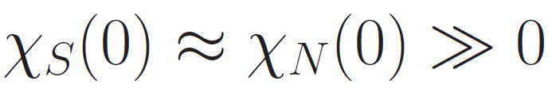
Effect of the spin-orbit coupling
Singlet:
Triplet:
Singlet:
Triplet:
Möckli & Khodas, 2020
Ilić, Meyer & Houzet, 2023

Slide 6
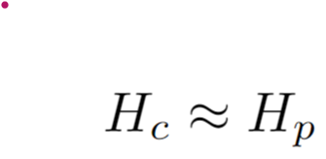

Expansion in Δ of the susceptibility
Regular singlet superconductor (spin-degenerate normal state)
Triplet superconductor, (spin-degenerate normal state)
Singlet superconductor on spin-split normal state
Can be calculated analytically for parabolic bands

Slide 7
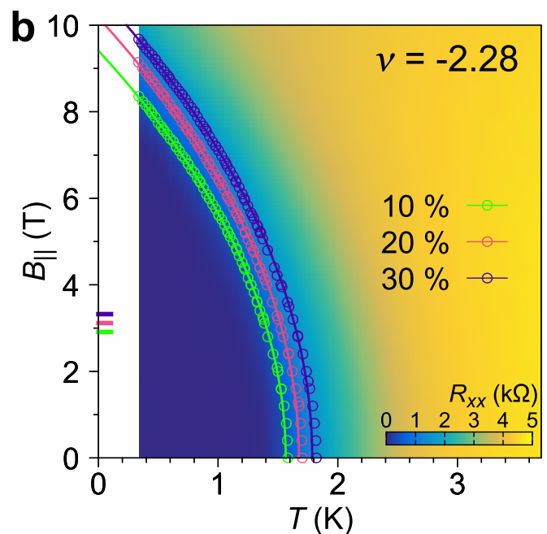
Hc > Hp : indicator of pairing symmetry ?
e.g. tTLG
H_{p} [T] = 1.86 T_{c} [K], is proportional to ∆₀=1.76 T_{c}
Cases where H_{c} > H_{p} :
Triplet pairing
Strong coupling
Spin-orbit coupling (SOC)
H_{c} affected by e.g. disorder, but carries information about the pairing symmetry in few-layer compounds
Cao, Y., Park, J.M., Watanabe, K. et al. Nature 595, 526–531 (2021)

Slide 8
Ising superconductors

Slide 9
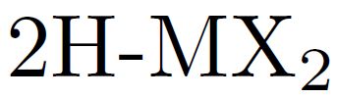
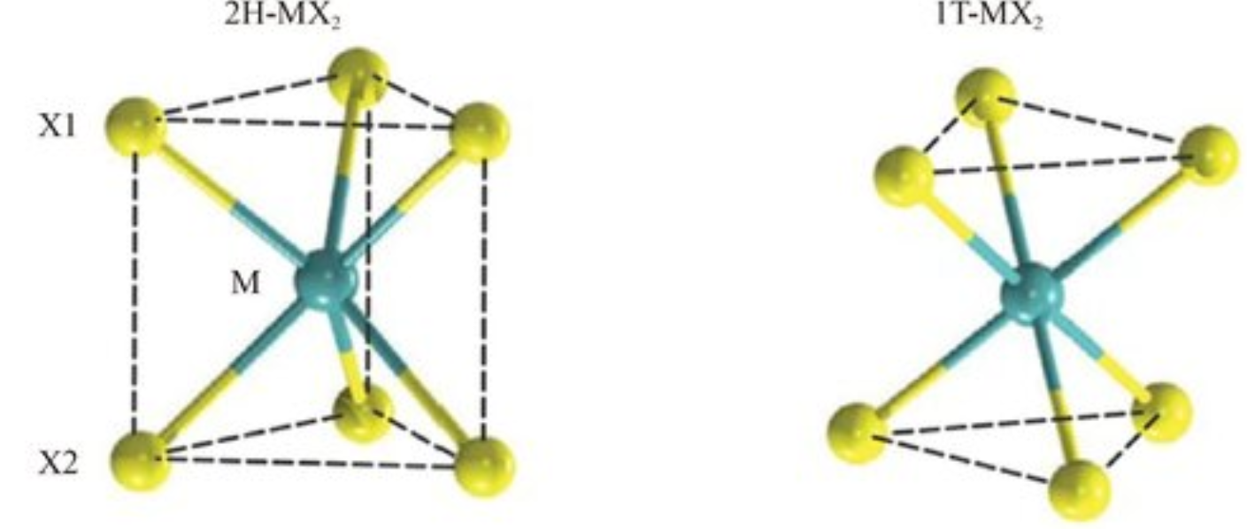
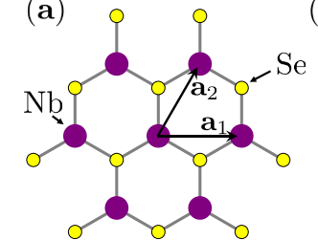


Transition Metal Dichalcogenides (TMDs)
Series of compounds
Zheng et al., Front. Phys. 18, 53603 (2023)
, Te
Inversion symmetry breaking
Ising SOC
Inversion symmetry
Stacked quasi-2D layers:
Semimetals, insulators, CDW, superconductivity
Unconventional order:
Predicted to be mixed-parity, triplet, and/or topological
Haim et al. 2022, PRB.105.024515

Slide 10
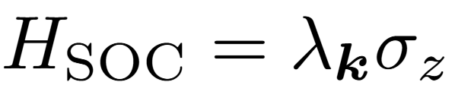

Ising spin-orbit coupling
’
Out-of-plane (z) spin-polarization
Ising spin-orbit coupling
Spin-polarized bands

Slide 11
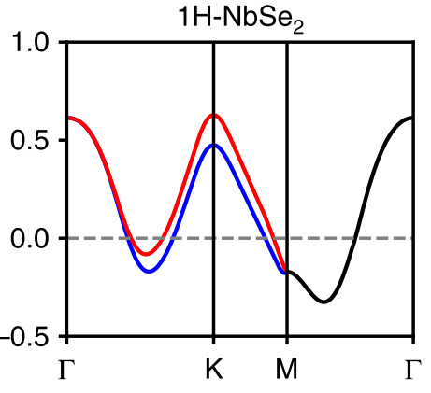

Ising spin-orbit coupling
’
Spin-polarized bands

Slide 12
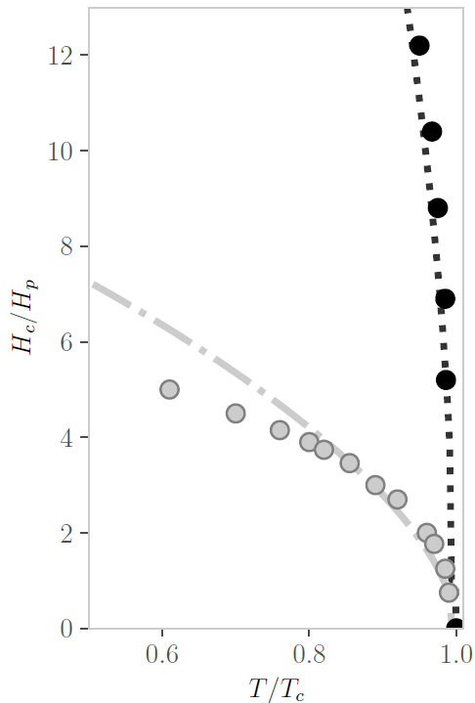
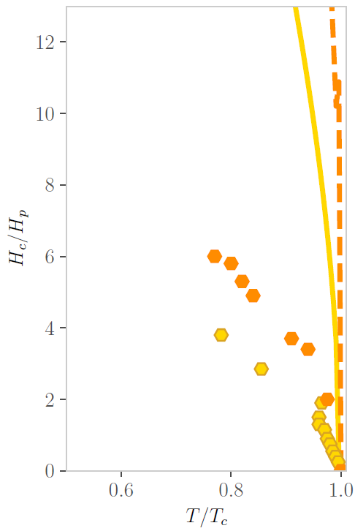
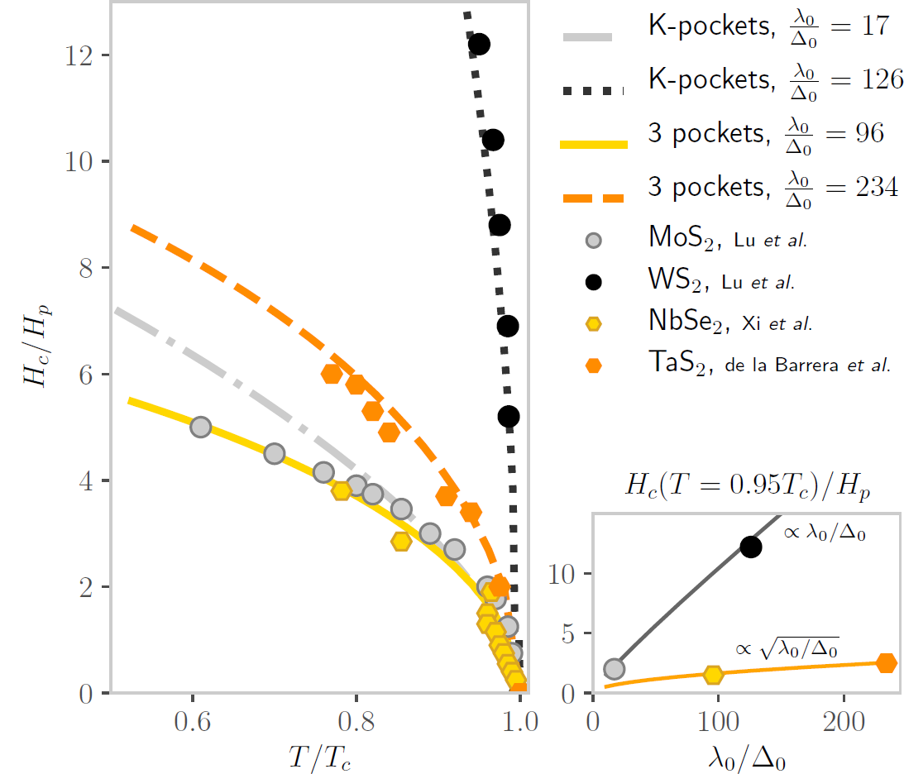
Experimental data (mono-layer)
de la Barrera et al., 2018 (Nature Comm.)
Xi et al., 2016 (Nature Physics)
Lu et al., 2015 (Science), Lu et al., 2018 (pnas)

Slide 13
Experimental data (mono-layer)
The compounds have the same symmetries and vary by doping
main difference: pocket at Г or not
de la Barrera et al., 2018 (Nature Comm.)
Xi et al., 2016 (Nature Physics)
Lu et al., 2015 (Science), Lu et al., 2018 (pnas)

Slide 14
Band structure in monolayer NbSe2
All points at the normal state FS are spin-split (by symmetry) except the 6 nodal points:
At these point the system is a conventional singlet superconductor
The susceptibility difference can be signficantly larger

Slide 15
Assuming uniform spin-singlet
Strategies
Compare models:
1. Only K-pockets: bands are split by a constant SOC
2. 3 pockets: one Г-pocket with nodes and K-pockets
Both numerical integration and an effective model for the Γ−pocket
Also compare to spin-triplet pairing

Slide 16
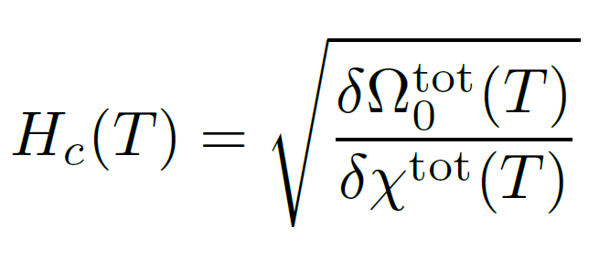
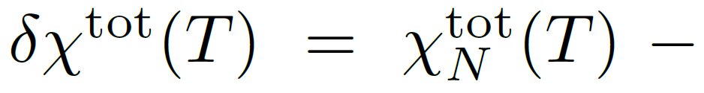
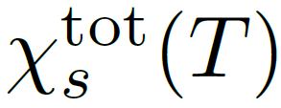
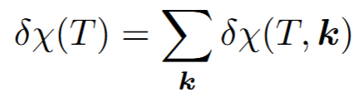

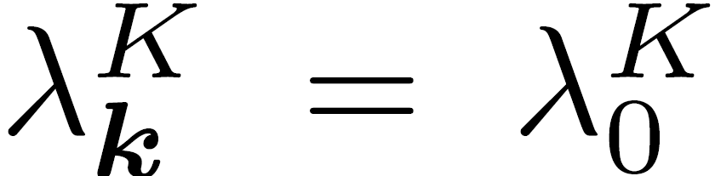
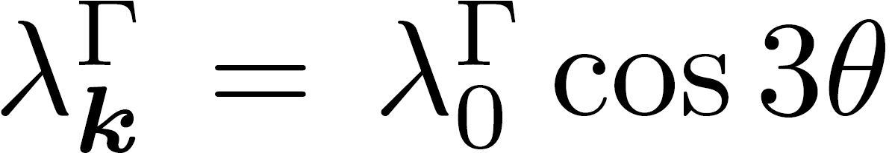
Effective model description
Assumptions:
Parabolic bands
SOC per pocket :
Compare spin singlet and spin triplet pairing

Slide 17
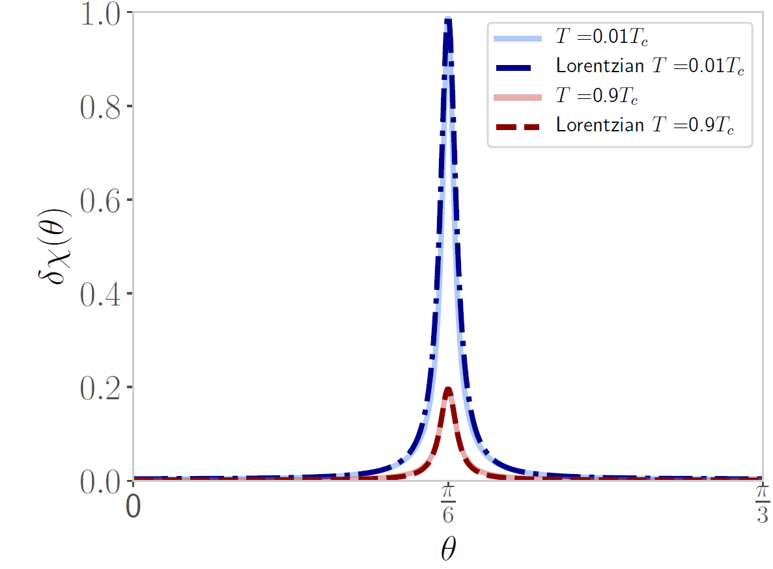
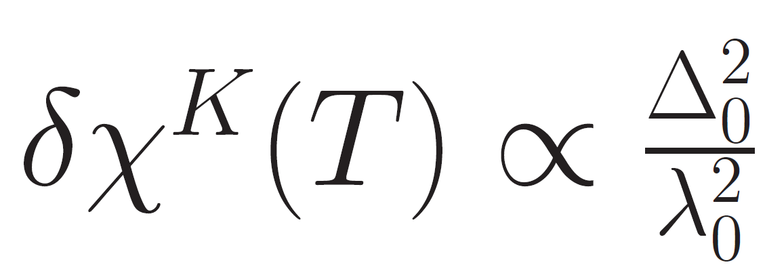
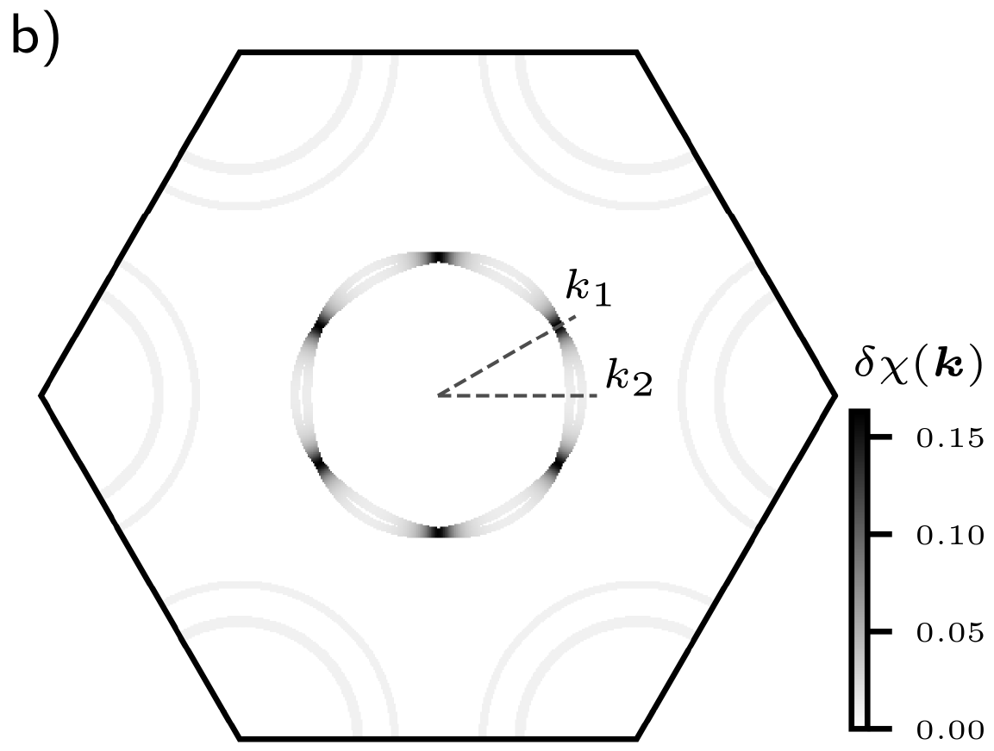
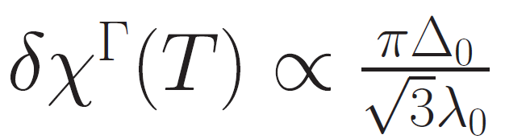
Г-pocket K-pockets
Contribution from the different bands
L. Engström, et al., Physical Review Letters 135, 236004 (2025)

Slide 18
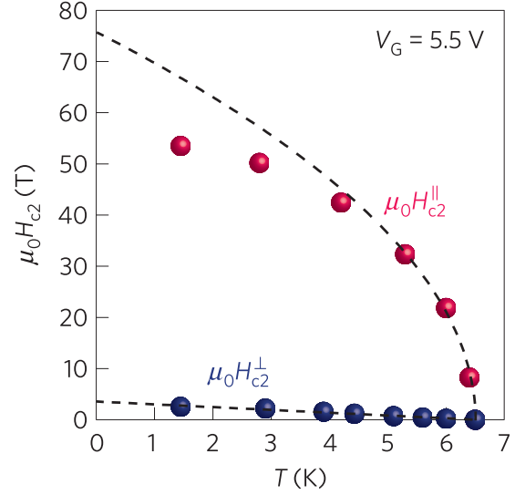
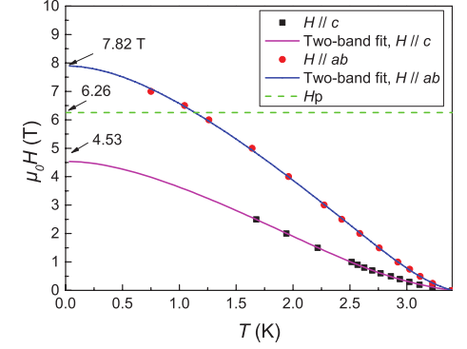
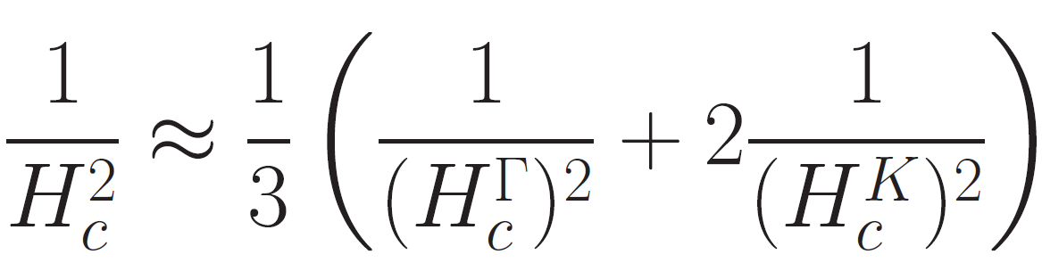
One gap:
Multi-pocket system
Two gaps:
If:
Temperature dependence at H=0 is equal for all pockets
There is only one H_{c} of the system
solving self-consistently the gap equations
inter-pocket intra-pocket interactions
The H_{c} of the multi-pocket system is:

Slide 19
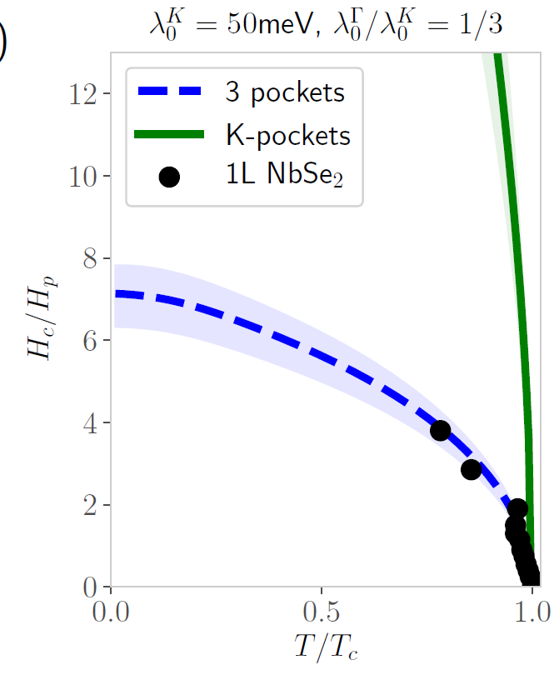

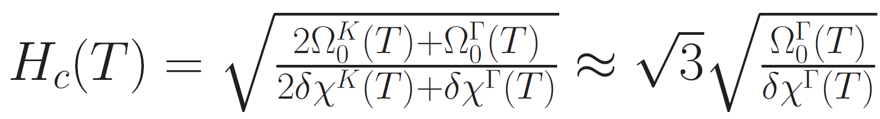
Application to NbSe2
For NbSe₂:

Slide 20
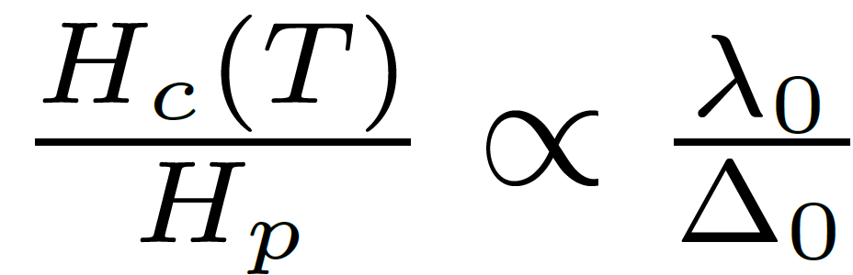
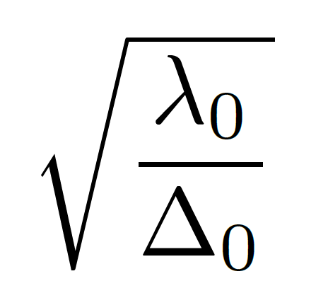
Application to NbSe2
For NbSe₂:
Only K-pockets:
Including the Г-pocket:
L. Engström, et al., Physical Review Letters 135, 236004 (2025)

Slide 21
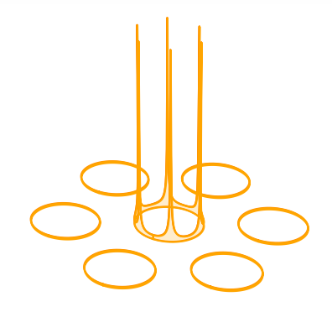
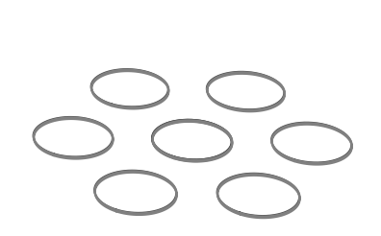
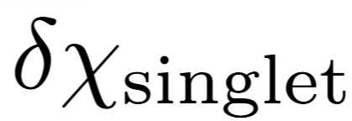
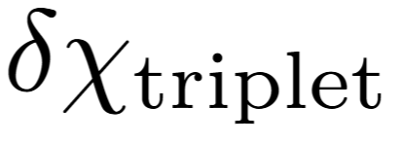
Singlet vs triplet
The upper critical field is lowest for the least exceptional
scenario (no band splitting, singlet pairing).
L. Engström, et al., Physical Review Letters 135, 236004 (2025)

Slide 22
Pairing symmetry in monolayers
For a singlet:
Sqrt scaling with SOC
Г-pocket limits H_{c}
For a triplet:
Nodal SOC points don’t affect H_{c}
Cannot generate sqrt scaling
Singlet at Г-pocket explains the data of 1H-NbSe₂ & 1H-TaS₂
Only consistent with some predicted orders:
Wickramaratne et al., PRX 10, 041003 (2020)
Möckli & Khodas, PRB 101, 014510 (2020)
Siegl et al., arXiv:2412.00273
Shaffer et al., PRB 101, 224503 (2020)

Slide 23
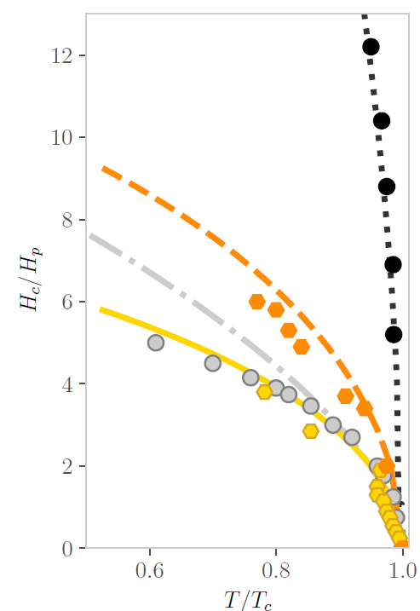
Comparison with data
Model parameters from ARPES and STM:
Nakata et al. npj 2D Mater Appl 2, 12 (2018)
Kuzmanović et al., PRB.106.184514 (2022)
de la Barrera et al., 2018 (Nature Comm.)
Xi et al., 2016 (Nature Physics)
Lu et al., 2015 (Science), Lu et al., 2018 (pnas)
L. Engström, et al., Physical Review Letters 135, 236004 (2025)

Slide 24
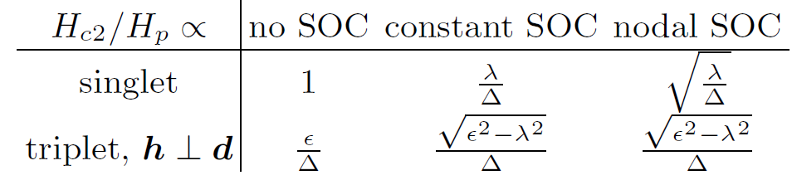
Comparison with data
Model parameters from ARPES and STM:
Nakata et al. npj 2D Mater Appl 2, 12 (2018)
Kuzmanović et al., PRB.106.184514 (2022)
Using values from experiment of SOC and order parameter we closely predict the curves (w/o incl. disorder)
Unique scaling with SOC for a spin-singlet
L. Engström, et al., Physical Review Letters 135, 236004 (2025)

Slide 25
Scaling of Hc2 for NbSe2 with doping
L. Engström, et al., Physical Review Letters 135, 236004 (2025)

Slide 26
Multi-layer TMDs

Slide 27
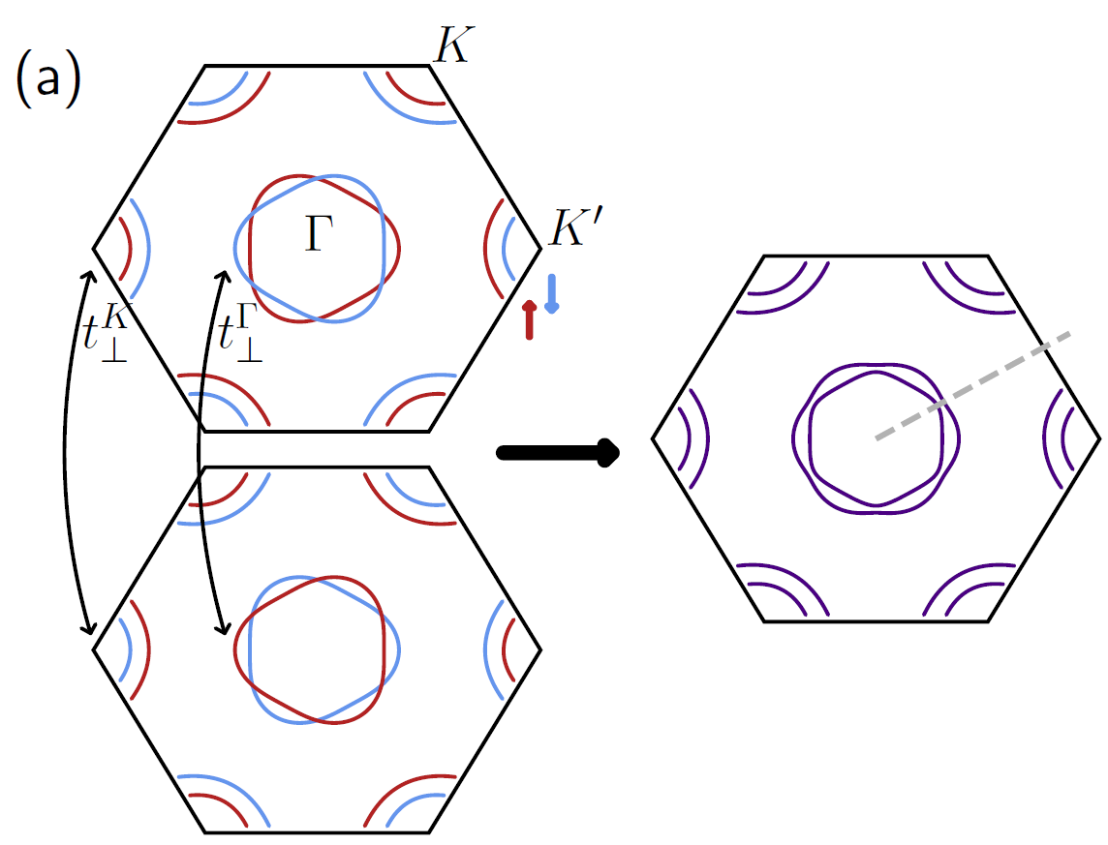

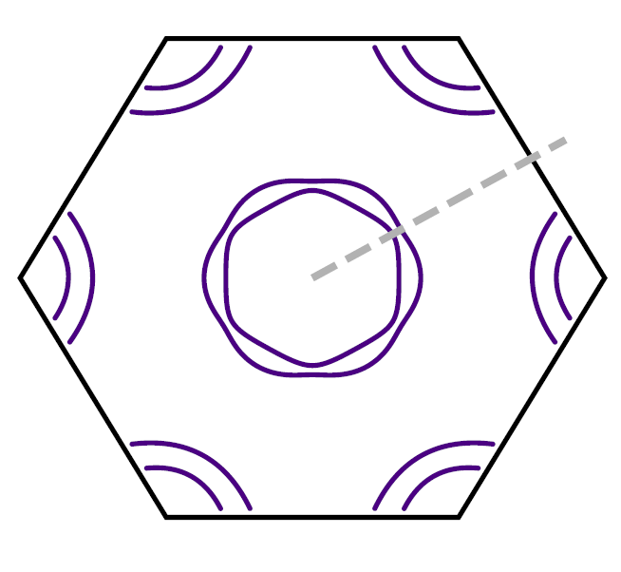
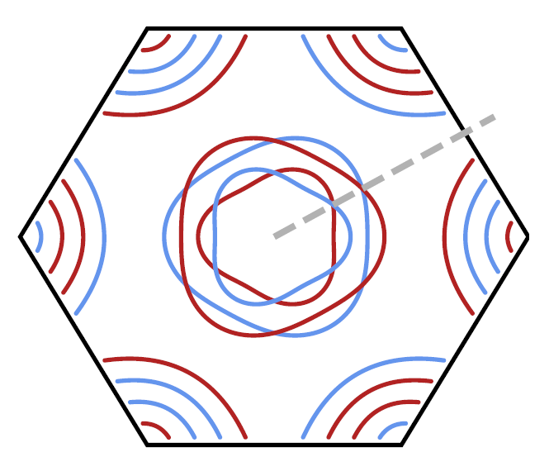
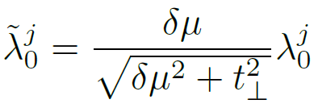


Bilayer NbSe2 with inversion symmetry breaking
→ spin
→ layer
Around nodes
For an intralayer spin-singlet:
L. Engström, A. Mesaros, P. Simon, arXiv:2602.14210

Slide 28
Comparison to data of bilayer TMDs
L. Engström, A. Mesaros, P. Simon, arXiv:2602.14210

Slide 29
Scaling of Hc2 with interlayer potential
L. Engström, A. Mesaros, P. Simon, arXiv:2602.14210

Slide 30
Summary
Summary
At SOC nodes:
signature difference between singlet and triplet pairing is large
Г-pocket:
Explains monolayer data
Necessary to describe multilayer data
Scaling of H_{c2} as a way
to narrow down possible pairing symmetry, incl. misfits, Moiré, TMD heterostructures ?
L. Engström, et al., Physical Review Letters 135, 236004 (2025)
L. Engström, A. Mesaros, P. Simon, arXiv:2602.14210

Slide 31






People
Andrej Mesaros
Ludovika Zullo
Tristan Cren
Lena Engström

Slide 32




Pairing symmetry
Phonon and/or spin fluctuations (Das et al., 2023)
Hsu et al., Nat. Com. s8 (14985) (2017)
Theoretical predictions:
Mixed parity
Induced triplet under field
Nematicity
Topological nodal superconductor under field
k
Wickramaratne et al., PRX 10, 041003 (2020)
Möckli & Khodas, PRB 101, 014510 (2020)
Siegl et al., arXiv:2412.00273
Shaffer et al., PRB 101, 224503 (2020)
-k

Slide 33




Mixed parity
Even with a large triplet component the mixed state response is dominated by that of the singlet component
with
L. Engström, A. Mesaros, P. Simon, arXiv:2602.14210

Slide 34


Beyond uniform singlet
Mixed parity, e.g. s+ f or p+ip + d+id
Nodal singlet
Topological nodal singlet
Purely triplet
Purely nematic
In NbSe₂, Cho et al., PRL 129.087002 (2022)

Slide 35

Few-layers: up to N=5
L. Engström, A. Mesaros, P. Simon, arXiv:2602.14210

Slide 36







Susceptibility
Pauli: from FS
Van Vleck: from band splitting
For singlet order

