Slide 1

Thickness tunes everything:
Superconductivity in the H-TMD family
Hadar Steinberg
Racah institute of Physics, Hebrew University, Jerusalem
TIDES, Paris, 16.7.2026
Notes:
The story I will present to you is embodied in these 2 graphs, recently published in two papers. Both represent a different effect where thickness tunes the fundamental properties of exfoliated superconductors.

Slide 2
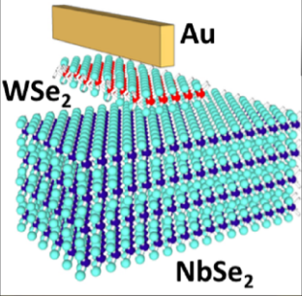
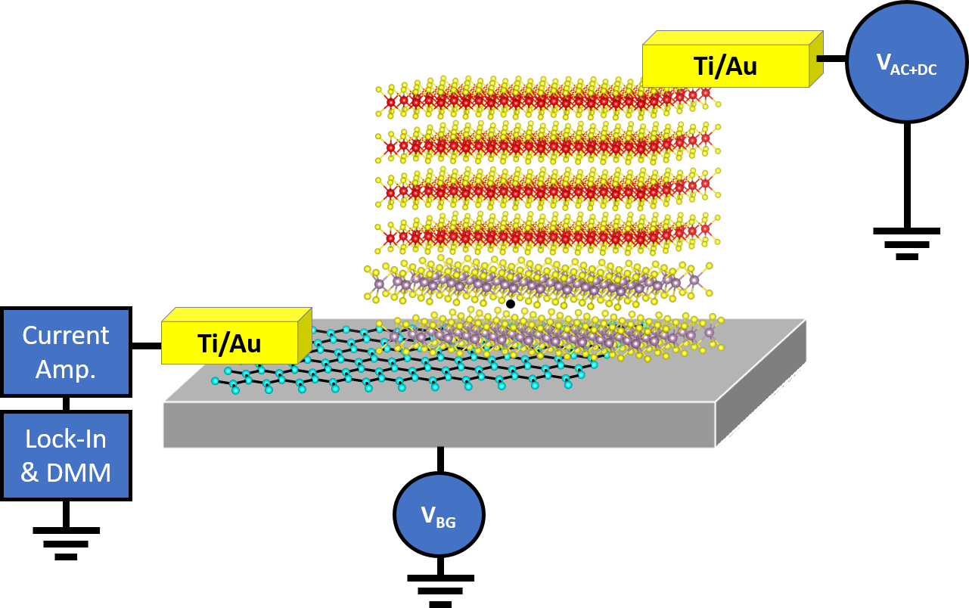
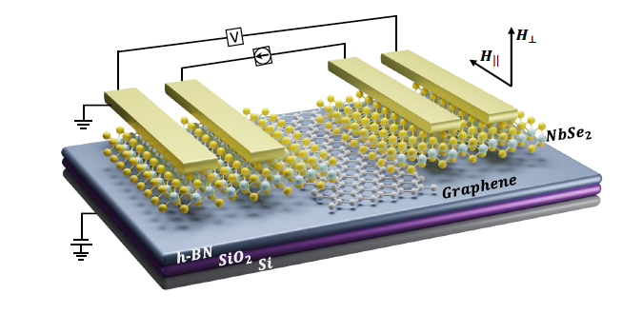
Steinberg Lab: 2D Superconducting Devices
NbSe₂:
Dvir et al., Nat. Comm. 9, 598 (2018)
Dvir et al., Nano Lett. 12, 7845 (2018)
Alpern et al., Nano Lett., 19, 5167 (2019)
M. Kuzmanovic et. al., PRB 106, 184514 (2022).
FeTe_{0.55}Se_{0.45}:
Zalic et al., PRB 100, 064517 (2019).
TaS₂:
S. Simon et al., Nature Comm., 15, 10439 (2024).
Dvir et al., PRL 123, 217003 (2019)
Keren et al., Nat. Comm. 11, 3048 (2020)
Devidas et al., Nano Lett. 21, 16, 6931 (2021)
M. Quincke et al., ACS Applied Nano Materials, 5, 8, 11429 (2022).
Devidas et al., PRB 107, 094502 (2023)
Fyhn et al., PRB 102, 024510 (2020)
Dvir et al., PRB 103, 115401 (2021)
Zalic et al, Nano Letters 23, 6102 (2023)
Grynszpan et al., 2D Materials, 12, 041004 (2025).

Slide 3
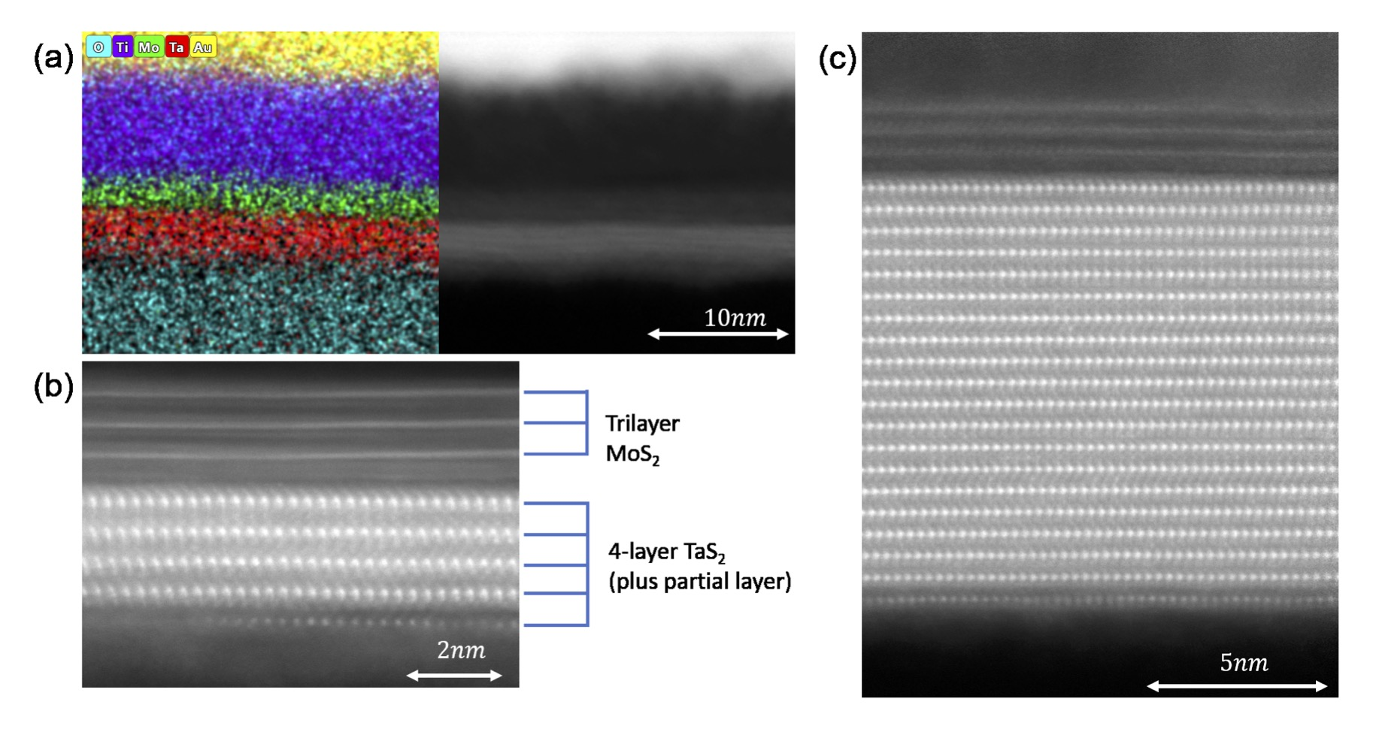
VdW Systems: A Laboratory for Thickness Control
4L, 20L TaS₂. Shahar Simon, M. Sc. Thesis

Slide 4
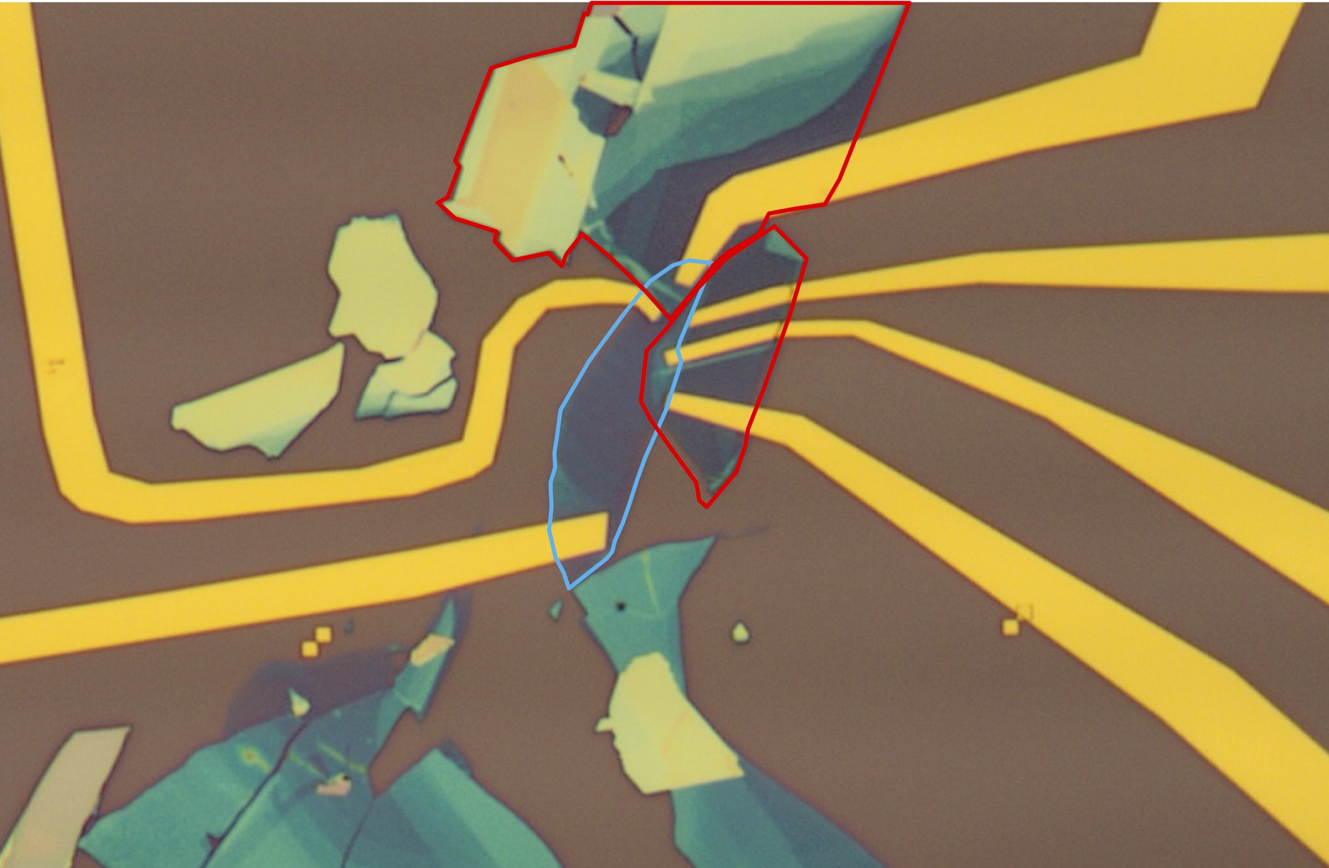
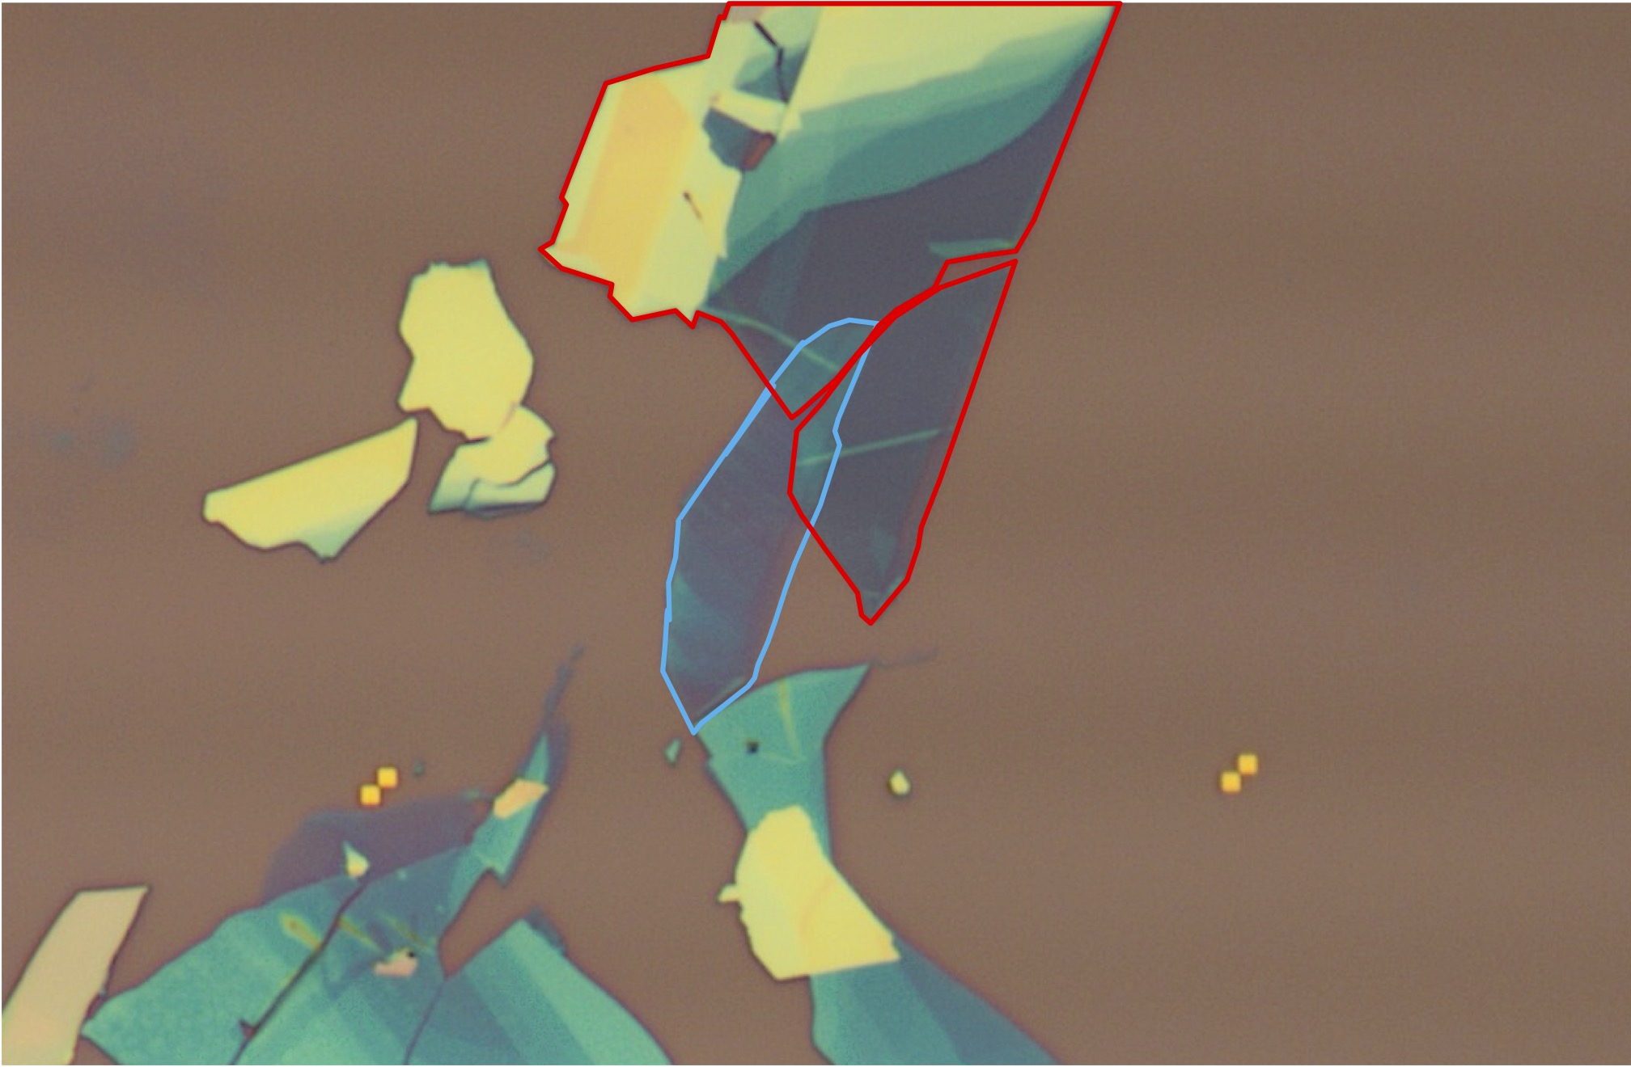
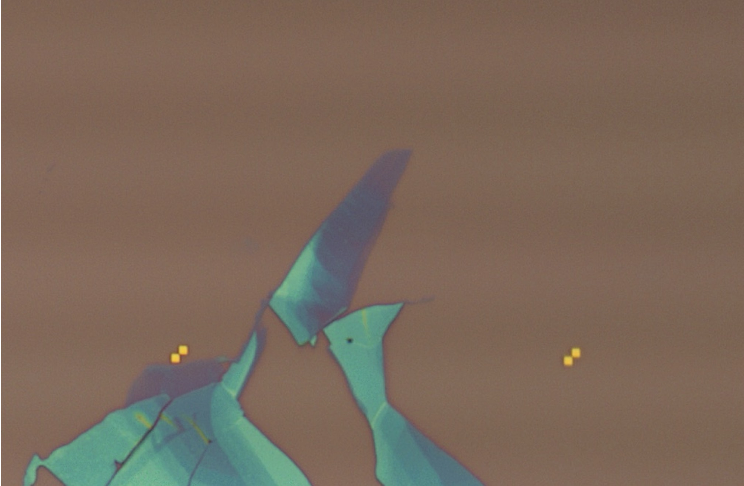


Tunnel Junction Fabrication and Architecture
Trilayer MoS₂
Superconductor on substrate
Semiconductor on superconductor
Contacted tunnel junction
$$2nm$$
4-layer TaS₂
(plus partial layer)
Image: Atzmon Vakahi, Sergei Remennik, HUJI center for nanoscience and nanotechnology
$$50μm$$

Slide 5
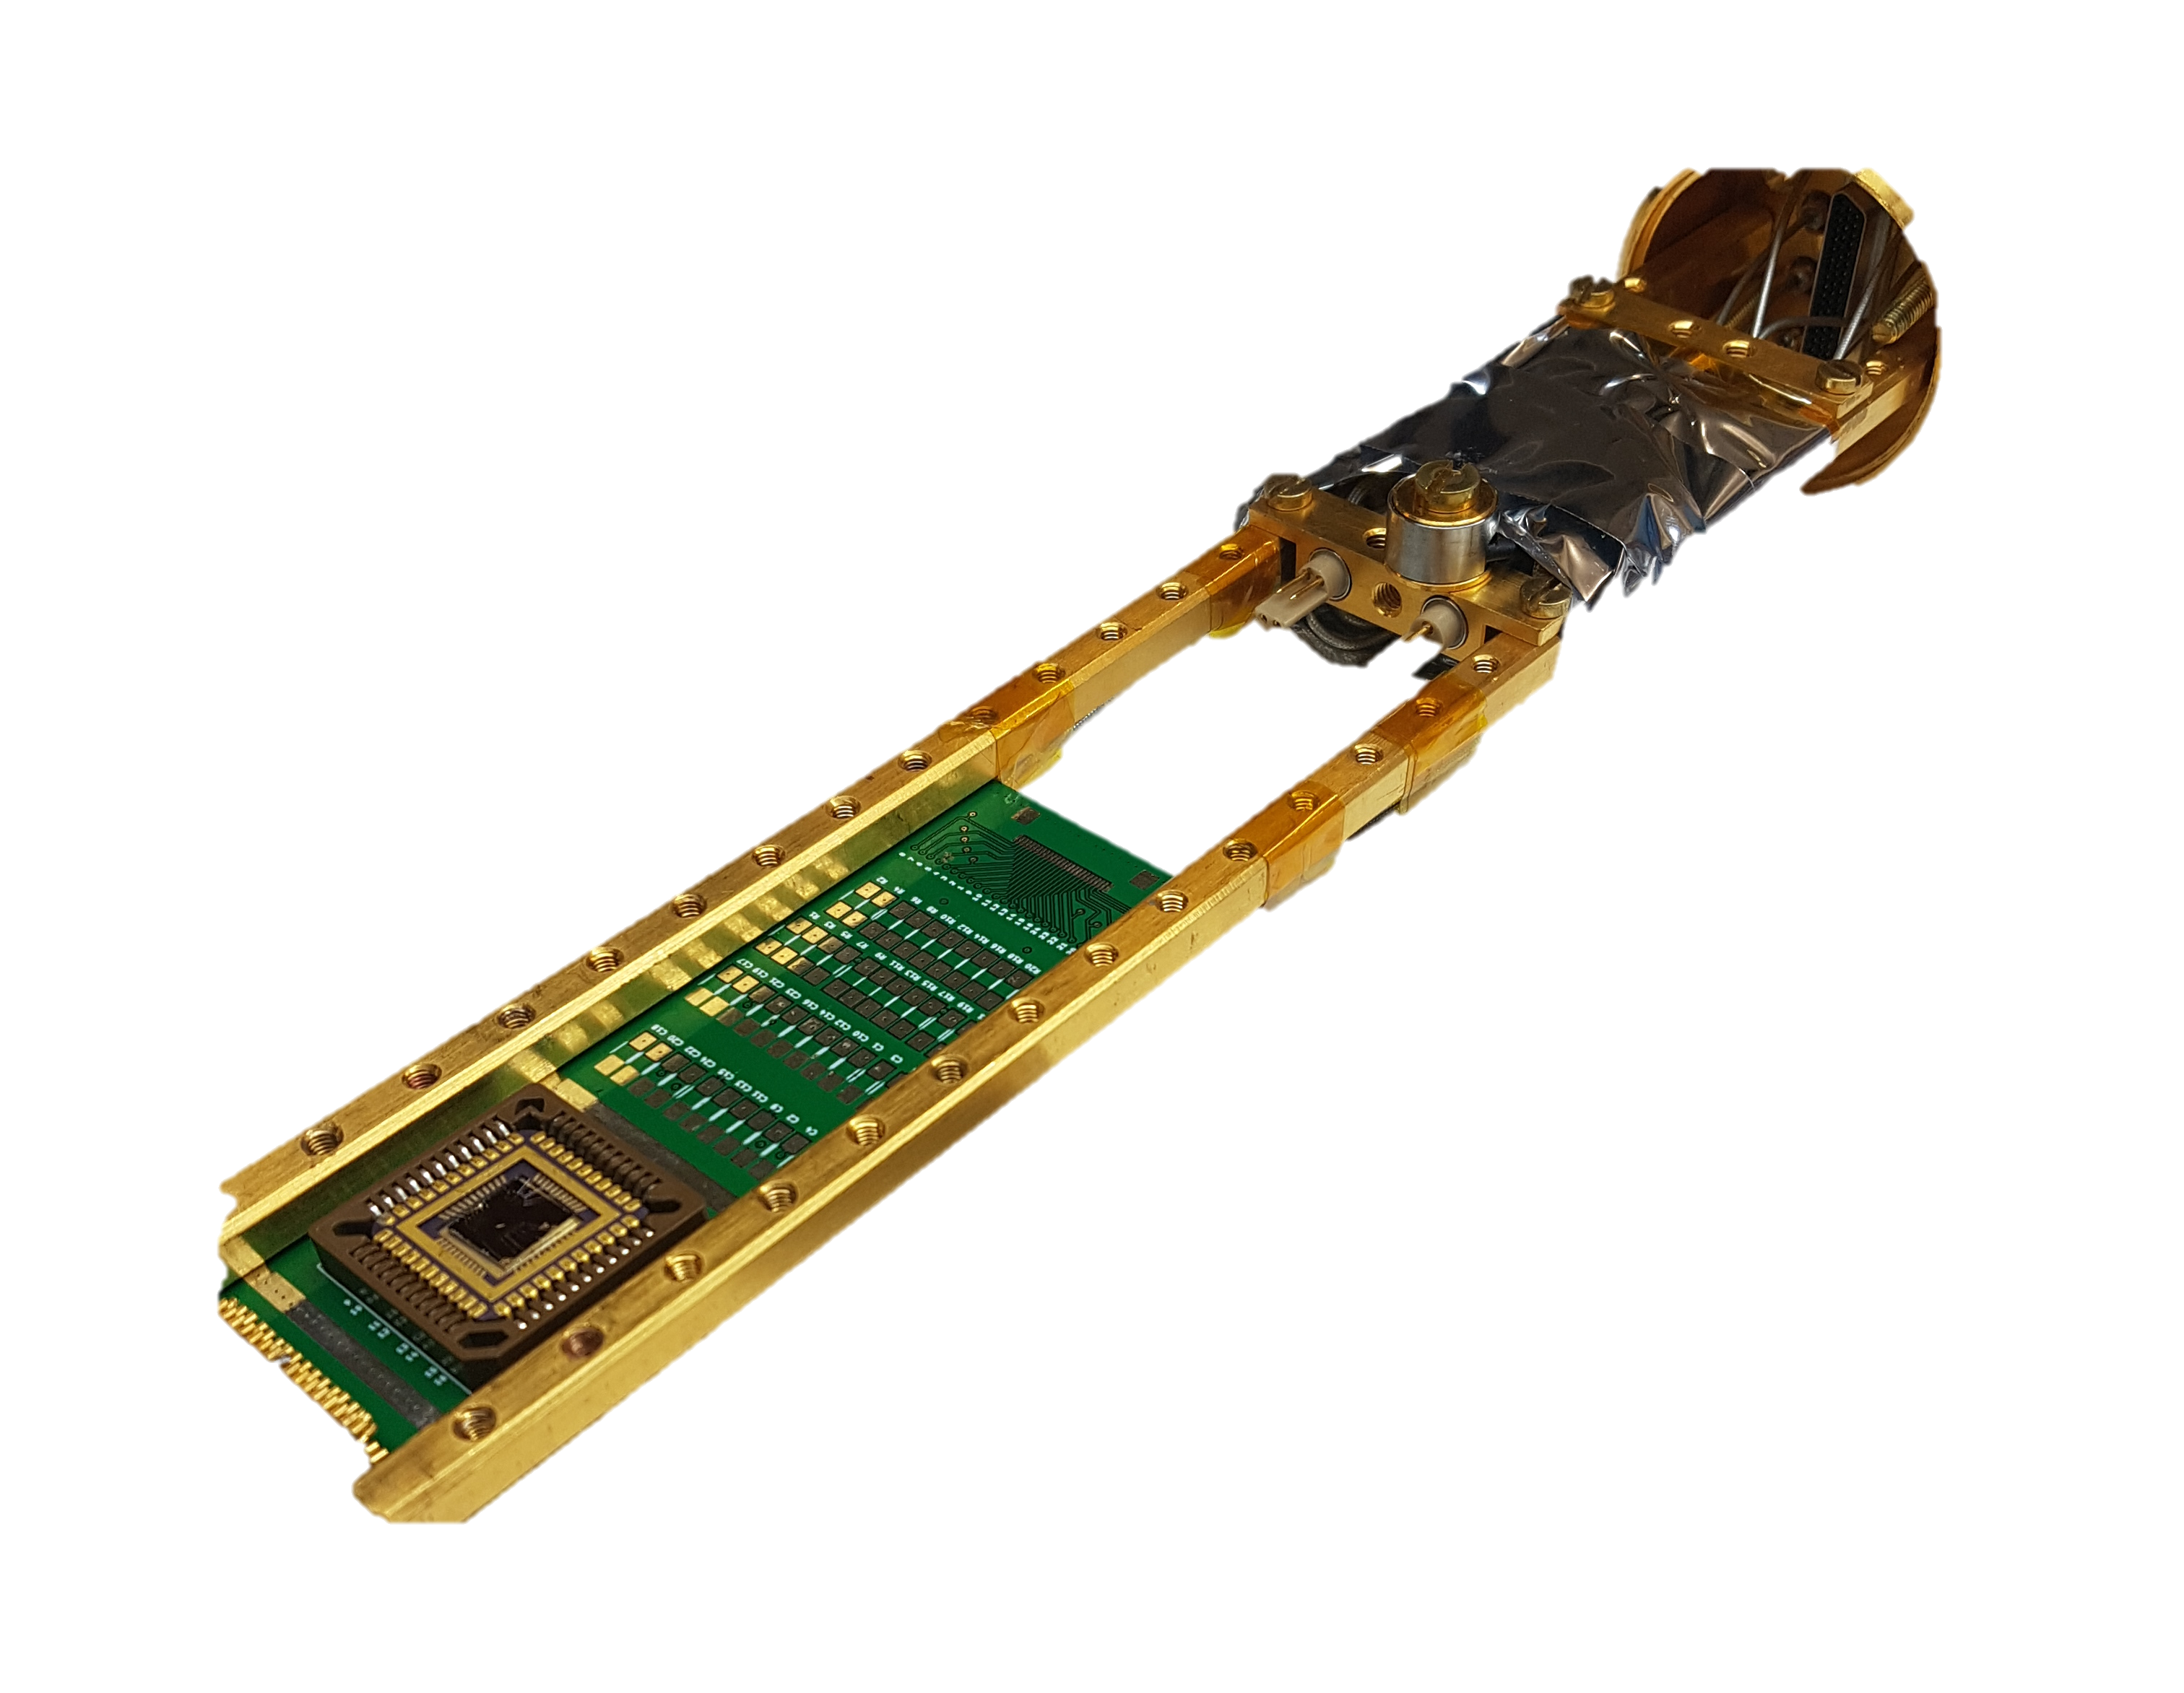
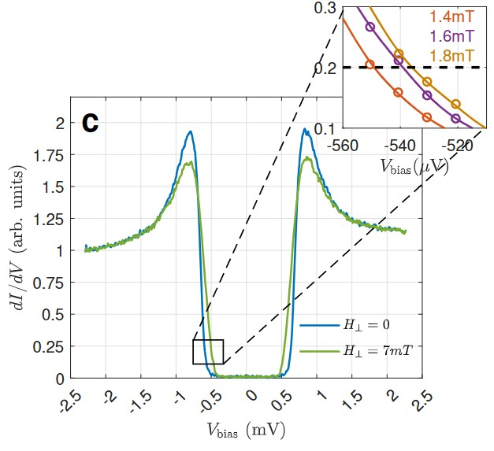
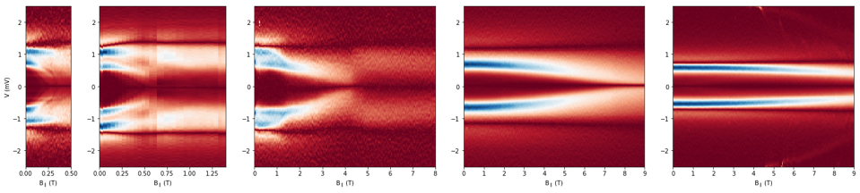
VdW Tunneling at mK Temperatures
Effective filtering
High in-plane field
Transport + Tunneling
Very fine energy precision (few µeV)
Sensitivity to depairing processes
Tunneling
electrodes

Slide 6


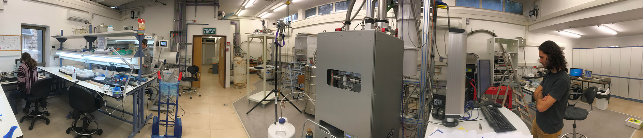

Tunneling Project: The People
Experiment: Tunneling
Shahar Simon
Tom Dvir
Saclay: Charis and friends
Theory
Jonathan Ruhman
Hennadii Yerzhakov
Maxim Khodas
Discussions
Oded Millo
Amit Kanigel
Materials
Sajilesh K. P.

Slide 7
TMD: Inversion Symmetry Broken Layers
TMD = Transition Metal Dichalcogenide
B_{SO}
k
𝛆 (crystal field)
D. Möckli, M. Khodas, PRB 98, 144518 (2018)

Slide 8
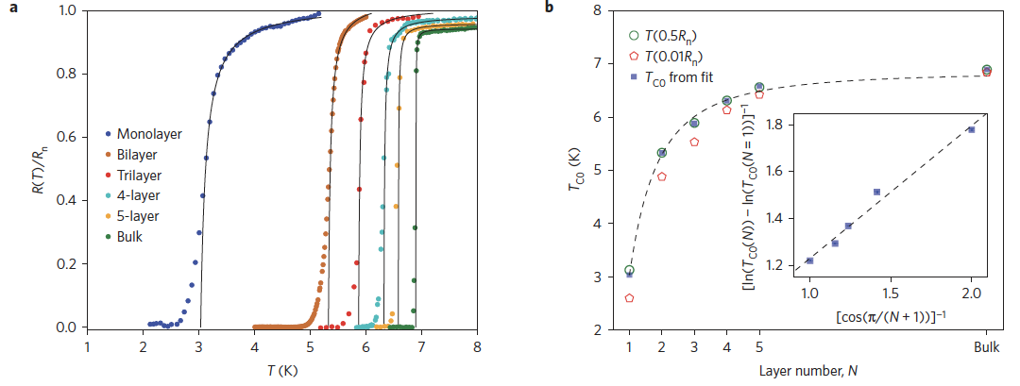
Tc vs Number of Layers
NbSe₂
KF Mak Group, Nat. Phys. 12, 139 (2016)
Theory (YBCO): “interlayer coupling enhances superconductivity”
Schneider et al., EPL 14, 261 (1991).

Slide 9
TMDs: Ising Superconductivity
TMD = Transition Metal Dichalcogenide
Xi, X. et al. Nat. Phys. 12, 139 (2016)
Lu et al., Science 350, 1353 (2015)
Saito et al., Nature Phys. 12, 144 (2016)
De la Barrera et al., Nat. Comm. 9, 1427 (2018)

Slide 10
The Many Roles of Thickness:
>20
1. Increase the Ising stability vs. In-plane magnetic field at the thin limit.
15
Number of Layers
10
Ising
5
1

Slide 11
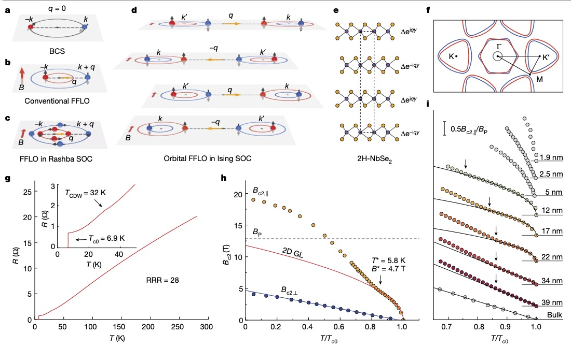
Orbital FFLO in TMD SC
P. Wan et al., Nature (2023)
Morpurgo / Zhang Groups
Lortz Group, Smet Group

Slide 12
The Many Roles of Thickness:
Orbital FFLO
>20
Increase the Ising stability vs. In-plane magnetic field at the thin limit.
Onset of orbital FFLO at finite thickness.
15
Number of Layers
10
Ising
5
1

Slide 13
NbSe₂: Two-Bands in In-plane magnetic field
H < H_{C1}: Meissner Current
Note: d < 𝜆, H is uniform
d
H_{C1} < H Vortex Penetration
Effective method to study tunneling at the presence of current
T. Dvir et al., Nature Comm. 9, 598 (2018)
Notes:
A flaky solution ☺
20-50 nm flakes are just think enough to get “bulk” behavior, and thin enough to suspend Hc1 to significant field.
Is there a calculation for an ’ideal’ flake?

Slide 14
Bulk: Depairing at In-plane field
Model
Data
H_{c1}
Orbital Depairing
Large gap: Ballistic
(Fulde, 1965)
Small gap: Diffusive
(Tinkham Ch. 10)
Large Diffusion Const:
Large V_{F}
Kiss et al. Nat. Phys. 3, 720 (2007)
Dvir et al., Nature Comm. 9, 598 (2018)

Slide 15
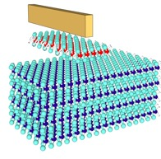
From thick to thin…
T. Dvir et al., Nature Comm. 9, 598 (2018)
M. Kuzmanović, T. Dvir et al., PRB 106, 184514 (2022)
d
Two gap -> One Gap
3 gaps -> 2 Gaps
50 nm
25 nm
20 nm
10 nm
5 nm: 8-10 layers
Thickness effects:
1. Gap decreases in size and becomes immune to field
2. Two (three!) gap structure lost

Slide 16
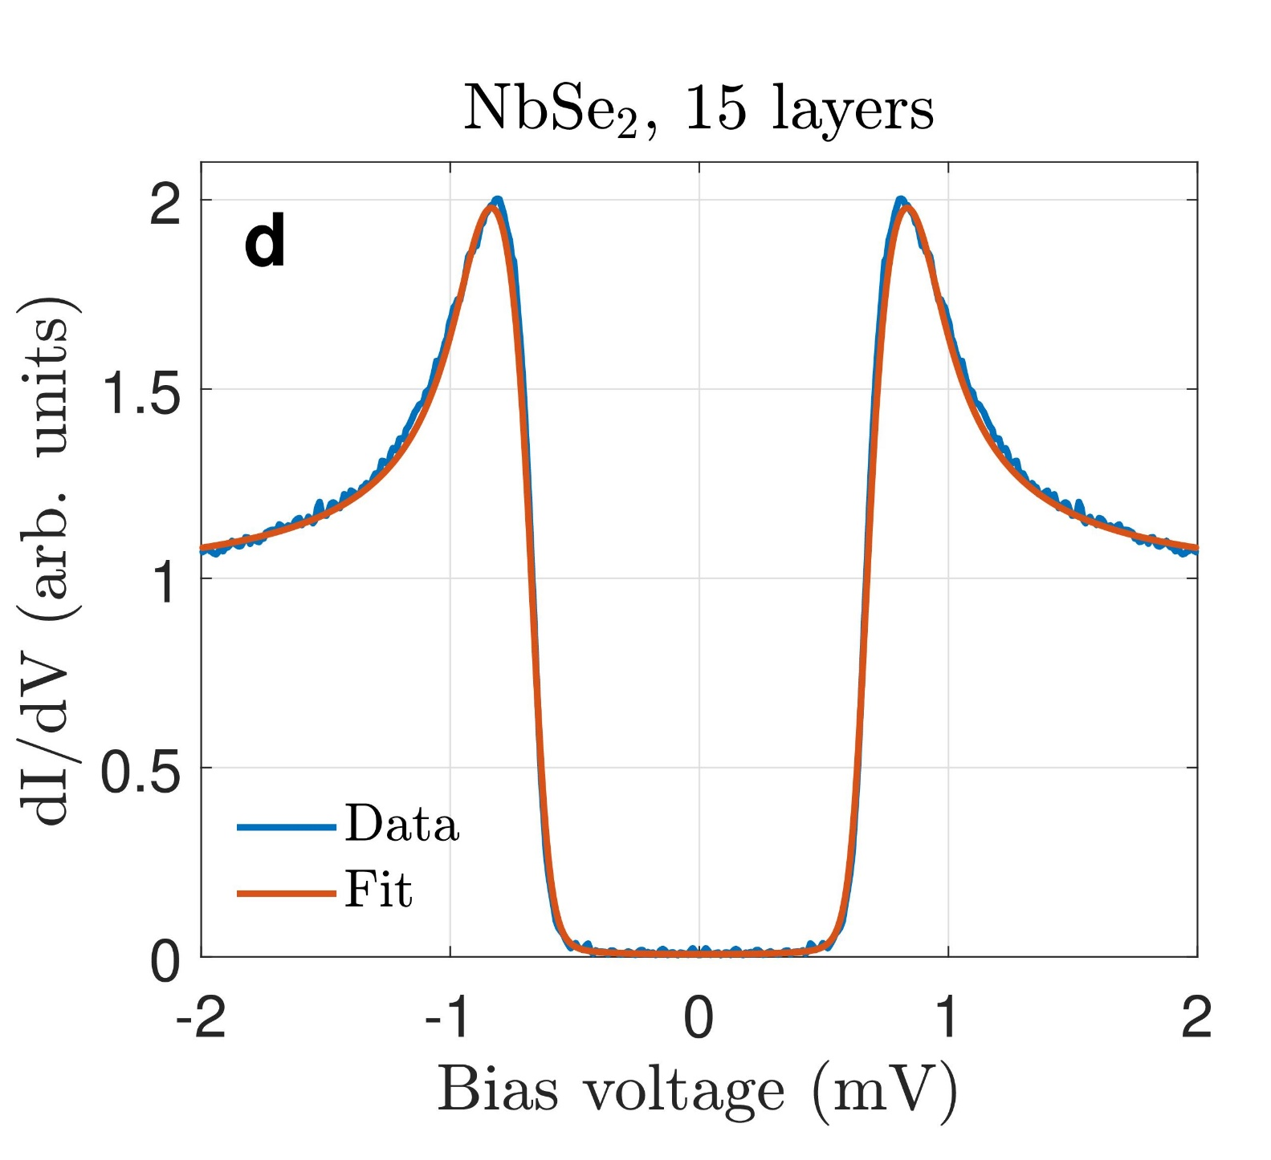
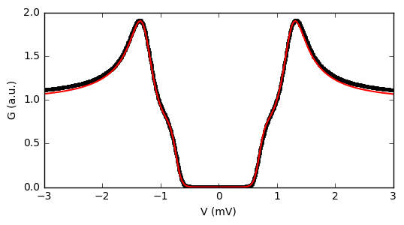
Fitting Multiple Gaps
NbSe₂, 30 Layers
Δ₁ = 1.05 meV
Δ₁ = 1.26 meV
Δ₂ = 0.30 meV
Δ₂ = 0.29 meV
Γ₁₂ = 0.27 meV
Γ₁₂ = 1.35 meV
T. Dvir et al., Nature Comm. 9, 598 (2018)
S. Simon et al., PRL, Acceped for Publication.
McMillan, Phys. Rev. 175, 537 (1968)

Slide 17
The Many Roles of Thickness:
Orbital FFLO
>20
Increase the Ising stability vs. In-plane magnetic field at the thin limit.
Onset of orbital FFLO at finite thickness.
3-band specturm turns to 2-band at the 10-20 nm range.
3 Bands
15
Number of Layers
10
Ising
5
2 Bands
1

Slide 18
Thin NbSe₂ Tunneling at Ultra-High Fields
6 Layers
2 Layers
1.2 K
1.2 K
< 50 mK
< 50 mK
Fit: Abrikosov-Gor’kov theory
Extract Delta
M. Kuzmanović, T. Dvir et al., PRB 2022

Slide 19
The Many Roles of Thickness:
Orbital FFLO
>20
Increase the Ising stability vs. In-plane magnetic field.
Onset of orbital FFLO at finite thickness.
Two-band specturm disappears at the 10-20 nm range.
Putative onset of a triplet component at high in-plane field.
3 Bands
15
Number of Layers
10
Ising + Triplet?
5
2 Bands
1

Slide 20
T_{C} and H_{C2}: Story Gets Complicated
NbSe₂
KF Mak Group, Nat. Phys. 12, 139 (2016)
Theory (YBCO): “interlayer coupling enhances superconductivity”
Schneider et al., EPL 14, 261 (1991).

Slide 21
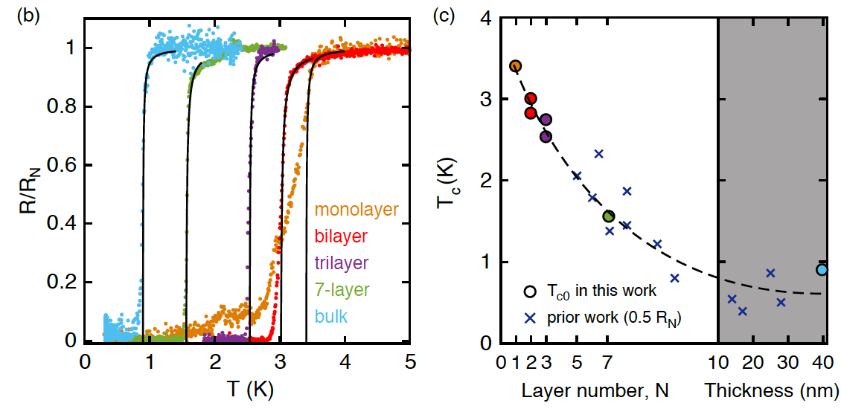
This was NbSe_{2.} Now let’s look at TaS₂
Y. Yang et al., PRB 98, 035203 (2018)
Previous work by E. Navarro-Moratalla et al.
Notes:
Efren: effect of DOS on screening of the Coulomb repulsion

Slide 22
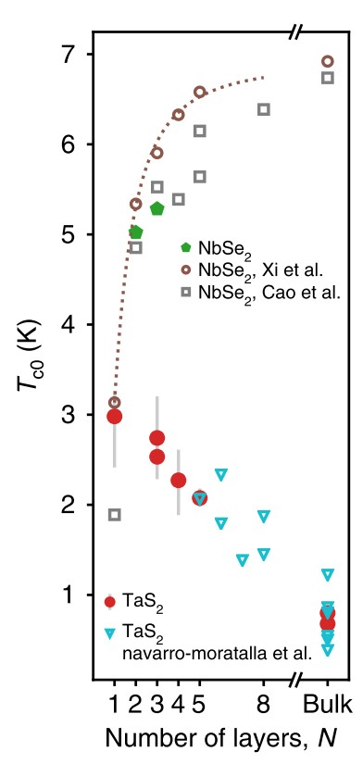
Opposite Response to Thickness
What is the origin of the different thickness response?
The role of CDW could be important
Y. Yang et al., PRB 98, 035203 (2018)
Any relation between the mechanisms?
De la Barrera et al., Nat. Comm. 9, 1427 (2018)

Slide 23
The Many Roles of Thickness:
Increase the Ising stability vs. In-plane magnetic field at the thin limit.
Onset of orbital FFLO at finite thickness.
Two-band specturm disappears at the 10-20 nm range.
Putative onset of a triplet component at high in-plane field.
Change T_{c} – Reduce for NbSe₂, Increase for TaS₂.

Slide 24
Tunneling Spectra of TaS₂
T = 25 mK, Low temperature filters
Hard gap
QP peaks weaker at thicker samples (hanlding?)
Trilayer MoS₂
$$2nm$$
4-layer TaS₂
(plus partial layer)

Slide 25
Temperature Dependence of the Spectrum
When Tc is evaluated using the 95% criterion: Gives good agreement with transport data

Slide 26
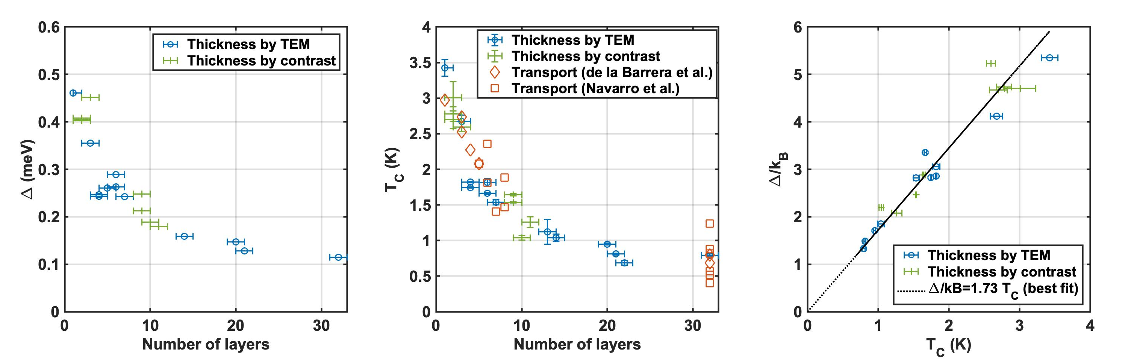
Dependence of T_{c} on Thickness
When Tc is evaluated using the 95% criterion: Gives good agreement with transport data

Slide 27
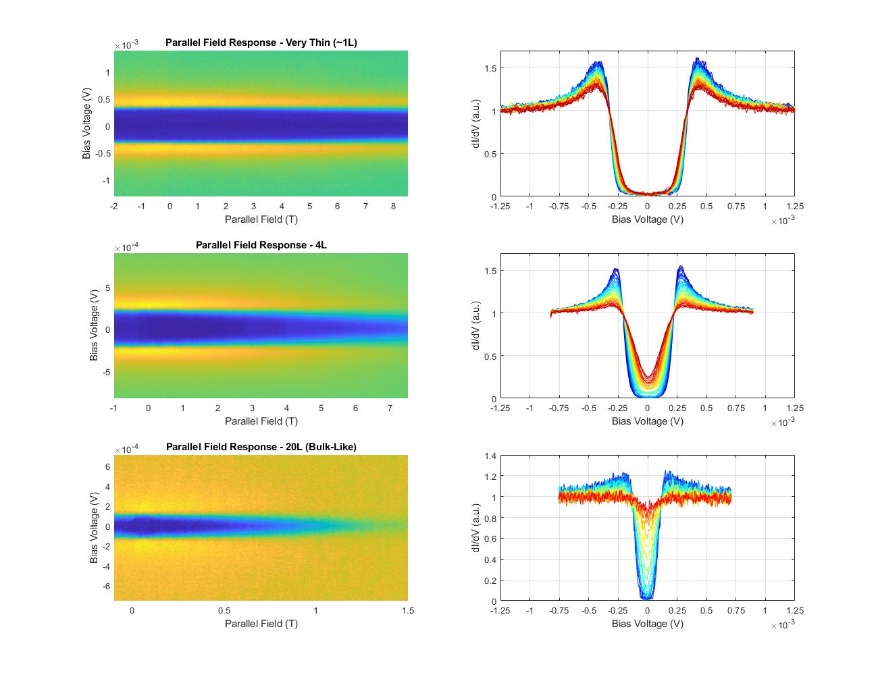
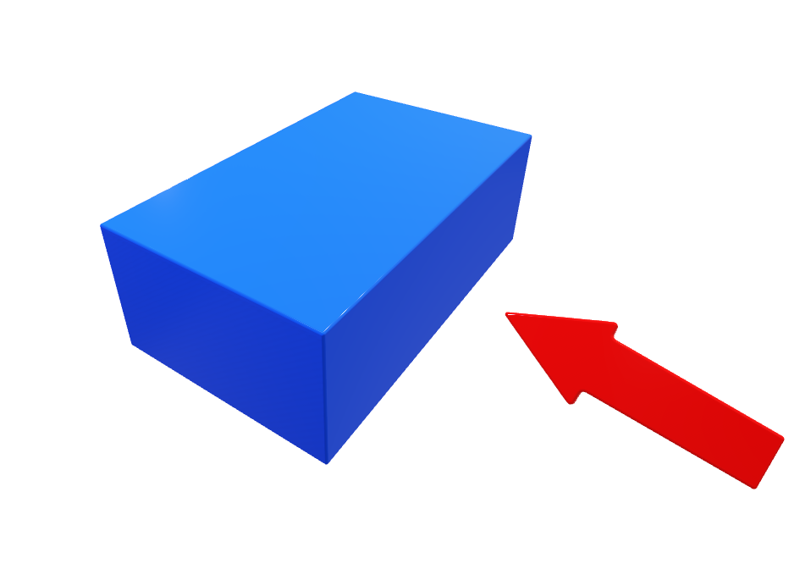

Response to In-Plane Magnetic Field
$$H_{∥}$$

Slide 28
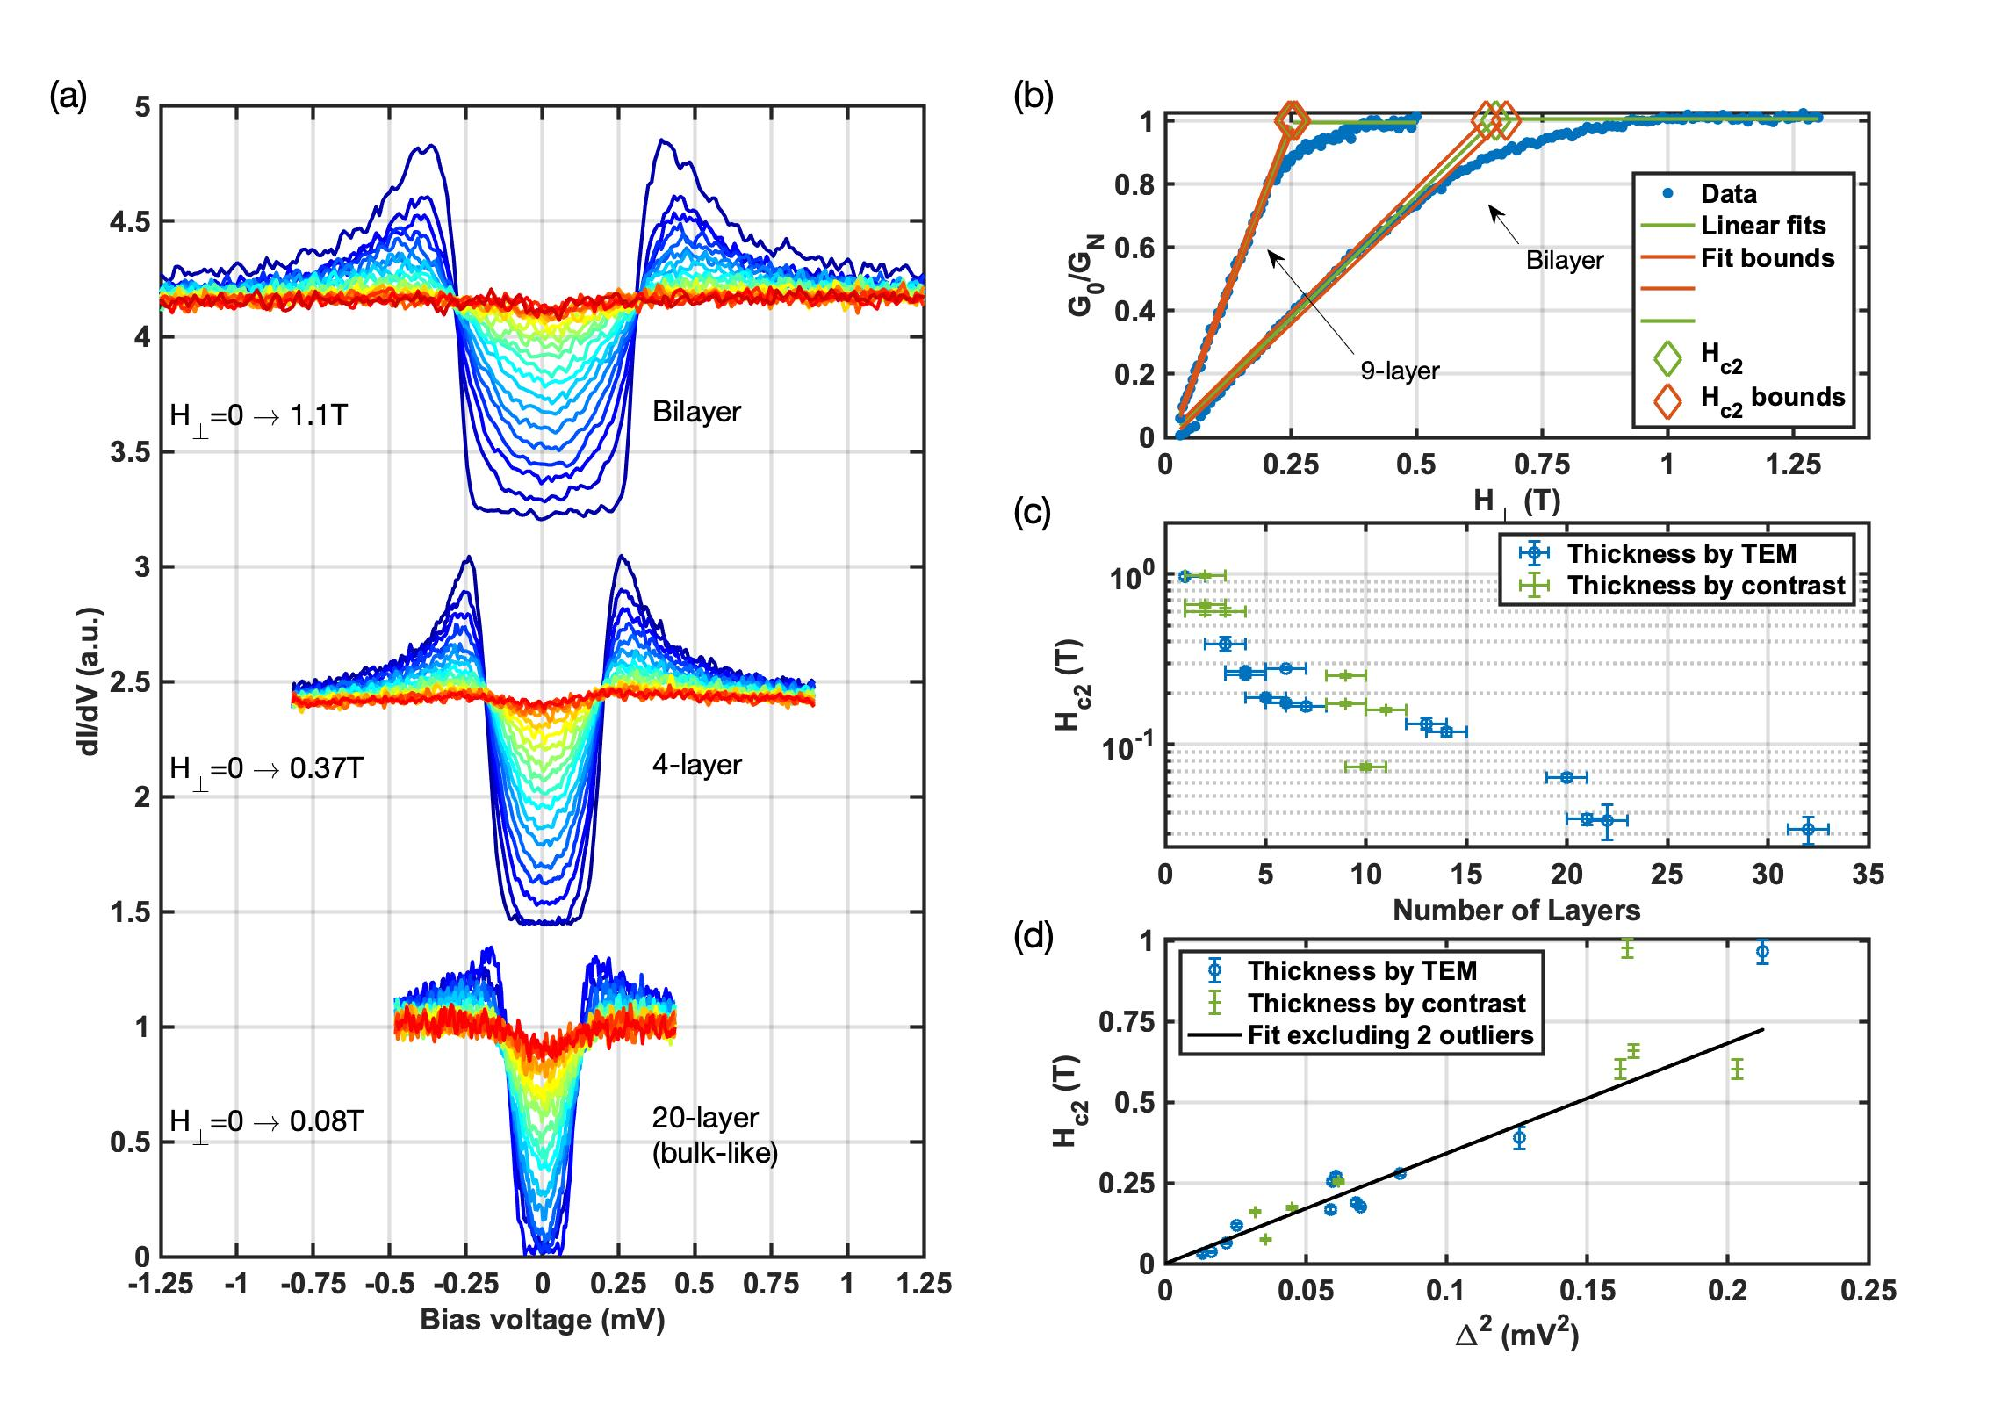
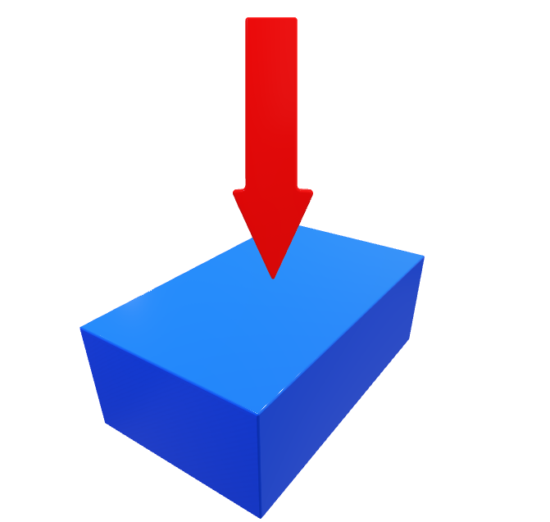

Response to Out-of-Plane Magnetic Field
$$H_{⊥}$$

Slide 29



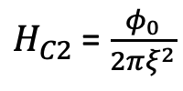
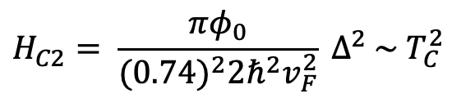
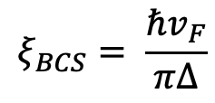
H_{C2} vs. ∆: Clean vs. Dirty limits
Landau Ginzburg:
$H_{C2}$ = $\frac{φ_{0}}{2πξ^{2}}$
In the clean limit:
$$ξ=0.74ξ_{BCS}$$
In the dirty limit:
$ξ=\sqrt{v_{F}lℏ/Δ}$ = $\sqrt{ξ_{clean}l}$
$$ξ_{BCS}= \frac{ℏv_{F}}{πΔ}$$
Where:
$$H_{C2}= \frac{{πφ}_{0}}{{(0.74)}^{2}2ℏ^{2}v_{F}^{2}} Δ^{2} \sim T_{C}^{2}$$
$$H_{C2} \sim ∆$$
So:
We have a problem: TaS₂ is not supposed to be a clean superconductor

Slide 30
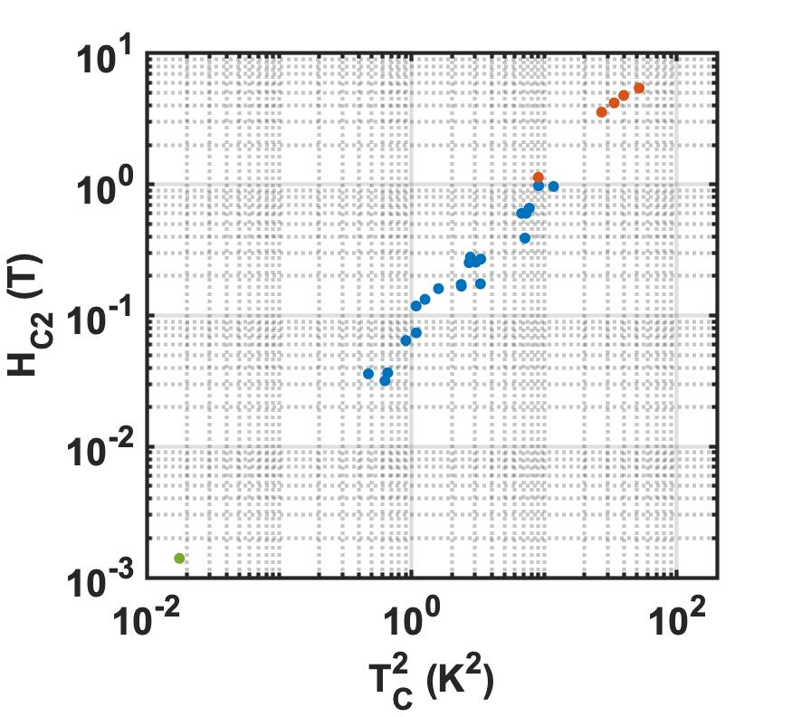
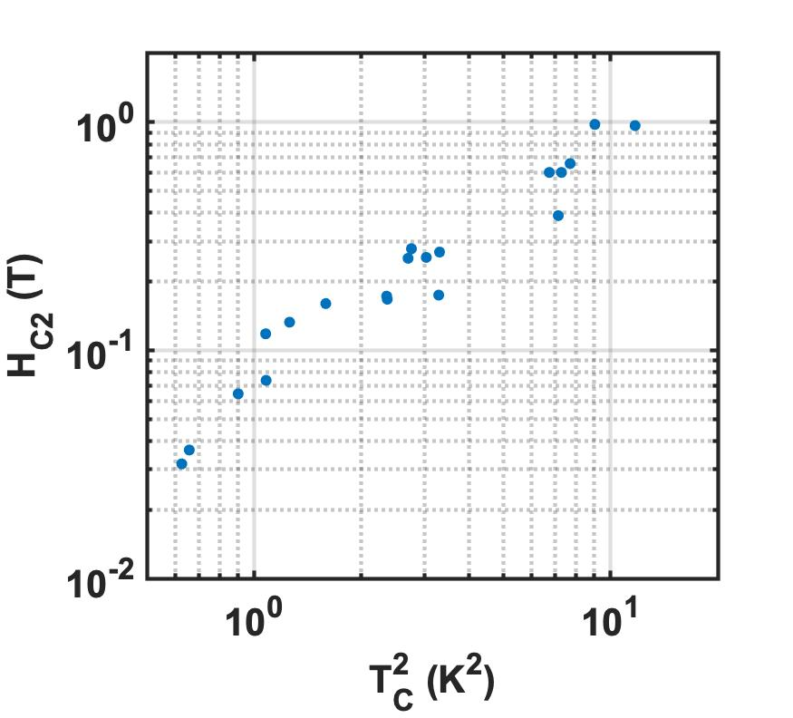
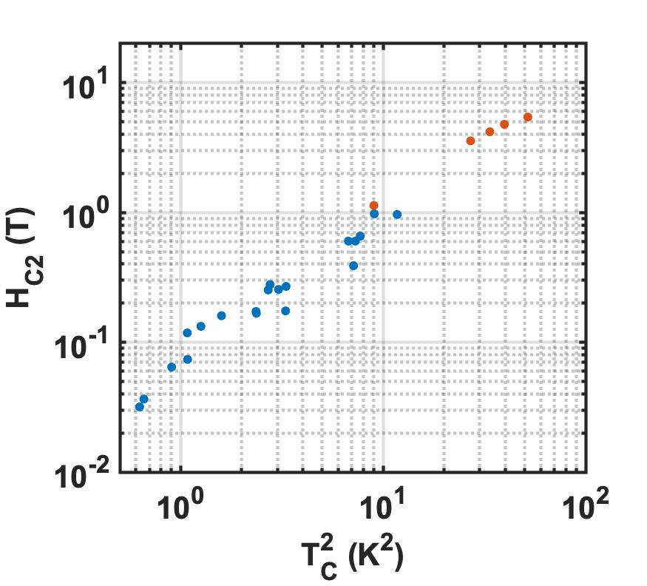
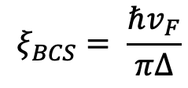

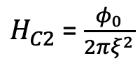
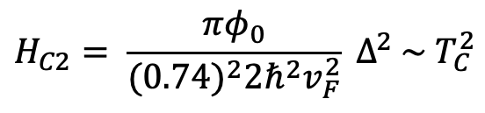
H_{c2} vs. Tc²
TaS₂: Our data (Tunneling)
NbSe₂: Xi, X. et al. Nat. Phys. 12, 139 (2016)
Transport
Landau Ginzburg:
$H_{C2}$ = $\frac{φ_{0}}{2πξ^{2}}$
NbSe₂
NbSe₂
Bulk
NbS₂
TaSe₂: Yokota et al., Physica B 284, 551 (2000) (Self-inductance)
In the clean limit:
$$ξ=0.74ξ_{BCS}$$
5L TaSe₂
TaS₂
TaS₂
$$ξ_{BCS}= \frac{ℏv_{F}}{πΔ}$$
Slope = 1 over 4 decades
Where:
16L TaSe₂
So:
$$H_{C2}= \frac{{πφ}_{0}}{{(0.74)}^{2}2ℏ^{2}v_{F}^{2}} Δ^{2} \sim T_{C}^{2}$$
Bulk TaSe₂
Shared property + Tunable parameter

Slide 31
Questions: Shared vs. Tunable?
Is there any other system which can be tuned like this?
What is the shared property
What is the tunable parameter?
Why is the system clean?
How does the slope depend on v_{F}?

Slide 32
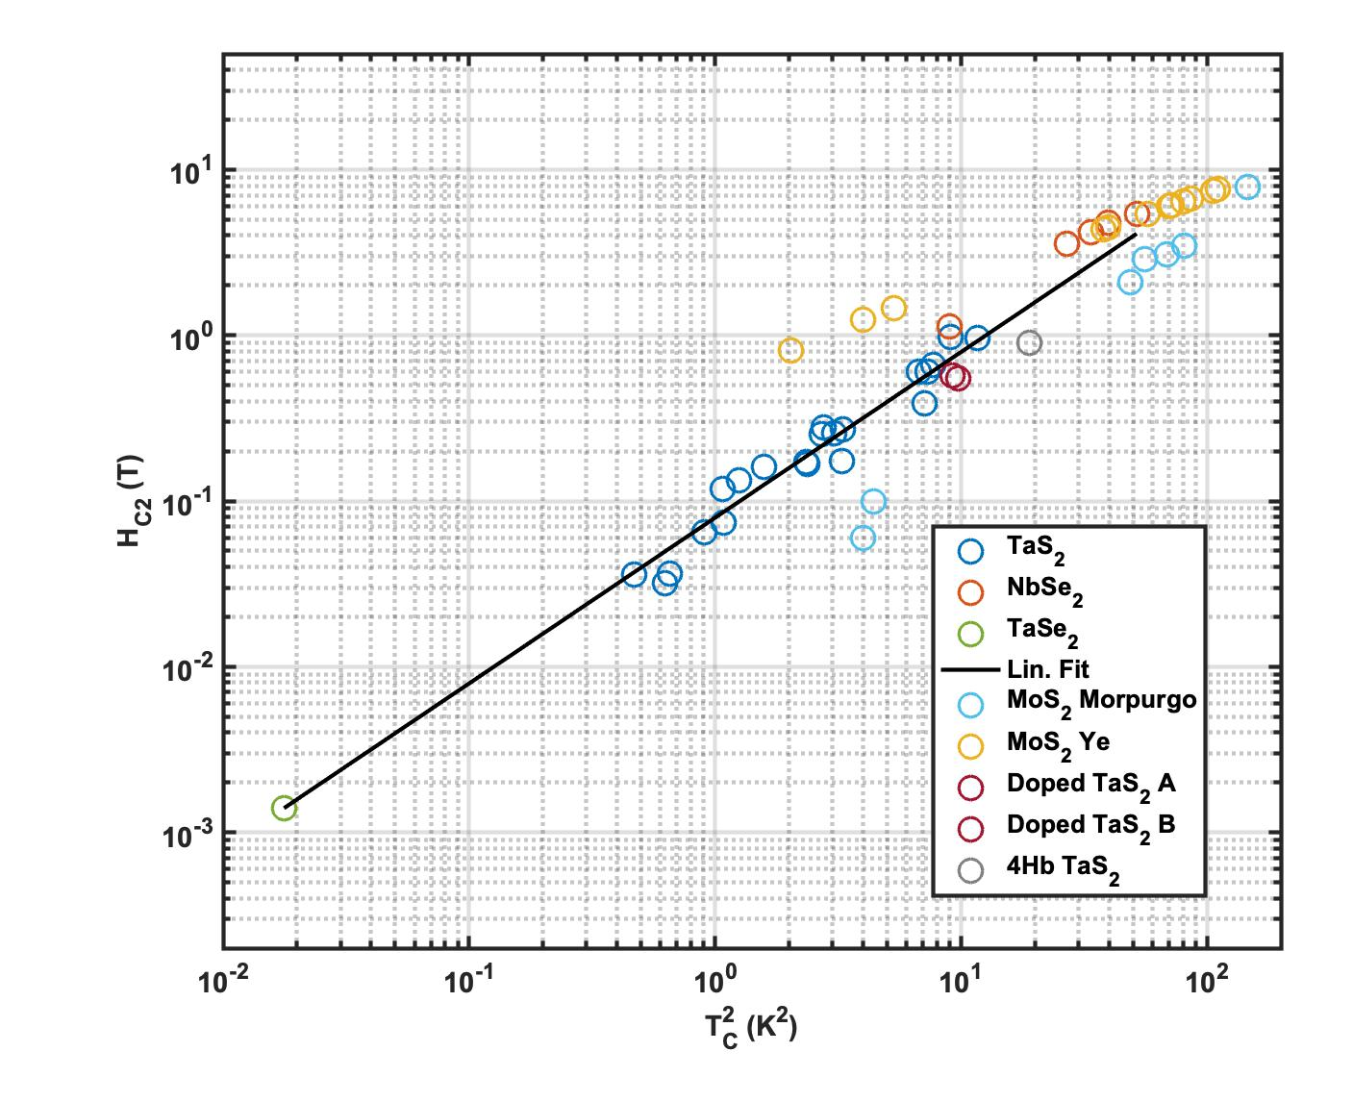

Is there any other system like this?
$$ξ\sim ∆$$

Slide 33
Shared Property: Band Structure
NbSe₂, TaS₂ are doped versions of the intrinsic TMDs

Slide 34
Tunable Property: CDW?
The existence of a universal progression through different TMDs suggests that the same mechanism suppresses superconductivity in all of them.
This observation disagrees with model of thickness-dependent coupling
Xi 2016 (NbSe₂): CDW not likely to be important.
Yang 2018 (TaS₂): CDW IS important.
What are we going to do?

Slide 35
Theory: Vary CDW
Jonathan Ruhman, Hennadii Yerzhakov, Maxim Khodas
Tight-binding -> TMD Band-structure
CDW is momentum-dependent: J. van Wezel, PRB 2016
(Because smooth CDW would increase T_{C} ).
Band-structure including CDW modification, DOS depends on CDW
Self-consistent determination of Tc (BCS)
H_{C2} is calculated based on Ginzburg-Landau theory
Notes:
We investigate this possibility by employing Gor'kov's theory to compute \Hc close to $T_C$, starting from a tight-binding model including SOC and the 3$\times$3 CDW for both \tas and \nbse parameters.
In this calculation, we assume the attractive phonon-mediated interaction is of equal strength on all three transition metal $d$-orbitals.
We use the strength of the CDW order parameter, denoted by $b$, as the tuning parameter of $T_C$ and $\Delta$.

Slide 36
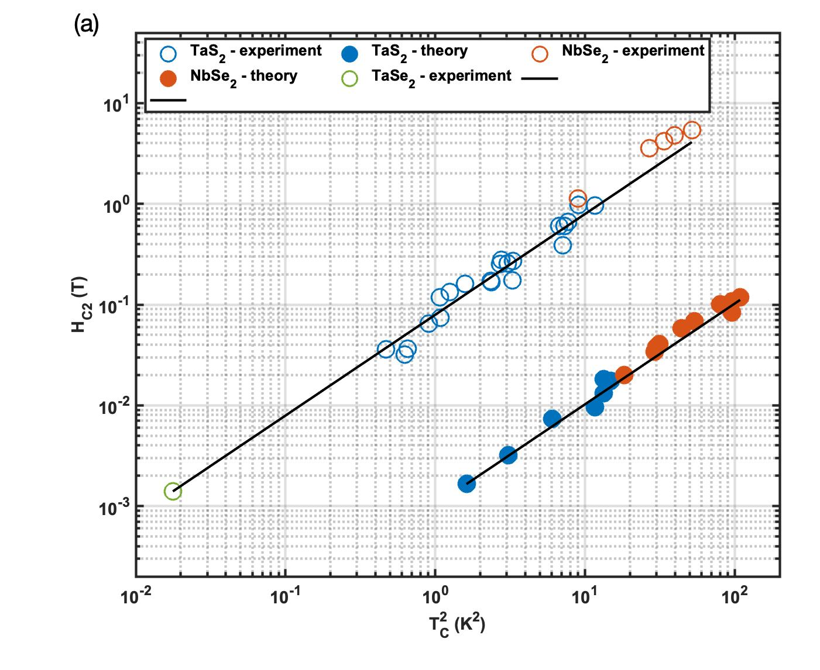
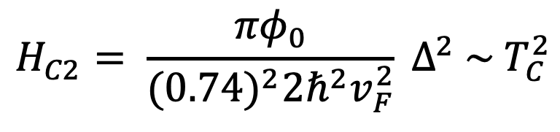
Excellent agreement with the H_{C2} vs T_{C}² dependence
We exctract v_{F} = 3.2x10⁴ m/s – Too Low!!
How does theory “miss” H_{C2}??
Experiment
v_{F}
Theory
$$H_{C2}= \frac{{πφ}_{0}}{{(0.74)}^{2}2ℏ^{2}v_{F}^{2}} Δ^{2} \sim T_{C}^{2}$$
Notes:
VF = 3.2e4 m/s in this fit
ARPES: 0.6 to 0.8 in Kiss paper
Greater in TaS2 (Sanders?) paper

Slide 37
The Many Roles of Thickness:
Orbital FFLO
>20
Reduced Tc (Nb)
Increased Tc (Ta)
Increase the Ising stability vs. In-plane magnetic field at the thin limit.
Onset of orbital FFLO at finite thickness.
Two-band specturm disappears at the 10-20 nm range.
Putative onset of a triplet component at high in-plane field.
Change T_{c} and H_{C2} along a universal ratio, likely through tuning CDW
3 Bands
15
Number of Layers
10
Ising + Triplet?
5
2 Bands
1

Slide 38
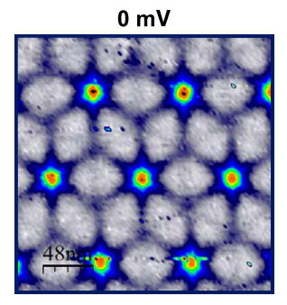
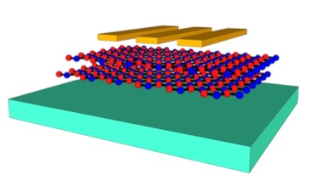
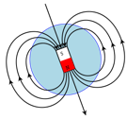
Tunneling, Vortices, and Thickness
Tunnel Junction
STM
Guillamon I, 2009, PhD Thesis, UAM

Slide 39
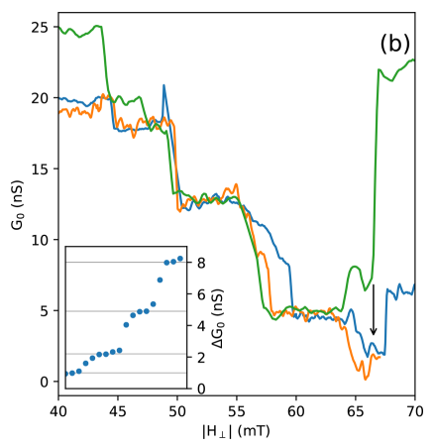
Tunneling and Vortices: Through CdGM
$$L$$
$$Λ=2\frac{λ_{L}^{2}}{d}\sim L$$
Dvir, Tom, et al. "Tunneling into the Vortex State of NbSe₂ with van der Waals Junctions." Nano Letters 18.12 (2018): 7845-7850.

Slide 40

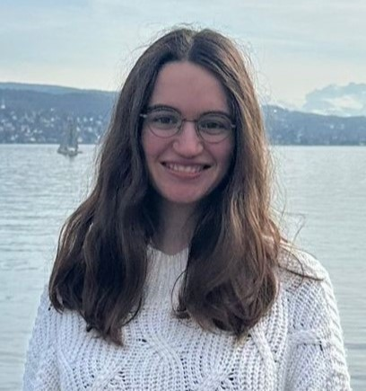
Tunnel Junction as Current Sensor
Clean limit Doppler shift:
  $$E_{k}={\left(ε_{k}^{2}+Δ^{2}\right)}^{1/2}+mv_{F}⋅v_{s}$$
  $$⇒\left|δE_{min}\right|∝H$$
Precision: Few µeV
Shahar Simon, Maya Klang, Submitted

Slide 41
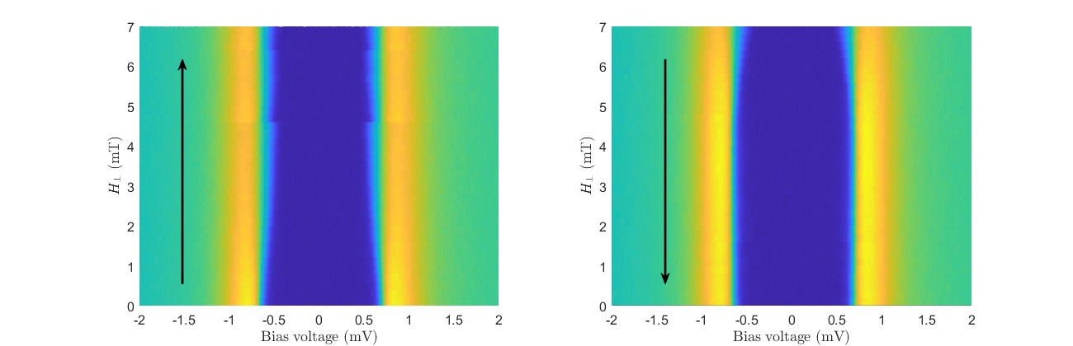
Tunneling and Vortices: Through Meissner
NbSe₂, 15 Layers
$$?$$
Shahar Simon, Maya Klang, Submitted

Slide 42
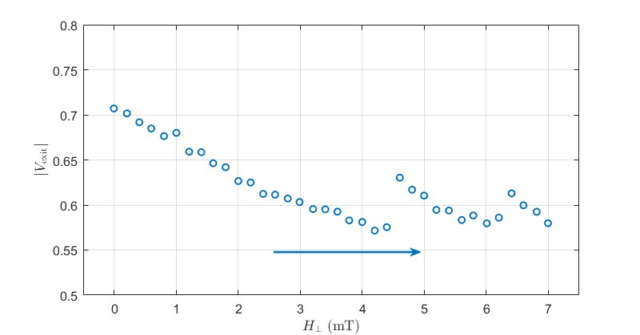
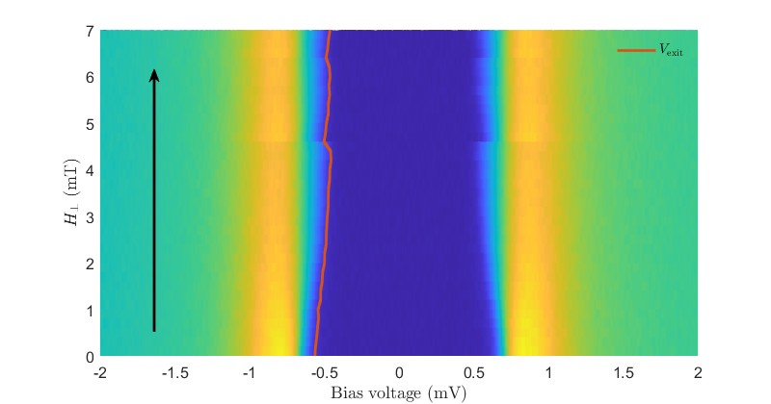

Visually:
Two regimes in increasing field:
$H_{⊥}<3mT$: Meissner+vortices increasing
$H_{⊥}>3mT:$ Meissner saturated
$$H$$

Slide 43
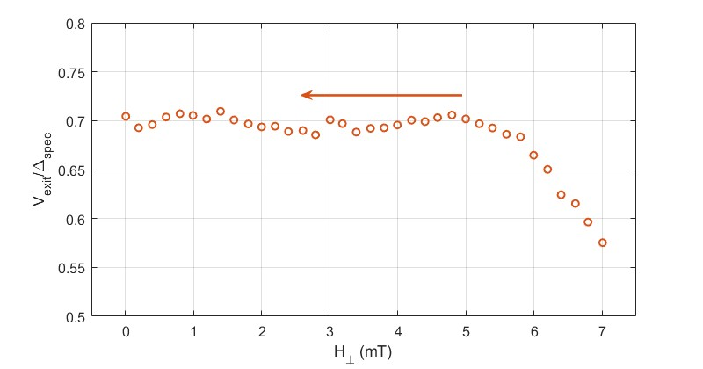
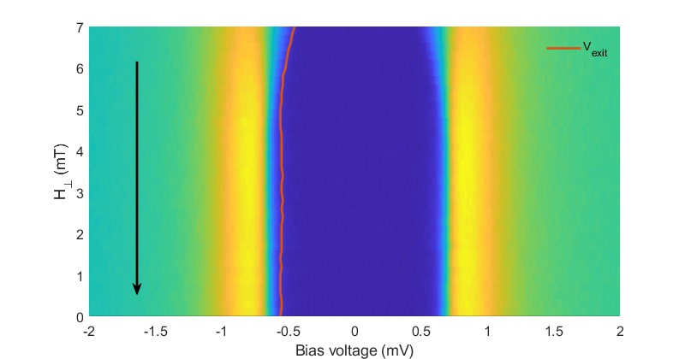
Vortex Entry / Exit Affect Spectra
Two regimes in decreasing field:
$H_{⊥}>5mT$: Meissner decreasing to full cancellation
$H_{⊥} < 5mT$: Vortices exit
$≈$Full cancellation regime
$$H$$

Slide 44
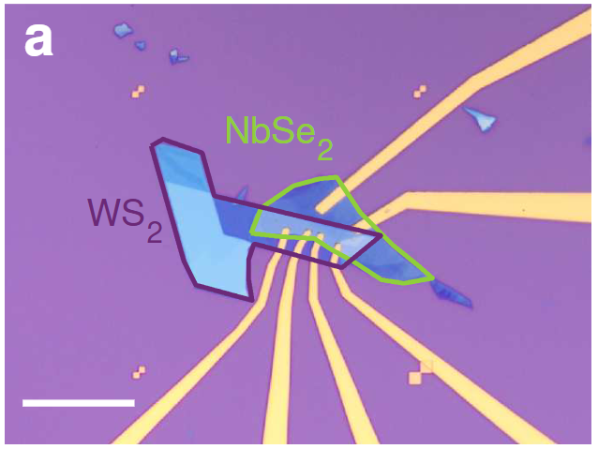
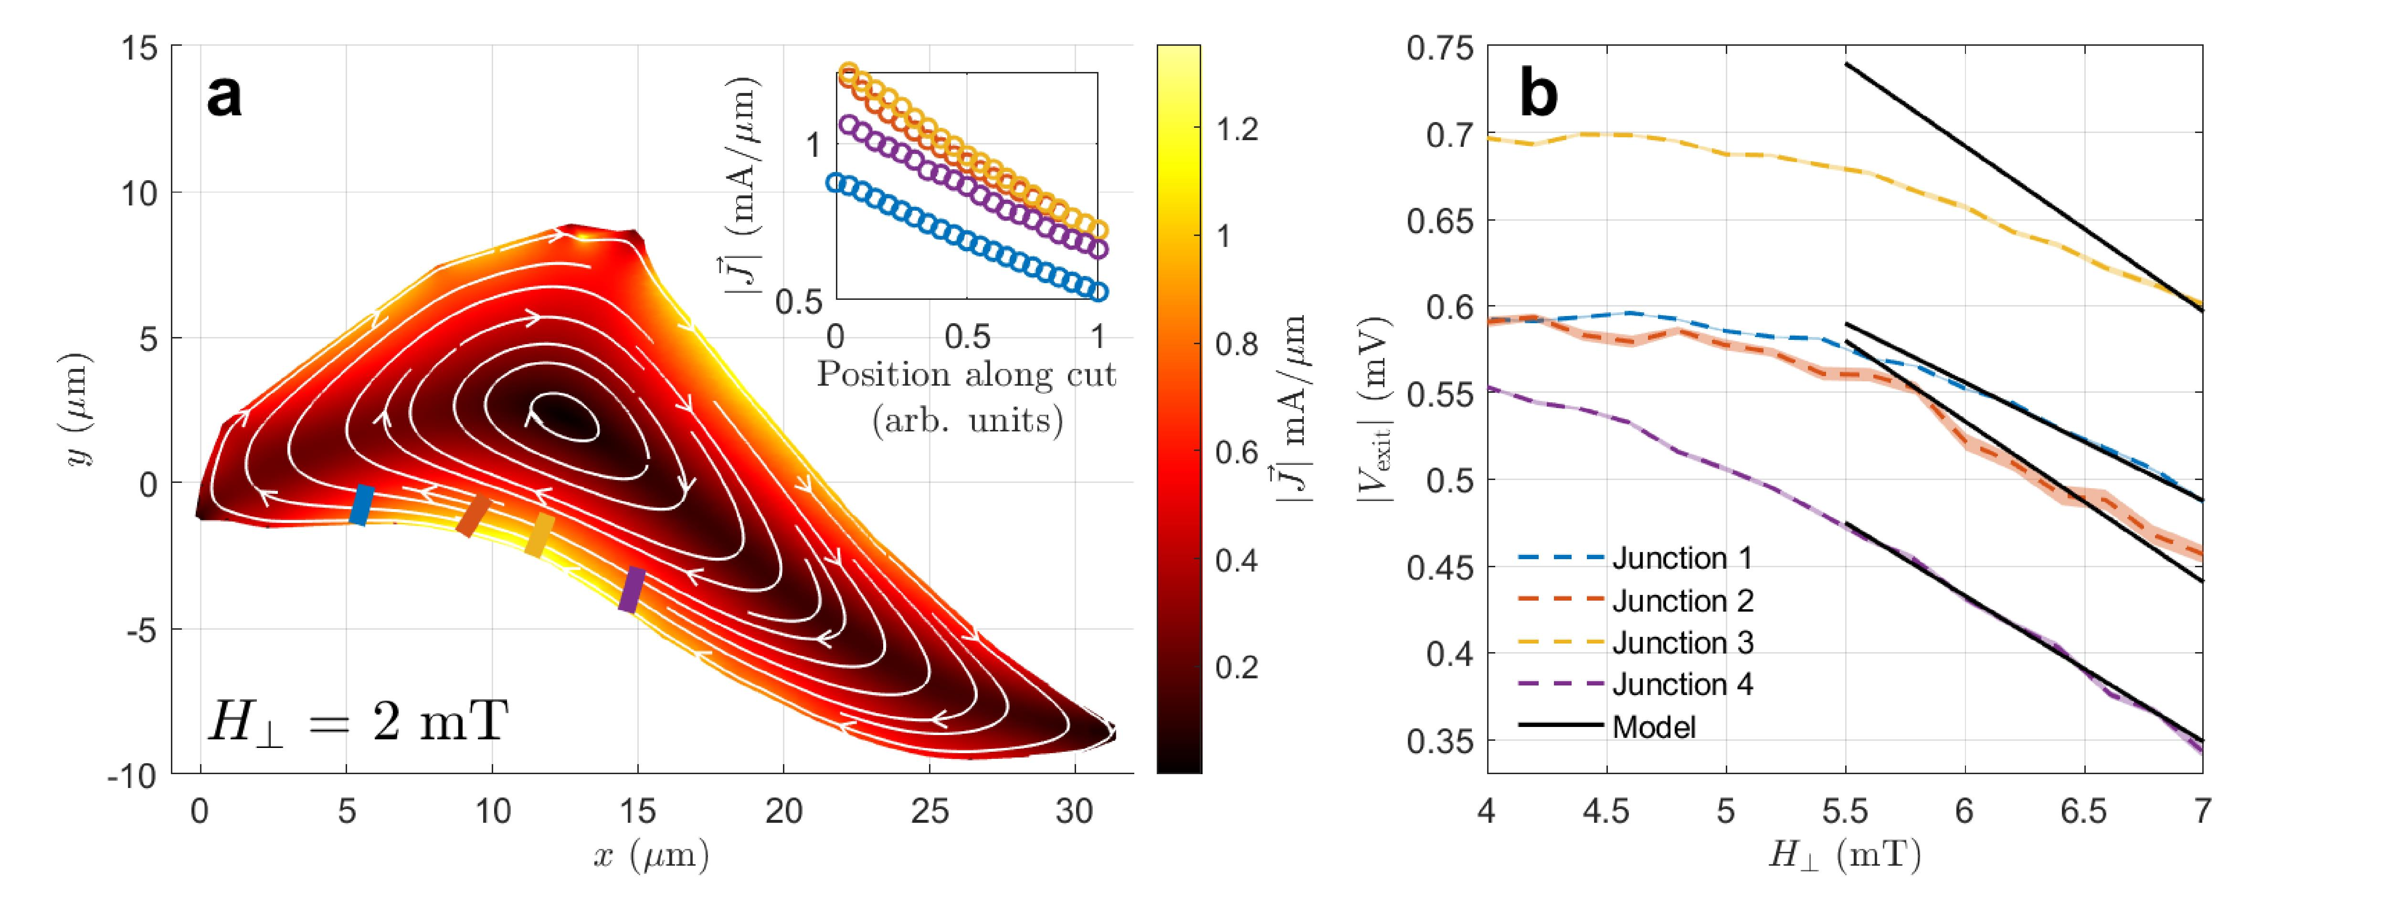
Numerical solution to London equations fits:
$$20μm$$
Bishop-Van Horn, Logan, and Kathryn A. Moler. "SuperScreen: An open-source package for simulating the magnetic response of two-dimensional superconducting devices." Computer Physics Communications 280 (2022): 108464.

Slide 45
So far…
At the 10-15 layer range, vortices can be detected at a distance of few µm away, by their signature on the screening current
BUT
What is actually the structure of the vortex at the ultrathin limit in TMD superconductors?

Slide 46
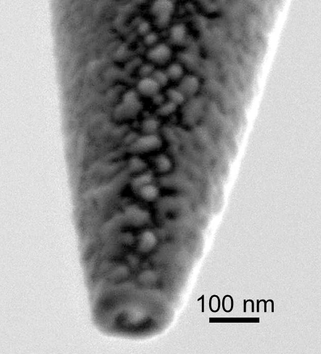
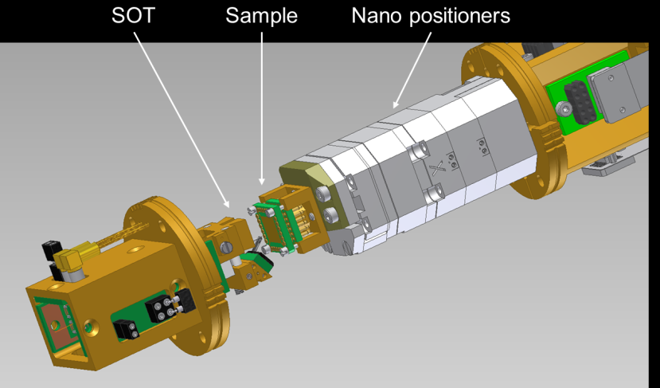
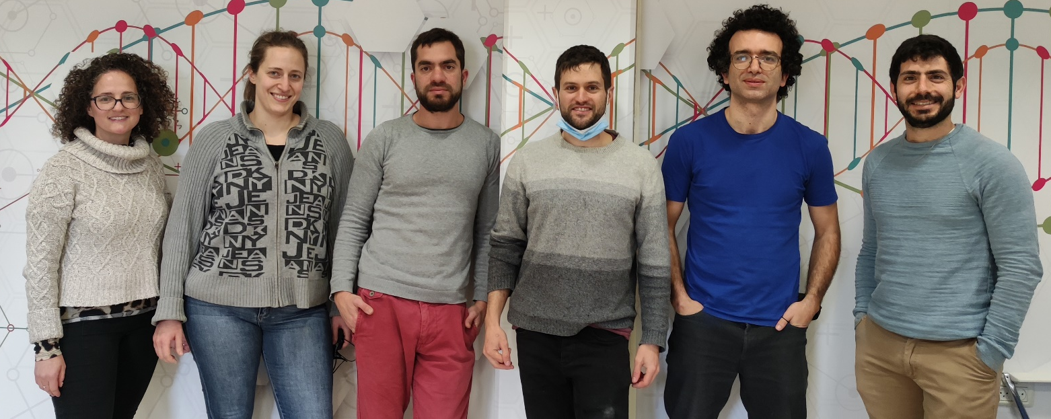
Scanning SQUID-on-tip microscopy: Anahory Group
gap
Pb
Pb
G. Romagnoli et al. APL (2023)
Y. Anahory et al. Nanoscale (2020)
D. Harlbertal et al. Nature (2016)
Y. Anahory, J. Reiner, et al. Nano Lett. (2014)
D. Vasyukov, Y. Anahory et al. Nature Nano. (2013)
A. Uri et al. Nano Lett. (2016)
Notes:
The work I will present here was carried out using a technique that we developed in our group over the last 10 year… It’s a scanning SQUID technique, but not any type… We call it the scanning SQUID-on-tip. -> Here is an SEM picture of the device. It’s a SQUID loop that reside at the end of a sharp pulled pipette -> You can observe here two lead leads separated by a gap. -> There two leads meet at the end of the pipette to form the SQUID loop. -> We can make them in different size, here is our smallest ever made with 46 nm diameter. -> the idea is to mount this into a scanning probe microscope to perform scanning SQUID microscopy -> Let me go through the main features of our device. -> it has suitable for scanning probe because -> we can make them small -> and because we can bring the SQUID loop in close proximity to the sample. -> as a result -> we can achieve outstanding spin sensitivty with 0.38 Bohr magneton, and -> flux sensitivty of 50 nano phi0. In addition, this technique offers also higher spatial resolution and can work up to 2 T which is a few order of magnitude above other techniques.

Slide 47

Vortices at the Ultrathin Regime

Slide 48


Encapsulated NbSe₂
hBN
NbSe₂
4
hBN

Slide 49
Size of Vortex: Pearl Length
Bulk Superconductors:
Screening current suppressed exponentially.
Length scale:
$$λ$$
Thin Superconductors (d << ):
Screening less effective. It is govered by the Pearl length
$$λ$$
T = 4.2 K
$$Λ=2\frac{λ_{L}^{2}}{d}$$
$$\frac{1}{Λr}$$
It is suppressed polynomically, as near the core, and
$$\frac{Λ}{r^{3}}$$
… as far from the core (r > $Λ$).
We measure at the 1/r regime. Other vortices + edge:
Constant Backgroud -> eliminated by gradient
We can measure the Pearl length even when it is greater than the sample size

Slide 50
Pearl Length vs. Thickness
$$Λ=2\frac{λ_{L}^{2}}{d}$$
Transition appears at N = 6
T = 4.2 K
Se band? No. It would give another 1/d term
N < 6: Superfluid density independent of thickness
-> Surface??
Notes:
Surface: Rashba or strain due to lattice mismatch.

Slide 51

Model: Onset of Surface-Bound Order
Order competition: Surface contribution negligible at the thick limit
Takes over at 6 L and below
Where has it been until now?
Not seen in transport, tunneling…
Pristine sample?
Notes:
If you measure Tc, you are sensitive to conditions near Tc.

Slide 52
The Many Roles of Thickness:
Orbital FFLO
>20
Increase the Ising stability vs. In-plane magnetic field at the thin limit.
Onset of orbital FFLO at finite thickness.
3-band specturm turn to 2-band at the 10-20 nm range.
Putative onset of a triplet component at high in-plane field.
Change T_{c} and HC₂ along a universal ratio, likely through tuning CDW
NbSe₂: Transition from bulk to surface-dominated Pearl Length at 6 L.
Reduced Tc (Nb)
Increased Tc (Ta)
3 Bands
15
Number of Layers
10
Ising + Triplet?
5
Surface-Dominated
2 Bands
1
Are these all different effects?

