Slide 1


An Introduction to CsK₂Sb Photocathodes: Growth Physics and Performance Optimization
Lei Guo
Hiroshima University
Notes:
Good afternoon.
My name is Lei Guo from Hiroshima University.
Today,
I would like to talk about cesium potassium antimonide, or CsK2Sb, photocathodes.
Rather than focusing only on how high the QE can be, this talk focuses on why the performance of CsK2Sb varies so widely, and how we can improve reproducibility in a systematic and physics based way.
I will refer to my notes from time to time.

Slide 2

Motivation & Background
Why do we need CsK₂Sb photocathode?
High QE
Stable electron emission
A material system
Notes:
From a practical point of view, we typically want three things from a photocathode.
First, high QE, so that the required laser power can be reduced.
Second, stable electron emission over long term of operation.
And third, a material system that can be fabricated reproducibly by different users and in different facilities.

Slide 3
Motivation & Background
Photocathodes for high-brightness
Property | NEA GaAs | Alkali Antimonides (CsK₂Sb, Cs₃Sb) | Metals (Cu, Mg)
QE
Laser wavelength
Lifetime
Vacuum required
Robustness
SRF gun compatibility
Ease of growth
Use case
⭐⭐⭐⭐⭐ (>10%) Red
Visible (532-780 nm)
⭐ (a few hours)
⭐<10⁻¹¹ mbar
Very fragile
Poor–moderate
Difficult (activation)
Spin-polarized beams
⭐⭐⭐⭐ ⭐ (1–10%) Green
Visible (400–550 nm)
⭐⭐⭐ (months @ a few mA)
⭐⭐⭐10⁻⁹ mbar
Moderate
Excellent
Moderate
High-current ERL/SRF (PERLE)
⭐ (0.01–0.3%) UV
UV (257–266 nm)
⭐⭐⭐⭐⭐ (months)
⭐⭐⭐⭐10⁻⁸ mbar
Very robust
Excellent
Easy
Rugged, UV-laser systems
Notes:
Let us see the different photocathode materials used for high-brightness electron sources, and helps clarify the motivation for focusing on alkali antimonide photocathodes.
Let me start with NEA GaAs (gallium arsenide).
NEA GaAs can provide extremely high QE, using visible laser.
However, the lifetime is typically only a few hours, and the required vacuum level is extremely demanding, below 10 to the minus ninth pascal.
As a result, NEA GaAs photocathodes are very unstable and difficult to operate in routine accelerator environments.
Next, let me move to alkali antimonides, like CsK₂Sb and Cs₃Sb. These materials provide high QE, typically in a few percent, using visible light.
Their lifetime is significantly longer than NEA GaAs, often months at a few milliamperes, and the required vacuum level is relaxed to 10 to the minus seventh pascal.
For these reasons, alkali antimonides are considered ideal candidates for high-current ERL and SRF-based injectors.
Finally, metal photocathodes, like copper or magnesium, are extremely robust and can operate for months.
However, their QE is very low, typically below 0.3 percent, and UV lasers with high power are required.
This limits their usefulness for applications requiring high current.
In summary, this comparison clearly shows that alkali antimonide photocathodes, and in particular, CsK₂Sb, offer the best balance between QE, lifetime, robustness, and operational practicality.
let me first summarize its key characteristics.

Slide 4
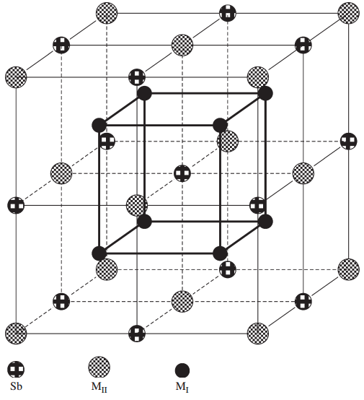
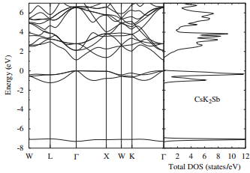

Overview of CsK₂Sb structure
Past cesium–potassium–antimony compounds include CsK₂Sb and Cs₂KSb, among others. The most stable structure is CsK₂Sb.
Direct Bandgap: ~1.2eV
$$a=8.6Å$$
Band dispersion
DO₃ structure
Electron affinity: 0.7eV
Photoemission threshold: 1.9eV
(for wavelength of light: 653 nm)
Minimum unit : body-centered cubic lattice (bcc)
L. Kalarasse et al. Journal of Physics and Chemistry of Solids 71 (2010) 314–322.
Notes:
In this slide, I introduce the crystal and electronic structure of CsK₂Sb.
Several cesium–potassium–antimony compounds are known, like CsK₂Sb and Cs₂KSb.
Among them, both theoretical calculations and experimental studies have shown that CsK₂Sb is the most stable stoichiometry.
Therefore, CsK₂Sb is the dominant phase relevant for photocathode applications.
Let me first explain the crystal structure shown on the left.
CsK₂Sb has a DO₃-type structure, with a body-center cubic lattice as the minimum structural unit.
The lattice constant is about 8.6 angstroms.
Next, I move to the band dispersion, shown on the right.
CsK₂Sb has a direct bandgap of about 1.2 eV.
In addition, the electron affinity is about 0.7 eV.
Combining these values, the photoemission threshold energy is about 1.9 eV, which corresponds to a wavelength of about 653 nanometers.
This explains why CsK₂Sb can be driven by visible light, as green lasers.

Slide 5
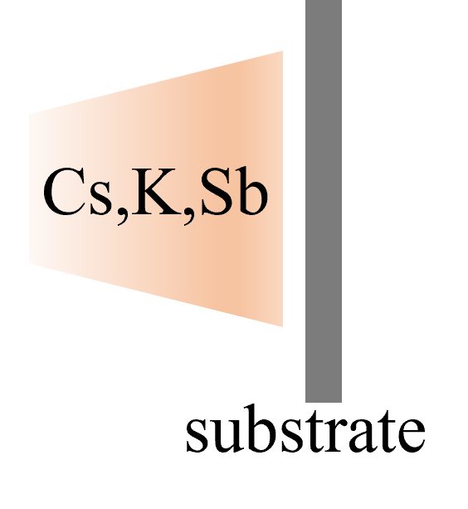
Challenges of CsK₂Sb Photocathodes
Why is reproducibility difficult?
Substrate dependence
  Nucleation and crystallinity depend on substrate
  Electronic structure and QE are strongly affected
Stoichiometry control
  Sequential evaporation of Sb, K, and Cs
  Easy deviation from ideal CsK₂Sb composition
  Mixed phases and excess alkali layers can form
➡ Systematic control of substrate and stoichiometry is essential
(Stainless Steel, Si, Mo)
Wide QE variation
  Reported QE: ~1% to >10%
  ➡ Strong dependence on growth conditions
Notes:
On the other hand, reported QE range from about 1 percent to more than 10 percent, even though the material is nominally the same.
So, why is reproducibility so difficult for CsK₂Sb photocathodes?
On the left, this schematic shows a sequential deposition process for forming a CsK₂Sb photocathode on a substrate, stainless steel, silicon, and molybdenum.
This large spread indicates a strong dependence on growth conditions.
For CsK₂Sb photocathodes, the main challenge is not achieving a high peak QE once, but achieving high QE reproducibly.
From our experience, the reasons can be summarized into two major factors:
substrate dependence and stoichiometry control.
Importantly, even non-ideal internal structures can still produce a high initial QE.
However, their stability is usually poor, and rapid degradation often follows.
This presents a serious practical problem for accelerator applications.

Slide 6
Which substrate properties can affect
the photocathode growth and performance?
・crystallographic orientation.
・surface condition.
・semiconductor doping type.
Notes:
Let us to see which substrate properties matter most for CsK₂Sb photocathodes?
From our experiments, many substrate parameters can vary, but only a few consistently control growth and performance.
In this talk, I focus on three properties that are both physically important and experimentally controllable.
・crystallographic orientation.
・surface condition.
・semiconductor doping type.
In the next slides, I will discuss each of them in detail, starting with crystallographic orientation.

Slide 7
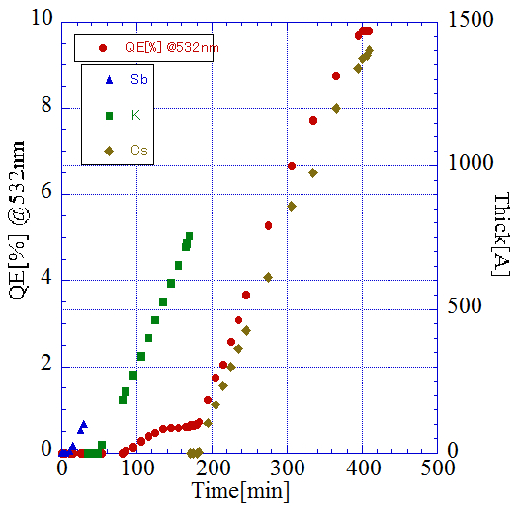
Substrate Dependence (I):
Crystallographic Orientation & Surface Condition
  Surface Treatment
  Si(100)
  GaAs(100)
  Si(111)
5%HF
H₂SO₄:H₂O₂:H₂O
CsK₂Sb film deposition
  Substrate surface: untreated
  Substrate surface: untreated
5%HF
  Substrate surface: untreated
Si(100)
Si(111)
GaAs(100)
L. Guo et al., Prog. Theor. Exp. Phys. (2017) 033G01 (2017).
Notes:
Here, we compare CsK₂Sb photocathodes grown on substrates with different surface orientations, typically the (100) and (111) planes.
On the left, I list the substrates used in this study:
Si(100), Si(111), and GaAs(100).
Before deposition, some substrates were chemically treated, while others were left untreated.
Let me focus on the plot on the right, which summarizes the QE.
For Si(100), chemical treatment leads to a QE close to 10%, while untreated shows a significantly lower QE.
A similar trend is observed for Si(111), but the absolute QEs are much lower, even after chemical treatment.
This clearly shows that crystallographic orientation plays a critical role, with the (100) surface being much more favorable than the (111) surface.
For GaAs(100), shows same results as Si(100).
These results show a clean surface alone is not enough— the atomic arrangement of the substrate surface strongly effects CsK₂Sb growth.
In the following slide, I will explain the physical base of this difference in more detail.

Slide 8
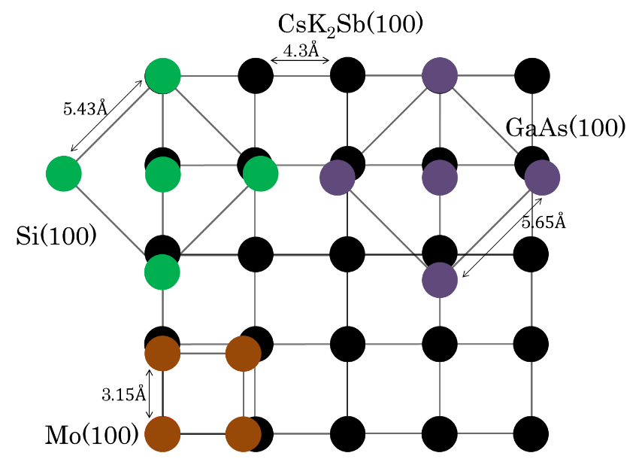
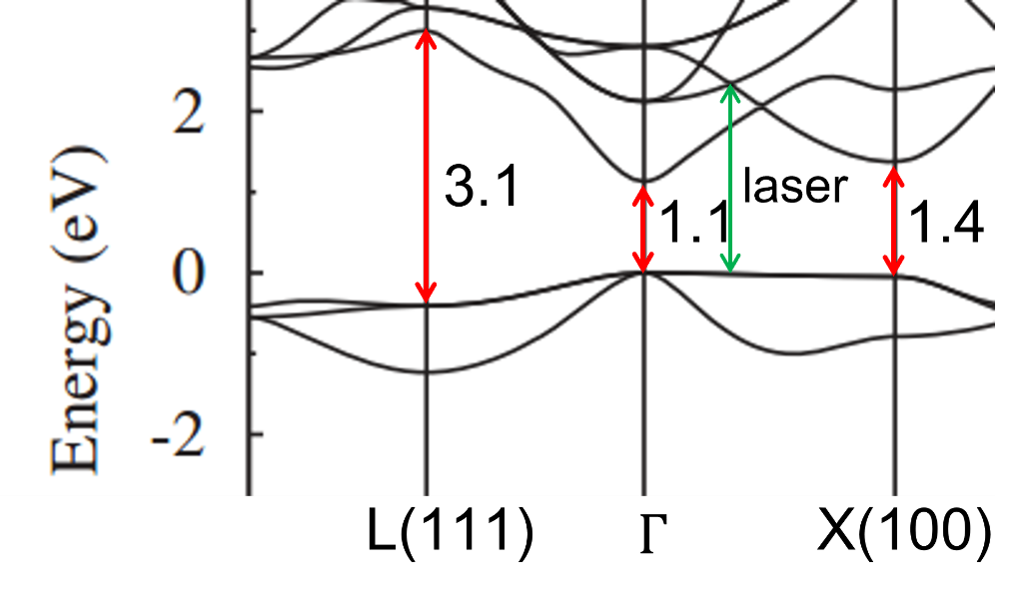
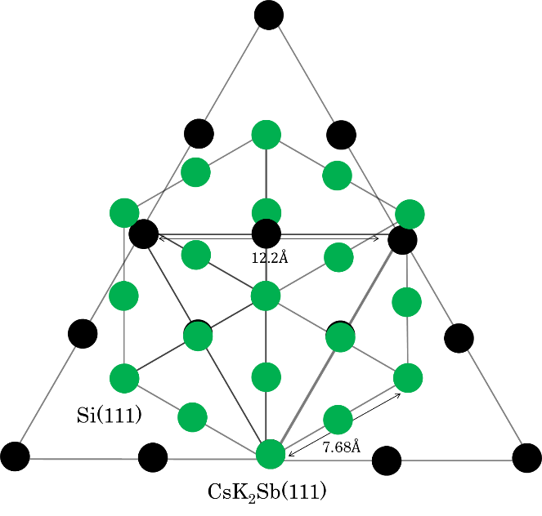
Differences in QE caused by band dispersion
532nm ～2.3eV
CsK₂Sb(100)
L. Kalarasse et al. Journal of Physics and Chemistry of Solids 71 (2010) 314–322.
Photoemission from the CsK₂Sb (100) surface orientation occurs from both the Γ point (1.1 eV) and the X point (1.4 eV).
Photoemission from the (111) surface orientation arises only from the Γ point.
CsK₂Sb(111)
[1]L. Guo et al., Prog. Theor. Exp. Phys. (2017) 033G01 (2017).
[2]K. P. Mondal, Epitaxial Growth of Cesium Potassium Antimonide Photocathode, Photocathode Physics for Photoinjectors (P3), BNL, Oct. 3, 2023.
Notes:
On the left, I show the lattice matching between CsK₂Sb and different substrates.
CsK₂Sb can grow to (100) on Si, GaAs, and Mo (100), while a different surface atomic arrangement is formed on the (111) orientation.
Let me focus on the electronic structure, shown on the right.
For the CsK₂Sb(100) surface, photoemission can happen from two k-points.
Because our 532-nanometer laser corresponds to 2.3 eV, which is sufficient to excite electrons from both Γ and X points.
As a result, several excitation channels contribute to photoemission, leading to a higher QE for the (100) orientation.
In contrast, for the CsK₂Sb(111) surface, photoemission gets only from the Γ point.
There is no same contribution from other k-points within the same energy range.
Therefore, the number of electronic states contributing to photoemission is reduced, which directly explains the lower QE observed for the (111) orientation.
In summary, the QE difference is not only a surface chemistry, but linked to band structure and momentum-space selection rules.

Slide 9
Substrate Dependence (II): p-type vs n-type Semiconductor Effects
  Surface Treatment
  p-Si(100)
  n-Si(100)
  p-Si(111)
  n-Si(111)
  p-GaAs(100)
  n-GaAs(100)
p
p
n
n
p
Cs₃Sb
n
p
n
p
n
CsK₂Sb
Si(100)
Si(111)
GaAs(100)
CsK₂Sb
Cs₃Sb
Si(100)
GaAs(100)
L. Guo et al., Phys. Rev. Accel. Beams 22, 033401 (2019).
Notes:
That next, I want to move to the third substrate factor: the semiconductor doping type.
We systematically compared p and n type silicon and GaAs substrates.
The central plot shows the QE of CsK₂Sb photocathodes on different substrates.
For all substrates is observed that p-type substrates consistently show higher QE than n-type substrates.
And the plot on the right, which shows results for Cs₃Sb photocathodes.
In this case, the QE difference between p and n type substrates is much smaller.
These results indicate that the strong p–n dependence observed for CsK₂Sb is not a universal substrate effect, but rather a property related to the CsK₂Sb–semiconductor interface.

Slide 10
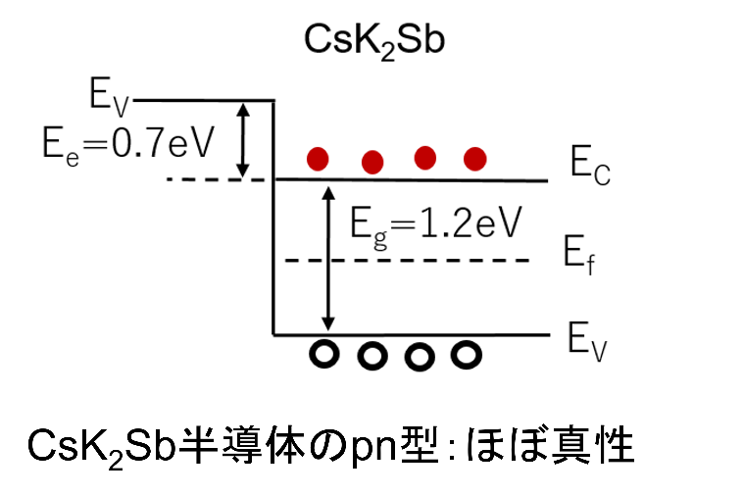
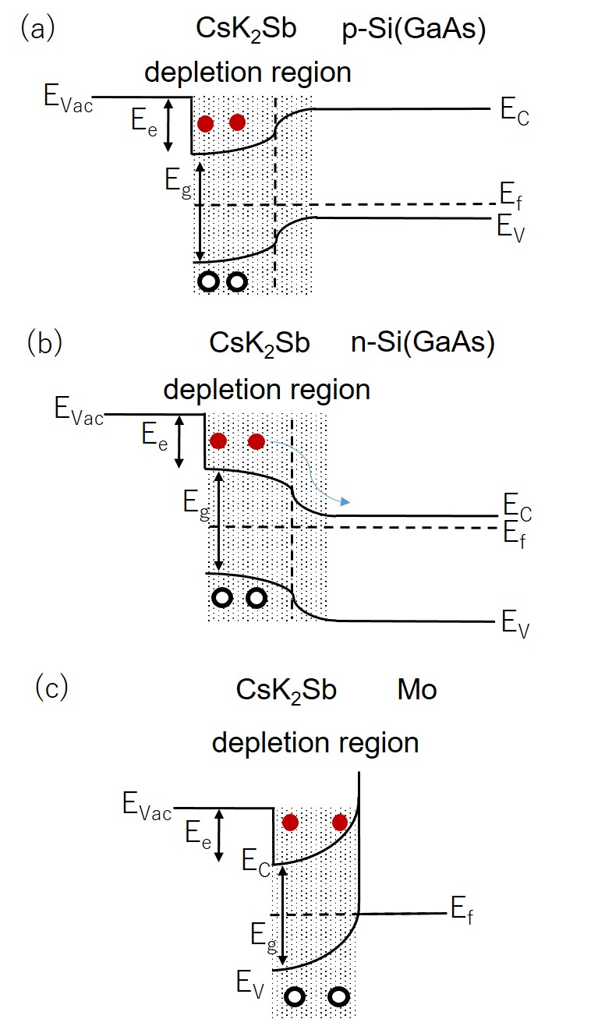
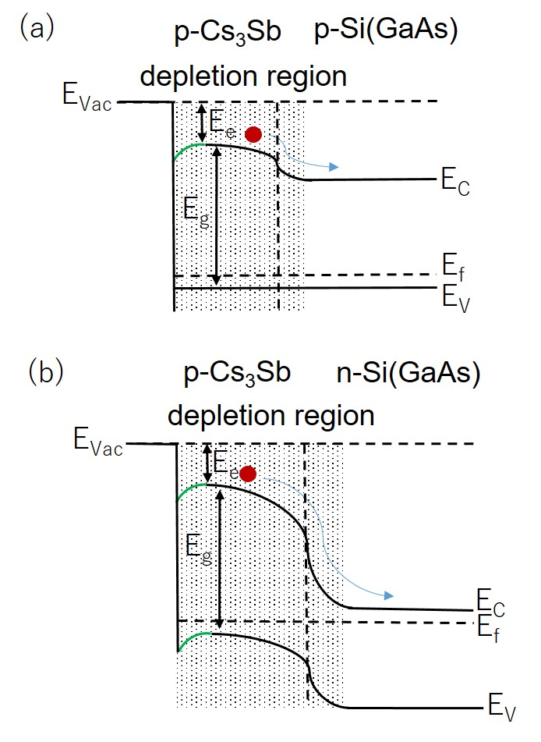
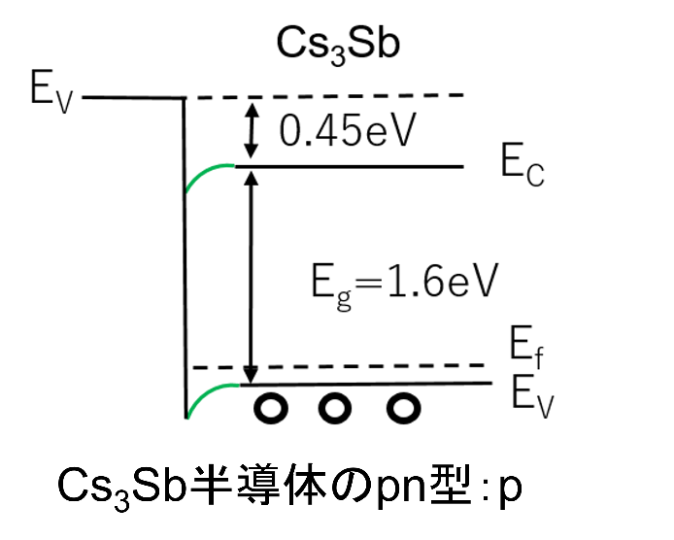
QE Difference Due to the p–n Junction Between the Photocathode and the Substrate
CsK₂Sb is treated as an Intrinsic Semiconductor
Cs₃Sb as a p-type Semiconductor
E_{bg}：1.1eV Si
1.4eV GaAs
L. Guo et al., Phys. Rev. Accel. Beams 22, 033401 (2019).
Notes:
In this slide, I explain the physical reason of the QE difference using band diagrams, focusing on the p–n junction formed at the interface between the photocathode and the substrate.
Let me start from the left-hand side.
Here, CsK₂Sb is treated as an intrinsic semiconductor, and Cs₃Sb behaves as a p-type semiconductor.
This difference already suggests that the interface physics will not be the same for these two materials.
Now let me move to the central panel, which shows CsK₂Sb on different substrates.
When CsK₂Sb is on a p-type substrate, a p–n junction is formed, resulting in band bending that drives electrons toward the surface.
This band bending effectively helps electron transport, increasing the probability that photoexcited electrons reach the surface before recombining.
As a result, higher QE is observed.
In contrast, when CsK₂Sb is deposited on an n-type substrate, the band bending is reversed.
Electrons are driven away from the surface, which suppresses electron transport toward the vacuum interface and reduces QE.
Finally, on the right-hand side, I show band diagrams for Cs₃Sb.
In this case, because Cs₃Sb itself is p-type, so the additional p–n junction effect at the interface is weaker.
This comparison clearly explains why CsK₂Sb shows strong substrate doping dependence, while Cs₃Sb does not.
So far, I have introduced the Substrate dependence.

Slide 11
Is the structure of our fabricated Cs-K-Sb cathode actually CsK₂Sb?
Notes:
At this point, a critical question is seen: is the photocathode structure really CsK₂Sb throughout the film?
Therefore, to understand stability and reproducibility, we need to check not only the surface, but also the internal structure of the photocathode.
In the next slide, I will introduce a growth strategy designed to make sure that the CsK₂Sb phase is formed robustly throughout the film.

Slide 12
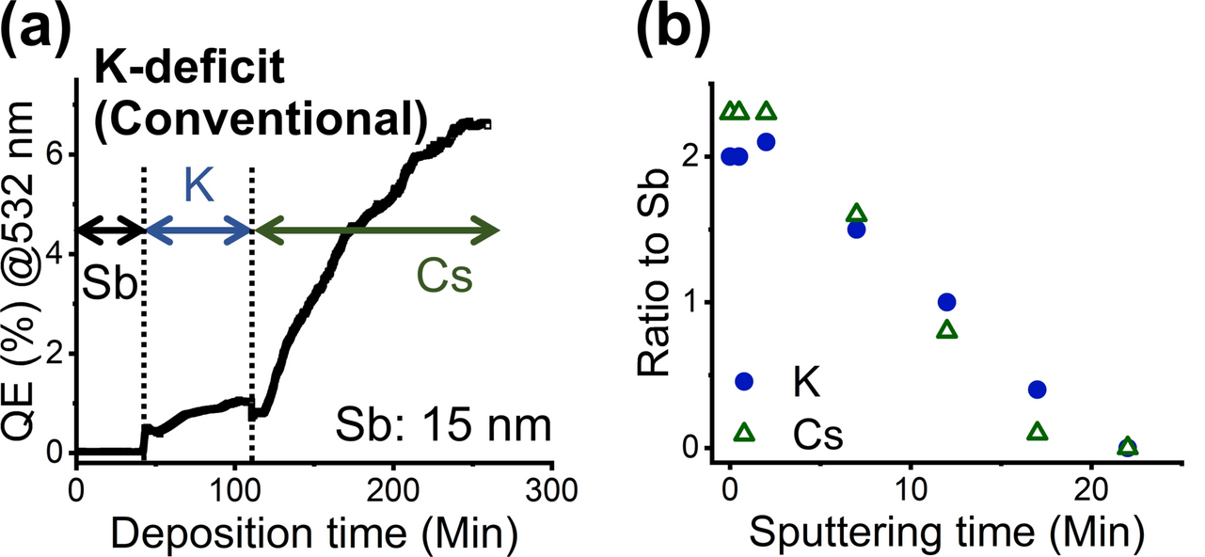
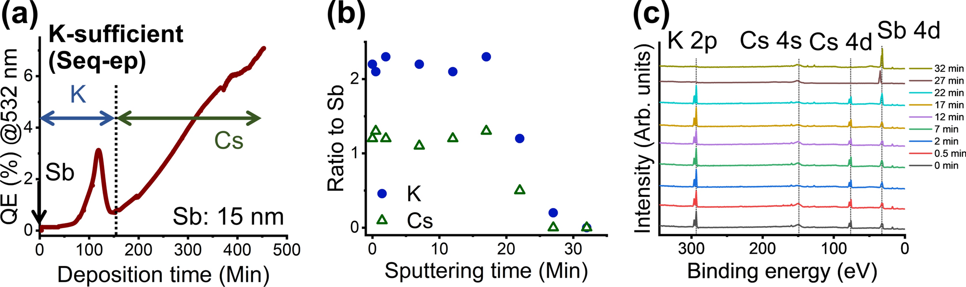
Improvement of the recipe
We investigated the internal composition of the deposited cathode by means of sputtering and synchrotron XPS.
We will increase the potassium deposition rate by raising the dispenser current from 6.0 A to 7.0 A and proceed with the deposition.
Lei Guo et al., Sci Rep 15, 2900 (2025).
Notes:
Let me start with the upper panels, which represent to the conventional recipe.
(a) shows the QE evolution during deposition.
Although the QE eventually reaches a high value, we observe that the growth process is potassium-deficient when potassium deposition is stopped at an early stage.
To understand what happens inside the film, we performed depth-sensitive analysis using sputtering and synchrotron XPS.
(b) shows the ratio of potassium and cesium to antimony as a function of sputtering time.
We clearly see that potassium is not enough in the deeper area of the film, while cesium mainly gathers near the surface.
These results indicate although a CsK2Sb-like phase may form near the surface, the internal composition is far from significantly from the ideal stoichiometry.
This explains why cathodes fabricated using the conventional recipe often show good initial QE, but suffer from poor stability and rapid degradation.
Based on this insight, we changed the deposition recipe, as shown in the lower panels.
In particular, we increased the potassium deposition rate by raising the dispenser current from 6.0 amperes to 7.0 amperes, and then proceeded with the sequential deposition.
(a) shows this potassium-rich recipe.
You can see a QE mountain at the potassium deposition stage.
The depth profiles in (b) show that the potassium-to-antimony ratio remains close to the stoichiometric value over a much wider depth range.
In summary, by increasing the potassium, we successfully formed a chemically robust CsK2Sb phase not only at the surface, but also inside the photocathode.

Slide 13
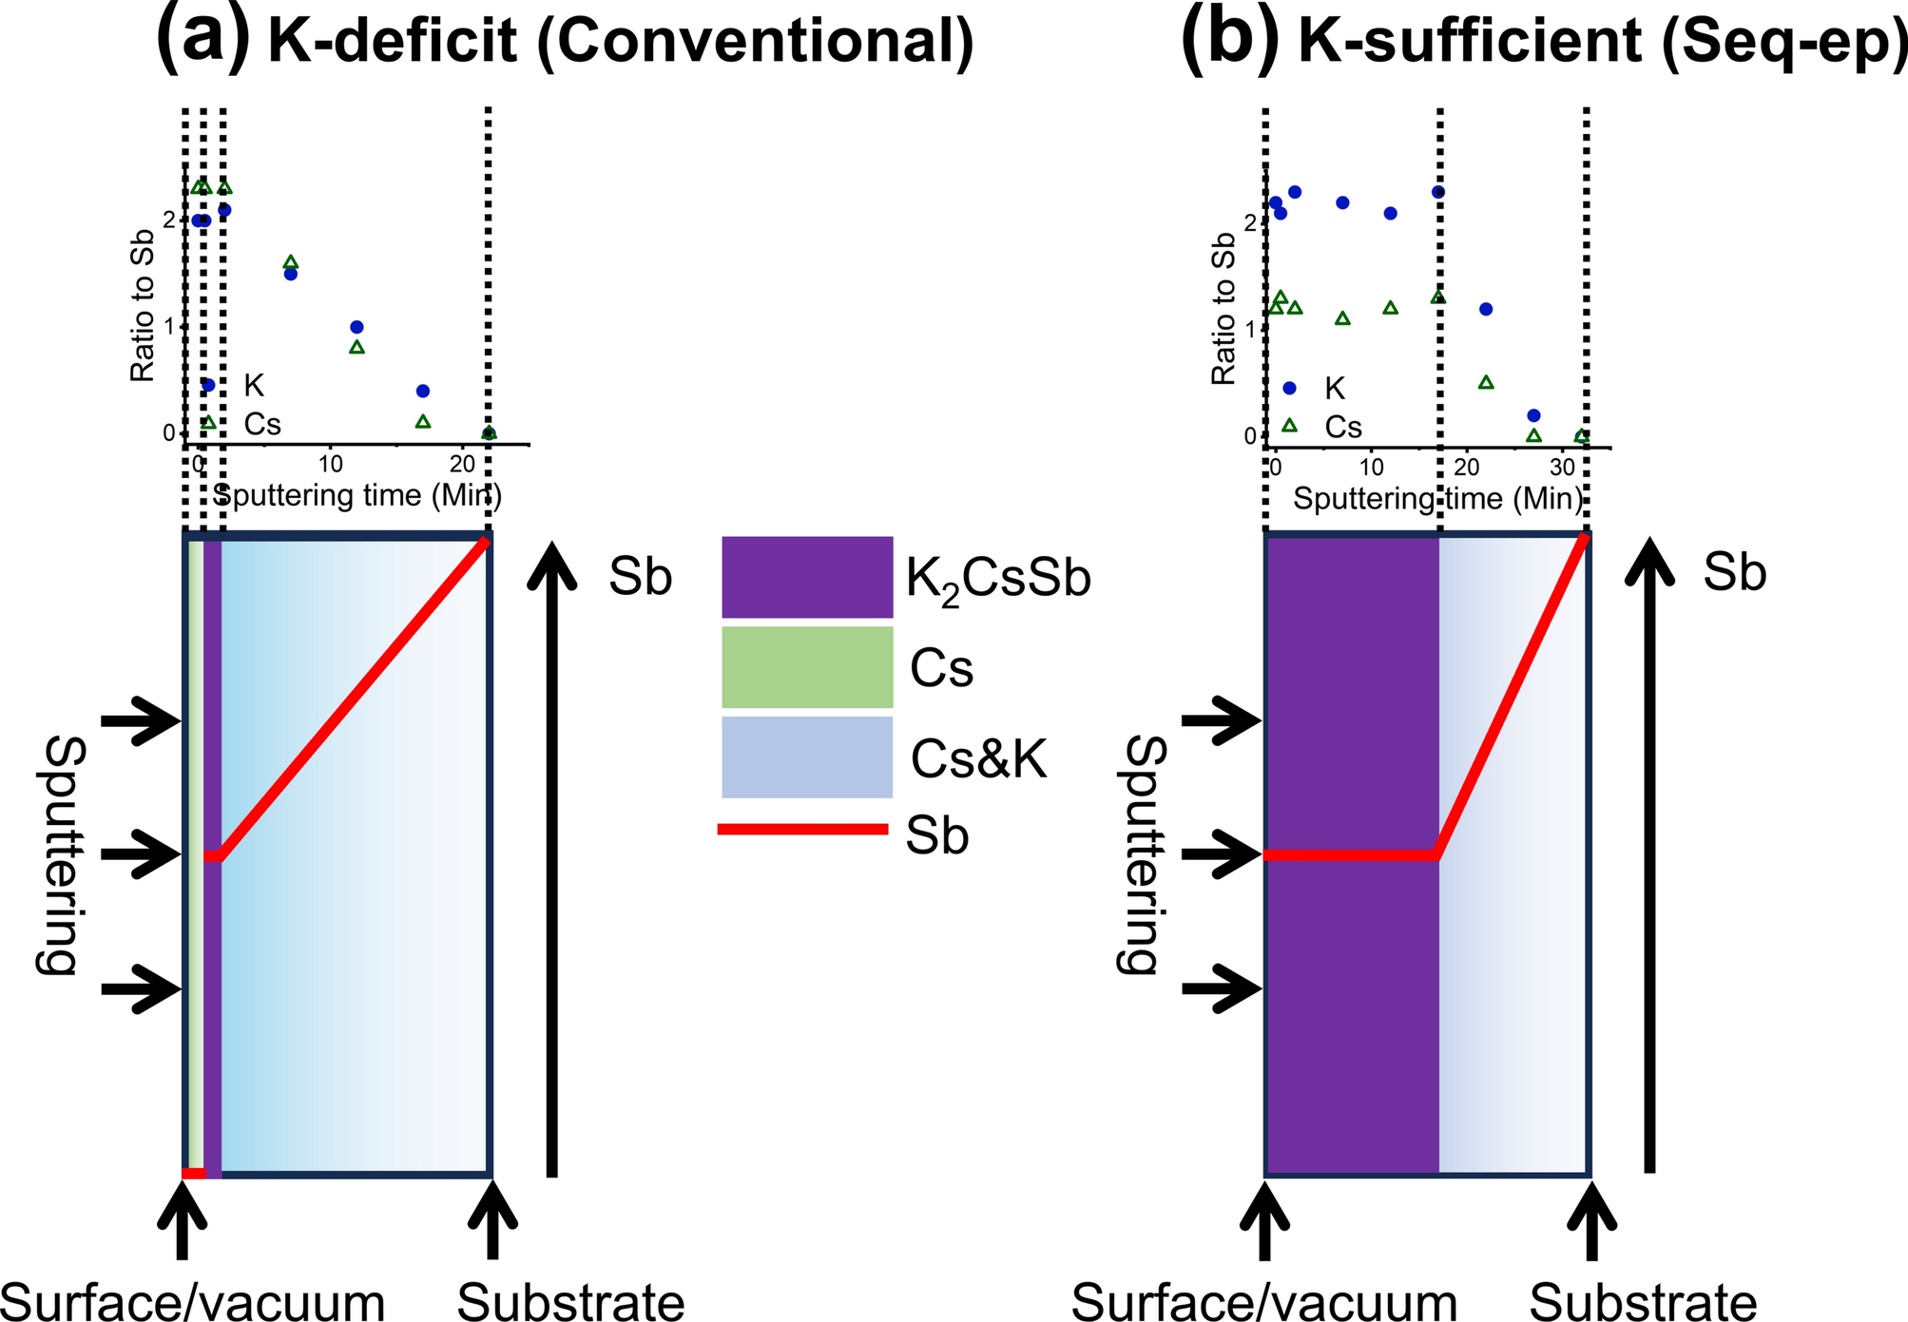
Comparison of oxygen durability
Conventional method
K-rich deposition
With the same QE, the oxygen durability differs by an order of magnitude.
Lei Guo et al., Sci Rep 15, 2900 (2025).
Notes:
In this slide, I compare oxygen durability between the two depositions.
At first, both of them can produce similar initial QE.
If we look only at the QE measured at once after growth, the difference may appear small.
However, a clear difference comes out when we consider oxygen durability.
For cathodes grown by the conventional, QE degrades rapidly even with a small amount of oxygen.
In contrast, cathodes grown using the potassium-rich strategy show an improvement in oxygen tolerance by a factor of ten.
Initial QE alone is not a sufficient metric of photocathode quality.
The internal stoichiometry and phase stability, controlled by the growth strategy, play a key role in long-term performance.

Slide 14
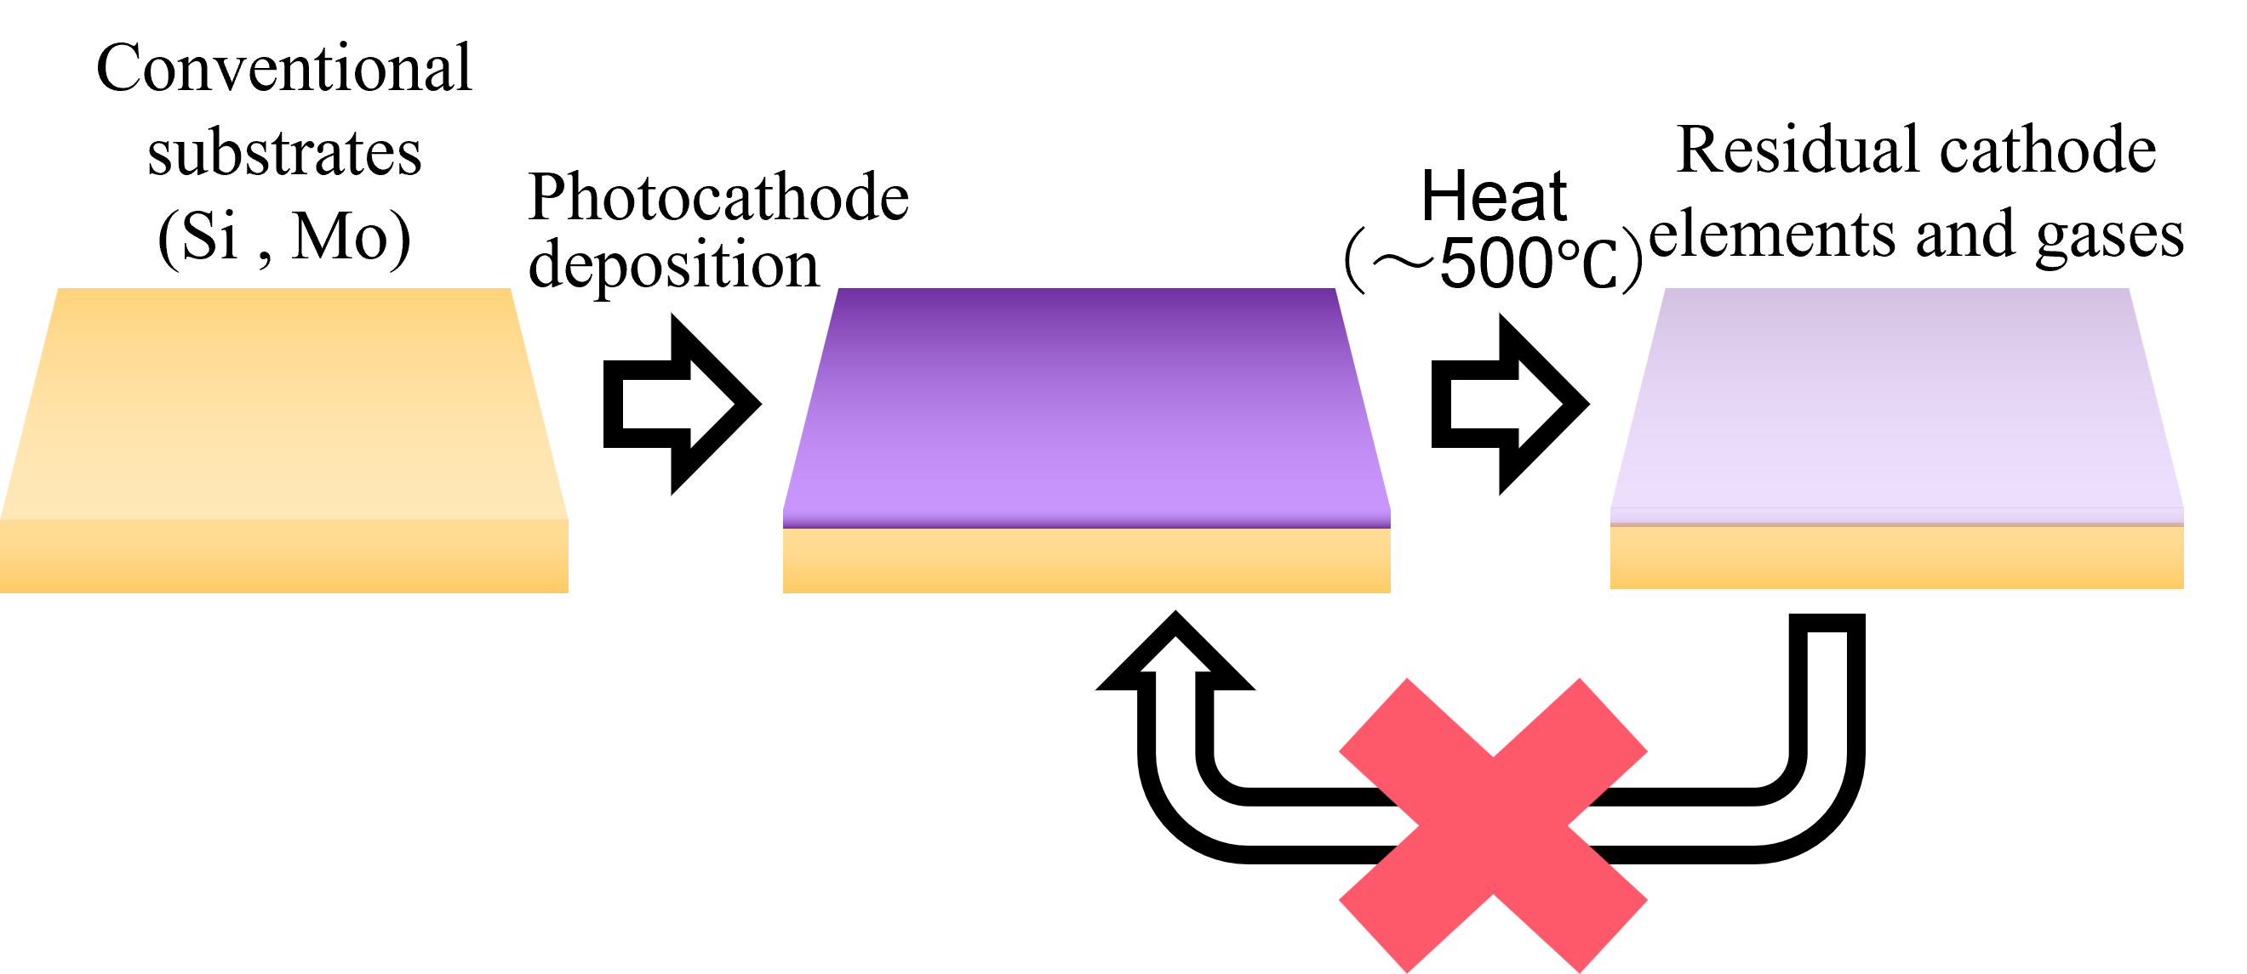
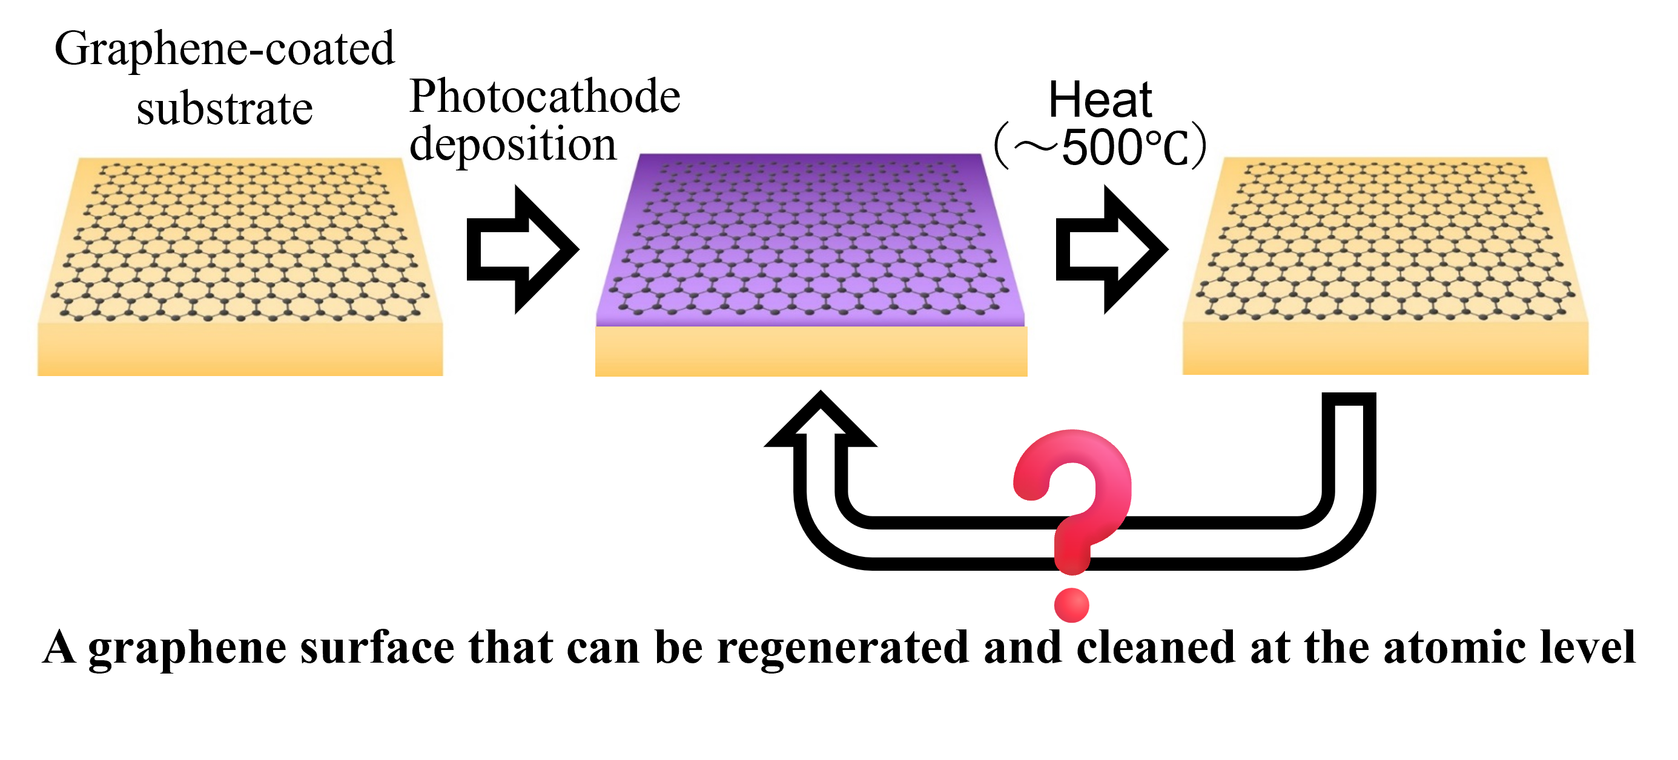
Attempts to Reuse Substrates
We aim to refresh the substrate surface under vacuum.
Features of Graphene
chemically inert
excellent thermal stability
mechanically flexible
Notes:
So far, I have introduced the substrate dependence and stoichiometry control.
This slide shows our attempts to reuse photocathode substrates and the motivation behind introducing graphene.
Let me start with the conventional approach.
Using standard substrates like silicon or molybdenum, we first deposit the photocathode layer.
After operation, the cathode is removed by heating to around 500 degrees Celsius.
However, this process leaves behind remaining cathode elements and released gases on the substrate surface.
As a result, the initial surface condition cannot be fully recovered.
This is why direct substrate reuse with conventional materials is essentially not feasible.
We want to refresh the substrate surface under vacuum system.
In the lower part of the slide, we show the concept of a graphene-coated substrate.
This raises a fundamental question: can we repeatedly remove and redeposit photocathodes while preserving the substrate?
The key lies in the unique properties of graphene.
Graphene is chemically inert, highly stable at high temperatures, and flexible.

Slide 15
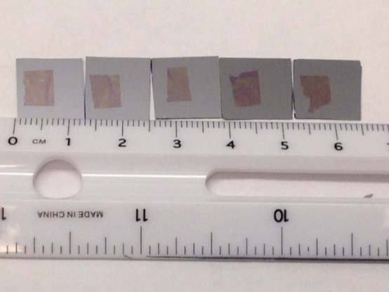
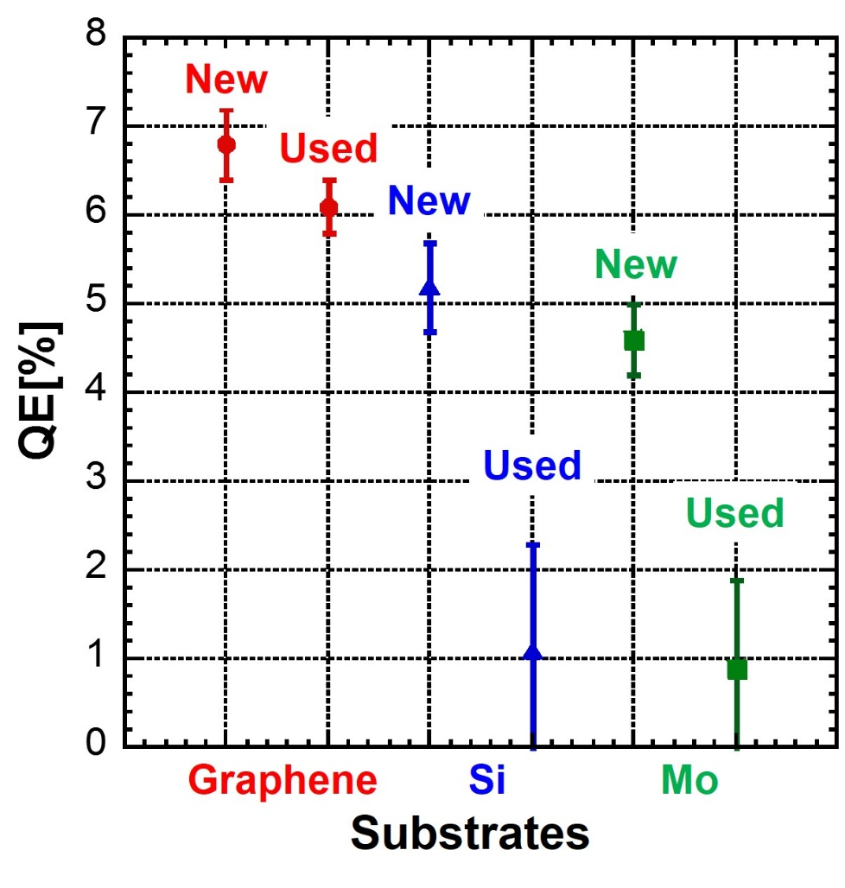

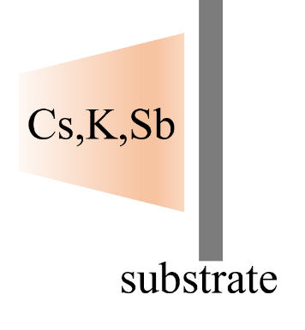
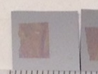
Cathode deposition on graphene substrates
Graphene
Si
Mo
The graphene substrates were provided by Dr. Yamaguchi’s team at Los Alamos National Laboratory
Air
New：First-time cathode deposition
Used：Re-deposition after venting to air
L. Guo et al., Appl. Phys. Lett. 116, 251903 (2020).
Notes:
In this slide, I show how graphene makes reproducible cathode deposition possible, even after air exposure.
Let me start with the photograph on the left.
The graphene substrates were provided by Dr. Yamaguchi’s team.
Here, graphene is transferred onto different substrates, silicon and molybdenum.
The schematic at the bottom shows that after Cs–K–Sb deposition, the sample is vented to air, and then reintroduced into the vacuum system for re-deposition.
This process would normally contaminate the surface and degrade performance.
Let me focus on the plot on the right.
This graph compares the QE for new substrates and used substrates after air exposure.
For graphene substrates, the QE remains almost unchanged after reuse.
In contrast, for uncoated silicon and molybdenum substrates, the QE drops significantly after reuse.
These results clearly show that graphene acts as a protective and reusable interface, allowing stable and reproducible photocathode deposition.

Slide 16
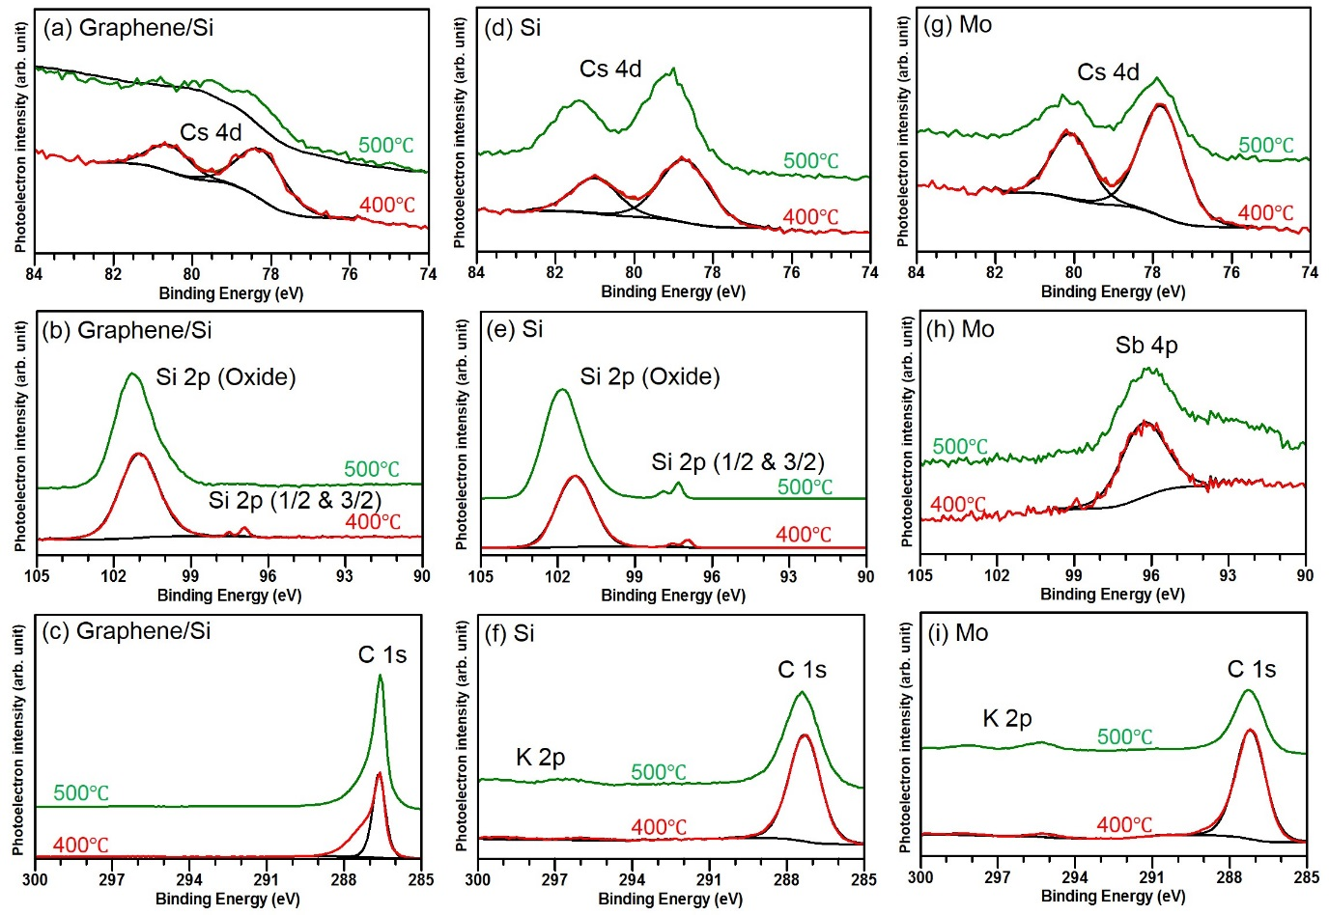
Verification of Residual Cathode Elements – Synchrotron XPS
Substrate | Cleaning temperatures [℃] | Si | C | Sb | K | Cs | Mo
Graphene/Si | 400 | 22.8 | 75.2 | 0 | 0 | 2.0 | NA
Graphene/Si | 500 | 19.8 | 80.2 | 0 | 0 | 0 | NA
Si | 400 | 70.1 | 25.9 | 0 | 1.3 | 2.7 | NA
Si | 500 | 76.9 | 18.9 | 0 | 1.4 | 2.8 | NA
Mo | 400 | NA | 27.8 | 2.2 | 7.3 | 3.0 | 59.7
Mo | 500 | NA | 22.9 | 1.7 | 7.5 | 2.9 | 65.0
L. Guo et al., Appl. Phys. Lett. 116, 251903 (2020).
Notes:
To make sure whether the substrate surface is truly refreshed, we performed Synchrotron XPS.
The spectra compare three cases: graphene on silicon, uncoated silicon, and molybdenum.
In particular, we look for signals from cesium, potassium, and antimony.
After removal of the photocathode, none of these elements are detected.
Only the signals are from graphene and the underlying substrate are observed.
This result indicates that alkali metals and antimony do not remain on the surface after the removal process.

Slide 17
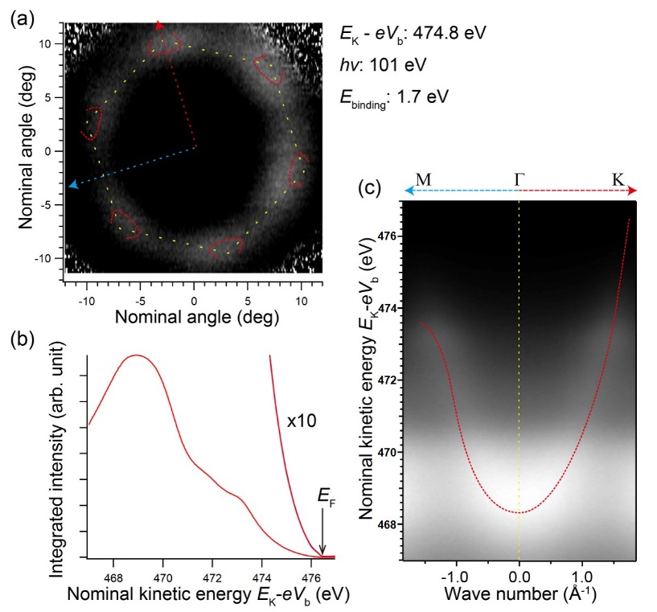


Verification of Graphene Crystal Structure – ARPES
Undamaged graphene
No detachment from the base substrates (Si, Mo).
$$σ$$
Quasi-permanent
$$π$$
L. Guo et al., Appl. Phys. Lett. 116, 251903 (2020).
Notes:
We also need to make sure that the graphene layer itself remains intact after photocathode deposition and removal.
To address this, we performed ARPES.
As shown in this slide, the Dirac cone of graphene is clearly observed after the deposition–removal cycle.
These results show that graphene remains structurally and electronically intact.
Together with the XPS results, show that graphene can survive repeated photocathode fabrication cycles, which is essential for realizing reusable substrates.
We can now introduce the concept of a quasi-permanent substrate.

Slide 18
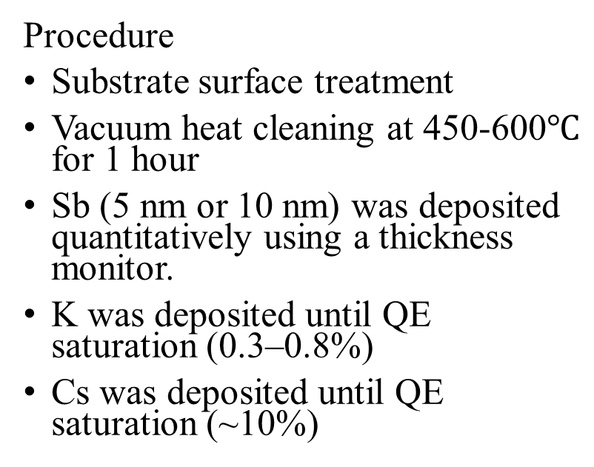
A stable deposition recipe
Procedure
Substrate surface treatment
Vacuum heat cleaning at 450-600$℃$ for 1 hour
Sb (5 nm or 10 nm) was deposited quantitatively using a thickness monitor.
K was deposited until QE saturation (0.3–0.8%)
Cs was deposited until QE saturation (~10%)
The thicknesses of K and Cs were adjusted to maximize the QE.
A technique to reproducibly achieve high QE has been established
Notes:
Finally, I want to talk about a stable deposition recipe.
The plot shows the QE evolution during deposition.
The substrate surface is treated, followed by vacuum heat cleaning for one hour.
Next, antimony is deposited first.
Here, we control the Sb thickness, typically 5 or 10 nanometers, using a thickness monitor.
This allows us to fix the starting point of the growth process.
After that, potassium is deposited up to make a QE mountain.
Finally, cesium is deposited up to the QE reaches its maximum value.
By carefully adjusting the potassium and cesium thicknesses while monitoring QE in real time, we can reproducibly reach high QE.
Taken together, these results show that a stable and reproducible technique to achieve high QE has been successfully established.

Slide 19
Conclusion
Key Takeaways
Substrate-aware growth is essential
  Clean surface, (100) orientation, and p-type substrates enable high QE
Stoichiometry control determines durability
  K-rich growth forms a thick, stable CsK₂Sb phase
  Similar initial QE, but order-of-magnitude improvement in robustness
Graphene enables substrate reuse
  Acts as a chemically inert, robust interlayer
  Verified by XPS and ARPES → quasi-permanent substrate
Implication
CsK₂Sb fabrication can move from
trial-and-error → physics-guided and reproducible growth
Provides a practical pathway toward stable photocathodes for
high-average-current accelerator injectors
Notes:
The key messages of this talk.
First, we checked the substrate factors.
Second, we showed the potassium-rich deposition method.
Third, we found a quasi-permanent substrate use graphene.
Taken together, these approaches shift CsK₂Sb photocathode fabrication from a trial-and-error process toward a more physics-guided and reproducible methodology.
We believe that this framework provides a practical pathway toward stable, high-performance photocathodes for high-average-current accelerator applications.

Slide 20
Thank you very much for your attention.
Notes:
Thank you very much for your attention.
I would like to acknowledge my collaborators and colleagues who contributed to this work.
I will be happy to take any questions or comments.

Slide 21
Back up

Slide 22
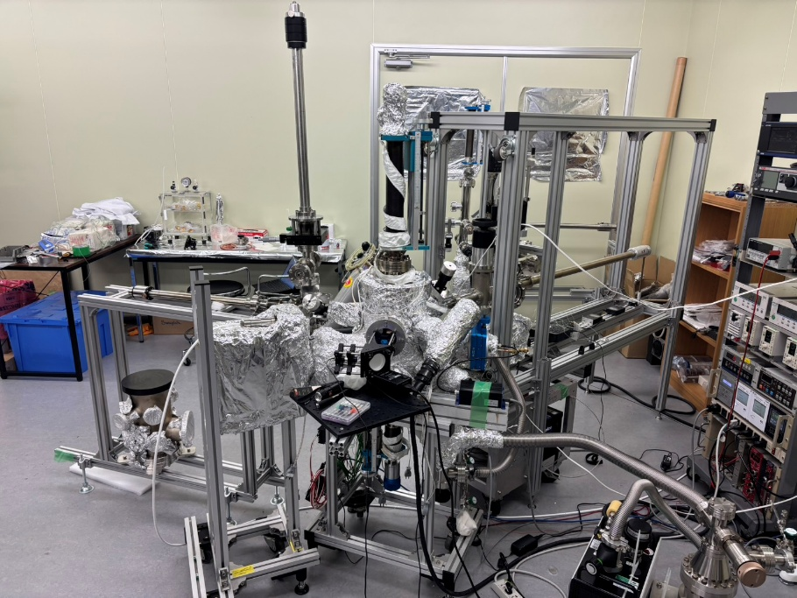
Vacuum Transport System
Cathode Deposition Chamber
VSC

Slide 23
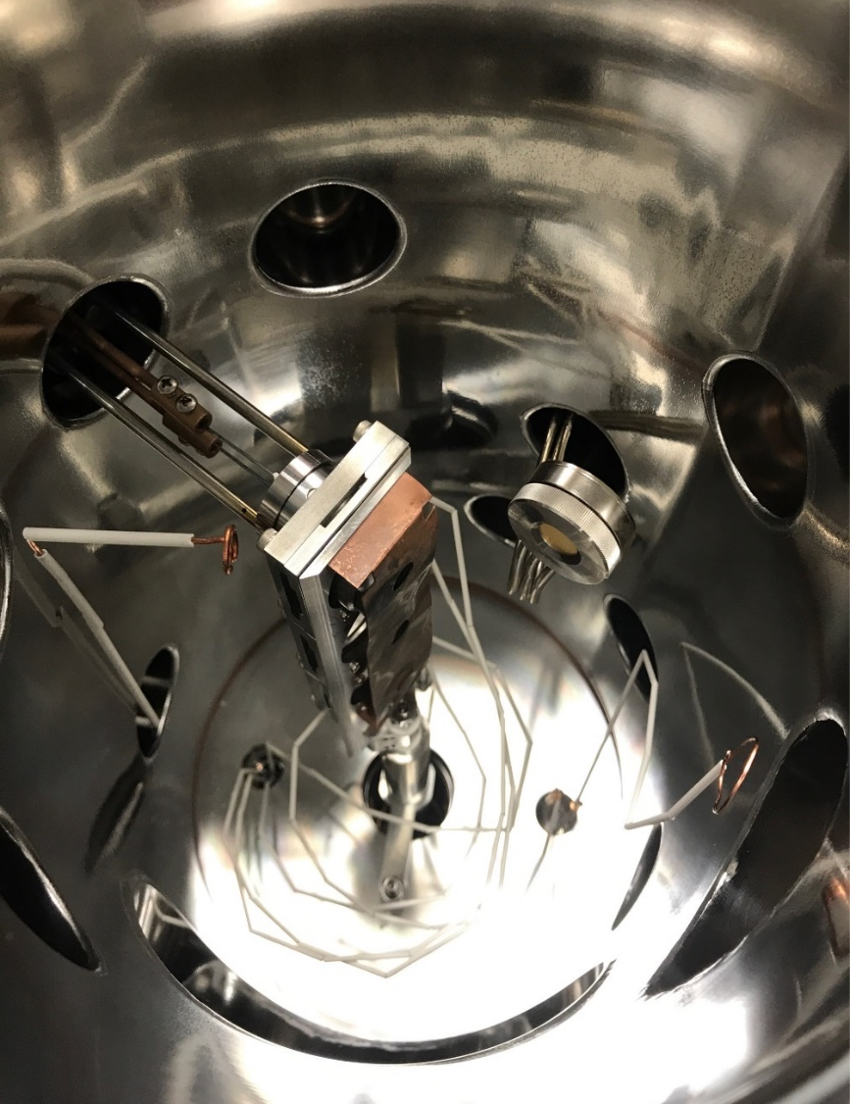
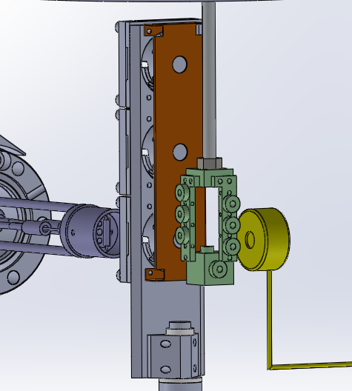
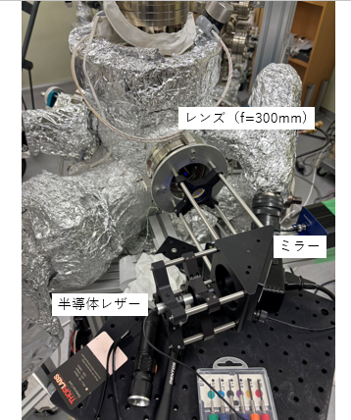
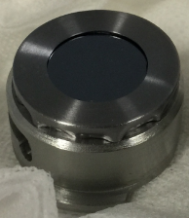
Cathode Holder
K,Cs Dispensers
Heater
Thickness Monitor
Sb
Source
Lens
Mirror
semiconductor laser

Slide 24
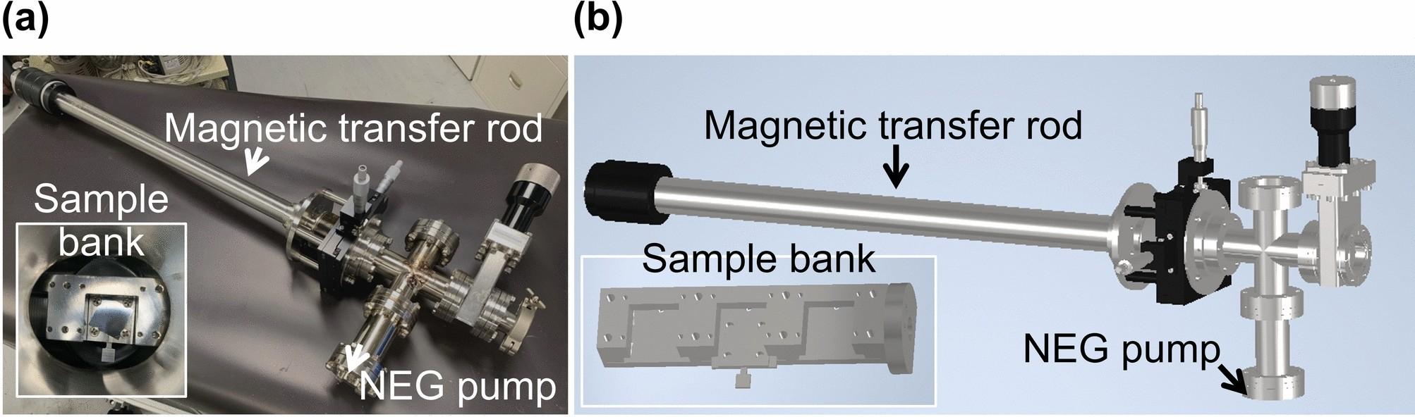
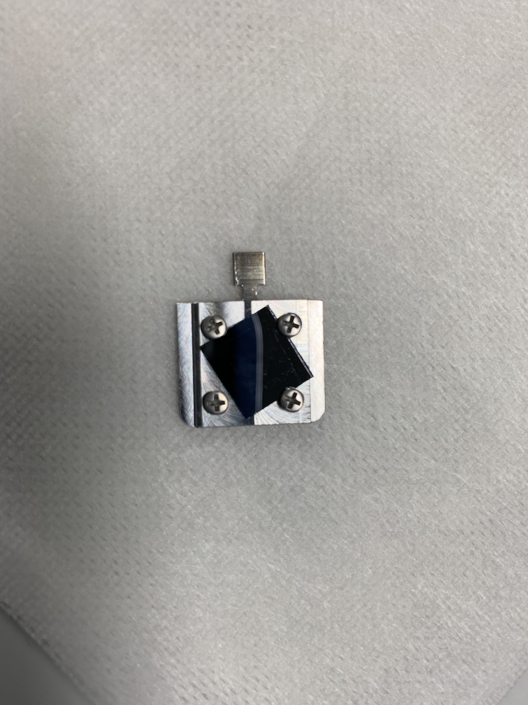

Slide 25
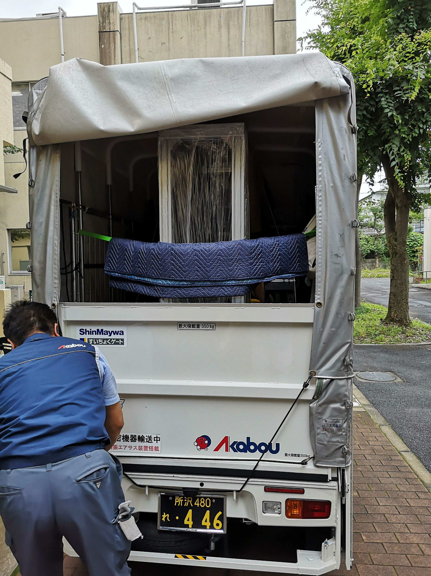
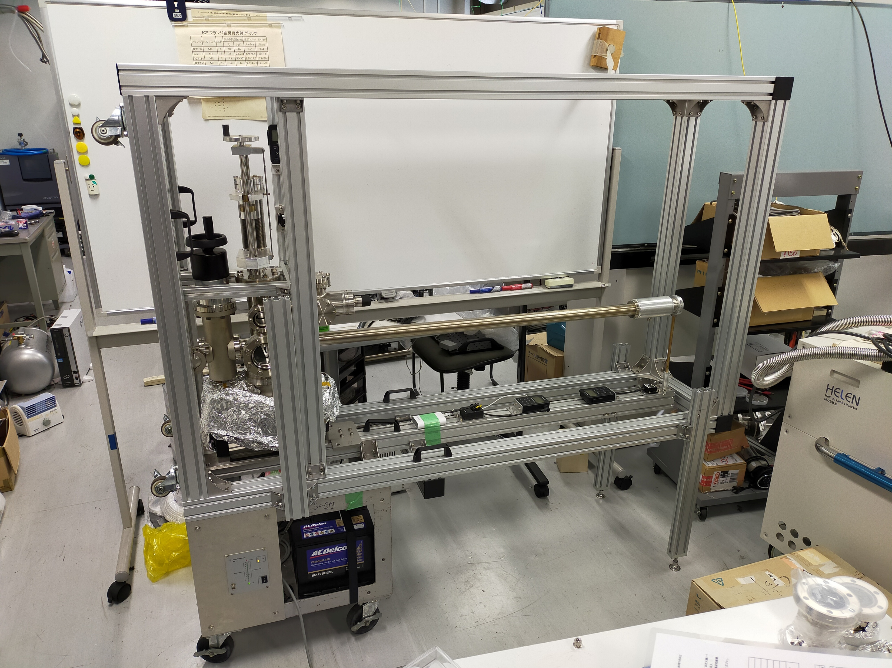

Slide 26
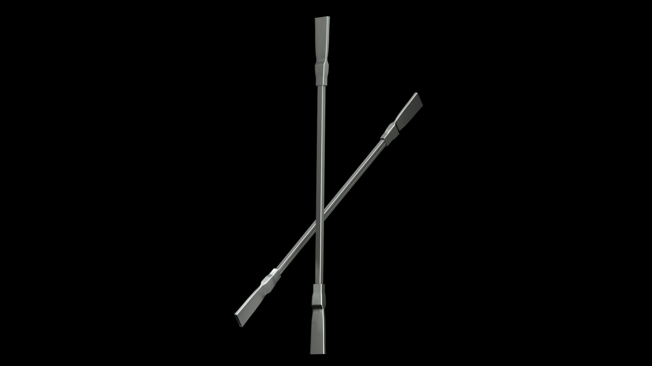
SAES
dispenser
Electrical conductivity
Heat conductivity

Slide 27
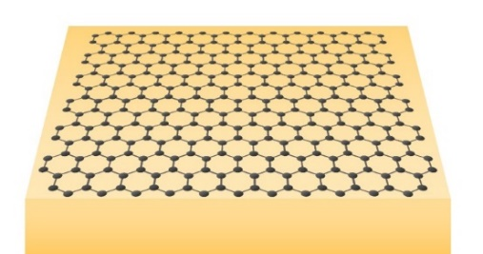
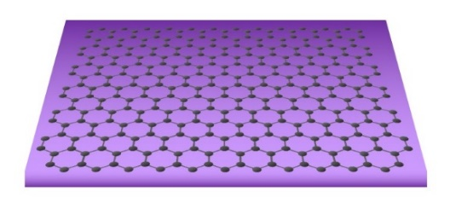

quasi-permanent substrate
Graphene-coated substrate
No residue (XPS)
Graphene intact (ARPES)
Photocathode deposition
Heat
（～500℃）
An atomically regenerable and clean graphene surface
Notes:
Graphene acts as a protective and reusable interface layer.
It prevents chemical modification of the substrate while remaining intact after repeated photocathode deposition and removal.
As a result, the substrate does not need to be replaced after each fabrication cycle.
Rather, it can be reused several times under vacuum with consistent surface conditions.
This shifts CsK₂Sb photocathode fabrication from a single-use process to a more long-term and reproducible approach.
In this sense, the substrate becomes quasi-permanent.

Slide 28
Attempts to Reuse Substrates
Conventional substrates
(Si , Mo)
Residual cathode elements and gases
Photocathode deposition
Heat
（～500℃）
We aim to refresh the substrate surface under vacuum.
Graphene-coated substrate
Photocathode deposition
Heat
（～500℃）
❓
A graphene surface that can be regenerated and cleaned at the atomic level

Slide 29
@532 nm
Graphene
Sb Evp.
K Evp.
Cs Evp.

