Slide 1


Status of neutrinos
L. Simard, journée P2I, 26/11/25

Slide 2
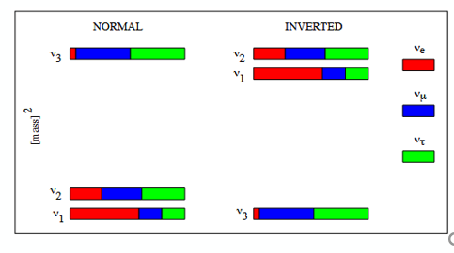
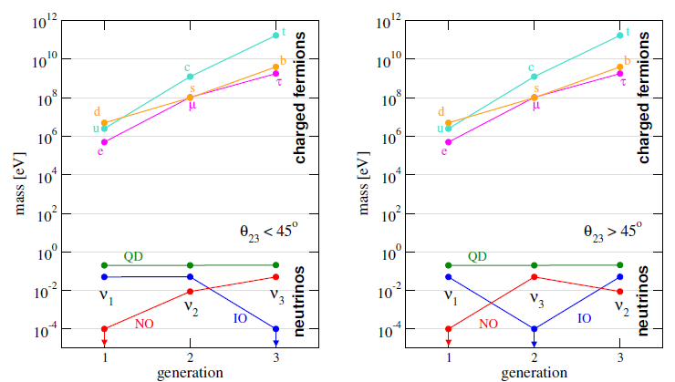
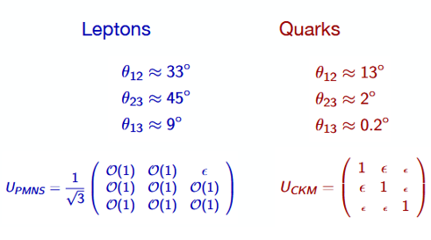
The neutrino challenge
Mixing of leptons is very different from quarks
Neutrino masses are tiny

Slide 3
Topics studied about the neutrino
Oscillations : Mixing angles, CP phase and squared mass differences
Sterile neutrinos : additional flavour
Direct mass measurement : absolute mass
Double beta decay : nature

Slide 4
Neutrino oscillations

Slide 5
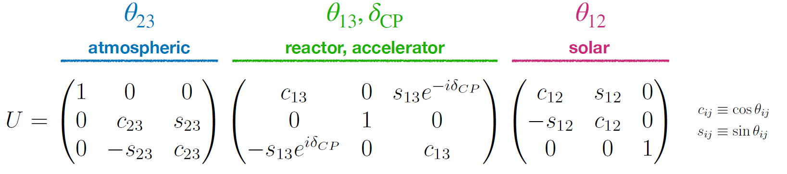
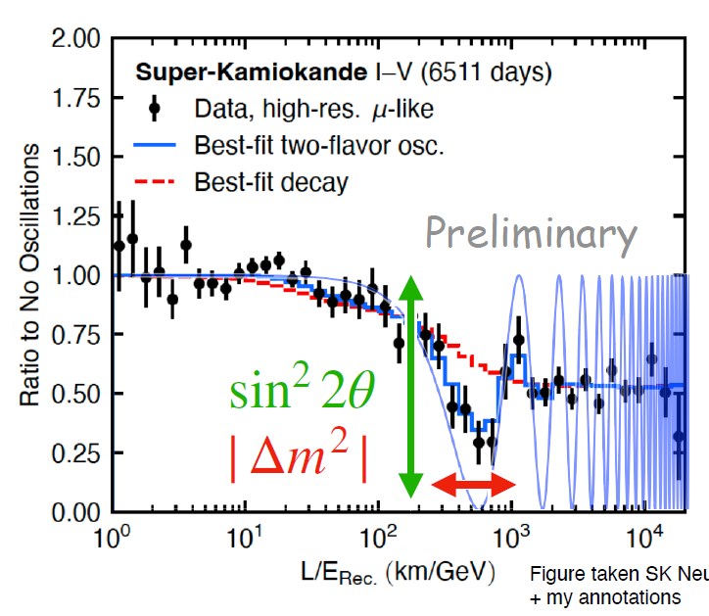
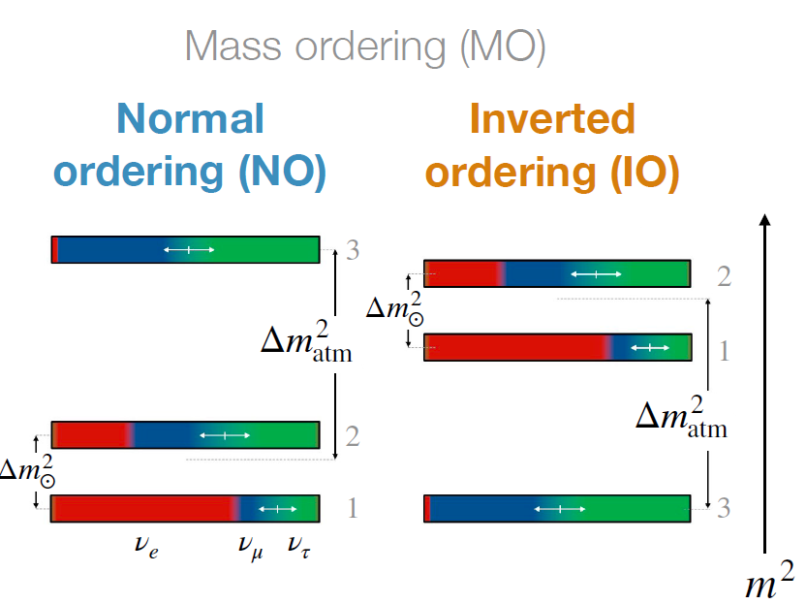
Mixing angles, CP phase and squared mass differences
constrained by neutrino oscillations

Slide 6
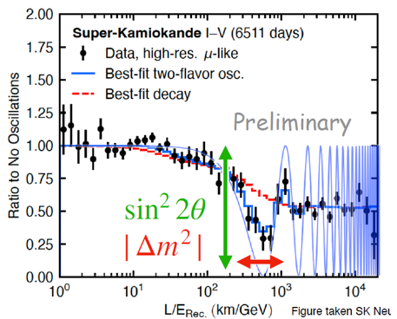
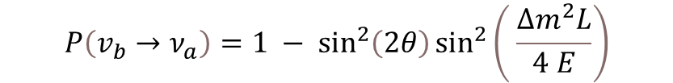

Current neutrino oscillation experiments
Simple approach : 2 ν families
appearance
$$P\left(v_{α}→ν_{B}\right)=\sin^{2}\left(2θ\right)\sin^{2}\left( \frac{Δm^{2}L}{4 E}\right)$$
disappeareance
$$P\left(v_{b}→ν_{a}\right)=1 − \sin^{2}\left(2θ\right)\sin^{2}\left( \frac{Δm^{2}L}{4 E}\right)$$

Slide 7
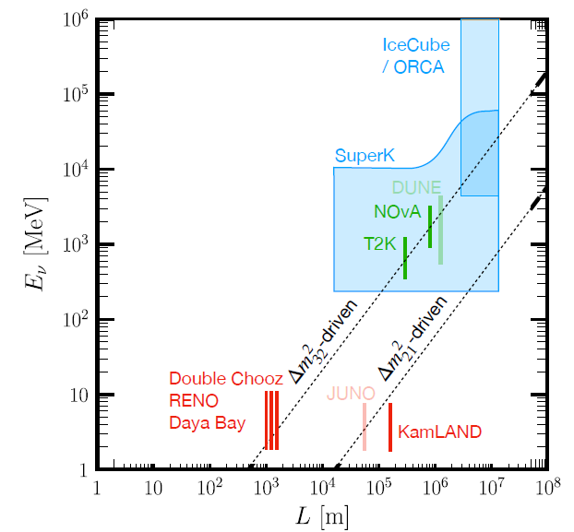

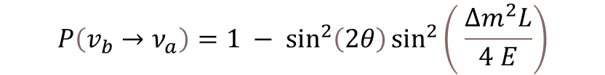
Current neutrino oscillation experiments
Simple approach : 2 ν families
appearance
$$P\left(v_{α}→ν_{B}\right)=\sin^{2}\left(2θ\right)\sin^{2}\left( \frac{Δm^{2}L}{4 E}\right)$$
disappareance
$$P\left(v_{b}→ν_{a}\right)=1 − \sin^{2}\left(2θ\right)\sin^{2}\left( \frac{Δm^{2}L}{4 E}\right)$$

Slide 8
Short baseline reactor experiments

Slide 9
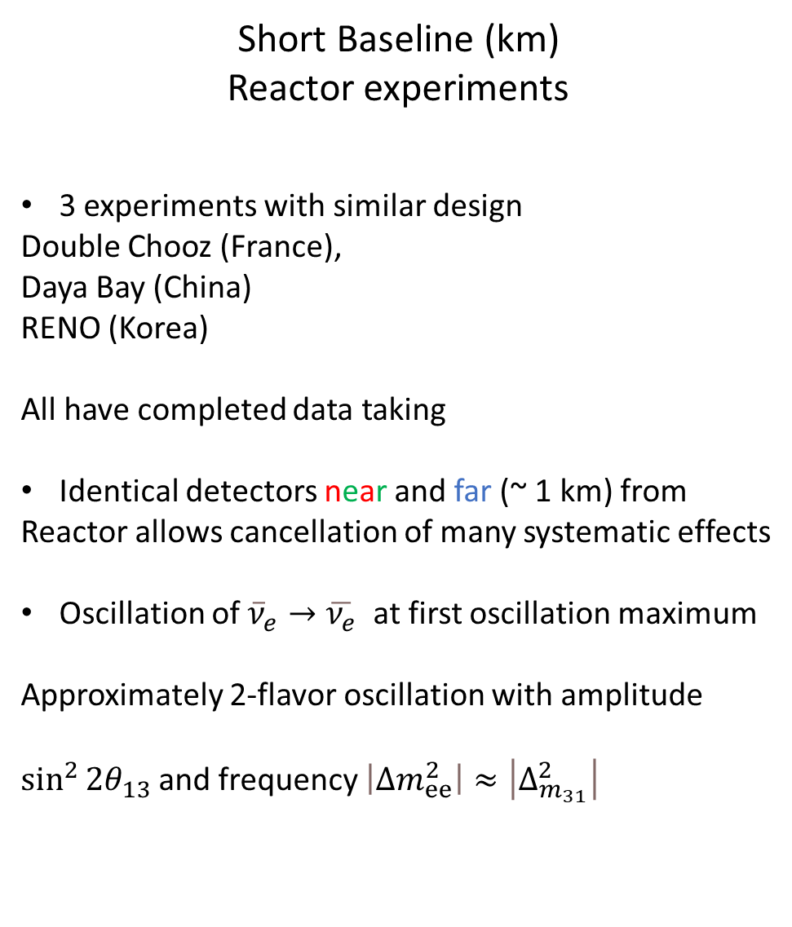
Short Baseline (km)
Reactor experiments
3 experiments with similar design
Double Chooz (France),
Daya Bay (China)
RENO (Korea)
All have completed data taking
Identical detectors near and far (~ 1 km) from
Reactor allows cancellation of many systematic effects
Oscillation of ${\overline{ν}}_{e}→\overline{ν_{e}}$ at first oscillation maximum
Approximately 2-flavor oscillation with amplitude
$\sin^{2}{2θ_{13}}$and frequency $\left|Δm_{ⅇⅇ}^{2}\right|≈\left|Δ_{m_{31}}^{2}\right|$

Slide 11
Medium baseline reactor experiments
JUNO

Slide 12
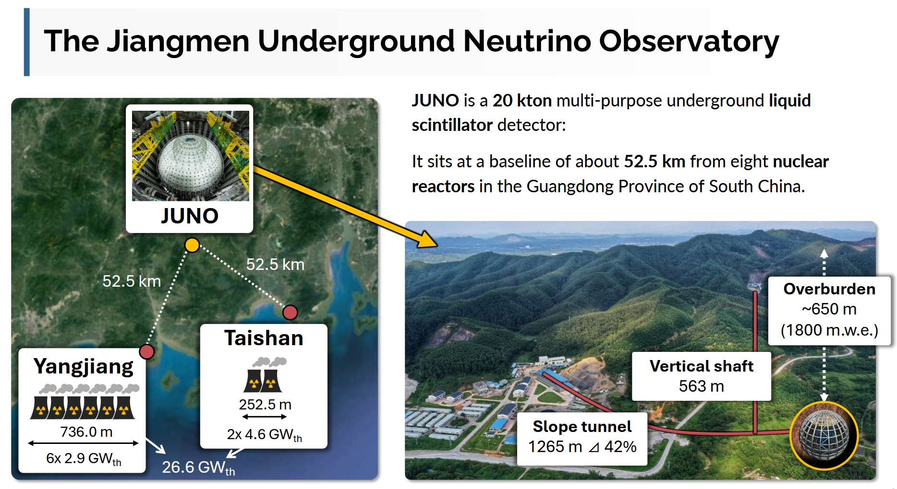

Slide 13
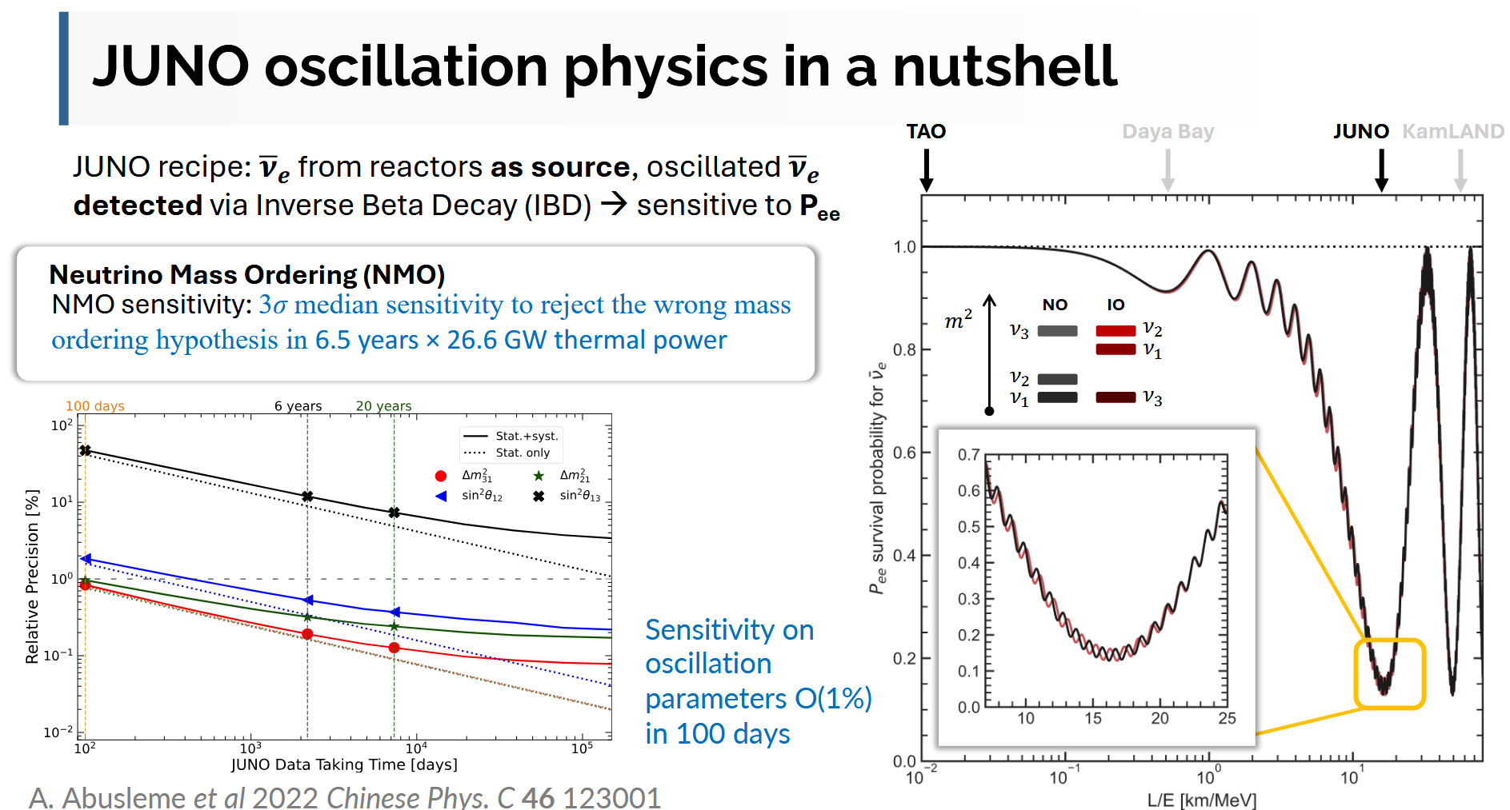

Slide 14
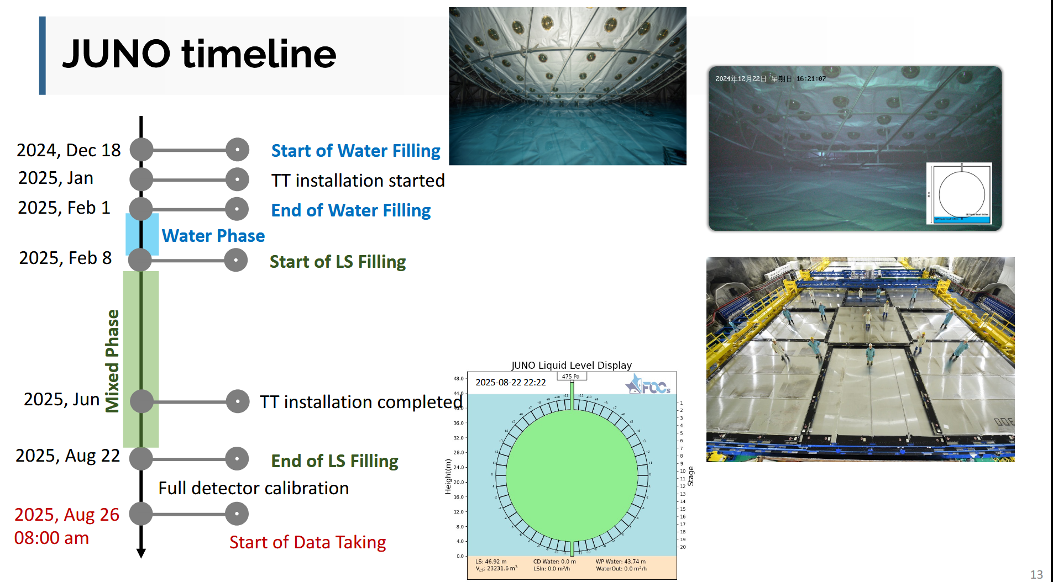

Slide 15
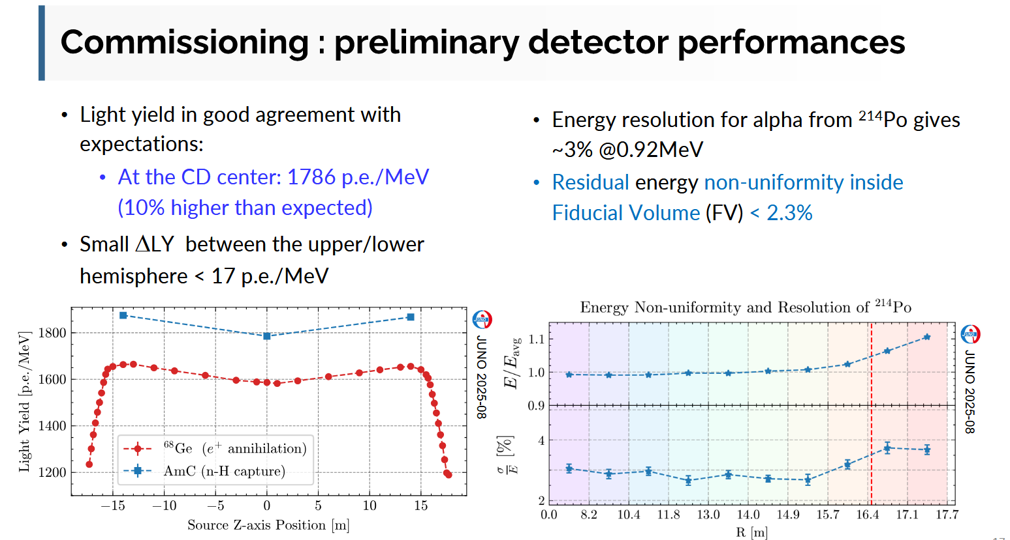

Slide 16
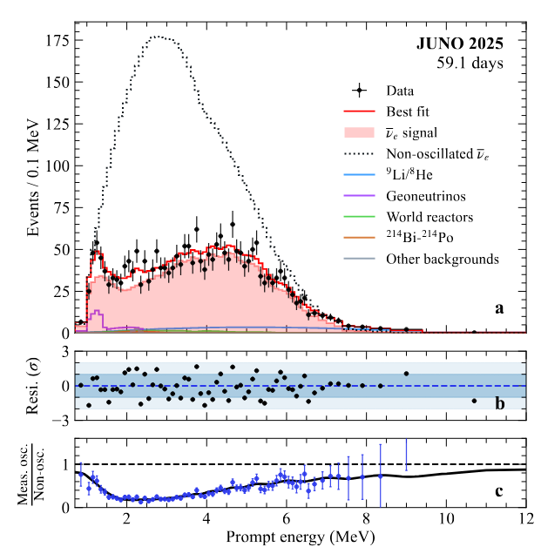
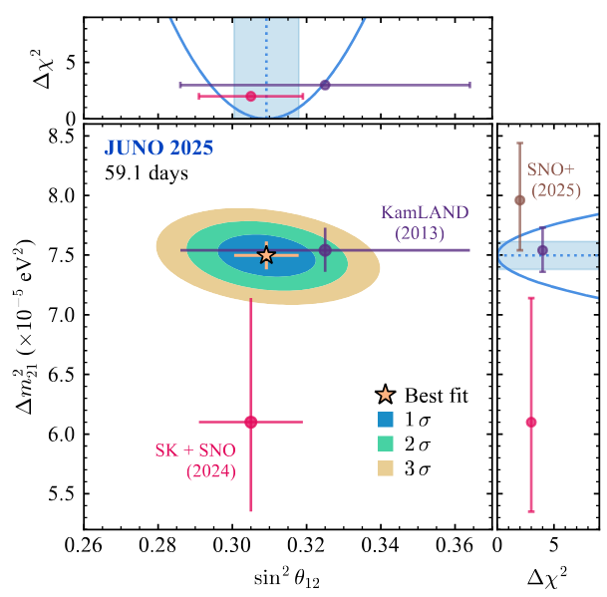
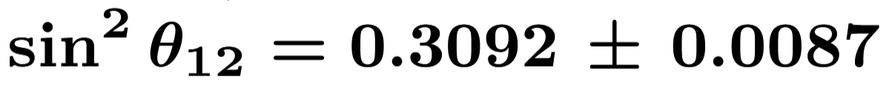
Juno first results (18/11/25)

Slide 17
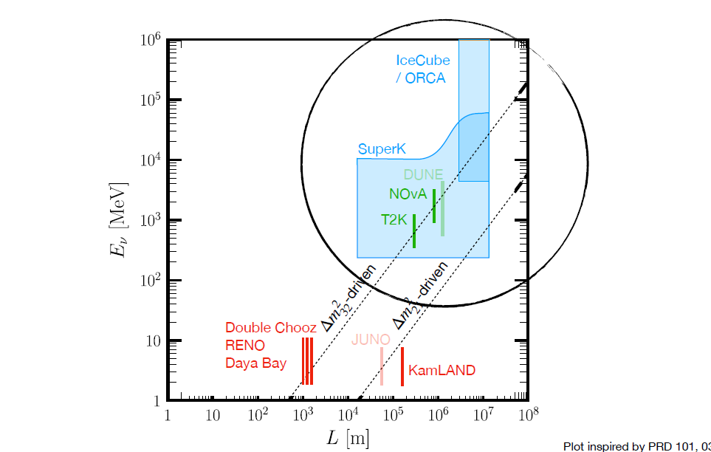
Long baseline experiments

Slide 18
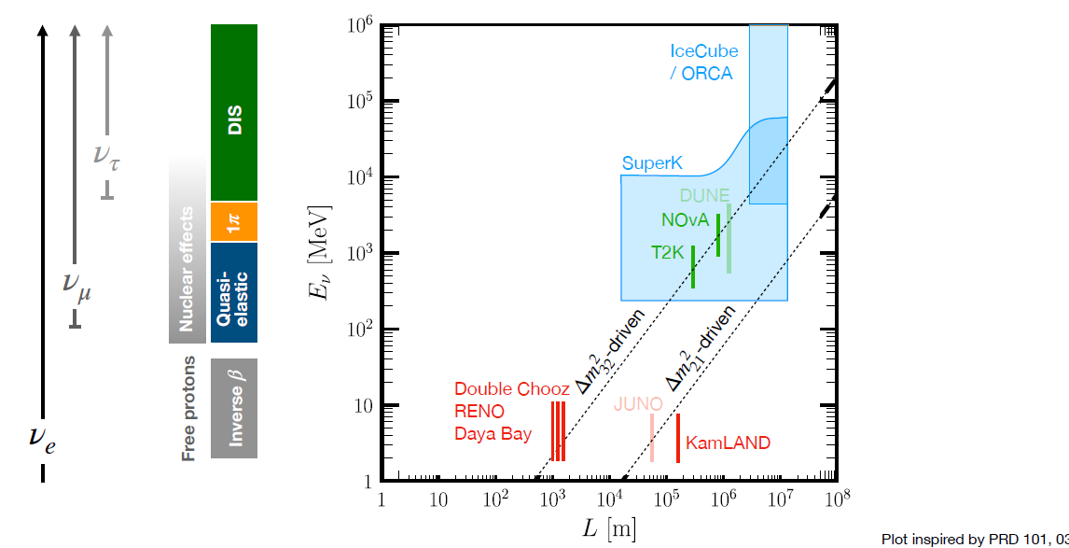
Long baseline experiments

Slide 19
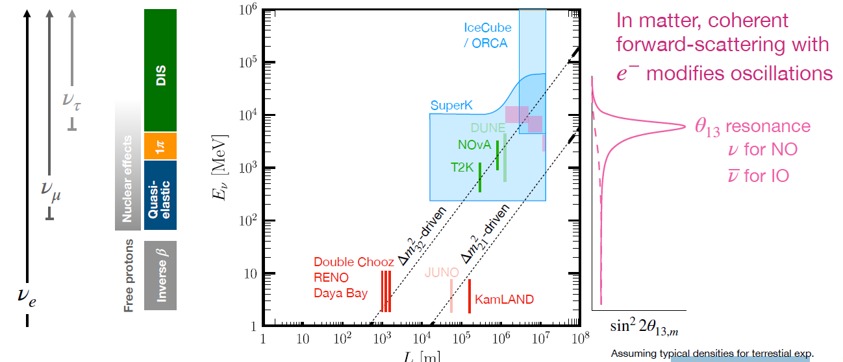
Long baseline experiments

Slide 20
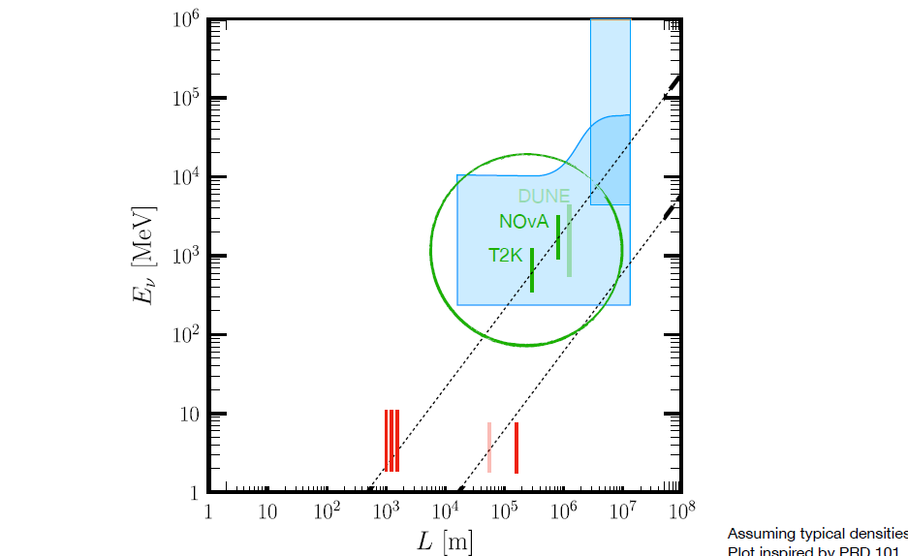
Accelerator experiments

Slide 21
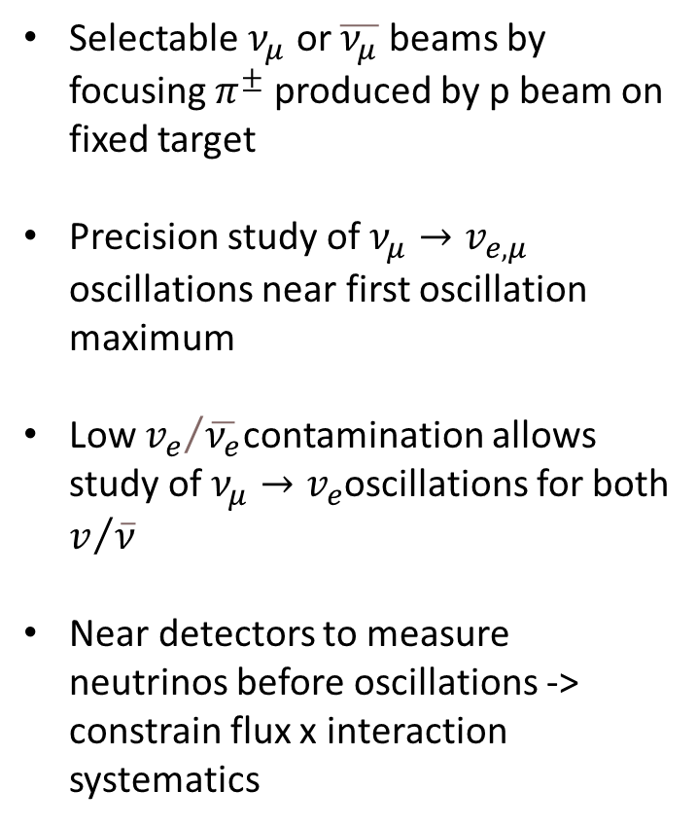
Accelerator neutrinos
Selectable $ν_{μ}$ or $\overline{ν_{μ}}$ beams by focusing $π^{±}$ produced by p beam on fixed target
Precision study of $ν_{μ}→v_{e,μ}$ oscillations near first oscillation maximum
Low ${v_{e}}/{\overline{ν_{e}}}$contamination allows study of $ν_{μ}→v_{e}$oscillations for both $v/{\overline{ν}}$
Near detectors to measure neutrinos before oscillations -> constrain flux x interaction systematics
810 km

Slide 22
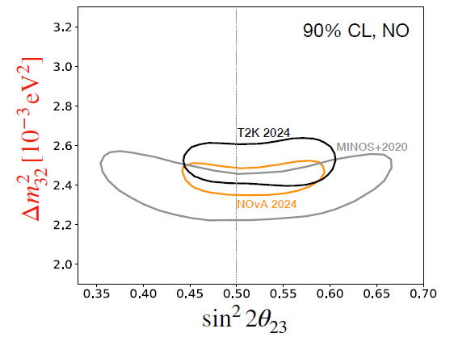

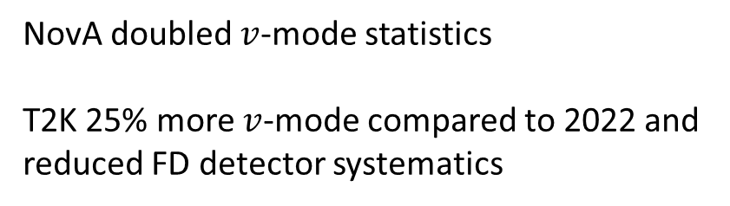
$ν_{μ}$ disappearance
NovA doubled $v$-mode statistics
T2K 25% more $v$-mode compared to 2022 and reduced FD detector systematics
Consistent with maximal mixing
T2K has been upgrading beamline and ND.
-> expect improvement in future

Slide 23
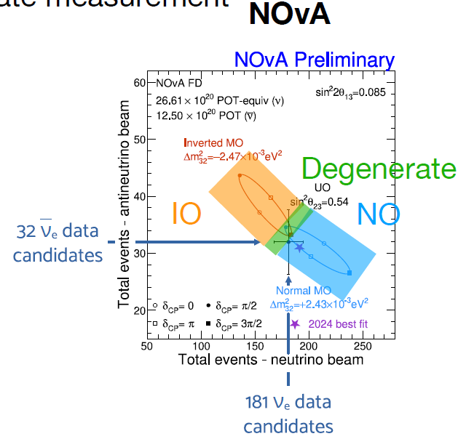
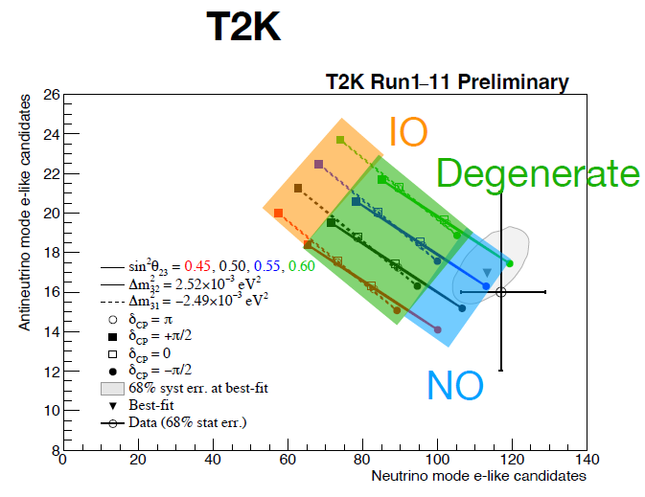
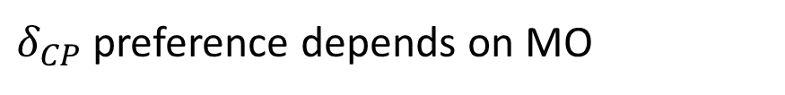
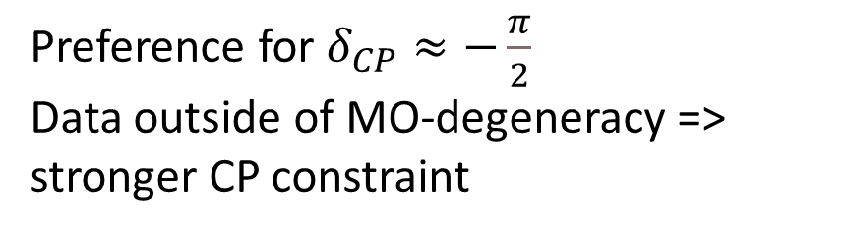

${ν_{e}}/{\overline{ν_{e}}}$ appearance
Currently mostly a rate measurement
Preference for NO
More sensitive to MO than T2K due to higher energy (longer baseline)
But data prefers MO-degenerate region.
Preference for $δ_{CP}≈−\frac{π}{2}$
Data outside of MO-degeneracy => stronger CP constraint
$δ_{CP}$ preference depends on MO

Slide 24
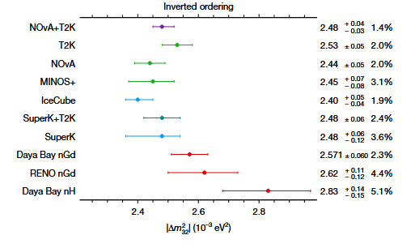
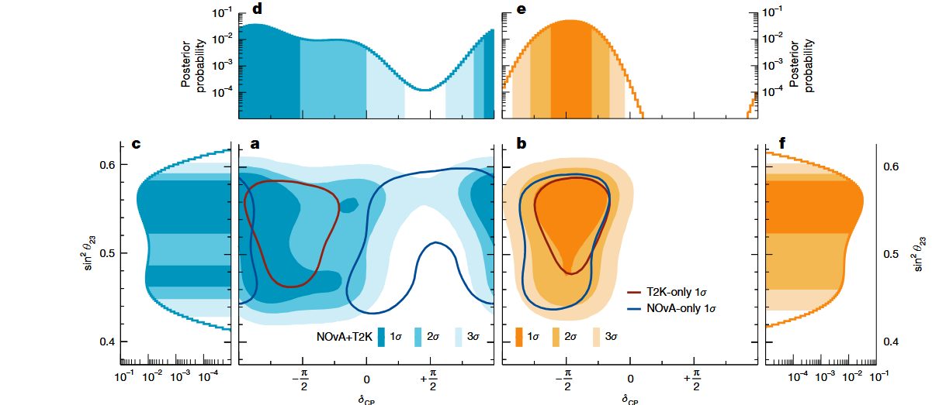
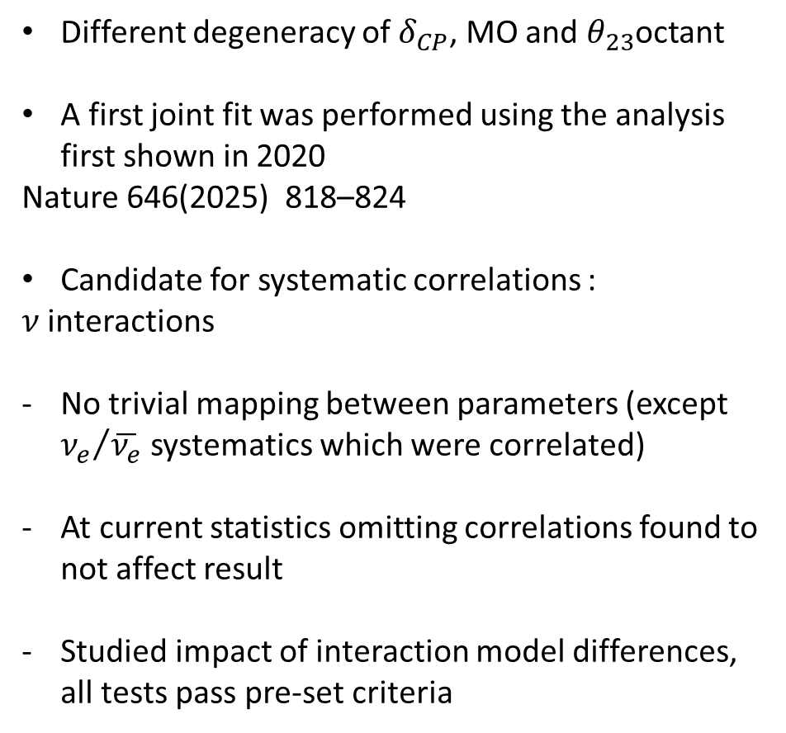
Combination T2K NOVA
Different degeneracy of $δ_{CP}$, MO and $θ_{23}$octant
A first joint fit was performed using the analysis first shown in 2020
Nature 646(2025) 818–824
Candidate for systematic correlations :
$ν$ interactions
No trivial mapping between parameters (except ${ν_{e}}/{\overline{ν_{e}}}$ systematics which were correlated)
At current statistics omitting correlations found to not affect result
Studied impact of interaction model differences, all tests pass pre-set criteria

Slide 25
Atmospheric experiments

Slide 26
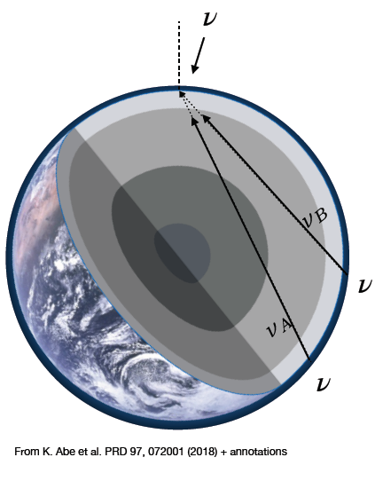
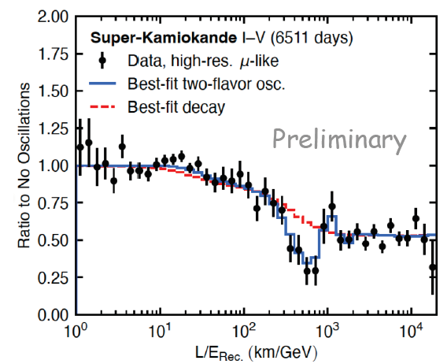
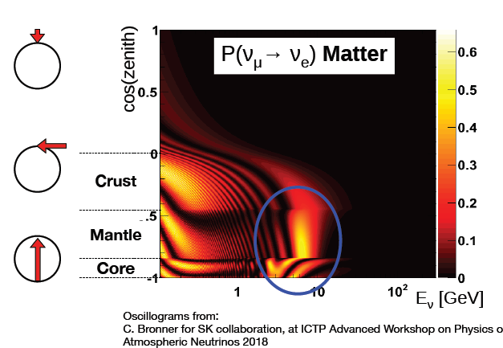
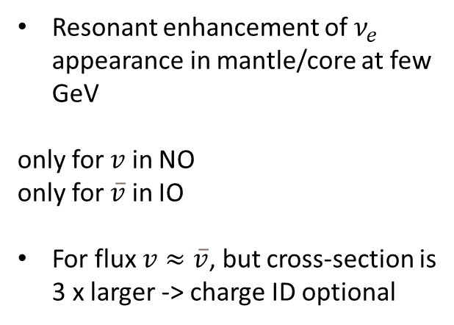
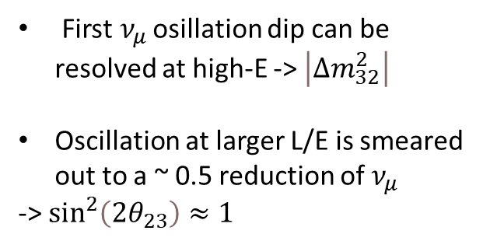
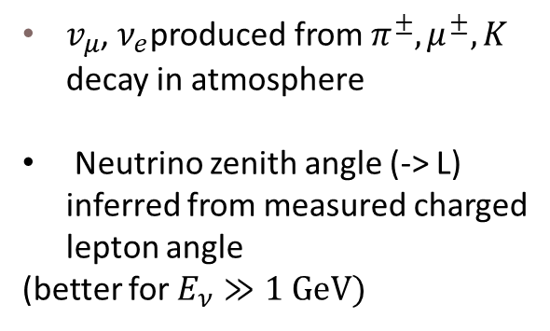
Atmospheric neutrinos
Resonant enhancement of $ν_{e}$ appearance in mantle/core at few GeV
only for $v$ in NO
only for $\overline{v}$ in IO
For flux $v≈\overline{v}$, but cross-section is 3 x larger -> charge ID optional
$v_{μ}$, $ν_{e}$produced from $π^{±},μ^{±},K$ decay in atmosphere
Neutrino zenith angle (-> L) inferred from measured charged lepton angle
(better for $E_{ν}≫1 GeV)$
First$ν_{μ}$ osillation dip can be resolved at high-E -> $\left|Δm_{32}^{2}\right|$
Oscillation at larger L/E is smeared out to a ~ 0.5 reduction of $ν_{μ}$
-> $\sin^{2}\left(2θ_{23}\right)≈1$
-> MO

Slide 27
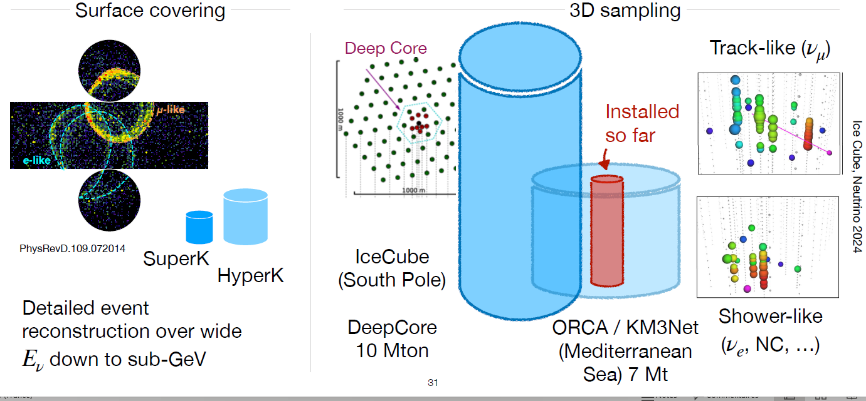

Atmospheric $v$ detectors
detectors drawn roughly to scale

Slide 28
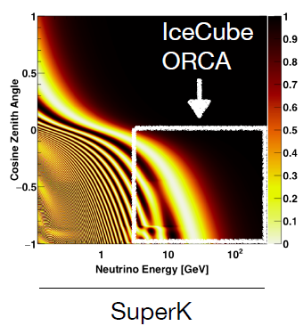
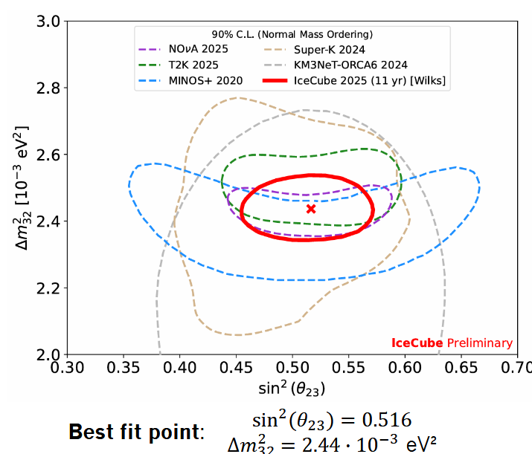
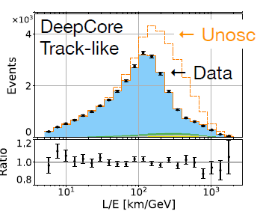

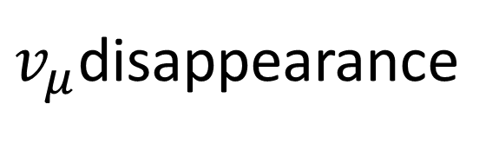
$v_{μ}$disappearance
SuperK : 20% expansion of fiducial volume + additional years
PRD 109, 072014 (2024)
In total 48% statistics increase over previous publication
DeepCore move to CNN-based reconstruction + 2 years
arXiv2105.02163
7x increase in statistics
Expect 2x reduction of errors in 4 years

Slide 29
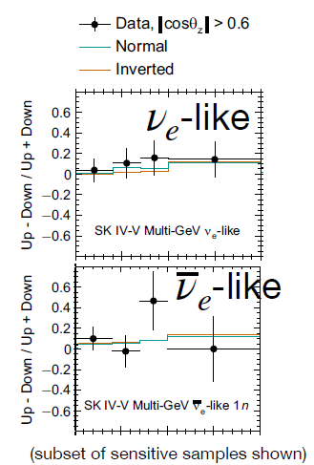
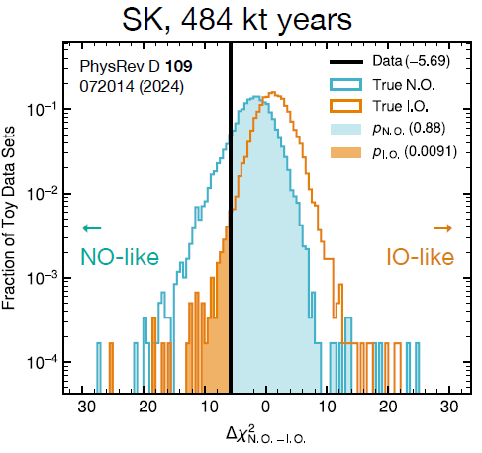
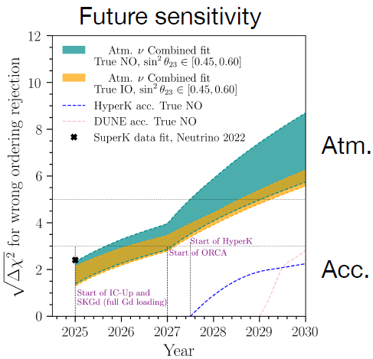
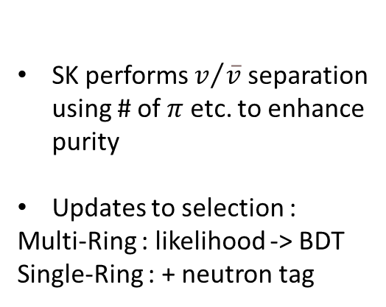
Mass ordering
From matter resonance
SK performs $v/{\overline{v}}$ separation using # of $π$ etc. to enhance purity
Updates to selection :
Multi-Ring : likelihood -> BDT
Single-Ring : + neutron tag
Indication of NO.
Rejection of IO at 92.3 % Cls
Dominated by stat, then x-sec.
IceCube upgrade, ORCA, and HyperK expected to measure MO in the next few years.
PRX 13, 041055 (2023)

Slide 30
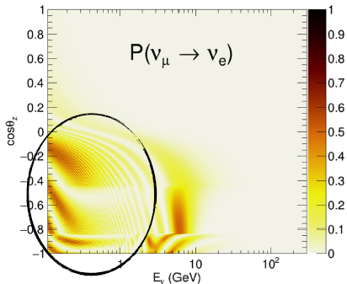
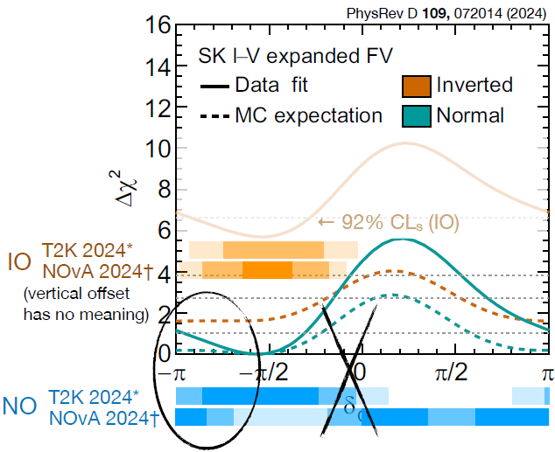
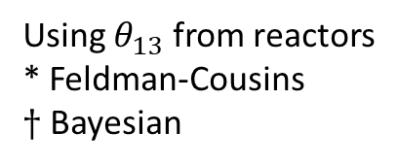

Using $θ_{13}$ from reactors
* Feldman-Cousins
$†$ Bayesian
CP phase
SK also constrains $δ_{CP}$ from normalization of sub-GeV e-like events. Unlike accelerators, decoupled from MO.
Interplay of $Δm_{32}^{2}$-$Δm_{21}^{2}$interference phase-shift and flux/x-sec shape, fully smeared dur to resolution.
Weak indication of maximal CP violation but CP conservation still allowed
Caveat: somewhat stronger exclusion than sensitivity. Due to parameter boundaries and degeneracies cannot take $\sqrt{Δx^{2}}$ as sigmas.
Prefer $δ_{CP}$= π over 0.
Interesting contribution to NOvA and T2K’s NO constraints.

Slide 31


3-flavour oscillation parameters
robust determination of 5 parameters,
Complementarity of various data sets
Non trivial consistency checks of 3-flavour paradigm :
test of unitarity of PMNS matrix
Relative precision at 3σ :

Slide 32


Slide 33


Slide 34


Slide 35


Slide 36


Slide 37




DUNE mass ordering and $δ_{CP}$ sensitivity
Mass ordering :
Whatever the values of other oscillation parameters :
Can establish MO at > 5 σ in 1 year (best-case scenario)
Can establish MO at > 5 σ in 3 years (worst case scenario)
CP violation (CPV) :
can establish CPV at > 3 σ in 3.5 year (best-case scenario)
Over 50% of $δ_{CP}$ values at > 5 σ values after 10 y
Over 75% of $δ_{CP}$ values at > 3 σ values after 10 y

Slide 38


Slide 39

4

Slide 40


Slide 41
Other physics than accelerator neutrinos with JUNO, DUNE, HyperK

Slide 42

DUNE and HyperK
~ similar sensitivities
few 10³ evts

Slide 43


DUNE could observe the hep-solar neutrinos
with a gamma and neutron shielding

Slide 44

Sterile neutrinos : existence of additional flavours

Slide 45


Reactor anomaly
2021 : measurement of 235U/239Pu beta-spectra at Kurchatov Inst.
Kopeikin, Skorokhvatov, Titov, 2103.01684
5.4% smaller than ILL suggests bias in ²³⁵U ILL spectrum
„ad-initio“ calculation of reactor neutrino spectrum
Perissé et al. 2304.14992
good agreement with measured neutrino rates

Slide 46


The Gallium anomaly and BEST
Measurements of gallium experiments with radioactive ⁵¹Cr or ³⁷Ar sources: rates lower than expected at high significance
sterile neutrino oscillations in severe tension with solar and reactor neutrinos and cosmology
Giunti, Li, Ternes, Tyagi, Xin, 2209.00916; Berryman, Coloma, Huber, TS, Zhou, 2111.12530; Goldhagen, Maltoni, Reichard, TS, 2109.14898
no convincing explanation is known (BSM or conventional)
Brdar, Gehrlein, Kopp, 2303.05528; Farzan, TS, 2306.09422

Slide 47



LSND, MiniBoone
tension between appearance and disappearance data
sterile oscillation explanation of LSND/MiniB robustly disfavoured
non-observation of oscillations in μ disappearance (CDHS, MiniB, MINOS+, SK, IceCube)
consistency of appearance and disapp. data with a p-value < 10⁻⁶

Slide 48


Short-baseline anomalies no convincing indication for eV-scale sterile neutrino oscillations
Background $Δ→Nγ$
(studied by MicroBoone)

Slide 49
Constrain on mass from cosmology

Slide 50

Neutrino mass from cosmology

Slide 51

Tension between cosmology and laboratory?

Slide 52

Tensions in cosmology
• Hubble tension
• CMB-BAO tension?
• Neutrino tension?

Slide 53

Cosmology bounds can be relaxed in non-standard scenarios

Slide 54

Cosmology bounds can be relaxed in non-standard scenarios

Slide 55

Example 1 : hint for dynamical dark energy?

Slide 56

Example 1 : hint for dynamical dark energy?

Slide 57
Coherent elastic neutrino-nucleon scattering

Slide 58

Coherent elastic neutrino-nucleon scattering
ν-wavelength big enough
à Z scattering @whole nucleus
small momentum transfer
è coherent scattering
• Coherence length ~ 1/E
- Eν below O(50) MeV
lower for full coherence
• cross section ~(E_{ν})²
à overcompensate:
- very high ν flux
- coherence ~ N²
E.g. Germanium target:
N ~ 40-44 è N² ~ 1600-1900 è conventional detector mass 10t ßà few kg

Slide 59

Coherent elastic neutrino-nucleon scattering
finally observed O(50) years after invention, CEvNS is fast growing field with many recent detections:
● SNS pion decay-at-rest (pulsed): COHERENT
first detection of CEvNS in 2017 with CsI, followed by LAr (2021) and HPGe (2023)
● Reactor (lower energies): first detection in 2024 by CONUS+ with HPGe
multitude of efforts with different technologies at reactors:
CCDs (CONNIE,..), cryogenic bolometers (NUCLEUS, Ricochet), twophase TPCs (RED-100,..),…
● first evidence on CEvNS from solar neutrinos (XenonNT, PandaX)
→ bright future:
more exposure, lower thresholds, different isotopes
=> many more CEvNS events in the next few years
→ precision test of the standard model with neutrinos

Slide 60
Direct mass measurements

Slide 61

Beta-decay kinematics
● Direct measurement of phase space modification, squared neutrino mass
-> Measure sub-eV scale spectral distortion close to keV-scale kinematic endpoint
○ High-activity source (>> MBq), low-Q value (T with 18.6 keV, ¹⁶³Ho with 2.8 keV)
○ High acceptance, excellent energy resolution (~eV), low background (~mcps)
○ High precision understanding of theoretical spectrum and experimental response

Slide 62


Effective electron neutrino mass, $mβ^{2}=\sum_{i}{{\left|U_{e_{i}}\right|}^{2}m_{i}^{2}}$
● Weighted incoherent sum of mass eigenstates
● Minimum values for normal ordering, m1 < m2 << m3
min(m_{β} )_{NO} = 0.01 eV
and inverted ordering, m3 << m1 ≈ m2
min(m_{β} )_{IO} = 0.05 eV
● Current experiments probe degenerate regime,
m1 ≈ m2 ≈ m3

Slide 63

Experimental approaches

Slide 64

KATRIN working principle
● High-activity (~100 GBq) windowless gaseous
molecular tritium source, closed loop
● High-resolution (~1 eV) large-acceptance
(0-51°) MAC-E spectrometer system
● Electron counting with silicon PIN diode
➔ Integral spectrum scans, discrete retarding potential steps

Slide 65

KATRIN result
● 3rd result, 5 campaigns, 1757 scans, 259 measurement days,
7 different configurations, 1609 data points
● Best-fit compatible with zero m_{β}² = -0.14 +0.13 -0.15 eV²
➔ World-best constraint m_{β} < 0.45 eV (90% CL)
[Aker et al., Science 388 (2025) 6743]

Slide 66


KATRIN outlook
● Data taking ongoing until end-2025,
1000 measurement days, projected
final sensitivity
m_{β} < 0.3 eV (90% 𝐶𝐿)
● Rich physics program beyond neutrino mass,
eV-scale sterile neutrinos, relic neutrinos, ..
[Acharya et al., arXiv:2503.18667; Aker et al., PRL 129 (2022), 1, 011806]
● TRISTAN detector upgrade in 2026, search for keV-scale sterile neutrinos
[Mertens et al., J.Phys.G 46 (2019) 6, 065203]
● KATRIN++, development of differential electron detection and atomic tritium technologies

Slide 67




Nature
$$ν≡\overline{v}$$
$$\text{or} ν≠\overline{ν}$$

Slide 68


Neutrinoless double beta decay
● Unaccompanied emission of two electrons from isotope ^{A}_{Z}X would ..
a. .. prove lepton number violation
b. .. identify the neutrino as a Majorana particle
[Schechter, Valle, PRD 25 (1982) 2951]
c. .. constrain the absolute neutrino mass
T_{1/2}(^{A}X) = .. → m_{ββ} = [.., ..]
assuming light Majorana neutrino exchange
and corresponding nuclear matrix element
➔ Search for MeV-scale mono-energetic emission of two electrons
○ Macroscopic amount of ββ isotope (~t), maximal detection efficiency
○ Excellent energy resolution (~keV), ultra-low background (~cts / t / yr)

Slide 69



Effective Majorana neutrino mass, $m_{ββ}={\left|\sum_{\dot{μ}}{U_{e_{i}}^{2}m_{i}}\right|}^{2}$
● Coherent sum of mass eigenstates, sensitive to complex
Majorana phases
● Minimum value for inverted ordering, m₃ << m₁ ≈ m₂
min(m_{ββ} )IO = 18 meV
● Cancellation possible for normal ordering, m₁ < m₂ << m₃

Slide 70

Experimental approaches

Slide 71


Kamland-Zen
● 1000-t liquid scintillator detector,
rich non-ββ decay physics program
[Abe et al., PRL 100 (2008) 221803]
● Nylon balloon with enrXe-loaded scintillator
● KamLAND-Zen-800, 2nd phase
○ Large isotope mass, 750 kg of 91% 136Xe
○ Poor energy resolution, 4% at 2.5 MeV
➔ Final result, world-best constraint [Abe et al., arXiv:2406.11438]
T_{1/2}(¹³⁶Xe) > 3.8⋅10²⁶ yr (90% CL) → mββ < [28, 122] meV (90% CL)
T1/2(136Xe) > 2.6⋅10²⁶ yr (90% CL, sensitivity)
● KamLAND2-Zen, planned detector upgrade

Slide 72

Experimental approaches

Slide 73


Cuore
Cupid
● Cryogenic natTeO₂ bolometers,
dilution refrigerator, 10 mK
○ Sizeable isotope mass, 740 kg with 200 kg ¹³⁰Te
○ Good energy resolution, 7.3 keV (FWHM) at 2.5 MeV
○ Background dominated by α decays
➔ 2nd result, 2 t yr of TeO₂ exposure [Adams et al, arXiv:2404.04453]
T_{1/2}(¹³⁰Te) > 3.8⋅10²⁵ yr (90% CI)
T1/2(130Te) > 4.4⋅10²⁵ yr (90% CI, sensitivity)
→ m_{ββ} < [70, 240] meV (90% CI)
● Data taking ongoing, then low
energy upgrade
● Cryogenic scintillating Li₂MoO₄
bolometers in CUORE infrastructure
○ Particle identification,
background reduction
○ Similar isotope mass,
250 kg ¹⁰⁰Mo
➔ Projected sensitivity, 10 yr
[Armstrong et al., arXiv:1907.09376]
T_{1/2}(¹⁰⁰Mo) = 1.5⋅10²⁷ yr (90% CL)
T_{1/2}(¹⁰⁰Mo) = 1.1⋅10²⁷ yr (3σ)

Slide 74


Legend
● High-purity enrGe detectors in active liquid argon shield, building on ..
○ .. GERDA, lowest background, background-free scaling
[Agostini et al., PRL 125 (2020) 25, 252502]
○ .. MAJORANA, best energy resolution, 2.5 keV (FWHM) at 2.0 MeV
[Arnquist et al., PRL 130 (2023) 6, 062501]
● LEGEND-200, up to 200 kg of 90% ⁷⁶Ge in upgraded
GERDA infrastructure, improved light read-out
➔ First 140 kg deployed, 1st result
[Acharya et al., arXiv:2505.10440]
T_{1/2}(⁷⁶Ge) > 1.9⋅10²⁶ yr (90% CL) → m_{ββ} < [75, 200] meV (90% CL)
T1/2(76G> 2.8⋅10²⁶ yr (90% CL, sensitivity)

Slide 75

Legend outlook
Cdex
● LEGEND-200, data taking resumed after maintenance
➔ Projected sensitivity, 5 yr
[Agostini et al., Rev.Mod.Phys. 95 (2023) 2, 025002]
T_{1/2}(⁷⁶Ge) = 1.5⋅10²⁷ yr (3σ)
● LEGEND-1000, new infrastructure in preparation at LNGS
○ Sizeable isotope mass, 1 t of 90% ⁷⁶Ge
○ Nested active shield, 20 t underground LAr,
250 t atmospheric LAr with neutron moderator,
700 t water
➔ Projected sensitivity, 10 yr
[Abgrall et al., arXiv:2107.11462]
T_{1/2}(⁷⁶Ge) > 1.6⋅10²⁸ yr (90% CL)
T_{1/2}(⁷⁶Ge) = 1.3⋅10²⁸ yr (3σ)
● CDEX-300ν, in preparation at CJPL
○ 225 kg HPGe detectors, >86% ⁷⁶Ge
○ 20 t active LAr shield,
1725 m³ passive LN2 shield
● Plans for CDEX-1T and CDEX-10T

Slide 76

Experimental approaches

Slide 77




SuperNEMO demonstrator
Tracko-calo detector
With 6.11 kg of 82Se
Running with low-Radon
Mode since November 2025
Activity | NEMO-3 | SuperNEMO specification
²⁰⁸Tl (mBq/kg) | 100 | 2
²¹⁴Bi (mBq/kg) | 300 | 10
²²²Rn (mBq/m³) | 6 | 0.15
Maintenant après l’injection de l’air sans Radon : activité Radon < 2 mBq/m³

Slide 78

Effective Majorana neutrino mass, $m_{ββ}={\left|\sum_{\dot{μ}}{U_{e_{i}}^{2}m_{i}}\right|}^{2}$
Most stringent bounds placed at
[Acharya et al., arXiv:2505.10440; Adams et al, arXiv:2404.04453; Abe et al., arXiv:2406.11438]
m_{ββ} < [75, 200] eV (90% CL), LEGEND-200 + .. (⁷⁶Ge)
m_{ββ} < [70, 240] eV (90% CI), CUORE (¹³⁰Te)
m_{ββ} < [28, 122] eV (90% CL), KamLAND-Zen (¹³⁶Xe)
● LEGEND-200 and CUORE ongoing, SNO+ about to start
● Tonne-scale projects will probe inverted ordering scenario
(and significant part of normal ordering space), e.g.
[Abgrall et al., arXiv:2107.11462]
m_{ββ} = [9, 21] meV (3σ), LEGEND-1000
similar numbers for CUPID, nEXO, ..

Slide 79

Conclusion
PMNS parameters (except $δ_{CP}$) determined with a precision < few %
(octant of $θ_{23}$ to be determined)
MO, $δ_{CP}$, $θ_{23}$ should be determined by JUNO, ORCA+IceCUBE, DUNE, HyperK
Absolute mass constrained by KATRIN, new results to come soon
$\sum{m}$ window between upper limit from cosmology and minimal value from oscillations narrowing (but dependent of the cosmology theory used?)
Nature : new projets (LEGEND-1000, CUPID…) could determine if $v$ is a Majorana particle
Sorry for the subjects not covered : astrophysical neutrinos, supernovae neutrinos…

Slide 80
Material used
TAUP2025 talks
T. Schwetz, Neutrino oscillation theory
L. Berns, Neutrino oscillation experiment
M. Lindner, Sterile and coherent neutrino nucleon scattering
C. Wiesinger, Beta and double-beta decay
NNN 2025 talks
- J. Hakenmüller, Coherent neutrino nucleon scattering

Slide 81
Backup

Slide 83
Medium baseline

Slide 84


Slide 85




Oscillation in matter

Slide 86


Slide 87




${ν_{e}}/{\overline{ν_{e}}}$ appearance
Currently mostly a rate measurement
Accelerator only : $θ_{13}$
Correlated change
With reactor $θ_{13} :$
$θ_{23}$ octant, $δ_{CP}$

Slide 88




${ν_{e}}/{\overline{ν_{e}}}$ appearance
Currently mostly a rate measurement
Preference for $δ_{CP}≈−\frac{π}{2}$
Data outside of MO-degeneracy => stronger CP constraint
$δ_{CP}$ preference depends on MO

Slide 89

Using reactor $θ_{13}$ constraint
(different values are used)
Warning : different frequentist vs bayesian

Slide 90


Slide 91


Slide 92


Slide 93


Slide 94


Slide 95


Slide 96


Slide 97


Slide 98


Slide 99
Atmospheric neutrinos

Slide 100


Slide 101


Slide 103


Slide 104


Slide 105
Sterile neutrinos

Slide 106


Slide 107


Slide 108


Slide 109


Slide 110


Slide 111


Slide 112


Slide 113


Slide 114


Slide 115


Slide 116


If $\sin^{2}\left(2θ_{ee}\right)=0, \sin^{2}\left(2θμⅇ\right)=0$
Absence of disparition => absence of apparition

Slide 117
Neutrino mass from cosmology

Slide 118


Slide 119


Slide 120
Coherent scattering

Slide 121


Slide 122


Slide 123


Slide 124


Slide 125
Double-beta

Slide 126


SNO+
nEXO
● 780-t liquid scintillator detector,
rich non-ββ physics program
[Allega et al., PRL 130 (2023) 9, 9]
● Staged natTe loading
○ Large isotope mass,
e.g. 1.3 t of ¹³⁰Te for 0.5% loading
○ Poor energy resolution, 4% at 2.5 MeV
● Water phase completed, scintillator phase
ongoing, 0.5% loading in preparation
➔ Projected sensitivity
T_{1/2}(¹³⁰Te) > 2.0⋅10²⁶ yr (90% CL), 3 yr with 0.5%
T_{1/2}(¹³⁰Te) > 7.4⋅10²⁶ yr (90% CL), 5 yr with 1.5 %
● Liquid enrXe time projection chamber,
building on EXO-200
○ Large isotope mass, 5 t of 90% ¹³⁶Xe
○ Reasonable energy resolution,
1% at 2.5 MeV
➔ Projected sensitivity, 10 yr
[Adhikari et al., J.Phys.G 49 (2022) 1, 015104]
T_{1/2}(¹³⁶Xe) > 1.4⋅10²⁸ yr (90% CL)
T_{1/2}(¹³⁶Xe) = 7.4⋅10²⁷ yr (3σ)
● Development of Ba tagging
[Chambers et al., Nature 569 (2019)

Slide 127


