Slide 1


grit.in2p3.fr
Cluster formation in nuclei and multineutron systems
D.Beaumel
IJCLab, Orsay, France

Slide 2
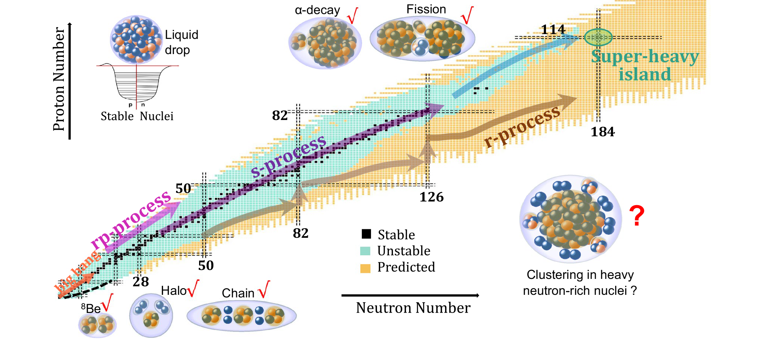
Clustering in nuclei
Cluster emission in Heavy-Ion collisions
Adapted from K.Wei et al, Nucl.Sci.Tech (2024)

Slide 3
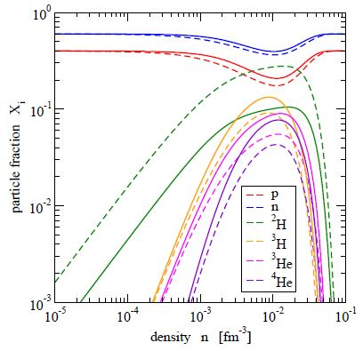
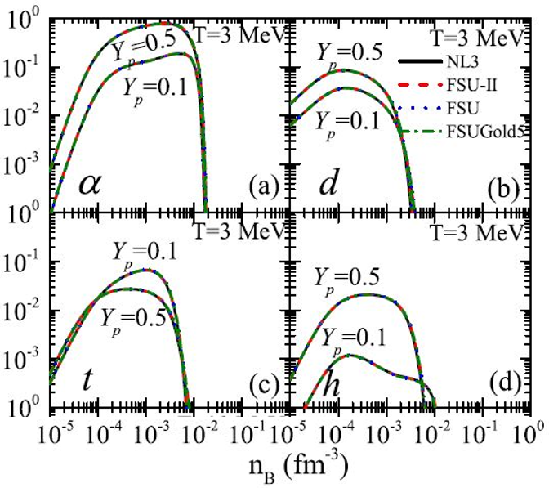
Formation of clusters in infinite nuclear matter
Generalized DFT calculations: include explicitly the cluster D.O.F
All kind of clusters should be formed at low density
Triton fraction increases in neutron-rich matter
triton vs α
S.Typel, J.Phys.Conf.Ser.420,012078(2013)
Z.-W. Zhang and L.-W Chen, Phys. Rev. C 95, 064330 (2017)
Cluster formation at the surface of nuclei Study by means of DIRECT REACTIONS

Slide 4
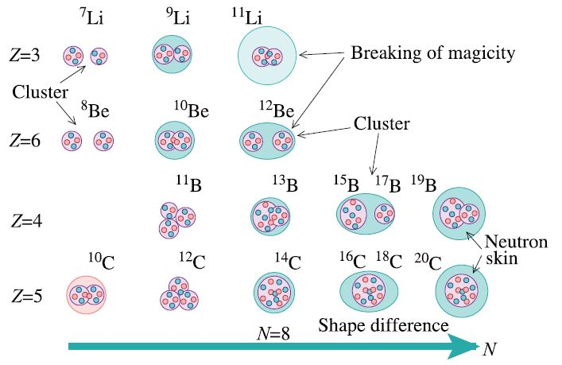
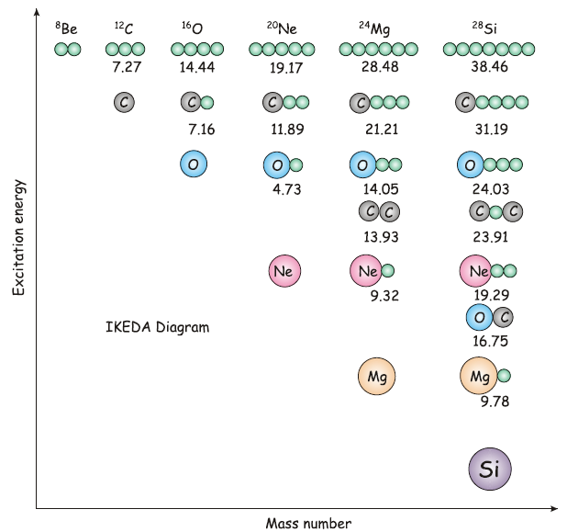
Clustering in light exotic nuclei
GROUND-STATES !
The Ikeda diagram
(alpha-conjugate nuclei)
Z=3
Z=4
Z=5
Z=6
Antisymmetrized Molecular Dynamics (AMD) predictions
K.Ikeda, N.Takigawa, H.Horiuchi, PTP (1968)
Cluster structure typically occurs
close to cluster decay thresholds
Based on properties of some near threshold states
Rotational bands with molecule-like structure
Very large moment of inertia
Large alpha-decay widths
Adding neutrons to N=Z :
Molecular structure for ground and low lying states
Towards the neutron dripline
Role of excess neutrons ?
Enhancement of n-rich clusters formation ?
Neutron clusters ?

Slide 5
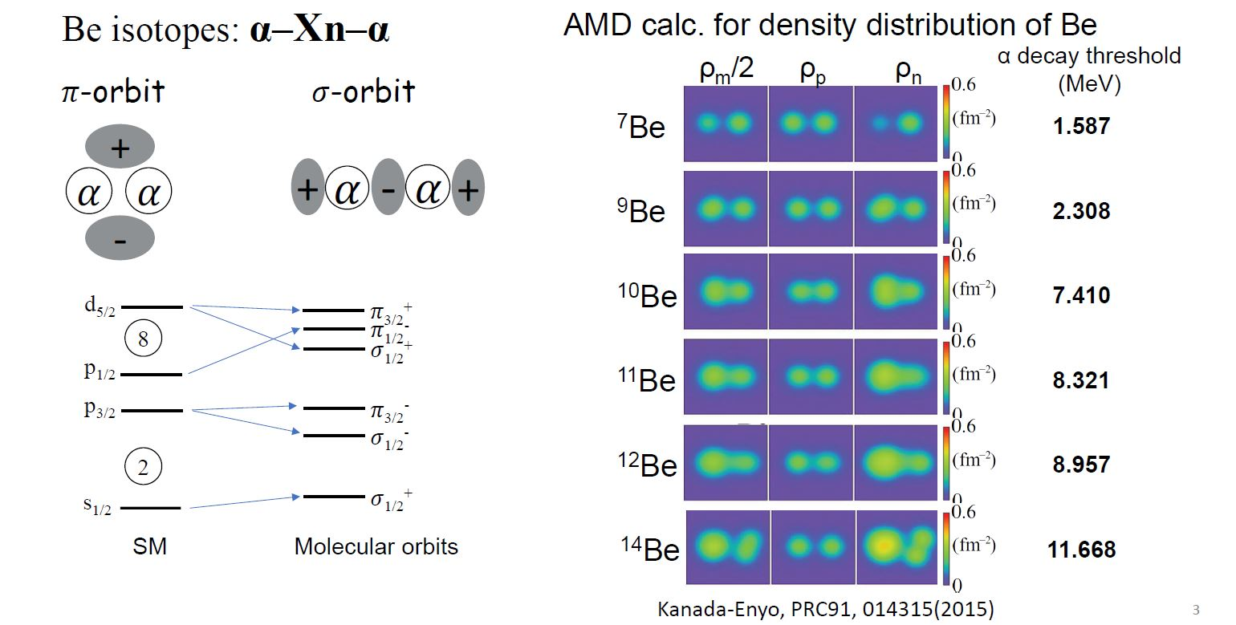
Clustering in beryllium isotopes – AMD calculation
AMD: no preformed cluster
Density distributions of Be

Slide 6
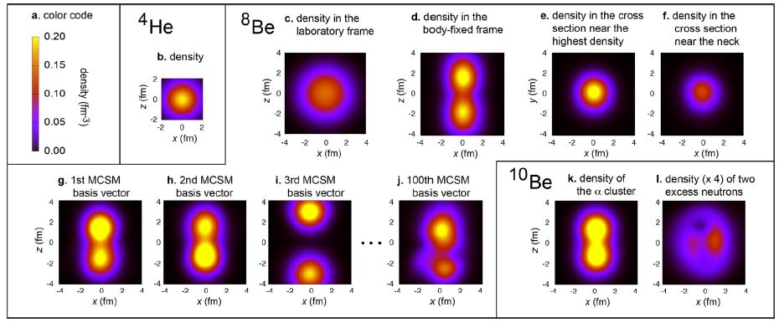
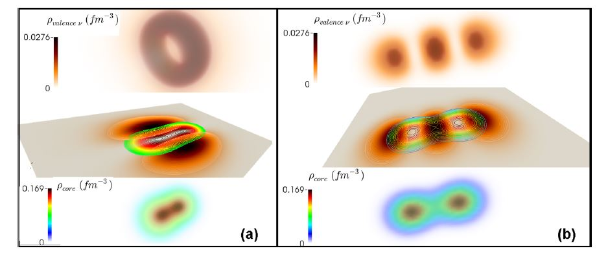
Calculations of density distributions for Be isotopes
DDME2 relativistic functional in rel. HB calculations
^{8,10}Be isotopes in no-core Monte-Carlo Shell Model
J.P.Ebran, E.Khan,T.Niksic, D.Vretenar, PRC90 (2014)
T.Otsuka, T.Abe et al., Nature comm. 2022
Neutron orbits
¹⁰Be^{GS}
¹⁰Be*
Density of α+α core

Slide 7
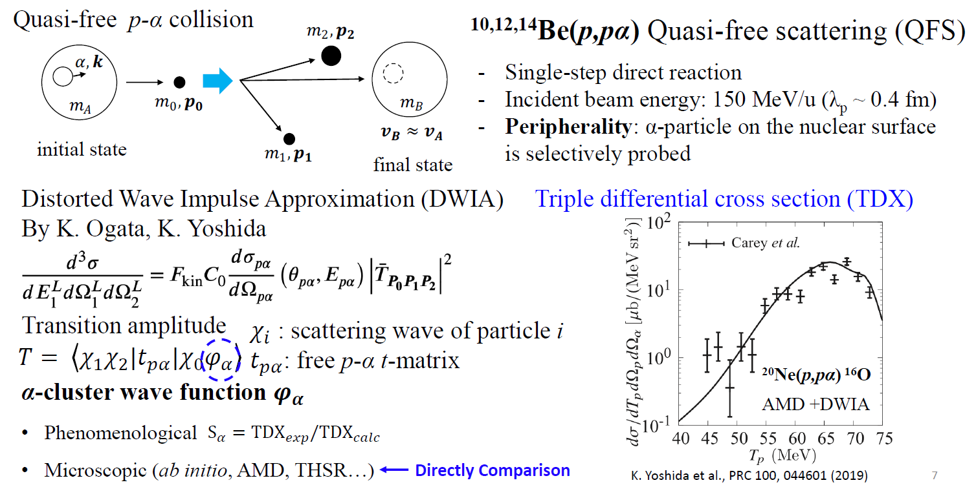
Approach using cluster quasi-free scattering

Slide 8
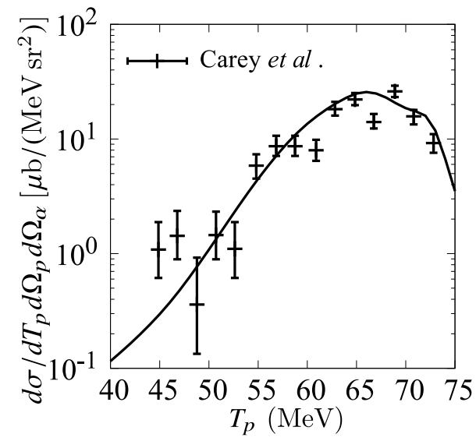
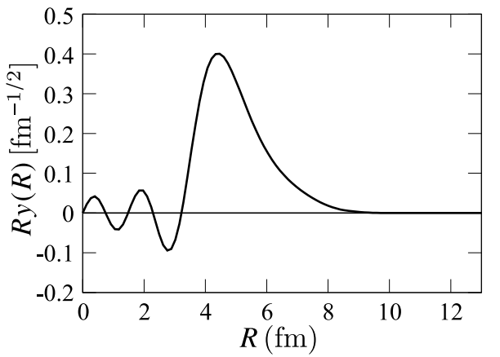
Test case of cluster K.O. study within a microscopic framework
Reanalysis of ²⁰Ne(p,pα)¹⁶O data at 101.5 MeV/u
K.Yoshida et al., PRC 99, 064610 (2019)
AMD cluster WF
Reliable α+¹⁶O optical potential
AMD α+¹⁶O cluster WF
Data reproduced without any normalization
(p,pα) represents a quantitative probe for a-clustering in light nuclei
New DWIA code: PIKOE [Ogata, Yoshida, Chazono, Computer Physics Comm. 297 (2024) 109058]

Slide 9
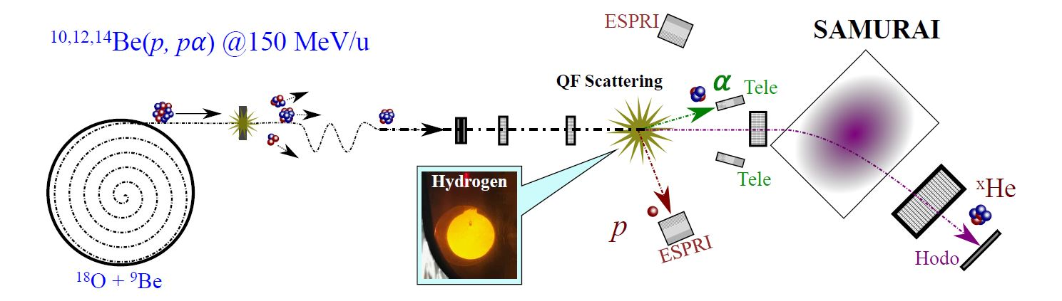
Study of ^{10,12, 14}Be(p,pα) at 150 MeV/u
First study in Inverse Kinematics with proper kinematics condition
Collaboration: IJCLab, Hong Kong U., RIKEN, TI Tech, LPC Caen, Tohoku U., RCNP Osaka,
CEA Saclay, Kyoto U., TU Darmstadt, NIPNE Bucharest, Kyushu U.

Slide 10
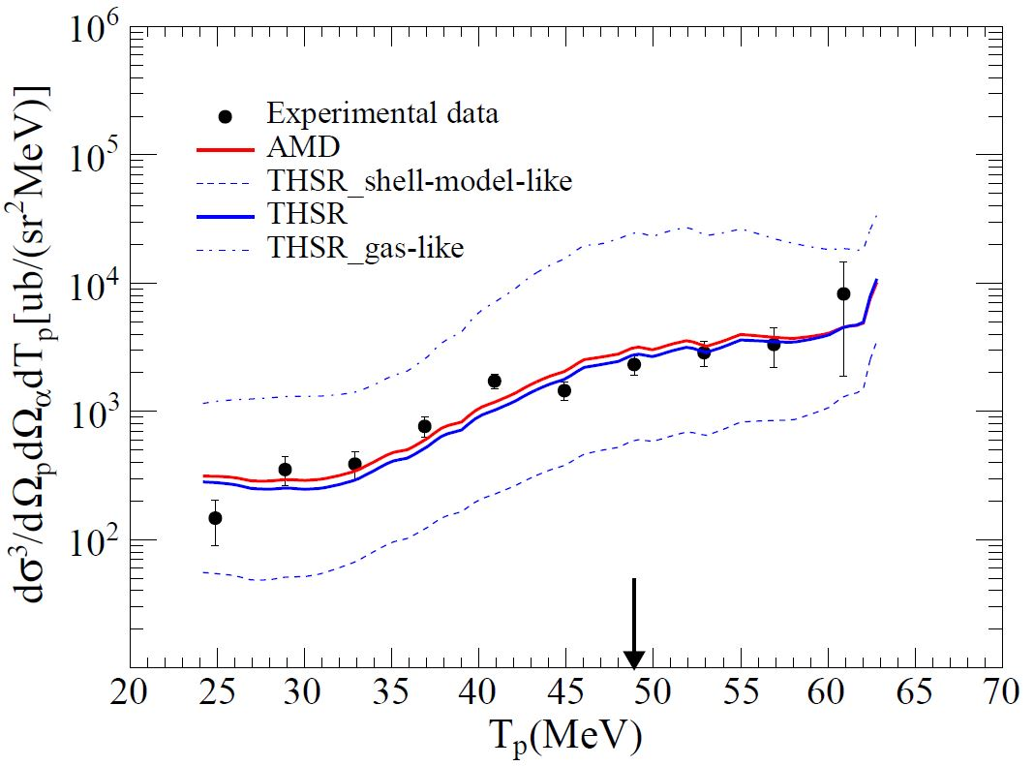
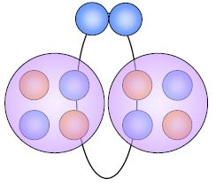
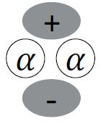
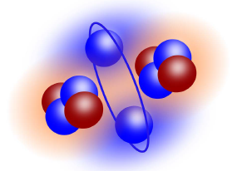
Results for ¹⁰Be(p,pα)⁶He^{(GS)}
Microscopic cluster WF used in DWIA calc.
Extended THSR
(M.Lyu)
AMD
(Y.Kanada-En’yo)
Norm. factor=0.90
DWIA
Norm. factor=1.04
P_{R}=0
Predicted structure of ¹⁰Be GS: 2α + 2n(π)
Molecular structure of the ¹⁰Be GS is validated
P.Li, D.B., et al, PRL 131, 212501 (2023)

Slide 11
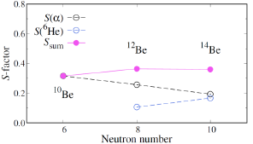
Experimental TDX for ^{10~14}Be(p,pα)
¹⁰Be(p,pα)⁶He
¹²Be(p,pα)⁸He
¹⁴Be(p,pα)⁸He
preliminary
Gated by ⁸He residue
Clustering evolution with N

Slide 12
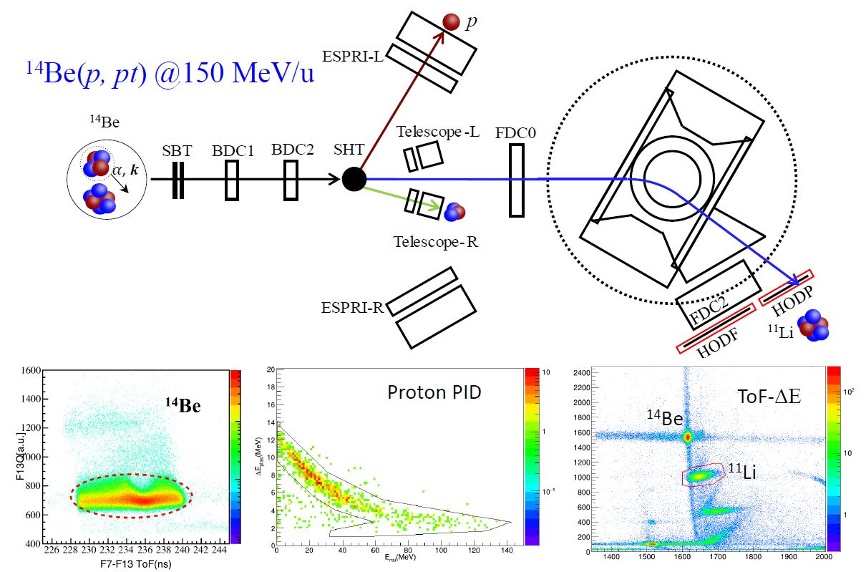
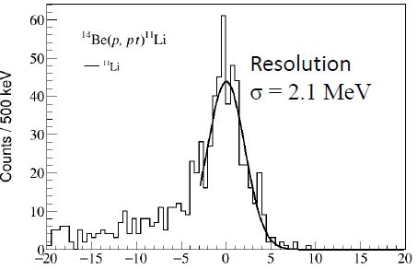
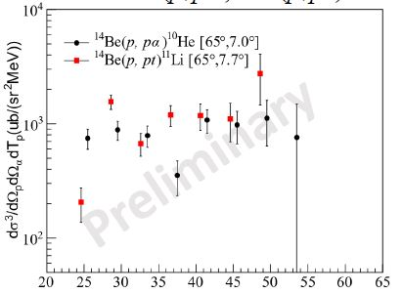
Search for triton formation at the surface of ¹⁴Be
¹⁴Be(p,pt) ¹¹Li @ 150 MeV/u
SAMURAI
NEBULA
Missing mass spectrum of ¹⁴Be(p,pt) ¹¹Li
TDX of ¹⁴Be(p,pα) vs ¹⁴Be(p,pt)
Ex in ¹¹Li (MeV)
Tp (MeV)

Slide 13
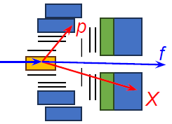
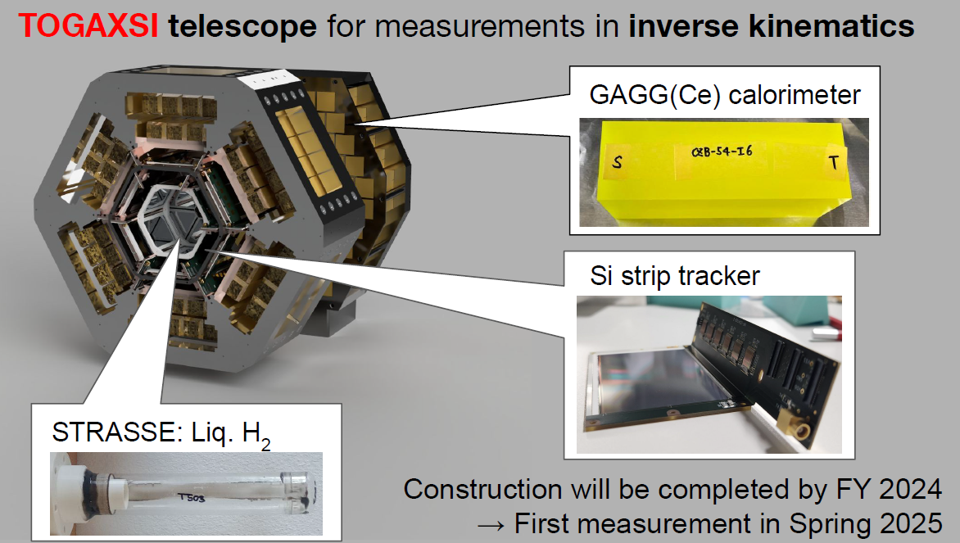
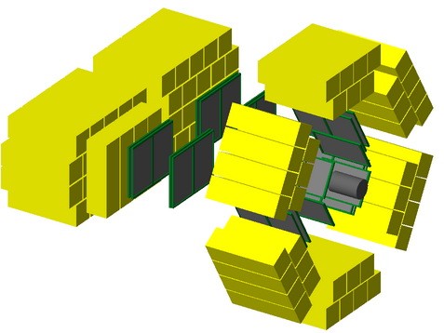
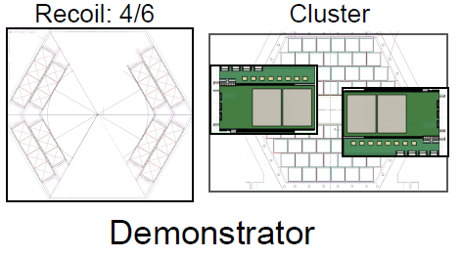

The TOGAXSI array for (p,pX) in I.K.
(Y.Kubota)
Simulation code: V.Girard-Alcindor (IJCLab)
Commissioning of the demonstrator
and ^{50,52}Ca(p,pX) exp in June 2025

Slide 14


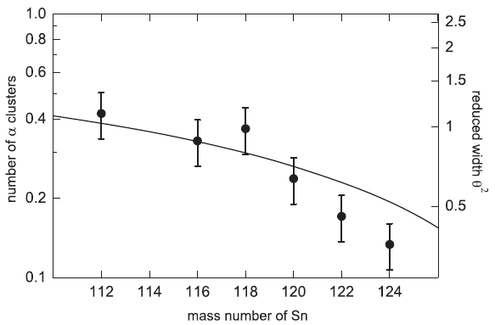
Approach using cluster transfer reactions
Compare measured cross-sections with calculated ones making use of microscopic cluster WF
Only few studies performed so far
(stable nuclei)
Cluster structure of ground-states
Access to excited states using stripping
Need collaboration with theorist
structure AND reaction
AMD only suitable for light nuclei
Generalized DFT failed to reproduce the
magnitude of ¹¹²⁻¹²⁴Sn(p,pα) Xsection
Need γ-ray detection to separate GS->GS from other channels
Same trend observed in transfer as in knockout
¹¹²⁻¹²⁴Sn (d,⁶Li)
Mass number of Sn
A.A.Cowley, PRC 93 (2016)

Slide 15
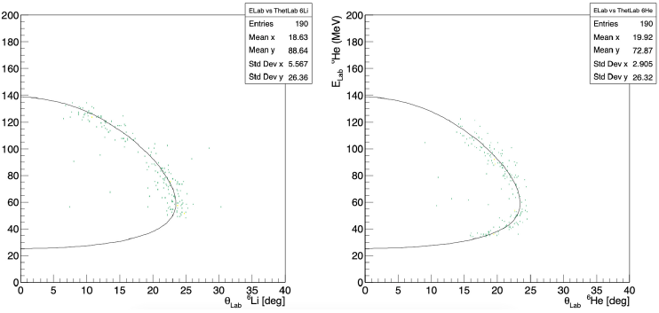
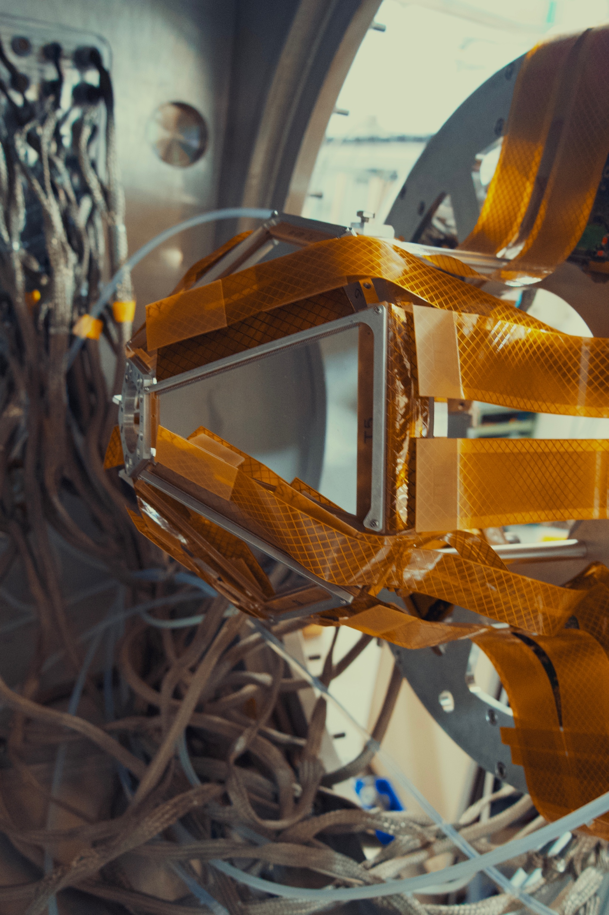
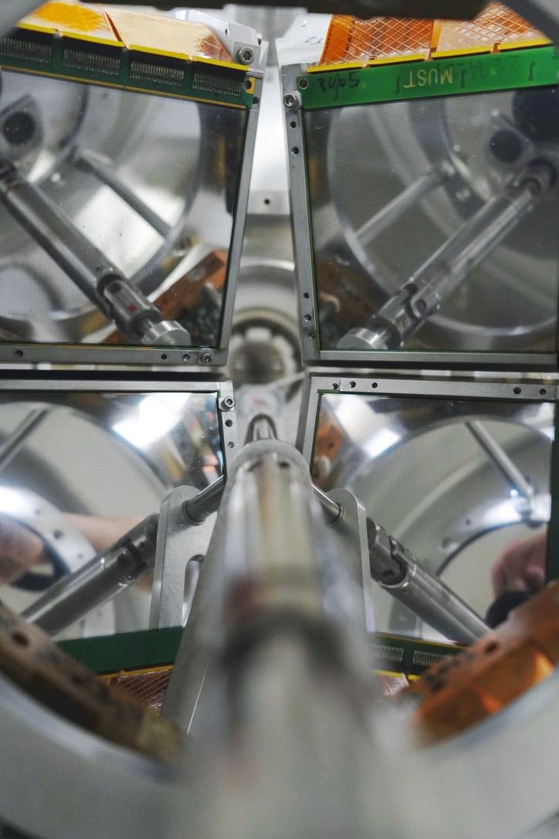
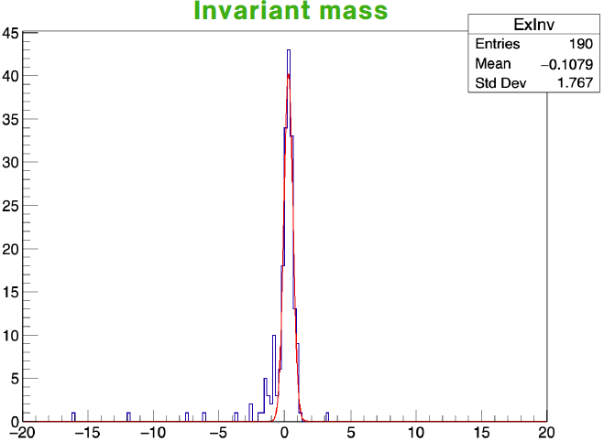
Clustering in light n-rich nuclei using transfer reactions
MUGAST@LISE-GANIL
¹⁰Be(d,⁶Li)⁶He
⁶Li
⁶He
E_{LAB} (MeV)
RI Beam
θ_{LAB} (MeV)
θ_{LAB} (MeV)
EXOGAM
Counts
Study of ^{10,12}Be(p,α) and ¹⁰Be(d,⁶Li)
Spokesperson : V.Girard-Alcindor, DB
Ph.D Student: T.Zanatta-Martinez
Performed in June 2024
Cross-section calculation by T.Fukui (Kyushu Univ.)

Slide 16
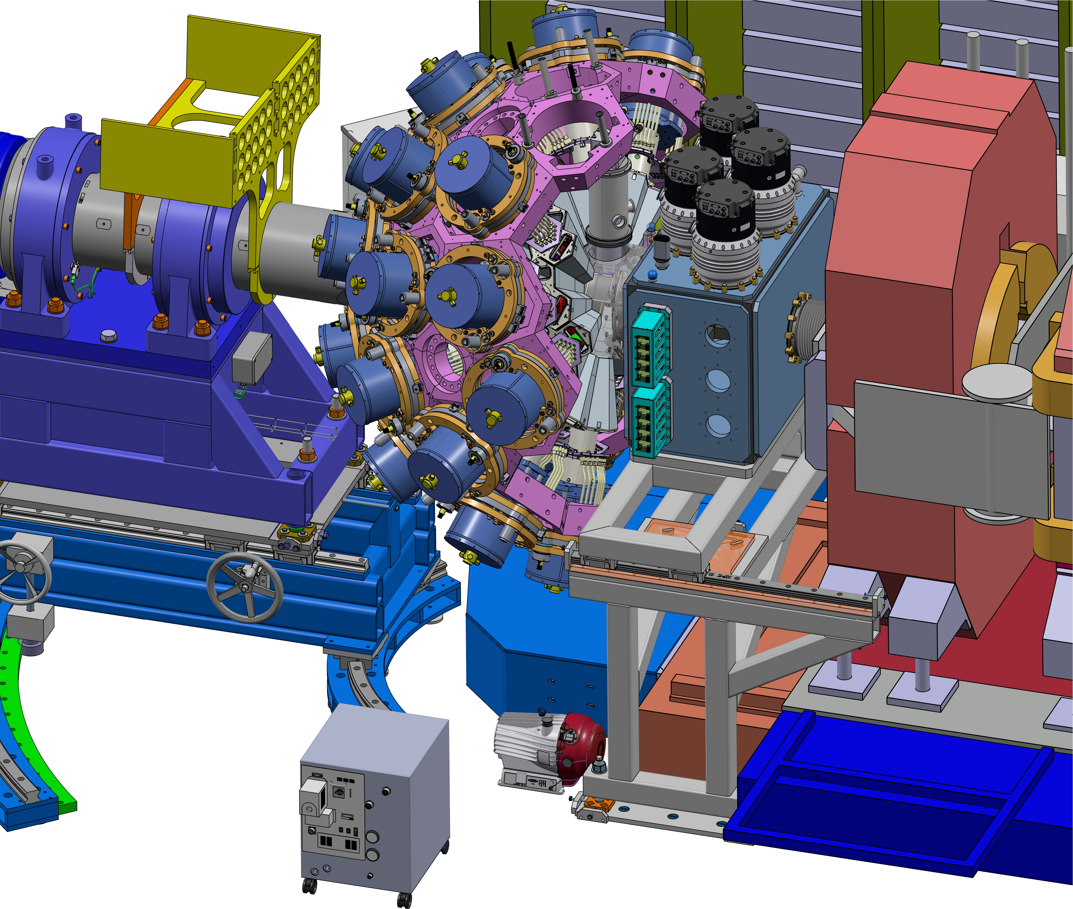
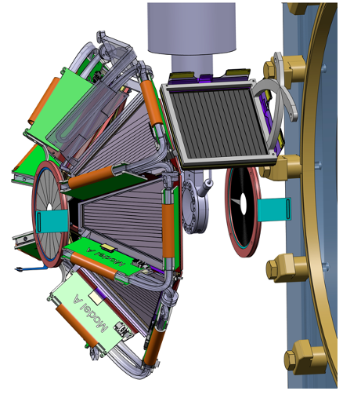
AGATA – GRIT setup to be used at VAMOS
An AGATA-GRIT[Phase0]-VAMOS campaign is now planned at GANIL starting 2029
SPIRAL1 beams
Backward: 6 trapezoidal telescopes (2 stages)
read by GRIT electronics
+ Additional detectors readout by Mesytec Electronics
+ Helium cryo target
Proposal to study (⁶Li,t) and (⁶Li,³He)
Mirror cluster formation fction of Isospin
AGATA-GRIT-VAMOS workshop on June 11-13, 2025 at GANIL

Slide 17
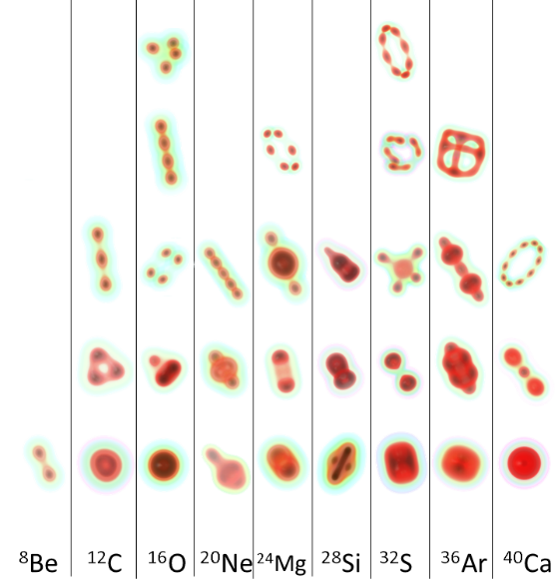
Setting of a theory-experiment collaboration on cluster traces in nuclei
Alpha and cluster form factors (Covariant EDF):
R. Didier-Pichat (Ph.D student, IJCLab)
L.Heitz, J.P.Ebran (CEA Bruyeres-le-Chatel)
E. Khan (IJCLab)
S. Typel (GSI)
Reaction model (transfer, DWIA):
C. Hebborn (IJCLab)
S. Typel (GSI)
¹⁰Be(p,pα)
Comparison with exp. differential cross section
(cluster knockout and transfer)
From E.Khan
P.J. Li et al., PRL 131, 212501 (2023)
Y. Taniguchi et al., PRC 103, L031305 (2021)

Slide 18
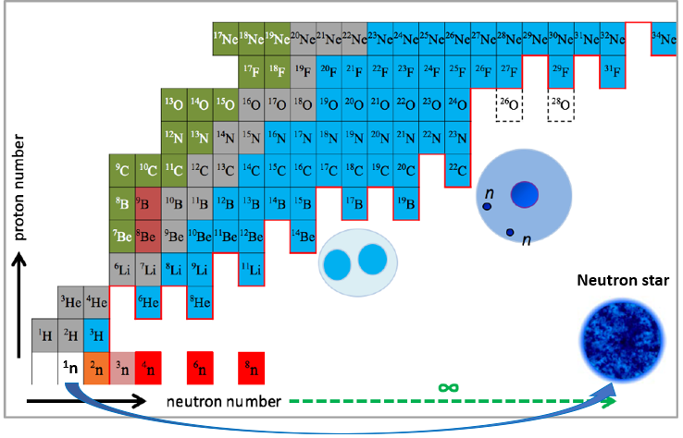
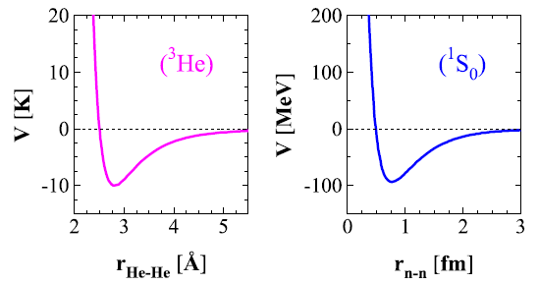
The quest for multineutron states
Case of (³He)_{N} drops
³He inter-atomic potential nn potential
Critical number of atoms N ̴30
to form a bound system
No realistic predictions for multineutrons with A>5

Slide 19
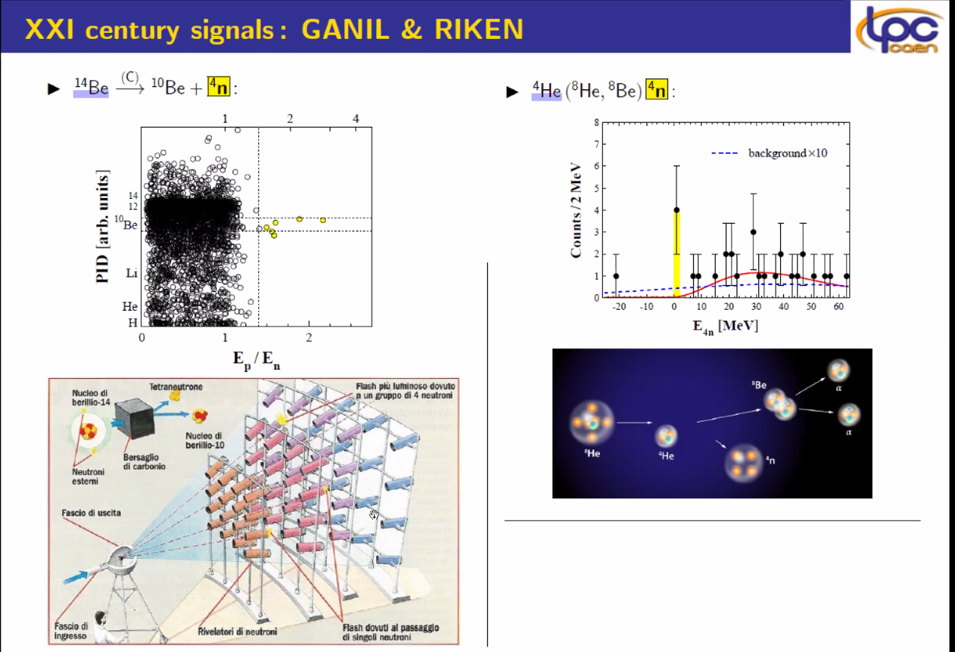
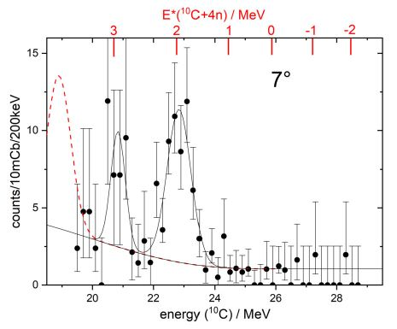
Recent ( XXIth century) signals on tetraneutron
¹⁴Be → ¹⁰Be + 4n
⁴He (⁸He,αα) 4n
⁷Li (⁷Li, ¹⁰C) 4n
M.Marques et al., PRC65, 044006 (2002)
6 events compatible with a bound
or quasi-bound multineutron cluster
K.Kisamori et al., PRL 116, 052501 (2016)
E = 0.83 ± 0.65 (stat) ± 1.25 (syst) MeV
T.Faestermann et al. Phys.Lett. B 824 (2022)
E = 0.42 ± 0.16MeV
Notes:
”

Slide 20
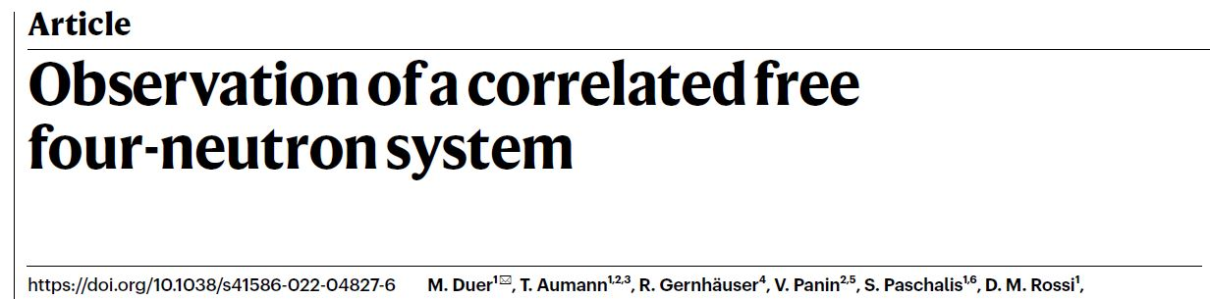
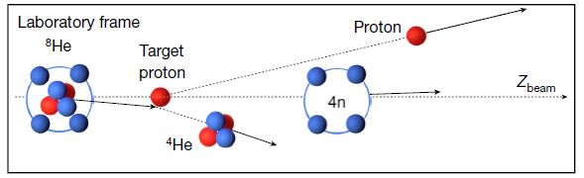
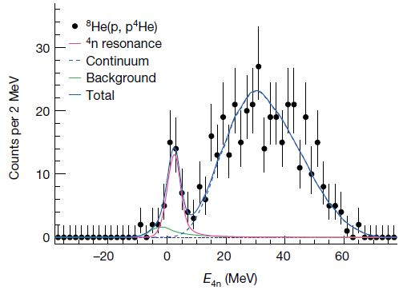
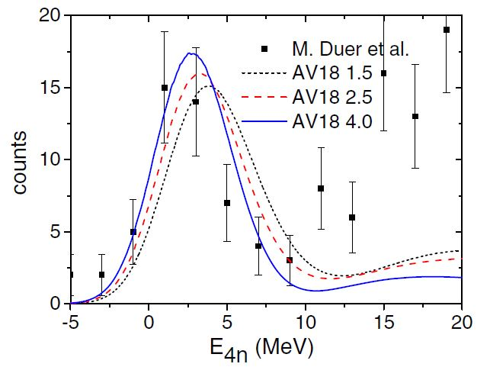
M. Duer et al, Nature 606(2022)
⁸He(p,pα) @ 156 MeV/u
RIKEN/Samurai
Missing mass
Recoilless condition
Low energy peak
E = 2.37 ± 0.38(stat.) ± 0.44 (sys.) MeV
Γ = 1.7 ± 0.22 (stat.) ± 0.30 (sys.) MeV
Broad bump
well described by non-resonant continuum calculations
Interpreted as due to dineutron-dineutron correl.
Lazauskas, Hiyama, Carbonell, PRL 130 (2023)
Notes:
8He well clusterized in alpha+4n
- The chosen kinematics at large momentum
transfer between the proton and the α-particle ensures that the
four-neutron system will recoil only with the intrinsic momentum of
the 4He core in the 8He rest frame, without any further momentum
transfer, thus allowing the recoil-less production

Slide 21
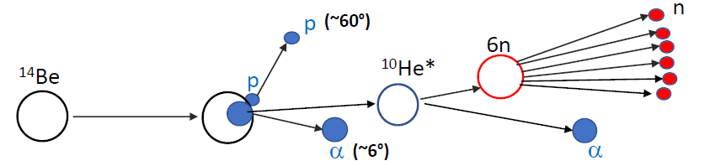
First exp^{al} determination of the 6-neutron spectrum
¹⁴Be(p,pα) reaction
High ¹⁴Be rate at RIBF
¹⁰He* populated by ¹⁴Be(p,pα) close to threshold
Decay channel : α + 6n
α is detected by SAMURAI
6n spectrum reconstructed by missing mass
No need of neutron detection
No direct info on neutron correlations
⁴He + 6n
Extended Ikeda picture
⁶He + 4n
¹⁰He GS
⁸He + 2n
¹⁴Be
Theory: no realistic calculation for the 6n system
Notes:
C’est une voie de production tres specifique, qui n’est peut-etre pas la plus favorable mais on peut l’etudier

Slide 22
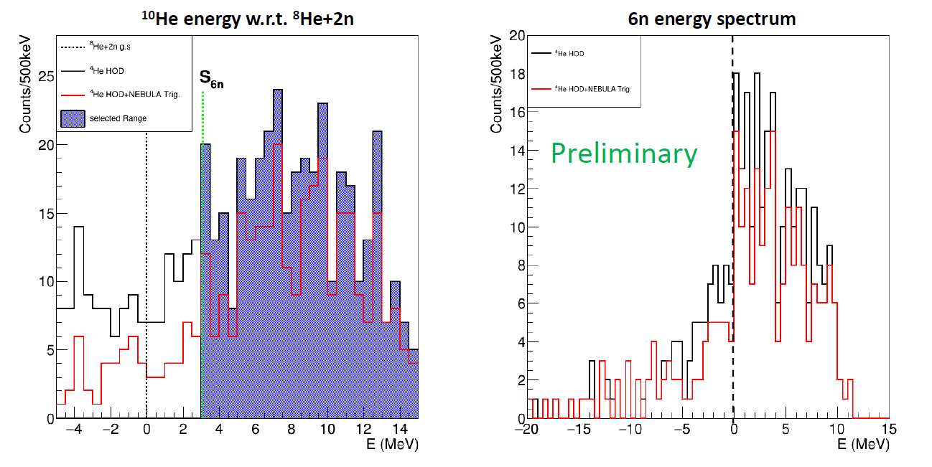
Preliminary results
bound
unbound
PROSPECTS for the 6n system
¹⁴Be(p,pa)¹⁰He* -> 6n+alpha - Data under analysis (Ph.D thesis: O.Nasr, IJCLab)
¹¹Li(p,2p)¹⁰He* -> 6n+alpha - S47 (Sp. T.Nakamura) run in April 2024
^{6,8}He(p,3p) accepted at RIKEN with TOGAXSI

Slide 23
Thank you

