Slide 1

SRF Systems for the EIC Project
This material is based upon work supported by the U.S. Department of Energy, Office of Science, Office of Nuclear Physics under Contract No. 89243126CSC000213
Joseph Matalevich
Jefferson Lab - Cryomodule Design Manager
TTC 2026 Meeting at CEA-CNRS
June 9-12, 2026

Slide 2
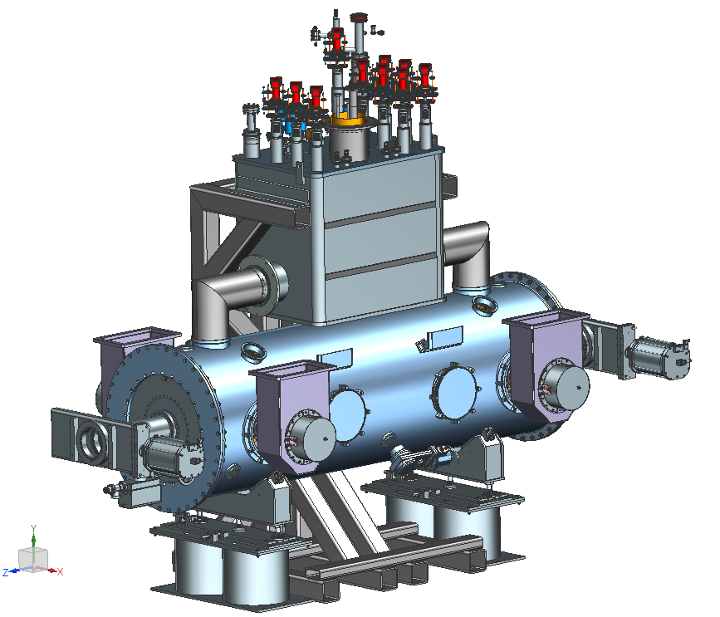
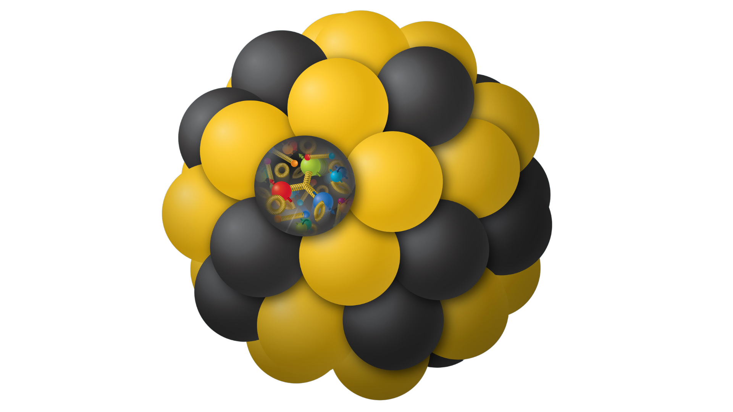
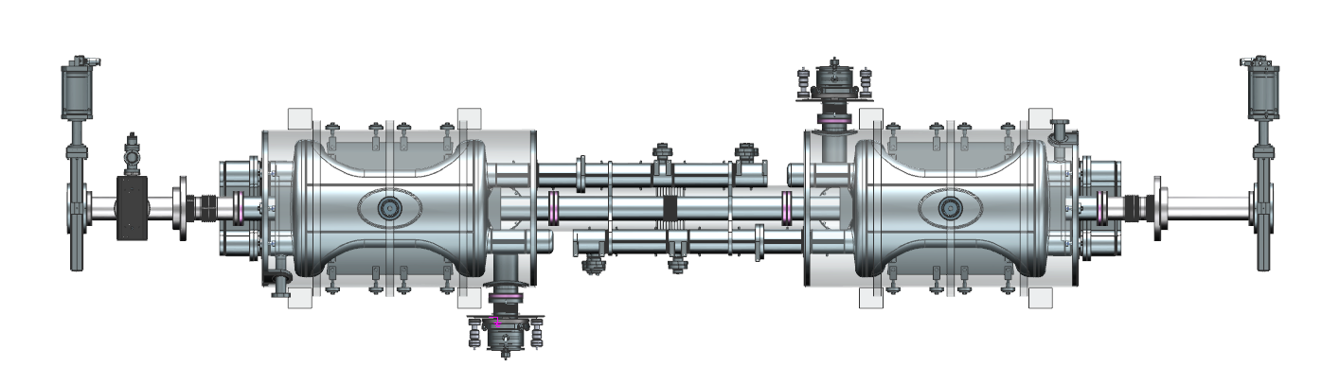
Outline
Overview of the EIC
  SRF for the EIC
591 MHz 1-cell cavity cryomodule
  Design history
  Design challenges
  Component testing plans
197 MHz crab cavity cryomodule
  Design status
  Cavity fabrication
“The science questions that an EIC will answer are central to completing an understanding of atoms as well as being integral to the agenda of nuclear physics today.” (National Academy of Sciences, 2018)
“We recommend the expeditious completion of the EIC as the highest priority for facility construction.” (Nuclear Science Advisory Committee, 2023)

Slide 3



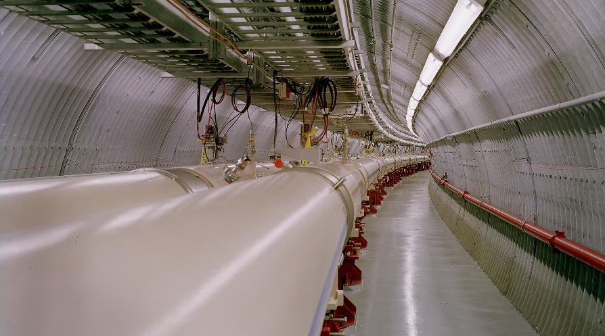
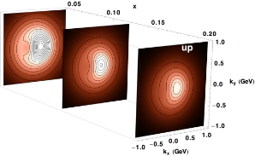
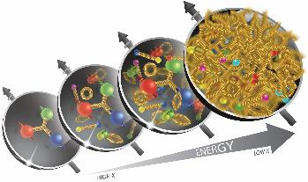
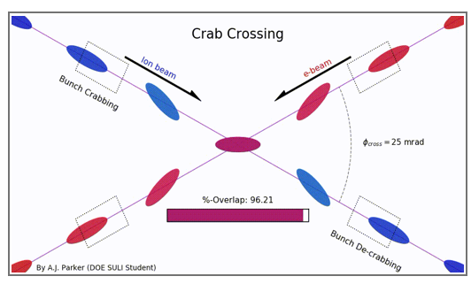
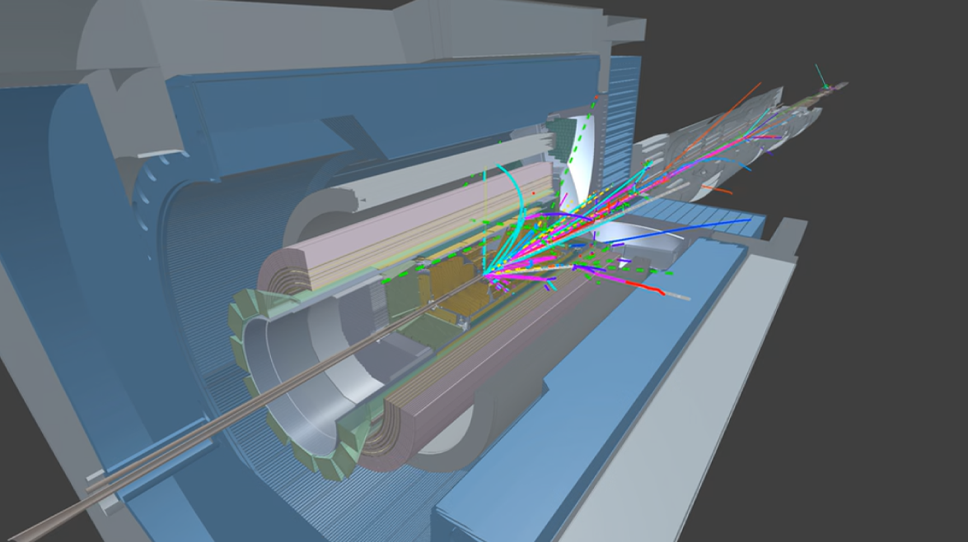
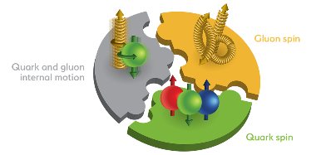
What is the EIC
  Partnership between BNL & JLab
  Utilizes infrastructure of BNL’s RHIC facility
  High luminosity
  Variable center of mass energy collisions
  Highly polarized electron beams colliding with highly polarized proton and ion beams
    Beam polarization ~ 70%
    Ion beams from protons to Uranium
  Luminosity 10³³ -10³⁴ cm⁻² s⁻¹
  20 to 140 GeV (e-p) Center-of-Mass energies

Slide 4
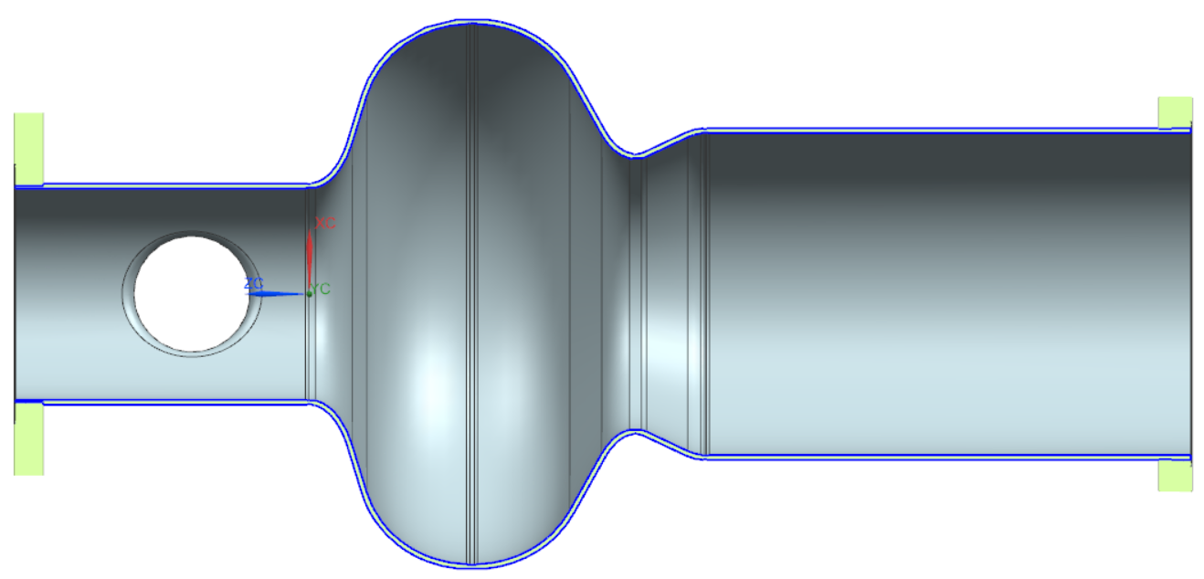
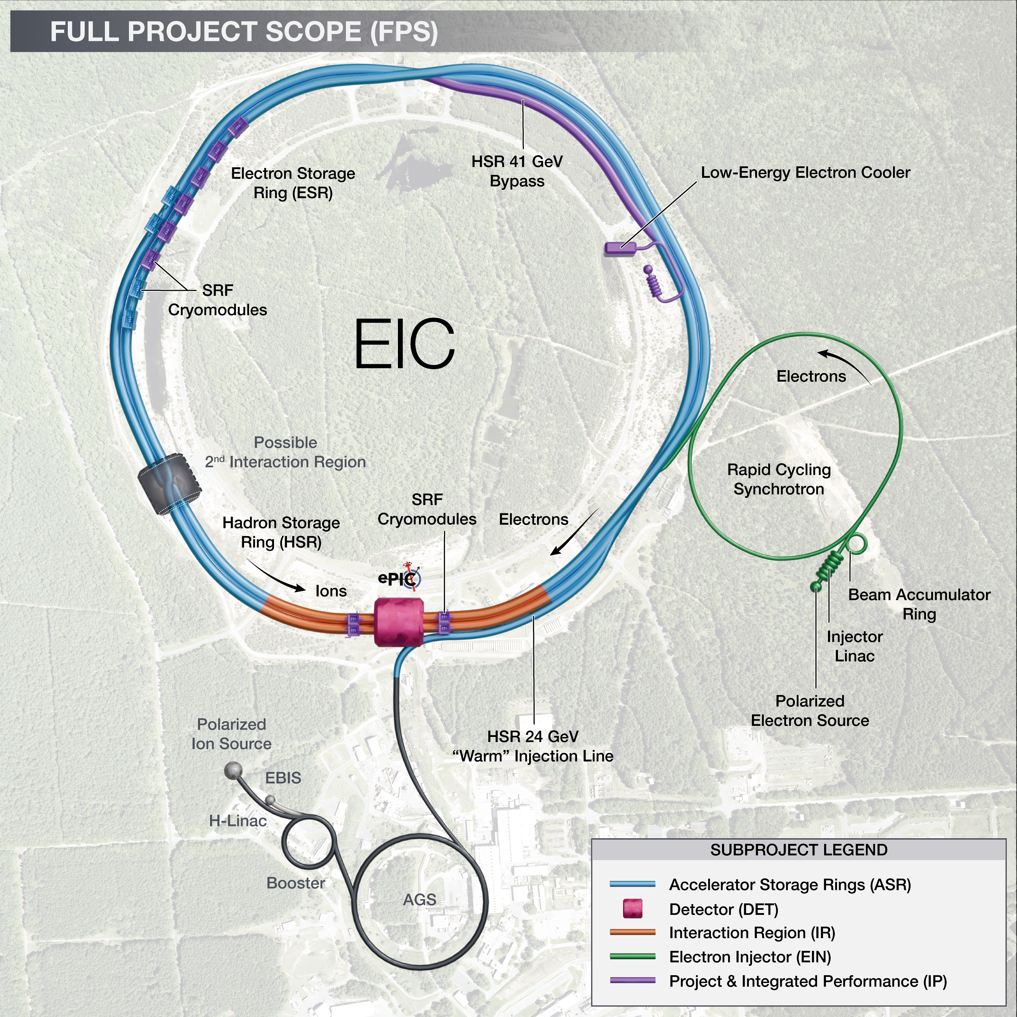
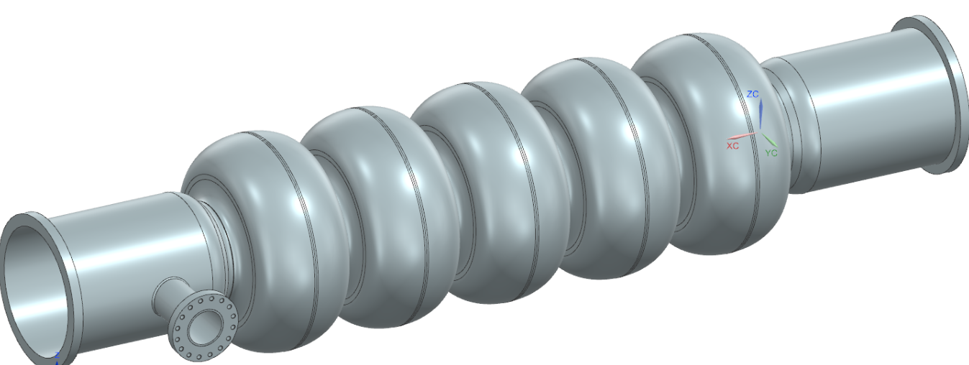
SRF cavities in the EIC
591 MHz 1-cell in IR10
Crab cavities in IR6
591 MHz 5-cell in RCS

Slide 5
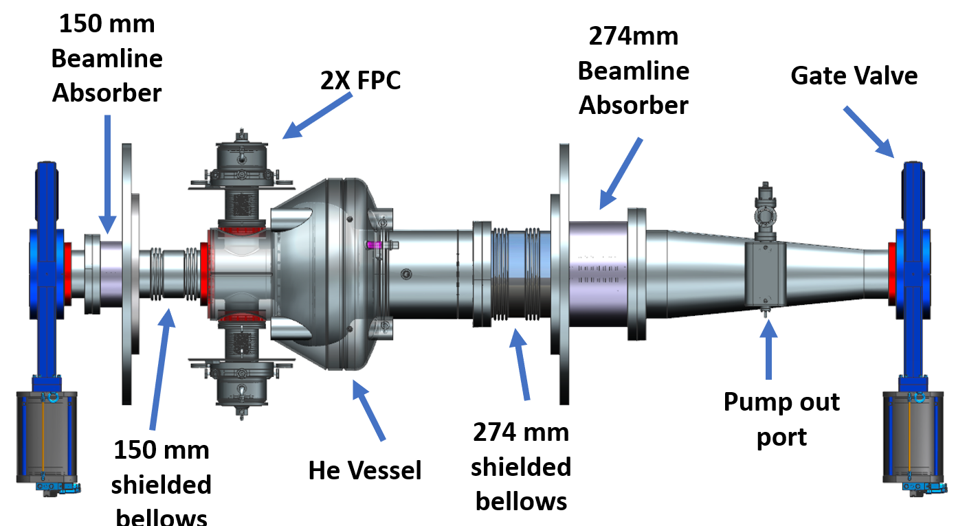
591 MHz 1-Cell Cryomodule – Design Challenges
RF Design
  Provide 68 MV and 10 MW @ 591 MHz
    2.5 A beam current
    Loaded Q = 3x10⁵
    Peak surface fields of ~40 MV/m and ~80 mT
    Two coaxial FPCs per cavity, 400 kW each
  Analysis Results
    Short-range wavefield amplitude due to ∅ 150 mm beamline absorber exceeds allowable limit
    Shielded bellows at ∅ 150 mm overheating
591 MHz beamline with 150 mm & 274 mm diameter beampipes

Slide 6
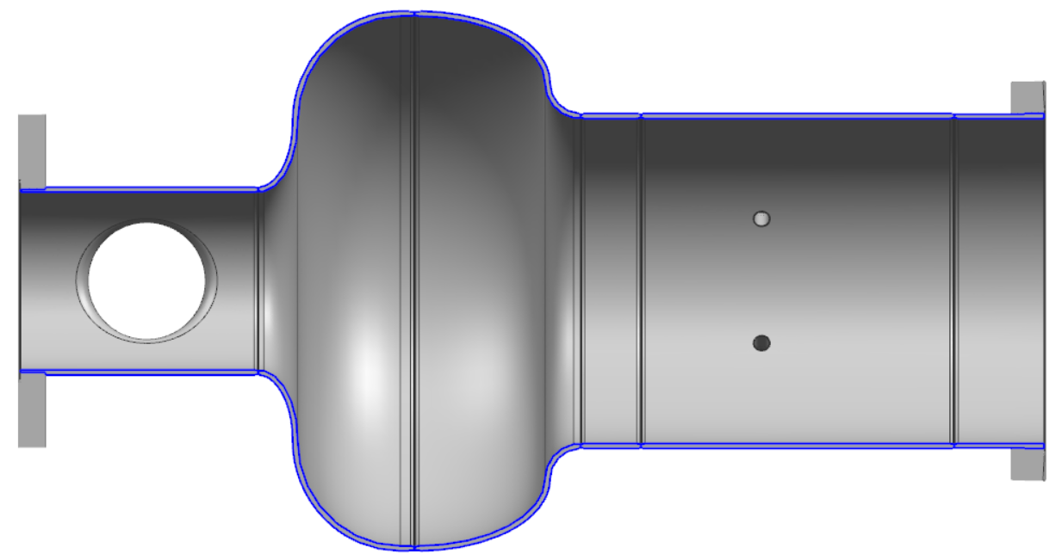
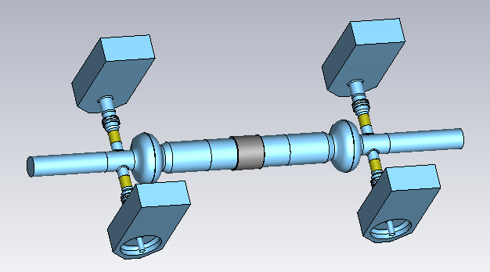
591 MHz 1-Cell Cryomodule – Design Challenges
RF Design
  2-cavity beamline
    Enlarged FPC side beampipe to ∅ 180 mm
    Fewer BLAs, one larger BLA per cavity pair
    Eliminates all tapers from 274 mm to beam pipe diameter
      Reduced HOM losses
      Reduced heating of shielded bellows and gate valves
∅ 150 mm FPC side beampipe
∅ 180 mm FPC side beampipe
J. Guo
591 MHz 2-cavity beamline with 180 mm & 274 mm diameter beampipes

Slide 7
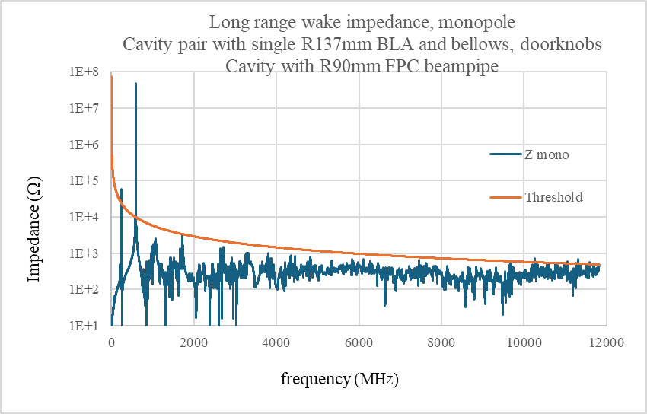
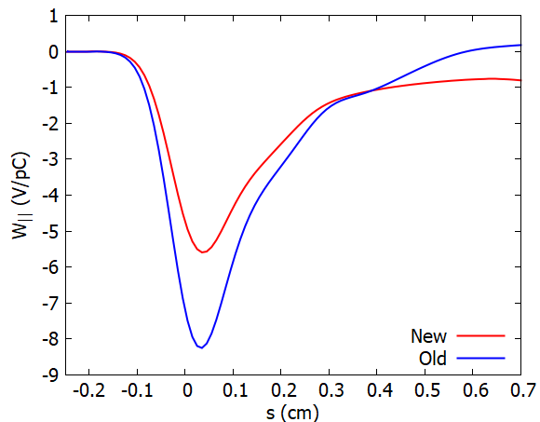
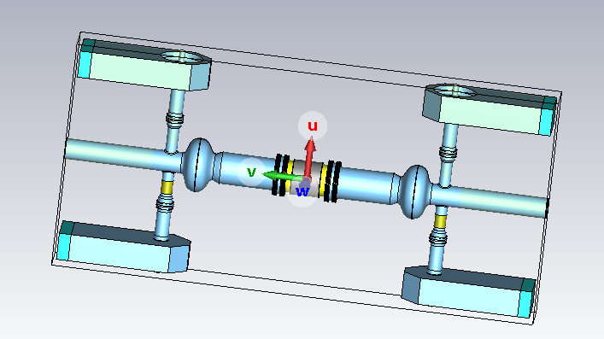
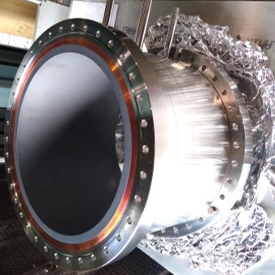
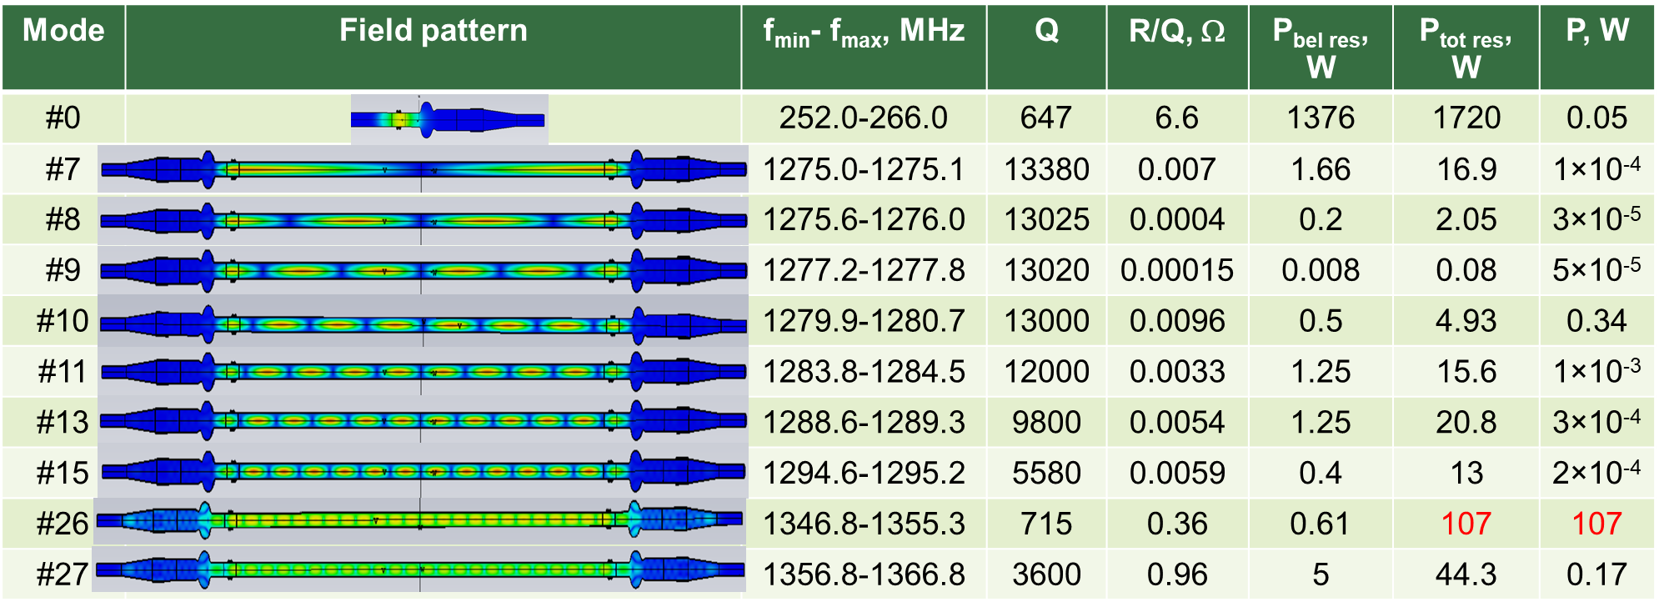
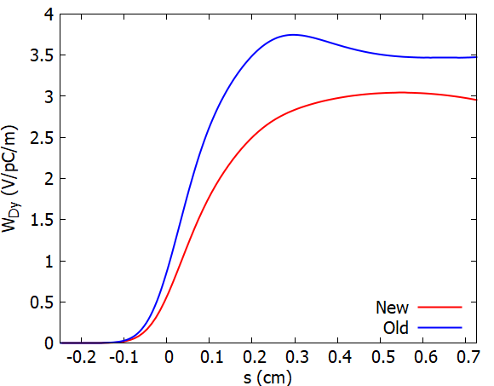

591 MHz 1-Cell Cryomodule – RF analyses of 2-cavity design
Longitudinal Wakefield
Long range wake impedance
J. Guo
Vertical Dipole Wakefield
Inter-cryomodule interactions
G. Wang & A. Blednykh
S. Kuzikov & J. Guo
7

Slide 8
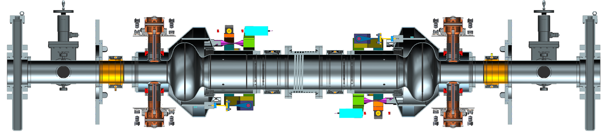
591 MHz 1-Cell Cryomodule – Cavity String
Vacuum Vessel Interface
Vacuum Vessel Interface
Helium Vessel
274 mm
WTC
274 mm
WTC
Helium Vessel
FPC
FPC
Vacuum / Ion Pump Spool
BLA
Vacuum / Ion Pump Spool
FPC
Tuner
Tuner
FPC
180 mm
WTC
180 mm
WTC
591 MHz 1-cell Cavity
591 MHz 1-cell Cavity
Gate Valve
Gate Valve

Slide 9
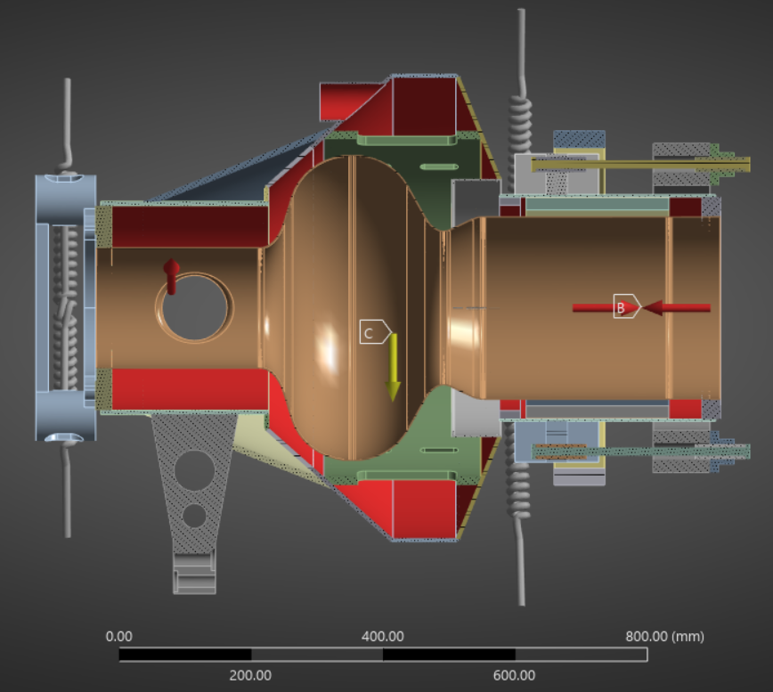
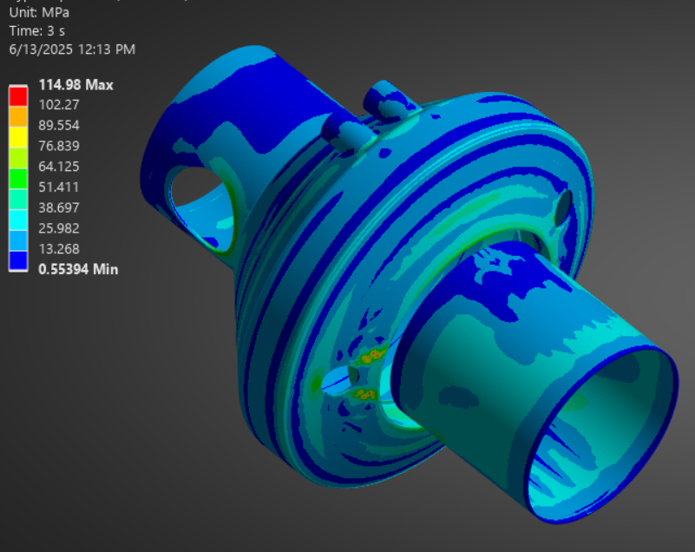
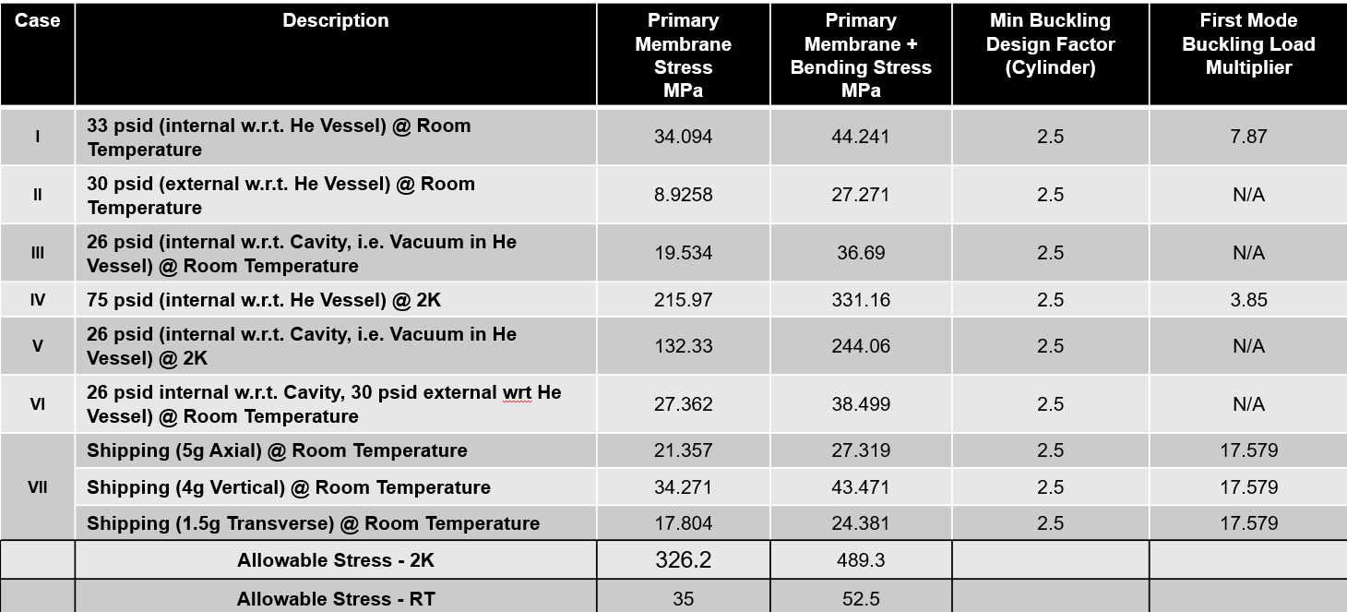
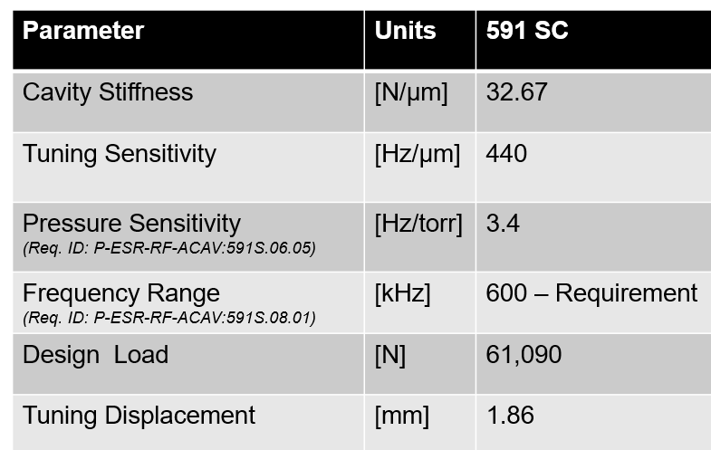
591 MHz 1-Cell Cryomodule – Design Challenges
Cavity Design
Thickness optimization
Design to ASME BPVC
Cavity and He vessel meet allowable stresses for all load cases.
Determine tuning requirements
Design Goal: Tuner / He Vessel 10x stiffness of cavity
S. Shanmugasundaram

Slide 10
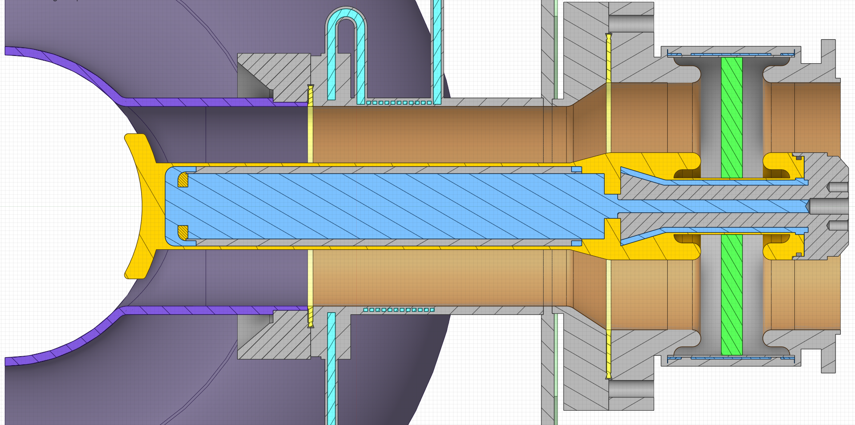
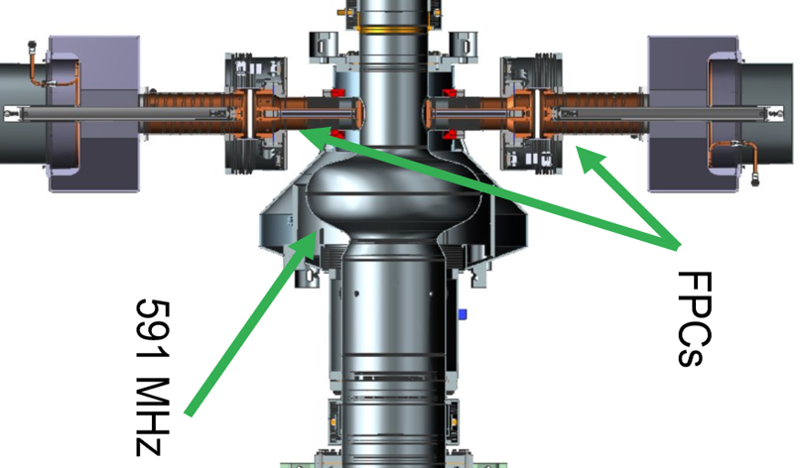
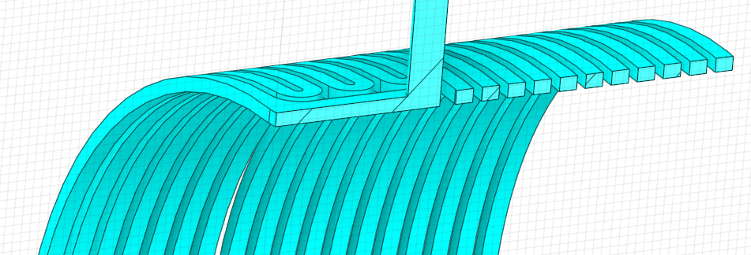
591 MHz 1-Cell Cryomodule - Design Challenges: FPC
Coupling 400kW of power
OC transitions from RT to 2.0 K in ~4in (11cm)
Trace cooling intercepts 78 watts from 2.0 K bath (per FPC)
Cross Section: Power Coupler Cavity Interface
2.0 K Cavity Flange
Vacuum
Air
L He
Water Cooling
L He
FPCs
Cavity
Cu
SS w/ Cu
Nb
Water
Al₂O₃
3.7”
Dimension limited by installation in RHIC tunnel
R.T.
Vacuum Break
Helium Trace Cooling
E. Drachuk

Slide 11
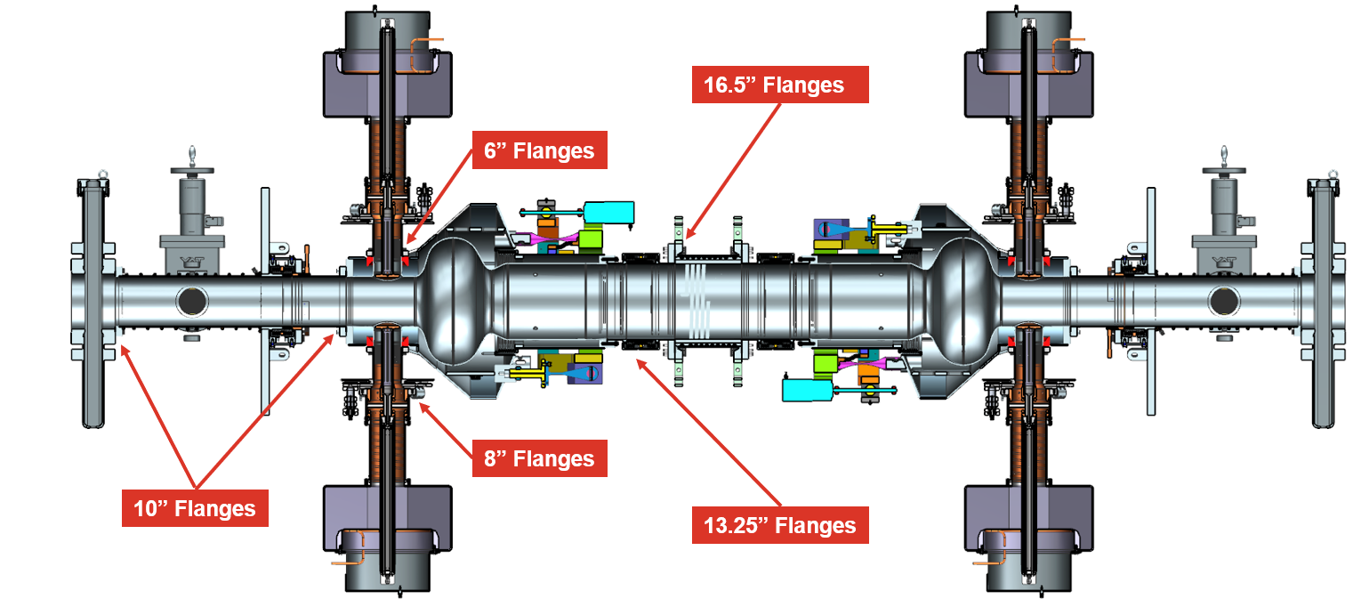
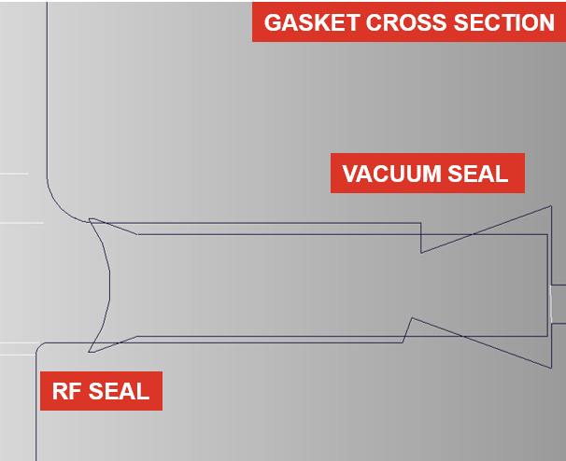
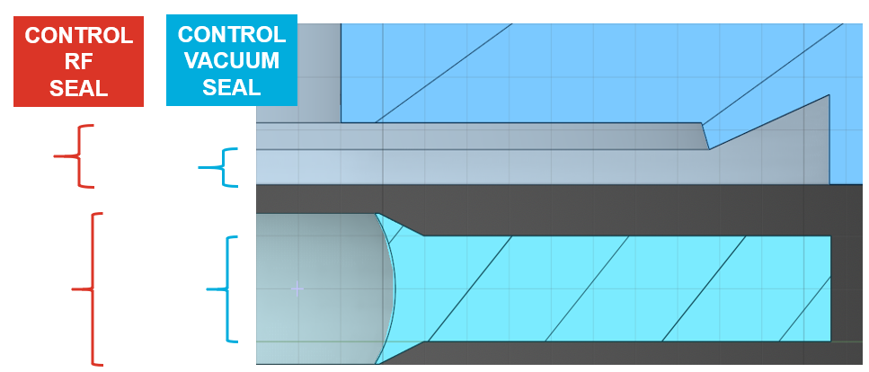
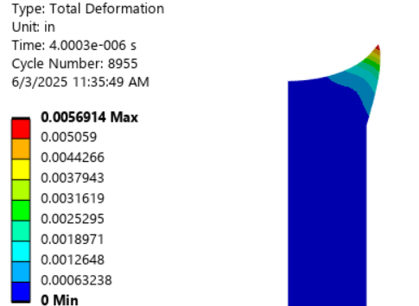
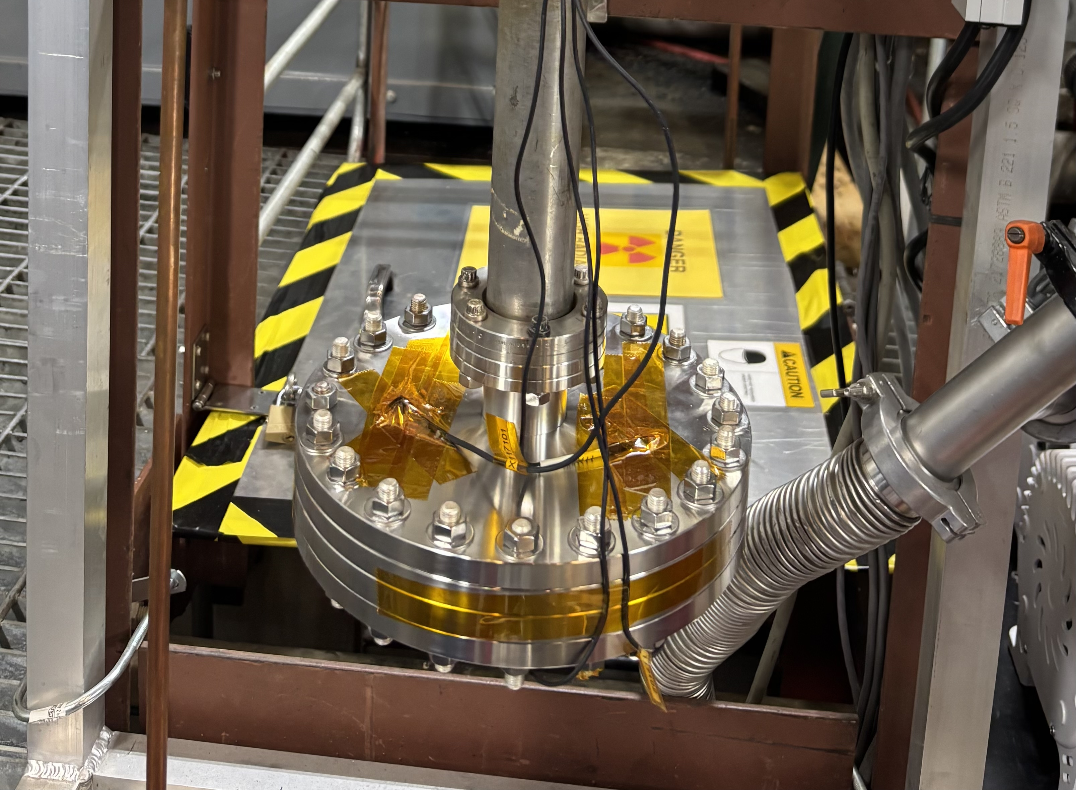
591 MHz 1-Cell Cryomodule – Design Challenges
Beamline Flange Seals
  5 different diameter flanges
  Copper conflat vacuum seal with additional contact for RF seal
Optimization of RF contact shape
Thermal cycling to validate design
Component tolerance stack can result in very high load requirement to ensure vacuum seal and RF contact
C. Paul

Slide 12
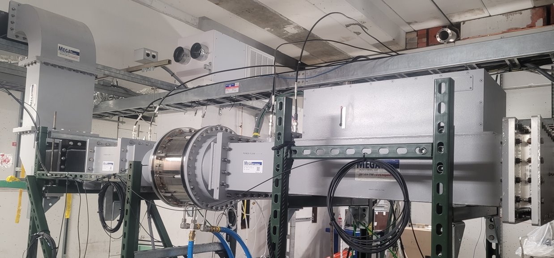
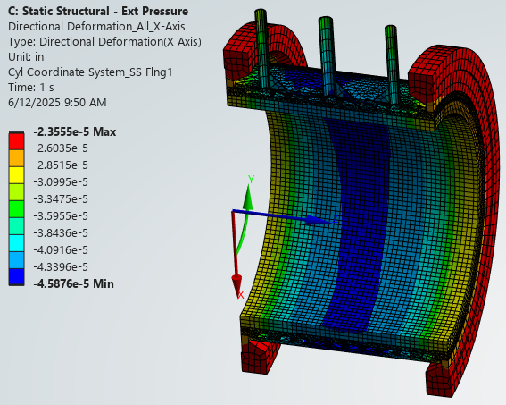
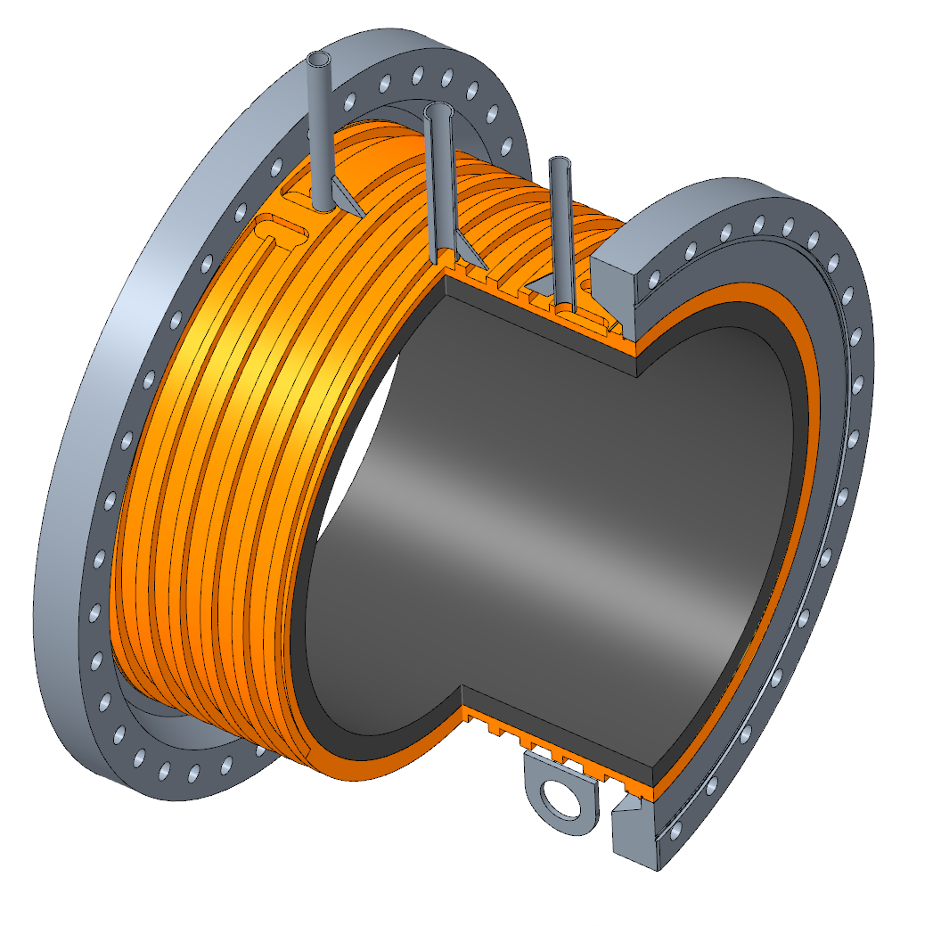
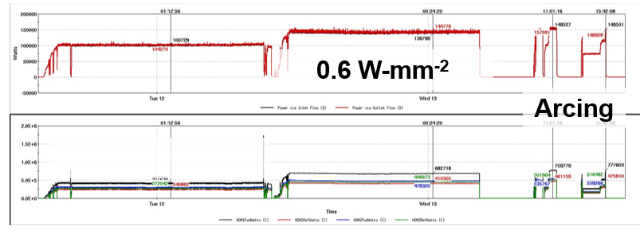
591 MHz 1-Cell Cryomodule – Design Challenges
BLA
  Extract 66 kW of HOM power
  Located 0.6 m from SRF cavity, operates at RT with water cooling
LDRD Funded Large Diameter Absorber
Close but a bit too large for the EIC
Optimize cooling channel geometry
Verify temperature profiles within acceptable ranges
BLA tested to progressively higher power levels: failure measured to be ~0.6 W-mm⁻²
BLA operation limited to ~0.3 W-mm⁻²
.00005
E. Link
W. Xu

Slide 13
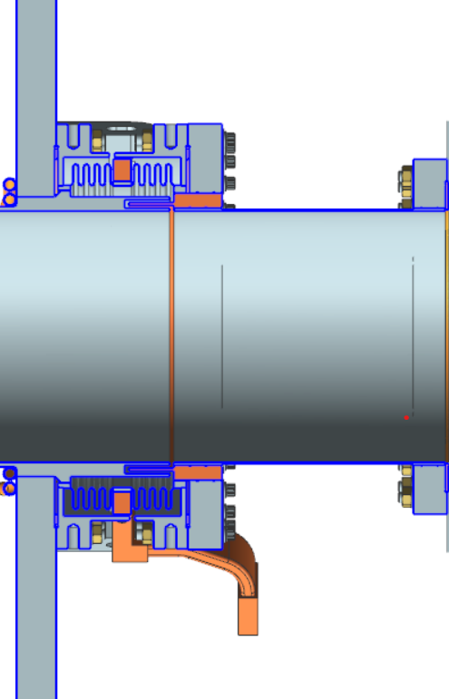
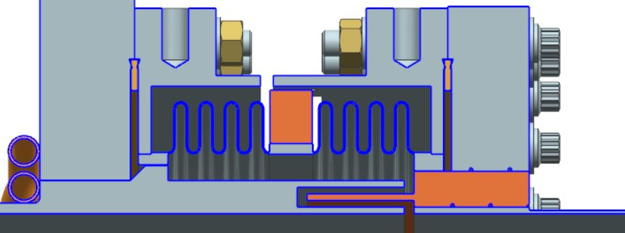
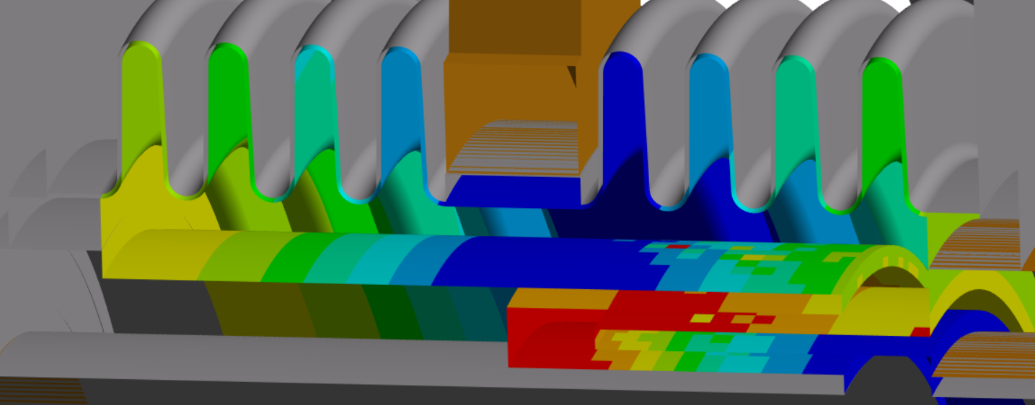
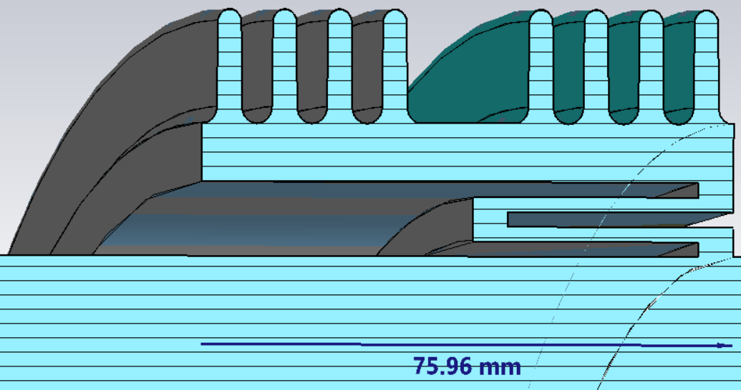
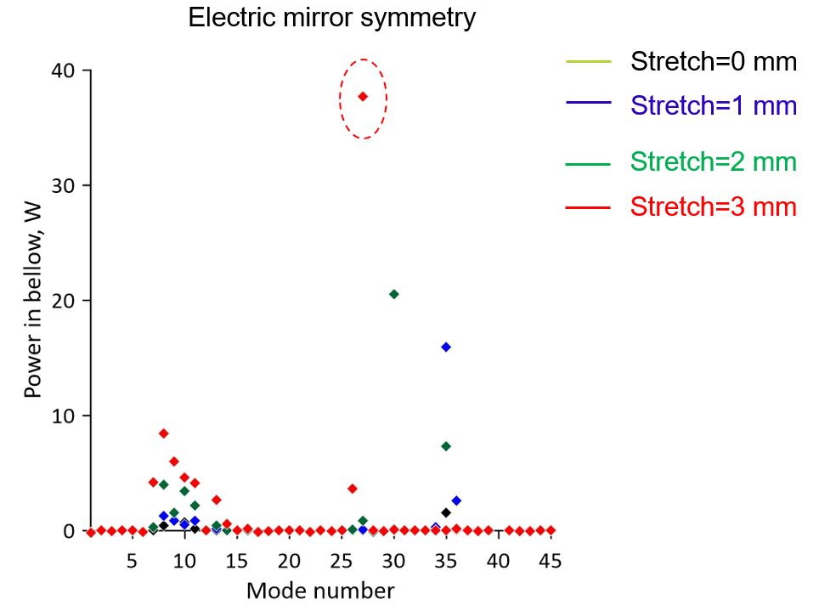
591 MHz 1-Cell Cryomodule – Design Challenges
Warm-to-Cold Transitions
Cavity string incorporates shielded WTC bellows, 2x ∅180 mm and 2x ∅ 274 mm​
The design approach is similar to the BESSY VSR choke shielded cold bellows
RF Shielded Bellows 2 K to RT Transition
Power deposition from CST imported into thermo-mechanical model (ANSYS) for design optimization
Analysis performed to determine power deposition in the bellows
S. Kuzikov
A. Fuller

Slide 14
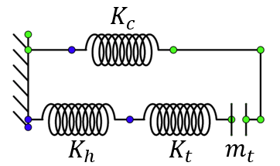
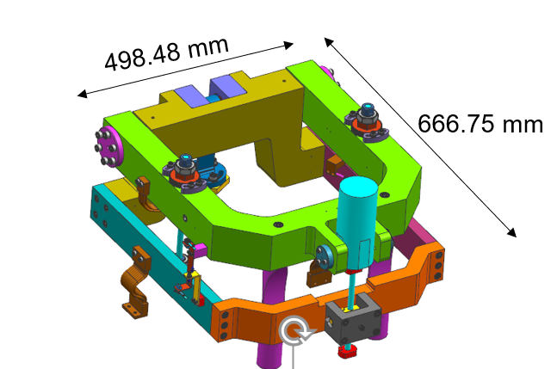
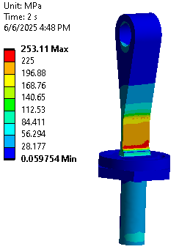
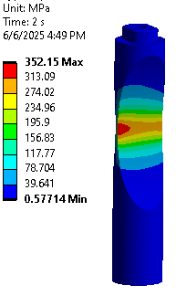
591 MHz 1-Cell Cryomodule – Design Challenges
Cavity Tuner
Design based on double-lever design (SNS)
61 kN tuning load and high desired stiffness ratio (Tuner + He Vessel / Cavity) leads to large and heavy components
He vessel / cavity differential thermal contraction requires design feature to prevent cavity compression during cooldown
Cavity cold stiffness: 32 kN/mm)
Flexures carry heavy axial loads and must enable transverse compliance: requires challenging geometry optimization
R. Fernandes

Slide 15
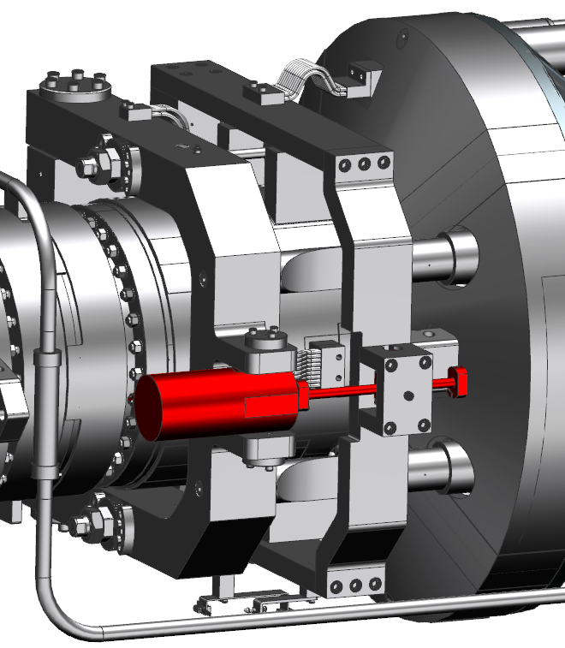
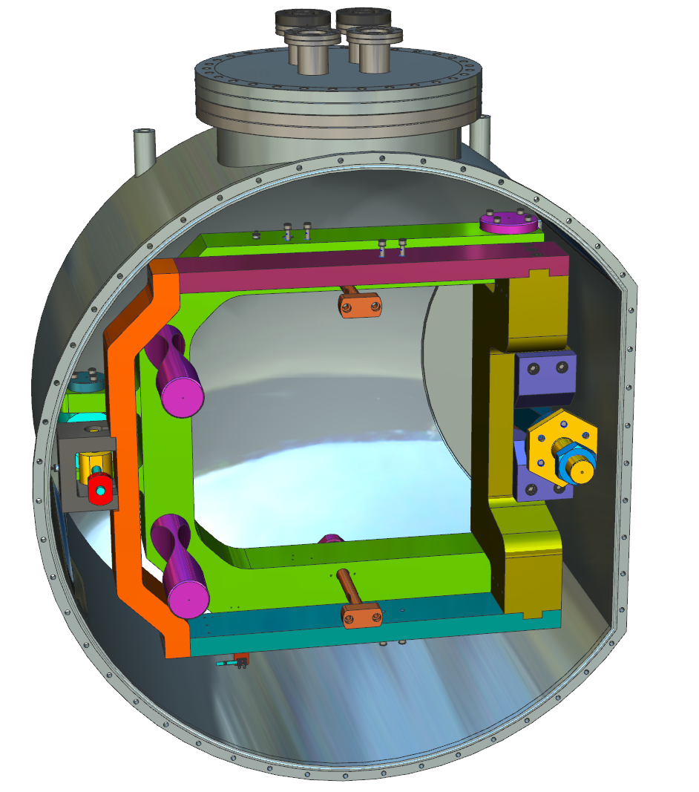
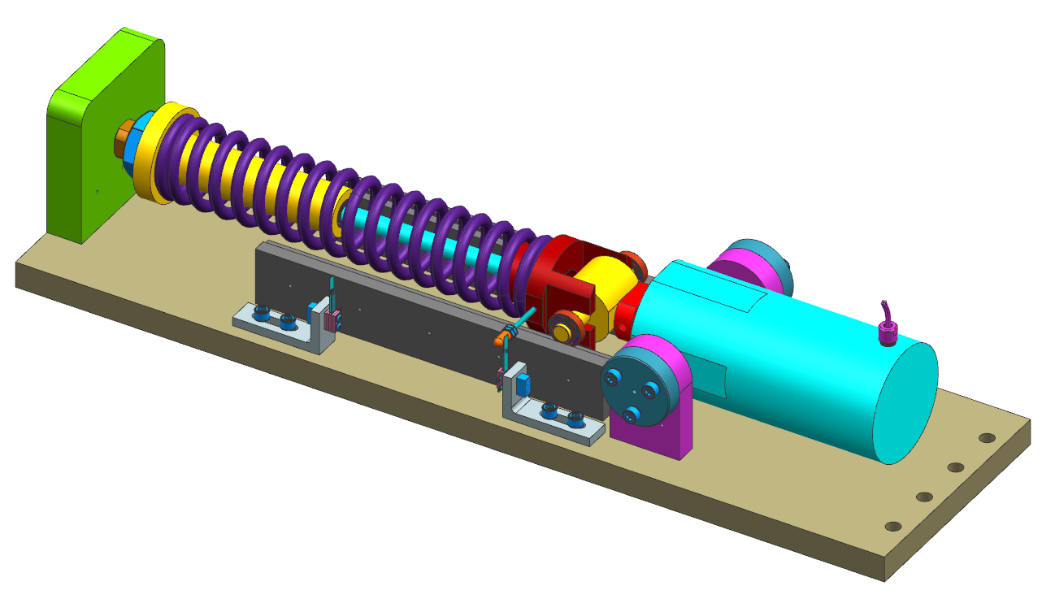

591 MHz 1-Cell Cryomodule – Design Challenges
Cavity Tuner Testing
3 stages of tuner testing
    Drive component static load tests
    Drive components cold dynamic test
    Full tuner cold lifetime test
Full frame test to validate tuner functionality under operating conditions
Static load tests validated cold material properties
Accelerated lifetime test of drive components to verify performance under load
D. Galway

Slide 16




591 MHz 1-Cell Cryomodule – Design Challenges
Cryomodule Components
  Magnetic shields / Thermal shields / Spaceframe / Vacuum Vessel
  Design optimization utilizing FEA to ensure all requirements are met
    Magnetic Hygiene
    Thermal performance
    Allowable stresses
  Value engineering & manufacturability
Cryogenic Interface
    ASME code compliance
    Shipping Loads
  Very limited space within tunnel
  Removable vs permanent connections?
  1 cryogenic supply

Slide 17




591 MHz 1-Cell Cryomodule – Design Challenges
Clean Assembly
Operation power levels require minimizing particulates for success
Many individual components require handling tooling due to size
Precise alignment to minimize particulate generation (conflat gaskets)
Purge system to keep beamline particulate free
Goal is zero field emission
S. DeHart / D. Savransky

Slide 18



197 MHz Crab Cavity String
197 MHz crab cavities are large and have a technically challenging mechanical design
Leveraging experience from HL-LHC to incorporate lessons learned:
  Provisions for processing
  Tolerance reduction studies
Gate Valve
Cavity
Helium Vessel
VHOM Damper
Ion Pump
Warm-to-Cold Transition
HHOM Waveguide
VHOM Waveguide

Slide 19


197 MHz Crab Cavity Design
Requirements:
  Cavity frequency: 197.0508 MHz
  Normal operating voltage: 8.5 MV
  Minimum beam aperture: 100 mm
  Crossing angle (IR6): 25 mrad
Design Goals:
  Maximum operating voltage: 11.5 MV
    Corresponds to: Epk ≤ 45 MV/m & Bpk ≤ 80 mT
    Gives balanced peak surface fields
  Optimize cavity geometry to suppress multipacting resonances, particularly near the nominal operating voltage of 8.5 MV
Higher-order multipole components limit the dynamic aperture and long-term stability in the HSR
Curved poles are required to suppress multipoles
Multipacting analysis performed on cavity and its components
S. De Silva

Slide 20





197 MHz Crab Cavity Design – RF Analyses
FPC multipacting
FPC thermal
Sensitivity analysis performed to quantify effects of machining and welding tolerances
HOM waveguide thermal
Wakefield simulation
Cavity multipacting
B. Xiao
S. De Silva

Slide 21





197 MHz Crab Cavity Mechanical Design
Cavity / Tuner
  Multiple load cases analyzed to ensure compliance of cavity and He vessel with ASME BPVC
  Sensitivity parameters determined
Cavity tuned in compression at magnetic field regions
C. Andhare
J. Cox

Slide 22







Fabrication of 197 MHz Prototype Cavity
A prototype 197 MHz cavity is currently being fabricated at JLab
Cavity will be built and tested at JLab by late 2026
  Processing will be done at ANL, leveraging recent experience with the CERN crab cavity
N. Huque
22

Slide 23
EIC SRF Team – Our most important resource
BNL Silvia Verdú-Andrés, Binping Xiao, Qiong Wu, Guangjiang Li, Clifford Brutus, Wencan Xu, Mike Blaskiewicz, Jessie Fite, Eric Link, George Dacos, Doug Holmes, Kevin Smith, Scott Seberg, Alexei Blednykh, Gang Wang, Alex Zaltsman, Geetha Narayan, Shaoheng Wang, Freddy Severino, Kevin Mernick, Lin Guo, and many more
JLAB Gary Cheng, Zachary Conway, Matt Marchlik, Naeem Huque, Chinmay Andhare, David Savransky, Jiquan Guo, Justine Cox, Eduard Drachuk, Alex Fuller, Daniel Galway, Rossana Fernandes, Caleb Paul. Sean DeHart, Trevor Keenan, Patrick, Minter Paul Carrieri, John Buttles, Damon Rath, Ethan Senecal, Bruce Reinhart, Michelle Oast, Adam O’Brien, Greg Grose, Josh Armstrong, Phil Denny, Sergey Kuzikov, Alex Castilla, Haipeng Wang, Bob Rimmer, Katherine Wilson, Nabin Raut, Pashupati Dhakal, Sarra Bira, Chris Wilkes, Robert Smith, Chris Andrews, David Powell, Dylan Paul, Matt Weaks, William Johnson, Huy Duong, Jason Colley, and many more
More Suba De Silva (ODU), Zhenghai Li (SLAC), M. Kelly (ANL), and many more

Slide 24
Thank you!
This material is based upon work supported by the U.S. Department of Energy, Office of Science, Office of Nuclear Physics under Contract No. 89243126CSC000213

