Slide 1
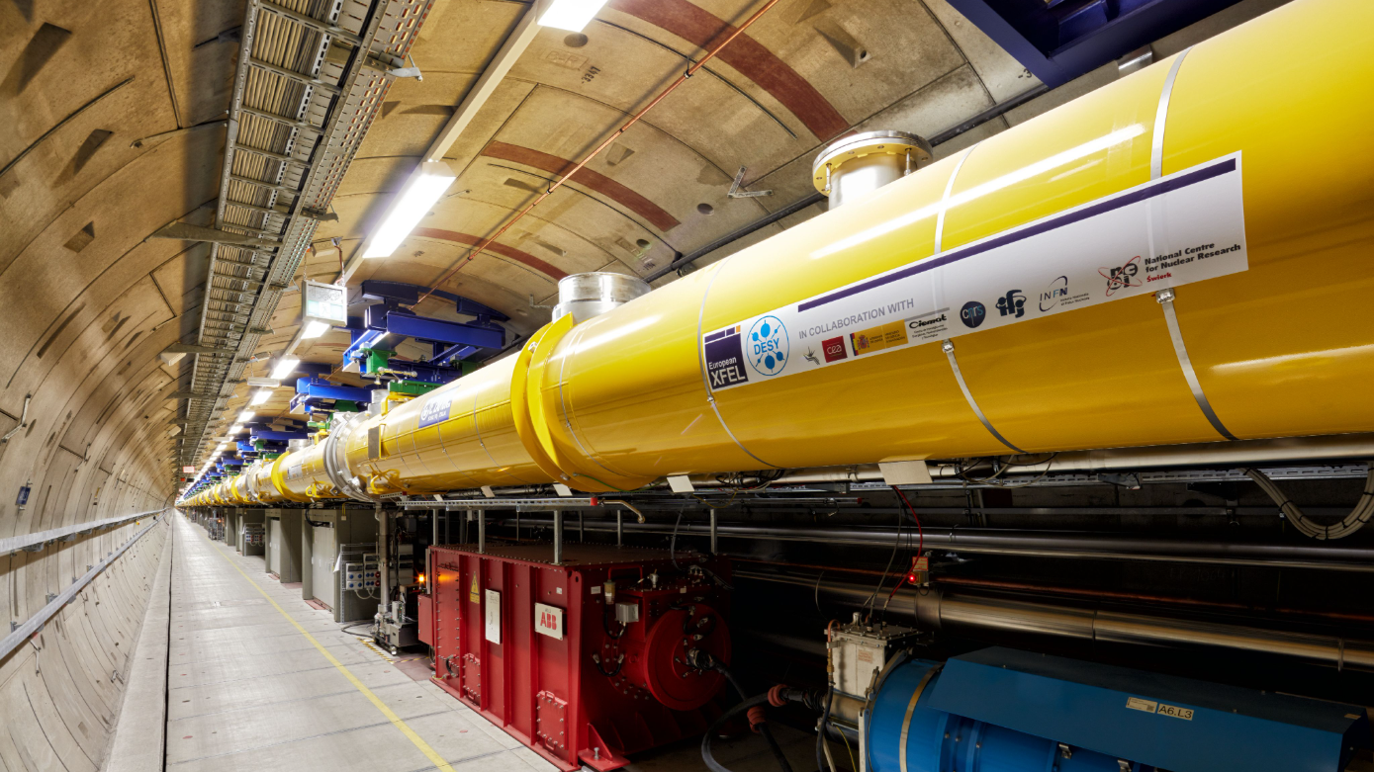

Experience with recommissioning of the European XFEL after Long Installation and Maintenance Period
Mateusz Wiencek – on behalf of XFEL recommissioning team
TTC 26, 11.06.2026

Slide 2
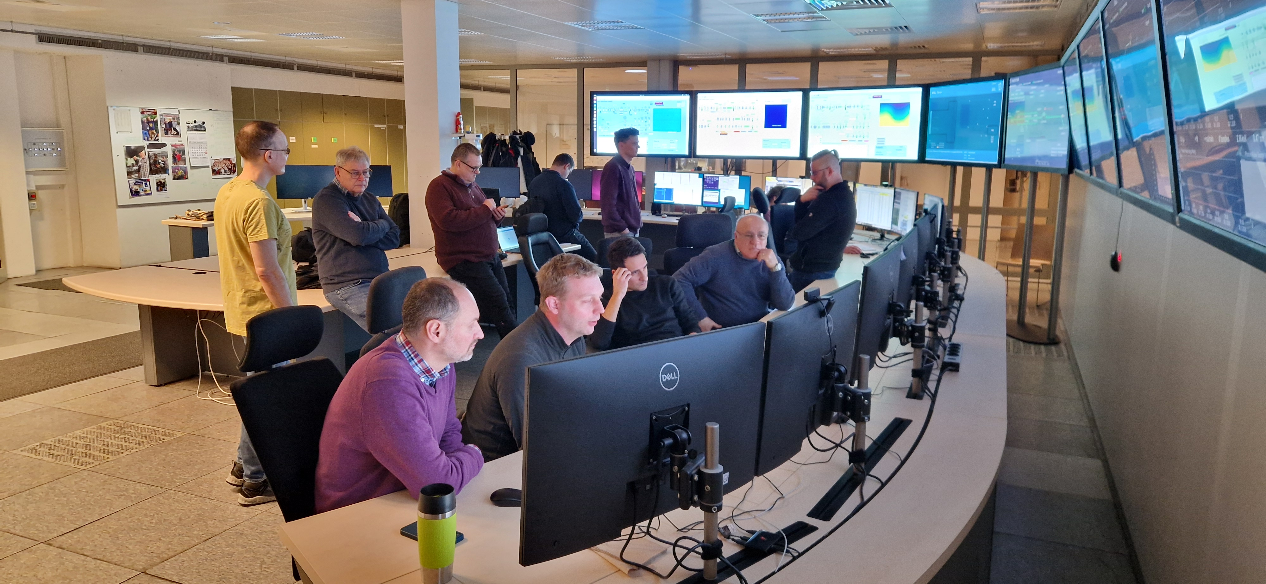
OUTLINE
  Eu - XFEL small reminder
  Long Installation and Maintenance Period 2025 (LIMP25)
  Eu-XFEL LINAC recommissioning:
    Expectations based on experience
    Commissioning strategy and timeline
    Radiation measurement in the tunnel
    Cavities tuning to resonance
    Coupler conditioning
    Cavities conditioning
    Status after recommissioning
  Summary

Slide 3
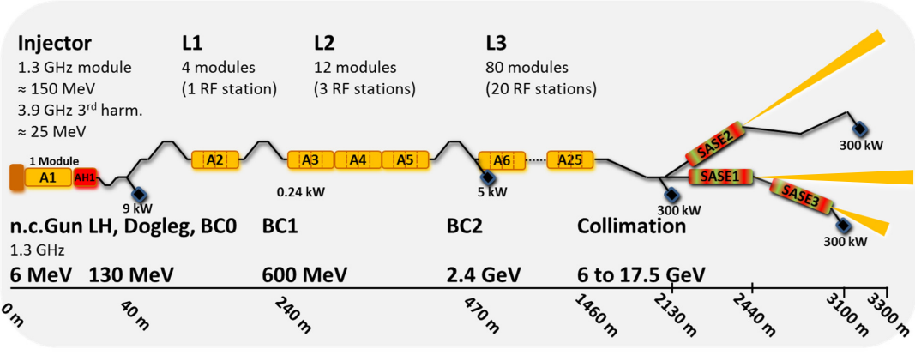
European XFEL small reminder
97 x 1.3GHz Cryomodules, 776 SRF TESLA type cavities
Out of 776 installed cavities, 26 are detuned:
7 x based on initial AMTF test
9 x due to high FE
2 x initial commissioning
8 x to optimize Vector Sum
No radiation monitors in the tunnel dedicated to measure radiation from cavities. However we do have MARWIN – radiation measurement robot
Tailored waveguide system

Slide 4
Eu-XFEL Energy status before LIMP
97 x 1.3GHz Cryomodules, 776 SRF TESLA type cavities
Predefined energy modes:
  8 GeV
  10.5 GeV
  11.5 GeV
  14 GeV
  16.1 GeV
  16.3 GeV

Slide 5
Eu-XFEL Energy status before LIMP
97 x 1.3GHz Cryomodules, 776 SRF TESLA type cavities
Predefined energy modes:
  8 GeV
  10.5 GeV
  11.5 GeV
  14 GeV
  16.1 GeV
  16.3 GeV
2.4 GeV at BC2
During user run always one spare OFF crest station available

Slide 6
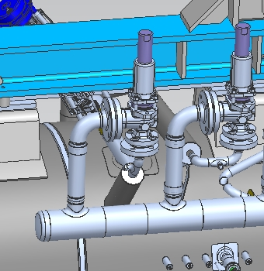
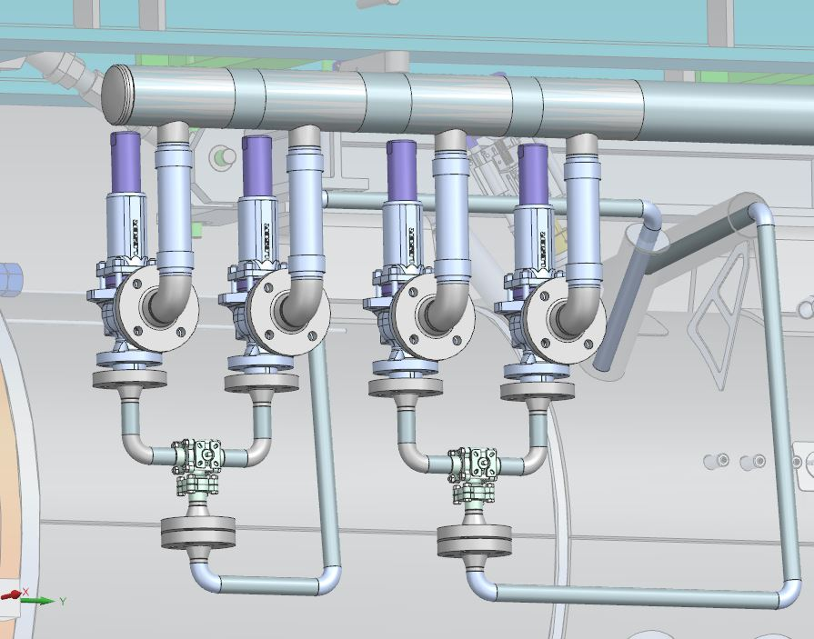
Long Maintenance and Installation Period 2025
Most important modification: cryogenic safety valves
  In Eu-XFEL there is a necessity to test cryogenic safety valves regularly
  Before LIMP: Warming up the LINAC is needed to perform safety valves check
  After LIMP:
    Doubling safety valves
    One valve can be tested while the second one is in operation
      No warming – up is needed to perform this operation
      In – situ check

Slide 7
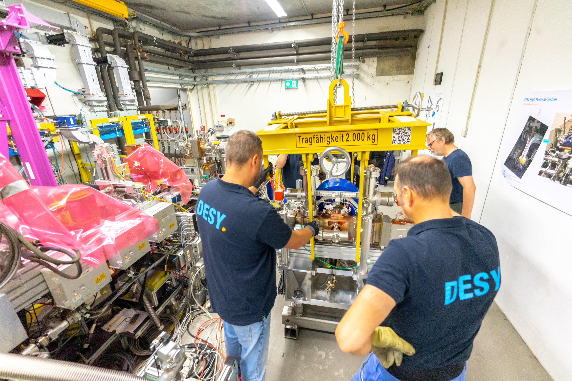
Long Maintenance and Installation Period 2025
7 months of extensive effort
Some numbers on cryogenic modifications:
  150 safety valves including piping system have been modified
  600 new flanges have been installed
  1500 welded connections with zero leaks
  In 2031: Internal check of safety valves
  In 2036: Check of safety valves by authority
In addition, plenty of other upgrades were introduced:
Gun5 installation
SCU / S-PRESSO (XTD1, SASE2)
ASPECT (XTD2, SASE1 modification)
Streaker North (XTD4, passive streaker)
STERN (XS4 – XTD8)
Master oscillator upgrade
RF distribution update
RF hardware maintenance
Electrical safety checks
Preventive maintenance
(fans, power supplies, filters, …)
Inventory check

Slide 8
LIMP 2025
From the SRF cavities / cryomodules perspective
What we did:
Cavity detuning to safe positions
Warm – up entire LINAC
What we did not:
vent beam vacuum
vent coupler vacuum
vent cryomodules insulation vacuum

Slide 9
LIMP 2025
From the SRF cavities / cryomodules perspective
What we did:
Cavity detuning to safe positions
Warm – up entire LINAC
100 kHz or 200 kHz from 1.3 GHz (depending on initial cavity frequency). Avoiding plastic deformation while saving lifetime of the stepping motor tuners. Done with automatic system
What we did not:
vent beam vacuum
vent coupler vacuum
vent cryomodules insulation vacuum

Slide 10
LIMP 2025
From the SRF cavities / cryomodules perspective
What we did:
Cavity detuning to safe positions
Warm – up entire LINAC
100 kHz or 200 kHz from 1.3 GHz (depending on initial cavity frequency). Avoiding plastic deformation while saving lifetime of the stepping motor tuners. Done with automatic system
Outgassing on cavities RF surface
What we did not:
vent beam vacuum
vent coupler vacuum
vent cryomodules insulation vacuum

Slide 11
LIMP 2025
From the SRF cavities / cryomodules perspective
What we did:
Cavity detuning to safe positions
Warm – up entire LINAC
100 kHz or 200 kHz from 1.3 GHz (depending on initial cavity frequency). Avoiding plastic deformation while saving lifetime of the stepping motor tuners. Done with automatic system
Outgassing on cavities RF surface
What we did not:
vent beam vacuum
vent coupler vacuum
vent cryomodules insulation vacuum
Should secure good performance of the couplers and cavities.

Slide 12
General considerations or what did we expect?
Reaching nominal energy after initial commissioning took long
During initial commissioning of the Eu-XFEL, plenty of challenges with regards to achieve desired energy were spotted
Special Task Force was established to analyze the problem and push LINAC Energy to its maximum
In parallel with XFEL user operation we scheduled dedicated study time to achieve 17.5 GeV which was finally reached after 1.5 years
Nick Walker - TTC Meeting - UBC, Vancouver, 5.02.2019

Slide 13
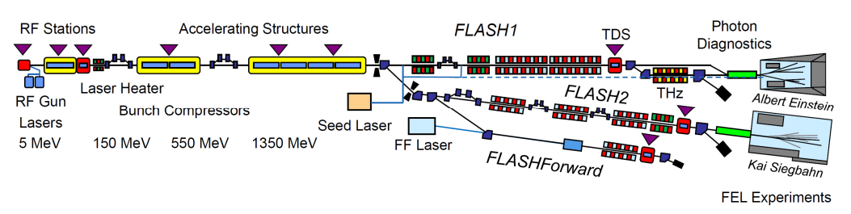
General considerations or what did we expect?
FLASH experience
FLASH, being a user facility, was the basis which can be seen also as prototype for European XFEL
  It was extensively used to develop technology
  Since the course of almost 30 years of operation it was cryo cycled several times
  Some of the cryomodules were added or exchanged during years of operation
  For FLASH 2020+ upgrade, 2 cryomodules were exchanged
    Those modules showed quite good performance, nevertheless they needed a long processing
    After each cryo cycle they need processing

Slide 14
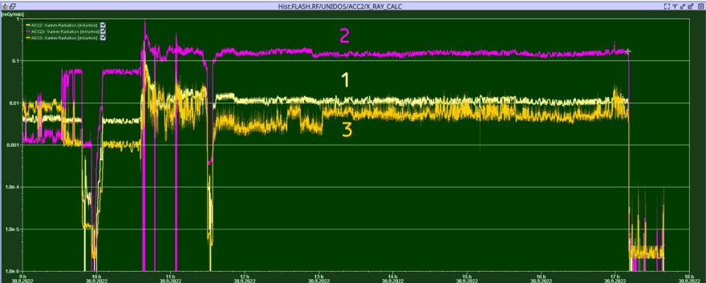
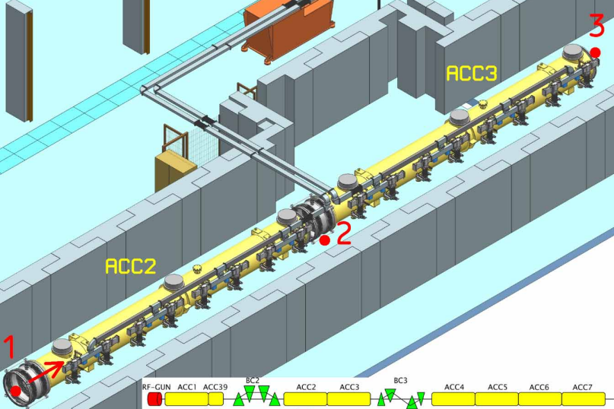
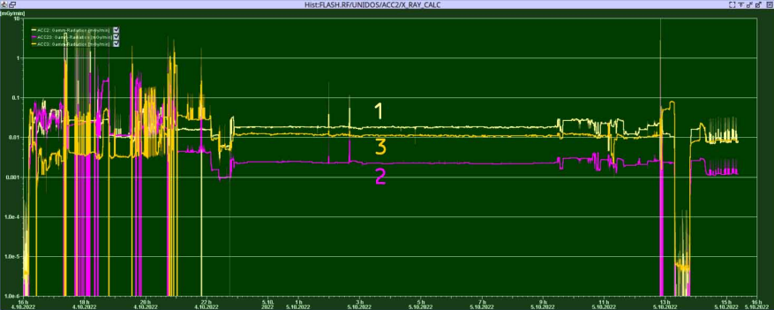
General considerations or what did we expect?
FLASH ACC2 and ACC3 conditioning
Both of the FLASH2020+ upgrade cryomodules required several weeks of processing in AMTF tests stand
For the initial commissioning it was decided to install additional radiation monitors for processing
Around one week of processing reduced field emission significantly
https://proceedings.jacow.org/srf2023/papers/mopmb082.pdf

Slide 15
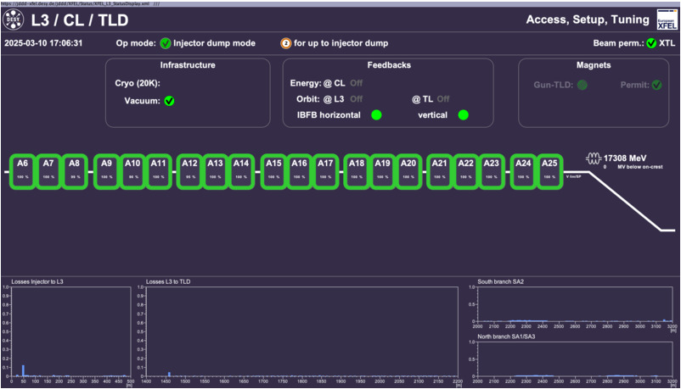
Goals for EuXFEL recommissioning
Preserve energy and amount of cavities in use
Before Warm - up
750 Cavities up and running

Slide 16
Goals for EuXFEL recommissioning
Preserve energy and amount of cavities in use
Before Warm - up
750 Cavities up and running
After LIMP
750 Cavities up and running

Slide 17
Goals for EuXFEL recommissioning
Preserve energy and amount of cavities in use
Before Warm - up
750 Cavities up and running
After LIMP
We assumed that 3 to 5 RF station will need long processing. We predicted that other will go rather smoothly – few hours per station.
Therefore we scheduled 2 weeks for processing.
750 Cavities up and running

Slide 18


Conditioning strategies…
the safest…
Power rise one cavity at a time
Very safe approach
A lot of experience and statistics can be collected
Detailed radiation profile for each cavity can be obtained
Very long and unpredictable amount of time needed

Slide 19
Conditioning strategies…
…the fastest…
Load machine configuration file and press START
In case everything goes smoothly takes very little amount of time
Not predictable behavior of the entire system
According to our experience high risk of spoiling cavities with radiation

Slide 20

Conditioning strategies…
…the compromise
Power up RF station (32 cavities) carefully
Observe all signals
Ramp – up speed dependent on cavities behavior
Time needed could be predicted
Requires skilled operators for each RF station

Slide 21
The recommissioning team
9 people in total
6 LLRF experts
  Treat cavities as black box which always behaves the same way
3 SRF cavities experts
  Treat cavities as a piece of Niobium, everything can happen there

Slide 22
The recommissioning team
9 people in total
6 LLRF experts
  Treat cavities as black box which always behaves the same way
3 SRF cavities experts
  Treat cavities as a piece of Niobium, everything can happen there
One RF station as a training and explaining the algorithm for both groups

Slide 23
The recommissioning team
9 people in total
6 LLRF experts
  Treat cavities as black box which always behaves the same way
3 SRF cavities experts
  Treat cavities as a piece of Niobium, everything can happen there
One RF station as a training and explaining the algorithm for both groups
One LLRF expert and one cavity expert make a conditioning of RF station together.

Slide 24
The recommissioning team
9 people in total
6 LLRF experts
  Treat cavities as black box which always behaves the same way
3 SRF cavities experts
  Treat cavities as a piece of Niobium, everything can happen there
One RF station as a training and explaining the algorithm for both groups
One LLRF expert and one cavity expert make a conditioning of RF station together.
Each operator took RF station and make conditioning

Slide 25
The recommissioning team
9 people in total
6 LLRF experts
  Treat cavities as black box which always behaves the same way
3 SRF cavities experts
  Treat cavities as a piece of Niobium, everything can happen there
One RF station as a training and explaining the algorithm for both groups
One LLRF expert and one cavity expert make a conditioning of RF station together.
Each operator took RF station and make conditioning
Coordinator is always available to address special cases or challenges

Slide 26
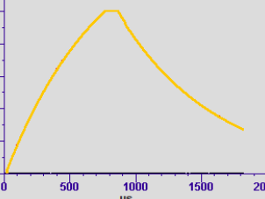
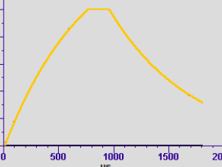
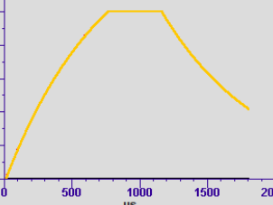
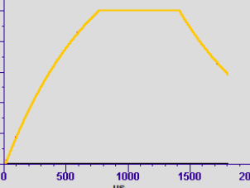
Cavities conditioning algorithm
Preparation
SP=600 MV
Flat-top = 100us
Increase SP by 10 MV
Radiation?
Vacuum events?
Nominal setpoints [MV]
A2:680
A3:700
A4:750
A5:746
A6:665
A7:680
A8:810
A9:655
A10:800
A11:800
A12:785
A13:765
A14:635
A15:605
A16:810
A17:725
A18:830
A19:710
A20:795
A21:845
A22:800
A23:842
A24:755
A25:635
Flat top length:
200 us
400 us
650 us
YES
NO
Wait until radiation goes down or stabilize
Nominal SP?
YES
NO
SP=Nominal – 50MV
Flat-top = x00us
Increase SP by 10 MV
Radiation?
Vacuum events?
YES
NO
Wait until radiation goes down or stabilize
Nominal SP?
YES
NO
YES
Flat – top 650us?
NO
RF STATION CONDITIONED

Slide 27
Radiation measurement for processing
A real-time Gamma Dosimeter for XFEL using PIN-Diode-Sensors
For FLASH radiation studies, X-rays detectors were installed temporarily
  This option was not possible for entire 1.5 km long LINAC
On the other hand in order to perform cavities processing, some radiation monitoring is needed.
Radiation?
Vacuum events?

Slide 28
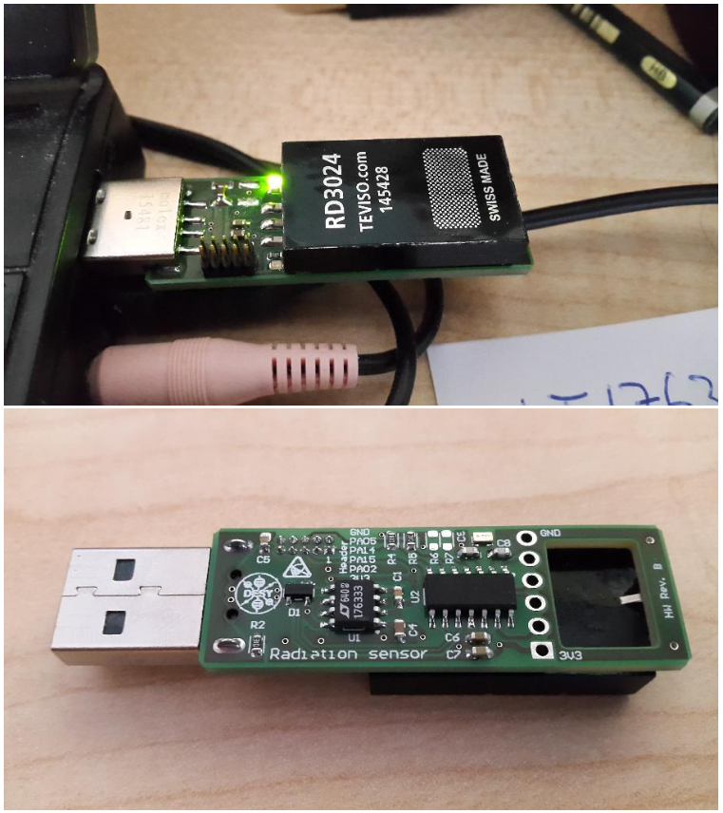
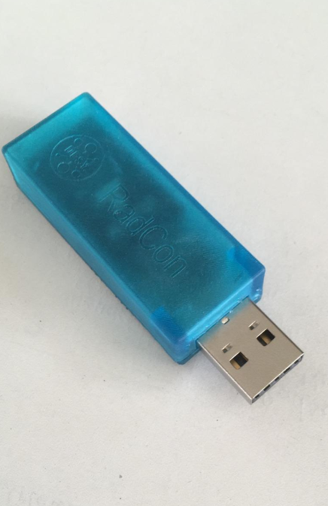
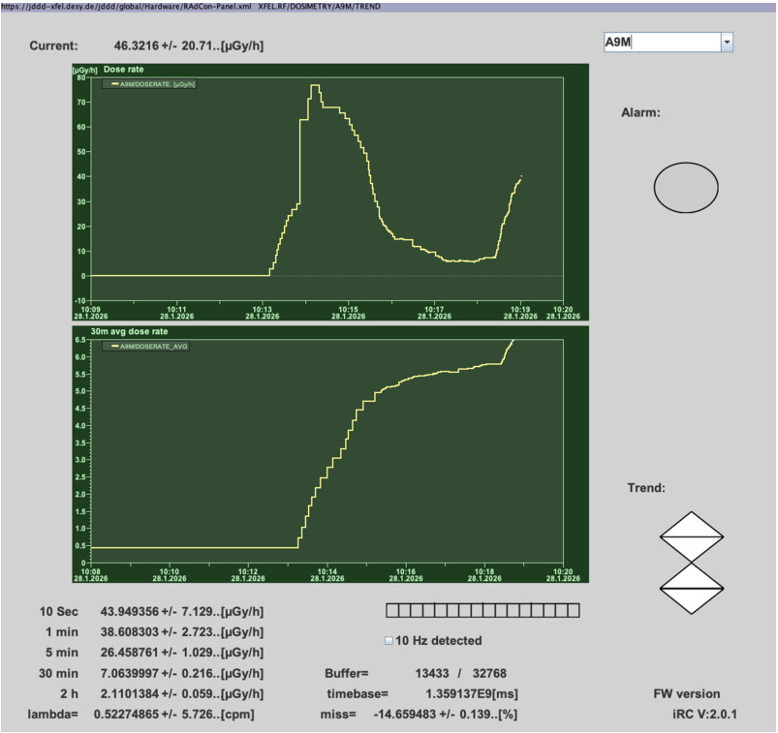
Radiation measurement for processing
A real-time Gamma Dosimeter for XFEL using PIN-Diode-Sensors
For FLASH radiation studies, X-rays detectors were installed temporarily
  This option was not possible for entire 1.5 km long LINAC
On the other hand in order to perform cavities processing, some radiation monitoring is needed.

Slide 29
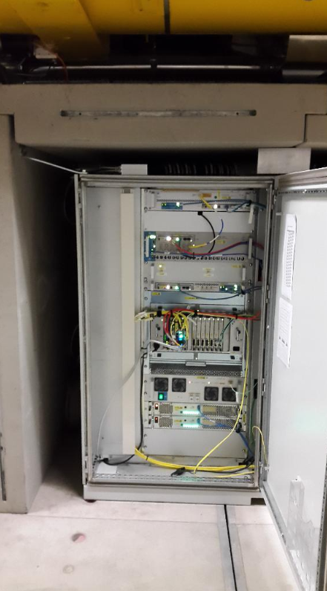
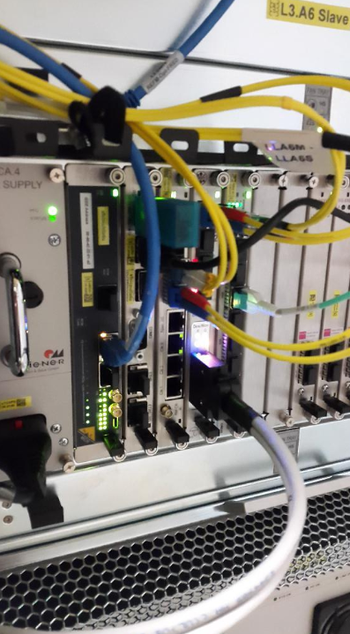
RadCon…
A real-time Gamma Dosimeter for XFEL using PIN-Diode-Sensors
Developed by DESY (MSK Group)
Placed in the electronic rack underneath RF station, protected by radiation shielding
Can measure only Gamma radiation
Qualitative, not quantitative measurement
BUT WE ARE NOT BLIND

Slide 30
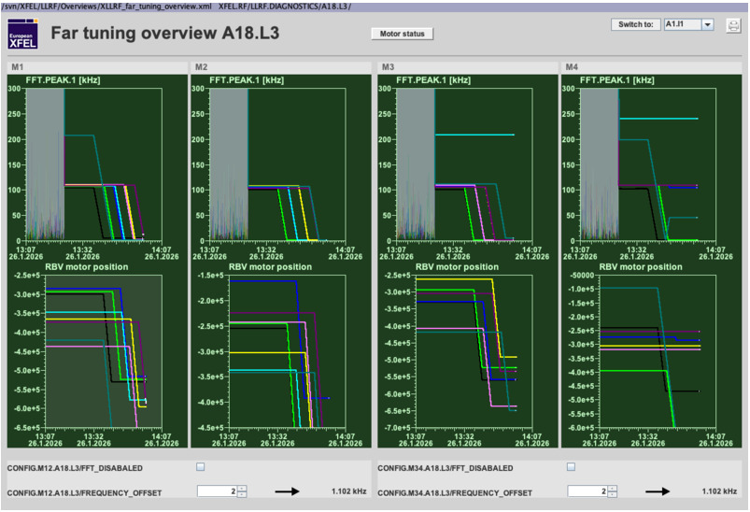
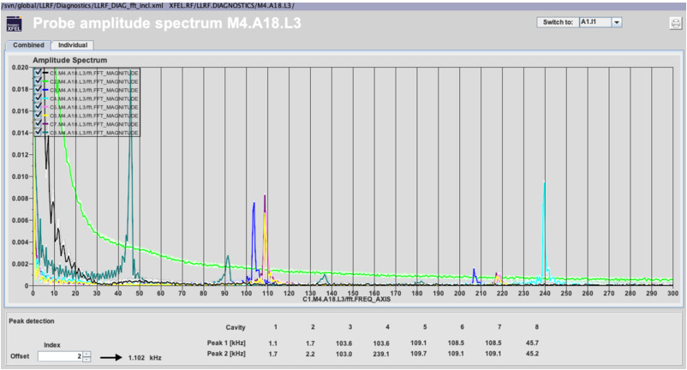
Cavities tuning to resonance after cool down
Using semi – automatic tool
Cool down to 2K took around 6 weeks
All cavities were tuned with semi – automatic tool developed for emergency detuning
  Nevertheless cavities resonant frequencies were observed in order to not exceed 1.3 GHz
2 operators for 2 RF stations
Takes one shift (8 hours)
One motor driver failure (16 cavities) → needs intervention in the tunnel

Slide 31
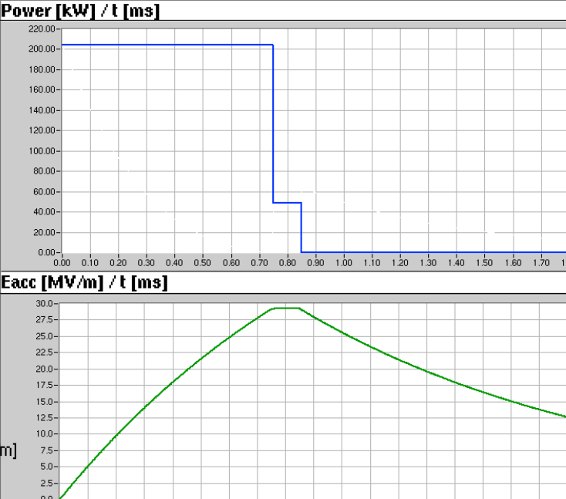
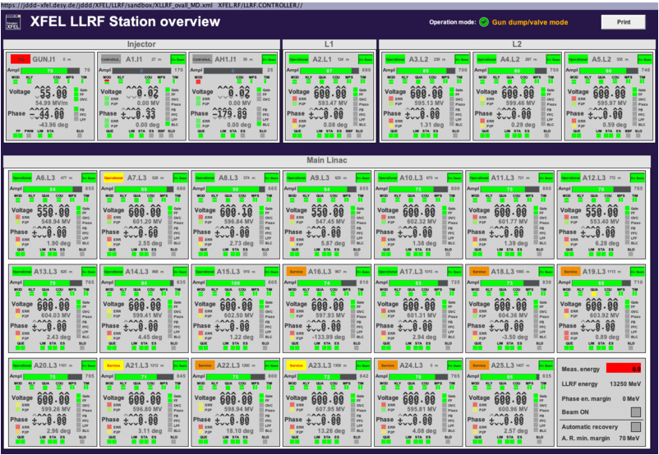
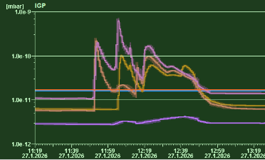
Coupler conditioning
After cryo cycle it is worth to check what happened with power couplers
All cavities tuned → took time until late afternoon
We decided to leave entire machine over night with short pulse and low setpoint → check if everything is stable

Slide 32
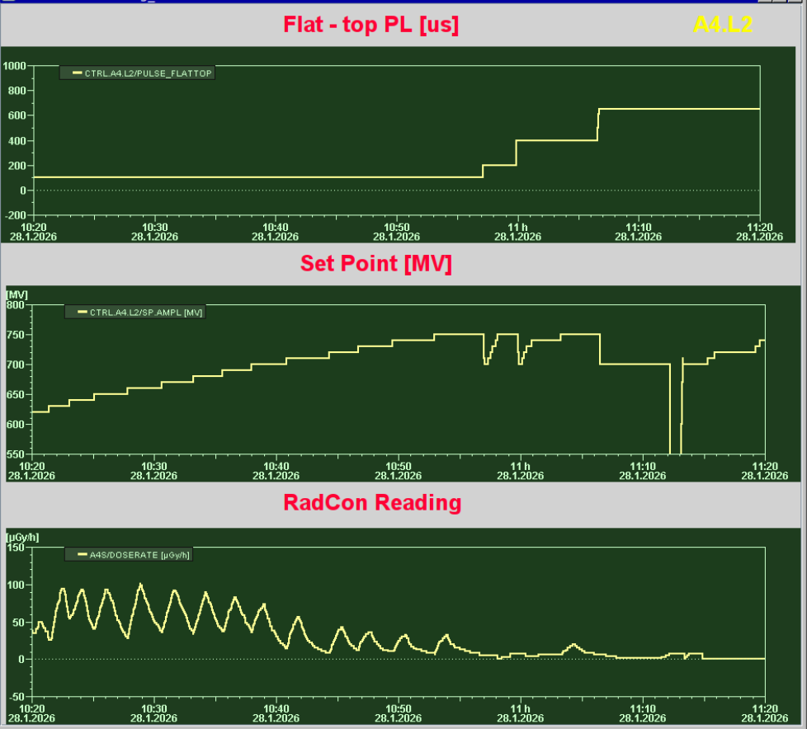
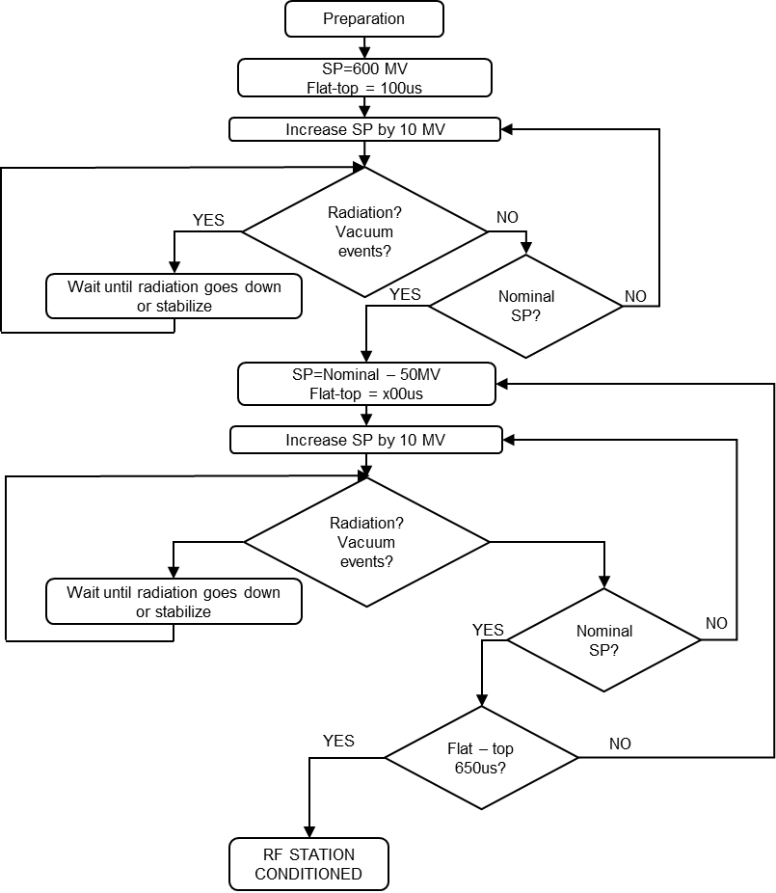

Cavities conditioning – most common case
RF Station: A4.L2 example
Conditioning took 1h
Final steps another 0,5 hour

Slide 33
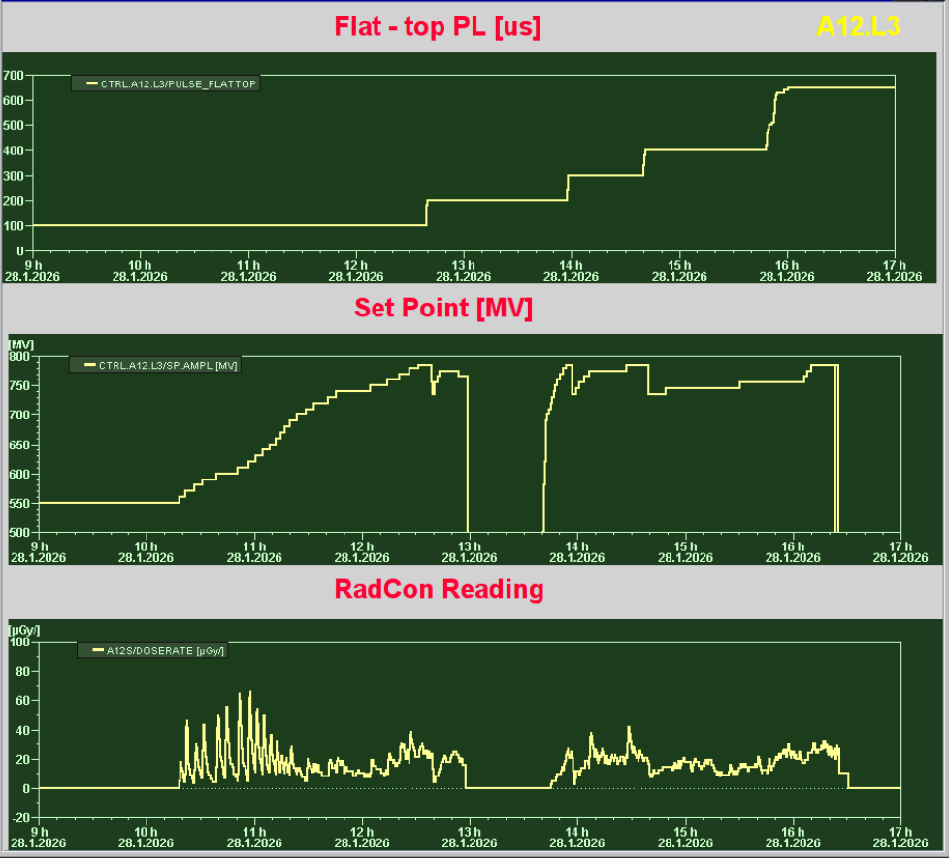
Cavities conditioning – worst case
RF Station: A12.L3

Slide 34
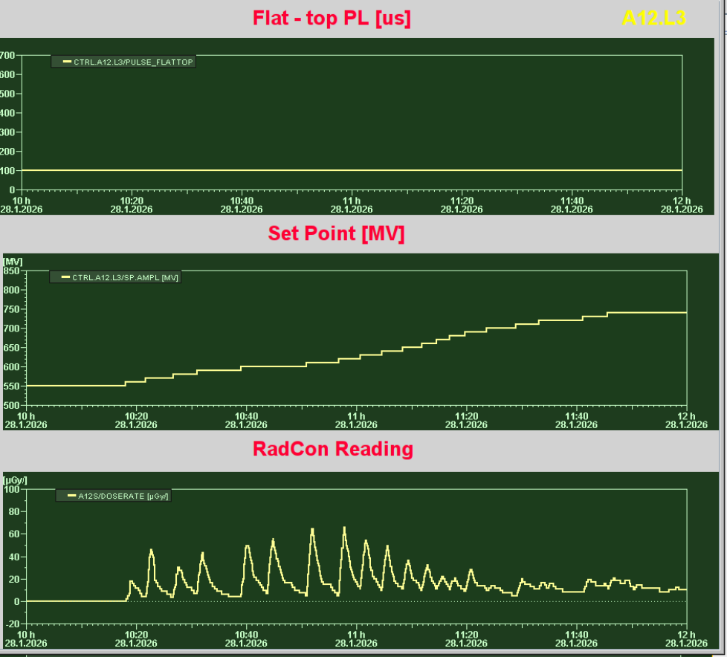
Cavities conditioning – worst case
RF Station: A12.L3
Took 7 hours overall

Slide 35
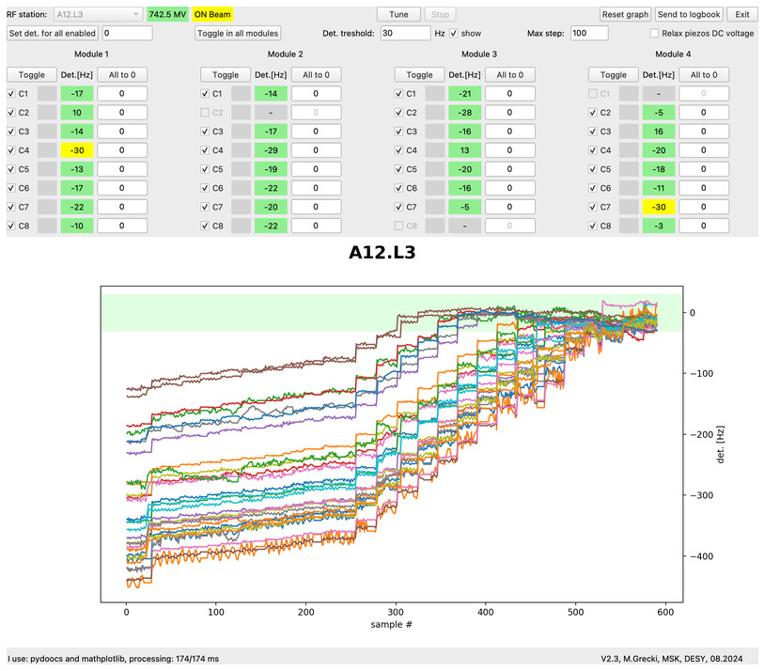
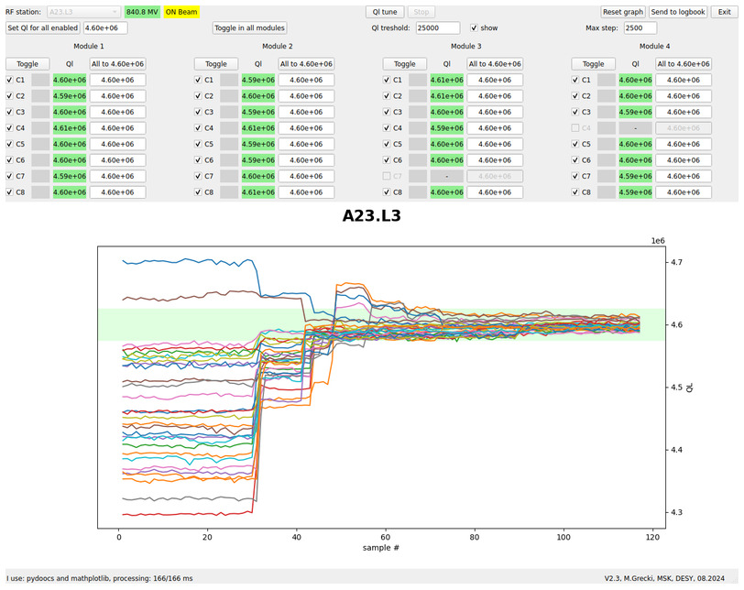
LINAC conditioning – final steps
Get everything prepared for the beam
Fine tuning with mechanical tuners and piezos
Set everything for the beam
  Feedback
  Feedforward correction
  Learning Feed forward
After few hours
  Qext correction

Slide 36
Cavities conditioning – All RF station statistics
2 days instead of planned 2 weeks!
9 people
2 working shifts
In average 2 hours needed for RF station

Slide 37

Energy before and after LIMP
Before

Slide 38
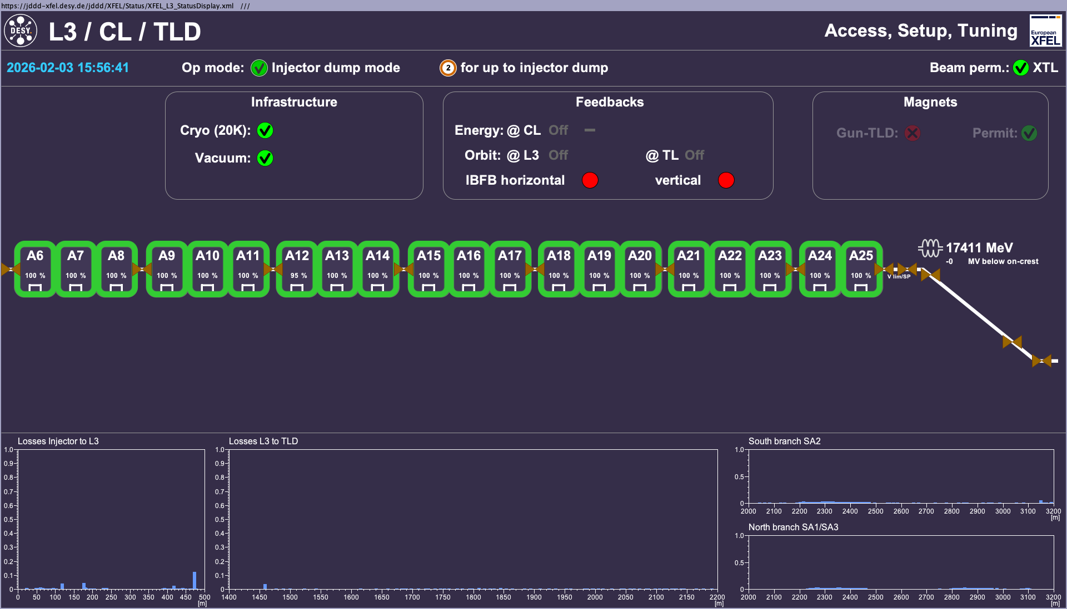
Energy before and after LIMP
After

Slide 39
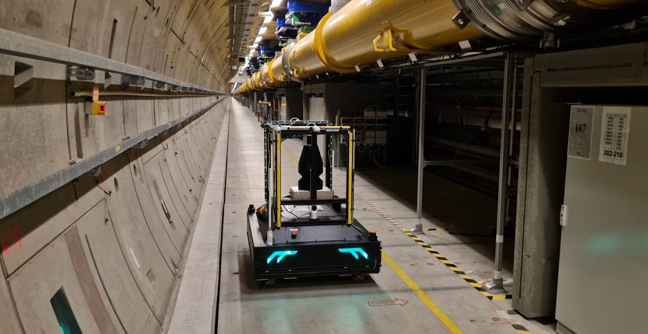
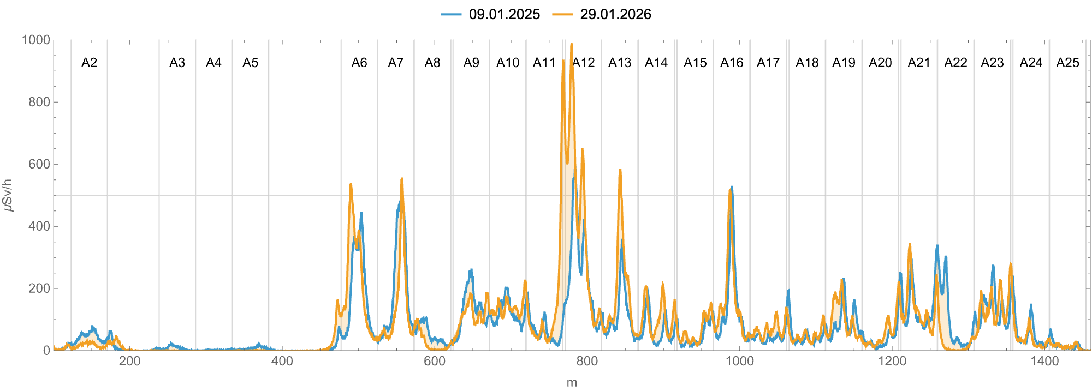
MARWIN SCAN
Before and after LIMP25

Slide 40
Summary
Recomissiong was a great sucess!
After 8 years of successful operation, European XFEL underwent its first cryo cycle
  Main purpose of the LIMP was to make cryogenic modifications
  Warming up the machine as well as cooling down showed no major technical problems
  No vacuum leaks during cryogenic cycle
RF commissioning was planned taking into account experience from FLASH and Eu – XFEL
RF recommissioning of the entire LINAC took 2 days instead of planned 2 weeks.
We preserve Energy of the EuXFEL and not lose any cavity during the process

Slide 41
Thank you
I will be happy to answer Your questions…
Mateusz Wiencek
MSL
mateusz.wiencek@desy.de

