Slide 1
Commissioning of CM1 and current Status of HELIAC Project at GSI
Maksym Miski-Oglu

Slide 2
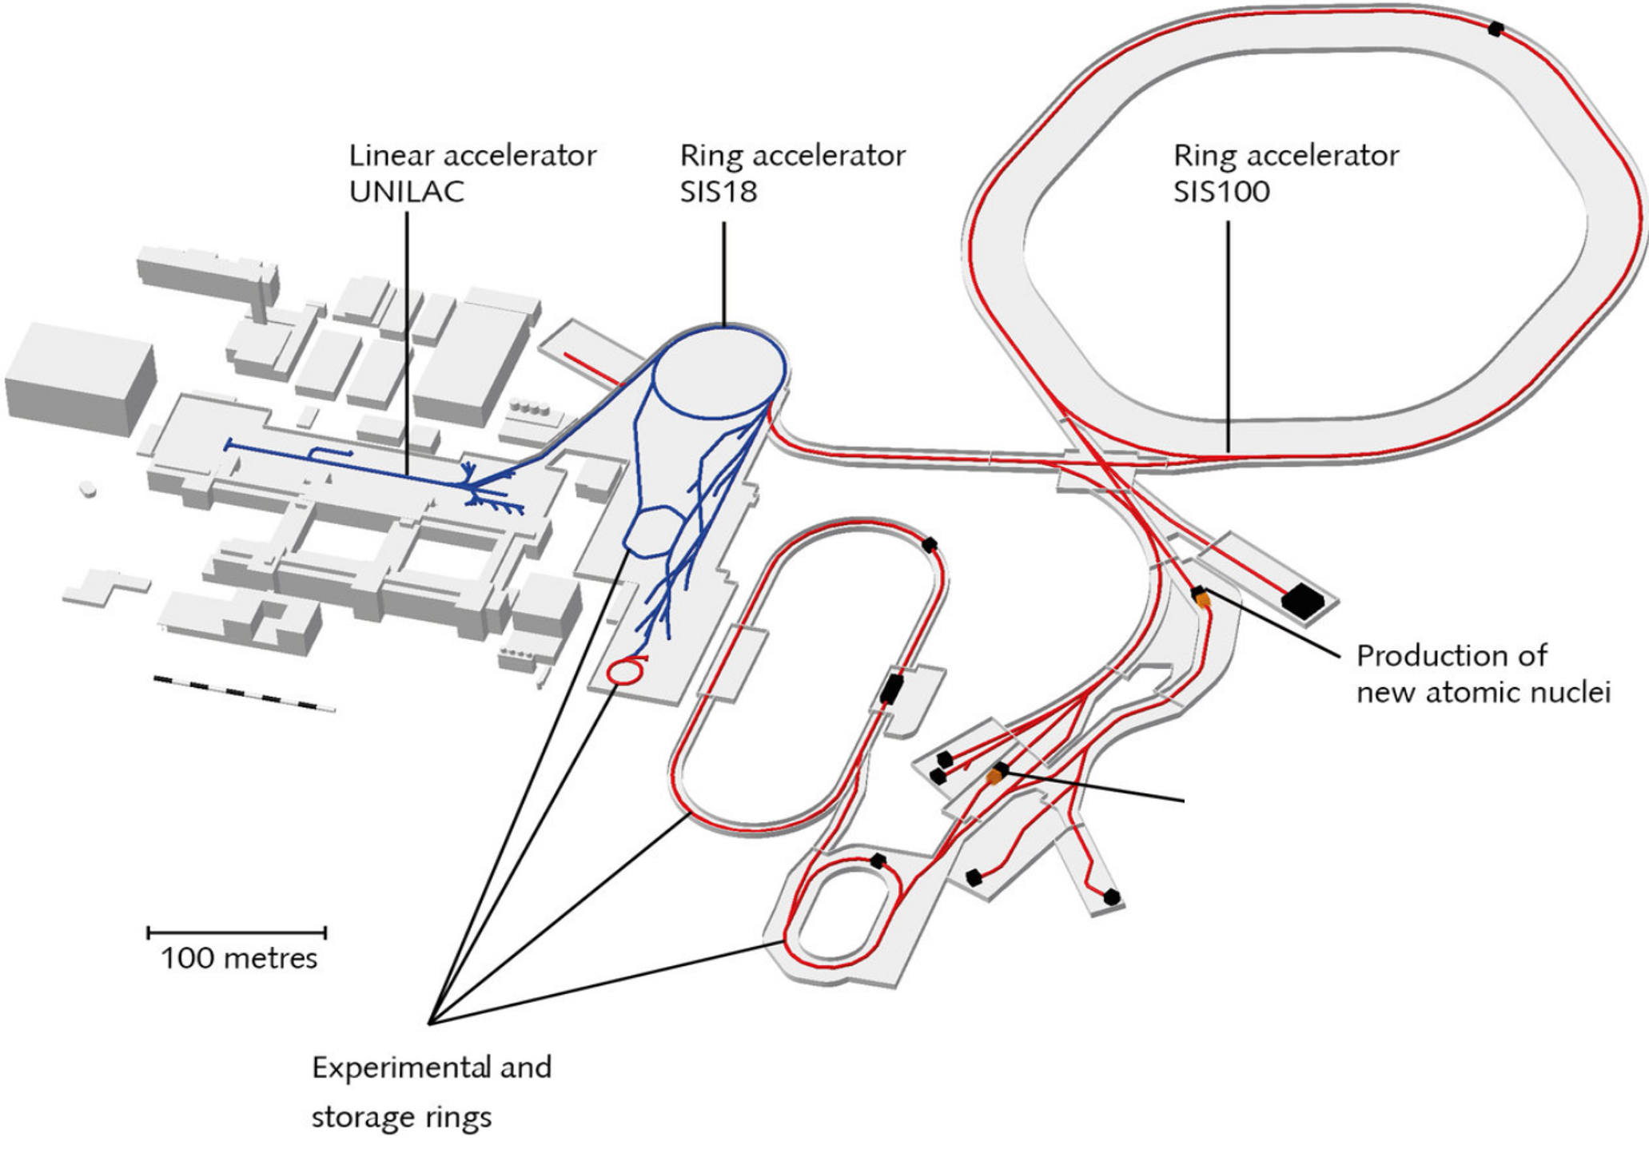
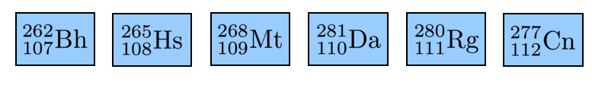
Existing GSI facility and future FAIR complex
Existing facility
Future facility
Experiments
UNILAC provide beam for SHE research @ GSI
UNILAC will serves as injector for FAIR
SHE program and material research requires a dedicated LINAC
Word wide quest for synthesis of element 120

Slide 3
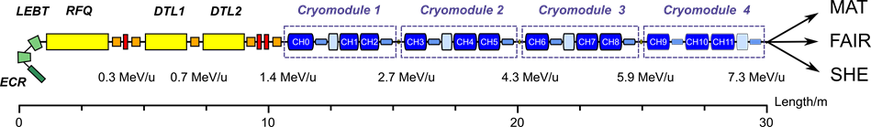
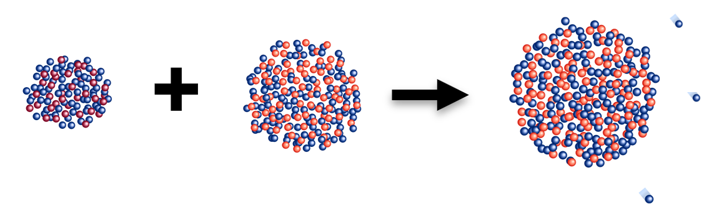
HELIAC - HElmholtz LInear ACcelarator
Variable output energy: 3.5 – 7.3 MeV/u
Operation temperature: 4K
Beam current: ≤ 1 mA in cw-mode
Ion species with 1 ≤ A/q ≤ 6
Planned to be installed in parallel tunnel to UNILAC
4 Times more beam on target (compared to UNILAC) due to cw mode and up to 8 times due to new 18GHz-ECR Ion source
Electric power consumption is 1 MW (5 times lower compared to UNILAC)
HELIAC has been optimized for the needs of SHE & MAT programs and could be used as SIS18-injector for medium intensities
HELIAC – „discovery machine“
Uue?
Ubn?

Slide 4
Cryomodule Layout for HELIAC
Standard Cryomodule Layout
CH
S
B
CH
CH
S
4.8 m
B
Buncher cavity – Single Spoke Resonator
CH
Accelerator cavity – Crossbar H-mode cavity
S
9.5 Tesla sc-Solenoid with integrated XY-stearing coils

Slide 5
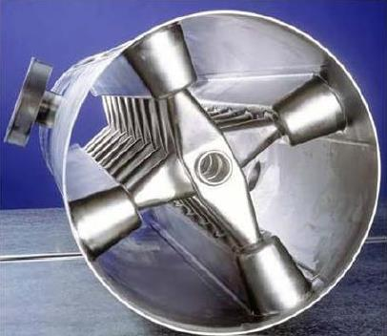
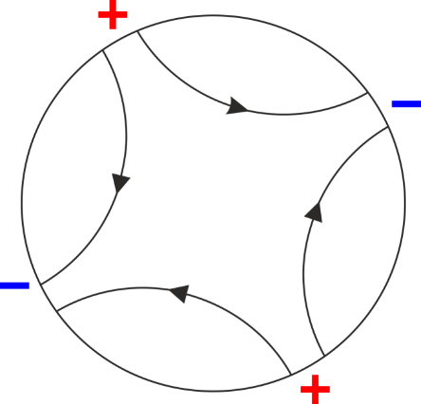
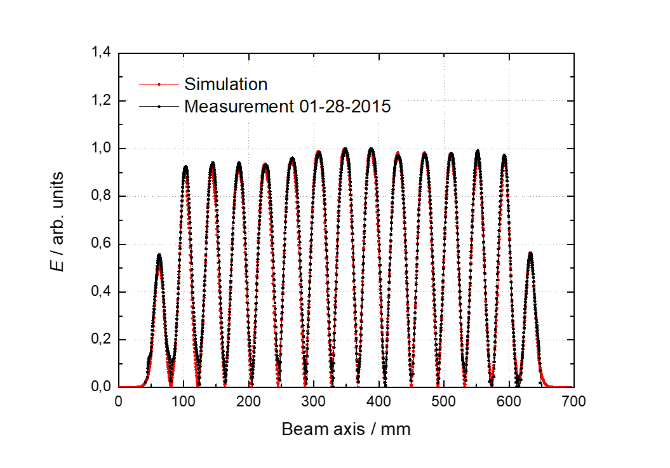
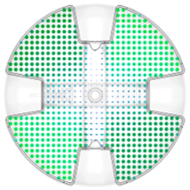
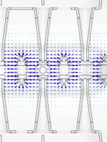
CH-Cavities (TE211-mode)
H₂₁₁ mode of ”pillbox“ cavity
H field
E field
E field along beam axis
Longitudinal motion of
bunch in the constant-β-section
0.01
ψ_{m}
ψ_{o}
3
Δβ
0
2
1
-0.01
ψ (deg)
0
-90
-180
-270
Drift tubes alternating connected to “+” and “-” potential
Multigap drift tube cavity for the acceleration of heavy ions in the low and medium β
Cross-bar-H-mode cavity → CH cavity
Equidistant drift tubes length → special beam dynamics

Slide 6

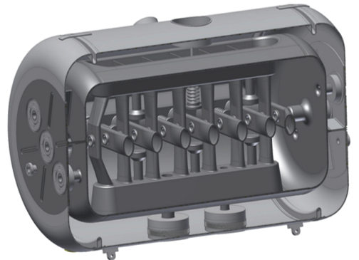
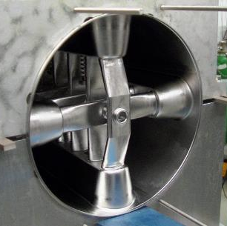
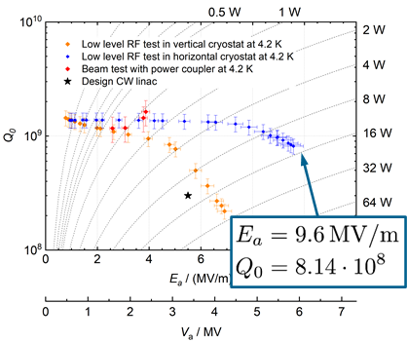
CH Cavity for HELIAC
800mm
CH0 Cavity | Unit | Value
Cavity type |  | CH
β (v/c) |  | 0.059
Frequency | MHz | 216.8
Diameter | mm | 409
E_{a} (design) | MV/m | 5.5
E_{p}/E_{a} |  | 6.3
B_{p}/E_{a} | mT/(MV/m) | 5.7
Stem with
drift tube nose
Titanium
Helium vessel
4mm Nb
cavity wall

Slide 7
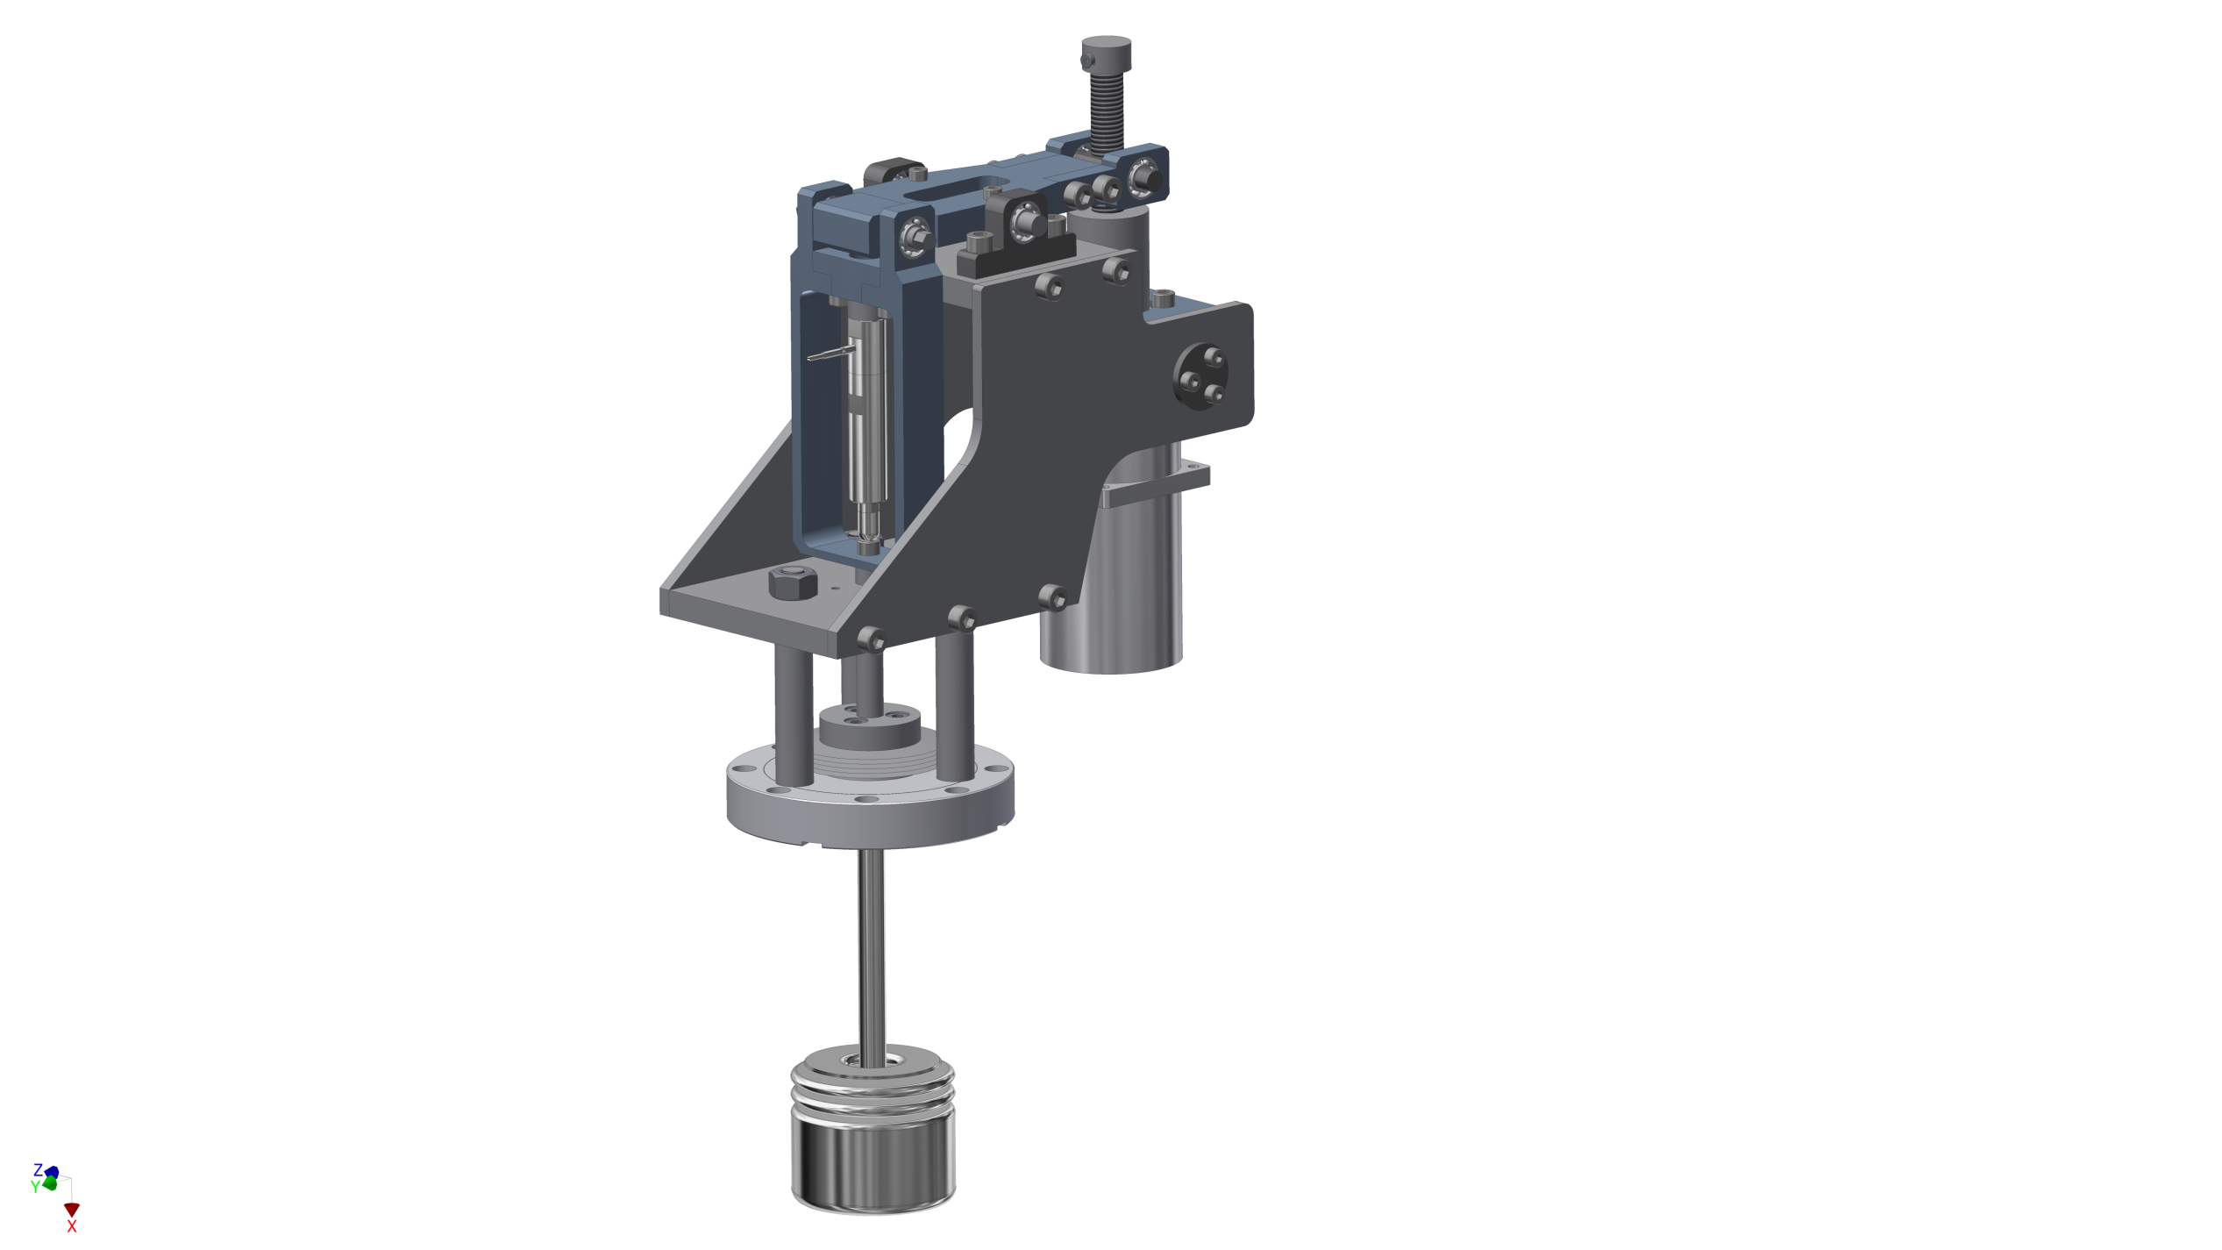
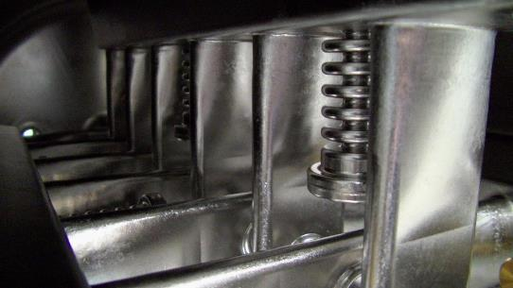
CH Cavity for HELIAC
Main properties of the tuning system:
Capacitive bellow tuner
Enables slow & fast frequency adjustment
Mechanical displacement ±1 mm (≈ ±60 kHz)
Required force < 800 N
Lever with pivot point ratio ≈ 2:1
Gear reduction ratio 50:1
Piezo actuator “connected in series” with slow tuning unit
Achieved displacement of piezo ±5 µm (≈ ±300 Hz)
Compact, simple and durable mechanics
Rotation axis
Spindle
Lever
Piezo
actuator
Stepping motor
Source
Bellow tuner

Slide 8
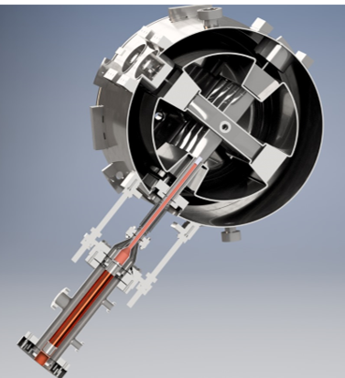
CH Cavity for HELIAC
He-Outlet
Stems oriented 45° to horizon
LHe flowing through hollow stems
3kW cw fundamental power coupler
2 windows: 300K and 60K
Cold window unit assembled in clean room
Cold window unit slides on guiding roads
Variable coupling, penetration depth ±10mm
Warm window unit assembled after integration
with cryostat
guiding
road
He-Inlet
Cold window unit

Slide 9
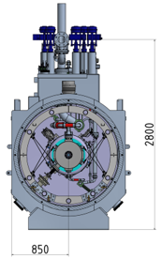
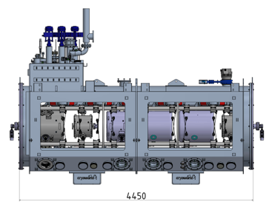
Design requirements & solutions for Cryostat
On site alignment of each component with a laser tracker
Assembly of RF power couplers and solenoid current leads after integration of string into the cryostat
2 rectangular service doors on each side
Trans. position of each component will be preserved within
± 0.1 mm during cool down
Nuclotron suspension of single components
Segmented support frame @300 K
Segmented frame standing on dedicated points of the bottom of the cryostat
Deformations of outer vessel during evacuation do not affect the position of the segmented frame
Thermal shield suspended inside of segmented frame
Maintenance of auxiliary components (tuner, coupler etc….)

Slide 10
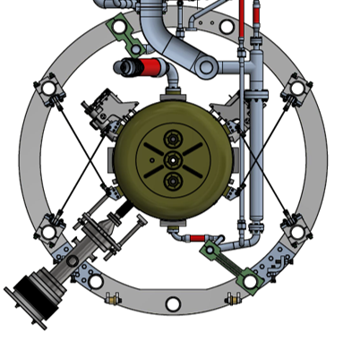
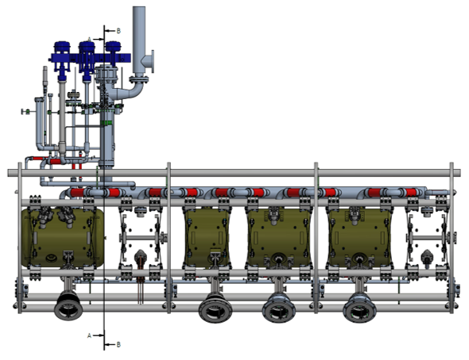

Nuclotron Suspension
engineered and manufactured by
Segmented Frame
opening

Slide 11
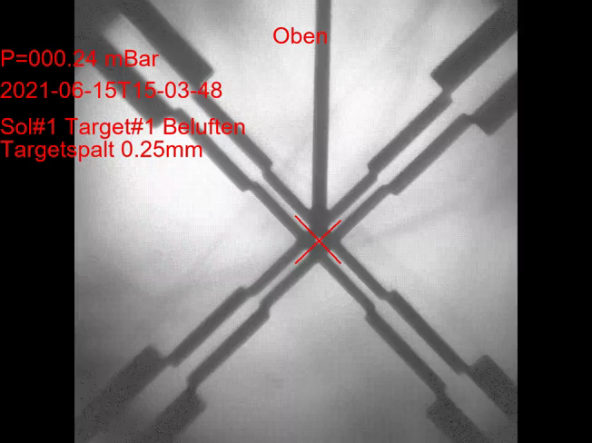
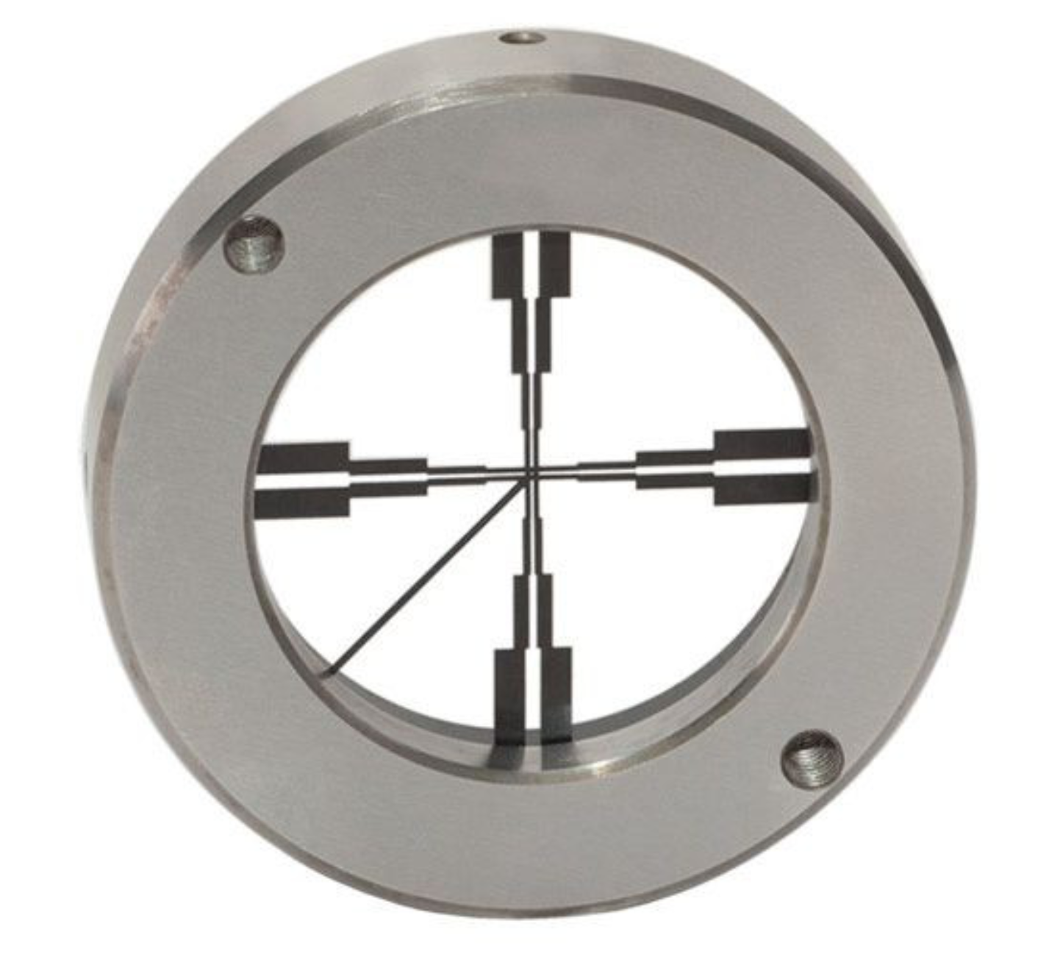
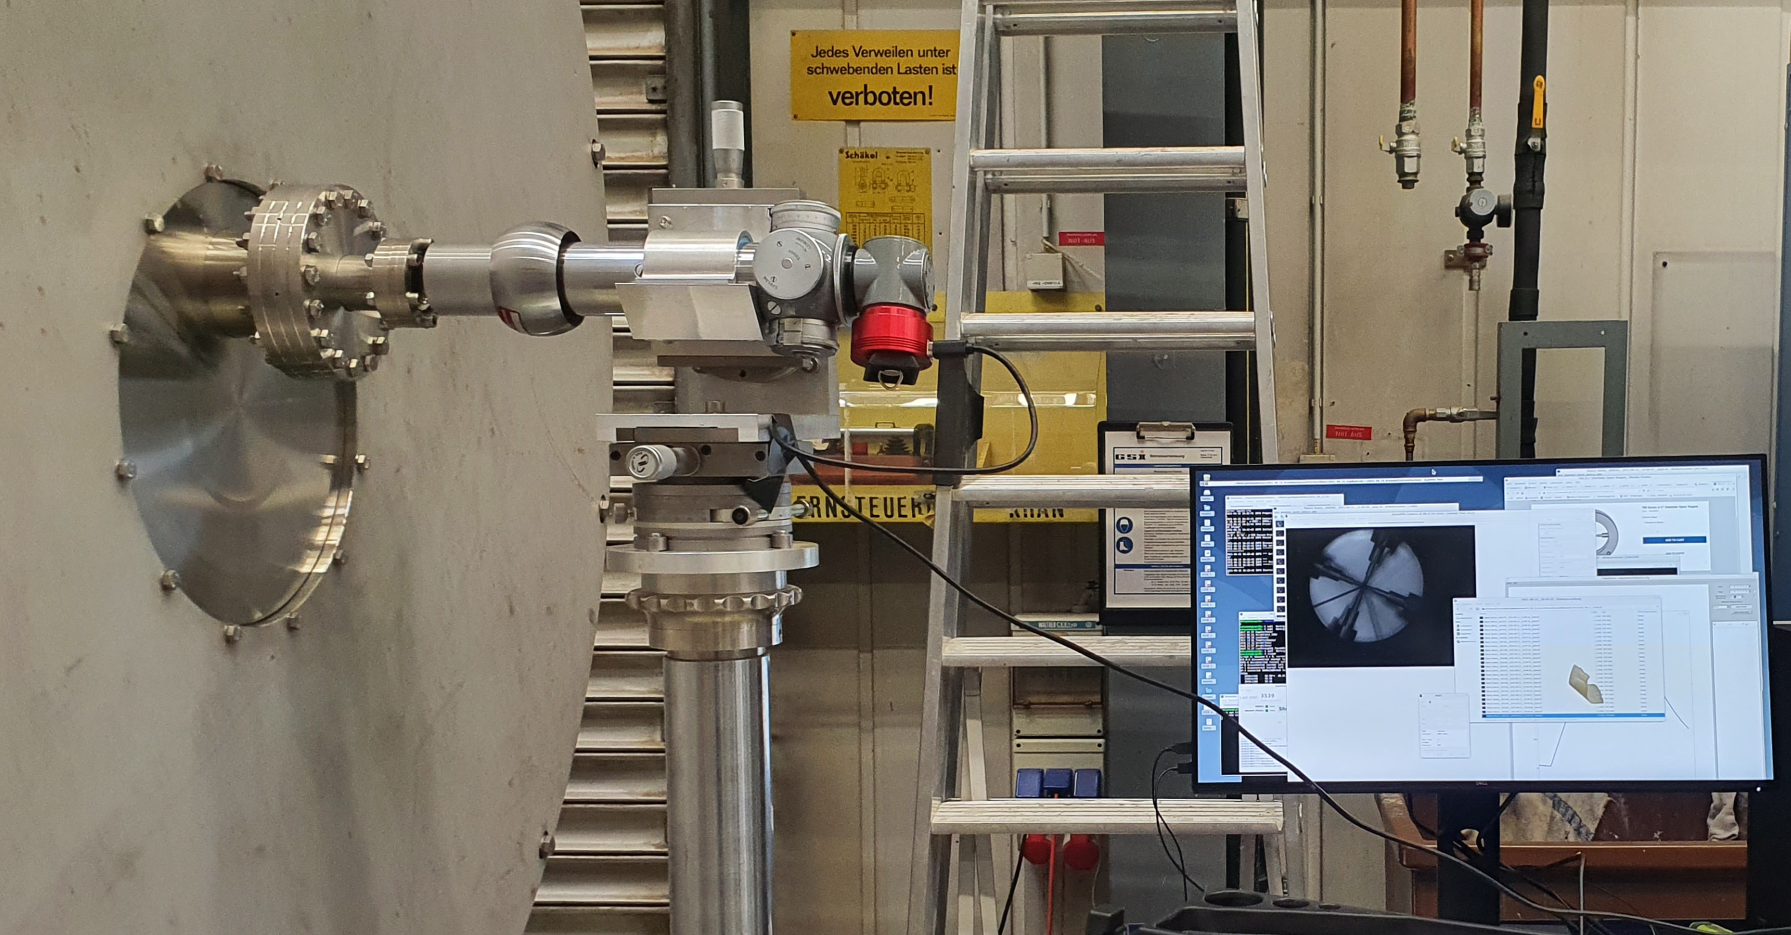
SAT of Cryostat with Dummy Cavities in 2021
Transversal Positioning Fidelity
Open target mounted on flange of solenoid
Vacuum window at beam ports of cryostat
Taylor-Hobson micro alignment telescope
CMOS Camera
Measurement during evacuation/venting
∼0.15mm displacement
0.25 mm

Slide 12
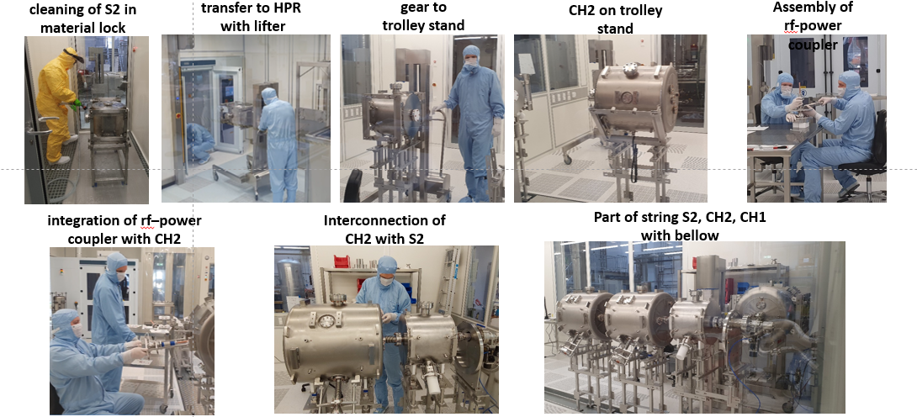
Cold string Assembly of CM1 in Clean Room of Helmholtz Institute Mainz

Slide 13
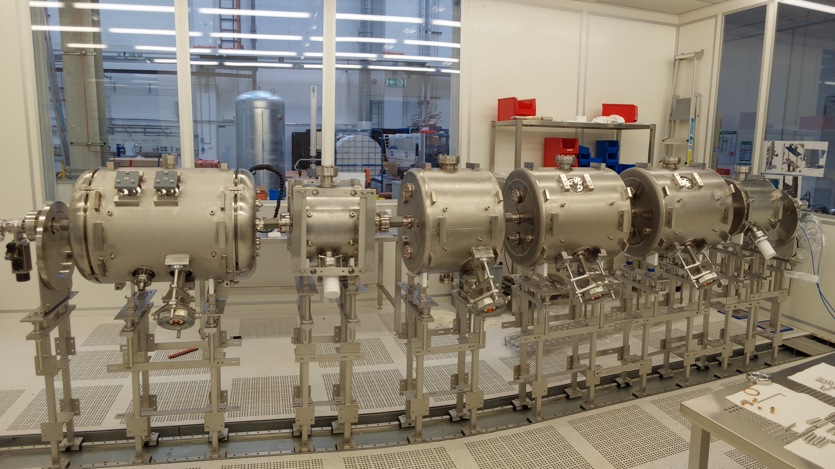
07.02.2023

Slide 14
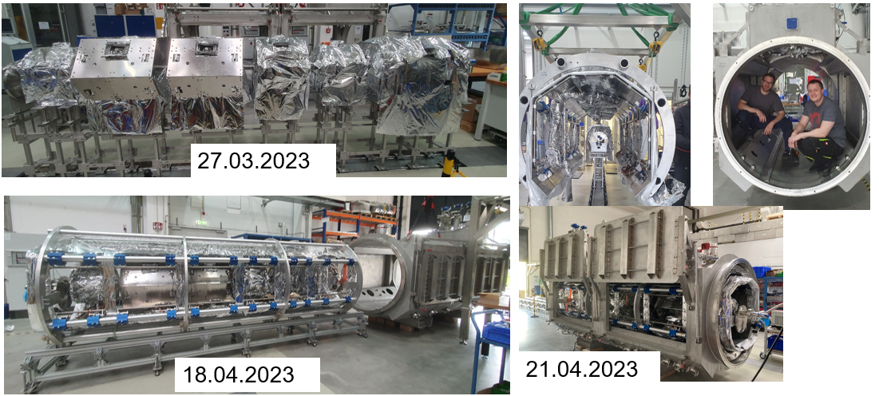
Integaration of CM1 cold string with cryostat

Slide 15
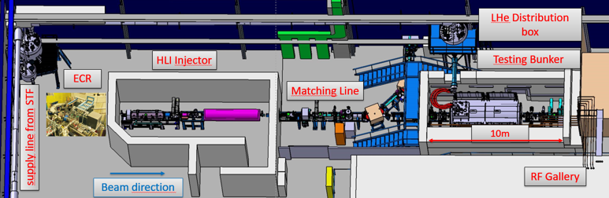
Testing Area @GSI for “Advanced Demonstrator”
Dedicated radiation protection shelter for cryogenic modules
Cryo plant of Series Test Facility(STF) for SIS100 serving also cryogenic modules at Testing Area
50K He-Circuit with 2 kW@ 10Bar; 4K He-Circuit with 700W@ 3Bar
HLI injector serve UILAC with beam and Testing Area with ions from H to Xe A/Z<6

Slide 16
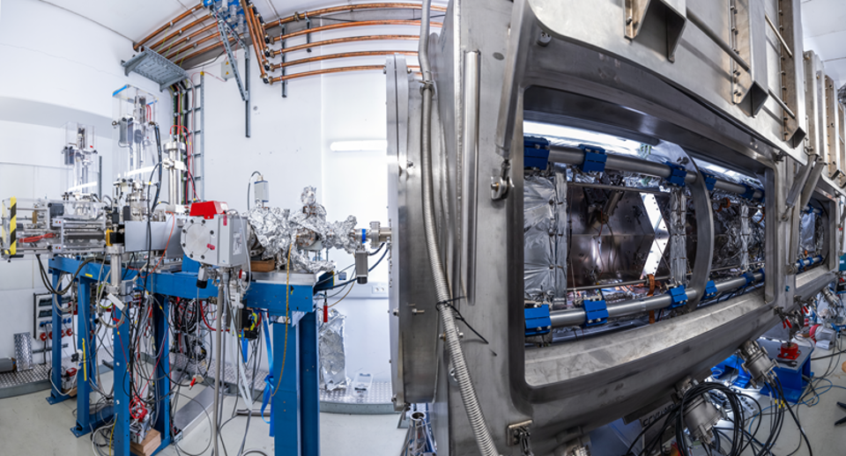

Slide 17
CM1 – Performance Test @ GSI
Cavity performance test with PLL in cw mode
After RF conditioning all cavities reached design gradient
Measurement of Q₀ not possible (β > 100)
P_{t} / P_{f} describes non ohmic losses
Design gradient: dashed line
Limits:
  CH0: thermal quenching just above design gradient, no field emission.
  some dirt in high B-field region?
  Q₀ is probably to low
  B1, CH1, CH2 thermal quench
Cavity treatments during production:
  BCP, HPR, 800K backing only by B1
All cavities are unique, no spares, no test object!
We are seeking for tailored treatment recipe
We are looking for an external partner to
jointly develop this recipe!
E_{p} = 36 MV
B_{p} = 31 mT/MV/m
Q_{ext} = 2.3e6
3MV @ P_{f} = 380W
Q_{ext} = 1.5e6
0.5MV @ P_{f} = 320W
E_{p} = 64 MV
B_{p} = 94 mT/MV/m
E_{p} = 81 MV
B_{p} = 106 mT/MV/m
Q_{ext} = 8.6e6
2MV @ P_{f} = 130W
E_{p} = 52 MV
B_{p} = 68 mT/MV/m
Q_{ext} = 8.6e6
2MV @ P_{f} = 130W

Slide 18
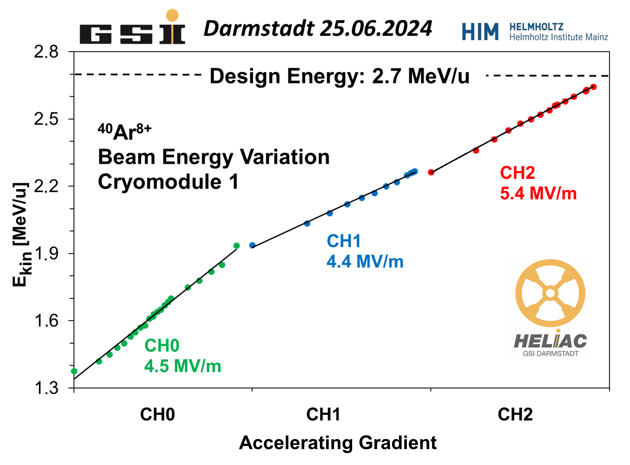
CM1: current status
In operation since December 2023
Design energy achieved
Smooth energy variation achieved
Stable operation of cryogenic infrastructure
Challenges:
Beam transmission of 90%
  analog rf-control loops are unstable: δf=5°
  due to pondermotive instability
  → dLLRF based on μTCA+ Struck boards is
  currently under development (looking for collaboration, help is welcome!)
  B1 resonance frequency is 140kHz to high (out of range of dynamic tuner 50kHz )
  HLI beam have to high transversal emittance. Improvement measures are identified
SIBAF-Project (2026-2029) aiming operation of CM1 for material research

Slide 19
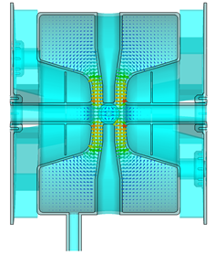
Eigenfrequency of Buncher
20t
20t
Single spoke cavity with very strong capacitive load
every μm of gap distance results in fraction of kHz eigenfrequency deviation
Error in prediction of pressure sensitivity (stiffness of He-Jacket was underestimated )
Pressure sensitivity is overestimated and overcompensated → eigenfrequency is to high
Mechanical Pressure on the end faces → plastic deformation (intended reduction of gap 20μm )
Repair would be done at Research Instruments

Slide 20
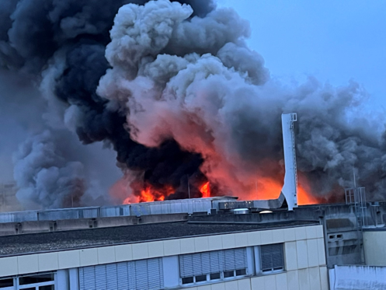
Current Situation
05.02.2026
Short circuit in the primary winding of the Transformer in high Voltage supply for anode voltage of 2 MW tetrode amplifier
Subsequent fire of the oil‑filled high‑voltage capacitors

Slide 21
HELIAC is part of Mittiagation Strategie
All rf-supplies of UNILAC are destroyed
Major readout systems of Beam Diagnostics is destroyed
Restoration of UNILAC is started. Full operation expected in 2030
Intermediate solution Q4 2027 : 4 MeV low duty factor LINAC for A/q<2.5 in synchrotron transfer channel
UNILAC was operated in pulse mode with beam pulses up to 5ms@50Hz
Restored would provide only 1ms@10Hz (Disruption of SHE Program)
HELIAC
Restore and further strengthen GSI’s SHE research program
Start of civil construction planed for Q3 2029 due to prioritized FAIR activities
on HELIAC construction site
Planed start of regular operation 2032

Slide 22
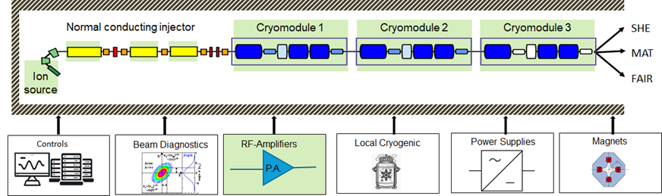
Status of Components for Starting Version of HELIAC (CM1-CM3)
R&D successful, components available by <2030
components not yet secured
Major components for the start version of HELIAC are either in manufacturing or under development
Controls, beam diagnostics, local cryogenic, power supplies and magnets are not yet funded

Slide 23
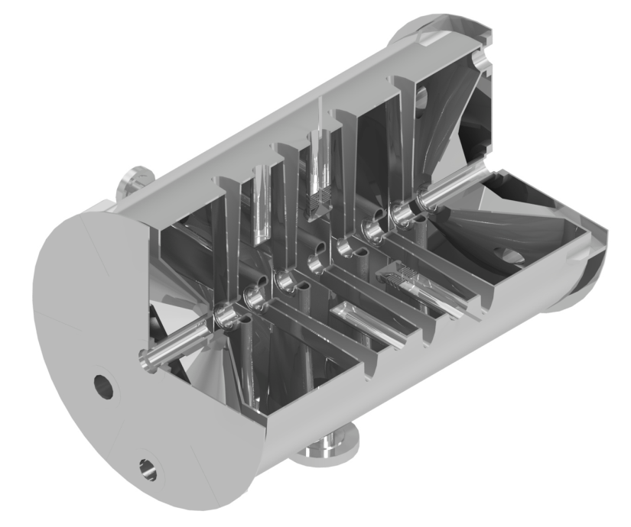
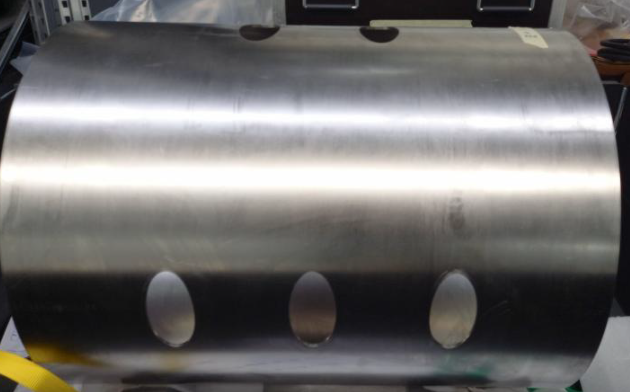
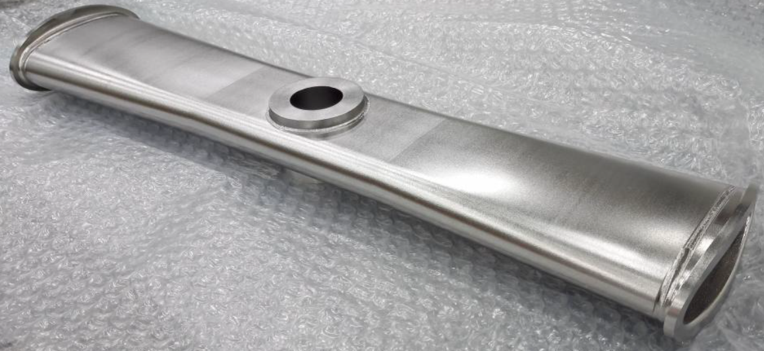
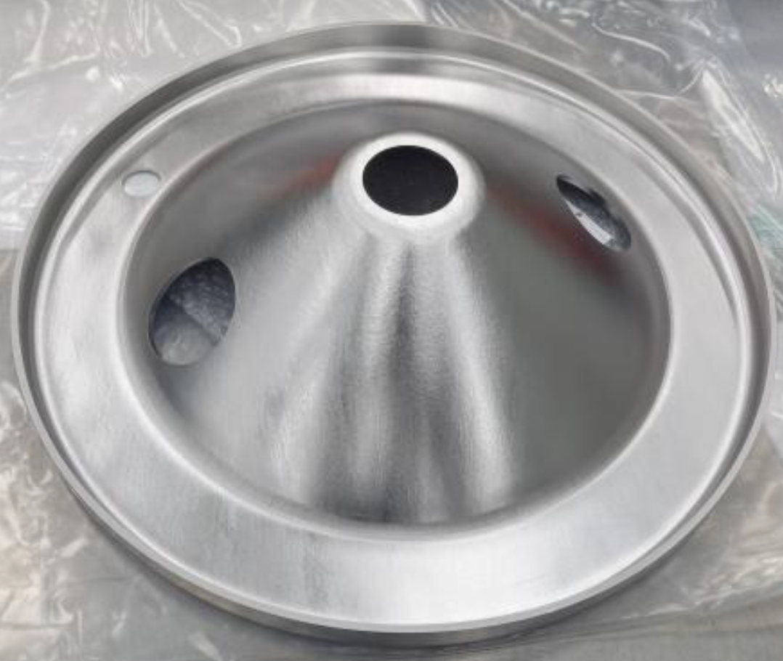
Manufacturing Status for CH3-CH8 cavities
Cavity spoke
(x7 per cavity)
4 mm thick Nb-body
Cavity endcap
(x2 per cavity)
3D model of cavity
Components for all cavities are produced. Assembly/Welding of CH3 started

Slide 24
Summary & Outlook
Testing area
  Not affected by fire: cryogenic and 216MHz rf-infrastructure is in operation
  No ion beam. 108 MHz amplifiers for HLI-Injector are destroyed
Improvement of CM1 performance:
  CM1 cavities reach the design gradient, but are limited by thermal quench and non‑ohmic losses.
  To develop a robust treatment recipe for long‑term operation, we are seeking collaboration with an external partner.
  Development of digital LLRF based on Self exited loop
Components of HELIAC
  Components for CM2: CH3-5 in manufacturing; buncher & cryostat delivered;
  Components for CM3: CH6-8 in manufacturing
  Components (RFQ, 108MHz cw-Amplifiers) of normal conducting injector under development
  18GHz ECR-Source for HELIAC is in procurement
  Expecting positive decision to build HELIAC of Management Board Meeting on 11.06.2026

Slide 25
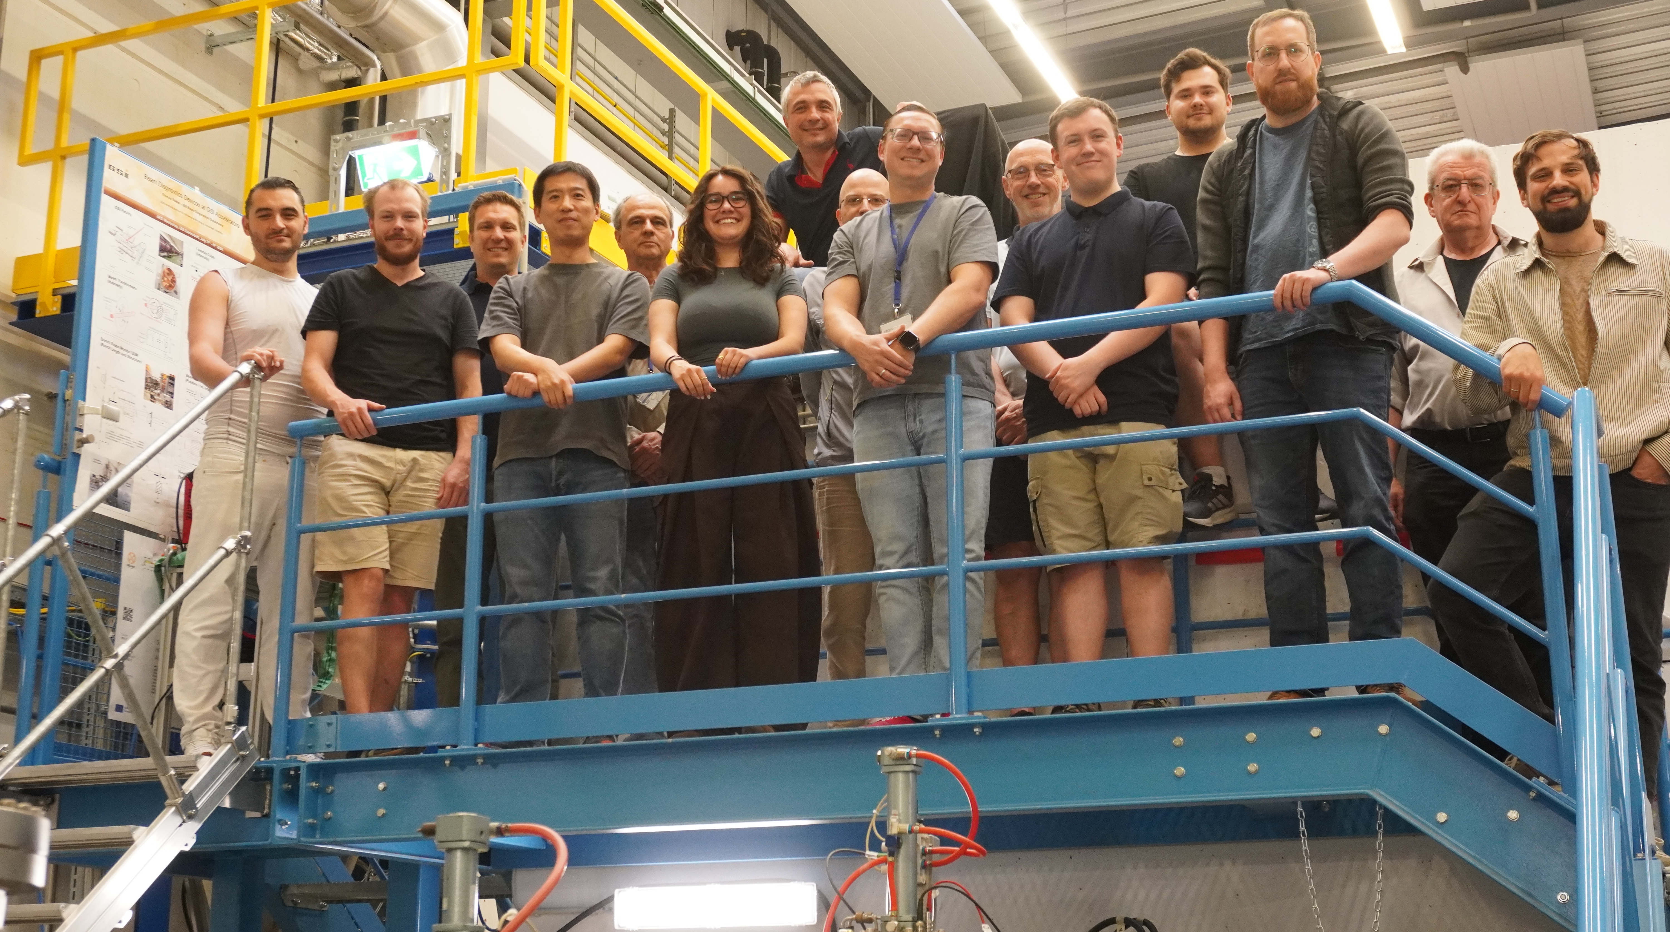
Join the
HELIAC Team @GSI

