Slide 1
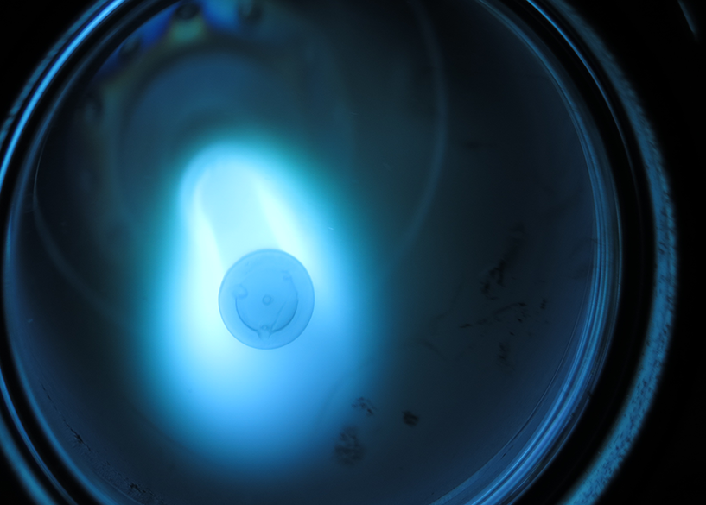
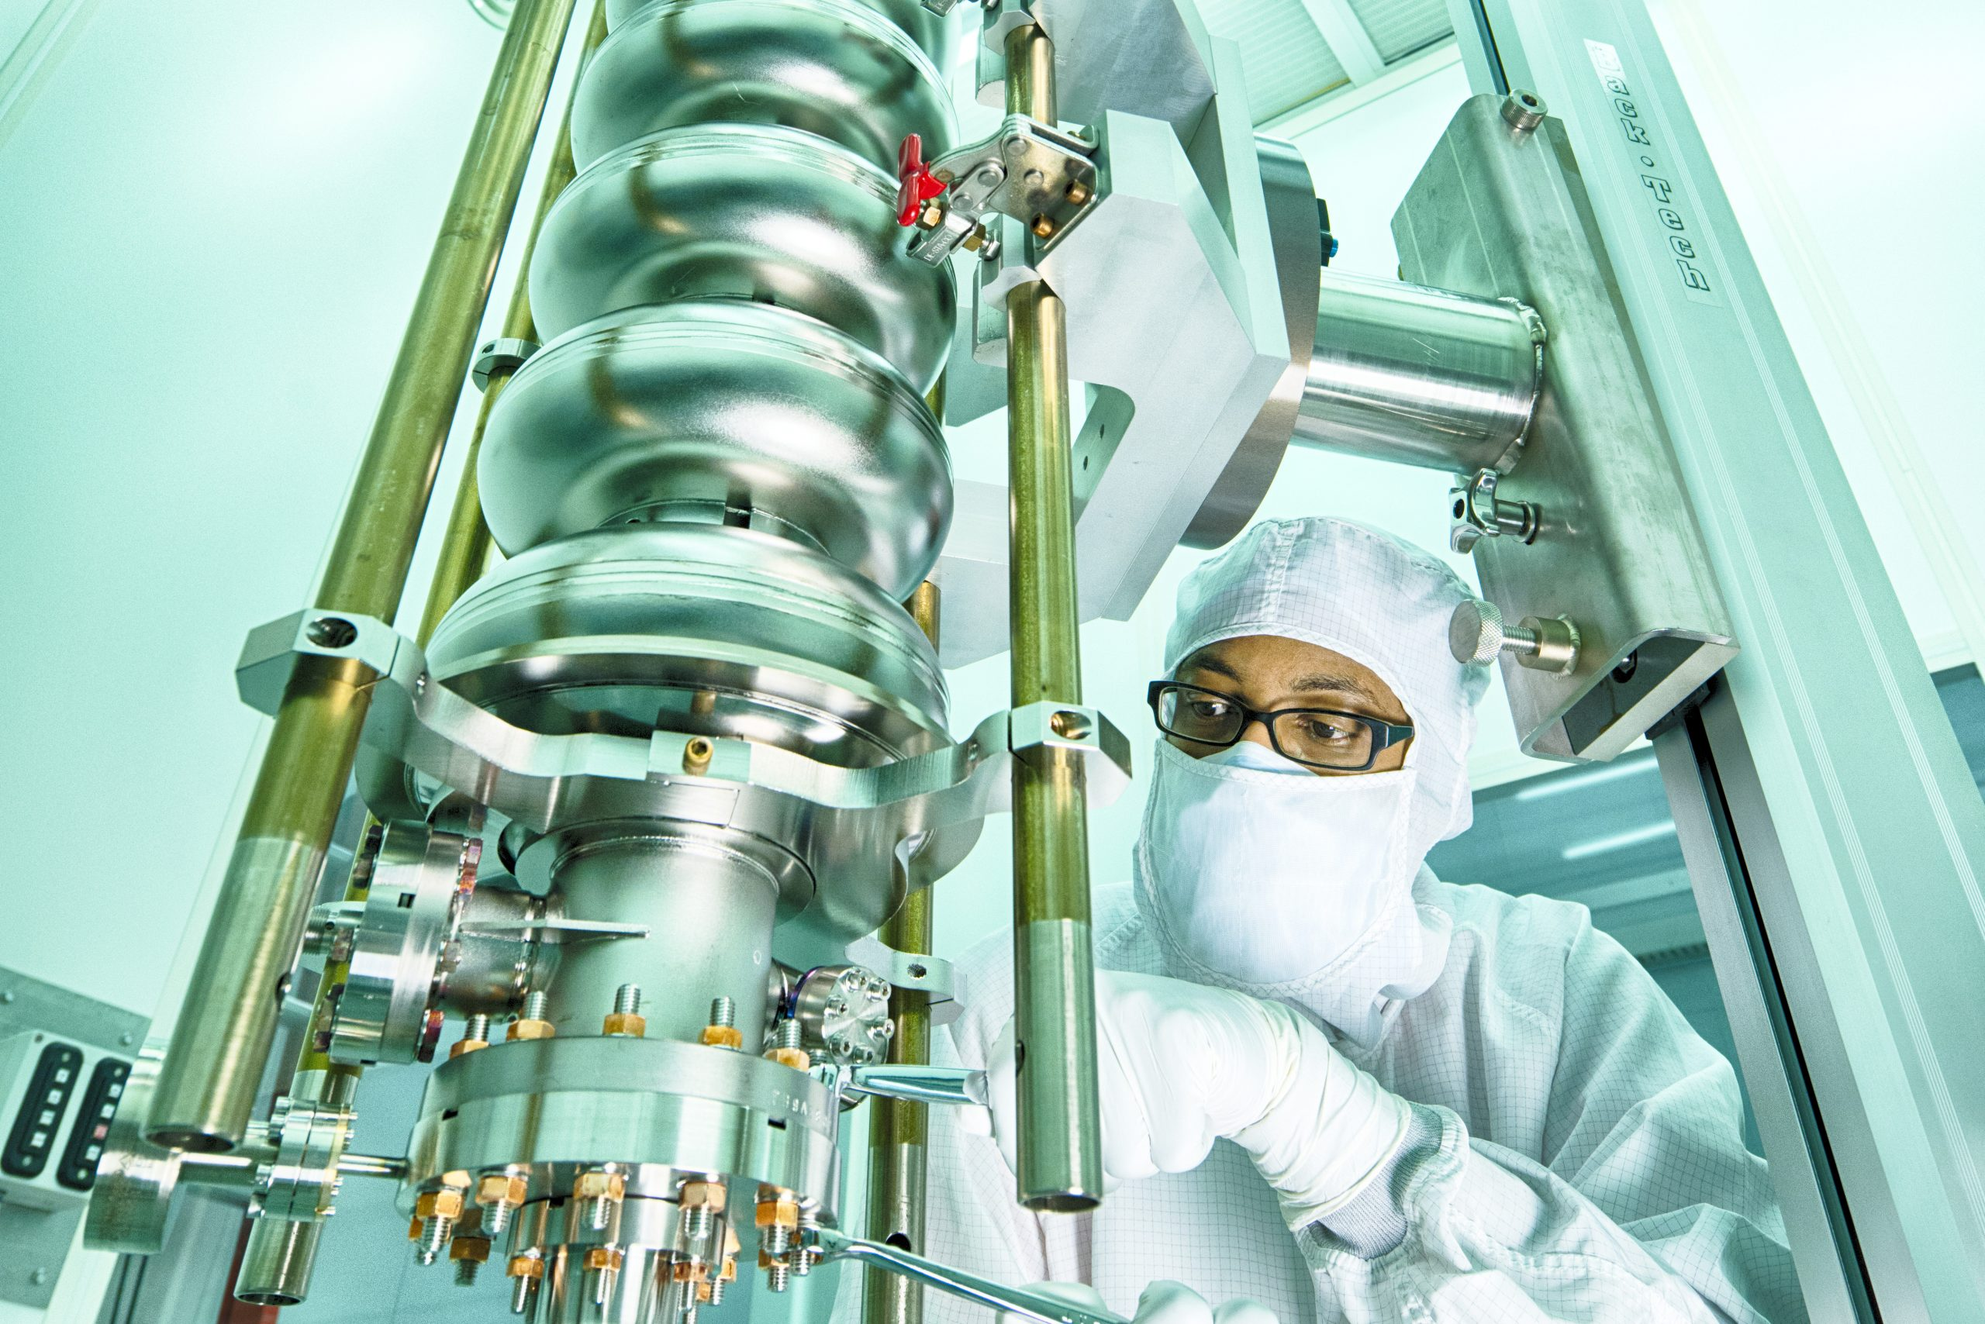
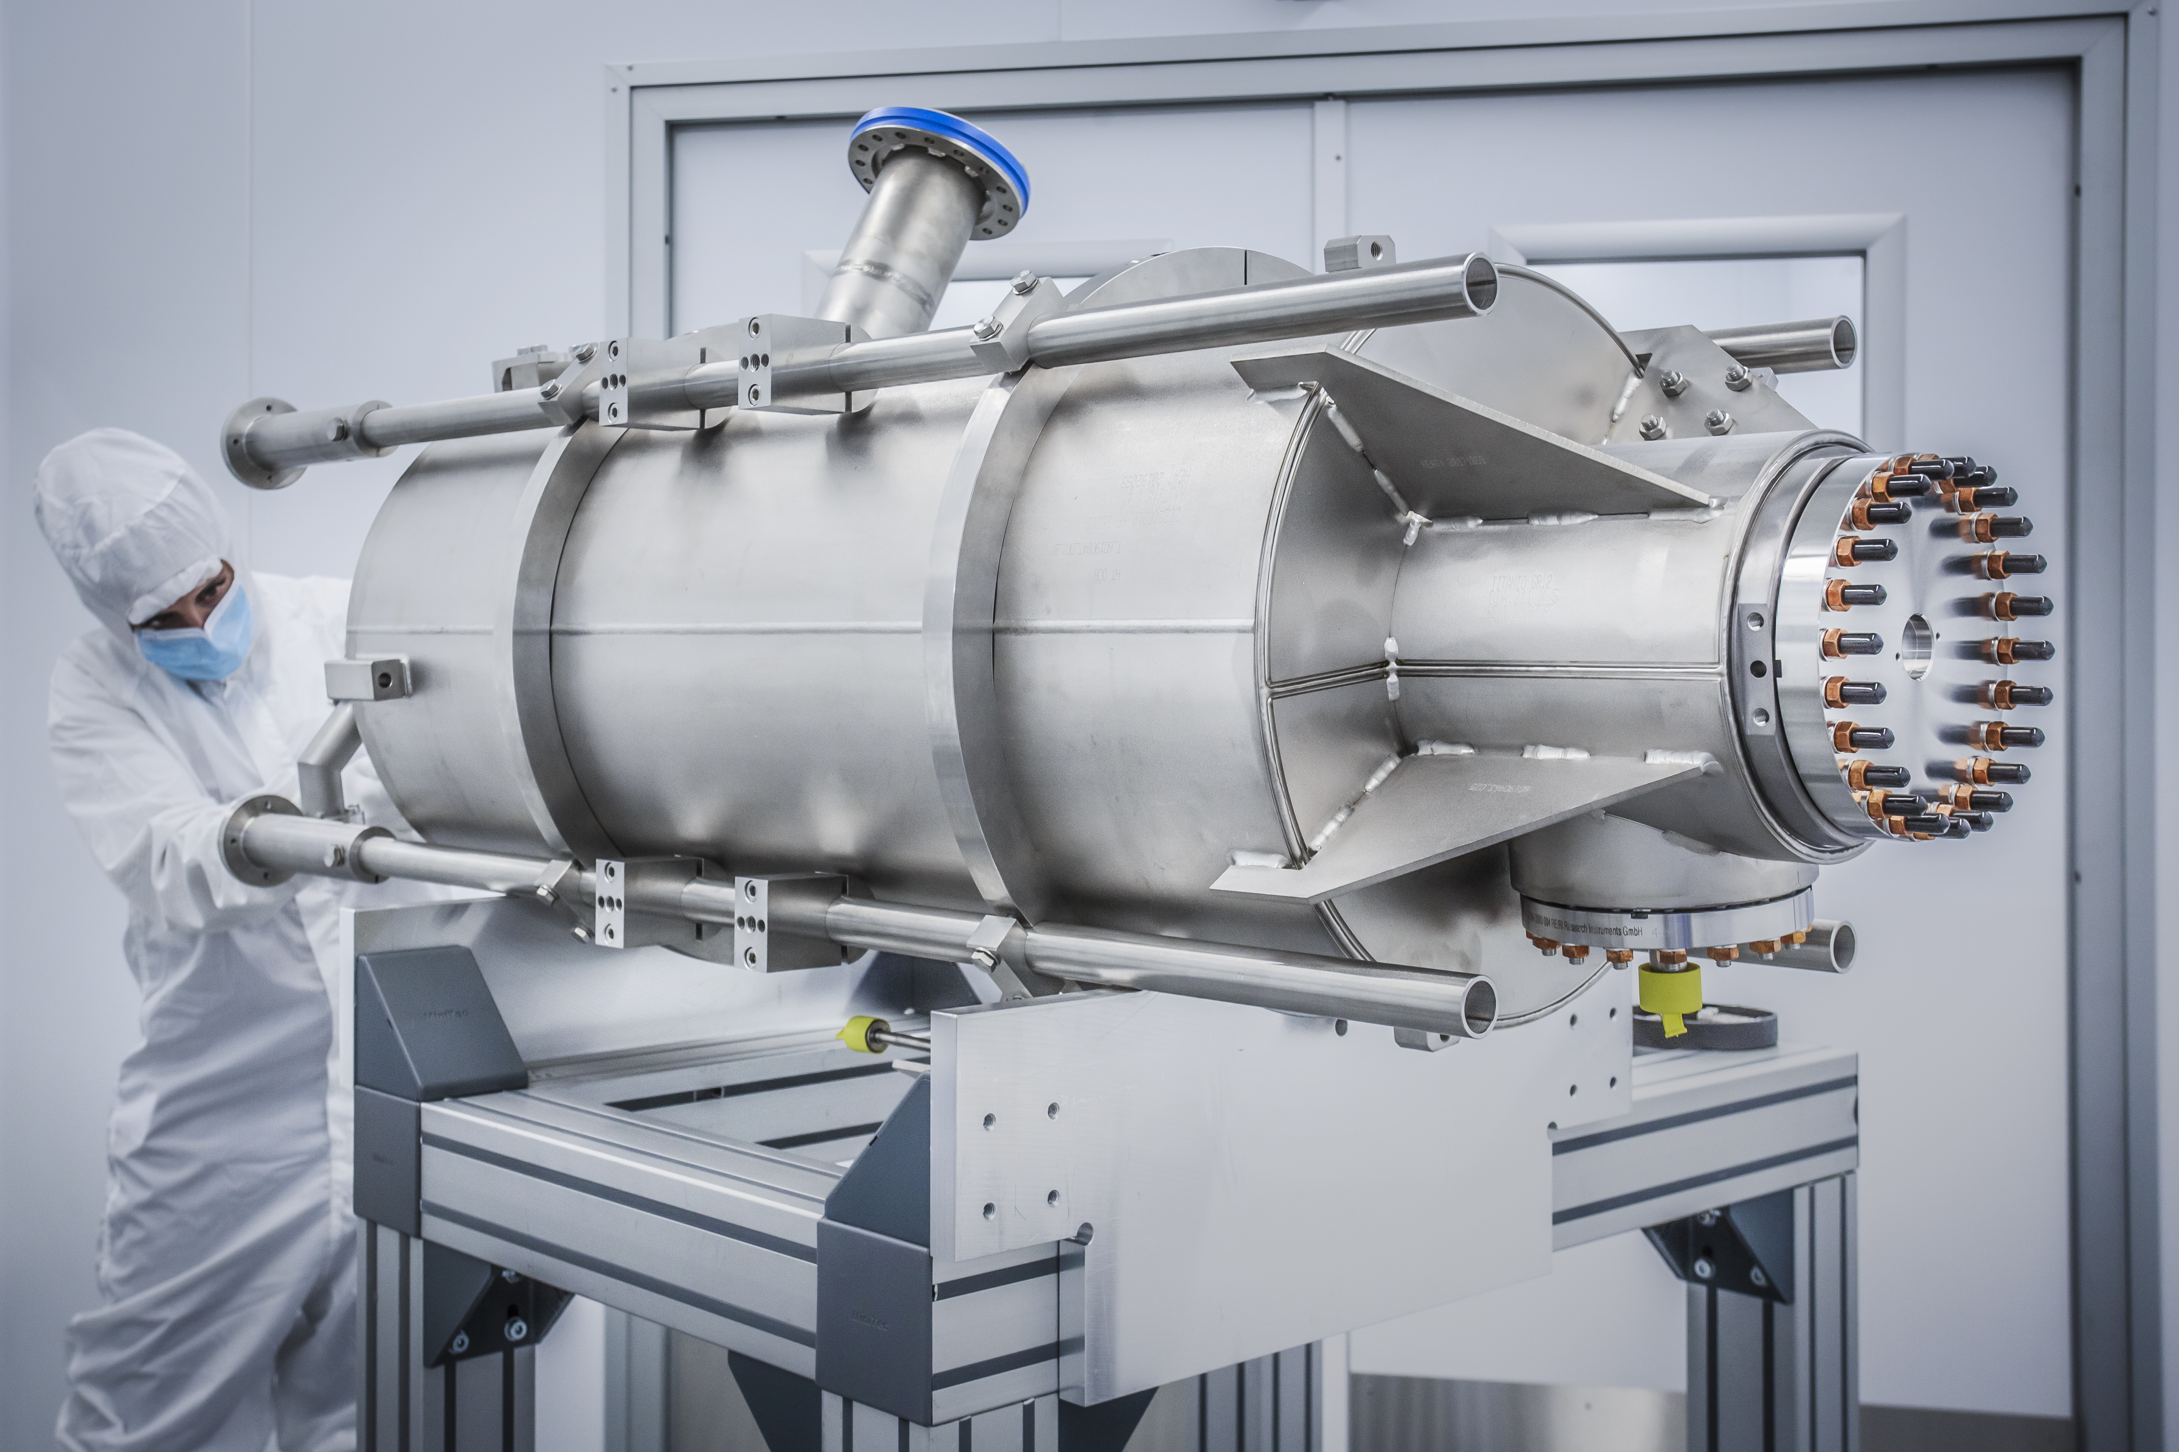
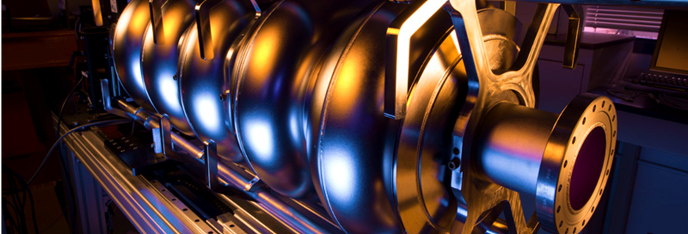
European Strategy for SRF Development
Peter McIntosh (STFC Daresbury Laboratory)
TTC 2026
CEA-CNRS-Universite Paris Saclay
9 – 12 June 2026

Slide 2
Outline
LDG RF Coordination Panel
HEP Facility SRF Requirements:
  FCC
  ILC
  LHeC (ERL) – Highest SRF sustainability targeted!
R&D Priorities and Timescale Expectations
SRF Technology Developments:
  Bulk-Nb cavities
  Thin Film cavities
  Ferro-Electric Fast Reactive Tuners (FE-FRT)
Sustainability Priorities
Summary
}
Highest SRF performance targeted!

Slide 3

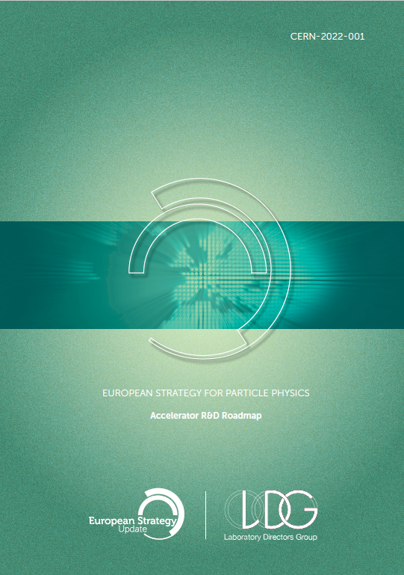
European Strategy for Particle Physics 2020
Accelerator R&D Roadmap (CERN 2022.001)
High Field Magnets
High Gradient RF Structures and Systems
High Gradient Plasma and Laser Accelerators
Bright Muon Beams and Muon Colliders
Energy Recovery Linacs
R&D Programmes Oriented to Future Facilities:
  FCC-ee
  ILC
  CLIC
Sustainability

Slide 4
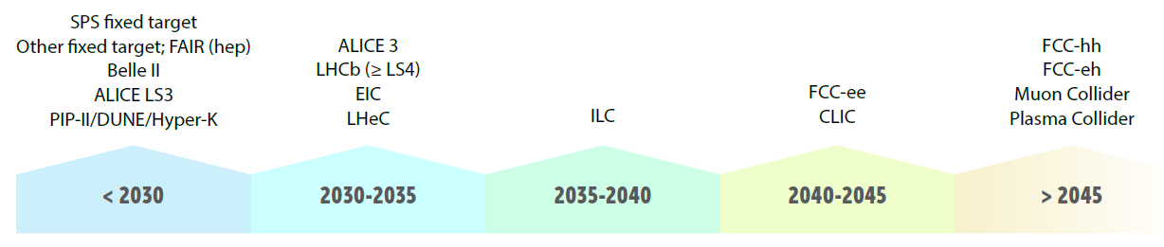
Implementation of an Approved R&D Strategy
2020-2022: ESPP Accelerator R&D Roadmap, presented to CERN-SPC in March 2022
RF items by: S. Bousson (IJCLab), H. Weise (DESY). G. Burt (ULAN); G. Devanz, T. Proslier (CEA); A. Gallo (INFN); F. Gerigk, A. Grudiev (CERN); D. Longuevergne (IJCLab); R. Ruber (Uppsala), + experts
Superconducting RF: bulk niobium cavities, surface preparation, thin films
NC structures: fundamental limitations, surface preparation, manufacturing techniques
High power RF sources, accelerating structures ancillaries (couplers, tuners…), LLRF and AI
This update
Major HEP tech driver:
LHeC
ILC and LCF
FCC_{ee} and FCC_{hh}
Muon Collider
Plasma Collider
Major HEP tech driver:
LHeC
ILC and LCF@CERN
FCC_{ee} and FCC_{hh}
Muon Collider
Plasma Collider
Notes:
The LDG was mandated by CERN Council to prepare and follow the implementation of an accelerator R&D roadmap for future collider options.
HL-LHC → future e-e+ Higgs factory → future hadron collider at highest E and L

Slide 5
LDG RF Coordination Panel (RFCP)
From LDG Review ESG recommendations in 2025, RFCP focused on a limited set of high-impact and cross-cutting technologies aligned for HEP facility demands:
– advanced SC/NC RF structures
– high-efficiency RF power sources
– high-current ERLs
– in a longer-term: wakefield acceleration and MC tech.
RFCP assessed RF priorities for the main collider options (FCC-ee/hh, LCF, LEP3, LHeC, Muon Collider, HALHF), with TRL6 by 2031 as common target, evaluating:
  Performance gaps.
  Remaining challenges, with emphasis on synergies, reliability and energy efficiency.
  Required infrastructures and resource needs.
  Laboratory engagement.
LDG - RF Panel |  | G. Bisoffi INFN, P. McIntosh STFC
WG1 | Bulk Nb | M. Baylac CNRS, C. Madec CEA, L. Monaco INFN
WG2 | Thin films | O. Malyshev STFC, T. Proslier CEA (C. Antoine CEA)
WG3 | Couplers | F. Gerigk CERN, A. Neumann HZB (E. Montesinos CERN)
WG4 | NC High gradient | W. Wünsch CERN, D. Alesini INFN
WG5 | RF Power sources | I. Syratchev CERN, G. Burt STFC, M. Jensen ESS
WG6 | LLRF, AI, ML | W. Cichalewski U-Lodz (Z. Geng PSI)
RF Coordination Panel (RFCP) established in 2022 to support implementation of the ESPP-U 2020 roadmap, coordinating RF R&D activities across CERN and LDG laboratories and identifying common priorities.

Slide 6
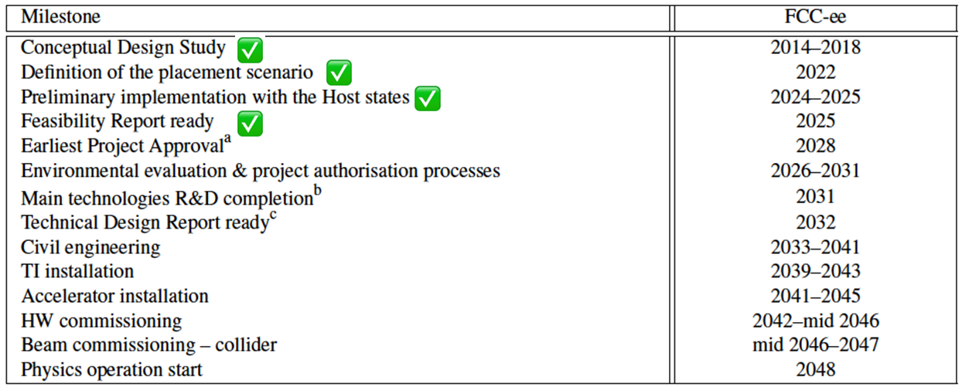
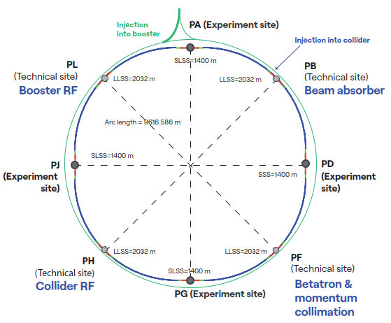
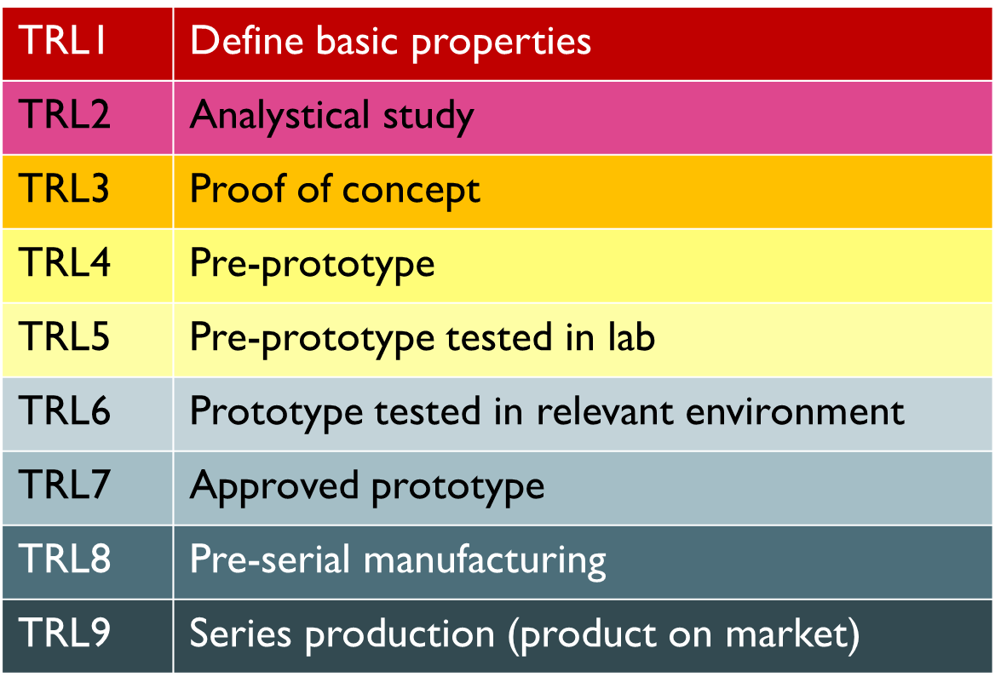
Timeline Anticipated for TRL6
The FCC-ee submission schedule and the duration of the next ESPP-U establish the time reference for all future HEP COLLIDER projects.
2028
2031
RF system R&D is targeted to achieve a TRL6, within the next ESPP-U period (by 2031), for the most mature collider schemes, or ASAP for the others.
2031
2032-2036
2036-2044
6

Slide 7
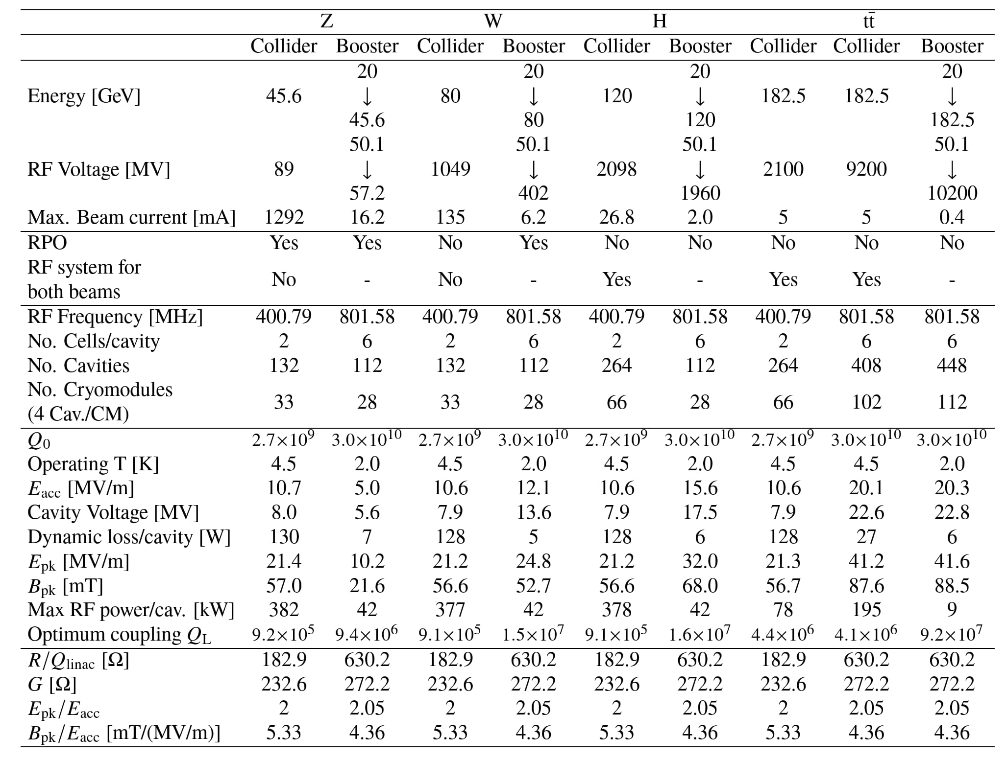
FCC-ee RF Parameters
  High level machine parameters
RPO: Reverse Phase Operation
High beam current, high RF power → 400 MHz 2-cell @ 10 MV/m @ >2.7x10⁹
Frequency
# Cavities
Q₀
  Expected performances in operation
E_{acc}
High accelerating gradient
→ 800 MHz 6-cell @ 20 MV/m @ >3x10¹⁰
Power/cav
  Cavity design parameters
Shahnam Gorgi Zadeh (CERN) SRF 2025

Slide 8
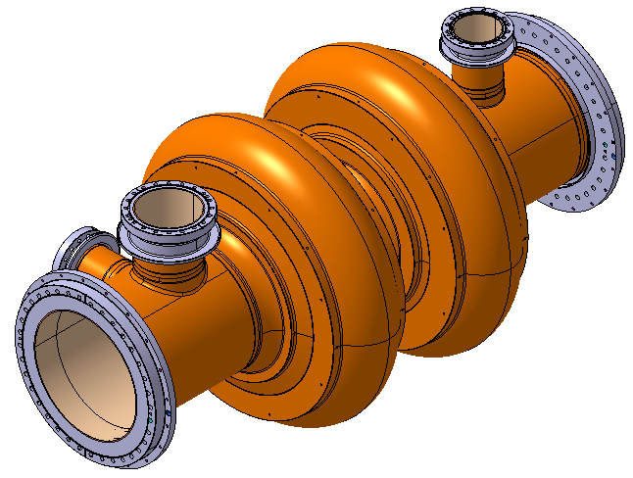
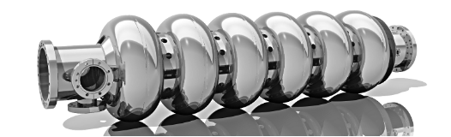
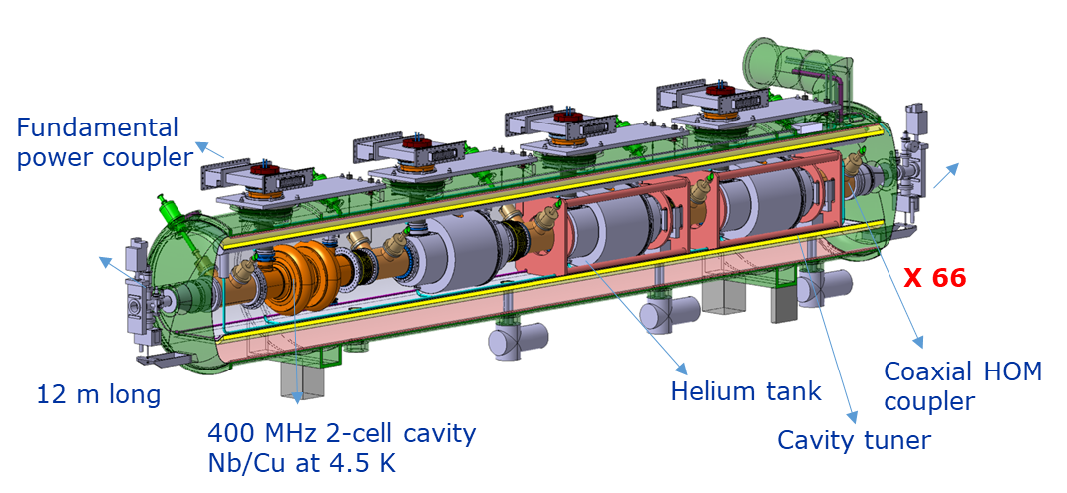
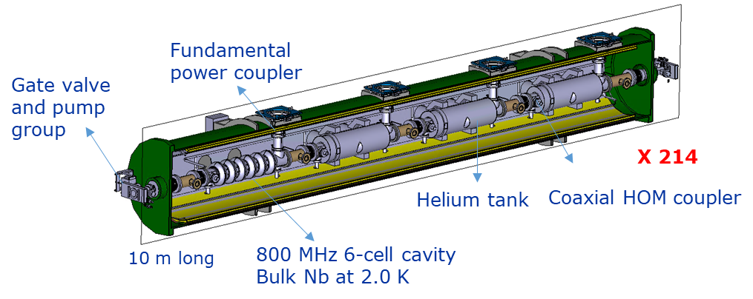
FCC-ee SRF Cavities and Cryomodules
Conceptual & preliminary designs
Z, W, H
ttb, booster
X 856
X 264
400 MHz
Niobium thin film on Copper
Operation at 4.5 Kelvin
E_{acc} = 13.2 MV/m
Quality factor Q₀ = 3.3 x 10⁹
800 MHz
Bulk Niobium (Nb₃Sn possibly)
Operation at 2 Kelvin
E_{acc} = 24.5 MV/m
Quality factor Q₀ = 3.8 x 10¹⁰
LEP
Between 2026 – 2032, objective is to develop full scale cryomodule demonstrators, at both 400 MHz and at 800 MHz.
1.5 m long
1.5 m long

Slide 9
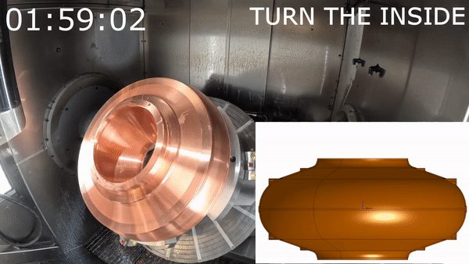
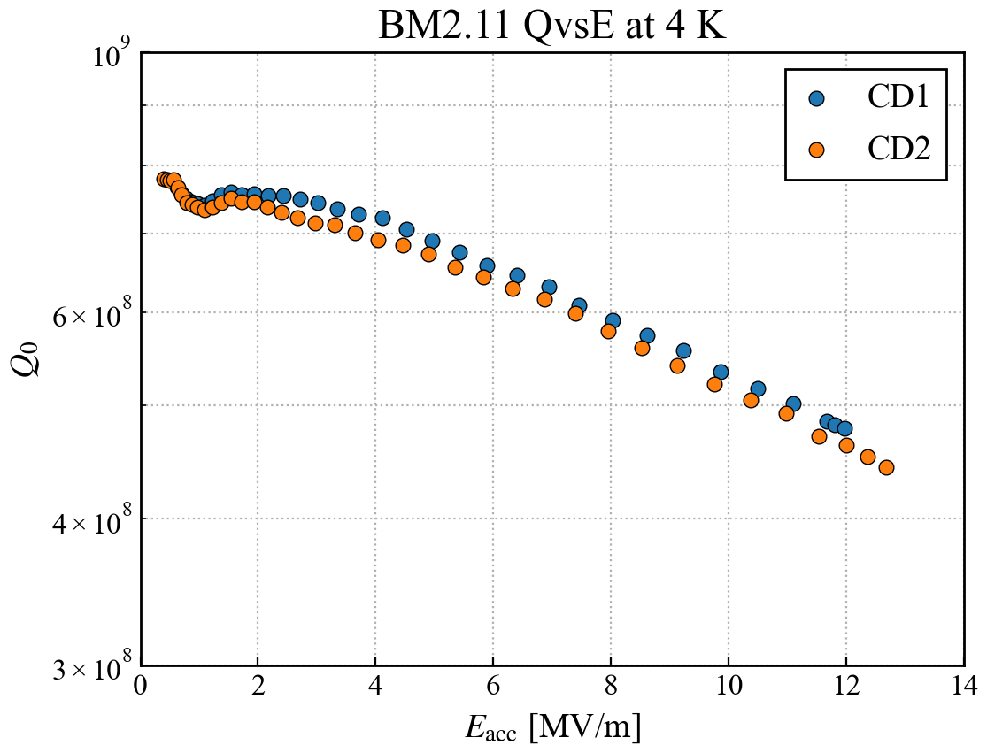
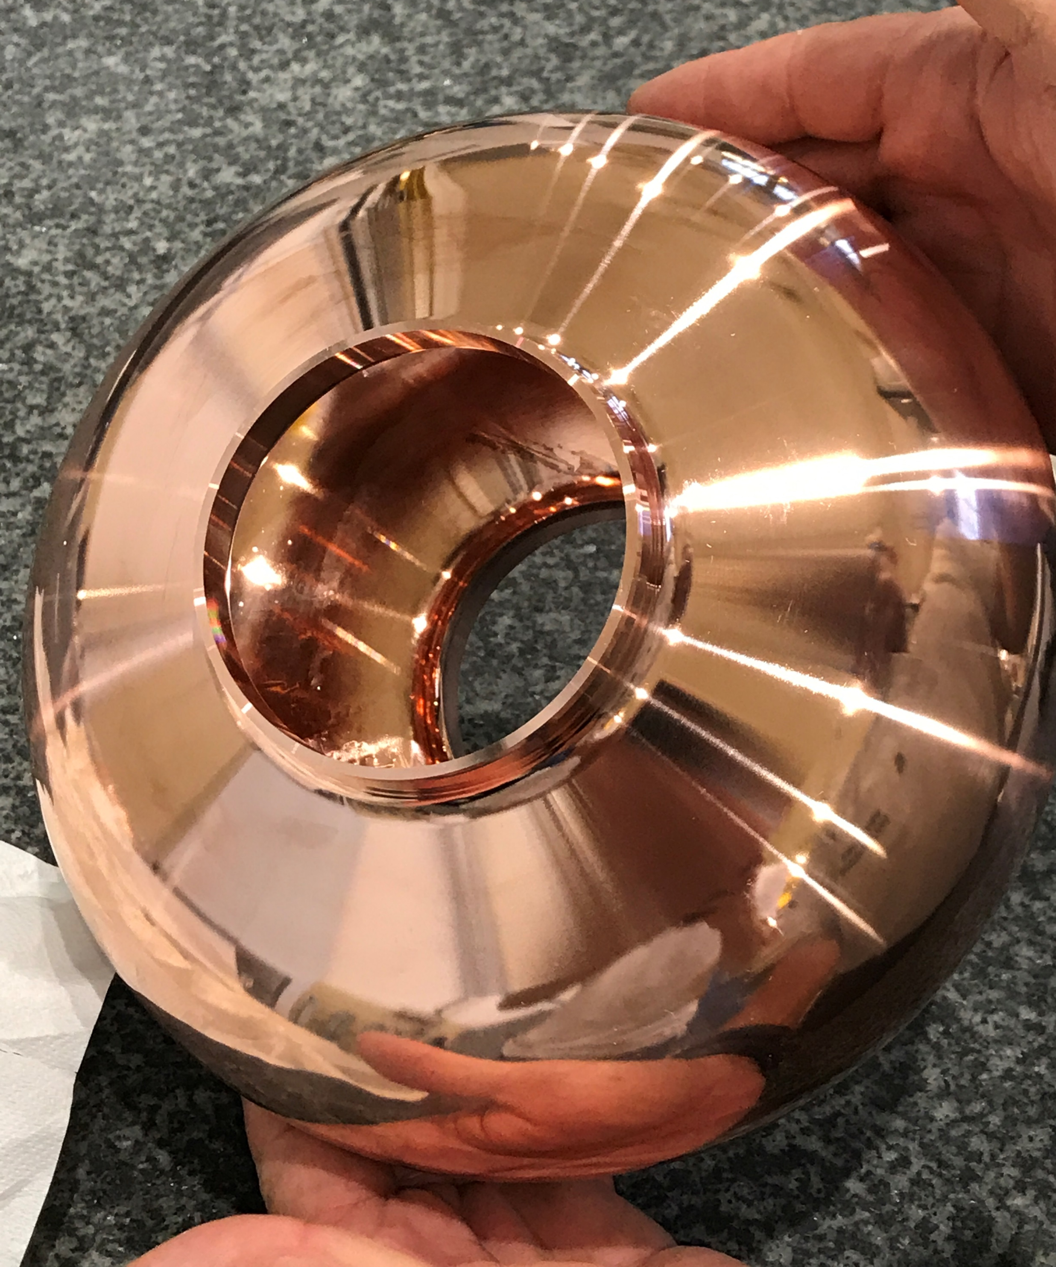
Cavity Performances – 1.3 GHz Nb/Cu
Using “seamless” 1.3 GHz cavities, developments are cheaper and faster, chemical EP and Nb coating using High Power Impulse Magnetron Sputtering (HiPIMS) at CERN has shown successful performances at 4.2K.
The E_{acc} and Q₀ scaled FCC targets have been reached on bulk machined cavities with a good reproducibility.
Preliminary obtained promising results for hydroformed cavities within the CERN-KEK collaboration.
BM2.11
Scaled FCC target
4.2 K
Kristof Brunner (CERN) - LCWS 2025
RF characterization of 1.3 GHz one-cell Nb/Cu full-seamless cavities manufactured by hydroforming, M Yamankana (KEK)

Slide 10
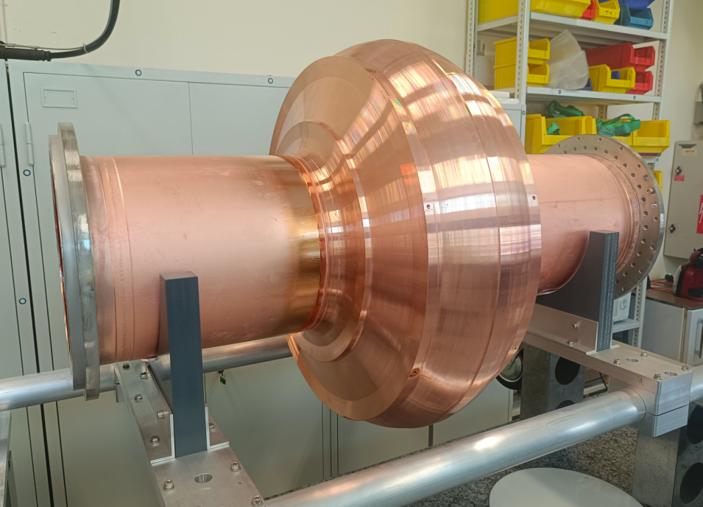
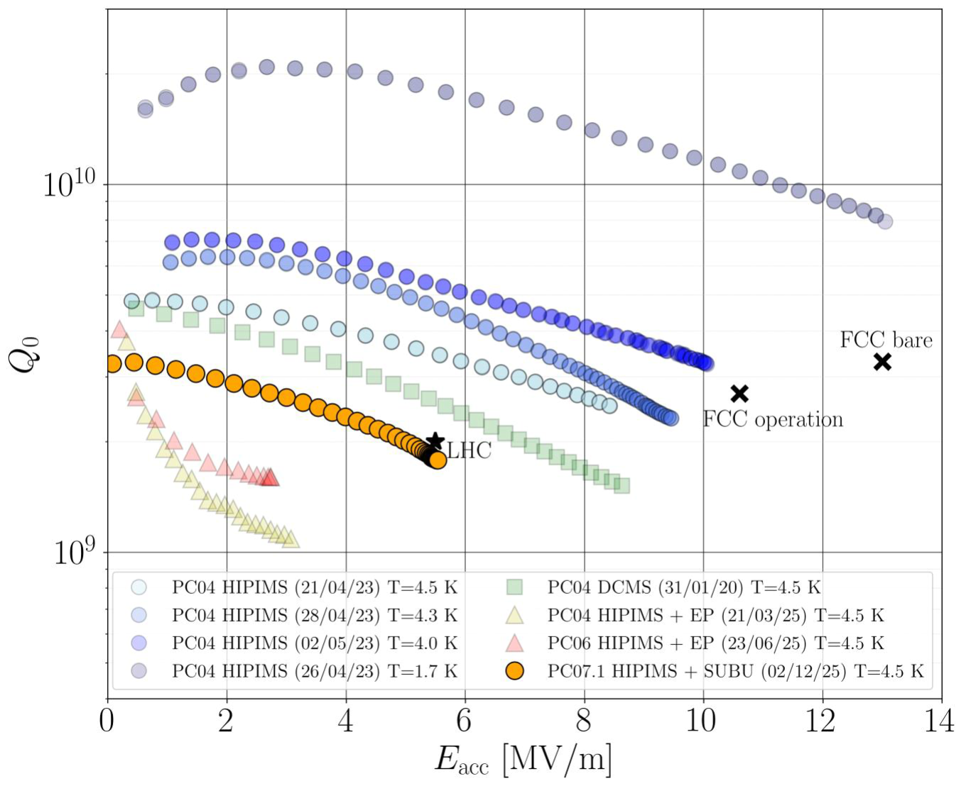
Cavity Performances – 400 MHz Nb/Cu
Translating from 1.3 GHz to 400 MHz is on-going with single-cell cavity prototypes.
The control of the surface treatments and Nb coating process becomes more challenging:
  Increase of the superconducting RF surface by a factor 10.
Priority is to ramp-up progressively to one cavity test per month in order to iterate more quickly on surface preparation parameters.
Shahnam Gorgi Zadeh (CERN) - SRF 2025

Slide 11
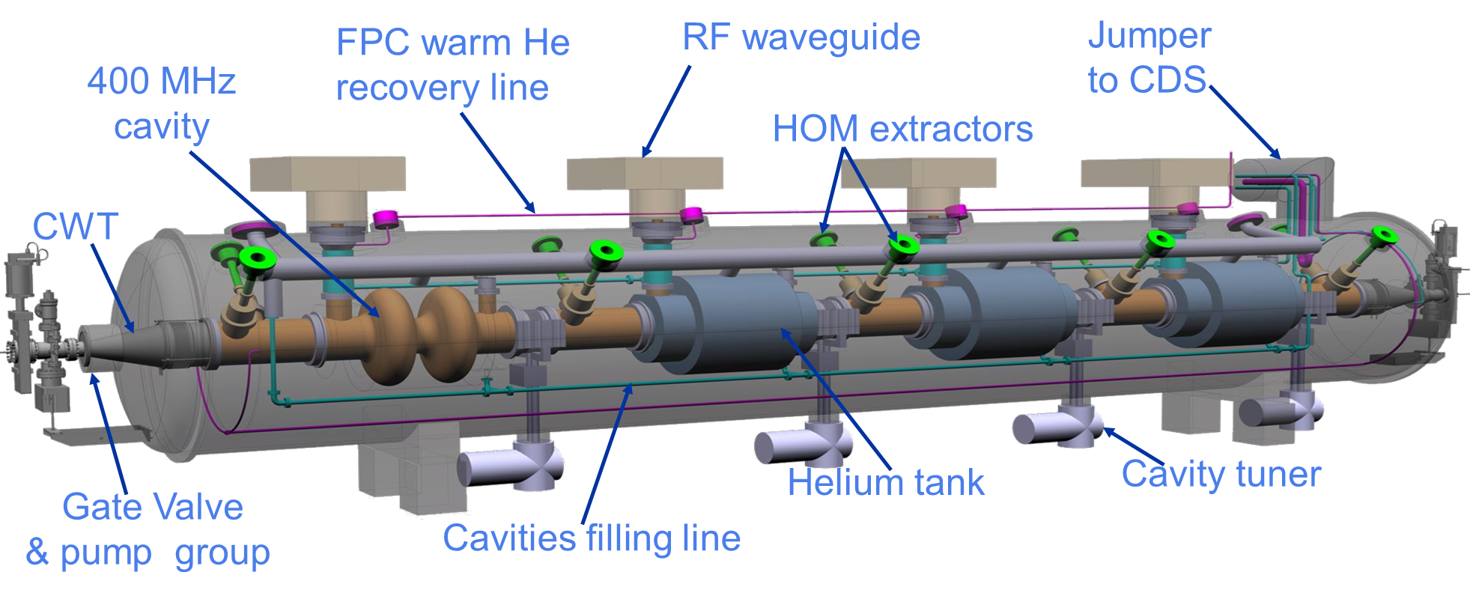
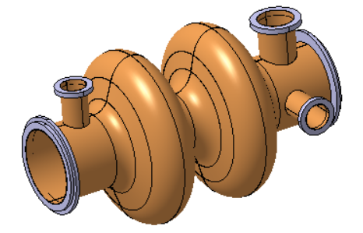
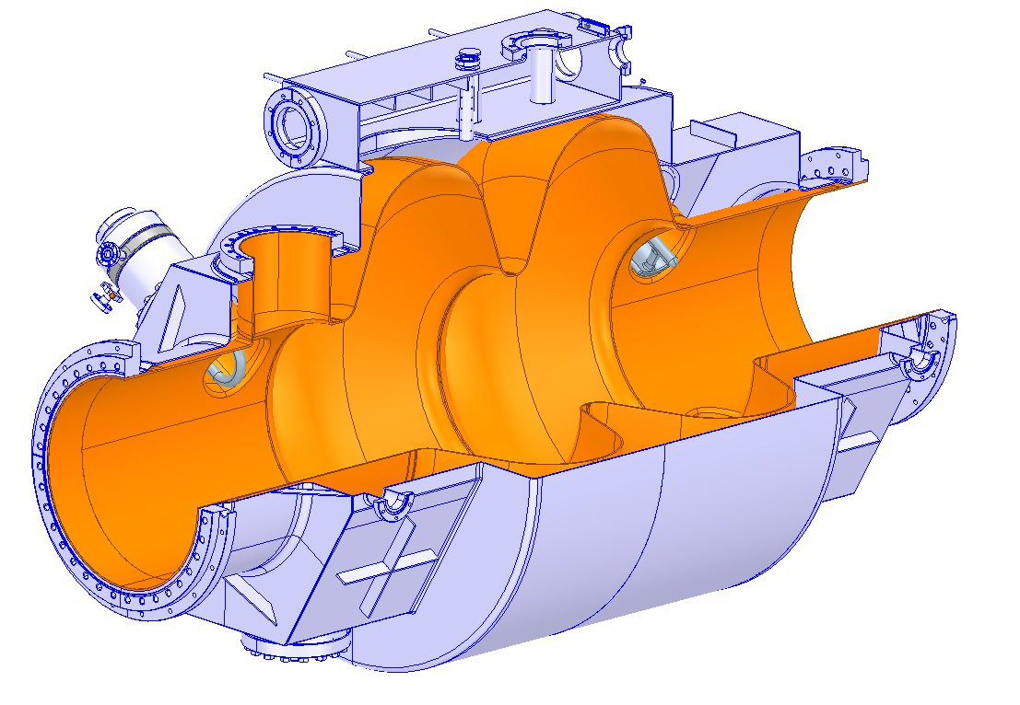
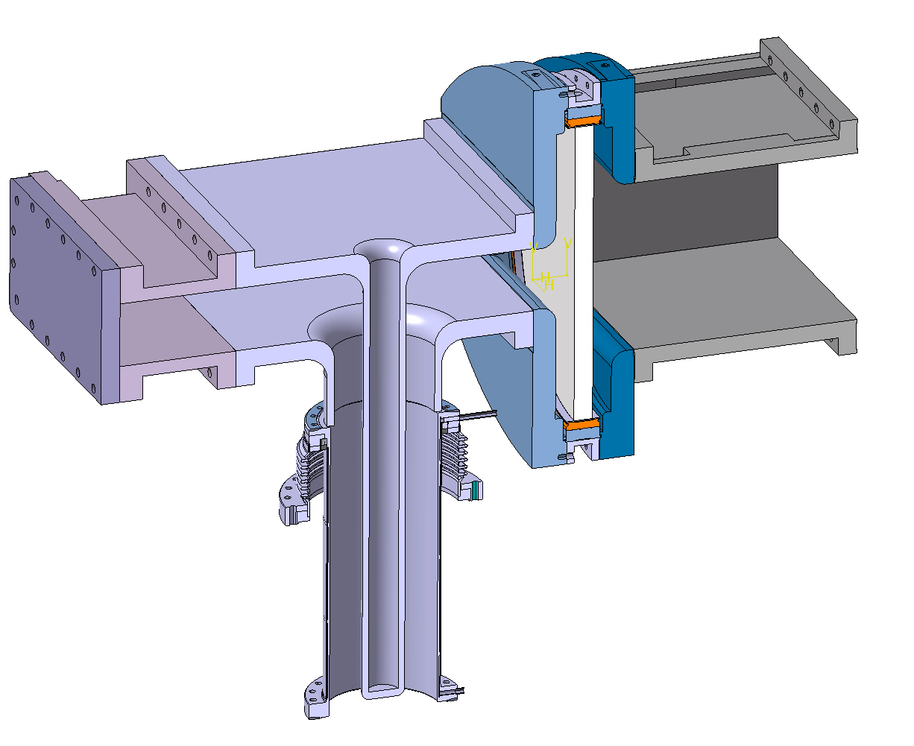
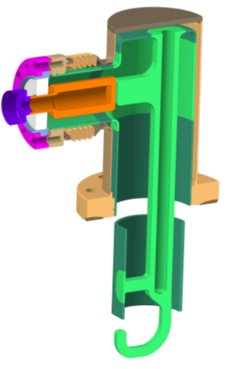
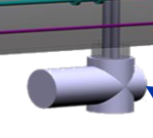
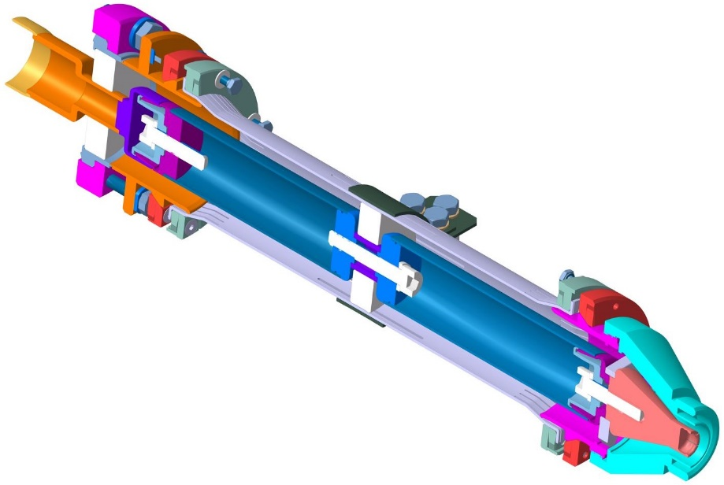
400 MHz Demonstration - Full-size Cryomodule
Parameter (machine installed) | Value
No. cryomodules | 66
2-cell cav/CM | 4
CM length | ~ 11 m
RF frequency (MHz) | 400.79
Cavity voltage (MV) | 7.95
Cavity gradient Eacc (MV/m) | 10.6
Qo | 2.7E+09
Dyn. HL (CW)/cavity at 4.5 K | 129 W
Stat. HL/CM | 197 W
Environ. Magnetic field | ≤ 5 mG
RF power (kW, CW) | 380
Q _{L} (optimum coupling) | 9.2E+05
HOM power per CM: Z (W/H/ttbar) | 62.3 kW (coax. Extractor for 15/20 kW peak!)
Items to be designed, built and qualified (non exhaustive list!)
Cavity Nb sputtered
He tank (LHC design shown)/cavity assy
Tuning system
FPC (with WG windows)
HOMs, RF extraction lines (LHC/Crab designs shown)
V Parma (CERN), FCC Week, May 2025

Slide 12
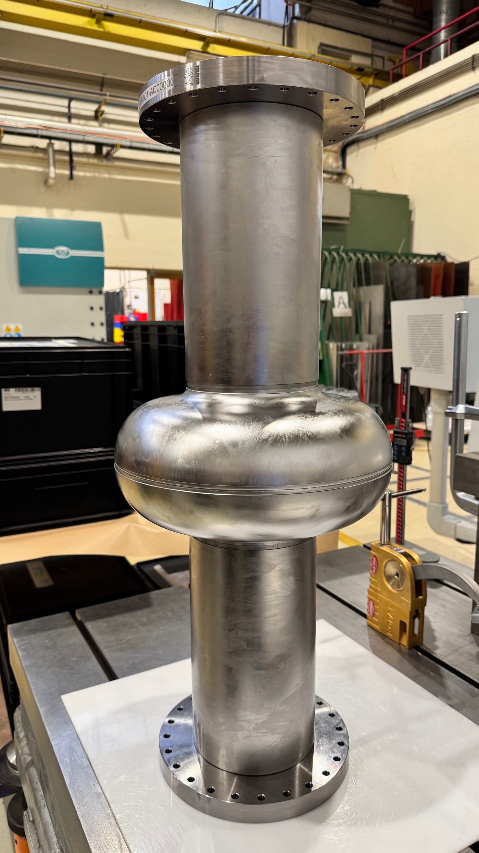
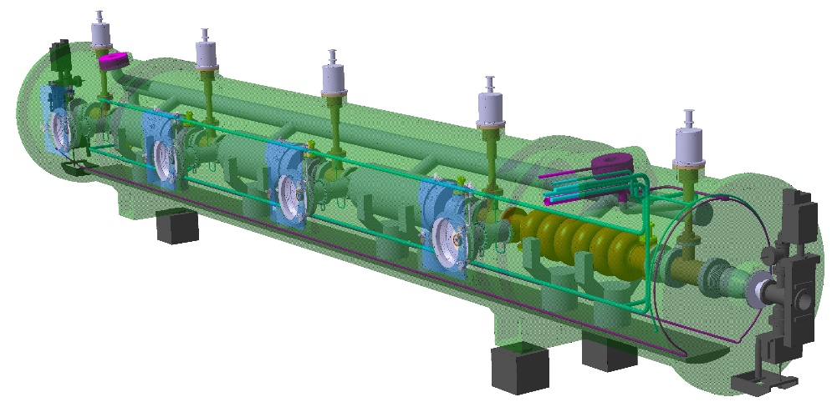
Cavity Fabrication – 800 MHz
CURRENT STATE OF THE ART:
5-cell prototype w/o ports, built by JLAB: 2 x 10¹⁰, ~30 MV/m in VT.
JLAB shape (all cells the same).
FCC Spec
CERN-now: seven 1-cell cavities under fabrication at CERN (deep-drawing and EBW), in collaboration with FNAL, IJCLab, Cornell University and others.
Short-term goal: develop recipes for high Q₀ factor and high gradient for 6-cell cavity – achieving TRL6 (in VT) with 3.8x10¹⁰ at 25 MV/m
Final goal: a 6-cell cavity, achieving TRL7 (test in CM) with 3x10¹⁰ at 20.25 MV/m.
Design compatible with Nb₃Sn thin film coating, very attractive for ttb.

Slide 13
Exploring Alternative FCC RF Frequencies (Recent)
Operating FCC-ee at an intermediate frequency of 600 MHz was proposed in the past to simplify and unify the overall SRF system. This was suggested within the SWELL cavity project.
However, due to beam lifetime limitations caused by beam-beam instabilities, the 400 MHz RF frequency remained the baseline.
In March 2026, new Local Chromaticity Correction (LCC) baseline optics recommended, solving several concerns and re-opening the possibility to operate at higher frequency.
FCC-ee SRF systems at 600 – 650 MHz brings several technical advantages and opens more collaboration possibilities:
  More compact RF system: reduced cavity size, RF source and waveguide system.
  Higher accelerating gradient: 20 MV/m instead of 10 MV/m.
  Compatible with both bulk-Nb and thin film technology (at 2 K or in the 2-4 K range).
  Reduced HOM power due to reduced tapering of the cryomodule beam line.
  Possible synergies with CEPC, PIP-II, EIC.
  Possible re-use of TESLA/XFEL/ILC 1.3 GHz SRF for injector & booster, esp. at 182.5 GeV (ttb mode).
Many
associated
benefits!
Intensive beam dynamics and RF studies are ongoing and a “go”/“no-go” decision will be taken soon to further assess machine performances, integration and cost.

Slide 14
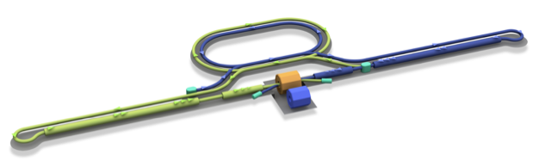
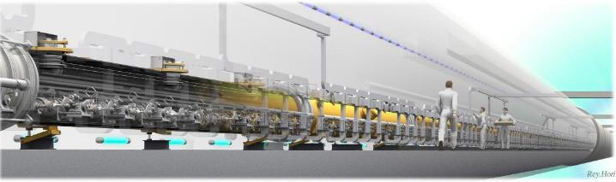

ILC250 RF Requirements
Input into LC Vision and LCF@CERN
Damping Ring
e+ Source
e- Source
e- Main Linac
Interaction point
Parameters | Value
Beam Energy | 125 + 125 GeV
Luminosity | 1.35 / 2.7 x 10³⁴ cm²/s
Beam rep. rate | 5 Hz
Pulse duration | 0.73 / 0.961 ms
# bunch / pulse | 1312 / 2625
Beam Current | 5.8 / 8.8 mA
Beam size (y) at FF | 7.7 nm
SRF Field gradient | < 31.5 > MV/m (+/-20%) Q₀ = 1x10¹⁰
#SRF 9-cell cavities (CM) | ~ 8,000 (~ 900)
AC-plug Power | 111 / 138 MW
~20km
e+ Main Liinac
Detectors
e+
e-
TDR was published in 2013 and SRF technology became matured by large-SRF accelerators (European XFEL, LCLS-II, SHINE etc.).
Source
Nano-Beam Technology
SRF Technology

Slide 15
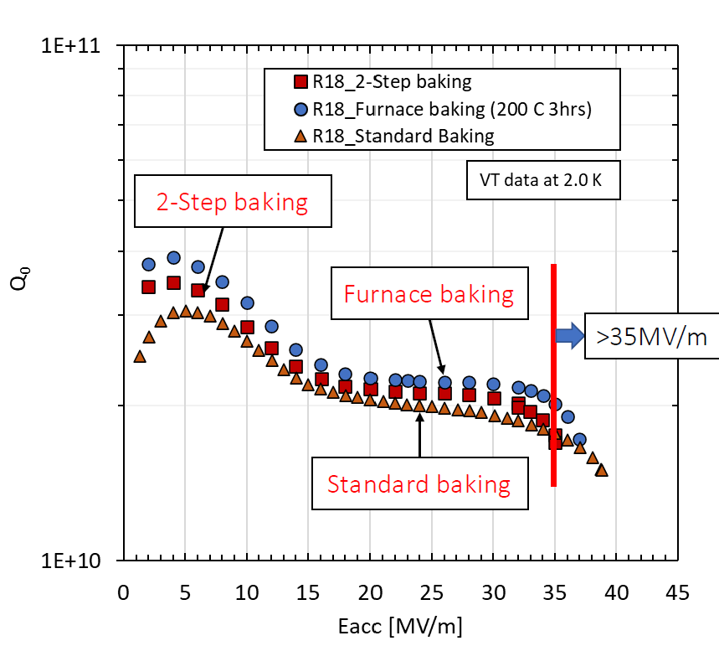
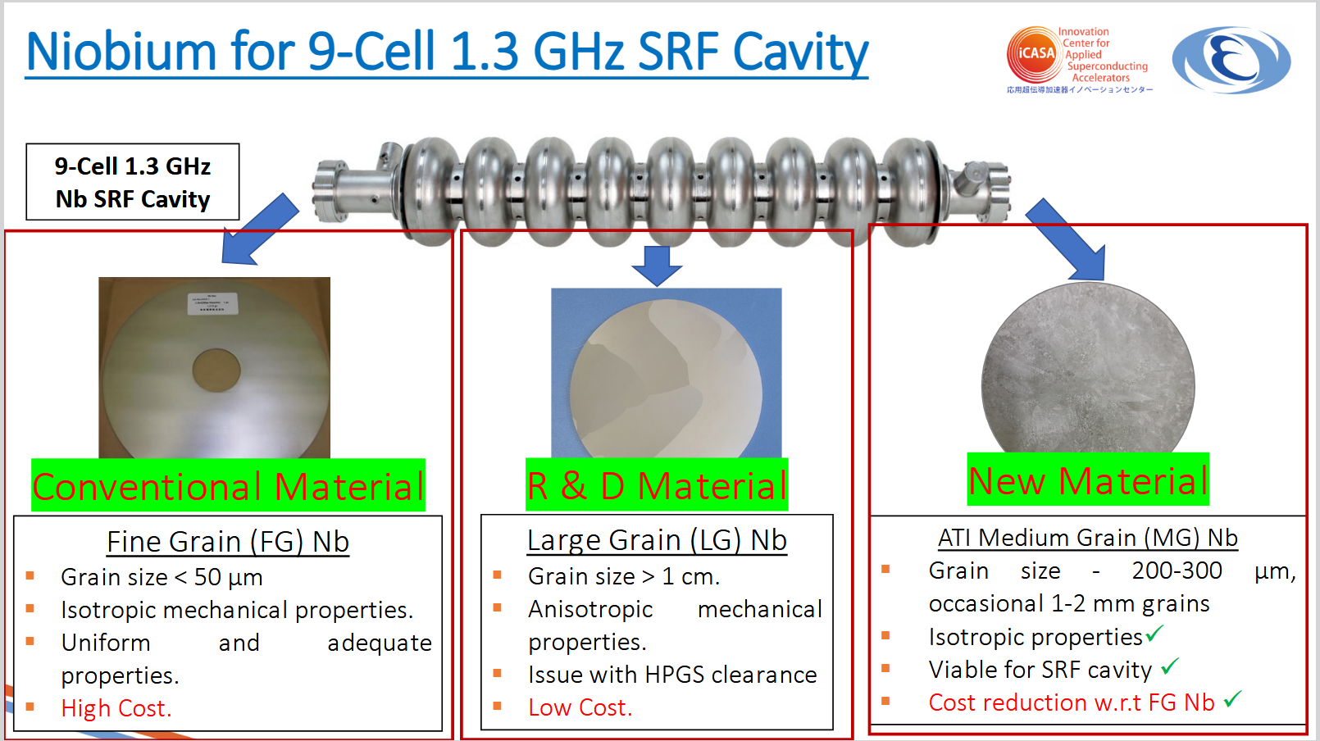
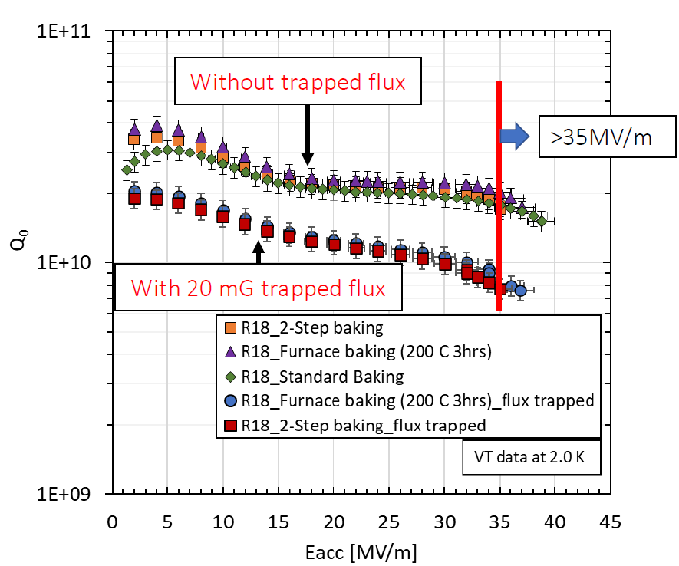
Medium Grain: HPGS Material Assessment at KEK
Different annealing treatments
Flux sensitivity studies
A. Kumar (KEK/SOKENDAi), SRF23

Slide 16
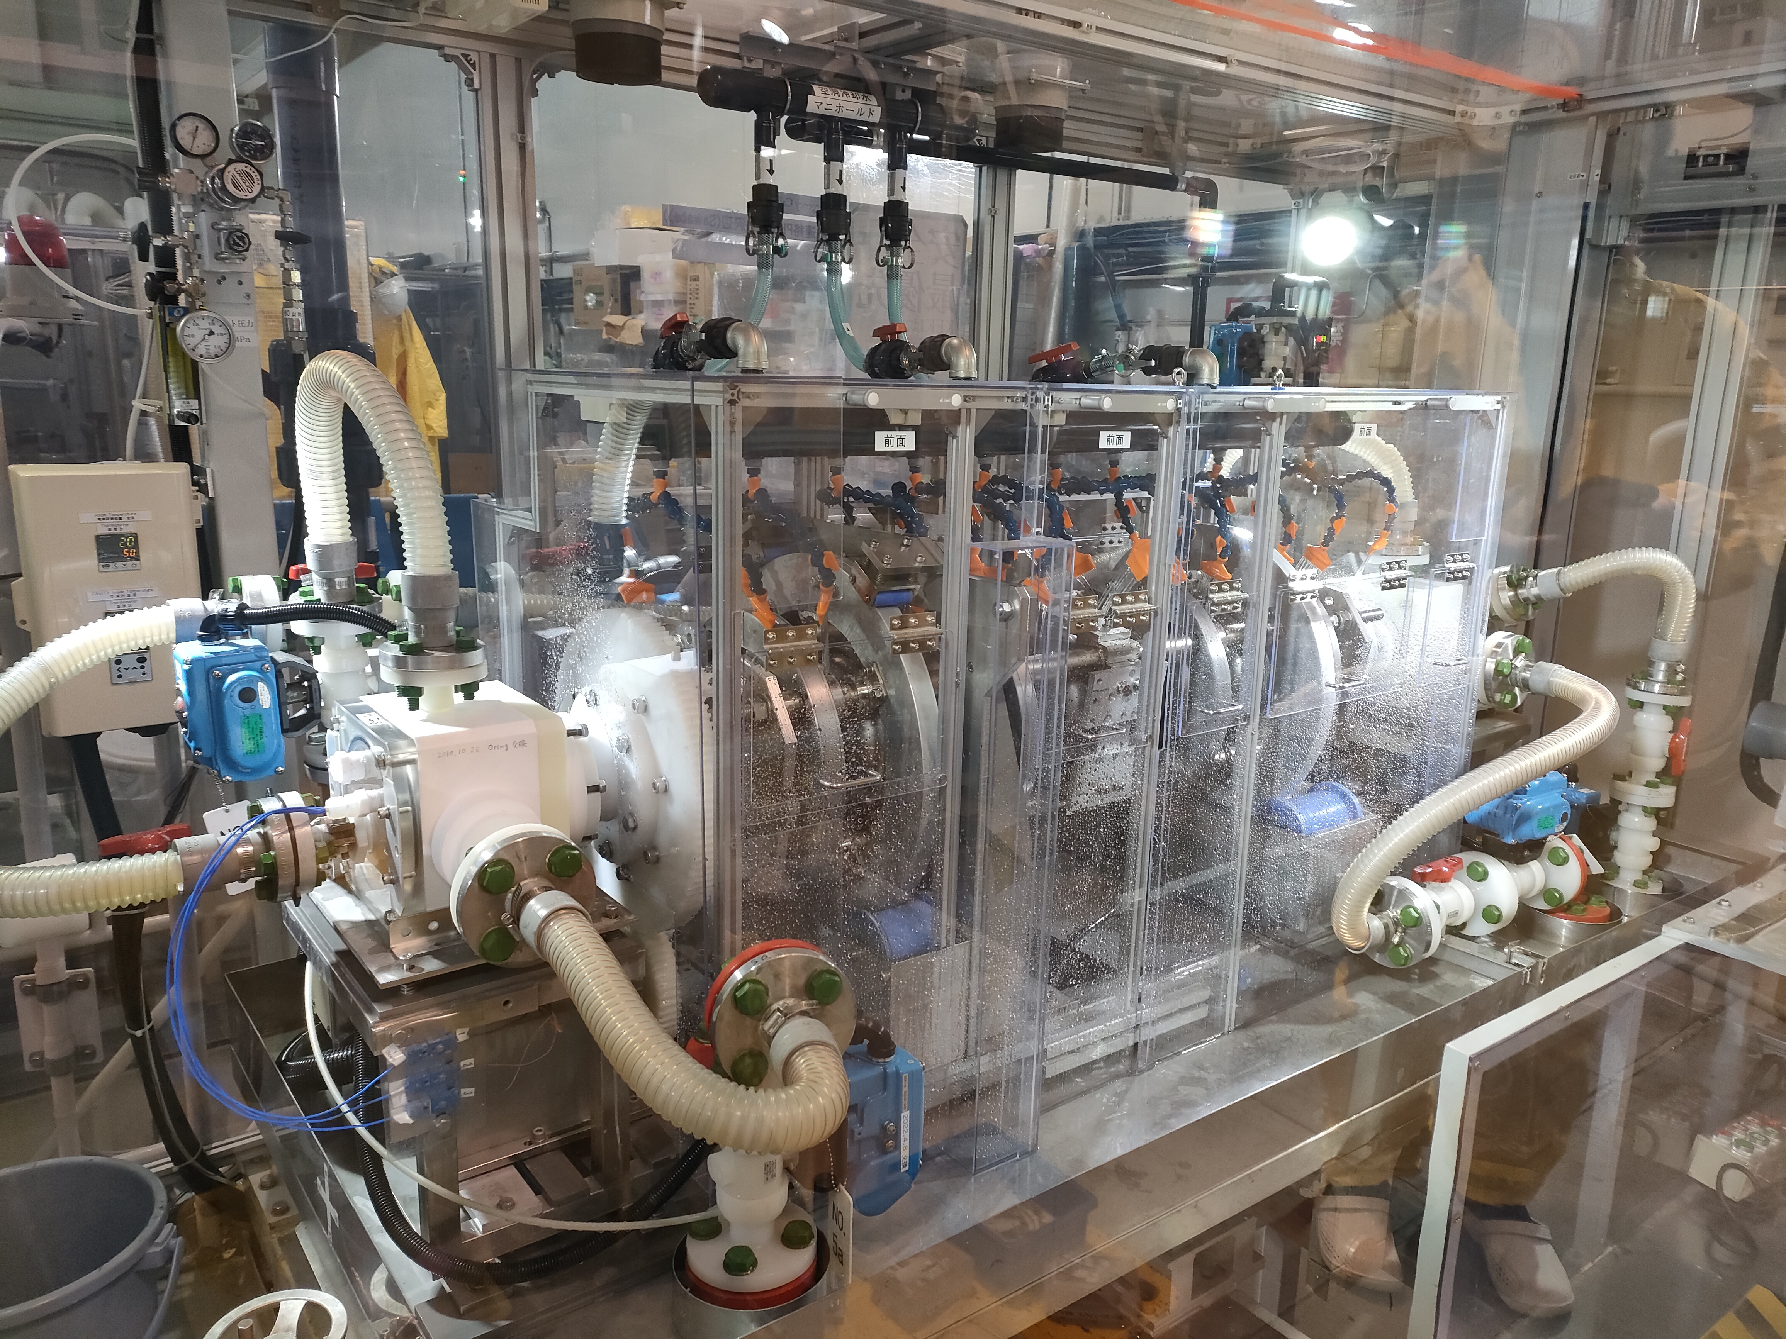
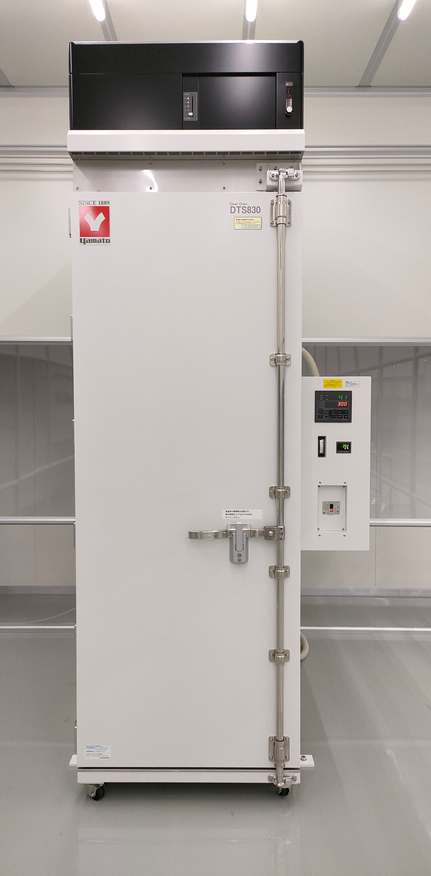
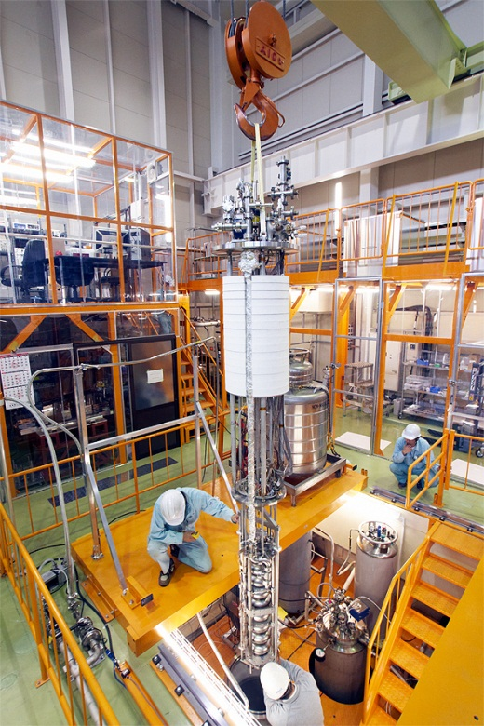
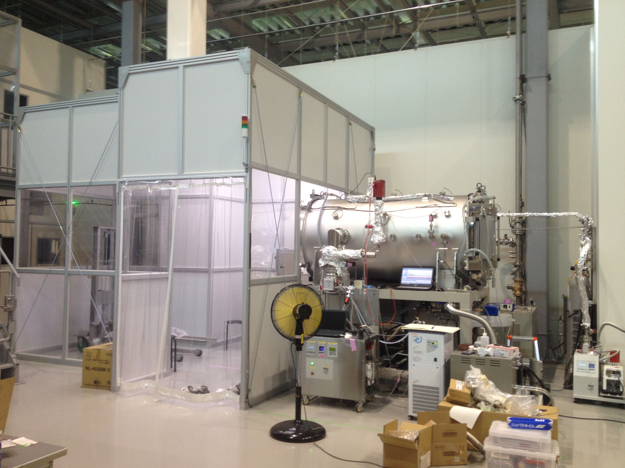
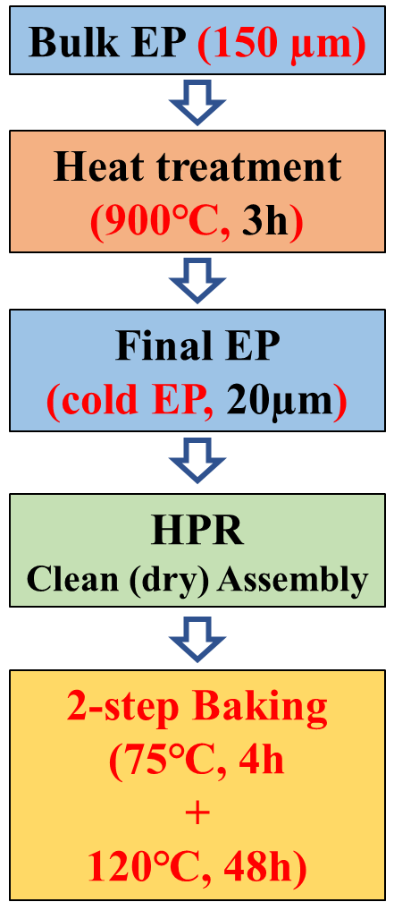
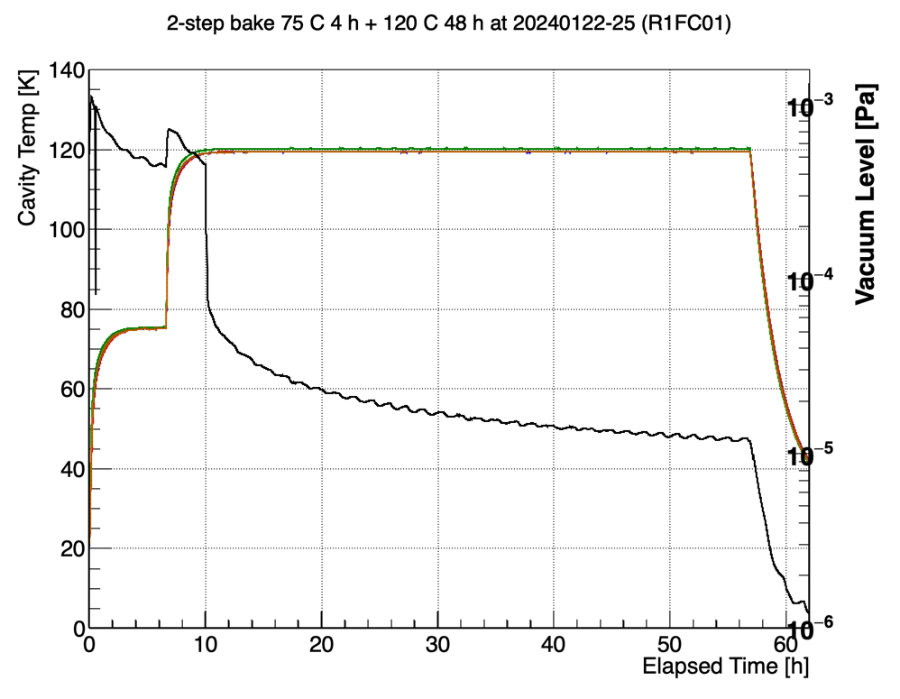
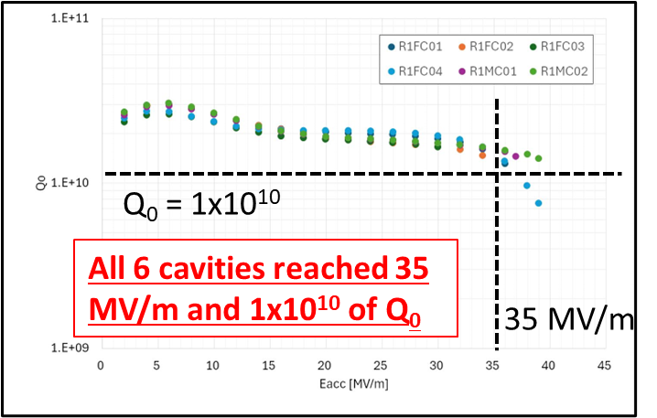
2-step Baking Surface Treatment at KEK
Based on the results of past R&D, 2-step baking chosen.
VT for six 1-cell cavities was successfully done, going to 9-cell cavities in KEK.
(FY2025) All 6 cavities passed the spec
KEK’s recipe
2 step Baking
VT
Heat treatment
Cold EP
In a clean room
Kensei Umemori/Ryo Katayama
75 C, 4h + 120 C, 48h

Slide 17
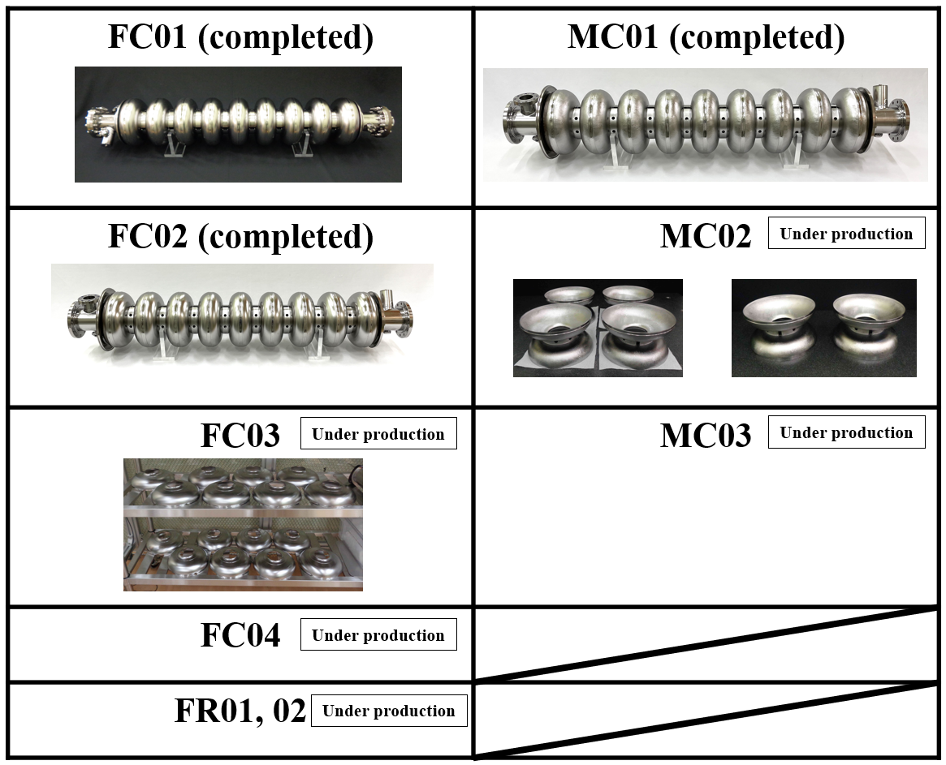
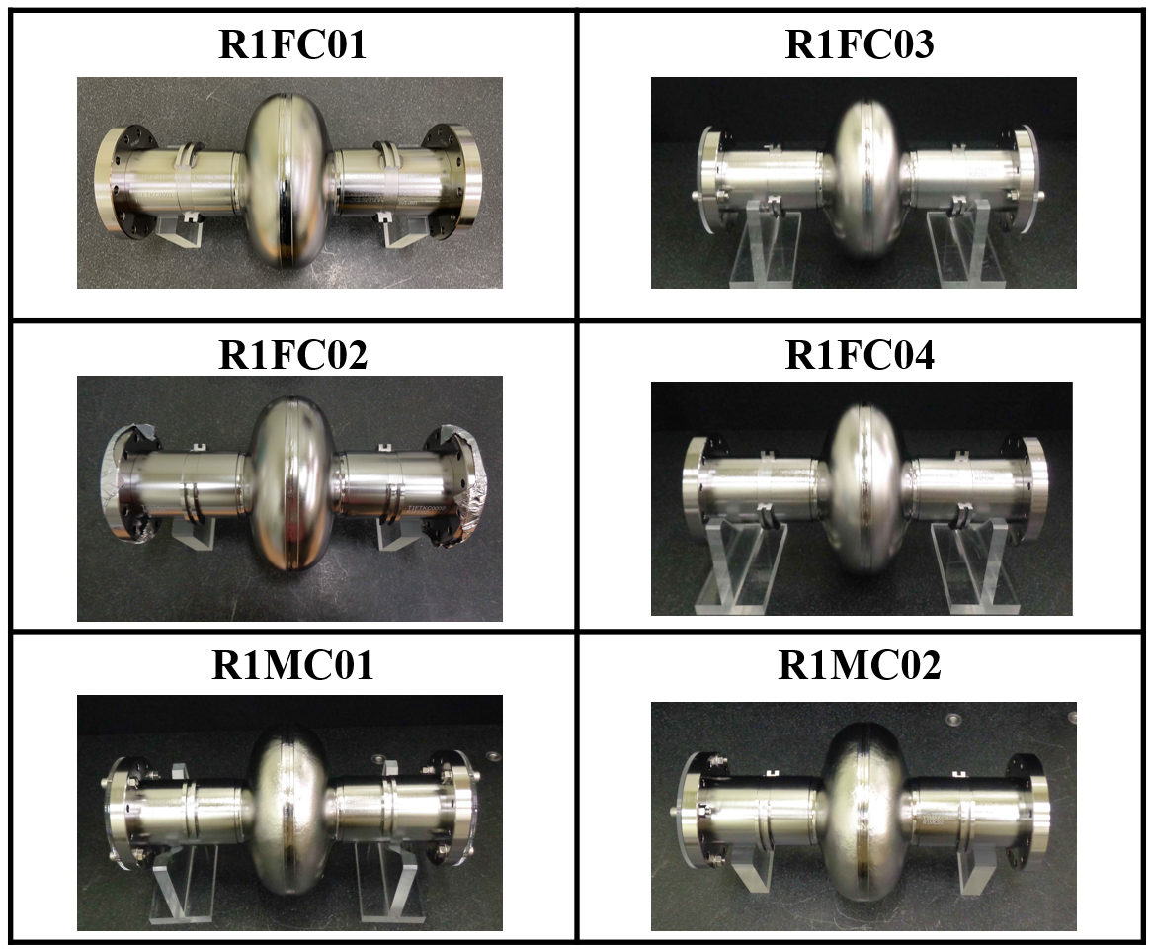
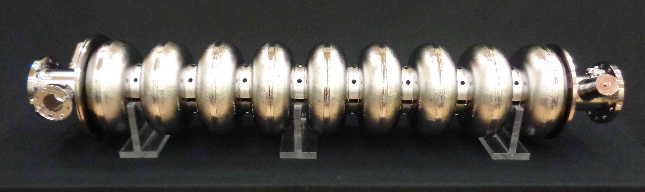
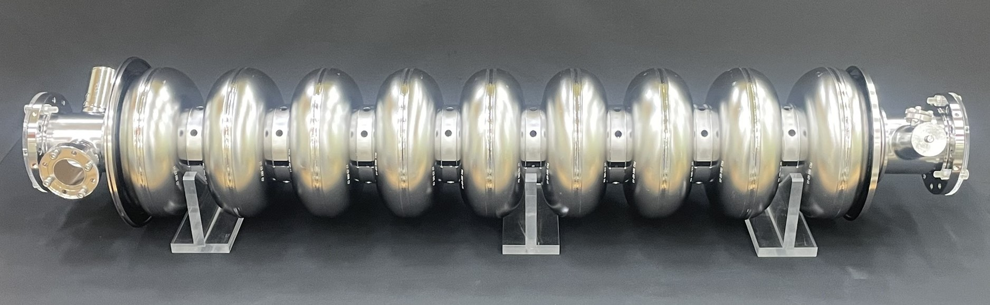
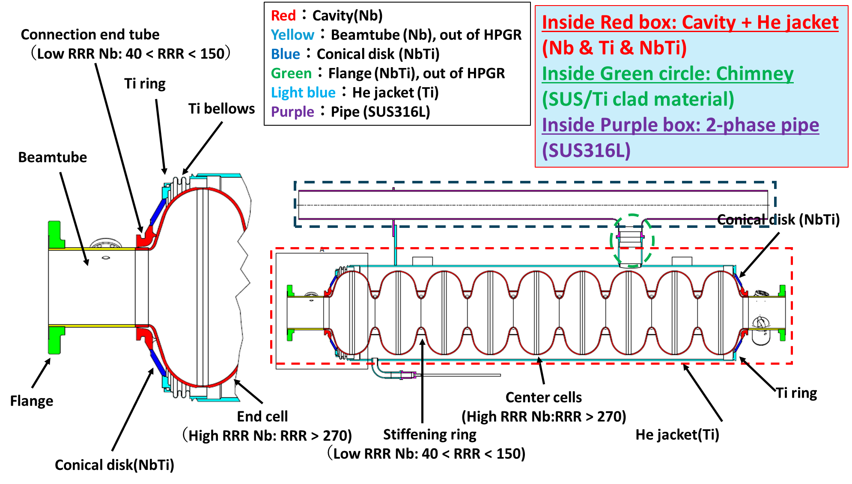
MG Cavity Production at KEK (2025)
The world’s first MG cavity!
The last few year one-cell MG Nb cavity reached more than 35 MV/m.
Five 9-cell cavity produced
Six 1-cell cavities produced
Change FC05
These cavities are made by RI!
(at the first time for KEK)
HPGS categorisation
Takayuki Saeki/Takeshi Dohmae/Kensei Umemori

Slide 18
R&D for ITN-EU: from 1-cell to 9-cells (1.3 GHz)
Single-cells for R&D studies of the “best recipes” for ILC.
  Baseline (Eu-XFEL modified) on FG and MG cavities -> only one industry (mechanical and baseline) for trustable comparison in performances.
  Only FG will be later used for “new” recipes studies:
  Mid-T, 2-step baking and their combination:
  -> Optimization of parameters (EP cold, T-treatments).
  -> Cold VT cross check between labs.
  Migration to MG for cross-check performances of the “best” recipe.
9-cells for industrialisation.
  Best recipe will be migrated to 9-cell FG cavities:
  Eu industries will be involved.
  HPGS requirements must be fulfilled.
  Final goal -> install two EU cavities in the ILC CM planned at KEK.
Active participation also in:
  CM activities, string assembly, development of diagnostics and CM tests.

Slide 19
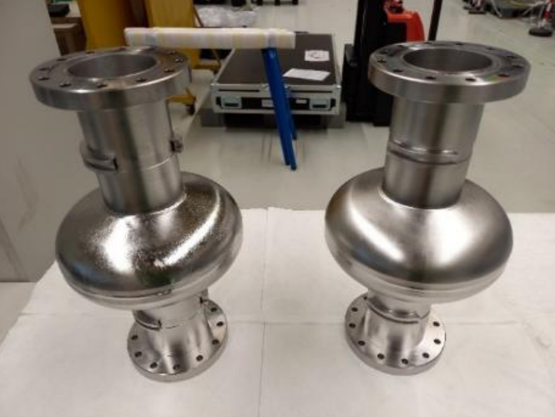
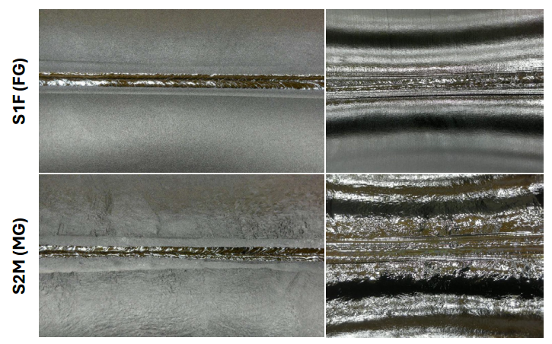
ITN-EU industrialisation activities for SRF (single-cell)
CERN (coordination), INFN LASA, CEA Saclay
Aim to use best “recipe” development for HQ/HG (ILC Japan goal):
  Status: 2 x single-cell cavities ready for tests:
    All materials provided by KEK:
      1 Fine Grain (FG) and 1 Medium Grain (MG),
      QC done at DESY (ECS).
    Mechanical and surface treatment in industry (RI)
    Baseline recipe: Eu-XFEL modified treatment (150um BulkEP, 900 °C 3h, 20um coldEP, 120 °C 48h) for comparison of performances at 2K (FG vs MG).
  Next step single-cell:
    Optimisation of the recipe (with FG single-cell).
    Migration of the best recipe on MG single-cell (for FG vs MG performance comparison).
Med-Grain
Fine-Grain
Update on the ITN Coordinated Effort for ILC Technology Development in Europe, L Monaco et al, IPAC26 (WEP1016)

Slide 20
ITN-EU industrialisation activities for SRF (9-cell)
CERN (coordination), INFN LASA, CEA Saclay
Industrialisation of 9-cell cavities in EU, compliant with the Japanese HPGS (High Pressure Gas Safety) and proof of best recipe migration to multi-cell cavities:
  Status: 4 x 9-cell cavities (ordered to RI), mechanical production and surface treatment in EU-industry, subassembly now in production:
    All materials provided by KEK,
    QC done at DESY (ECS),
    Mechanical specs prepared by KEK - INFN LASA - CEA Saclay team considering HPGS requirements and adding all QC steps performed for the 2 x 9-cell ordered by KEK in EU (RI),
    Surface treatment specs defined by the same team and prepared by CEA-INFN for the tender,
    Aug 2026: expect mechanical fabrication completed.
    Oct 2026: expect surface treatment completed.
  Next step 9-cell:
    Qualification (VT) of 4 cavities, with two (best performances) delivered to KEK for jacketing and then inserted in the ILC-type CM (at KEK).
    Preparation of specs for jacketing process to demonstrate the industrialisation (full-process in EU industries).
    Qualification of a 2nd vendor in EU (ordering two 9-cell cavities).
Cross-check of cavity performances foreseen at different labs.
Update on the ITN Coordinated Effort for ILC Technology Development in Europe, L Monaco et al, IPAC26 (WEP1016)

Slide 21
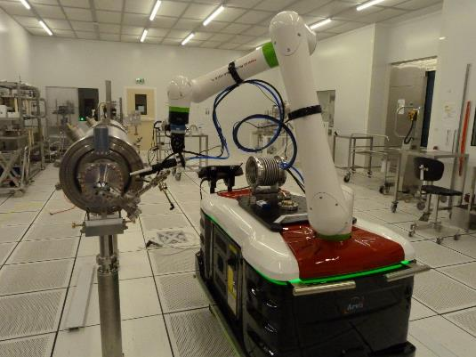
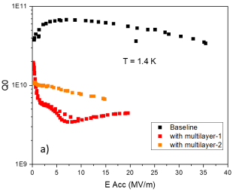
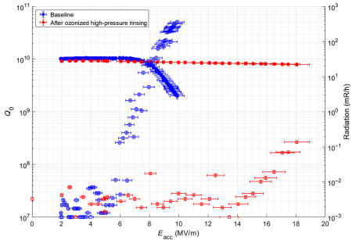
General Bulk-Nb Performance Developments
Cleanroom contamination:
  Cobots (CEA, FNAL, IJCLab, Jlab).
FE diagnostics:
  For VTs and for CM operation (CEA, INFN, ESS).
FE processing:
  Plasma, ozone (JLab, FNAL, CEA, IJCLab, INFN-LASA, ESS)
ALD coatings:
  Tune electron emission and conductivity (CEA, Hamburg-U, IJCLab).
Plasma Electro Polishing (INFN):
  No acids/HF, higher etch rate than EP, 10nm roughness achieved.
Supplier shortages:
  Nb material: 2 in China, 1 in Japan, 1 in USA → only 2 can deliver at large scale & high performance.
  Cavities: 2 in Europe, 2 - 3 in China, 1 in Japan, 1 in Korea → few can deliver at large scale.
ALD AlN + NbTiN
ALD AlN
O3 processing

Slide 22


Cryomodule Design Progress (2025)
ILC “Type B” CM chosen (eight cavities + one SC magnet/BPM).
Single thermal shield @ 40K (5K dropped).
Tuner access available.
3D model completed.
Heat load simulation done (dynamic under progress).
Waveguide support frame designed.
Total cost for contract under estimation.
Specifications
Type | B
Thermal shield | Single
Vacuum vessel length | 12,652 m
Vacuum vessel diameter | OD965mm, ID946mm
Coupler pitch distance | 1326.7 mm
Cavity length | 1247.4 mm
3D model of CM with waveguide system
Thermal analysis for 40K shield
A. Kumar
Takeshi Dohmae/Tomohiro Yamada/Takafumi Hara

Slide 23


LHeC (ERL) SRF Requirements
802 MHz cavity design for high gradient > 22 MV/m and Q₀ of > 3 x 10¹⁰ (re: FCC_{ee}) and low HOMs. ➔ J-Lab demo and PERLE (IJCLab).
Coupler design: HOM (2W @ 2K/coupler), FPC (50 KW CW) and FE-FRT (low BW) couplers ➔ IJCLab, J-Lab and CERN.
CM design and integration ➔ iSAS and ESS collaboration with PERLE.
LLRF tools feedback development with multiple beam energies and acceleration/deceleration modes (Q_{L} = 8x10⁶, BW = 100 Hz) ➔ PERLE ➔ by 2030.
PERLE test facility at IJCLab to be used as a technology demonstrator.
New 50 GeV electron accelerator, 7 TeV HL-LHC
→ 1 TeV c.o.m. ep collisions
O Bruning (CERN), Front. Phys. 10.886473, Feb 2022

Slide 24


PERLE-LHeC 802 MHz SRF Cavity Development
Bare-cavity prototype by Jlab/CERN exceeds specs.
Challenges:
High dynamic losses → High Q₀.
High HOM excitation → Extraction.
Microphonics detuning and mechanical stability → Fast tuning → FE-FRT.
F Marhauser (JLab), IPAC18, THPAL146
Powerful ERL for Experiments (PERLE) at IJCLab
Strong synergy with FCC developments
First Nb 800 MHz 5-Cell cavity
fabricated @ JLAB
Principal SRF technology demonstrator for LHeC

Slide 25







Innovate for Sustainable Accelerator Systems (iSAS)
Horizon Europe: Innovate for Sustainable Accelerator Systems (iSAS):
  13 M€, 1000 person months,
  17 partners for 4 yrs (2024 – 28) .
Incl: CEA, CERN, CNRS, DESY, EPFL, ESS, HZB, INFN, Nikhef, UKRI, ULAN, VUB.
Strong LDG RFCP integration.
PERLE 1st cryomodule adapted from ESS design and optimised for efficient, high current ERL operation.
In-kind from ESS, re-use MB prototype components
iSAS has broad accelerator applicability:
Bulk-Nb
SRF thin films
FE-FRT’s
RF Controls
Amplifiers
By 2028
https://isas.ijclab.in2p3.fr/

Slide 26


Sustainability Priorities – Thin Films
In last 5-years, prices have increased:
Bulk-Nb material by factor of 3!
LHe by factor 10!
Grid Power by factor 3!
Operating at 4 K (from 2 K) reduces cryo power by factor of 3!
3 x COP
reduction
S. Posen (FNAL), Supercond. Sci. Technol. 30 033004, 2017
Estimated cryogenic costs of ESS (M€)
Infrastructure
Operation
2 K (Bulk Nb)
40
11
4.5 K (Thin Film)
25
4
43% less cost!!!
C Antoine (CEA), IPAC2023
C. Antoine (CEA), IFAST Del.9.1 (2024)
M. Titov (CEA) talk @ ESPPU2025

Slide 27



4K Cavity Developments (1/2)
WP3: CEA, HZB, INFN and STFC
Coating recipe optimised and validated on small planar resonator (QPR).
2 coating systems for 1.3 GHz cavities ready, in the testing phase.
Translate

Slide 28


4K Cavity Developments (2/2)
WP3: CEA, HZB, INFN and STFC
Advanced characterisation facilities to investigate
An interlayer between Nb3Sn coating and Cu substrate to enhance film mechanical stability and tunability.

Slide 29
Thin-films Challenges/Limitations
Seamless substrate manufacture:
  Machining, hydroforming, electro-forming, spinning, etc.
Magnetic flux sensitivity mitigation:
  Material, thickness, quality, cooling, thermo-current mitigation etc.
Provision of deposition targets – industry capability:
  Cylindrical alloy/compound targets for cavity deposition.
Optimise deposition processes:
  PVD, CVD, HIPIMS, ALD, etc.
Validate deposition from 2D to 3D:
  Surface analysis capabilities: SEM, FIB, AFM, XPS, XRD, RBS, TEM, etc
Enhance cryogenic testing infrastructures:
  Characterise: T_{c}, RRR, AC/DC magnetic susceptibility, H_{c}, H_{fp}, H_{sh}, Field penetration
  RF: QPR, choke cavity, VT facilities.
Validate cavity deposition:
  Over wide frequency range (400 MHz to 1.3 GHz)
Qualify thin film project focussed cavities to high TRL level:
  Industrialise thin-film cavity deposition.

Slide 30



Sustainability Priorities - FE-FRT
Ferro-Electric Fast Reactive Tuners (FE-FRT):
Potential game-changer for SRF cavity tuning, transient beam loading/microphonics – particularly beneficial for ERL applications.
Short coaxial structure, with FE element:
  RF power in and reflected back. FE permittivity changed by an applied voltage → change of Prefl → rapid change of frequency.
  Tuning speed > 600 ns (HV cct limit), deliver power savings (x10) and improved stability.
Based on previous work by CERN, Lancaster U, BNL and Euclid techlabs.
Partners: HZB, CERN, CNRS, Lancaster U.
LHeC Power Savings
FE-FRT Device and Equivalent Cct
7.5 x less power!!!
https://euclidtechlabs.com/fast-reactive-tuner/
M Baylac (CNRS/LPSC), Energy saving performance (iSAS task 9.5).

Slide 31


FRT Developments (1/2)
WP1: CERN, CNRS, Euclid Techlabs, HZB and Univ Lancaster
FE-FRT for transient beam loading: Develop and test a FE-FRT for 400 MHz LHC cavities:
• Specifications: 8 kHz tuning, 7.2 kV bias V, 100 ns switching time at 150 kHz switching rate.
• RF design and choice of material validated.
• After manufacturing at CERN, the first warm tests have shown the expected tuning functionality.
• Cold tests to be resumed (Q3 2026).
*S. Smith et al., “Towards high power tests of an FE-FRT for transient detuning”, in Proc. SRF2025, Tokyo, Sep. 2025, pp. 516-521, doi:10.18429/JACoW-SRF2025-WEA03

Slide 32

FRT Developments (2/2)
WP1: CERN, CNRS, Euclid Techlabs, HZB and Univ Lancaster
FE-FRT for microphonics detuning compensation (HZB, Euclid Techlabs)
Develop and test an FE-FRT at 1.3 GHz
  FE-FRT for the two-cell SRF cavity was designed and manufactured.
  To be tested in a cavity horizontal test stand (HoBiCat).
  Design will be improved for a 9-cell TESLA/XFEL cavity.
Investigate materials permittivity in this frequency range
  Test stand to characterise the FE material at 1.3 GHz.
  Measurements underway (permittivity versus voltage).
  Sample preparation (grinding, polishing, planarity of faces) is of utmost importance for optimal performance of the tuner.
FE-FRT for energy recovery linac (CERN, U. Lancaster, HZB, CNRS/IJCLab)
Develop an FE-FRT at 802 MHz
  Test in the ERL PERLE (also a use case for FCC-ee).
Note: Considering limited available space for end groups of most SRF cavities, retrofitting existing designs with a FE-FRT may require to combine the FE-FRT with a HOM or FPC port.

Slide 33
European Strategy for Particle Physics: 2026 Update
Recommendations by the European Strategy Group – May 2026
https://cds.cern.ch/record/2950671/files/English%20version.pdf?version=1
Relevant priority recommendations:
Complete and fully exploit the HL‑LHC programme.
Adopt FCC‑ee as the preferred next flagship collider.
Retain a descoped FCC‑ee as fallback option.
Strengthen accelerator, detector, and computing R&D.
Defer final construction decision to ~2028.
Relevant technology recommendations:
Highest priority to industrialise key technologies: SRF structures, RF amplifiers and high field magnets (incl. HTS).
Demonstration of high-current multi-turn ERL to be pursued.
Longer-term high field wakefield and bright muon beam developments, in synergy with US.
Expect LDG to formulate a revised Accelerator R&D Roadmap (2026 – 2032).
Refocus the RF R&D objective priorities for the next ESPP-U in 2032.

Slide 34

Summary
Next ESPP R&D programme will demand high SRF TRL verification by 2031.
SRF cavity gradient and Q factors continue to improve, for both bulk-Nb and thin films.
Recent surface processing advances (N-doping/infusion, HT/mid-T/2-step baking, PEP) enabling much higher project specs to be realised.
SRF fundamentally drives higher sustainability provisions (gradient, efficiency, footprint, costs) for future large-scale HEP facilities:
FCC-ee and ERL’s both need higher gradients & Q-factors,
breakthrough for thin-films and FE-FRT integration will be fundamental!

Slide 35
Acknowledgements
LDG RF Coordination Panel Team Members:
Claire Antoine (CEA)
Maud Baylac (CNRS)
Giovanni Bisoffi (INFN)
Frank Gerigk (CERN)
Catharine Madec (CEA)
Oleg Malyshev (STFC)
Laura Monaco (INFN)
Thomas Proslier (CEA)
Others:
Franck Peauger (CERN)
Hiroshi Sakai (KEK)
Mike Seidel (PSI)

Slide 36

MANY THANKS

Slide 37
Backup Slides

Slide 38






FCC_{ee} SRF Systems
Collider RF system (400 MHz and 800 MHz)
Booster RF system (800 MHz)
Z-WW-ZH
ttbar
448
264
408
+
112
66
102

Slide 39







SRF R&D
Collaborations & Work Breakdown
Mandatory for cryomodule demonstrators development
Opportunities for major cost savings for the contruction FCC-ee
SRF Basic Research
Fundamental research on RF superconductivity
Point contact Tunnelling Spectroscopy
Magnetic flux expulsion studies
Nb coating on copper
Atomic Layer Deposition
SRF thin films
Nb3Sn coating on niobium
Nb3Sn coating on copper
SRF surface treatments
High Q₀ 800 MHz cavities with Nb doping
Clean room process, electropolishing, surface inspection, robotisation
SRF process equipment for SA18 building
Low & high pressure ultra-pure water rinsing systems
Clean equipment (Lifters, gantries, assembly toolings)
Horizontal airflow cleanrooms
SRF Technologies
Hydroforming of copper cavity substrates
Cavity test methods and diagnostics
Ferro-electric Fast-Reactive tuner
Dry cryogenics cooling

Slide 40




Substrate Cavity Manufacturing
Explore novel fabrication methods: Bulk machining, Hydroforming, Electro-forming.
Develop non mechanical tuning.
Explore novel cooling methods.
400 MHz Monoblock prototype
1.3 GHz hydroforming (KEK Collaboration)
M. Garlasche, S. Atieh, et. al

Slide 41
Bulk nb cavities
Applied in many collider schemes
Roots: exceptional expertise made on 1.3 GHz (800 cavities pulsed on Eu-XFEL, 400 cavities CW on LCLS-II-HE, 600 cavities CW on SHINE), and the ILC/ITN multi-decade developments.
LCF: higher Q (by improved surface/thermal treatments), tests planned at KEK in 2026-2027
FCCee: transfer of LCF expertise at 800 MHz (mid-T baking, f-depenence and flux trapping to be investigated)
LHeC: targets and R&D path similar to FCCee at 800 MHz (and to PERLE in France)
LEP3: would also require bulk-Nb 1-cell, 4-cell, 6-cell cavities, at 800 MHz and 500 kW (higher than state-of-the-art), requiring effort on FP-couplers/RF sources
Labs with TRL6* (and European with TRL7 *) expertise: CEA, CERN, CNRS/IJCLab, DESY, ESS, HZB, INFN, STFC, UHH, Uppsala/FREIA, et al. (Eu),
FNAL, JLAB, SLAC, et al. (Am),
KEK, IHEP, SHINE, Korea Univ. Et al. (Asia)
iSAS European Project: rationalising R&D on 800 MHz; joint experiments on 1.3 GHz
CURRENT STATE OF THE ART:
5-cell prototype w/o ports, built by JLAB: 3 x 10¹⁰, ~30 MV/m in VT (Vertical Test)
CERN-now: 1-cell cavities under fabrication (deep-drawing and EBW), collab with FNAL, IJCLab, Cornell U and others.
Short-term goal: recipes for needed Q₀ factor at high gradient. Final goal: 6-cell cavity, at TRL7 (test in CM) 3x10¹⁰, 20.25 MV/m

Slide 42

800 MHz, 6-cell, Bulk-Nb
TODAY:
5-cell prototype w/o ports, built by JLAB: 3 x 10¹⁰, ~30 MV/m in VT.
JLAB shape (all cells the same)
SPECIFICATIONS:
6-cell (FCC shape) prototype with ports: 3.8 x 10¹⁰, ~25 MV/m in VT.
Tested in HT with FPC and HOMCs with 3.5 x 10¹⁰, 22.5 MV/m.
Tested in CM with 3 x 10¹⁰, 20.25 MV/m.
Demonstration required by 2031.
TRL4
TRL5
TRL6
TRL7
FCC
F Marhauser (Jlab), IPAC18, THPAL146

Slide 43




6-cell 800 MHz Cavity
Courtesy Marco Chiodini
Cavity shape:
  6-cell 800 MHz cavity → in total 856 cavities for booster and tt collider.
  Asymmetric end-cell shape for better HOM damping.
  1 port for FPC, 4 ports for HOM couplers, 1 port for pick up antenna and 1 port for FRT.
Material:
  Bulk Nb with EP and doped RF surface.
  Nb₃Sn coating as an option to operate at 4.5 K.
Fabrication and R&D program:
  Fabrication of 10 single-cell cavities at CERN.
  Collaboration with international partners to achieve required high Q₀: FNAL, IJCLab (LHeC/PERLE) and Cornell.
112 cavities for Z, W and H booster
408+448 additional cavities for ttbar operation
Courtesy Laurent Prever-Loiri
Deep drawing tests performed on copper sheets
Courtesy F. Peauger (CERN)

Slide 44



Thin film cavities
FCC_{ee}
Nb/Cu
FCCee to implement Nb/Cu (an ameliorated LEP tech) on 2–cell 400 MHz cavities (lower material impact, same energy).
MC may adopt Nb/Cu cavities with 2x E_{a} (very ambitious for now).
It may be the long-term goal for the LHeC collider option.
Lower R at 4K versus Nb → higher operating T → smaller energy quest.
Nb₃Sn the most mature: promising Nb3Sn/Nb (good for energy saving not for material saving);
Nb3Sn/Cu real goal (material and energy saving).
Other thin-film options are farther from the goal
The production of high-quality Cu bases is paramount (and critical).
TF-collaboration very well integrated, little resources.
IFAST, iSAS and EPITA Projects nicely complementary, fostering infrastructures with standardized equipment and processes.
400 MHz, Nb/Cu thin film, @ 4.5 K (2x LHC E_{a} and Q₀)
Higher T_{c} materials
From the old LEP2 expertise:
Scaled (1.3 GHz) FCC targets for E_{a} and Q₀ have been reached on bulk-machined seamless Cu bases, with a good reproducibility
Chemical electropolishing; Nb coating with High Power Impulse Magnetron Sputtering (HiPIMS).
Promising preliminary results obtained recently on hydroformed cavities within the CERN-KEK collaboration.

Slide 45

Long Term FCC_{ee} RF Schedule

Slide 46



What is ITN (ILC Technology Network)?
It is an international collaborative framework established to advance the technological development necessary for the construction of the International Linear Collider (ILC). Initiated jointly by the High Energy Accelerator Research Organization (KEK) and the ILC International Development Team (IDT*), the ITN focuses on executing high-priority accelerator development tasks, known as "work packages," as outlined in the ILC Pre-lab Proposal.
This talk “SRF”
*IDT: International Development Team formed by ICFA in 2021

Slide 47














ITN/MEXT-ATD Structure (SRF elliptical cavities)
MOU and Sub-LA
Materials and funding
NDA
US-JP Science and Technology Cooperation
Cavities preparation and tests
ECS
LA and MOU
MOU and Sub-LA

Slide 48


IDT* Scope for ILC Realisation
ILC Technology Network (ITN)
-- global collaboration program ---
Acc. R&Ds focusing on:
  SRF technologies
  e- & e+ Sources
  Nano-beam
2021 May
2022 June
WP-Primes
for
Time Critical
WPs for
ILC Pre-Lab
http://doi.org/10.5281/ze nodo.4742018
https://agenda.linearcollider.org/event/9649/attac hments/38003/60567/Time-Critical_WPsV8b.pdf
KEK obtained a budget for these R&Ds and started the activity from 2023.
*IDT: International Development Team formed by ICFA in 2021

Slide 49


Motivation
©Rey.hori
As part of the ITN collaboration, we aim to develop an ILC-style cryomodule as a technology demonstrator.
It will include several cavities that are manufactured, processed, and tested within the EU
It will strengthen collaboration and network across the European accelerator community, sharing know-how
Here is a list of performance requirements for vertical tests and cryomodule tests:
 | Vertical Test |  |  |  | Cryomodule Test
 | Eacc nominal [MV/m] | Q0 nominal | max X-ray dose [mSv/h] | Max Eacc (admin limit) [MV/m] | Eacc nominal [MV/m] | Q0 nominal [W calorimetric] | max X-ray dose rate [mSv/h] | Max Eacc (admin limit) [MV/m] | Energy gain [MeV]
Single-cell | 35 | ≥1x10¹⁰ | No FE (<35MV/m) | at quench
9-Cell | 35 | ≥1x10¹⁰ | <10 | ±20% | 31.5 | ≥1x10¹⁰ | no perf. degradation | ±20% | 209-314

Slide 50
(Re)scheduled ITN Plan from FY2026
 | 2023 | 2024 | 2025 | 2026 | 2027
Superconducting RF cavities | Nb Material Procurement Cavity Development High-Pressure Gas action | Cavity development(0) Single cell (6) Vertical test (single cell) High-Pressure Gas action (continue) | Cavity development (4+2+2) From abroad (2) Vertical test （35MV/m, 1E10） High-Pressure Gas action (continue) | Cavity development（35MV/m, 1E10） Welding Helium tank Further High Performance High-Pressure Gas action (continue) | Further High Performance High-Pressure Gas action (continue)
SRF Cryomodule | Drawing module and each components High-Pressure Gas action | Coupler fabrication (4) Tuner prototype magnetic shield prototype SC magnet fabrication Fabrication CM | Coupler fabrication (4) Tuner fabrication (4) magnetic shield fabrication (2) SC magnet fabrication (Cont’) Fabrication CM | Coupler fabrication (8) Tuner fabrication (4) magnetic shield fabrication (6) Fabrication CM (Cont’） String assembly High-Pressure Gas | Coupler power test String assembly Construction CM High-Pressure Gas （inspection） Performance test of CM （31.5MV/m, 1E10）
Due to the cavity fabrication under HPGS law and power coupler fabrication issues and increasing costs since 2022.
New plan is to complete the cryomodule, to high power test in the additional two years after finising MEXT-ATD program.

Slide 51


European SRF Thin Film Roadmap
European SRF Thin films recommendations
IFAST Del 9.1 (2024)
https://zenodo.org/records/14731412

Slide 52


General Bulk-Nb to Date (non-ESPP)
Eu-XFEL
Project | Frequency (GHz) | Processing | Specification Eacc (MV/m) and Q₀ | Achieved Average Eacc (MV/m) and Q₀ | # Cavities Needed
CEPC* | 0.650 1.3 | Mid-T bake, N-infusion, BCP, HPR | 27.5 @ 3 x 10¹⁰ 21.8 @ 3 x 10¹⁰ | 31 @ 6.3 x 10¹⁰ 31 @ 4.3 x 10¹⁰ | 240 256
E-XFEL | 1.3 | HT treatment, BCP, EP, HPR | 23.6 @ 1 x 10¹⁰ | 29.8 @ 1.4 x 10¹⁰ | 800
ESS (MB/HB) | 0.704 | BCP, HPR | 16.7 @ 5 x 10⁹ 19.9 @ 5 x 10⁹ | 20 @ 1.7 x 10¹⁰ 22.7 @ 1.2 x 10¹⁰ | 36 84
LCLS-II-HE | 1.3 | HT treatment, Cold-EP, N2-doping, HPR | 21 @ 2.7 x10¹⁰ | 27.3 @ 3.2 x 10¹⁰ | 184
PIP-II (LB/HB)* | 0.650 | HT treatment, N2-doping, HPR | 16.9 @ 2.9 x 10¹⁰ 18.8 @ 4 x 10¹⁰ | TBC 21.6 @ 5 x 10¹⁰ | 36 18
SHINE* | 1.3 | HT treatment, N2-doping, mid-T bake, HPR | 16 @ 2.7 x 10¹⁰ | 27 @ 3.3 x 10¹⁰ | 600
Range | 0.65 – 1.3 | Mixed | Eacc: 16 – 27.5 Q₀: 1 x 10¹⁰ – 4 x 10¹⁰ | 20 – 31 MV/m 1.2 – 6.3 x 10¹⁰
LCLS-II-HE
SHINE
*Limited testing to date
15% - 70% Eacc
15% – 340% Q₀

Slide 53


General Thin-Film Developments to Date
Technique | Achievements | Challenges | Who
Nb on Cu | 10 MV/m @ 5 x 10⁸ achieved @ 4.2K at 1.3 GHz (CERN) | Cavity substrates, deposition optimisation, flux trapping, thermos currents, role of H2. | CERN, INFN-LNL, STFC/CI, CEA Jlab, FNAL, Cornell U IMP, Peking U
Nb3Sn on Cu or Nb | 15.5 MV/m @ 1 x 10¹⁰ achieved at 4.2K at 1.5 GHz for Nb3Sn/Nb (Jlab/FNAL, China) | Deposition optimisation, deposition targets for PVD, flux trapping, thermos currents, tuning. | CERN, CEA, INFN-LNL, HUH/DESY, STFC/CI, USI JLab, FNAL, Cornell U, KEK, IHEP
Other SCs (A15, MgB2, etc) on Cu or Nb | Early stage 2D sample verification. | Deposition optimisation, deposition targets for PVD, lack of expertise. | STFC/CI, USI Temple U, JLab, LANL, U Tennessee KEK
Multilayer SIS on Nb | First deposition on 1.3 GHz cavities (delamination) | Delamination, insulating layer performance, thermal stress, | CEA, HUH/DESY, STFC/CI, USI Jlab, FNAL KEK, CAS
Nb on Cu, 1.3 GHz, single-cell
4.2K
Nb3Sn on Nb, 1.5 GHz, 5-cell
4K

Slide 54
European Strategy for Particle Physics: 2026 Update
Recommendations by the European Strategy Group – May 2026
Accelerator science and technology recommendations being:
In order to realise the visionary plan presented, the highest priority must be the development and industrialisation of key technologies: advanced superconducting and normal-conducting RF structures, efficient RF power sources and accelerator-quality magnets in the 14–20 T range, including those based on high-temperature superconductors.
Demonstration of high-current multi-turn energy recovery in linacs constitutes an important step towards power-efficient lepton accelerators for a broad range of applications and should be pursued.
The longer-term development of advanced technologies, such as high-gradient wakefield acceleration and those underpinning bright muon beams, should be supported at an appropriate level. Synergies with the US initiative on muon collider R&D should be exploited.
Expect LDG to formulate a revised Accelerator R&D Roadmap (2026 – 2032).
Refocus the RF R&D objective priorities for the next ESPP-U in 2032.

