Slide 1
Summary of TTC remote WG high-Q/high-G meetings
Akira Miyazaki (IJCLab), Martina Martinello (SLAC), Kensei Umemori (KEK)
TTC2026 @ Paris region

Slide 2
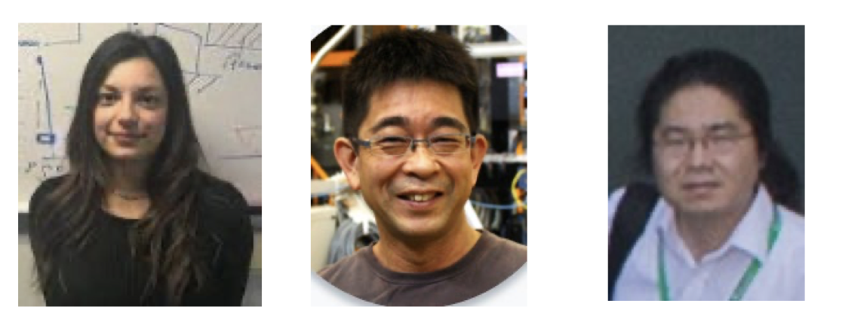
Statistics of the remote WG high-Q/high-G
72 names on the list
https://conference-indico.kek.jp/category/77/
Martina Martinello
Kensei Umemori
Akira Miyazaki
martinam@slac.stanford.edu
kensei.umemori@kek.jp
akira.miyazaki@cern.ch

Slide 3
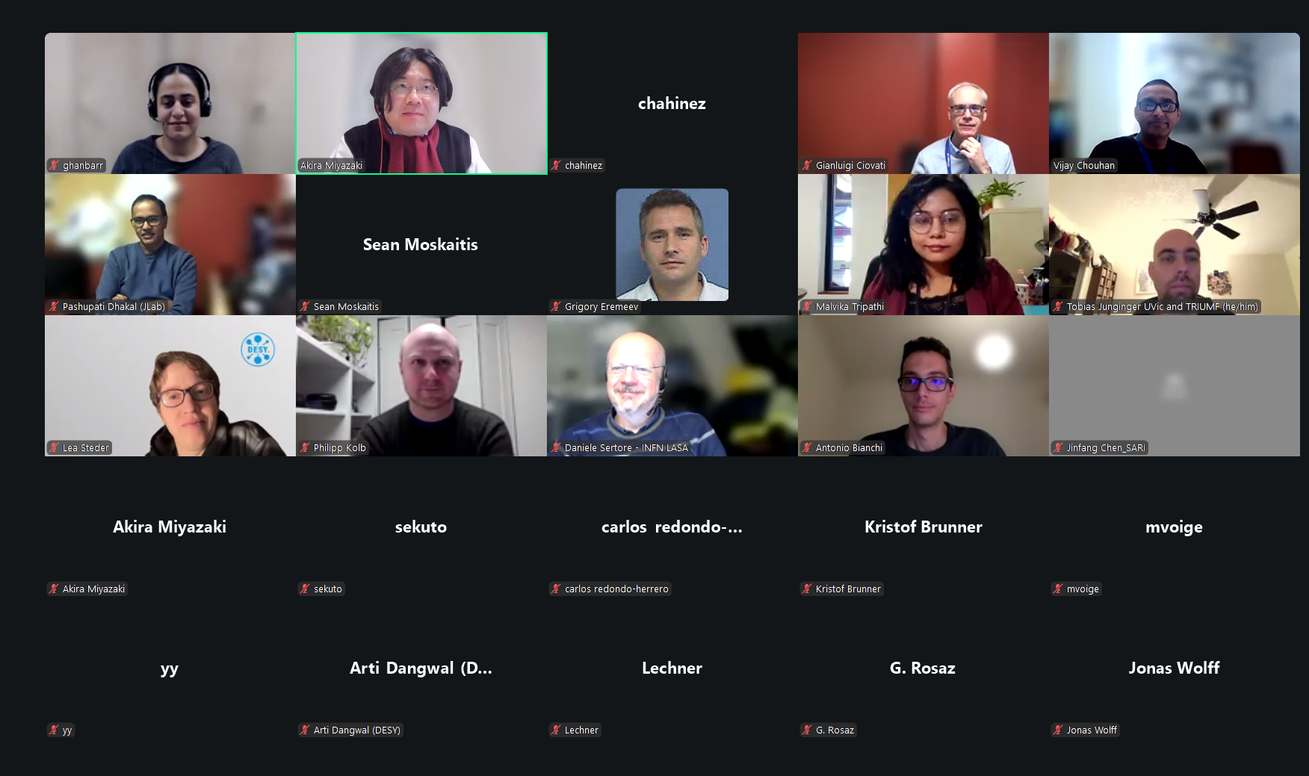
1st meeting in December 2025: max 39 participants

Slide 4
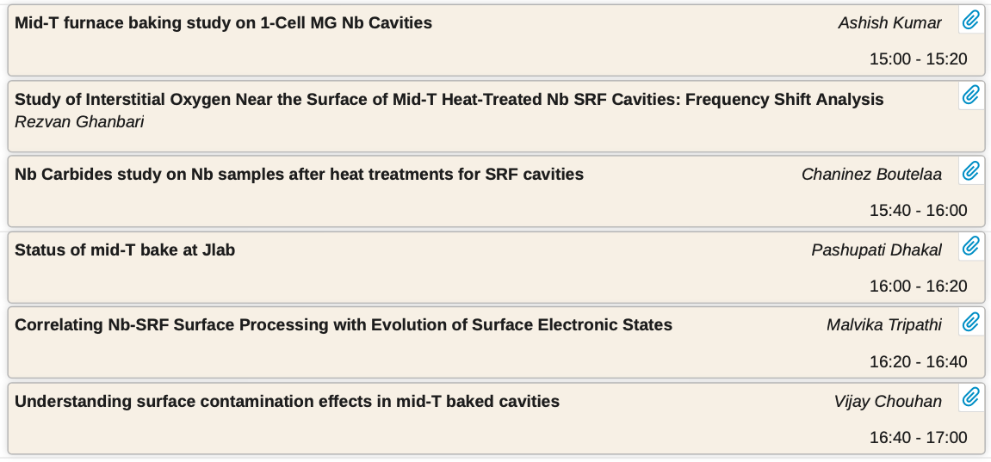
1st meeting in December 2025: 6 contributions
https://conference-indico.kek.jp/event/359/

Slide 5
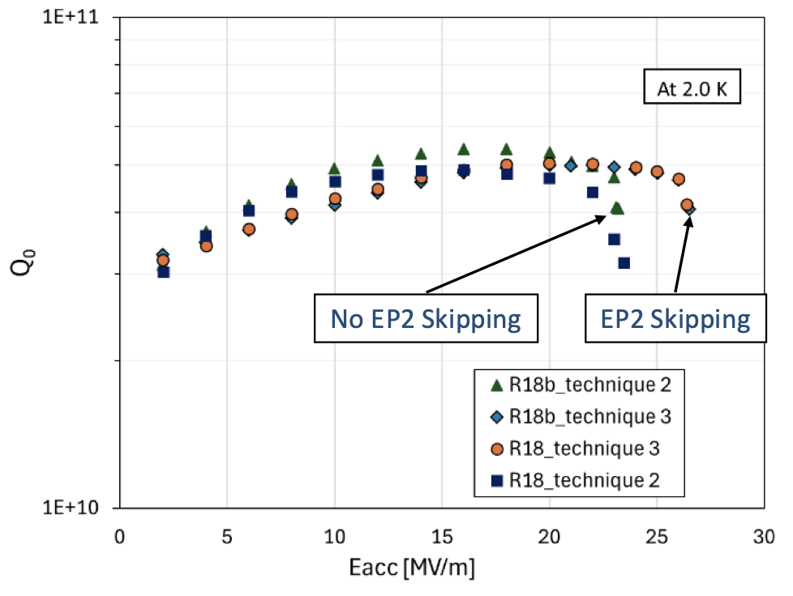
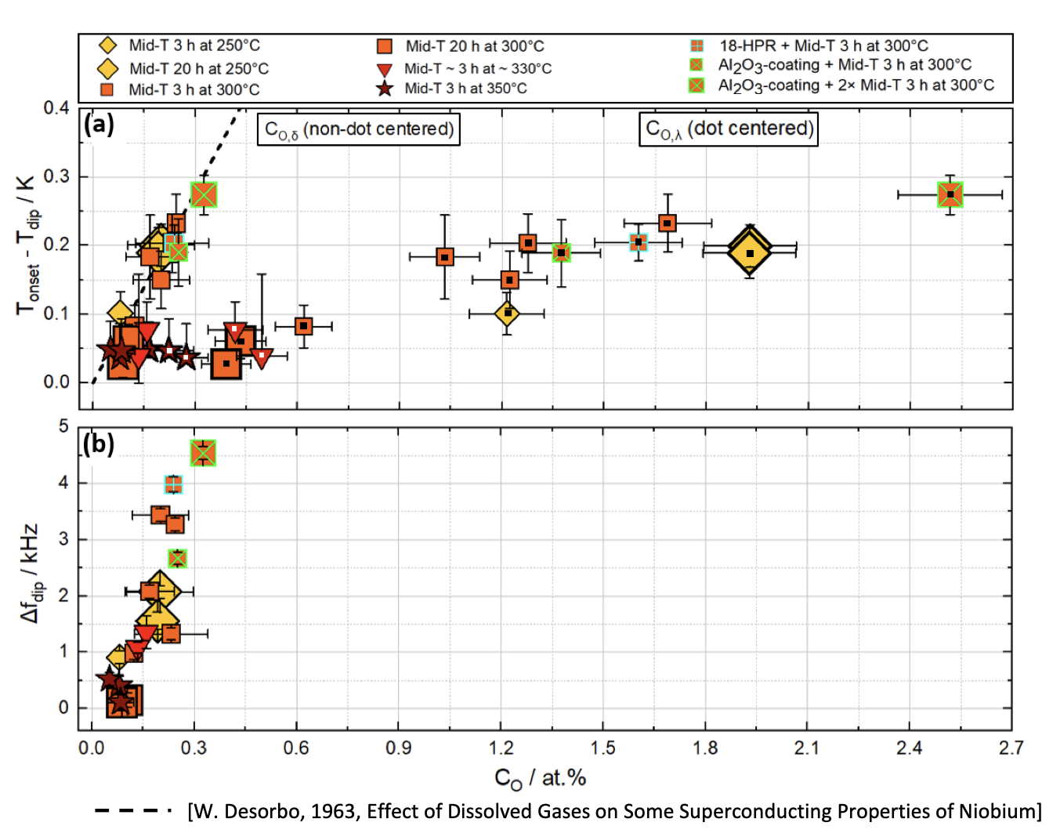
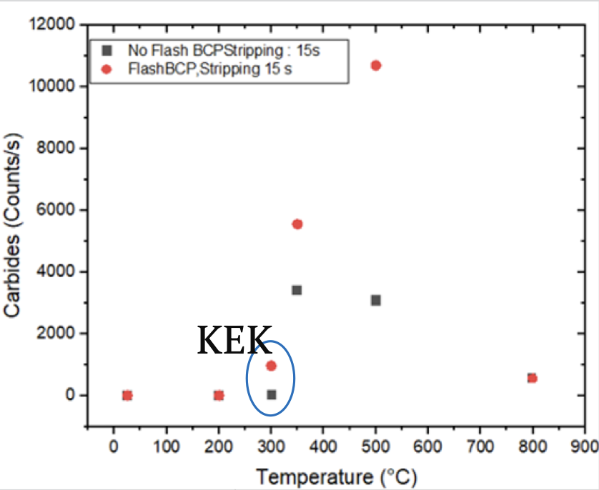
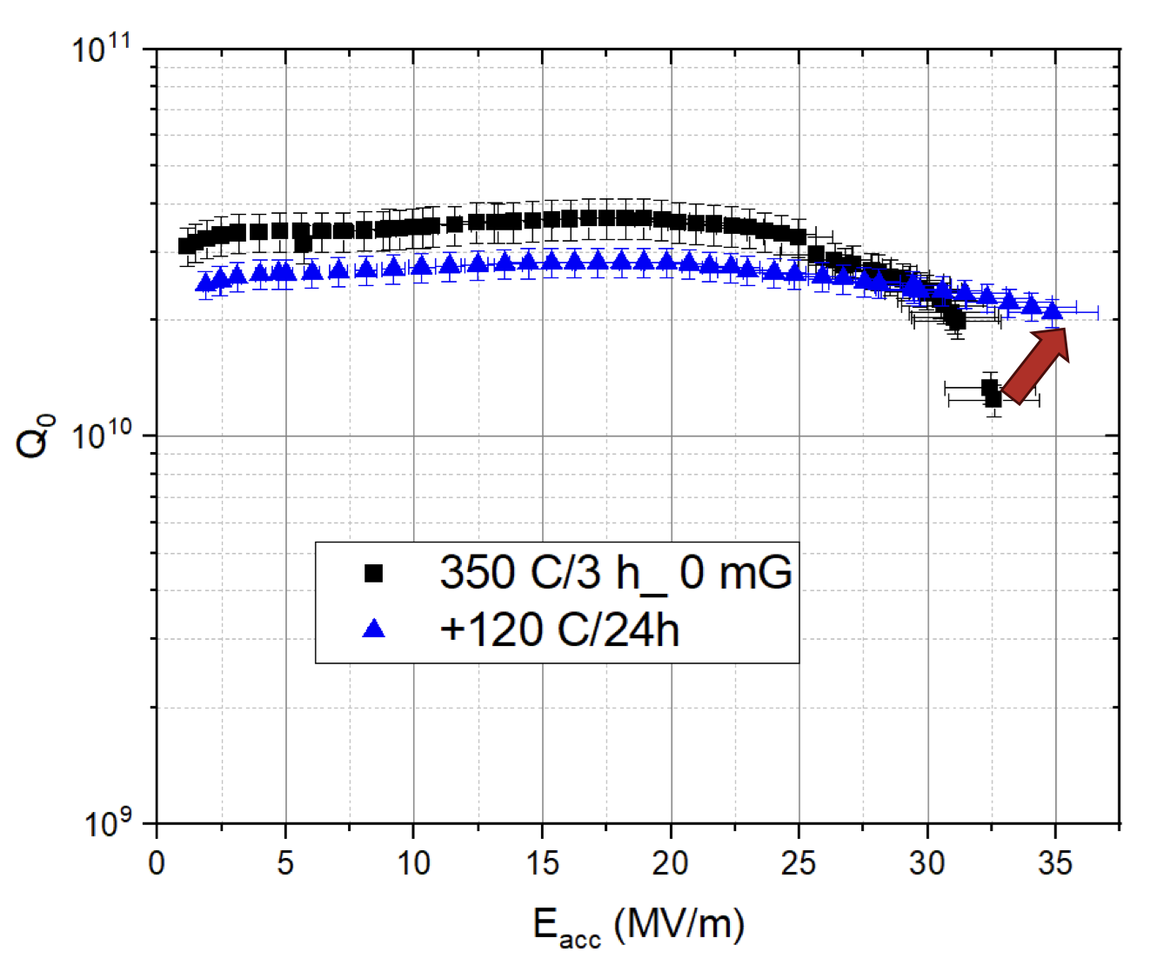
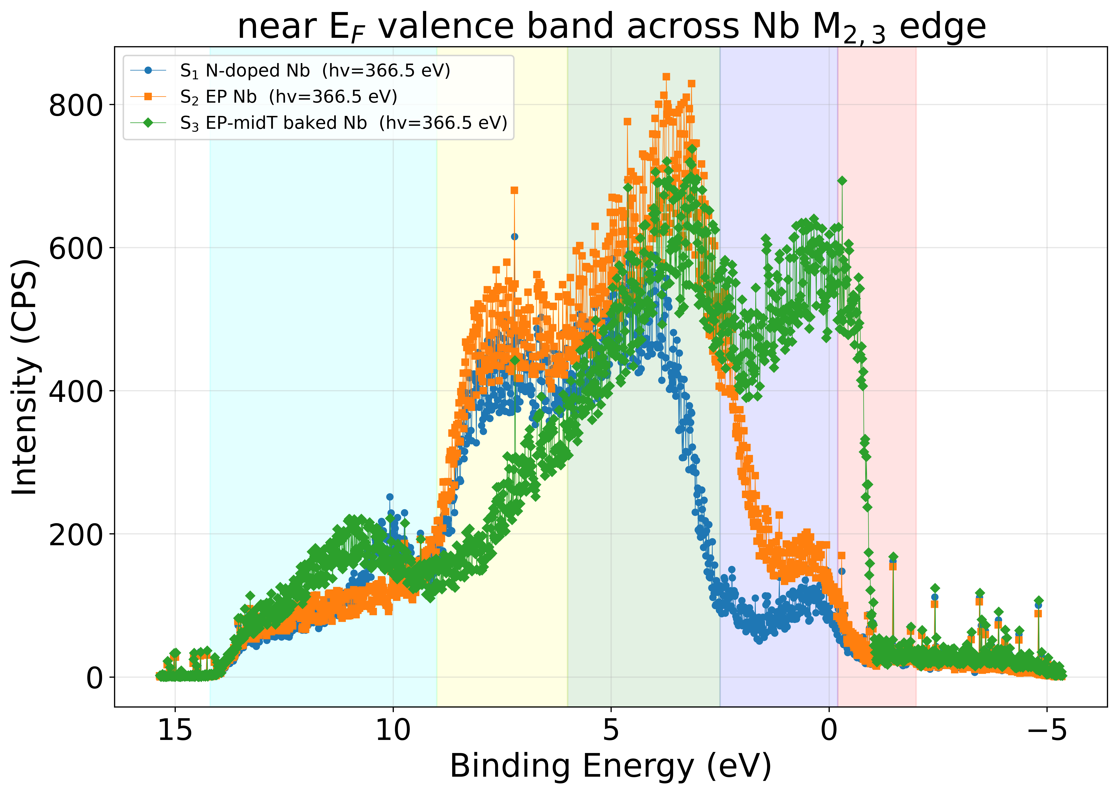
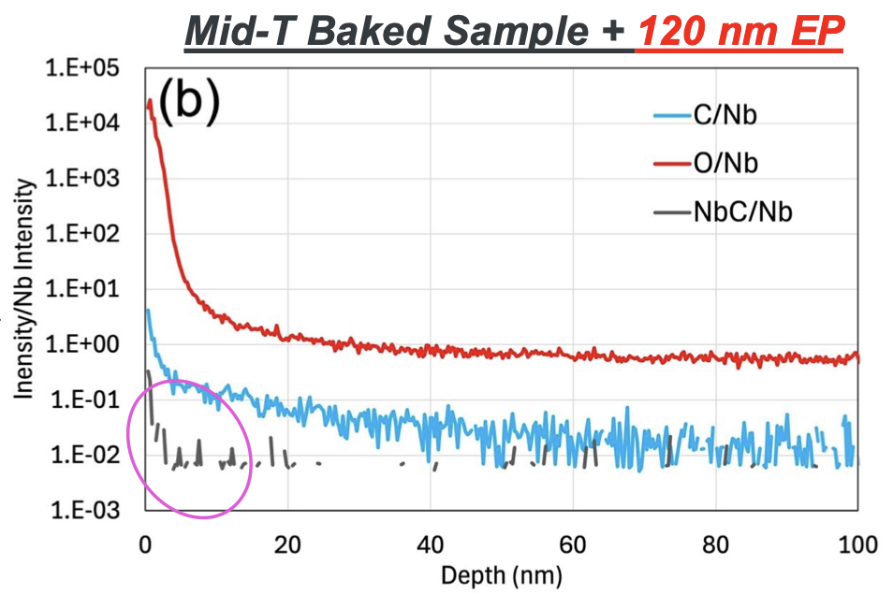
Highlights of the 1st meeting: before/after mid-T
Ashish Kumar
Chahinez Boutelaa
Rezvan Ghanbari
Malvika Tripathi
Pashupati Dhakal
Vijay Chouhan

Slide 6
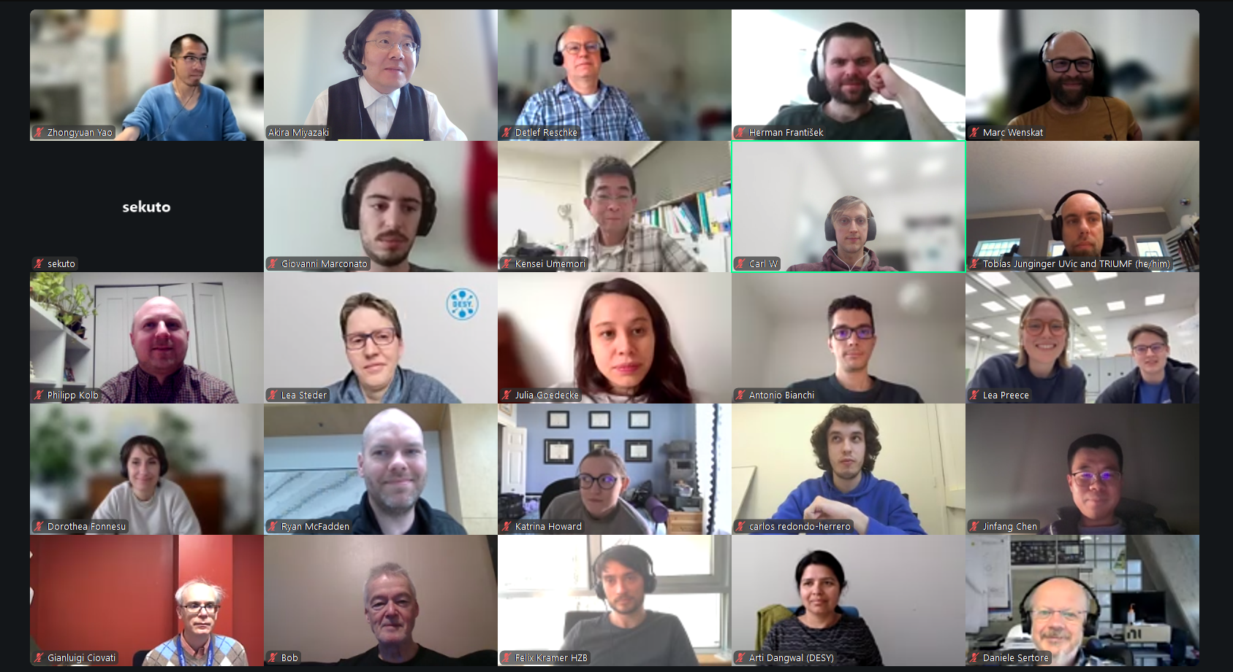
2nd meeting in March 2026: max 41 participants

Slide 7
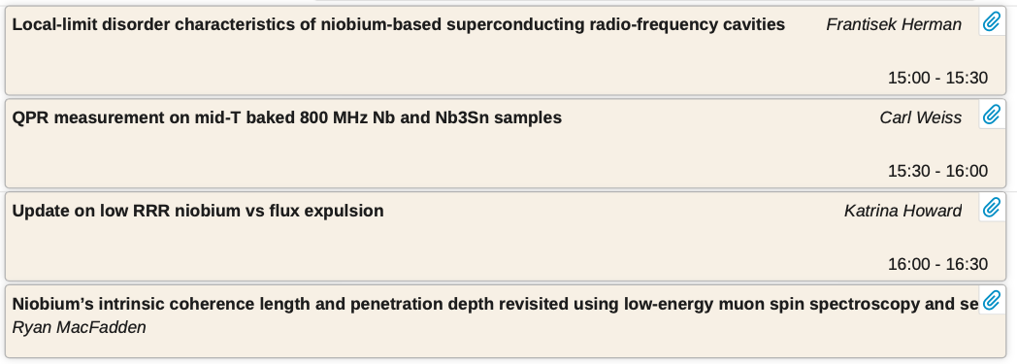
2nd meeting in March 2026: 4 contributions
https://conference-indico.kek.jp/event/368/overview

Slide 8
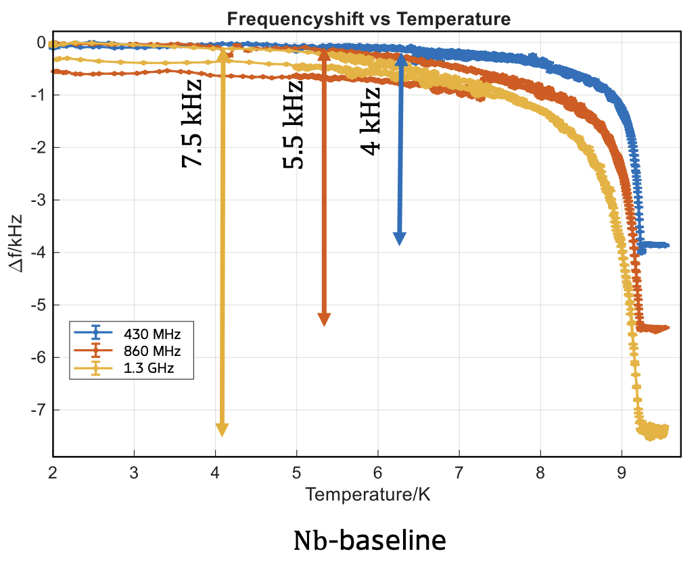
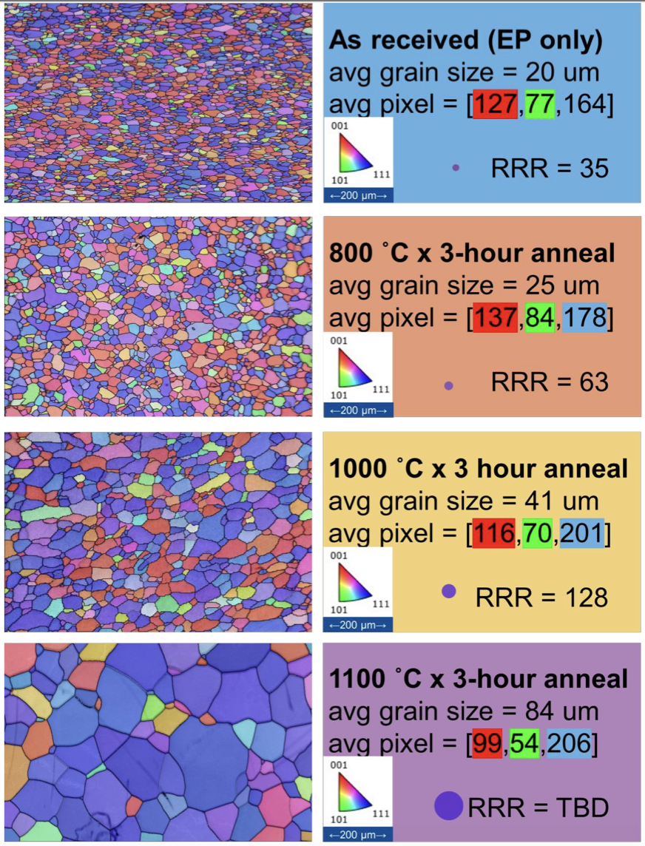
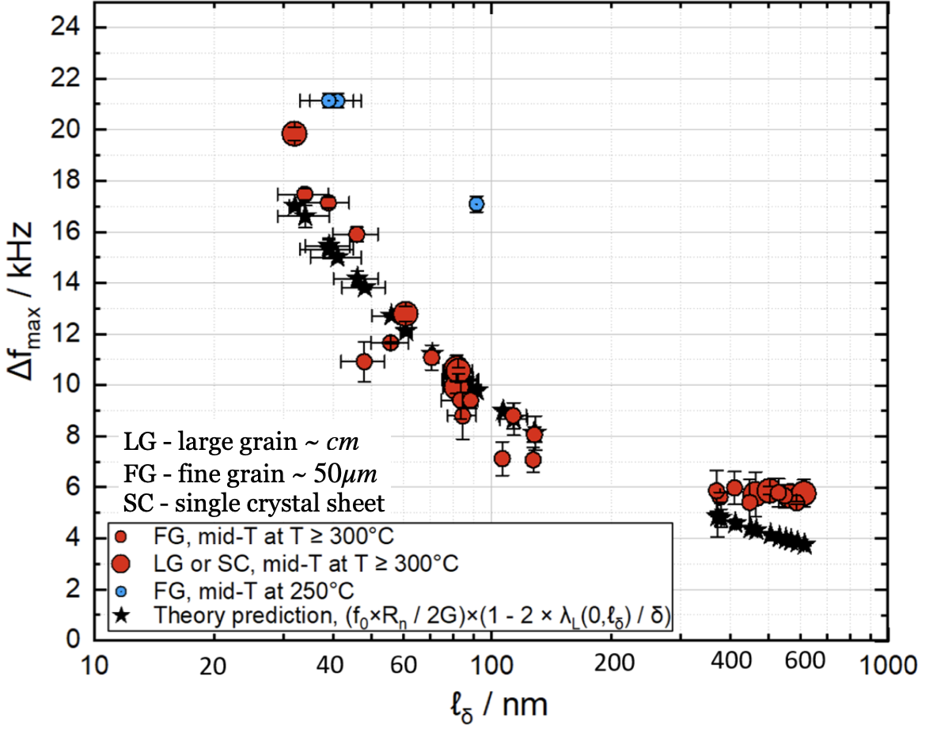
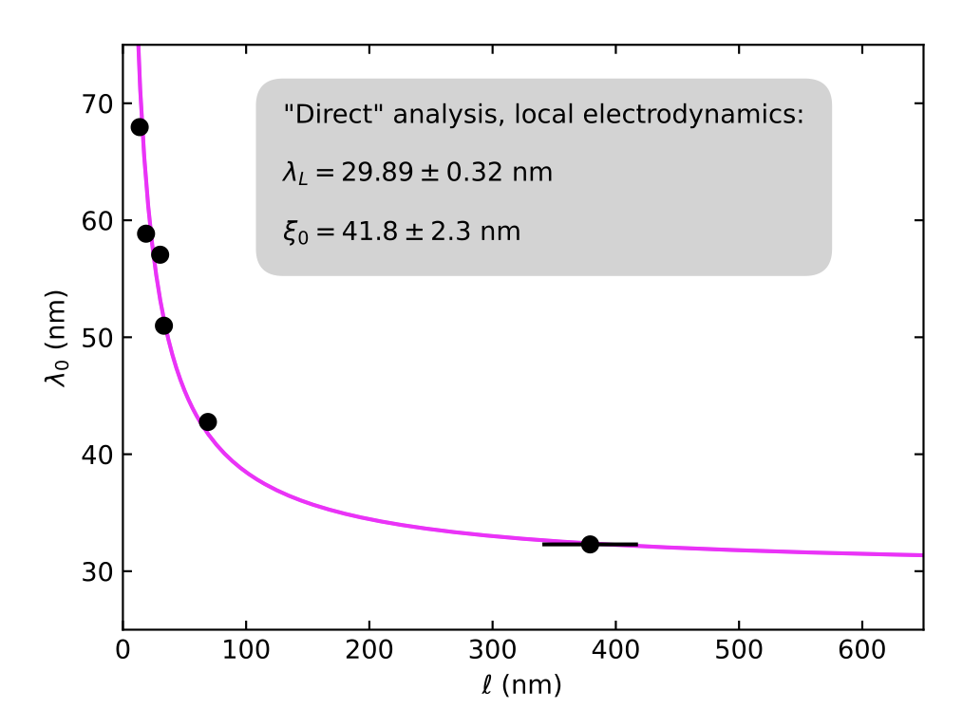
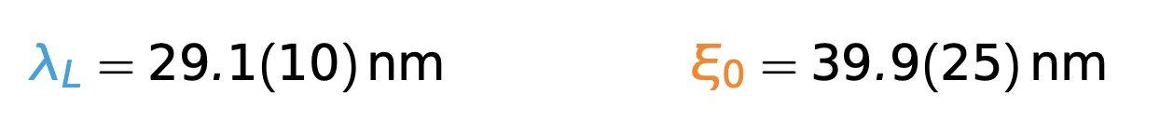
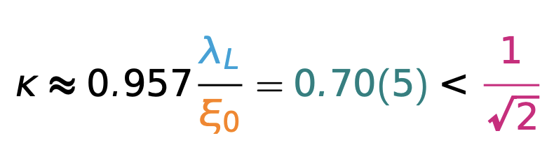
Highlights of the 2nd meeting: theory to material
Katrina Haward
Carl Weiss
Frantisek Herman
(BPS limit…)
Did we observe similar tendency during LCLSII for high RRR samples?
Ryan M. L. MacFadden

Slide 9
Conclusion
Two meetings per year
Around 40 participants / 72 names registered
Complement researchers with VISA / funding issues for in-person meetings
Studies around mid-T seem like a hot topic
  RF measurement, pre-/post-chemistry, material studies, theoretical models
  This could be biased by Akira’s personal interests
Broad subjects are welcome
Next meeting? → Autumn-winter 2026

