Slide 1
Recent results of 2-step baking at KEK
iCASA SRF Group
2026/06/09
Eric Viklund

Slide 2
Discussion Topics
2-step baking satisfies the ITN specification.
Total EP over 200 um is needed to consistently reach the ITN specification.
Is cold EP necessary to achieve the specification?
The effect of HPR on 2-Step Baked Cavities.

Slide 3
Acknowledgements
Collaborators:
  Ryo Katayama
  Mathieu Omet
  Kensei Umemori
  Takafumi Hara
  Sora Arai
Funding:
  This work was supported by the MEXT Development of key element technologies to improve the performance of future accelerators Program Japan Grant Number JPMXP1423812204

Slide 4
ITN Single Cell Cavity Vertical Test Activities
To ensure the ITN cavities fulfill the requirements.
  35 MV/m and Q₀ > 1x10¹⁰
Six cavities treated with proposed treatment plan and tested.
  2 medium grain cavities
    R1MC01 – C02
  4 fine grain cavities
    R1FC01 – C04
One production 9-cell ITN cavity tested.
  I9FC02

Slide 5
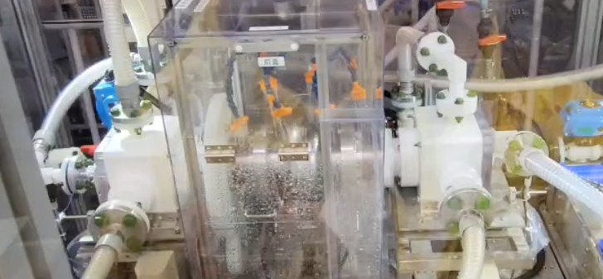
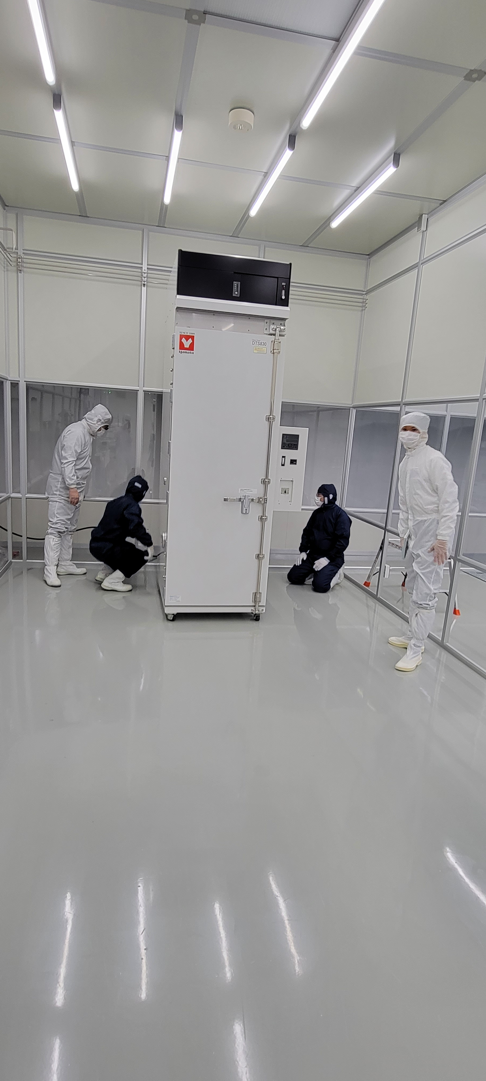
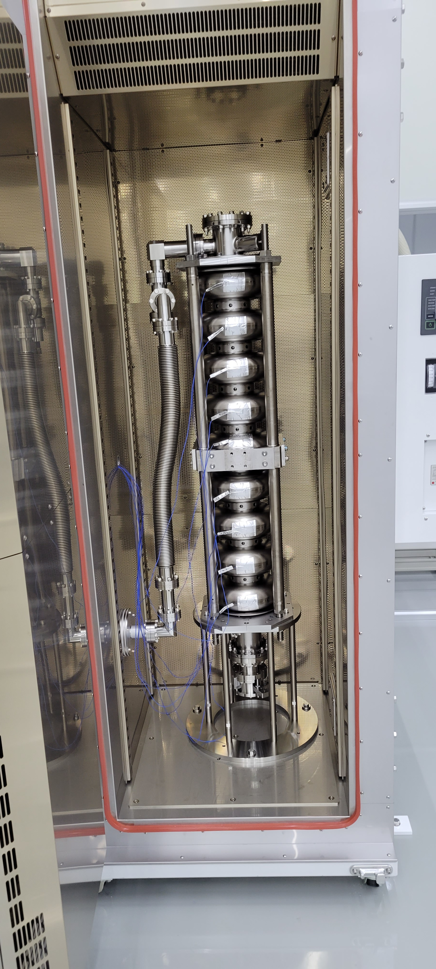
Proposed ITN Cavity Surface Treatment
PreEP + EP1 (5um + 150um)
Annealing (900C, 3h)
EP2
(15-20um cold EP)
HPR
Class 10 Cleanroom Assembly
2-Step Baking
(75C, 4h + 120C, 48h)
VT
Under Vacuum

Slide 6
Discussion Point: 2-step Baking Recipe Satisfies the ITN Specification
4 after 1st EP2
2 after 3rd EP2
Both MG and FG show good performance.
ITN Specification

Slide 7
Discussion Point: Is EP2 Necessary to Achieve ITN Specification?
EP2 was skipped to reduce cost and manufacturing time for ITN cavities.
Quench field was very high.
  39 MV/m
Strong high field Q-slope was observed.
Increased flux sensitivity.
We can still satisfy the ITN specification.
ITN Specification
VT | Flux Sensitivity [Ohm/mT]
R1FC03 | 3.26E-10
R1FC04 | 5.16E-10
R1MC01 | 2.35E-10
R1MC02 | 2.35E-10
R1FC01 | 3.76E-10
R1FC02 | 3.25E-10

Slide 8
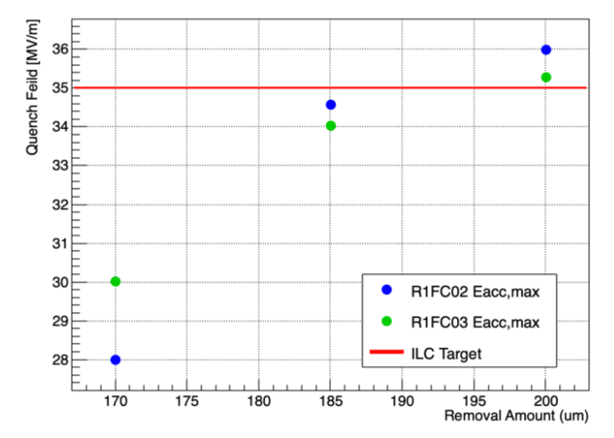
Discussion Point: At Least 200 um EP Removal After Annealing is Necessary
EP2 and 2-Step Baking was reapplied to cavities that could not reach the target.
Only after 200 µm removal, cavities could achieve specification consistently.
Modified EP process
  40 µm EP removal + 10 µm cold EP after annealing.
EP2
(15um cold EP)
EP2
(40um + 10um cold EP)
Credit: Ryo Katayama

Slide 9
Effect of HPR on 2-step Baked Cavity Q
We had to apply extra HPR step after 2-step baking due to field emission.
Q₀ > 2x10¹⁰ at 35 MV/m was achieved.
This result was reproduced on the same cavity.
  EP2 → HPR → 2-Step Baking → VT → HPR → VT
Flux trapping is well controlled for single cell cavities.
Q Increase
Q Increase

Slide 10
Effect of HPR on 2-Step Baked Cavity Resistance
The R_{BCS} of the cavity was unchanged by HPR.
R_{res} was decreased by 1.5 nOhm.
No significant change in flux sensitivity.
VT # | Flux Sensitivity [Ohm/mT]
1 | 3.67E-10
6 | 4.43E-10
8 | 3.25E-10
10 | 3.50E-10
12 | 3.73E-10

Slide 11
Q value is maintained at high field.
Compared to other cavities R1FC02 has higher Q₀, especially at low and high gradients.
Normal 2-step baked cavities cannot reach Q₀ > 2x10¹⁰ at 35 MV/m.
Different curve shape implies Q₀ increase is not due to trapped flux.

Slide 12
Effect of HPR on 2-Step Baked Cavity Resistance
R1FC02 has lower R_{res} than other cavities, but R_{BCS} is comparable.
VT | Flux Sensitivity [Ohm/mT]
R1FC03 VT 4 | 3.26E-10
R1FC04 VT 1 | 5.16E-10
R1MC01 VT 1 | 2.35E-10
R1MC02 VT 1 | 2.35E-10
R1FC01 VT 1 | 3.76E-10
R1FC02 VT 8 | 3.25E-10
R1FC02 VT 12 | 3.73E-10

Slide 13
9-cell ITN Cavity Preparation and Testing
750C annealing was used instead of 900C.
Cavity received HPR after 1st VT due to field emission.
The Q₀ once again increased after HPR is applied.
Flux expulsion is not clear compared to 1-cell cavity.
Temperature control is not perfect at high field.

Slide 14
Discussion Point: What is the Possible Cause of Q₀ Increase?
Normally 2-step baked cavities are kept under vacuum after baking.
The cavity is vented and exposed to air (oxygen and water) for approximately 1-2 weeks to apply HPR and reassemble.
High pressure water is also shown to cause oxidation of Niobium.
Temperature is too low for significant diffusion to occur. Q₀ increase must be caused by a change in the oxide layer or oxide-metal interface.

Slide 15
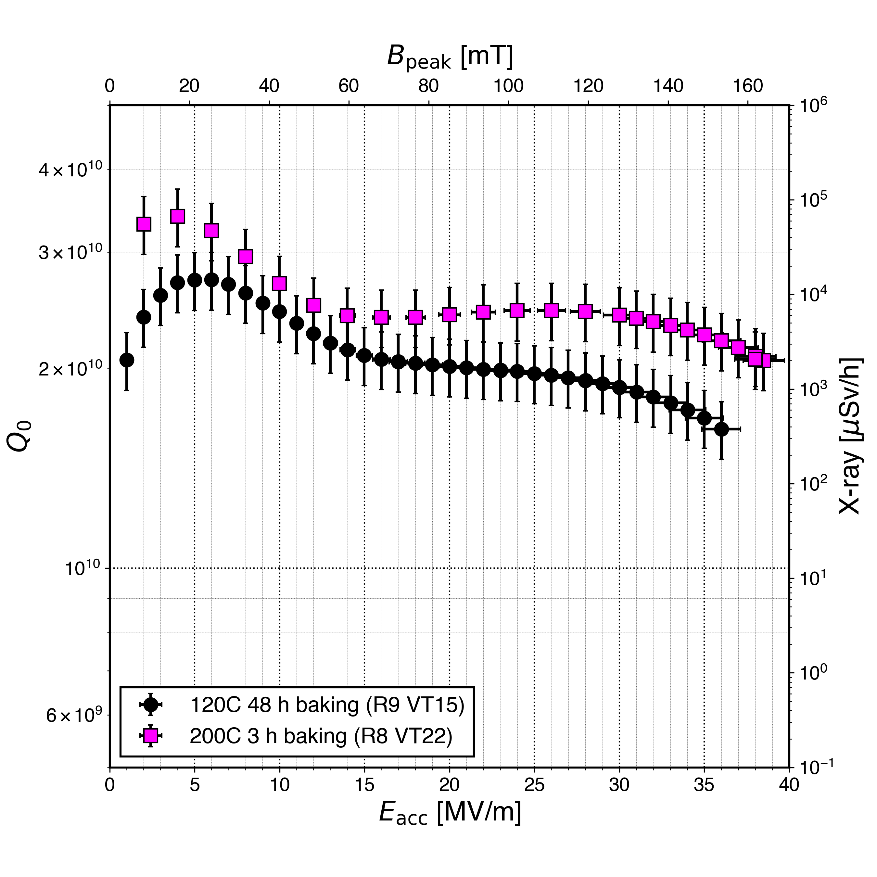
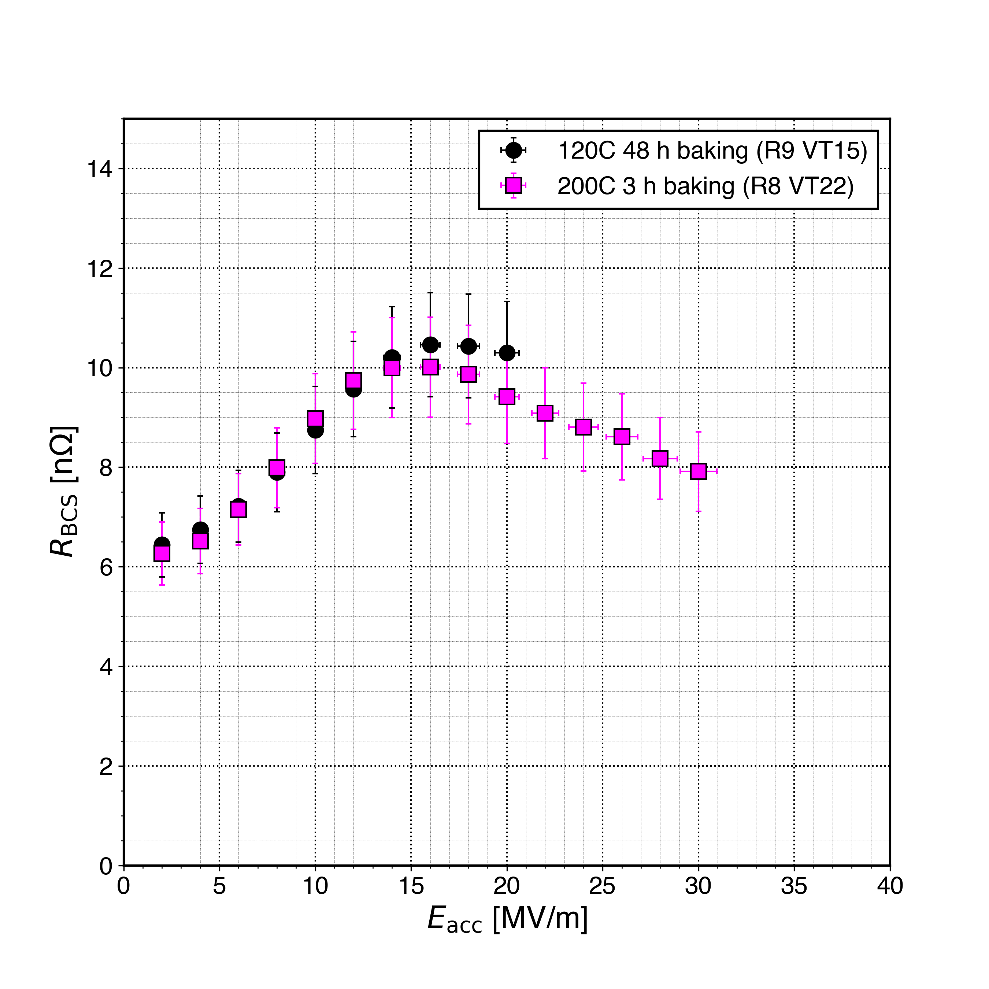
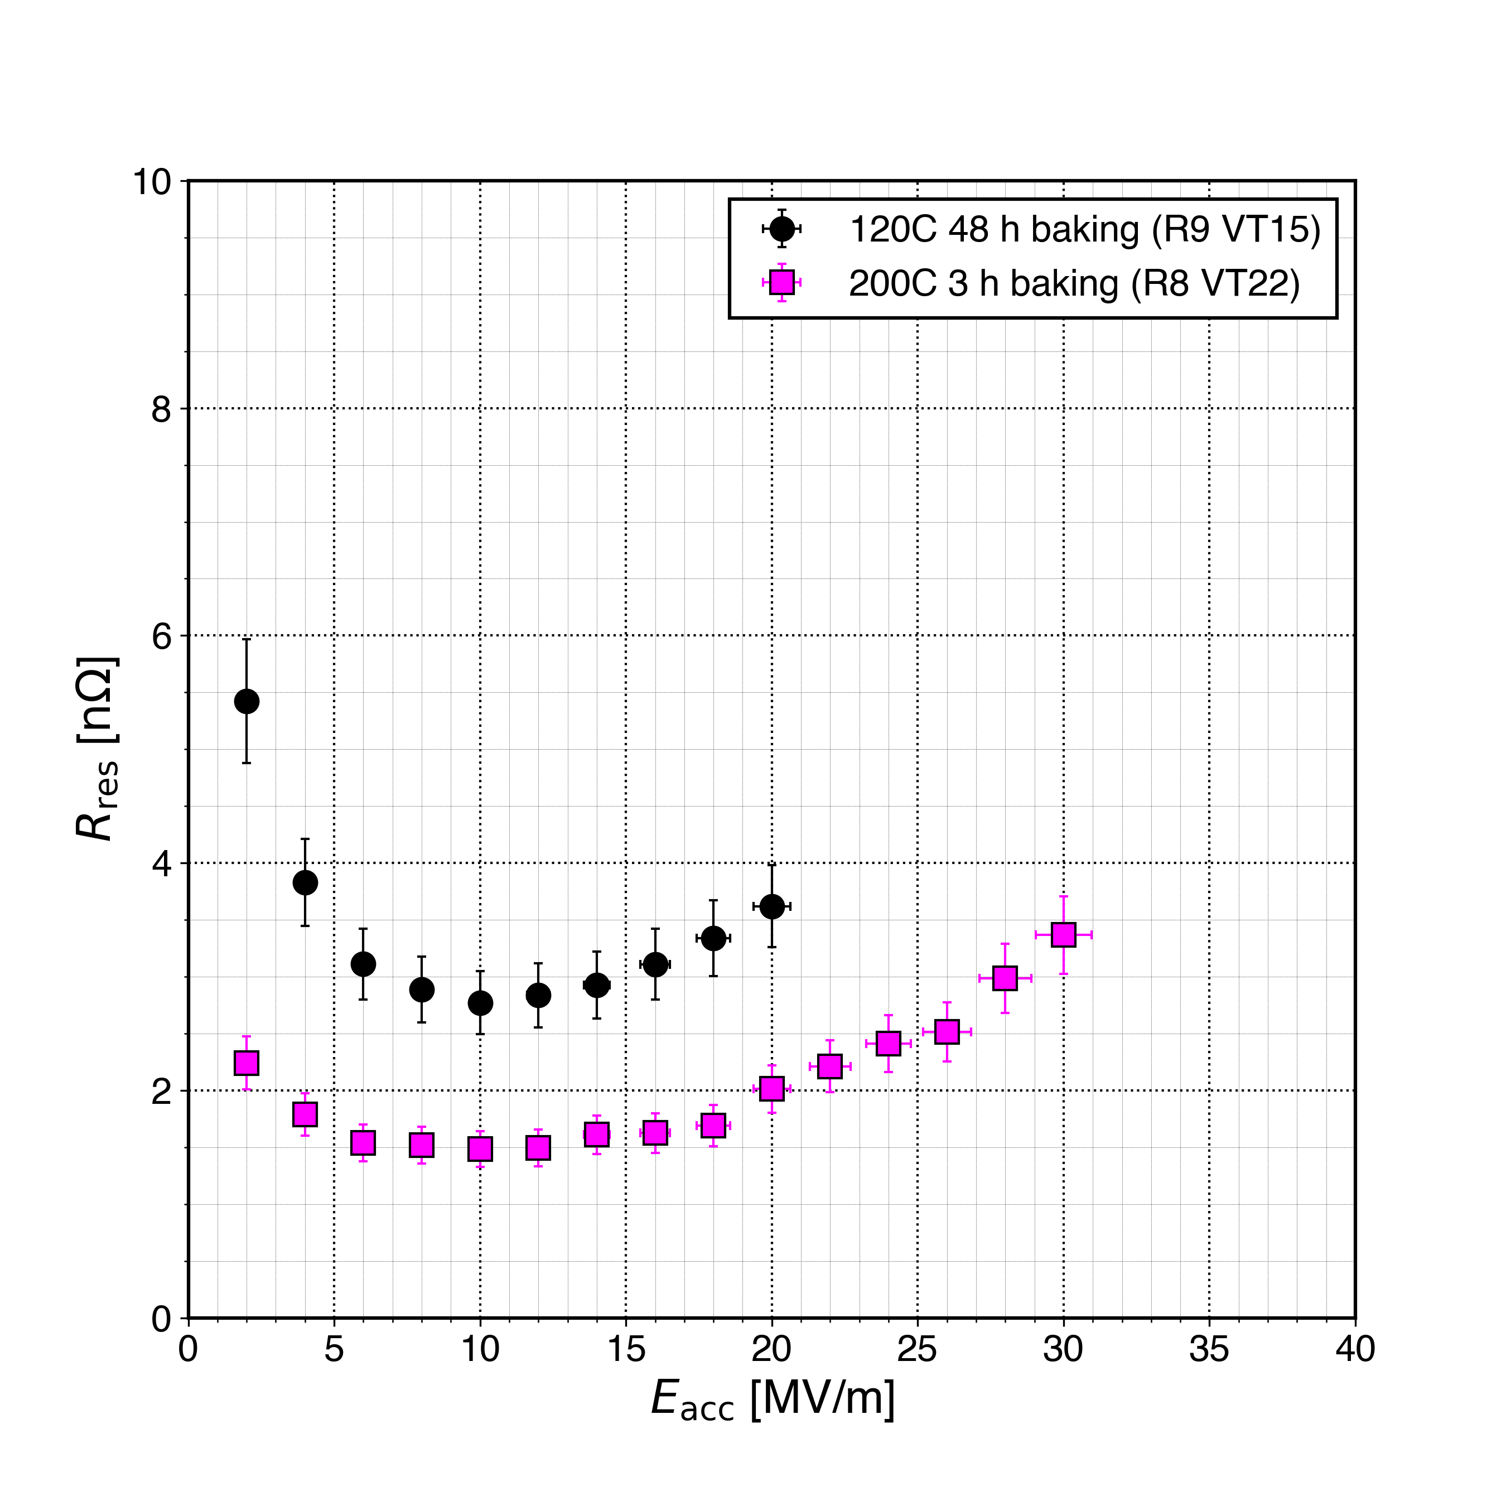
200°C Furnace Baking
Similar Q₀ curve and quench field.
R_{BCS} is similar.
R_{res} decreased by 1-2 nOhm.
H. Ito, H. Araki, and K. Umemori, “Surface Resistance and Trapped Flux Sensitivity as Function of Baking Temperature”, presented at the 21th Int. Conf. RF Supercond. (SRF'23), Grand Rapids, MI, USA, Jun. 2023, paper TUIXA03, unpublished.

Slide 16
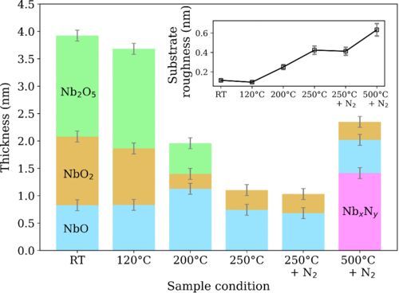
Low-Incidence X-ray Diffraction of Baked Niobium
120°C baking has little effect on oxide.
200°C baking dissolves Nb₂O₅ and NbO₂ while growing NbO.
NbO is a weak superconductor while NbO₂ is a semiconductor.
Can HPR produce a similar effect?
G. D. L. Semione et al., “Niobium near-surface composition during nitrogen infusion relevant for superconducting radio-frequency cavities,” Phys. Rev. Accel. Beams, vol. 22, no. 10, p. 103102, Oct. 2019, doi: 10.1103/PhysRevAccelBeams.22.103102.

Slide 17
Summary
We have successfully demonstrated that 2-step baked cavities can reach the ITN specification.
Cavity was shown to reach ITN specification even when EP2 is skipped.
Additional EP was required for some cavities to achieve the specification.
  Greater than 200 µm removal after annealing is necessary.
By applying HPR after 2-step baking Q₀ > 2x10¹⁰ at 35 MV/m was achieved.
  Performance is similar to 200C baked cavities.
Thank you very much for
your attention! Questions?

Slide 18
Vacuum Failures During Preparation and Testing
2-step baking furnace turbomolecular pump failure
  unknown error
  generated a large amount of particles.
Field emission was observed during VT.
VT pumping system also had a leak.
We will update our procedure if there is a risk of contamination
  abort the preparation
  re-apply HPR and reassemble to prevent damage to the cavity and save time.

Slide 19
Updated ITN Cavity Surface Treatment
PreEP + EP1 (5um + 150um)
Annealing (900C, 3h)
EP2
(15um cold EP)
HPR
Class 10 Cleanroom Assembly
2-Step Baking
(75C, 4h + 120C, 48h)
PreEP + EP1 (5um + 150um)
Annealing (750C, 3h)
EP2
(40um + 10um cold EP)
Pre-tuning
HPR
Class 10 Cleanroom Assembly
2-Step Baking
(75C, 4h + 120C, 48h)
VT
HPR
Class 10 Cleanroom Assembly
Cavity Contaminated

Slide 20
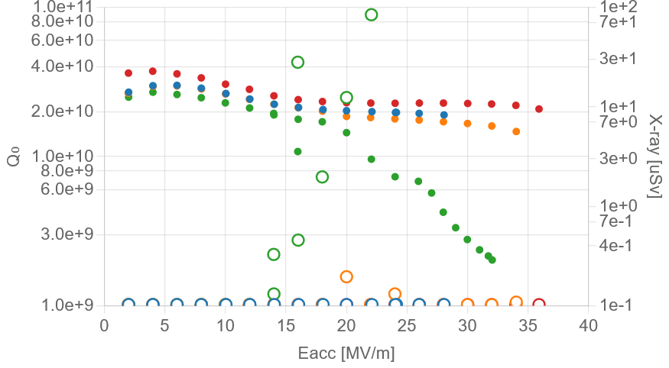
High Q Observed After Additional HPR
R1FC02 contaminated due to vacuum pump error.
HPR applied after 2-step baking instead of before.
Unusually high Q.
VT 8
VT 1 & 3
VT 6

