Slide 1


Recent progress of SHINE
high-Q cavities
Yue ZONG
on behalf of the Surface Treatment Team
Shanghai Advanced Research Institute, CAS
9 Jun., TTC’2026, Ecole Centrale Supelec, Gif-sur-Yvette, France

Slide 2
Contents
Introduction
Performance of SHINE high-Q cavities
Status of cavities surface treatment at Wuxi platform
Repair of unqualified cavities
Summary

Slide 3
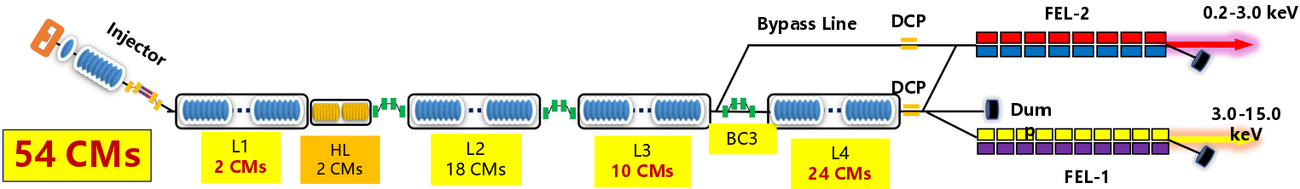
Introduction
SHINE, launched in 2017, groundbreaking in 2018, aiming at the first lasing in 2026.
Accelerator: an 8 GeV SRF Linac, 2 undulator lines, generating photons from 0.2-15 keV
Cryomodules (CMs) requirements
  1 i1CM with one twin-FPC cavity, 1 i8CM with eight 1.3 GHz cavities
  54 CMs with eight 1.3 GHz cavities with high-Q
  2 CMs with eight 3.9 GHz cavities

Slide 4
Introduction
2026 Production Targets: Aiming to complete the delivery of all cryomodules.
Assembly ramp-up to 3 CMs/month requires a steady supply of 24 qualified cavities monthly, posing a significant challenge for surface treatment infrastructure.
 | 1.3GHz high-Q cavity | 1.3 GHz high-Q CM
Amount | > 432 | 54（+4 spare）
Q₀ | ≥ 3.0×10¹⁰ @ 20MV/m | ≥ 3.0×10¹⁰ @ 20MV/m
Max E_{acc} | ≥ 22 MV/m | 26 MV/m (admin. limit)
FE onset | ≥ 22 MV/m
Total voltage |  | ≥ 166 MV

Slide 5
Contents
Introduction
Performance of SHINE high-Q cavities
Status of cavities surface treatment at Wuxi platform
Repair of unqualified cavities
Summary

Slide 6
Surface treatment of 1.3 GHz cavities
Domestic Production Line: Mid-T baking
  150 bare cavities have been tested.
  250 dressed cavities have been processed and tested.
  Note: Since April 2025, over 100 bare cavities progressed directly to helium vessel welding without prior VT to drastically accelerate throughput.
International Vendor Line: Nitrogen doping
  138 dressed cavities have been processed and tested.
Mid-T baking recipe
Nitrogen doping recipe
Arrival of bare cavity
Arrival of bare cavity
Arrival of bare cavity
Bulk EP 180 μm
Bulk EP 140 μm
Bulk EP 140 μm
EP (cold) 20 μm
(with fresh acid)
900℃/3h
900℃/3h
900 ℃/3h
Bulk EP 50 μm (cold EP)
Bulk EP 50 μm (cold EP)
Exposed to air (48 h)
Holding 30 min at 800℃ 3/60 N-doping
Holding 30 min at 800℃ 3/60 N-doping
300 ℃/3h
Final EP 10 μm (cold EP)
Final EP 10 μm (cold EP)
HPR+Assembly
HPR+Assembly
HPR+Assembly
VT
VT
VT

Slide 7
Surface treatment of 1.3 GHz cavities
In total, 5 cavity manufacturers: three domestic and two international companies.
Cavities contracted: 530 in three batches, around 3/4 domestic and 1/4 international.
388 dressed cavities have been vertical tested.
 | Domestic |  |  | International
Nb materials | NX/TD | NX/TD | NX/TD | NX | NX
1.3 GHz cavity Manufacturing | HERT (8+72+64) | OSTEC (8+40+40) | Shanghai Electric (2+64+96) | RI (8+60) | ZANON (8+60)
High-Q recipes | Mid-T baking(300℃/3h) |  |  | N-doping(modified 3/60)
Surface treatment | SHINE facilities at Wuxi Creative |  |  | RI | ZANON
VT | SHINE

Slide 8
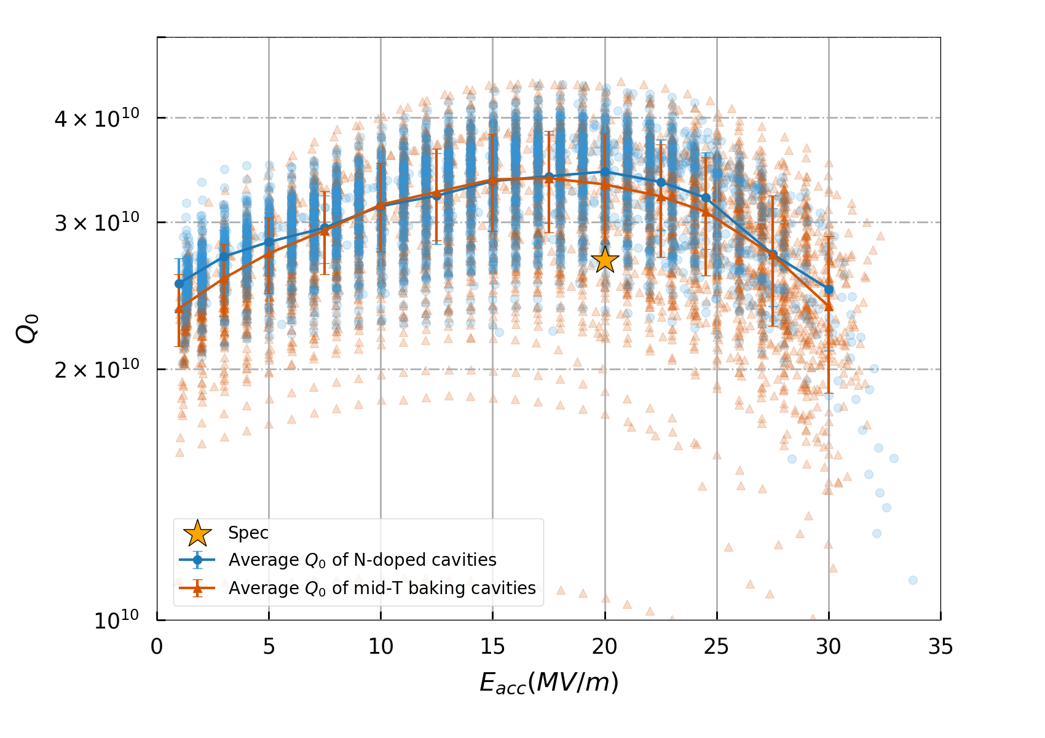
Performance of SHINE high-Q cavities
308 dressed cavities qualified (79%)
  242 qualified on the first pass (as-received)
    Over 60 cavities repaired successfully during bare cavities processing (Light BCP, Hand grinding, CBP)
  48 qualified after HPR (with FE)
  7 qualified after change thicker sealing ring (Q-switch)
  11 qualified after repair (CBP, re-treatment, Light BCP)
    5 N-doped cavities repaired successfully after CBP and re-mid-T baking treatment
57 cavities concessionally accepted for CMs (15%)
  E_{acc} ≥ 18 MV/m, or Q₀ ≥ 2.5E+10@20MV/m
23 cavities still unqualified (6%)
  1 with FE, awaiting further HPR
  22 with too low E_{acc} or Q₀, under repair
Flange losses not deducted
22 MV/m
Recipes | Ave. max E_{acc}（MV/m) | Ave. Q₀
Mid-T | 27.9 | 3.3E+10
N-doping | 25.2 | 3.4E+10

Slide 9
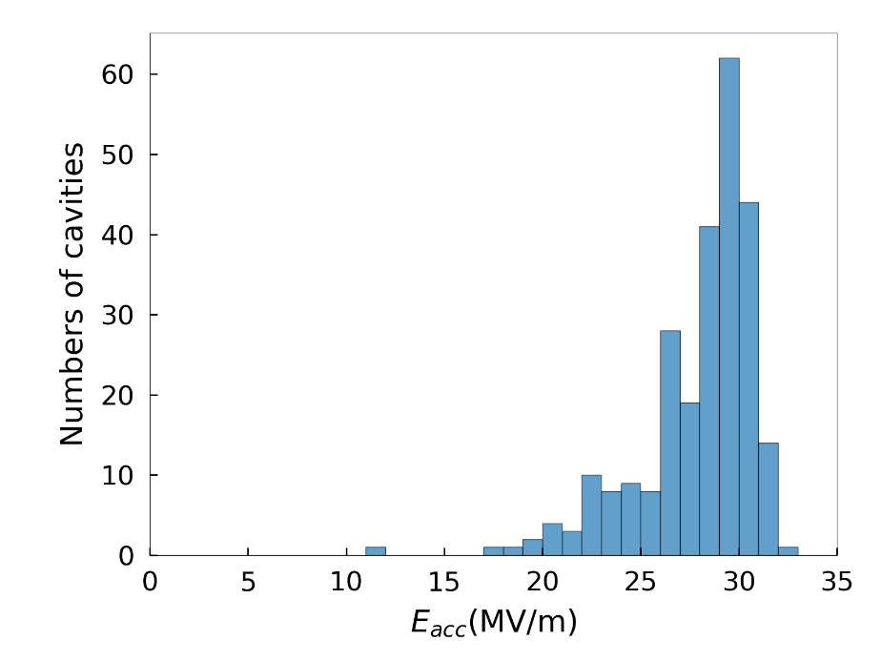
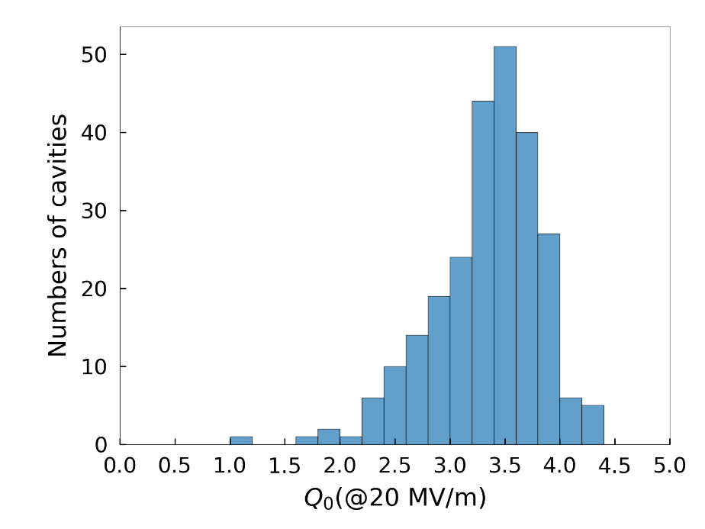
Performance of mid-T baked cavities
250 dressed cavities have been processed by mid-T baking recipe and tested at SHINE.
203 cavities qualified (81%)
  155 qualified on the first pass
  36 qualified after HPR (with FE)
  7 qualified after change thicker sealing ring (Q-switch)
  5 qualified after repair (CBP, re-treatment, Light BCP)
33 cavities concessionally accepted for CMs (13%)
  E_{acc} ≥ 18 MV/m, or Q₀ ≥ 2.5E+10@20MV/m
14 cavities still unqualified (6%)
  1 with FE, awaiting further HPR
  13 with too low E_{acc} or Q₀, under repair
Mid-T
<max E_{acc}>
27.9±2.9 MV/m
Mid-T
< Q₀ >
3.3±0.5×10¹⁰
（including 0.8 nΩ flange losses）

Slide 10
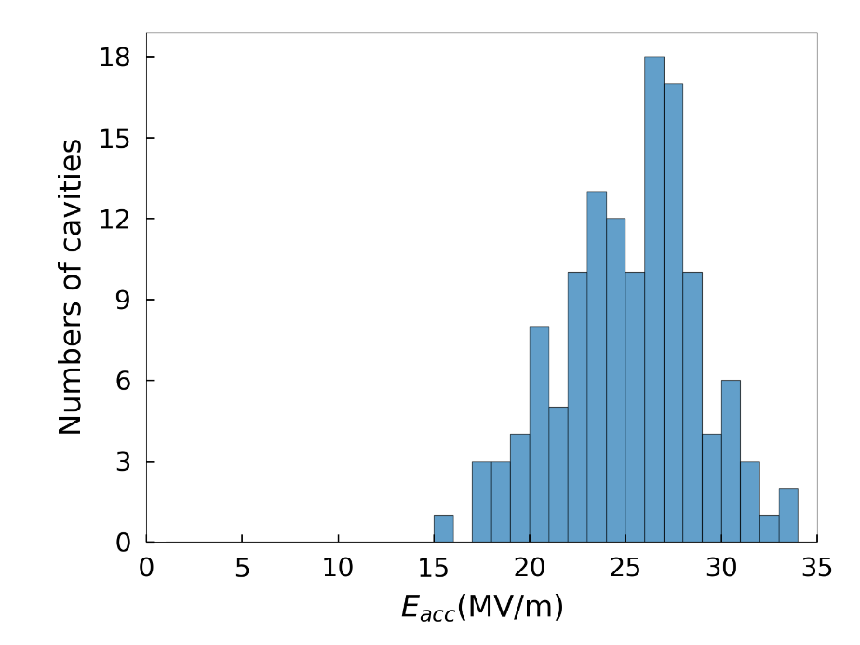
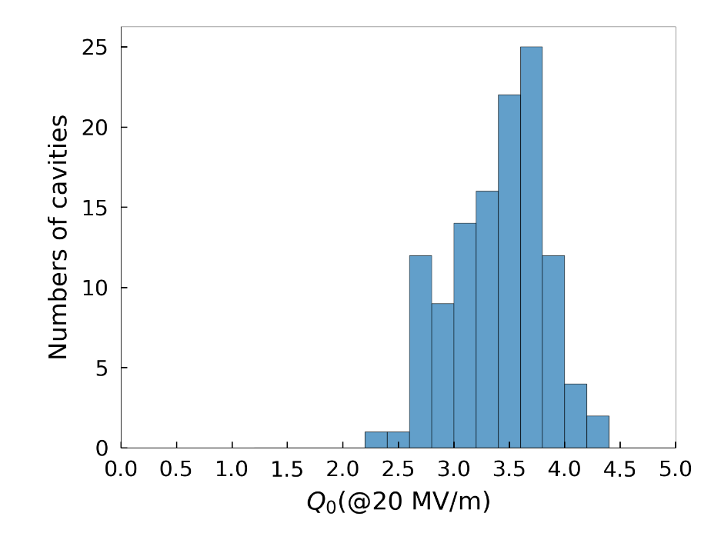
Performance of N-doped cavities
138 dressed cavities have been treated by international manufacturers and tested at SHINE.
105 cavities qualified (76%)
  87 qualified on the first pass
  12 recovered and qualified after additional HPR
  6 qualified after repair
    1 repaired by light BCP
    5 repaired by CBP+mid-T baking
24 cavities concessionally accepted for CMs (17%)
  E_{acc} ≥ 18 MV/m, or Q₀ ≥ 2.5E+10@20MV/m
9 cavities still unqualified (7%)
  All with too low E_{acc} or Q₀, under repair
N-doping
<max E_{acc}>
25.2±3.5 MV/m
N-doping
< Q₀ >
3.4±0.4×10¹⁰
（including 0.8 nΩ flange losses）

Slide 11
Contents
Introduction
Performance of SHINE high-Q cavities
Status of cavities surface treatment at Wuxi platform
Repair of unqualified cavities
Summary

Slide 12
Status of cavities surface treatment
Capacity Upgrade at Wuxi Platform: Aiming for a peak capacity of 30 cavities/month to ensure the delivery of 24 qualified cavities monthly.
Bottleneck Identification: Addressing key throughput constraints in optical inspection, EP and the pre-tuning efficiency.
Workflow Acceleration: Shortening the overall cycle from bare cavities to dressed cavities to enhance processing efficiency.
Yield Optimization: Suppressing Field Emission (FE) rates and implementing timely defect remediation to maximize the first-pass success rate of cavity production.

Slide 13
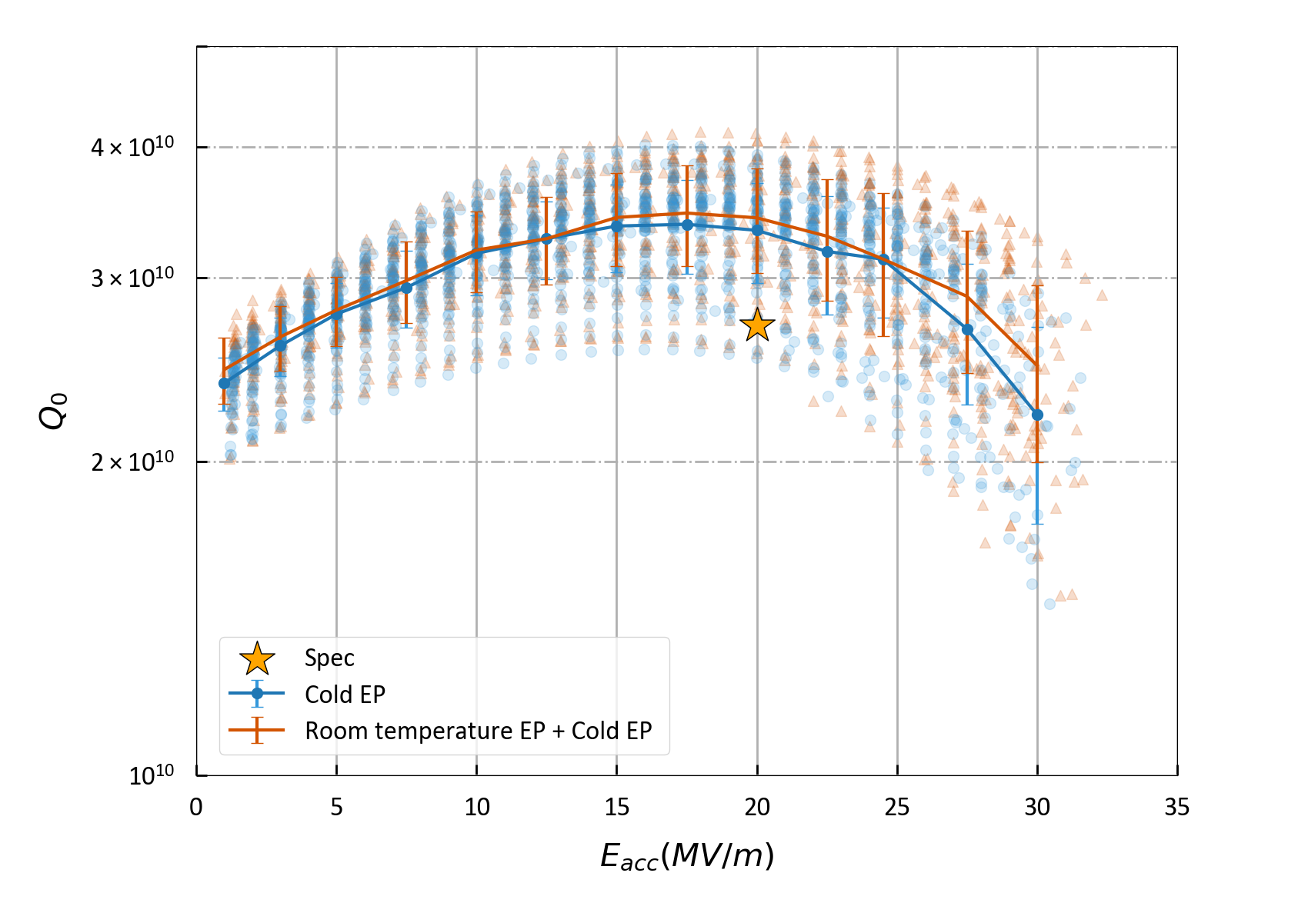
Status of cavities surface treatment
Process Transition (Since Mid-2025): Transitioned from the Full Cold EP process to the Room temperature EP + Cold EP hybrid process.
  Cold EP Cavities: Average Q₀ = 3.3×10¹⁰ @20MV/m, Average Max E_{acc} = 28.0MV/m
  Room temperature EP + Cold EP Cavities: Average Q₀ = 3.4×10¹⁰ @20MV/m, Average Max E_{acc} = 28.8MV/m
  The overall average may be impacted by batch effects.
Based on VT results before and after the process change, and accounting for batch-to-batch variations, both processing techniques yield comparable RF performance.

Slide 14
Status of cavities surface treatment
Since the beginning of 2025, upon confirming that there are no significant inner surface defects after EP, the cavity will be directly shipped to the manufacturer for helium vessel welding, significantly shortening the production cycle.
Mid-T
process
HPR+
Clean assembly
VT of bare cavities
FF check
& Tuning
He-vessel
welding
HPR+
Clean assembly
VT of dressed cavities
Mid-T
process
NO defects
Tuning
He-vessel
welding
HPR+
Clean assembly
VT of dressed cavities

Slide 15
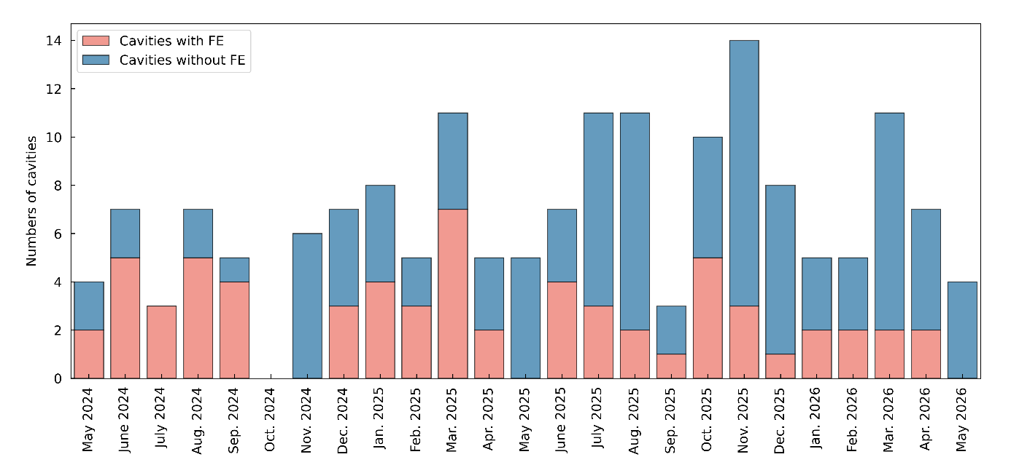
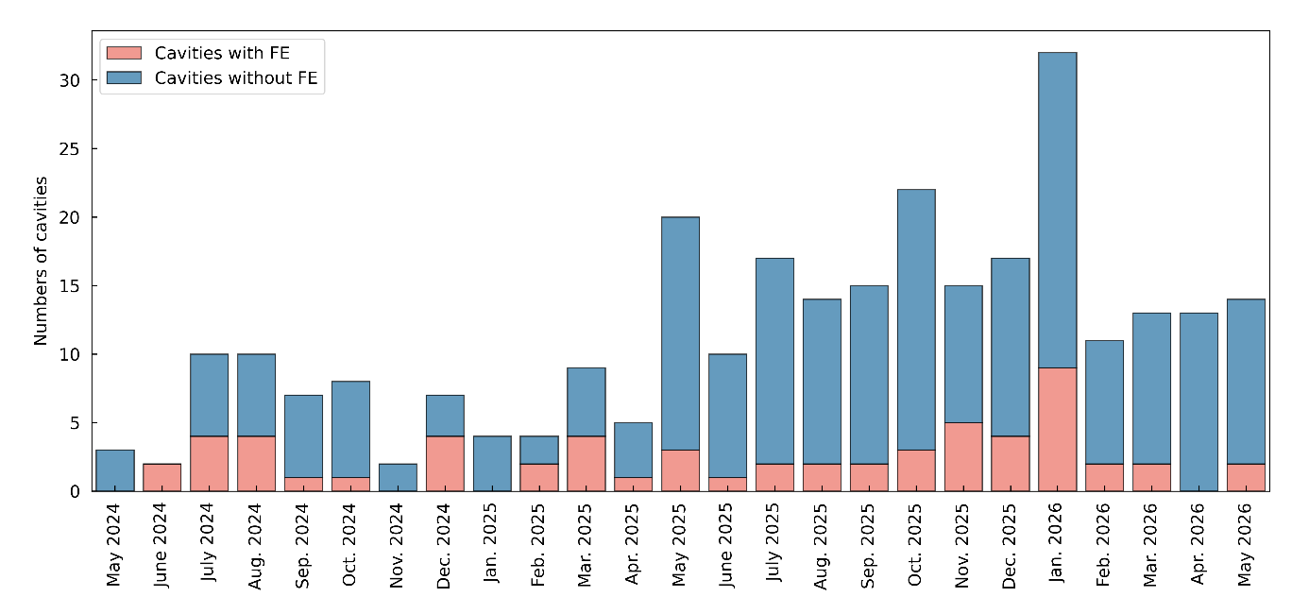
Repair of cavities
Field Emission (FE) Suppression: FE degradation rates have been significantly reduced through rigorous cleanroom discipline and control of UPW quality.
Monthly FE Rate Tracking of Wuxi Cleanroom
Monthly FE Rate Tracking of Shanghai Cleanroom

Slide 16
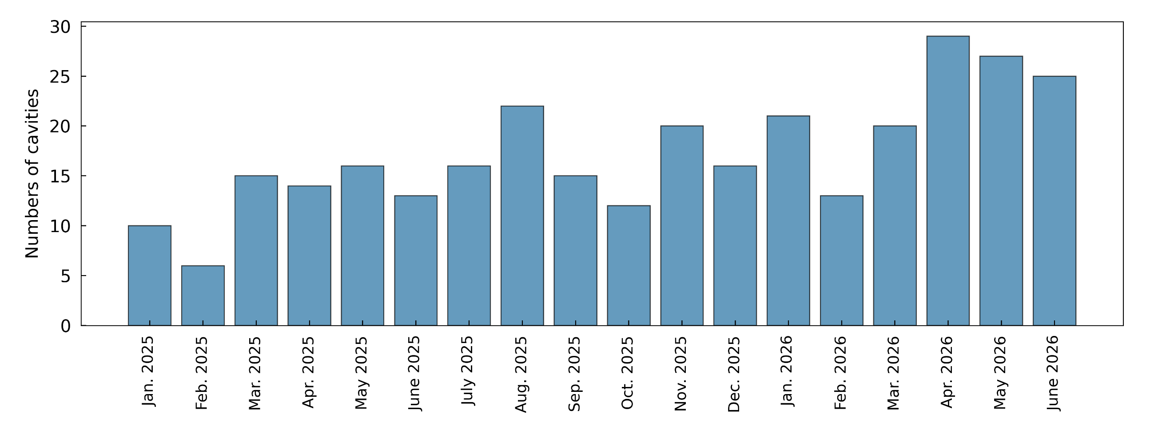
Status of cavities surface treatment
Throughput Enhancement: Over the past year, the processing and production capacity of the Wuxi platform has been effectively enhanced.
Achieved a peak capacity of 29 cavities/month in Q2 2026.
Note: Actual monthly throughput depends on new cavity delivery schedules. This peak demonstrates the platform's established capability to handle up to 30 cavities/month.
Monthly Surface Treatment Throughput of SRF Cavities

Slide 17
Contents
Introduction
Performance of SHINE high-Q cavities
Status of cavities surface treatment at Wuxi platform
Repair of unqualified cavities
Summary

Slide 18
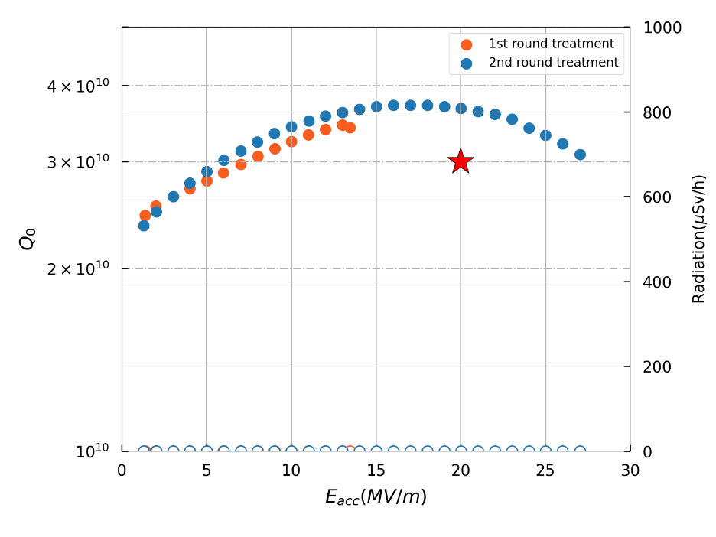
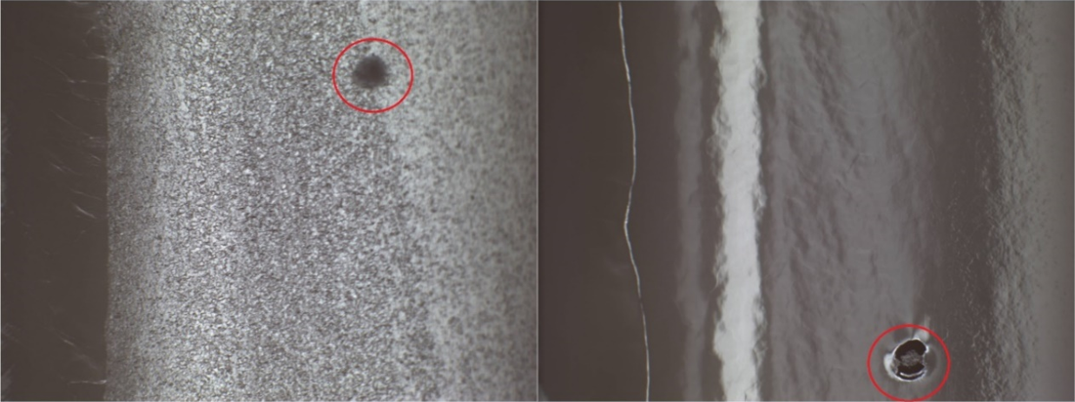
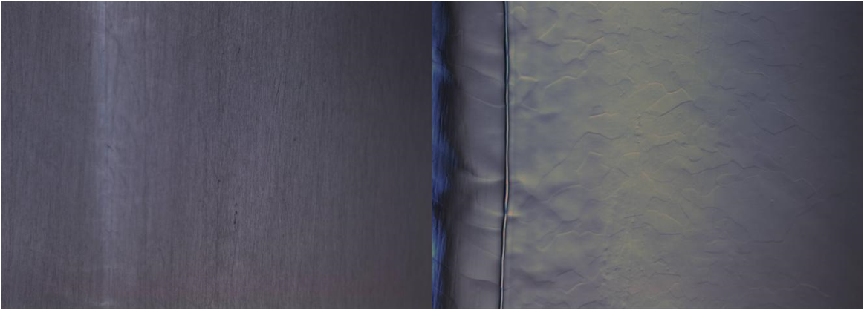
Repair of cavities
Defects Mitigation: Localized surface defects act as primary performance-limiting factors for SRF cavities.
Successful removal of these anomalies fully restores the cavity's high-Q and high-gradient capabilities.
1st round treatment
Before treatment
After EP
2nd round treatment
After mechanical grinding
After EP

Slide 19
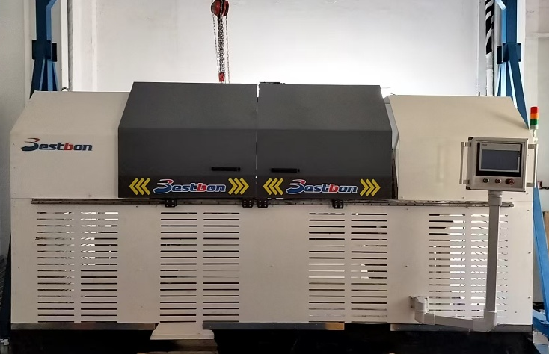
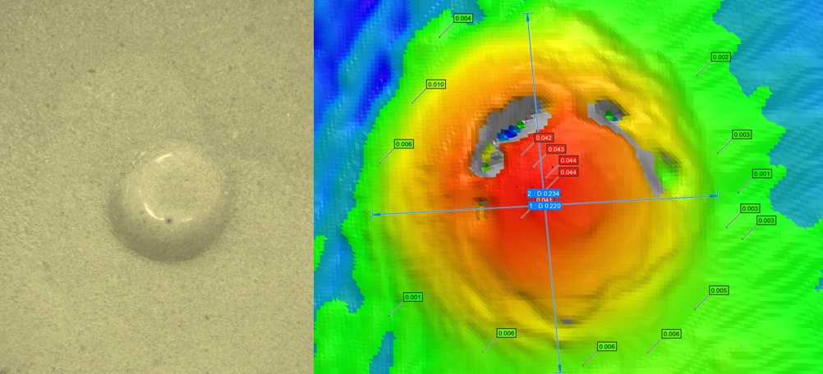
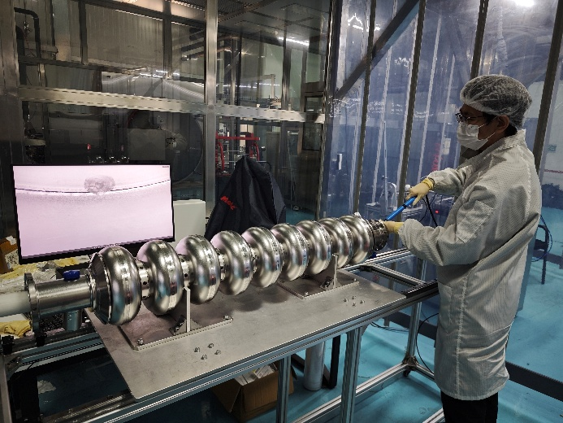
Repair of cavities
Defects Management Strategy: Integrating mechanical and chemical repairs at early processing stages to avoid lengthy full-cycle re-testing.
Remediation Toolbox:
    Light BCP: A rapid and convenient method deployed to eliminate inner-surface contaminants.
    Local Hand Grinding: Highly effective for removing localized, accessible anomalies in end-cells.
    Centrifugal Barrel Polishing (CBP): Targeted at eliminating bulk material or welding defects in inner-cells.
CBP device
Microscopic photos of Replica sample
Hand grinding

Slide 20
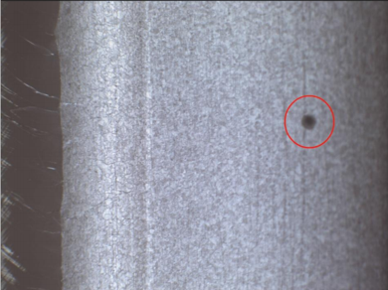
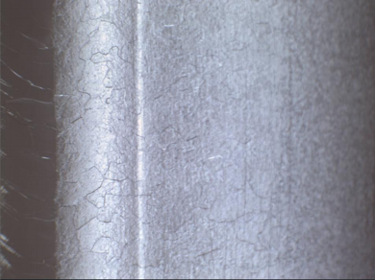
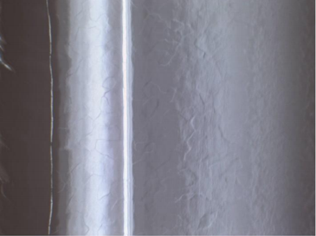
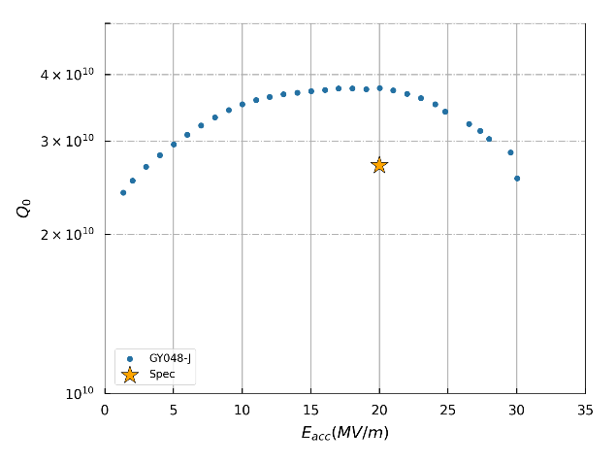
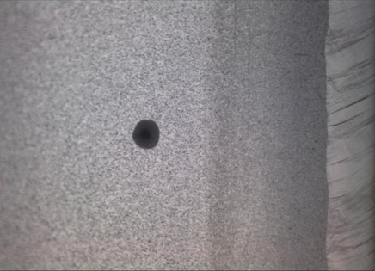

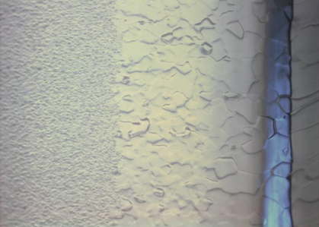
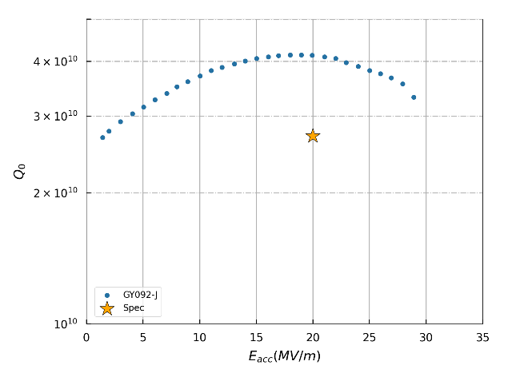
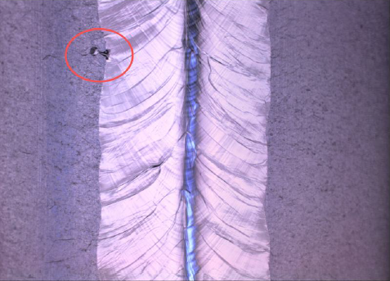
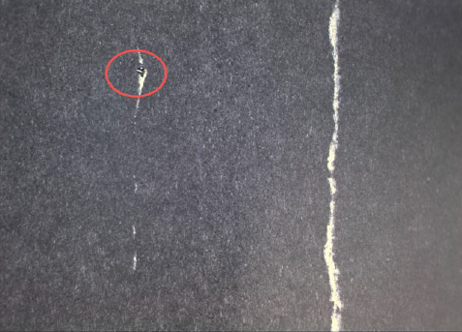
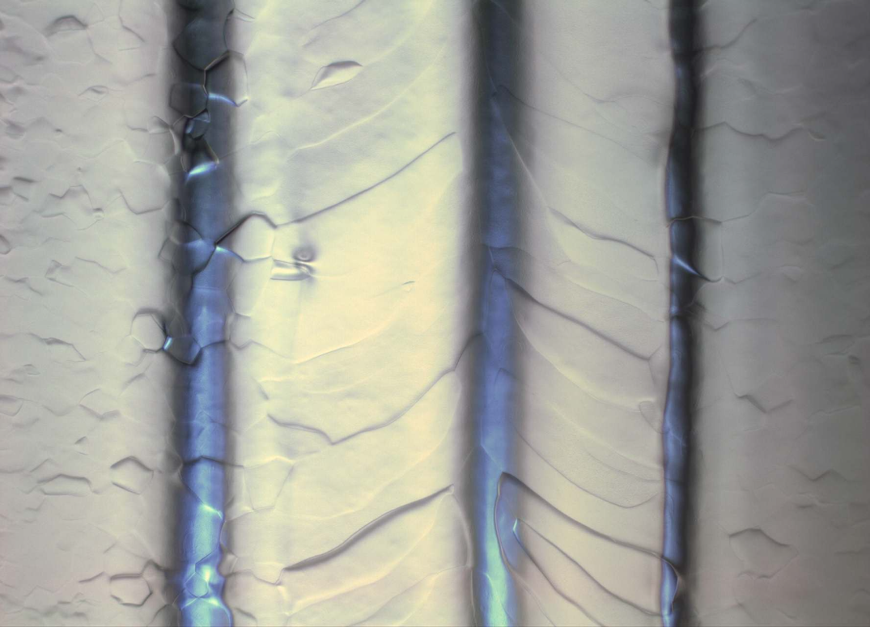
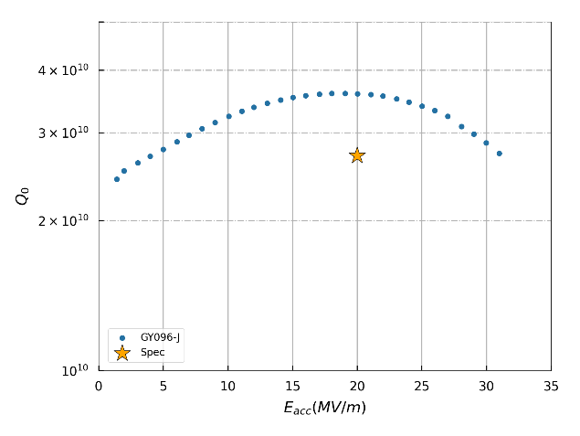
Repair of cavities
After light BCP
After bulk EP
After grinding
After bulk EP
After grinding
After bulk EP

Slide 21
Repair of cavities
Updated to May 2026
Defects | Method | N. cavities | Qualified | Non-qualified | Under testing | Qualified ratio
Stain/cat-eye | Hand Grinding | 28 | 21 | 5 | 2 | 75%
Stain | Light BCP | 44 | 32 | 9 | 3 | 73%
Cat-eye pit etc | CBP | 20 | 16 | 3 | 1 | 80%
Total |  | 92 | 69 | 17 | 6 | 75%
A subset of cavities remained unrecovered even after undergoing rework/re-treatment.
The degradation in performance was driven by other underlying mechanisms (or factors).

Slide 22
Summary
Production Scale: Successfully delivered and integrated over 360 cavities into CMs; < 80 cavities remain for final-phase processing.
Capacity Upgrade: Sustained Wuxi platform throughput at 27 cavities/month, fully securing the module assembly timeline.
Defects Mitigation: Implemented early-stage localized repairs (light BCP/grinding /CBP) driven by optical inspections, markedly improving first-pass yields.
Performance Stability: Achieved highly consistent High-Q performance across both domestic (Mid-T) and international (N-doped) production lines.
Future R&D: Advanced defect diagnostics utilizing Second Sound (OST) and T-mapping.

Slide 23
Thank you for your attention

