Slide 1
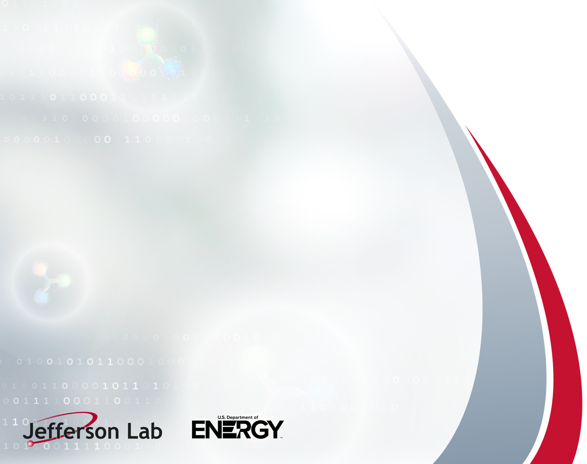
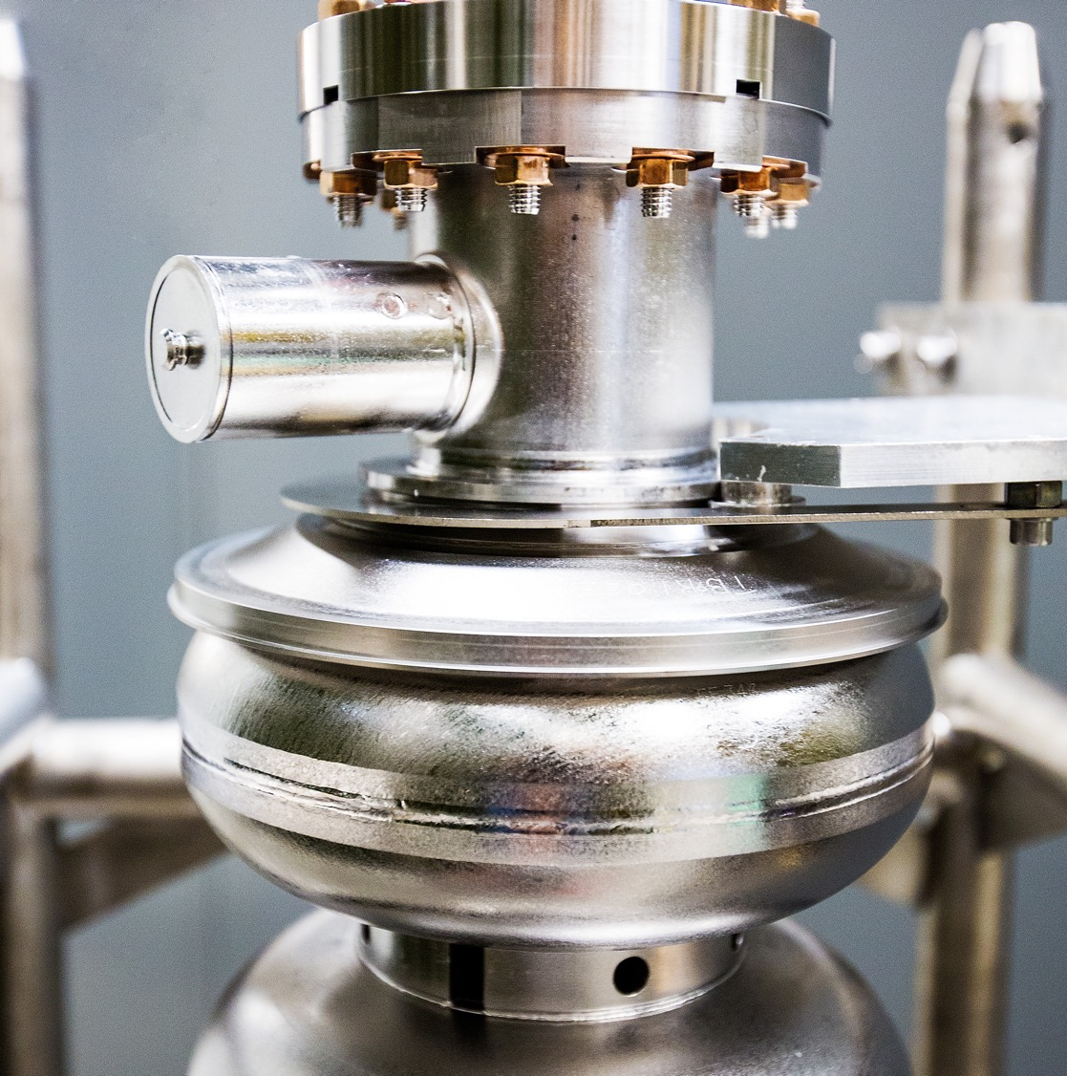

Results From mid-T Bake Applied to 1.5 GHz C75 5-cell Cavities for CEBAF
Pashupati Dhakal, E. Lechner, and G. Ciovati
This material is based upon work supported by the U.S. Department of Energy, Office of Science, Office of Nuclear Physics under Contract No. 89243126CSC000213

Slide 2
Continuous Electron Beam Accelerator Facility (CEBAF)
Currently 400 5/7 cell cavities are installed providing 12 Gev CW electron beam

Slide 3
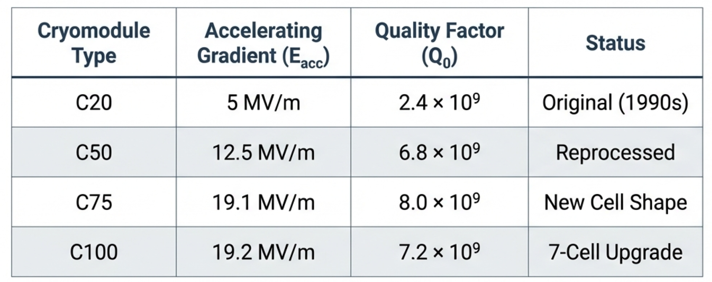
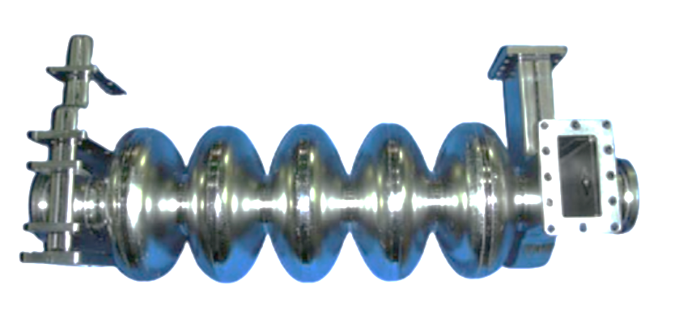
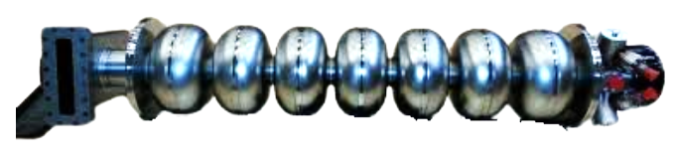
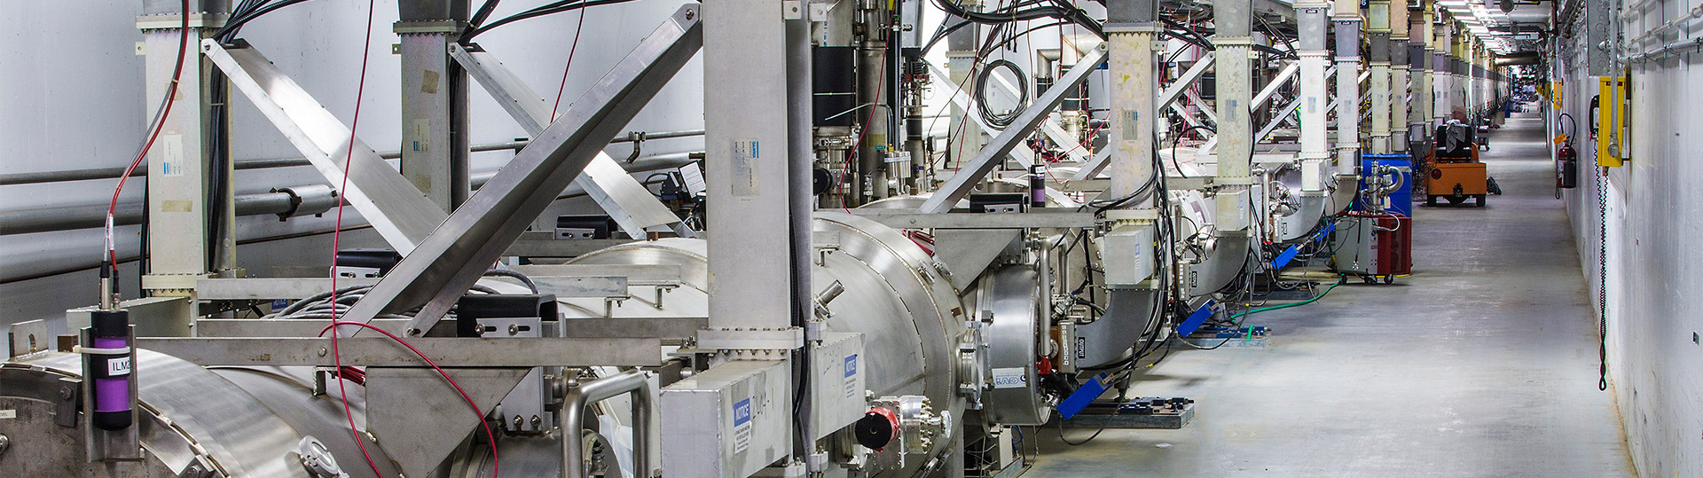
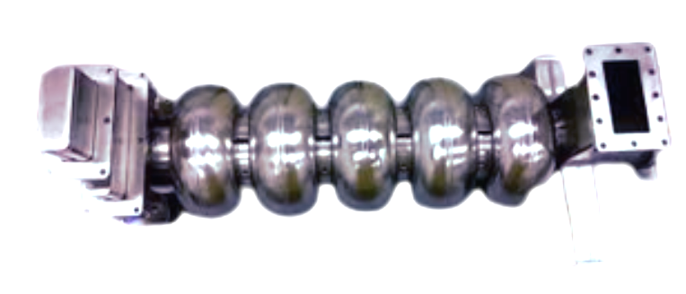
SRF cavities @ CEBAF
C20/C50
C100
C75

Slide 4
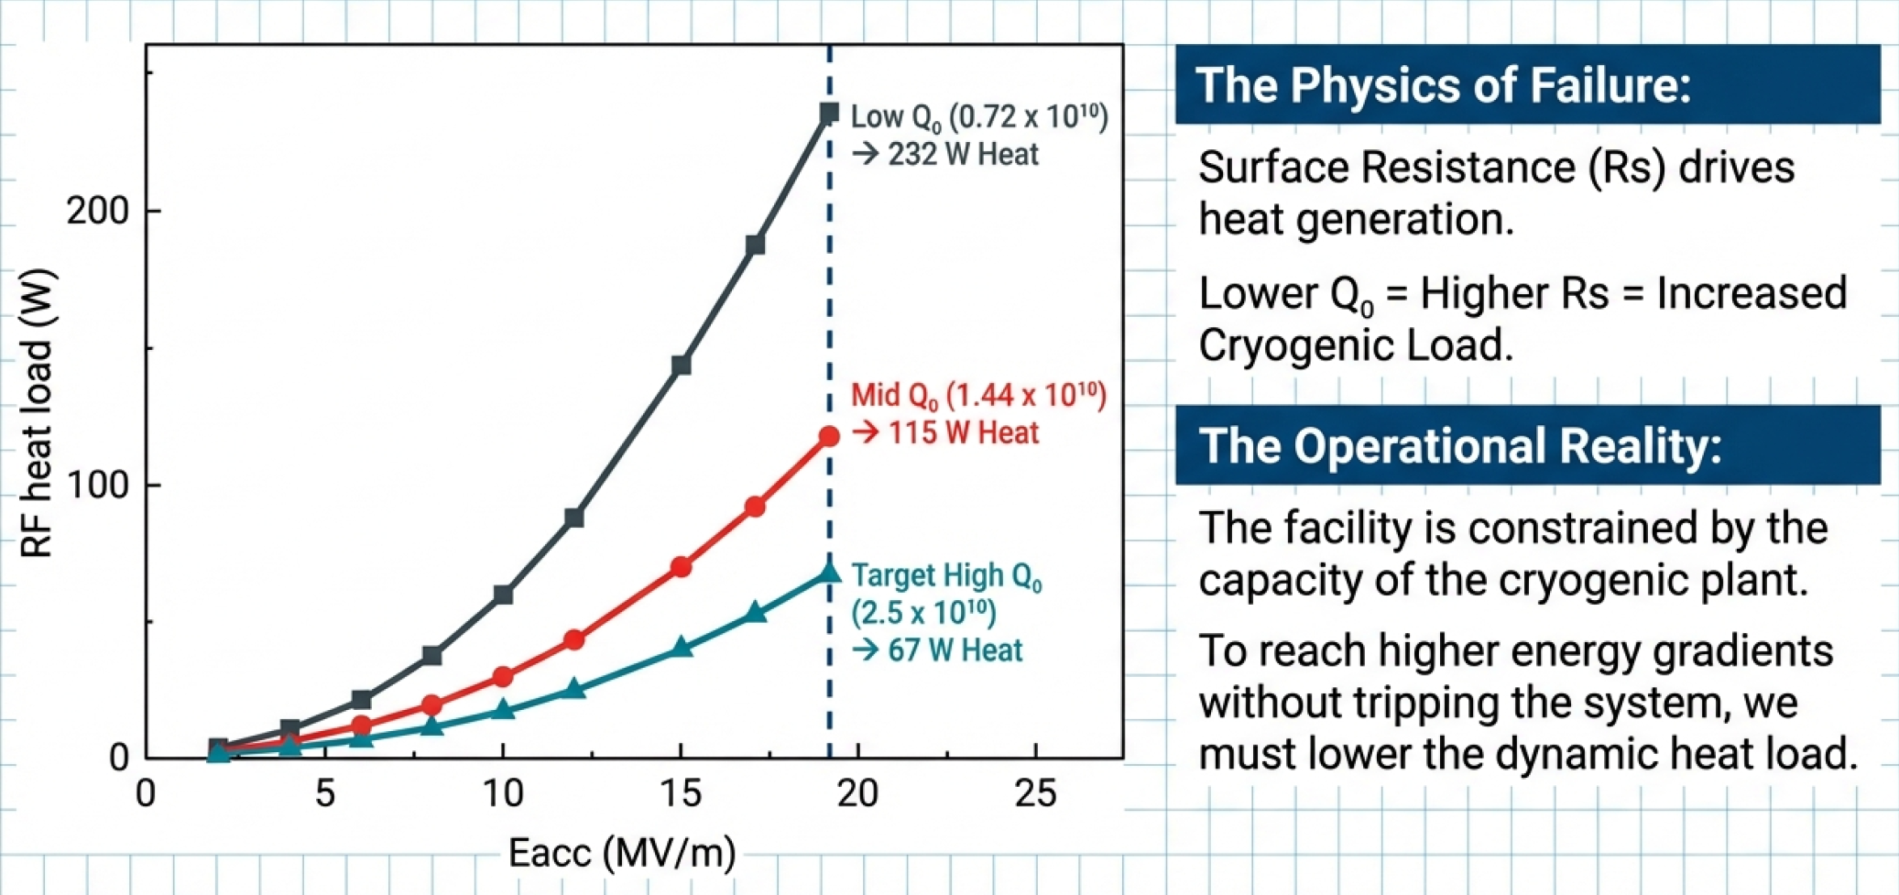
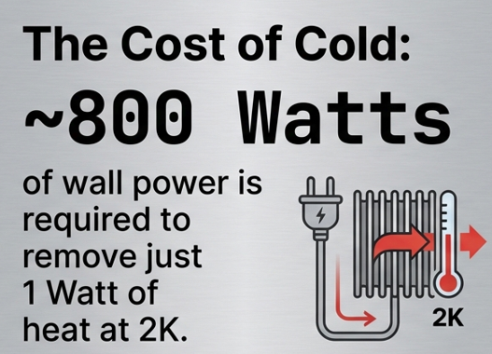
Current Status
Bottleneck: Heat Load
One of the linac is reaching cryo- capacity
To reach higher energy gradients without tripping the system, we must lower the dynamic heat load
Target High Q₀
(2x10¹⁰)
→ 80 W Heat
Quality factor Q₀ is not only performance metrics of SRF cavity; it is an operating expense.

Slide 5
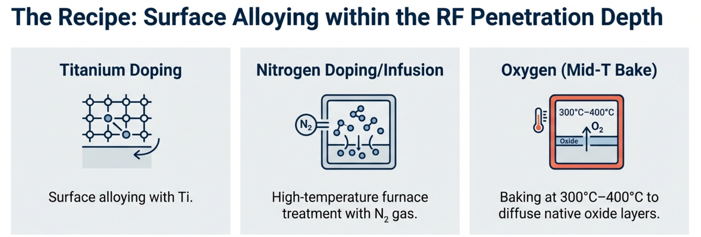
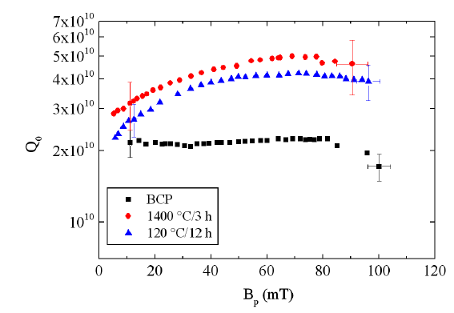
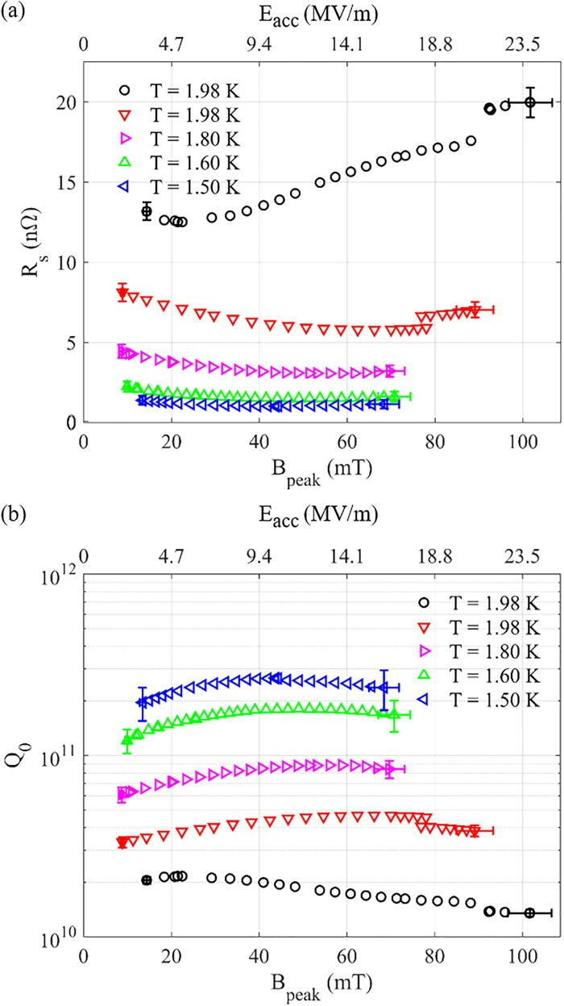
High Q₀ Development (2012- Present)
P Dhakal et al., IPAC '12, 2012
P. Dhakal et al., PRAB 16, 042001 (2013)
G. Ciovati, Appl. Phys. Lett. 89, 022507(2006)
S. Posen et al., Phys. Rev. Applied 13, 014024 (2020)
E. Lechner et al., Appl. Phys. Lett. 119, 082601 (2021)
A Grassellino et al 2013 Supercond. Sci. Technol. 26 102001

Slide 6
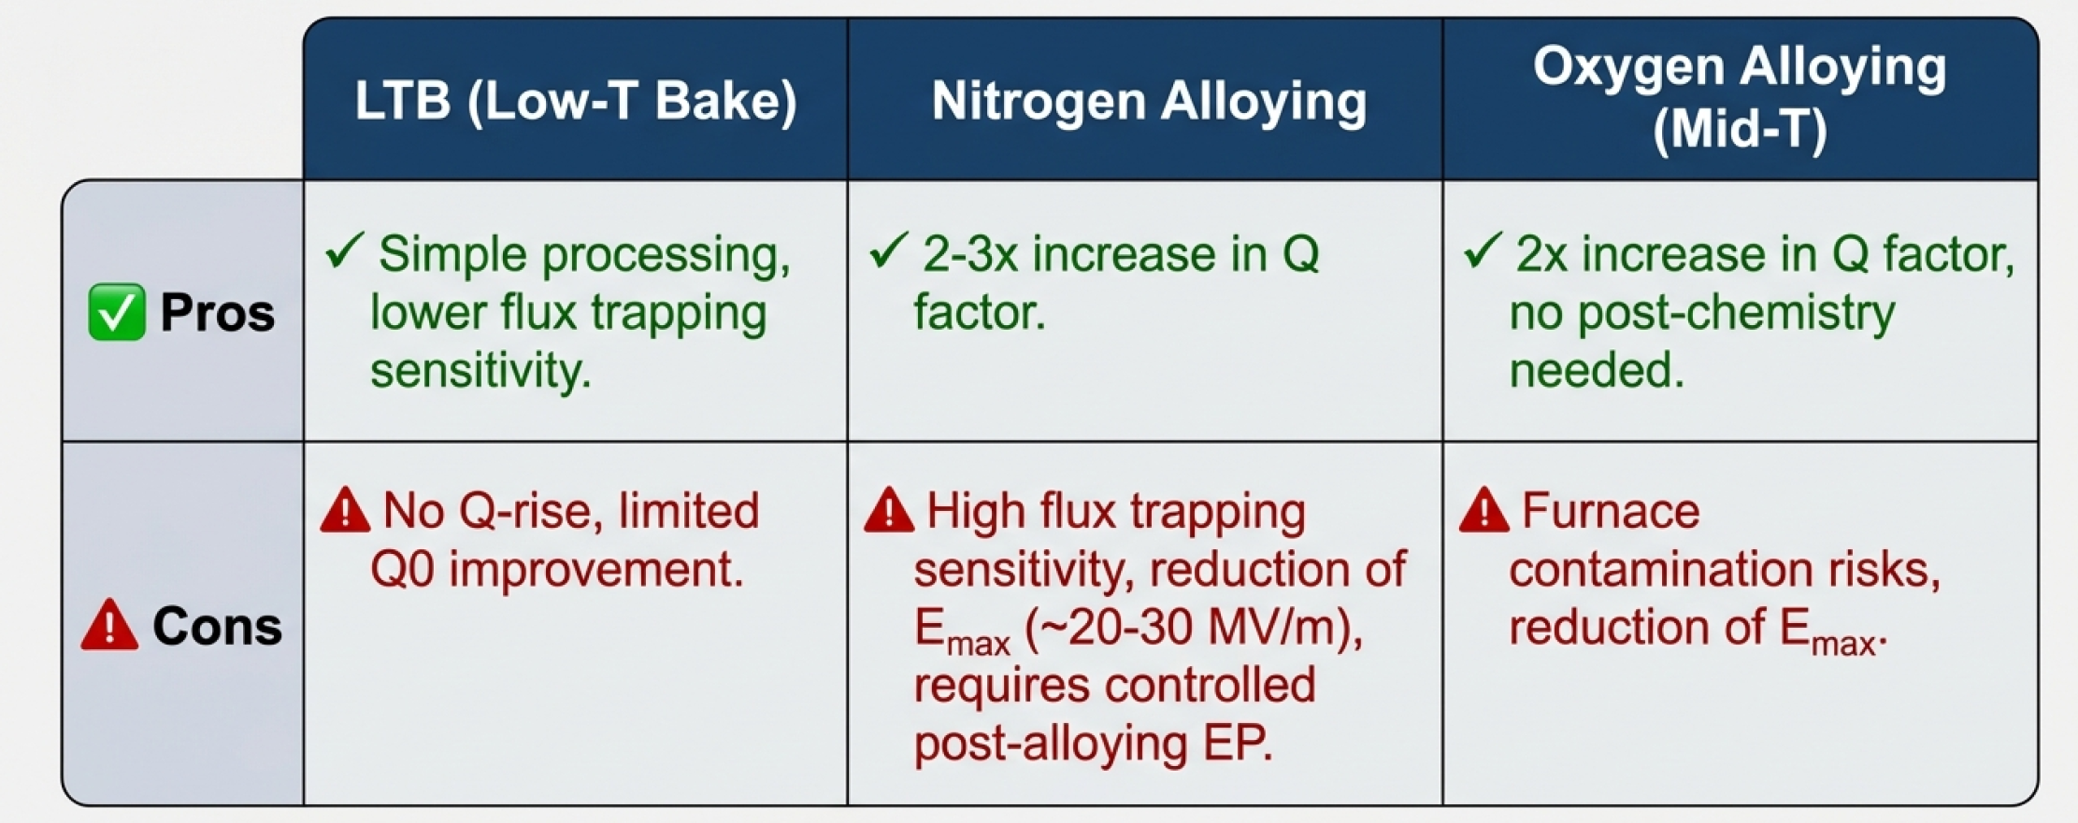
High Q₀ Option for CEBAF Cavities
Despite drawbacks, alloyed cavities are expected to outperform baseline cavities in cryomodules.

Slide 7
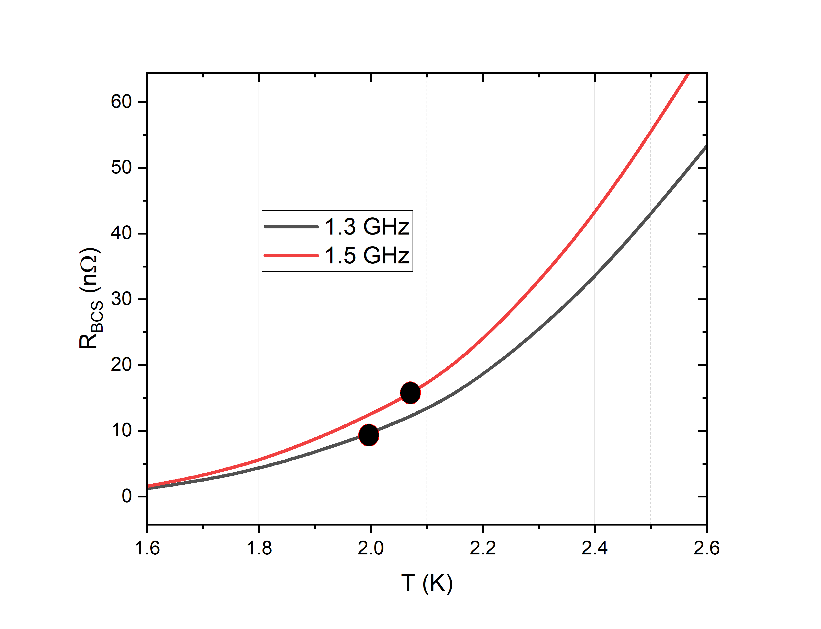
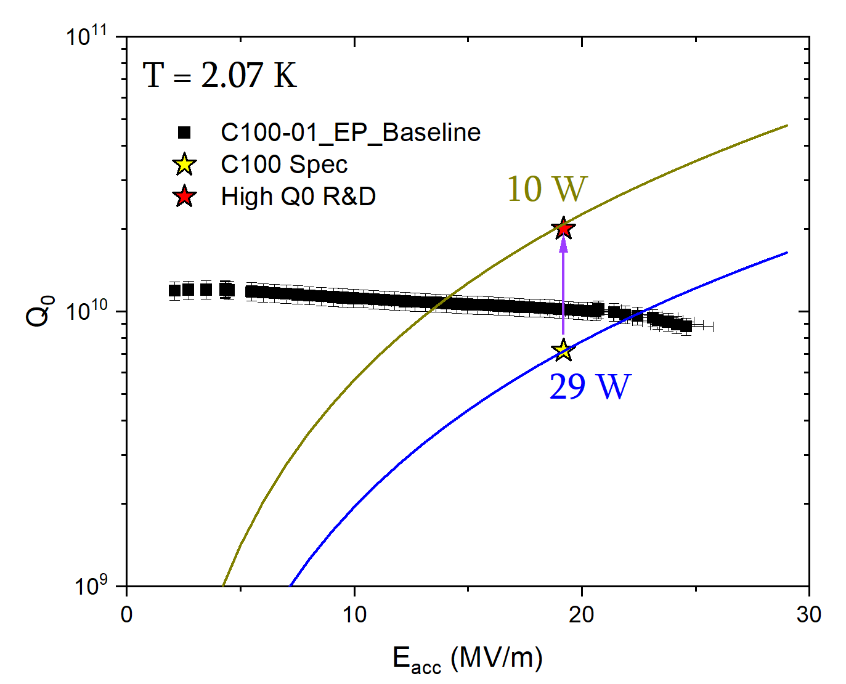
High Q₀ Option for CEBAF Cavities
~ 33%

Slide 8
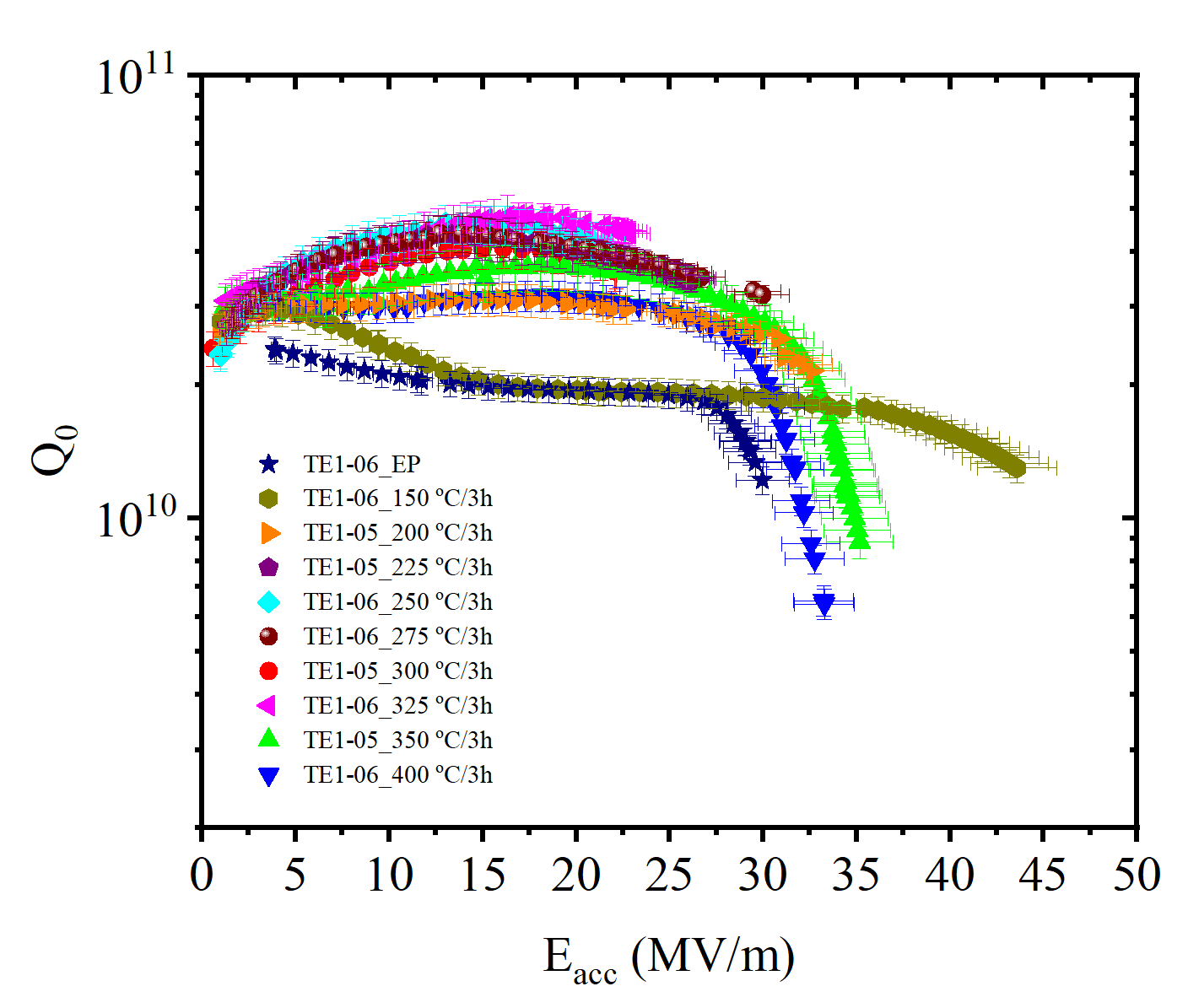
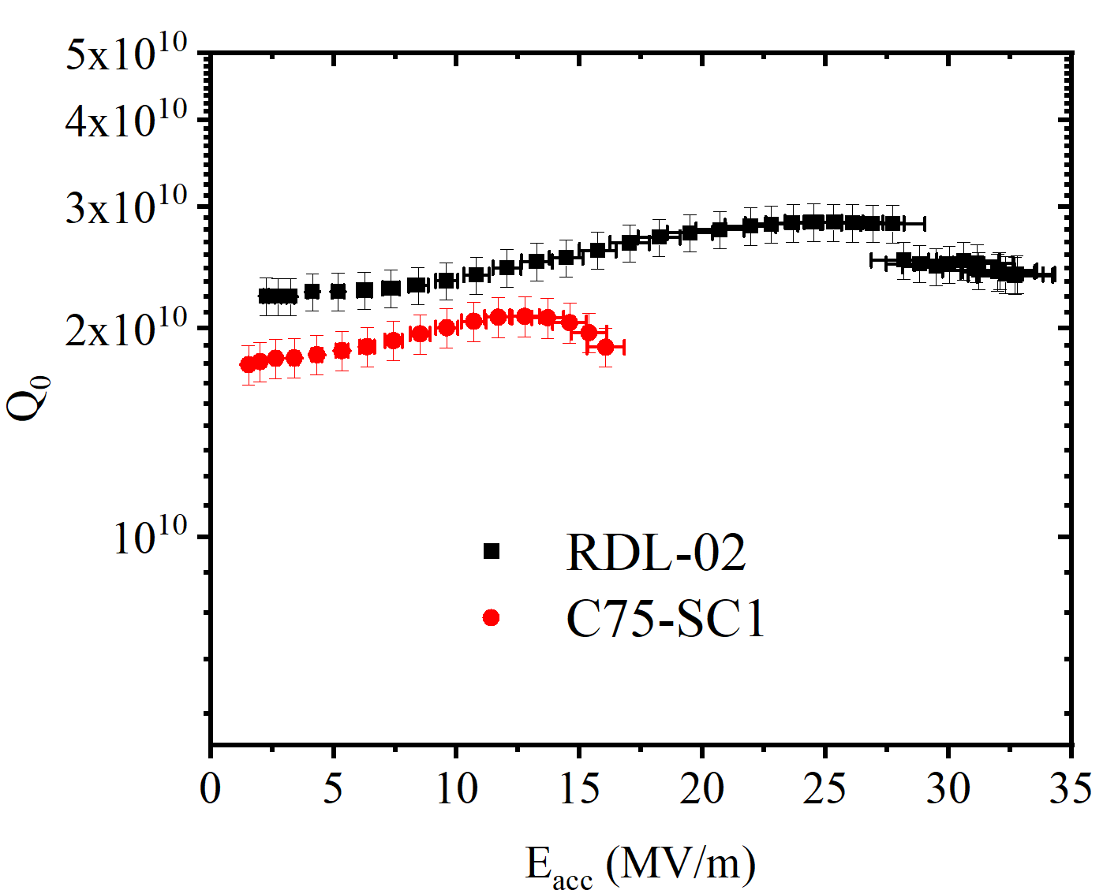
Single Cell Results
T = 2.0 K, f = 1.3 GHz
350 C/3h
T = 2.07 K, f = 1.5 GHz
FG
LG
Cavities were EP’ed prior to each treatment

Slide 9
Flux Trapping Sensitivity ( @4MV/m)
Flux Trapping Sensitivity (nΩ/mG)
Heat Treatment Temperature (ºC/ 3h)

Slide 10

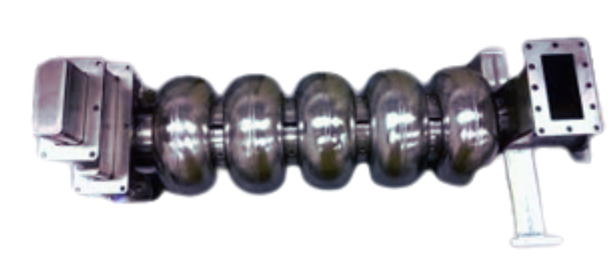
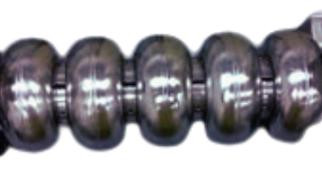
High Q₀ Option for CEBAF Cavities
CEBAF is in operation, the only way to implement high Q₀ on existing cavities are during refurbishment and upgrades:
Currently older C20 are being replaced with new C75 cavities to increase the over all gradient by ~ 55 MeV per cryomodules
Refurbish underperforming C100 (with light EP and HPR) and reinstallation.
C20
C75

Slide 11
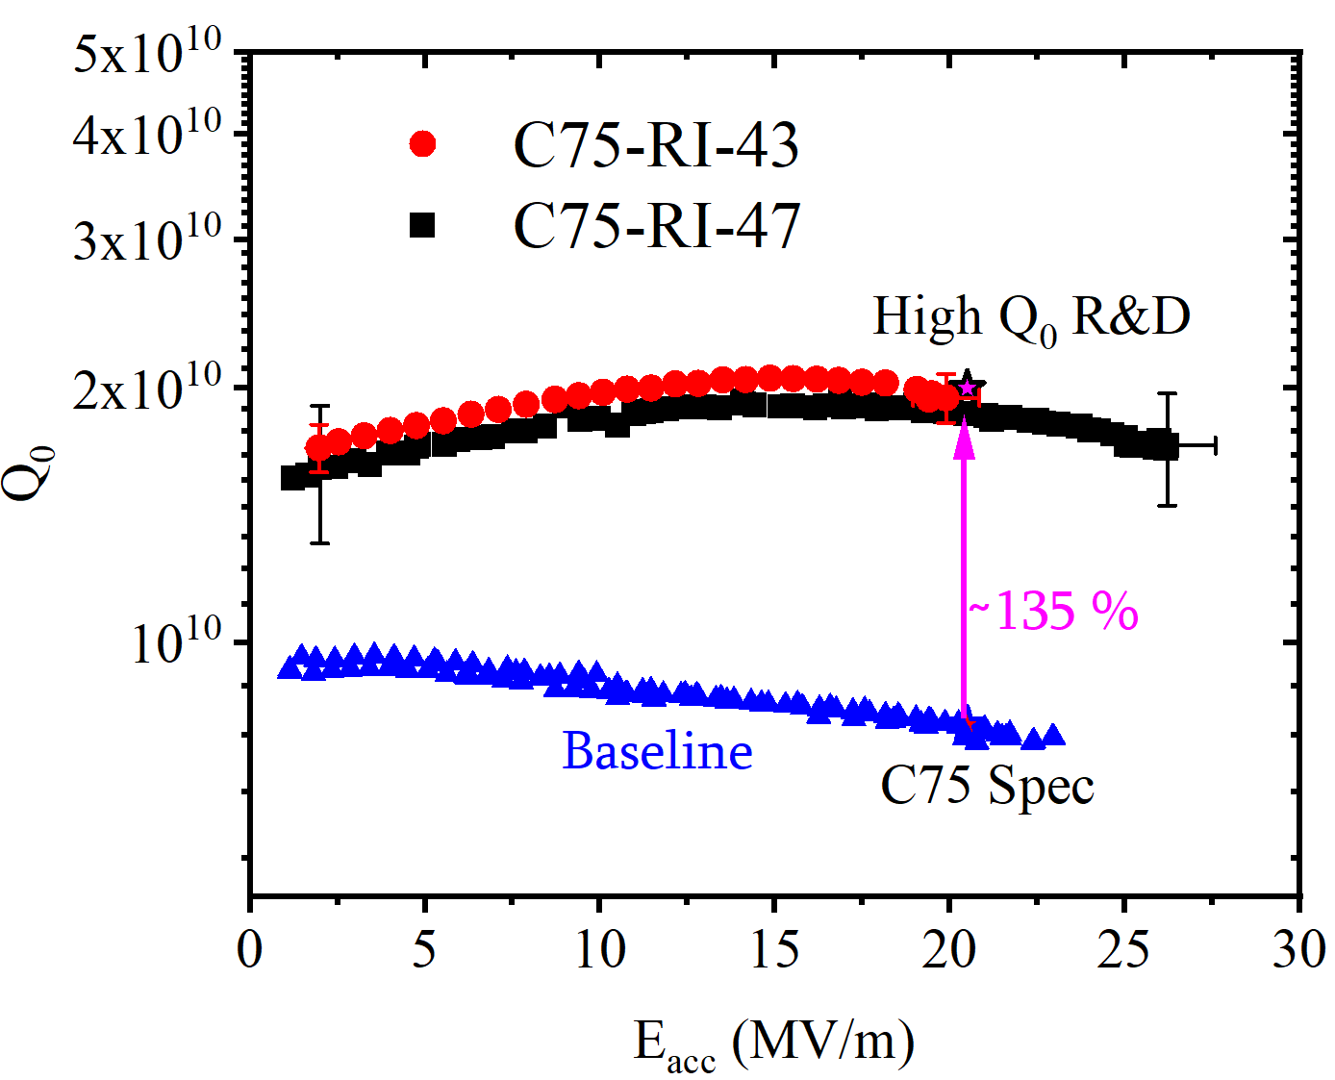
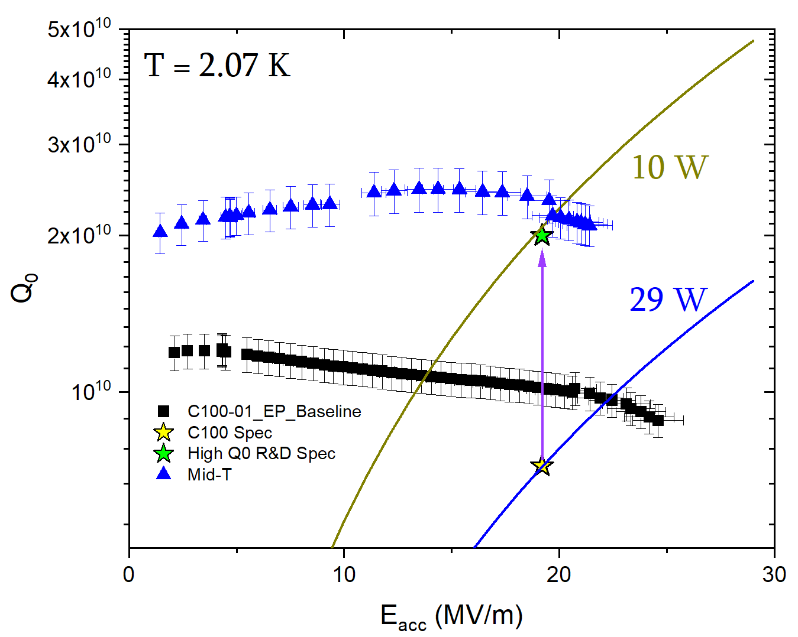
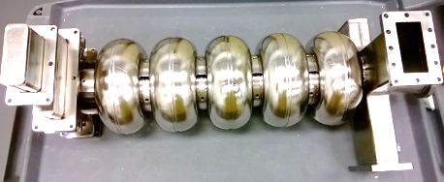
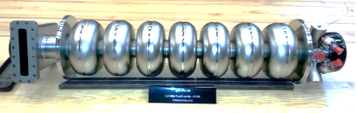
High Q₀ Option for CEBAF Cavities
C75, 5-Cell cavities, Large Grain
C100, 7-Cell cavity, Fine Grain

Slide 12
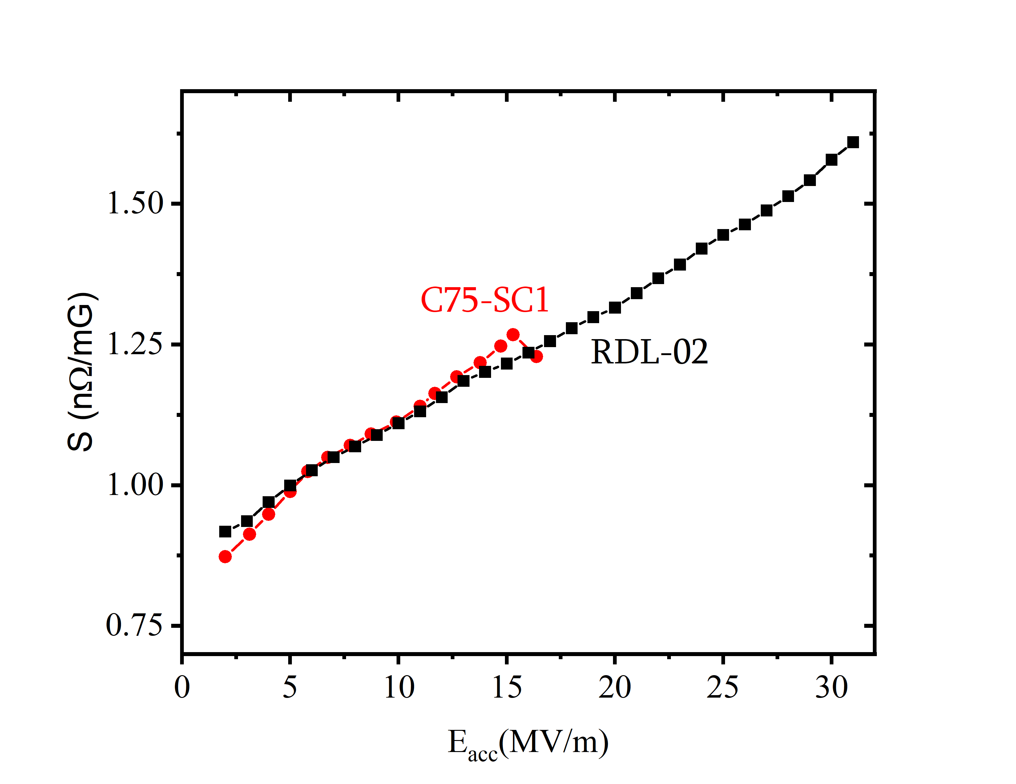
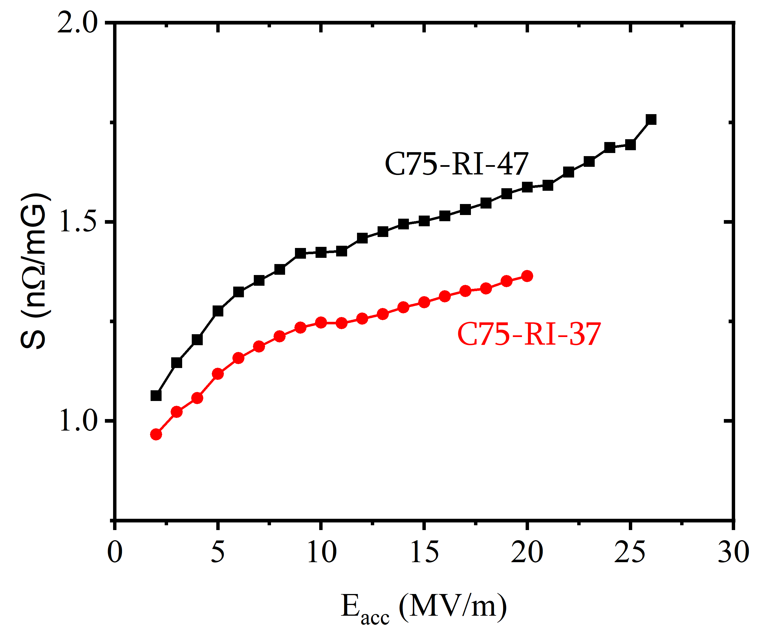
Flux Trapping Sensitivity
T = 2.07 K, f = 1.5 GHz
C75, 5-Cell cavities
Single cavities
S@20 mV/m ≈ 1.45±0.1

Slide 13
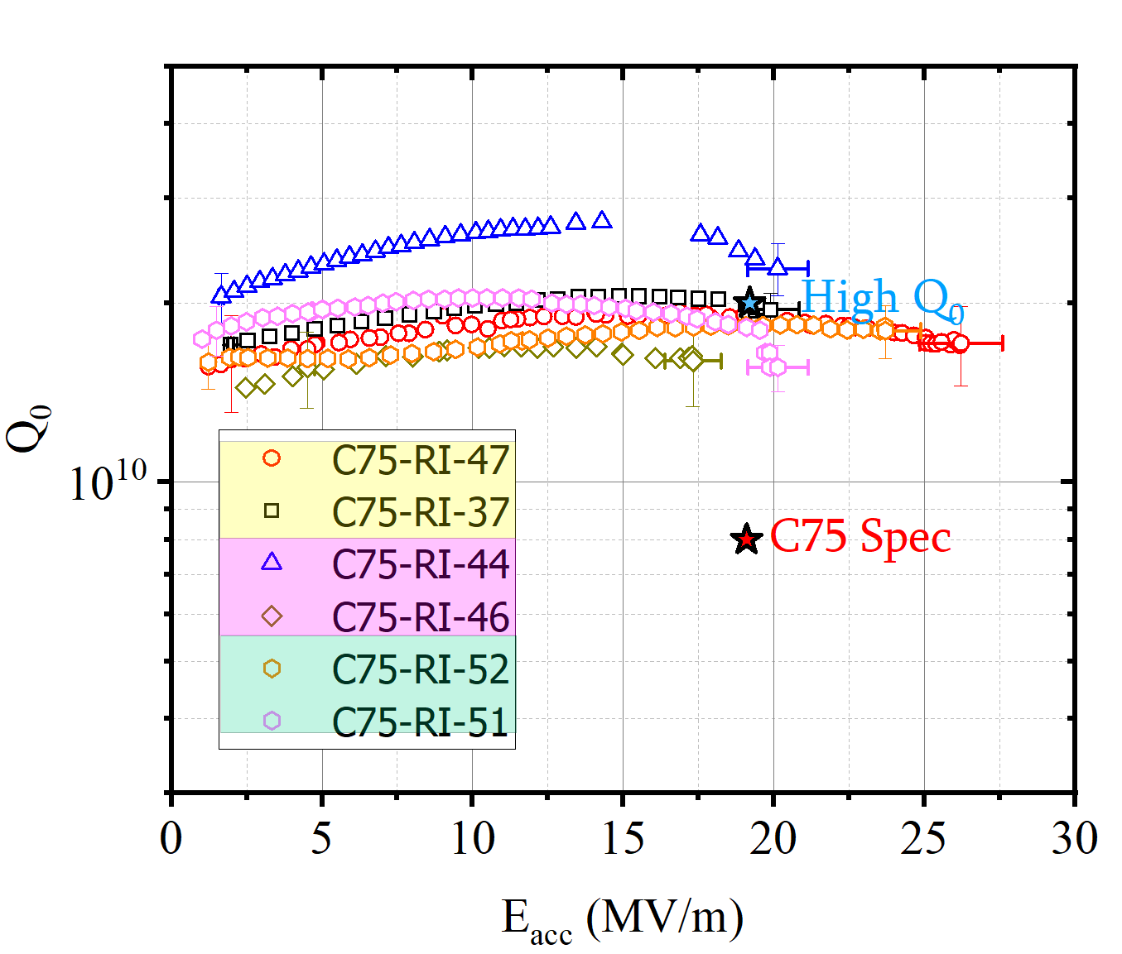
High Q₀ Option for CEBAF Cavities
T = 2.07 K, f = 1.5 GHz, Large Grain
Cryomodule integration in progress…

Slide 14
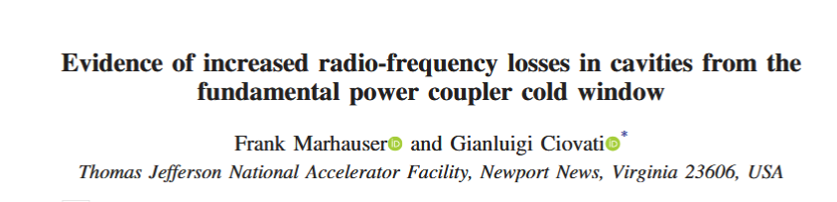
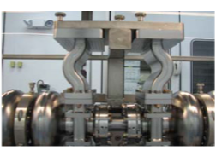
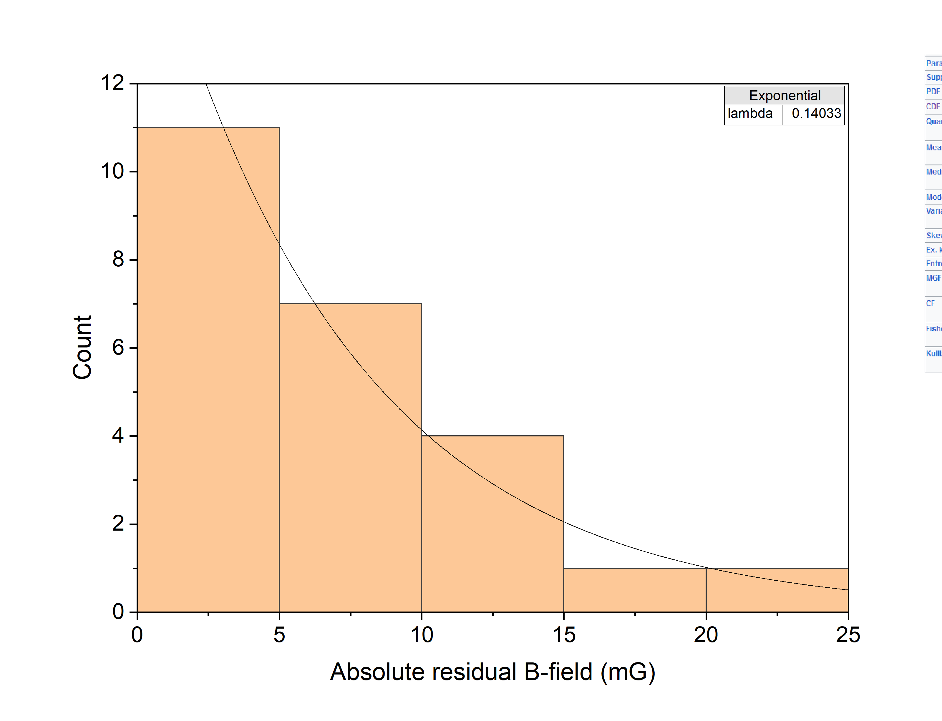
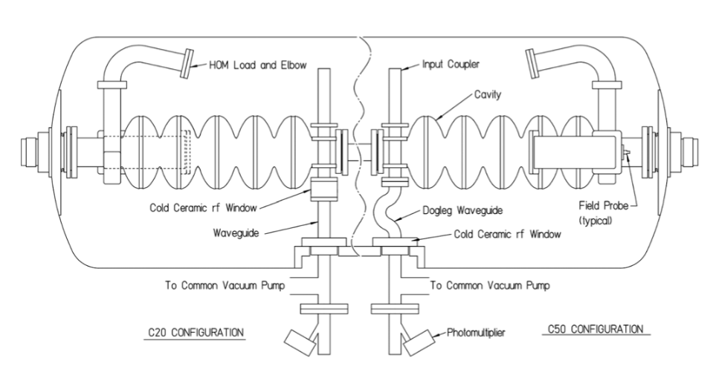
Challenges for using high-Q cavities in C75 CM
Improvement was made by increasing the distance between the waveguide and cavity cell in C75 Cavities
Cooldown challenge for high Q₀ cavities
<B_{res}> = 7 mG
C75 CONFIGURATION

Slide 15
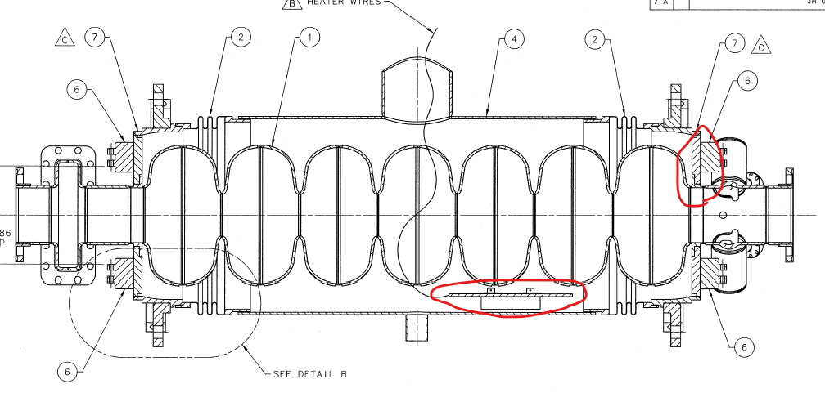
Challenges for using high-Q recipes in C100 cavities
A C100 bare cavity has a SS-Nb brazed joint
  The highest temperature it can be annealed as a bare cavity is 600 °C (poor flux expulsion)
A refurbished C100 cavity has a SS He tank welded to it with a heater inside
  Issues with differential thermal expansion and G10 used in heater assy, the highest annealing temperature is ~140 °C
Removal and reweld of Helium vessel is needed

Slide 16
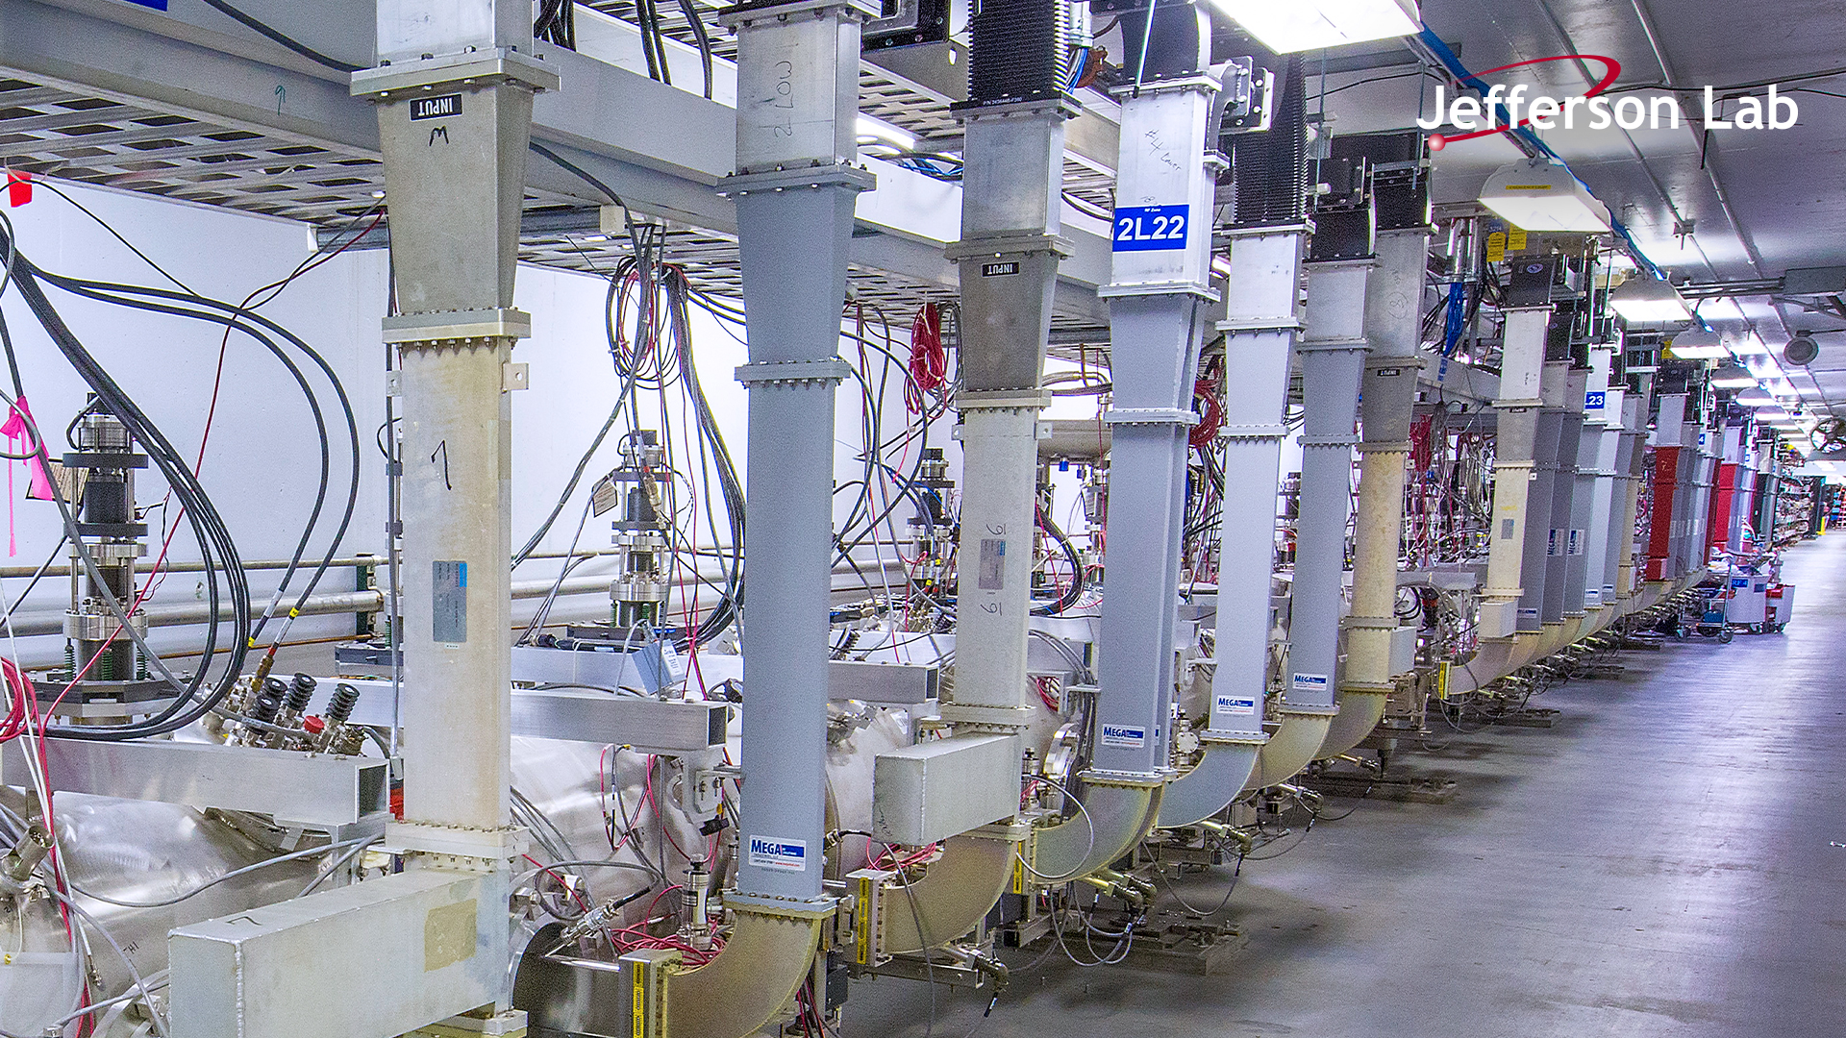
Summary & Path Forward
High Q₀ recipes ( Oxygen alloying with Mid-T bake) have been validated to reduce the dynamic heat load at operating gradients.
Refurbishment is underway for C75 (new) and C100 (legacy) cryomodules, addressing the heat load and other mechanical constraints.
These upgrades ensure CEBAF remains the premier facility for continuous electron beam nuclear physics pushing the energy frontier within existing cryogenic limits.

Slide 17
Questions
Pashupati Dhakal
dhakal@jlab.org

