Slide 1



Surface treatment platform construction and preliminary experiment for $S^{3}$FEL
Shaohua Peng
Institute of Advanced Light Source Facilities, Shenzhen
  09th June, TTC’2026 Meeting, Paris French

Slide 2
01
Introduction
02
Surface treatment platform construction
Outline
03
preliminary experiment on single cell
04
Summary

Slide 3
Introduction

Slide 4
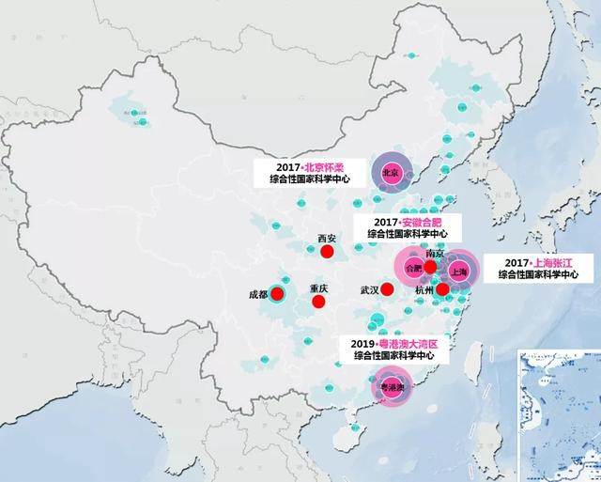
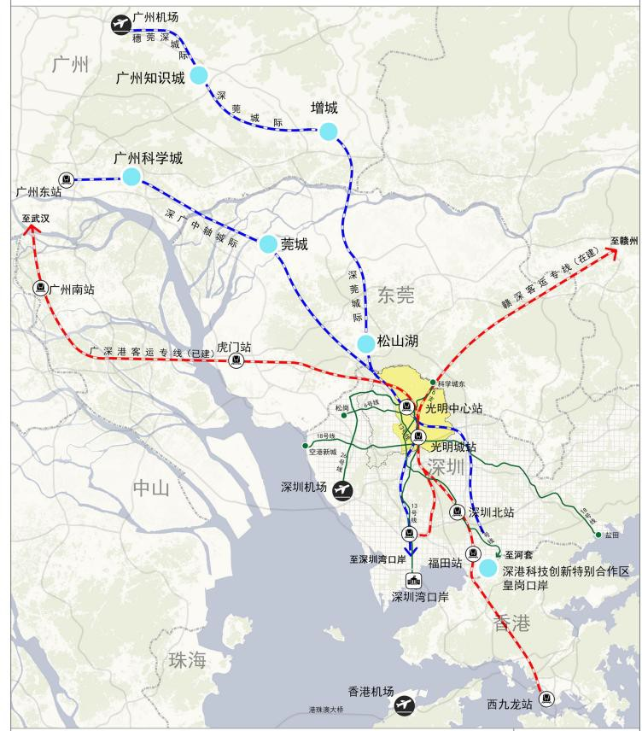
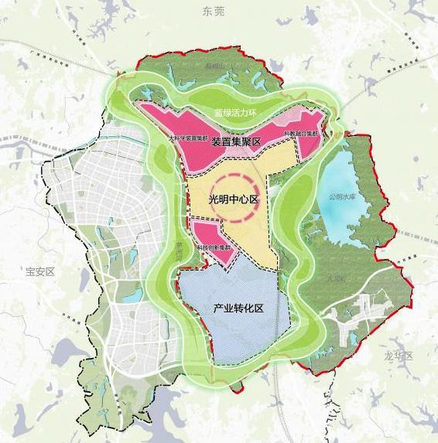

S³FEL: Shenzhen Superconducting Soft x-ray Free Electron Laser
Construction unit: Institute of Advanced Light Source Facilities, Shenzhen (IASF)
Construction site: Guangming District, Shenzhen (Guangming science city, cluster of facilities)

Slide 5
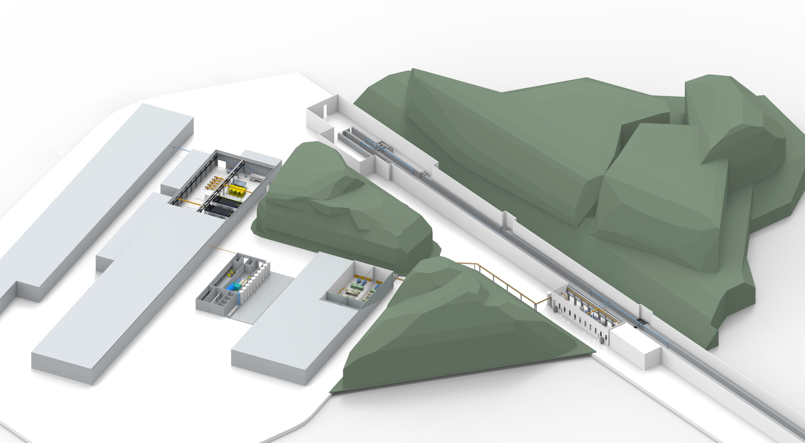
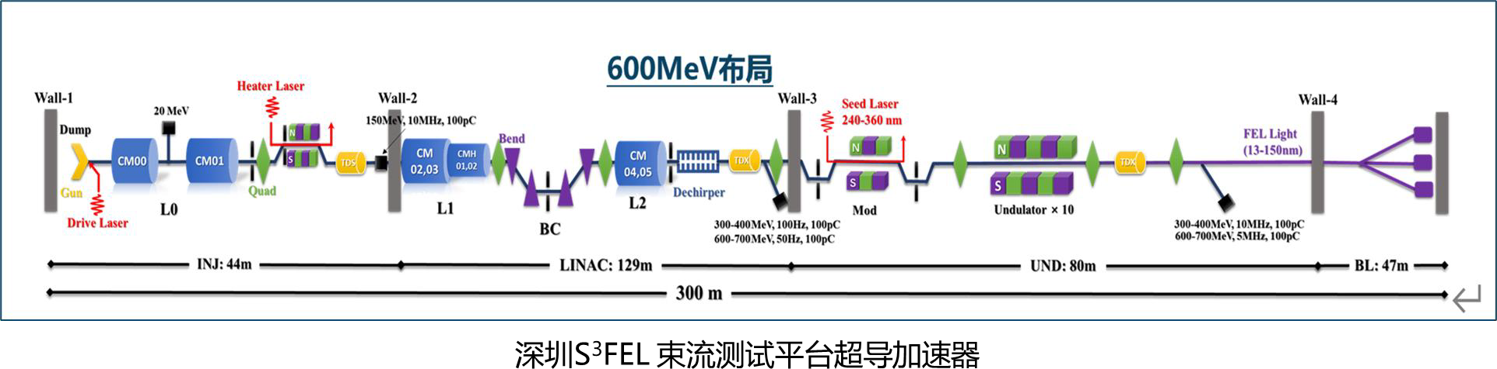
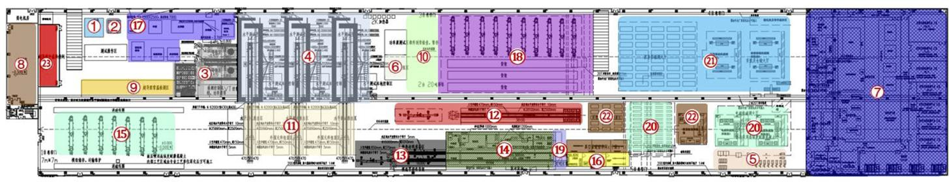
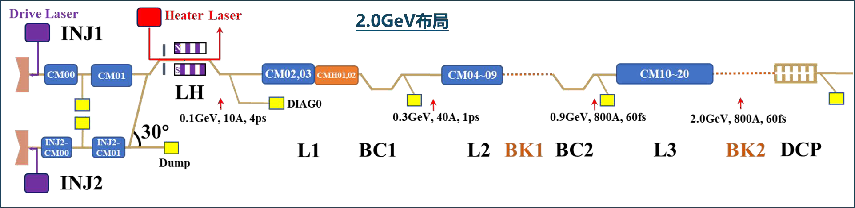
Layout of S³FEL Accelerator
No. | Nameing
1 | S³FEL
2 | Superconducting Module Test Facility (SMTF)
3 | Linac Test Facility (LTF)
3
2
1

Slide 6
S³FEL Projects Need of cavities
 | SMTF | LTF | S³FEL | Total
1.3 GHz CM | 1 | 5 | 18 | 24
1.3 GHz-9cell cavity | 10 | 40 | 162 | 212
3.9 GHz CM | 1 | 2 | 2 | 5
3.9 GHz-9cell cavity | 10 | 16 | 19 | 45
Injector CM | / | 1 | 2 | 3
1.3GHz-9cell cavity（double coupler） | / | 1 | 2 | 3
S³FEL need 212 1.3GHz -9cell cavities, 45 3.9GHz -9cell cavities and 3 injector 1.3GHz -9cell cavities in total.
Most 1.3GHz-9cell cavities will be carried out surface-treatment by IASF. 3.9GHz-9cell caivties mainly undergoes BCP and will be carried out by the manufacturer.

Slide 7
Surface treatment platform construction

Slide 8
layout
Equipment | Quantity | Progress | Position
EP | 1 | In use | Zhongshan
HPR | 1 | Debugging completed | Shenzhen
Vacuum baking oven | 1 | In use | Shenzhen
Ultrasonic Cleaner | 1 | In use | Shenzhen
CBP | 1 | Under development
IASF built an EP system, located in Zhongshan City. IASF has set up a Vacuum baking oven、HPR and ultrasonic cleaning machine in the pre-research laboratory . IASF is developing CBP equipment, which is expected to arrive in October.

Slide 9
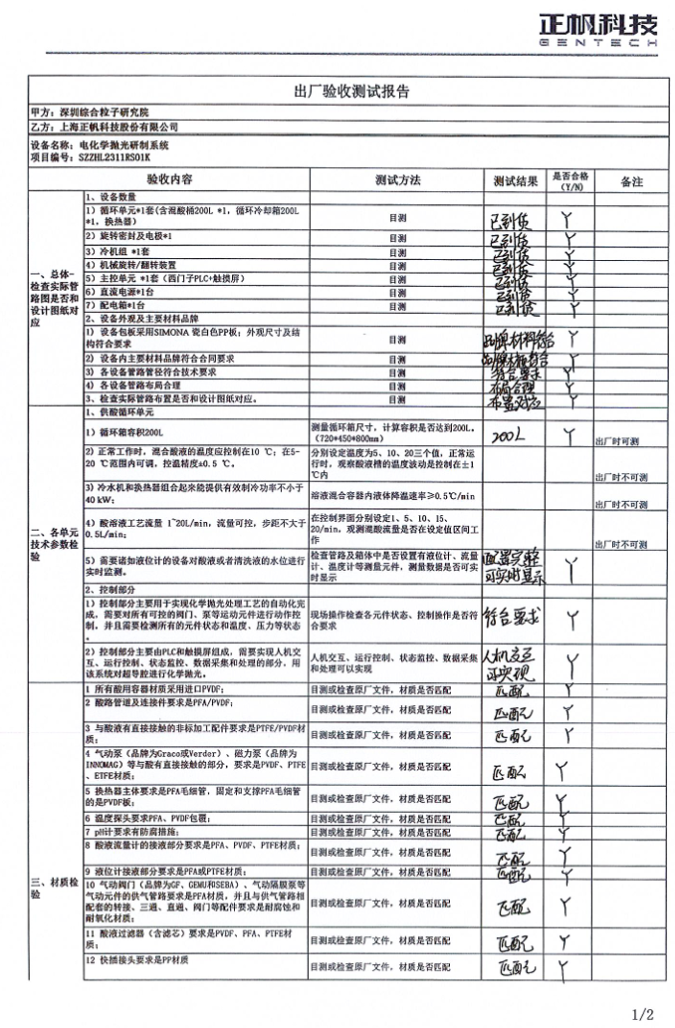
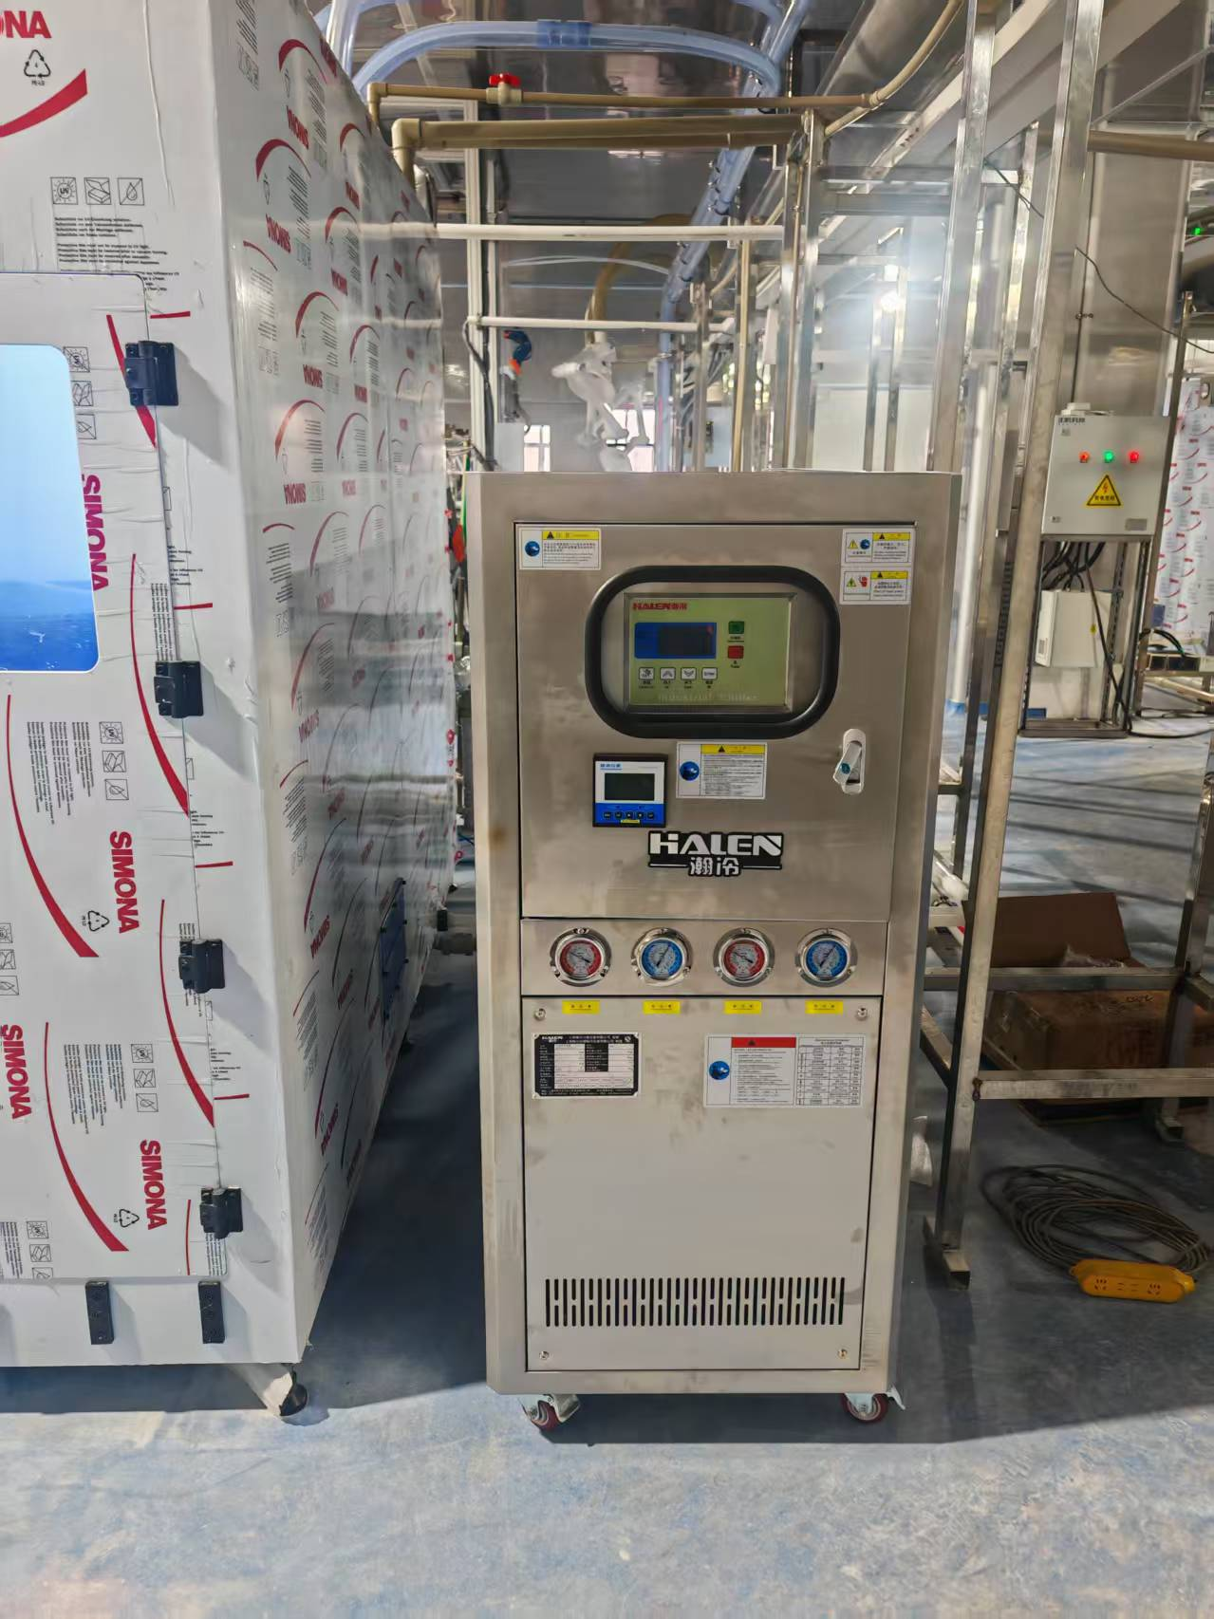
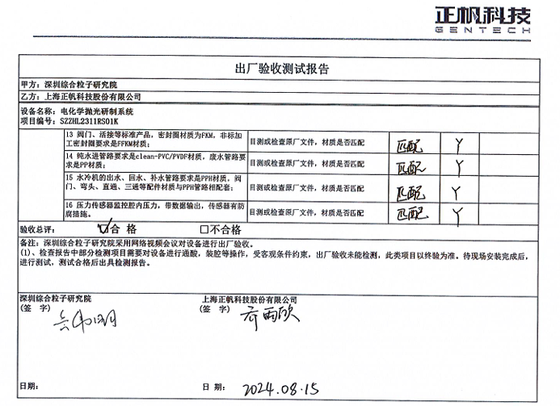
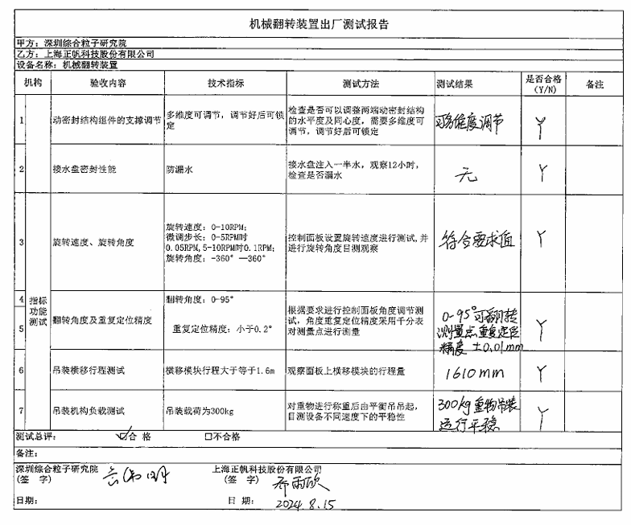
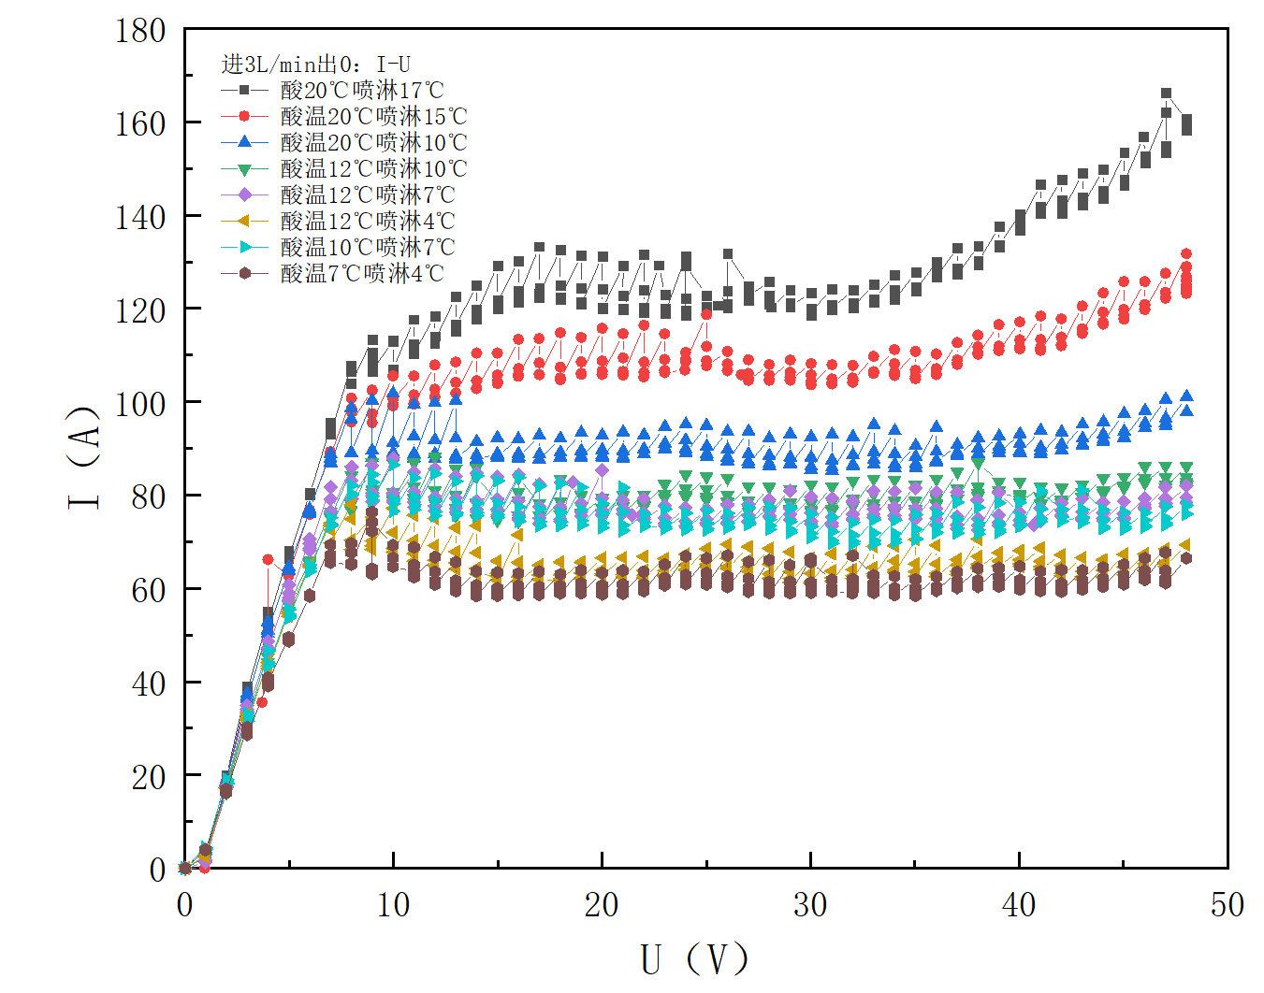
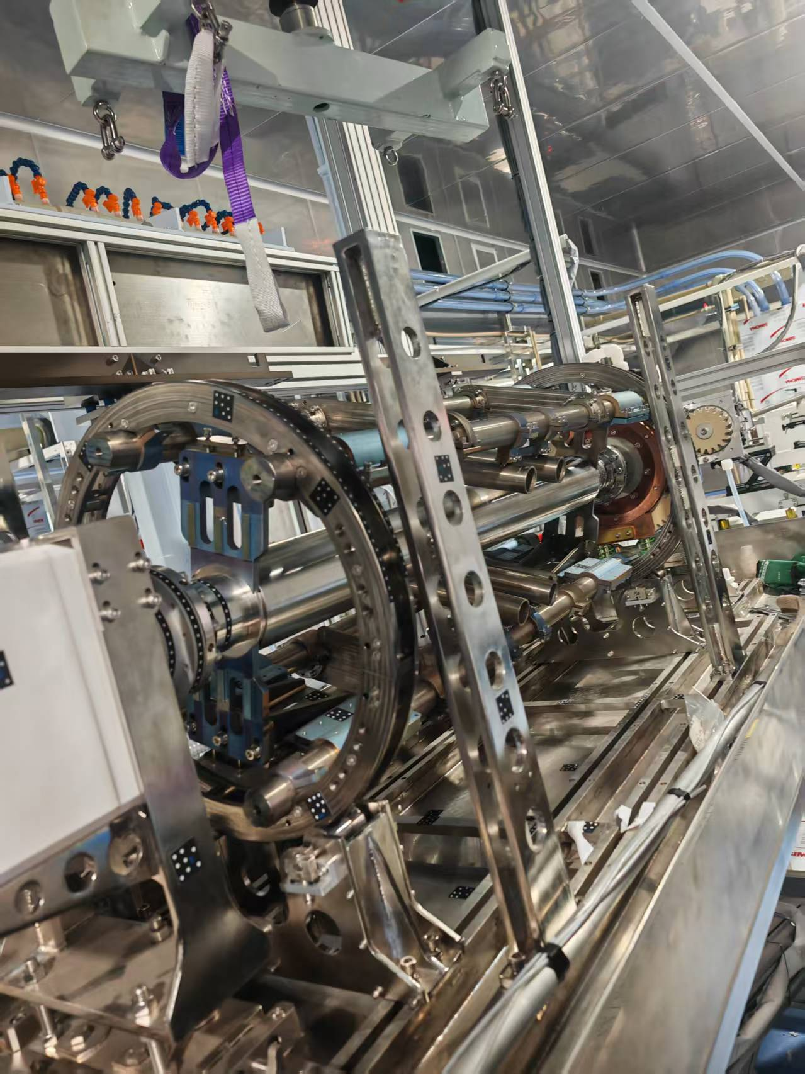
EP
Unit | Requirements
Acid supply unit | The materials are all PFA and PVDF materials.
Mixed acid circulation unit | The volume of the circulating cooling tank shall not be less than 200L
 | The acid temperature range is not less than 10~20℃, and the acid temperature accuracy is 1℃
 | Acid solution process flow 1~20 L/min, flow controllable, step size not greater than 0.5 L/min
Cleaning system and hydrogen forced discharge system | Nitrogen flow rate 0~50 L/min
Chiller unit for spray cooling | Cooling capacity 40 kW, used in conjunction with the spray cleaning unit
Chiller Unit for EP Polishing | Cooling capacity 30 kW, water outlet temperature control accuracy ±0.5°C
Spray cleaning unit | Spray flow control, 0~20 L/min, temperature control range not less than 5~20℃
DC power supply | Voltage continuously adjustable from 0 to 50V, maximum current 500A
2025.4、5
Carry out on-site water flow commissioning and related modifications
2024.8
Complete factory testing and send to Zhongshan
2025.8、9
Completed the EP test
2023.9
Start platform layout diagram
2025.3
Complete on-site installation
2025.6.20
Held a review meeting for the EP test acceptance plan
2025.10.23
Completed the equipment acceptance
The EP equipment was placed in Zhongshan, and has currently conducted polishing experiments on several single-cell cavities. EP equipment can accommodate the polishing of 1.3GHz 9-cell bare cavities, helium cavities, and 1.5m long cavities.

Slide 10
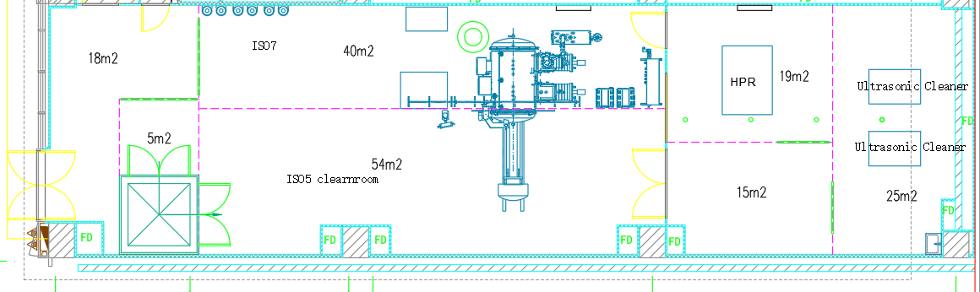
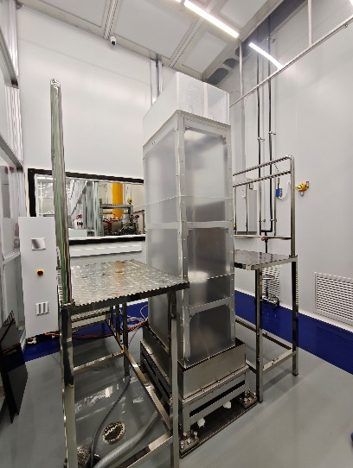
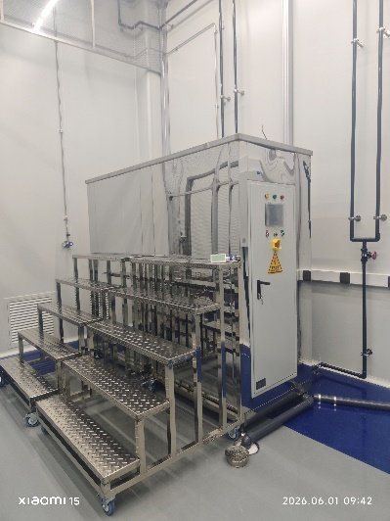
HPR + Ultrasonic Cleaner
Device Name | HPR
Parameter | Indicator
Effective cleaning length | ＞1300mm
Boom pressure resistance | ＞150bar
Other pipelines under pressure | ＞120bar
Boom rotation speed | 4-20rpm
Spray boom vertical movement speed | 5-500mm/min Adjustable
Load | ≥500kg
Protection level | IP67
Matching filter | Filtration 0.01um accuracy
Matching nozzle | Nine 0.6mm holes
Cleanliness level | Better than ISO-5 (Class 100)
Control method | Automatic/Manual
HPR
Ultrasonic Cleaner

Slide 11
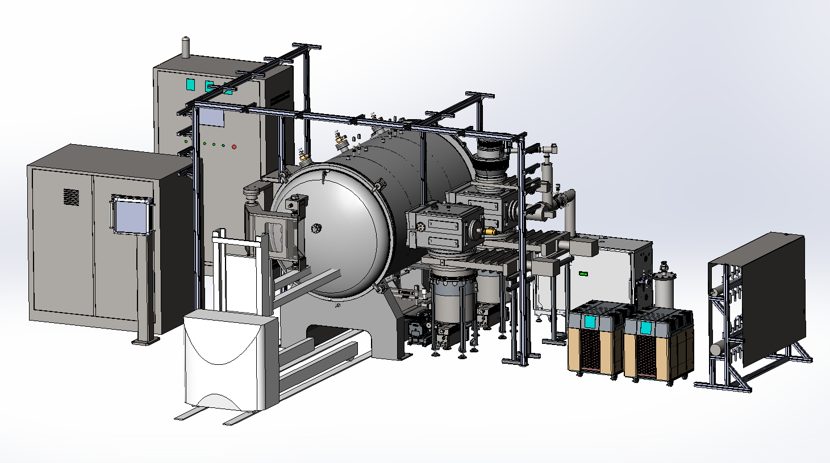
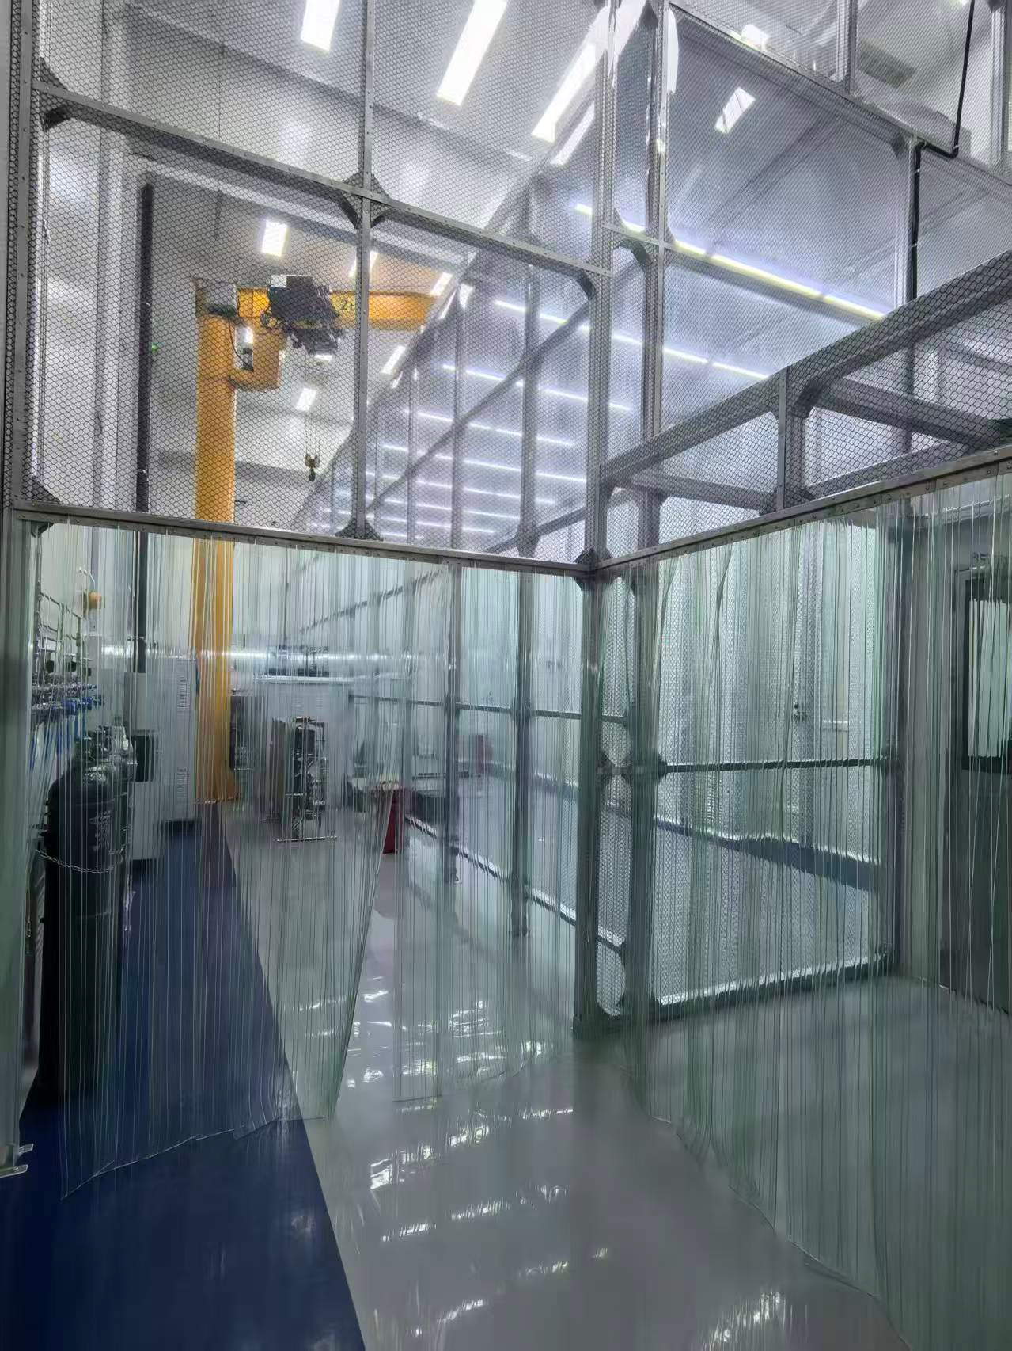
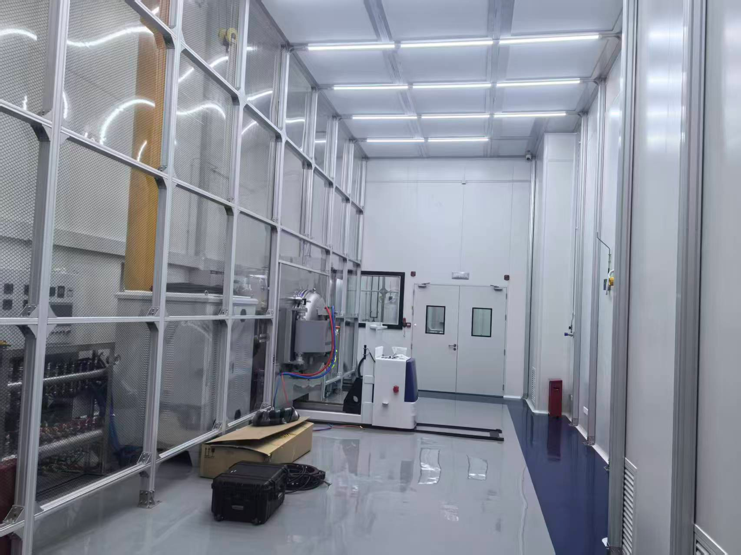
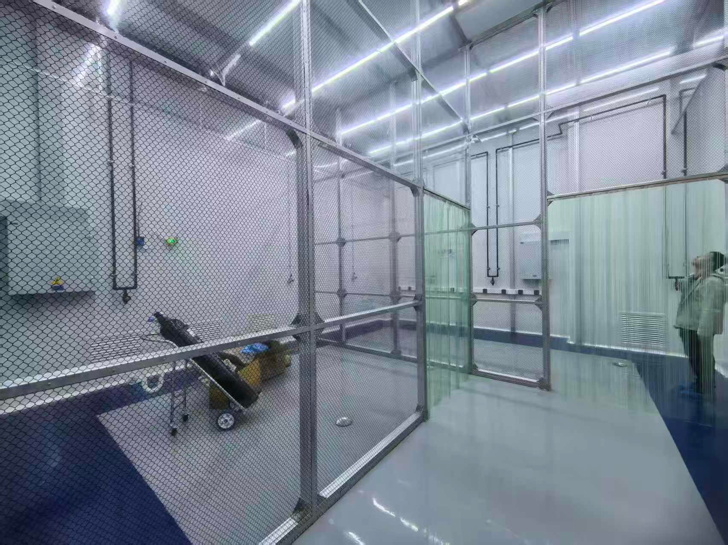
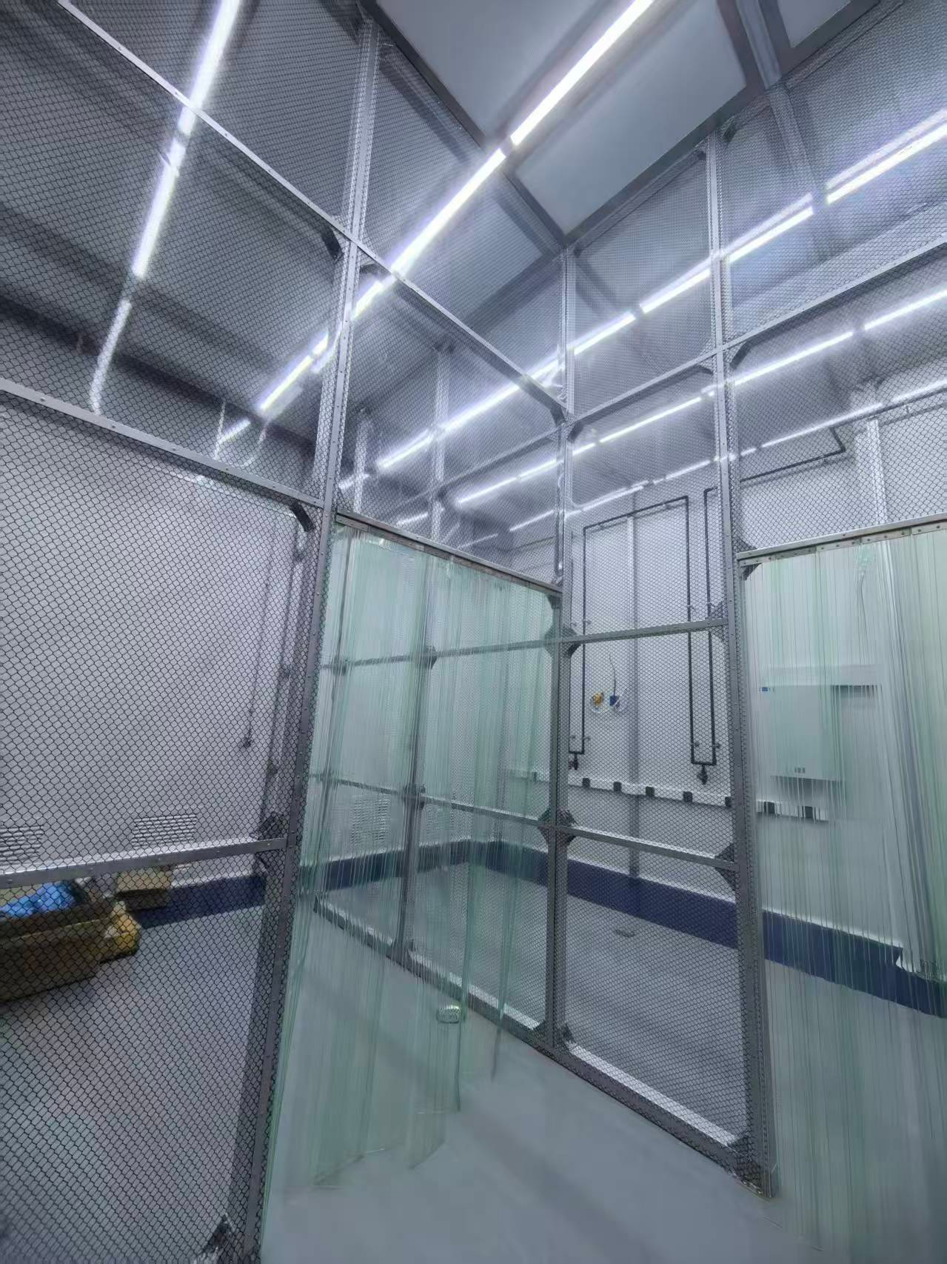
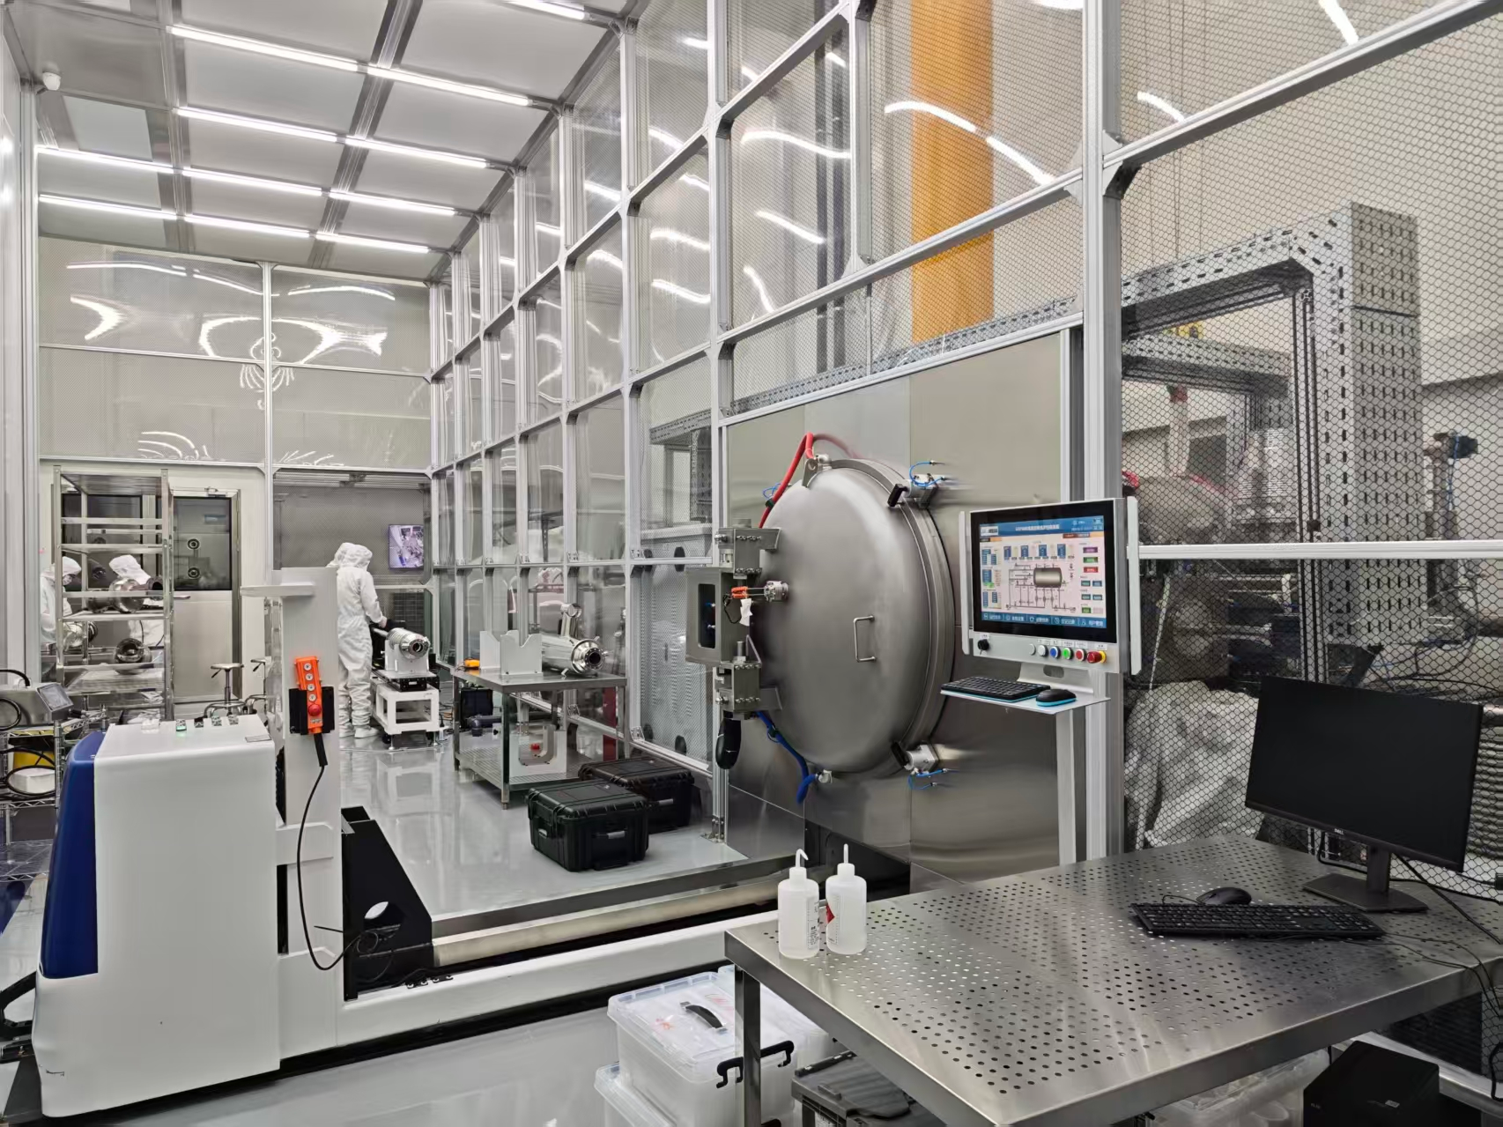
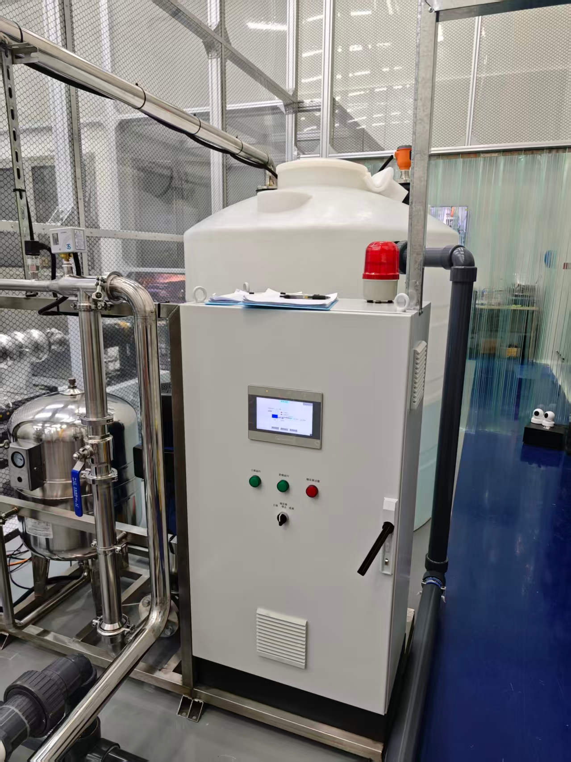
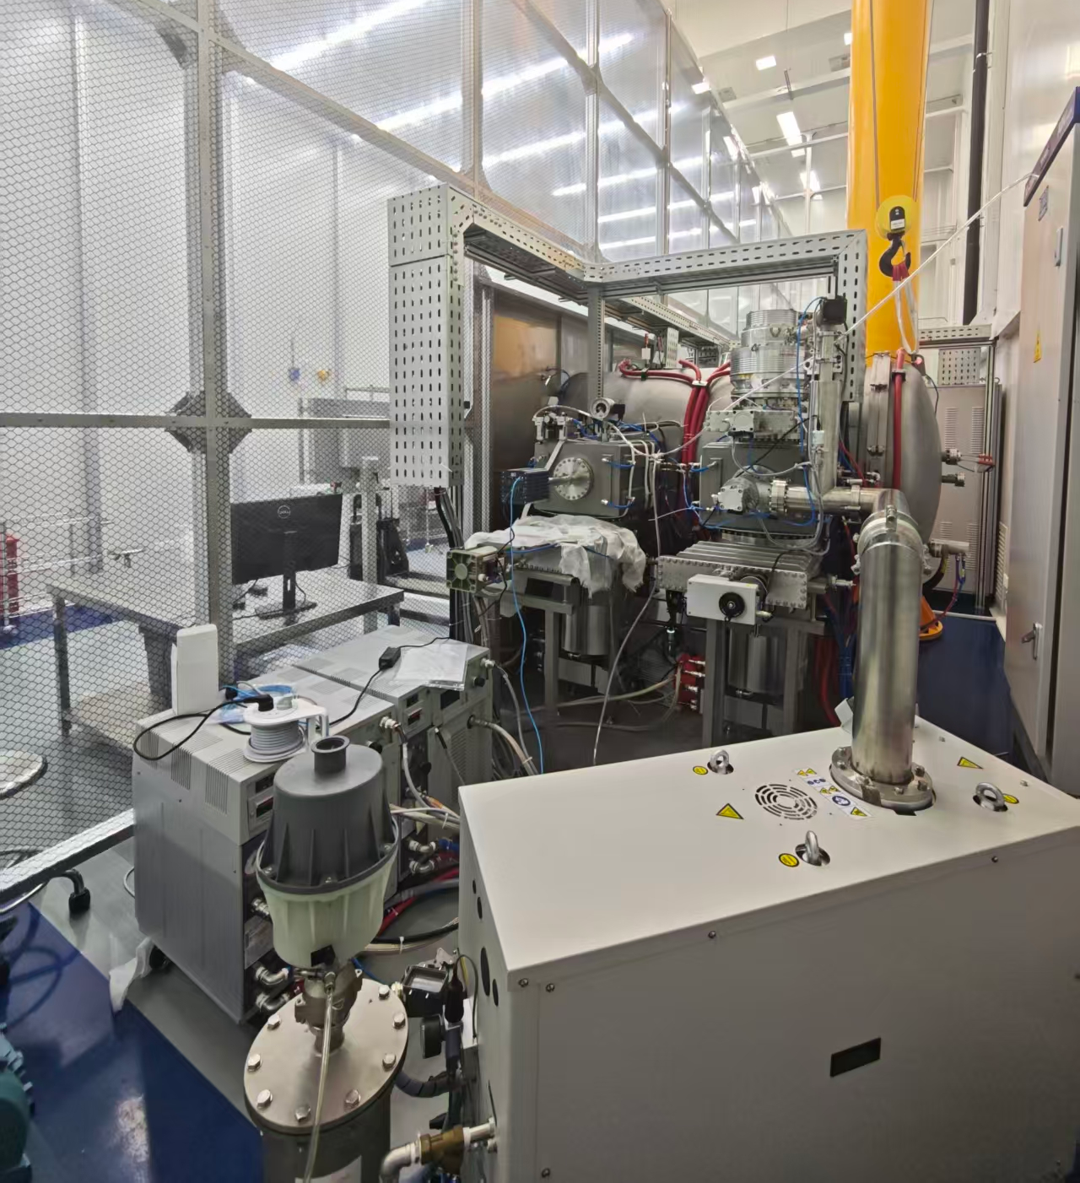
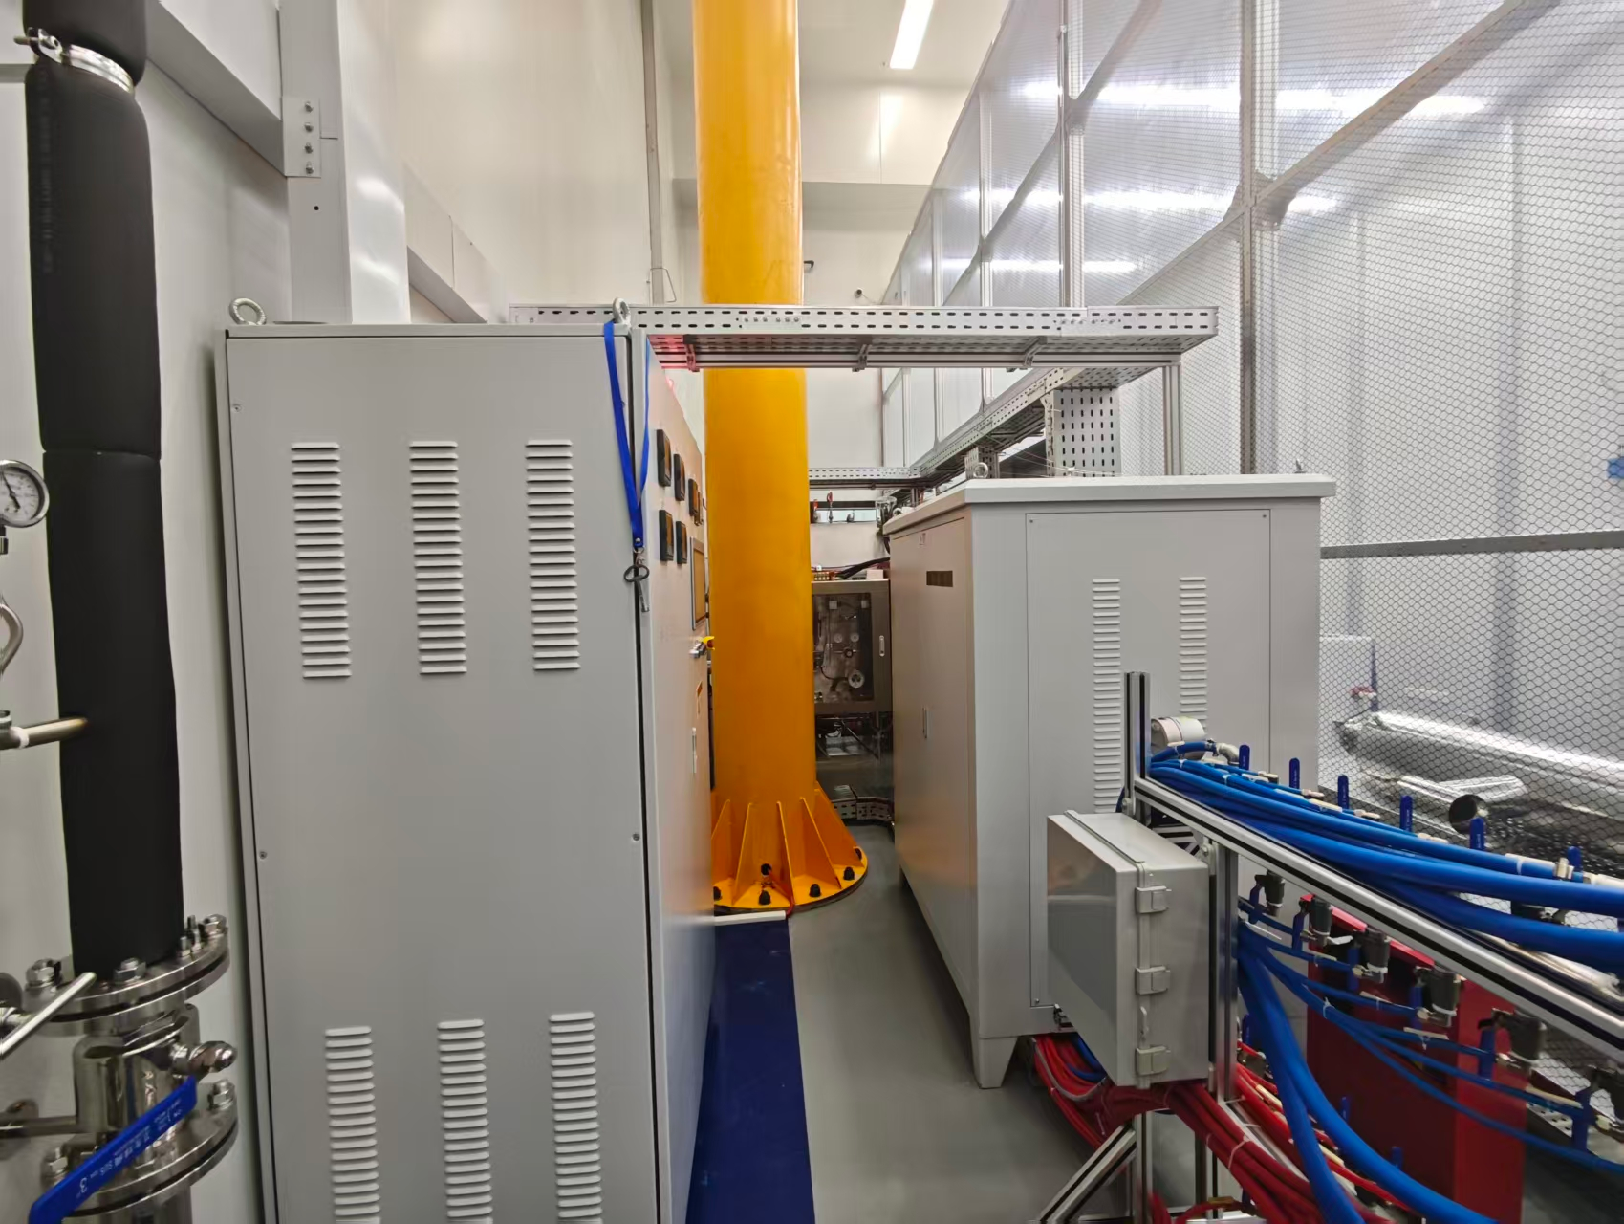
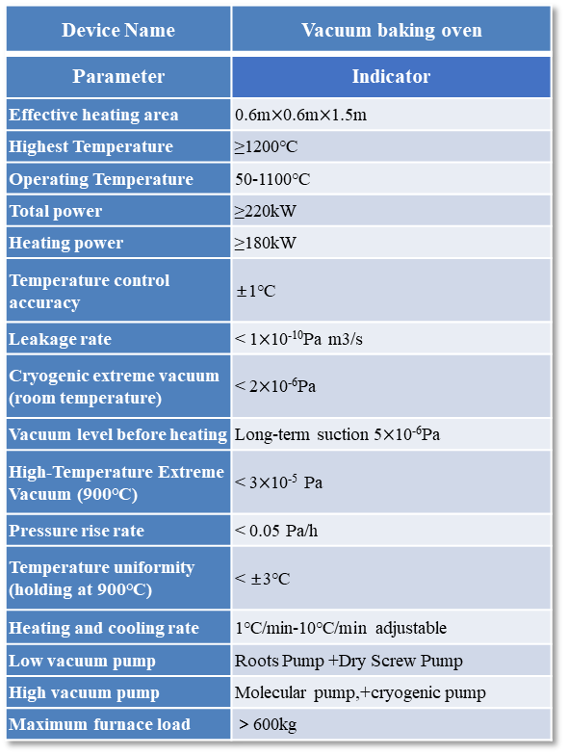
Device Name | Vacuum baking oven
Parameter | Indicator
Effective heating area | 0.6m$×$0.6m$×$1.5m
Highest Temperature | ≥1200℃
Operating Temperature | 50-1100℃
Total power | ≥220kW
Heating power | ≥180kW
Temperature control accuracy | ±1℃
Leakage rate | < 1$×$10⁻¹⁰Pa m3/s
Cryogenic extreme vacuum (room temperature) | < 2$×$10⁻⁶Pa
Vacuum level before heating | Long-term suction 5$×$10⁻⁶Pa
High-Temperature Extreme Vacuum (900℃) | < 3$×$10⁻⁵ Pa
Pressure rise rate | < 0.05 Pa/h
Temperature uniformity (holding at 900℃) | < ±3℃
Heating and cooling rate | 1℃/min-10℃/min adjustable
Low vacuum pump | Roots Pump +Dry Screw Pump
High vacuum pump | Molecular pump,+cryogenic pump
Maximum furnace load | ＞600kg
Furnace body area
Front furnace door
Cooling water tank
Vacuum pump unit
Distribution System
Vacuum furnace (furnace body、vacuum pump unit、nitrogen filling system、power distribution system and water cooling system), Class 100 cleanroom.

Slide 12
preliminary experiment on 1.3GHz single cell

Slide 13
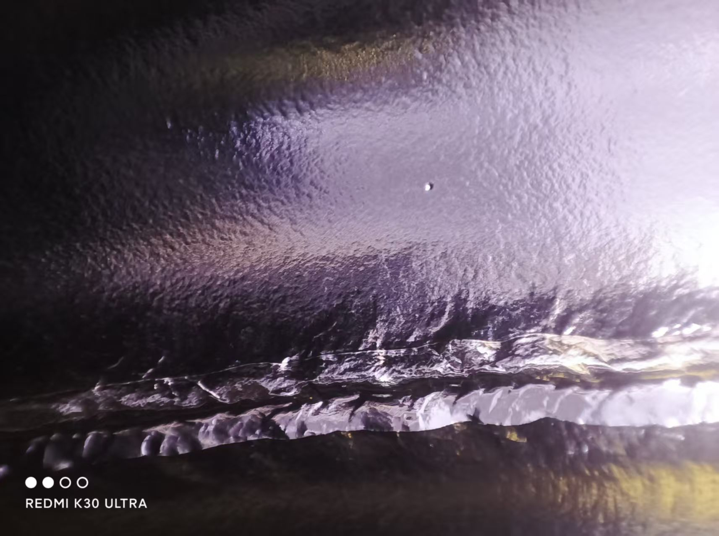
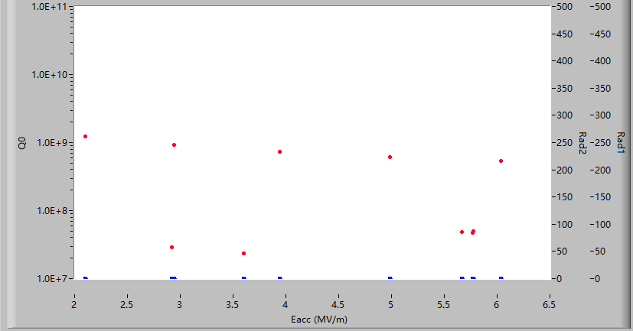
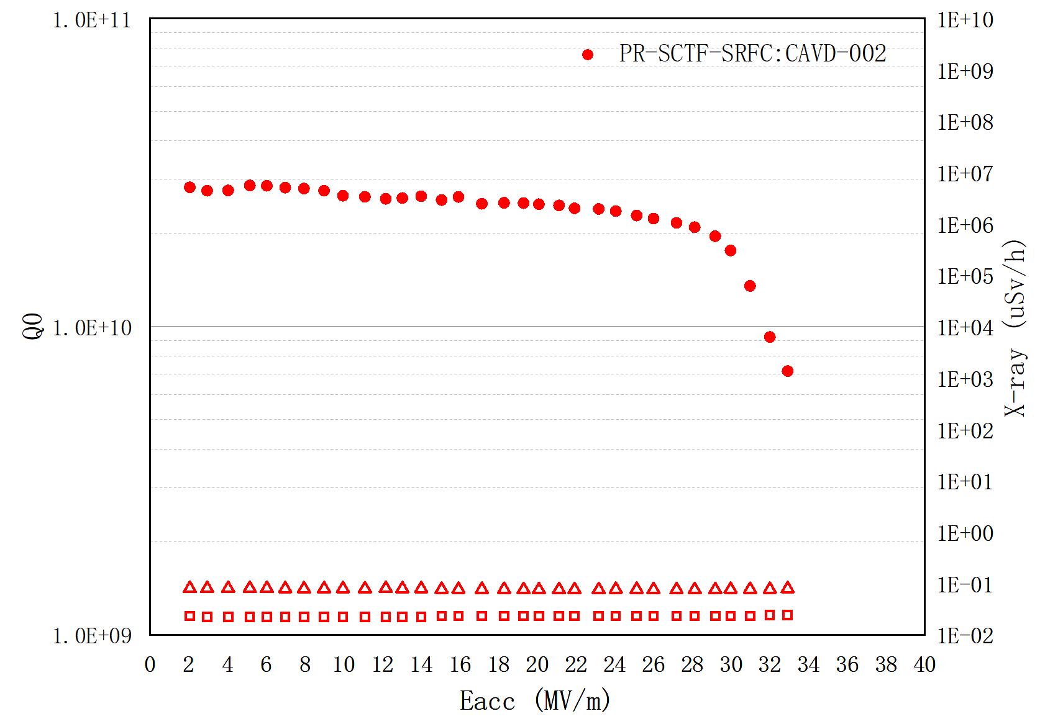






1.3GHz Single cell surface-treatment
EP $132μm$
PR-SCTF-SRFC:CAVD-002
BCP 60$μm$
Out BCP 10$μm$
CAVD-002 single cell cavity was treated by OITC. After EP, small pits were found at the welds, then a 60-micron BCP polish was performed. The cathode rod is wrapped with a PTFE porous tube and an additional mesh membrane;
OITC
900℃ 3h baking
EP 30$μm$
VT
Treated by OITC
EP 200$μm$(acid T=10℃)
900℃ 3h baking
IASF
Treated by IASF
EP 30$μm$ (acid T=7℃)
VT

Slide 14
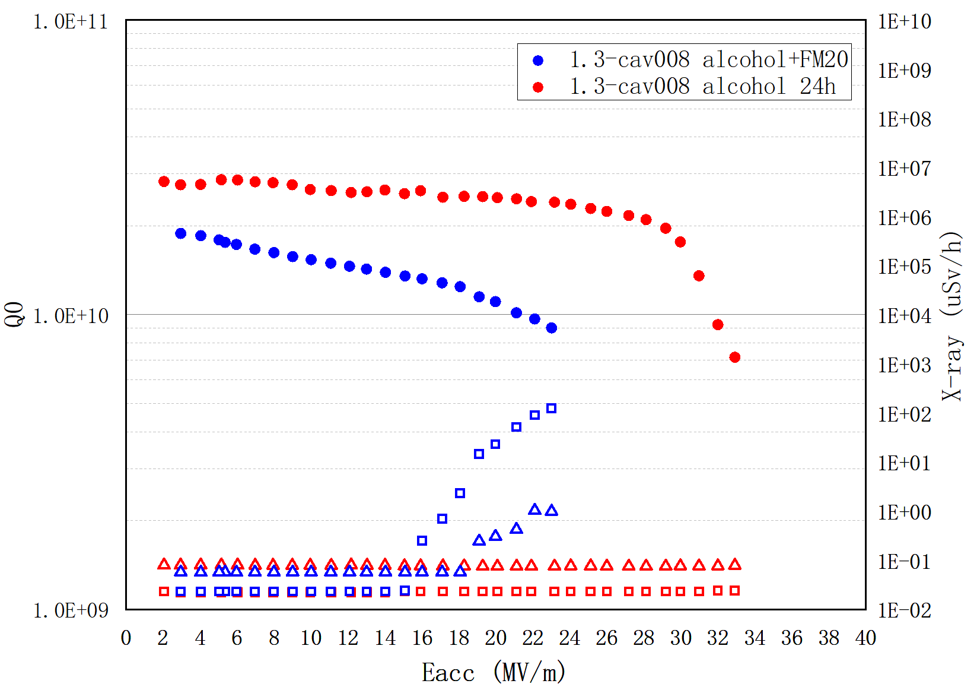
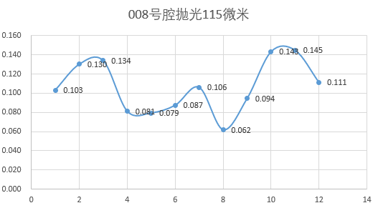
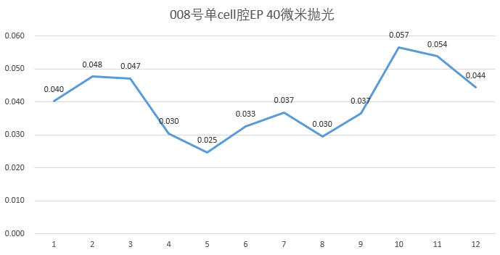
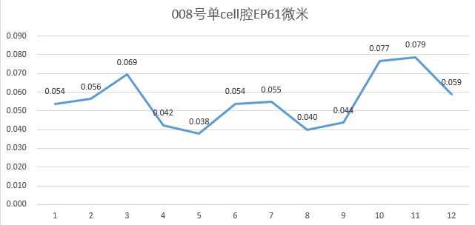
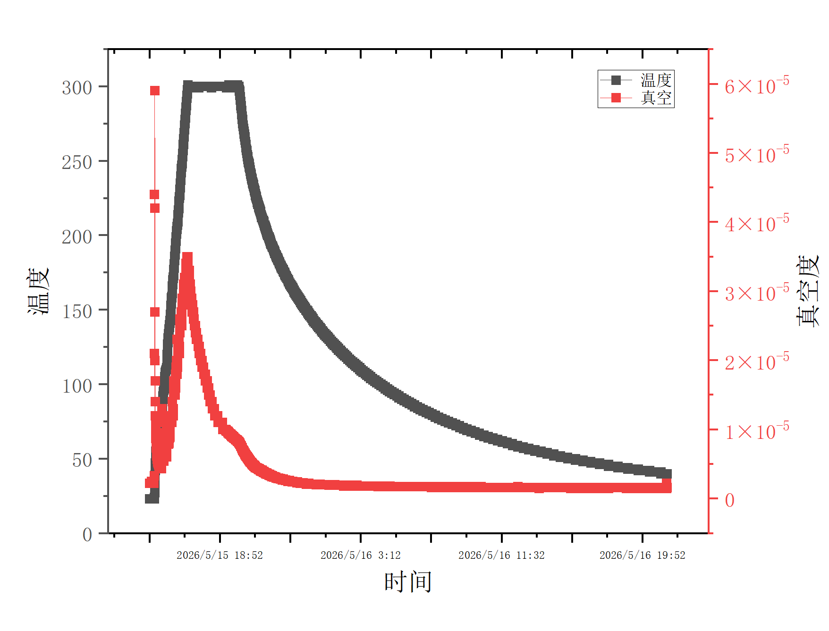



EP $216μm$ (acid T=10℃)
1.3GHz Single cell surface-treatment
PR-SCTF-SRFC:CAVD-008
Out BCP 16$μm$
The cathode rod is wrapped with PTFE raw sealing tape at the part corresponding to the beamtube,but the polishing thickness effect of the beamtube and cell part is not very good.
900℃ 3h baking
EP 60$μm$ (acid T=7℃)
VT
alcohol ultrasonic cleaning 1h and FM20 ultrasonic cleaning 3h;
alcohol ultrasonic cleaning 24h;
EP 30$μm$ (acid T=7℃)
VT
Number | Polishing thickness | beamtube Average | Cell Average | Max Polishing Thickness | Min polishing thickness | Max/min
1 | 115 | 127.67 | 84.83 | 145 | 62 | 1.84
2 | 40 | 48.3 | 32 | 57 | 30 | 1.9
3 | 61 | 65.67 | 45.5 | 79 | 40 | 1.975
900℃ 3h
300℃ 3h
Waiting for VT

Slide 15
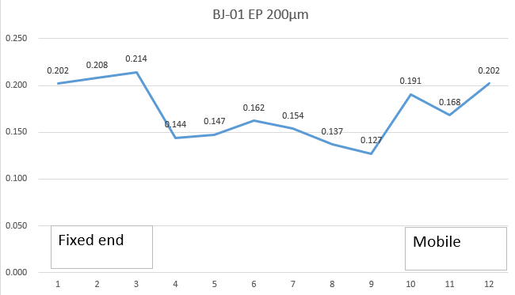
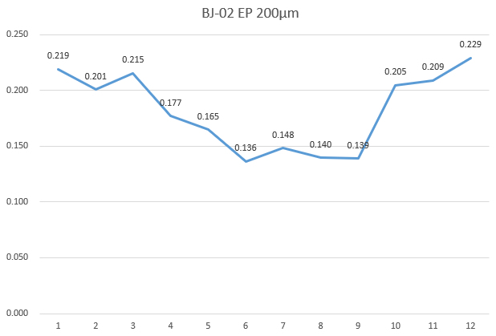


1.3GHz Single cell surface-treatment
BJ-01、BJ02
EP $200μm$ (acid T=10℃)
The cathode rod is wrapped with a PTFE porous tube and an additional mesh membrane , and the polishing thickness effect of the beamtube with cell part is better.BJ-01 and BJ-02 citvities are waiting for VT.
900℃ 3h baking
Out BCP 10$μm$
EP 30$μm$ (acid T=7℃)
Waiting for VT
cavity | Polishing thickness | beamtube Average | Cell Average | Max Polishing Thickness | Min polishing thickness | Max/min
BJ-01 | 200 | 197.5 | 145.3 | 214 | 147 | 1.68
BJ-02 | 200 | 212.9 | 150.76 | 229 | 136 | 1.68

Slide 16
Summary

Slide 17
Summary
We have basically completed the construction of the surface treatment platform and have carried out surface treatment on several single-cell cavities.
We plan complete the optimization and solidification of the surface treatment process and technology this year. We plan to achieve an production capacity of 40-50 cavities per year.
Future Process Optimization
  We plan to develop vibration equipment to perform ultrasonic vibration desulfurization on superconducting cavities.
  Change the temperature difference between the spray water and acid, and study the effect of the temperature difference on the polishing uniformity.
  Our endoscope has just passed inspection, and we will subsequently add endoscopic examinations before and after EP.

Slide 18

THANK YOU
深圳市光明区新湖街道
荔湖西路618号
No. 618, Lihu West Road, Guangming District,
Shenzhen, Guangdong, P.R.China

