Slide 1
Recent progress in high-frequency pulse electropolishing of niobium and SRF cavity in ionic liquid
Qingwei Chu
Institute of Modern Physics, Chinese Academy of Sciences
2026.6.9
TESLA Technology Collaboration (TTC) 2026
1

Slide 2
Content
01
Intro & Tech Overview
Background, Goals
02
Sample Study
Params, Eval. & Analysis
03
Cavity Application
Device Progress & Verification
04
Summary & Outlook
Conclusions & Future Work

Slide 3
01、Introduction
Improve polishing safety and material removal rate for BCP and EP processes:
Eliminates HF usage, reducing operational hazards and environmental burden.
Delivers a high removal rate, effectively increasing polishing efficiency.
To balance surface quality and processing efficiency.
Issues with conventional BCP/EP:
Bipolar Pulsed Electropolishing (BPEP) – JLab
Plasma Electrolytic Polishing (PEP) – INFN
Pulsed Electropolishing in Non-Aqueous Solvent (e.g., ionic liquid) – Our team (IMP)
……

Slide 4
01、Tech Overview
High-frequency pulse polishing technology
Main Report Content: Exploration from Sample to Cavity
Sample-level Basic Research: Optimize the electrolyte system and pulse parameters, verify the advantages of the new process in removal rate, surface roughness and complete laboratory principle verification.
Cavity-level Engineering Application: Expand the technology from planar samples to complex cavity structures, solve the uniformity control challenges in process scaling up.
▌ Core System: Non-Aqueous Solvent Polishing System
Base Solvent: Ethylene Glycol
Core Component: Fluoride salt solution
Auxiliary Additives: specific chemical substances to optimize polishing effect
▌ Key Control Parameters
Pulse Voltage: Set within the range of 100–200 V.
Pulse Frequency: High-frequency signal (kHz level)
stirring rate
electrolyte temperature
……

Slide 5
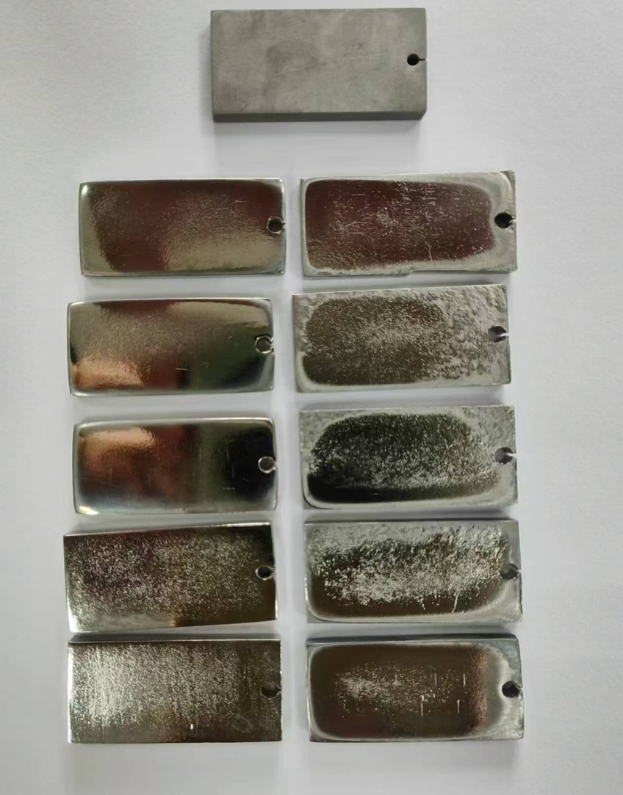
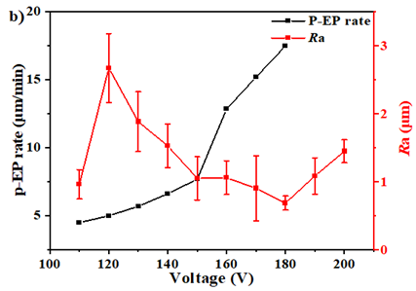
02 Sample Study
Low Frequency: Polishing Performance & Challenges
110 120 130 140 150 V
Raw
160 170 180 190 200 V
The Nb samples were electropolished at 700Hz, 30%, 10 minutes, 110 V to 200 V.
✅ Advantages
Roughness down to 0.7 μm
Polishing rate up to 10 μm/min
⚠️Challenges
Excessive current rise rate
Rapid temperature rise of electrolyte, difficult to control
Notes:
We first used conventional-frequency polishing power supplies – ranging from a few hundred to a few thousand hertz. This work was presented at the last TTC meeting. Today, I will briefly look back it as the foundation for our next work.
As you can see, at 700 hertz, approximately 180 volts is needed to achieve a good polishing result. The corresponding polishing rate is as high as 17 micrometers per minute – extremely fast.
However, we also observed that within just 10 minutes, the current density increased from 0.4 to 1.4. the total current rose from 4 amperes to 15 amperes – a very rapid increase. This caused the electrolyte temperature to rise quickly as well.
When we try to apply these same parameters to a full 1.3 gigahertz cavity, the polishing current and electrolyte temperature can easily become uncontrollable. Therefore, in our subsequent work, we have been looking for ways to control the rise in both current and temperature

Slide 6
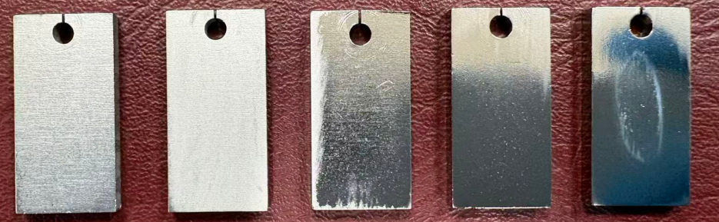
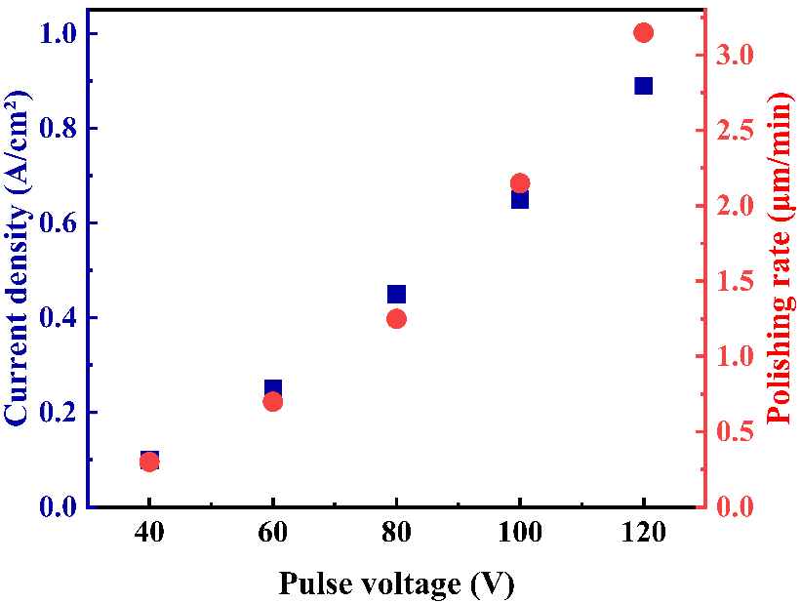
02 Sample Study
High Frequency: Polishing Performance & Challenges
Influence of voltage:
Polishing comparison: low/high frequency @ optimal voltage.
 | Low frequency (700 Hz) | High frequency (20 kHz)
U (V) | 180 | 100
i | High | Low
Δ T | Rapidly rise (~80 ºC) | Stable rise ~20 ºC
Ra (μm) | 0.7 | 0.7
Δ PR (μm/min) | 17 | 2.2
40 60 80 100 120
20 kHz 25%
10 min
✅ High frequency operation results in a milder process and more manageable electrolyte temperature.
Notes:
We tried to solve this problem by adjusting the polishing parameters and optimizing the electrolyte composition, but it was not very successful.
We then replaced the power supply with a new pulsed one, increasing the polishing frequency to several tens of kilohertz, and found that this helped to some extent.
When using a frequency of 20 kHz and a voltage of 100 V, compared to the low‑frequency setup shown on the previous slide, both the current density and temperature change more gradually over a 10‑minute period. This significantly improves the controllability of the entire polishing process. However, the polishing rate is also greatly reduced — though it still remains higher than that of EP and BCp.

Slide 7
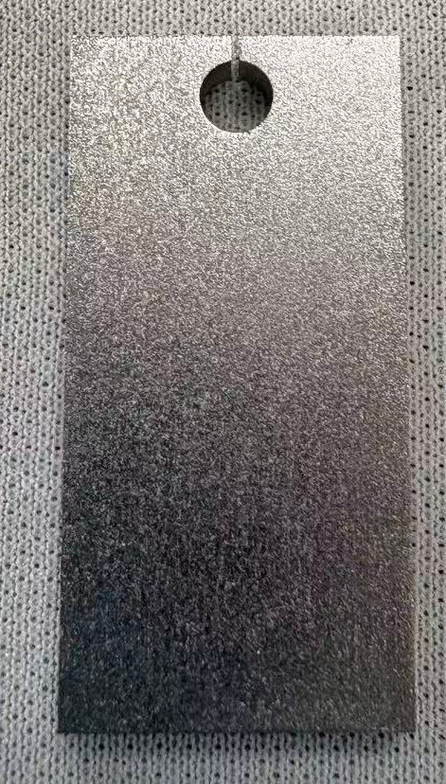
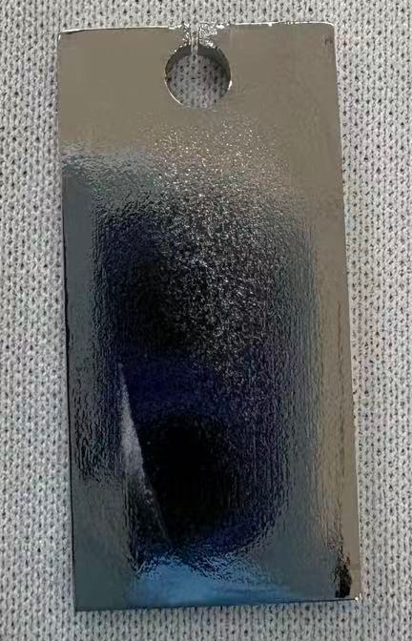
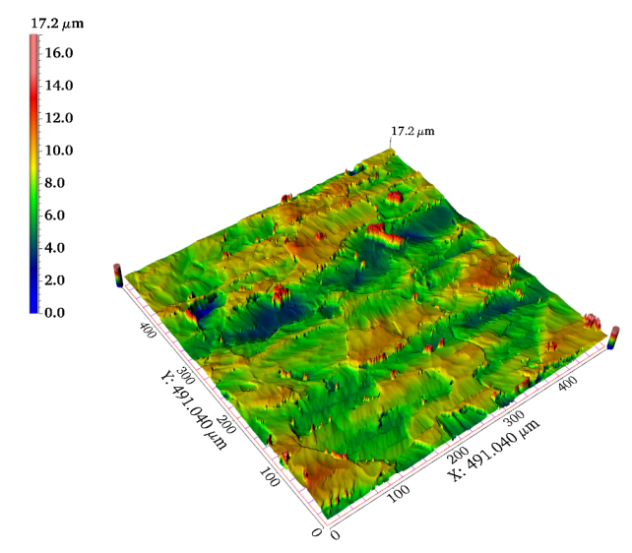
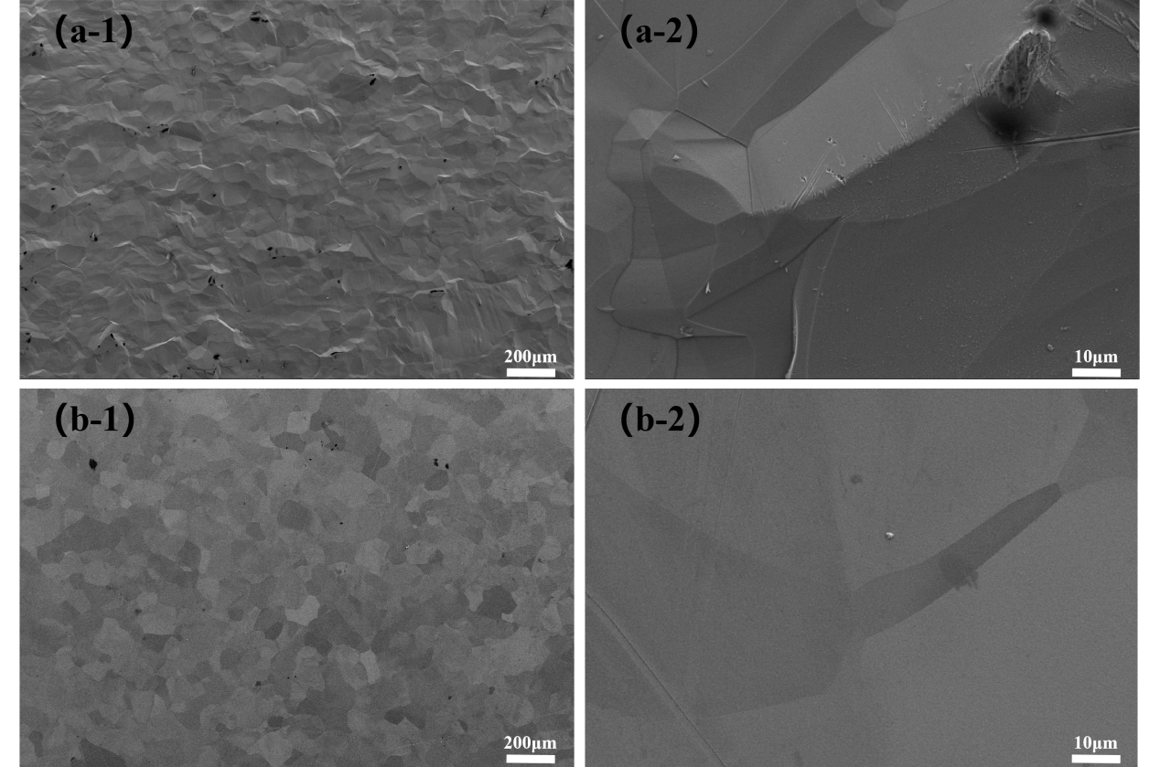
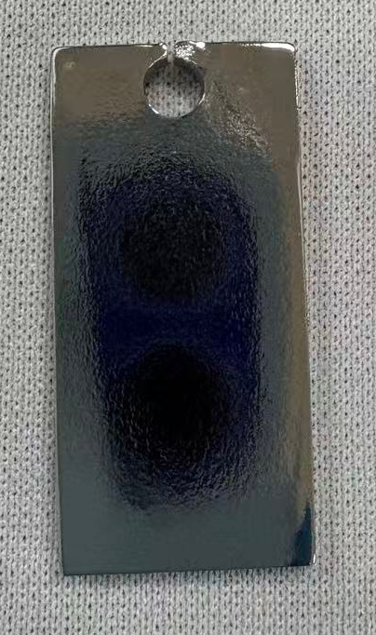
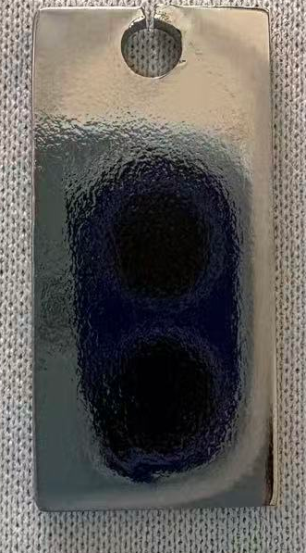
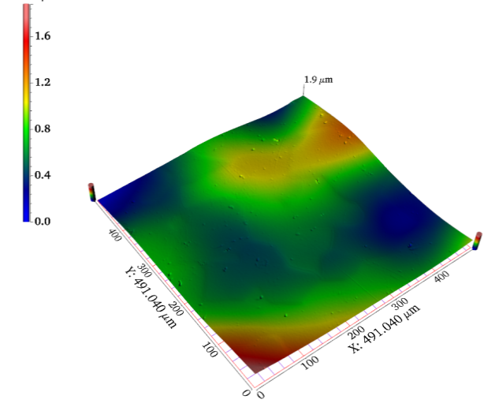
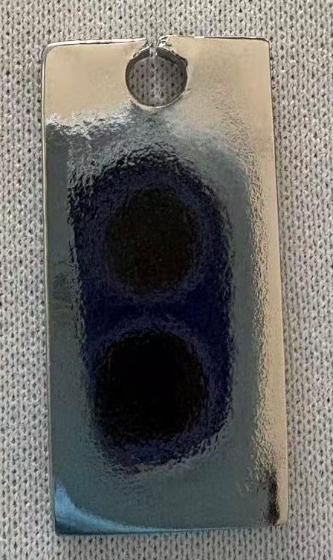
02 Sample Study
20 kHz 25% 100 V
R_{a} 1.15 μm
Raw
50 μm
R_{a} 0.22 μm
100 μm
150 μm
Removal
amount
✅ A uniform and mirror-like Nb surface can be obtained
200 μm

Slide 8
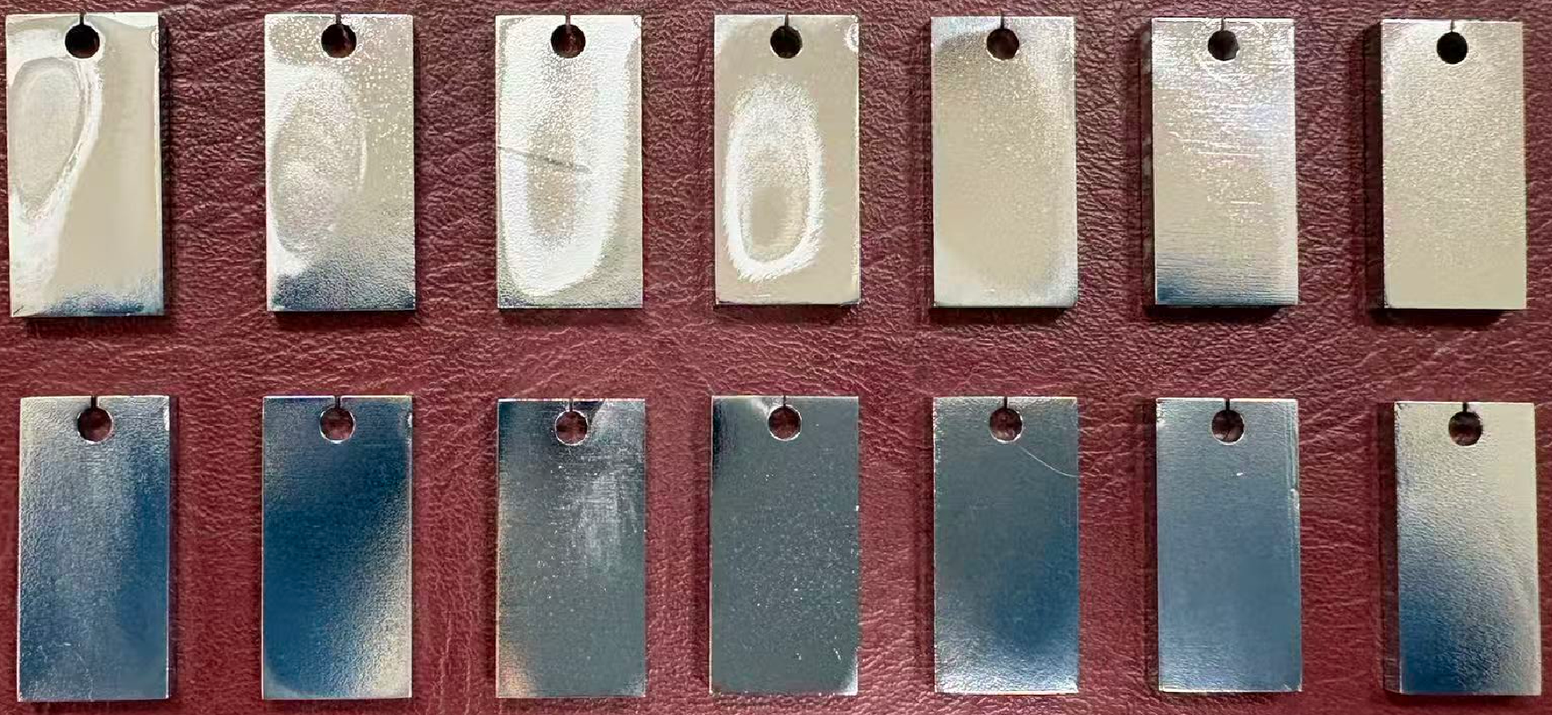
02 Sample Study
High Frequency: Polishing Performance & Challenges
Influence of frequency:
250 500 750 1k 3k 6k 9k
12k 15k 20k 25k 30k 35k 40k
The Nb samples were electropolished at 100 V, 25%, 10 minutes, 250 Hz-40 kHz.
✅ low frequency → prone to white film formation (to be avoided)
✅ The polishing rate reaches up to 2–3 μm/min, which is significantly higher than that of BCP and EP.
✅ High-frequency conditions can effectively suppress the formation of white film and achieve good surface quality.
Notes:
Here are the results from samples polished at different frequencies, all at a voltage of 100 volts. The current density remained nearly constant, similar to the low-voltage results shown on the previous page.
At relatively low frequencies, the surface quality was poor, and a white film tended to form. However, when the frequency reached 20 kilohertz, the surface became bright and shiny.
The polishing rate under these conditions is approximately 3 micrometers per minute. Although this is much lower than the previous 17 micrometers per minute, it is still far higher than that of conventional BCP and EP.
By significantly increasing the frequency, we traded off polishing rate for stable control of current density and electrolyte temperature.

Slide 9
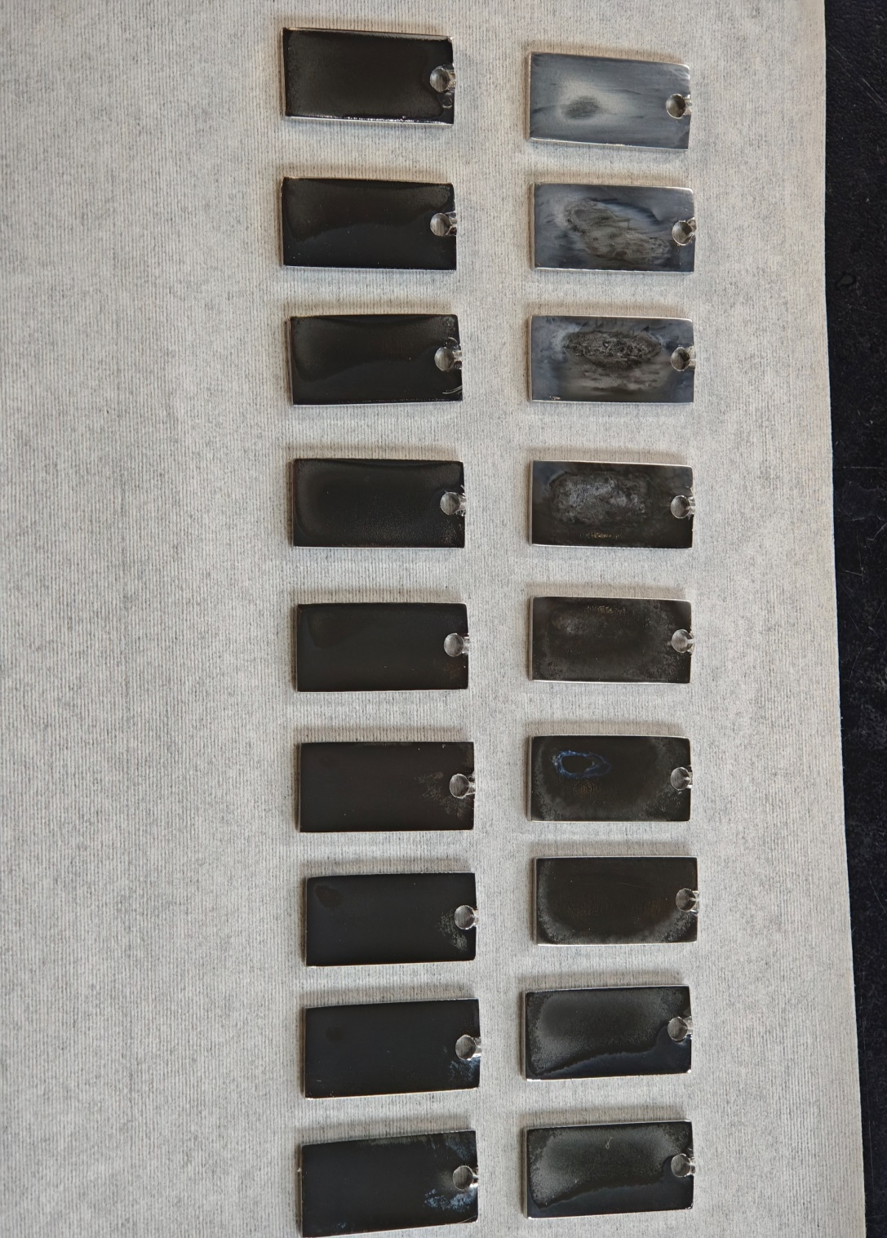
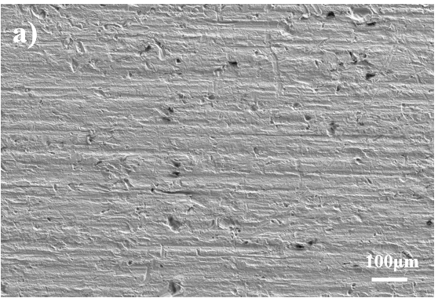
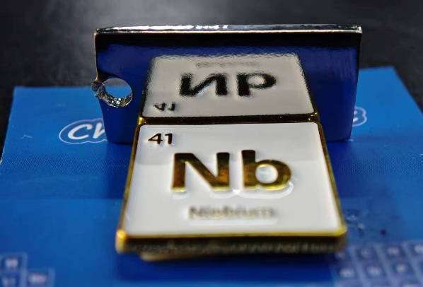
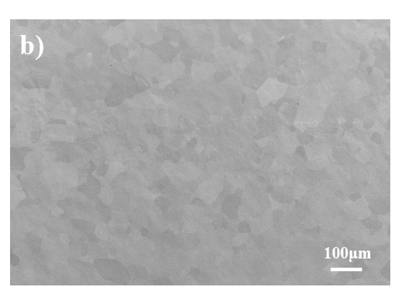
02 Sample Study
Influence of stirring rate (rpm):
100 V 25 kHz 25%
10 min
0
150
200
250
300
350
400
450
500
0 150 200 250 300 350 400 450 500
550
600
650
700
750
800
850
900
950
550 600 650 700 750 800 850 900 950
⚠️ Static / Low : White film
⚠️ Medium : Non‑uniform polishing
✅ Solution: Optimize via experiments – use a sufficiently high & stable stirring rate.
Before EP
After EP
Notes:
In addition to voltage and frequency, the stirring rate of the electrolyte plays an important role in the polishing outcome.
When the stirring rate is too low, the surface tends to develop a white film or become uneven.
On the other hand, if the stirring rate is excessively high, vortices may form in the solution, which is likewise harmful to the polishing process.
When the stirring rate is too slow, mass transfer becomes insufficient. As a result, the diffusion layer thickness increases and becomes unstable. An unstable diffusion layer leads to non-uniform current density distribution across the anode surface.
In areas with locally higher current density, preferential dissolution occurs, forming pits or cavities. Meanwhile, in other areas with lower current density, dissolution is insufficient, leaving behind raised or rough spots. This explains the formation of the white film and poor surface quality.
Since the stirring speed settings vary from one stirrer to another, the optimal speed needs to be determined experimentally for each setup."

Slide 10
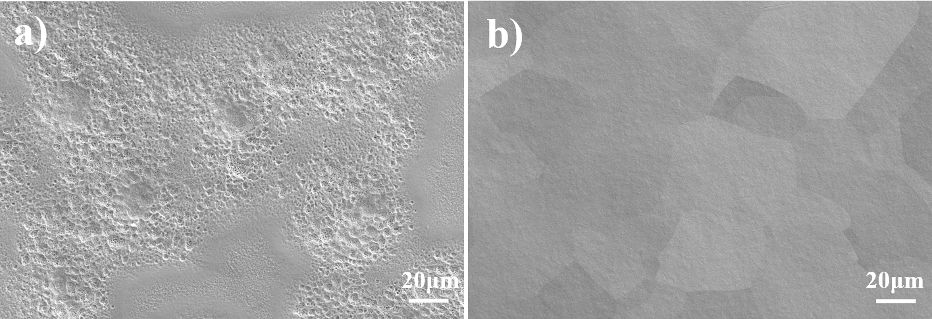
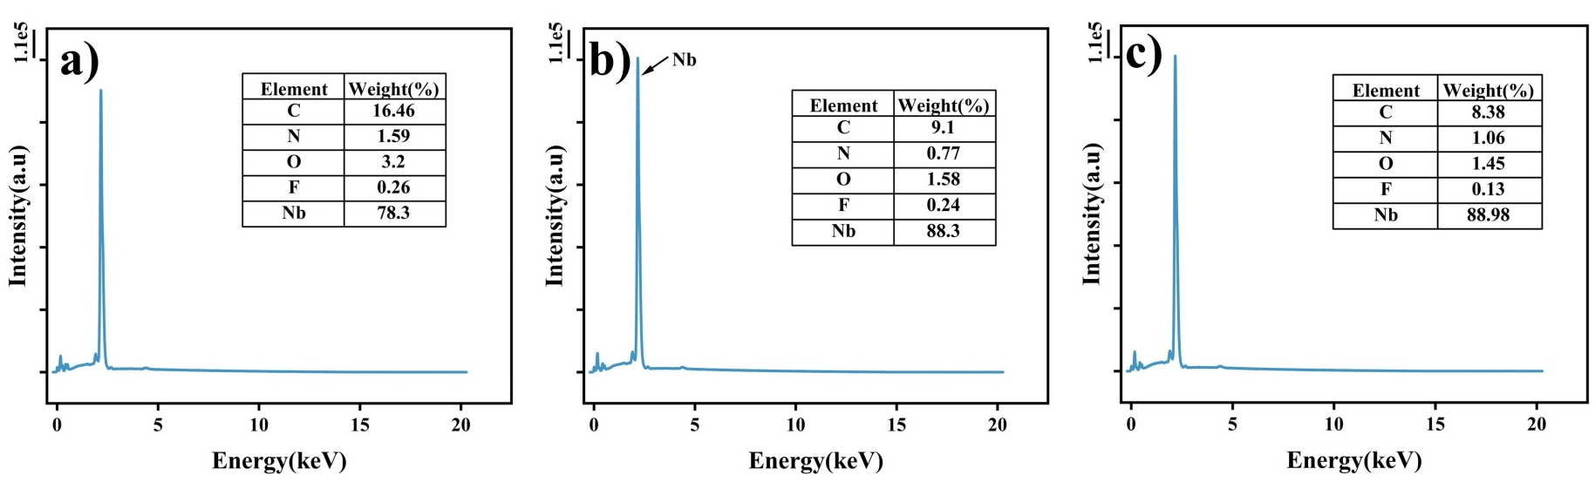
02 Sample Study
Bright Region vs. White Film Region – Comparison & Analysis
White film
Bright region
Before EP
White film
Bright region
✅ The white film is attributed to surface roughness and pits from polishing, rather than the material composition.
Notes:
To figure out what the white film really is, we compared the morphology and composition of the white film region and the bright region.
The white film region appears rough with many pits, whereas the bright region is smooth and flat.
EDS analysis revealed that after polishing, the carbon, nitrogen, and oxygen contents all decreased. But importantly, there is little difference in composition between the white film and bright regions.
So we conclude that the white film is primarily due to non-uniform polishing and defects on the surface – not due to surface passivation. This corrects our previous explanation given at the last TTC meeting.

Slide 11
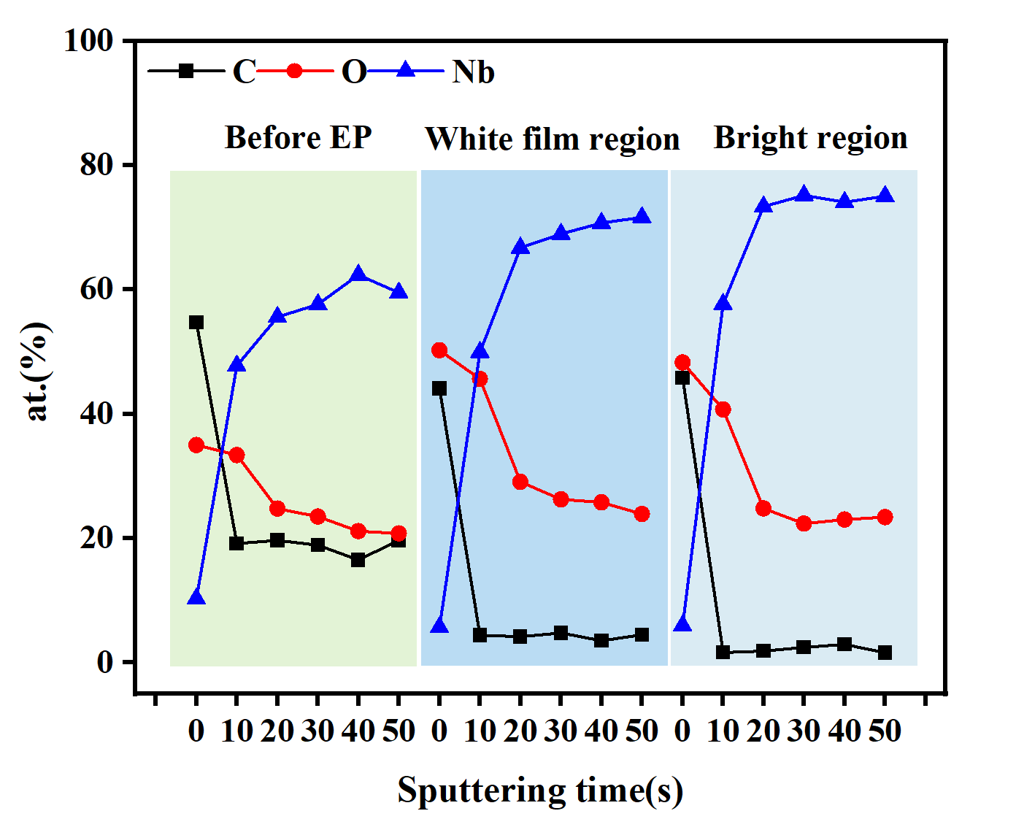
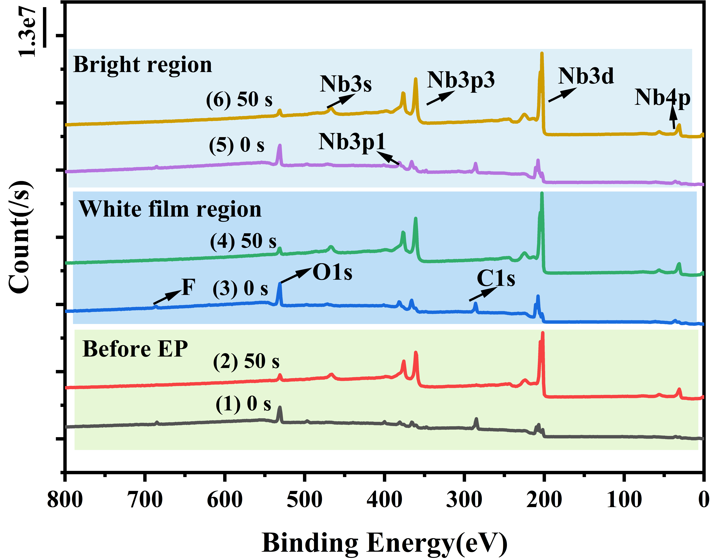
02 Sample Study
Notes:
To further verify whether the white film is related to the surface composition, we performed XPS analysis on different regions of the sample. The changes in carbon, oxygen, and niobium content on the polished surface were essentially similar across all regions, which further confirmed our conclusion.

Slide 12
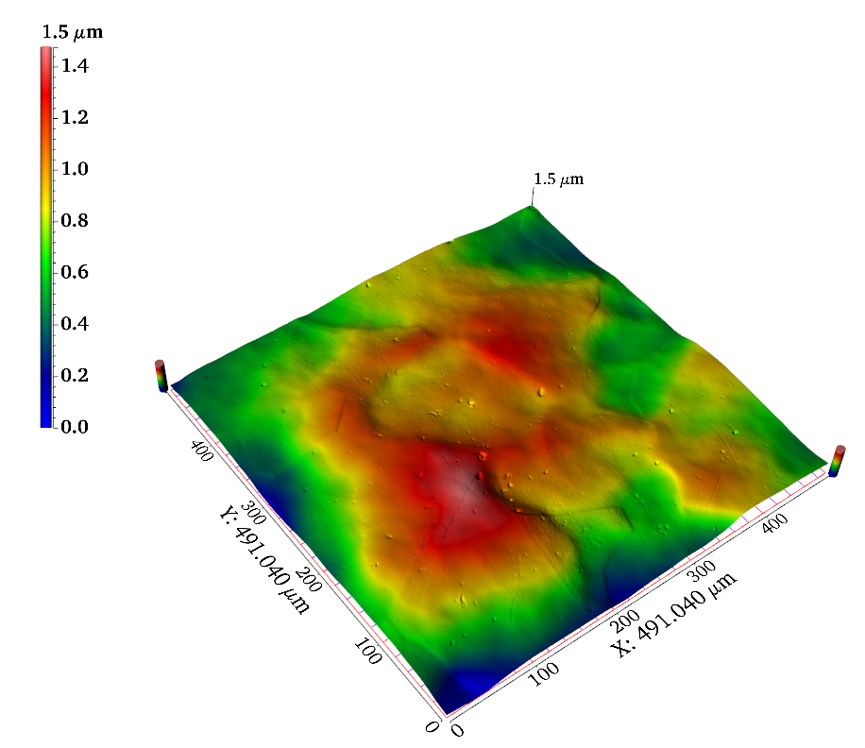
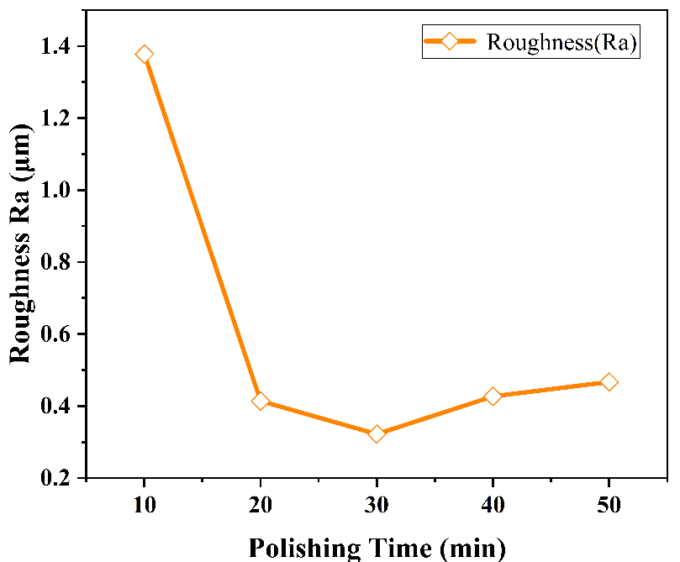
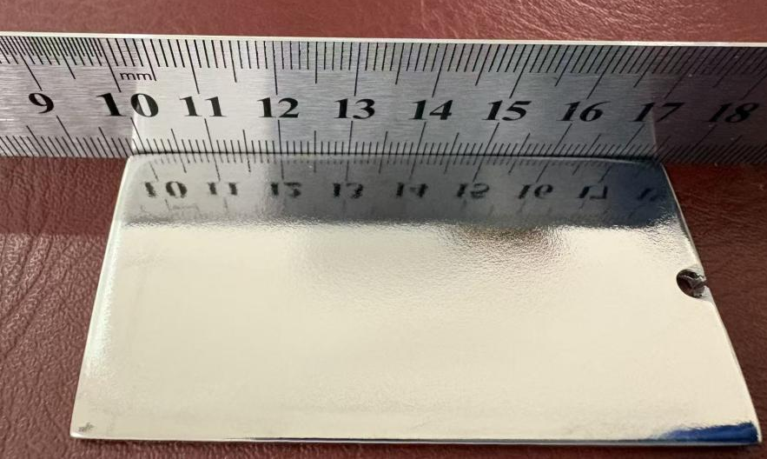
02 Sample Study
Large-area planar sample experiment
R_{a} 0.31 μm
100 V 25 kHz 25% 50 min
✅ Controlled electropolishing parameters → excellent surface finish
Notes:
Based on the results from small samples, we then processed a large-area planar sample. After 50 minutes of polishing, the removal amount exceeded 150 micrometers. The surface became bright, with an obvious mirror-like effect and low roughness.

Slide 13
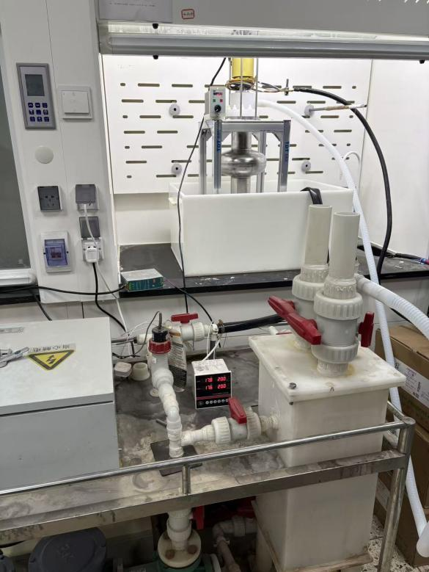

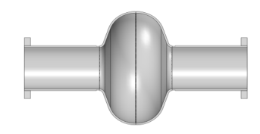

03 Cavity Application
outlet
cathode
inlet
Anode
Power
temperature probe
flowmeter
buffer pool
valve
magnetic drive pump
cooling water
The 1.3 GHz cavity polishing equipment
Notes:
The polishing setup for the 1.3 gigahertz whole cavity has been successfully built. On the left is a schematic diagram. The setup mainly includes a temperature monitoring system and a flow rate monitoring system. The cavity itself serves as a container and is connected to a buffer tank. The flow rate of the liquid is controlled by adjusting the rotation speed of a magnetic drive pump. On the right is a photograph of the actual setup.

Slide 14
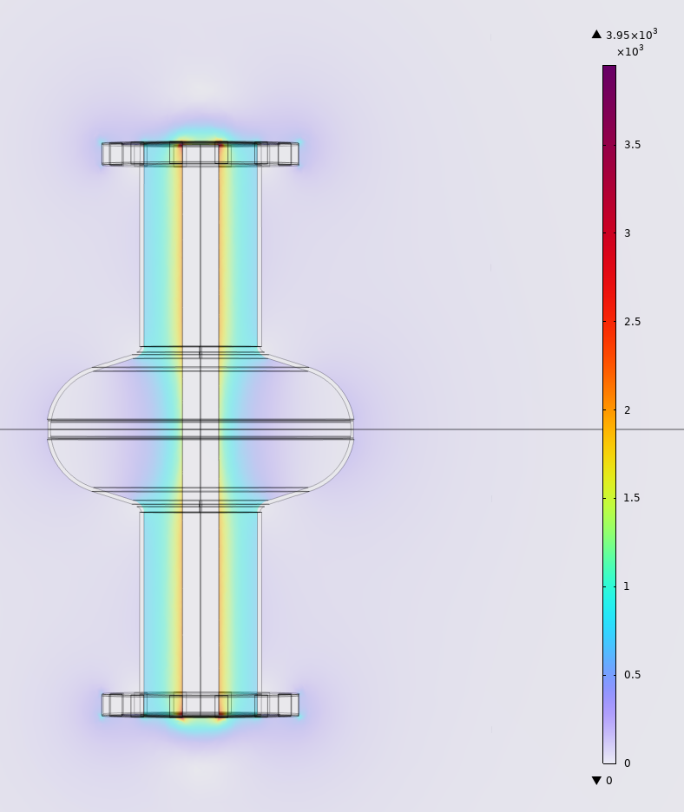
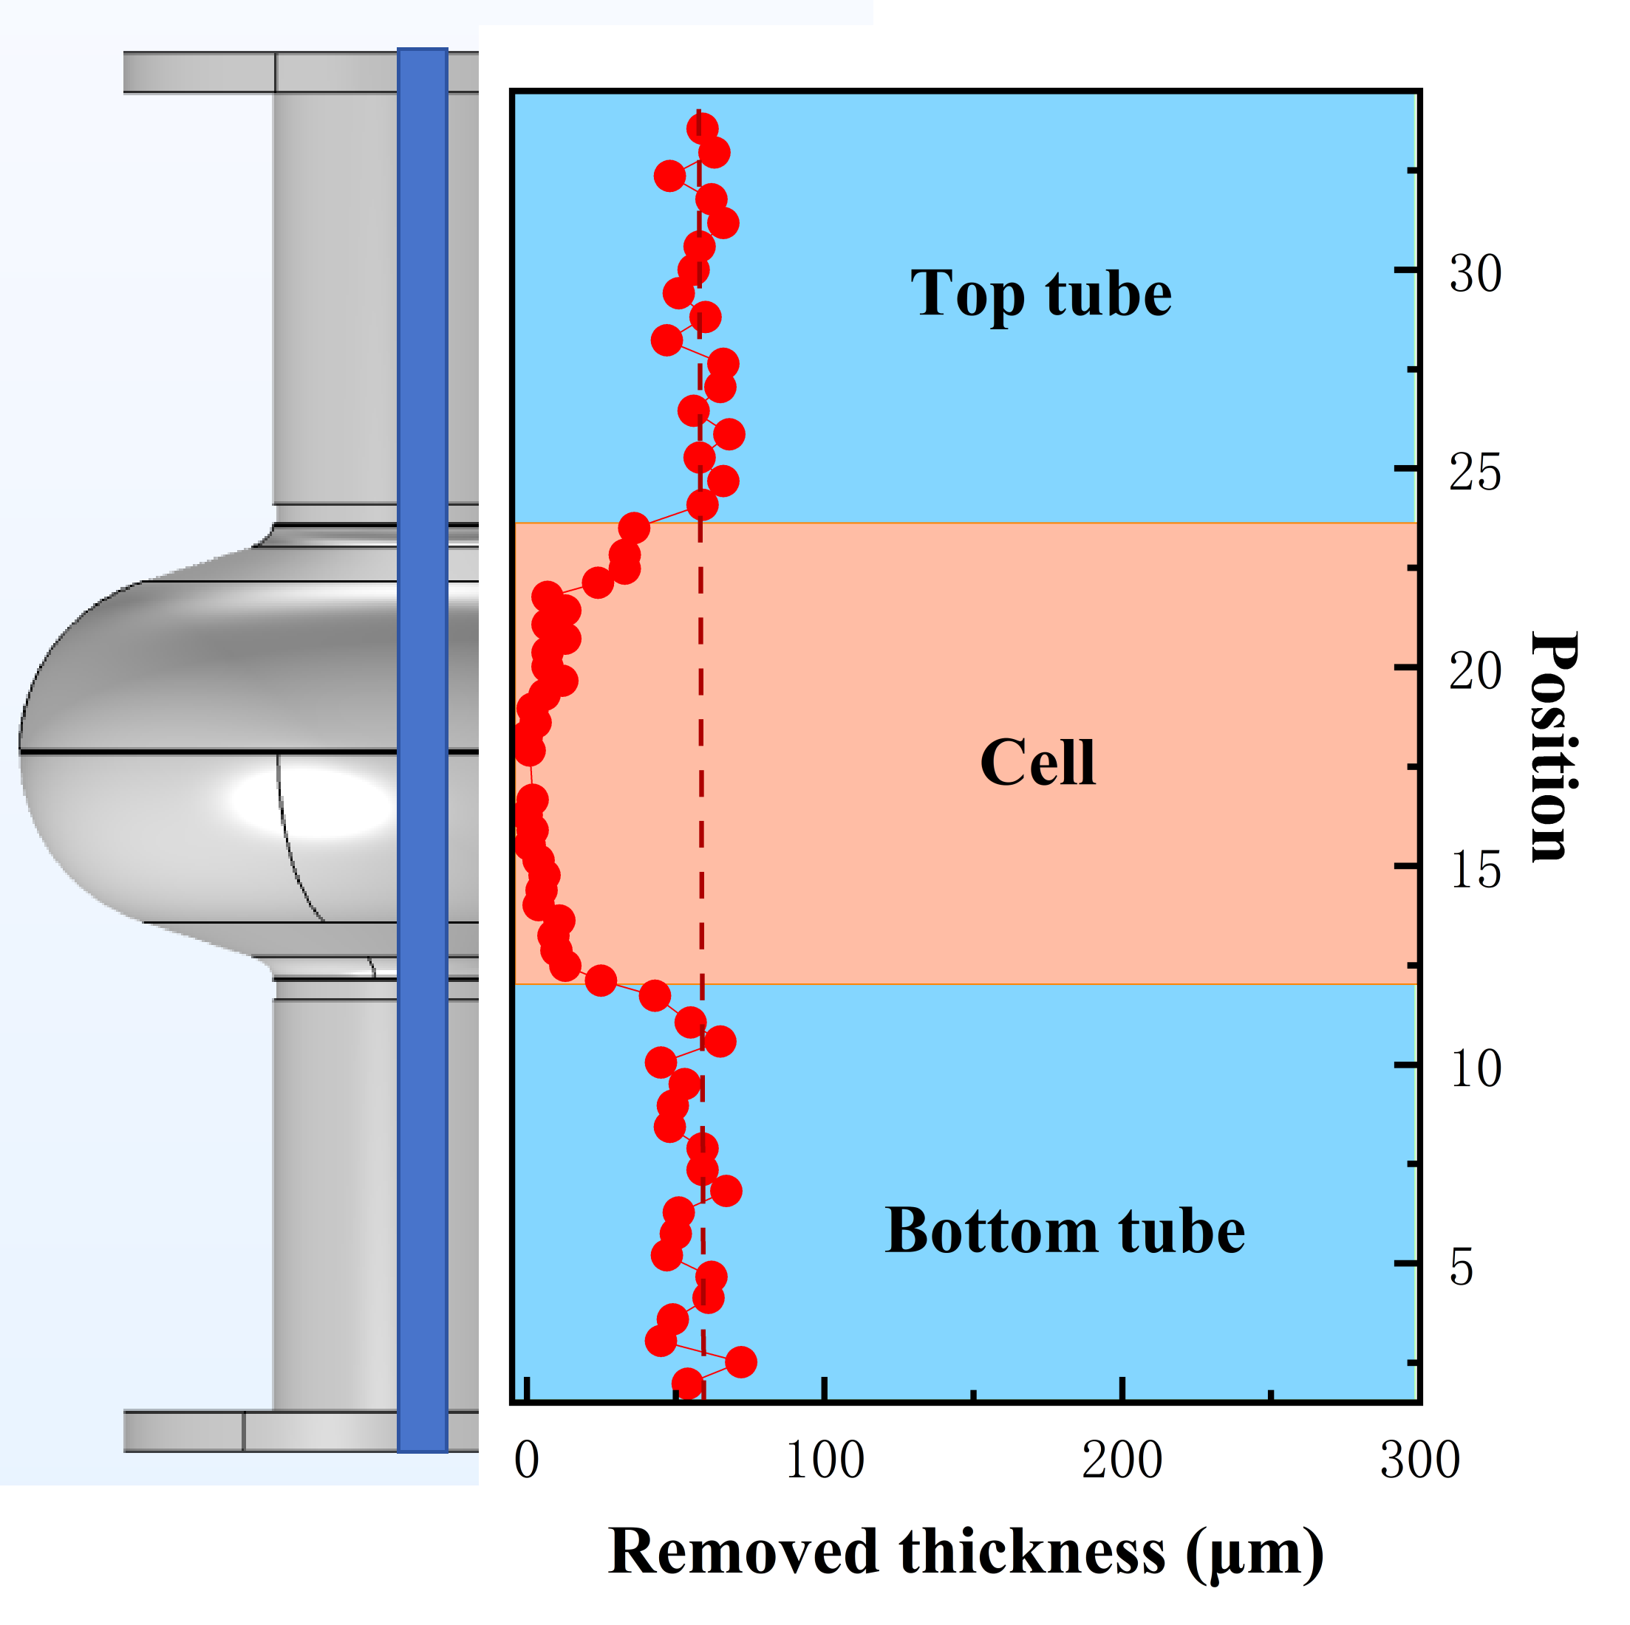
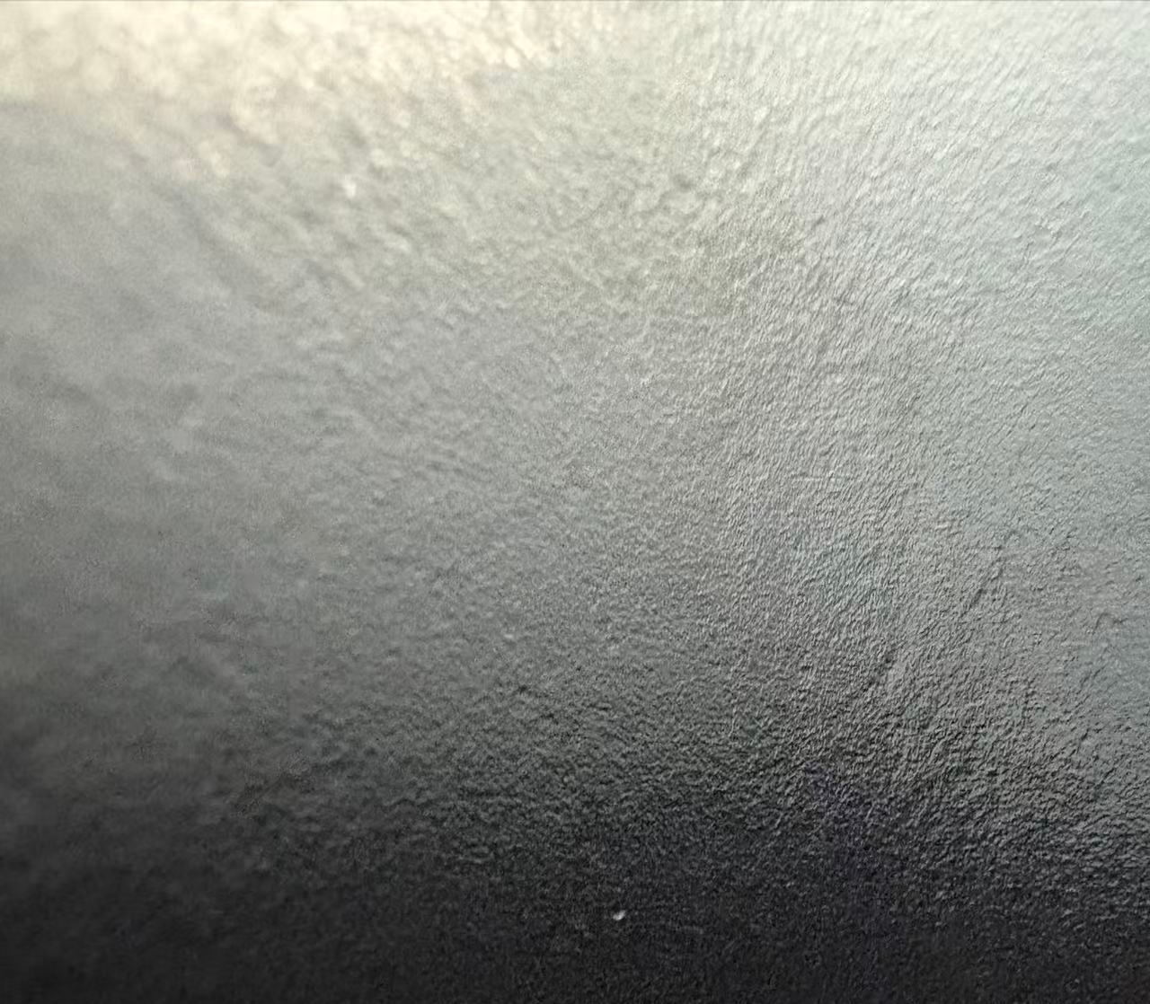
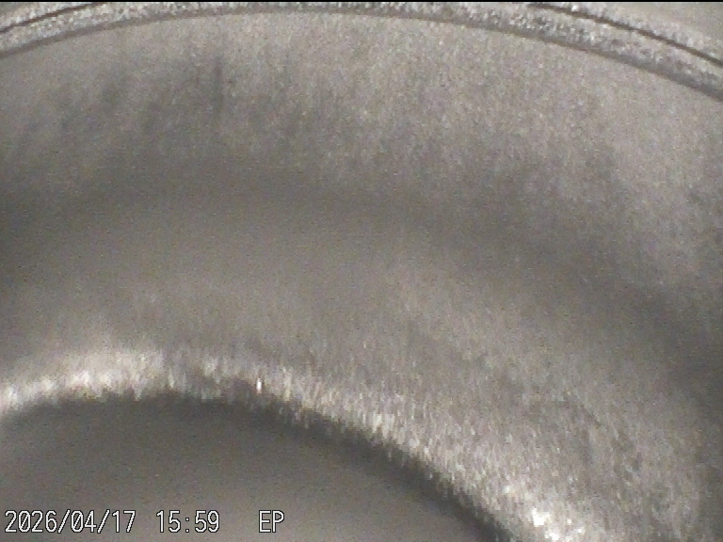
03 Cavity Application
80V 20KHz 25% 40min
straight rod cathode
cell
Straight rod electrode → weak electric field intensity
Especially at the cell → almost no polishing effect
Tube polishing rate：≈ 1.3 μm/min
Average current density：≈ 15 mA/cm²（relatively low）
tube
Notes:
We started with a simple straight rod cathode. Simulation of the electric field showed that the field was weak, particularly in the cell region.
After 40 minutes of polishing under these conditions, the removal at the tube was about 52 micrometers, giving a rate of roughly 1.3 micrometers per minute. In contrast, almost no material was removed at the cell.
The current gradually rose to 21 amperes, corresponding to a current density of about 15 milliamperes per square centimeter."

Slide 15
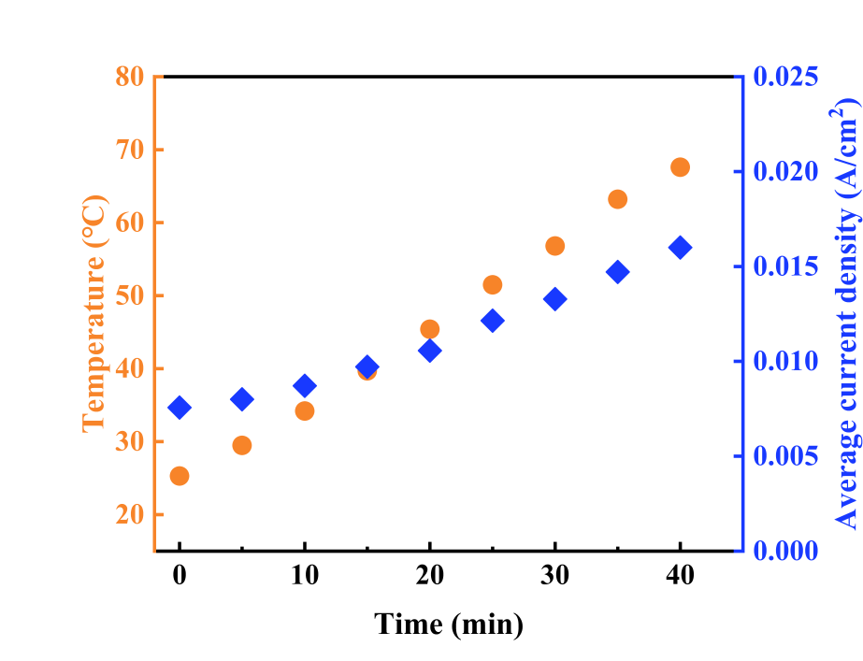
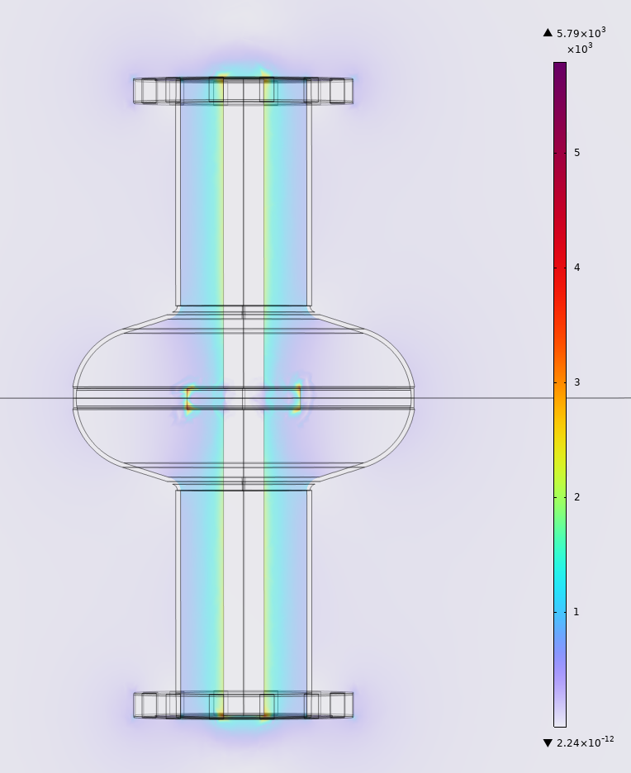
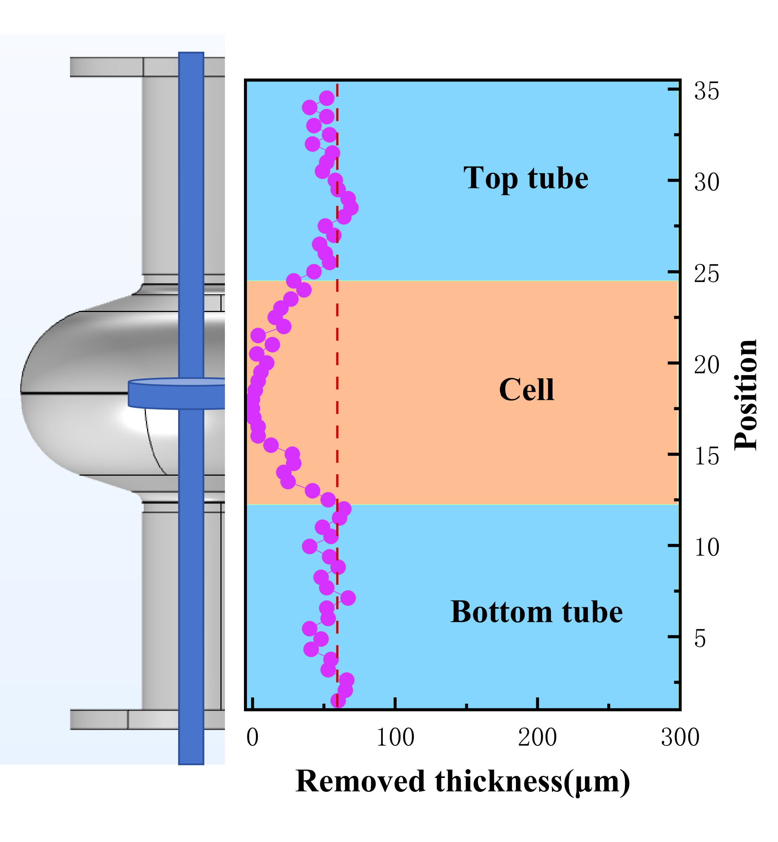
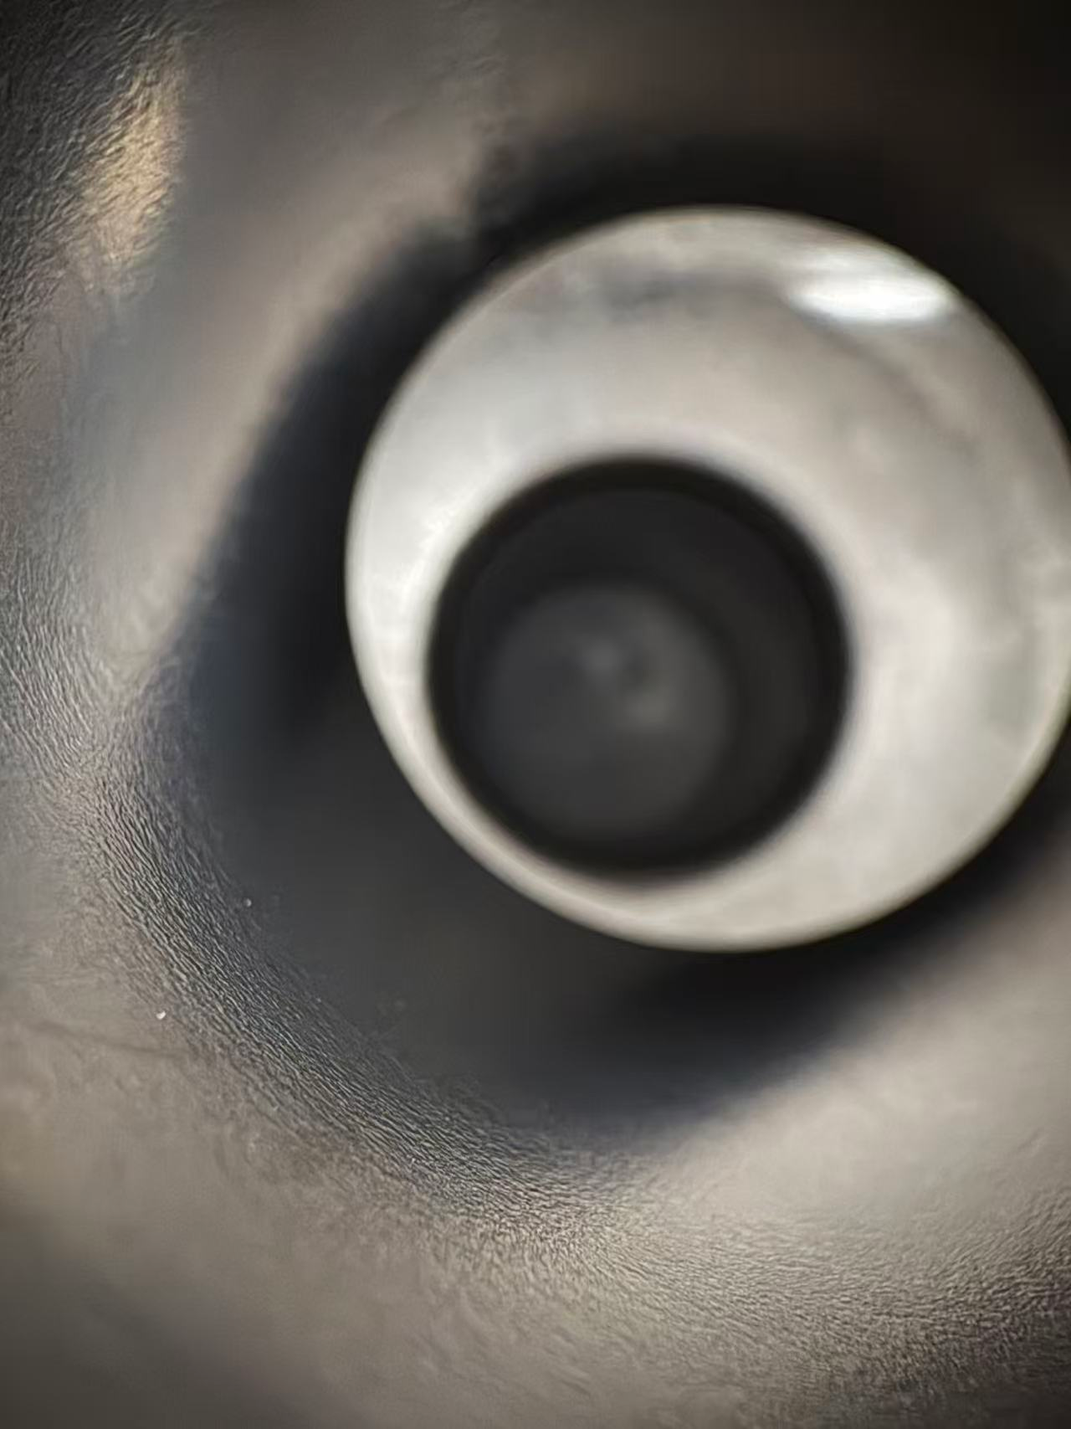
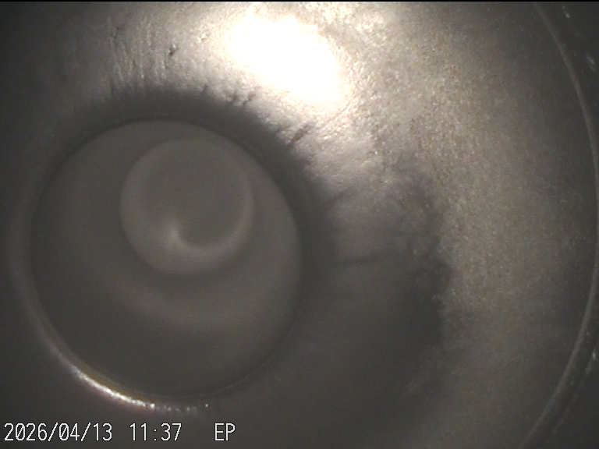
03 Cavity Application
80V 20KHz 25% 40min
straight rod + disc cathode
tube
cell
cell
Straight rod + disc electrode → weak electric field intensity
Especially at the cell → almost no polishing effect
Tube polishing rate ≈ 1.3 μm/min, improved surface finish
Average current density：≈ 16 mA/cm²
tube
Notes:
To enhance the electric field at the cell, we added a disc. The disc diameter is slightly smaller than the tube diameter for proper installation.
The simulation shows that the field strength at the cell increased. After 40 minutes of polishing, the tube removal was about 52 micrometers – a rate of 1.3 micrometers per minute – and the polishing effect was good. But the cell still had almost no removal.

Slide 16
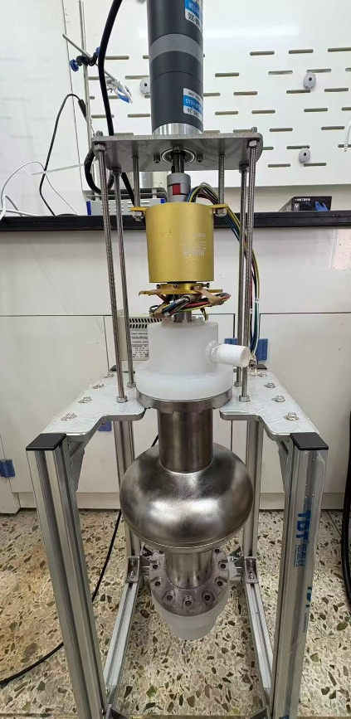
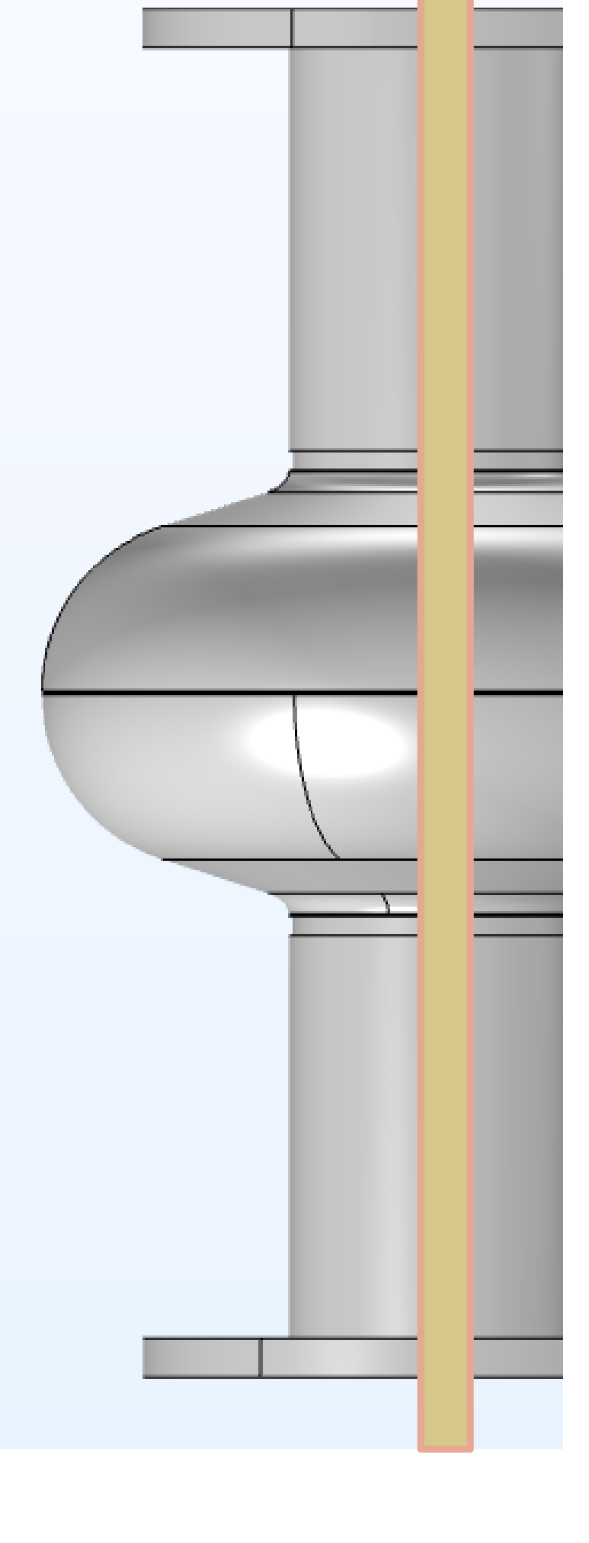
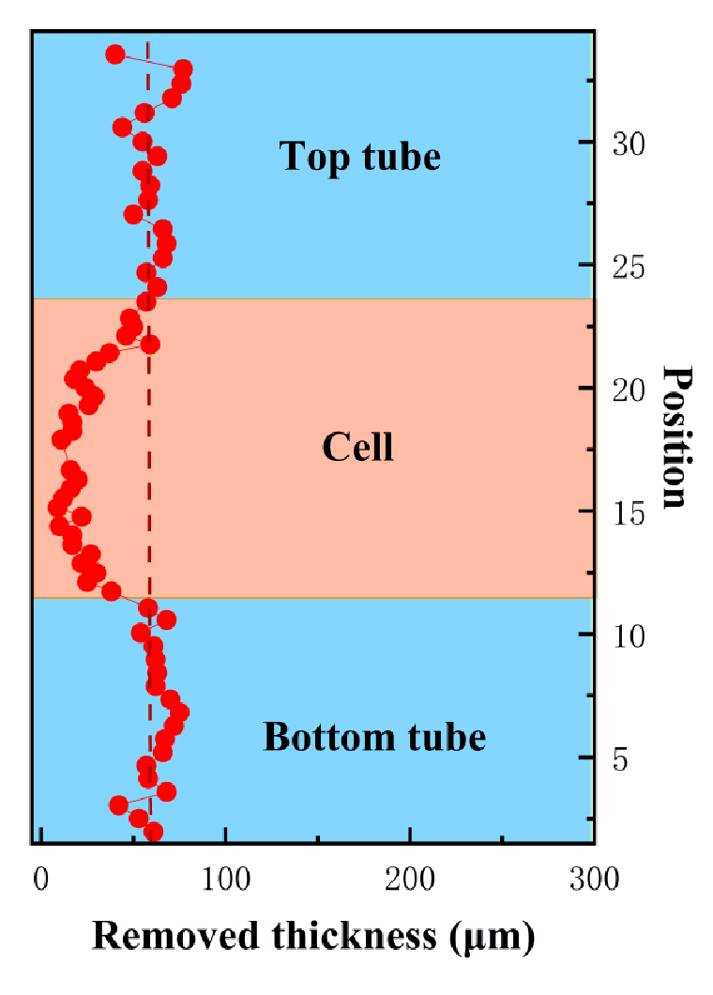
03 Cavity Application
Straight rod + D-shaped rotating electrode, rotation speed: 4 rpm.
Disc electrode was changed to a D-shaped electrode to increase electrode size at the cell.
Polishing rate at the cell improved slightly, but remains unsatisfactory.
Notes:
To continue enhancing the electric field at the cell, we replaced the disc with a D-shaped electrode. This electrode is connected to a motor, allowing it to rotate at 4 revolutions per minute. The rotation speed is also adjustable. The right panel shows a photo of the rotating electrode.
We can now observe some removal at the cell region, which confirms that increasing the electrode size is effective.

Slide 17
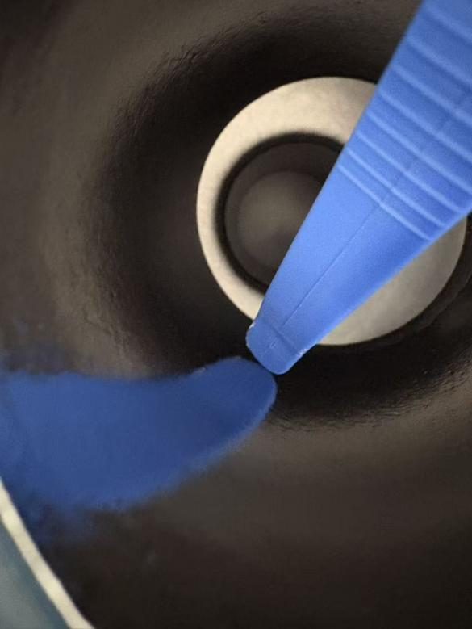
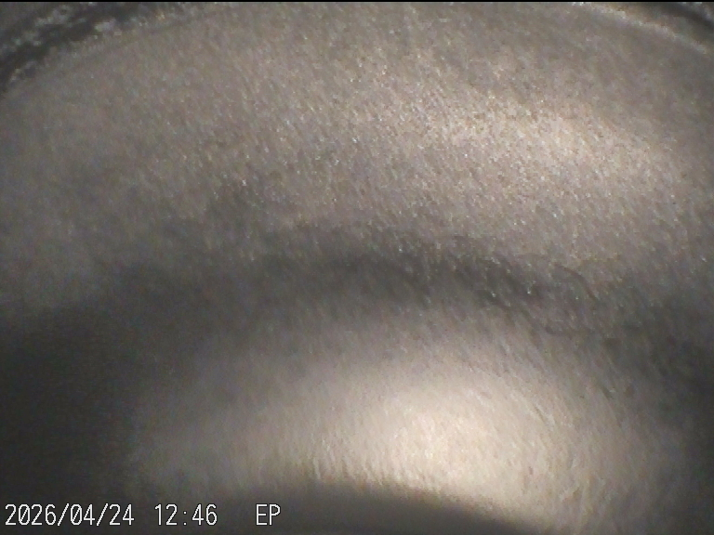
03 Cavity Application
80V 20KHz 25% 50min
tube
tube
Ra ~0.6 μm
cell
After ~50 minutes, electrolyte temperature reached 80 ºC.
Current density reached 16 mA/cm², with a current of ~30 A.
For full-cavity polishing, these electrical parameters are within an acceptable range.
Notes:
After 50 minutes of polishing with these parameters, the current density and electrolyte temperature behaved much the same as before. But when we looked at the cell region with an endoscope, we saw almost no material removal – the electric field was not suitable. So, no polishing occurred at the cell."

Slide 18
04 Summary
Technical Feasibility
  Successfully developed and validated a non-aqueous, HF-free, high-efficiency, high-quality high-frequency pulse polishing technology.
Superior Surface Quality
  Material removal rate: > 3 μm/min
  Surface roughness: < 0.5 μm
  Mirror-like surface finish achieved
Clear Process Window
  Optimal process parameter range determined
  Good reproducibility and stability
Great Potential in Cavity Application
  Experimental setup and preliminary simulation completed
  Application prospect in cavity processing verified
Notes:
We processed single crystal niobium and polycrystalline niobium under this parameter, with a removal amount of about 140 microns. The ep surface is uniform and smooth, with a very good mirror effect, especially for single crystal samples. From the 3D photos, roughness is very low. The previous roughness was measured using a roughness meter, which differed from the 3D results, but the trend remained the same

Slide 19
04 Outlook
Improve process stability & polishing uniformity
  Further increase polishing success rate
  Especially reduce white film formation
Perform vertical testing on polished cavities
  Conduct comprehensive RF performance evaluation
Design and fabricate a retractable electrode
  Optimize electrode shape and distance at the cell
  Achieve stronger and more uniform electric field intensity
Notes:
We processed single crystal niobium and polycrystalline niobium under this parameter, with a removal amount of about 140 microns. The ep surface is uniform and smooth, with a very good mirror effect, especially for single crystal samples. From the 3D photos, roughness is very low. The previous roughness was measured using a roughness meter, which differed from the 3D results, but the trend remained the same

Slide 20
Thanks!
Q & A

