Slide 1


Update: Enhancement of medium-temperature heat-treated 1.3 GHz SRF cavities for high quality and high gradient
Julia Goedecke for the complete SRF team
TTC 2026, 9.–12. June 2026

Slide 2
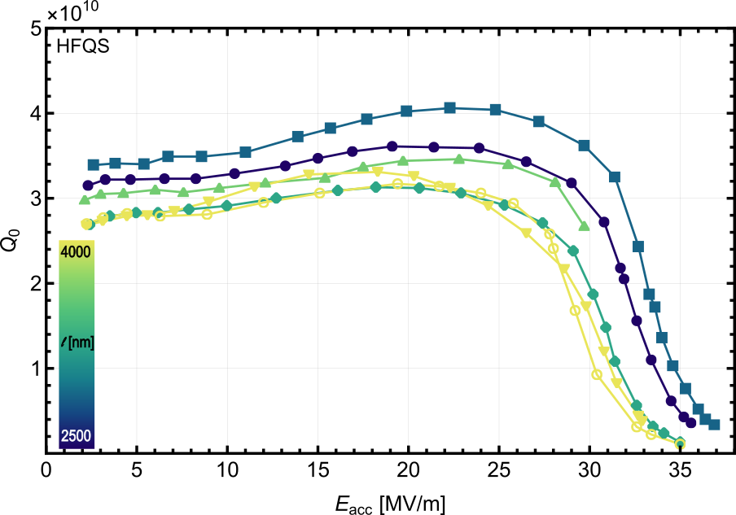
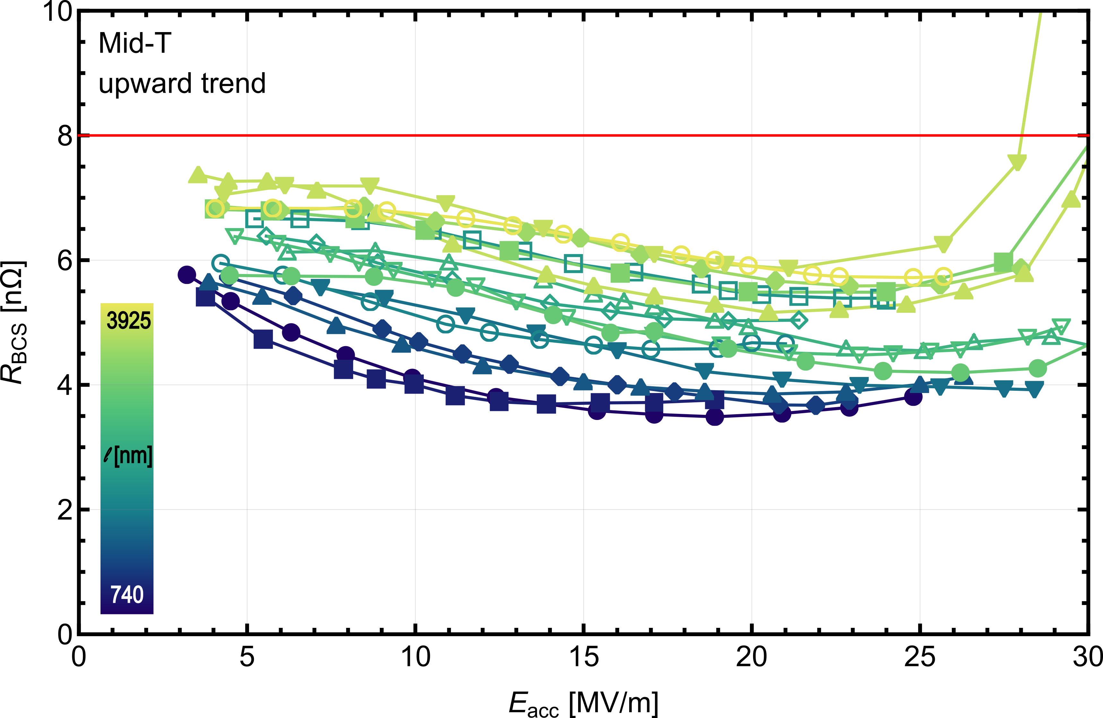
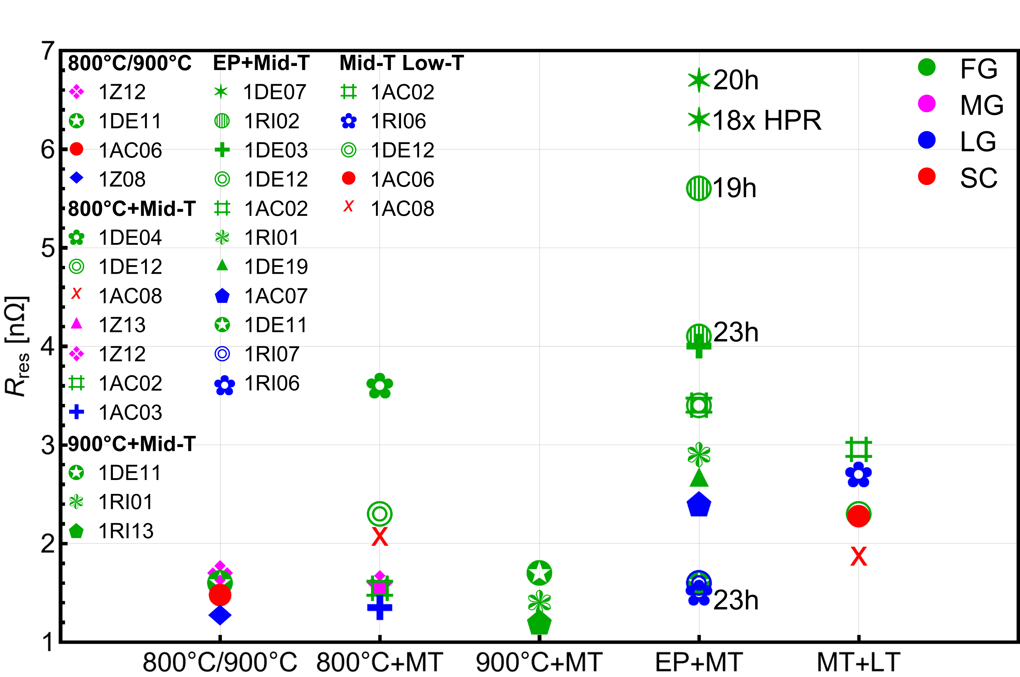
What is new since SRF 2025 in Tokyo?
New data, furnace upgrade
additional data on mid-T treated cavities with long l

Slide 3
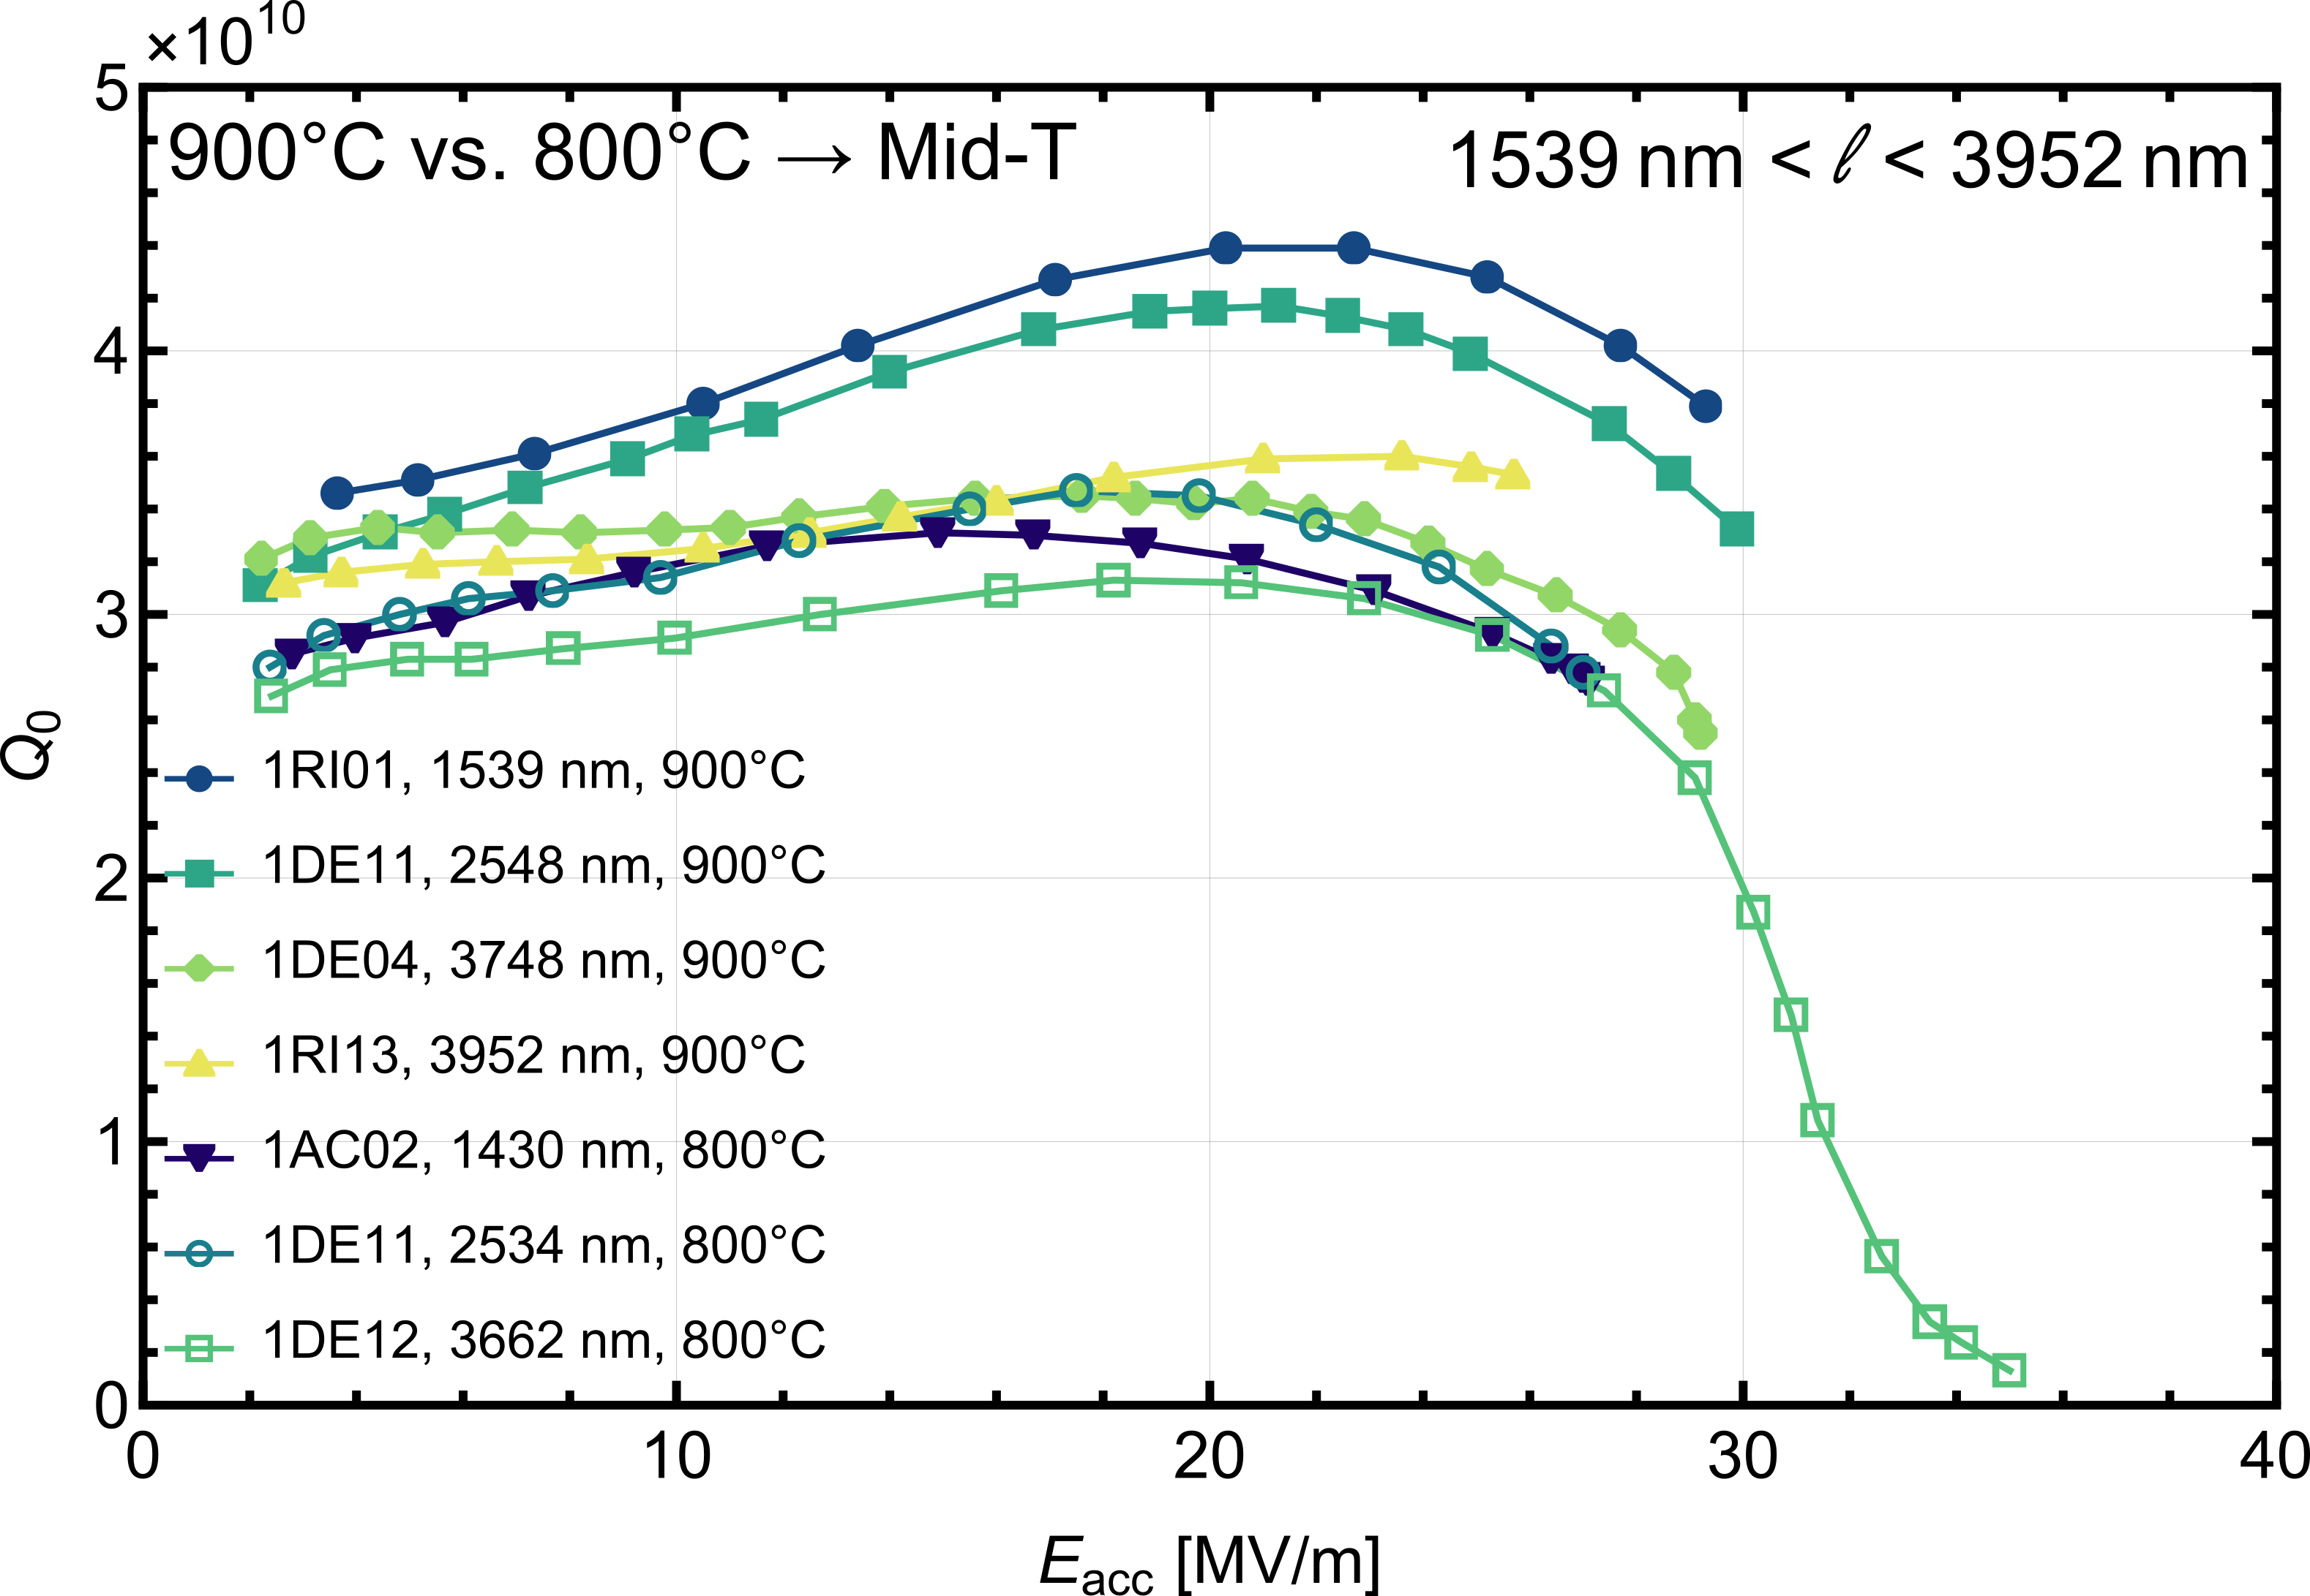
What is new since SRF 2025 in Tokyo?
New data, furnace upgrade
additional data on mid-T treated cavities with long l
mid-T with soft reset of 900°C

Slide 4
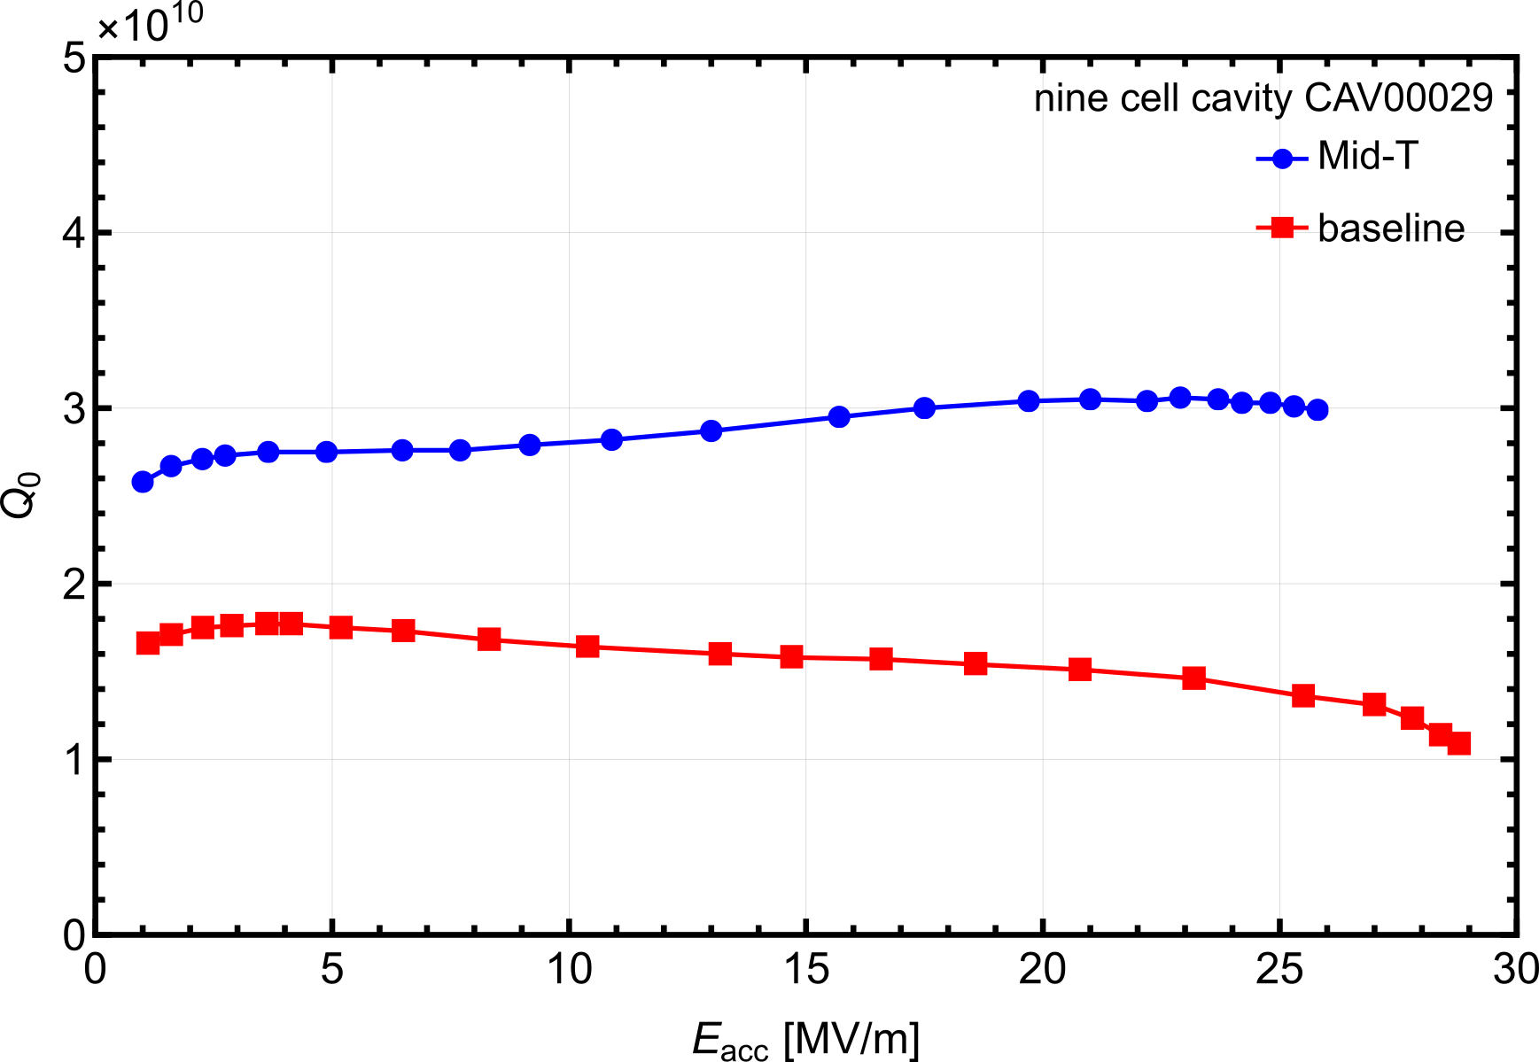
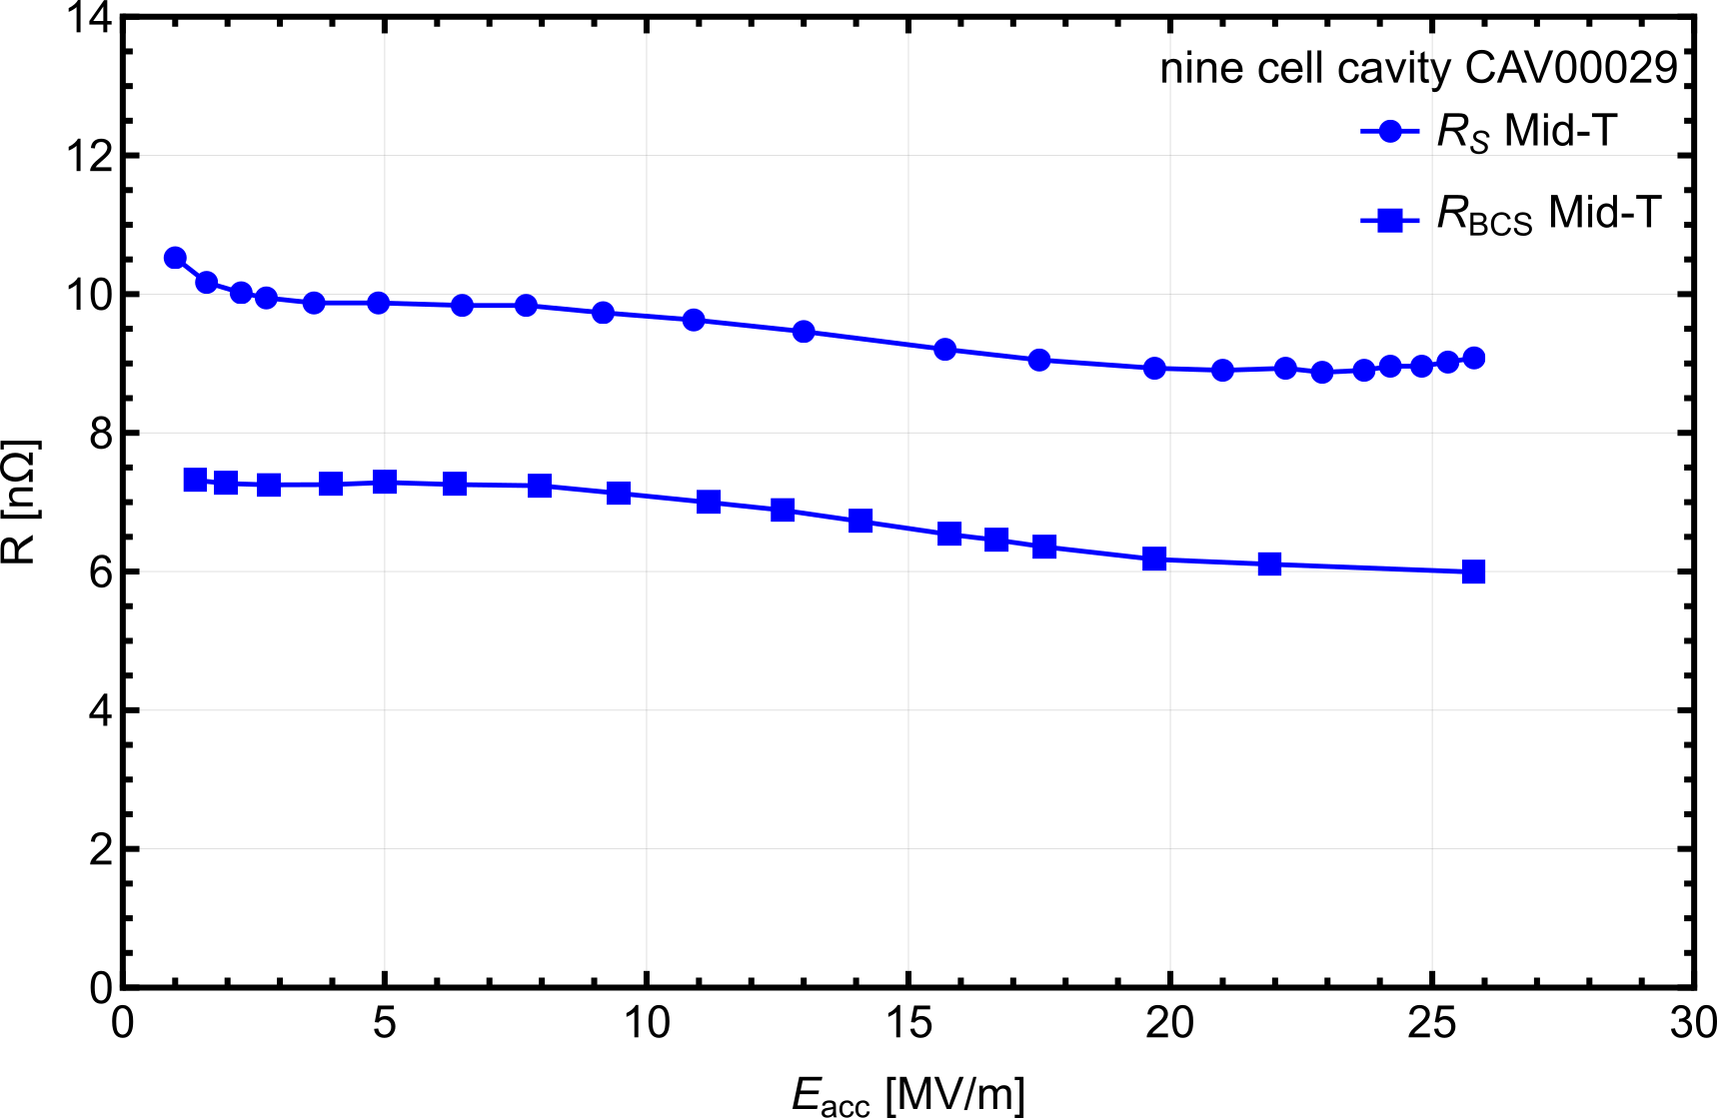
What is new since SRF 2025 in Tokyo?
New data, furnace upgrade
mid-T heat treatment of a nine cell cavity
additional data on mid-T treated cavities with long l
mid-T with soft reset of 900°C

Slide 5
What is new since SRF 2025 in Tokyo?
New data, furnace upgrade
mid-T heat treatment of a nine cell cavity
additional data on mid-T treated cavities with long l
Nb furnace upgrade
mid-T with soft reset of 900°C

Slide 6
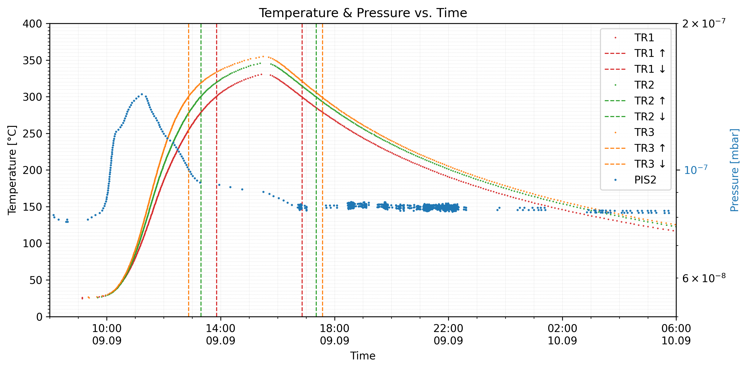
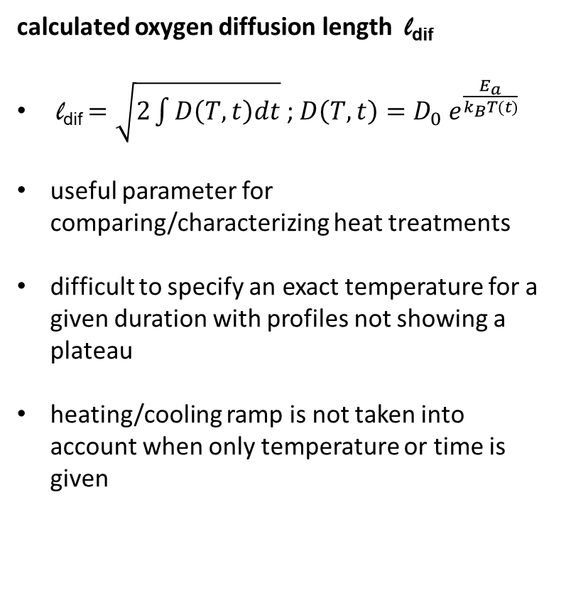
Characterization of heat treatments
Compare heat treatments using the calculated oxygen diffusion length l_{dif}
calculated oxygen diffusion length l_{dif}
l_{dif} $=\sqrt{2\int{D\left(T,t\right)dt}}$ ; $D\left(T,t\right)=D_{0} e^{\frac{E_{a}}{k_{B}T(t)}}$
useful parameter for comparing/characterizing heat treatments
difficult to specify an exact temperature for a given duration with profiles not showing a plateau
heating/cooling ramp is not taken into account when only temperature or time is given

Slide 7
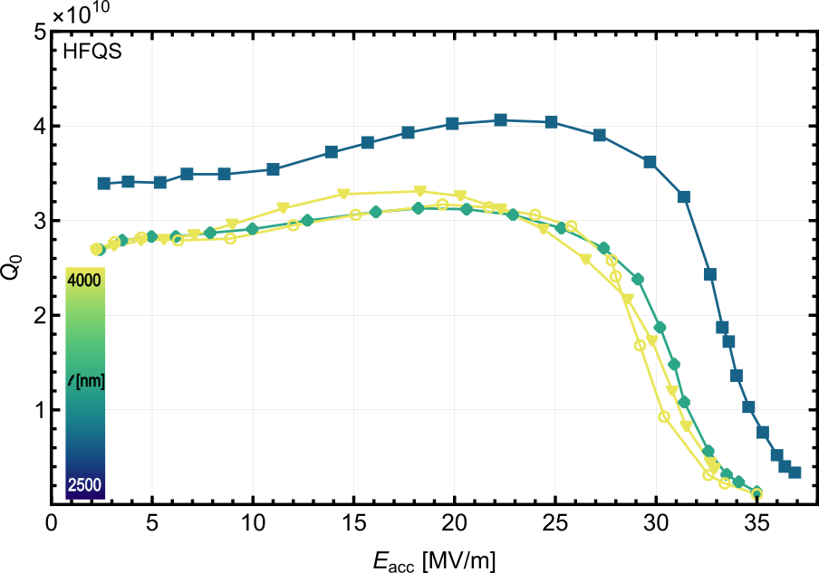

Mid-T heat treatment of 1.3 GHz single cell cavities
Cavities with long diffusion length l_{dif} showing HFQS
T = 2 K
diffusion length l in the range of 3500 nm < l < 4000 nm
  translate in approx. 350°C for 4h to 4½h
due to the relatively long l -> decrease in c_{O} in the RF layer, which may result in a decrease of the anti-Q-slope
HFQS can be observed

Slide 8
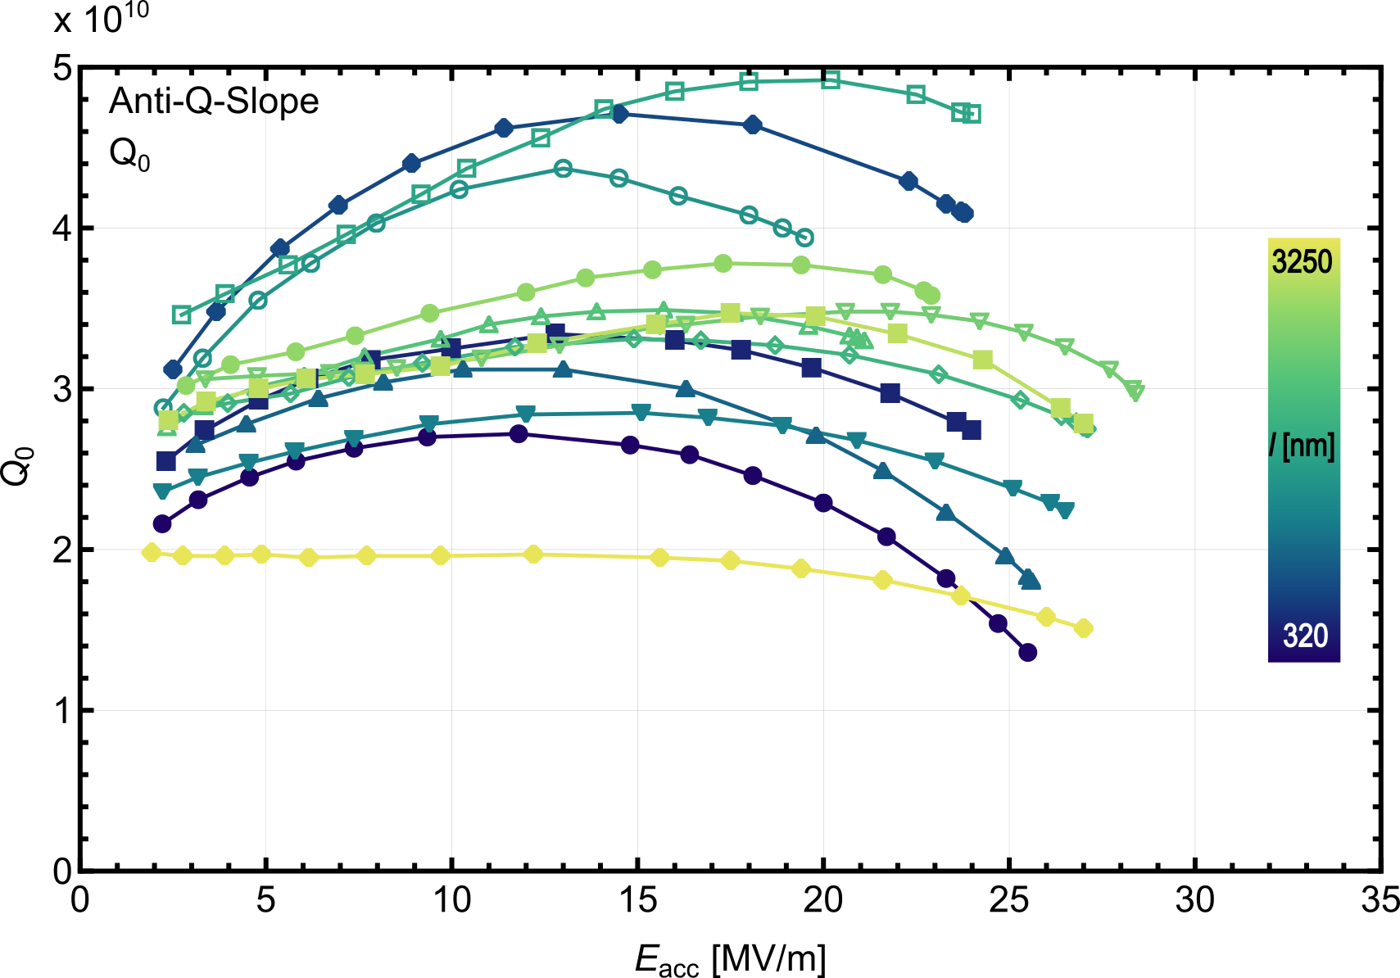
Mid-T heat treatment of 1.3 GHz single cell cavities
Cavities with long diffusion length l_{dif} showing HFQS and no quench
T = 2 K
T = 2 K
HFQS can be observed
usually no breakdown of the cavities compares to mid-T heat treated cavities with l < 2500 nm
still have an improvement with the benefit that the cavities don’t quench

Slide 9
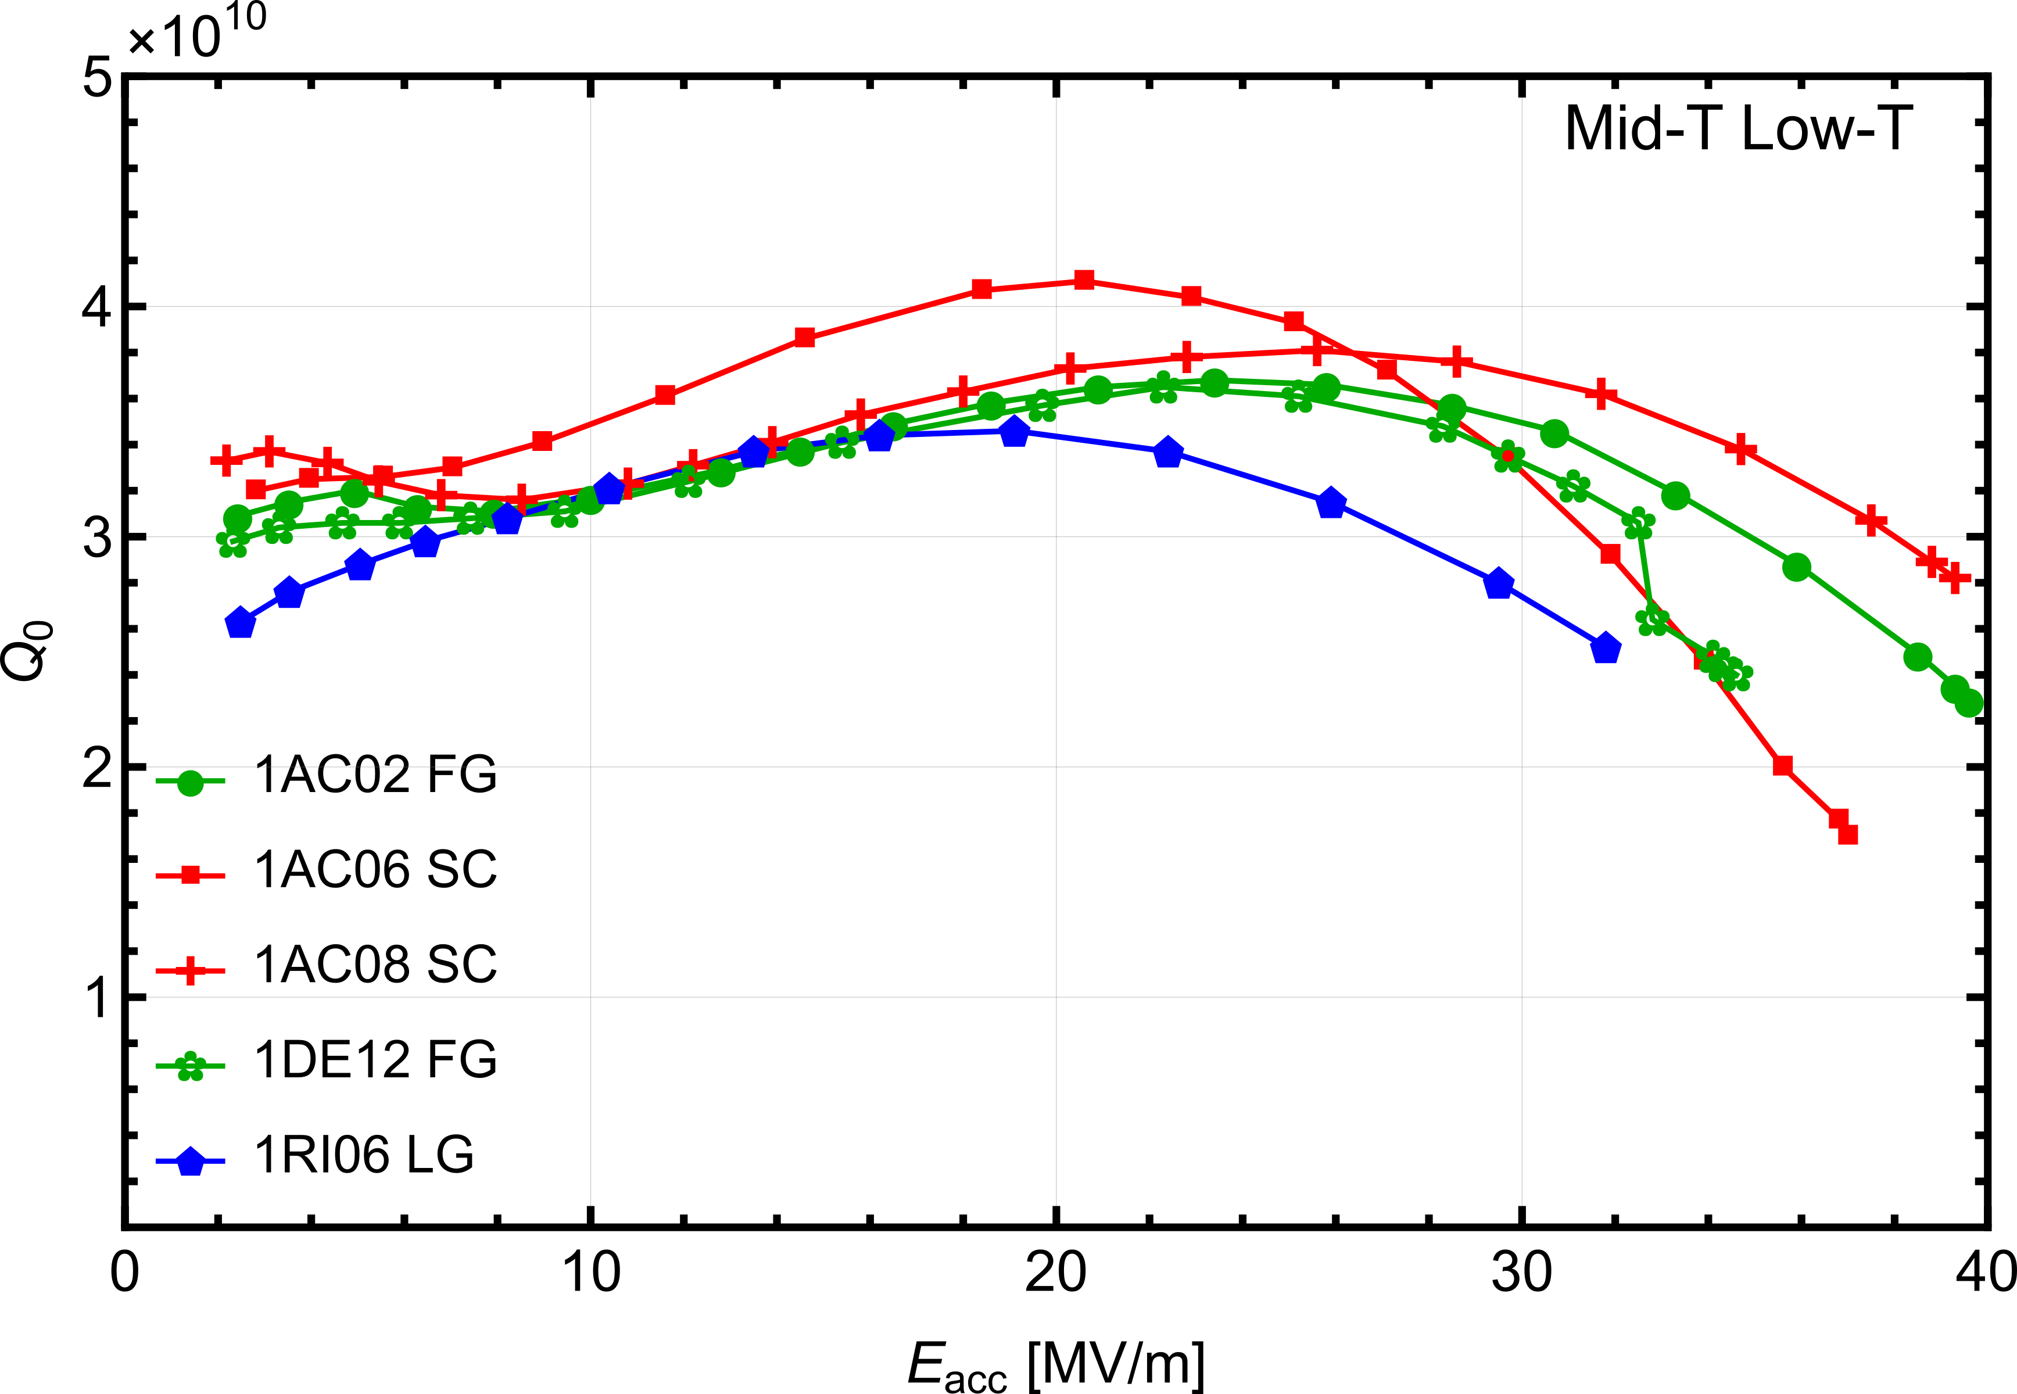
Enhancement of mid-T heat treated single cell cavities
With additional low-T heat treatment
T = 2 K
T = 2 K
selecting cavities that showed HFQS after a mid-T heat treatment
applying additional low-T
improvement in the performance for high gradients
old data with l showing HFQS starting at 3500 nm

Slide 10
New mid-T data with long diffusion length l_{dif}
1RI12: HFQS with l_{dif} =2500 nm, 1Z13: hint of HFQS
additional new data: 1RI12 (fine grain) & 1Z13 (medium grain)
1RI12 HFQS appears already with a l_{dif} of 2500 nm (approx. 330°C for 3½h)
1Z13 a hint of an HFQS is observed
  consists of MG niobium material from a completely different niobium supplier
  cleanliness of the niobium RF surface of this new cavity is still relatively low
  reflected in the increased annealing pressure 𝑝_{max} = 3.7 · 10⁻⁵ mbar (usually 10⁻⁷ mbar)
  how pressure during heating affects performance is subject of ongoing research
T = 2 K

Slide 11
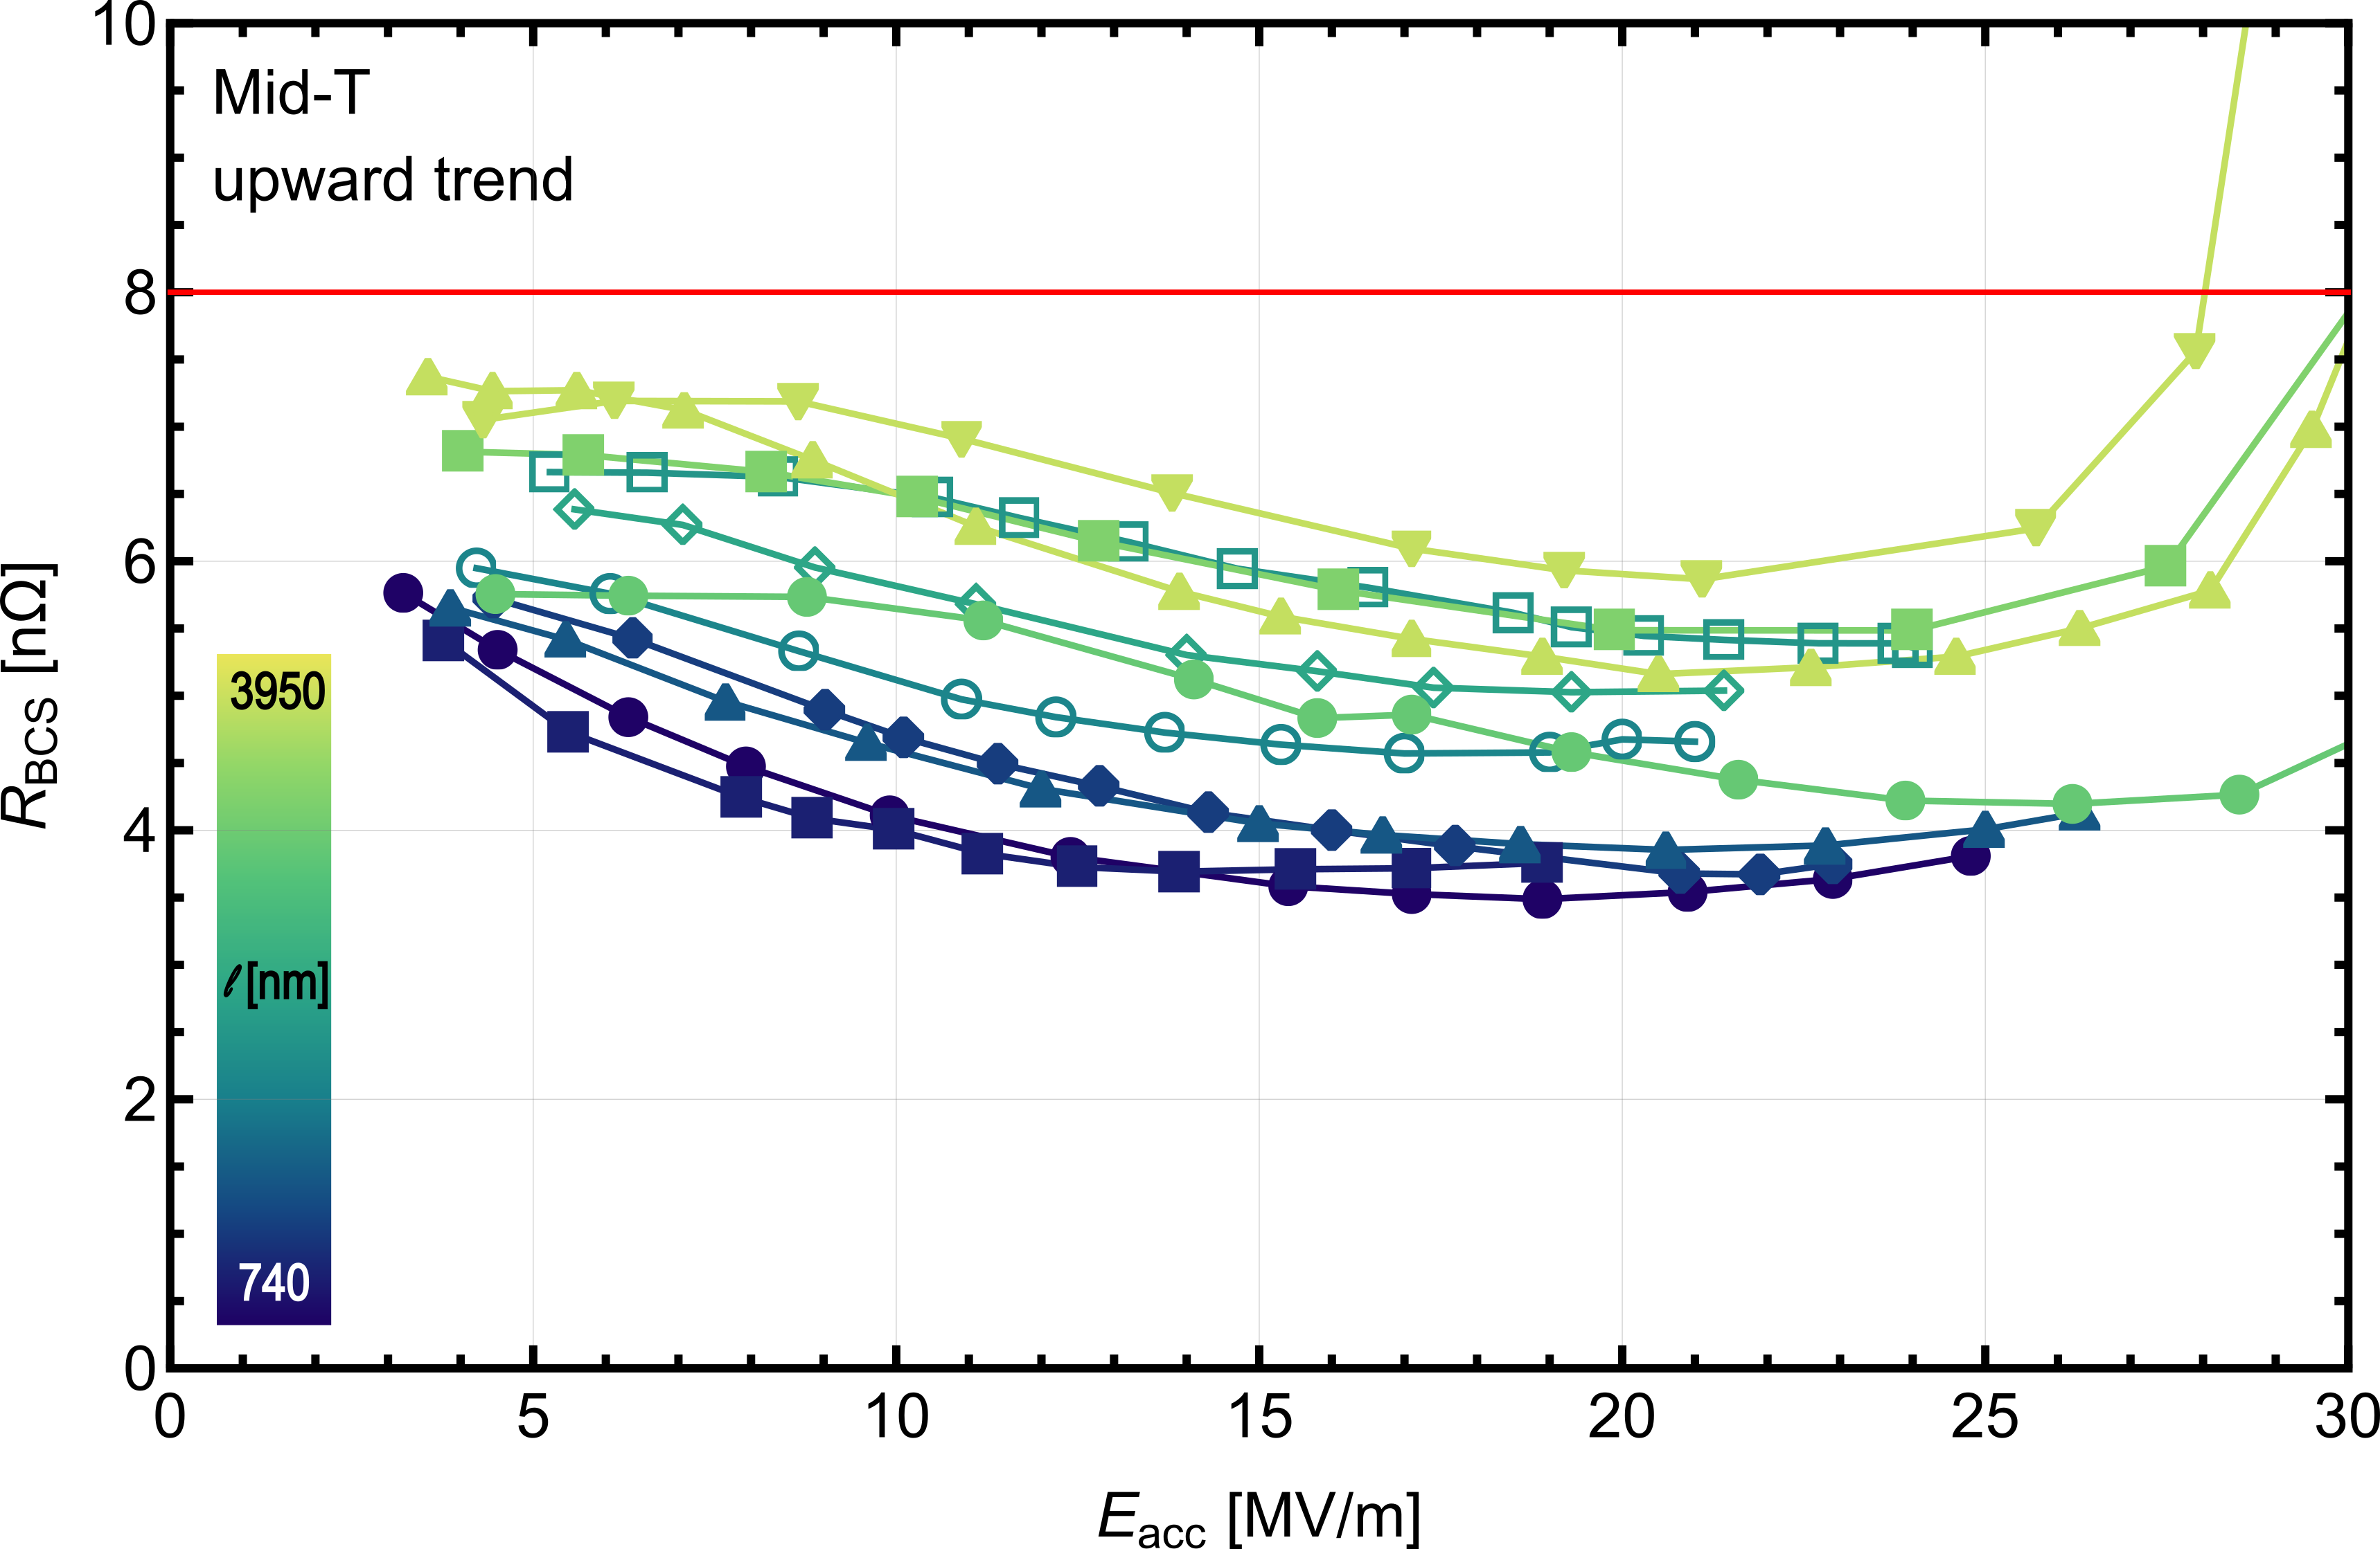
R_{BCS} resistance of mid-T heat treated cavities
Upward trend of R_{BCS} with increasing l_{dif}
T = 2 K
mid-T heat treatments affect the R_{BCS} resistance
  generally lower than R_{BCS} of baseline treated cavities (above 8 nΩ)
  correlation can be observed between the diffusion length and the R_{BCS}
    upward trend of R_{BCS} for l_{dif} > 740 nm

Slide 12

R_{BCS} resistance of mid-T heat treated cavities
Upward trend of R_{BCS} with increasing l_{dif} is also consistent with new data
T = 2 K
mid-T heat treatments affect the R_{BCS} resistance
  generally lower than R_{BCS} of baseline treated cavities (above 8 nΩ)
  correlation can be observed between the diffusion length and the R_{BCS}
    upward trend of R_{BCS} for l_{dif} > 740 nm
  new data also fits in very well
    2x800°C -> mid-T
    4x900°C -> mid-T

Slide 13
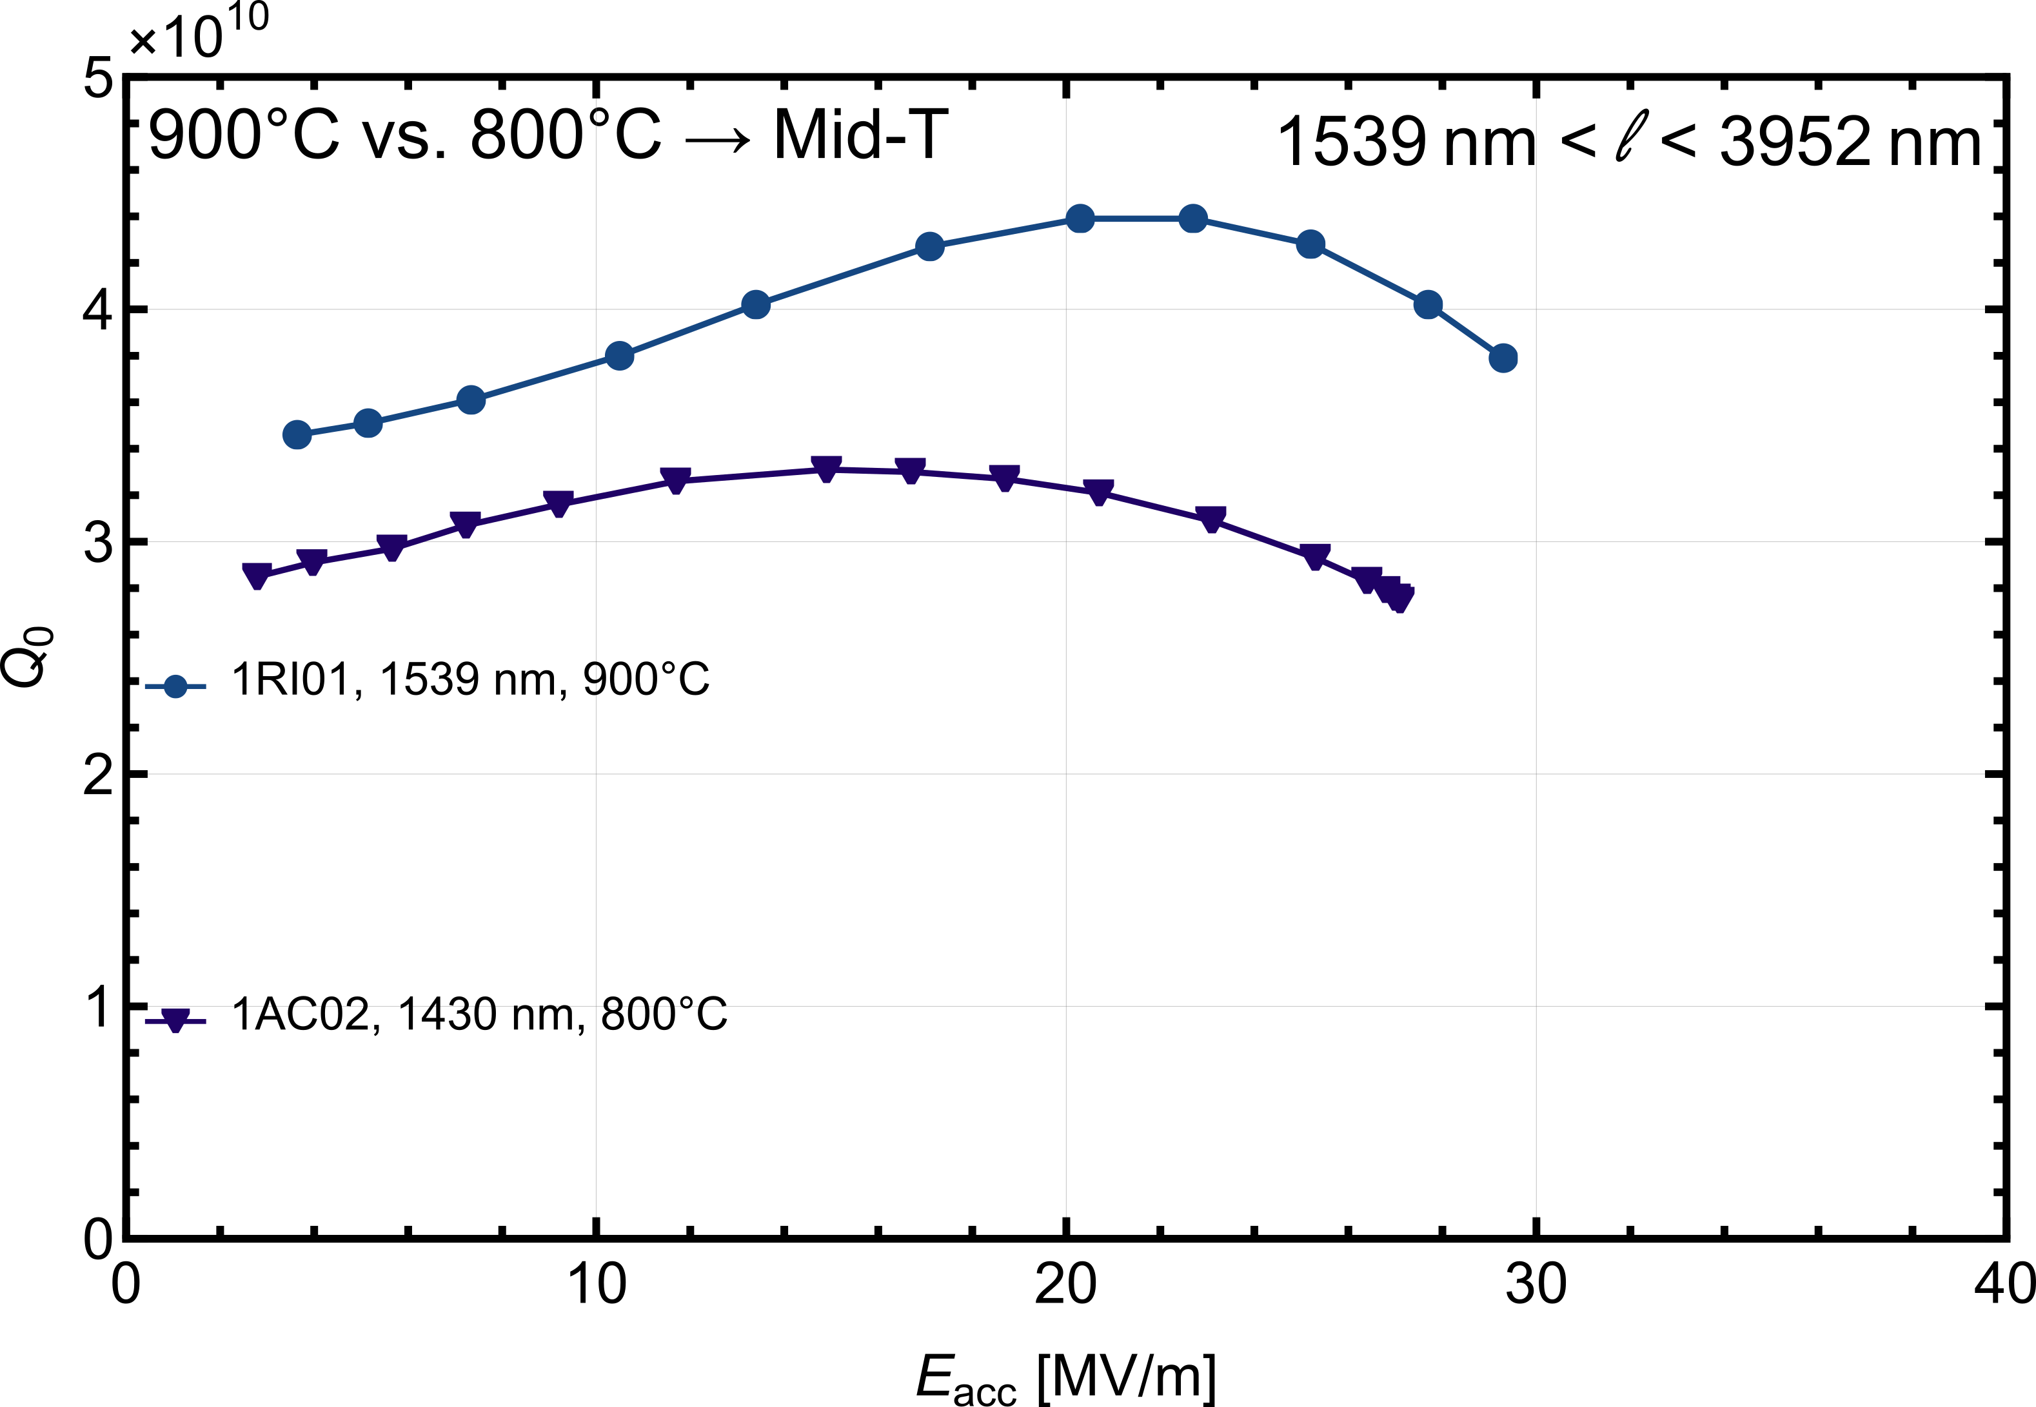
Mid-T heat treatment of single cell with 900°C as soft reset
Better performance than an 800°C soft reset
first 900°C soft resets on 1RI01, 1DE11, 1DE04, & 1RI13
soft resets at 800 °C versus 900 °C followed by mid-T heat treatment with similar oxygen diffusion lengths
better performance can be observed in 𝑄₀ in each case
T = 2 K

Slide 14
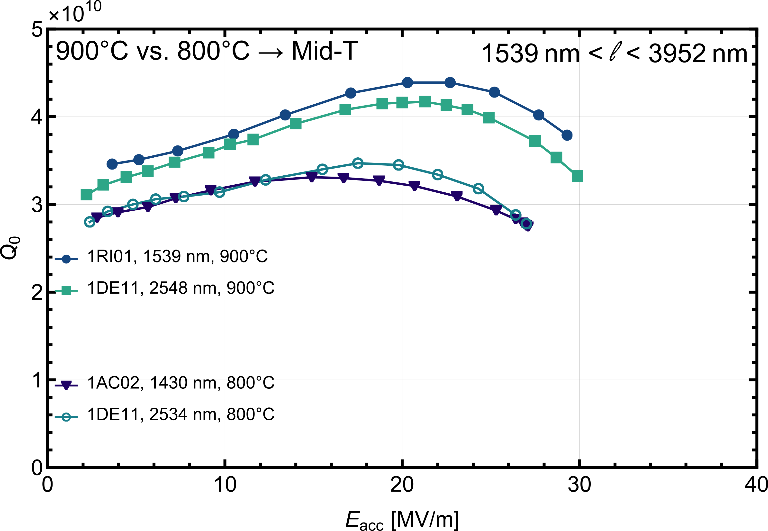
Mid-T heat treatment of single cell with 900°C as soft reset
Better performance than an 800°C soft reset
first 900°C soft resets on 1RI01, 1DE11, 1DE04, & 1RI13
soft resets at 800 °C versus 900 °C followed by mid-T heat treatment with similar oxygen diffusion lengths
better performance can be observed in 𝑄₀ in each case
T = 2 K

Slide 15
Mid-T heat treatment of single cell with 900°C as soft reset
Better performance than an 800°C soft reset
first 900°C soft resets on 1RI01, 1DE11, 1DE04, & 1RI13
soft resets at 800 °C versus 900 °C followed by mid-T heat treatment with similar oxygen diffusion lengths
better performance can be observed in 𝑄₀ in each case
still unclear: no HFQS for long diffusion lengths for a 900°C reset
T = 2 K

Slide 16
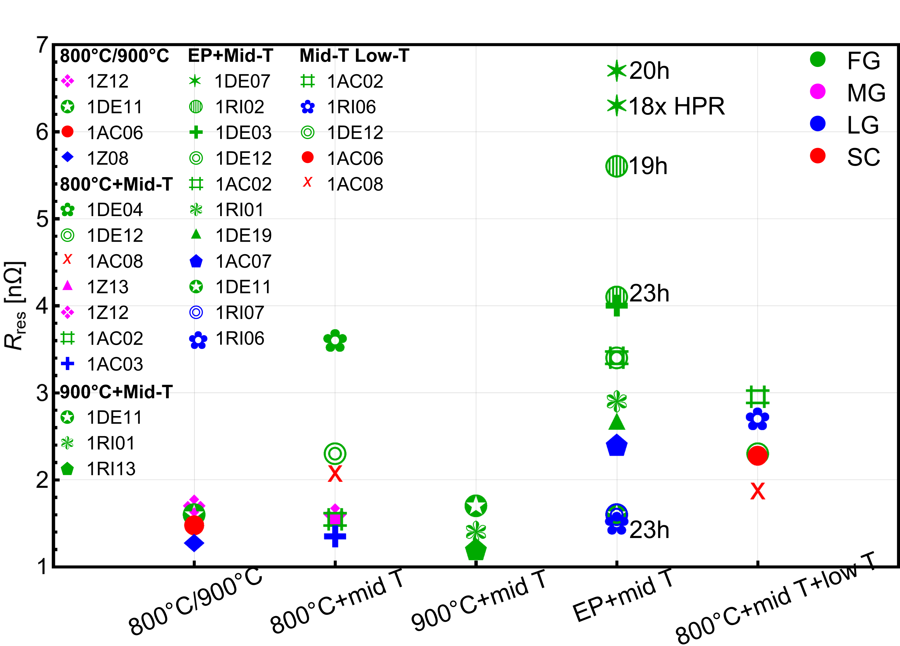
The residual resistance R_{res}
Low resistance for mid-T heat treated cavities with a 900°C soft reset
why do 900°C+mid T perform better than the 800°C+mid T ?
decreasing the R_{res} for 900°C+mid T instead of 800°C+mid T
  R_{res} is below 2 nΩ
  pinned magnetic flux affects R_{res}
    grain boundaries and dislocations can pin the magnetic flux
    by heating grain expand and a reduction of grain boundaries and dislocations

Slide 17
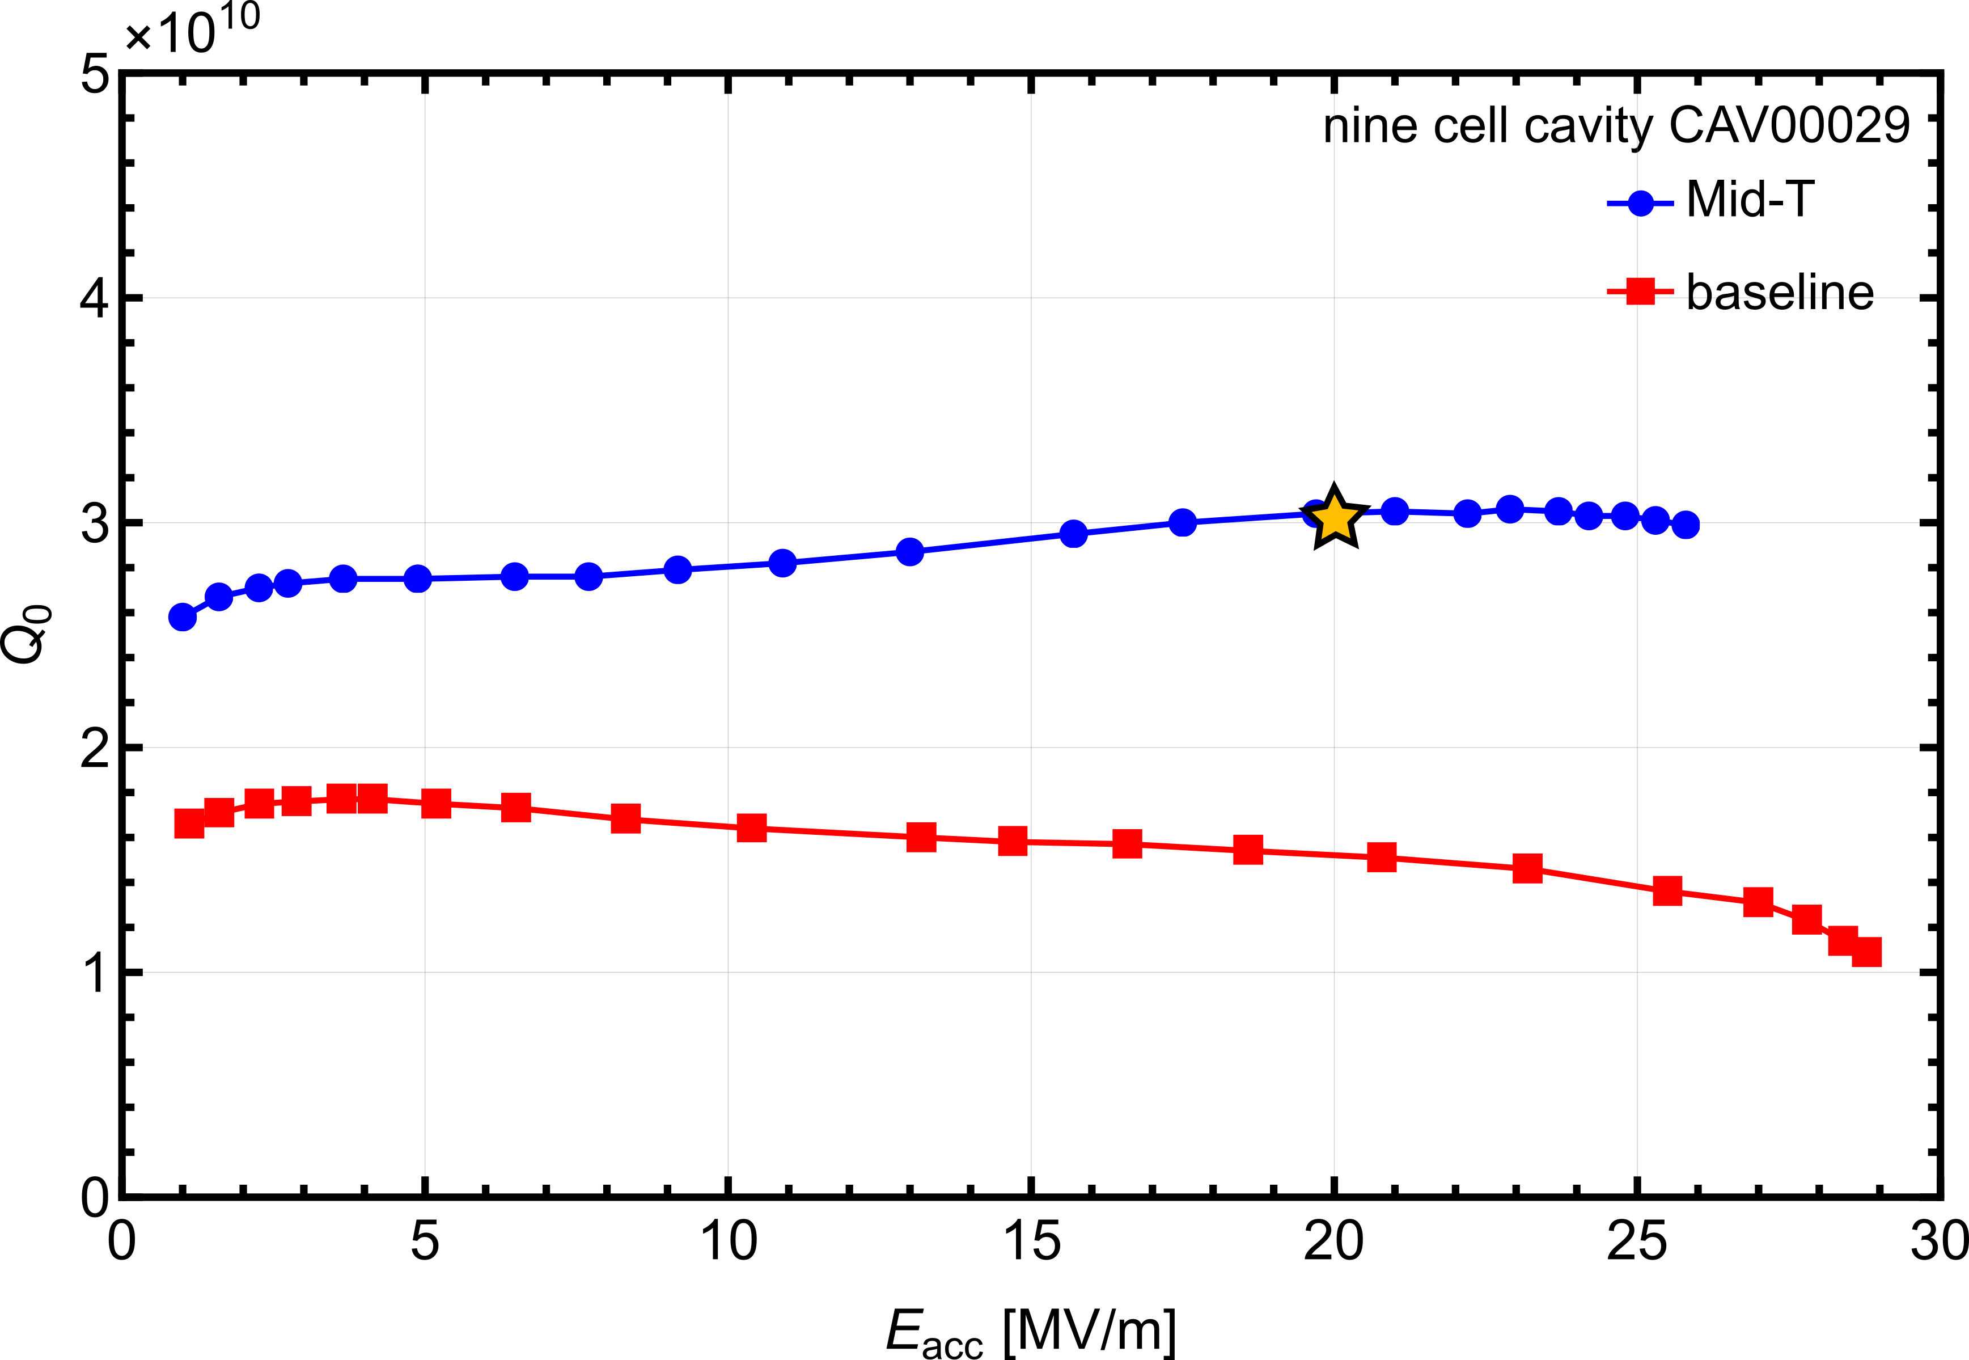
Mid-T heat treatment of a nine cell cavity
still needs improvement
T = 2 K
T = 2 K
improvement after mid-T
expected behavior with long l
  a weak anti-Q slope at higher accelerating gradients (at ~20 MV/m)
but no HFQS is apparent
R_{BCS} between 6 nΩ and 8 nΩ; R_{res} 2.3 nΩ
temperature gradient in furnace
effect of the treatment less pronounced than for single cell cavities, optimization of the furnace is necessary

Slide 18
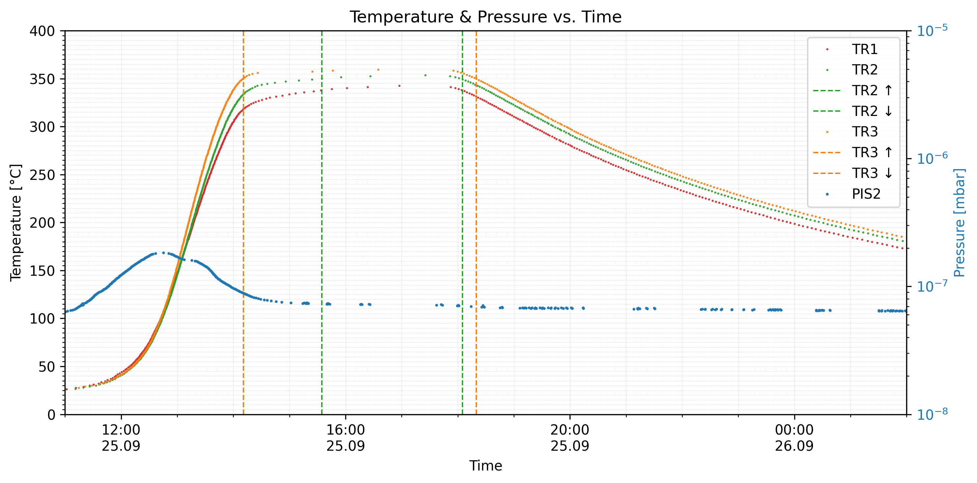
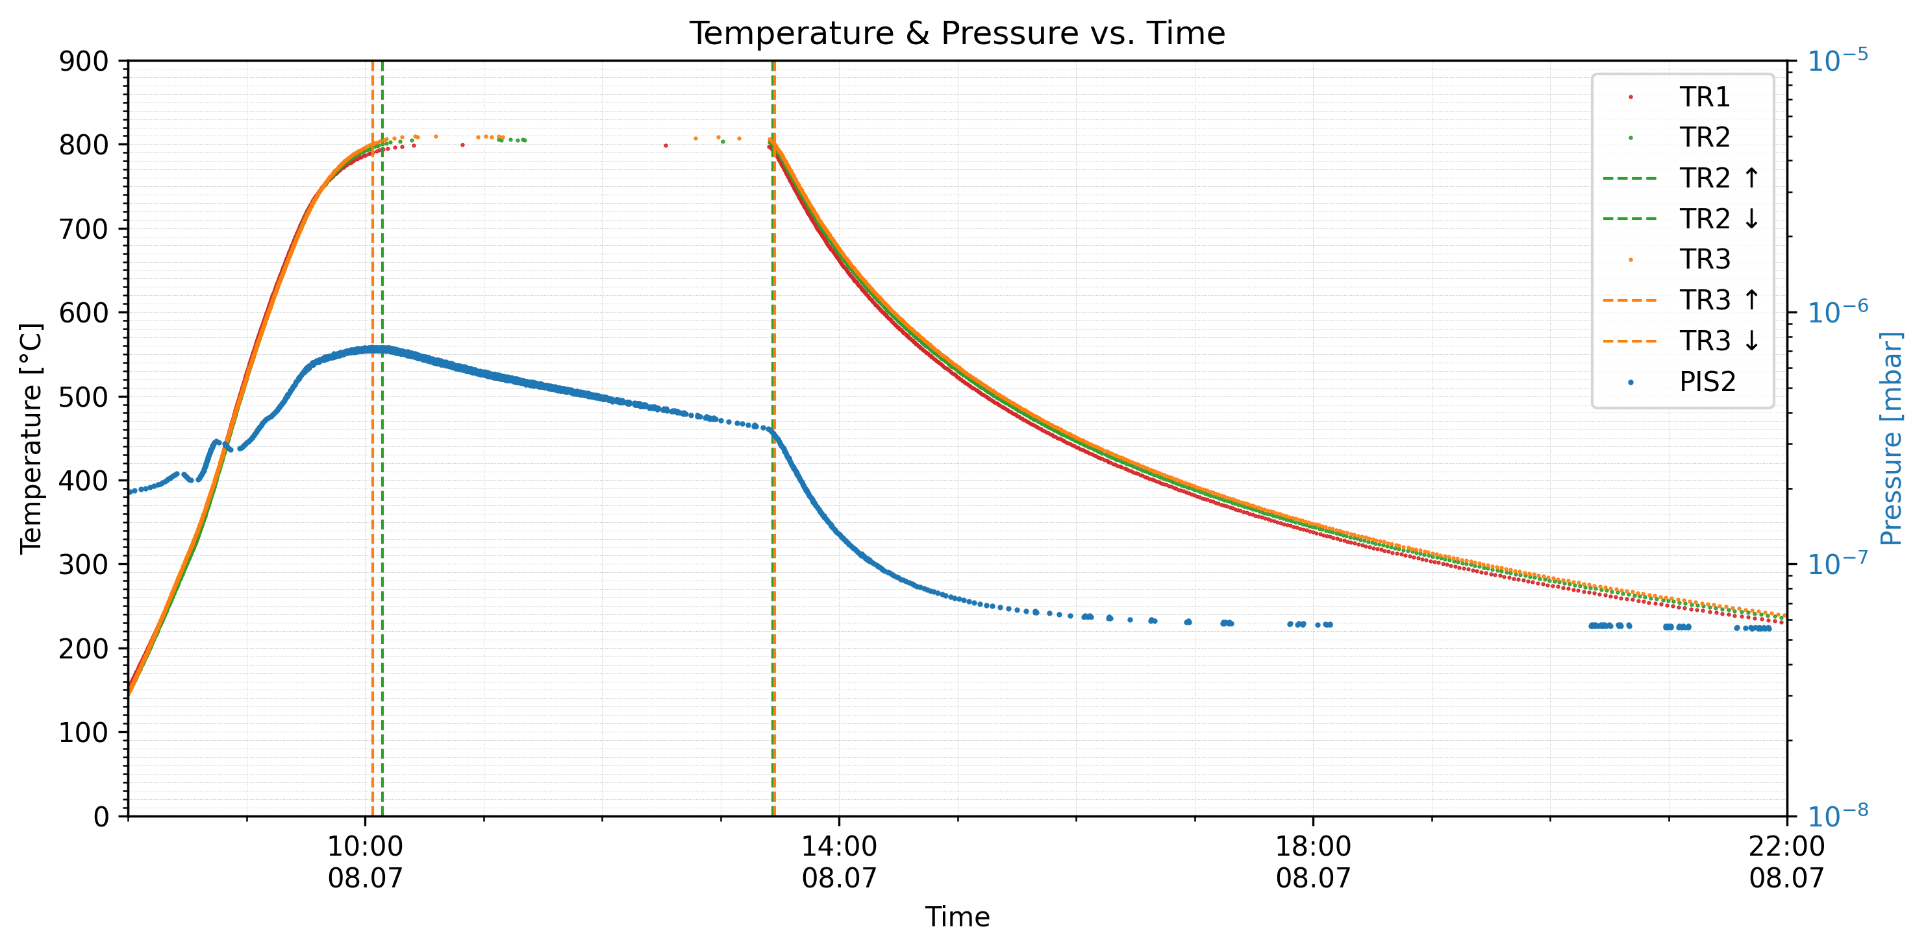
Nb retort furnace
temperature gradient
due to heat dissipation through the mechanical connection via furnace flange
  350°C recipe max gradient of ca. 50°C between TR 1 & TR 3
  800°C recipe max gradient of ca. 10°C between TR 1 & TR 3

Slide 19

Nb retort furnace
Upgrade
gas inlet
temperature gradient
control loop for the heaters is currently running only through TS2
independent control loops for H1 and H2
additional temperature sensors to map whole length
heater 1
TS 1
temperature gradient
TR 1
TS 2
TR 2
TR 3
heater 2

Slide 20
Nb retort furnace
Upgrade
gas inlet
temperature gradient
control loop for the heaters is currently running only through TS2
independent control loops for H1 and H2
additional temperature sensors to map whole length
gas inlet
oxidation of the surface using clean oxygen rather than air
venting the furnace with gas mixture: O/N, O/Ar
heater 1
TS 1
temperature gradient
TR 1
TS 2
TR 2
TR 3
heater 2

Slide 21
Summary & Outlook
new mid-T data
fit very well into the existing data
mid-T with soft reset of 900°C
Improvement compared to 800°C
  low R_{res} was found
mid-T heat treatment of a nine cell cavity
more mid-T nine cell to coming soon
on a good way
Nb furnace upgrade
independent control loops for H1 and H2
venting the furnace with gas mixture: O/N, O/Ar

Slide 22
Thank you for you attention!
Questions?

