Slide 1

f-shift properties
as indicator for SRF performance
Marc Wenskat on behalf of the SRF R&D Team
9.6.2026 - TTC Meeting @ CEA-CNRS-Université Paris Saclay

Slide 2
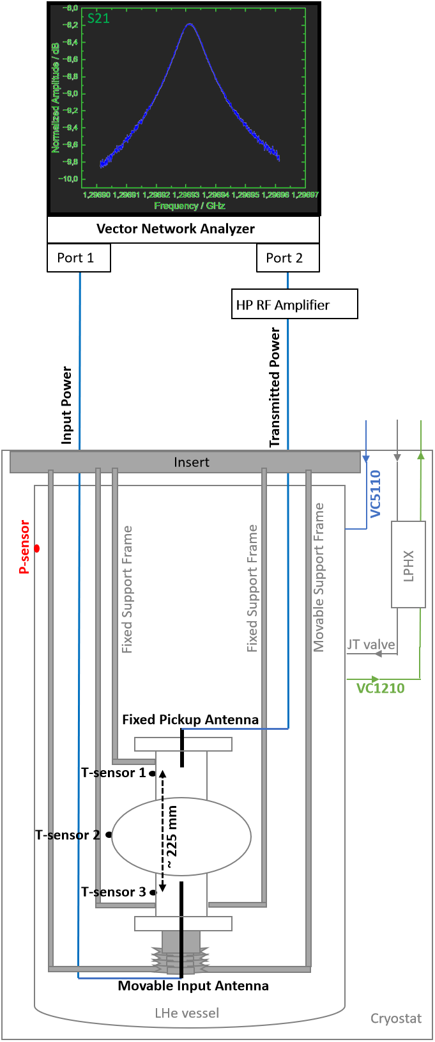
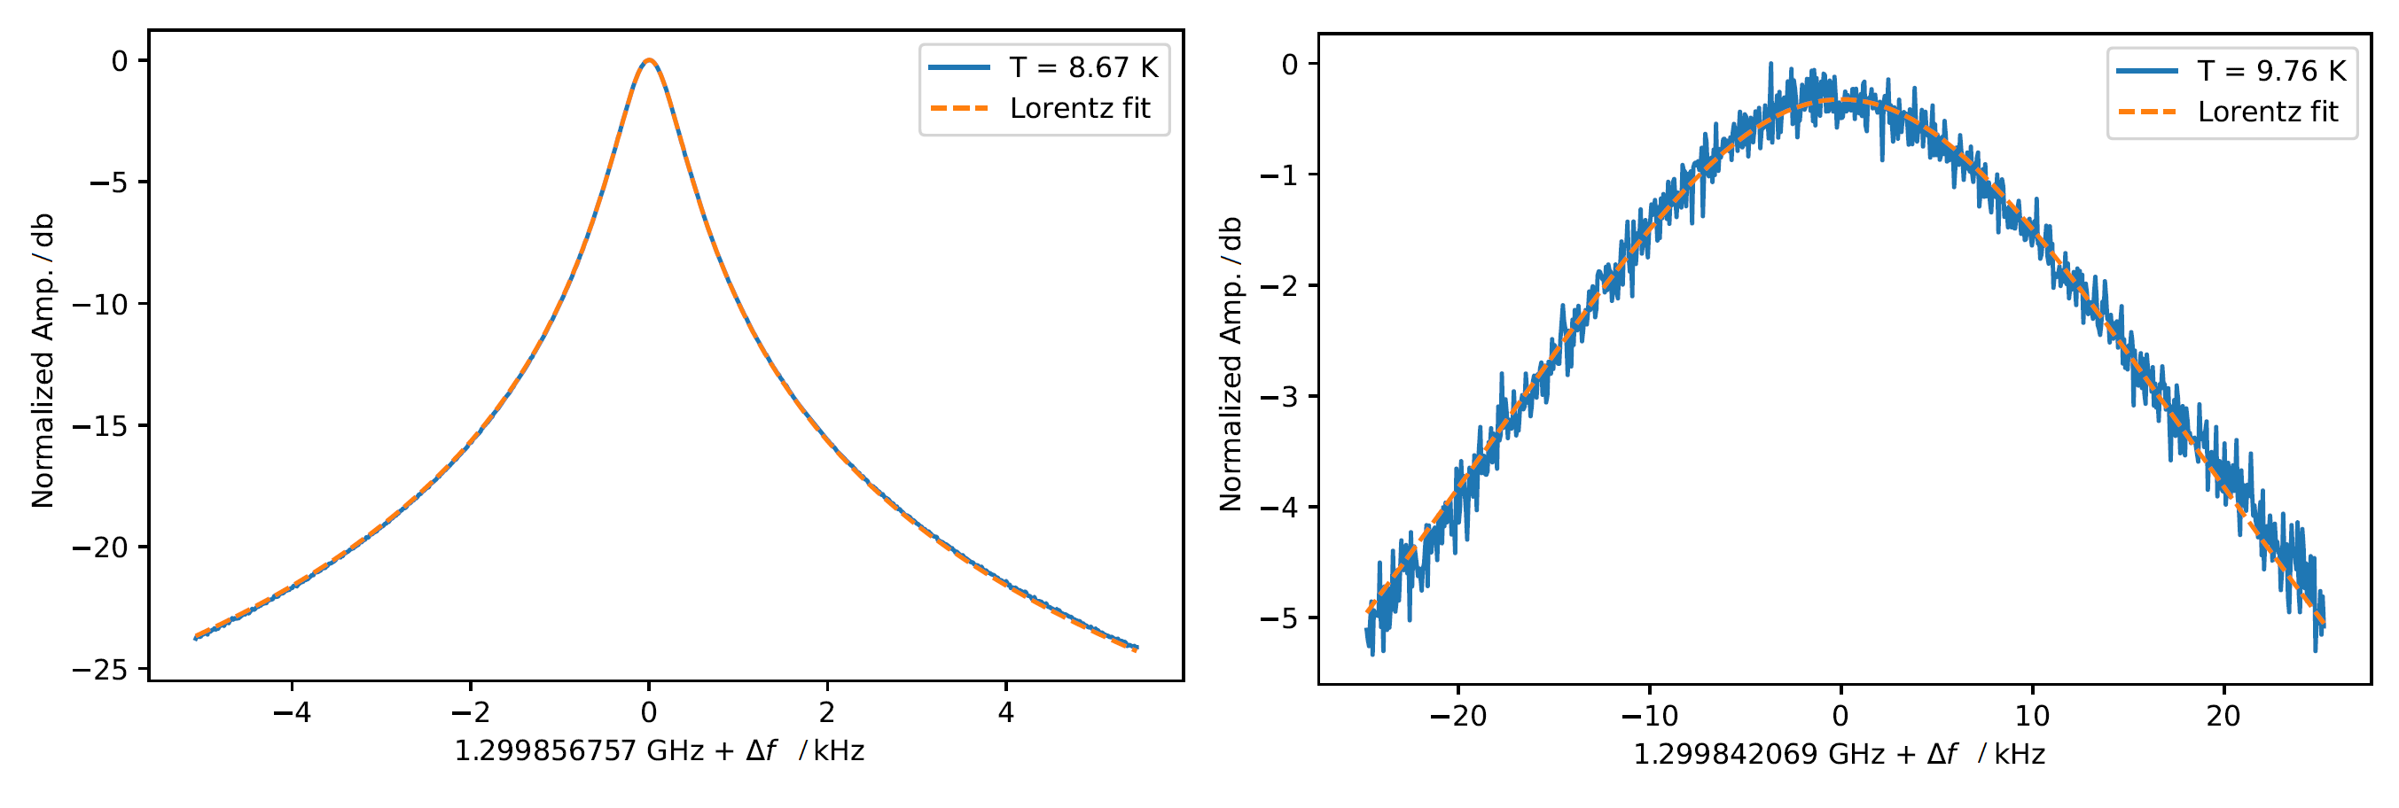
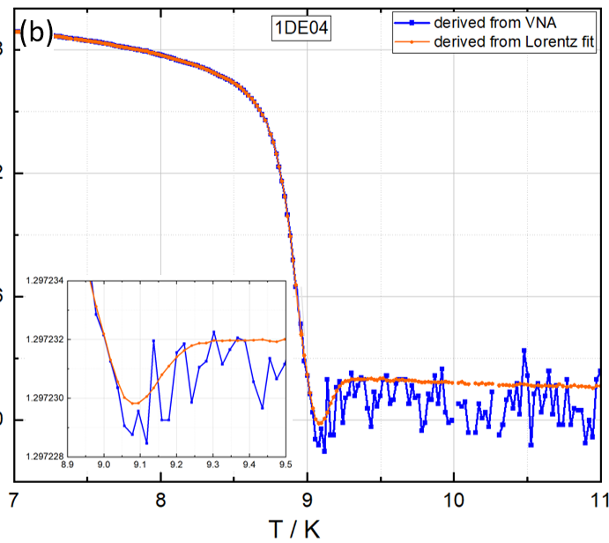
fvT has become a standard measurement at DESY
Record S₂₁ resonance spectrum with SA while warming up
  Postprocessing: fit curve with Lorentz distribution
  Also obtain Q₀
Contains information on impurity content in rf penetration depth
For this study:
  11 standard treatments (120°C, 800°C, EP as last treatment before test)
  21 midT
  3 midT/lowT
Method paper:
[R. Ghanbari et al., arXiv:2604.22596]
max. P
max. P
f₀
Not „real“ f₀
Reduced noise around T_{c}

Slide 3
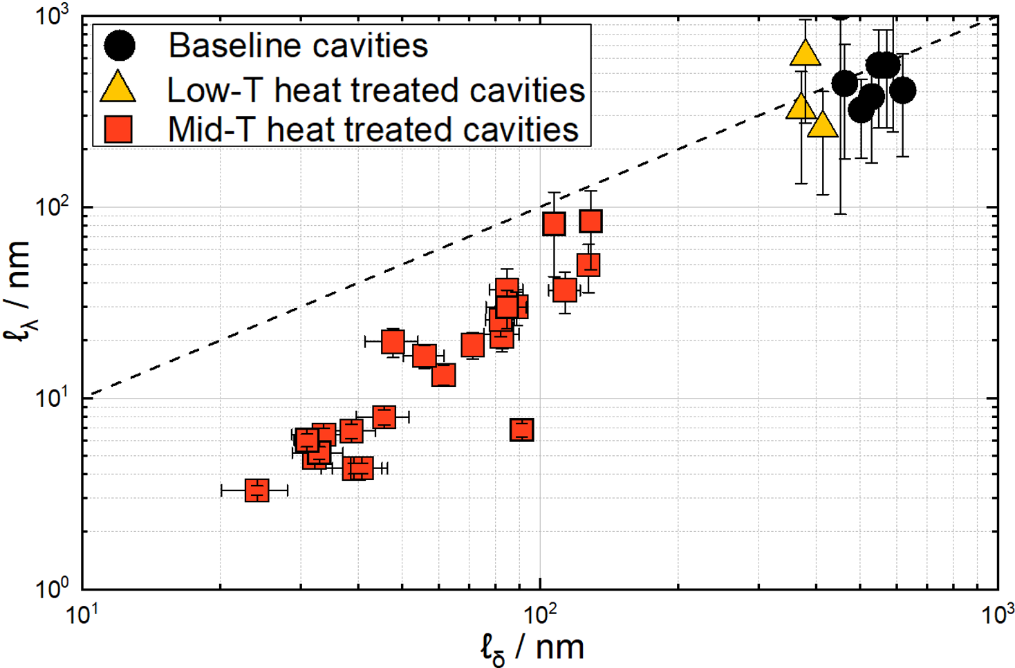
Different mfp ℓ in δ vs. λ depth
Mid-T: near-surface higher concentration of interstitials
identity line

Slide 4
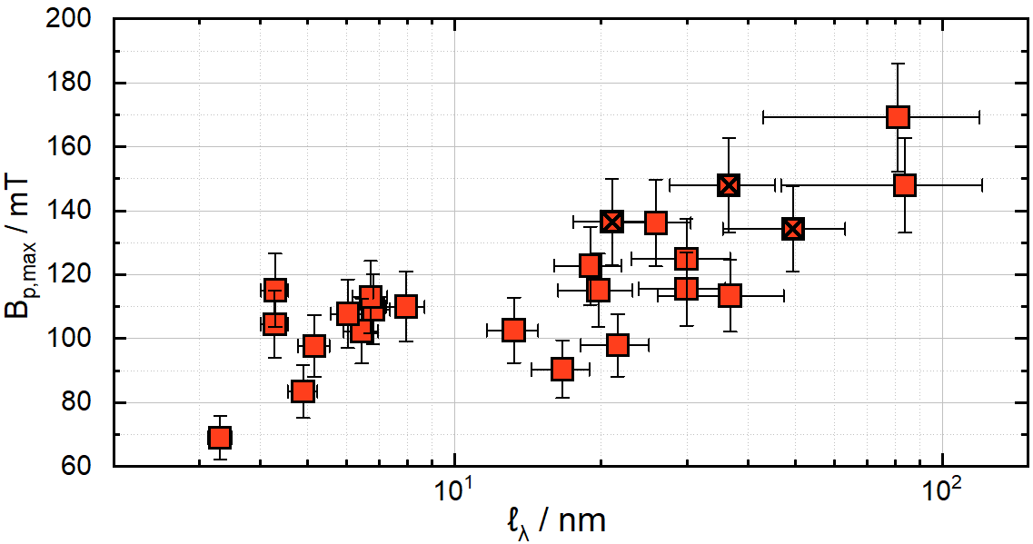
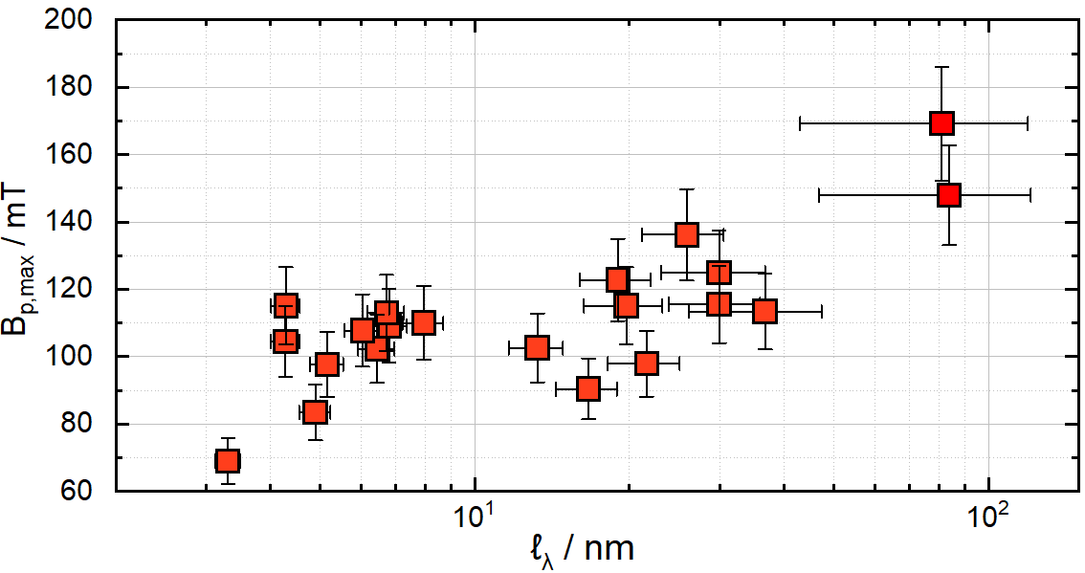
Quenchfield scales with mean free path

Slide 5
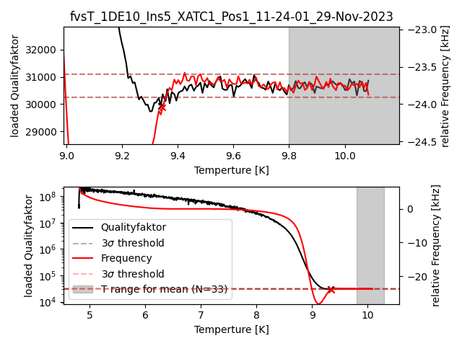
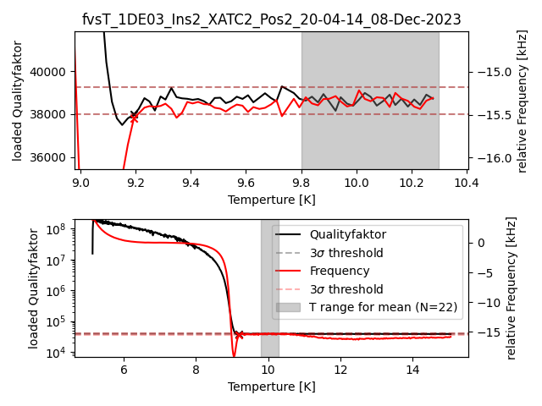
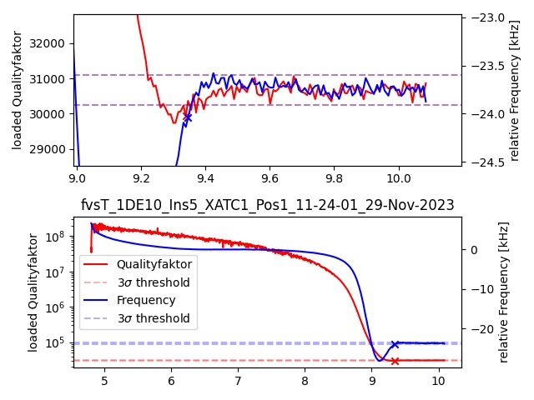
Observation: small dip in Q₀ as well
Significant in only two cavities – but which had the largest dip in f → otherwise Q₀ dip too small to be outside 3σ
Q₀
∆f / kHz
∆f / kHz
Q₀
T / K
Q₀
Q₀
∆f / kHz
∆f / kHz
T / K
T / K

Slide 6
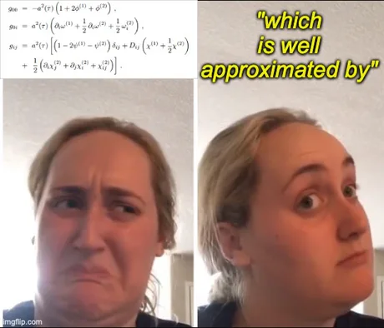
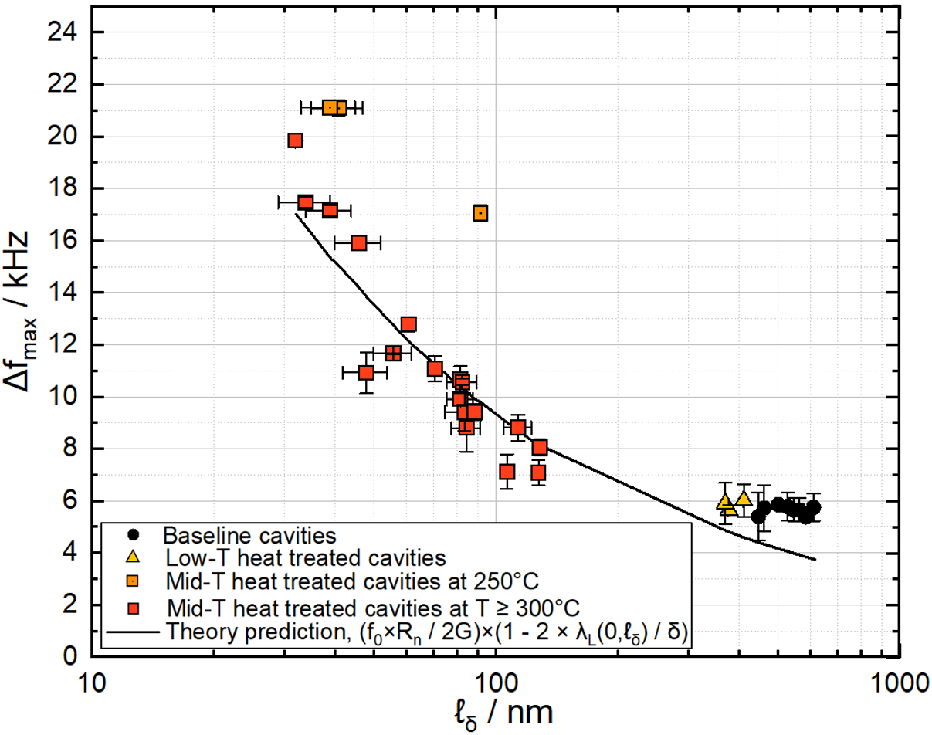

First comparison with theory is promising
Collaboration with F. Herman
[A. Lebedeva, et al. Physical Review Applied 24.4 (2025): 044007]
250°C treatment differs
$$∆f= f\left(7K\right)−f\left(10K\right) / kHz$$

Slide 7

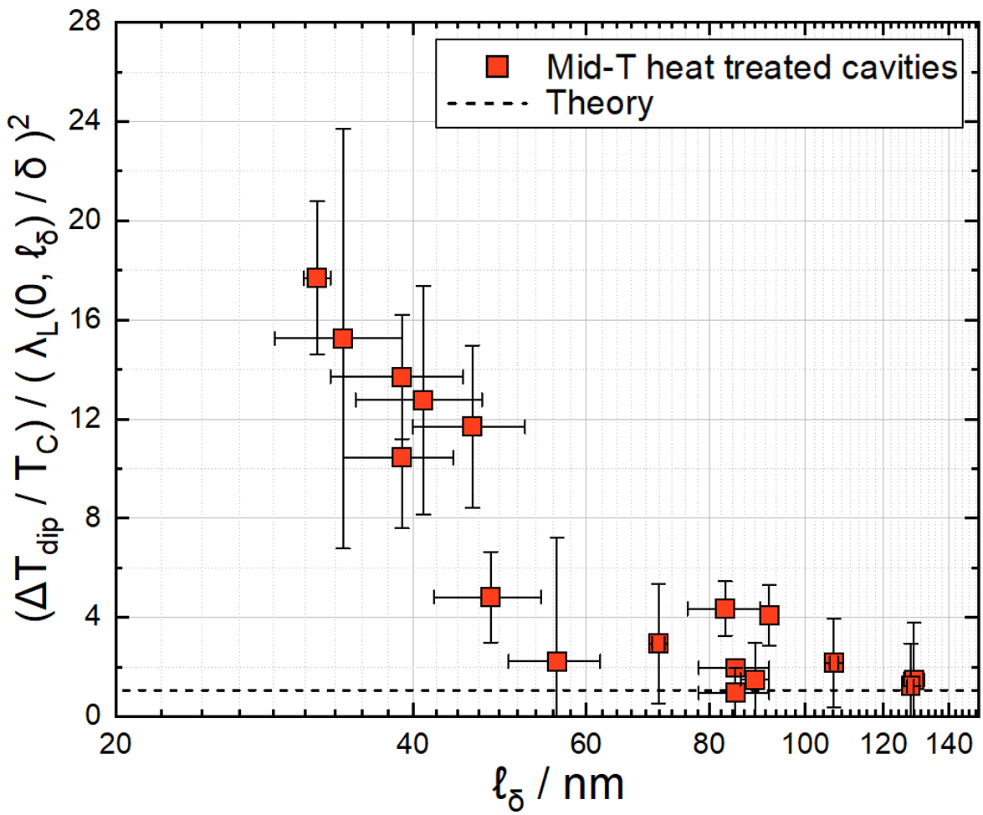



Predictions of dip properties within reasonable limits
Collaboration with F. Herman
[A. Lebedeva, et al. Physical Review Applied 24.4 (2025): 044007]
f
Higher concentration of interstitials
$$∆T_{Dip}$$
$$∆f_{Dip}$$
T
Prediction: $\frac{{∆f}_{dip}}{a∙f(10K)}−b$ = -0.167
Assumption: Dip is symmetric
Average_{N=17} -0.168 ± 0.005

Slide 8
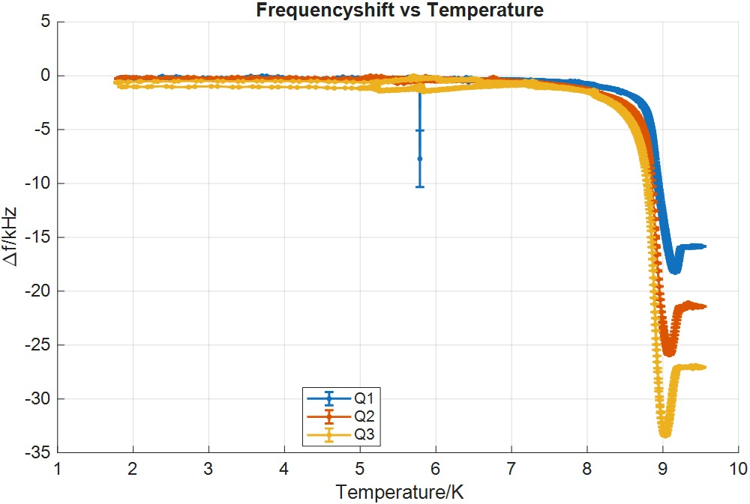



fvT with QPR on mid-T treated sample
Dip depth Δf scales with f as model predicts
Expect: ${∆f}_{dip}=a+b∙f$
$$f$$
$${∆f}_{dip}$$
433 MHz
↔
2.4 kHz
866 MHz
↔
4.3 kHz
1300 MHz
↔
6.4 kHz

Slide 9

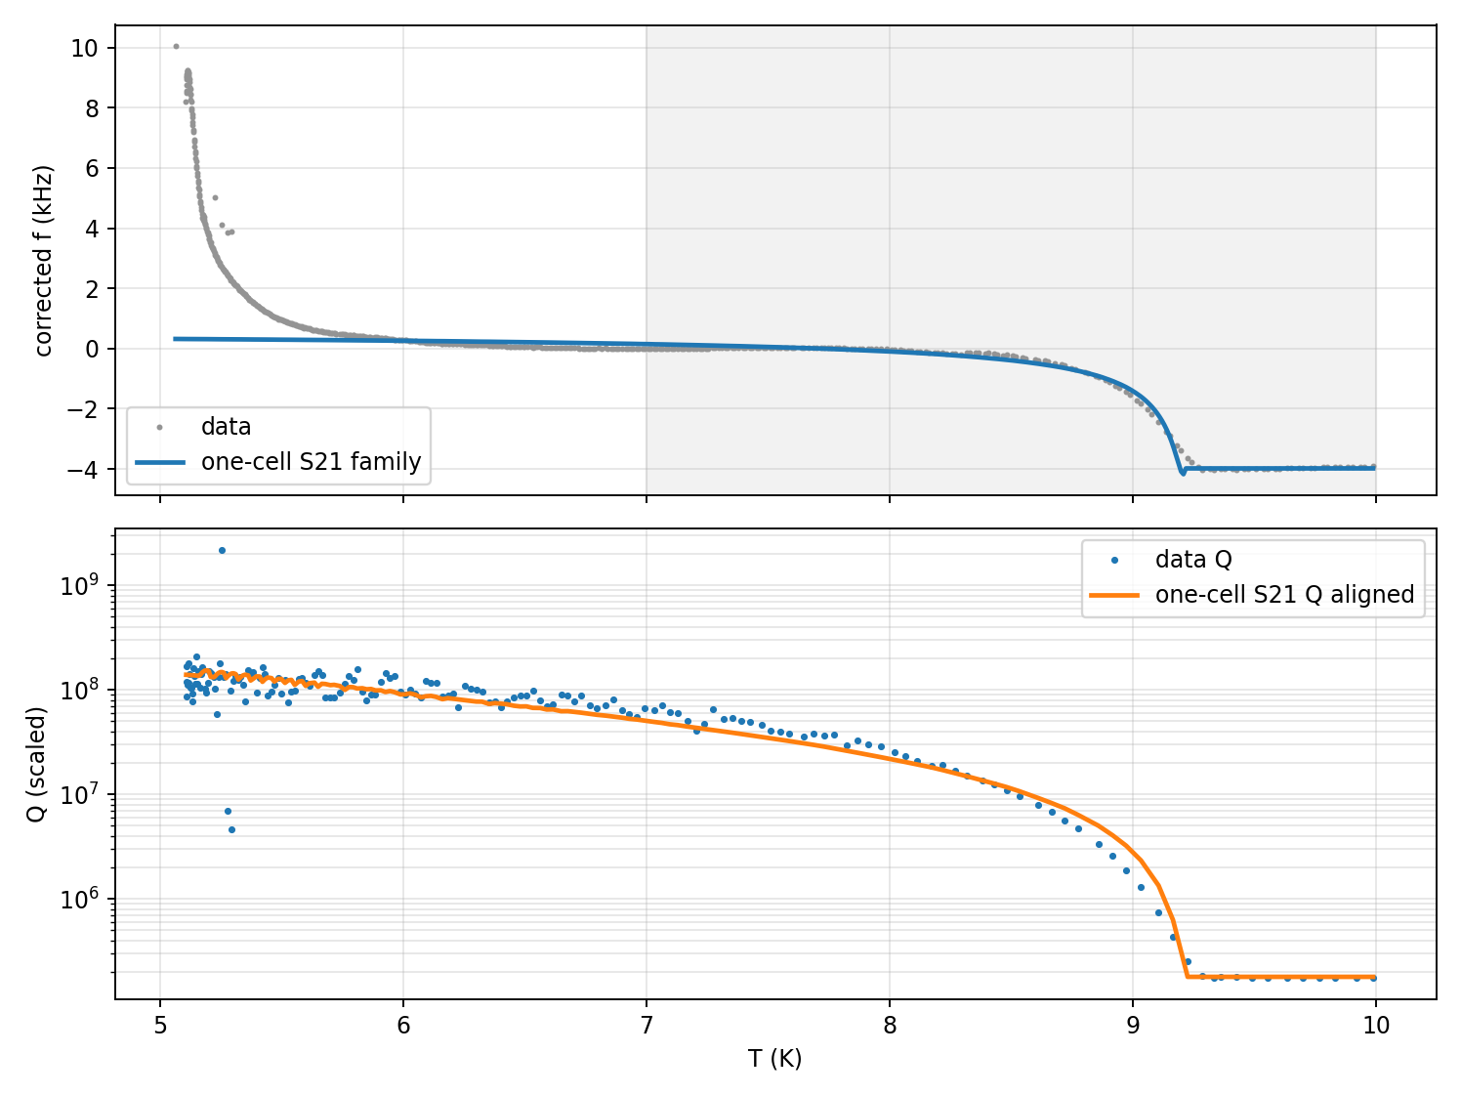
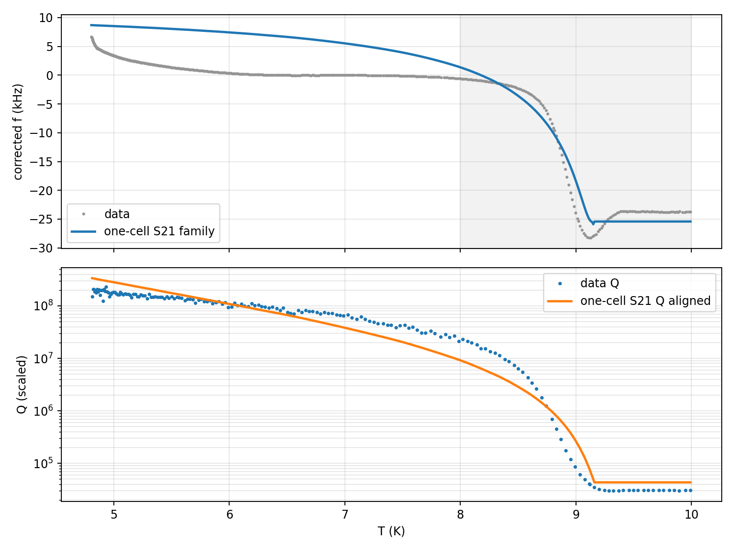
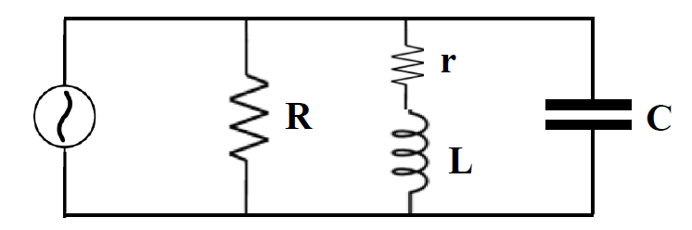
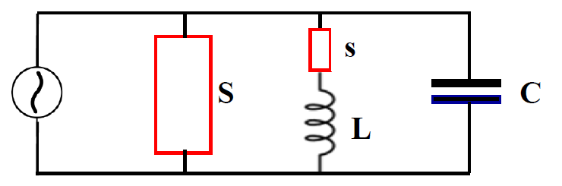
Zimmermann BCS: calculation of optical and AC conductivity (RLC circuit)
Disorder in midT too significant to be described by mean-field / „weakly polluted material“ BCS
[F. Bolle, O. Saritas, M. Scheffler et al., arXiv:2602.15003]
[O. Saritas, BSc Thesis, U Stuttgart (2024)]
∆f / kHz
∆f / kHz
Data
Data
Fit
Fit
Fits okay-ish
  T_{c}, Δ and σ_{nc} are material fit parameters
Intrinsic dip already appears (if σ_{nc} < σ_{nc,0} )
Modify RLC circuit by adding T_{c} reduced regions
Based on R. Vagglio & on our microscopic model
Data
Data
Fit
Fit
Q₀
Q₀
[R. Ghanbari et al., TTCMeeting 2023 @ FNAL]
T / K
T / K

Slide 10
Conclusion
fvT contains relevant information on material properties within RF penetration depth
Correlation studies „alone“ result in findings as fvT is probing the same volume as QvE
But as f and Q₀ are linked by theory, this is also expected → predictive power & model building of fvT
Working with two models to analyze RF response – they are congruent to each other
  Model starts to gradually deviate from data if impurity levels becomes „too large“
  Need additional disorder than „regular“ inhomogeneity to work with our dips

Slide 11





Questions?
Thanks…
to you for listening / your patience
to the conveners to invite me
to the students who did the work
to BMFTR for funding (05H24GU1, 05K25GU3)
Looking for a position
Marc Wenskat / MSL
marc.wenskat@desy.de
Rezvan Ghanbari
PhD Student
Carl Weiss
MSc Student
Ozan Saritas
MSc Student
Darian Holfert
BSc Student

Slide 12
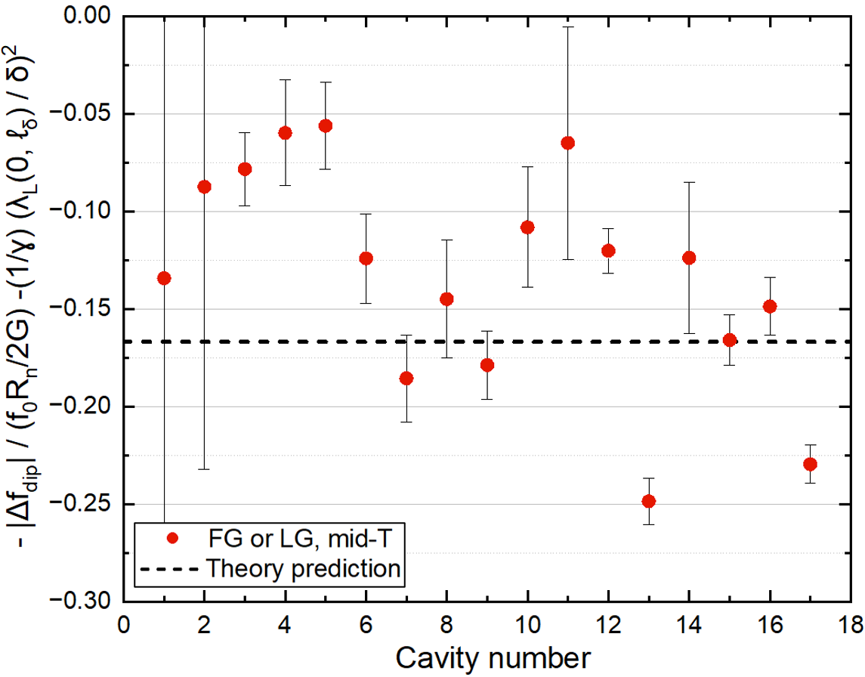


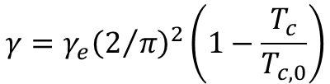
Dip depth
Collaboration with F. Herman
[A. Lebedeva, et al. Physical Review Applied 24.4 (2025): 044007]
$$γ=γ_{e}{\left(2/π\right)}^{2}\left(1−\frac{T_{c}}{T_{c,0}}\right)$$
$≈−\frac{{10}^{3}Hz}{{10}^{9}Hz ×\frac{{10}^{−3}Ω}{{10}^{3}Ω}}$ = $−\frac{{10}^{3}Hz}{{10}^{3}Hz}=−1$
$≪$1
−0.167
Average is -0.133 ± 0.014
Weighted average is −0.168 ± 0.005

Slide 13
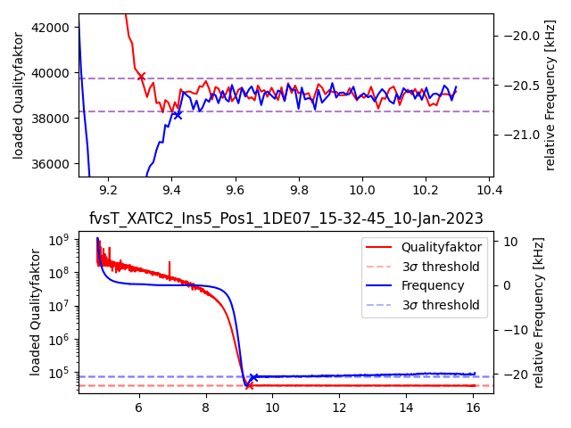
Dips in Q₀ within 3σ noise floor
Clear trend for all midT treated cavities: T_{c} from Q₀ is always smaller as from f for mid-T
→ Maybe no significant dip, but as a consequence rise in Q₀ happens at lower T compared to f

Slide 14
Microscopic model for disordered superconductor
An increased oxygen concentration reduces T_{c} of Nb by 0.93K per 1 at.%
- to have a dip minimum at 9.1K we would need ≈ 0.2 at.%
    - „end of dip“ around 8.9K ≈ 0.3 at.%
Solubility limit of O in Nb is 1 at.% @ 500°C and 0.33 at.% at 145°C
We have shown that C diffusion speed in Nb along GB vary with GB orientation, increasing disorder by spatially varying concentration
→ Assume same is true for O: not homogenous distributed within the rf layer, but clusters with uneven O-concentration
→ Expect non-constant (gaussian shaped) T_{c} reduction
→ Lowest T_{c} equal to the max. at.% concentration at RT (≈ 0.33 at.%)
→ Only locally saturated – not globally. If SIMS spot size ≈ multiple grains, obtained c_{O} below saturation limit
[Desorbo, W. Phys. Rev. 132 (1963): 107.]
[Benvenuti, C., et al. 10th SRF (2001): p441.]
[Kolchin, O.P., et al. Soviet Atomic Energy 45 (4) (1978): p999.]
[Dangwal Pandey, A., et al. Appl. Phys. Lett. 119(2021): 194102]
Notes:
1nm Nb2O5 can easily saturate several hundred nm of Nb!

Slide 15
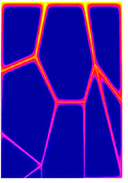


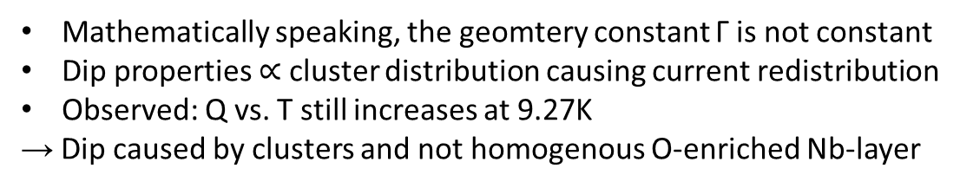
Disordered superconductor show dip
[Barra, M., et al. SUST 18.3 (2005): 271.]
T_{c,Nb}
$$f_{tot}∝\frac{Γ}{λ\left(ℓ,T\right)}$$
Mathematically speaking, the geomtery constant Γ is not constant
Dip properties $∝$ cluster distribution causing current redistribution
Observed: Q vs. T still increases at 9.27K
→ Dip caused by clusters and not homogenous O-enriched Nb-layer
<T_{c}>
T
j
Skin depth
T_{c} < T_{c,Nb}
T_{c} < T_{c,Nb}
$$λ\left(ℓ,T\right)$$

Slide 16
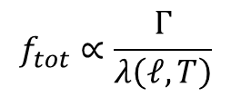
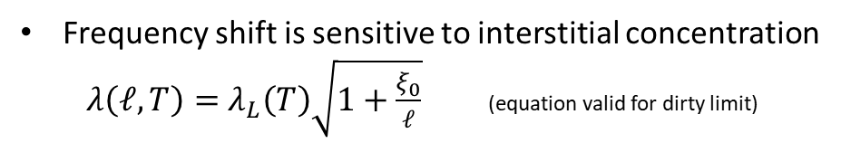

What information is encoded in f vs. T?
T_{c}
$$f_{tot}∝\frac{Γ}{λ\left(ℓ,T\right)}$$
Frequency shift is sensitive to interstitial concentration
$λ\left(ℓ,T\right)=$ $λ_{L}\left(T\right)\sqrt{1+\frac{ξ_{0}}{ℓ}}$ (equation valid for dirty limit)
Δf_{tot} for EXFEL type cavities is typcially 5-6 kHz
Mid-T: more interstitials → larger Δf, but yet no dip
T
j
Skin depth
$$λ\left(ℓ,T\right)$$

