Slide 1


Crystalline ZrO₂ Capping Layer with Atomically- Sharp Oxide-Superconductor Interface
June 9th, 2026
TTC 2026 Meeting, CEA-CNRS-Université Paris Saclay
Nathan Sitaraman, Zhaslan Baraissov, Alexis Grassl, Hongbin Yang, Daniel Tong, David A. Muller, and Matthias Liepe

Slide 2
Outline
Background
  What properties are desirable in a capping layer?
  Why is ZrO₂ a good candidate?
XPS analysis
  Effect of vacuum annealing on oxidation state
SEM and cross-section analysis
  Continuity of capping layer and surface defects
  Analysis of Nb-ZrO₂ interface
Conclusions

Slide 3
What properties are desirable in a capping layer?
Prevent oxygen diffusion to substrate
Non-reactive with atmosphere
Free of lossy defects
Non-reactive with substrate

Slide 4
What properties are desirable in a capping layer?
Prevent oxygen diffusion to substrate
Non-reactive with atmosphere
Free of lossy defects
Non-reactive with substrate
Most of all…
Need a practical deposition/growth process that does not trap excess oxygen or other impurities at the interface with the substrate!

Slide 5
What properties are desirable in a capping layer?
Prevent oxygen diffusion to substrate <- oxygen vacancies
Non-reactive with atmosphere
Free of lossy defects <- oxygen vacancies
Non-reactive with substrate
Most of all…
Need a practical deposition/growth process that does not trap excess oxygen or other impurities at the interface with the substrate!

Slide 6
What properties are desirable in a capping layer?
Defects in simple binary
oxides depend on
oxygen chemical potential

Slide 7
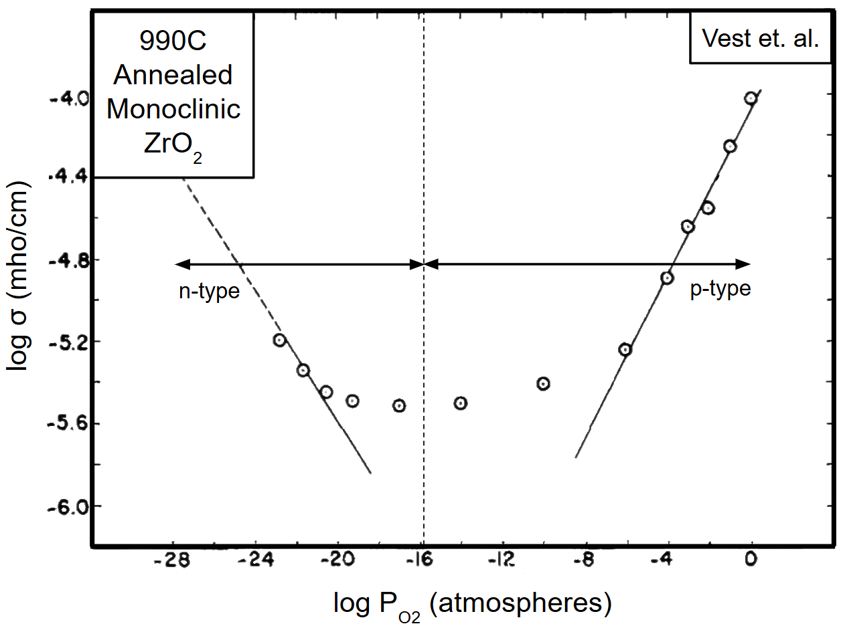
What properties are desirable in a capping layer?
Defects in simple binary
oxides depend on
oxygen chemical potential
Oxygen-poor conditions
result in oxygen vacancies,
oxygen-rich conditions
result in metal vacancies

Slide 8
What properties are desirable in a capping layer?
Defects in simple binary
oxides depend on
oxygen chemical potential
Oxygen-poor conditions
result in oxygen vacancies,
oxygen-rich conditions
result in metal vacancies
Defects may make the
oxide a less effective diffusion
barrier, and may cause RF losses

Slide 9
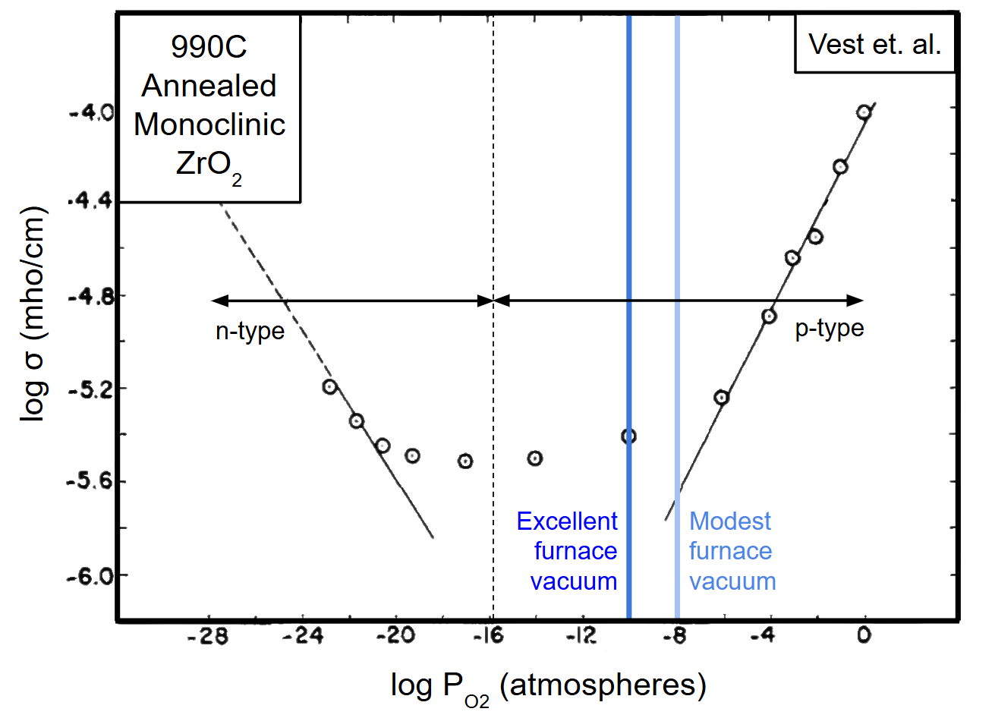
What properties are desirable in a capping layer?
Defects in simple binary
oxides depend on
oxygen chemical potential
Oxygen-poor conditions
result in oxygen vacancies,
oxygen-rich conditions
result in metal vacancies
Defects may make the
oxide a less effective diffusion
barrier, and may cause RF losses

Slide 10
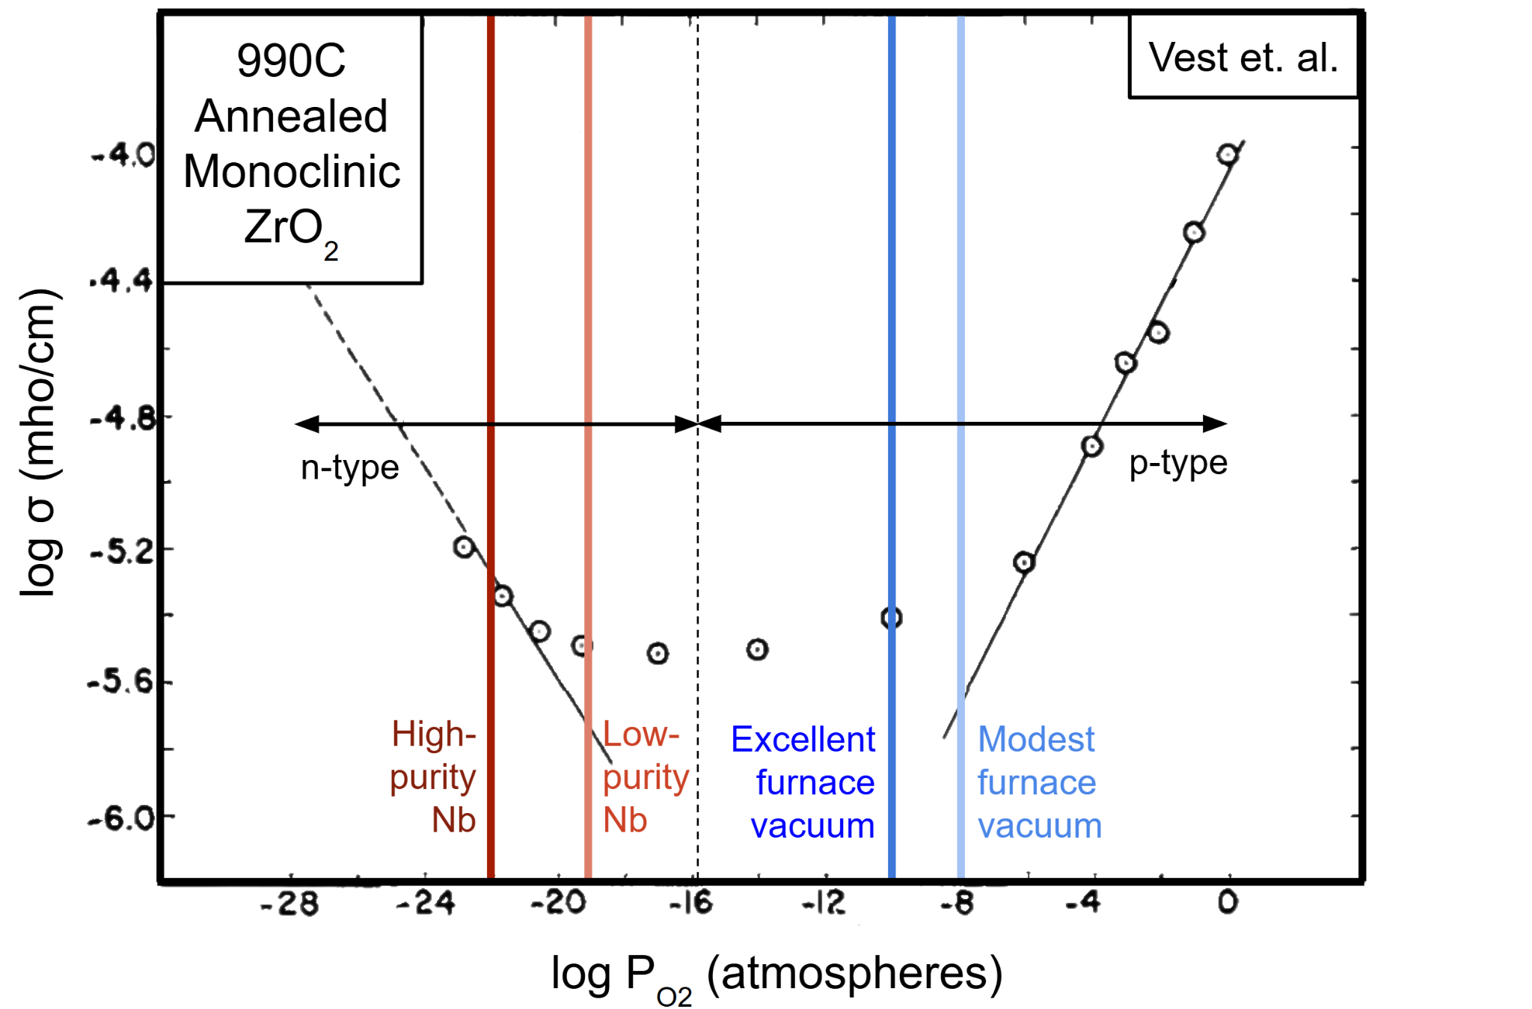
What properties are desirable in a capping layer?
Defects in simple binary
oxides depend on
oxygen chemical potential
Oxygen-poor conditions
result in oxygen vacancies,
oxygen-rich conditions
result in metal vacancies
Defects may make the
oxide a less effective diffusion
barrier, and may cause RF losses

Slide 11
What properties are desirable in a capping layer?
Defects in simple binary
oxides depend on
oxygen chemical potential
Oxygen-poor conditions
result in oxygen vacancies,
oxygen-rich conditions
result in metal vacancies
Defects may make the
oxide a less effective diffusion
barrier, and may cause RF losses
Nb vacuum annealing conditions
perfectly align with minimum defect
concentration in monoclinic ZrO₂!

Slide 12
XPS Analysis
Recipe
3mm cavity-grade Nb
Chemistry (BCP + EP)
300s argon sputter
cleaning
~4nm metallic Zr
deposition
Exposure to atmosphere

Slide 13
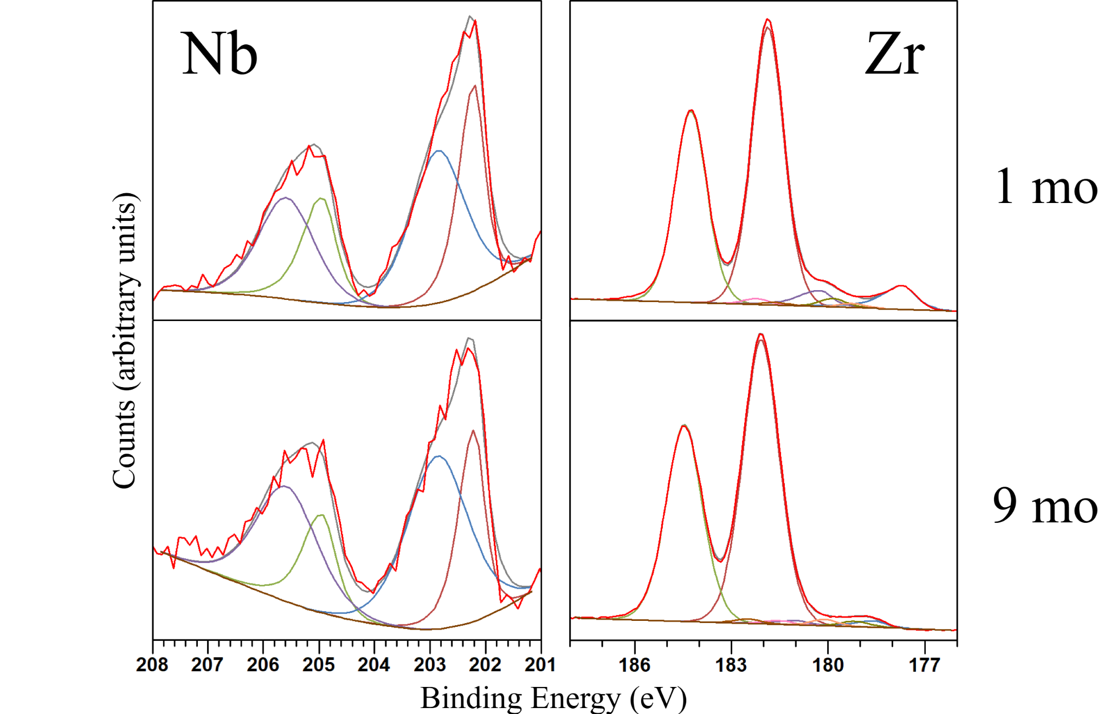
XPS Analysis
Recipe
3mm cavity-grade Nb
Chemistry (BCP + EP)
300s argon sputter
cleaning
~4nm metallic Zr
deposition
Exposure to atmosphere

Slide 14
XPS Analysis
Recipe
3mm cavity-grade Nb
Chemistry (BCP + EP)
300s argon sputter
cleaning
~4nm metallic Zr
deposition
Exposure to atmosphere
Zr slowly approaches complete oxidation, but a stubborn Nb suboxide layer remains

Slide 15
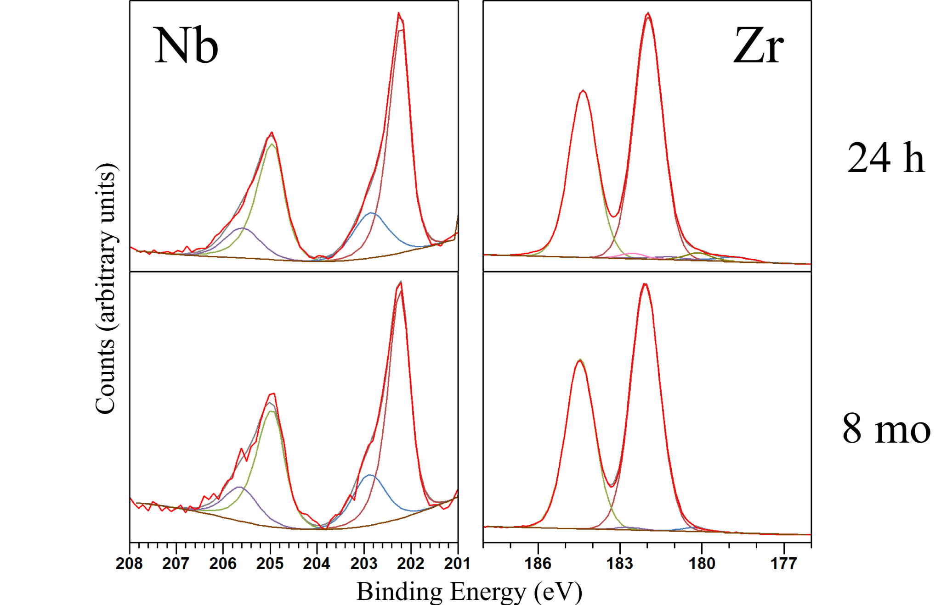
XPS Analysis
Recipe
3mm cavity-grade Nb
Chemistry (BCP + EP)
300s argon sputter
cleaning
~4nm metallic Zr
deposition
Exposure to atmosphere
120C 2-step Bake

Slide 16
XPS Analysis
Recipe
3mm cavity-grade Nb
Chemistry (BCP + EP)
300s argon sputter
cleaning
~4nm metallic Zr
deposition
Exposure to atmosphere
120C 2-step Bake
Suboxide components significantly diminished!

Slide 17
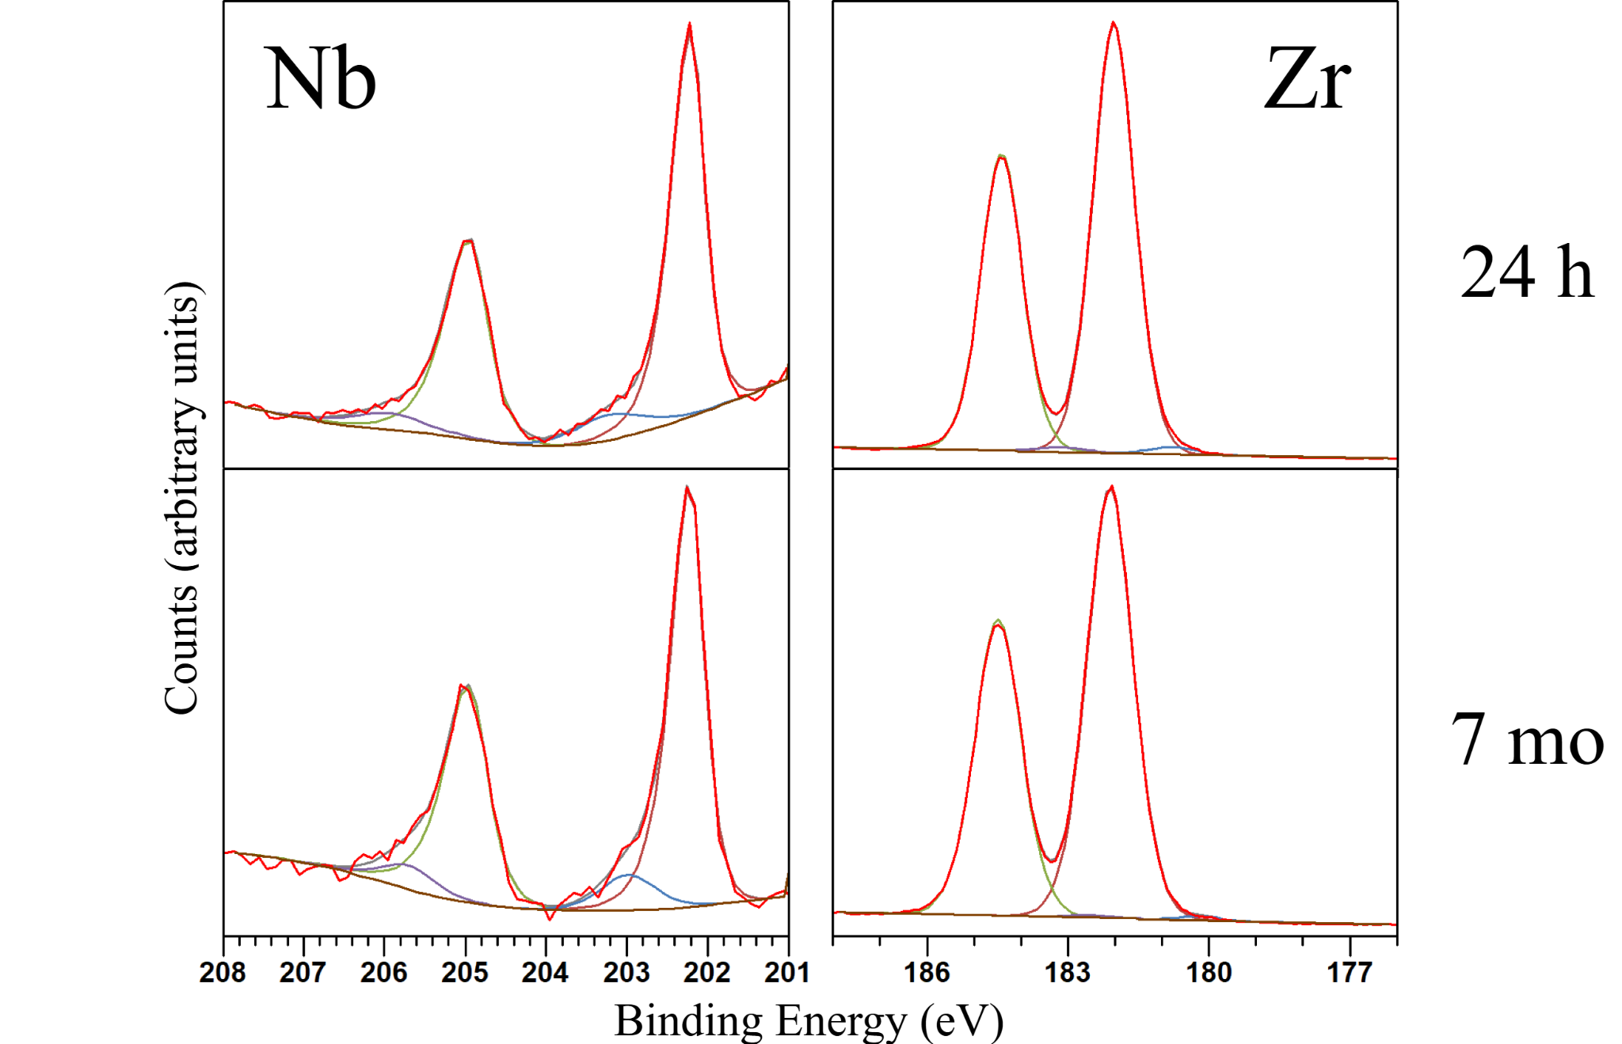
XPS Analysis
Recipe
3mm cavity-grade Nb
Chemistry (BCP + EP)
300s argon sputter
cleaning
~4nm metallic Zr
deposition
Exposure to atmosphere
5H 800C Bake
Suboxide components even further diminished!

Slide 18
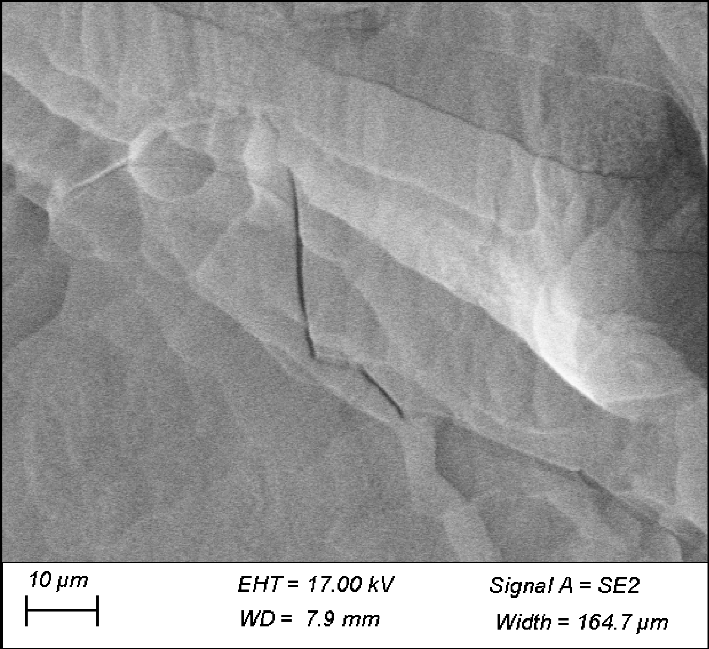
SEM Analysis
Recipe
3mm cavity-grade Nb
Chemistry (BCP + EP)
300s argon sputter
cleaning
~4nm metallic Zr
deposition
Exposure to atmosphere
5H 800C Bake
Looks like normal Nb…lack of precipitates surprising?

Slide 19
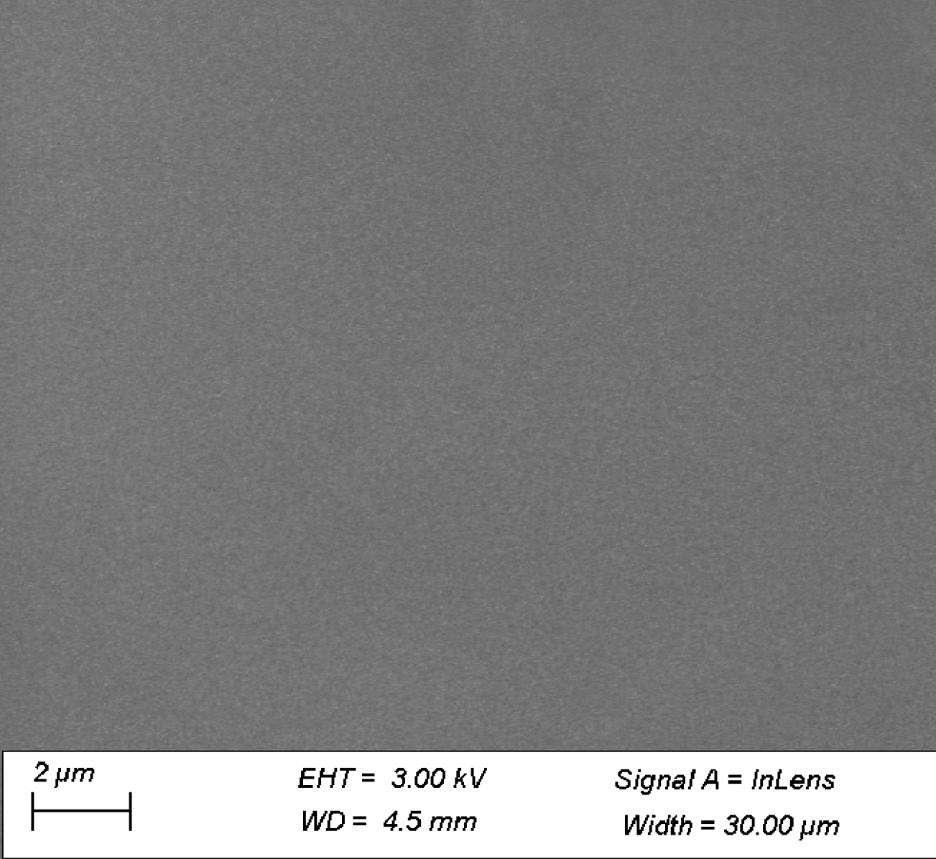
SEM Analysis
Recipe
3mm cavity-grade Nb
Chemistry (BCP + EP)
300s argon sputter
cleaning
~4nm metallic Zr
deposition
Exposure to atmosphere
5H 800C Bake
At smaller scale, surface seems nearly featureless

Slide 20
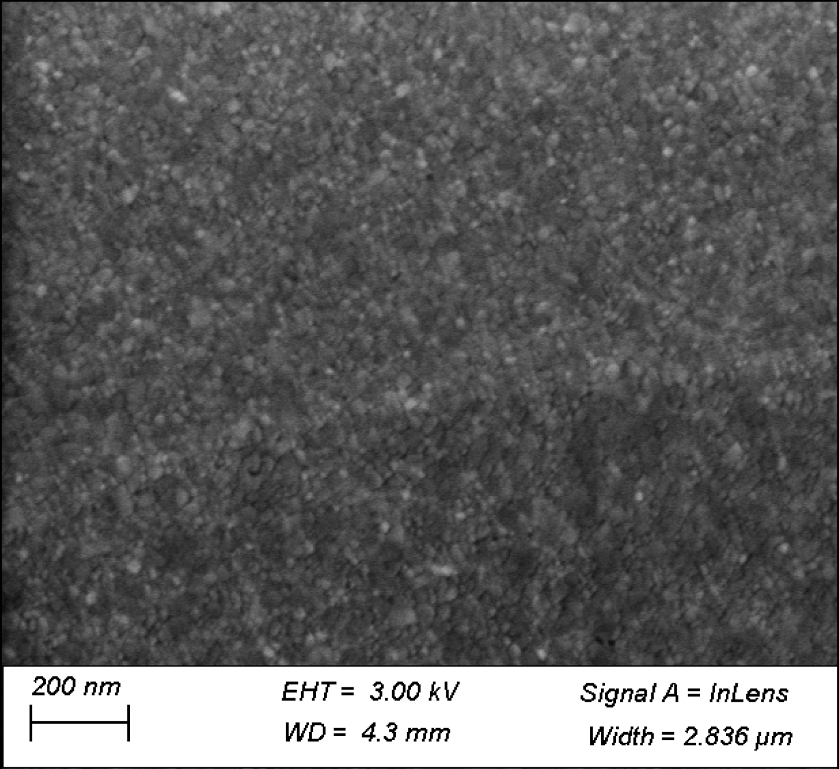
SEM Analysis
Recipe
3mm cavity-grade Nb
Chemistry (BCP + EP)
300s argon sputter
cleaning
~4nm metallic Zr
deposition
Exposure to atmosphere
5H 800C Bake
At even smaller scale, ZrO₂ grains clearly visible!

Slide 21
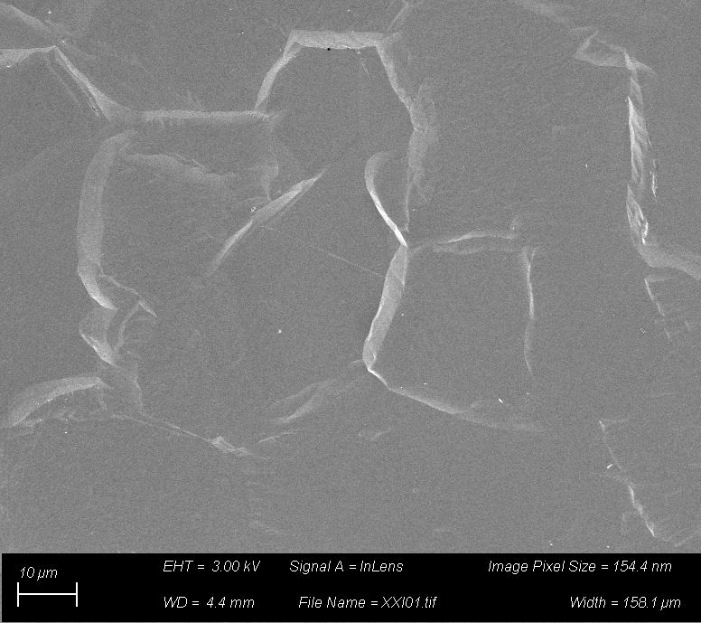
SEM Analysis
Recipe
3mm cavity-grade Nb
Chemistry (BCP + EP)
300s argon sputter
cleaning
~4nm metallic Zr
deposition
Exposure to atmosphere
48H 800C Bake
After longer annealing, precipitates appear!

Slide 22
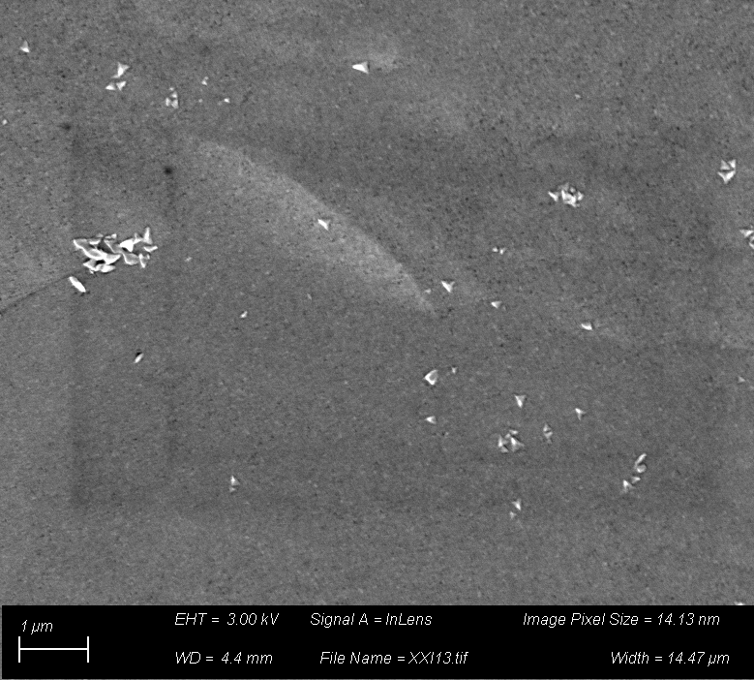
SEM Analysis
Recipe
3mm cavity-grade Nb
Chemistry (BCP + EP)
300s argon sputter
cleaning
~4nm metallic Zr
deposition
Exposure to atmosphere
48H 800C Bake
After longer annealing, precipitates appear!

Slide 23
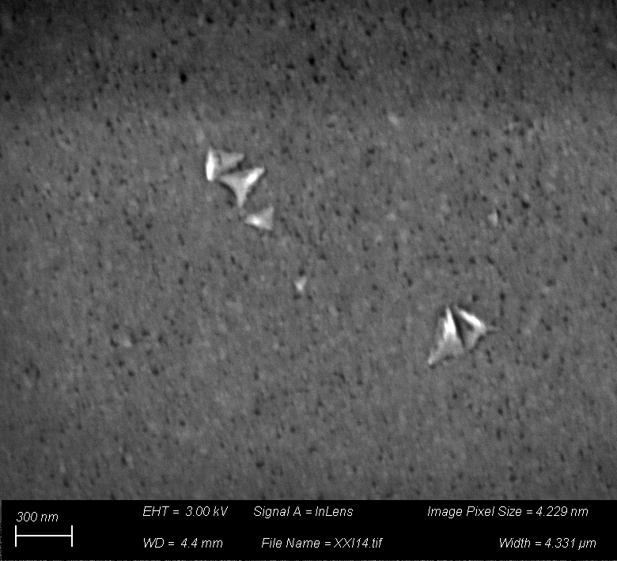
SEM Analysis
Recipe
3mm cavity-grade Nb
Chemistry (BCP + EP)
300s argon sputter
cleaning
~4nm metallic Zr
deposition
Exposure to atmosphere
48H 800C Bake
Familiar “shark tooth” shape?
Black spots = tiny gaps in capping layer?

Slide 24
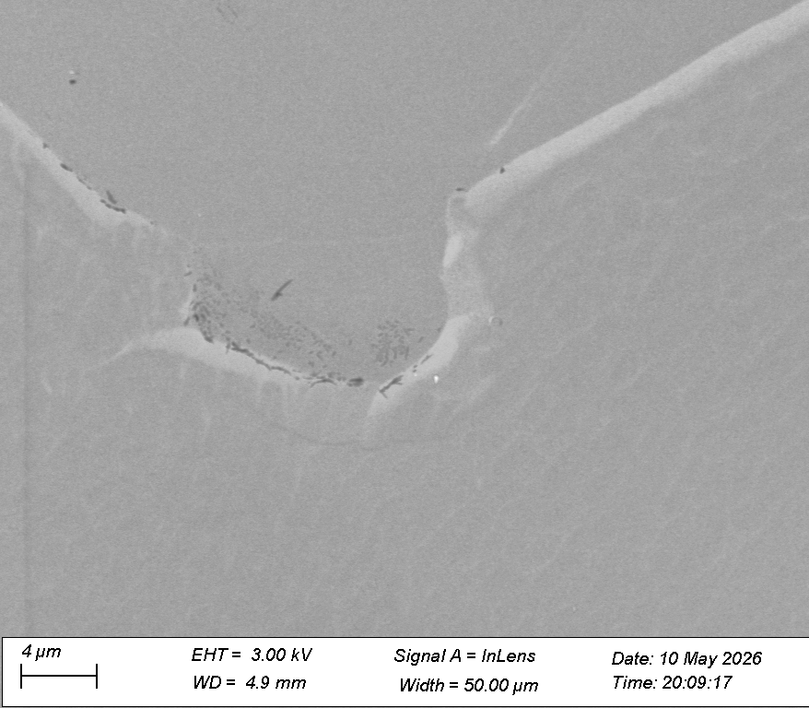
SEM Analysis
Recipe
3mm cavity-grade Nb
Chemistry (BCP + EP)
300s argon sputter
cleaning
~4nm metallic Zr
deposition
Exposure to atmosphere
5H 900C Bake
Dark features appear near Nb grain boundaries (related to faceting or GB migration?)

Slide 25
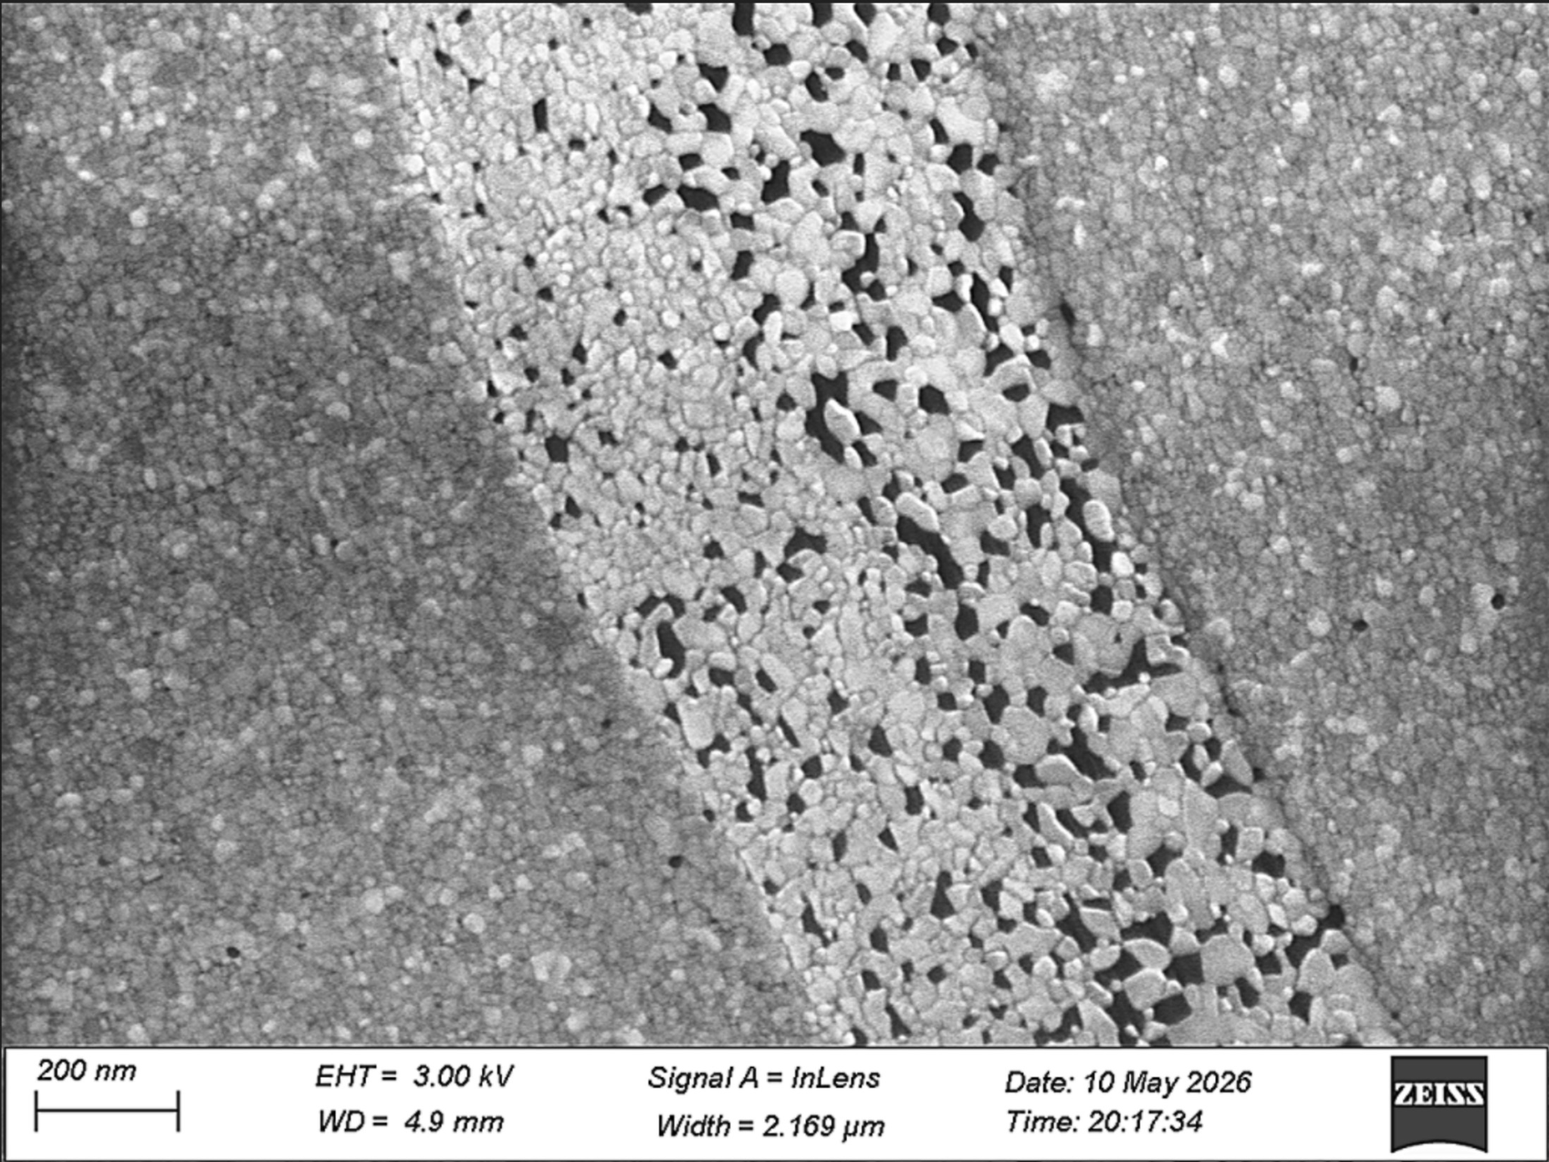
SEM Analysis
Recipe
3mm cavity-grade Nb
Chemistry (BCP + EP)
300s argon sputter
cleaning
~4nm metallic Zr
deposition
Exposure to atmosphere
5H 900C Bake
Beautiful “mosaic”-like appearance on nm scale, with clear gaps between ZrO₂ grains

Slide 26
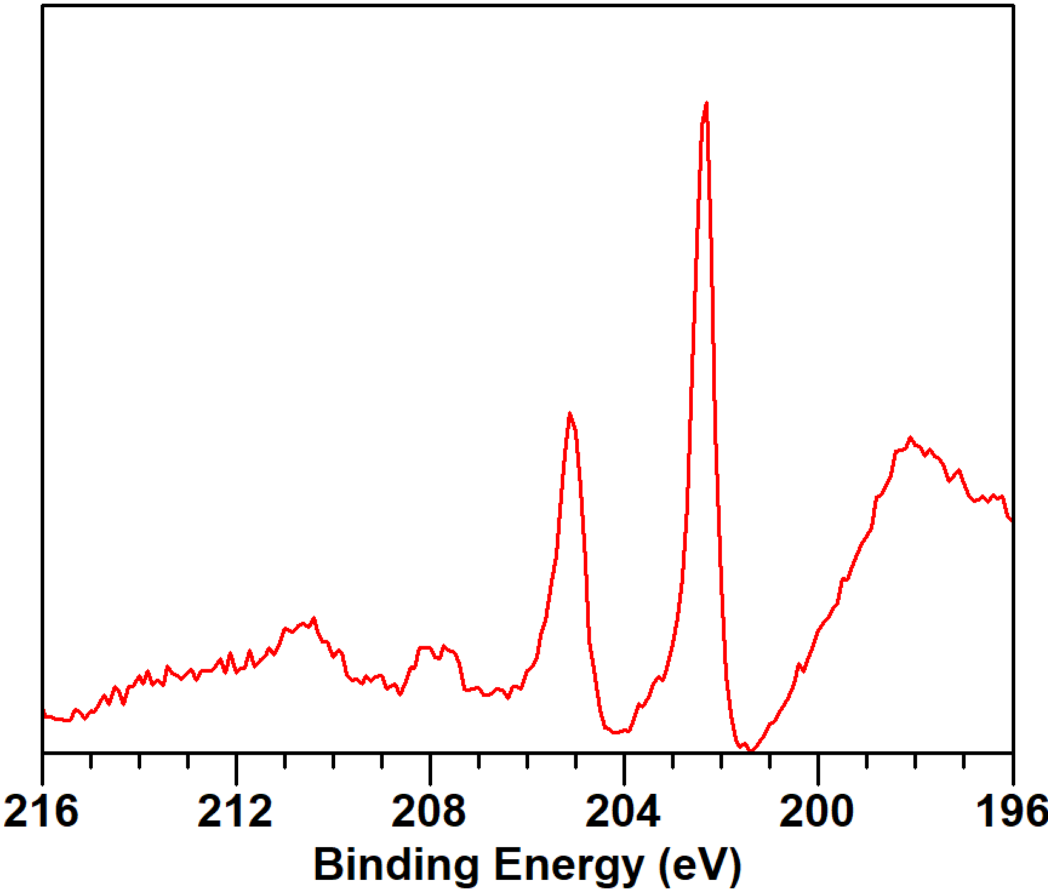
SEM Analysis
Recipe
3mm cavity-grade Nb
Chemistry (BCP + EP)
300s argon sputter
cleaning
~4nm metallic Zr
deposition
Exposure to atmosphere
5H 900C Bake
Small but distinct Nb2O5 peaks re-appear on XPS!

Slide 27
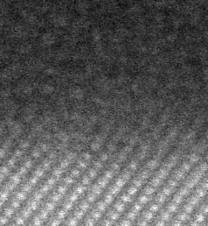
Cross section analysis
Cross section of Nb native oxide surface shows fuzzy interface
Because ZrO₂ is crystalline, we can use multislice electron ptychography to resolve the Nb-ZrO₂
interface much more
precisely
Amorphous
Nb₂O₅
B
1 nm
Nb

Slide 28
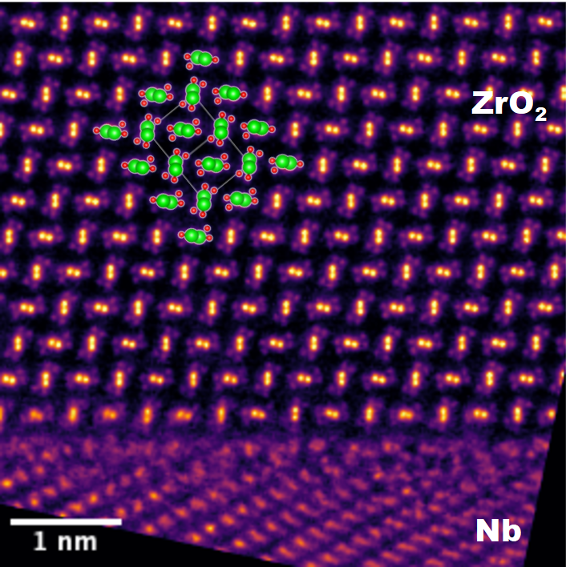
Cross section analysis
Cross section of Nb native oxide surface shows fuzzy interface
Because ZrO₂ is crystalline, we can use multislice electron ptychography to resolve the Nb-ZrO₂
interface much more
precisely
Amorphous
Nb₂O₅
B
1 nm
Nb

Slide 29
Cross section analysis
Cross section of Nb native oxide surface shows fuzzy interface
Because ZrO₂ is crystalline, we can use multislice electron ptychography to resolve the Nb-ZrO₂
interface much more
precisely
Amorphous
Nb₂O₅
Monoclinic structure clearly visible
Slight disorder apparent in substrate
near interface
B
1 nm
Nb

Slide 30
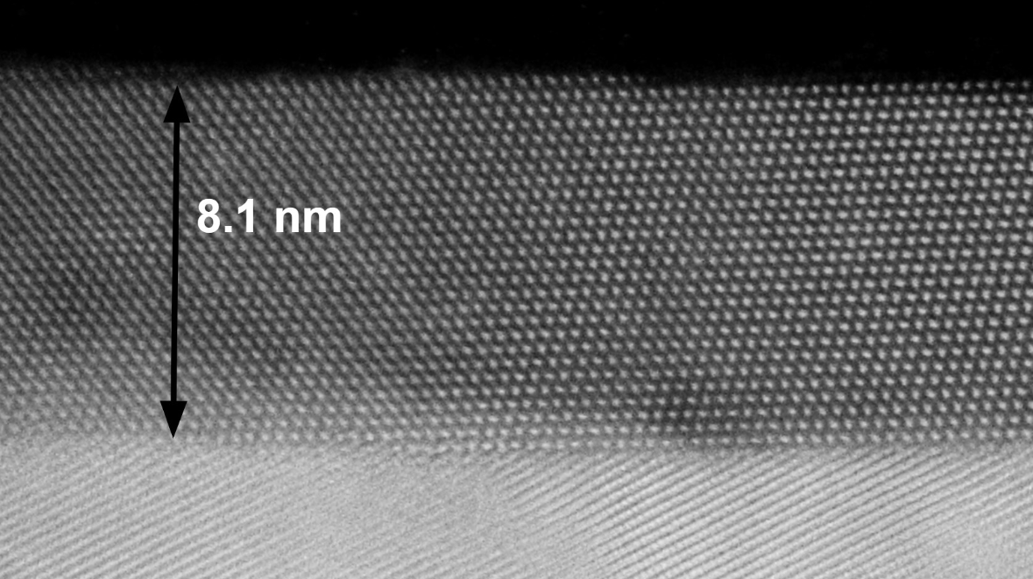
Cross section analysis
Cross section of Nb native oxide surface shows fuzzy interface
Because ZrO₂ is crystalline, we can use multislice electron ptychography to resolve the Nb-ZrO₂
interface much more
precisely
Overall thickness similar to Nb native oxide
Monoclinic structure clearly visible
Slight disorder apparent in substrate
near interface
B

Slide 31
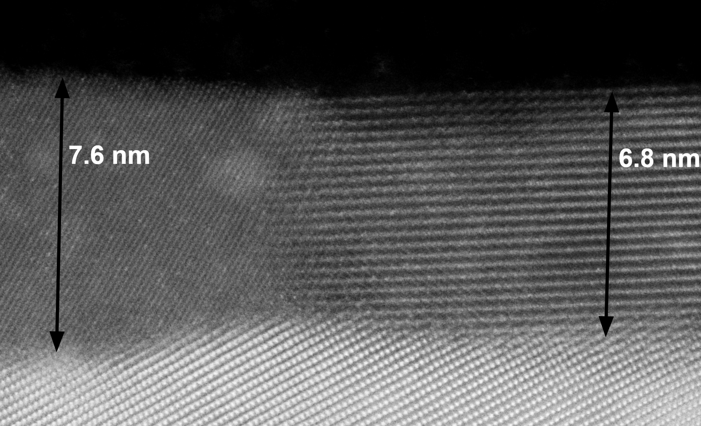
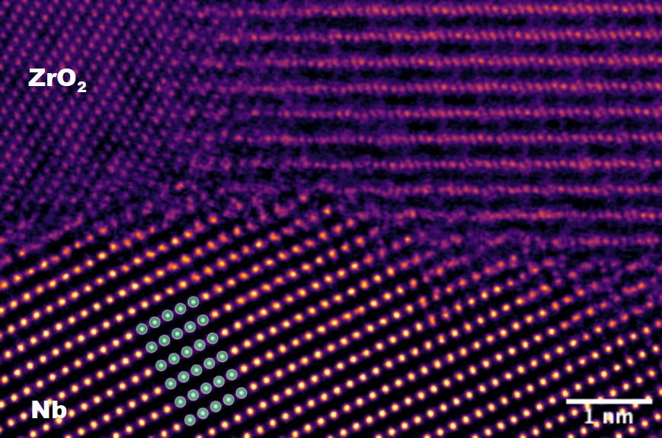
Cross section analysis
Cross section of Nb native oxide surface shows fuzzy interface
Because ZrO₂ is crystalline, we can use multislice electron ptychography to resolve the Nb-ZrO₂
interface much more
precisely
Overall thickness similar to Nb native oxide
Disordered interfacial layer remains relatively thin near capping layer grain boundaries
B

Slide 32
Conclusions
Intrinsic properties of ZrO₂ make it an excellent capping layer for Nb
Crystallinity and suboxide elimination require vacuum annealing
  Still room for further improvement/optimization
Capping layer inhibits precipitate formation?
  Unexpected but welcome side-effect. More study needed!
  Potential for low residual/high Q after 800C bake with no post-bake chemistry?
RF analysis
  Testing flat sample plate on sample host cavity soon!
  Scaling to 3D cavities with CVD ZrO₂

Slide 33
Bonus slide: We are still trying Zr doping!
Idea is to tune MFP in analogy to N-doping, and gain slight Tc enhancement
Similar process to N-doping
  Doping under optimized furnace conditions
  Short EP to remove damaged surface layer

Slide 34
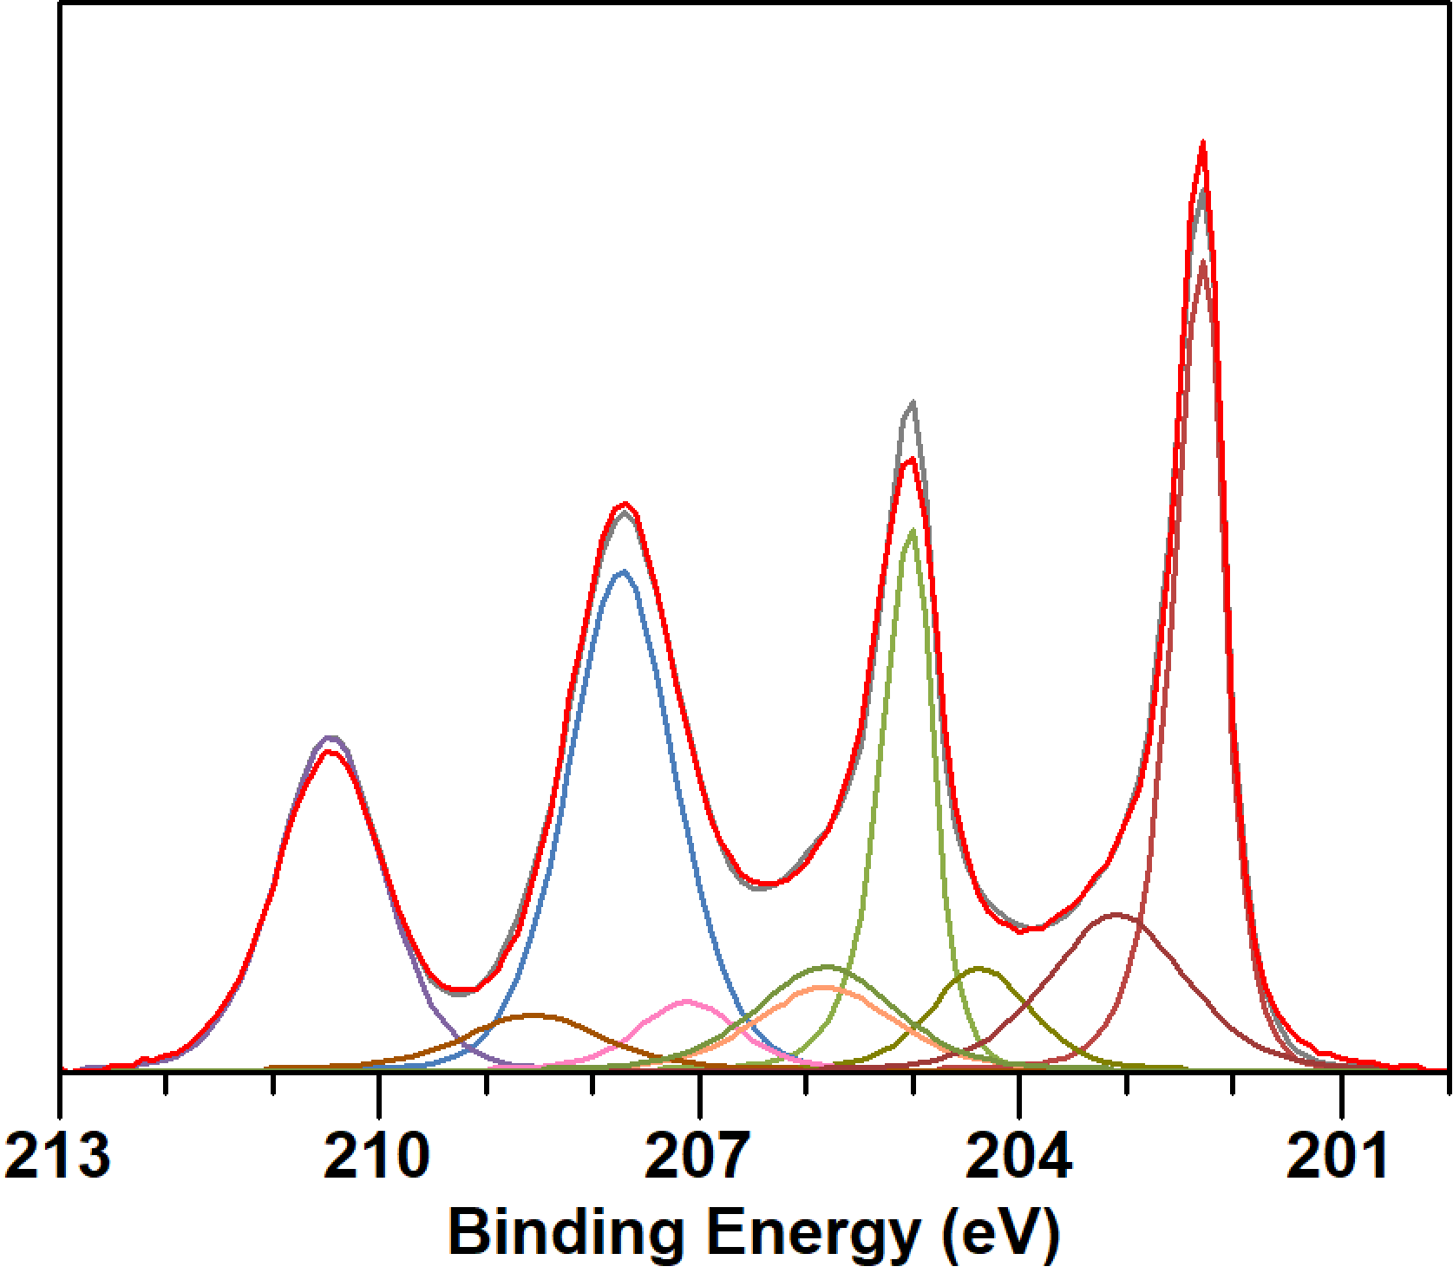
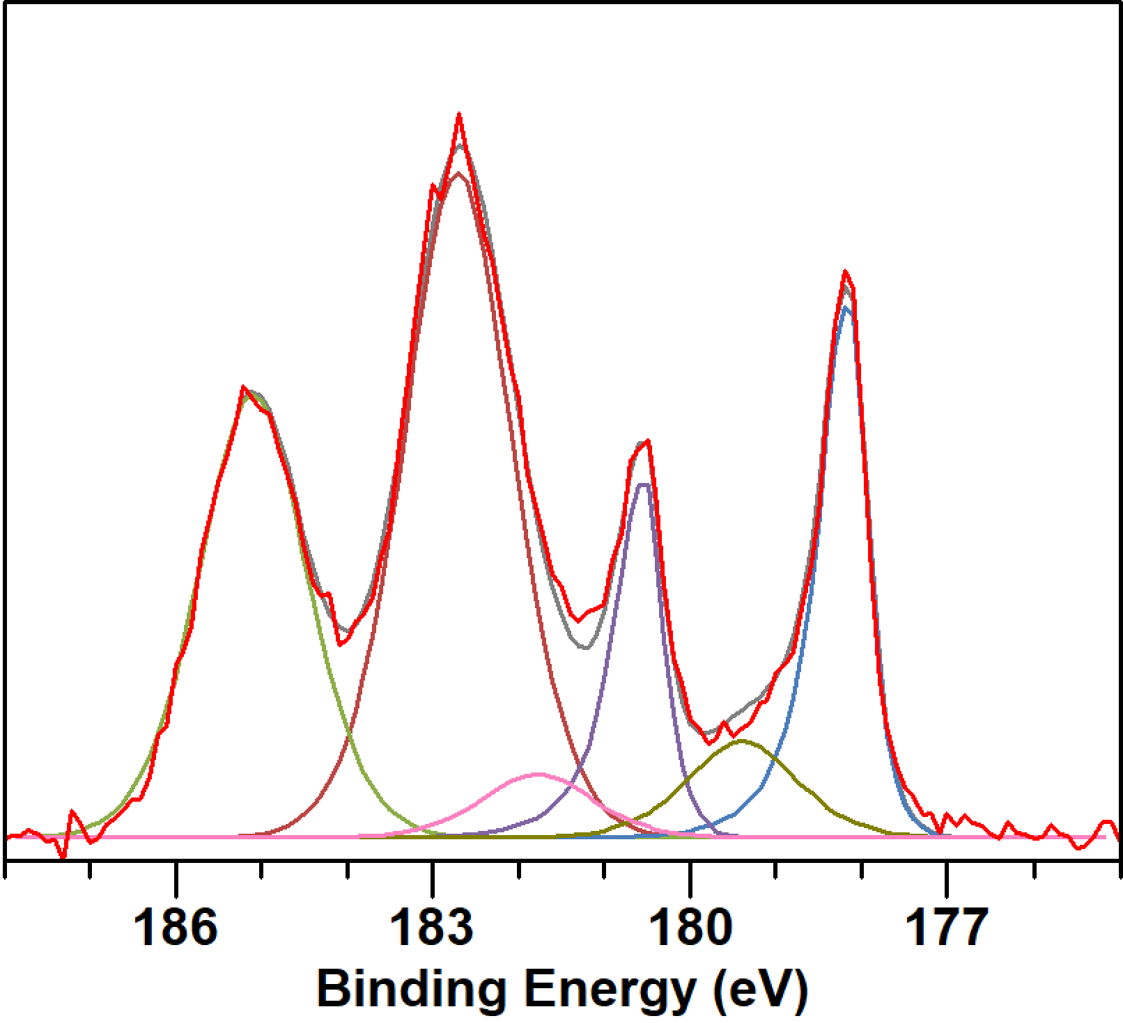
Bonus slide: We are still trying Zr doping!
Idea is to tune MFP in analogy to N-doping, and gain slight Tc enhancement
Similar process to N-doping
  Doping under optimized furnace conditions
  Short EP to remove damaged surface layer
Nb
Zr
Compositional analysis
Metal alloy: 92.6% Nb, 7.4% Zr
Oxide: 85.8% Nb, 14.2% Zr

Slide 35
Bonus slide: We are still trying Zr doping!
Idea is to tune MFP in analogy to N-doping, and gain slight Tc enhancement
Similar process to N-doping
  Doping under optimized furnace conditions
  Short EP to remove damaged surface layer
First RF test soon!
Nb
Zr
Compositional analysis
Metal alloy: 92.6% Nb, 7.4% Zr
Oxide: 85.8% Nb, 14.2% Zr

Slide 36
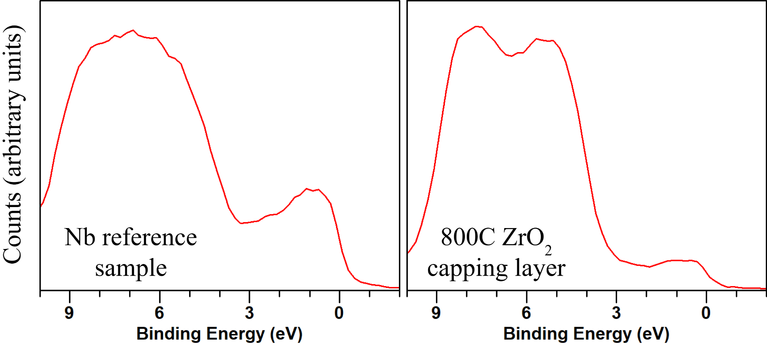

Slide 37
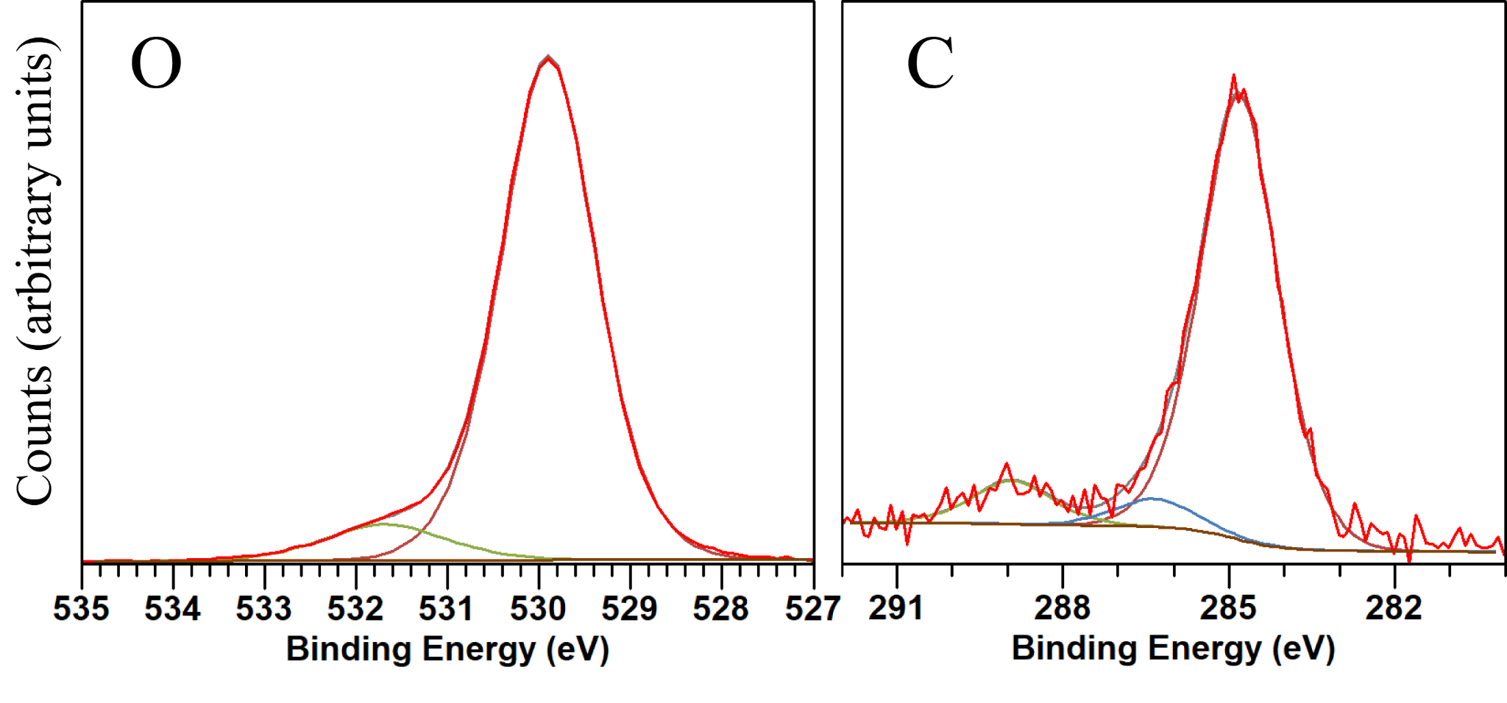

Slide 38
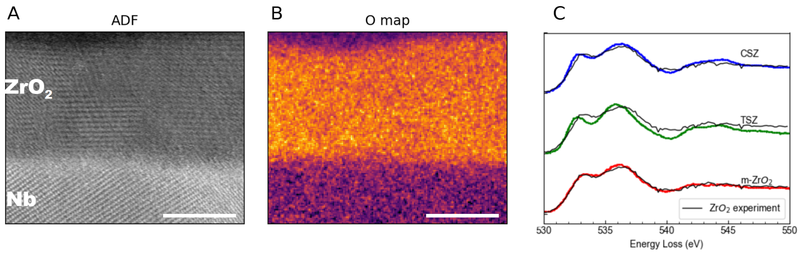
EELS analysis of cross section shows excellent match with monoclinic ZrO₂
5nm
5nm

Slide 39
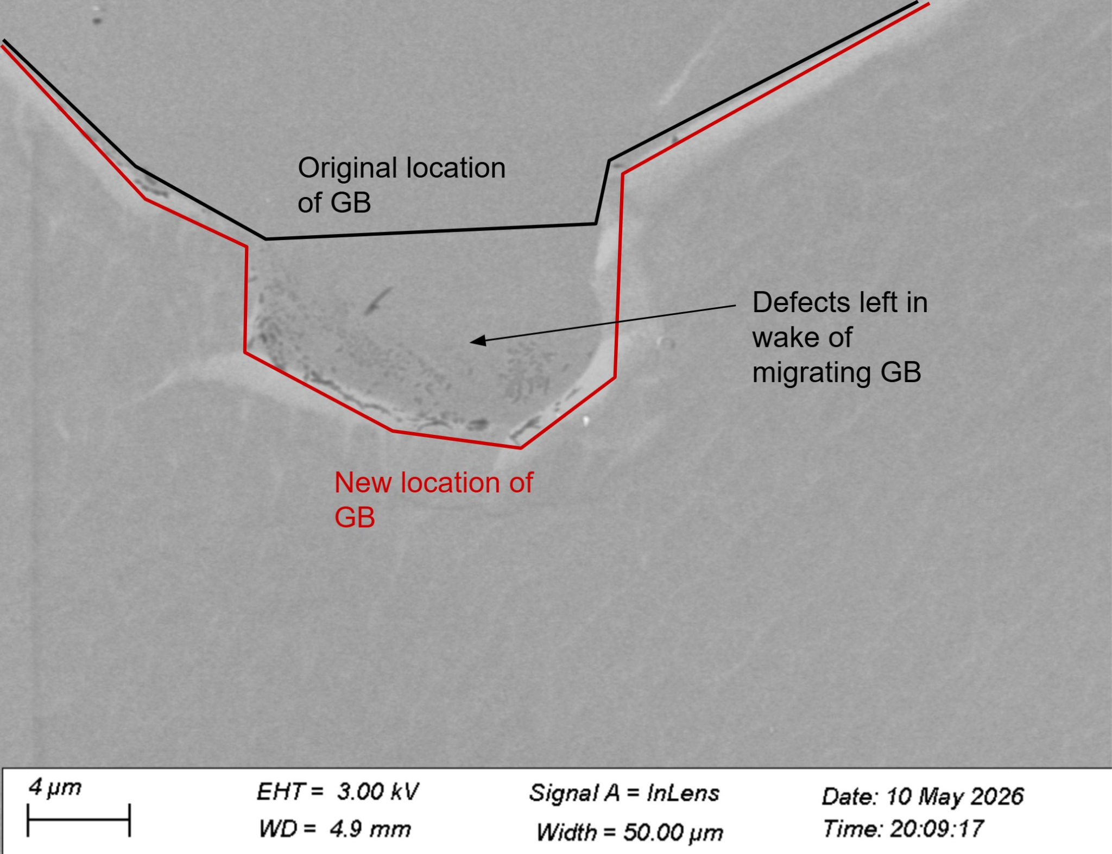
low energy facet forms near GB?

