Slide 1


Extending High-Q / High-Gradient Processing to a Novel SRF Cavity Geometry: The Barrel Cell Cavity
FERMILAB-SLIDES-26-0089-SQMS-TD
June 6, 2026
Daniel Bafia¹, Alexej Grudiev², Simon Barriere², Robin Betemps², Thomas Demaziere², Alex Netepenko¹, Tim Ring¹, Davida Smith¹
¹FNAL, Batavia, USA; ²CERN, Geneve, Switzerland;
TTC'2026, CEA-CNRS-Universite Paris Saclay

Slide 2
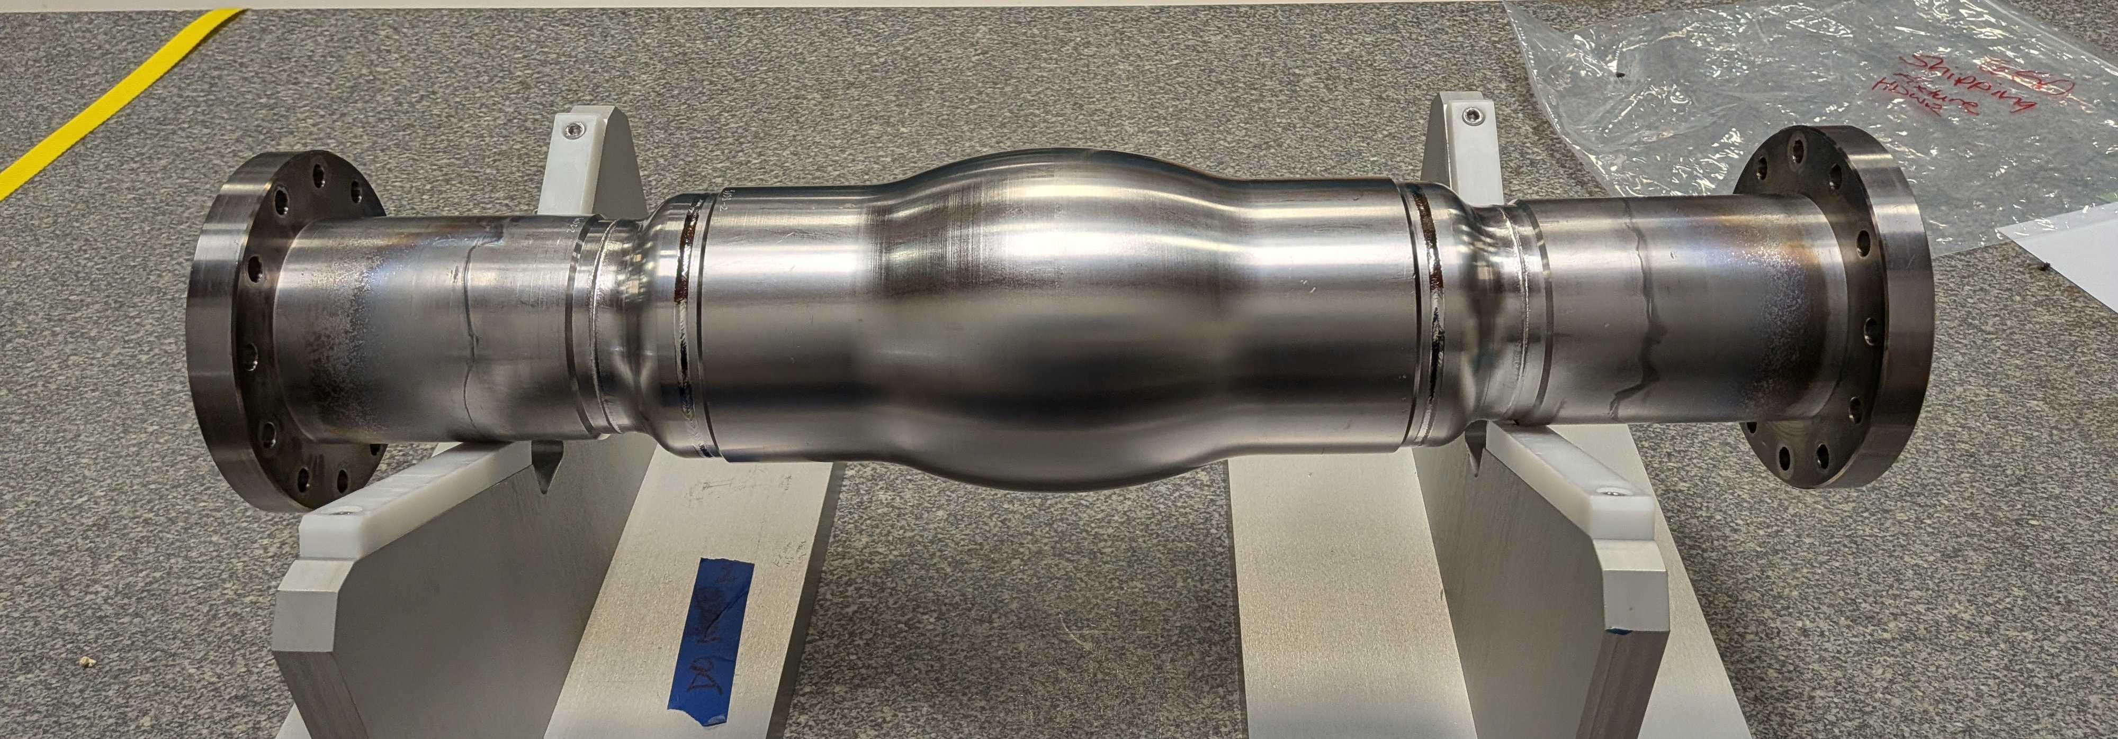
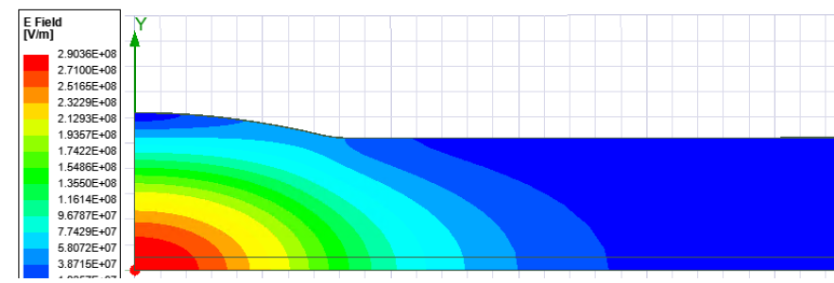
Extending High-Q / High-Gradient Processing to a Novel SRF Geometry
Barrel Cell Cavity (BCC)
Developed at CERN¹ as an ultra-low-R/Q cavity concept to mitigate beam-loading effects in future accelerators
2 GHz non-TESLA SRF cavity with a large aperture and extended cell length
Requires: operation at high stored energy → high sustained B_{p}
  Goal: B_{p} = 200 mT
Barrel Cell Cavity Prototype
R/Q ~ 2 Ω
Can high-Q/high-gradient processing be successfully transferred to this cavity?
¹A. Grudiev and T. Mastoridis, CERN-ACC-2021-0008, CLIC-Note-1173 (2021).

Slide 3
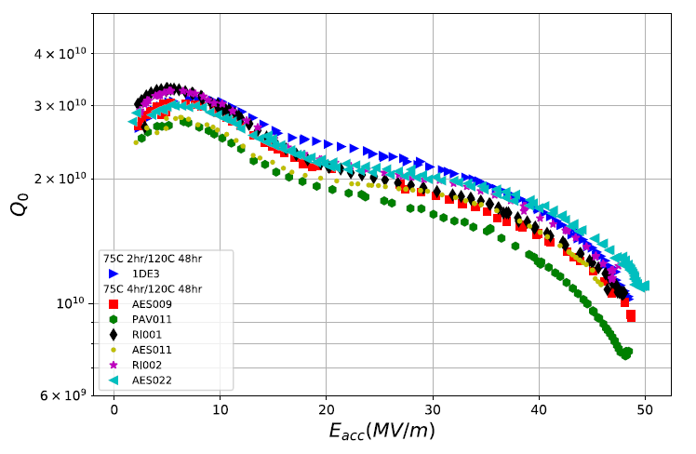
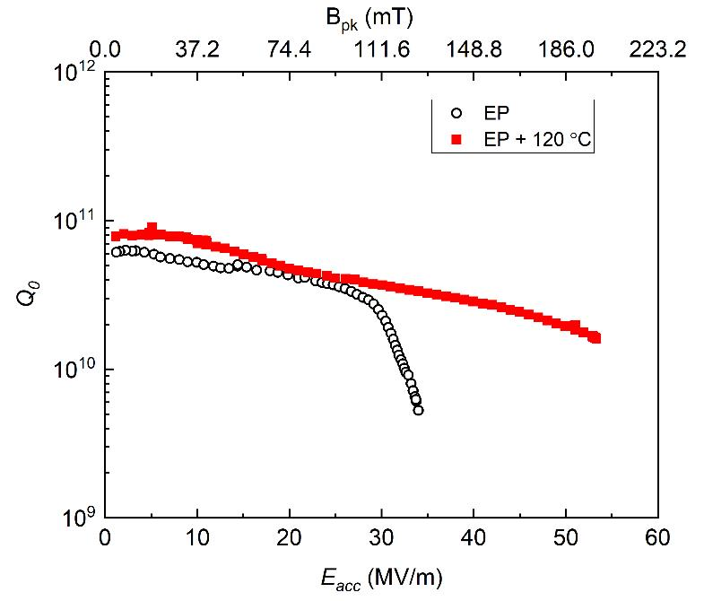
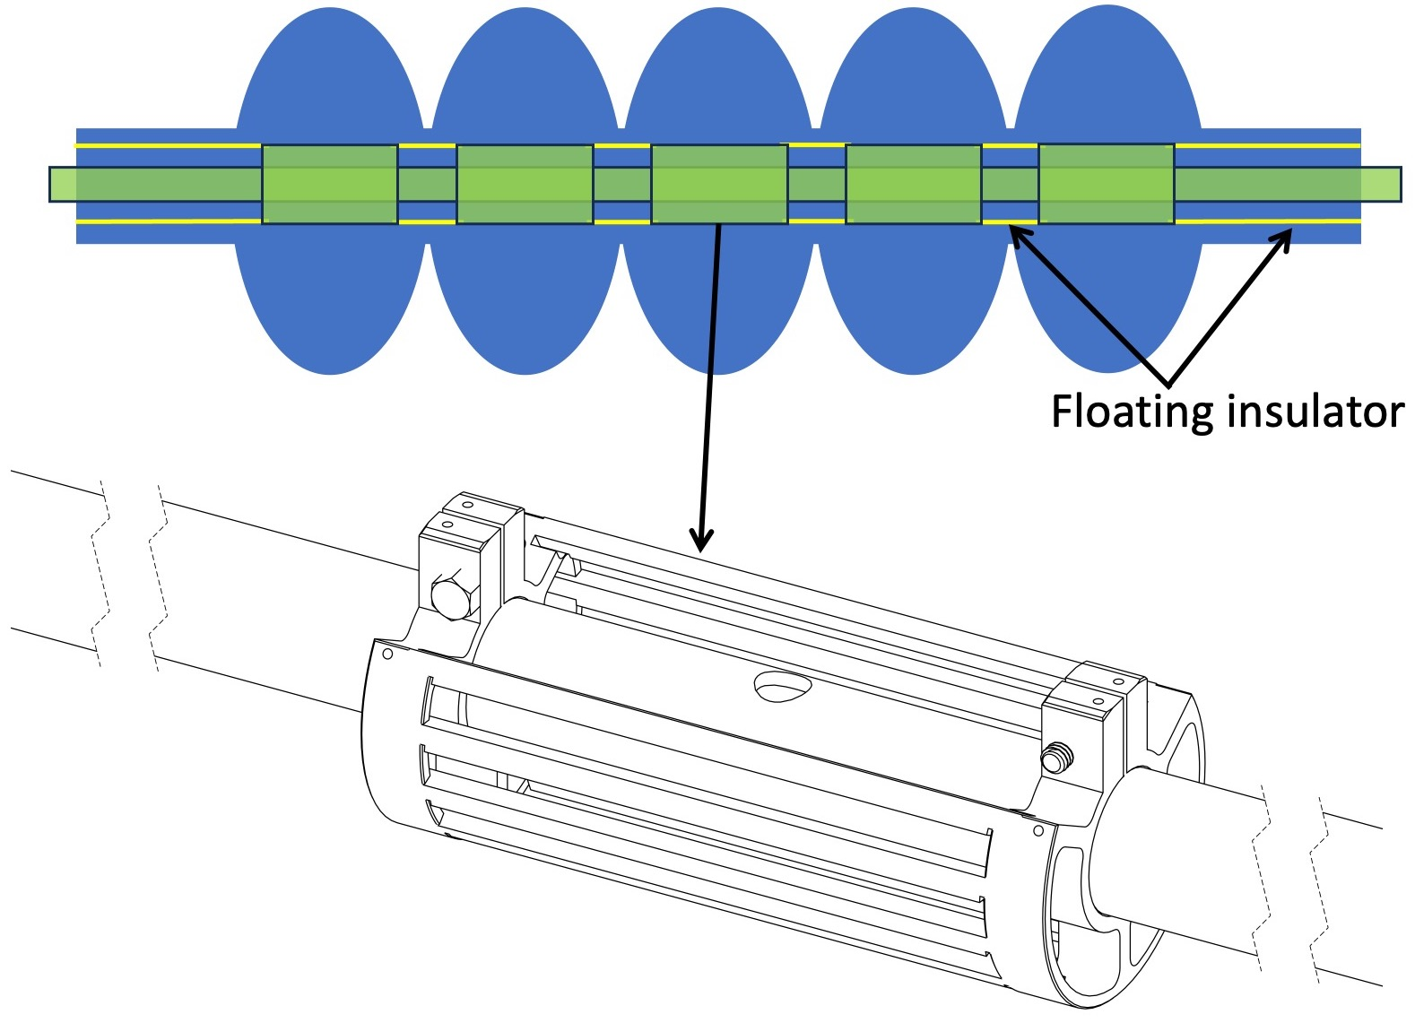
Selecting a High-Performance Processing Strategy for the BCC
Cold EP + 75/120 C Modified LTB on 1.3 GHz
Optimized EP + 120C baking on HB 650 MHz
D. Bafia, PhD Thesis, IIT, 2020
B_{p} = 200 mT
V. Chouhan et al., NIMPRA 1051, 168234 (2023)
B_{p} = 200 mT
Large statistics of TESLA-shaped, 1.3 GHz single-cells achieving B_{p} > 200 mT
Multiple HB 650 MHz single-cells demonstrate B_{p} > 200 mT
Chosen processing strategy: Cold EP + 75/120°C modified bake

Slide 4
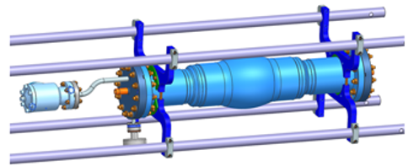
Preparing the BCC for High-Gradient Processing
Applied Surface Treatments
BCC Processing Required New Infrastructure
Custom electropolishing tooling
Dedicated cavity support fixture
VTS preparation
120 um bulk EP
800 C x 3 hr degas in UHV
40 um final EP
Assembly, HPR, evacuation
75 C x 4 hr + 120 C x 48 hr in situ LTB

Slide 5
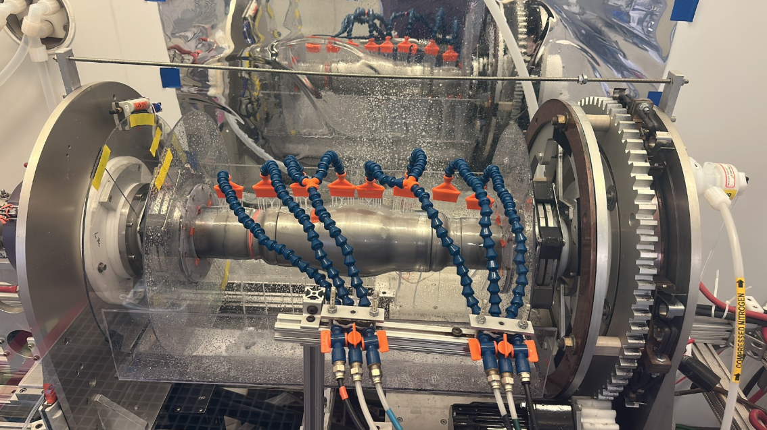
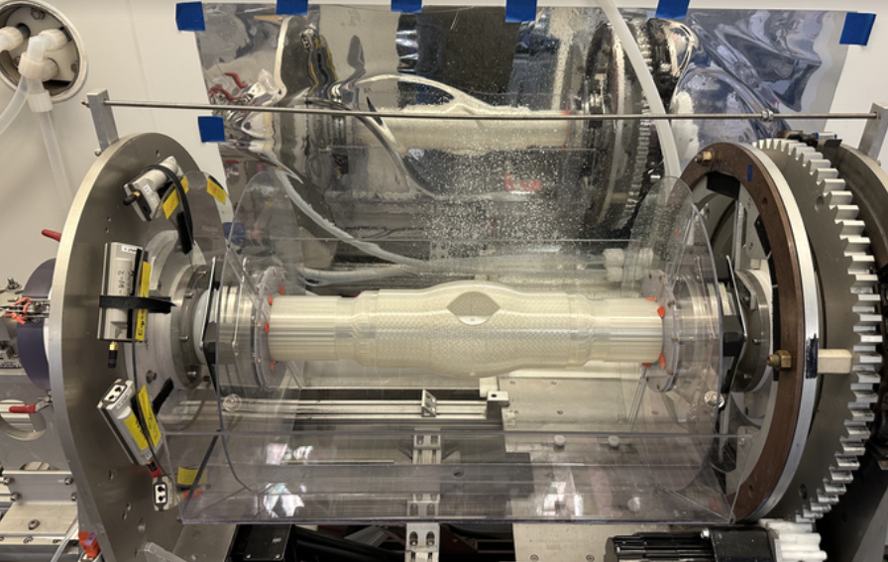
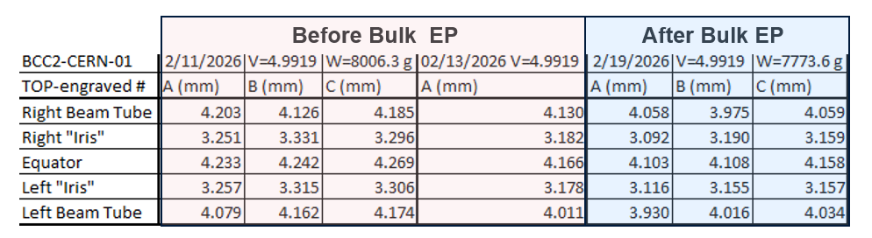
Developing an EP Strategy for the BCC
Challenge #1: Single prototype
Challenge #2: Uniform material removal required to preserve cavity rotational symmetry
Bulk EP Setup
EP development activities
Custom drip tray for BCC dimensions
Full-scale 3D printed cavity mockup for cathode position studies
US Thickness Measurements Pre/Post Bulk EP
3-D Printed Mockup for Cathode Positioning
Uniform material removal achieved after 120 μm bulk EP (<50 μm wall-thickness variation)
Thank you to Tim Ring and Davida Smith for EP work

Slide 6
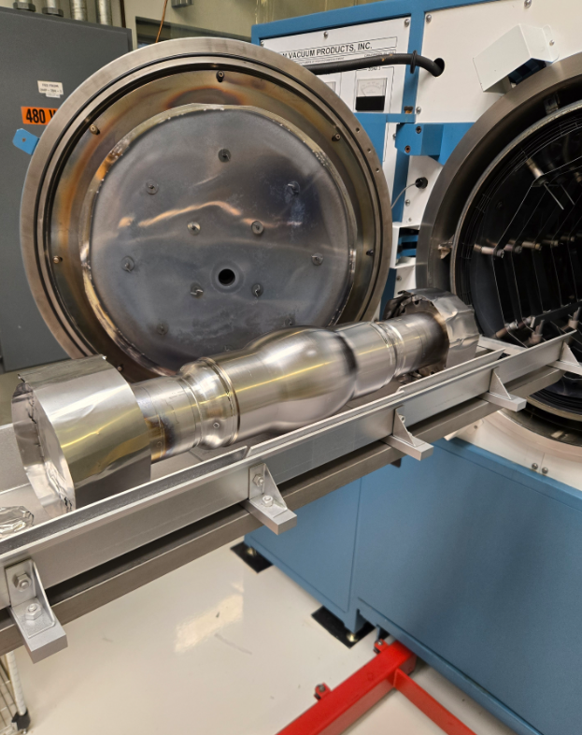
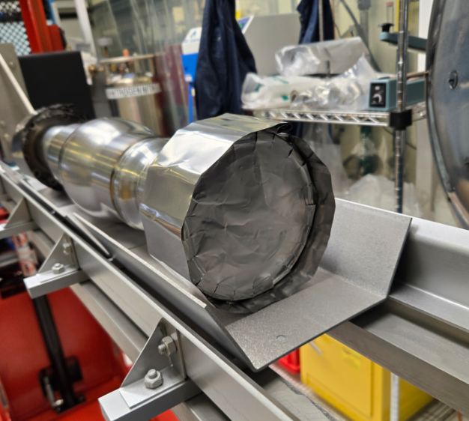
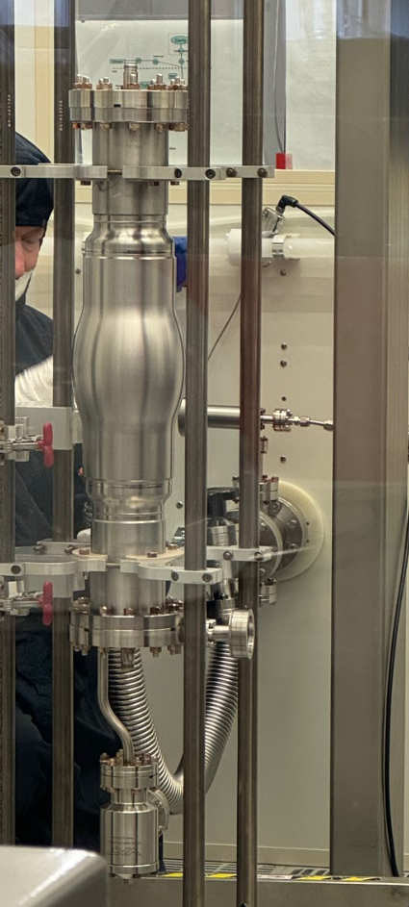
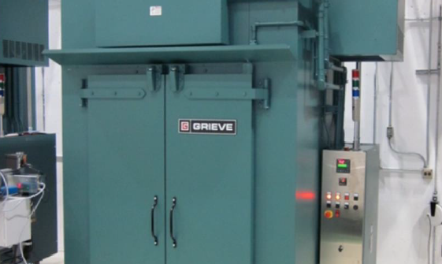
Applying the Cold EP + Modified Bake Treatment
HPR, assembly, & evacuation
Bake at 800 C x 3 hrs in UHV
75/120 C modified low temperature baking
40 um EP final removal
30 um @ ~22 C
10 um @ 12 C

Slide 7
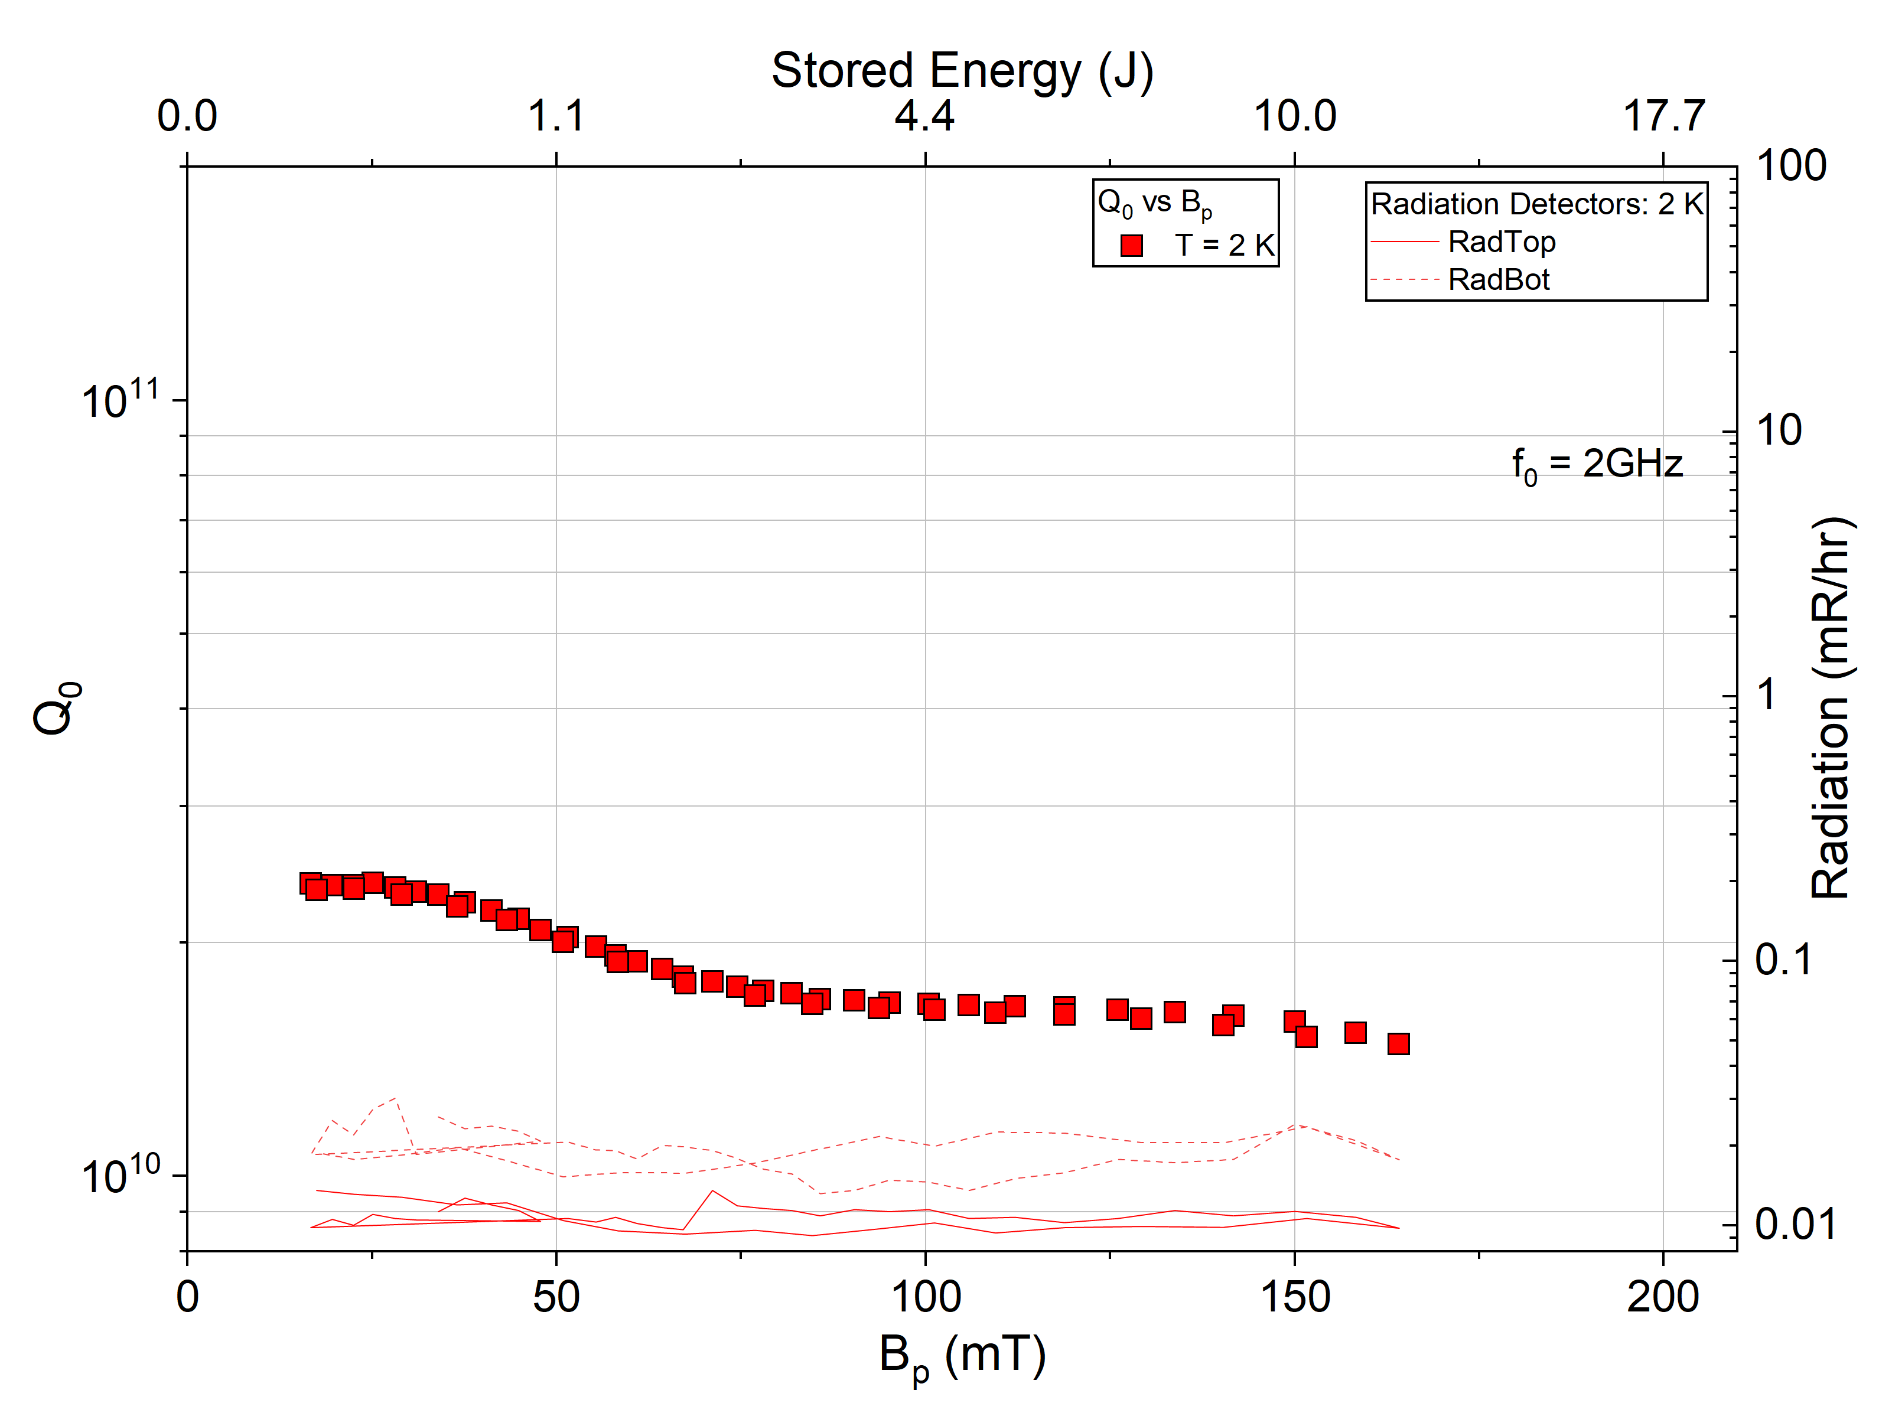
First BCC Test Demonstrates Successful Processing Transfer
Q₀ of BCC Post Cold EP + 75/120 C
T = 2 K
Q₀ > 1.5e10 at all fields
Quench at 164 mT (U = 12 J)
No x-rays/FE/Mping
  Due to low E_{surf}/B_{surf}

Slide 8
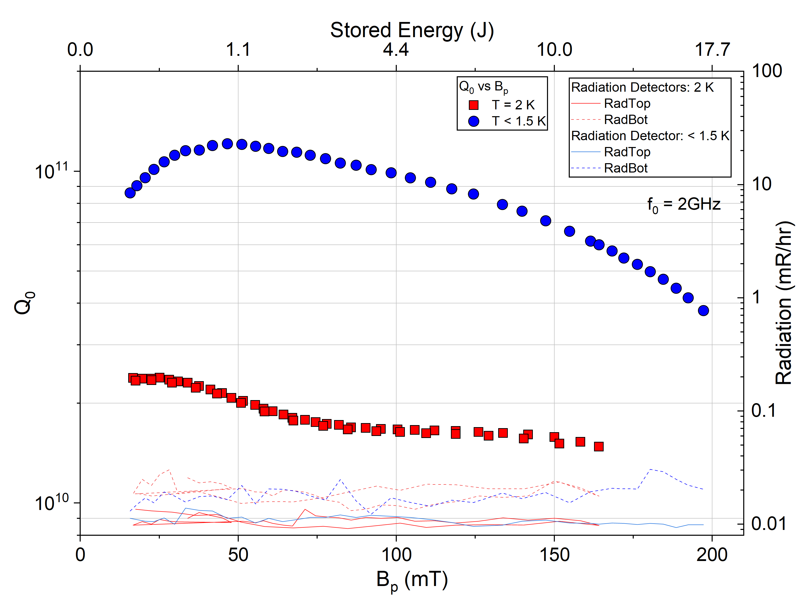
First BCC Test Demonstrates Successful Processing Transfer
Q₀ of BCC Post Cold EP + 75/120 C
T = 2 K
Q₀ > 1.5e10 at all fields
Quench at 164 mT (U = 12 J)
No x-rays/FE/Mping
  Due to low E_{surf}/B_{surf}
T = 1.44 K
Q₀ > 1e11 at moderate B_{p}
Quench at 197 mT (U = 17.3 J)!
No x-rays/FE/MPing
Near 200 mT operation achieved without field emission or multipacting in the first test.

Slide 9
Benchmarking BCC Against In-Situ Baked TESLA Cavities
Q₀ vs B_{p} of Cavities with Various f₀ Post Cold EP + in situ Baking
BCC 2 GHz
Quench at 1.45 K for 2 GHz BCC

Slide 10
Benchmarking BCC Against In-Situ Baked TESLA Cavities
Q₀ vs B_{p} of Cavities with Various f₀ Post Cold EP + in situ Baking
BCC falls within envelope established by in-situ baked 650 MHz – 2.6 GHz cavities
Similar Q₀ to 1.3 GHz TESLA cavity
  G = 446 Ω enables Q₀ comparable to 1.3 GHz cavities despite f₀ = 2 GHz
Quench of ~200 mT is within common range of quench fields for cold EP + in situ baked cavities
TESLA 650 MHz
TESLA 1.3 GHz
TESLA 2.6 GHz
BCC 2 GHz
Cold EP + in-situ bake demonstrates robust performance across multiple f₀ and geometries.
Quench at 1.45 K for 2 GHz BCC

Slide 11
Comparing R_{BCS} Across f₀ and Geometries
R_{BCS} vs B_{p} of Cavities with Various f₀ Post Cold EP + in situ Baking
BCC R_{BCS}(B_{p}) follows similar field dependence observed in TESLA cavities
TESLA 2.6 GHz
BCC 2 GHz
TESLA 1.3 GHz
TESLA 650 MHz

Slide 12

Comparing R_{BCS} Across f₀ and Geometries
R_{BCS} vs B_{p} of Cavities with Various f₀ Post Cold EP + in situ Baking
BCC R_{BCS}(B_{p}) follows similar field dependence observed in TESLA cavities
Consistent with f₀ scaling expectations
No geometry dependence
TESLA 2.6 GHz
M. Martinello et al. PRL 121, 224801 (2018)
BCC 2 GHz
TESLA 1.3 GHz
Same underlying RF loss mechanisms govern performance
TESLA 650 MHz

Slide 13
Comparing R_{res} Across f₀ and Geometries
R_{res} vs B_{p} of Cavities with Various f₀ Post Cold EP + in situ Baking
At 2 GHz, residual estimates include a non-negligible BCS contribution
Estimated R_{res} of BCC comparable to similarly treated cavities
  Nearly identical behavior with B_{p} for 650 MHz – 2 GHz cavities
No evidence of excess residual losses from the BCC geometry

Slide 14
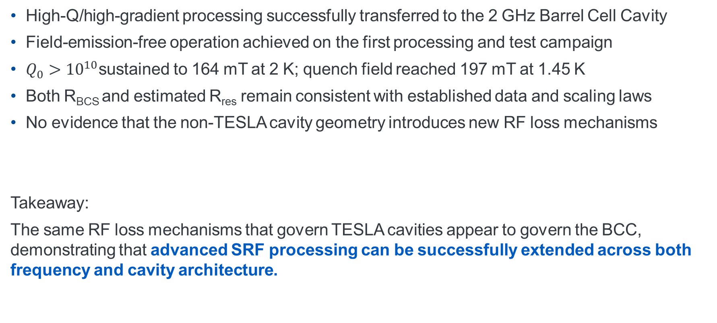
Conclusions
High-Q/high-gradient processing successfully transferred to the 2 GHz Barrel Cell Cavity
Field-emission-free operation achieved on the first processing and test campaign
$Q_{0}>{10}^{10}$sustained to 164 mT at 2 K; quench field reached 197 mT at 1.45 K
Both R_{BCS} and estimated R_{res} remain consistent with established data and scaling laws
No evidence that the non-TESLA cavity geometry introduces new RF loss mechanisms
Takeaway:
The same RF loss mechanisms that govern TESLA cavities appear to govern the BCC, demonstrating that advanced SRF processing can be successfully extended across both frequency and cavity architecture.

Slide 15
Acknowledgements
Alexej Grudiev (CERN) for initiating the collaboration, providing the Barrel Cell Cavity prototype, and valuable technical discussions throughout the project.
Tim Ring and Davida Smith for development and execution of the electropolishing campaign.
Fermilab SRF Processing, Assembly, and Vertical Test teams for cavity preparation and RF testing support.
This work was produced by Fermi Forward Discovery Group, LLC under Contract No. 89243024CSC000002 with the U.S. Department of Energy, Office of Science, Office of High Energy Physics. Publisher acknowledges the U.S. Government license to provide public access under the DOE Public Access Plan DOE Public Access Plan

Slide 16
Thank you!

Slide 17
Backup

Slide 18

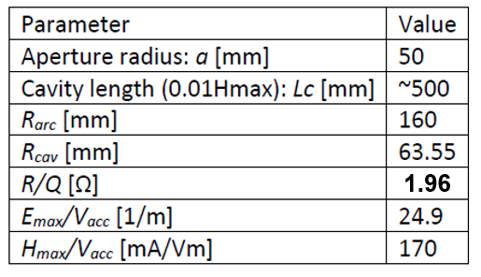
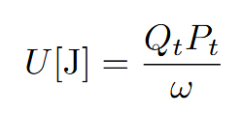


Cavity Metric Calculations
Simulated Cavity Parameters
Accelerator definition of R/Q:
Circuit Definition
From simulations
Measured Antenna Q’s
Q_{ext1} = 1.6e10
Q_{ext2} = 1.6e11

Slide 19
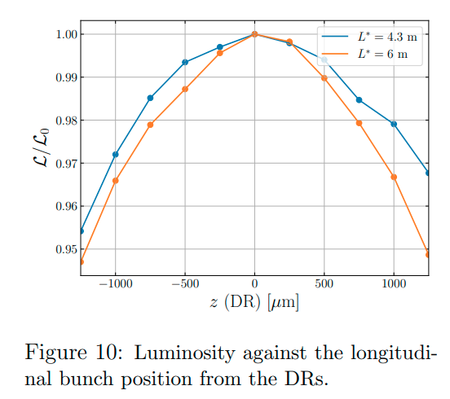
380 GeV CLIC DR parameters (PRAB22, 091601)
A. Grudiev, LCWS’25
Parameter of DR |  | value | unit
Energy | E | 2.86 | GeV
Circumference | C | 373.7 | m
Revolution frequency | f₀ | 802 | kHz
RF frequency | f_{RF} | 2 | GHz
Harmonic number | h | 2493
Energy loss per turn | eV_{A} | 5.8 | MeV
RF voltage | V_{C} | 6.5 | MV
RF stable phase | φ | -26.8 | º
Bunch population | N_{e} | 5.7 | 1e9
Number of bunches per train | N_{b} | 352
Number of trains | N_{t} | 1
Peak beam current | I_{b} | 1.8 | A
1%
±400μm
Strict specifications on the bunch spacing variation: δφ_{b} < ±1º at 2 GHz (±400μm) for Luminosity loss < 1% (CLIC-Note-1138)
This is difficult to maintain due to strong transient beam loading effects caused by large difference between peak and average beam power values of 10.4 MW and 1.5 MW, respectively

