Slide 1

Investigating Impurity-Based Treatments in SRF Cavities through Coupled RF and Materials Characterization
FERMILAB-SLIDES-26-0058-TD
June 9, 2026
Hannah Hu, Young-Kee Kim, Daniel Bafia
University of Chicago, Fermi National Accelerator Laboratory

Slide 2
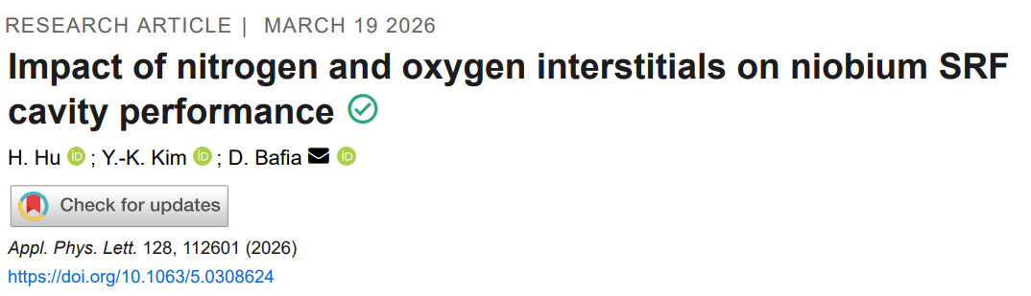
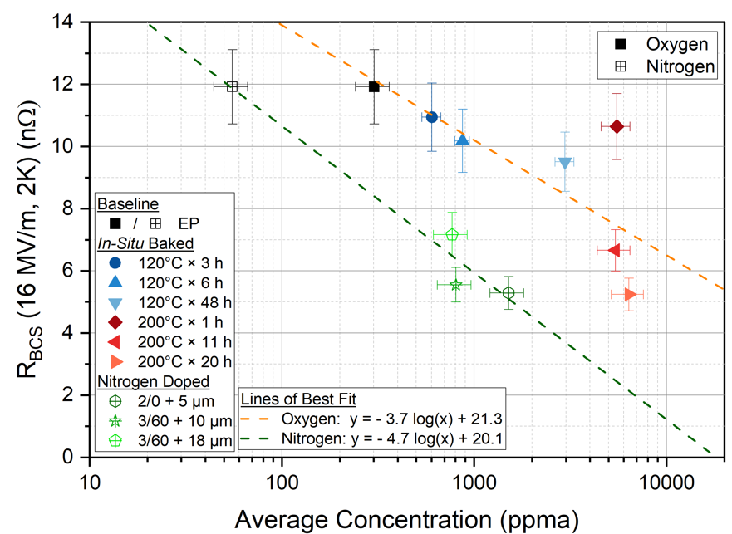
Previous Work Comparing Interstitial O and N
R_{BCS} Dependence on Impurity Concentration
10× difference in concentration
Key Takeaways
N and O perform similar roles: Increasing O/N concentration decreases R_{BCS}
N appears 10× more effective than O in reducing R_{BCS}

Slide 3
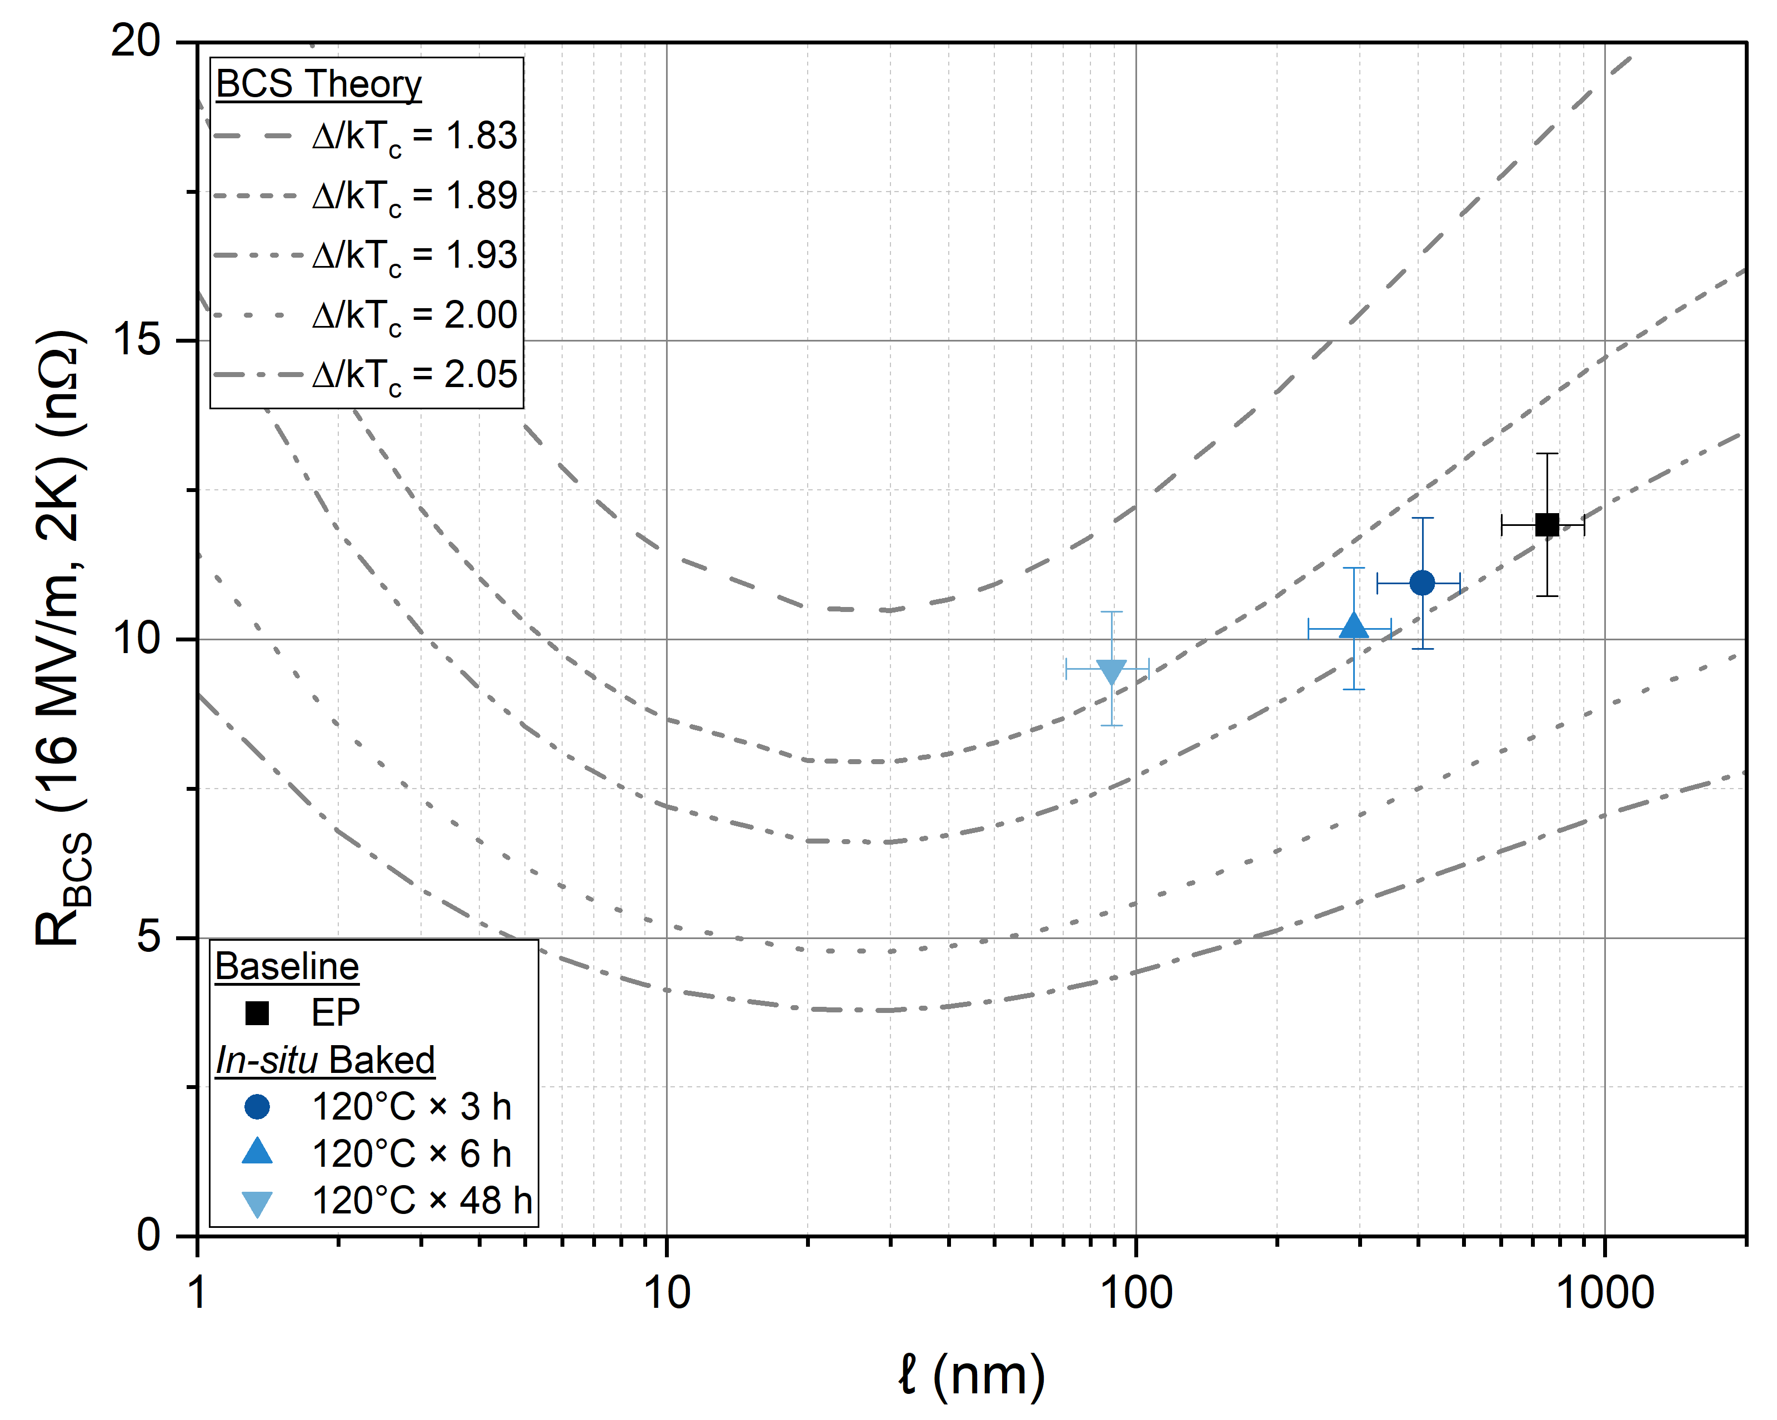
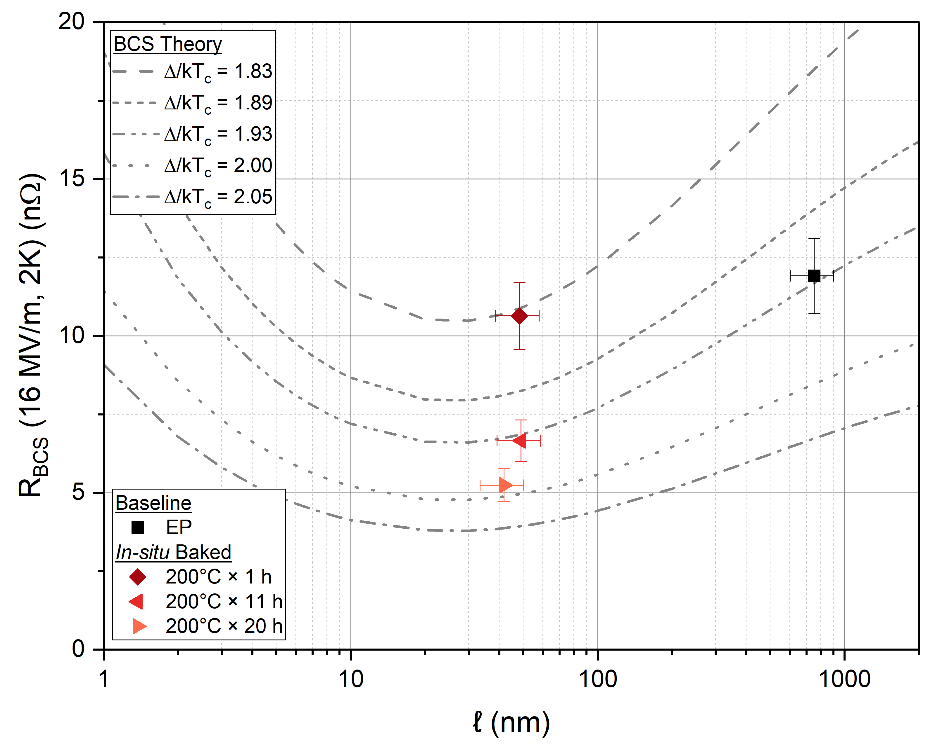
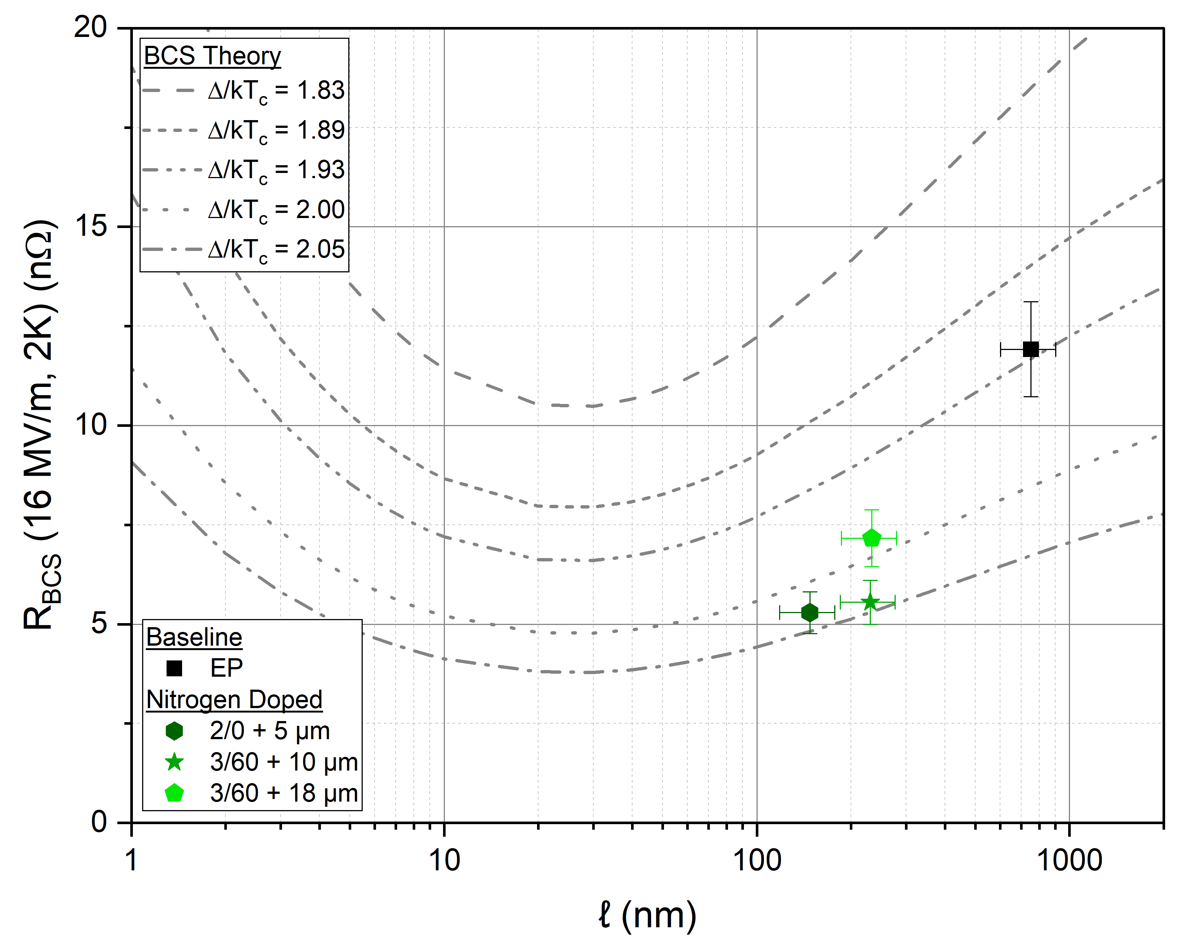
Decoupling the Effects of ℓ and Δ on BCS Resistance
120 °C Baked
200 °C Baked
N Doped
EP
EP
EP
Optimization in ℓ
No change in Δ
No change in ℓ
Increase in Δ
Simultaneous change in ℓ and Δ
Different impurity profiles reduce R_{BCS} through different mechanisms
O concentrated near the surface → ℓ optimization
Highly uniform profiles (200 °C x 20 h and N doped) → Δ enhancement

Slide 4
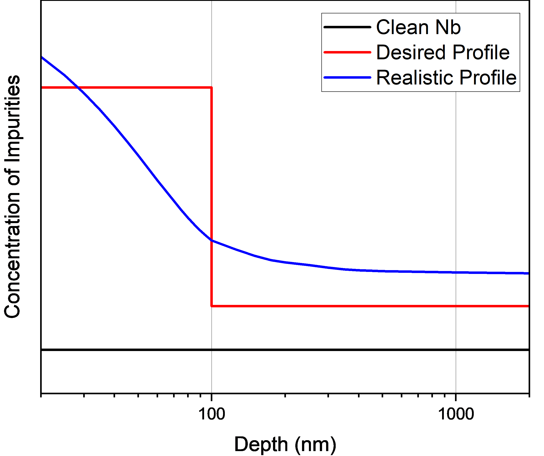
Surface Engineering For High Q₀ and High E_{acc}
Proposed impurity profile:
Uniform concentration of impurities → Δ Enhancement
Increased concentration in first 100 nm → ℓ optimization and increase in E_{acc}
Progress towards surface engineered Nb: Co-doping
Co-doping treatments contain both oxygen and nitrogen
Leverage the different diffusion coefficients and activation energies to independently tune N and O concentrations
Co-doping treatment recipe
Start with a treatment that has a uniform concentration (N Doping, Mid-T) as a base
Tune ℓ by adding oxygen without significant change to base concentration

Slide 5
Co-doping Treatments
Treatment | Recipe | Cavity
N Infused | 800 °C x 3 h + 120 °C x 48 h w/ N₂ | TE1PAV012
Mid-T + HF | 340 °C x 2.5 h in-situ + 2 HF | TE1RI015
Mid-T + HF + LTB | 340 °C x 2.5 h + 2 HF + 120 °C x 48 h in-situ
N Doped | 3/60 + 10 um | TE1RI006
N Doped + Mid-T* | 3/60 + 10 um + 340 °C x 2.5 h in-situ
Goals
Combine oxygen and nitrogen in a controlled manner
Use single impurity models to predict cavity performance from sample material characterizations
* Sample study in progress, used individual N-Doped and Mid-T profiles as an approximation

Slide 6
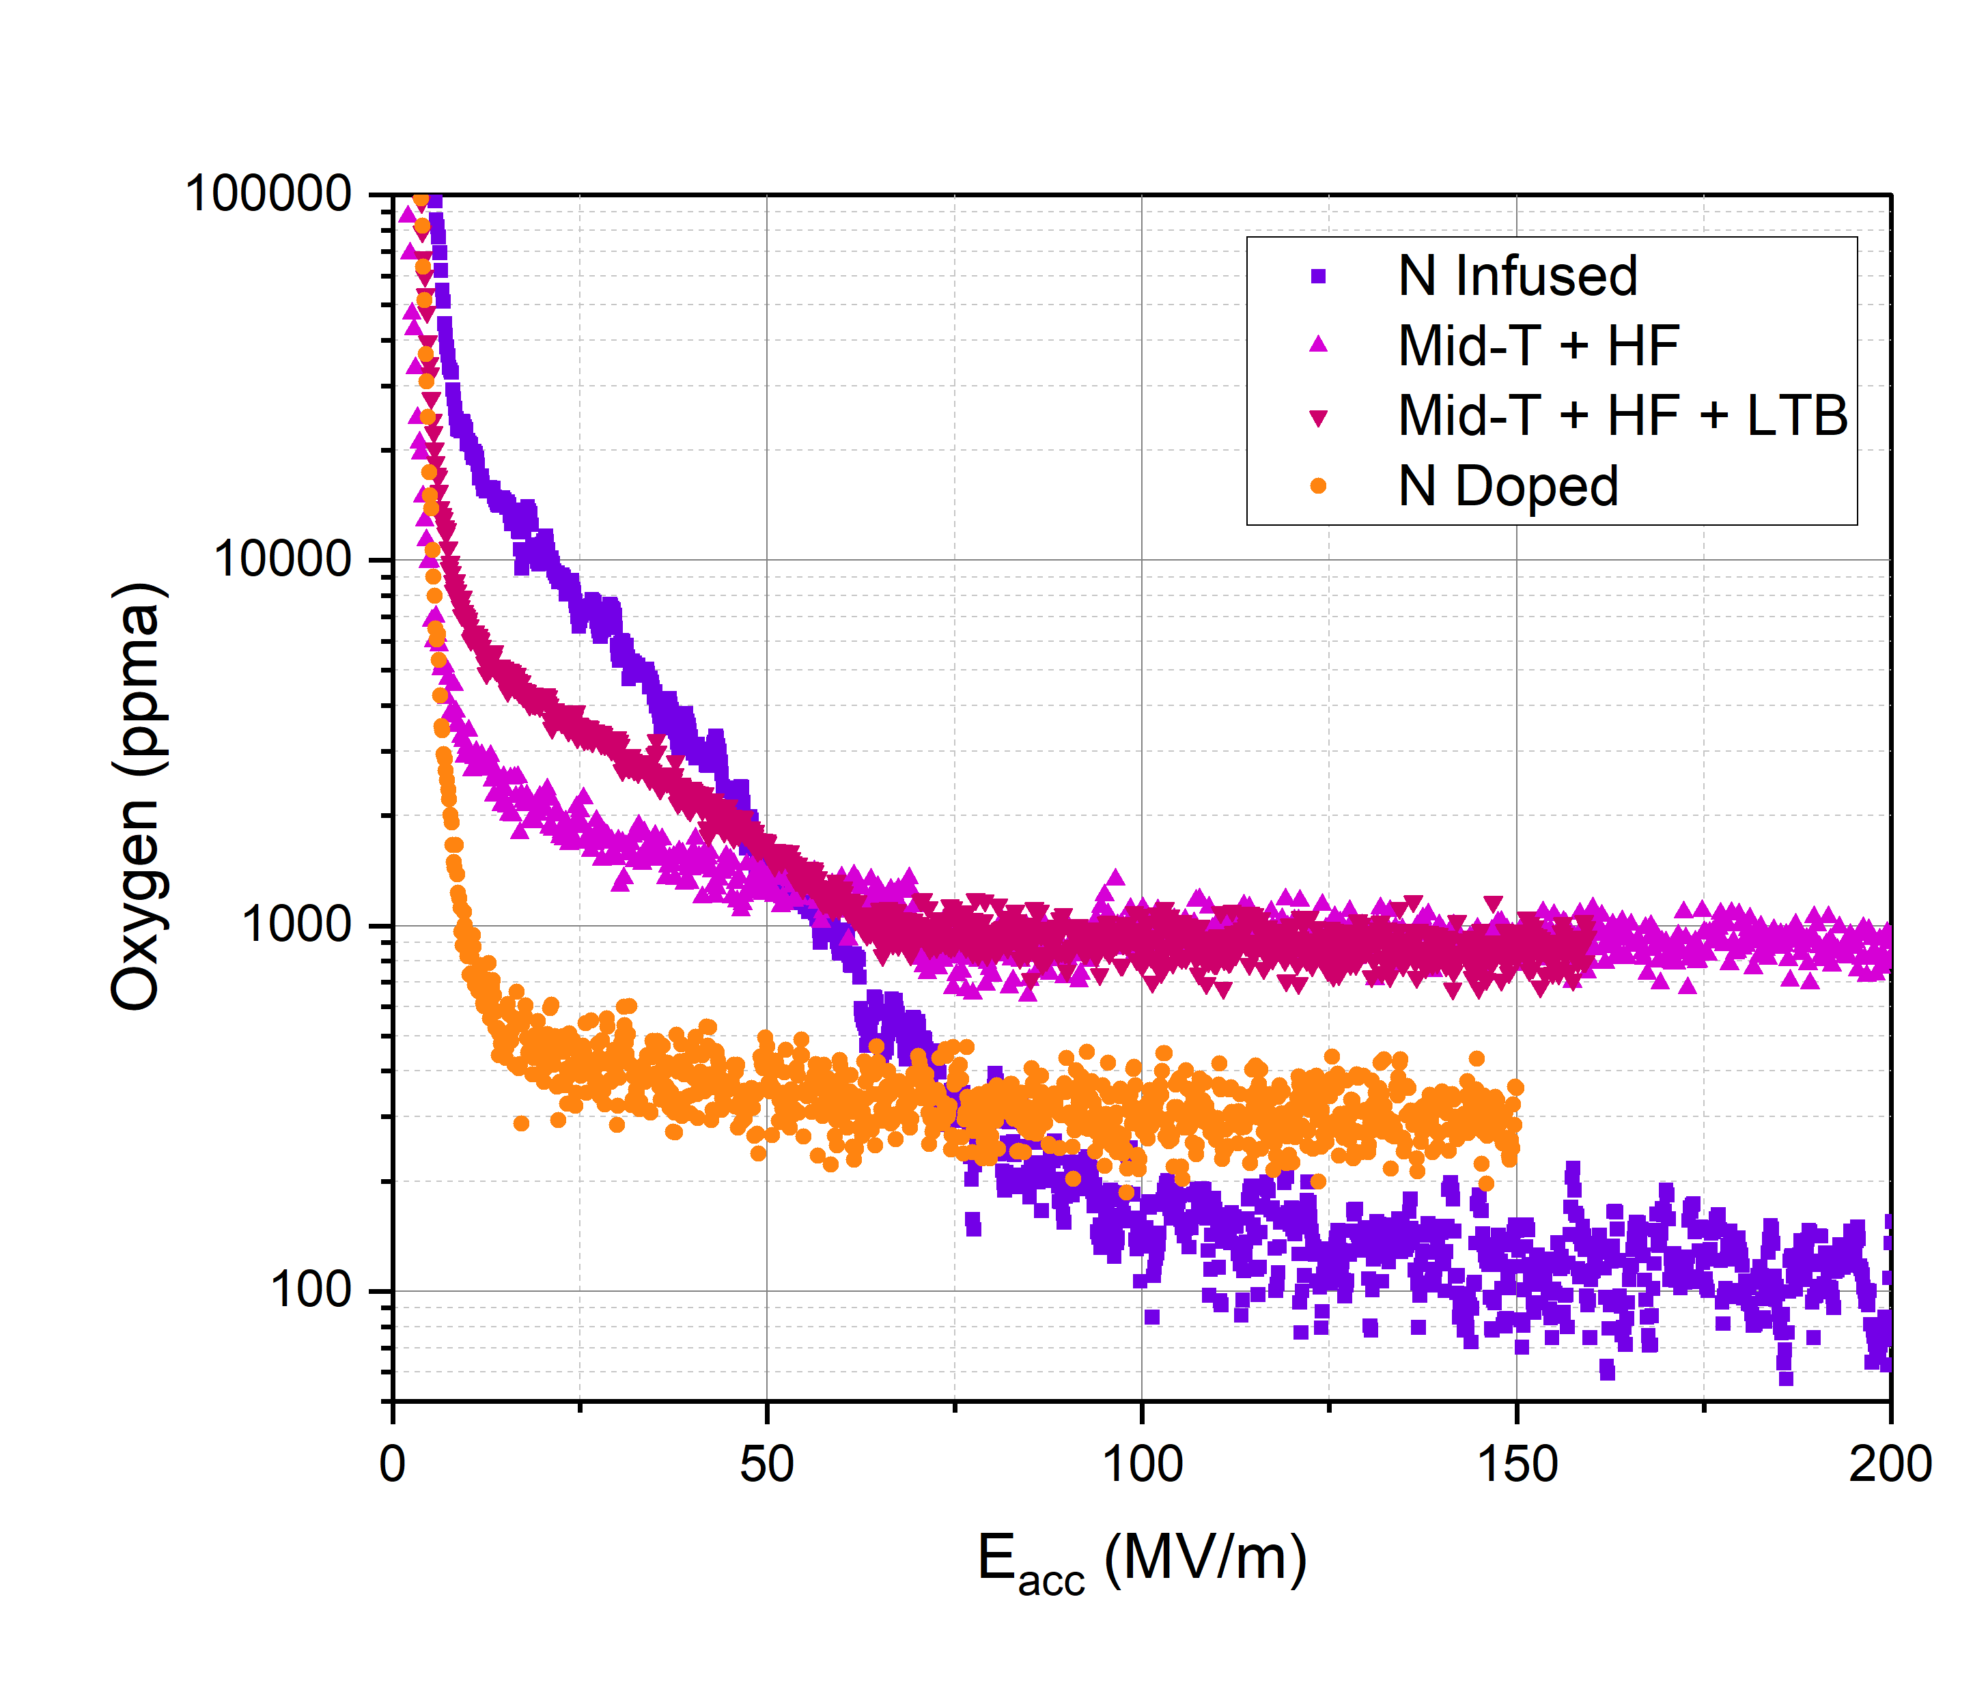
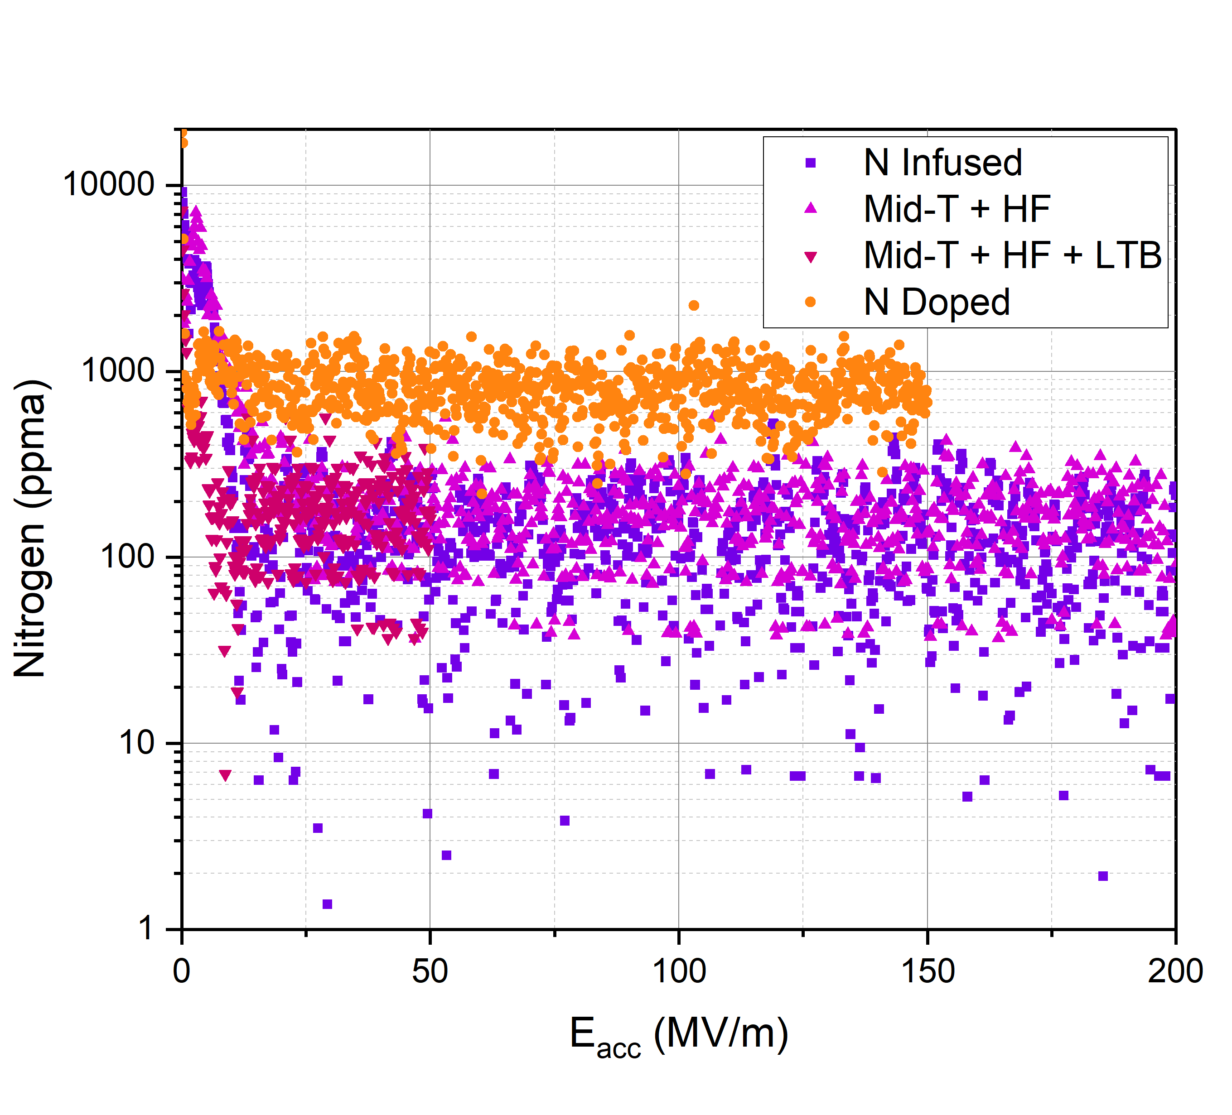
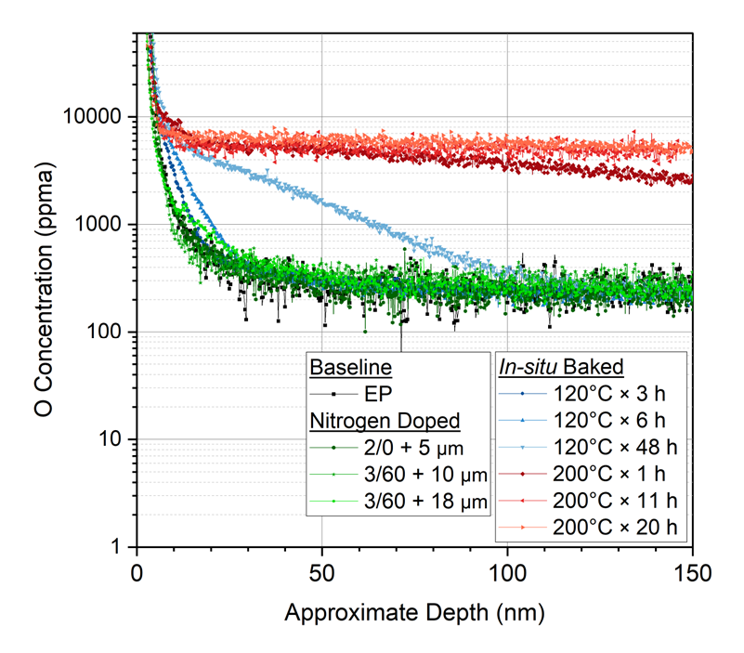
ToF-SIMS Depth Profiles
Oxygen Depth Profile
Nitrogen Depth Profile
Background N
Independently tune oxygen and nitrogen to achieve layered impurity profiles
Confirmed co-doping effect with presence of both oxygen and nitrogen

Slide 7
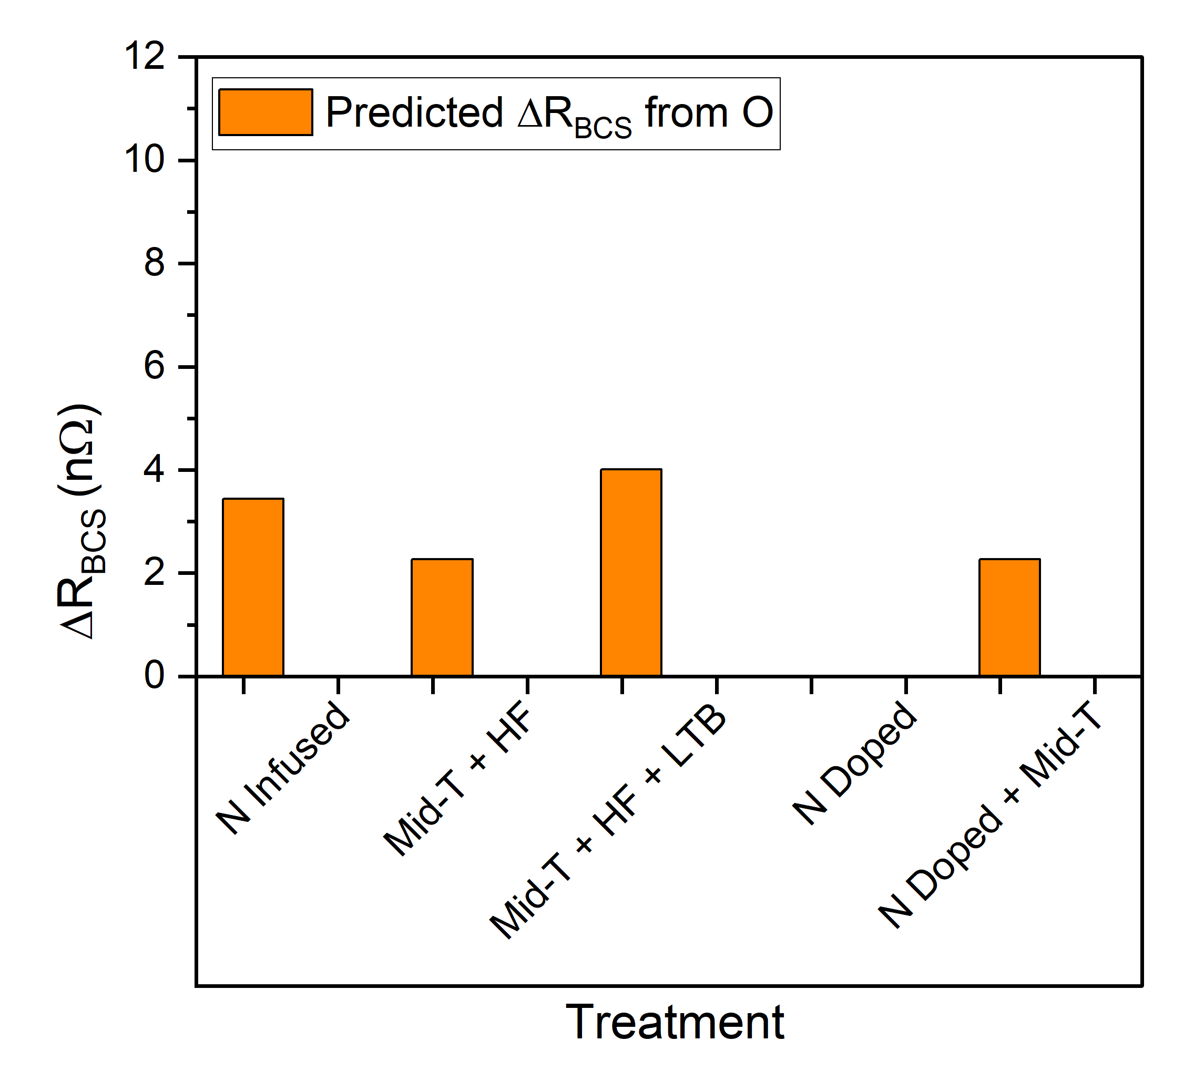
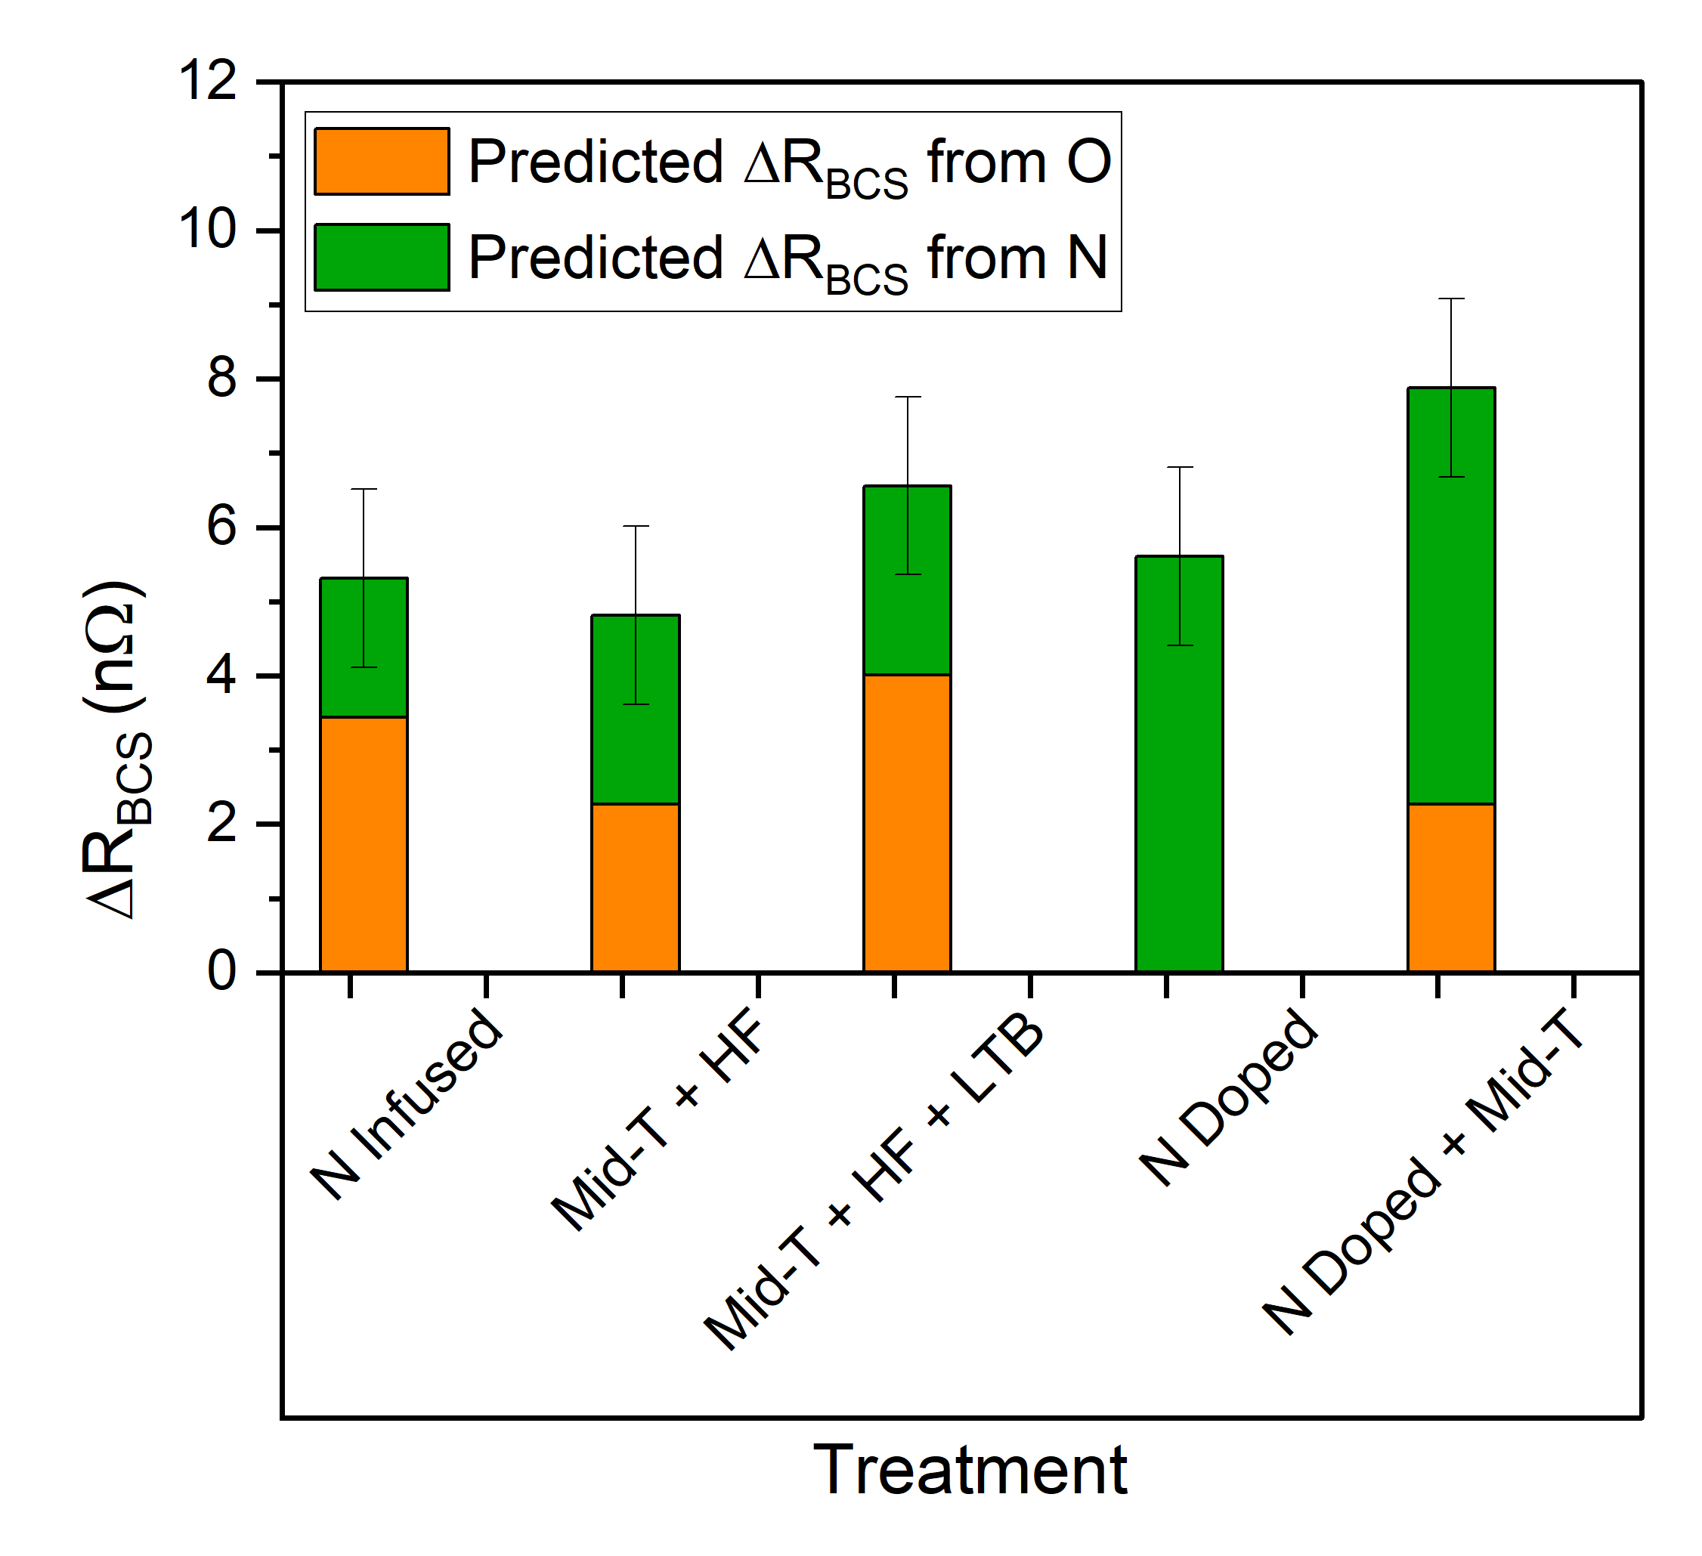


Predicting Cavity Performance
R_{BCS} Dependence on Impurity Concentration
Predicted ΔR_{BCS} from Impurity Concentration
$$ΔR_{BCS,O}$$
$$ΔR_{BCS,N}$$
$$ΔR_{BCS,O}=R_{BCS}\left(EP\right)−(−3.7\log\left(C_{O}\right)+21.3)$$
$ΔR_{BCS,N}$ $=R_{BCS}\left(EP\right)−(−4.7\log\left(C_{N}\right)+20.1)$
Combine O + N assuming a simple additive model

Slide 8
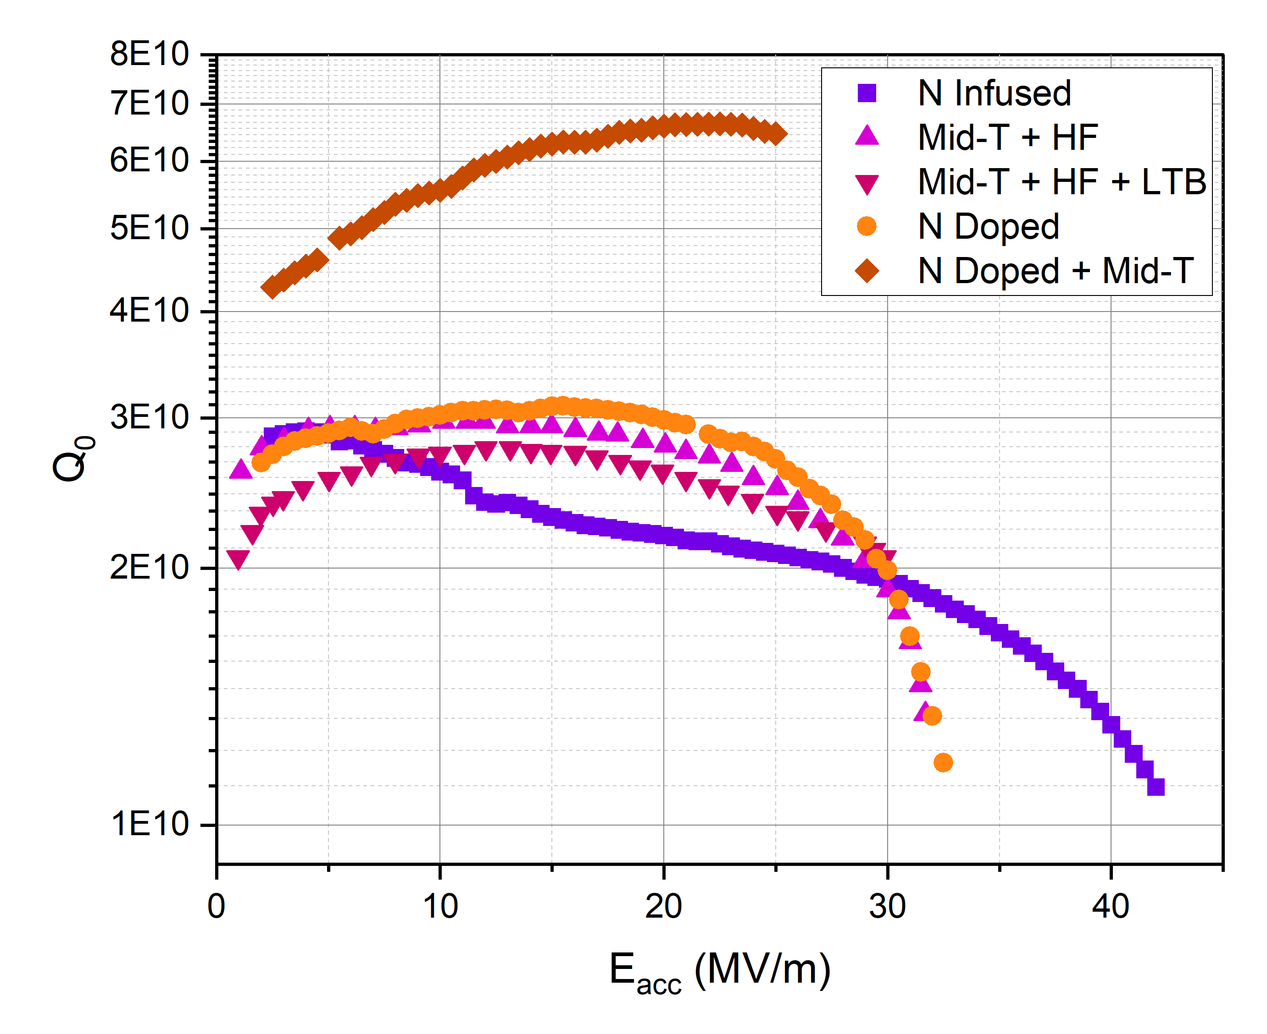
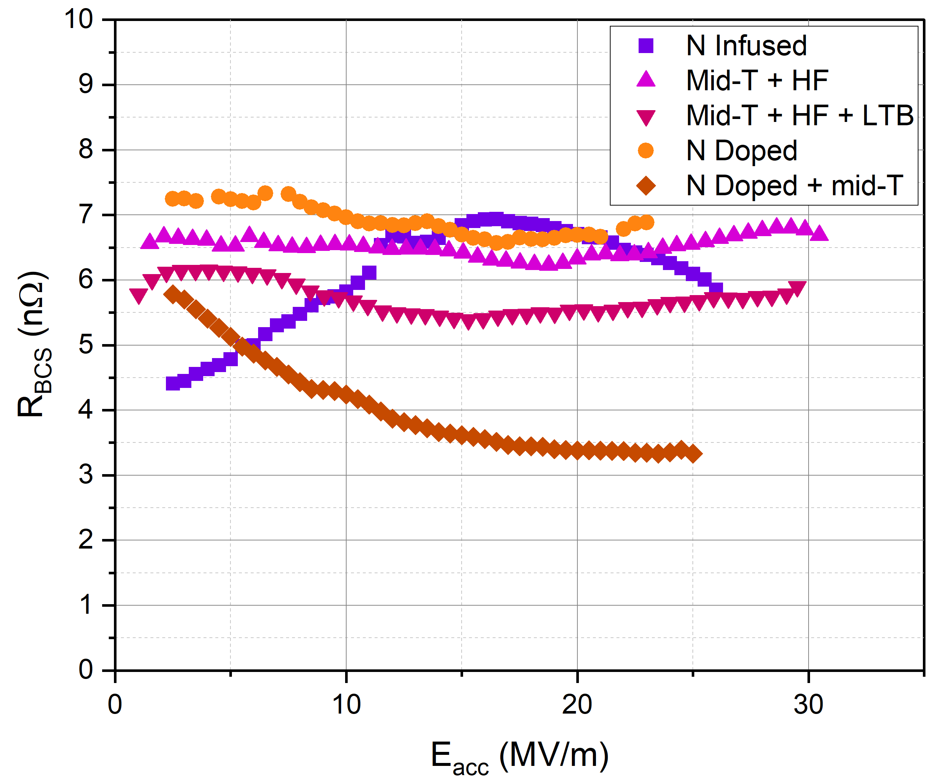
Co-doping: Cavity Performance
Q₀ vs. E_{acc}
R_{BCS} vs. E_{acc}
16 MV/m
Experimental ΔR_{BCS}

Slide 9
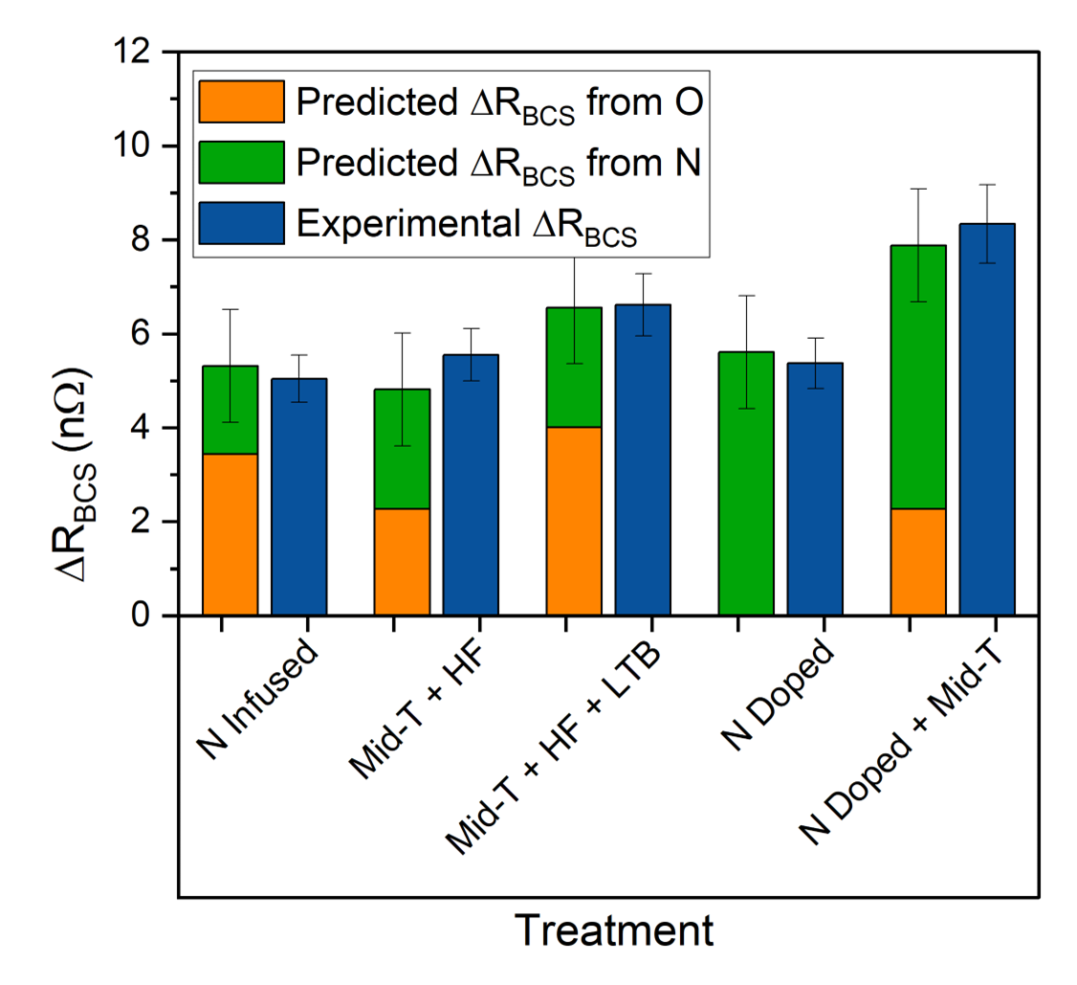
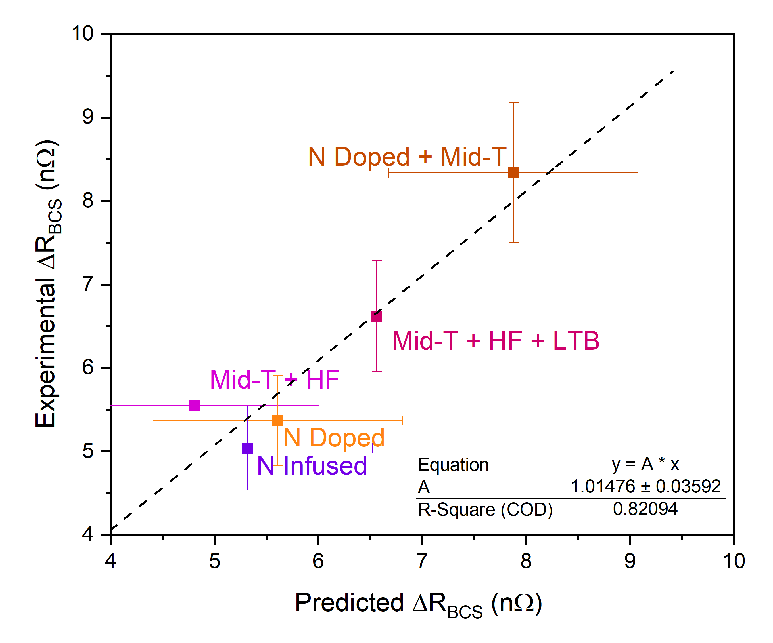
Predicted vs. Cavity Experimental Values
Predicted vs. Experimental ΔR_{BCS}
Correlation Plot
Additive effect in the reduction in R_{BCS} from both O and N

Slide 10
Conclusion
Key Takeaways
Co-doping is a promising strategy for reducing R_{BCS} beyond single-impurity limits
Simple additive effect with both O and N
Quantitative impurity profiling can serve as a reliable predictor of RF performance
Further work
Use material characterizations as a guide to further optimize co-doping treatments
Impurity-based predictive modeling in search for alternative impurities

Slide 11
Thank you!
Acknowledgments: Damon Bice, Vijay Chouhan, Adam Clairmont, Andrew Cravatta, Jae-Yel Lee, Akira Miyazaki, Akshay Murthy, Alexandr Netepenko, Tim Ring, and Davida Smith

Slide 13
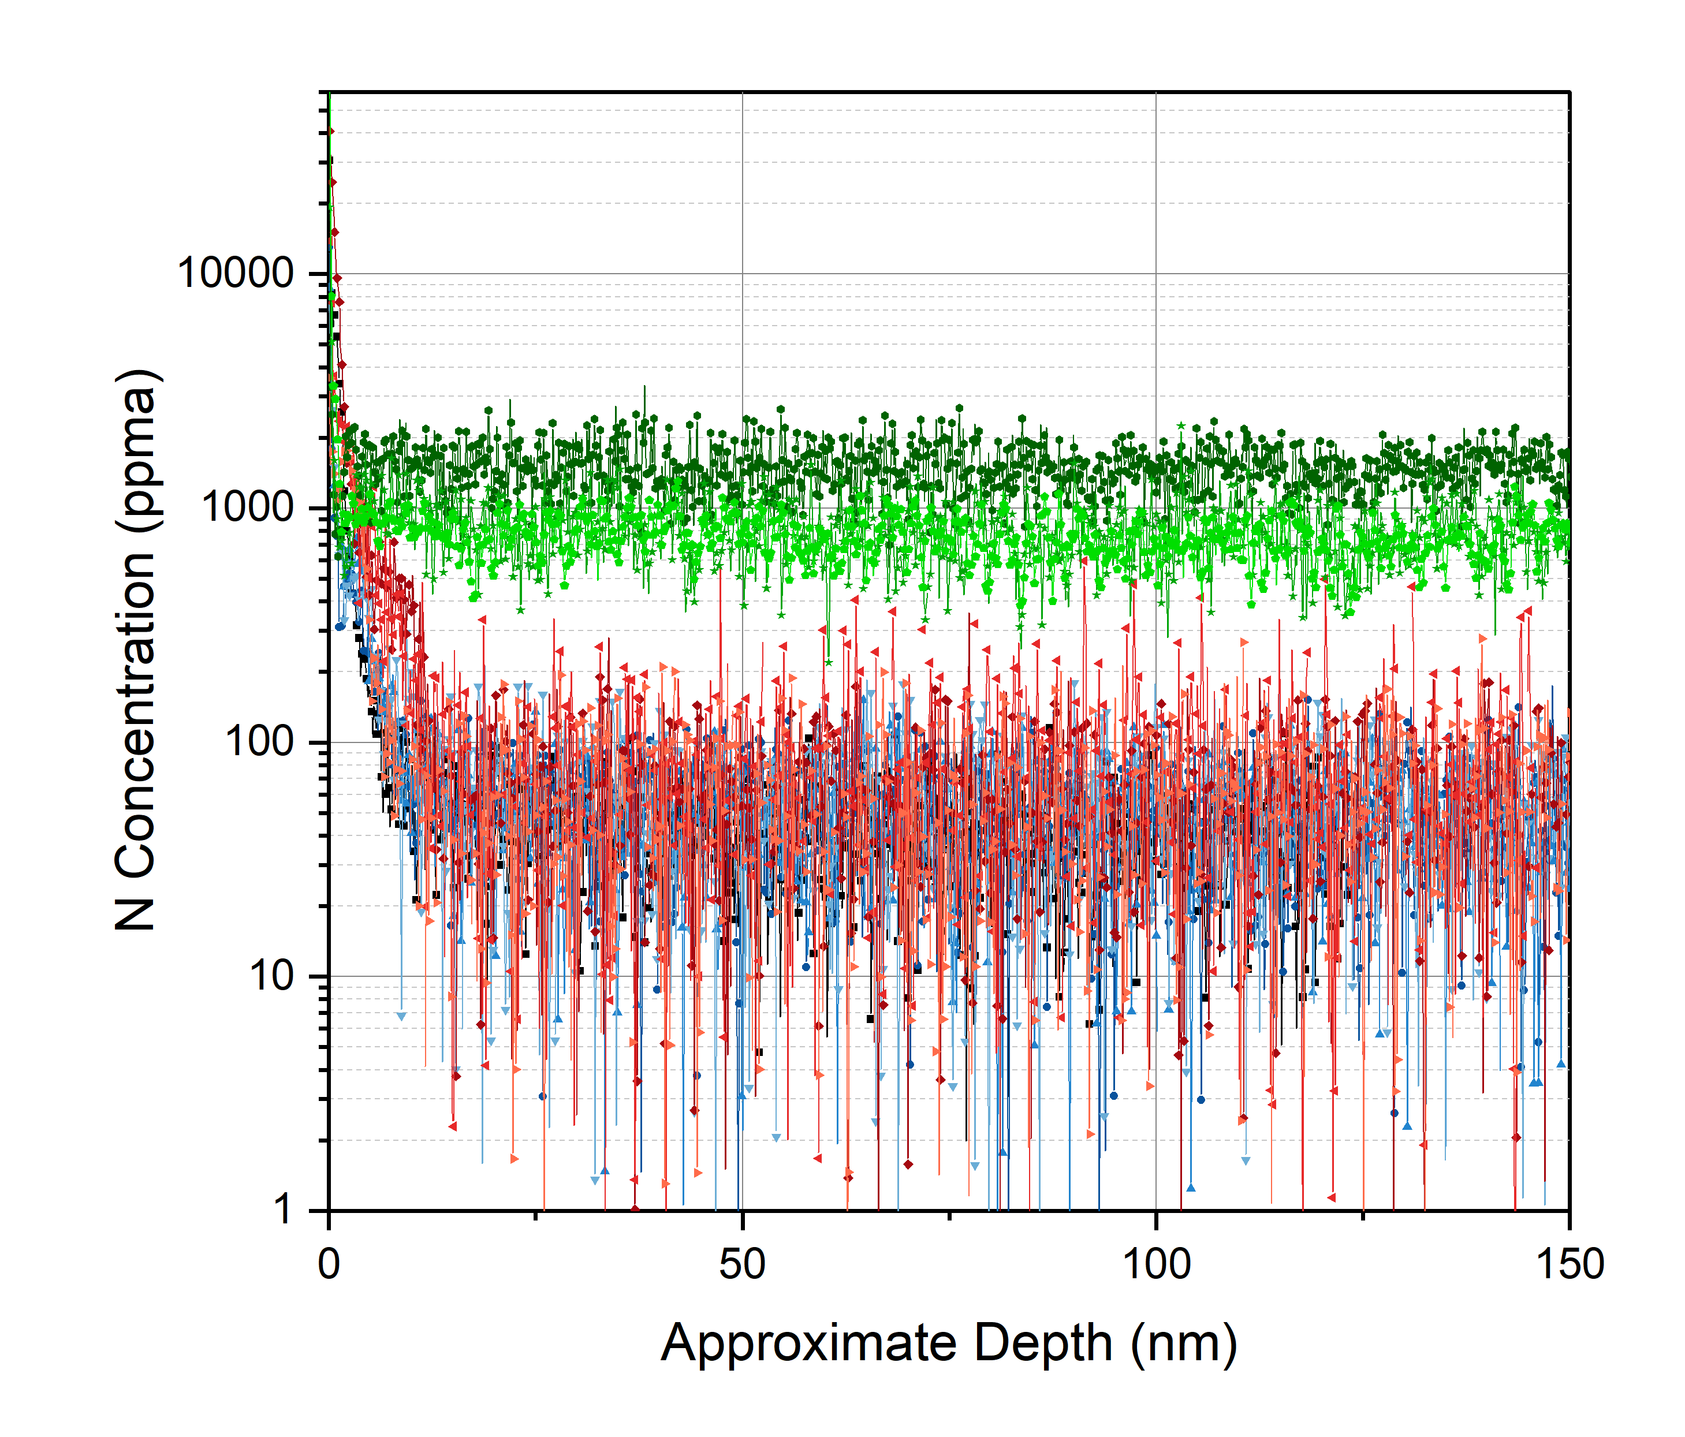
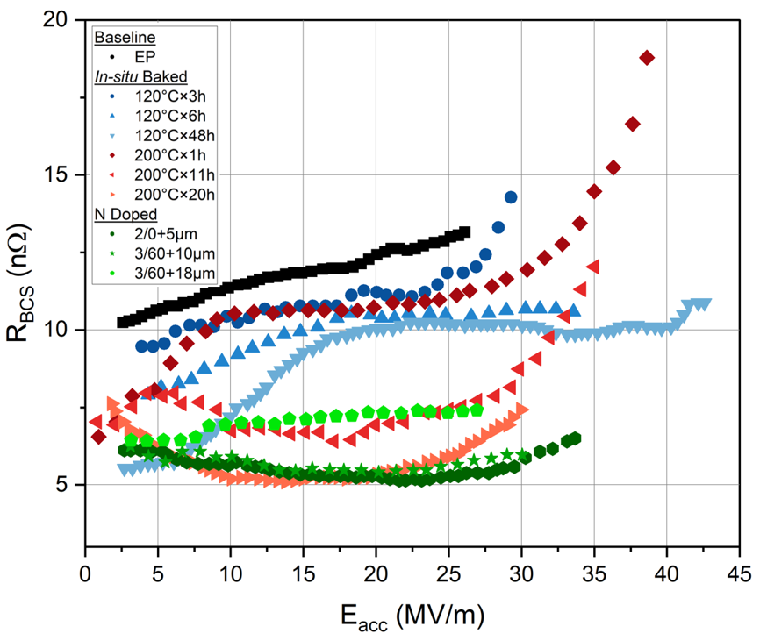
Oxygen vs. Nitrogen
R_{BCS} vs. E_{acc}
Oxygen Concentration Depth Profile
Nitrogen Concentration Depth Profile

