Slide 1


The Origin of Medium-Temperature Baking Efficacy: Formation and Role of an Ordered Oxide Template
SRF Group – LINAC Center - IMP, CAS
Didi Luo luodidi@impcas.ac.cn
2026.6.10, Paris

Slide 2
Outline
Methods
  HRTEM
  In-situ Baking
Results
Conclusion
Didi Luo, The Origin of Medium-Temperature Baking Efficacy: Formation and Role of an Ordered Oxide Template, TTC 2026, Paris

Slide 3
Comparison of Methods
​​Characterization Method​​ | ​​Purpose​​ | ​​Critical Findings​​
​​TEM (Transmission Electron Microscopy)​​ [1] | Analyze oxide layer evolution and carbide formation. | Nb₂O₅ disappears above ​​250°C​​, replaced by ​​5 nm NbC layer​​ Surface roughness reduced by carbide formation [1]
​​TOF-SIMS (Time-of-Flight Secondary Ion Mass Spectrometry)​​ [1, 2, 5] | Study surface element & compound, map oxygen/hydrogen redistribution. | Oxygen diffusion depth ​​~100 nm​​ at 250–350°C [2] Hydrogen concentration inversely correlates with oxygen doping [5]
​​XPS (X-ray Photoelectron Spectroscopy)​​ [1, 4] | Track surface chemical state changes. | Nb 3d peaks shift from ​​207.2 eV​​ (Nb₂O₅) to ​​203.8 eV​​ (NbC) [1] Fluorine signals correlate with accelerated oxygen diffusion [4]
​​In Situ Synchrotron XPS​​ [4] | Real-time monitoring of oxide reduction. | Dynamic observation of NbOₓ decomposition at ​​300–400°C​​ [4] Calculated oxygen diffusion activation energy: ​​1.2 eV​​.
​​Flux Sensitivity Tests​​ [2, 3] | Quantify magnetic flux trapping. | Peak flux sensitivity at ​​250°C​​ matches maximum oxygen concentration [3]
Can generally characterize the crystalline structures in regions with thicknesses < 100 nm.
Pro: precise, surface-sensitive elemental and molecular analysis with minimal damage under static conditions;
Con: ion sputtering (e.g., Bi³⁺, Au⁺, or C₆₀⁻ primary ions) may induce electron transfer and potential chemical state alterations ; no lattice information.
Pro: accurate, non-destructive chemical state identification
Con: limited to a shallow analysis depth (~5-10 nm) due to the short escape depth of photoelectrons; no lattice information.
Didi Luo, The Origin of Medium-Temperature Baking Efficacy: Formation and Role of an Ordered Oxide Template, TTC 2026, Paris

Slide 4
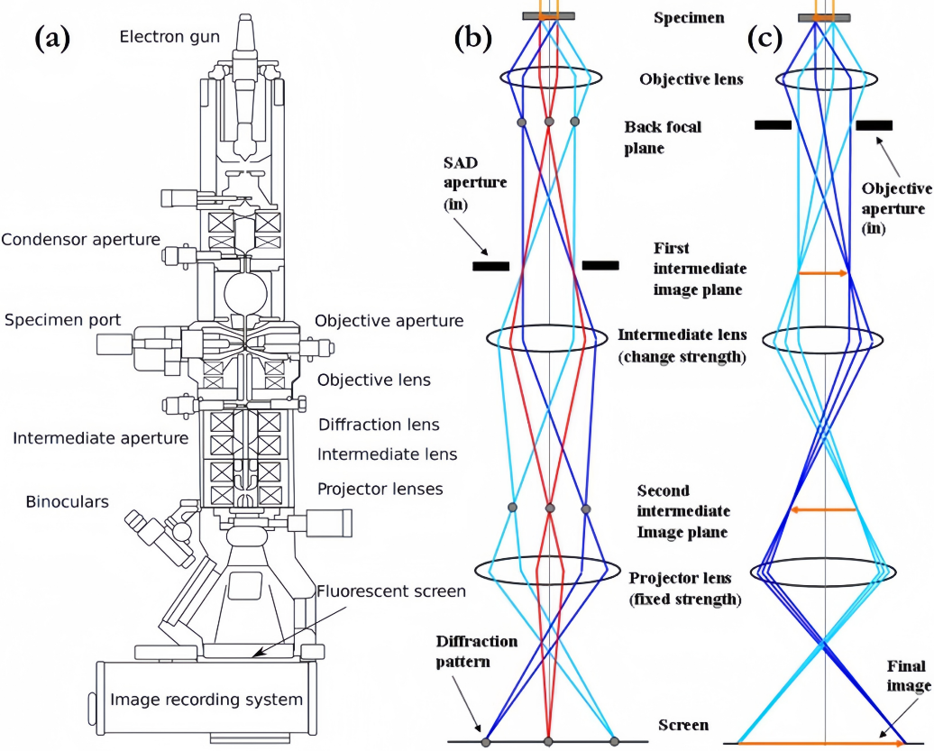
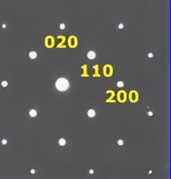
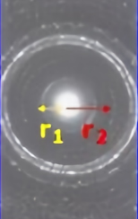

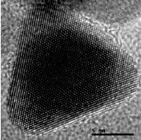
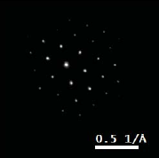
Introduction of HR-TEM
High-Resolution (<0.1 nm) Transmission Electron Microscopy (HR-TEM)
Sample thickness < 50 nm ~ λ_{L} of Nb
Diffraction Patterns
Single Crystal (selected area)
Polycrystalline
Amorphous
Didi Luo, The Origin of Medium-Temperature Baking Efficacy: Formation and Role of an Ordered Oxide Template, TTC 2026, Paris

Slide 5
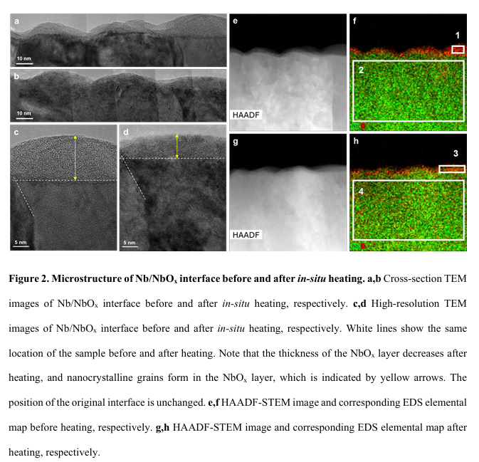
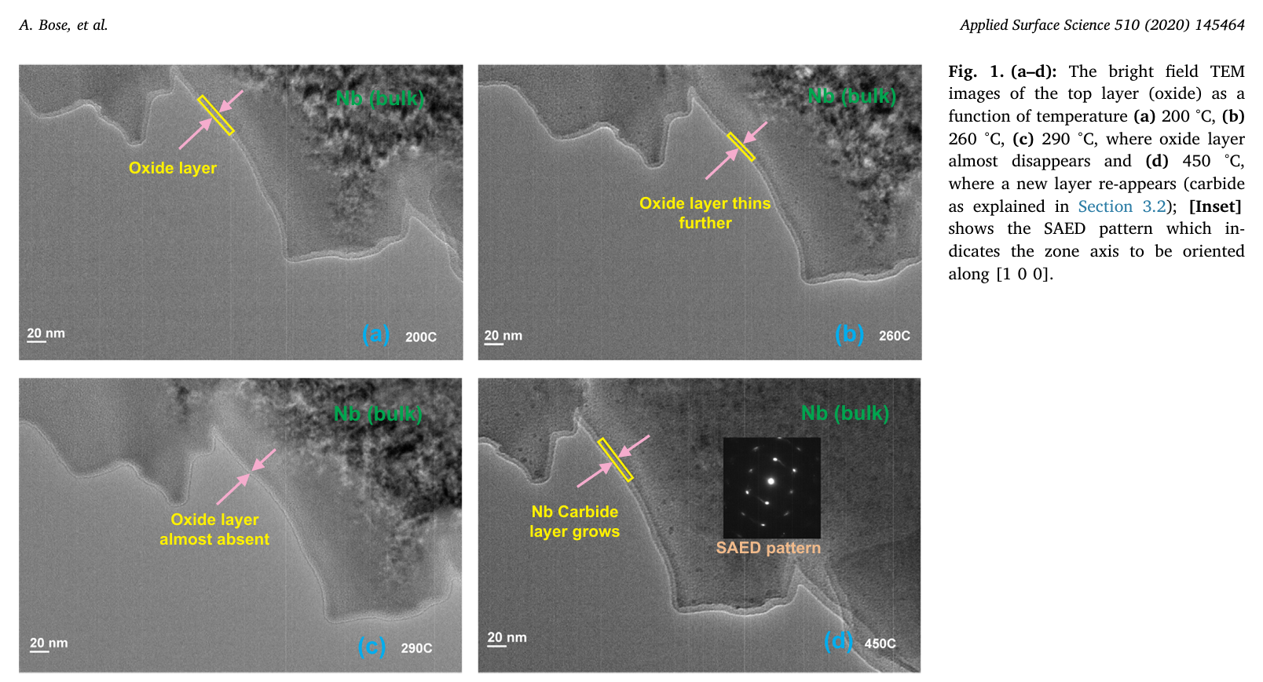
Previous Similar TEM Works of Nb
Year | Paper Title | Authors | Methods | Nb Surface Oxide Structure | Key Conclusions
2007 | TEM and SIMS Analysis of (100), (110), and (111) Single Crystal Niobium | A. D. Batchelor; D. N. Leonard; P. E. Russell; F. A. Stevie; D. P. Griffis; G. R. Myneni | TEM (FIB-prepared), SIMS | - 4.9-8.3 nm uniform oxide (no sub-oxides)<br>- >300 nm oxide after 1250°C treatment | Single-crystal Nb shows uniform oxidation; high-temperature annealing induces severe oxidation and Ti contamination.
2009 | TEM Study of Niobium Surfaces Processed by Different Polishing Techniques | A.T. Wu D. Gu | Cross-sectional TEM, improved ion milling | - ~3 nm Nb₂O₅ layer<br>- ~0.7 nm transition layer (NbO/Nb₂O₃) | BCP/BEP polishing creates similar oxide thickness; transition layer differences may affect RF performance.
2015 | Nanostructural features degrading the performance of superconducting radio frequency niobium cavities revealed by TEM and EELS | Y. Trenikhina, A. Romanenko, J. Kwon, J.-M. Zuo, and J. F. Zasadzinski | TEM, EELS, low-temperature nano-electron diffraction (NED/SEND) | - ~3 nm amorphous Nb₂O₅<br>- Sub-oxide interface layer<br>- β/ε-phase hydrides (5-20 nm) | Nanoscale hydrides cause HFQS; 120°C baking reduces hydrides; oxide structure remains stable.
2020 | Evolution of surface oxides and impurities in high vacuum heat treated Nb: A TEM and TOF-SIMS in-situ study, mechanism and repercussions on SRF cavity applications | A. Bose, Puspen Mondala, G.M. Bhaleraoc, S.V. Kokila, S. Raghavendraa, S.C. Joshia, A.K. Srivastavaa, R. Tewarid | In-situ TEM, TOF-SIMS, XRD/GIXRD | - ~5 nm Nb₂O₅ → 1-2 nm Nb(OC) + ~5 nm carbide layer (200-400°C) | Oxide layer transforms to carbide at 200-350°C; hydrogen desorption correlates with oxide decomposition.
2022 | In-situ Transmission Electron Microscopy Investigation on Surface Oxides Thermal Stability of Niobium (comment: Nb film) | Jin-Su Oh, Xiaotian Fang, Tae-Hoon Kim, Matt Lynn, Matt Kramer, Mehdi Zarea, James A. Sauls, A. Romanenko, S. Posen, A. Grassellino | In-situ aberration-corrected STEM, EELS, DFT simulations | - 5-13.4 nm amorphous Nb₂O₅ → FCC Nb nanocrystals (~10 nm) in Nb-O matrix after 360°C heating | Thermal decomposition of oxides reduces microwave loss; stable Nb/oxide interface enables optimized qubit coherence.
Didi Luo, The Origin of Medium-Temperature Baking Efficacy: Formation and Role of an Ordered Oxide Template, TTC 2026, Paris
5

Slide 6
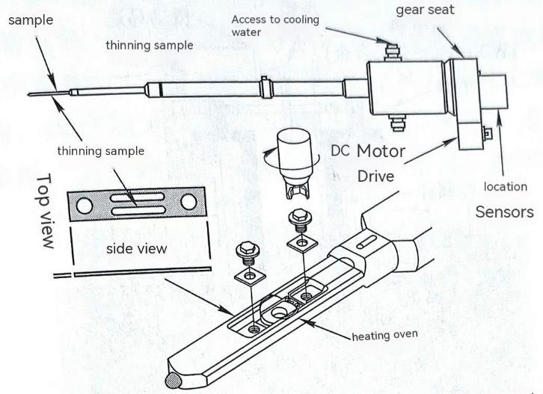

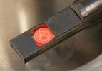

In-situ Sample Holder
Oxide layer re-grows right after air-exposure, changes the O location/state → In-situ characterization, enables real-time monitoring of oxygen diffusion and lattice evolution during heating.
In-situ Sample Holder
  Maintain TEM system’s ultra-high vacuum, mechanical stability, small sample chambers
  Avoid modifying microscopes, ensure cross-system compatibility
https://hummingbirdscientific.com/products/bulk-sample-heating/
https://zhouwu.ucas.ac.cn/index/resources/index.html
Didi Luo, The Origin of Medium-Temperature Baking Efficacy: Formation and Role of an Ordered Oxide Template, TTC 2026, Paris
6
Notes:
When exposed to air, the sample reacts instantly with oxygen to form a native oxide layer. ​In-situ characterization enables real-time monitoring of oxygen diffusion dynamics and lattice evolution during thermal treatment.
To maintain SEM/TEM ultra-high vacuum, mechanical stability, and compactness for sample chambers, in-situ techniques (e.g., heating) rely on specialized sample holders. These avoid modifying microscopes, reduce risks, and ensure cross-system compatibility, offering practicality and flexibility for real-time observations.

Slide 7
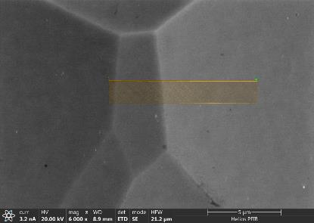
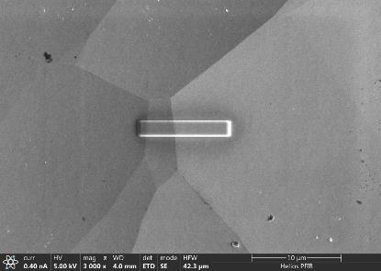
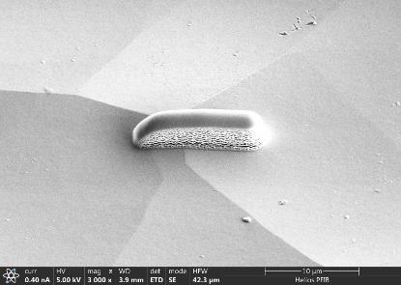
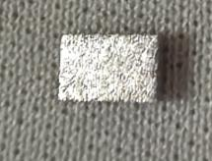
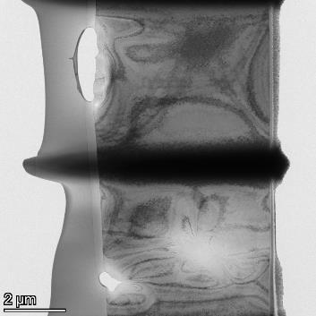
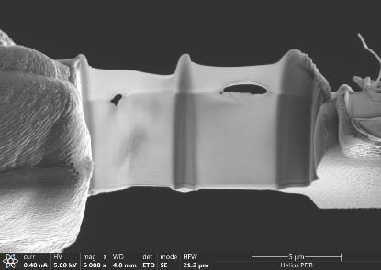
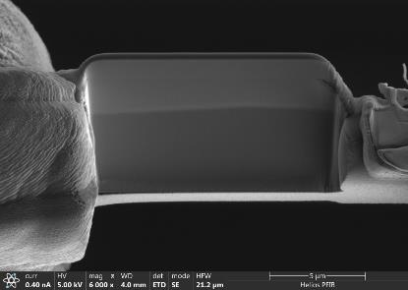
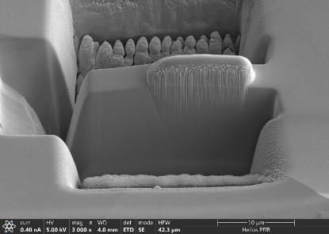
In-situ Sample Preparation
BCP (1:1:2, 2 hrs), Ningxia Fine-grain sample+exposure in air for > 1 month
Focused Ion Beam (FIB) and SEM Sample Preparation + welding on copper mesh with heating chip
Sample before FIB
SEM + FIB Sample Cutting
3 mm
5 mm
TEM Image of Final Sample
Selection
Pt Protection Coating
Pt Protection Coating
Welding +Thickness Reduction
Cutting + Transfer
Ion Sputtering
Didi Luo, The Origin of Medium-Temperature Baking Efficacy: Formation and Role of an Ordered Oxide Template, TTC 2026, Paris
7

Slide 8
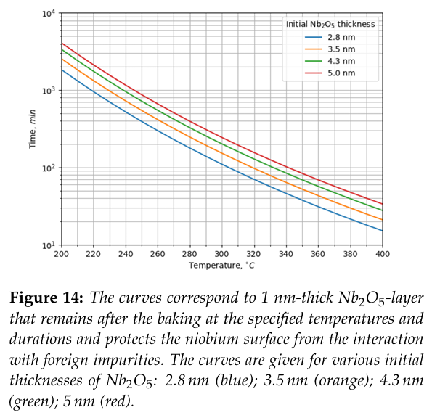
Experiment Setup
Plan: T = 350 ℃, keep 60 min, aiming for oxide layer < 1 nm
[1]
[1] In-situ Synchrotron X-Ray Photoelectron Spectroscopy Study of Medium-Temperature Baking of Niobium, A. Prudnikava, Y. Tamashevich, A. Makarova, D. Smirnov, J. Knobloch
Didi Luo, The Origin of Medium-Temperature Baking Efficacy: Formation and Role of an Ordered Oxide Template, TTC 2026, Paris
8

Slide 9
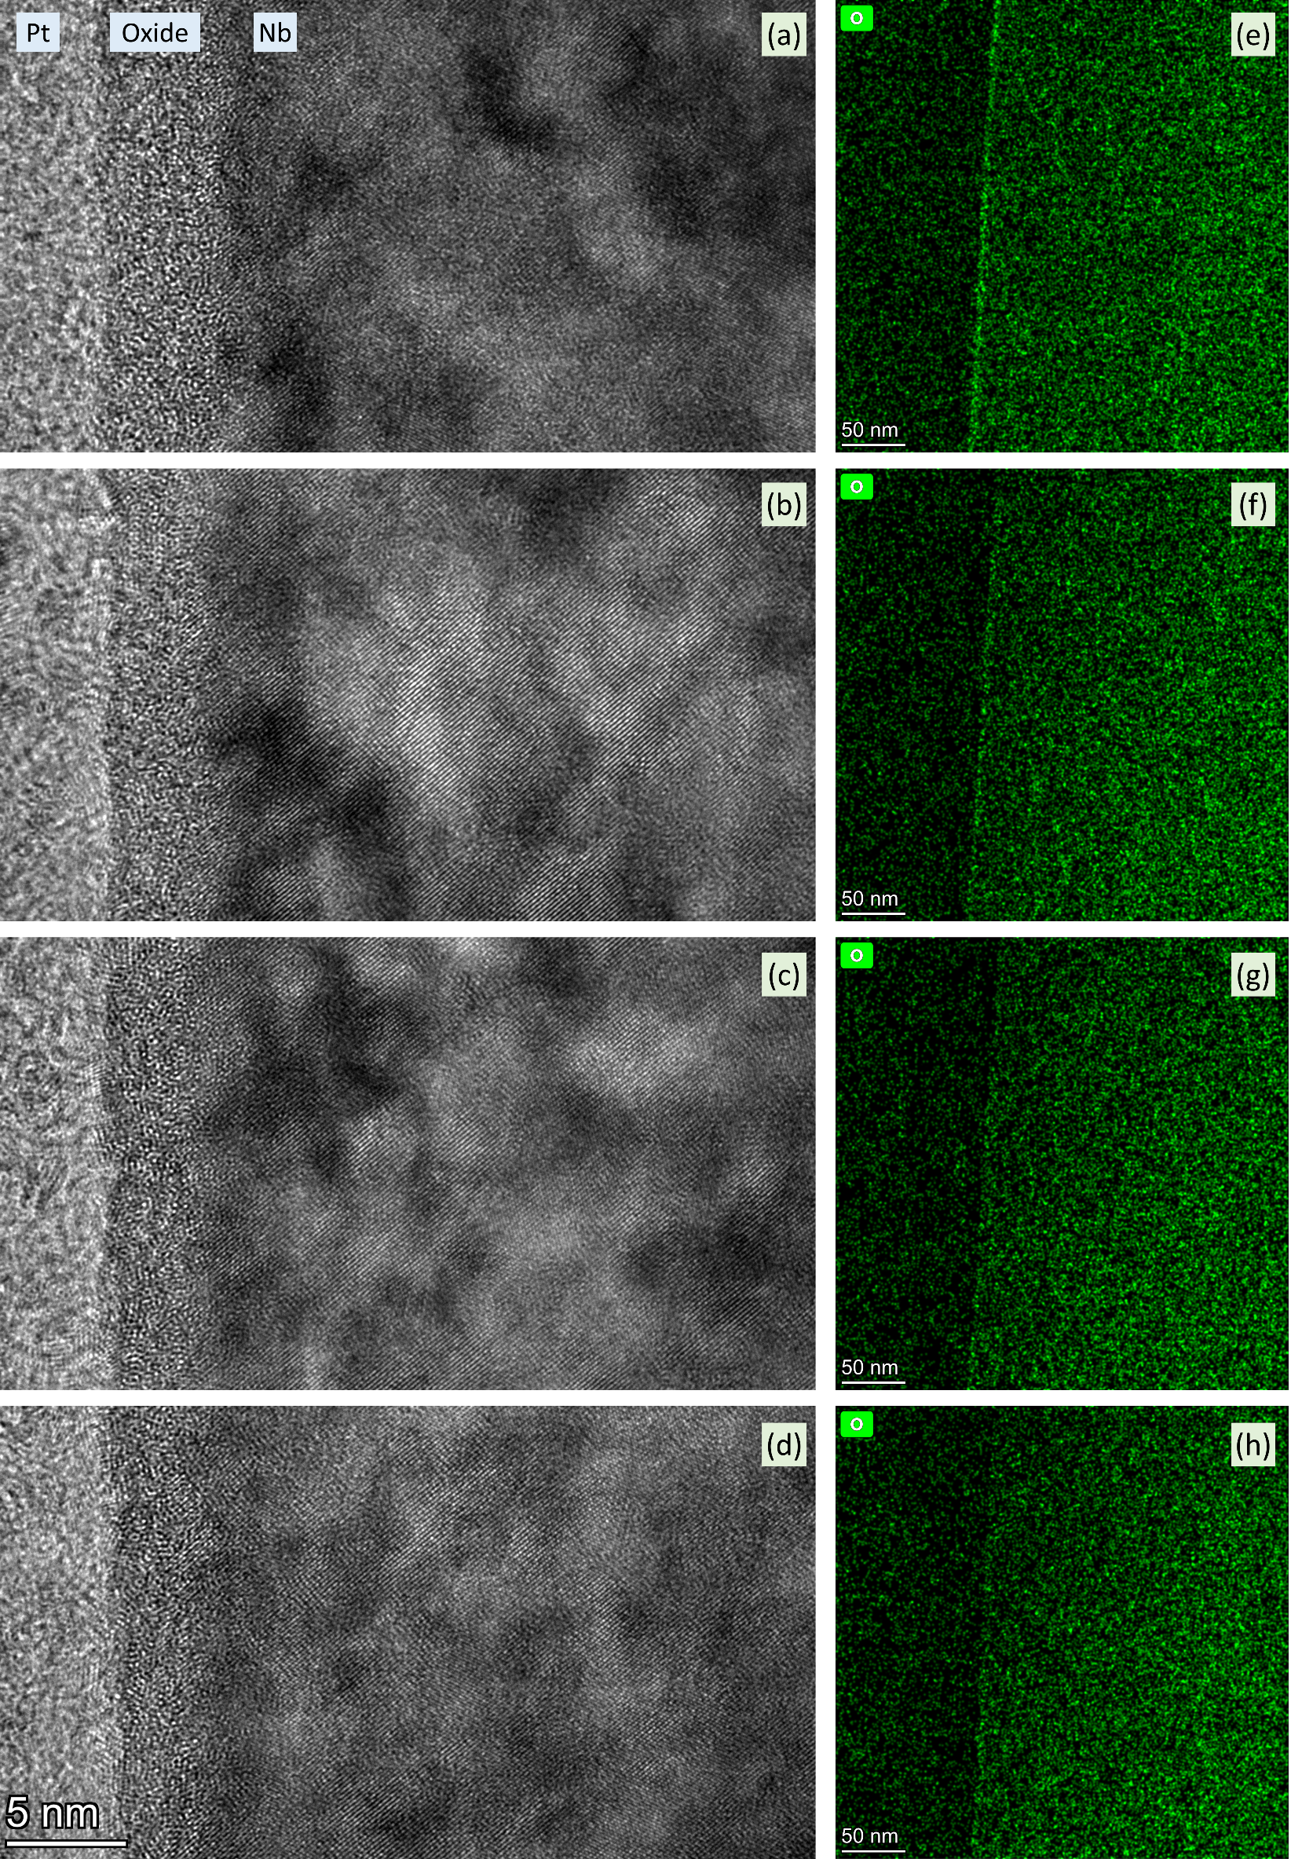
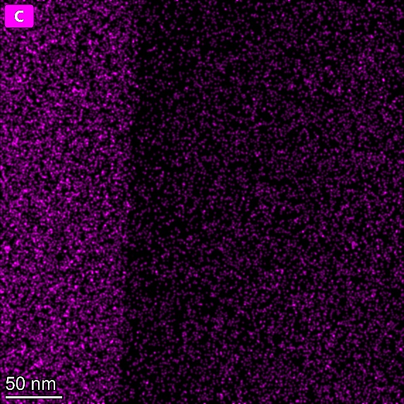
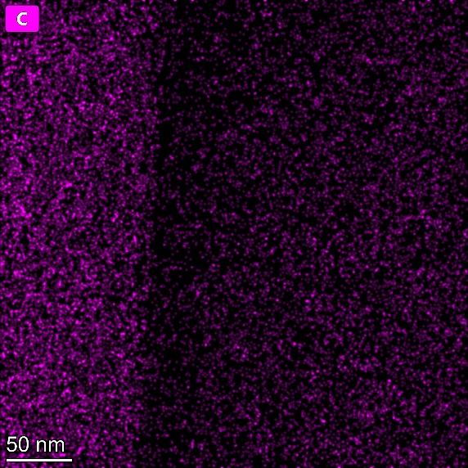
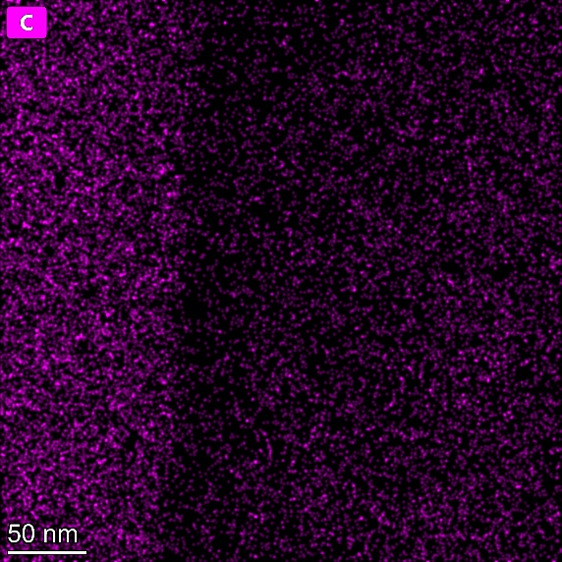
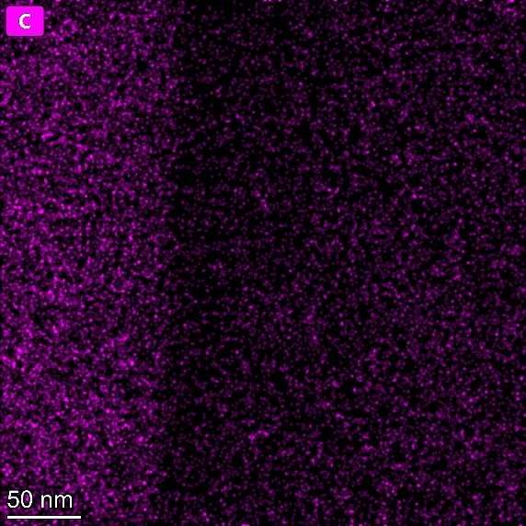
In-situ Results
Before baking, obvious oxide layer on EDS element mapping, thickness ~ 5 nm on TEM image
Upon reaching 350 ℃, oxide layer reduces to ~ 4 nm on TEM image
Keep 30 min, oxide layer on EDS no longer obvious, ~ 3.5 nm on TEM image
Keep 60 min, oxide layer < 3 nm on TEM image (but >1 nm)
No obvious changes on C element mapping during heating
Before baking
upon reaching 350 ℃
350 ℃ 30 min
350 ℃ 60 min
9
Didi Luo, The Origin of Medium-Temperature Baking Efficacy: Formation and Role of an Ordered Oxide Template, TTC 2026, Paris

Slide 10
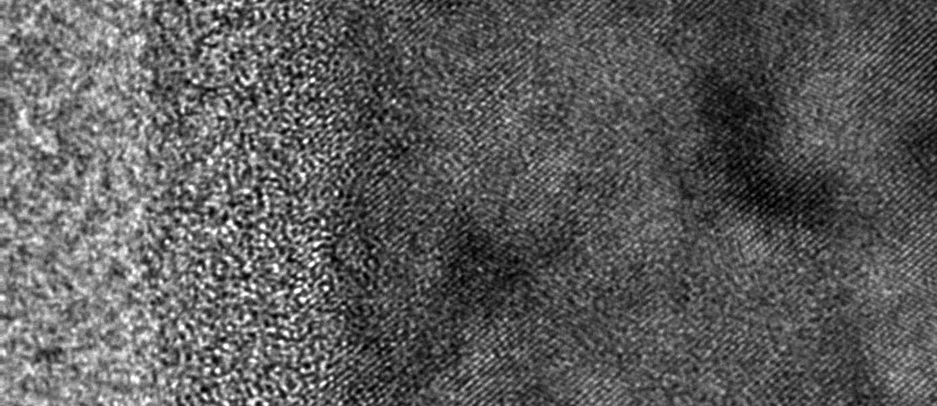

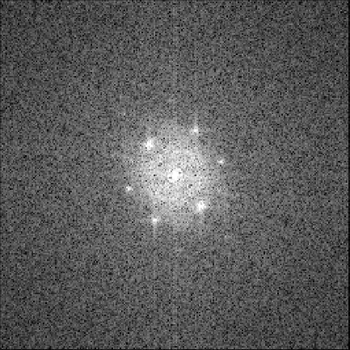

HRTEM + Fast Fourier Transform (FFT)
Before baking
Method that shows diffraction patterns from HRTEM image
Pt
Oxide
Nb
1 nm
Didi Luo, The Origin of Medium-Temperature Baking Efficacy: Formation and Role of an Ordered Oxide Template, TTC 2026, Paris

Slide 11
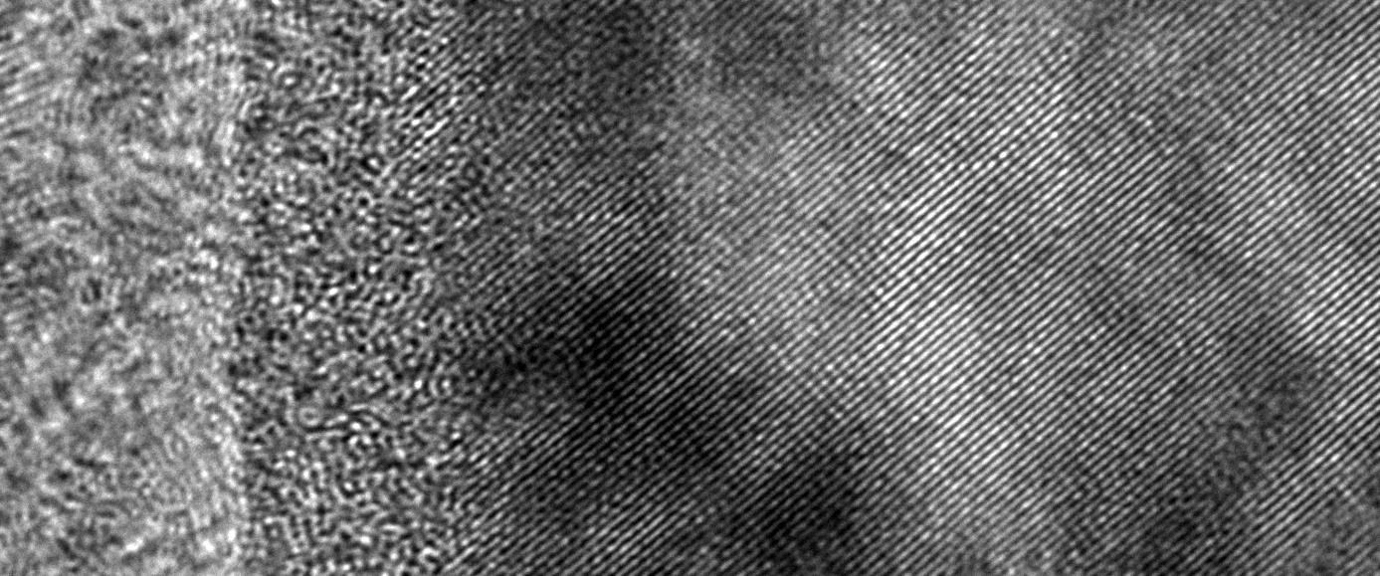

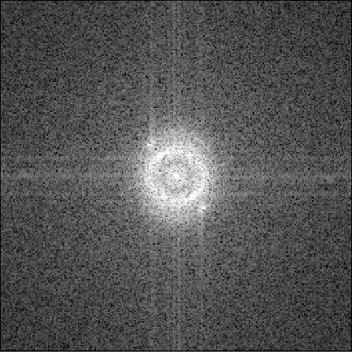
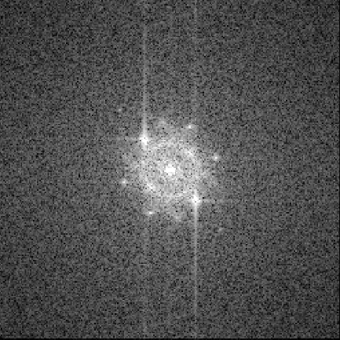
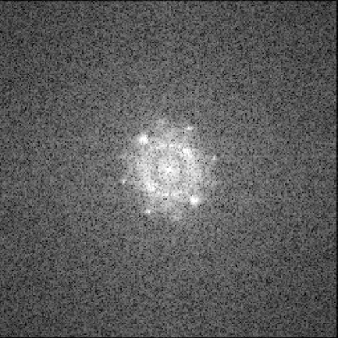
HRTEM + Fast Fourier Transform (FFT)
Upon reaching 350 ℃
1 nm
Didi Luo, The Origin of Medium-Temperature Baking Efficacy: Formation and Role of an Ordered Oxide Template, TTC 2026, Paris

Slide 12

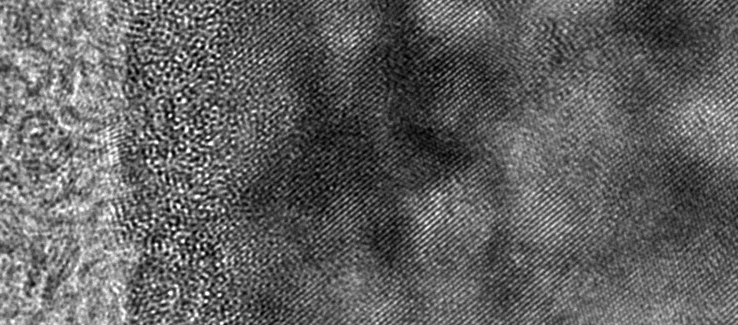
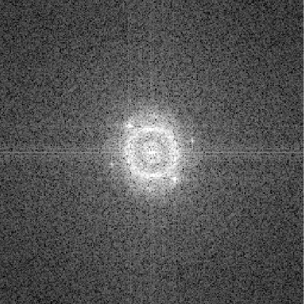
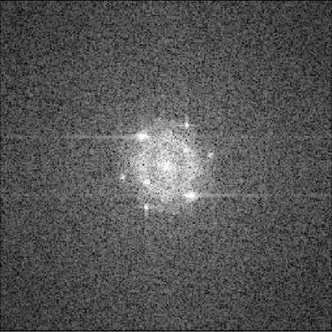
HRTEM + Fast Fourier Transform (FFT)
350 ℃ 30 min
1 nm
Didi Luo, The Origin of Medium-Temperature Baking Efficacy: Formation and Role of an Ordered Oxide Template, TTC 2026, Paris

Slide 13
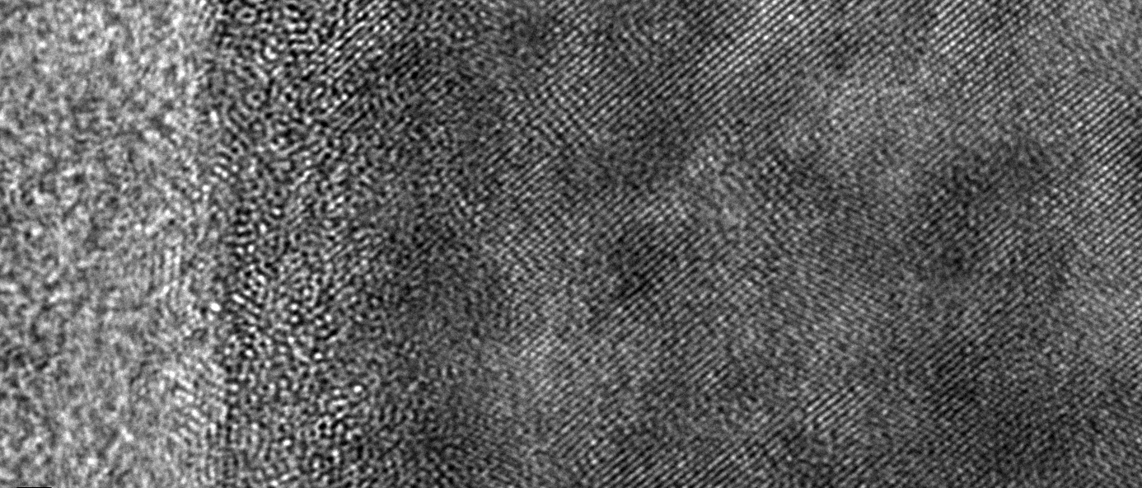

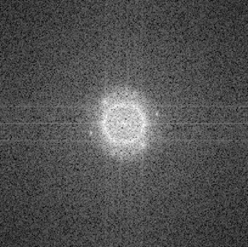
HRTEM + Fast Fourier Transform (FFT)
350 ℃ 60 min
new pattern: cross-section oxide also become ordered
1 nm
Didi Luo, The Origin of Medium-Temperature Baking Efficacy: Formation and Role of an Ordered Oxide Template, TTC 2026, Paris

Slide 14
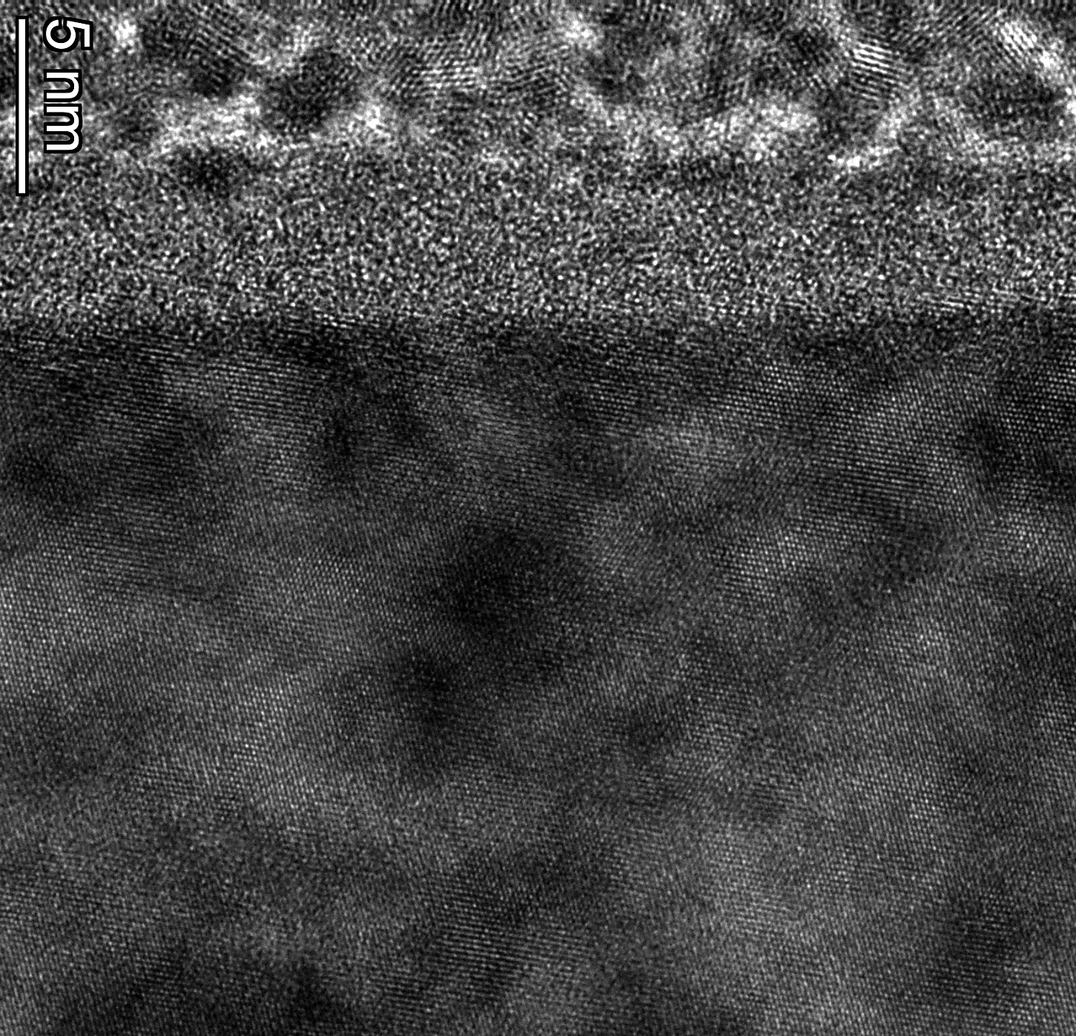
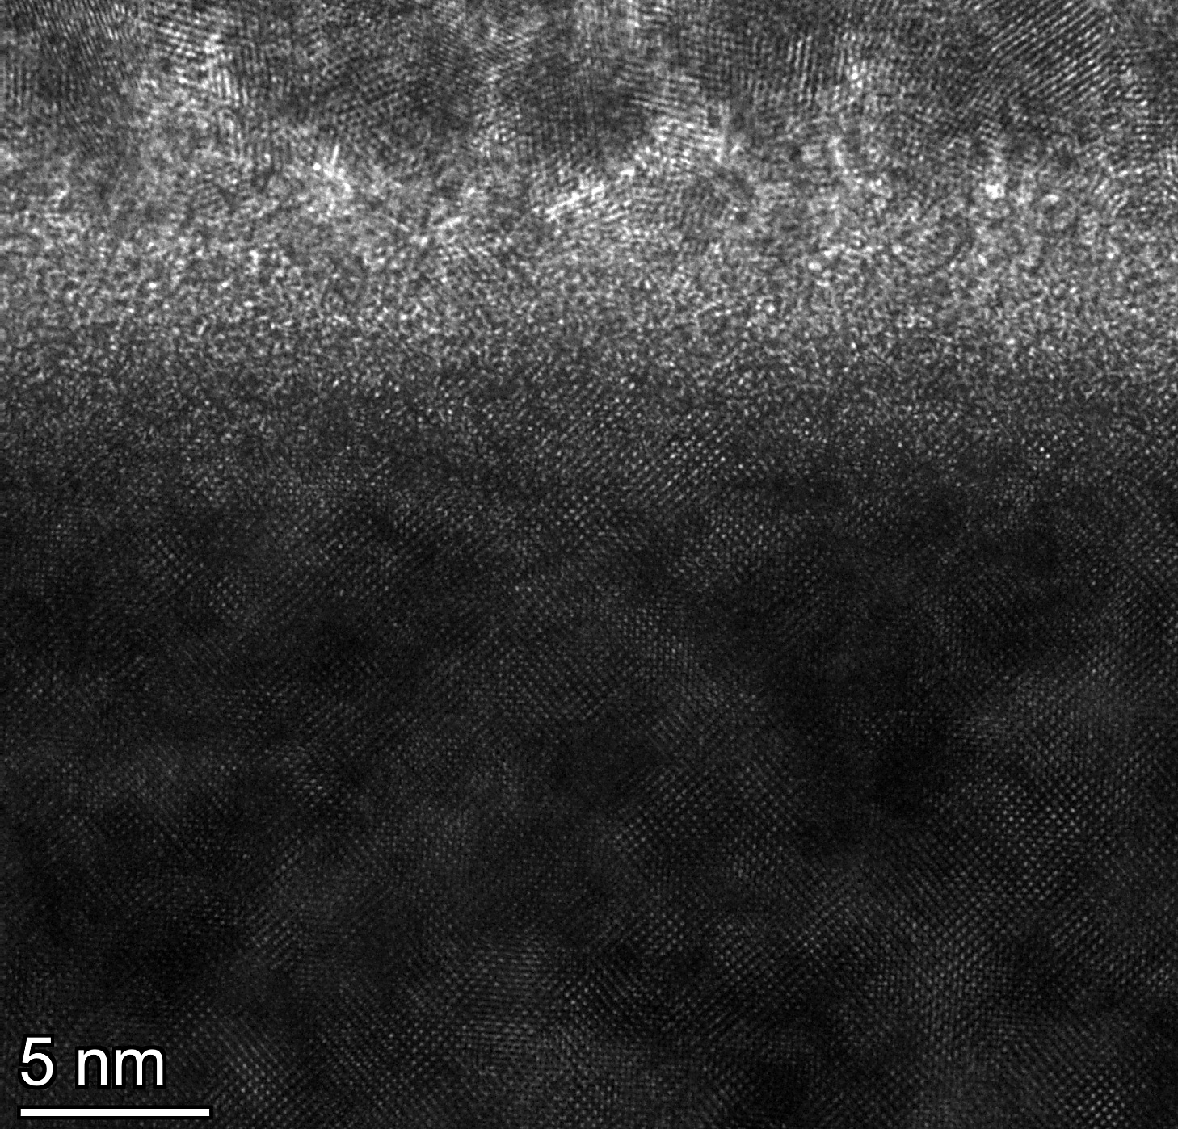
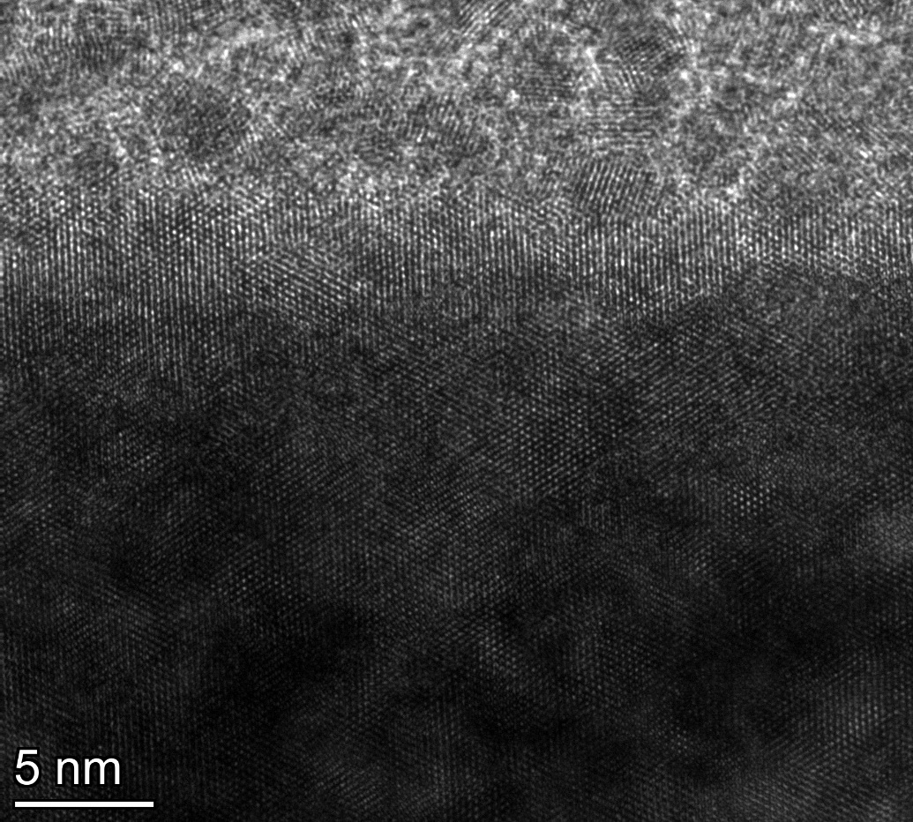
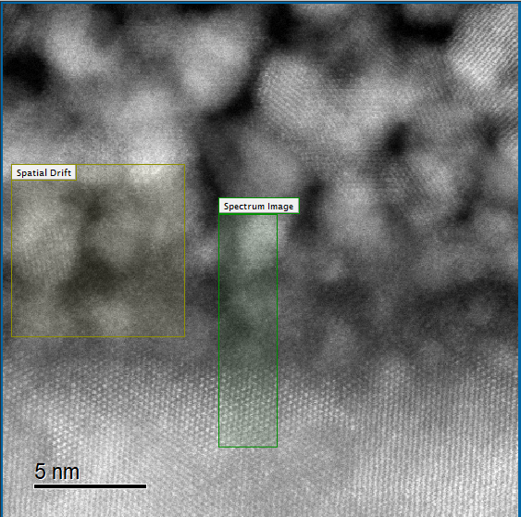
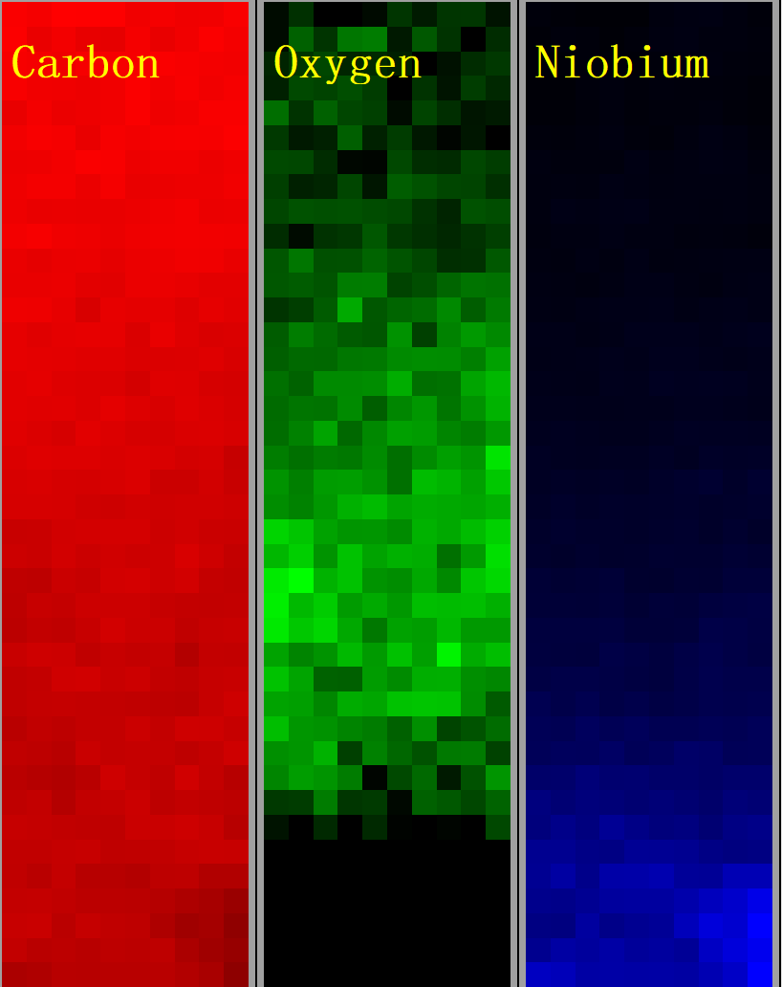
Ex-situ HRTEM Result
Pt
Oxide
Nb
Oxide re-grows along Template?
350 ℃ 1 hr baking in furnace + expose in air (~ 3 days)
Designed nano-crystal oxide, useful?
EELS results (more accurate than EDS for O)
Grey Scale intensity profile
Before baking
Didi Luo, The Origin of Medium-Temperature Baking Efficacy: Formation and Role of an Ordered Oxide Template, TTC 2026, Paris

Slide 15
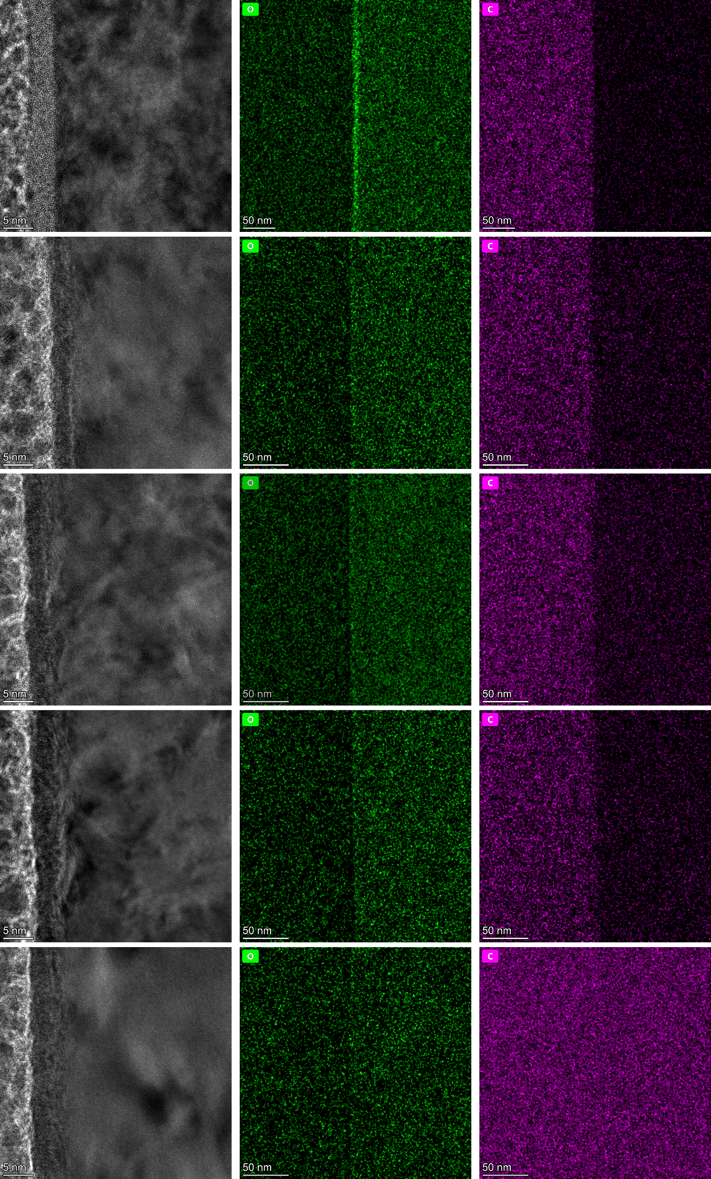
In-situ 550 ℃ + 650 ℃
Evolution is too fast even at 550 ℃
Oxide layer not obvious (< 2 nm) after 20 min 550 ℃, and saturates
Nb stress layer is generated (possibly due to Pt protecting layer)
Upon reaching 650 ℃, O & C element become more uniformly distributed
→ Each Temperature has a saturation thickness of the oxide layer, at 550 ℃, the ordered oxide is too thin to generate an ordered growth template
Before baking
upon reaching 550 ℃
550 ℃ 20 min
550 ℃ 40 min
Didi Luo, The Origin of Medium-Temperature Baking Efficacy: Formation and Role of an Ordered Oxide Template, TTC 2026, Paris
upon reaching 650 ℃

Slide 16
The Existence of Carbide?
Chemical reaction:
C + ½ O₂ → CO↑, ΔG ~ -400 kJ/mol (1)
Nb + C → NbC, ΔG ~ -140 kJ/mol (2)
ΔG of (1) much lower & CO gas easily escapes of system, accelerate the chemical reaction (1)
XPS results:
Furnace vacuum (~10⁻⁴ Pa) ×; in-situ XPS chamber vacuum (~10⁻⁸ Pa) ✓ [1]
Fine grain sample (higher roughness and more GB) ×; Single crystal (many sample studies use SC) ✓
Cavities baking vacuum~ furnace vacuum →Maybe no Carbide on cavities’ surface
Fine Grain
Single Crystal
BCP 1 min
BCP 1 min + 650℃ 10 h
H₂O₂ BCP 1 min
(more oxidized)
H₂O₂ BCP 1 min + 650℃ 10 h
[1] Mingming Yu et al 2024 Supercond. Sci. Technol. 37 105014
Didi Luo, The Origin of Medium-Temperature Baking Efficacy: Formation and Role of an Ordered Oxide Template, TTC 2026, Paris

Slide 17
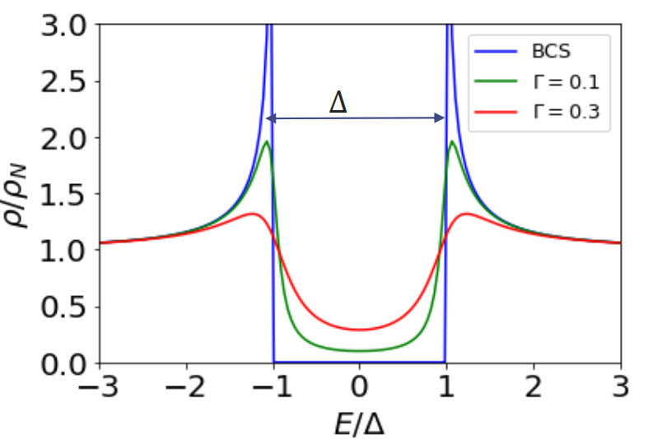
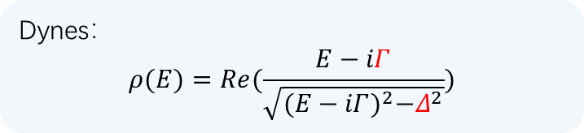
Conclusion
Phenomena: The oxide layer thickness saturates and becomes more ordered during heating, baking at 350°C yields an ordered final oxide layer.
Assumption: proximity effect enhances the cavity performance and/or the ordered outer wall reduces the Kapitza resistance between Nb and helium
Next: First-principles calculations + Point-contact tunneling (PCT) spectroscopy → superconducting energy gap, etc.
Dynes：
$$ρ(E)=Re(\frac{E−iΓ}{\sqrt{{(E−iΓ)}^{2}−Δ^{2}}})$$
Didi Luo, The Origin of Medium-Temperature Baking Efficacy: Formation and Role of an Ordered Oxide Template, TTC 2026, Paris

Slide 18
Thank you!
Notes:
谢谢各位评委老师

