Slide 1
Experiences of Eu-XFEL.
TTC 2026, WG3:
R&D for Mass production and Quality assurance for accelerator modules
Serena Barbanotti, Detlef Reschke for the DESY Eu-XFEL team
June 9, 2026

Slide 2
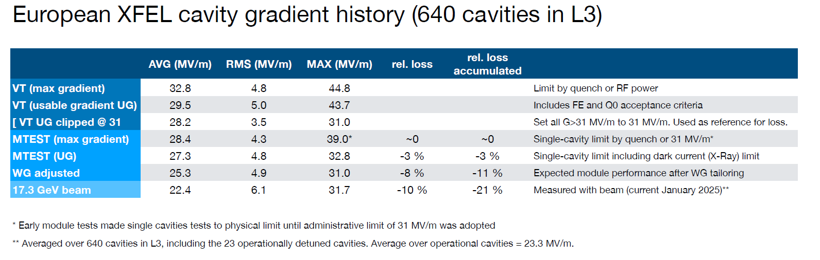
Achieved Yield vs. Design Specs:
What were the final yield rates for your project’s cavities, high-power couplers, and cryomodule components, and how did the achieved performance compare to the original design specifications?
Cavity performance
  No exact data for Qo in cryomodule available (pulsed operation with low dynamic losses in long 12 CM cryo string)
  N. Walker, TTC2019

Slide 3
Achieved Yield vs. Design Specs:
What were the final yield rates for your project’s cavities, high-power couplers, and cryomodule components, and how did the achieved performance compare to the original design specifications?
High power couplers (FPC)
  4 FPC shortened in EuXFEL linac (out of 776 FPC’s in the EuXFEL) -> high T
  184 FPC needed repair at CM test (out of 808 FPC assembled to CM) -> mix of assembly + design problems
Cryomodule components
  Cold masses + vacuum vessel: 100%
  (start-up with few problems alignment of leak tightness)
  Magnetic shielding: 100% ;
  (only sample test of shielding efficiency)
  Cold magnets: 100%;
  (100% characterization; initial problems with Cu coating of beam tube)
  BPM, 2 types (reentrant & button): nearly(?) 100%
  (initial cleaning problems)

Slide 4
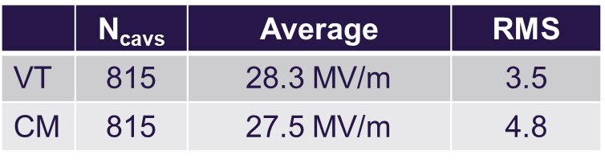
Performance Transfer & Margins
Performance Transfer & Margins: What was the observed performance degradation from the Vertical Test (VT) to the final cryomodule (CM) operation, and what rationale was used to define the design margins necessary to account for this "VT-to-CM" transfer?
VT to CM operation: (incl. clipping at 31MV/m as CM administrative limit)
  more radiation in CM tests than VT
rationale was used to define the design margins ?
  Design gradient in operation 23.6MV/m
  VT started with required usable gradient of 26MV/m; reduced to 20MV/m after VT of 270 Cavs => too high retreatment rate

Slide 5
Industrialization & Repeatability
Which specific cryomodule assembly tools, cleanroom assembly tools, or standardized procedures were most critical for ensuring repeatability and maintaining high throughput during the production phase?
Cryomodule assembly:
  assembly tools at CEA partially doubled
  Standarized procedures and documentation
  Extensive training and supervision of executing company
  Most critical: Ti welds at 2-phase pipe connections
Vacuum vessel + cold mass: 2 vendors (out of 4 qualified companies)
Two cavity vendors (qualified before start of production)
  Standarized procedures with intensive supervision

Slide 6
Supply Chain & Material Quality
How did material selection and vendor-specific quality assurance impact your production timeline, and did you encounter significant performance variations tied to different niobium batches or suppliers?
Critical compliance to PED for non-European vendor of cold mass
Delay of FPC’s (Cu coating); 2 FPC vendors (670 + 150)
Three Nb material suppliers for sheets (4 qualified high RRR Nb suppliers before production)
  single- source of supply for seamless tubes and HOM coupler housing
Extensive QC (incl. ECS of sheets) of all SFP’s
Both cavity vendors (RI, Zanon) started later than expected and with slower ramp-up caused by construction of new cavity production infrastructure
Vendor specific “change requests” for cavity fabrication and surface treatment for both vendors
Intensive supervision including regular vendor visits
Performance variations tied to different niobium batches or suppliers?
=> No (see cavity paper)

Slide 7
Logistics & Transportation
Logistics & Transportation: What were the primary technical difficulties encountered during the transportation of finished cryomodule components, and what specific monitoring criteria (e.g., vacuum, shocks, alignment) were used to validate the hardware's integrity upon arrival?
Transport of cavities “ready for vertical test” established (for series production)
(by truck: RI, Zanon to DESY & DESY to CEA Saclay)
  Standarized “Incoming inspection” wrt. shock-log, vacuum, rf spectra, shorts, mechanics
Transport of cryomodules established (by truck; CEA Saclay to DESY)
  Vacuum + shock-log monitoring during transport; GPS position tracking
  Incoming inspection: shock-log, rf spectra, shorts, mechanics
No specific technical difficulties by transport of cryomodules
No specialized trailer
Redundancy in transport components
Reliable shipping company mandatory

Slide 8
Spare Parts Strategy
Spare Parts Strategy: What was the ratio of spare parts (cavities, couplers, etc,) required versus the total installed count, and was this "buffer" sufficient to cover the actual non-conforming parts during production?
All high RRR Nb products: 3(-5)% overhead
1.3 GHz Cavities: “few”
(800 Cv’s ordered for series production; 4 add. Cv’s from overhead Nb material; 4 Cv’s for infrastructure qualification)
Cold mass + vacuum vessel: 103 for 101 cryomodules
FPC’s: 820 FPC’s (for required 808)
Magnets: 103 ordered for 101 cryomodules (+ few prototypes)
3.9 GHz cryomodule: 1x spare (+ 4 cavities)

Slide 9
Literature
“Superconducting cavity material for the European XFEL“
W Singer, X Singer, A Brinkmann, J Iversen, A Matheisen, A Navitski, Y Tamashevich, P Michelato and L Monaco
doi:10.1088/0953-2048/28/8/085014
“Production of superconducting 1.3-GHz cavities for the European X-ray Free Electron Laser“
W. Singer, A. Brinkmann, R. Brinkmann, J. Iversen, A. Matheisen, W.-D. Moeller, A. Navitski, D. Reschke, J. Schaffran, A. Sulimov, N. Walker, and H. Weise, P. Michelato and L. Monaco, C. Pagani, M. Wiencek
DOI: 10.1103/PhysRevAccelBeams.19.092001
“Performance in the vertical test of the 832 nine-cell 1.3 GHz cavities for the European X-ray Free Electron Laser”
D. Reschke, V. Gubarev, L. Monaco, J. Schaffran, L. Steder, N. Walker, and M. Wenskat
DOI: 10.1103/PhysRevAccelBeams.20.042004
“Fabrication and vertical test experience of the European X-ray Free Electron Laser 3.9 GHz superconducting cavities”
P. Pierini, M. Bertucci, A. Bosotti, J. F. Chen, C. G. Maiano, P. Michelato, L. Monaco, M. Moretti, C. Pagani, R. Paparella, and D. Sertore
DOI: 10.1103/PhysRevAccelBeams.20.042006
“Status of the European XFEL Accelerator” (talk), H. Weise & W. Decking
European XFEL User’s Meeting, 25-27 Jan 2017
N. Walker: “Summary of the maximum SCRF voltage in XFEL”, TTC2019 – Vancouver
“XFEL Cryomodule Transport …”
S. Barbanotti et al., LINAC2014, MOPP021

Slide 10
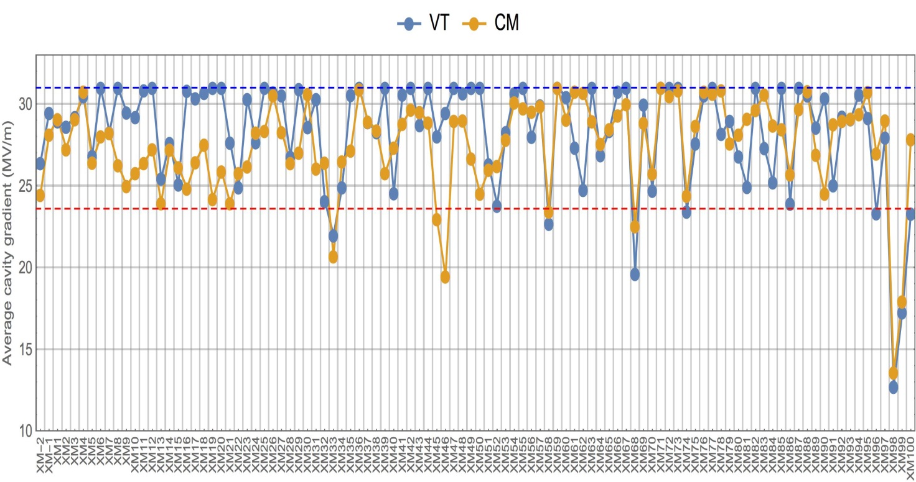

XFEL Module Performance
Module performance well above specs. and visible improvement with time
Tunnel installation used sorting of modules based on AMTF performance
XM98 as scavenger module
XFEL Spec
23.6 MV/m
vertical test (clipped at 31 MV/m)
module performance
Remark:
Clipping at 31 MV/m is done due to max. available RF power; limit given by waveguide distribution.
 | N_{cavs} | Average | RMS
VT | 815 | 28.3 MV/m | 3.5
CM | 815 | 27.5 MV/m | 4.8

