Slide 1
Introduction of the project: LCLS-II-HE
James Maniscalco
  23 new cryomodules added to existing 35 (plus 1 yield CM)
  1.3 GHz cavities produced in industry
  Cryomodule installation ongoing; cavity commissioning starts Mar. 2027
Quantity | LCLS-II Cavities | LCLS-II Cavities after upgrade | LCLS-II-HE Cavities | Unit
Number of 1.3 GHz cavities | 280 | 280 | 184
Minimum average cavity Q₀ at nominal E_{acc} | 2.7 | 2.7 | 2.7 | 10¹⁰
Vertical test qualifying gradient | 19 |  | 23 | MV/m
Assumed fraction of failed cavities | 6 | 3 | 6 | %
Nominal average operating gradient | 15.7 in L2-3 | 16.9 in L2-3 | 20.8 | MV/m
Vertical test field emission onset min. | 17.5 |  | No FE allowed | MV/m
Maximum CM captured dark current | 10 | 10 | 30 | nA

Slide 2
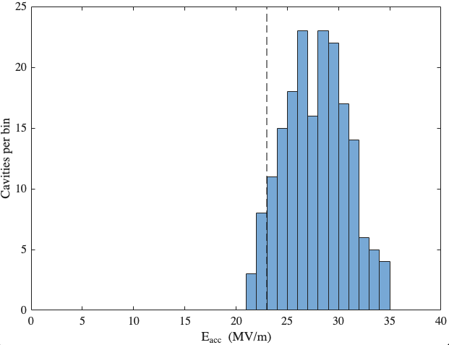
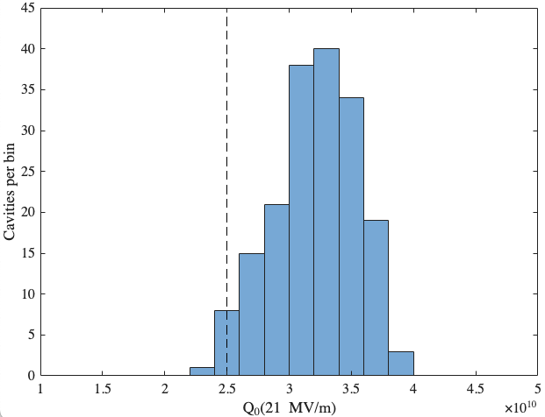
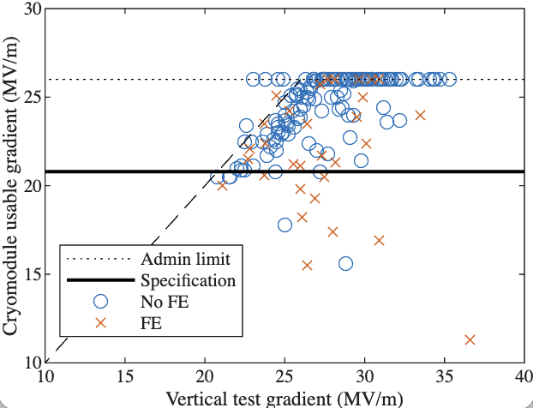
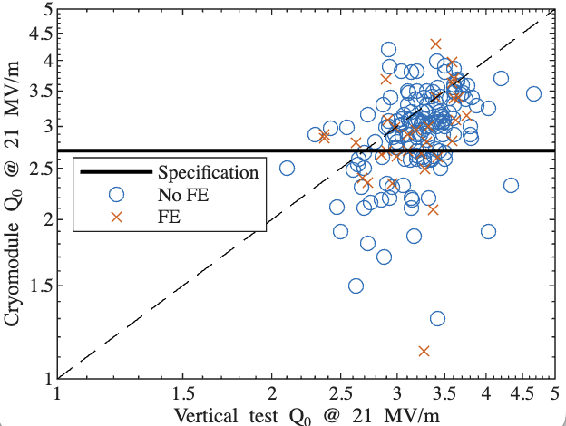
Q1. Achieved Yield vs. Design Specs:
What were the final yield rates for your project’s cavities, high-power couplers, and cryomodule components, and how did the achieved performance compare to the original design specifications?
Cavities: 183 of 192 qualified (95.3%)
125 of 192 qualified on first test (65.1%)
58 of 192 required reprocessing to qualify
(HPR, HF Rinse, etc. — 30.2%)
9 not qualified (4.7%)
  5 low E_{acc}; 1 low Q₀; 1 FE; 1 damaged HOM; 1 damaged bellows
High-Power Couplers: No notable performance issues
Average E_{quench}: 27.7±3.1 MV/m
Average Q₀: 3.25±0.38×10¹⁰
Q2. Performance Transfer & Margins:
What was the observed performance degradation from the Vertical Test (VT) to the final cryomodule (CM) operation, and what rationale was used to define the design margins necessary to account for this "VT-to-CM" transfer?
E_{acc} degradation: -3.6±4.5 MV/m
Q0 degradation: -0.26±0.54 x 10¹⁰ (7.6±17.1%)
Field emission: 0 cavities in VT, 32 in CM (17.4%)
Acceptance margin: VT E_{acc} spec 23 MV/m vs. 20.8 MV/m in CM
Rationale: Analysis of LCLS-II data showed ~2 MV/m drop
Analysis done following early cavities on impact of using “marginal” cavities (met CM spec in VT) → mean quench field was high enough to allow up to 2 “marginal” cavities per CM.
E_{quench}
Q₀
Note that
σ>Δ !

Slide 3
Q3. Industrialization & Repeatability:
Which specific cryomodule assembly tools, cleanroom assembly tools, or standardized procedures were most critical for ensuring repeatability and maintaining high throughput during the production phase?
Strong communication and collaboration with cavity supplier
  Frequent onsite presence (up to 5 week-long visits per year)
  Weekly meetings to discuss technical and schedule issues
  Prioritizing quality over schedule
  Problem-solving approach, not finger-pointing approach
Cavity Technical Board of SRF experts across 3 partner labs
  Weekly discussion of cavity results, open discussion of cavity dispositioning
  Prioritizing quality over cost and schedule
  Much lively discussion, never any non-unanimous decisions/recommendations
Q4. Supply Chain & Material Quality:
How did material selection and vendor-specific quality assurance impact your production timeline, and did you encounter significant performance variations tied to different niobium batches or suppliers?
Niobium sheets:
Qualification issues (sheet waviness that made ECS very difficult or impossible) impacted the cavity production schedule as the material rework plan was developed and executed. Up to 6 month impact for final cavities.
Different material lots required different heat treatment temperatures for flux expulsion
  Procedure to determine required temperature well developed after LCLS-II, no major issues for HE.
  1 single-cell cavity produced and tested for each lot (~100-150 sheets)
Cavity bellows damage:
Early high incidence of damage to helium vessel bellows. High perceived risk to long term operations.
Cavity production stopped while extent of condition investigated and root cause analysis performed
1-2 month impact; occasional recurrence later.

Slide 4
Q5. Logistics & Transportation:
What were the primary technical difficulties encountered during the transportation of finished cryomodule components, and what specific monitoring criteria (e.g., vacuum, shocks, alignment) were used to validate the hardware's integrity upon arrival?
LCLS-II had major issues early with coupler bellows breaking during CM transport
This issue was identified, addressed, and has not recurred during LCLS-II-HE
Cavities are shipped from the supplier with shock loggers and shock/tilt indicators (stickers)
Only major issue was a cavity crate that was stored on its side and may have fallen back to normal orientation, per the shock indicator
Severe bellows damage – not conclusively caused by this event though.
Exterior tilt and shock watches routinely damaged or tripped. Interior stickers usually OK.
Q6. Spare Parts Strategy:
What was the ratio of spare parts (cavities, couplers, etc.) required versus the total installed count, and was this "buffer" sufficient to cover the actual non-conforming parts during production?
Cavities:
8 yield spares purchased
Had several additional cavities on hand to use as spares:
  2 spare cavities from pre-production verification cryomodule
  9 former LCLS-II cavities that were remediated (HPR and/or nitric rinse in tank)
Production ended with 10 qualified spares.
Cryomodules:
1 yield cryomodule produced (verification cryomodule was installed)

