Slide 1
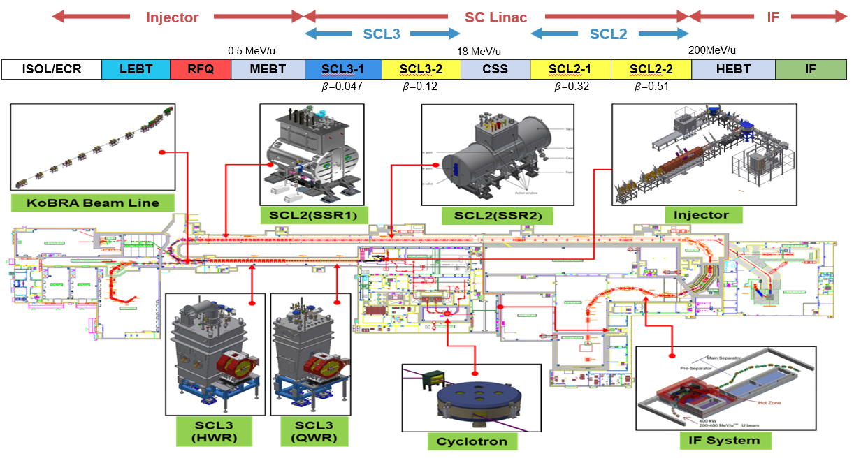
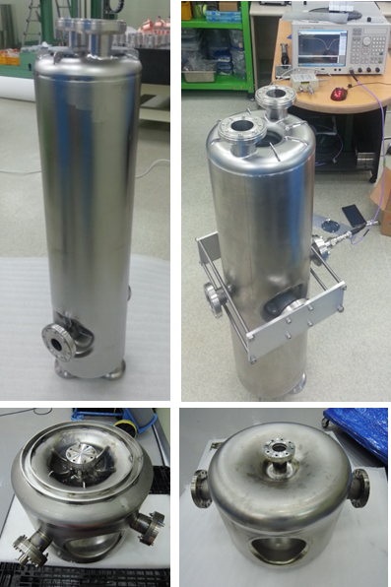
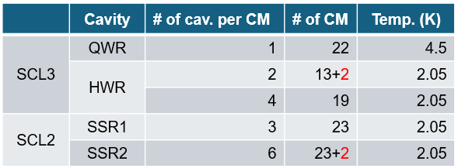
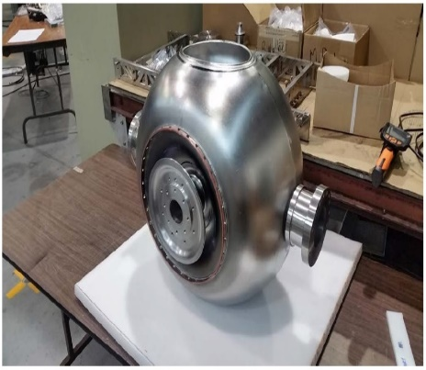
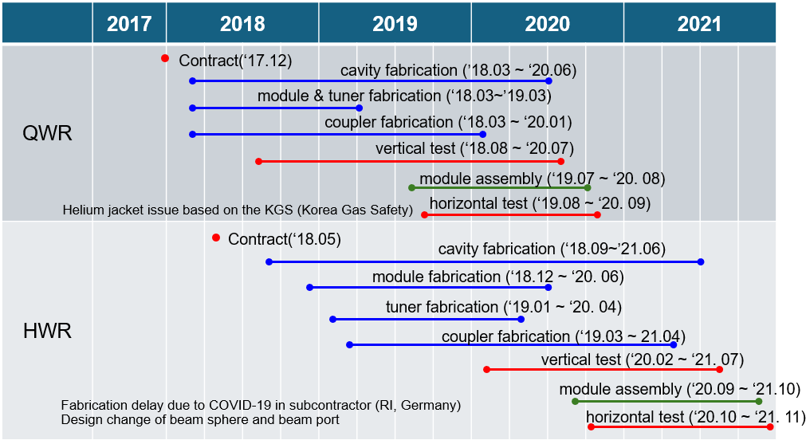
Introduction of the project: (RAON)
Youngkwon Kim
RAON – Rare isotope Accelerator complex for ON-line experiments
Mass production of SCL3 (low energy linac) from Dec. 2017 to Nov. 2021
SCL31: 22 QWR cavities, SCL32: 106 HWR cavities
Fabrication of cryomodules (cavities, FPCs, tuners, cryostats) were done in domestic company including surface processing of cavities.
  Half of the cavities were fabricated by RI (subcontractor).
VT and HT were done in SRF test facility by IRIS.

Slide 2
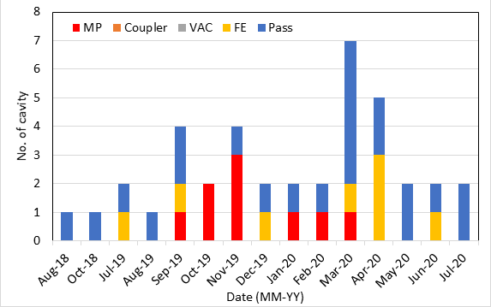
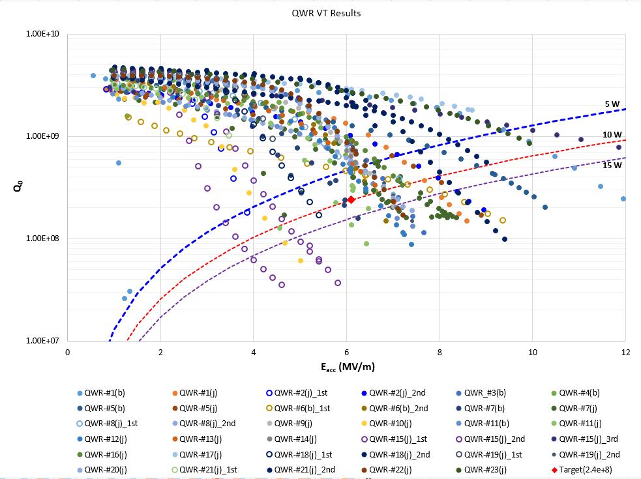
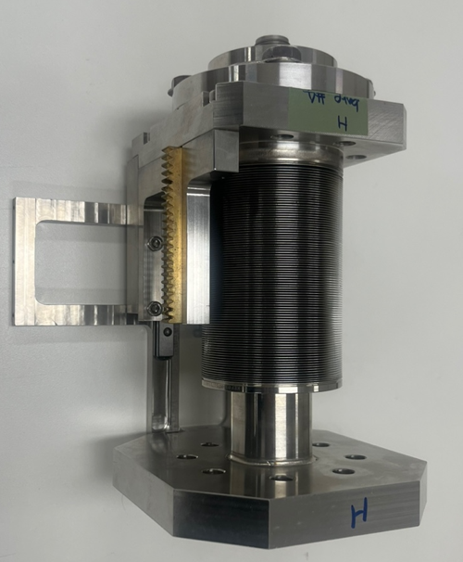
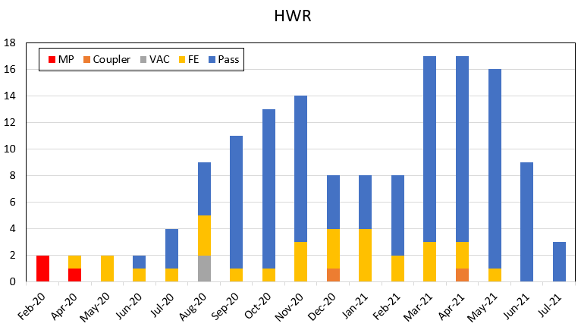
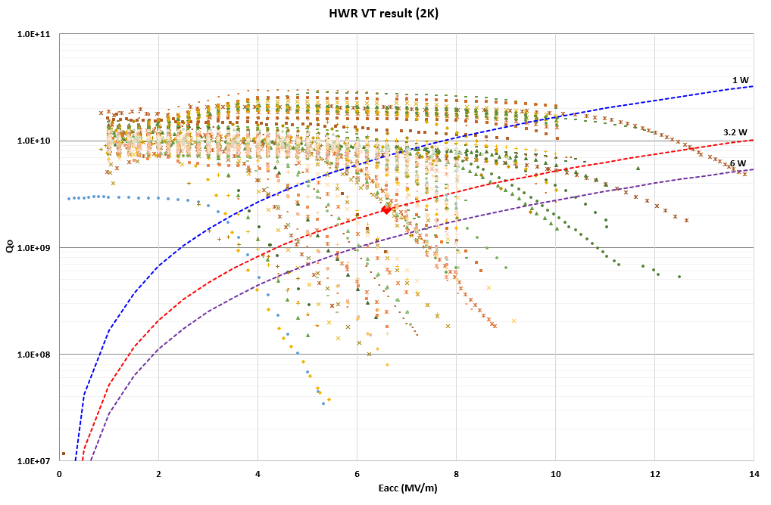
Q1. Achieved Yield vs. Design Specs:
What were the final yield rates for your project’s cavities, high-power couplers, and cryomodule components, and how did the achieved performance compare to the original design specifications?
Cavities
QWR
Target: Q₀=2.4e+8@6.1MV/m, 4.5 K
VT yield: 56%
Main cause of failure: Multipacting
(low temp. baking of variable couplers)
HWR
Target: Q₀=2.3e+9@6.6MV/m, 2.05 K
VT yield: 76%
Main cause of failure: field emission

Slide 3
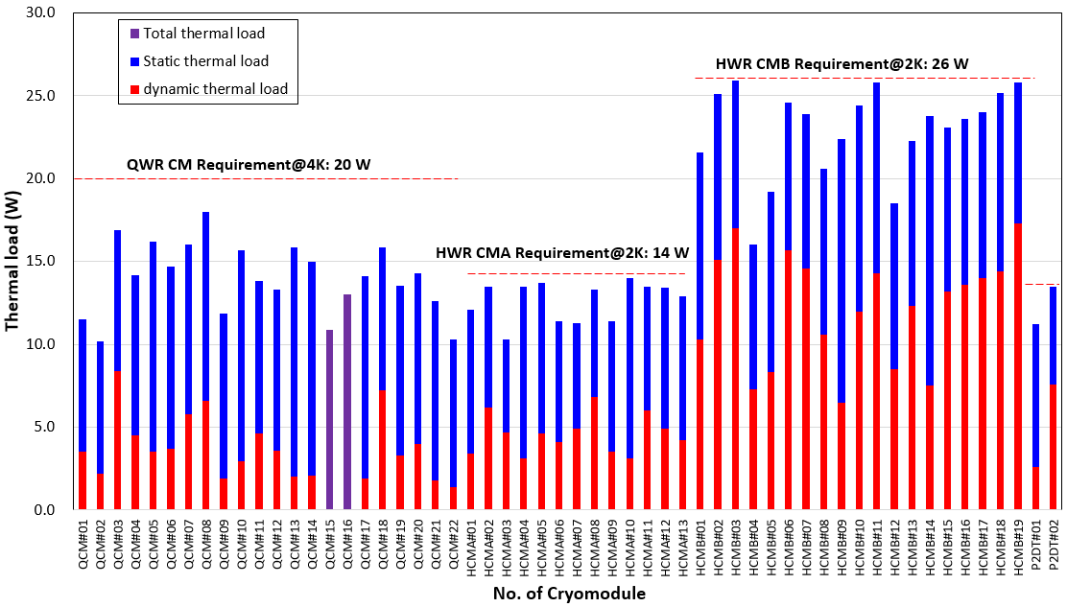
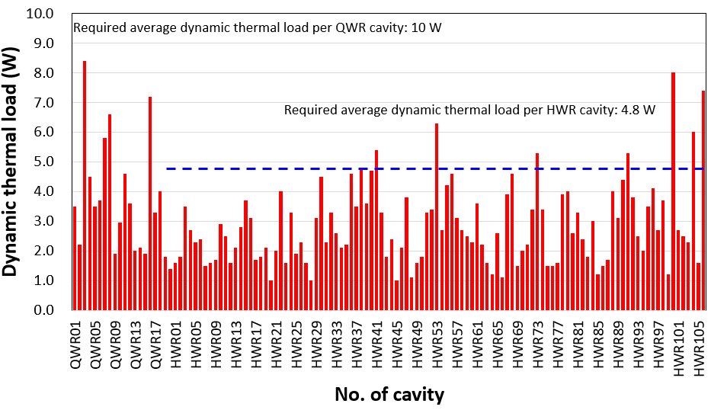
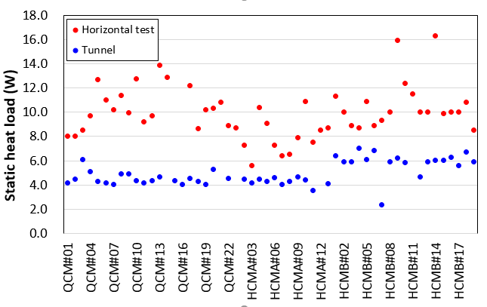
Cryomodules
QCMs
Total heat load: 20 W@6.1 MV/m, 4.5 K
  Q_{d}=10 W → Q₀= 1.6e+8@ @6.1MV/m, 4.5 K
HT yield: no statistics
HCMs
Q_{t}_HCMA = 14 W@6.6 MV/m, 2.05 K
Qt_HCMB = 26 W@6.6 MV/m, 2.05 K
  Q_{d}=4.8 W → Q₀= 1.5e+9@ @6.6 MV/m, 2.05 K
HT yield: 69 %
Main cause of failure: field emission
Failure during transportation (vacuum leak, etc.) were not included for HT yield

Slide 4
Q2. Performance Transfer & Margins:
What was the observed performance degradation from the Vertical Test (VT) to the final cryomodule (CM) operation, and what rationale was used to define the design margins necessary to account for this "VT-to-CM" transfer?
At the time of production, we had limited experience and therefore could not define the design margins based on well-established criteria. Furthermore, the cavity surface treatment and clean assembly procedures were still being optimized, making it difficult to build meaningful statistics on VT-to-CM performance degradation.
For instance, some HWR cavities that passed VT were initially assembled directly into the CM, but later an additional HPR step was introduced before assembly because of the low HT yield. Consequently, the production and preparation procedures were not sufficiently consistent to derive reliable VT-to-CM degradation statistics.
Q3. Industrialization & Repeatability:
Which specific cryomodule assembly tools, cleanroom assembly tools, or standardized procedures were most critical for ensuring repeatability and maintaining high throughput during the production phase?
Based on our experience, the HT yield was only about 70% even for cavities that had passed VT. This indicates that the clean assembly tools and procedures are likely important contributors to the VT-to-CM performance transfer. However, because the clean assembly activities were largely performed and controlled by the vendor, and because our own experience was limited at that time, it is difficult to pinpoint the exact causes of the performance degradation.

Slide 5
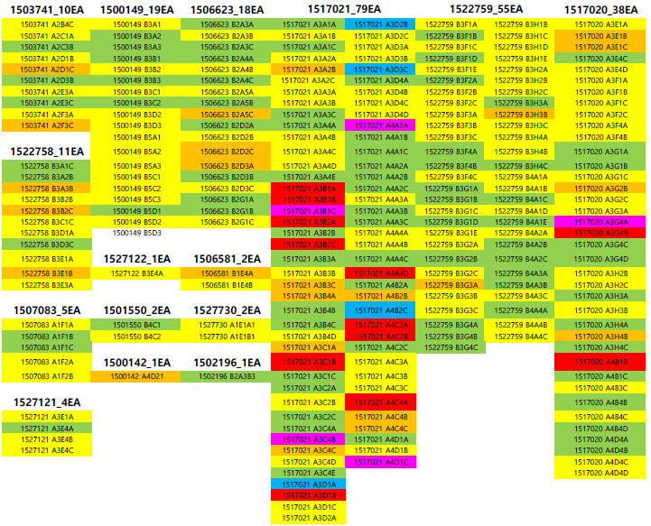
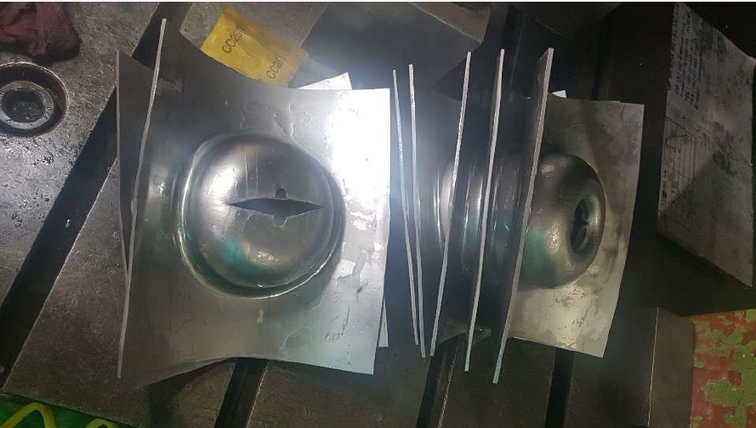
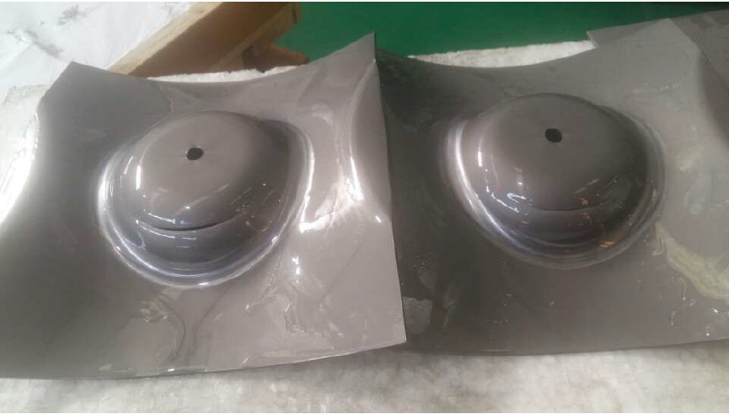
Q4. Supply Chain & Material Quality:
How did material selection and vendor-specific quality assurance impact your production timeline, and did you encounter significant performance variations tied to different niobium batches or suppliers?
Since the materials for SCL3 production had been purchased in advance before the manufacturing contract was placed, material selection and procurement did not have a significant impact on the production timeline.
For the HWR cavities, material tearing was observed during beam-port cup pressing for a specific niobium batch. We later confirmed that the materials from this batch exhibited lower elongation compared to the specification or other batches.

Slide 6
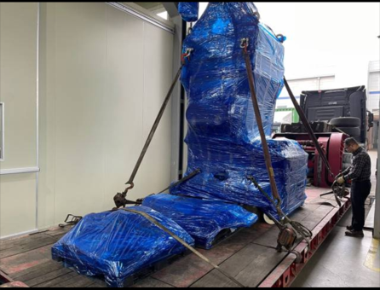
Q5. Logistics & Transportation:
What were the primary technical difficulties encountered during the transportation of finished cryomodule components, and what specific monitoring criteria (e.g., vacuum, shocks, alignment) were used to validate the hardware's integrity upon arrival?
The assembled modules were transported on a low-bed trailer with accelerometers and vacuum sensors installed for transportation monitoring. The high speed bumps in specific sections of the transportation route were replaced with low-profile plastic speed bumps. Despite these precautions, the cavity string was not designed to be rigidly fixed, and we experienced cavity vacuum leaks that were attributed to movement of the cavity string during transport.
Speed bump
Q6. Spare Parts Strategy:
What was the ratio of spare parts (cavities, couplers, etc.) required versus the total installed count, and was this "buffer" sufficient to cover the actual non-conforming parts during production?
Because of budget limitations, it was not possible to procure or manufacture spare parts for the project.

