Slide 1
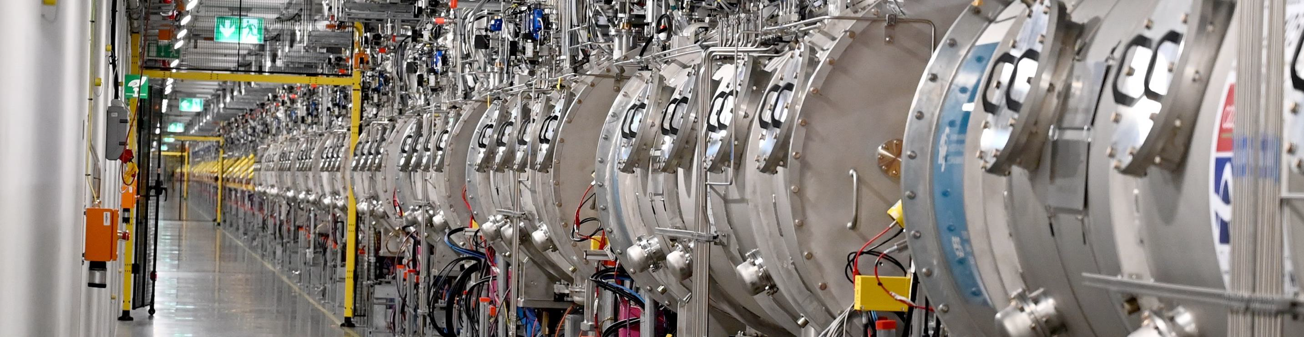
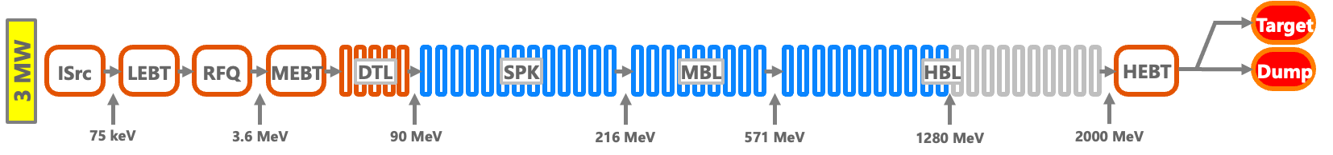


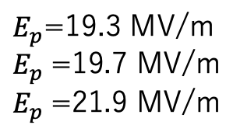
The European Spallation Source LINAC
Paolo Pierini
For SRF/Linac
Neutron Spallation Source, final goal of 5 MW beam power
Long proton pulses: 2.85 ms, 14 Hz, 62 mA at 2 GeV
Phased Project (Commissioning talk M.Skiba Wed)
Operational Now: 870 MeV (2 MW)
NC front end to 90 MeV
26 Double Spoke Resonators in 13 Cryomodules (nominal 9 MV/m)
36 Elliptical Medium Beta Cavities in 9 Cryomodules (nominal 16.7 MV/m)
20 Elliptical High Beta Cavities in 5 Cryomodules (nominal 19.9 MV/m)
Installed capability (but RF infrastructure not complete): 1280 MeV (3 MW)
24 Elliptical High Beta Cavities in 6 unpowered Cryomodules (nominal 19.9 MV/m)
Future installation: 2000 MeV (5 MW)
40 Elliptical High Beta Cavities in 10 Cryomodules (19.9 MV/m)
Now in linac 106 cavities at 2K, of which 82 with RF to nominal
Final goal 146 cavities
Spoke at 352.21 MHz, Elliptical 704.42 MHz
$E_{p}/E_{acc}$=4.28/2.36/2.2
$E_{p}$=19.3 MV/m
$E_{p}$=19.7 MV/m
$E_{p}$=21.9 MV/m
LARGE INKIND SCOPE

Slide 2
Q1. Achieved Yield vs. Design Specs:
What were the final yield rates for your project’s cavities, high-power couplers, and cryomodule components, and how did the achieved performance compare to the original design specifications?
All these components under responsibility of InKind to ESS, so this is the “Final User” POV
SPK yield 100%. Failures on coupler parts (DWT) required additional manufacturing – IJCLAB to comment
Largest project issue in this area is the (un)reliability of SPK cold motor solution
1 motor not moving, no access ports available
MBL 42 cavities manufactured to qualify 36 to CM and a couple of marginal spares - INFN Mi to comment
Production hiccup during COVID, several cavities with hard low-field quenches
First MB CM in freq jump section can’t use full MB gradient, placed 4 under performing cavities
  12-14 MV/m range, when 8 MV/m max can be used for long matching to SPK section
FE experience good, moderate levels [See Daniele later]
HBL 89 cavities manufactured + 4 recovered from CEA proto to qualify 84 to CM – STFC to comment
FE the most common cause for reprocessing, onset below operation point was accepted and we see it developing in the linac strongly in HB
  ESS focus: from ”no FE” to “how far can we operate reliably in the FE region?” [See Cecilia Wed]
  Progressive increase of FE levels in HB so far cured with high power short pulse processing
ELL couplers provided by CEA, minor issue during prototypes with DWT – CEA to comment [See Thibault later]
2 cracked coupler ceramics: exchanged in situ [Reported at previous TTCs]
Couplers considered as slow burning consumables
CM: 2 HB quarantined for superfluid leaks below 2.17K.
Repair plan at ESS being developed for the 5 MW completion.

Slide 3
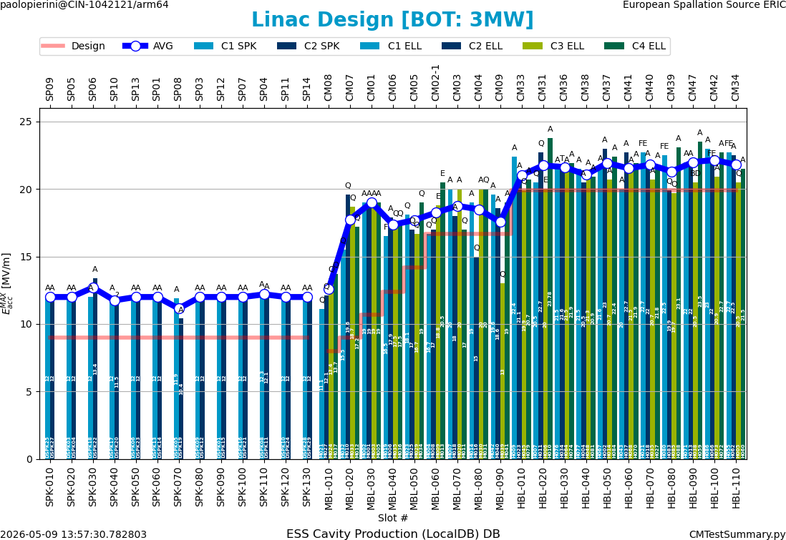
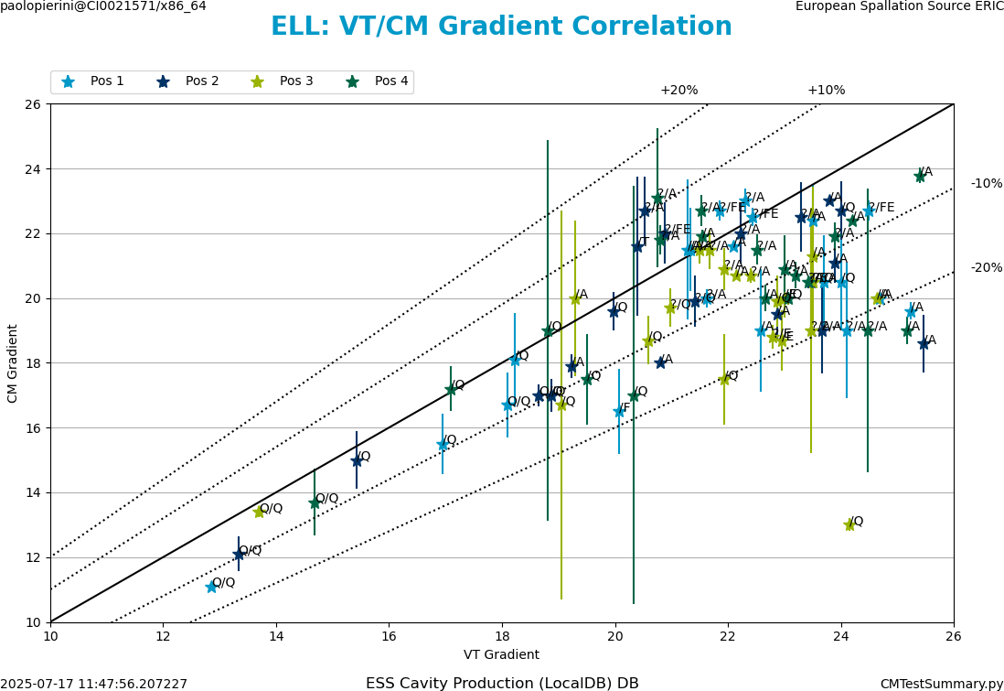
Q2. Performance Transfer & Margins:
What was the observed performance degradation from the Vertical Test (VT) to the final cryomodule (CM) operation, and what rationale was used to define the design margins necessary to account for this "VT-to-CM" transfer?
Correlation of performances of qualified cavities is good, with minor exceptions
Almost impossible in CM or facility to test the “ultimate performances” for high power machines due to the need to enforce administrative limits on power levels in full standing wave operation and a fixed coupler solution.
Correlation curve flattens around 20 MV/m approx. for ESS due to admin limits on FPC SW power.
Admin limit on Pfwd (SW): 300 kW MBL / 400 kW HBL
(plus spread in QL, fixed coupling)
Agreement usually within 10% before the onset of admin limit
Uncertainties were larger during test stand commissioning

Slide 4
Q3. Industrialization & Repeatability:
Which specific cryomodule assembly tools, cleanroom assembly tools, or standardized procedures were most critical for ensuring repeatability and maintaining high throughput during the production phase?
Refer to the project IK partners
IJCLAB for the whole SPK scope
INFN/STFC for ELL cavity production
CEA for CM assembly
The dependency of the cavities was a challenge for the CM throughput at times (Better addressed by CEA).
The ESS challenge is now to fully transfer the IK expertise for the future maintenance of the facility during the 40 years of expected operation. Example: establish an ESS supply chain of CPL spares (slow burning consumables)
ESS now participating in the assembly activities of the last few CM
Refurbishing of SPK spare at IJCLAB and last HB CM and MB spare at CEA
Q4. Supply Chain & Material Quality:
How did material selection and vendor-specific quality assurance impact your production timeline, and did you encounter significant performance variations tied to different niobium batches or suppliers?
Again seen from the “Final User” POV
Our supply chain deals mostly with the “finished” products, i.e. Qualified cavities and Finished Cryomodules
The flow of cavities had an impact on the assembly flow of cryomodules and the delivery for testing.
Any glitch in the cavity production, due to material, processes issues, or testing/processing infrastructure unavailability had consequences in the assembly workflow that needed action/rescheduling and generated extra costs to the project or to the partners.
PED compliance path agreed at project start [see Henry later]

Slide 5
Q5. Logistics & Transportation:
What were the primary technical difficulties encountered during the transportation of finished cryomodule components, and what specific monitoring criteria (e.g., vacuum, shocks, alignment) were used to validate the hardware's integrity upon arrival?
No relevant issues during CM transportation
A few loose bolt on the outer vessel flanges, never seen BV leaks
Transport was performed with shock and vacuum logging (ISOvac in N2 and Static BV)
Alignment of all ELL modules verified during incoming inspections
  Small deviations wrt outgoing at CEA seen on some modules, of no relevance to operation/specs
Only issue during transport between cavity IK and CEA for CM production was the complete loss of a cavity during a fatal road accident.
Internal CM handling in the construction phase: minor accidents (damaged cryo valve/He guard, vented SPK CM)
Q6. Spare Parts Strategy:
What was the ratio of spare parts (cavities, couplers, etc.) required versus the total installed count, and was this "buffer" sufficient to cover the actual non-conforming parts during production?
ESS IK Agreements for subcomponents were set only for the number of needed item and did not account operation-grade spares. Subcomponent spares were managed by IK to guarantee the yield (CAV, CPL)
We now keep the “best” of the unqualified components as possible spares or for reliability-focussed R&D activities (e.g. plasma processing).
Spare subcomponents (mainly couplers, tuners) are being procured by ESS in transition to operation.
We have made provisions for one full SPK spare CM and one full MBL spare CM (under construction) due to the need to ensure the capability to reach the transition energies between linac sections. No HB spare.

