Slide 1
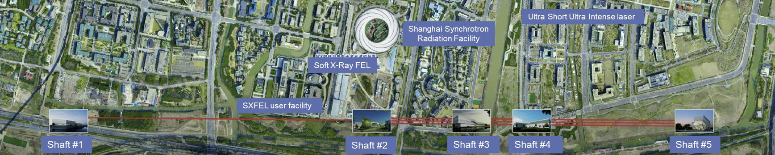
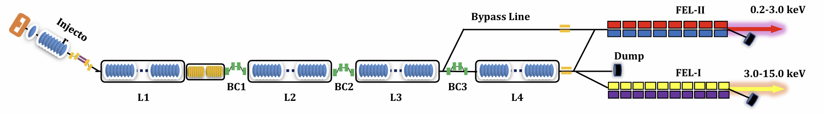
Introduction of the project: SHINE
Jinfang Chen, SARI
i1CM + i8CM
2 H-CMs
L1: 2 CMs
L2:18 CMs
L3:10 CMs
L4:24 CMs
SHINE Accelerator:
• 8.0 GeV, with a 4.5 GeV bypass line
• 54 standard 1.3GHz high-Q CMs ( specs improved to: Q₀= 3.0E+10 @20 MV/m）
• 2 3.9 GHz 8-cavity CMs

Slide 2
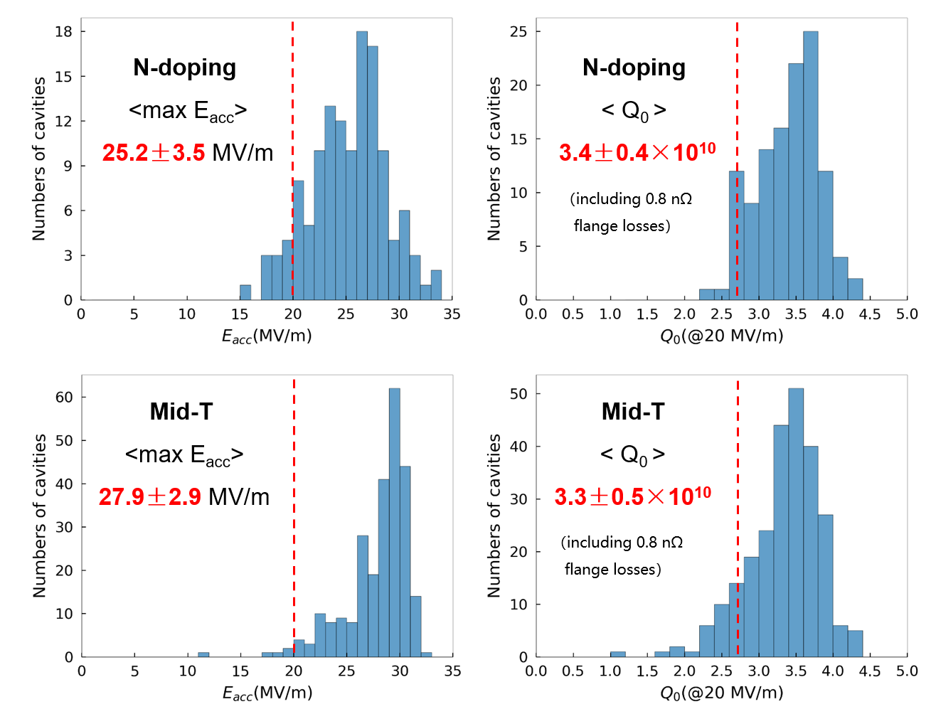


Q1. Achieved Yield vs. Design Specs:
What were the final yield rates for your project’s cavities, high-power couplers, and cryomodule components, and how did the achieved performance compare to the original design specifications?
Due to higher performance achieved, SHINE cavity/CM specs are improved:
2.7E+10 @16 MV/m →
3.0E+10 @20 MV/m, max Eacc > 22 MV/m
1.3 GHz cavities (388 cav, improved specs): ~79% qualified, and ~15% concessionally accepted
High-power couplers: yield rate > 87%
3/60 N-doping cavities
138
Mid-T baking cavities
250
Q2. Performance Transfer & Margins:
What was the observed performance degradation from the Vertical Test (VT) to the final cryomodule (CM) operation, and what rationale was used to define the design margins necessary to account for this "VT-to-CM" transfer?
36 high-Q CMs tested so far（admin limit at 26 MV/m）:
  Average Usable Gradient: 24.1 MV/m
  Average Usable Voltage: 199.9 MV
  Average Q₀ at 20 MV/m: 3.3 E+10
Performance change VT-to-CM:
ΔEacc= $−$1.85±4.00MV/m
ΔQ₀= $−0.45±0.37×{10}^{10}$

Slide 3
Q3. Industrialization & Repeatability:
Which specific cryomodule assembly tools, cleanroom assembly tools, or standardized procedures were most critical for ensuring repeatability and maintaining high throughput during the production phase?
Leak tight issues: sealing surface status, quality of gaskets and screws, torques
SPSV: safety interlock, power outage
HPR: UPW quality, device stability
Q4. Supply Chain & Material Quality:
How did material selection and vendor-specific quality assurance impact your production timeline, and did you encounter significant performance variations tied to different niobium batches or suppliers?
We ordered Nb from two suppliers: NX, TD
ECS applied on almost all materials
Some delay ~6 months for early cavity production
Aiming to match timeline, we ordered all the materials in advance (including the spare, and much earlier than cavities)

Slide 4
Q5. Logistics & Transportation:
What were the primary technical difficulties encountered during the transportation of finished cryomodule components, and what specific monitoring criteria (e.g., vacuum, shocks, alignment) were used to validate the hardware's integrity upon arrival?
Cavity, FPC, BPM, bellows transportation
Deformed, vacuum degradation, damaged
Accelerometer, SPSV for vacuum check upon arrival
Q6. Spare Parts Strategy:
What was the ratio of spare parts (cavities, couplers, etc.) required versus the total installed count, and was this "buffer" sufficient to cover the actual non-conforming parts during production?
1.3 GHz cavities: ~ 20% (ordered 530 vs 440 installed）, sufficient with cavity repair in parallel (> 90% accepted for CM)
3.9 GHz cavities: ~ 20% (ordered 19 vs 16 installed), sufficient (19 cav 100% qualified)
Other components: typically, < 5%, such as FPCs ~ 2 % (ordered +8 FPCs) , Cryostat: ~ 2% (ordered + 1), sufficient so far

