Slide 1


Shenzhen Superconducting Soft-X-ray Free Electron Laser (S³FEL)
Han Li
IASF
2026,June,TTC

Slide 2
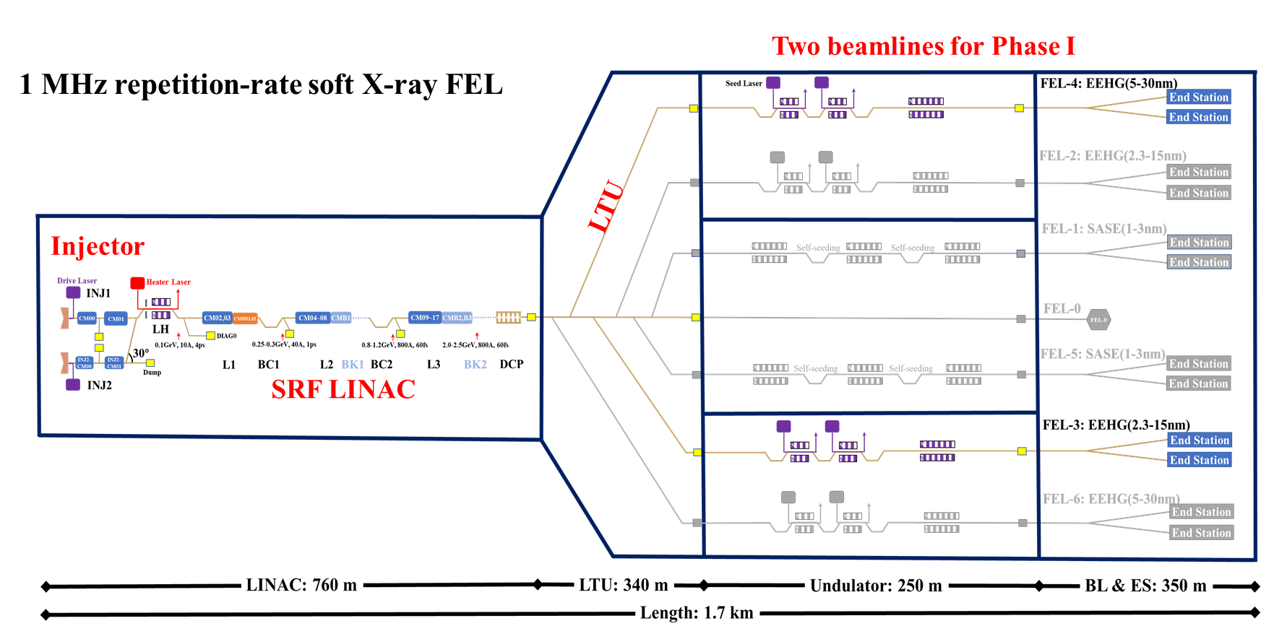

Shenzhen Superconducting Soft-X-ray Free Electron Laser (S³FEL)
Han Li
S³FEL is a new-generation large-scale scientific facility for coherent X-ray light sources. With a total construction length of 1.7 kilometers, the facility mainly consists of a superconducting linear accelerator (featuring an electron beam energy of 2.5 GeV and a repetition rate of 1 MHz), two undulator beamlines and nine initial experimental stations.
Official approved on 2025.11
Civil construction start on 2026.09
S3FEL main facility construction finish on 2029.09
LINAC full-chain commissioning 2031.10-2032.03
First beam light on 2032.09
parameter | design | range
beam energy/ GeV | 2.5 | 1-2.5
charge/ pC | 100 | 10-300
emittance/ mm-mrad | 0.5 | 0.2-1.0
rep. rate/ MHz | 1 | 0-1
FEL wavelength/ nm | 1-30 | 1-180

Slide 3

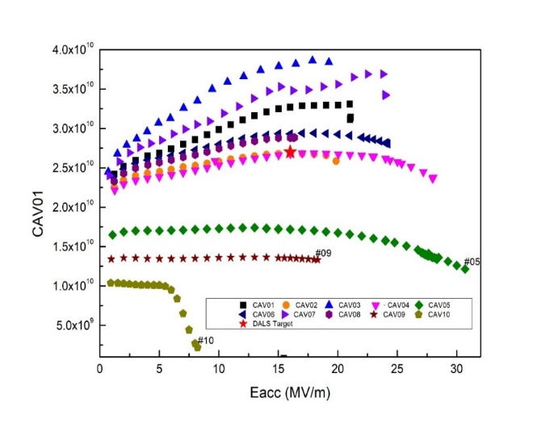
Q1. Achieved Yield vs. Design Specs
What were the final yield rates for your project’s cavities, high-power couplers, and cryomodule components, and how did the achieved performance compare to the original design specifications?
54 superconducting cavities have been put into production, among which 28 have passed all tests
95 superconducting cavities have been put into production, among which 25 have passed all tests and used in CM
Final yield rates for S3FEL
Cavities | first-pass rate at VT | 85%
 | final yield rates for S3FEL | 95%
High-power coupler | first-pass rate at VT | 90%
 | final yield rates for S3FEL | 100%
Tuner | 100%
Cryomodule components | 100%
Almost all component’s achieved performance match the original design specifications!!

Slide 4
Q2. Performance Transfer & Margins
What was the observed performance degradation from the Vertical Test (VT) to the final cryomodule (CM) operation, and what rationale was used to define the design margins necessary to account for this "VT-to-CM" transfer?
Average ration of Eacc_HT_usable over Eacc_VT is around 0.8
20% is used to define the design margins necessary to account for this "VT-to-CM" transfer
Typical parameters for prototype for DALS
Typical parameters for prototype for S3FEL
MV/m | Eacc_VT | Eacc_HT_max | Eacc_HT_usable | Ration of Eacc_HT_usable/Eacc_VT
Cav1 | 24.1 | 24.3 | 19.39 | 0.80
Cav2 | 29 | 22.7 | 17.97 | 0.61
Cav3 | 25.7 | 23.5 | 19.98 | 0.78
Cav4 | 28 | 25.2 | 19.29 | 0.69
Cav5 | 27.2 | 28.3 | 24.26 | 0.89
Cav6 | 26.5 | 23.1 | 20.43 | 0.77
Cav7 | 23.4 | 25.4 | 23.38 | 1
Cav8 | 29.1 | 27.3 | 22.95 | 0.79
Average ration of Eacc_HT_usable/Eacc_VT =0.79
MV/m | Eacc_VT | Eacc_HT_max | Eacc_HT_usable | Ration of Eacc_HT_usable/Eacc_VT
Cav1 | 22.15 | 20.6 | 20.1 | 0.91
Cav2 | 18 | 19.1 | 19 | 1.05
Cav3 | 25.39 | 24.1 | 16 | 0.63
Cav4 | 24.06 | 20 | 19.5 | 0.81
Cav5 | 25.78 | 22.9 | 22.5 | 0.87
Cav6 | 22.8 | 21.1 | 20.5 | 0.9
Cav7 | 19.26 | 18.9 | 18.3 | 0.95
Cav8 | 21.12 | 20.3 | 19.8 | 0.94
Average ration of Eacc_HT_usable/Eacc_VT =0.88
For operating gradient value of 20 MV/m, Eacc_max ≥ 24 MV/m is desirable
5% of spare parts (cavities, couplers, etc.)
3) Backup CM is deployed to guarantee the overall acceleration performance

Slide 5
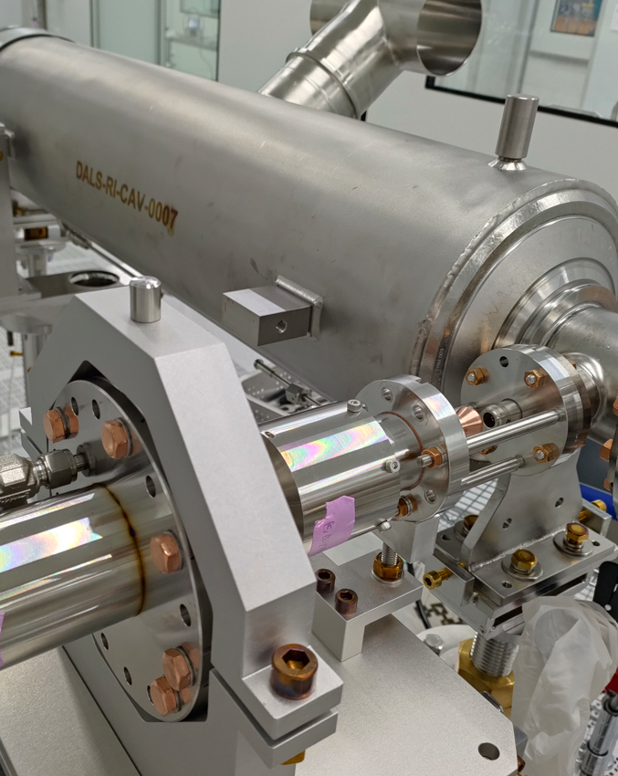
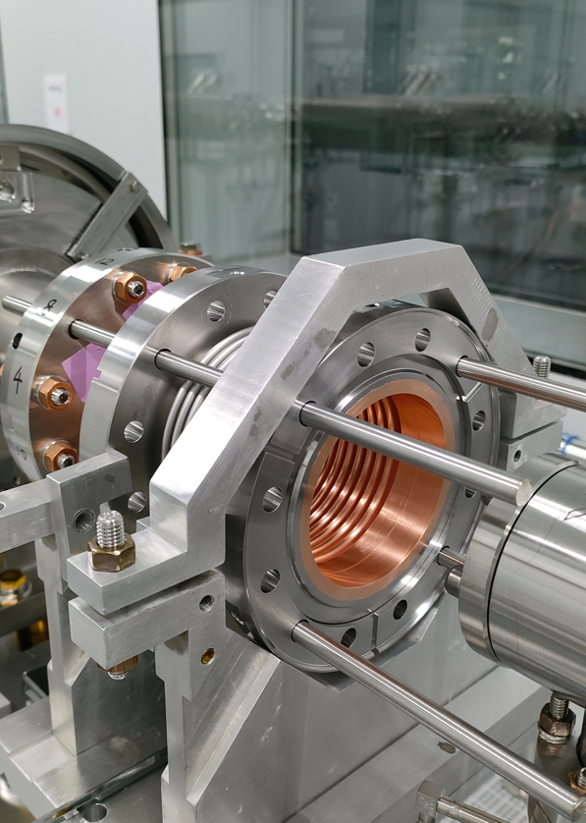
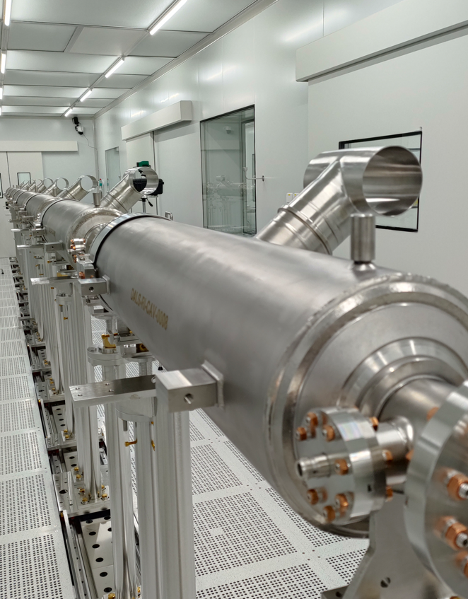
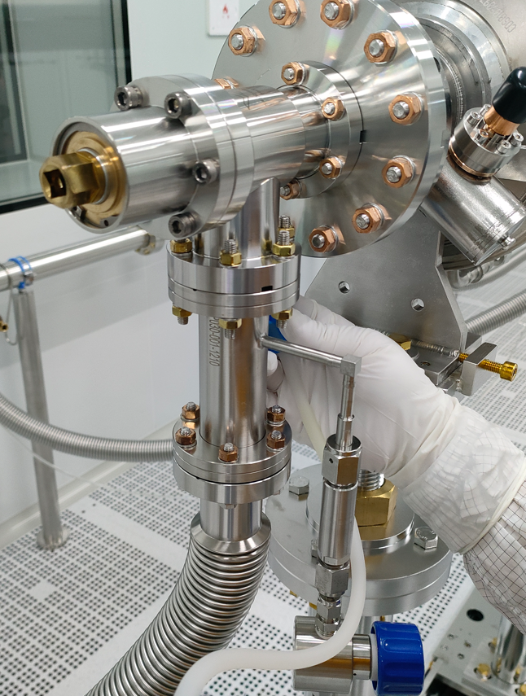
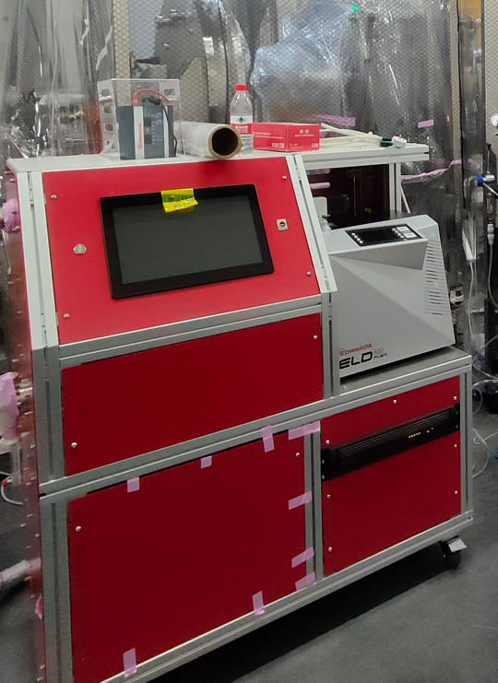
Q3. Industrialization & Repeatability
Which specific cryomodule assembly tools, cleanroom assembly tools, or standardized procedures were most critical for ensuring repeatability and maintaining high throughput during the production phase?
Practical tooling & equipment:
coupler assembly tooling, inter-cavity bellows assembly tooling, cavity string tooling, superconducting cavity flange N₂ purging system, slow pumping & filling unit, etc.
Clean Assembly Procedures:
Clean operation specifications for assembly personnel
Component cleaning protocols (dual-level: inside and outside the clean room)
Standard assembly procedures for cavity string components
The tool realizes precise mating of coupler cold end and superconducting cavity. It aligns flanges accurately, shortens exposure duration, prevents manual contamination and boosts assembly efficiency.
For connection of inter-cavity bellows and superconducting cavities. The tool delivers accurate alignment and installation assistance, limits personnel proximity to flanges and guarantees stable vacuum.
Adjusts the superconducting cavity position in all directions to set the assembly reference for cavity strings. It ensures high alignment accuracy of beam pipe flanges and facilitates subsequent bellows installation.
Provides positive pressure protection during mounting and dismounting of superconducting cavity flanges.
Used for evacuation, gas backfilling and leak testing of superconducting cavity strings. Its reliable control system enables slow pumping and slow gas filling, reduces particle migration in vacuum pipelines and mitigates field emission risks.

Slide 6
Q4. Supply Chain & Material Quality
How did material selection and vendor-specific quality assurance impact your production timeline, and did you encounter significant performance variations tied to different niobium batches or suppliers?
For Bulk niobium:
Two venders are involved (mainly OTIC and partialy Tokyo Denkai). NIN is in the process to qualify.
No discrepancy in performance has been observed for niobium materials across different batches and suppliers.
For cavity：
Mainly three venders are involved.
Quality control systems vary among suppliers, resulting in differences in first-pass rate (vertical test ).
For FPC：
Mainly two venders are involved.
Quality control systems vary among suppliers, resulting in different QL tuning range.

Slide 7
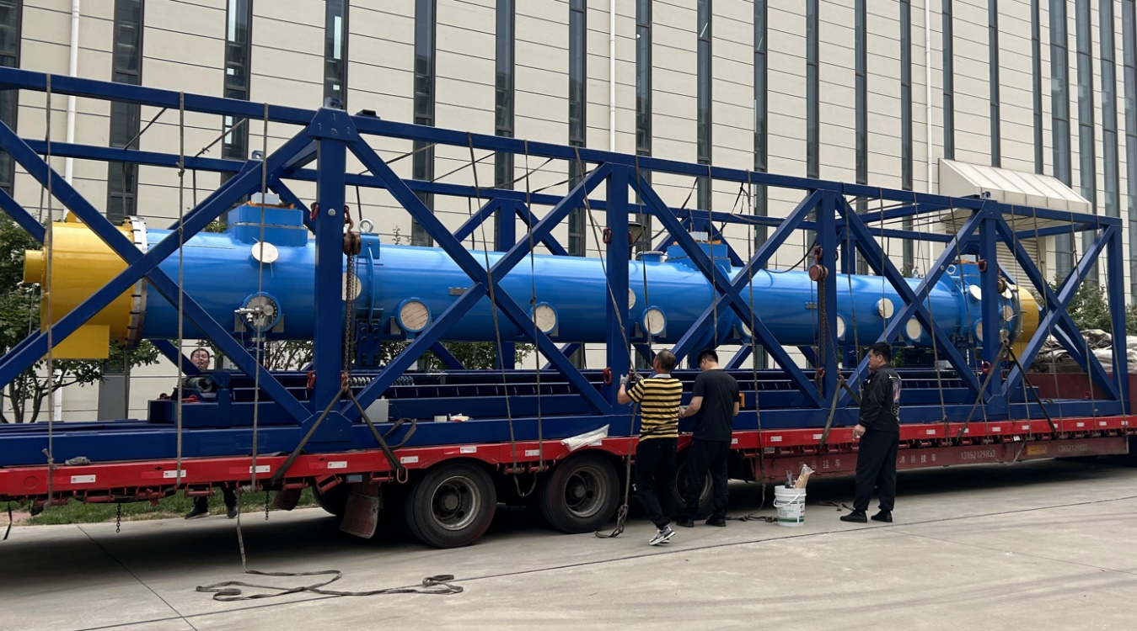
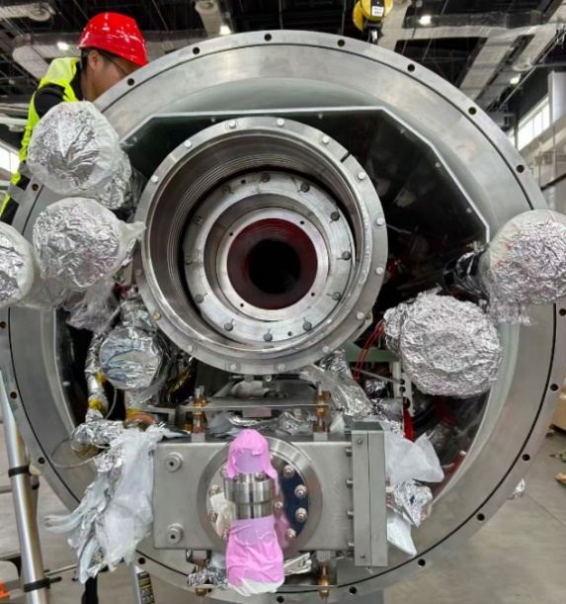
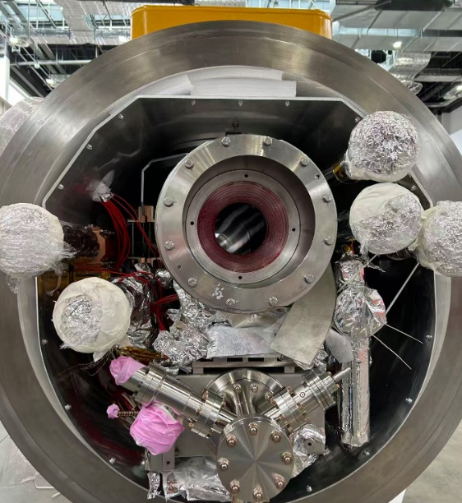
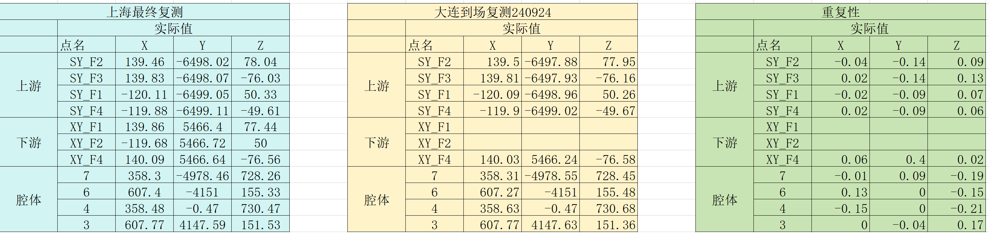
Q5. Logistics & Transportation:
What were the primary technical difficulties encountered during the transportation of finished cryomodule components, and what specific monitoring criteria (e.g., vacuum, shocks, alignment) were used to validate the hardware's integrity upon arrival?
Highway load tests and urban road trials were performed on the transportation system.
The acquired vibration data were analyzed to evaluate the vibration isolation performance of different isolator arrangements.
The optimal layout was determined for long-distance module transportation.
After module delivery, compare pre- and post-transport values of beam vacuum and coupler vacuum, which shall exceed 10⁻³ Pa. High-purity nitrogen is charged into the thermal insulation vacuum during transportation.
Evacuate and leak-test the thermal insulation vacuum on arrival; the total leak rate shall be better than 1.0×10⁻⁹ Pa·m³/s.
Recheck module alignment within ±0.2 mm

Slide 8
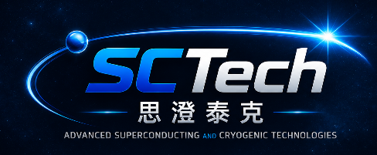
Contact: lihan@mail.iasf.ac.cn
Engineering Clarity at Extreme Conditions
Bridging Superconducting RF, Cryogenics and Intelligent Control
Superconducting RF
Cryogenic System
Intelligent Control
• SRF Cavities
• Couplers/Tuners
• HOM Components
• Cryomodules
• VTS & CMTS
• Helium Refrigeration
• Cryogenic Distribution
• 2 K & 4.5 K Systems
• System Integration
• Commissioning
• LLRF Control
• Cryogenic Control
• Machine Protection
• Data Acquisition
• Diagnostics
Applications: Advanced Light Sources • FEL • ERL • Fusion Cryogenics • Industrial Accelerators • Scientific Infrastructure
Superconducting RF + Cryogenic Engineering + Intelligent Control = Integrated Turn-Key Solutions
Design → Manufacturing → Integration → Commissioning → Operation Support

Slide 9

THANK YOU

