Slide 1
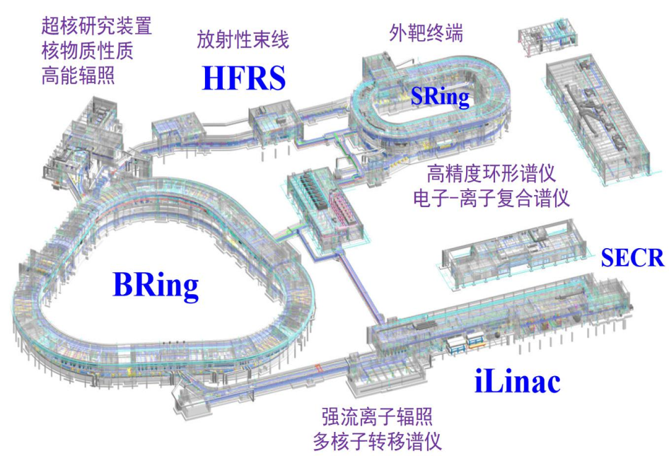
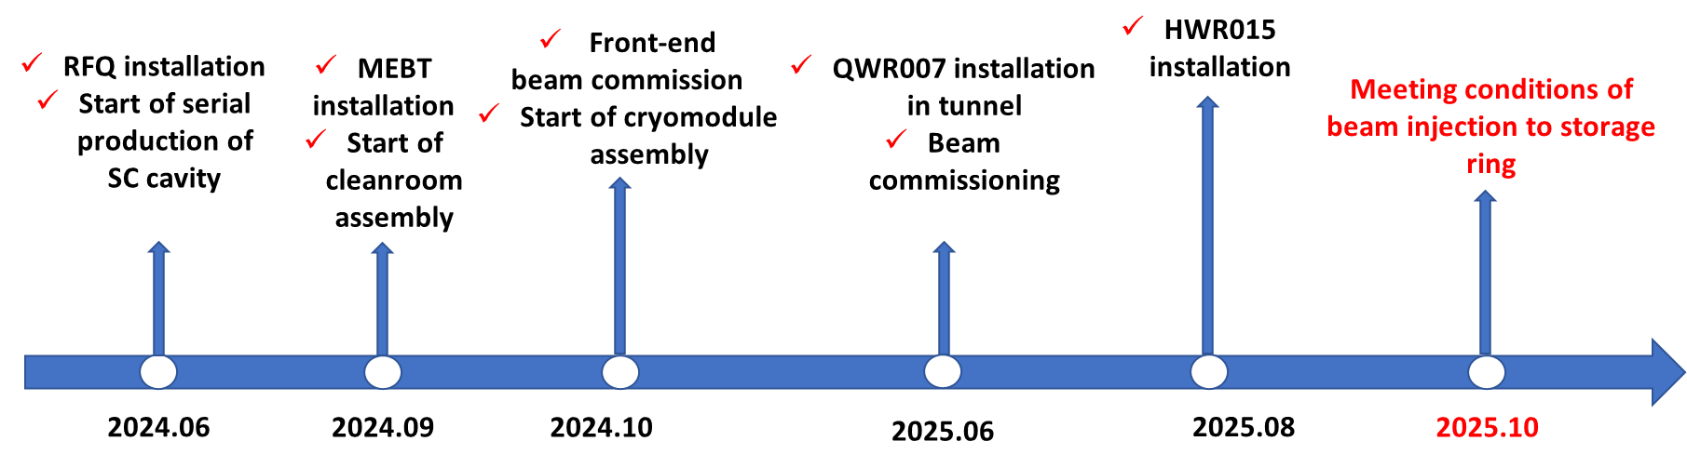
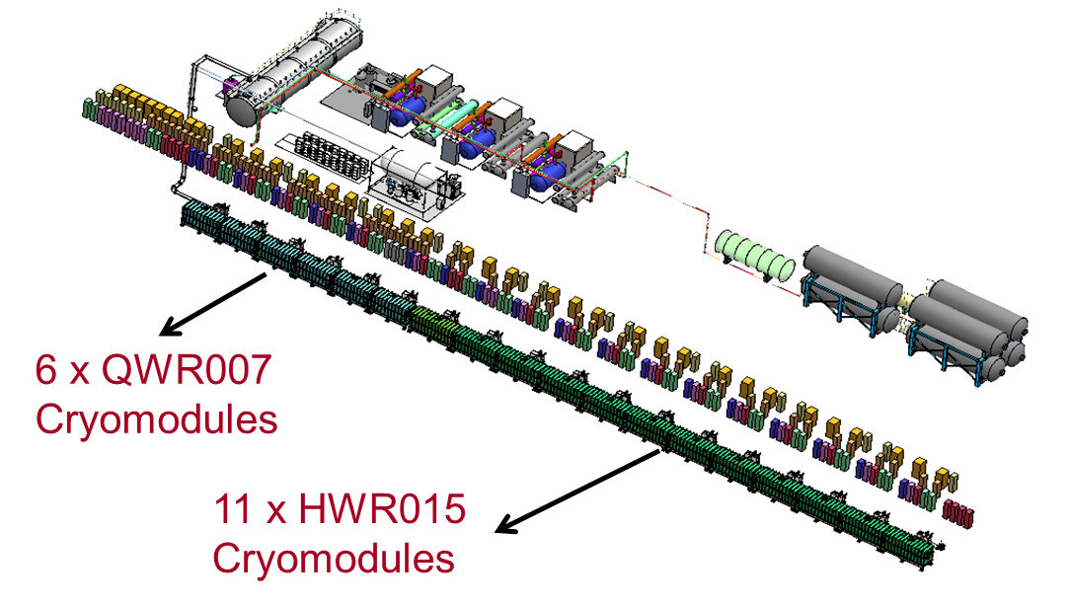
Introduction of the project: (HIAF)
Teng Tan
HIAF (High Intensity heavy-ion Accelerator Facility) is one of the mega-scientific projects
for nuclear science
Approved in Dec. 2015, beam commissioning date is December 2025
CW linac is used as the injector of synchrotron
Location: Huizhou, Guangdong Prov.

Slide 2
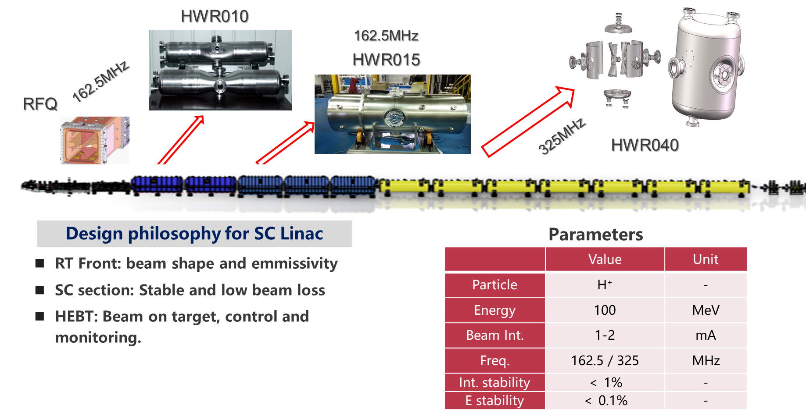
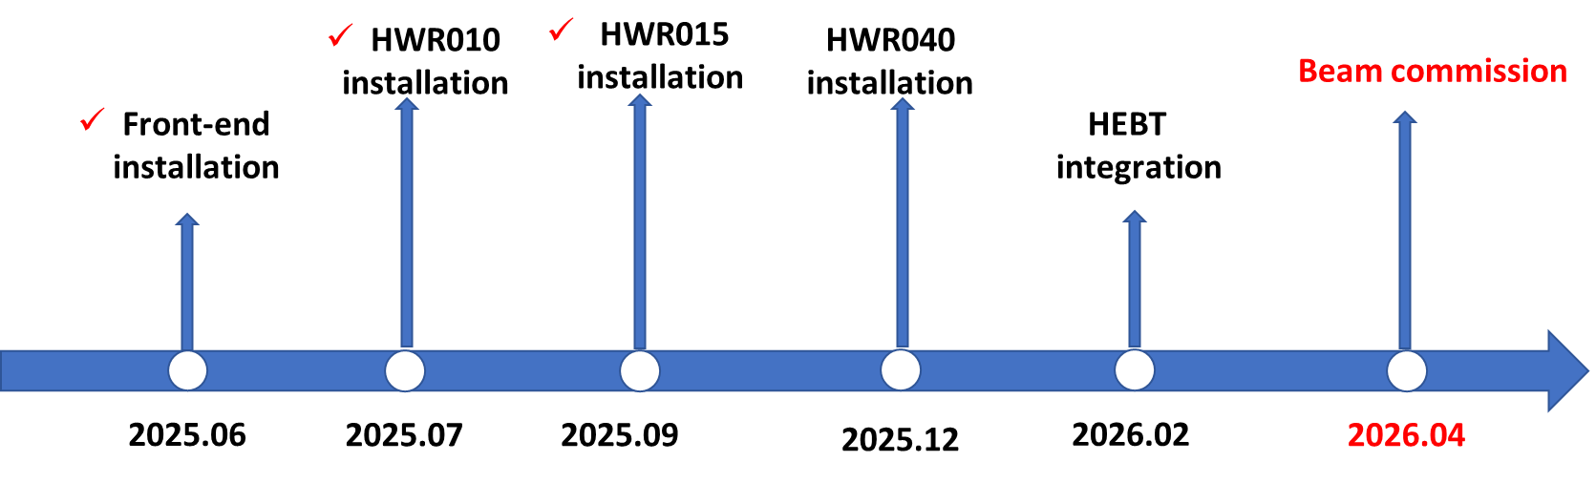
Introduction of the project: (IP-SAFE)
Teng Tan
World’s first proton machine for α-medicine production

Slide 3
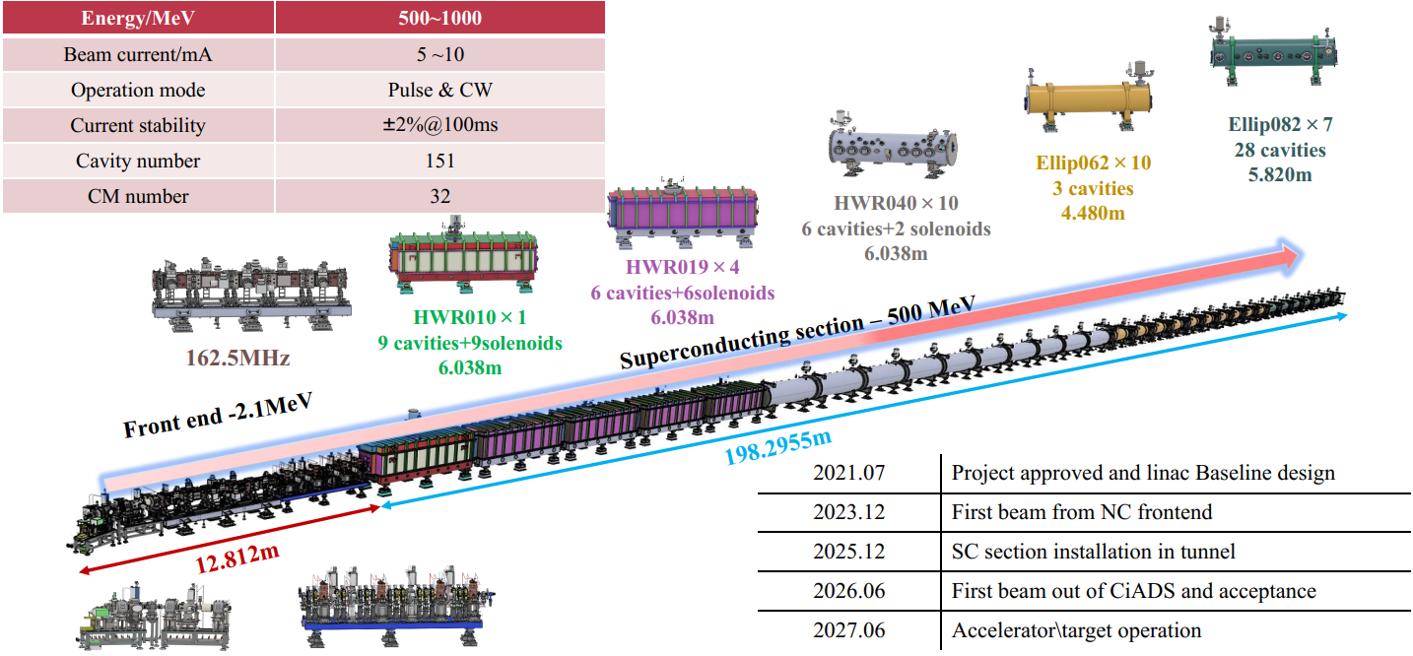
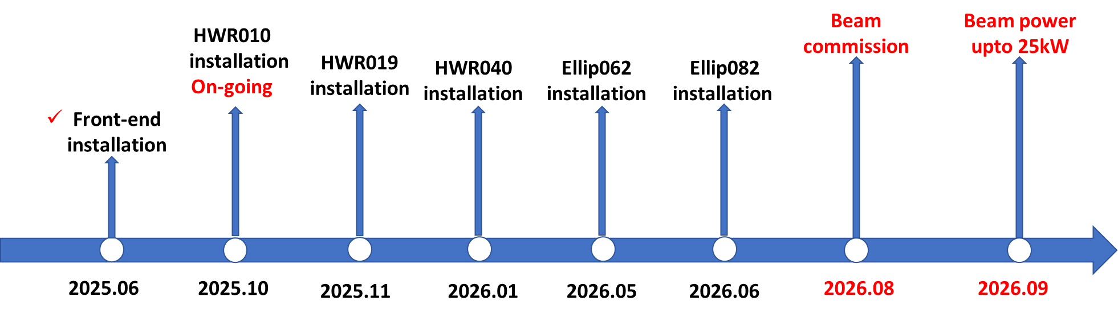
Introduction of the project: (CiADS)
Teng Tan
5 kinds, 32 cryomodules
SC section is about 200m long
Operated conditions，3130Pa@2K

Slide 4
Introduction of the project: (CiADS)
Teng Tan
HIAF
IP-SAFE
7 kinds of cavities, 282 cavities on-site
11 types of Cryomodule, 49 CM on-stie
CiADS

Slide 5
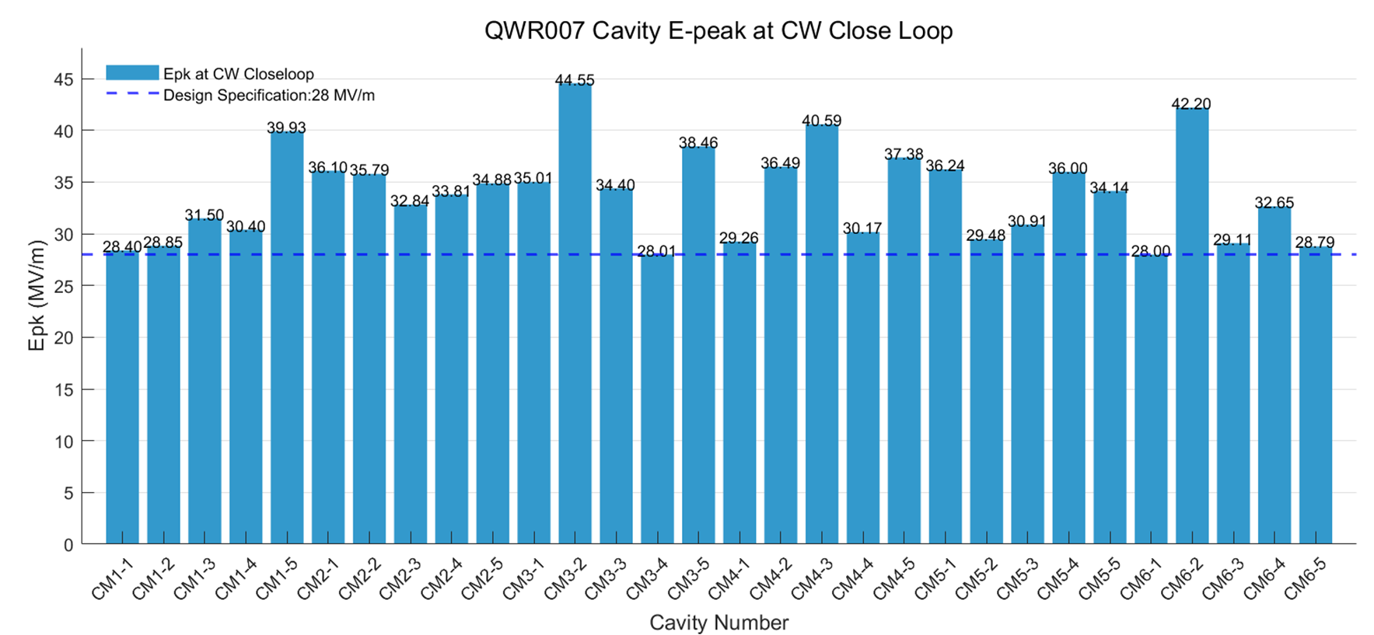
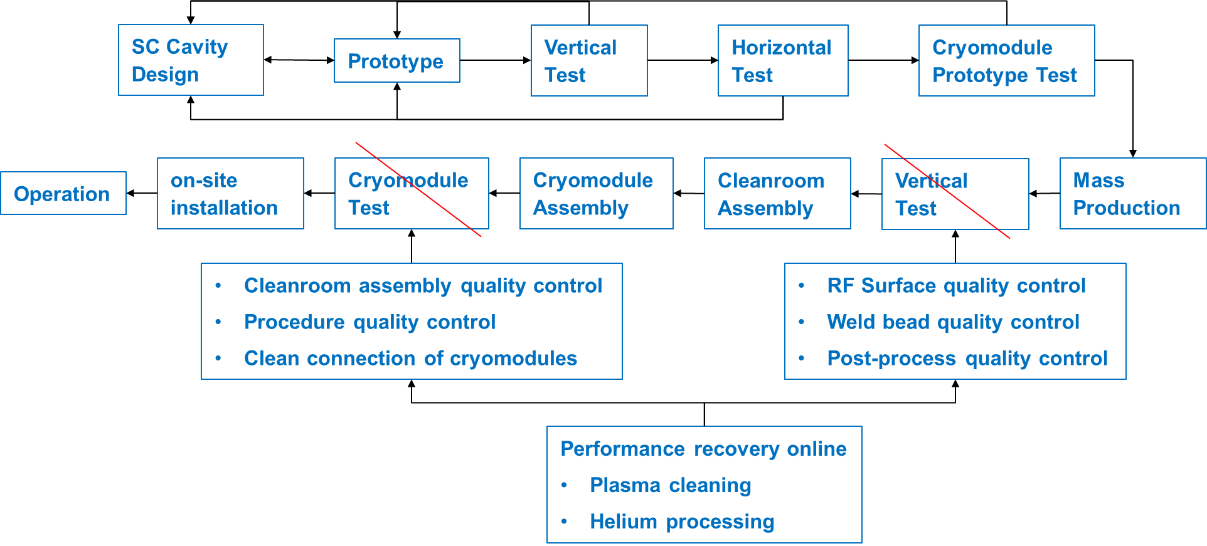
Q1. Achieved Yield vs. Design Specs:
What were the final yield rates for your project’s cavities, high-power couplers, and cryomodule components, and how did the achieved performance compare to the original design specifications?
Cavity:99%
Coupler:100%
Cryomodule:94%
In terms of acceleration gradient,
the actual performance fully meets the original design specifications.
Q2. Performance Transfer & Margins:
What was the observed performance degradation from the Vertical Test (VT) to the final cryomodule (CM) operation, and what rationale was used to define the design margins necessary to account for this "VT-to-CM" transfer?
No data

Slide 6
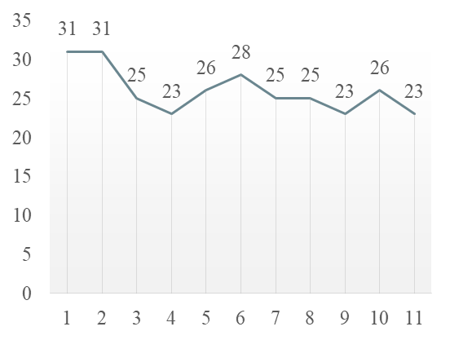
Q3. Industrialization & Repeatability:
Which specific cryomodule assembly tools, cleanroom assembly tools, or standardized procedures were most critical for ensuring repeatability and maintaining high throughput during the production phase?
Establish the alignment system, develop standardized operation process specifications for the entire process from machining to assembly, and improve component machining accuracy.
Cleanroom assembly
Assembly Time per Module: From 50 Days to 26 Days; Streamlined Parallel Assembly with 4 Lines
Q4. Supply Chain & Material Quality:
How did material selection and vendor-specific quality assurance impact your production timeline, and did you encounter significant performance variations tied to different niobium batches or suppliers?
Material selection and supplier QA caused minor delays to the schedule.
We noticed slight performance differences among niobium batches from different vendors.

Slide 7
Q5. Logistics & Transportation:
What were the primary technical difficulties encountered during the transportation of finished cryomodule components, and what specific monitoring criteria (e.g., vacuum, shocks, alignment) were used to validate the hardware's integrity upon arrival?
vacuum
Q6. Spare Parts Strategy:
What was the ratio of spare parts (cavities, couplers, etc.) required versus the total installed count, and was this "buffer" sufficient to cover the actual non-conforming parts during production?
Cavity: 1/96
Coupler: 16/96
The buffer was sufficient to cover non-conforming parts.

