Slide 1
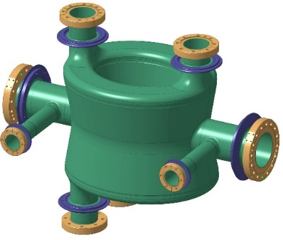
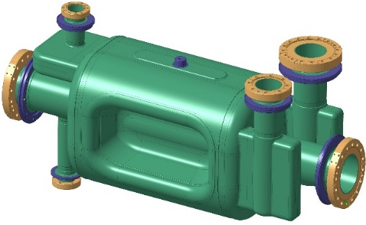
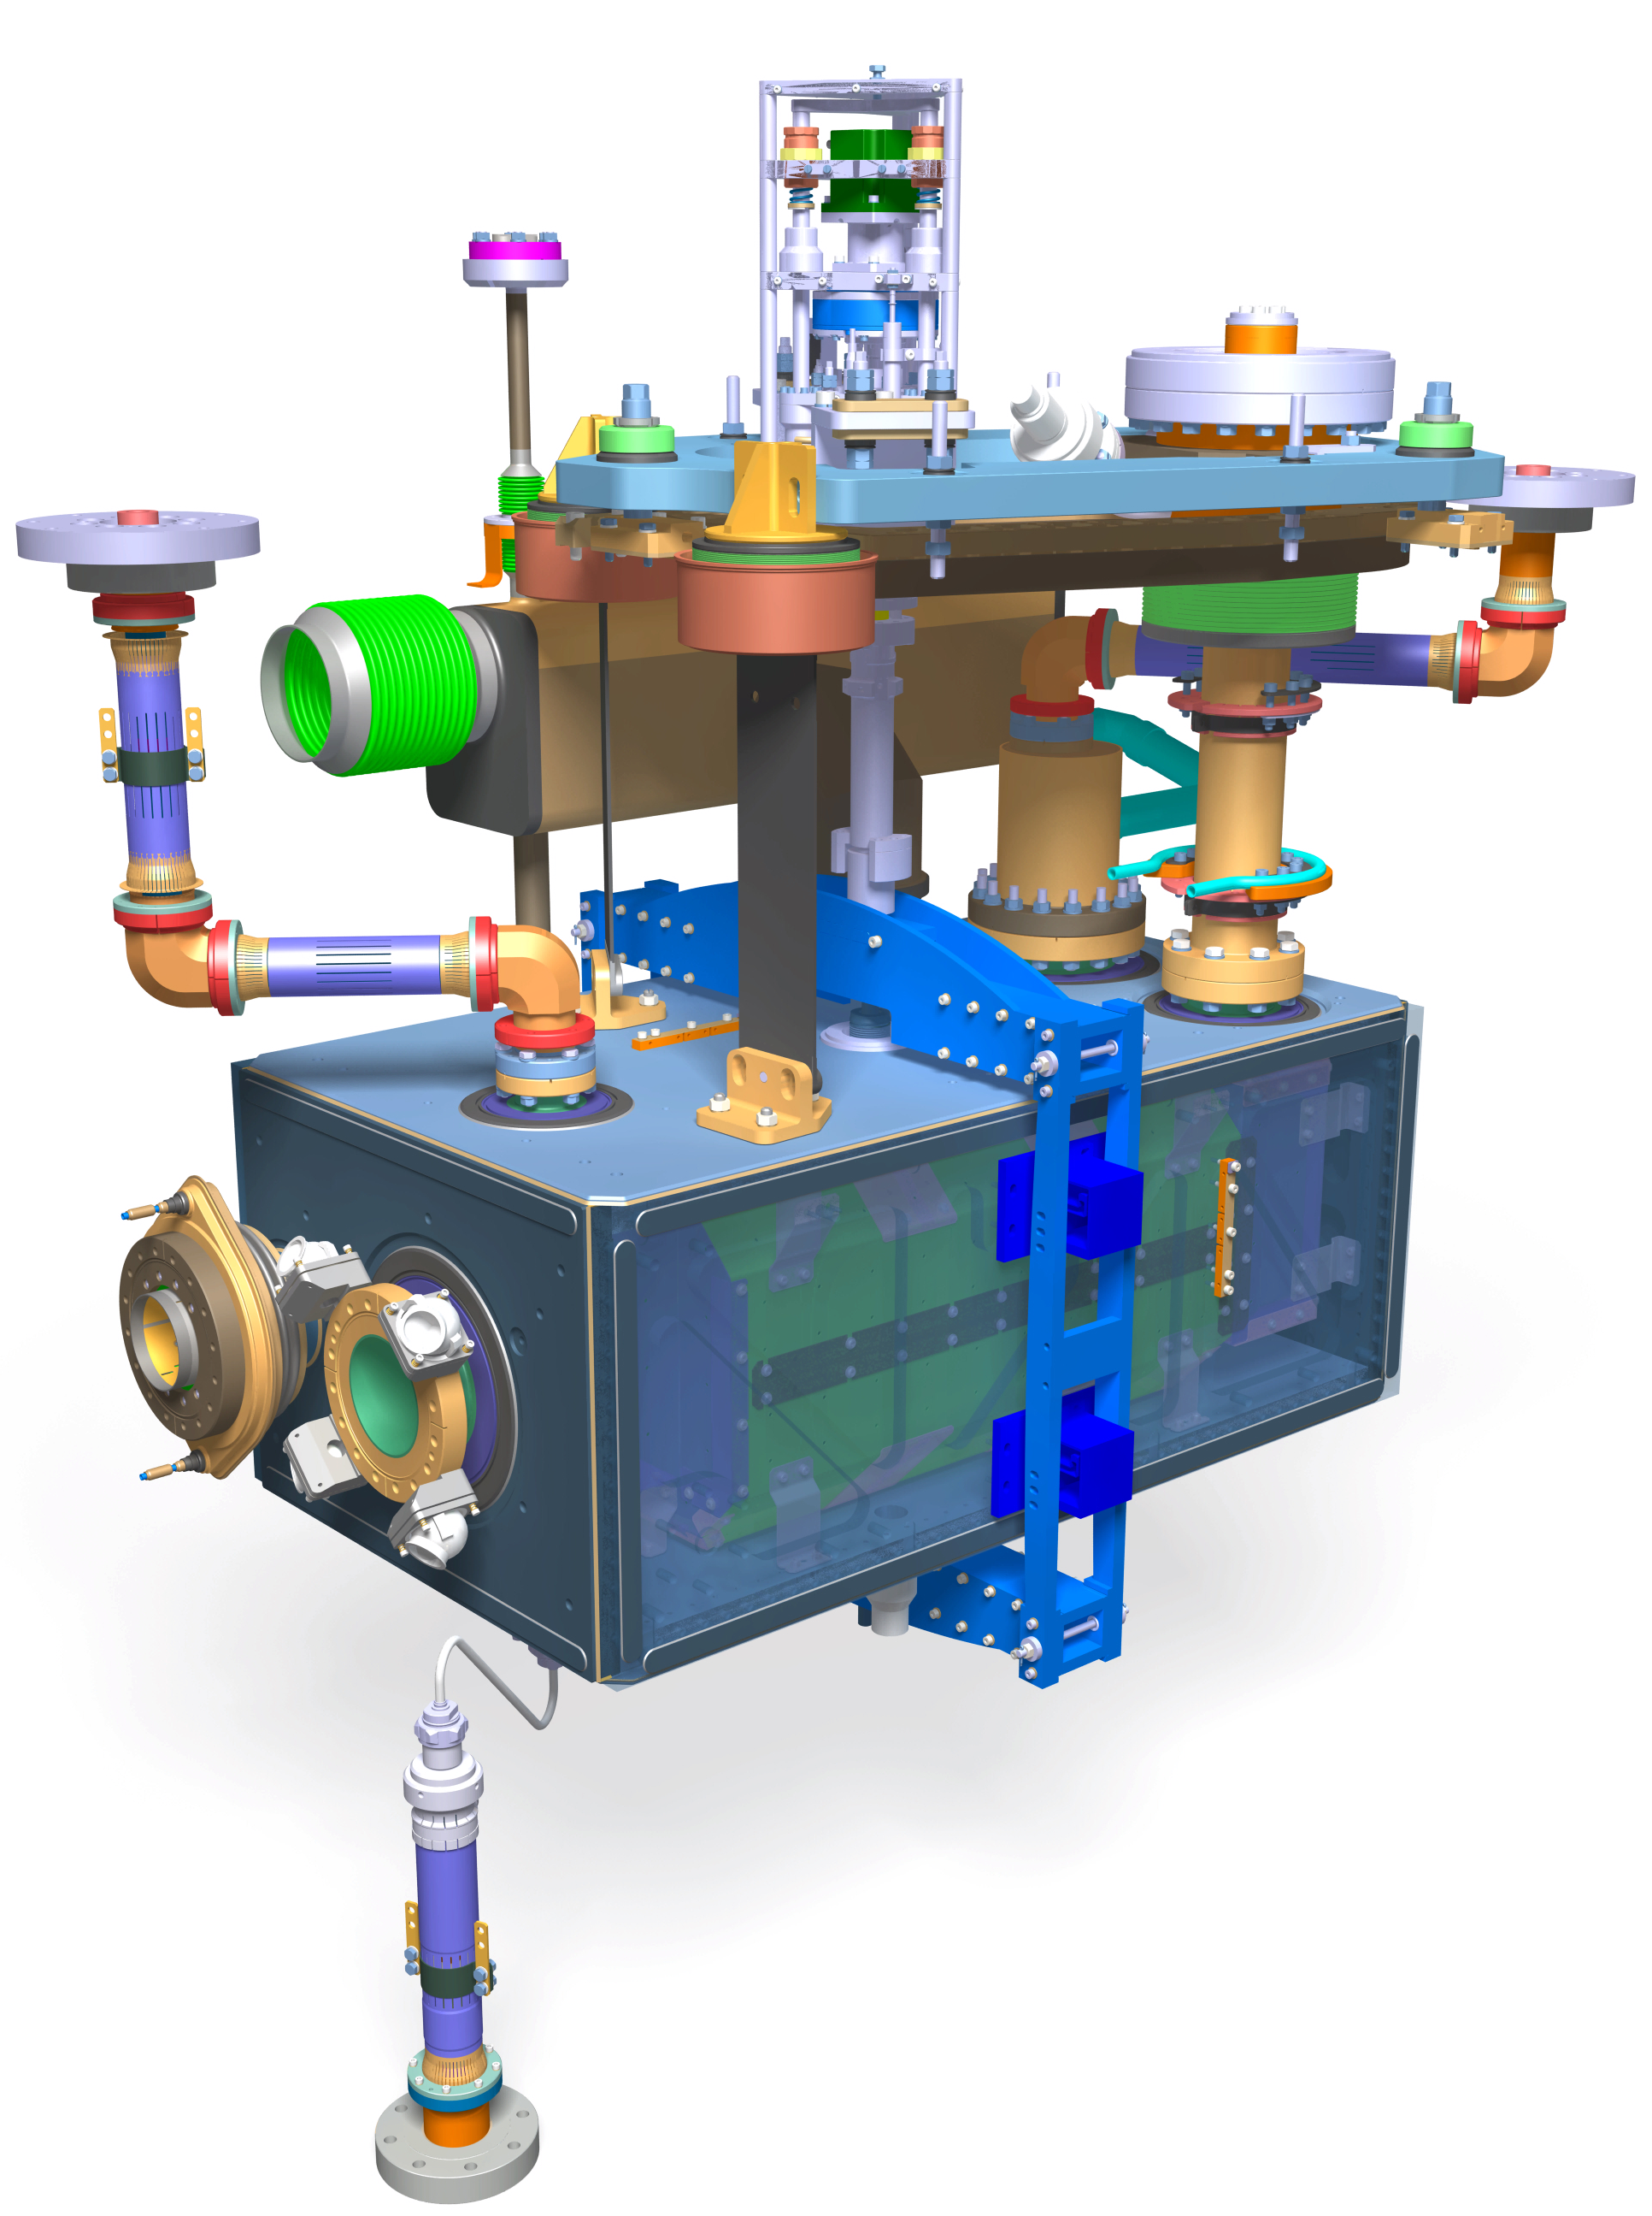
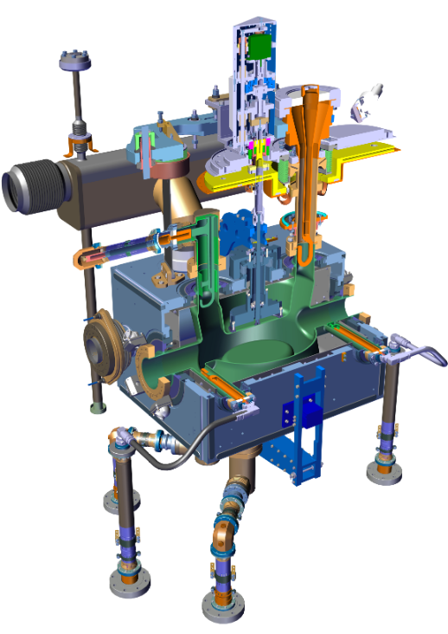
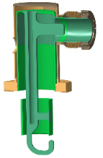
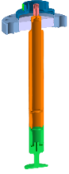
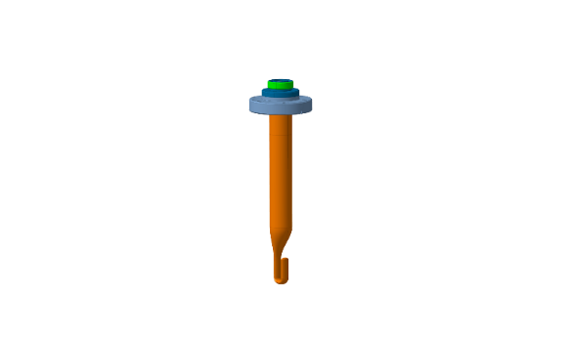
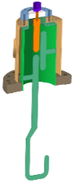
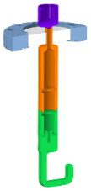
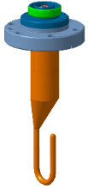
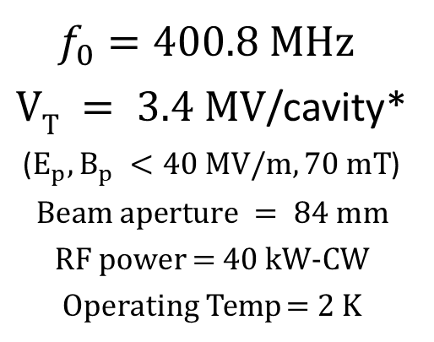
Introduction of the project: HL-LHC
K. Turaj on behalf of HL-LHC WP4
DQW (CMS)
RFD (ATLAS)
$f_{0}=400.8 MHz$
$VT = 3.4 MV$/cavity*
($E_{p}, B_{p} <40 MV/m, 70 mT$)
$$Beam aperture = 84 mm$$
RF power = 40 kW-CW
Operating Temp = 2 K
*Engineering spec: 4.1 MV dressed for 20% margin
Notes:
16 Superconducting compact RF deflectors (ATLAS, IP1 + CMS, IP5) to partially compensate the geometric angle of $\sim 500 μrad$.
The HL-LHC project aims to increase the design luminosity by 5-7 times compared to LHC nominal value.
This will be achieved in part by using two pairs of RF superconducting crab cavities, both up- and downstream of
the LHC Interaction Points (IPs): 1 (ATLAS) and 5 (CMS), to partially compensate for the geometric reduction in luminosity due to the beam crossing angle at the IPs.

Slide 2
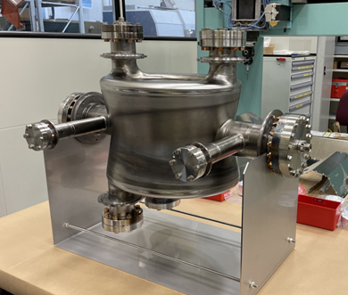
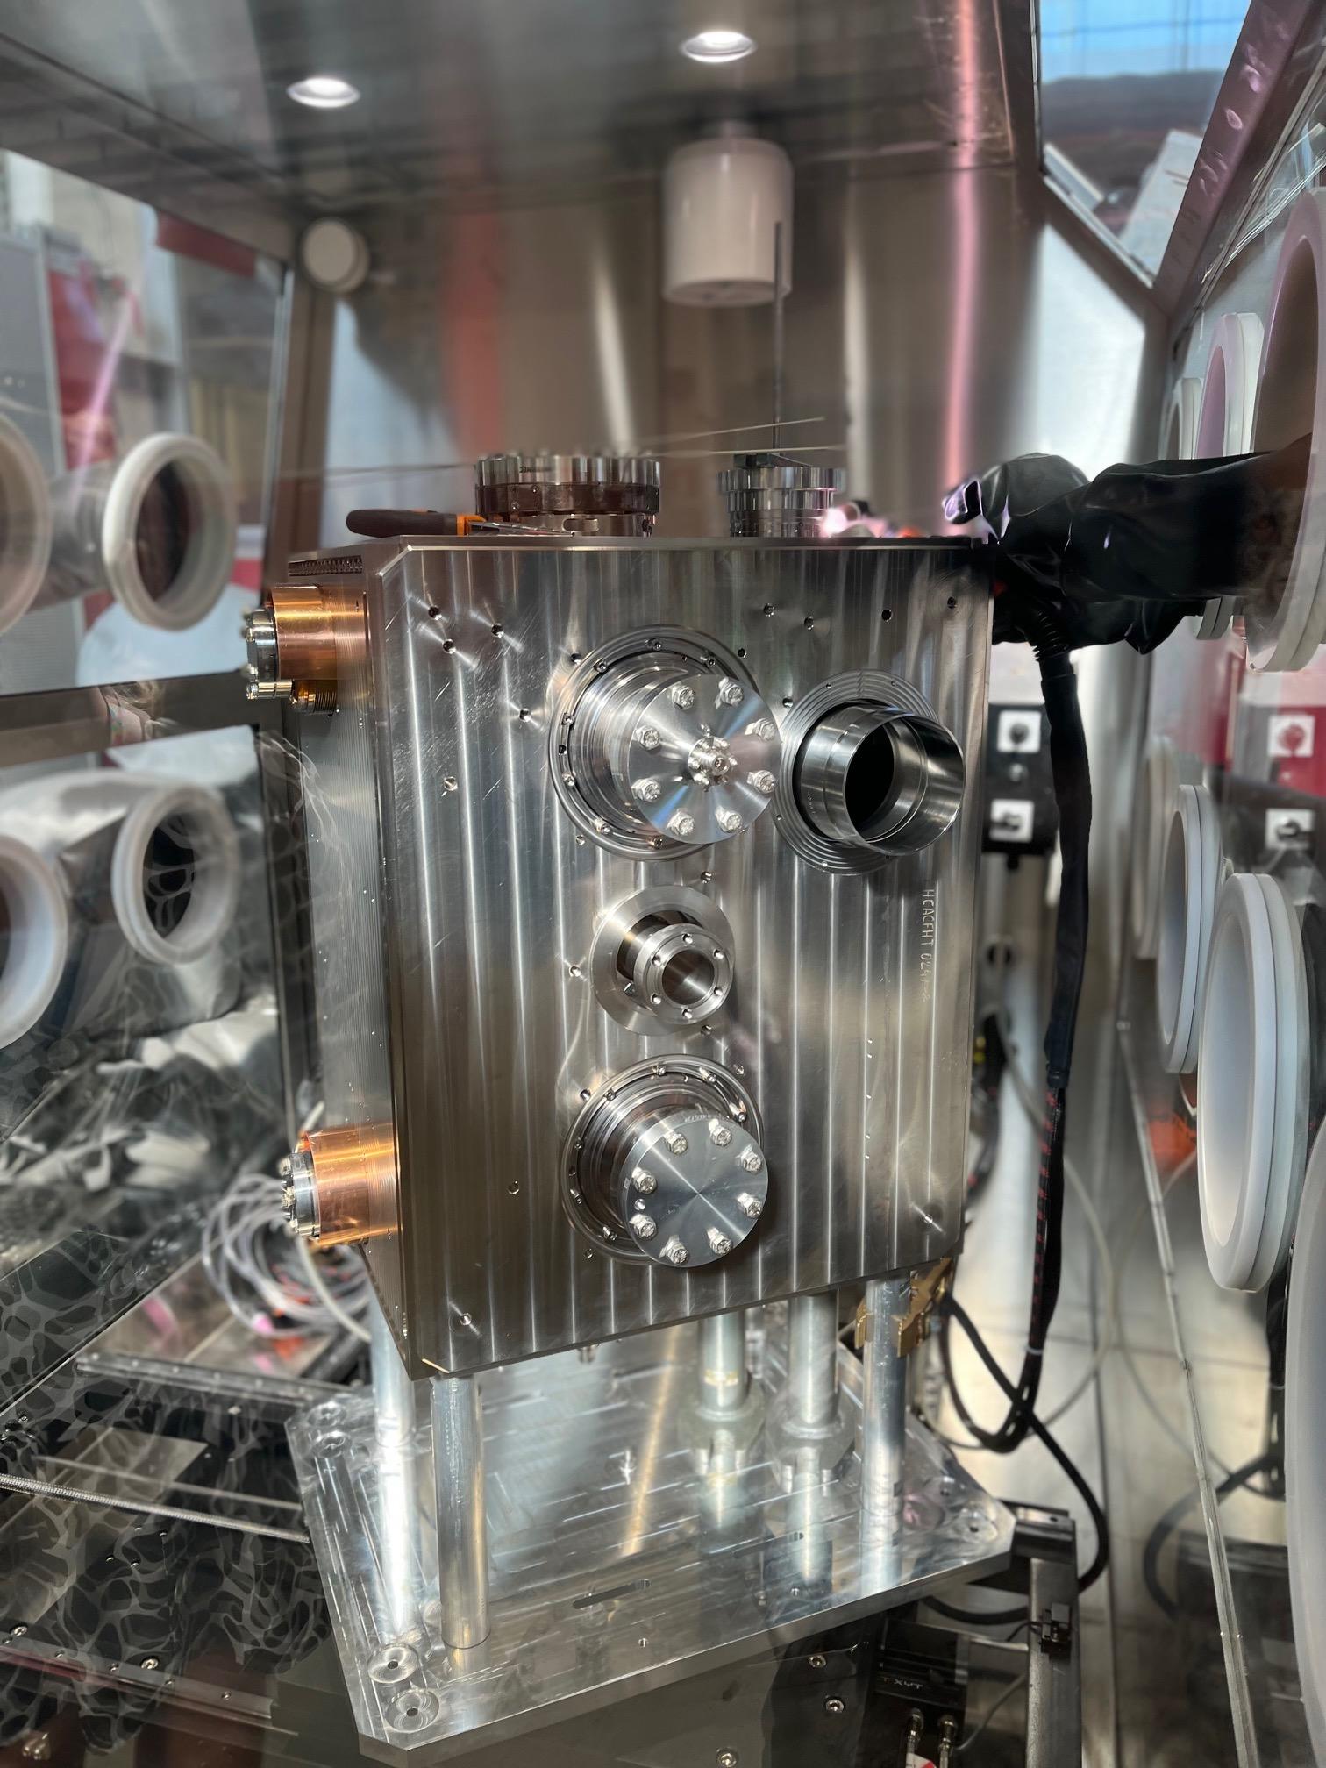
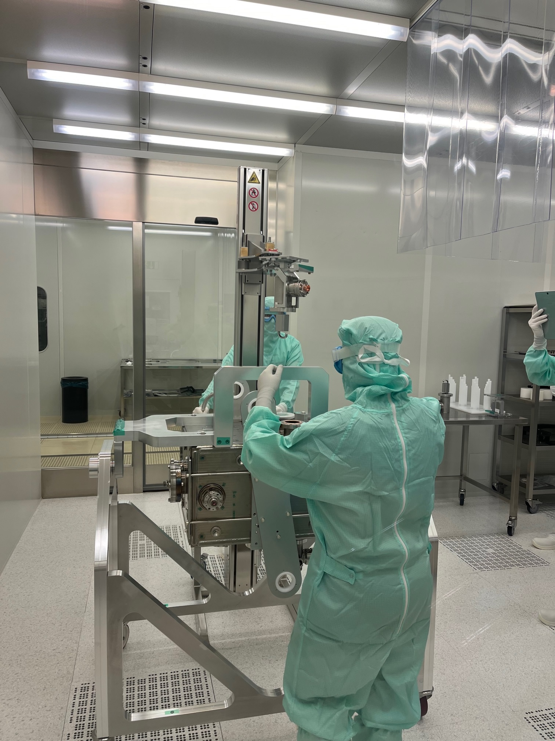
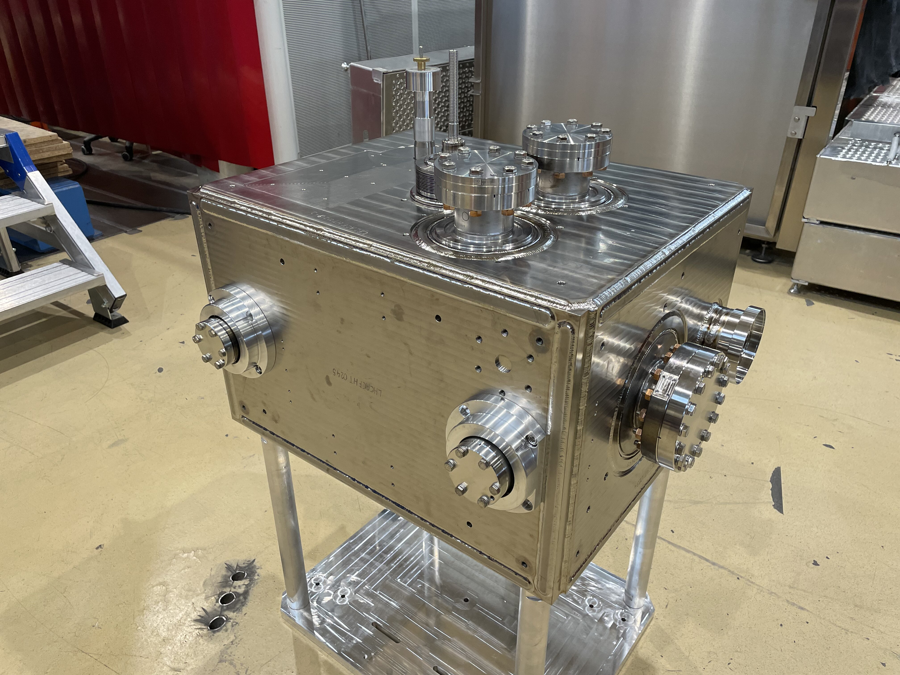
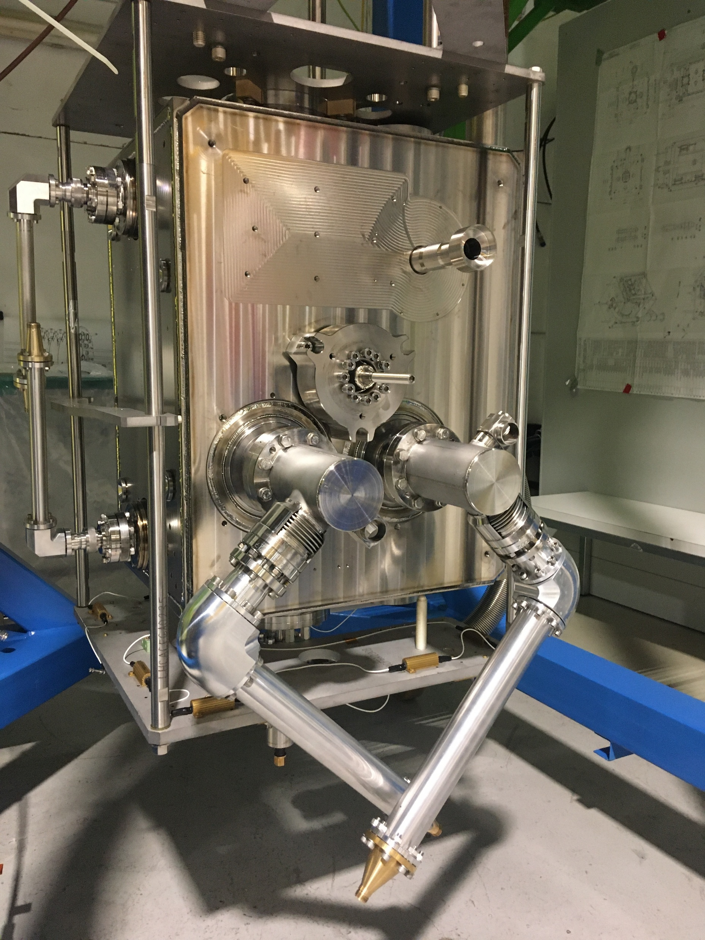
HL-LHC crab cavities
2 preseries and 10 series cavities of each type (12 cavities of each type)
Baseline: tested 3 times as bare, jacketed and dressed.
  Bare (BC)
  Jacketed (JC): Cold Magnetic Shield + Helium tank assembly (bolted) and TIG welding
  Dressed (DC): JC with RF couplers: HOMs (4 for DQW and 2 for RFD), 1 FA + VT input antenna & 25/50Ω adapters
DQW Bare
DQW Jacketed
DQW Dressed

Slide 3
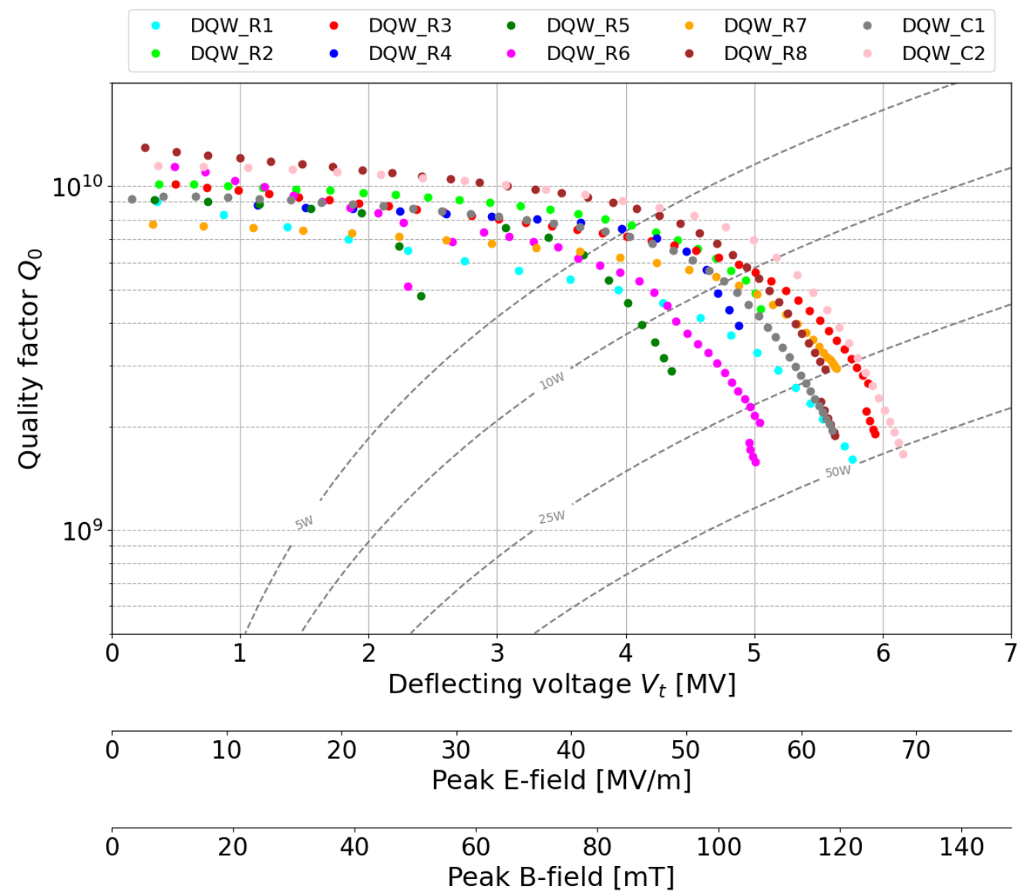
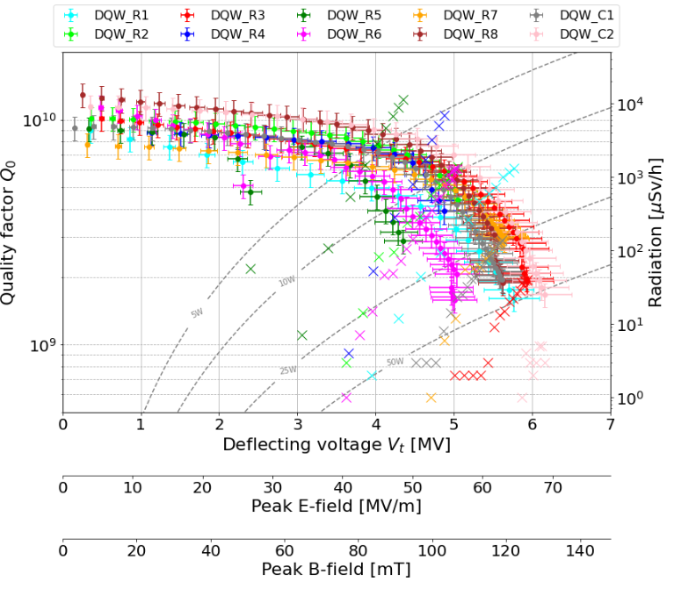
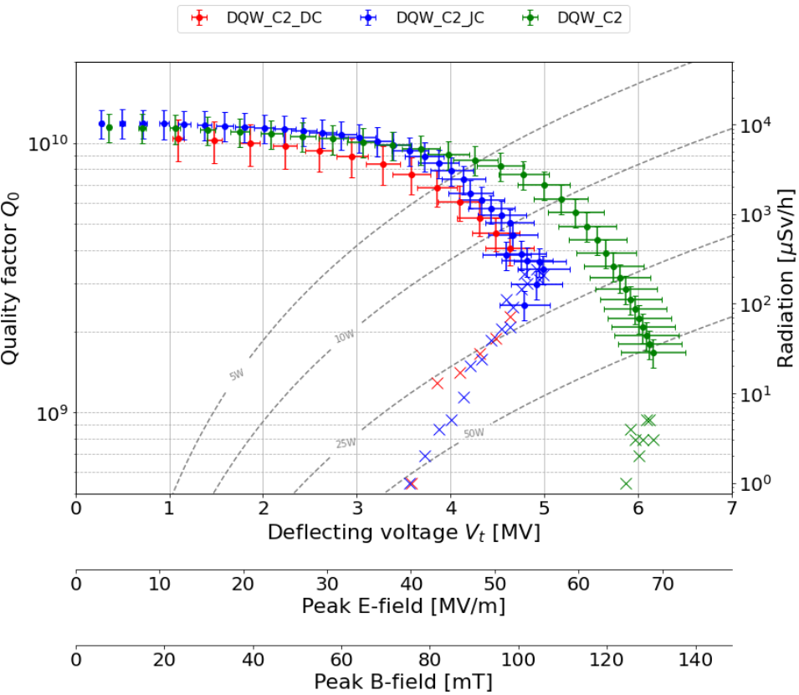
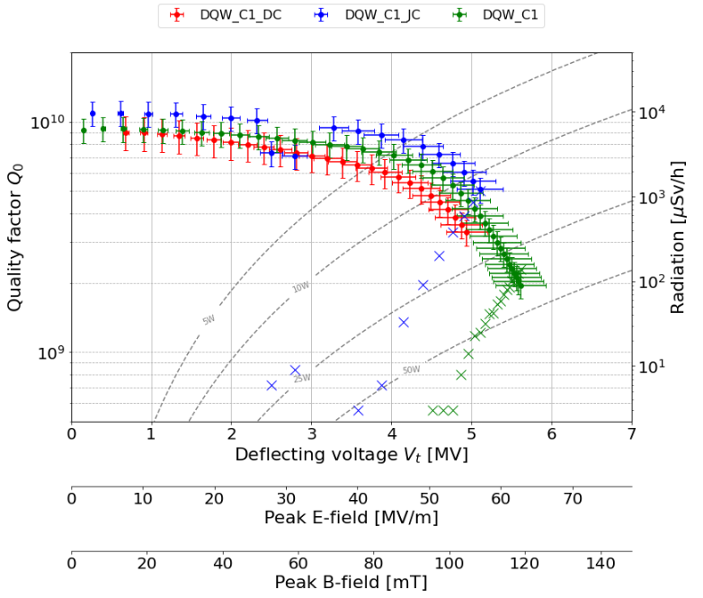
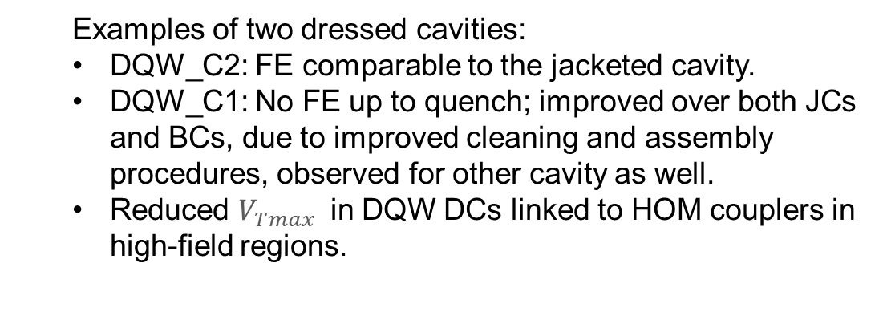
HL-LHC crab cavities
DQW BCs: all qualified
7 required additional light BCP
  Examples of two dressed cavities:
  DQW_C2: FE comparable to the jacketed cavity.
  DQW_C1: No FE up to quench; improved over both JCs and BCs, due to improved cleaning and assembly procedures, observed for other cavity as well.
  Reduced $V_{Tmax }$ in DQW DCs linked to HOM couplers in high-field regions.
*DQW5, additional flash BCP before jacketing
Notes:
Flash BCP (~10μm) before jacketing

Slide 4
Q1. Achieved Yield vs. Design Specs:
What were the final yield rates for your project’s cavities, high-power couplers, and cryomodule components, and how did the achieved performance compare to the original design specifications?
FE remains one of the main limiting factors for these cavities.
DQW cavity yield is 100%; RFD fabrication is underway.
All CERN bare cavities exceed specifications (10 DQWs and 3 RFDs).
Most cavities required reprocessing (additional HPR or light BCP + HPR), ~25% passed on the first test.
For cryomodules, no series production yet; high yield achieved for HOM and FPC couplers after an extended RF feedthrough campaign.
The first series cryomodule is scheduled for testing in Q3 2026.
Q2. Performance Transfer & Margins:
What was the observed performance degradation from the Vertical Test (VT) to the final cryomodule (CM) operation, and what rationale was used to define the design margins necessary to account for this "VT-to-CM" transfer?
Nominal operational deflecting voltage is 3.4MV
A 20% margin for dressed cavity tests was defined, corresponding to an acceptance voltage of 4.1 MV
DQW dressed cavities qualified up to now have reached deflecting voltages between 4.1MV and 5MV
In the SPS CM prototype, max voltage of 3.4MV in CW and 4MV in long pulse mode was achieved (cryo capacity limits)

Slide 5
Q3. Industrialization & Repeatability:
Which specific cryomodule assembly tools, cleanroom assembly tools, or standardized procedures were most critical for ensuring repeatability and maintaining high throughput during the production phase?
All the above: dedicated specialist teams, standardized cleanroom assembly procedures, and the availability of qualified assembly tooling with spare sets to avoid bottlenecks. Tight QA enabled CERN to increase its throughput from 5 to 20 cavity cold tests per year.
Development of rotational BCP especially for RFD was critical technology to increase cavity performance.
Q4. Supply Chain & Material Quality:
How did material selection and vendor-specific quality assurance impact your production timeline, and did you encounter significant performance variations tied to different niobium batches or suppliers?
For DQW prototypes: Tokio Denkai, for DQW series Ningxia was selected for Nb sheets, plates and rods
  All sheets underwent 100% UT, with a min 6 tensile test per batch & metallography examination, RRR per batch
  Some sheets did not meet required mechanical properties and were sent back to the vendor
    One batch contained alumina particulates, BCP at CERN needed
The material procured well in advance no impact on the production timeline.

Slide 6
Q5. Logistics & Transportation:
What were the primary technical difficulties encountered during the transportation of finished cryomodule components, and what specific monitoring criteria (e.g., vacuum, shocks, alignment) were used to validate the hardware's integrity upon arrival?
• Bare cavities: Transported in dedicated transport boxes equipped with shock loggers.
• Dressed cavities: Transported in suspension frames equipped with three accelerometers and one shock logger.
• FPCs: Transported in suspension frames equipped with a shock logger.
• CMs: Transported in specially designed suspension frames combined with rigidifying restraints on the cavity and cryoline supports with shock loggers, continuous vibration monitoring, and strain measurements on FPCs and support blades.
Q6. Spare Parts Strategy:
What was the ratio of spare parts (cavities, couplers, etc.) required versus the total installed count, and was this "buffer" sufficient to cover the actual non-conforming parts during production?
20% of spares

Slide 7
spares

Slide 8
HL-LHC DQW Cavity
 | Specification
Resonant frequency at 2K [MHz] | 400.79±0.15
(*) Max V_{t} [MV] | ≥4.1
Q₀ at 4.1 MV | ≥3.9×10⁹
Lorentz Force Detuning Coefficient [Hz/MV^2] | <400
Sensitivity to LHe pressure fluctuation dF/dp [Hz/mbar] | ≤300
P_{diss} at 4.1 MV [W] | ≤10
HOM power @ 400MHz [W] | ≤6
Double Quarter Wave (DQW) cavity
– to be used in Point 5 (CMS), vertical
*Engineering spec: 4.1 MV dressed for 20% margin

Slide 9
HL-LHC RFD Cavity
 | Specification
Resonant frequency at 2K [MHz] | 400.79±0.15
(*) Max V_{t} [MV] | ≥4.1
Q₀ at 4.1 MV | ≥3.9×10⁹
Lorentz Force Detuning Coefficient [Hz/MV^2] | <865
Sensitivity to LHe pressure fluctuation dF/dp [Hz/mbar] | ≤300
P_{diss} at 4.1 MV [W] | ≤10
HOM power @ 400MHz [W] | ≤6
Radio Frequency Dipole (RFD) cavity
– to be used in Point 1 (ATLAS), horizontal
*Engineering spec: 4.1 MV dressed for 20% margin

Slide 11
