Slide 2
“How to build proper cryogenic lines to fulfill PED requirements”
The ESS approach
WG-3: R&D for Mass production and Quality assurance for accelerator modules
Pressure Vessel Code in Accelerator Projects
Henry Przybilski
European Spallation source 09.06.2026

Slide 3

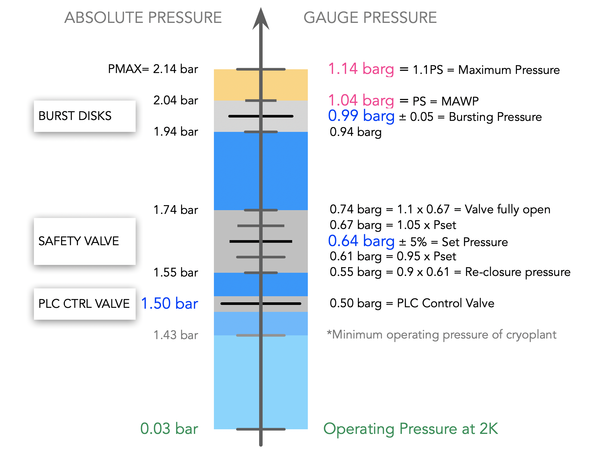
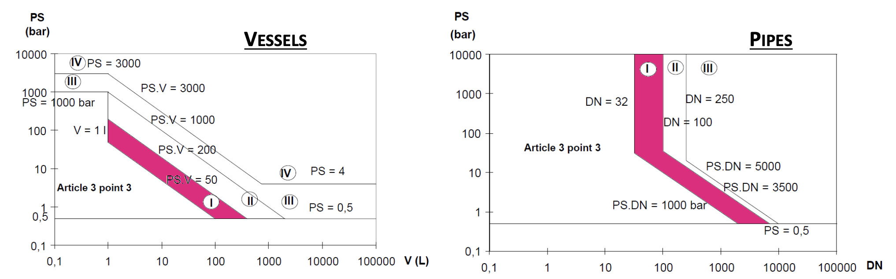
ESS Cryomodules (IJC Lab – CEA)
ACCP, CDS and CMs set independently according to PED. End-user (ESS) responsibility AFS 2005:2.
Spoke and ELL CM according to PED 2014/68/EU (Art.4(3) – Sound Engineering Practice)
  He tank volume: 48L (Spoke) | 46L (MB) | 48L (HB)
  Cryogenic distribution considered separately
  CM considered as a protected assembly
    Safety devices sizing, mech. analysis
    Piping breakdown (material, fluid, type (vessel, pipe, bellow))
Safety devices
SEP
SEP
48
P. DUTHIL - Cryogenic Safety review, 2016
N. Elias (ESS)

Slide 4
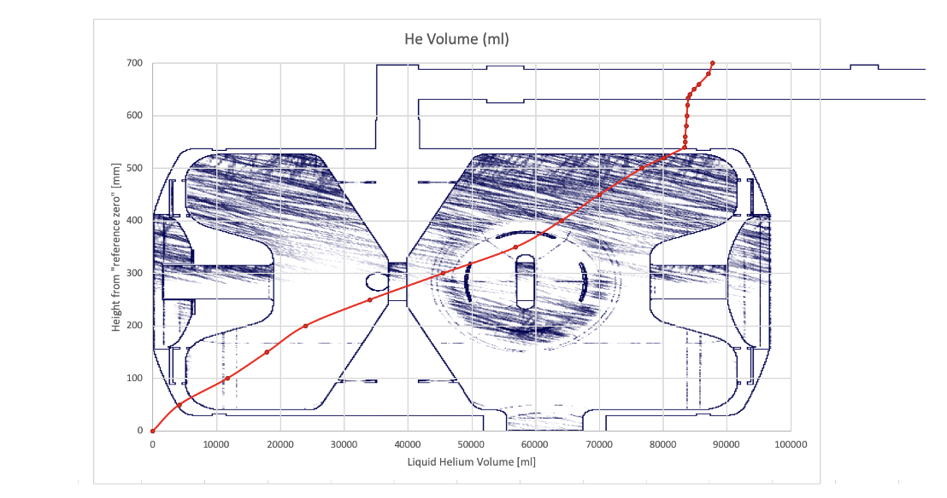
ESS Cryomodules (IJC Lab – CEA)
Spoke and ELL CM according to PED 2014/68/EU (Art.4(3) – Sound Engineering Practice)
  He tank volume: 48L (Spoke) | 46L (MB) | 48L (HB)
Safety devices
SEP
SEP
48
P. DUTHIL - Cryogenic Safety review, 2016
N. Elias (ESS)

Slide 5
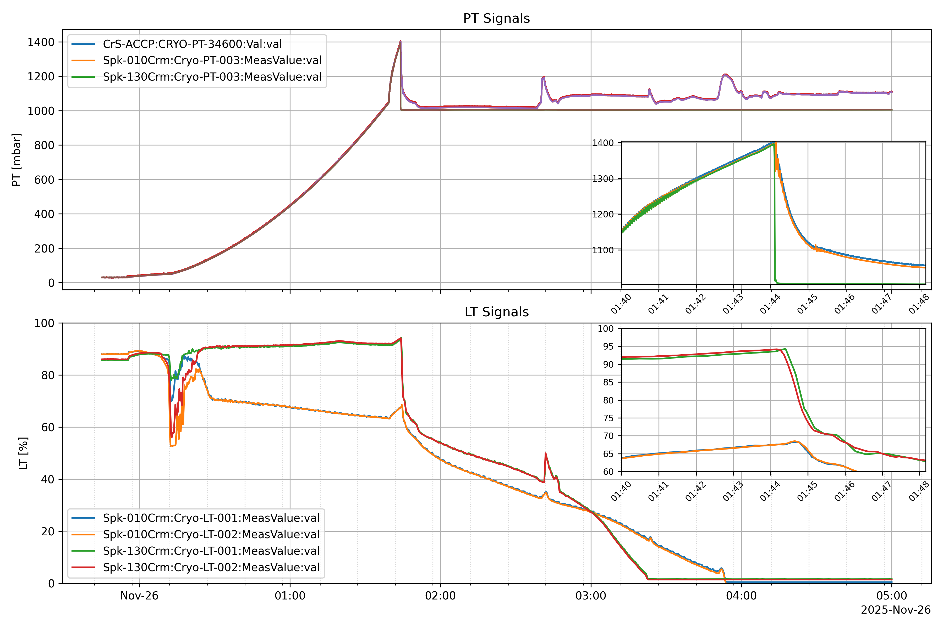
Operational impact – plant trip 25.11.2025
  Liquid density change (small volume in diphasic)
  6 burst discs ruptured/perforated in operation
  2 rupture discs isolated
  Ice formation inside the diphasic
  Early rupture
Safety devices
Spoke CM
Marek’s talk - Initial CM operation performances
on test and commissioning at ESS

Slide 6
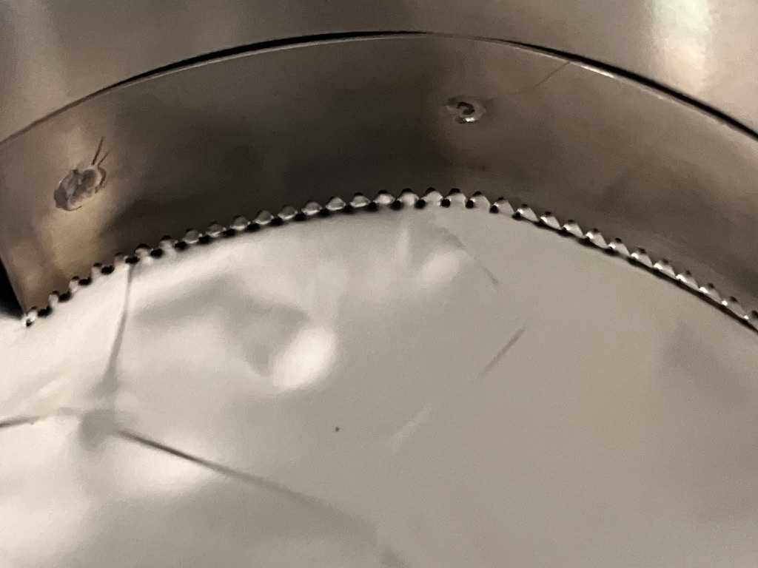
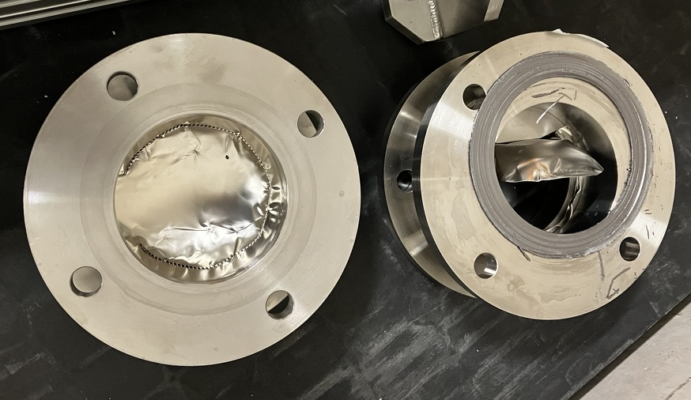
Operational impact – plant trip 25.11.2025
  Liquid density change (small volume in diphasic)
  6 burst discs ruptured/perforated in operation
  2 rupture discs isolated
  Ice formation inside the diphasic
  Early rupture
Spoke CM
Marek’s talk - Initial CM operation performances
on test and commissioning at ESS

