Slide 1


TTC2026, WG3, Session 2a
Pressure Vessel Code in Accelerator Projects
Takeshi DOHMAE, Kensei UMEMORI (KEK)

Slide 2
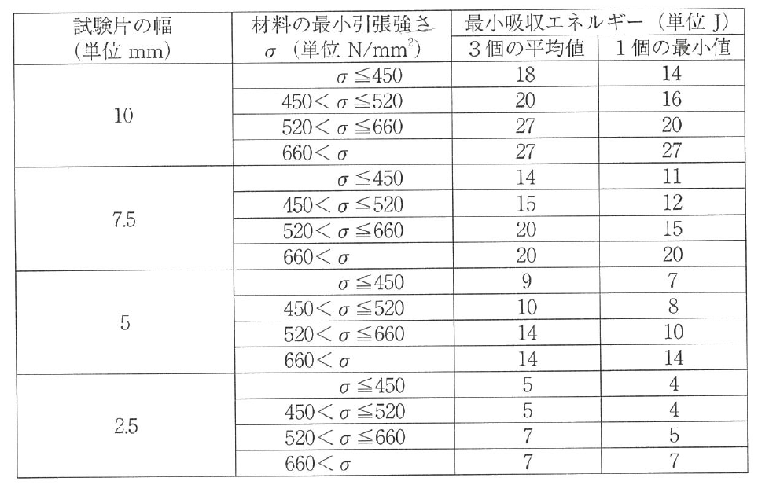
Q1. Material:
What is the request for materials which will be used for high pressure vessel? (ex. Mechanical property)
Material specification required for each material
  Tensile strength、0.2% proof strength（RT, 4K）
  Chemical composition ratio (Basically following ASTM B393-18)
Material specification often required as backup data
  Charpy impact test（RT, 4K）
Requirements of tensile strength
General requirements of Charpy impact test in Japanese HPGS
※ KEK certification value for materials after 900C heat treatment (example for ITN cavity)
Specimen’s width [mm]
Minimum tensile strength of material [MPa]
Minimum absorbed energy [J]
Average (3pcs)
Minimum
Materials | Temperature | Tensile strength (N/mm²) | 0.2% proof strength (N/mm²)
High RRR pure Nb (RRR > 270) | RT | ≧ 95 | ≧ 34
 | 4K | ≧ 400 | ≧ 150
Low RRR pure Nb (40 < RRR < 150) | RT | ≧ 130 | ≧ 50
 | 4K | ≧ 400 | ≧ 150
55% NbTi | RT | ≧ 300 | ≧ 115
 | 4K | ≧ 600 | ≧ 225
Pure Ti (Type-2, Japanese grade) | RT | ≧ 300 | ≧ 115
 | 4K | ≧ 600 | ≧ 225

Slide 3
Q2. Pressure test:
What kind of pressure test are required? And how much is the pressure?
For the cooling line,
  >= Operation/design pressure (0.1 MPa + 1 atm) @ low pressure regions such as cryomodule.

Slide 4
Q3. Industrialization:
How to harmonize each regions/country (how industries comply to foreign pressure vessel codes)?
Current Japanese case:
  It is impossible that over-sea vender understand Japanese HPGS and submit necessary application document, negotiate with KHK (Japanese HPGS authority), fabricate components, perform all necessary inspections. (I hope it can be in future.)
For ITN cavity:
KEK prepare HPGS application document and submit to KHK.
  Respect TESLA cavity design, and prepare document ⇒ No basic design change
All the necessary HPGS related tests/inspections are written in specification document of cavity fabrication.
  Thickness measurement
  Preparation of welding sample to confirm welding quality as quality control → Tensile test of welding sample is carried out at KEK, in order to follow JIS standard. (ASME? PED? Probably depends on negotiation with KHK. We did not try.)
Comments
Deep communication with vender is very important.
  Each company could have slight change of drawing
  Details of welding procedure have to be understood for quality control
  Important to well understand inspection procedure each other

Slide 5
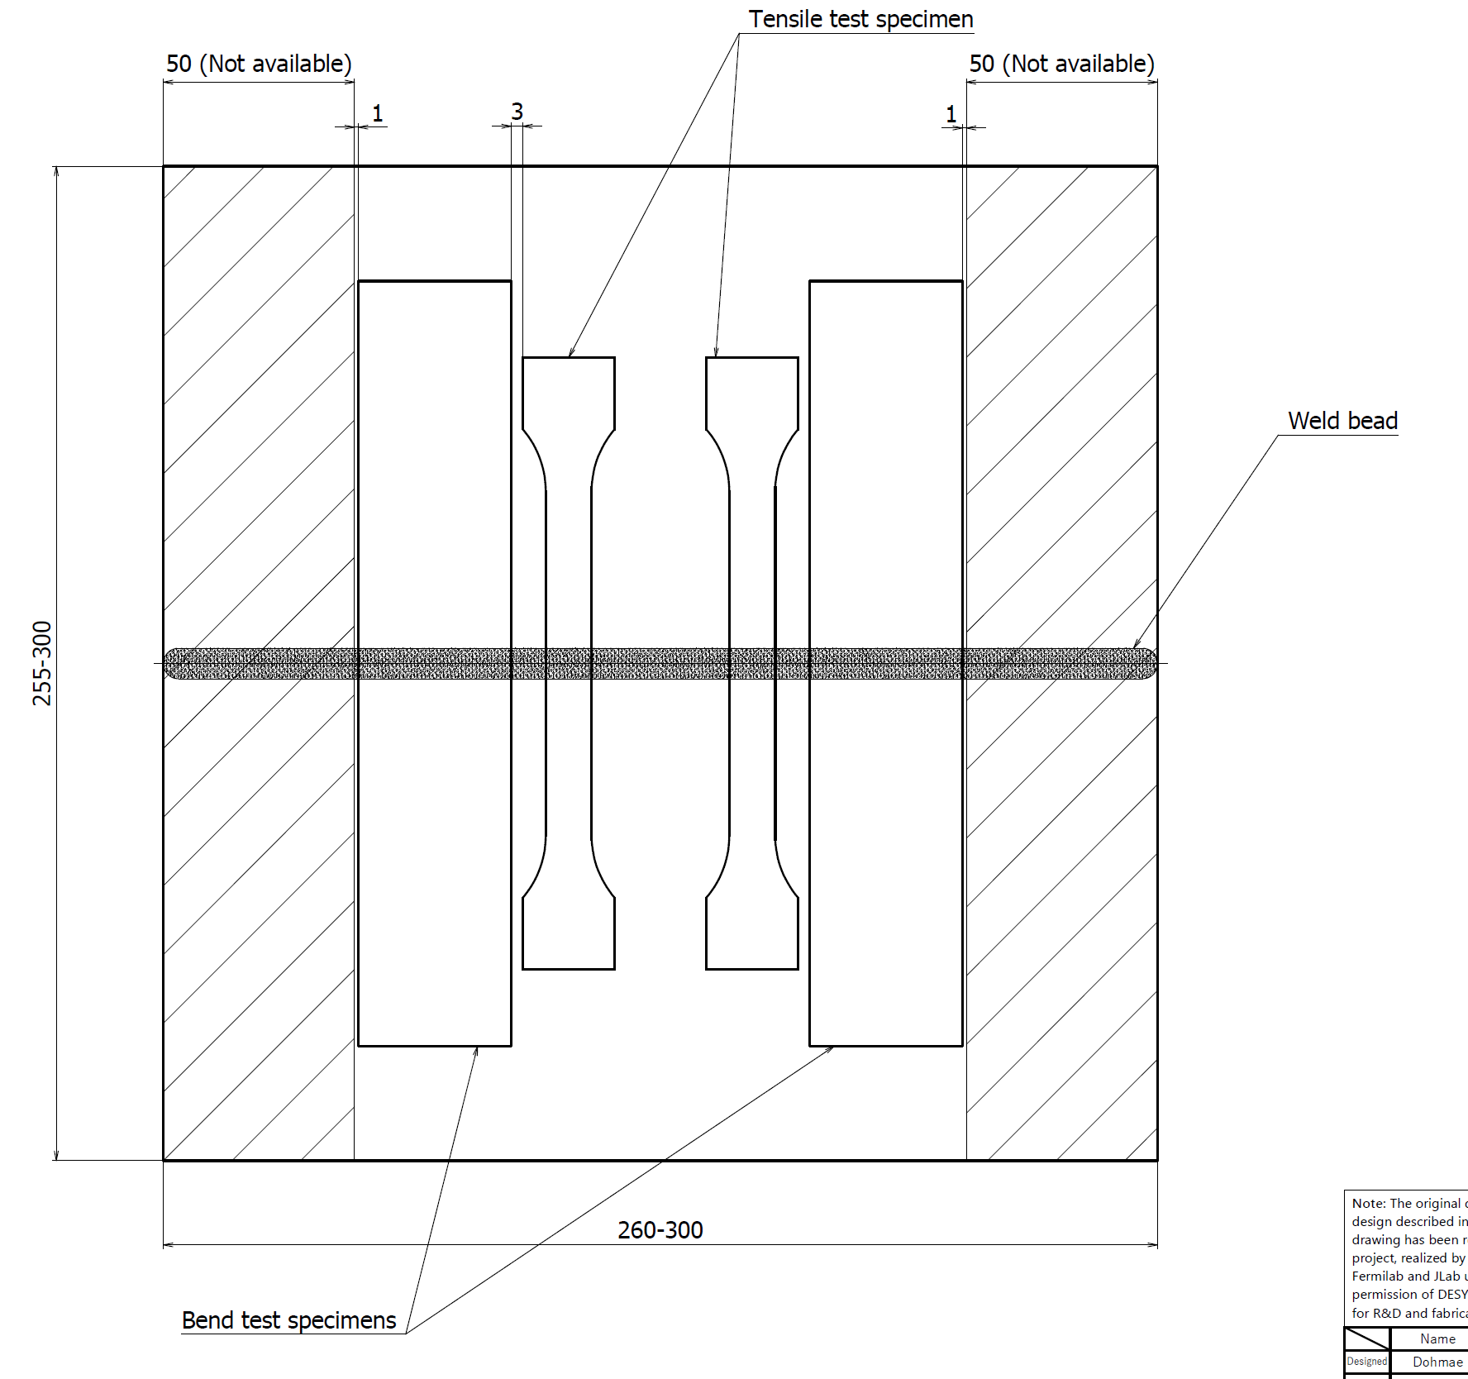
Q4. Welding:
Which kind welding test requested?
Using same thickness material as cavity, welding test has to be done.
Using welded samples, tensile test, surface bending test and back bending test are required.
Tensile strength of welded sample must be higher than the minimum strength required for the base material.
In bending test:
No crack more than 3mm.
Sum of crack length must be less than 7mm.
Total number of crack and blow hole must be less than 10.

Slide 6
Q5. Testing:
What kind of tests are required for the completed high pressure vessel?
3 step of pressure test applied.
Pressure test by water：1.5 times of design/operation pressure for bare cavity
Pressure test by water：1.5 times of design/operation pressure for He tank (without cavity)
Pressure test by gas：1.25 times of design/operation pressure for dressed cavity. Penetration test required for final welding joints.
② Pressure test for He tank
① Pressure test for bare cavity
③ Pressure test for dressed cavity

