Slide 1
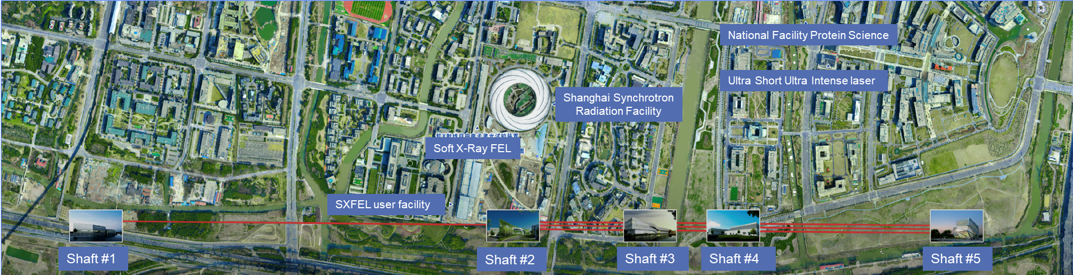

Development of SHINE
3.9 GHz Fundamental Power Couplers
Zhenyu Ma
Shanghai Advanced Research Institute(SARI), Chinese Academy of Sciences
9 June, 20246
TTC2026 Meeting, Paris, France

Slide 2
Outline
Introduction of SHINE 3.9 GHz FPCs
Development of SHINE 3.9 GHz FPCs
Assembly and test results of batch FPCs on cryomodules
Tunnel installation and commissioning
Questions and Discussions

Slide 3
Introduction of SHINE 3.9 GHz FPCs

Slide 4
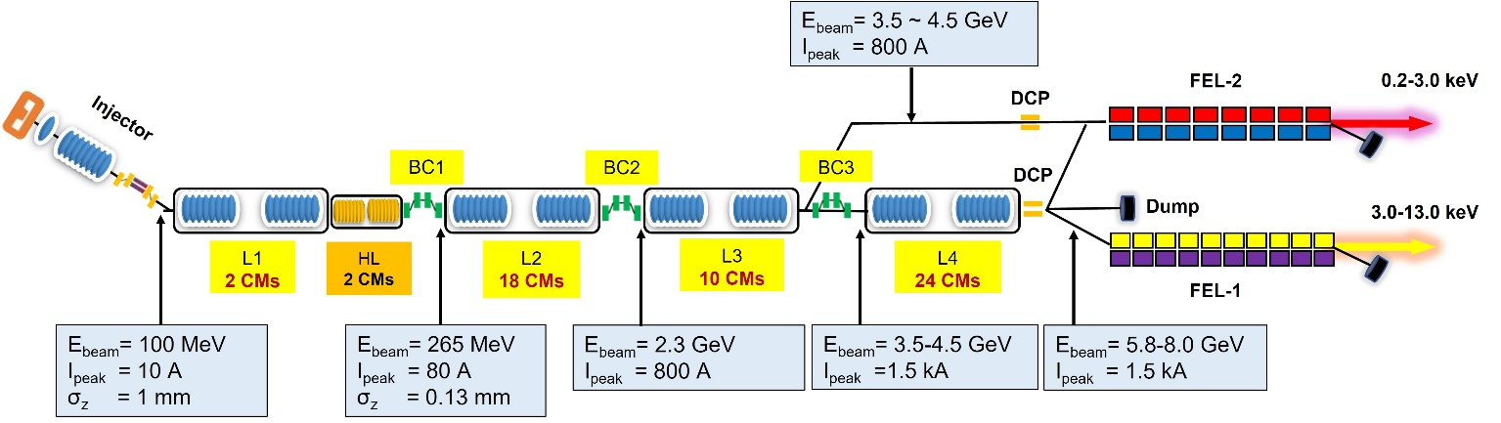
Introduction of SHIEN and 3.9 GHz FPCs
The Shanghai HIgh repetition rate XFEL aNd Extreme light facility (SHINE) consists of a CW SC Linac, two undulator lines, two X-ray beamlines, and six experimental end-stations.
An 8 GeV is expected from the main Linac by utilizing 54 1.3 GHz cryomodules (~166 MV), in combination with​ two 3.9 GHz third harmonic cryomodules.
Both 3.9 GHz couplers, for the E-XFEL and LCLS-II, adopt a fixed antenna length.
Q_{ext} measurements on the first LCLS-II 3.9 GHz cryomodule showed that the Q_{ext} can vary by the factor of two.
A SHINE 3.9 GHz FPC to withstand 2 kW CW power and with an adjustable function has been designed.
FIG. Schematic layout diagram of the SHINE facility
TABLE. Main technical parameters of the SHINE 3.9 GHz FPC

Slide 5
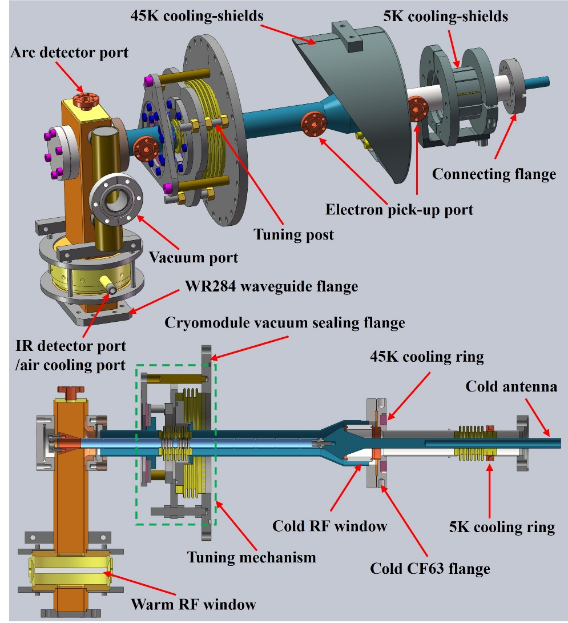
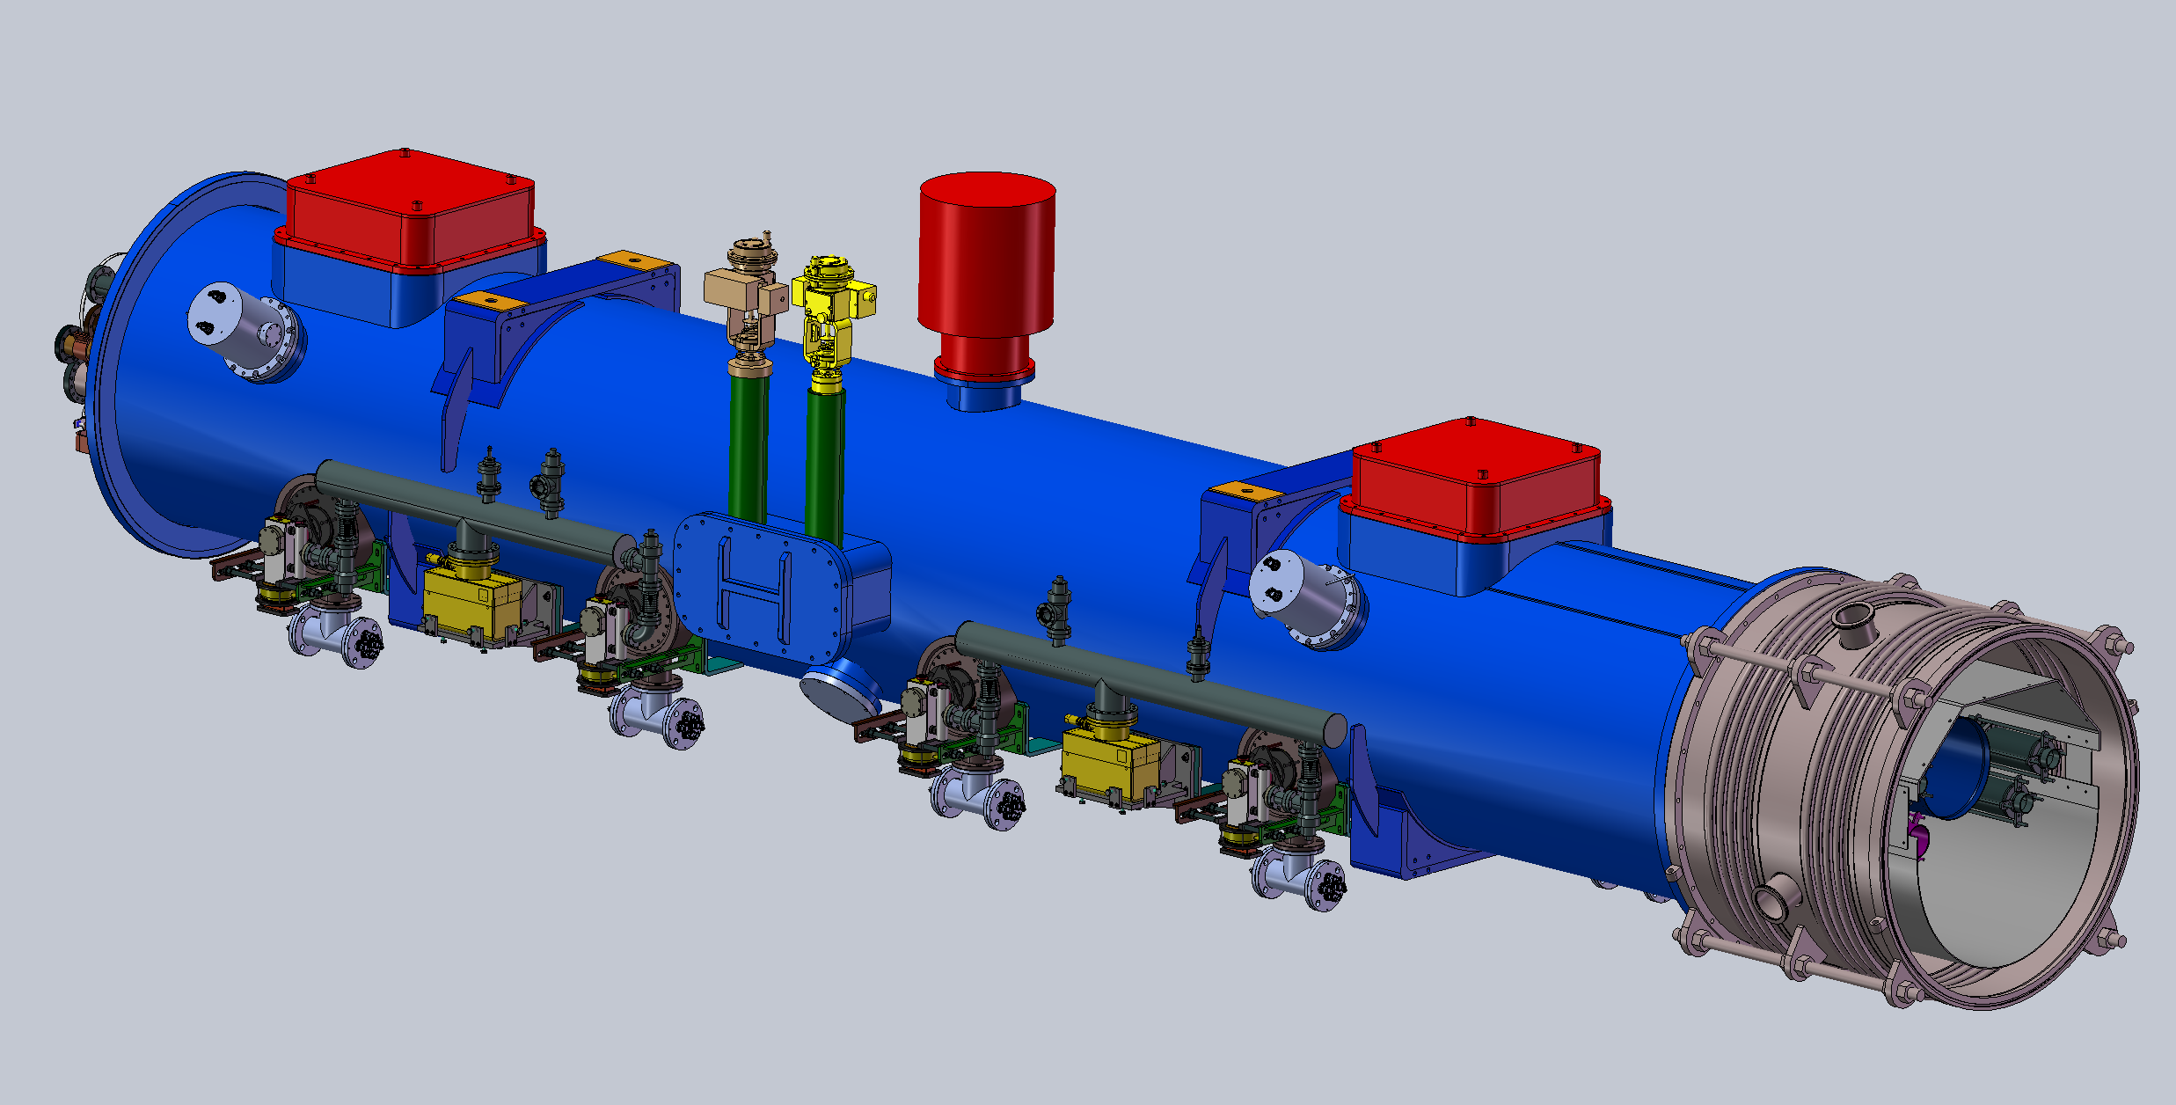
Design of SHIEN 3.9 GHz FPCs
Cold window: based on SHINE 1.3GHz coupler window design. Cold antenna is fabricated from OFHC copper with hollow to effectively mitigate mechanical stress on the cold RF ceramic window during thermal cycles.
Warm window: based on commercial klystrons window, adding the cooling structure.
Bellows: compensate for shrinkage and mechanical, and adjust the insertion depth of the inner conductor.
Tuning mechanism: located outside of the cryomodule, adjusts the antenna's insertion depth via three tuning posts.
Copper film thickness: the WIC was increased to 150 microns to reduce the maximum temperature of the bellows.
Performance monitoring: 3 e-pickup probes + 1 Arc detector + 2 ports located at waveguide for an infrared sensor and as an air-cooling interface if required.
A 180° rotational layout is adopted for the 3.9 GHz FPCs between adjacent cavities in the third harmonic cryomodule, minimizing​ the transverse RF kick induced by the FPCs.

Slide 6
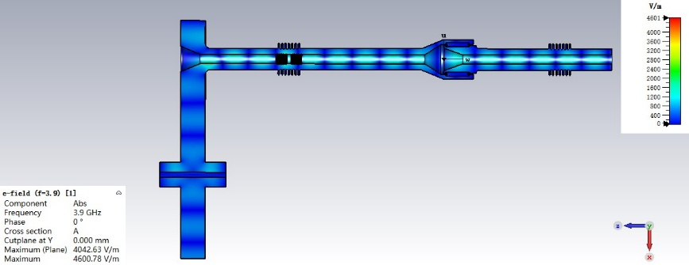
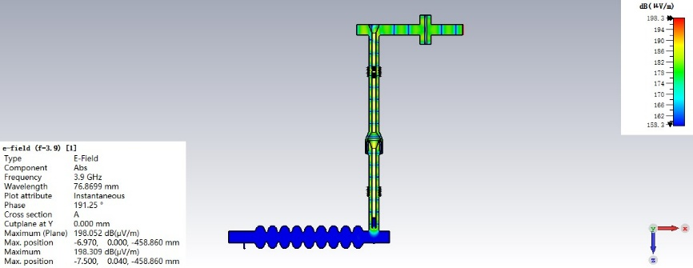
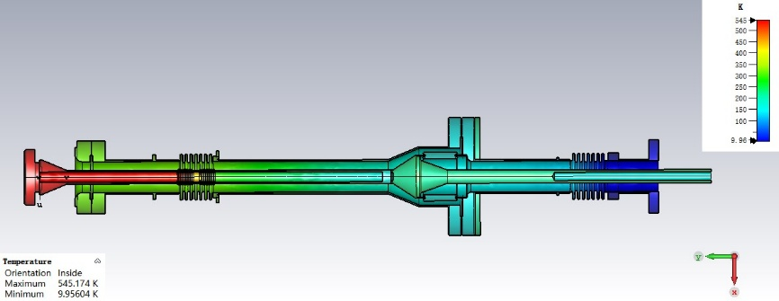
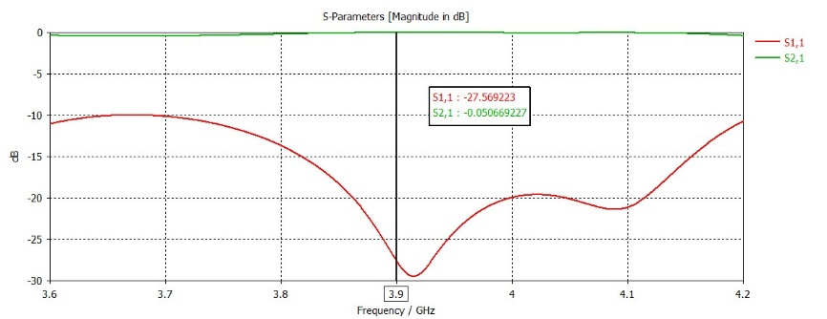
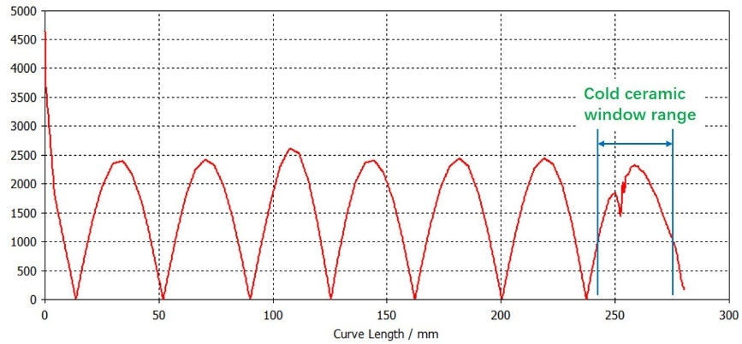
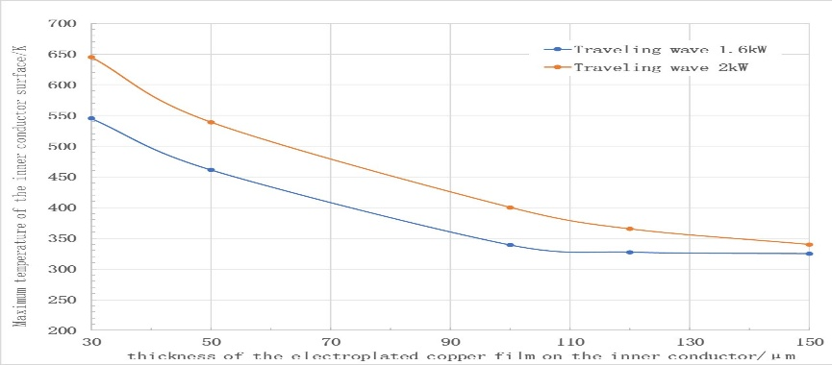
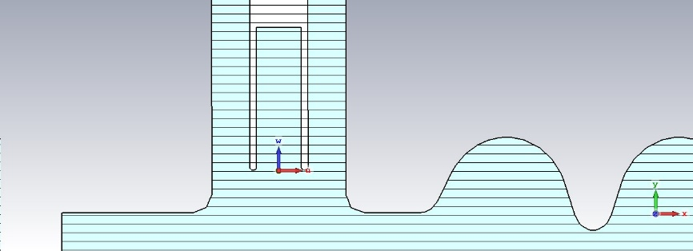
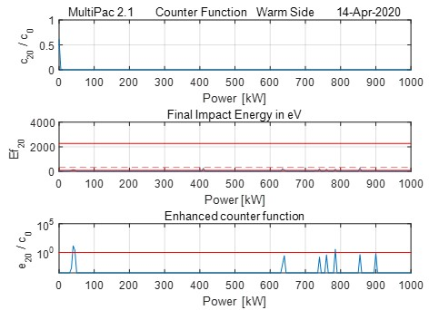
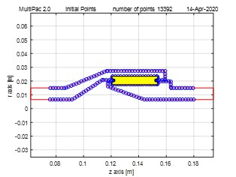
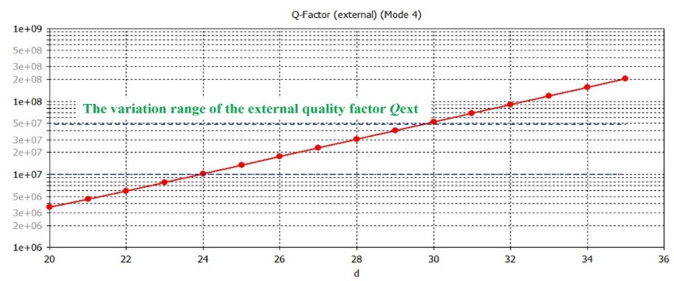
RF Simulations and Optimization of 3.9 GHz FPCs

Slide 7
Development of SHINE 3.9 GHz FPCs

Slide 8

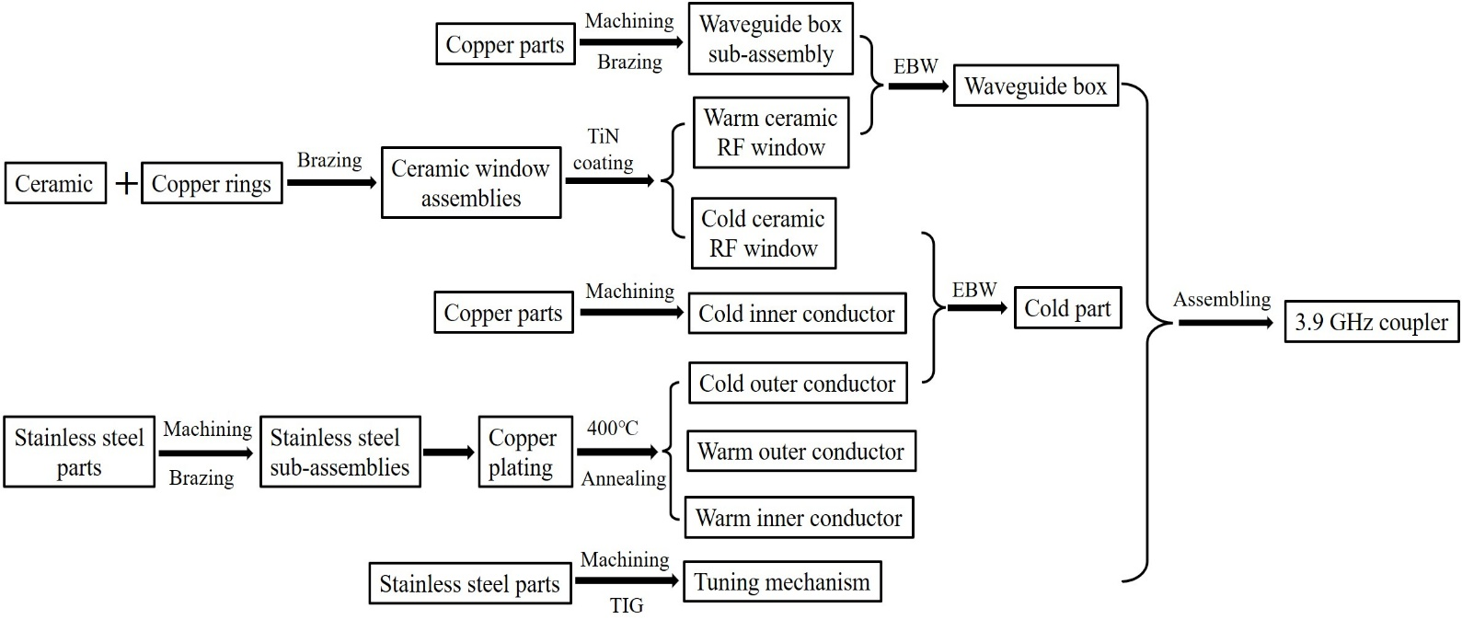
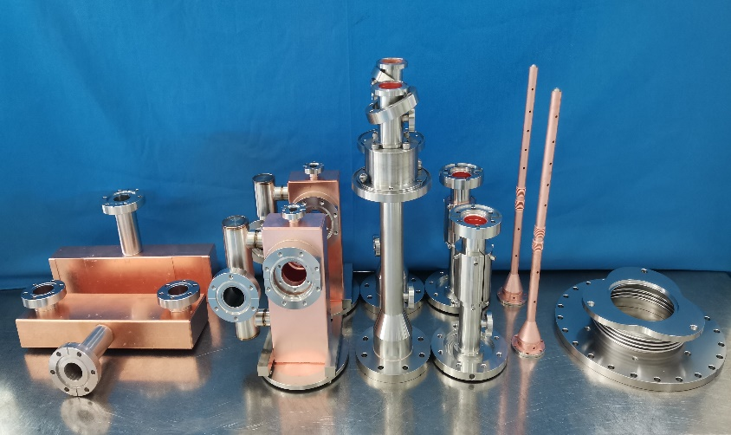
Development of SHINE 3.9GHz FPCs
 | FPC prototypes | Mass-production of PFCs
Schedule | September, 2020~ October, 2022 | December, 2022 ~ September, 2024
Manufacturer
Quantity | 2 | 16
Contents | Verification of FPC structural design; Key manufacturing technologies; Manufacturing process; Room temperature RF conditioning technology; Cryomodule assembling and RF conditioning technology. | Control of key processes; Keep the stability in the quality.
FIG. The flow chart of the 3.9 GHz coupler manufacturing processes.
FIG. 3.9GHz FPC prototypes

Slide 9
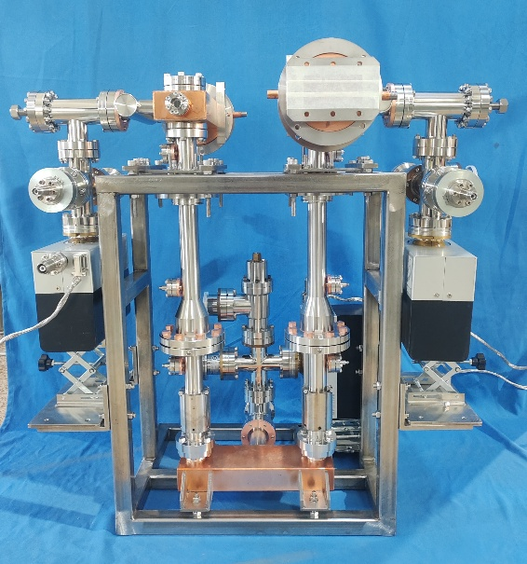
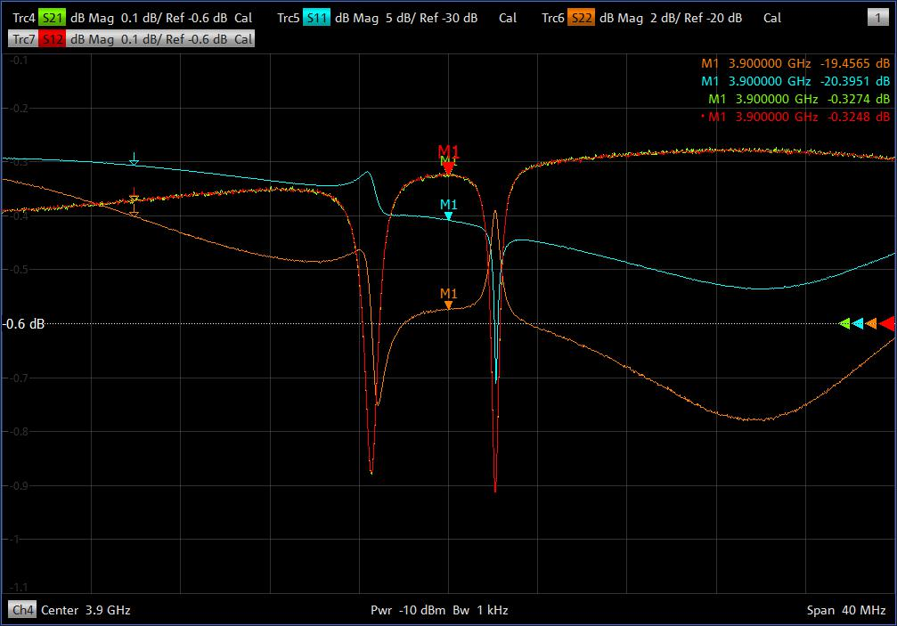
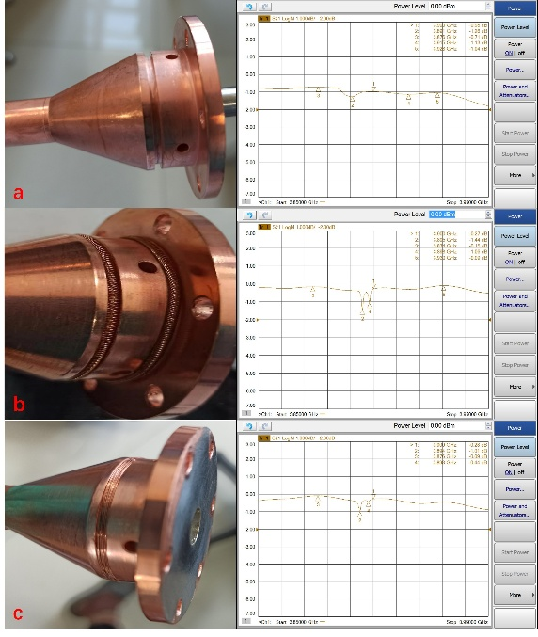
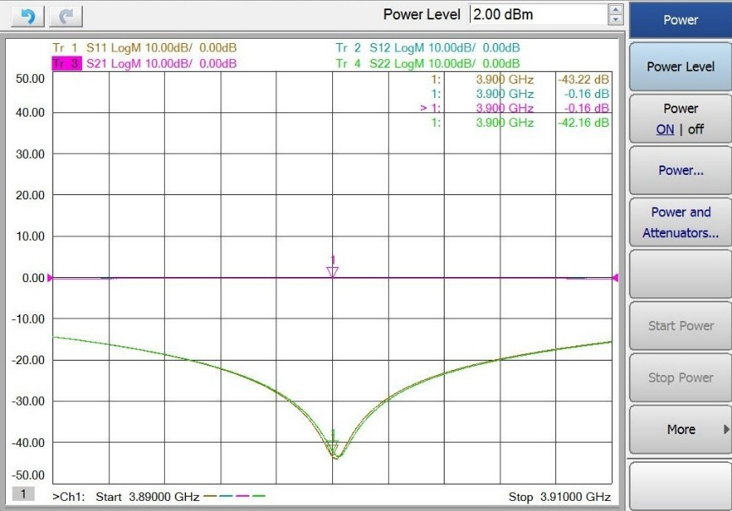
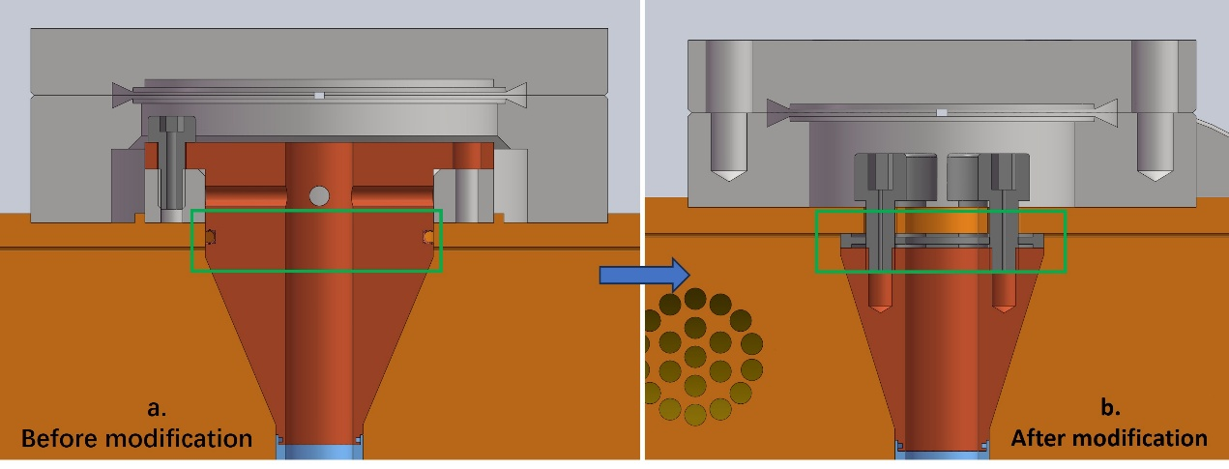
S-parameter measurements and structural optimization
Two 3.9 GHz coupler prototypes were produced and installed on the test bench;
S-parameters exhibit​ unexpected characteristics (anomalous peaks at 3.89 GHz and 3.915 GHz, which degrade the overall performance), this is suspected to arise from​ multiple signal reflections caused by impedance mismatch at discontinuities such as slits.
redesigned the installation structure at the connection point of the warm inner conductor to the waveguide box, replacing the original shielding spring seal with a bolted spring contact structure.
At 3.9 GHz, the measured S21 and S11 parameters were -0.16 dB and -43.22 dB, respectively.
Before structural optimization
FIG. 3.9 GHz couplers test bench.
FIG. Preliminary S-parameter measurements of the 3.9 GHz FPC prototypes
After structural optimization
FIG. S-parameter measurements for different installation configurations.
FIG. S-parameter measurements after design optimization.
FIG. S-parameter measurements for different installation configurations.

Slide 10
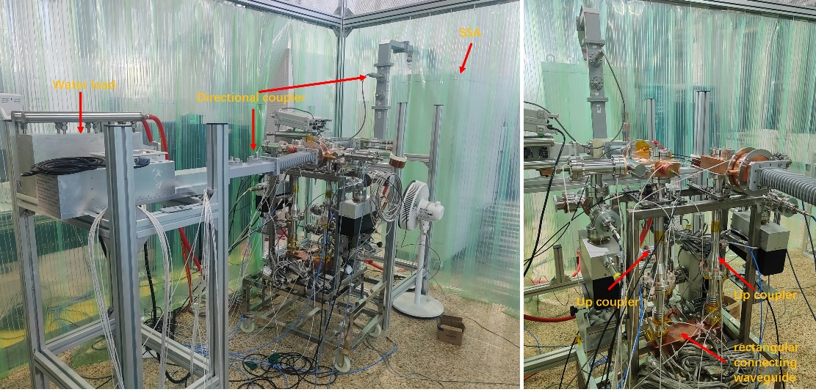
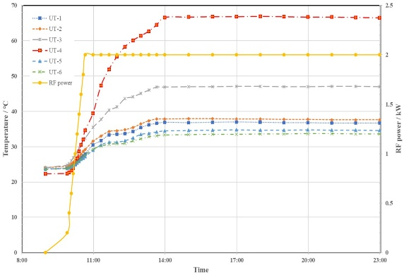
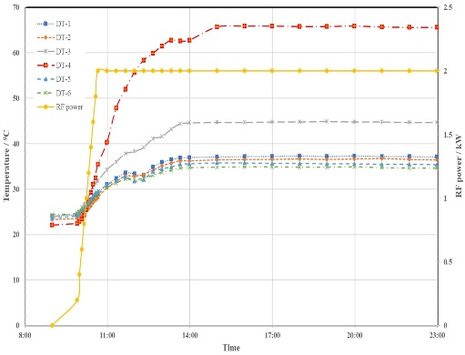
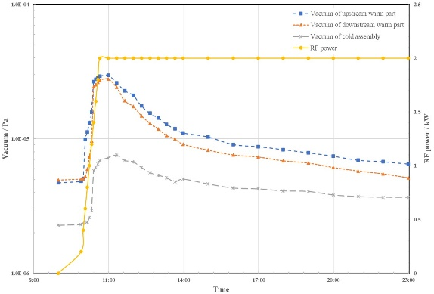
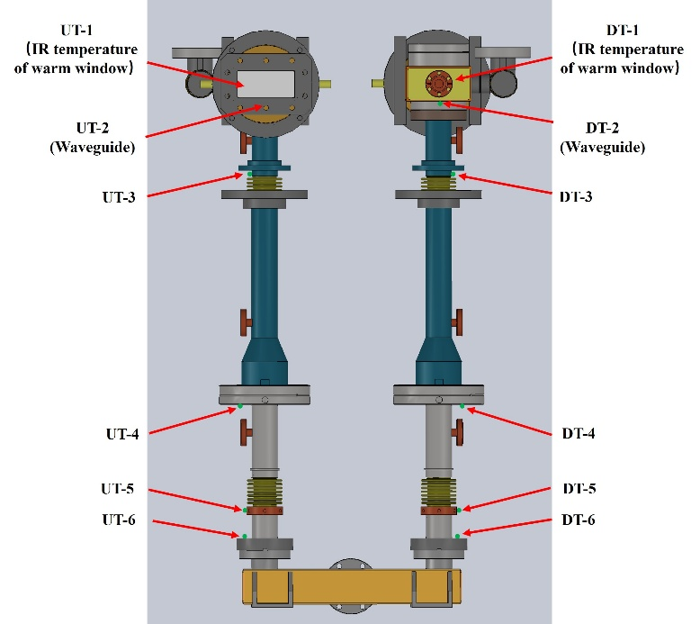
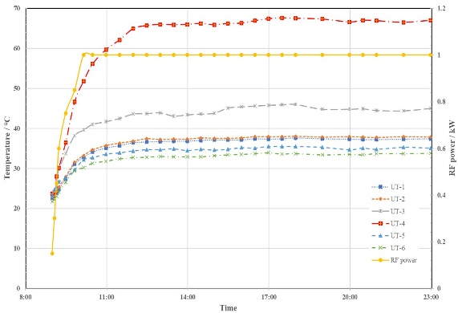
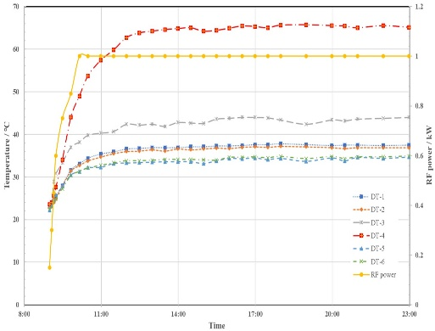
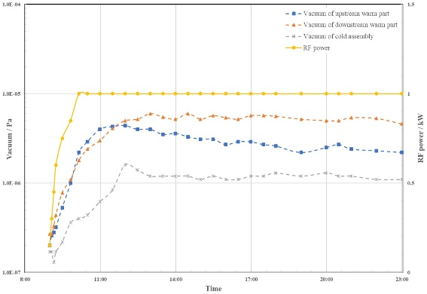
High-power RF tests of 3.9GHz FPC
Traveling wave CW test:
  2kW, 12 hours, no interlock;
Standing wave CW test:
  1 kW, 12 hours, no interlock;
  Maximum 2kW, 2 hours, no interlock.
FIG. Upstream and downstream coupler temperature and vacuum variations during TW CW RF conditioning
FIG. Upstream and downstream coupler temperature and vacuum variations during SW CW RF conditioning

Slide 11
Assembly and test results of batch FPCs on cryomodules

Slide 12
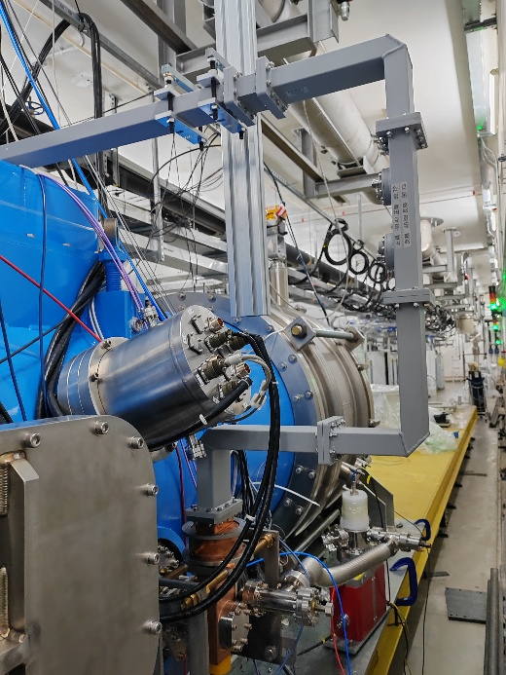
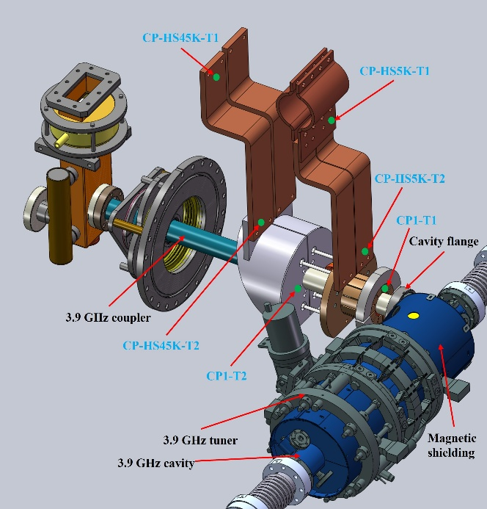
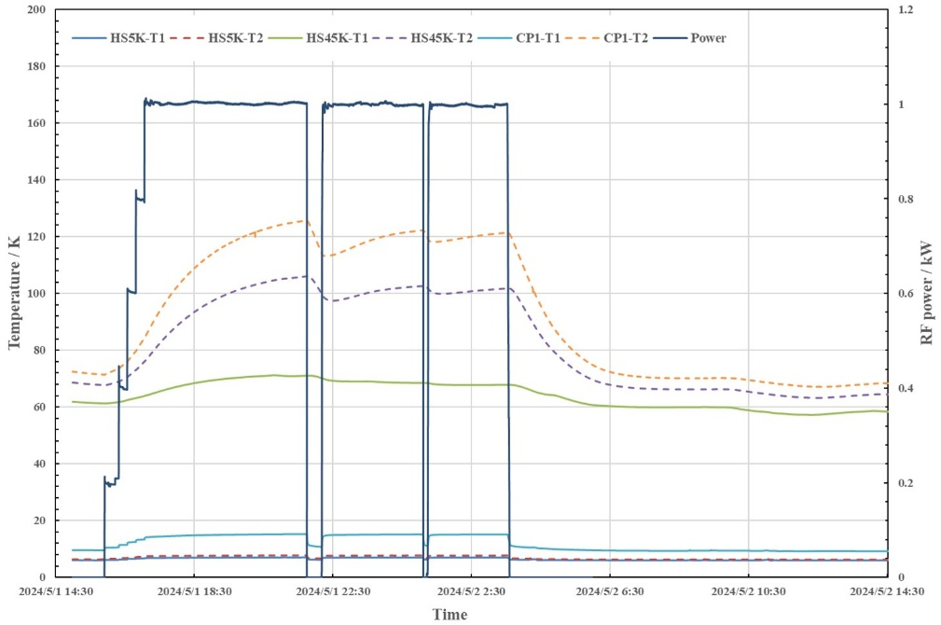
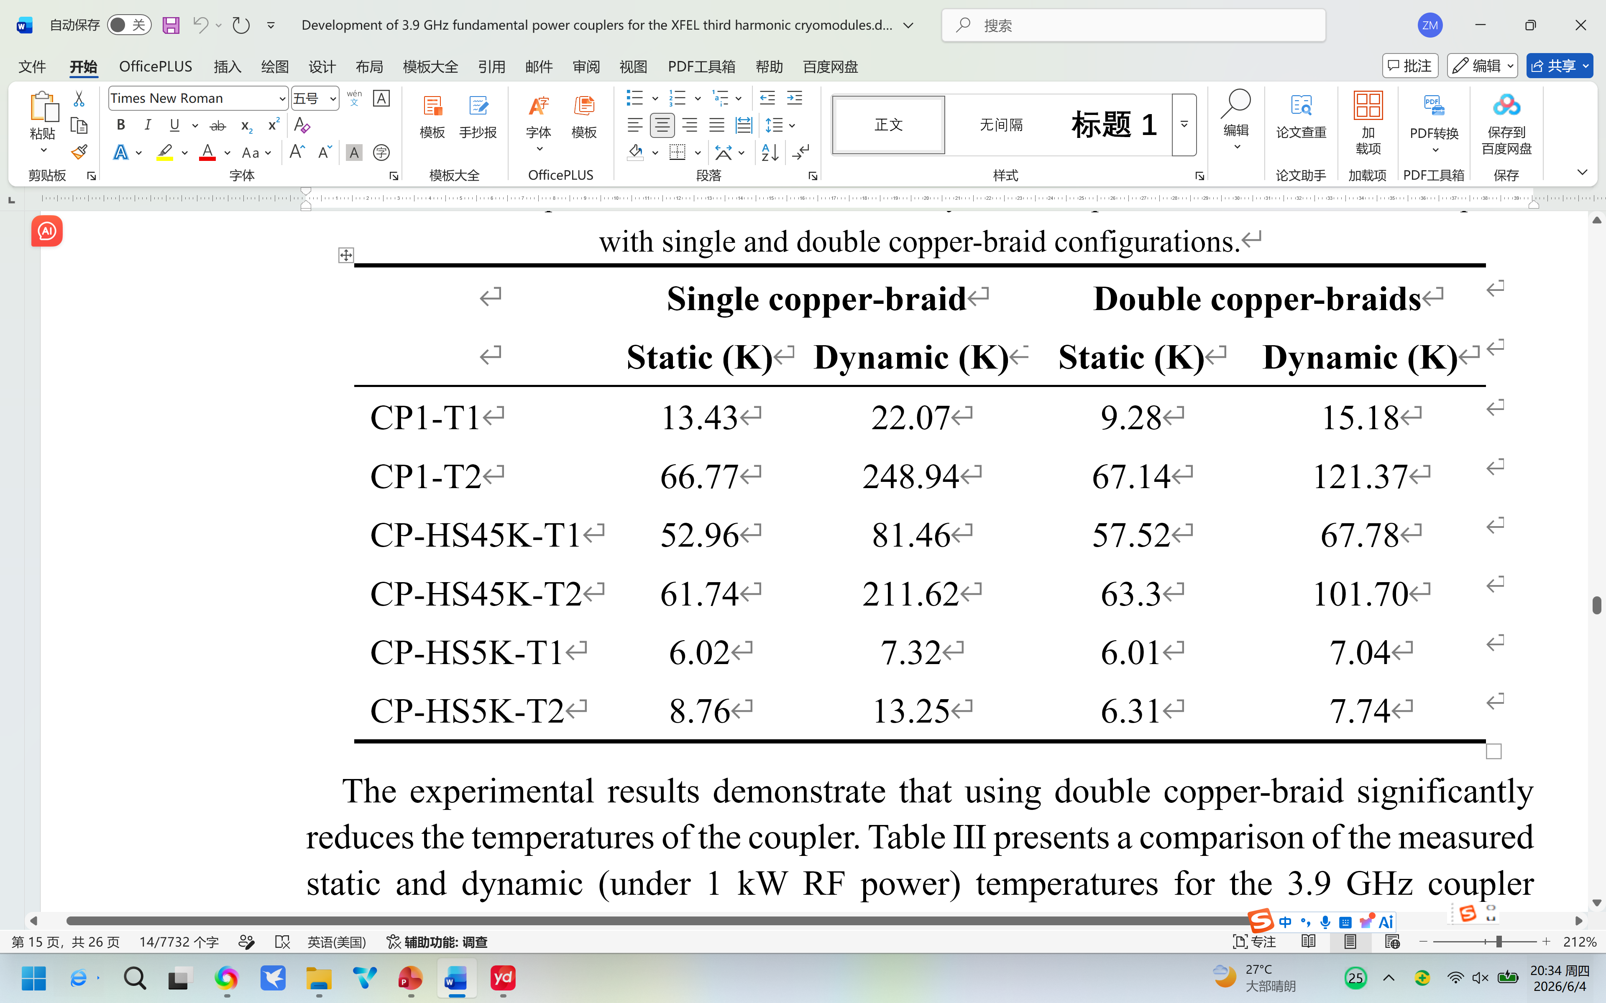
Single-cavity cryomodule integration and horizontal test
The test cryomodule integrates key components, including a 3.9 GHz SC cavity, a coupler, a tuner, and a magnetic shielding assembly.
verifying its cooling performance within the cryomodule;
validating its Q_{ext} adjustment function;
examining its RF power handling capabilities.
Two copper braids connect the coupler's 5 K thermal intercept to the 5 K helium pipe, while another two connect its 45 K intercept (specifically, the cold CF63 flange) to the 45 K cooling shield of the cryomodule.
TABLE. Comparison of measured static and dynamic temperatures for the 3.9 GHz coupler with single and double copper-braid configurations
The 5 K static heat load of the 3.9 GHz coupler is approximately 0.8 W, and the 45 K static heat load is approximately 7.1 W. Under 1 kW CW RF power, the 5 K dynamic heat load is about 2.2 W, and the 45 K dynamic heat load is approximately 29.4 W.

Slide 13
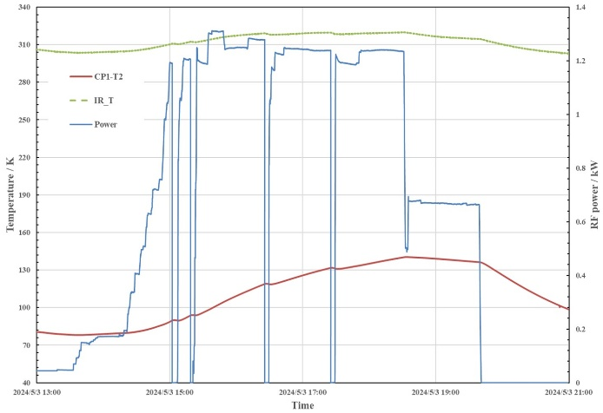
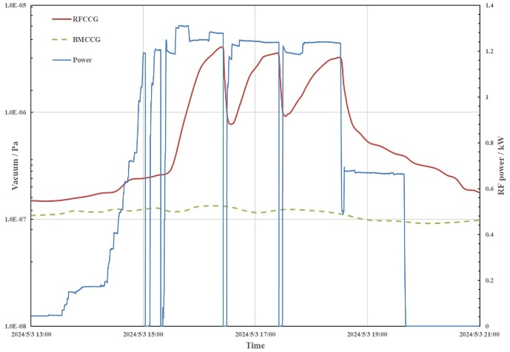
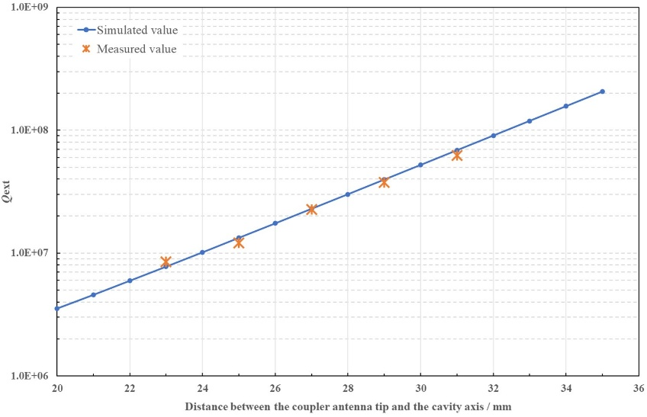
Single-cavity cryomodule integration and horizontal test
High-power RF conditioning of the 3.9 GHz coupler was first conducted online prior to the cooldown of the single-cavity cryomodule.
Following cryomodule cooldown, high-power RF conditioning was repeated to verify the coupler's thermal stability and vacuum integrity. CW power level of 1 kW for six hours.
The maximum cold CF63 flange temperature (CP1-T2) was 121 K, and the maximum warm RF window infrared temperature was 44 °C (317K).
The 3.9 GHz superconducting cavity achieved a maximum accelerating gradient of 20.3 MV/m, which is consistent with its vertical test results.
A stability test was conducted at a cavity gradient of 18.0 MV/m while the incident power on the coupler to be increased to 1.2 kW, to further verify the performance of the coupler.
The temperatures of the coupler’s warm RF ceramic window and the cold CF63 flange stabilized at safe levels, not exceeding 41 °C and remaining below 136 K, respectively.
FIG. (a) Temperature and (b) vacuum variation with incident power during the cavity gradient stability test.
Over a mechanical adjustment range of ±4 mm, the Q_{ext} was tuned​ from 8.5×10⁶ to 6.2×10⁷.
The discrepancy between the measured and simulated Q_{ext} values is within 10%.
The Q_{ext} was finally tuned to the design value of 2.1×10⁷.

Slide 14
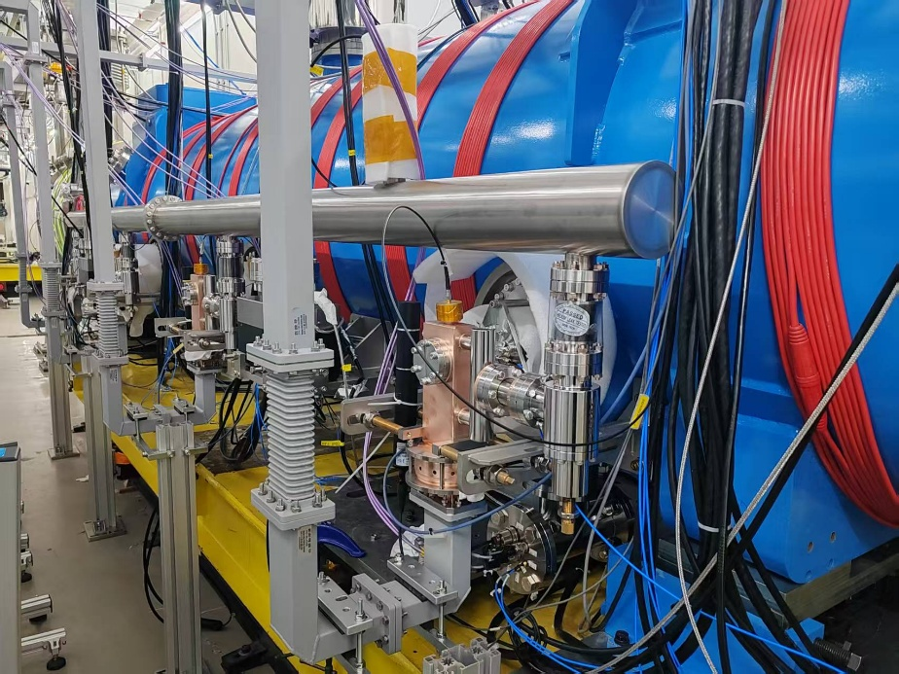
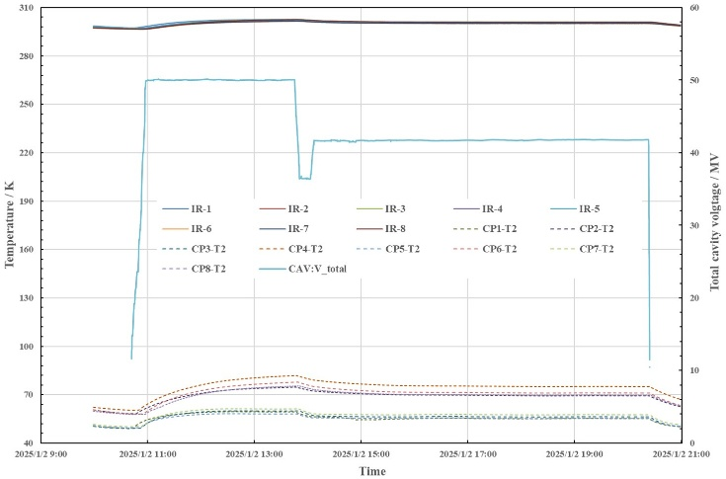
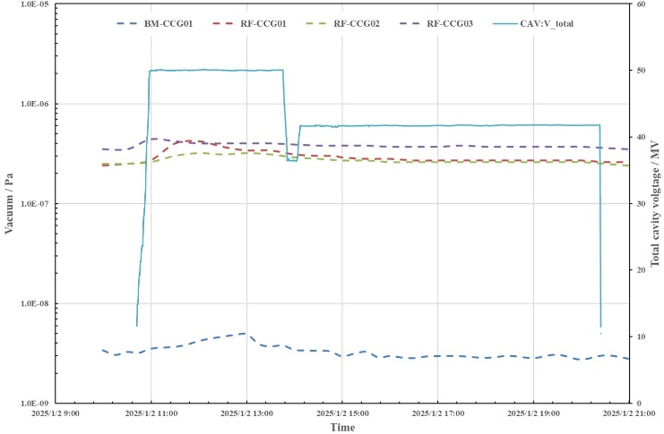
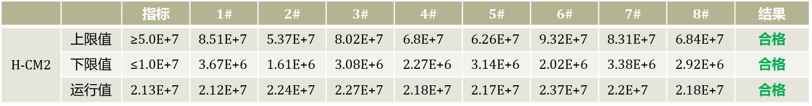
High-power RF tests of 3.9GHz FPC
16 batch 3.9 GHz couplers have been manufactured and tested, all passing high-power RF conditioning on a room-temperature test bench under 2 kW TW CW and 1 kW SW CW conditions.
These couplers were subsequently integrated into two SHINE 3.9 GHz third harmonic cryomodules and passed horizontal cryomodule testing.
The total available cavity voltages for the two cryomodules reached 63.6 MV and 59.8 MV, respectively, corresponding to average usable accelerating gradients of 23.0 MV/m and 21.6 MV/m.
The average Q₀ for both cryomodules was 3.4×10⁹, with 2K static heat loads measured at 29.5 W and 30.3 W, respectively.
FIG. (a) Temperatures and (b) vacuum variation during cryomodule cavity voltage stability test.
TABLE. Measured Qext adjustment range and final adjusted operation values for each coupler

Slide 15
Tunnel installation and commissioning

Slide 16
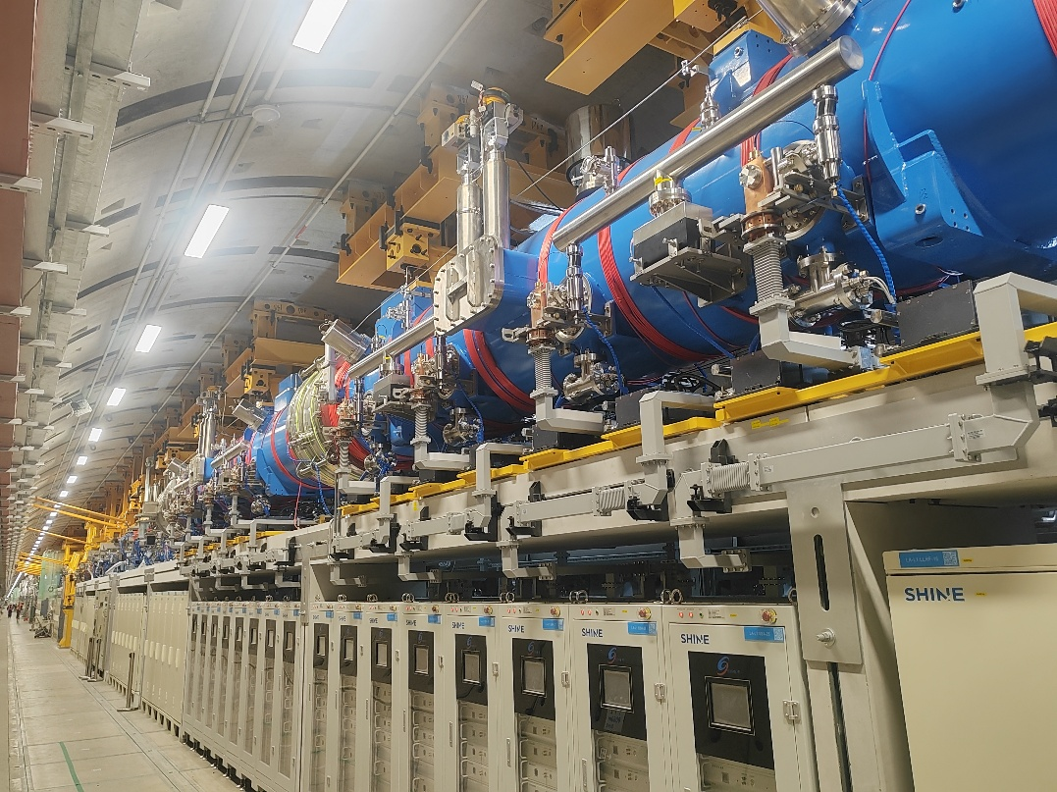
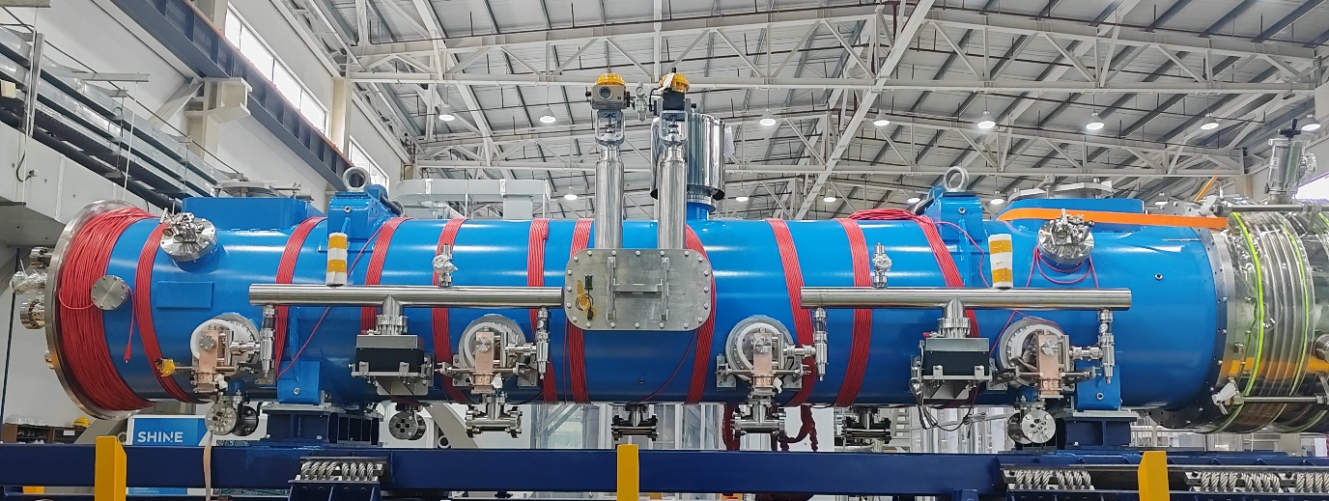
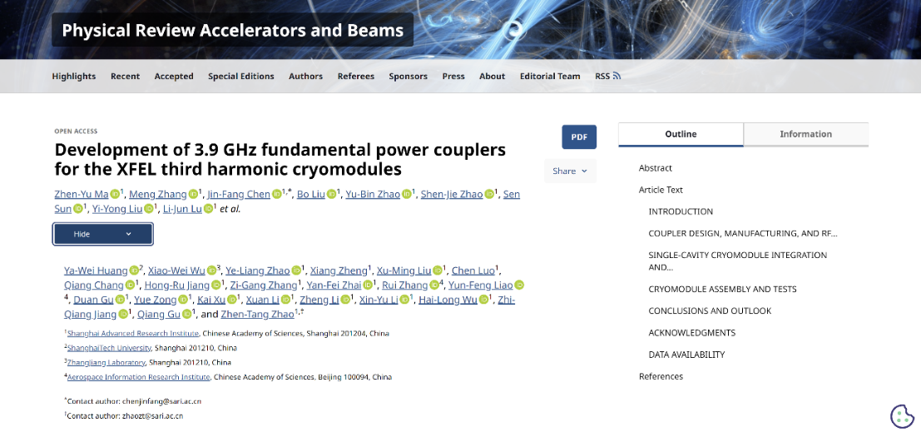
The injector was installed in 2024. The injector beam meets the design specifications, with a bunch charge of 20–100 pC, an energy >100 MeV, a peak current of up to 10.1 A, and a repetition rate of 1–100 Hz.
By June 2025, the installation of L1 section of the Linac was completed, including and 2 3.9GHz third harmonic cryomodules.
The entire L1 segment, including two 1.3GHz cryomodules and two third harmonic cryomodules, was installed in the tunnel by early August 2025.
Initial beam commissioning for the injector and L1-BC1 segment has been completed successfully. Key measured beam parameters include a bunch charge of 54.6 pC, a peak current of 56.4 A, a final beam energy of 273.5 MeV, and a bunch repetition rate of 1000 Hz.​
The installation of the 1.3 GHz cryomodules has been completed for both the L2 (18 units) and L3 (10 units) sections. The 1.3 GHz couplers have passed high-power conditioning at room temperature, and the cooldown process of the cryomodules is currently in progress.

Slide 17
Questions and Discussions

Slide 18
Both the SHINE 1.3 GHz and 3.9 GHz cryomodules undergo room-temperature high-power conditioning of the input couplers prior to cooldown, followed by low-temperature high-power conditioning after the cryomodules reach operating temperature. This two-stage conditioning is performed to purge adsorbed gases and desorb contaminants from the coupler surfaces.​
Question:​ In routine accelerator operation, will it be necessary to repeat room-temperature high-power coupler conditioning before every cryomodule cooldown?

Slide 19

Thanks for your attention
Zhenyu Ma
Email: mazy@sari.ac.cn

