Slide 1


Production and Quality Lessons from Large Cryomodule Projects at JLab
June 10th, 2026
Naeem Huque
Notes:
Tip: Keep titles under 60 characters for readability
To change the photo: Right-click on photo and select change photo

Slide 2
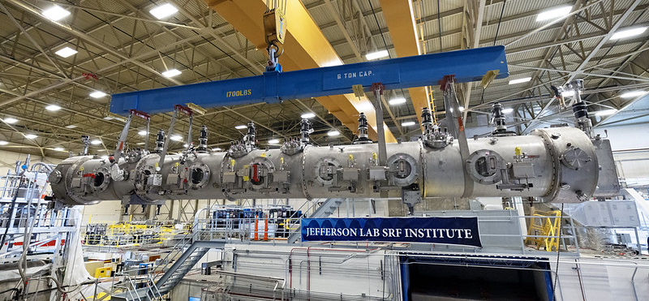
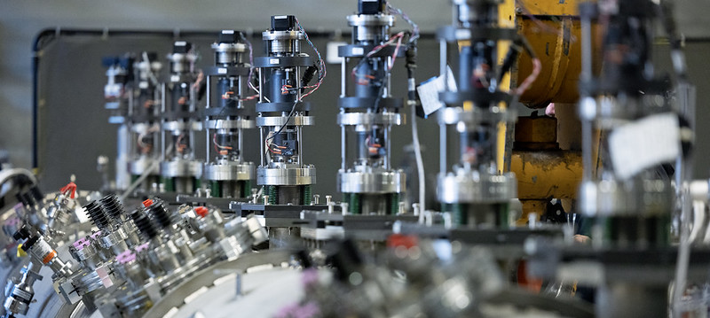
OUTLINE
JLab SRF History
Production Strategies
Copper Plating
Non-Conformances
Procurement Considerations
Notes:
Guidelines: 6-8 bullets per slide; Use sentence fragments for bullets
To change the photo: Right-click on photo and select change photo

Slide 3
INTRODUCTION
PROCUREMENT
ASSEMBLY AND TESTING
QA/QC
Inventory
Non-Conformance
Inspection
Specification
Vendor Selection
Notes:
Guidelines: 6-8 bullets per slide; Use sentence fragments for bullets
To change the photo: Right-click on photo and select change photo

Slide 4
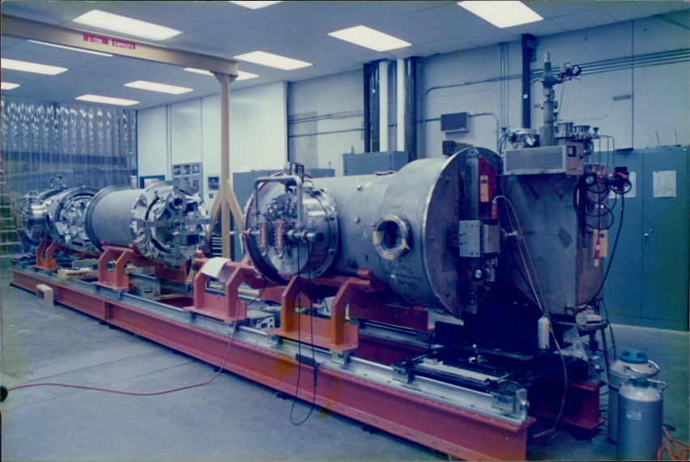
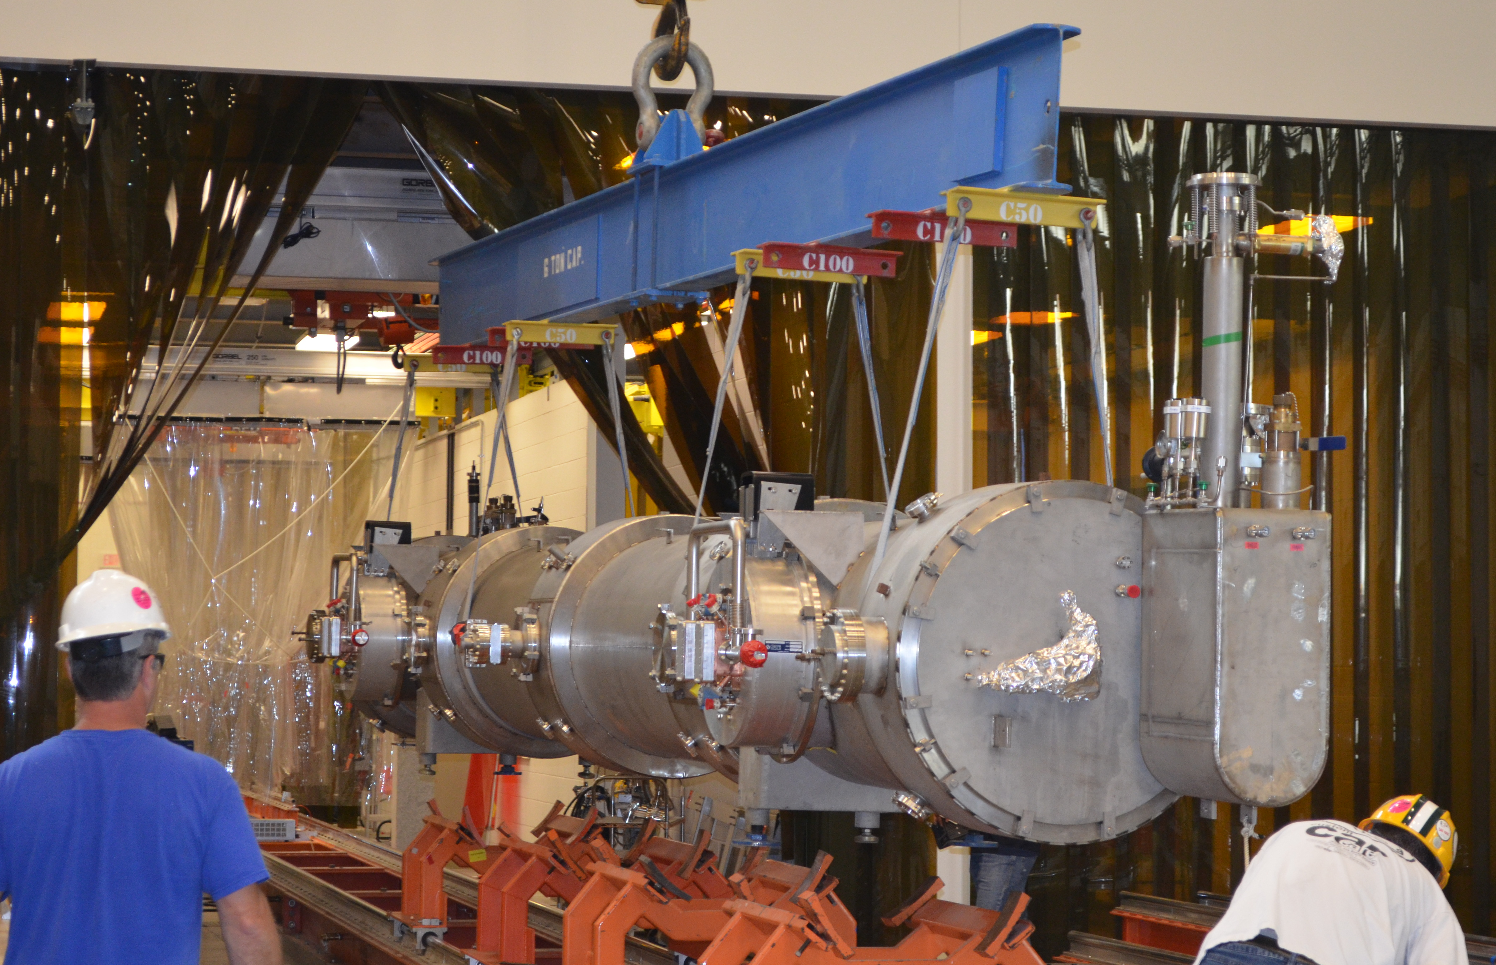
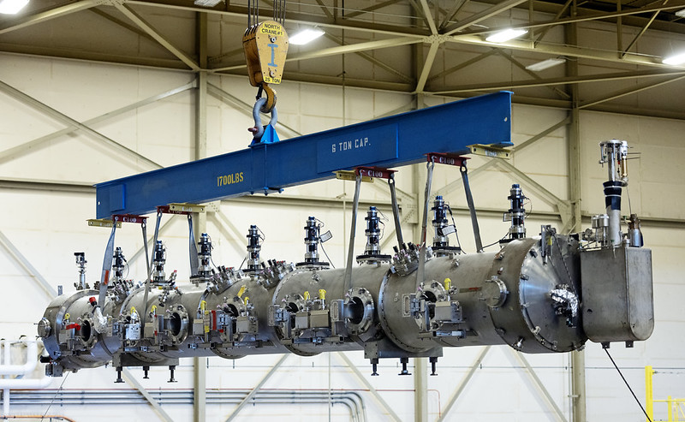
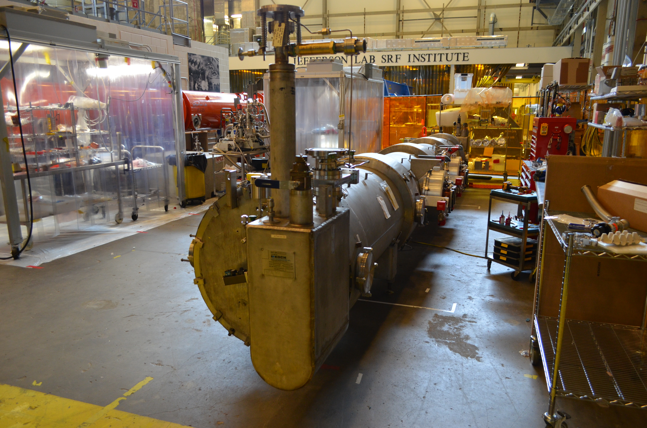
HISTORY AT JLAB SRF
CEBAF C20
Early 1990s
CEBAF C50
2000s - date
CEBAF C100
2010s
CEBAF C75
2020s to date
Notes:
Guidelines: 6-8 bullets per slide; Use sentence fragments for bullets
To change the photo: Right-click on photo and select change photo

Slide 5
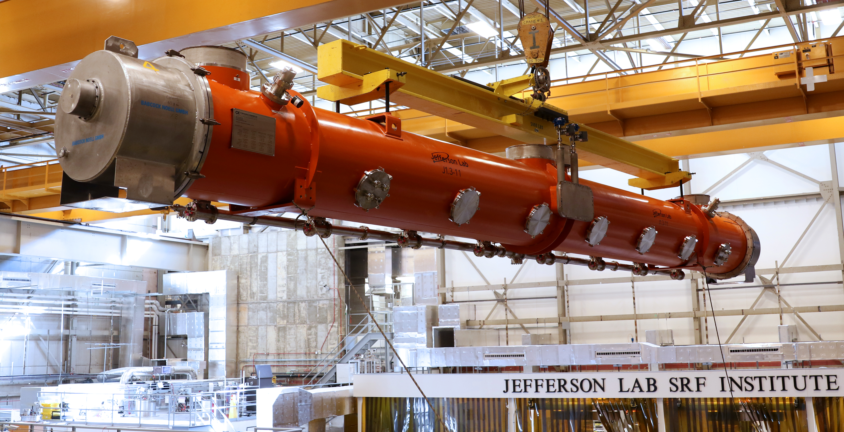
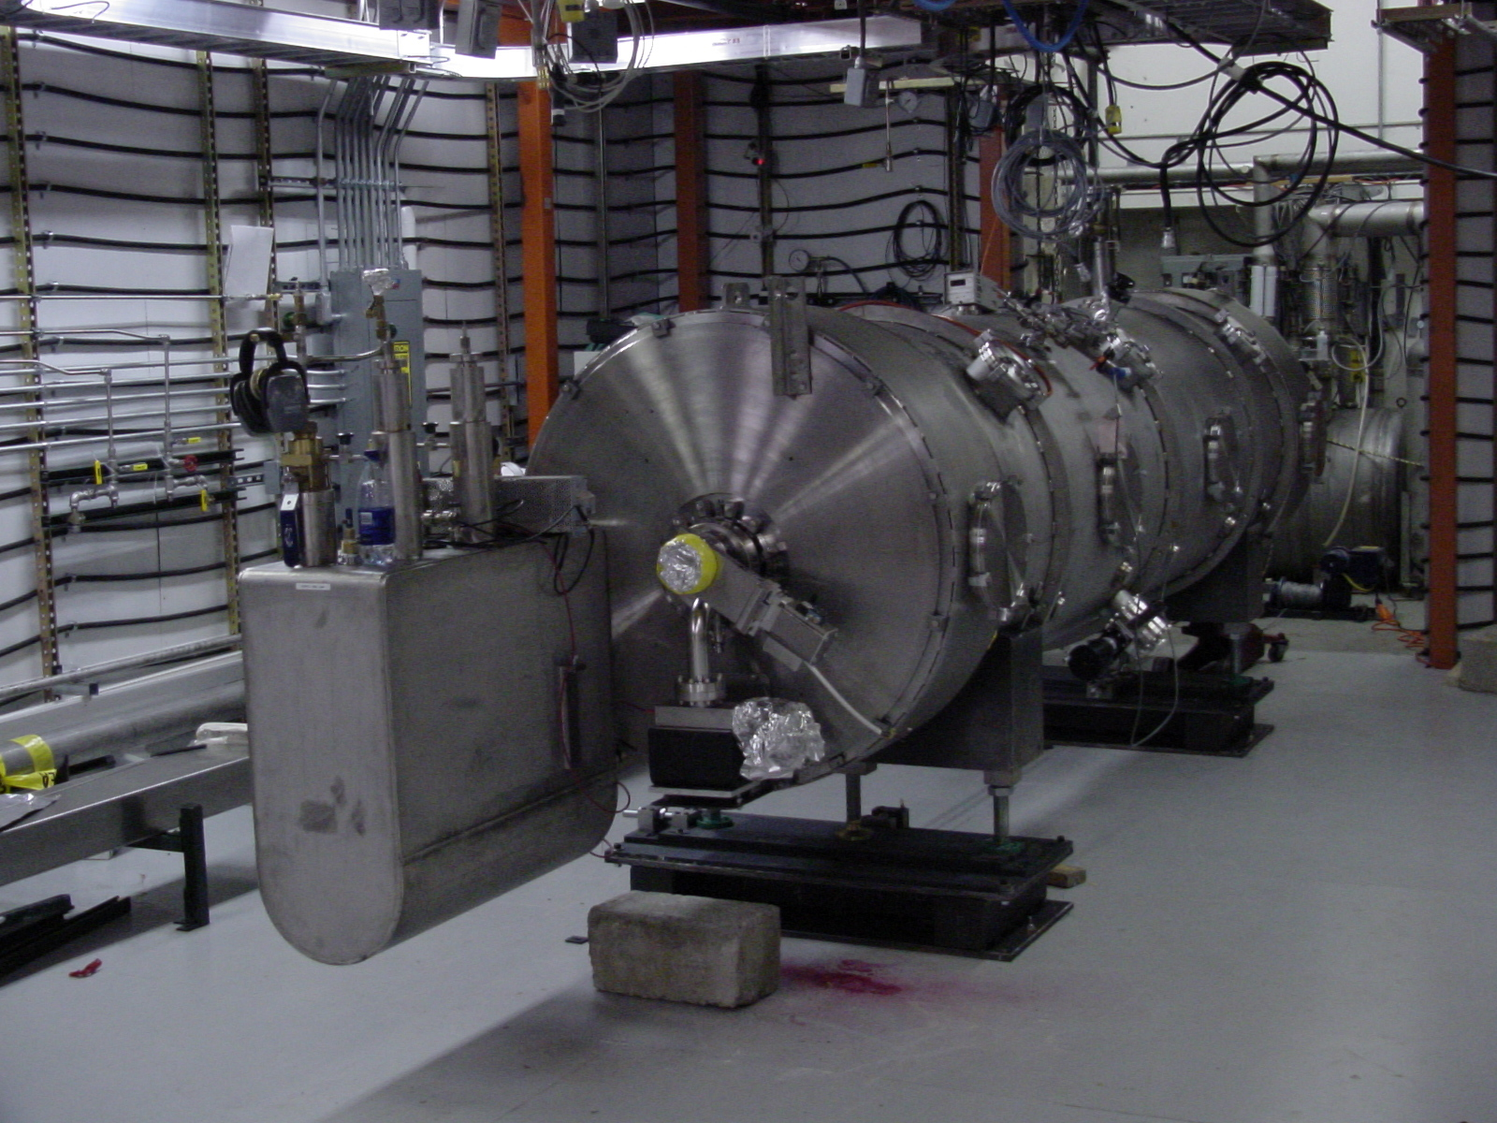
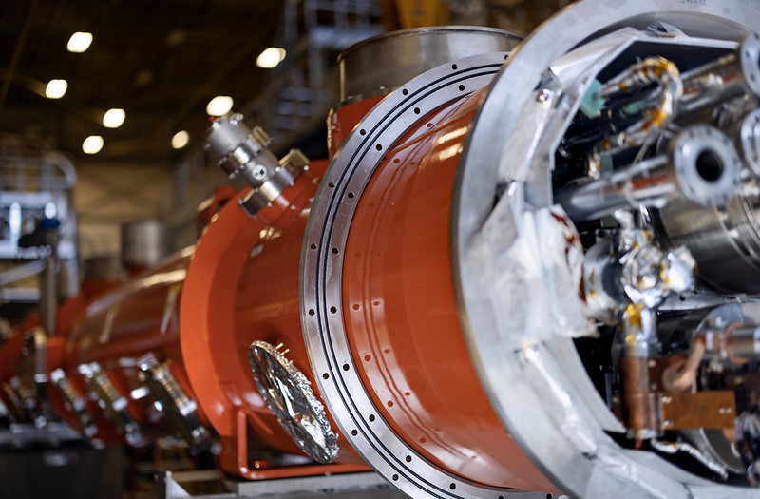
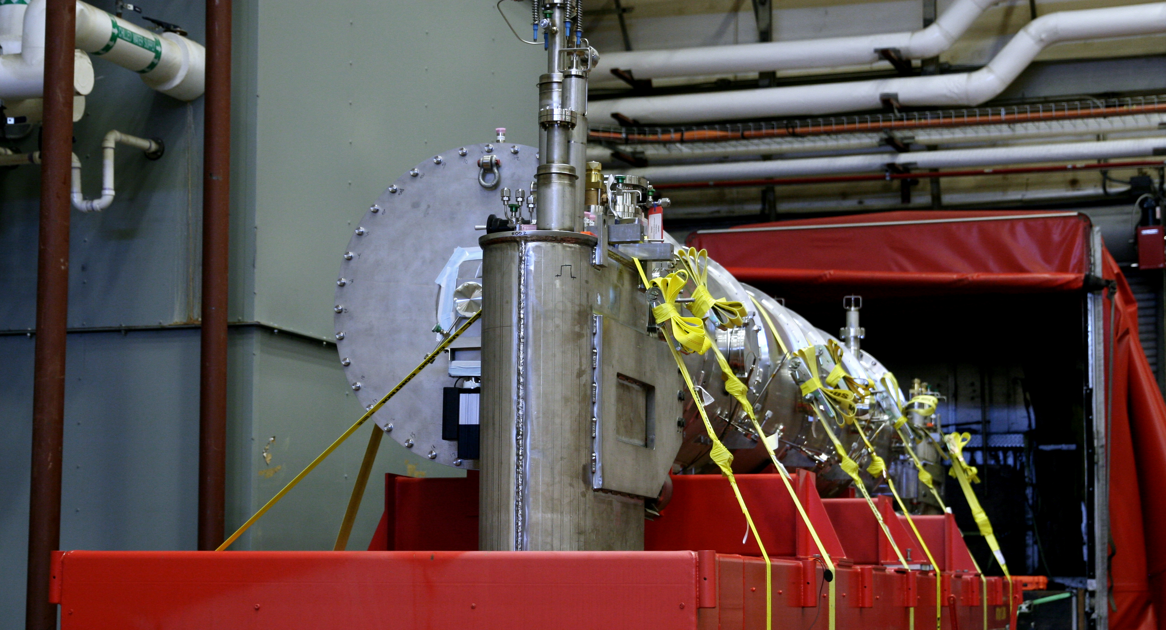
HISTORY AT JLAB SRF
LCLS-II
2010s
SNS
Early 2000s
LCLS-II-HE
2020s
SNS-PPU
2020s
Notes:
Guidelines: 6-8 bullets per slide; Use sentence fragments for bullets
To change the photo: Right-click on photo and select change photo

Slide 6
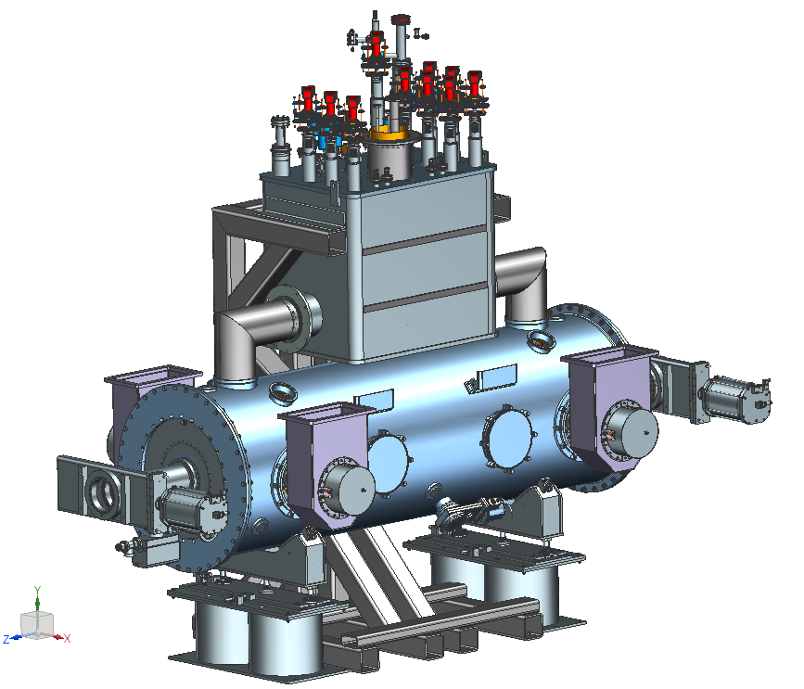
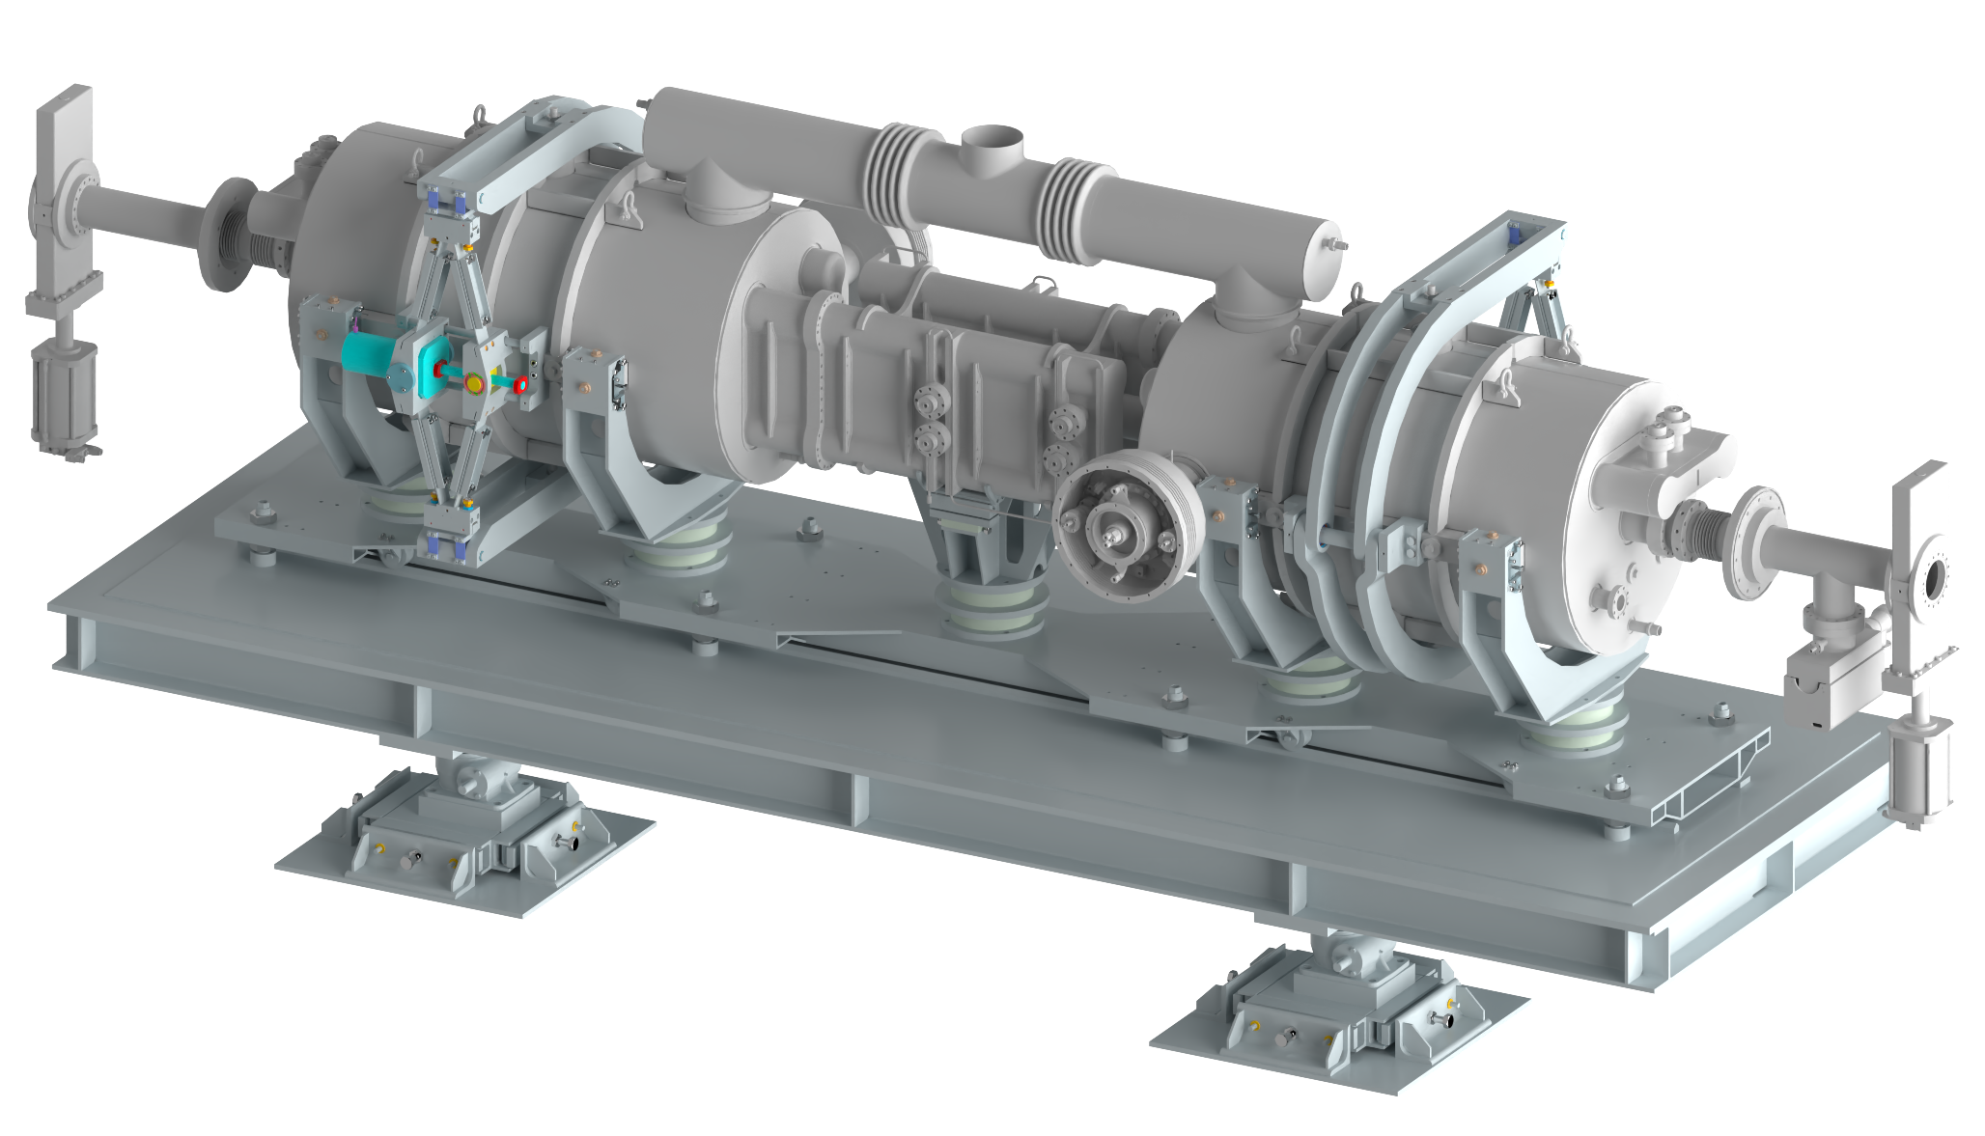
FUTURE AT JLAB SRF
2020s/2030s – EIC 591 MHZ
2020s/2030s – EIC 197/394 MHZ
Notes:
Guidelines: 6-8 bullets per slide; Use sentence fragments for bullets
To change the photo: Right-click on photo and select change photo

Slide 7
PRODUCTION STRATEGIES

Slide 8
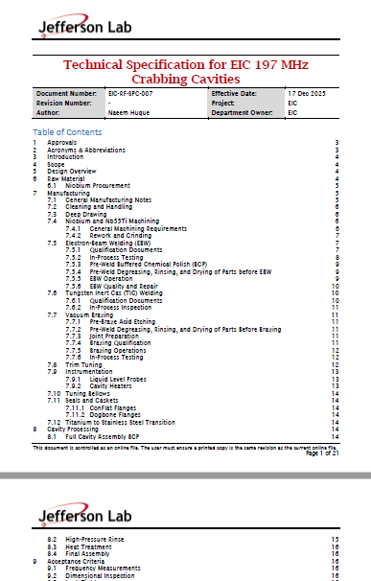
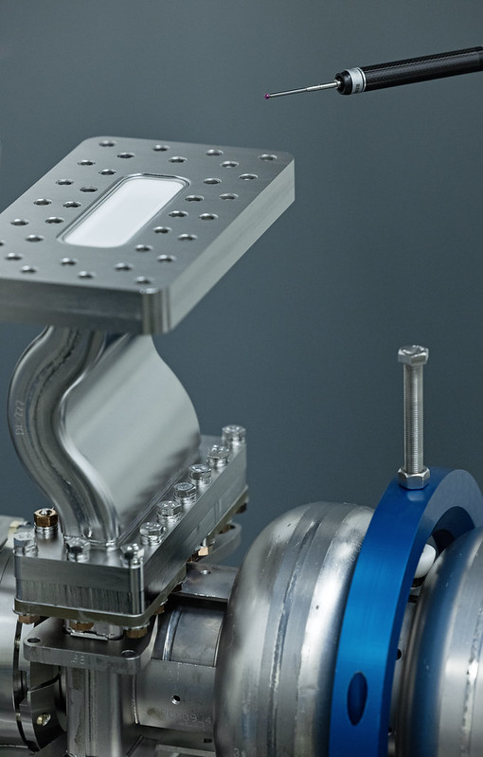
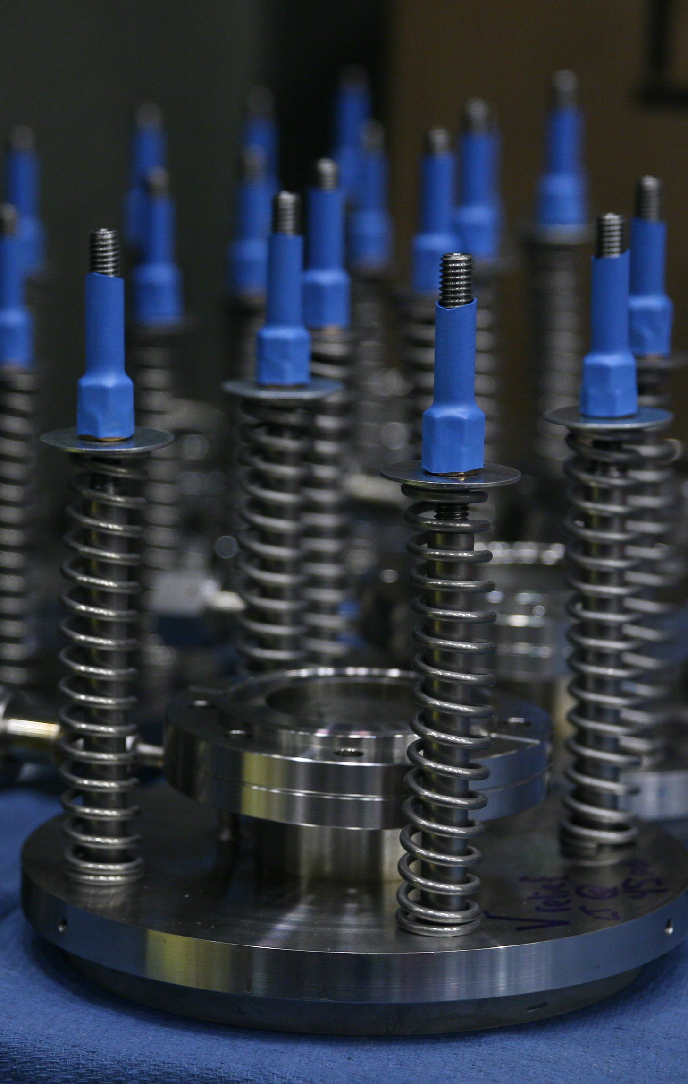
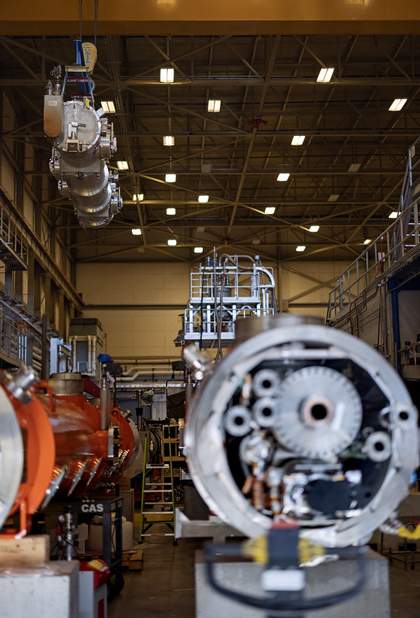
PPU PRODUCTION STRATEGIES
PROCUREMENT
INSPECTION
INVENTORY
ASSEMBLY
Notes:
Guidelines: 6-8 bullets per slide; Use sentence fragments for bullets
To change the photo: Right-click on photo and select change photo

Slide 9
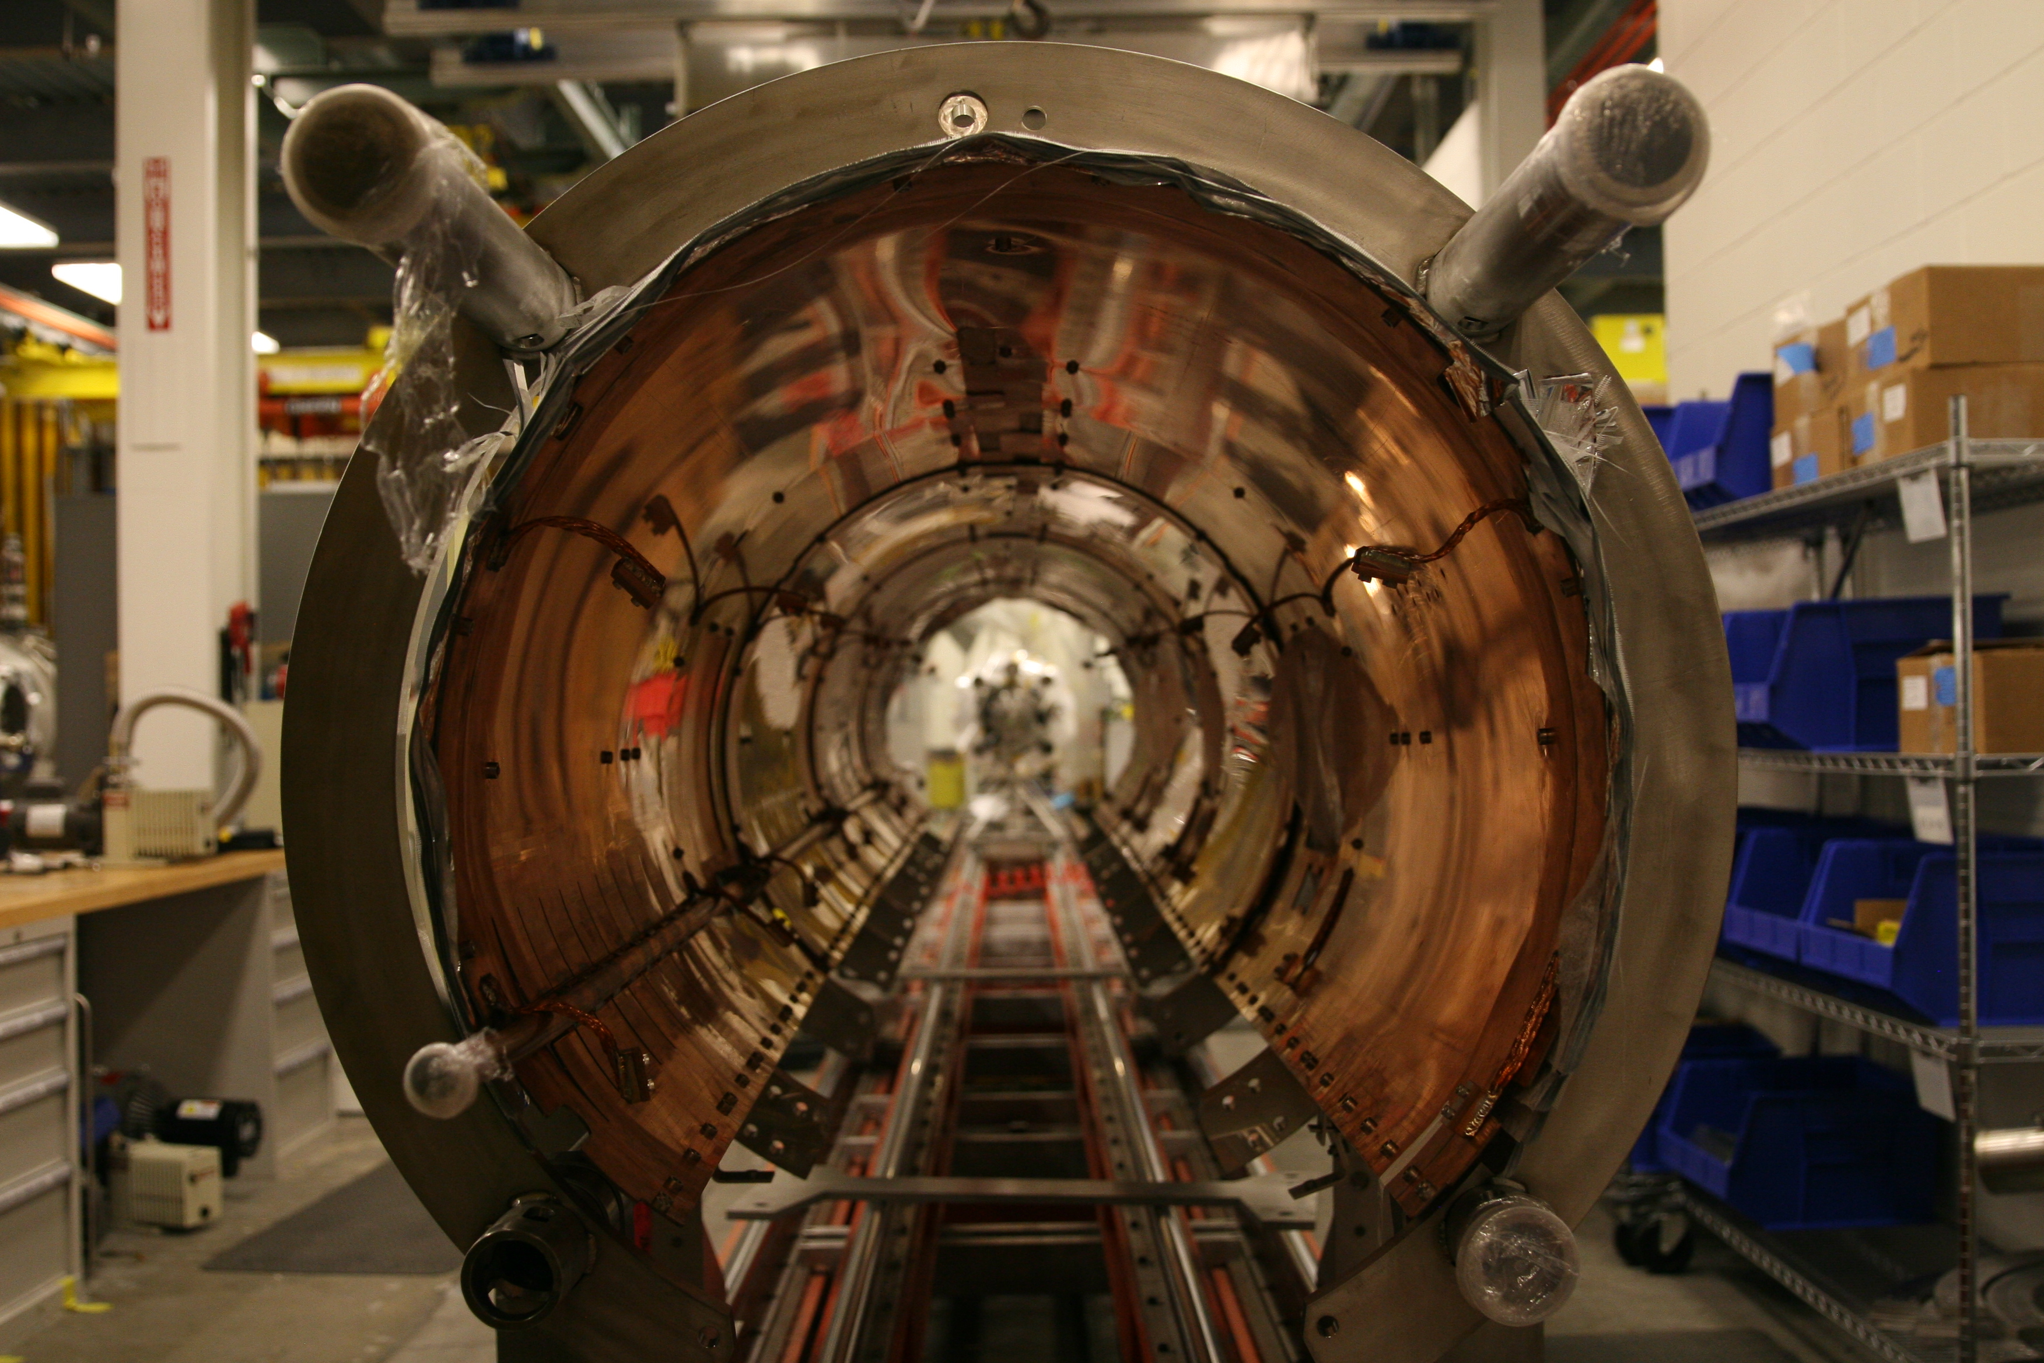
PPU PRODUCTION STRATEGIES
Vendor Sub-Assemblies
Thermal Shield, MLI, Spaceframe
VENDOR 1
PRE-ASSEMBLY
VENDOR 2
PROCUREMENT
INSPECTION
INVENTORY
ASSEMBLY
Notes:
Guidelines: 6-8 bullets per slide; Use sentence fragments for bullets
To change the photo: Right-click on photo and select change photo

Slide 10
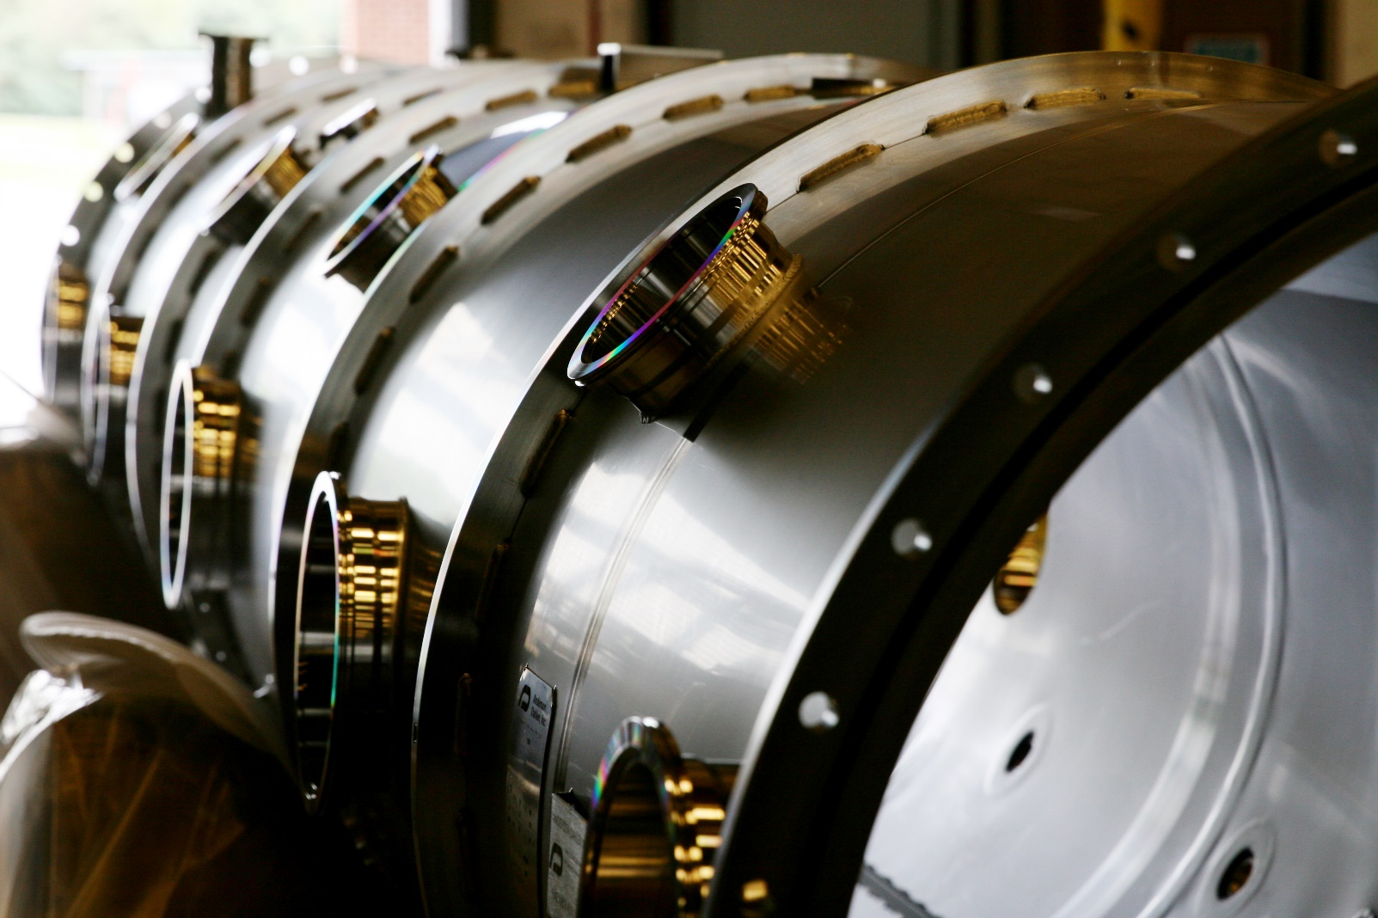
PPU PRODUCTION STRATEGIES
Third-Party Inspections
Vacuum Vessel
3RD PARTY INSP.
PROCUREMENT
INSPECTION
INVENTORY
ASSEMBLY
Notes:
Guidelines: 6-8 bullets per slide; Use sentence fragments for bullets
To change the photo: Right-click on photo and select change photo

Slide 11
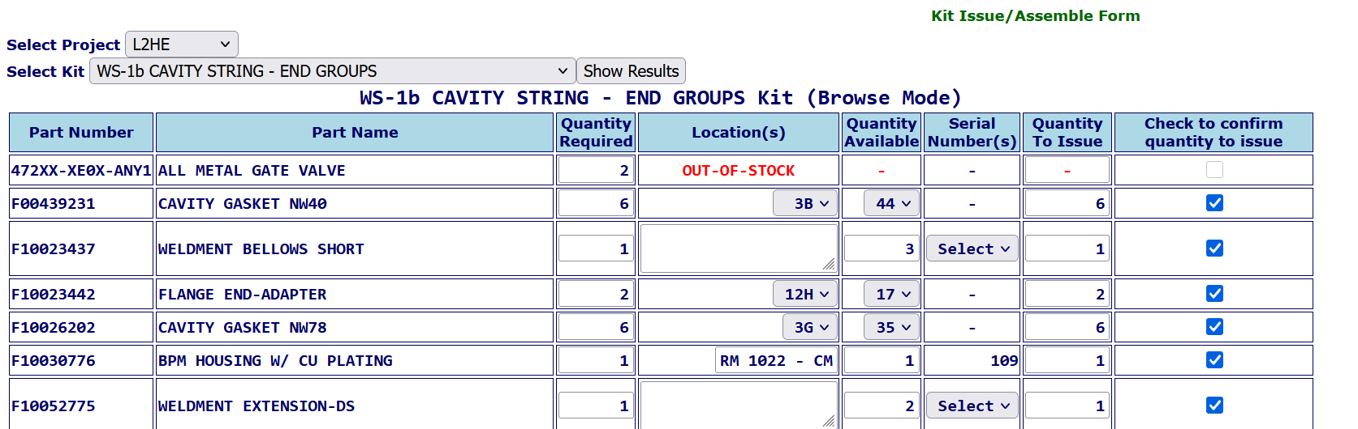
PRODUCTION STRATEGIES
Kit Generation
KIT GENERATION
PROCUREMENT
INSPECTION
INVENTORY
ASSEMBLY
Notes:
Guidelines: 6-8 bullets per slide; Use sentence fragments for bullets
To change the photo: Right-click on photo and select change photo

Slide 12
COPPER PLATING

Slide 13
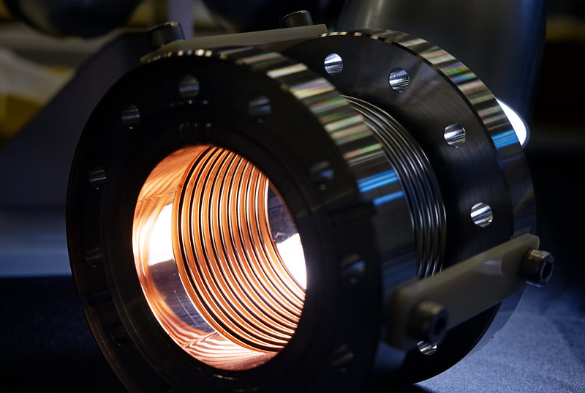
COPPER PLATING – LCLS-II BELLOWS
Non-Conformance Source
Non-Conformance Disposition
Notes:
Guidelines: 6-8 bullets per slide; Use sentence fragments for bullets
To change the photo: Right-click on photo and select change photo

Slide 14
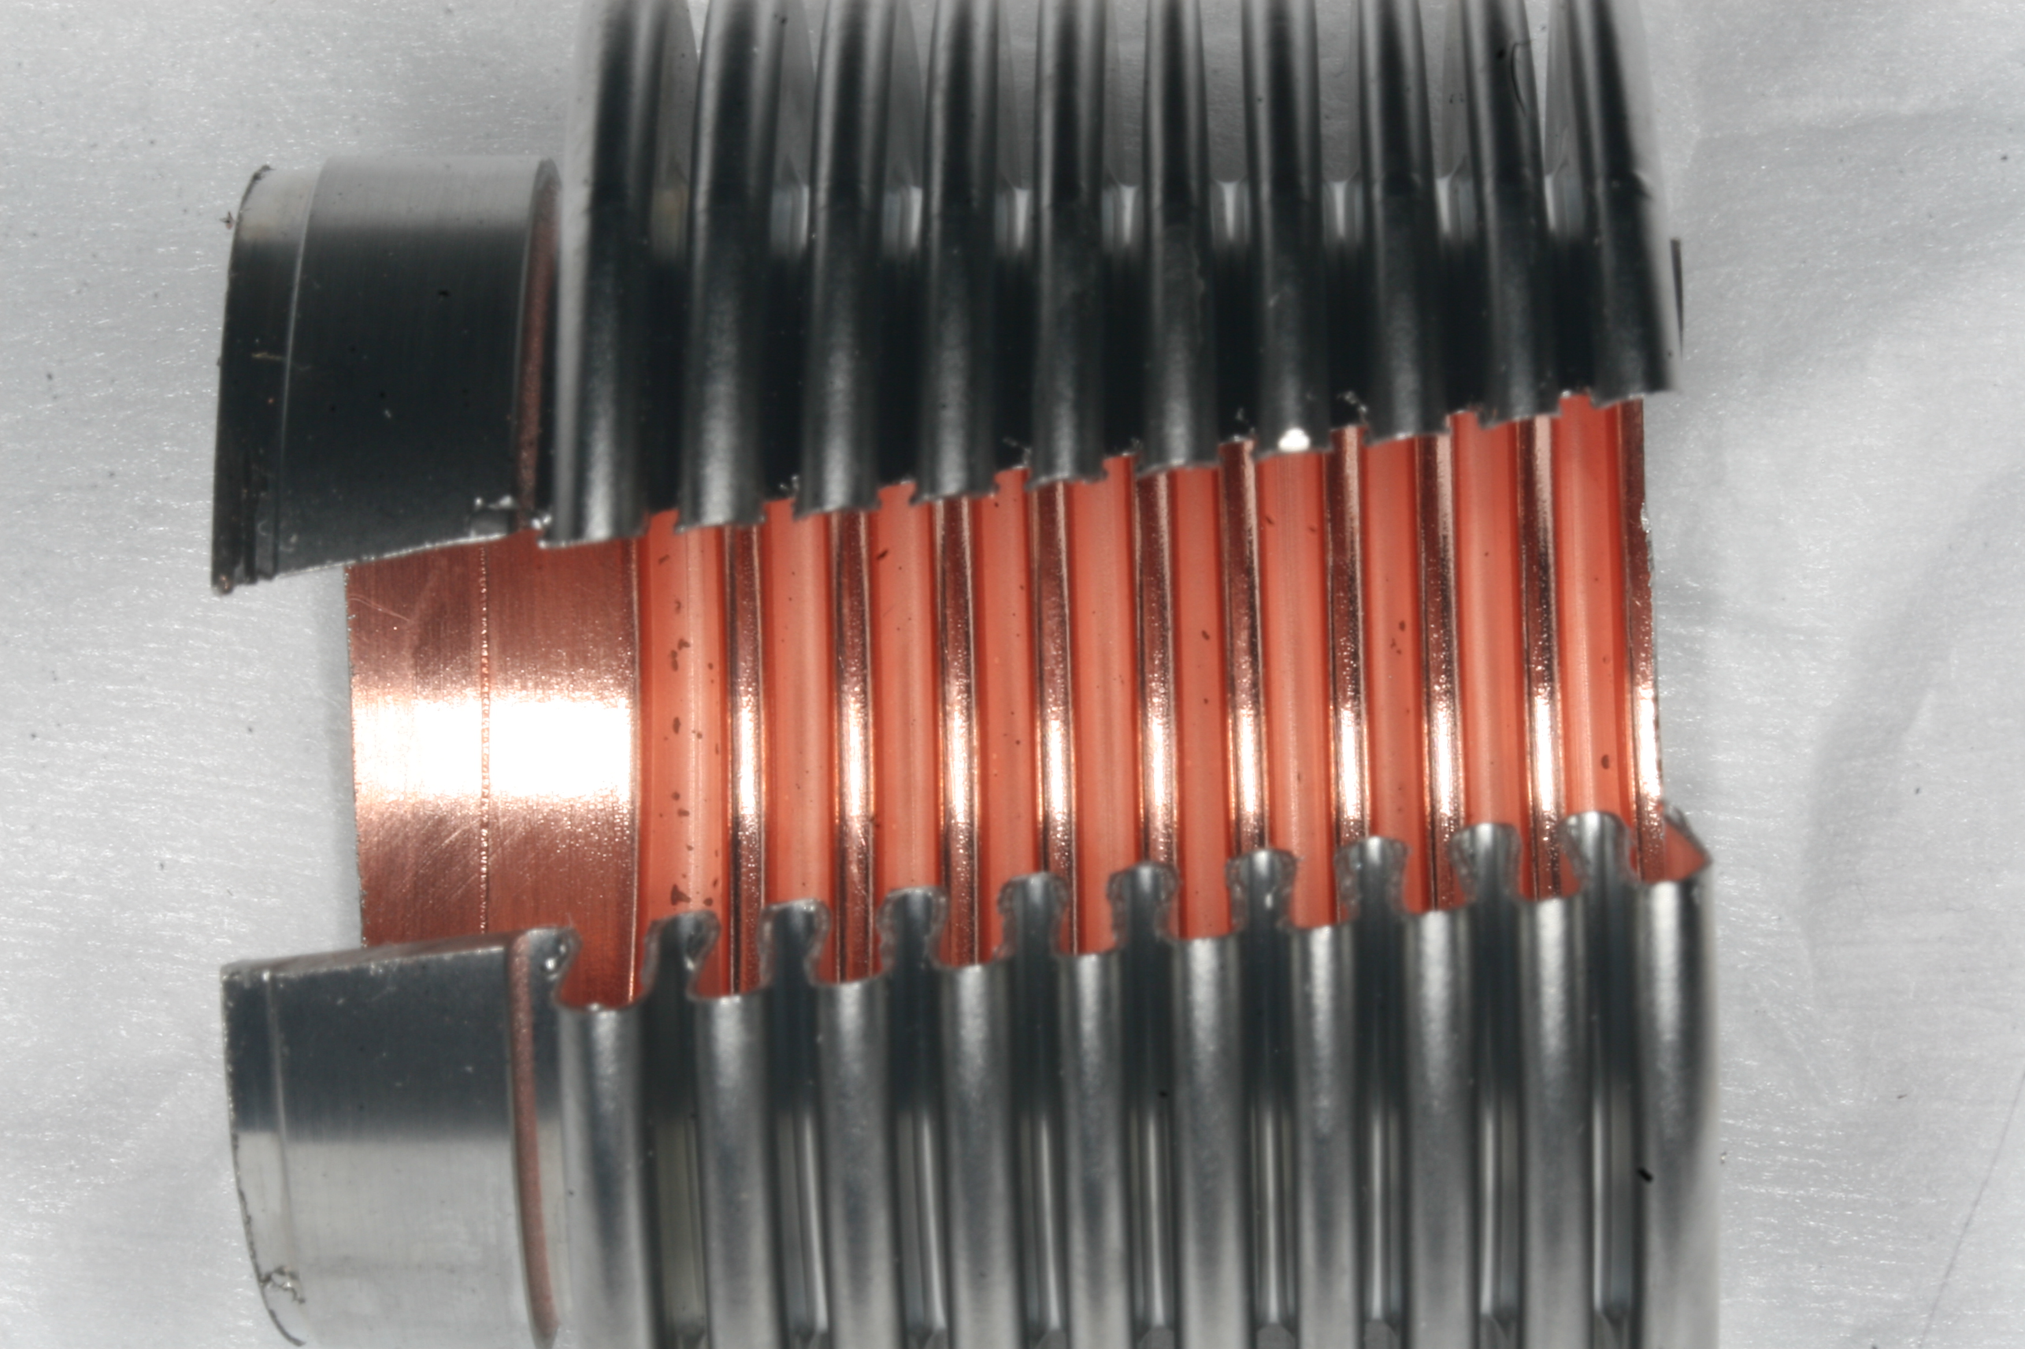
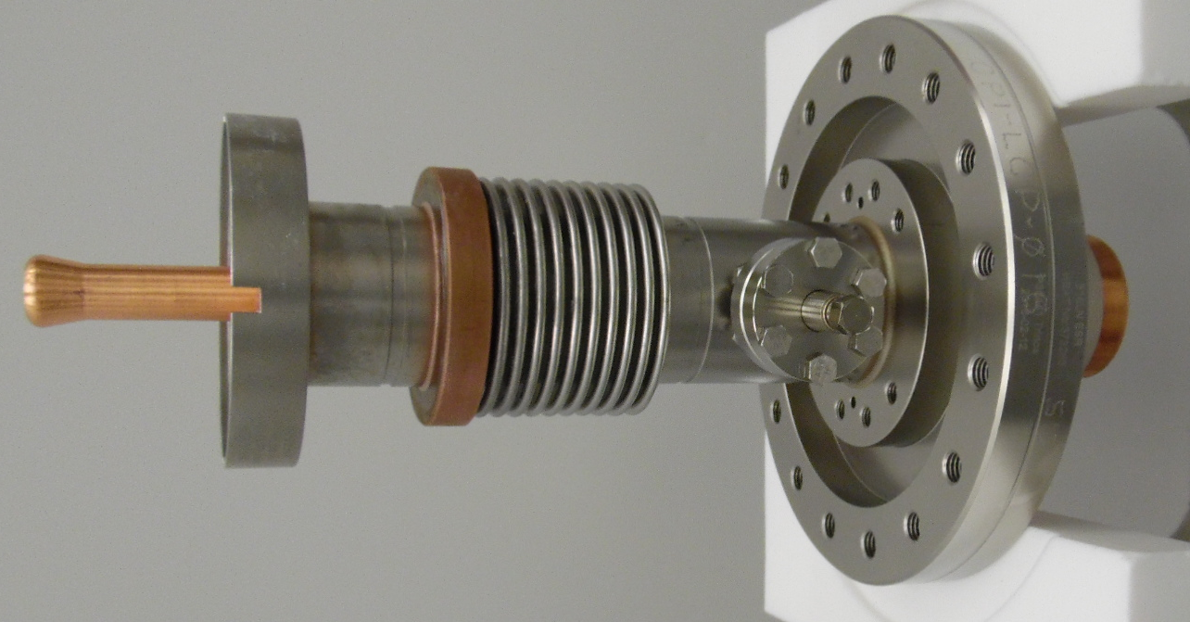
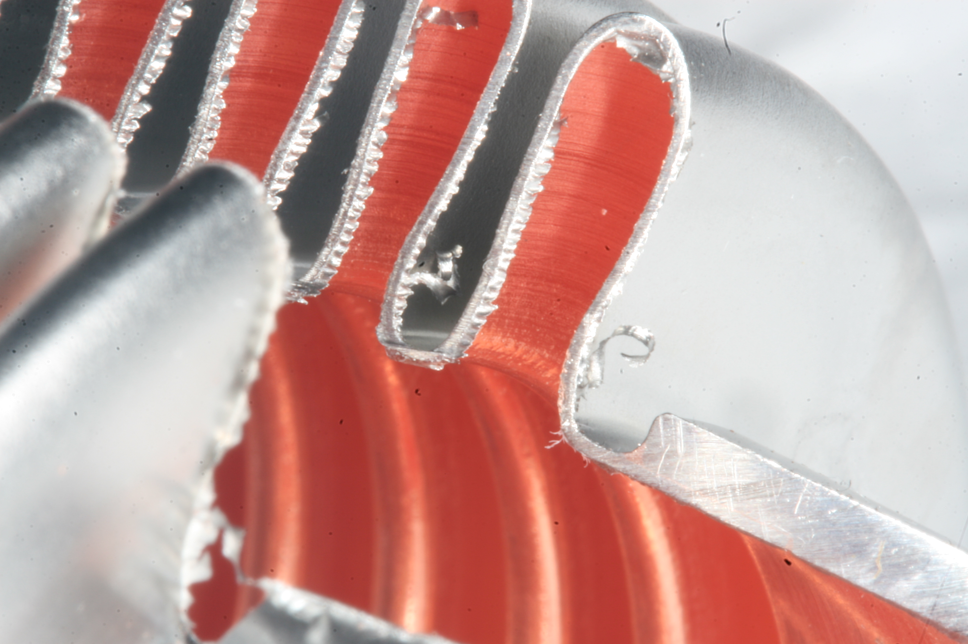
COPPER PLATING – L2HE FPC
Contract required third-party qualification of bellows and plating
  Sectioning
  Fatigue test
Notes:
Guidelines: 6-8 bullets per slide; Use sentence fragments for bullets
To change the photo: Right-click on photo and select change photo

Slide 15
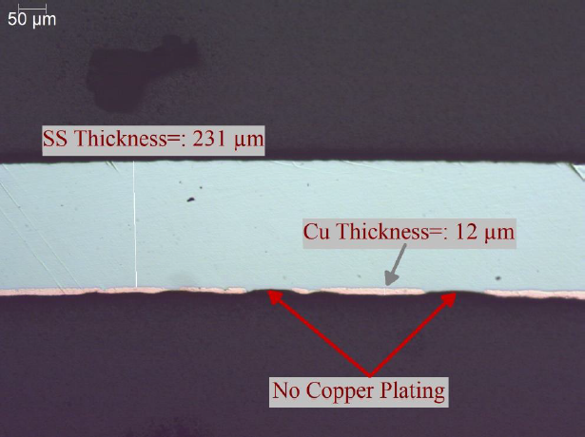
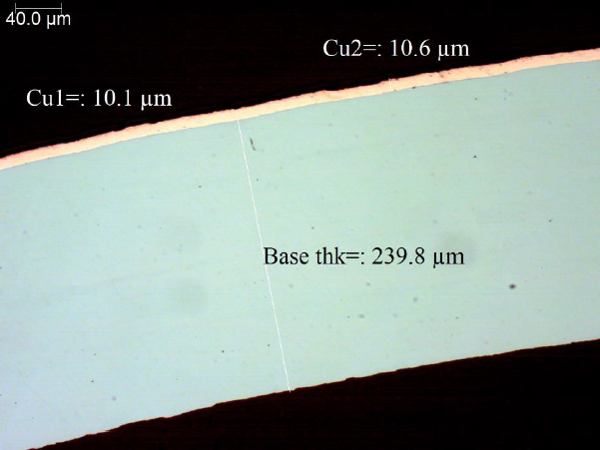
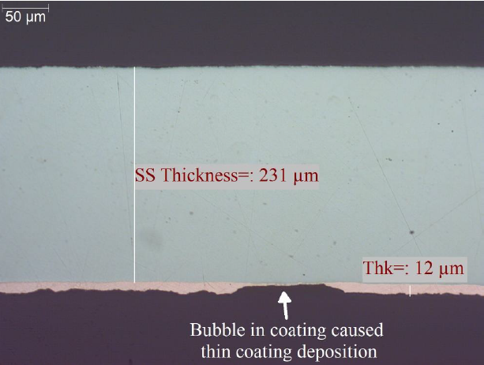
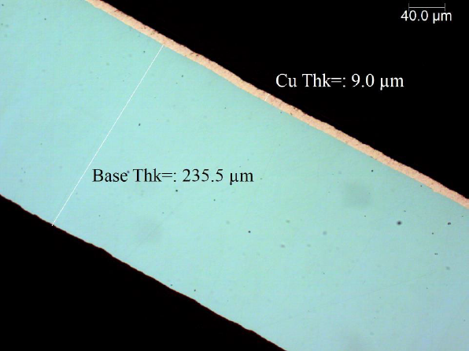
COPPER PLATING – L2HE FPC
Initial samples failed qualification; bubbles in plating
Successful qualification after several iterations
Notes:
Guidelines: 6-8 bullets per slide; Use sentence fragments for bullets
To change the photo: Right-click on photo and select change photo

Slide 16
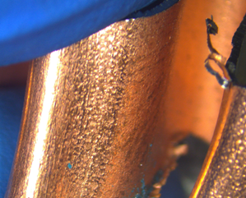

COPPER PLATING – L2HE FPC
Before
After
Notes:
Guidelines: 6-8 bullets per slide; Use sentence fragments for bullets
To change the photo: Right-click on photo and select change photo

Slide 17
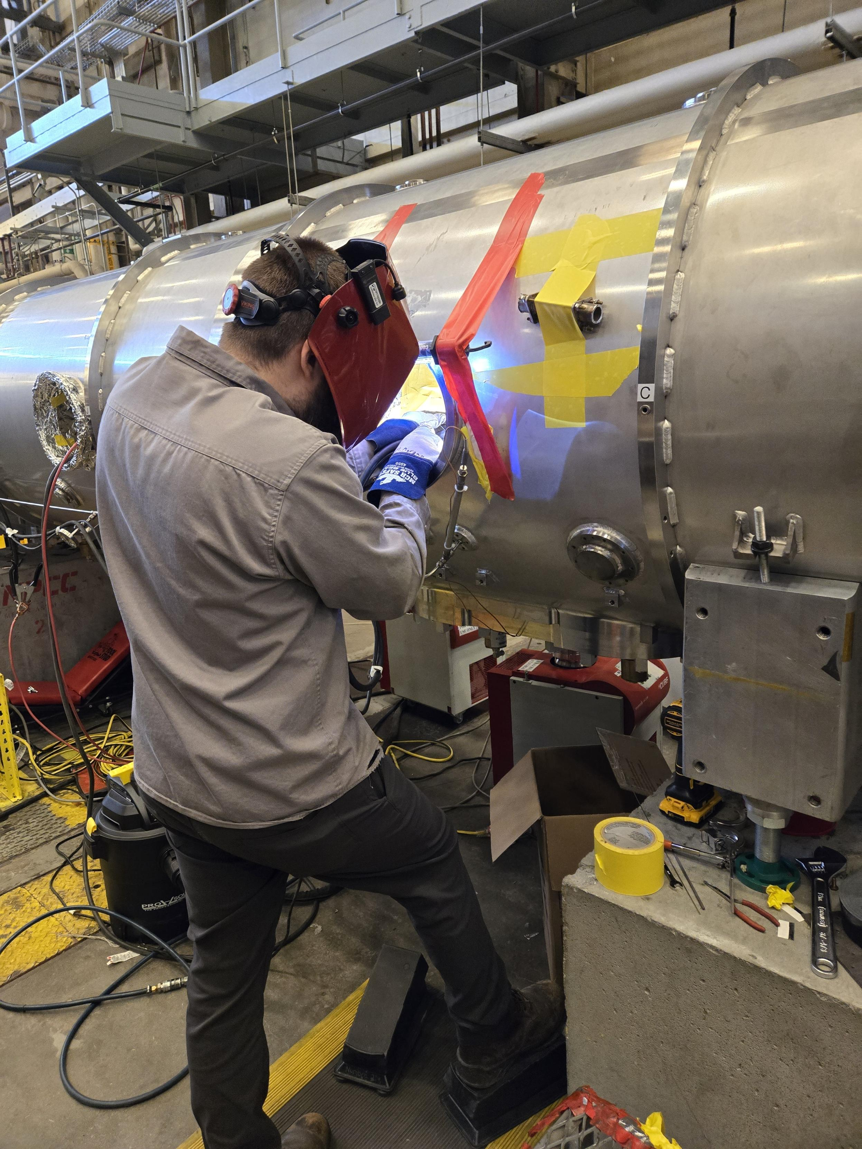
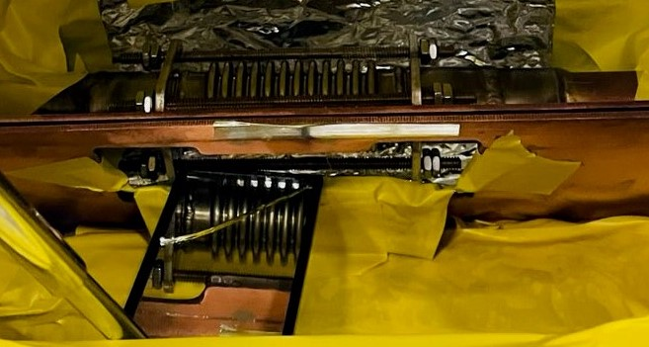
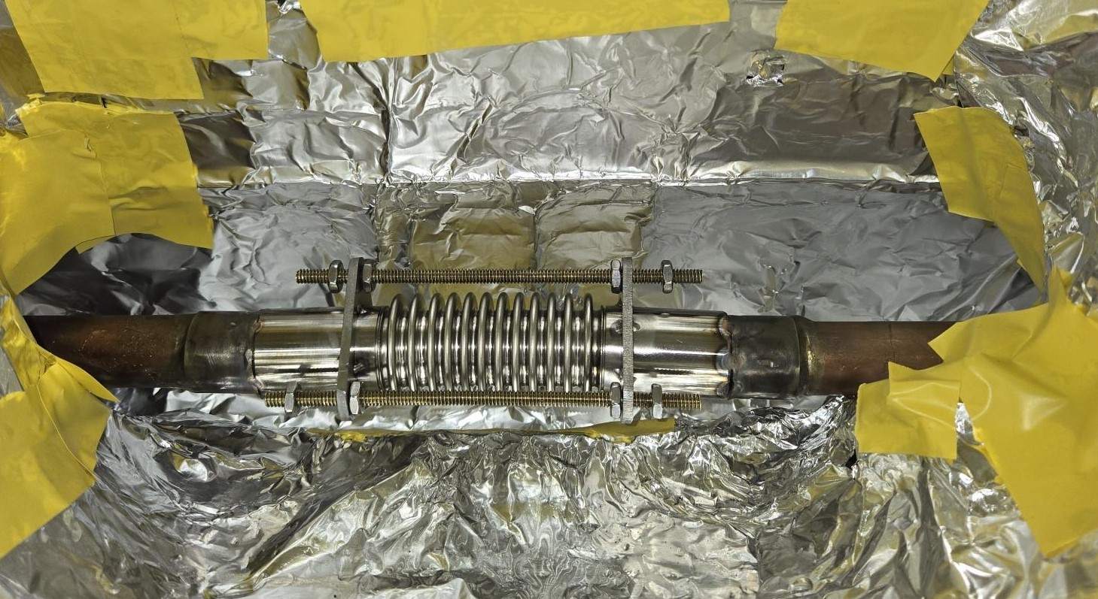
SPEAKING OF BELLOWS…
Leak found in thermal shield bellows, after final CM assembly
Found after pressure test
Vendor had spares
Repair was successful
Another unit had similar problem, caught earlier
Repair through access port
Lesson: Consider spares of critical/fragile subcomponents
Notes:
Guidelines: 6-8 bullets per slide; Use sentence fragments for bullets
To change the photo: Right-click on photo and select change photo

Slide 18
CAVITY PERFORMANCE

Slide 19
CAVITY PERFORMANCE – C100
- 25%
Total Cavities: 80
Spares: 7.5%
Retest Rate: 85%
Notes:
Guidelines: 6-8 bullets per slide; Use sentence fragments for bullets
To change the photo: Right-click on photo and select change photo

Slide 20
CAVITY PERFORMANCE – LCLS-II
- 7%
- 7%
Total Cavities (JLab): 168
Spares (JLab & FNAL): 26%
Cavity Retest Rate (JLab): 60%
Notes:
Guidelines: 6-8 bullets per slide; Use sentence fragments for bullets
To change the photo: Right-click on photo and select change photo

Slide 21
CAVITY PERFORMANCE – LCLS-II-HE
- 13%
- 12%
- 15%
Total Cavities (JLab & FNAL): 184
Spares (JLab & FNAL): 13%
Cavity Retest Rate (JLab): 90%
Notes:
Guidelines: 6-8 bullets per slide; Use sentence fragments for bullets
To change the photo: Right-click on photo and select change photo

Slide 22
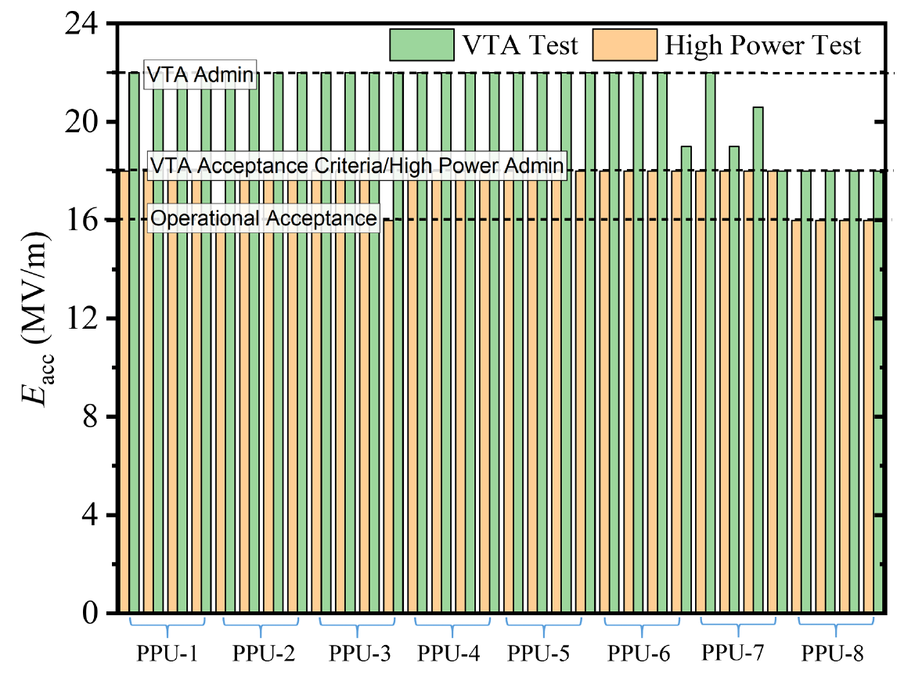
CAVITY PERFORMANCE – SNS-PPU
Total Cavities: 32
Spares: 0.0%
Retest Rate: 120%
P. Dhakal et. al. Performance of Oak Ridge National Laboratory spallation neutron source proton power upgrade cavities and cryomodule production, Phys. Rev. Accel. Beams 27, 102001
Notes:
Guidelines: 6-8 bullets per slide; Use sentence fragments for bullets
To change the photo: Right-click on photo and select change photo

Slide 23
NON-CONFORMANCES

Slide 24
NCRs
Non-Conformance Report (NCR) Dispositions
Notes:
Guidelines: 6-8 bullets per slide; Use sentence fragments for bullets
To change the photo: Right-click on photo and select change photo

Slide 25
PROCUREMENT LESSONS

Slide 26
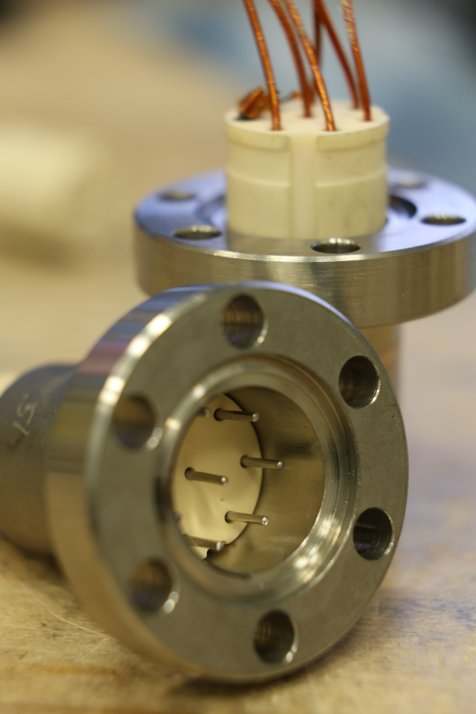
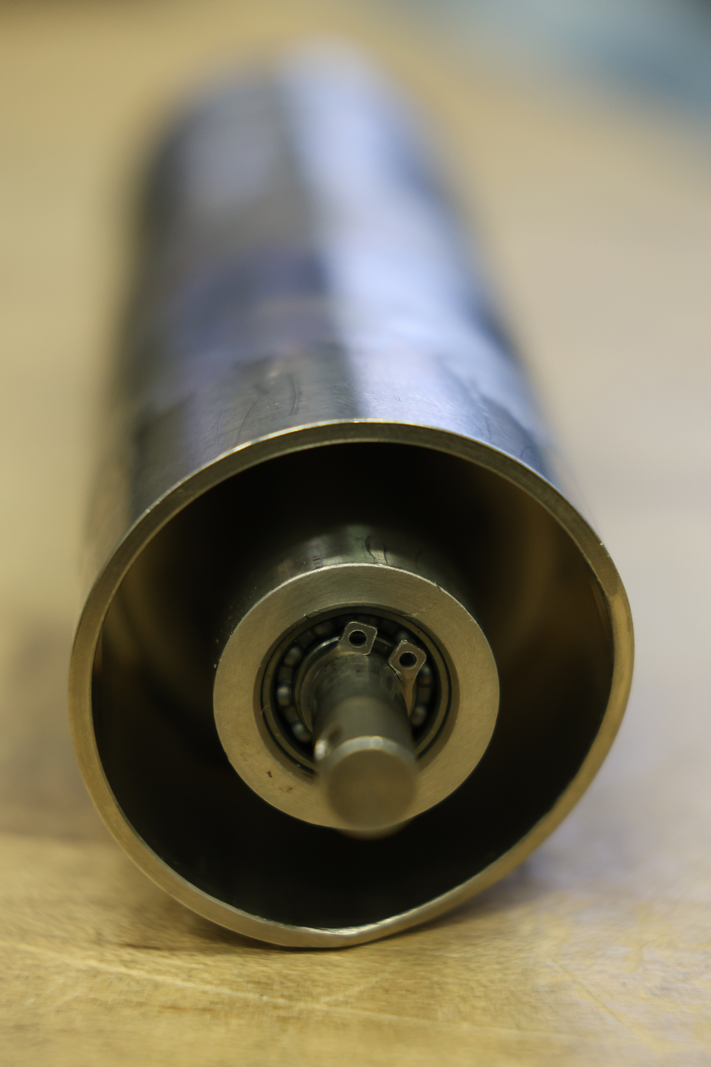
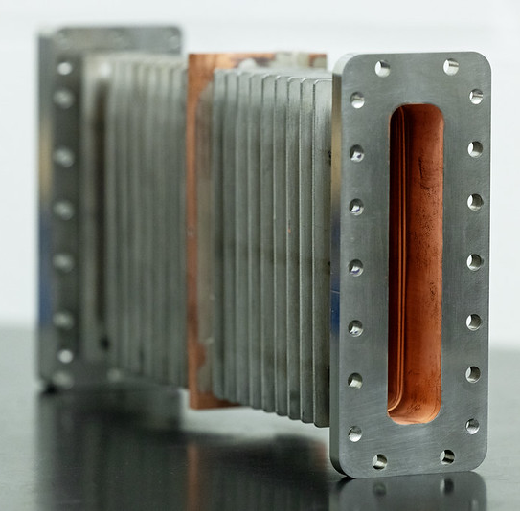
LONG-TERM PROCUREMENT LESSONS
Rectangular Waveguide
Vendor no longer makes the part; no alternative vendor
Re-plated and reused as needed
20 spares, no known source for more
Cryogenic Feedthrough
Developed for C20s in early 1990s
30% failure of later batch
Personnel change
Rotary Feedthru
Vendor no longer produces component
Parts have been repaired as needed; now reverse engineering
Notes:
Guidelines: 6-8 bullets per slide; Use sentence fragments for bullets
To change the photo: Right-click on photo and select change photo

Slide 27

SUMMARY
Notes:
Before sharing your presentation, confirm:
Fonts are consistent
Images meet quality standards
Charts use template colors
Footer information is current
Spell check completed
Links are working
File size is optimized

