Slide 1
RF Testing and Performance Analysis of Low Beta Superconducting Cavities for HIAF Facility
Shihui WEI, Feng QIU, Yuan HE, Lijuan YANG, Zheng GAO, Jiayi PENG,
Liepeng SUN, Tiancai JIANG (IMP), Rihua ZENG (Dongjiang Lab)
On behalf of IMP SRF team Institute of Modern Physics (IMP)
TESLA Technology Collaboration 2026 (TTC2026)
Notes:
Hello colleagues. It is my honor to speak at TTC2026. Today I will share our work: ‘RF Testing and Performance Analysis of Low Beta Superconducting Cavities for HIAF Facility.’HIAF is a major facility in China, and SRF cavity performance is critical.

Slide 2
01
Introduction-HIAF
02
RF Conditioning
CONTENTS
03
Horizontal test
04
Summary
Notes:
Today my talk has four parts. Introduction — briefly introduce the HIAF project
RF Conditioning—our core methods: automated conditioning and loading
Horizontal test— what we measure and how: key RF parameters for HIAF SRF cavities.
And finally I will give a brief summary

Slide 3
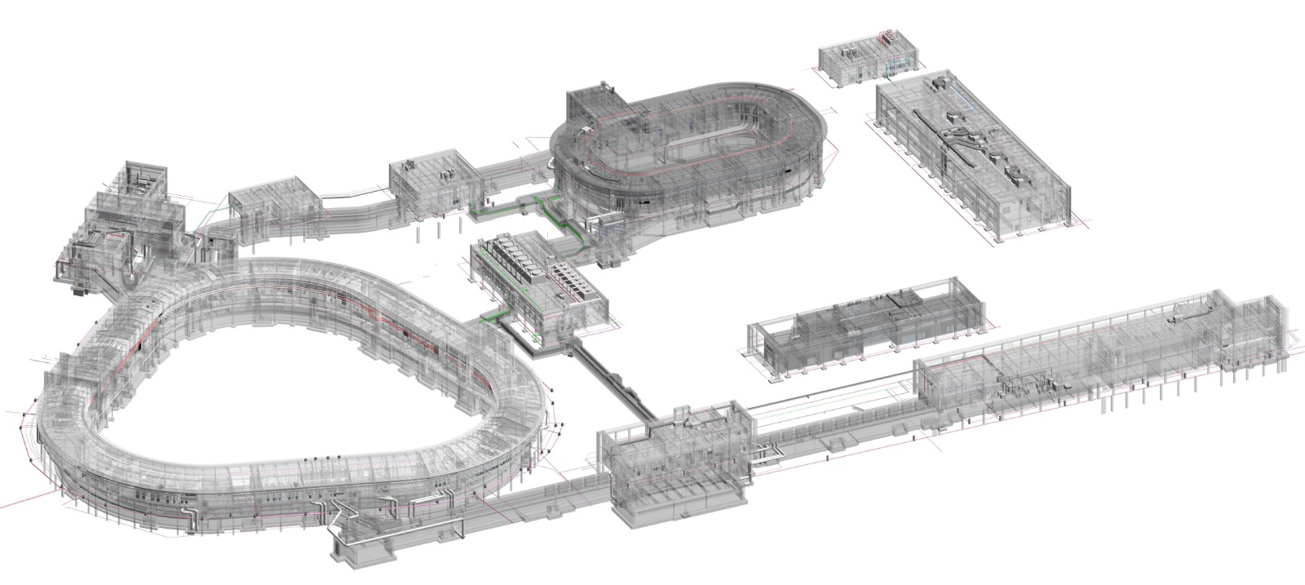
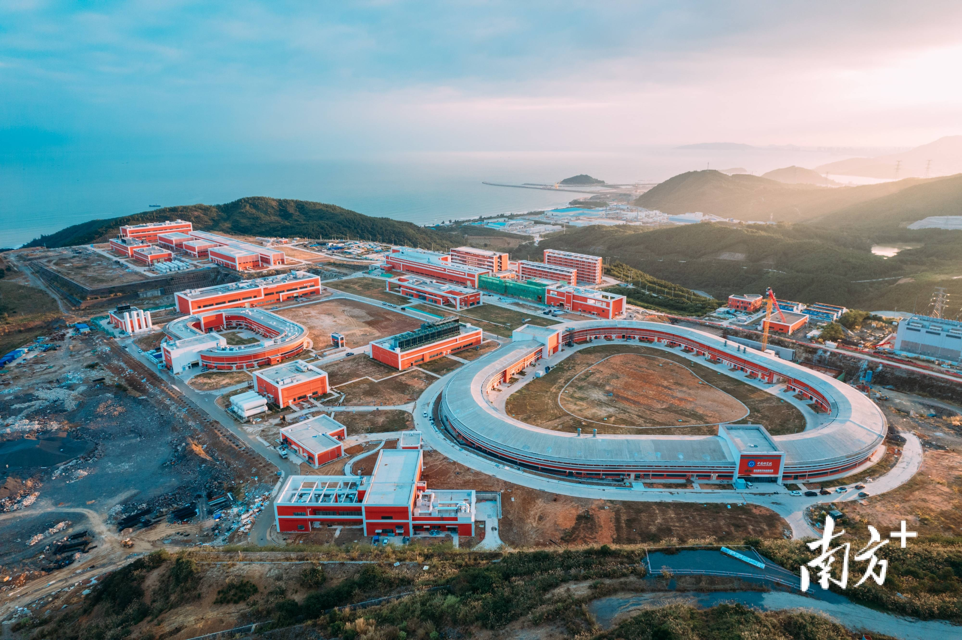
Introduction—HIAF
SRing
  HIAF: High Intensity heavy-ion Accelerator Facility
  Mainly designed to provide high energy (~800MeV/u) and high intensity (10¹¹ppp) heavy ion beams (up to U ³⁵⁺)
  Civil construction was started in the end of 2018
  Beam commissioning date is December 2025
HFRS
SECR
BRing
HIAF Facility
iLinac
  Approved in Dec. 2015, Ground broke in Aug.
  2018, Officially started in July 2021
  Leading institute: IMP
  Location: Huizhou, Guangdong Prov.
Notes:
Let me begin with a brief introduction to HIAF.
HIAF stands for the High Intensity heavy-ion Accelerator Facility. It is mainly designed to provide high-energy heavy ion beams — up to about 800 MeV per nucleon — with high intensity, up to 10^11 particles per pulse, for ions as heavy as uranium in charge state 35+.
The facility is located in Huizhou, Guangdong Province, and is led by the Institute of Modern Physics.
The project was approved in December 2015, ground was broken in August 2018, and construction officially started in July 2021. Civil construction began by the end of 2018. Beam commissioning is planned for December 2025.

Slide 4
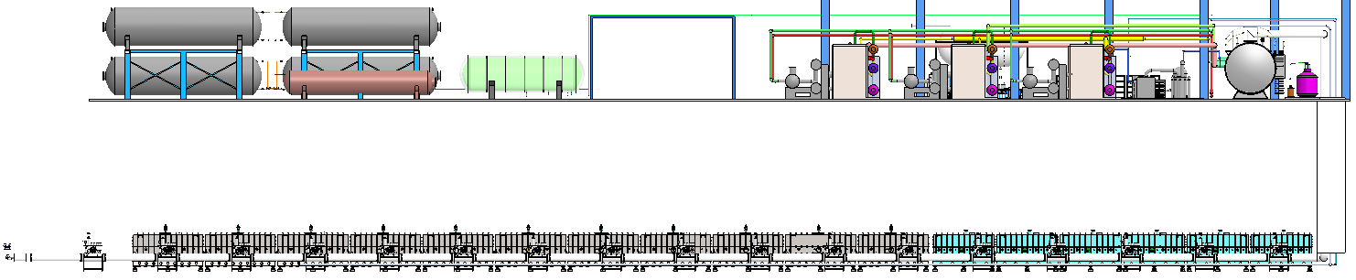
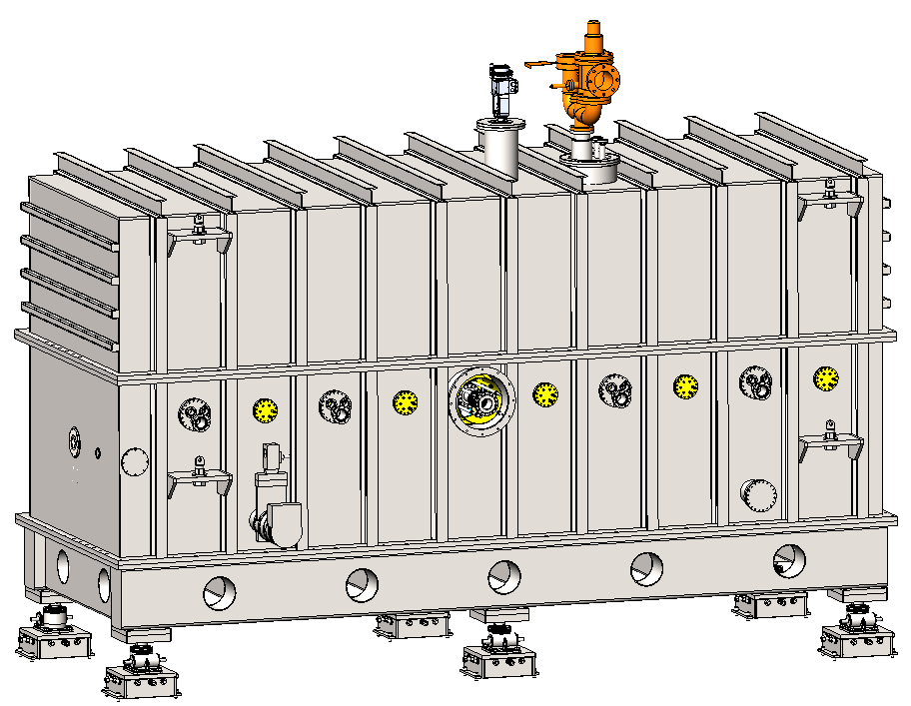
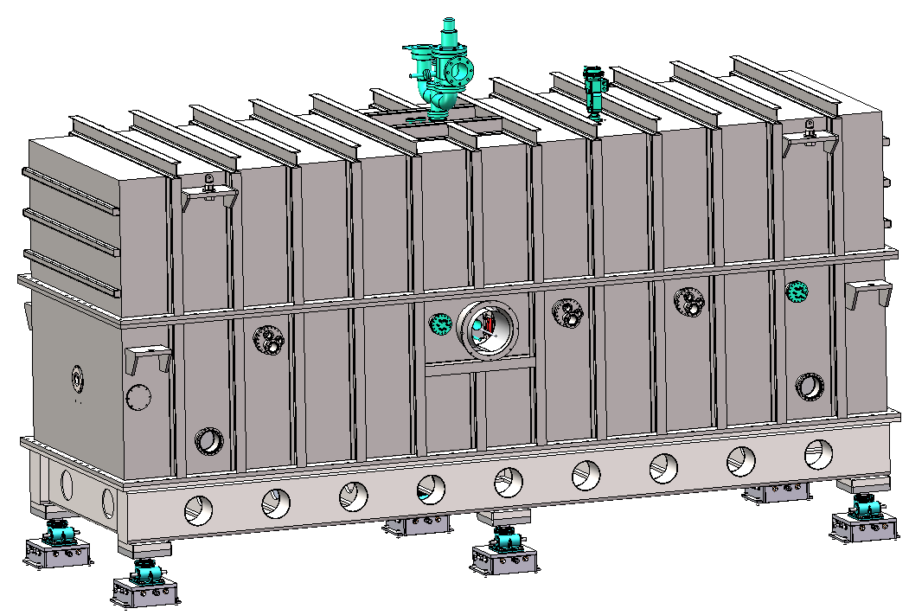
HIAF-iLINAC
 | HWR015 | QWR007
CM Quantity | 11 | 6
CM Length [mm] | 5836 | 5073
CM Width [mm] | 2000 | 2000
CM Height [mm] | 3800 | 3800
Cavity Quantity | 6 | 5
BPM Quantity | 1 | 4
CM-HWR015 (Quantity：11)
CM-QWR007 ( Quantity：6 )
CM-HWR015
(Half-Wave Resonator)
CM-QWR007
(Quarter-Wave Resonator)
Notes:
This slide shows the layout and key parameters of the iLINAC system at HIAF. The iLINAC is designed to handle both continuous wave (CW) and pulsed beams. It is a superconducting linac that employs 17 cryomodules with a total of 96 SRF cavities. Among them, 6 cryomodules are equipped with QWR007 (Quarter-Wave Resonator) cavities (5 cavities each), and the other 11 cryomodules use HWR015 (Half-Wave Resonator) cavities (6 cavities each). For beam monitoring, each QWR007 cryomodule contains 4 Beam Position Monitors (BPMs), while each HWR015 cryomodule has 1 BPM.

Slide 5
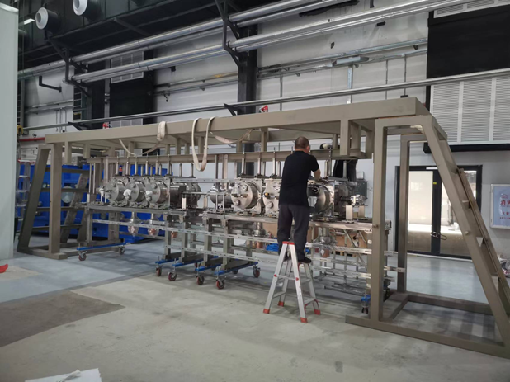
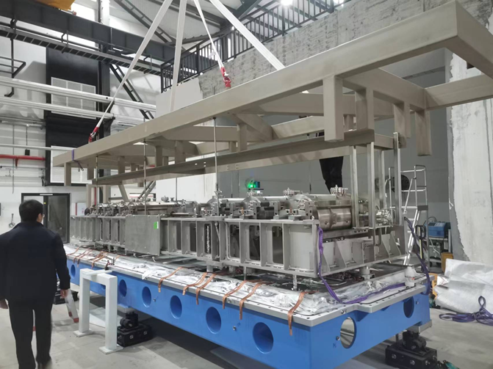
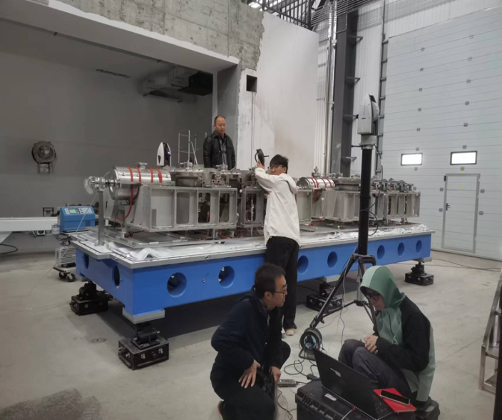
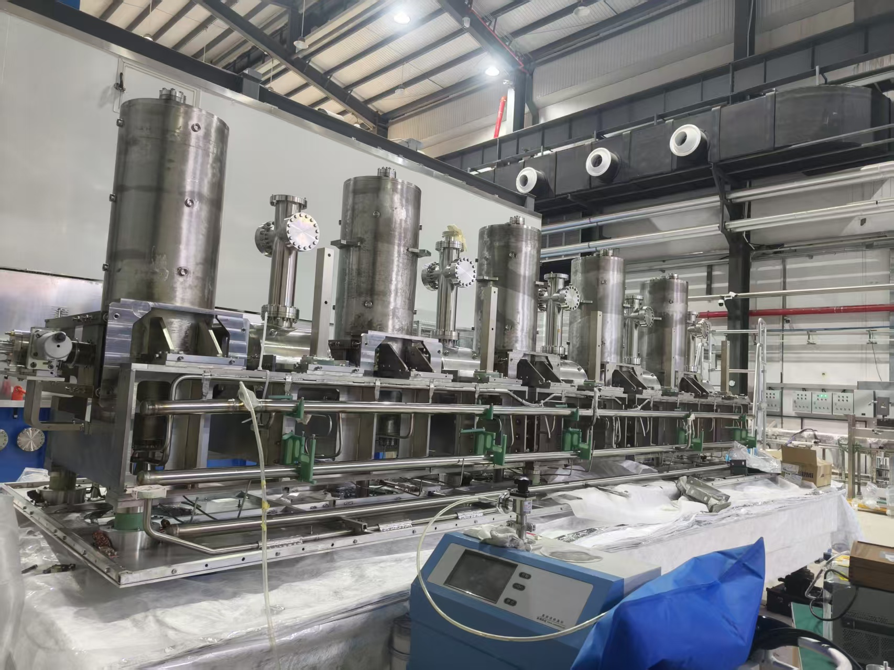
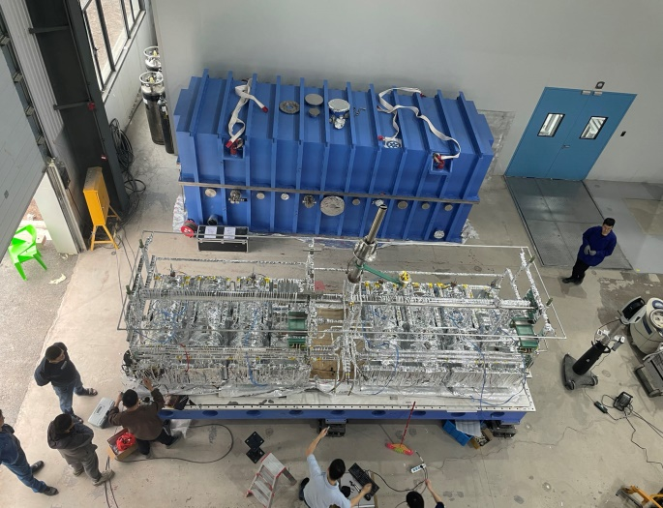
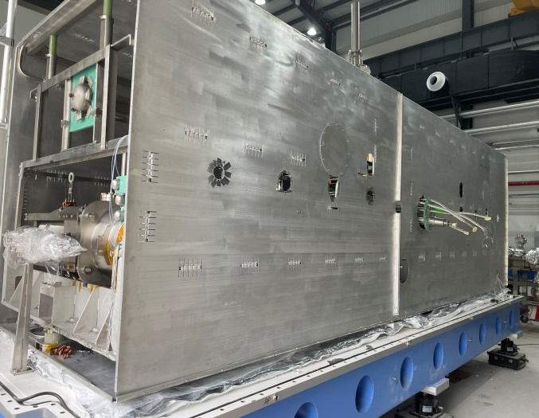
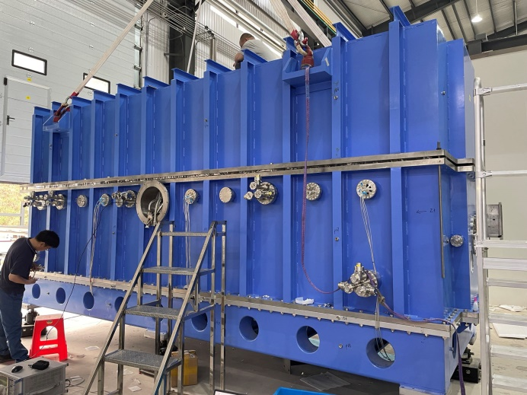
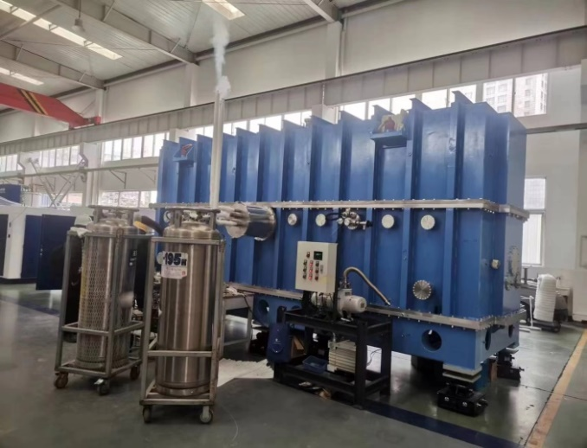
Assembling of QWR & HWR CMs
Cold mass
Hoisting together
Precise Alignment
QWR007
Multilayer insulation
Thermal shield
Completed assembly
LN2 testing for CMs
Notes:
This slide summarizes the assembly and testing of our QWR &HWR cryomodules. Starting from the cold mass, we hoist it into the vessel, then perform precise alignment. After installing multilayer insulation and the thermal shield, we complete the assembly. Finally, each cryomodule passes liquid nitrogen testing before installation.

Slide 6
01
Introduction
02
RF Conditioning
CONTENTS
03
Horizontal test
04
Summary
Notes:
Next, I will expand in detail on the conditioning of RF cavities and couplers.

Slide 7
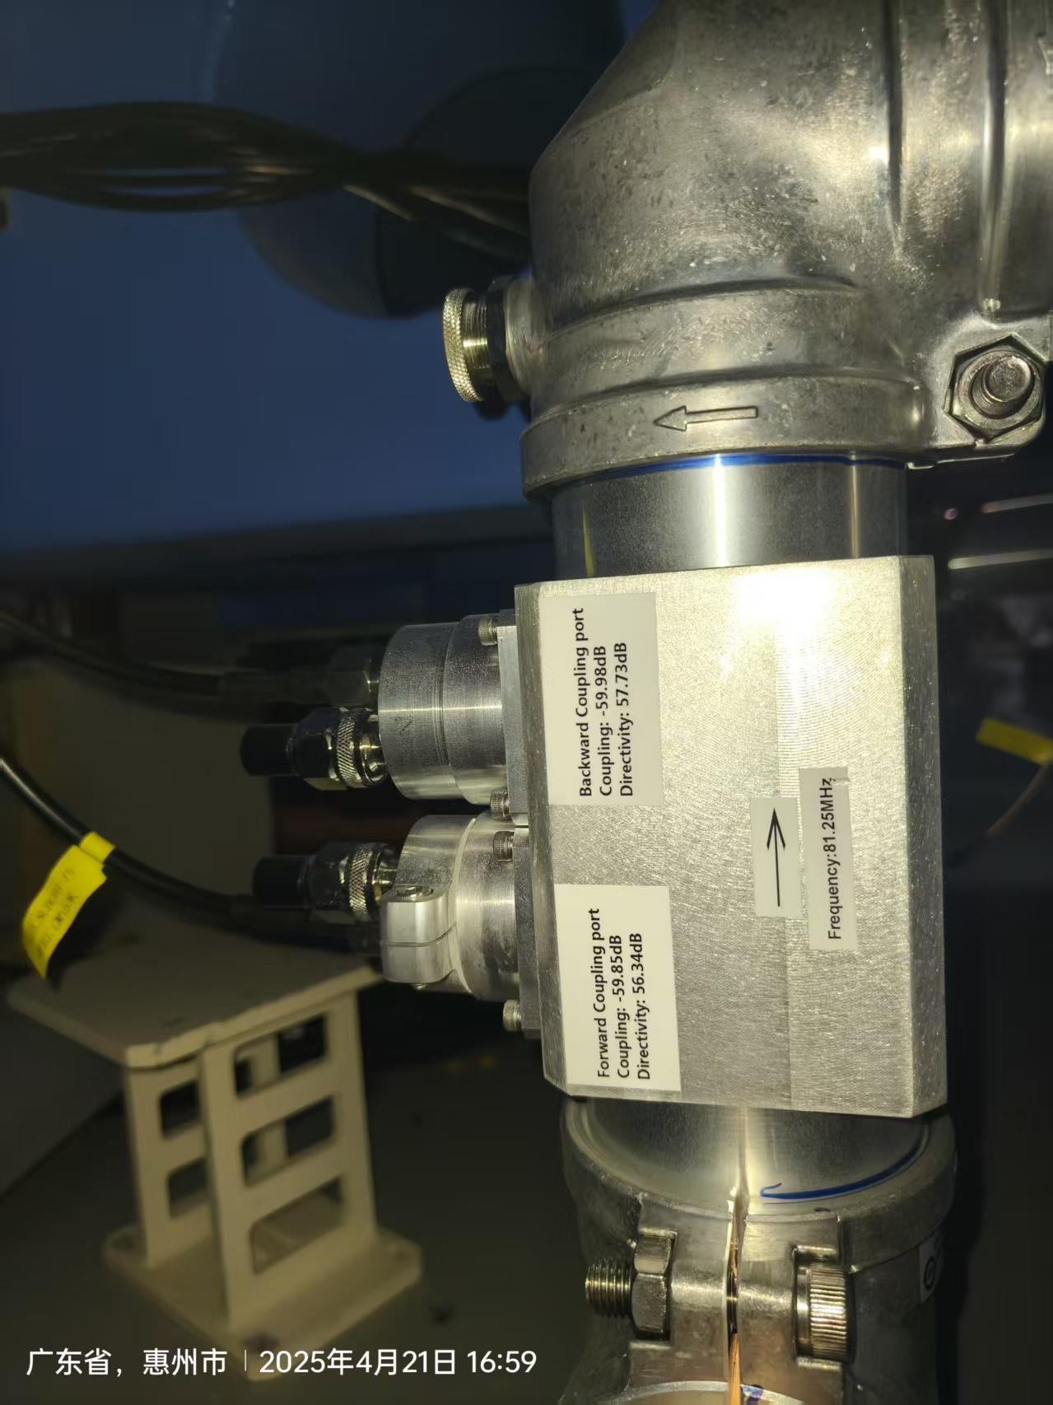
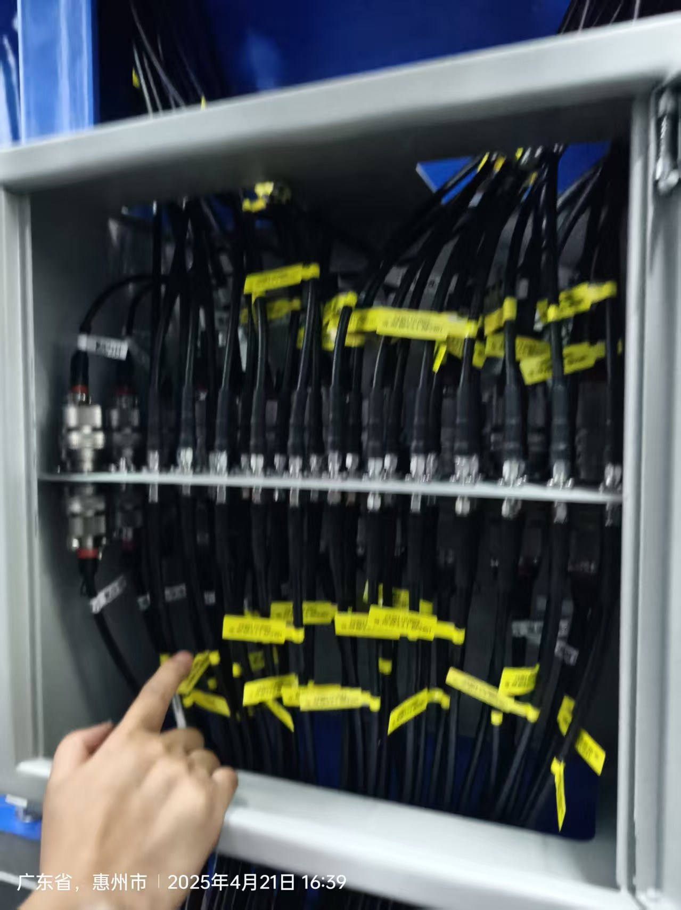
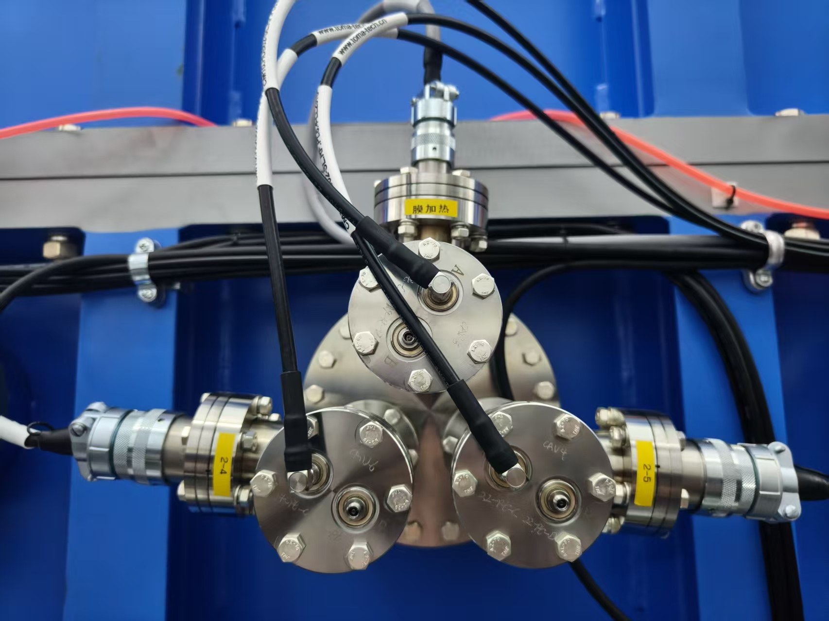
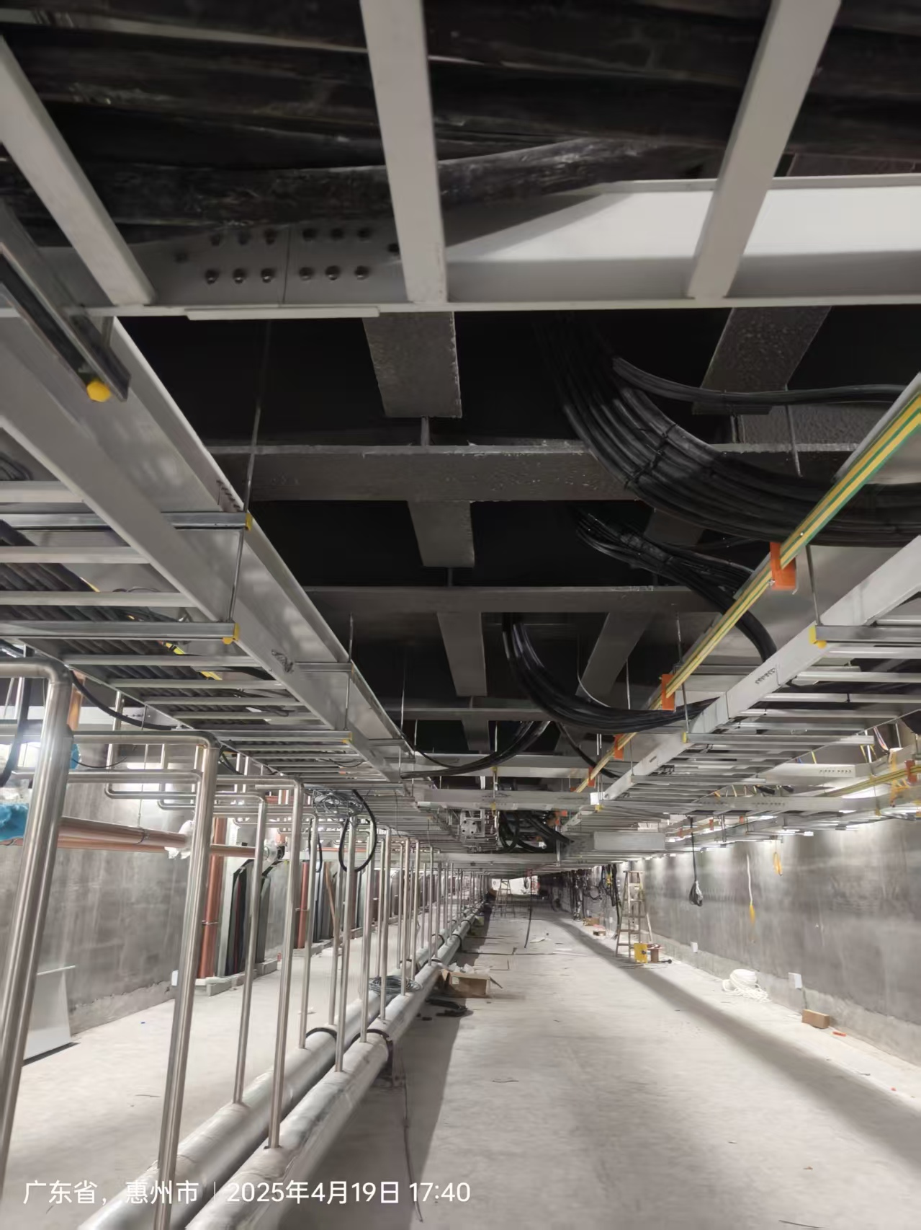
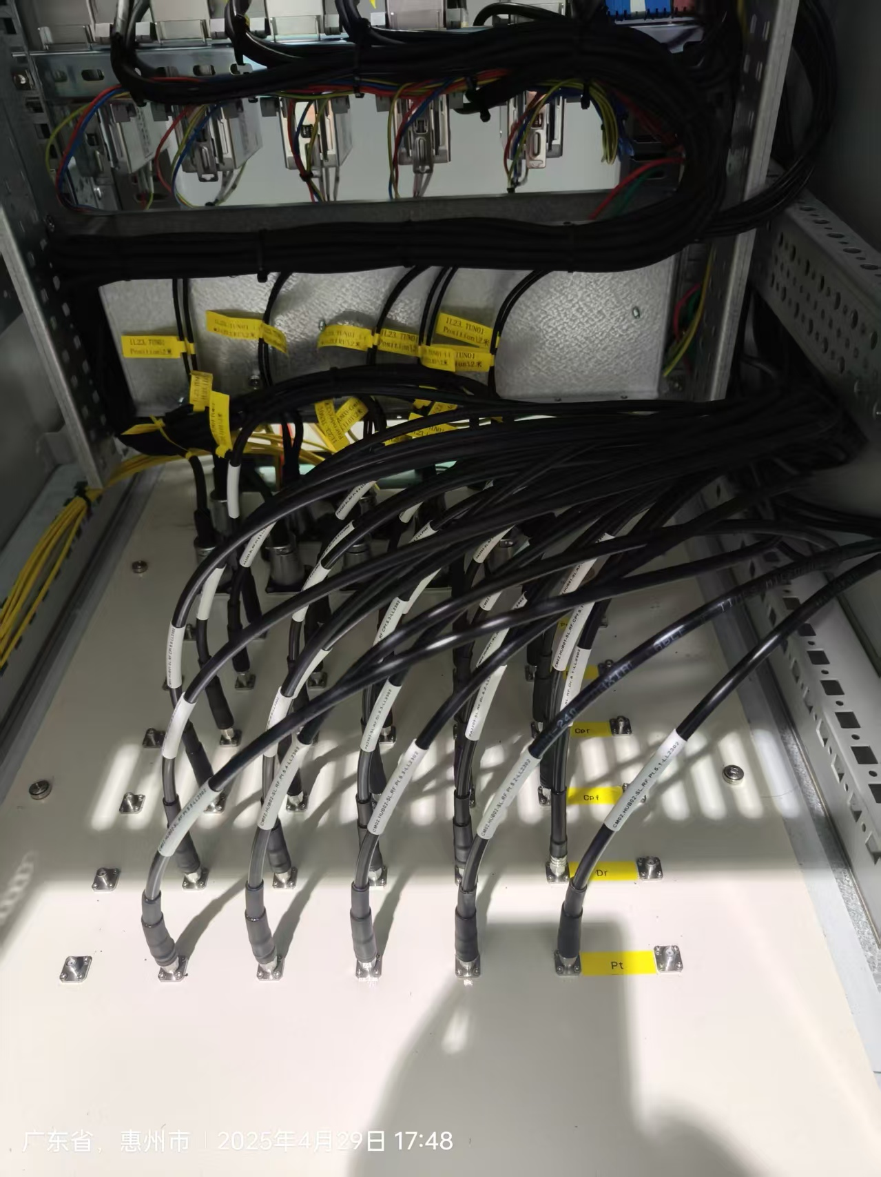
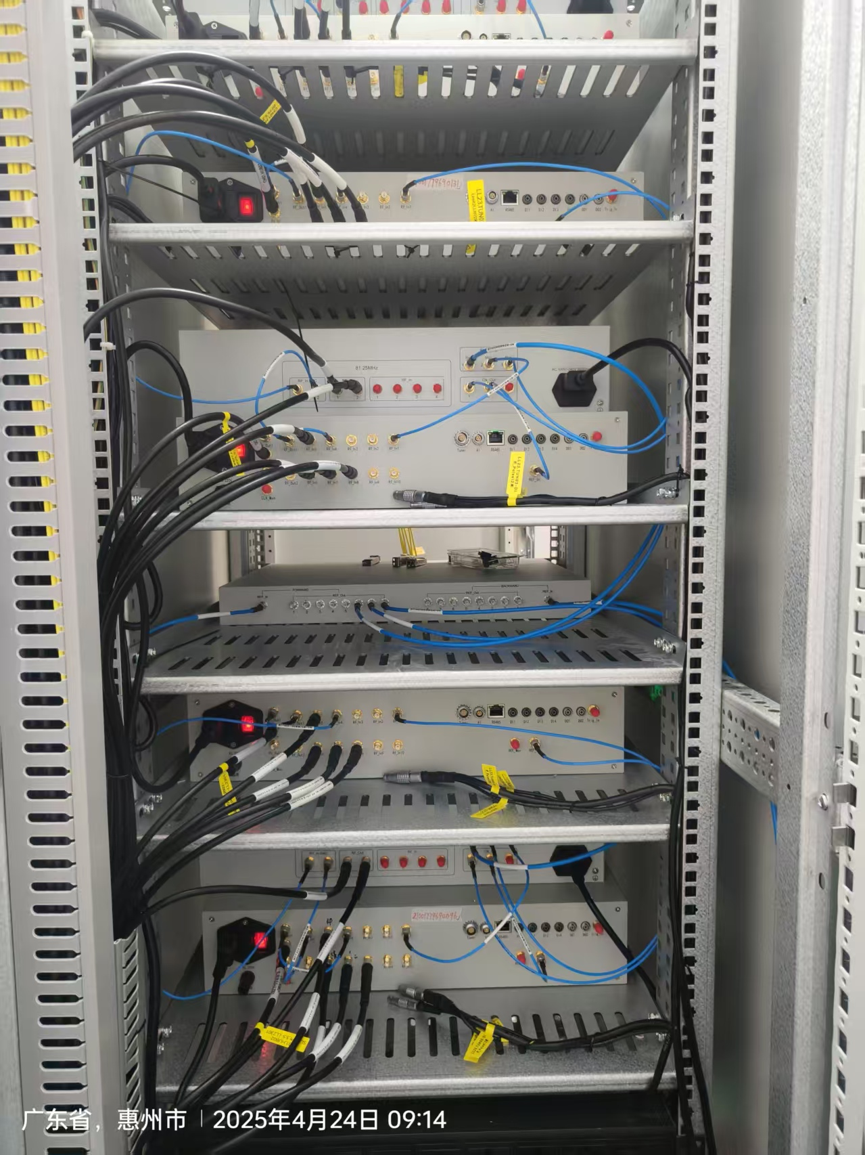
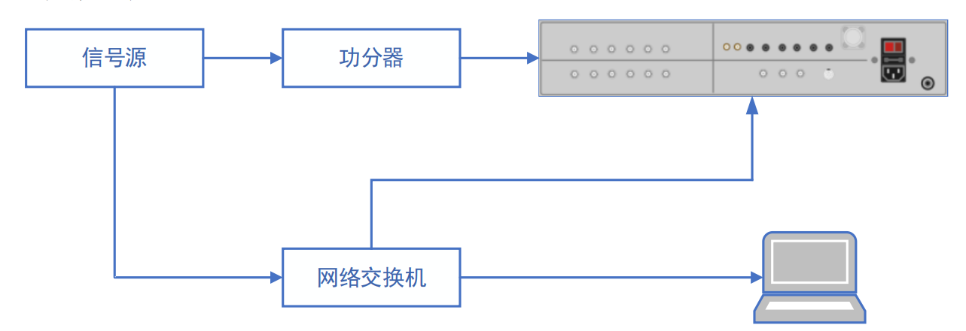
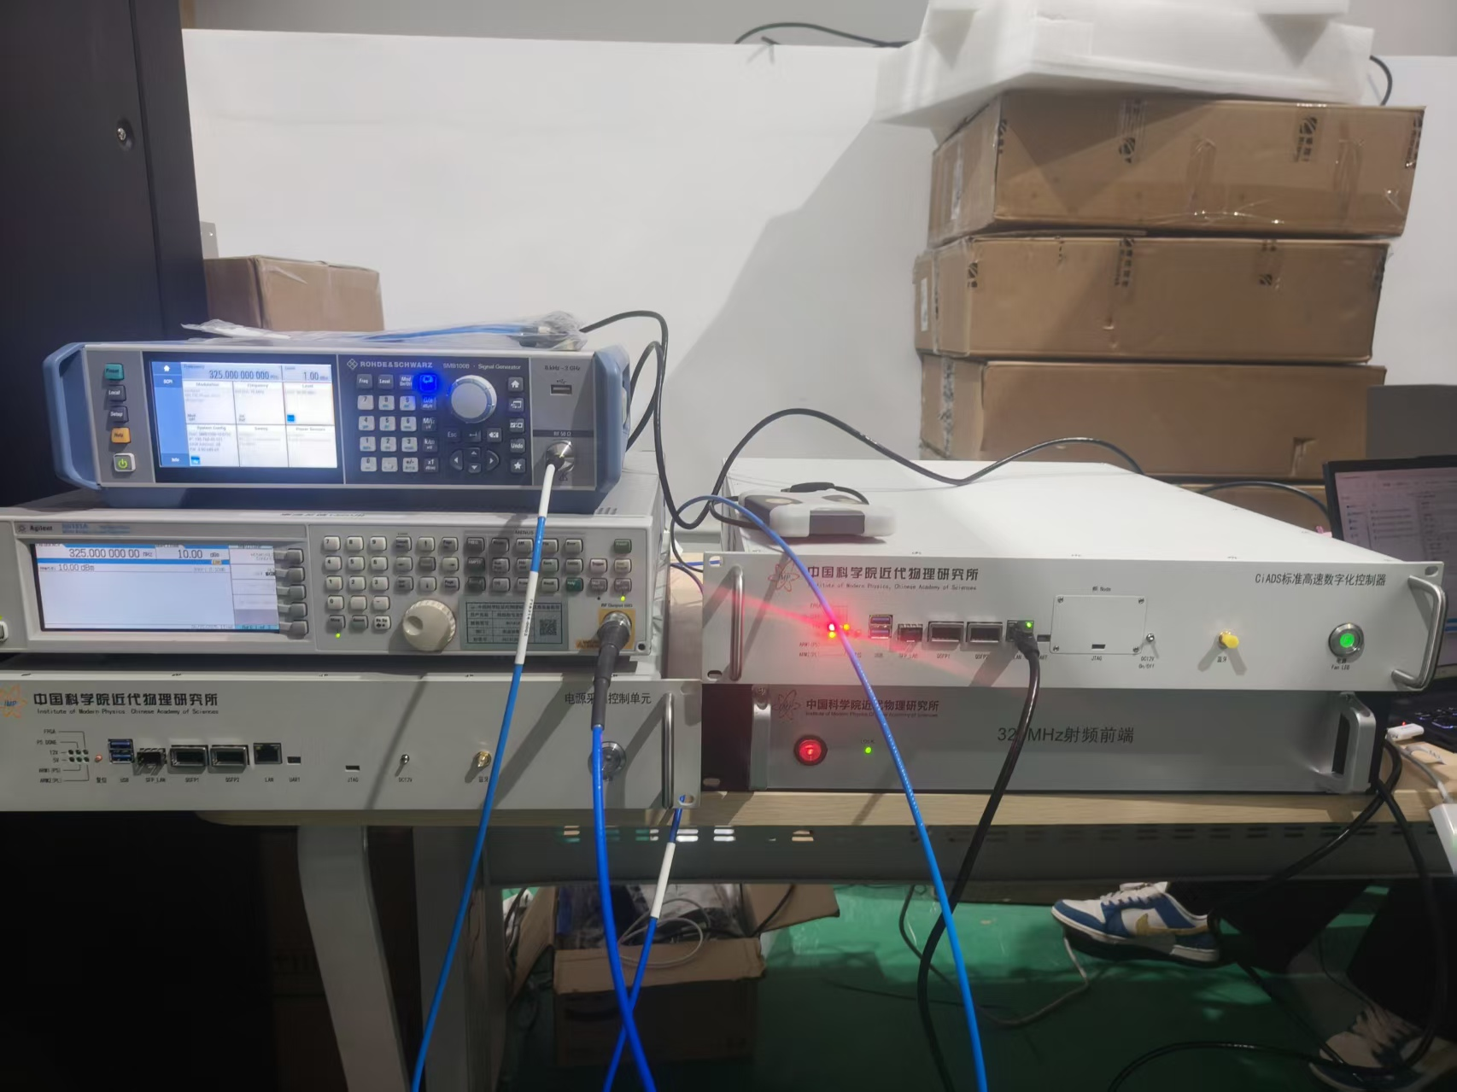
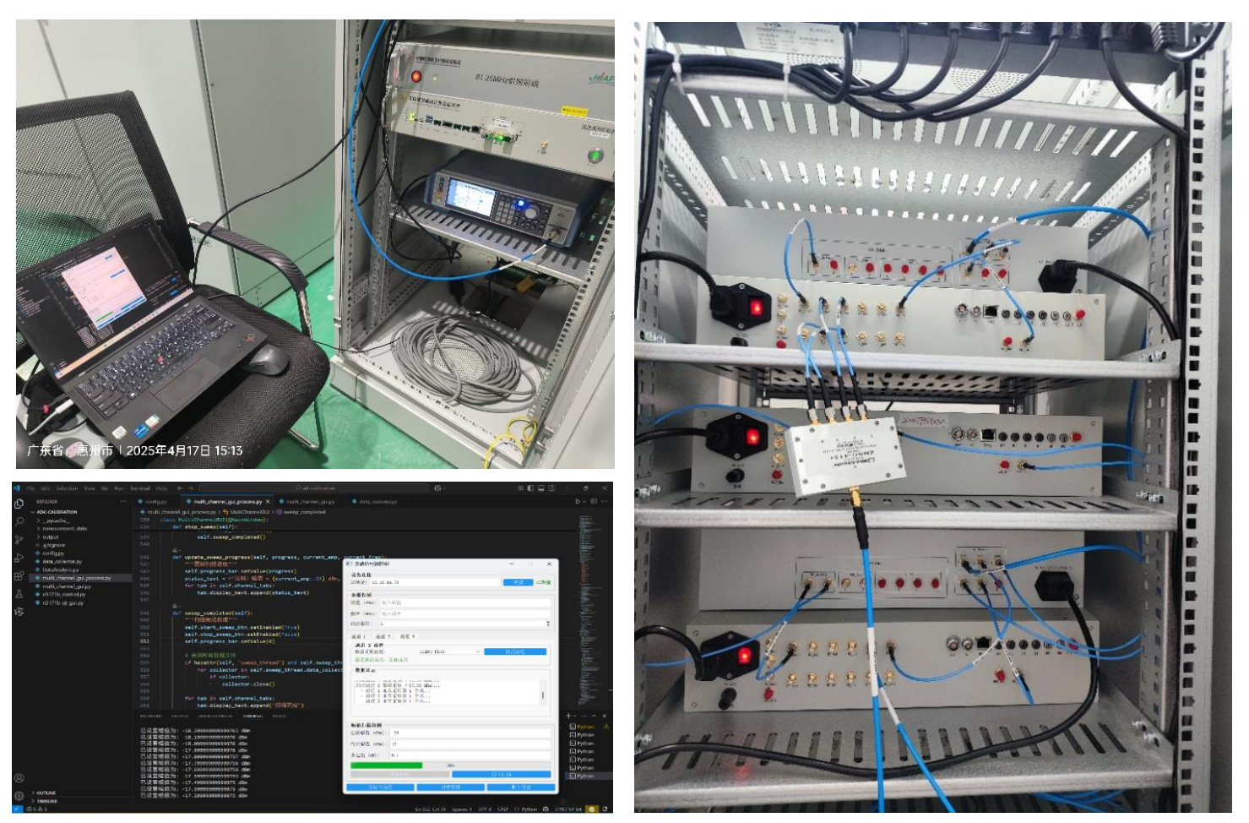
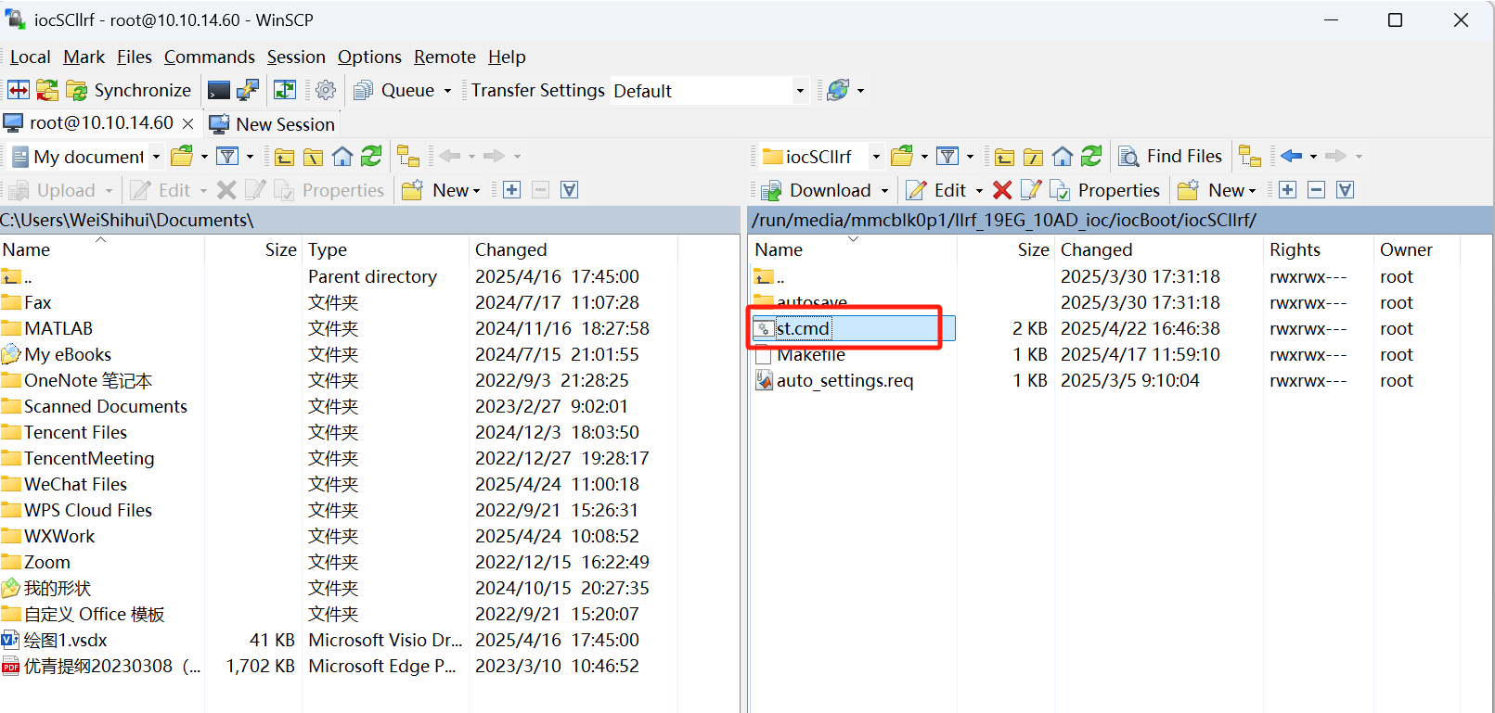
Pre-Conditioning Calibrations: LLRF Chassis & RF
Principles of RF Array Calibration
Full-Link High-Frequency Calibration of: Cavity Bottom Coupler — CM Side Junction Panel — Flange — Mezzanine — Rack Bottom Junction Panel — Chassis
RF Array Calibration Platform
RF Array Calibration Platform with High Portability
Updating Calibration Parameters to the IOC System of the Low-Level RF systems
Construction of a High-Precision Consistency Calibration System for Large-Scale RF Arrays
  Full-coverage calibration of 96 chassis, 672 channels, and 1,000+ RF cables completed; parameters updated to IOC. Through R²-based optimization, system power fitting accuracy reached >98%, resolving multi-cavity signal reference unification and laying the data foundation for beam stability.
6
Notes:
Before conditioning, We have completed full-coverage calibration of 96 chassis and 672 physical channels, as well as high-frequency calibration of over 1,000 RF cables. The calibration parameters have been updated to the IOC system. Through optimization based on the R² goodness of fit, the power fitting accuracy of the entire system has been achieved at over 98%. This resolves the challenge of unifying signal references for multi-cavity operation and lays the data foundation for beam stability.

Slide 8
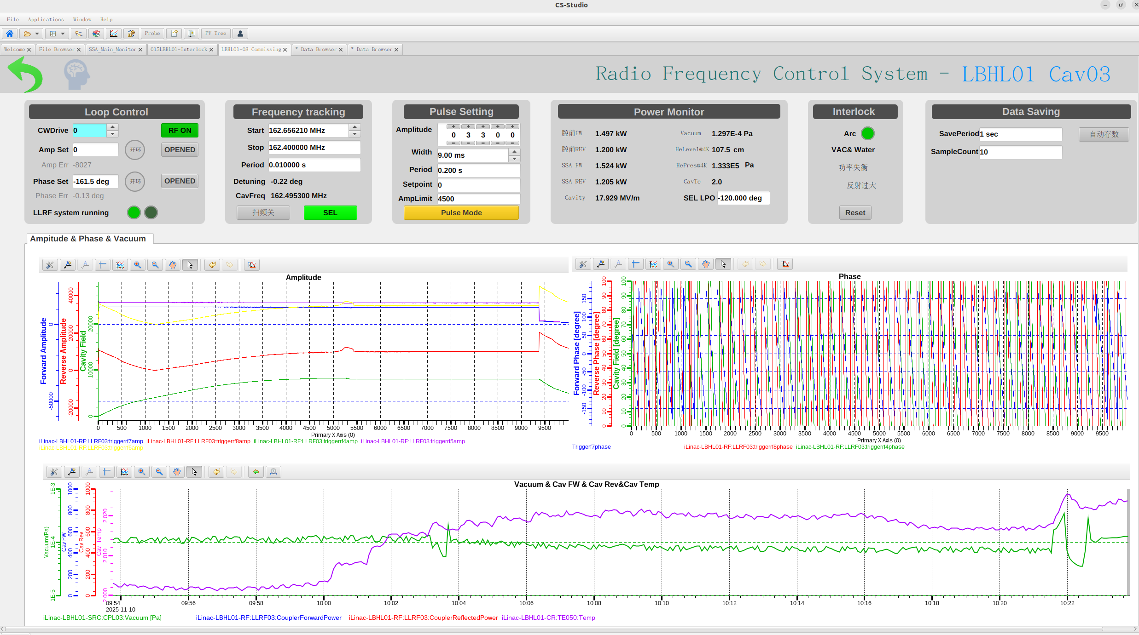
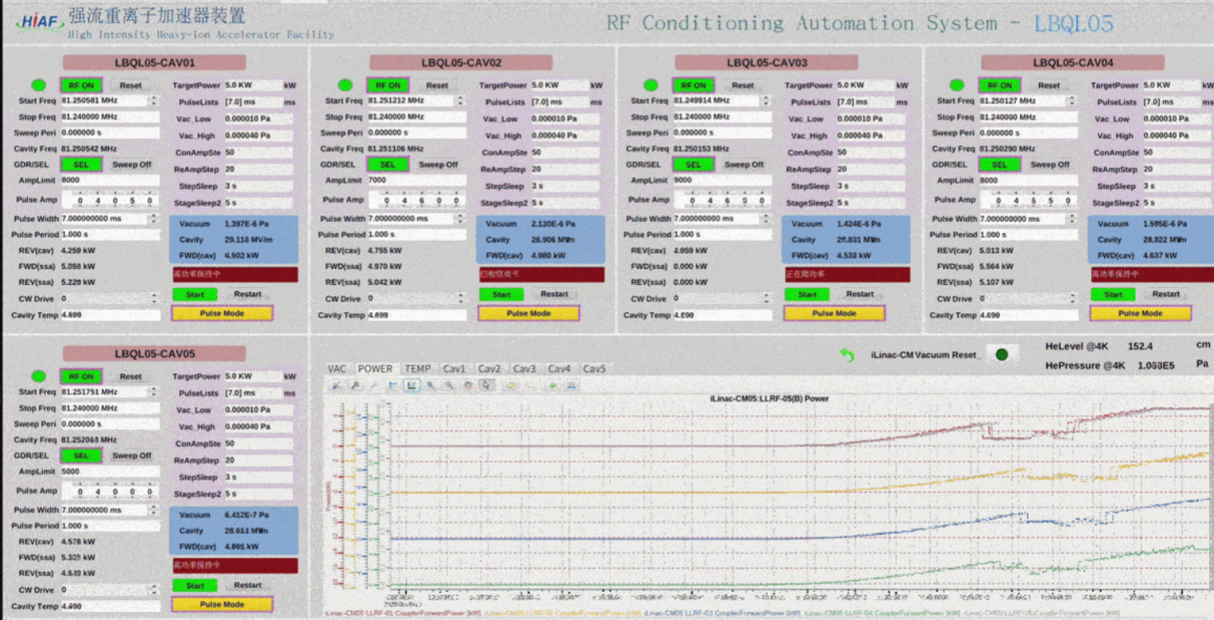
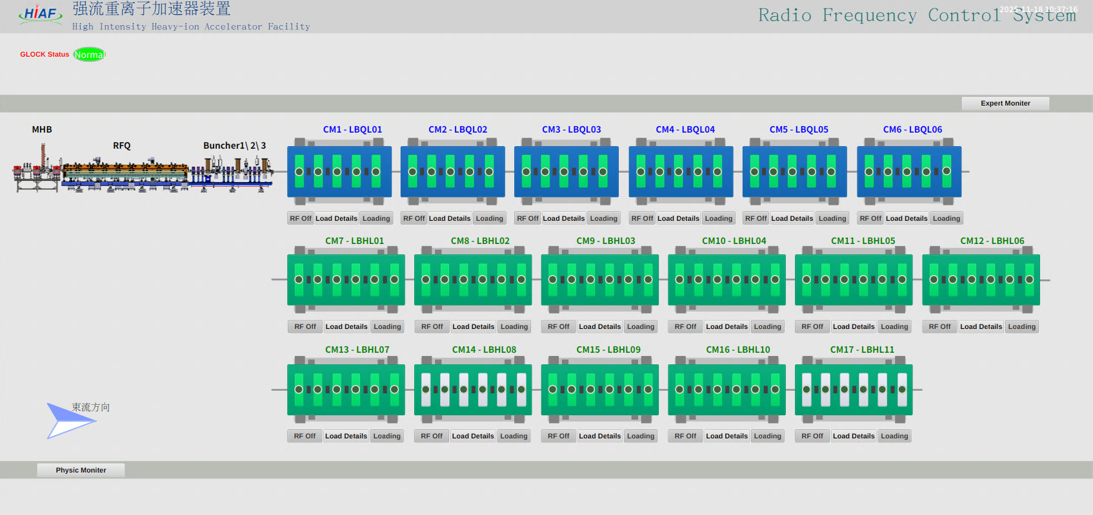
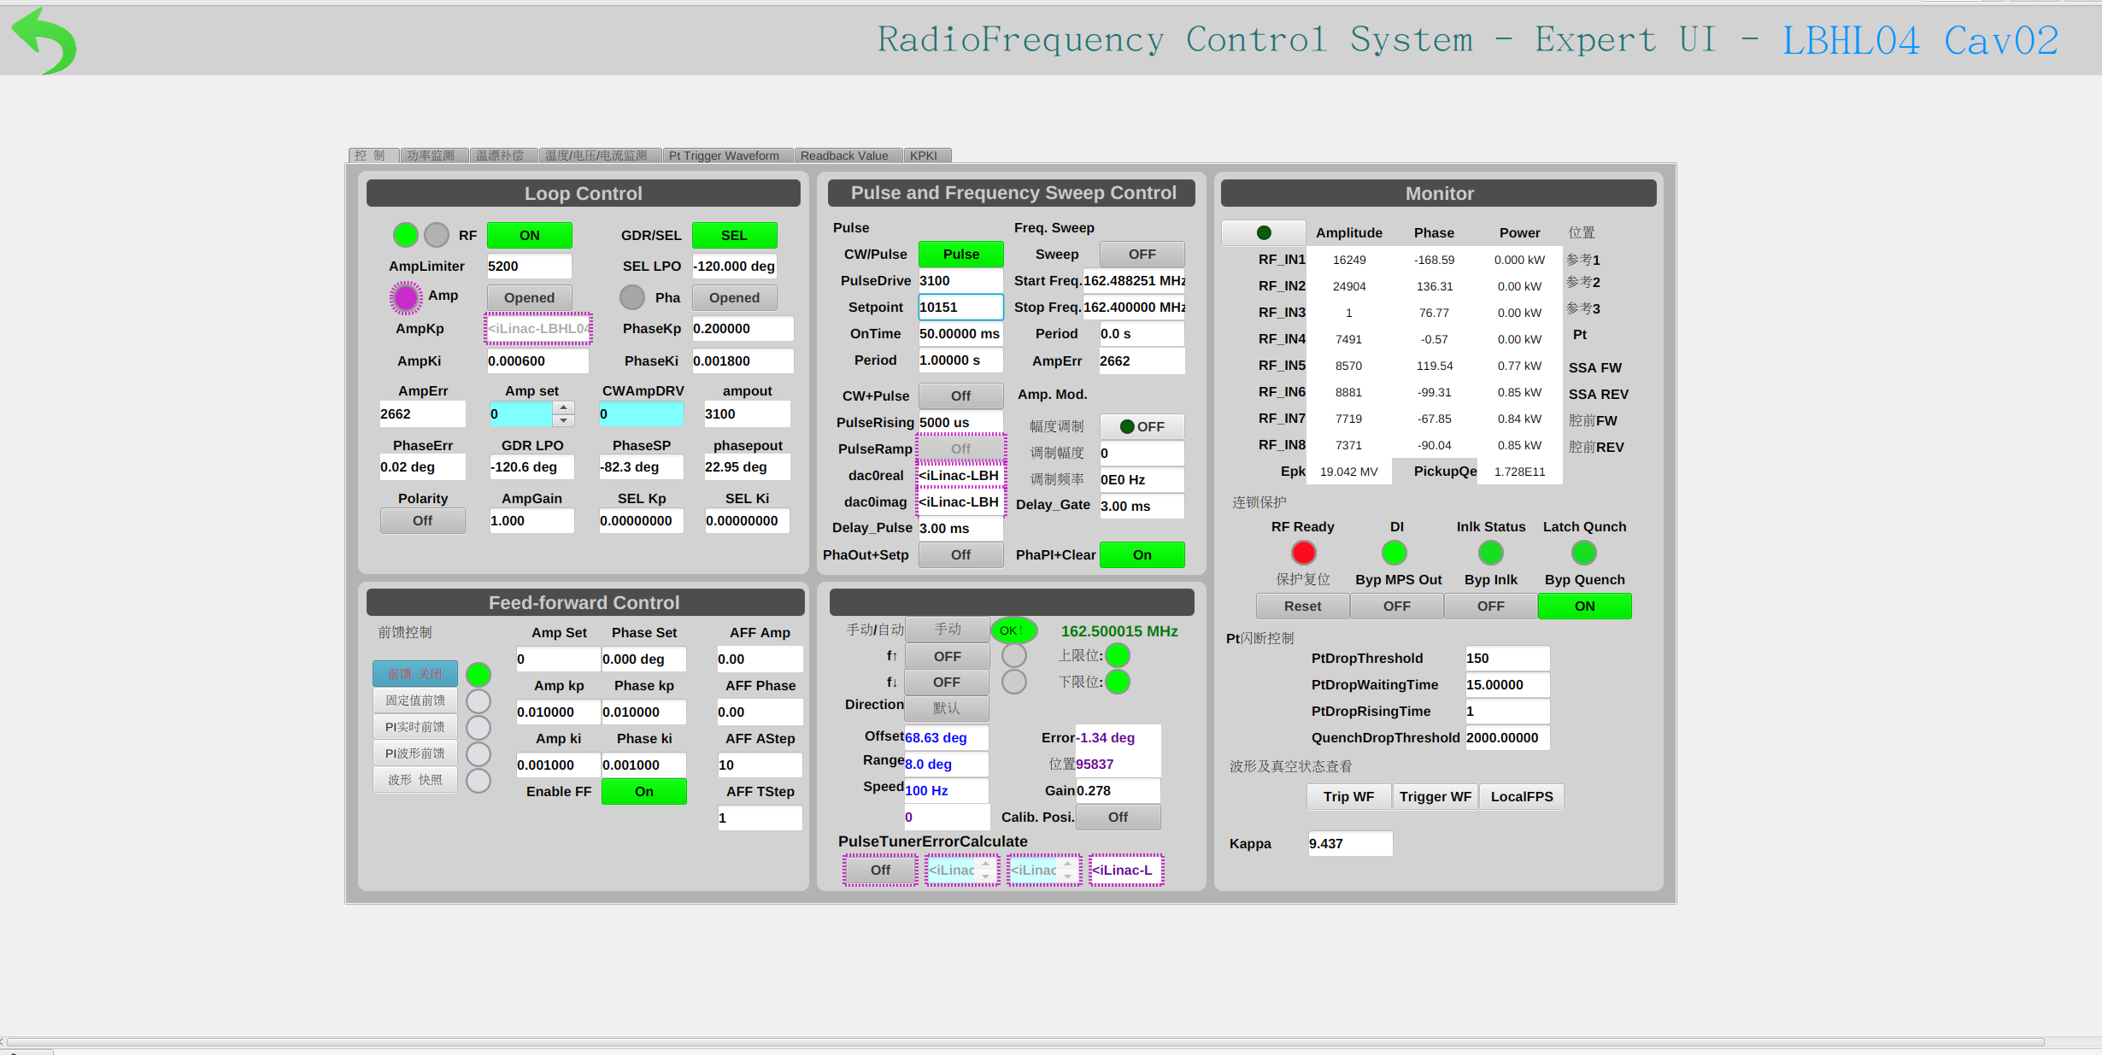
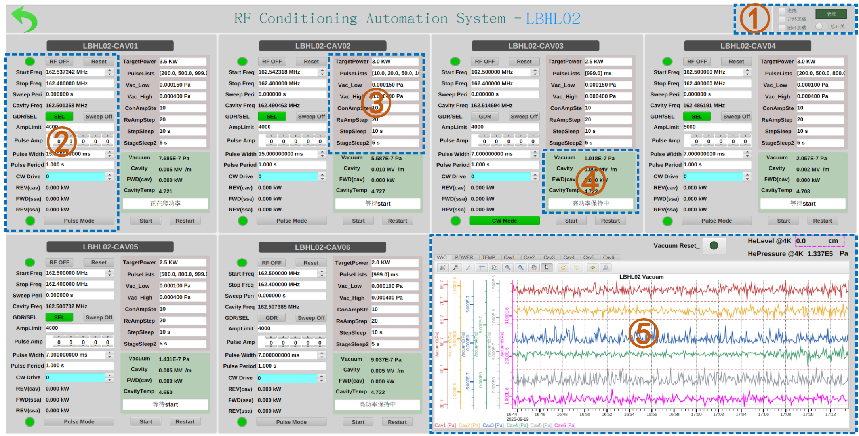
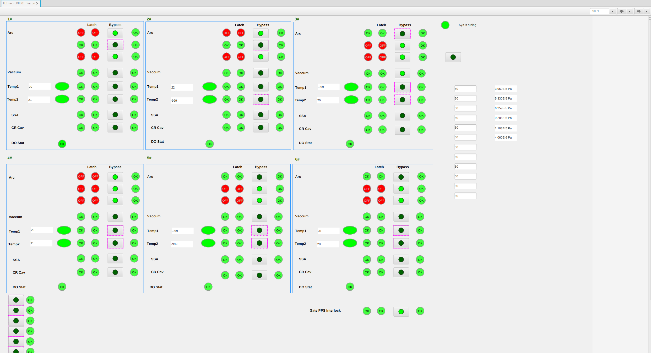
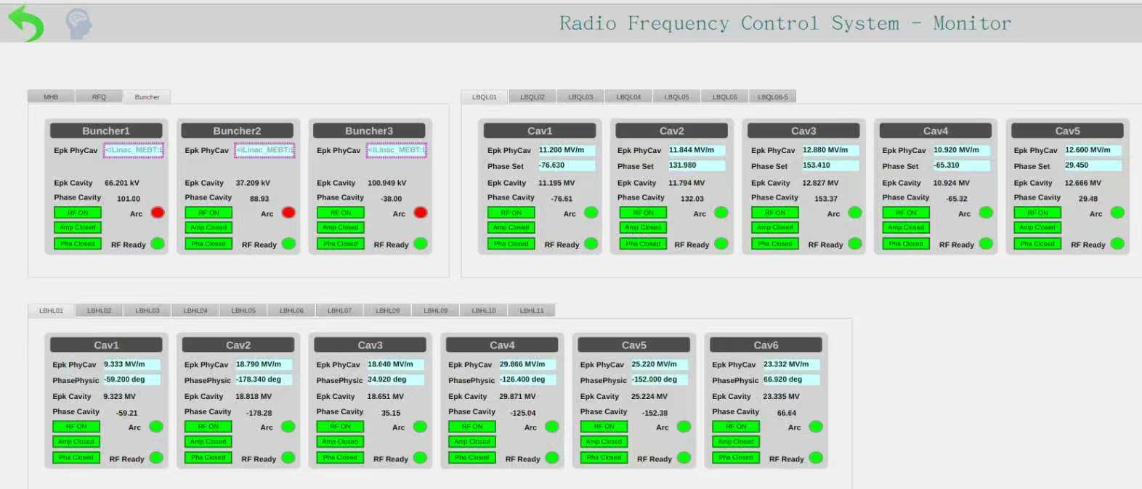
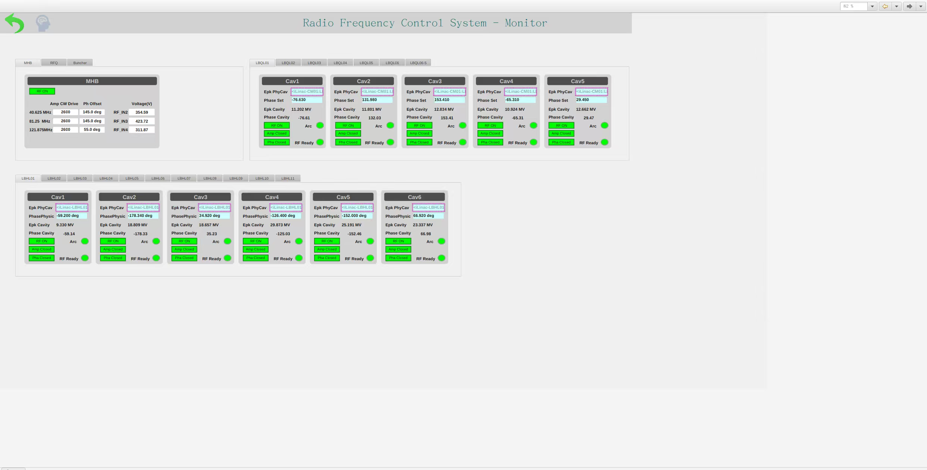
Full-Process Automation Control UIs
Designed & developed independently for HIAF’s complex conditions
>10 iterations | 240+ functional modules refactored
From engineering black box → visualized workflow
Key outcomes: ✔ Lower Operation & maintenance threshold ✔ Reduced misoperation risks
Operation UI
Conditioning UI
Expert UI
Loading UI
SC Interlock UI
Expert Diagnostics UI
Physics Diagnostics UI
7
Notes:
Then, to address the complex operating conditions of HIAF, we developed a comprehensive RF control interface.
A full-process automation control interface was developed, including: Operation Interface, Expert Interface, SC Interlock Interface, Physics Diagnostics Interface, Automated Conditioning Interface, Automated Loading Interface, and Expert Diagnostics Interface.
For the complex operating conditions of HIAF, we independently designed and developed this full-process automation control interface. Through more than 10 version iterations and refactoring of over 240 functional modules, we successfully transformed the "engineering black box" into a visualized operational workflow, significantly lowering the threshold for operation and maintenance as well as the risk of misoperation.

Slide 9
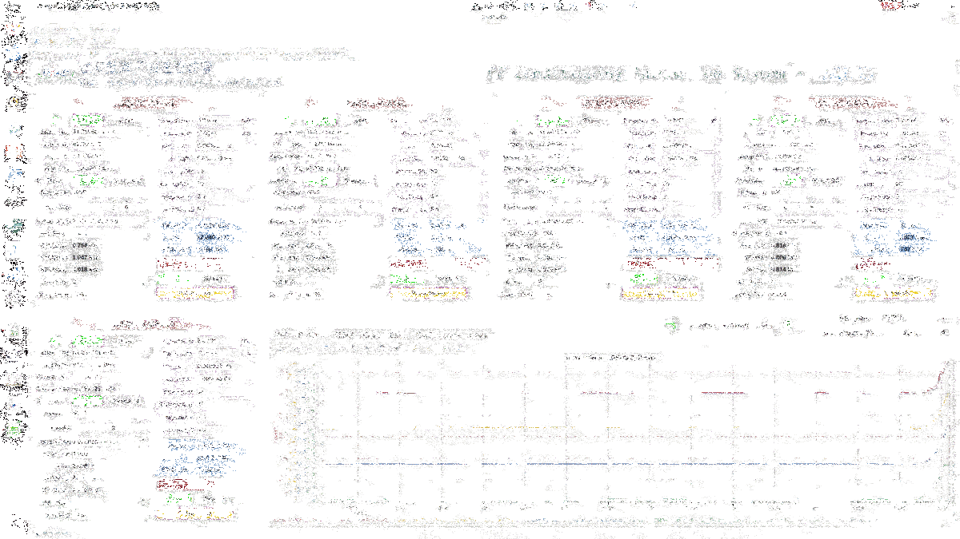
Automated RF Conditioning
The goal of conditioning is to gradually increase the RF power to the design value, eliminate field emission sources, and reduce the risk of sudden breakdown during cavity operation.
Automated conditioning + intelligent abnormal waveform recognition
Fully automatic conditioning with real‑time smart monitoring
Enables large‑scale 24/7 non‑stop conditioning
Epk | Before / MV/m | After / MV/m
CM8-3 | 31.073 | 41.62
CM8-4 | 17.373 | 23.722
CM8-6 | 21.366 | 42.347
CM9-4 | 39.351 | 41.579
CM9-5 | 23.6 | 41.357
CM9-6 | 13.468 | 18.675
CM10-6 | 15.01 | 24.86
both warm‑conditioning and cryogenic conditioning for all 96 SRF cavities of HIAF‑iLinac
Significantly accelerated commissioning progress
Developed a standardized, portable intelligent conditioning framework
Ready for direct reuse in CiADS and IP‑SAFE superconducting cavity conditioning
8
Notes:
Now let me present our systematic approach to RF conditioning of superconducting cavities. The goal of conditioning is to gradually increase the RF power to the design value, eliminate field emission sources, and reduce the risk of sudden breakdown during cavity operation. To achieve this, we introduced automated conditioning combined with intelligent abnormal waveform recognition. This enables fully automatic conditioning with smart real‑time monitoring. As a result, we can run large‑scale conditioning non‑stop, 24 hours a day, 7 days a week. As a result, we conditioned all 96 HIAF‑iLinac cavities at both room temperature and cryogenic temperature, greatly speeding up commissioning. Furthermore, we built a standardized, portable intelligent framework that can be directly reused for CiADS and IP‑SAFE

Slide 10
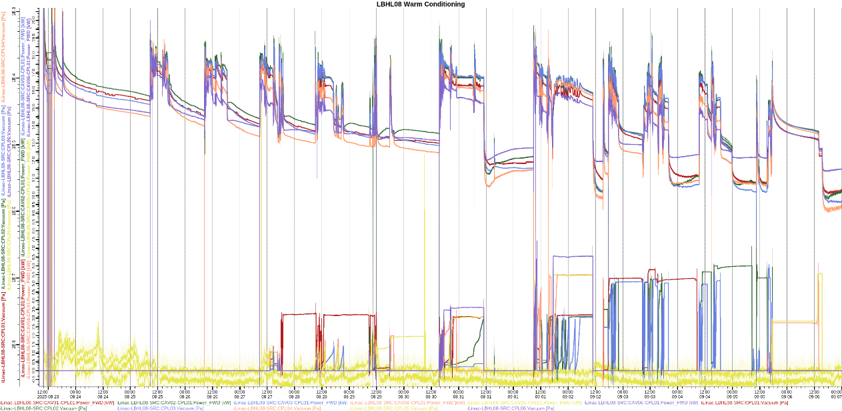
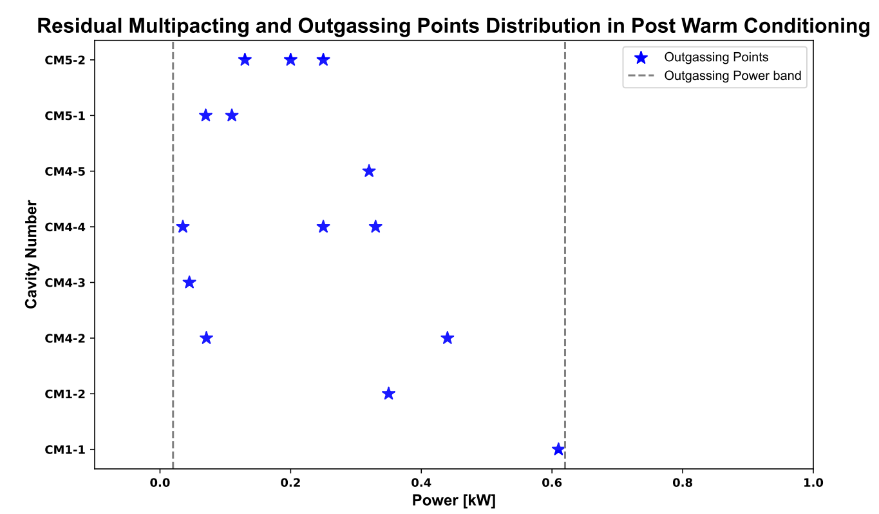
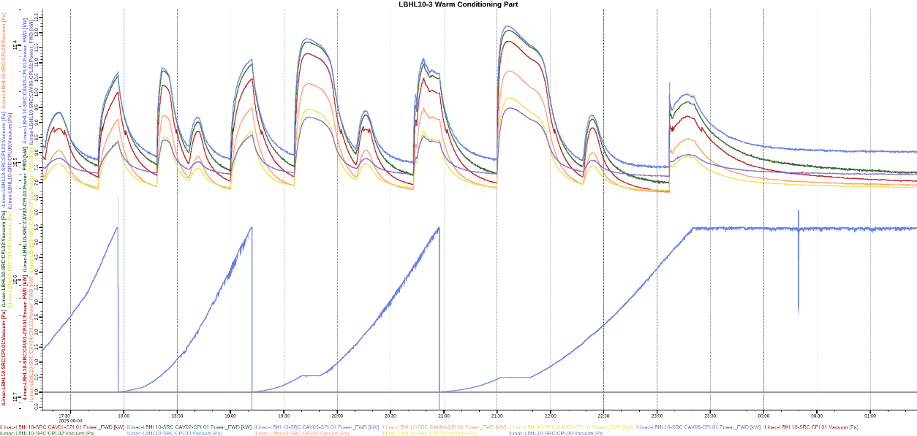
Automated RF Conditioning
HWR015 Room Condit-ioning
 | LBHL01 | LBHL02 | LBHL03 | LBHL04 | LBHL05 | LBHL06 | LBHL07 | LBHL08 | LBHL09 | LBHL10 | LBHL11 | Average
Conditioning Time/day | 18 | 12 | 8 | 10 | 10 | 12 | 9 | 9 | 6 | 9 | 10 | 10.27
P_Cav_FWD/Kw | 3 | 2 | 2.5 | 2.5 | 5 | 5 | 5 | 5.5 | 5 | 5 | 4 | 4.05
LBHL08 Room Conditioning
LBHL10-3 Roorm Conditioning
9
Notes:
Now, let me show you an example using HWR015 at room temperature.
With our automated conditioning framework, conditioning a single cryostat takes about ten days, and the peak power after conditioning is four kilowatts.
Looking at these two figures, we see that most of the cavity breakdown events happen at low power levels. More importantly, after room‑temperature conditioning, the cavity vacuum level becomes two orders of magnitude lower than before – a significant improvement.

Slide 11
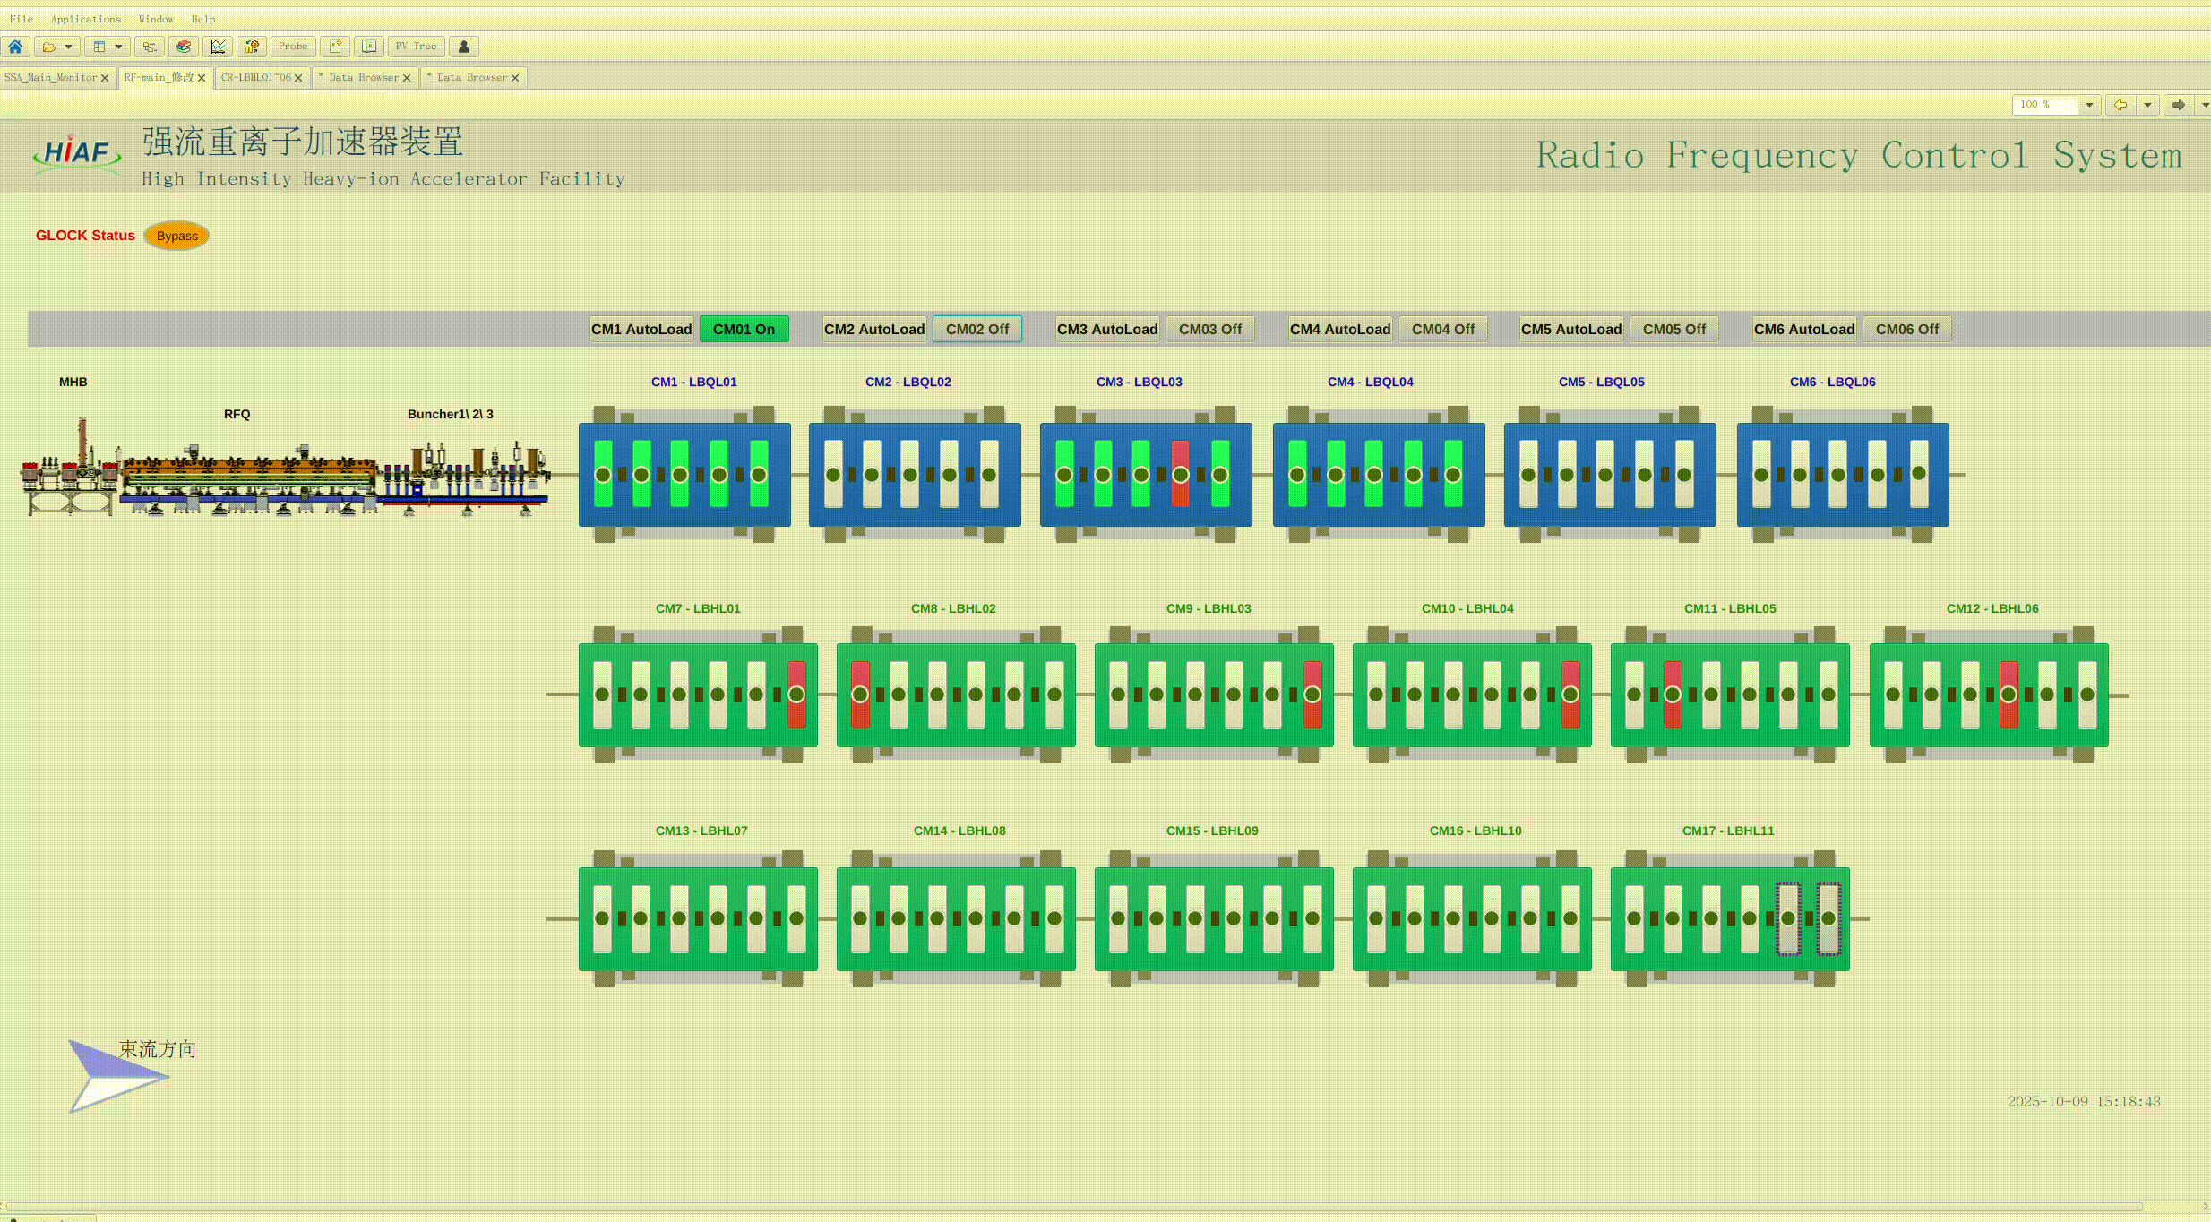
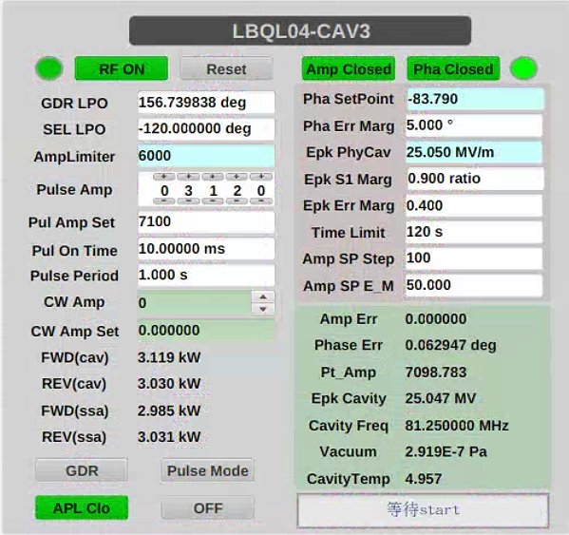
Automated RF Loading
  Background: Large-scale SRF accelerators require frequent loading operations (startup, mode switching, fault recovery), where the traditional manual approach is time-consuming and expert-dependent.
  Achievement:Using personalized loading strategies on HIAF, we achieved >90% automated loading success rate, supporting both single-cavity and cryostat‑based batch loading.
Customized loading schemes based on detuning measurements
10
Notes:
After room‑temperature and cryogenic conditioning, we must perform batch‑mode closed‑loop loading.
Frequent loading operations — startup, mode switching, fault recovery — are needed for large‑scale SRF accelerators. Manual loading is slow and expert‑dependent.
On HIAF, with personalized loading strategies, we reached >90% automated loading success rate, supporting single‑cavity and cryostat‑based batch loading

Slide 12
01
Introduction
02
RF Conditioning
CONTENTS
03
Horizontal test
04
Summary
Notes:
Next, I will move on to the horizontal test – specifically, the measurement of key performance parameters of the superconducting cavities.

Slide 13
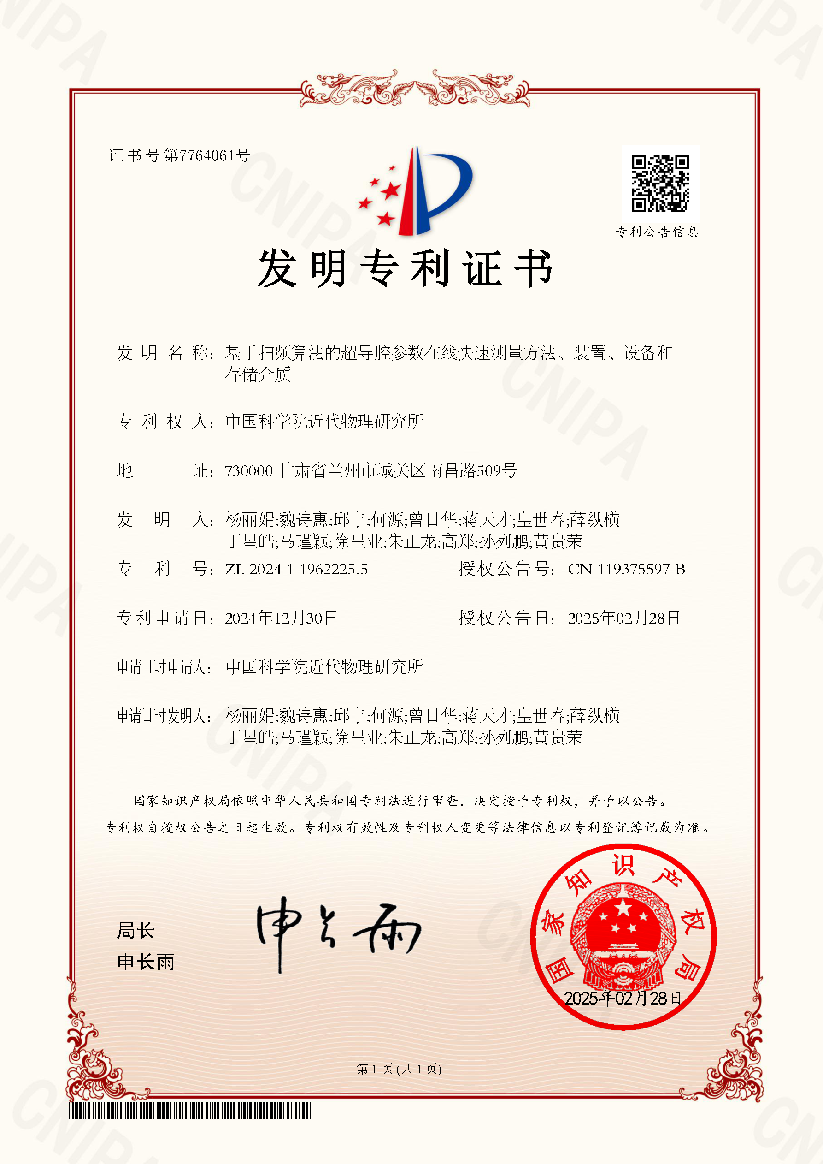
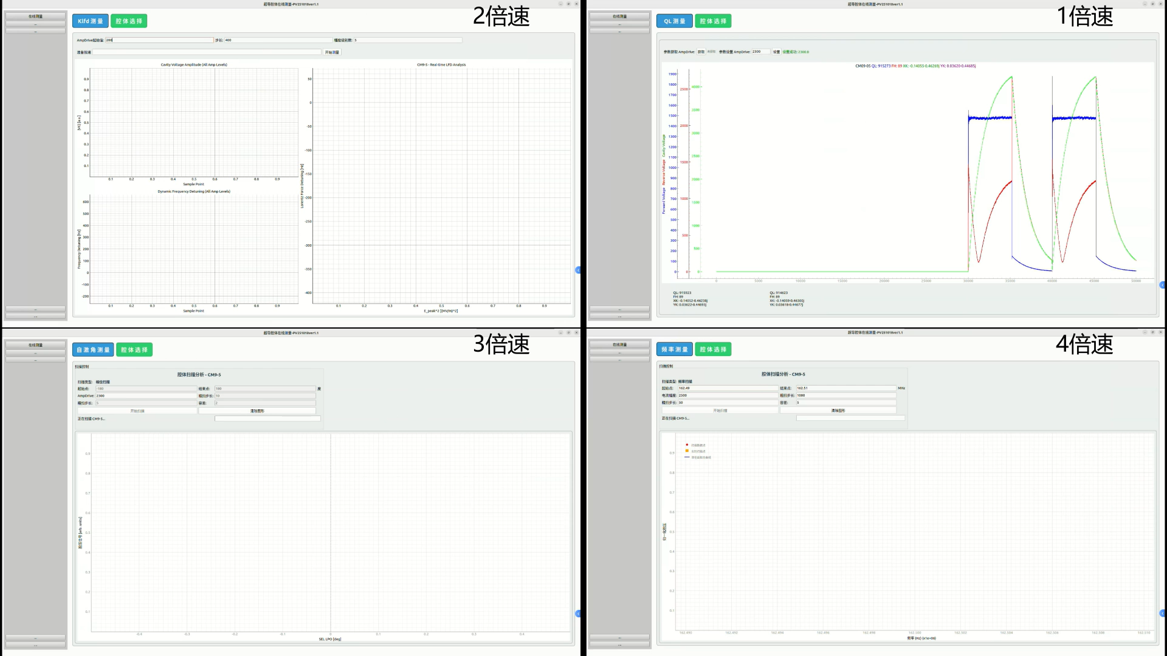

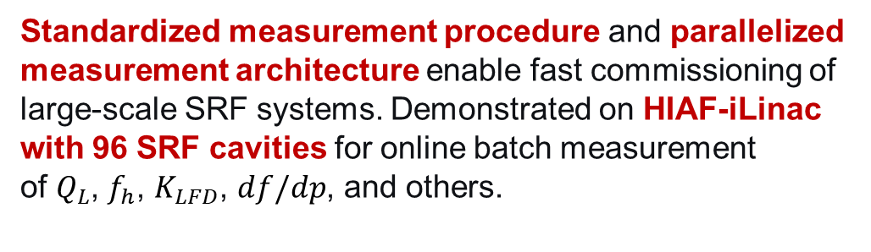
Online Measurement of SC Parameters
  Background
  Cavity parameter measurement is essential for:
  Performance evaluation
  Parameter calibration
  Control & anomaly monitoring
  Conventional approach
  Different parameters → different measurement configurations
  Serial measurement: one cavity after another
  Poor consistency among different operators
Online Measurement Process Demonstration
Standardized measurement procedure and parallelized measurement architecture enable fast commissioning of large-scale SRF systems. Demonstrated on HIAF-iLinac with 96 SRF cavities for online batch measurement of $Q_{L}$, $f_{h}$, $K_{LFD}$, $df/dp$, and others.
12
Notes:
"Next, I’d like to present our work on online measurement of superconducting cavity parameters.
Background. Accurate measurement of cavity parameters is fundamental to cavity performance evaluation, parameter calibration, control, and anomaly monitoring.
Conventional approach. In traditional methods, different measurement configurations are required for different parameters. Cavities are measured one by one in a serial manner. Moreover, results often lack consistency among different operators.
Our innovative solution. We have developed a standardized measurement procedure combined with a parallelized measurement architecture. This provides key technical support for rapid commissioning of large-scale superconducting cavity systems.
Breakthrough achievement. As a result, we have achieved online batch measurement of key parameters — including $Q_{L}$, $f_{h}$, $K_{LFD}$, $df/dp$, and others — for all 96 superconducting cavities of the HIAF-iLinac.

Slide 14
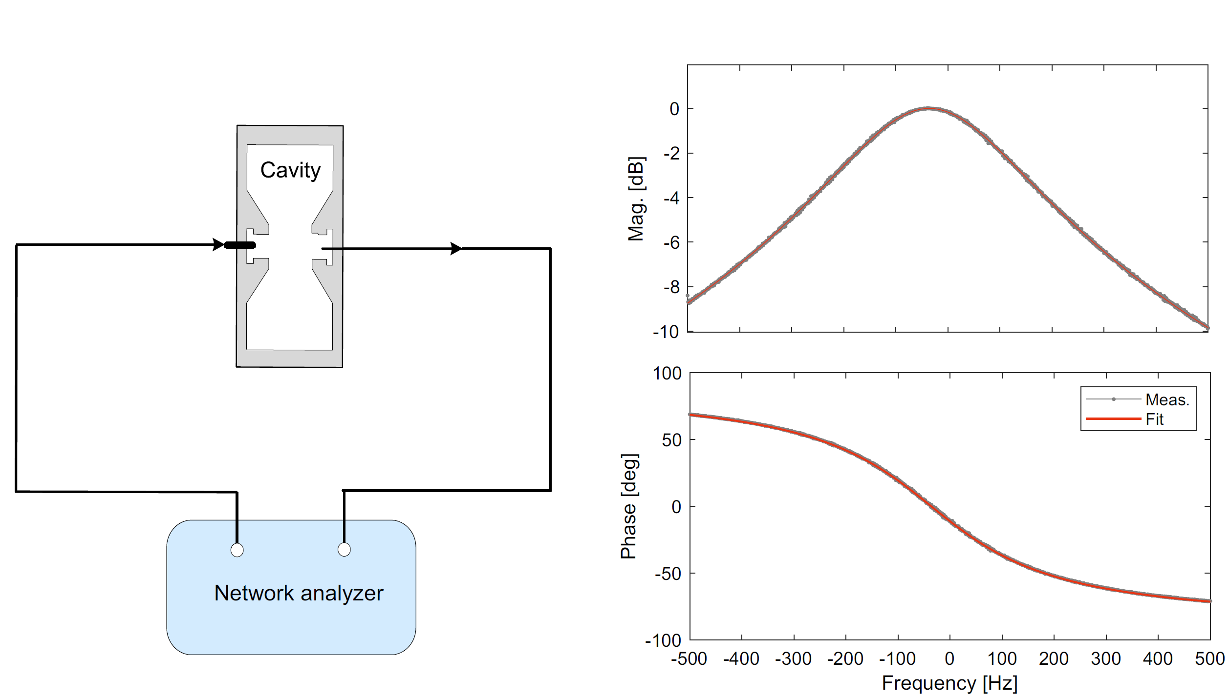
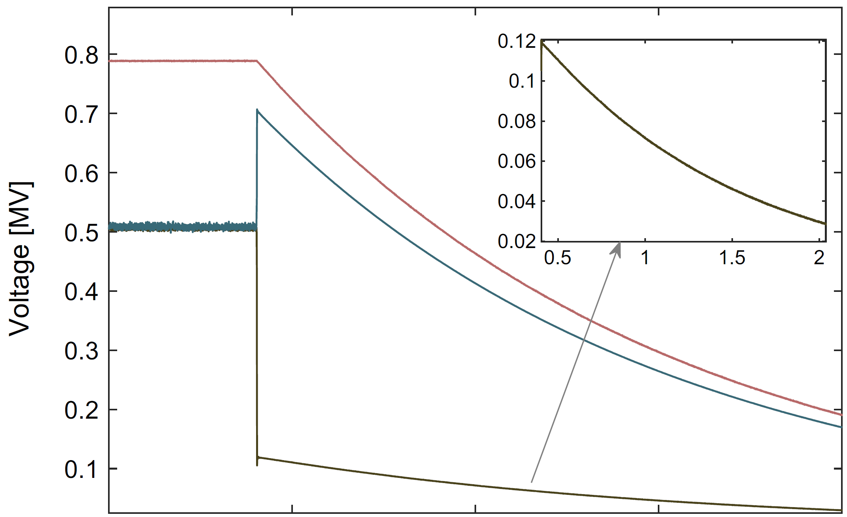

Measurement of Q_{L}
Calibration of QL under impedance mismatch
Error ↓ from ±30 % to ±2 %
Consistent with network-analyzer scan
The residual V_{f} after RF off
3dB half-bandwidth (f_{0.5,scan})
Imp. mismatch
Field decay
RF off
Before cali：Err~±30%
After cali.：Err~±2%
Detuning-dependent
Scan
Decay
F. Qiu, Z. J. Chen, S. H. Wei et al, A polar-coordinate algorithm for accurate measurement of dynamic loaded Q factor and detuning in SRF cavities, Nucl. Instrum. Methods Phys. Res. Sect. A, 1083(2025)171172. J.
J. Y. Ma,… F. Qiu* et al., Measurement of the cavity‑loaded Q factor in SRF systems with mismatched source impedance, Nucl. Sci. and Tech. 34:12, 2023
J. Y. Ma,… F. Qiu* et al., Application of a new cavity-loaded factor calibration algorithm on the Test Stand 2 facility at the European, Radiation Detection Technology and Methods, 8:4, 2024
13
Notes:
Now, let’s look at the measurement of key RF parameters. Due to the lack of high-power circulators in HIAF's RF system, impedance mismatch at the power source is a major issue. As shown, when RF is off, the forward signal is not zero. Also, under different detuning conditions, the decay curve of the RF field after RF off varies, which makes traditional QL measurement methods inaccurate. To address this, we derived a new QL calculation formula based on the cavity differential equation under these conditions and recalibrated QL. This calibration significantly reduces the measurement error, lowering it from ±30% to ±2%, and the results match those from the network analyzer scan.”

Slide 15
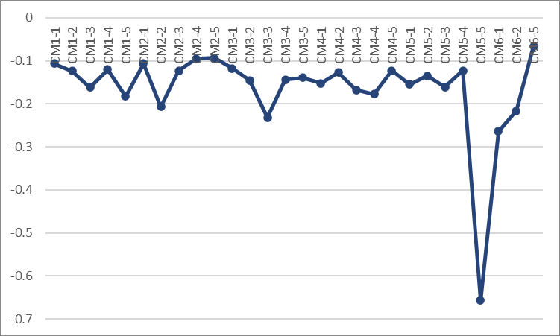
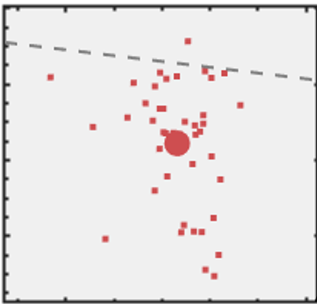
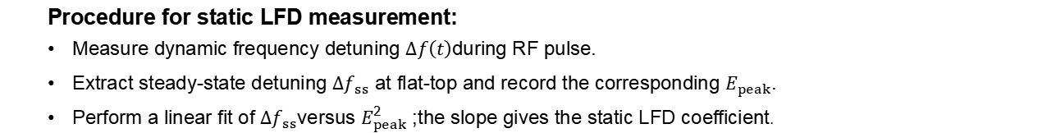




Static LFD coefficients
  Procedure for static LFD measurement:
  Measure dynamic frequency detuning $Δf\left(t\right)$during RF pulse.
  Extract steady-state detuning $Δf_{ss}$ at flat-top and record the corresponding $E_{peak}$.
  Perform a linear fit of $Δf_{ss}$versus $E_{peak}^{2}$; the slope gives the static LFD coefficient.
For nearly 80% of the cavities, $∣K_{LFD}∣$ lies in 0.1–0.2, with just one cavity above 0.6
$K_{LFD}[Hz/\left(\frac{MV}{m}\right)2]$
$$Δf\left(t\right)$$
$Δf_{ss}$
-0.66
A. Bellandi et al., IEEE Transactions on Nuclear Science, vol. 68, no. 4, pp. 385-393
14
Notes:
Now, let’s talk about the static LFD coefficient. There is a clear process for measuring the static LFD coefficient. First, measure the dynamic frequency detuning during the RF pulse. Then, extract the steady-state detuning at the flat-top and record the corresponding peak field strength. Finally, perform a linear fit of the steady-state detuning and the square of the peak field strength. The slope of this fit is the static LFD coefficient. It’s worth noting that nearly 80% of the cavities have a static LFD coefficient absolute value in the range of 0.1–0.2, with only one cavity exceeding 0.6. This shows that most cavities have concentrated characteristics in this aspect, providing important reference data for future research and applications.

Slide 16
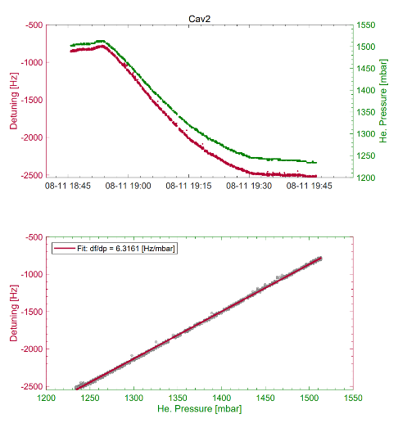
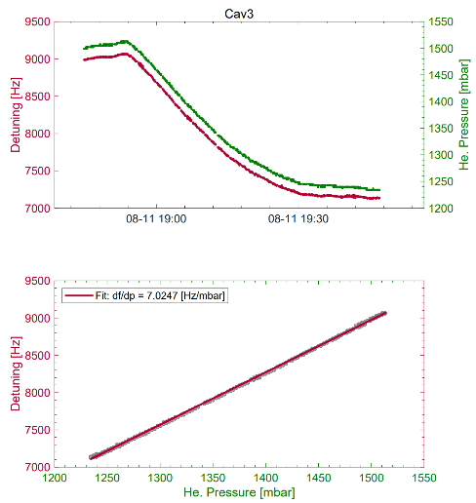
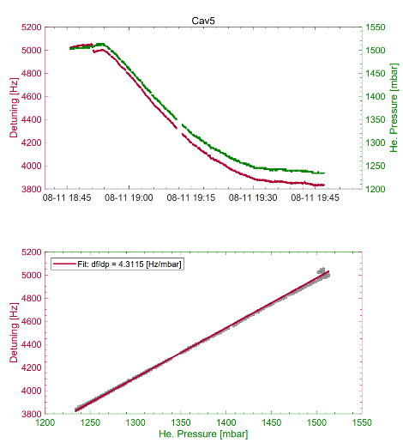
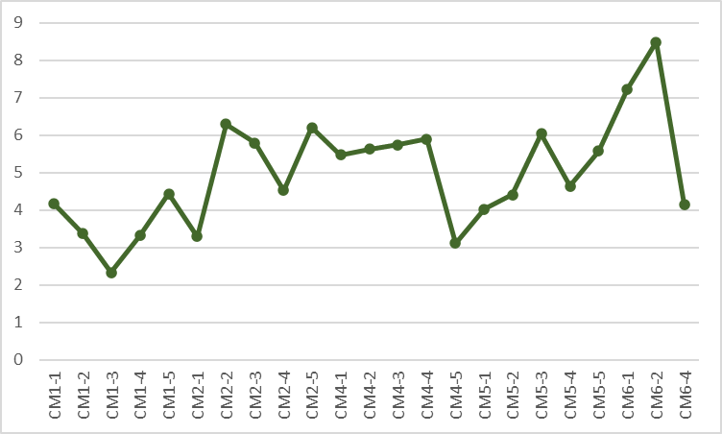

Pressure sensitivity
  Cavity pressure sensitivity coefficient (df/dp) is determined from helium-pressure induced detuning, with detuning extracted from the decay-phase slope of RF pulses
For ~80% of the cavities, the pressure sensitivity ($df/dp$) lies in the 3–7 Hz/mbar range.
Notes:
Pressure sensitivity is an important parameter, and its coefficient (df/dp) can be determined by the detuning caused by helium gas pressure. This detuning is extracted from the phase slope of the RF pulse decay. About 80% of the cavities have pressure sensitivity in the range of 3–7 Hz/mbar, indicating that most cavities show a concentrated frequency response to pressure changes. This concentration provides useful reference data for related research and applications. When designing or using cavities, this common range can be used for evaluation and optimization.

Slide 17
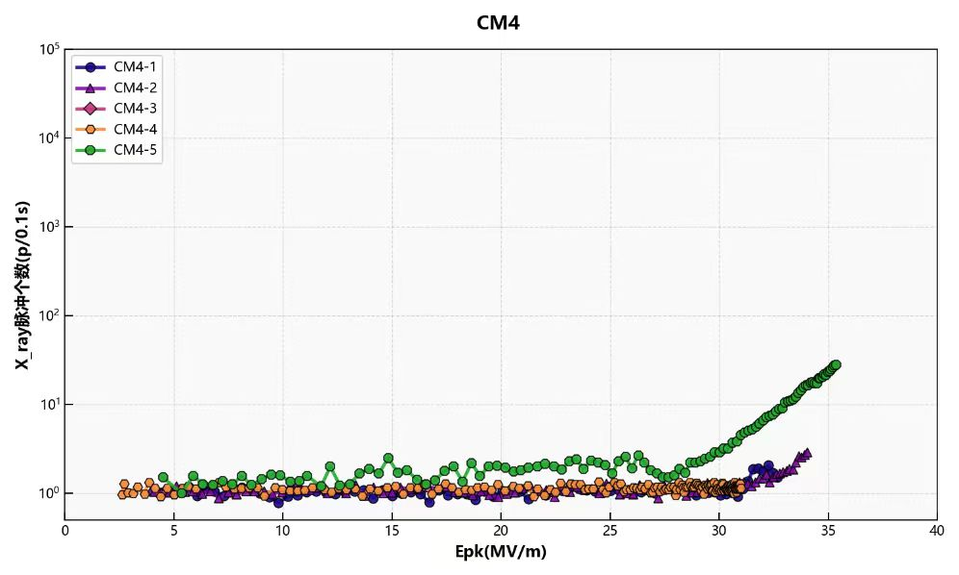


Peak gradient
  The average E_{peak}​ in closed-loop operation is ~33 MV/m, exceeding the design value of 28 MV/m
  Most cavities show field-emission onset above 20 MV/m
10⁴
CM4
10²
Radiation Dose [μSv]
10⁰
Peak gradient [MV/m]
10⁴
CM5
10²
Radiation Dose [μSv]
10⁰
Peak gradient [MV/m]
Notes:
Now, let’s focus on the peak gradient in the superconducting cavities. In CM4 and CM5, the average Epeak during closed-loop operation is about 33 MV/m, which is higher than the design value of 28 MV/m. Most cavities show field emission (FE) only when the electric field exceeds 20 MV/m, but a few cavities start to exhibit FE at less than 20 MV/m.

Slide 18
01
Introduction
02
RF Conditioning
CONTENTS
03
Horizontal test
04
Summary

Slide 19

Summary
  A high-precision RF reference system has been established and implemented, resolving the challenge of unifying signal references for multi-cavity operation and laying the data foundation for beam stability.
  Independently designed and developed a full-process automation control interface for HIAF’s complex operating conditions.
  An integrated LLRF automation framework was developed, enabling automatic measurement of key cavity parameters — loaded Q, Lorentz-force detuning coefficient, and pressure sensitivity
  Real-time batch operation was achieved for automated RF conditioning and pulse-mode loading across multiple superconducting cavities

Slide 20

Thanks for your attention !
Merci !

Slide 21
Back-up Slides

