Slide 1


Production of RFD crab cavities for the U.S. in-kind contribution to the HL-LHC upgrade
Leonardo Ristori - FNAL
HL-LHC AUP L2 Manager
TTC 2026 Meeting, CEA-CNRS-Université Paris Saclay, 9-12 June 2026

Slide 2
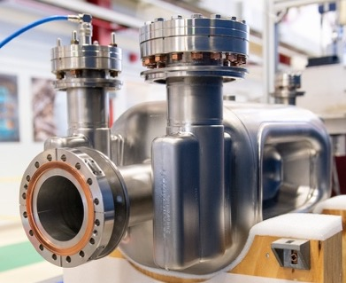
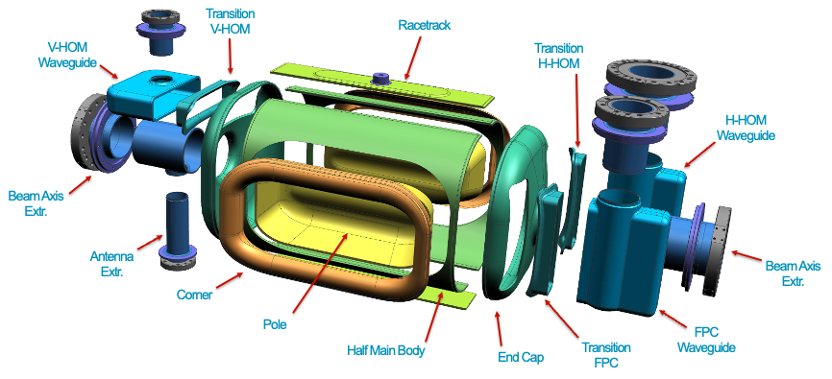
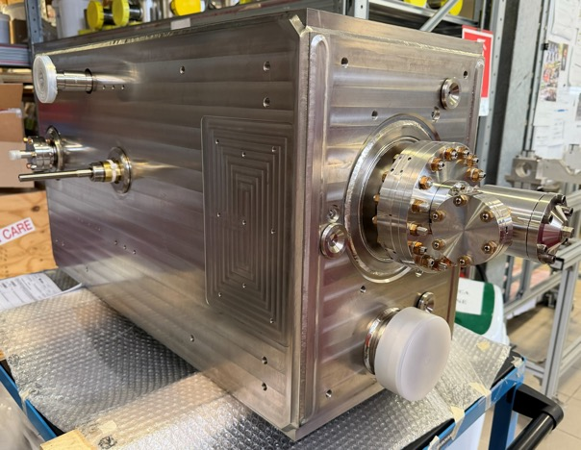
Outline
Introduction
Manufacturing and Processing Challenges
Bare Cavity Qualifications
Jacketing, Dressing and Delivery

Slide 3
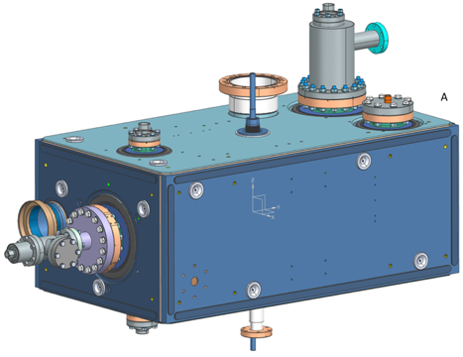
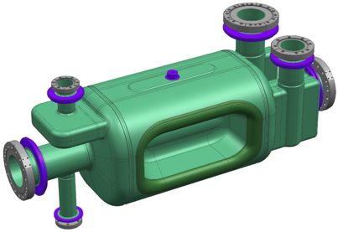
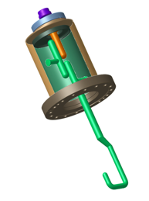
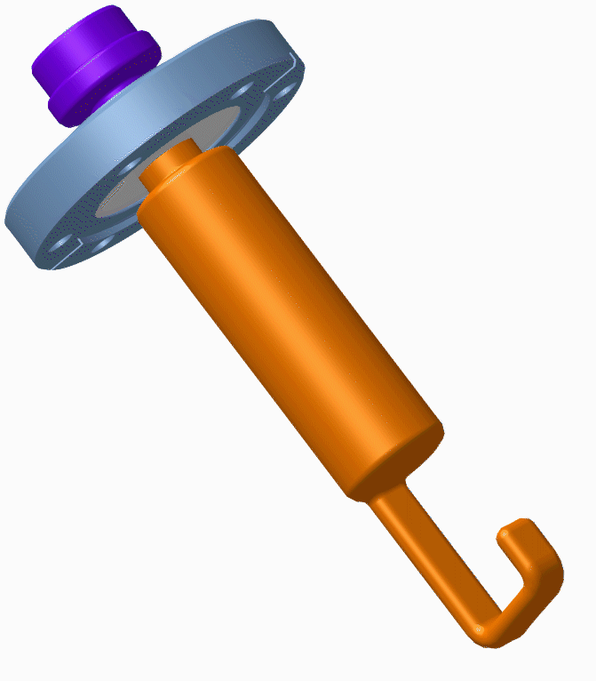
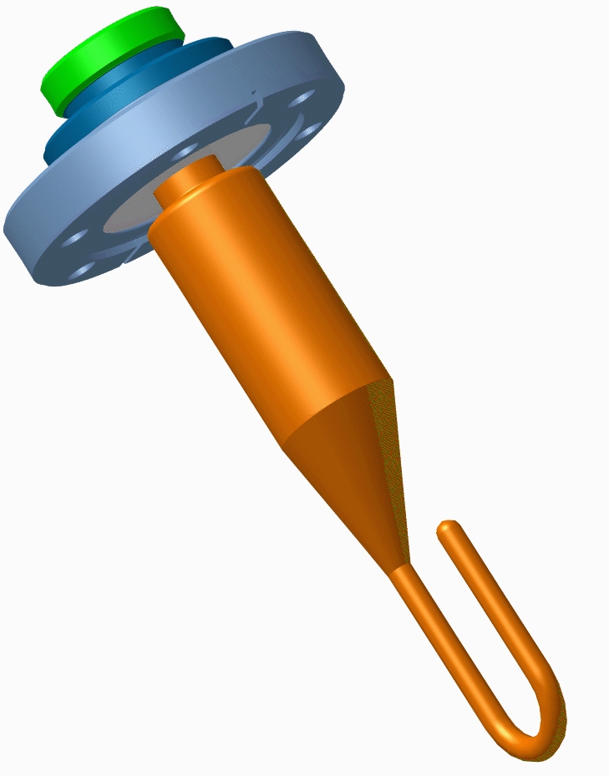
AUP RFD Scope and Deliverables
1
Nb Procurement (Ningxia)
& Cavity Fab (ZRI)
Bare Cavity Processing (ANL)
2
Bare RFD Cavity
Higher-Order-Mode Dampers
Dressed RFD Cavity
3
Bare Cavity 2K Test (FNAL)
US- AUP Project Scope (RFD cavities) includes: 2 Prototypes + 2 Pre-Series + 10 Series RFD cavities → Deliver 10 Dressed Cavities
Bare Cavities: fabrication in Industry → processing by ANL → Intermediate 2K qualification at FNAL → re-processing (if needed) by ANL
Jacketed Cavities: Magnetic Shields + Helium Tank fabrication and installation in Industry.
HOMs dampers: 10 H-HOMs by JLAB (2 additional by CERN); H-HOM FT, V-HOM, Pick-up by CERN.
Dressed Cavities: re-rinsing, HOMs installation and Final Qualification at JLAB at 2K.
Transport to TRIUMF: Confirm performance at 2K and acceptance by CERN.
He Tank
Integration (ZRI)
4
5
Dressed Cavity
Assembly, HPR and 2K Test (JLab)
6
Ship to TRIUMF and CERN Acceptance

Slide 4
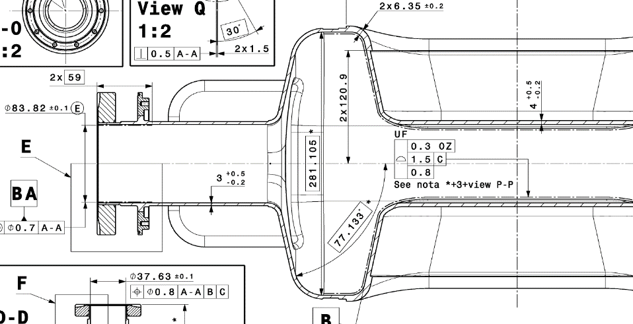
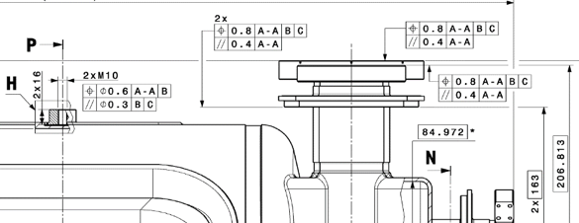
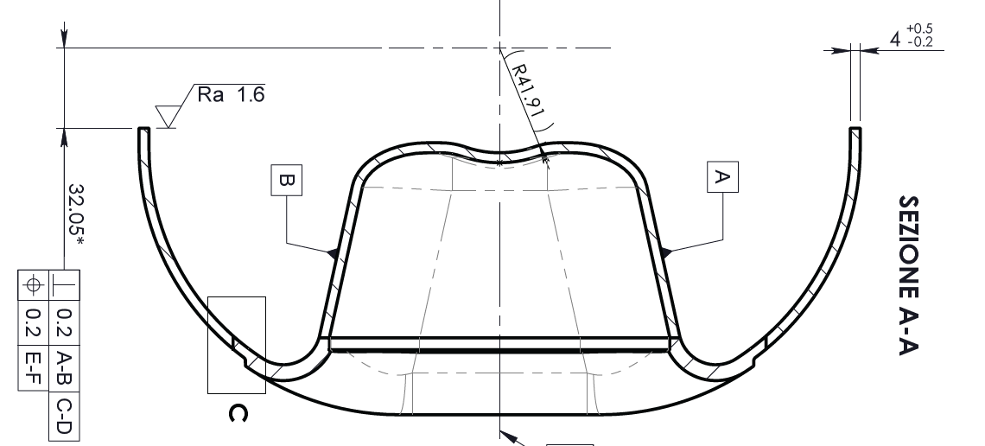
Manufacturing Challenges of Bare Cavities
Sub-mm mechanical tolerances
  Poles symmetry & subcomponents shape accuracy
  End Groups to Main Body alignment
  Flange positions critical for helium tank interface
Extreme deep-drawn pole shape
  Extensive R&D to avoid rupture, orange peel, thinning (also challenge for HPR)
Complex weld geometries
  Saddle-shape welds: pole-body, waveguide-endcap
1
2
3
3
4
5

Slide 5
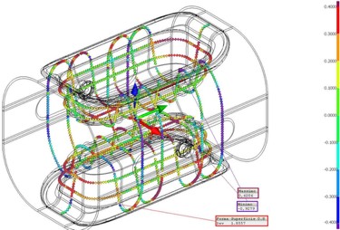
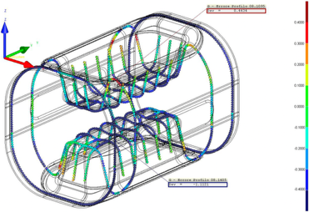
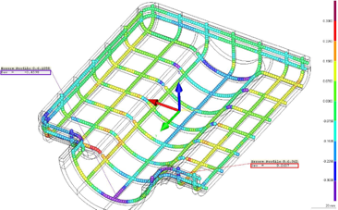
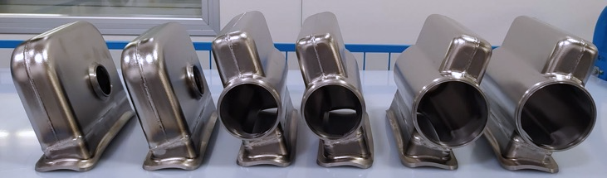
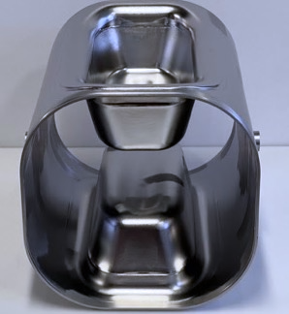
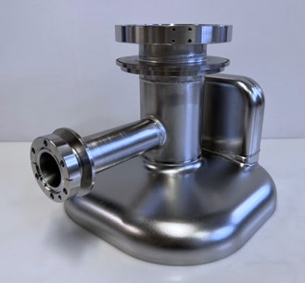
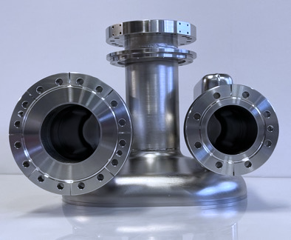
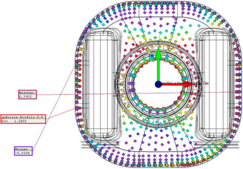
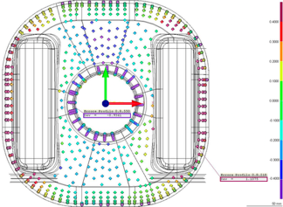
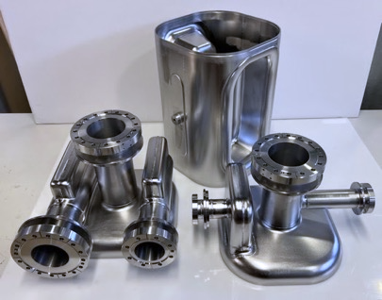
Metrology and Non-Conformities
Production Main Body
Prototype Main Body
Production V-HOM End Group
{+/-0.25mm scale}
Prototype V-HOM End Group
{+/-0.4mm scale}
Reduced deviations from prototypes to production (~ 50%)
Achieving acceptable quality
Components require multiple calibration steps after forming.

Slide 6
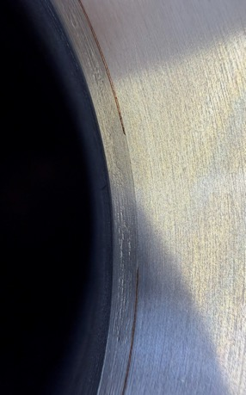
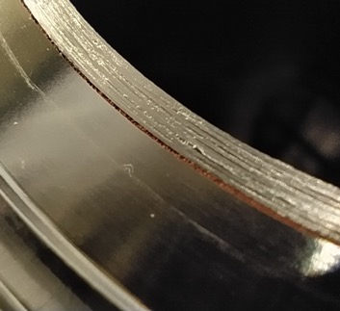
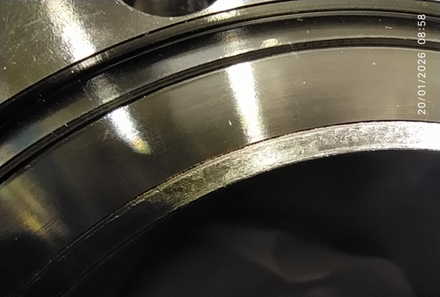
Braze Joints Non-Conformities
Leaks discovered after bulk BCP and 600°C heat treatment at ZRI
All leaky flanges were cut off and shipped to CERN for full analysis
Root Cause Analysis completed by CERN:
  NDT: Visual Testing, Leak Testing, C-Scan UT inspection
  DT: tomography + metallography confirmed deficiencies in sub-component manufacturing
  Root cause: surface roughness and insufficient brazing quality
NRFD03 additionally failed manual UT at CERN (beam-axis, VHOM side)
Mitigation plan under discussion: FNAL–CERN–ZRI
NRFD03: failed UT scan on Beam Axis (VHOM side) at CERN
Braze joints after BCP and HT

Slide 7
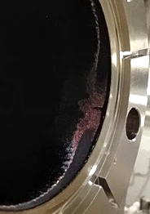
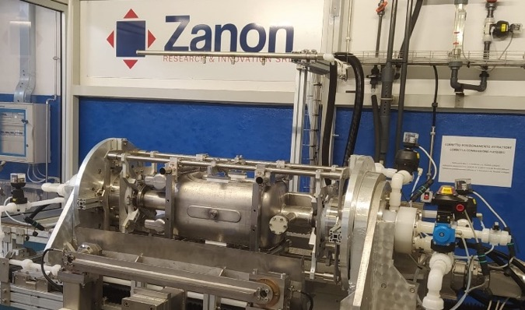
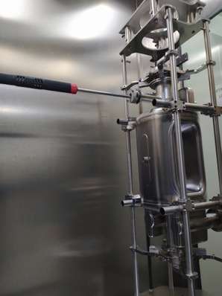
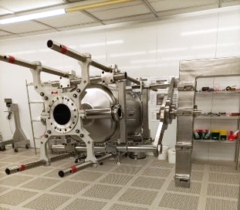
Processing and Rinsing: Solutions and Open Issues
ANL/FNAL Processing Recipe
BCP caused over-etching at peripherals at ZRI attributed to insufficient cooling of extremities: improved with waterjet cooling (ANL approach).
Rinsing and Clean-room assembly at ZRI audited by JLAB SME (in-situ).
  Manual HOM ports rinsing added using JLAB approach and tooling
  JLAB 6-fan-nozzles HPR system will be adopted by ZRI, tested on NRFD06.
  AUP demonstrated full performance recovery after light BCP at ANL
Degreasing → Bulk BCP (180µm) with waterjet cooling
10h plateau 600°C Heat Treatment → Light BCP (40µm)
High Pressure Rinsing (6-fan JLab nozzle)
120°C Baking (waive if only repeating HPR)
NRFDP001 over-etching
Rotational BCP with waterjet cooling
Manual port HPR and Clean room assembly at ZRI

Slide 8
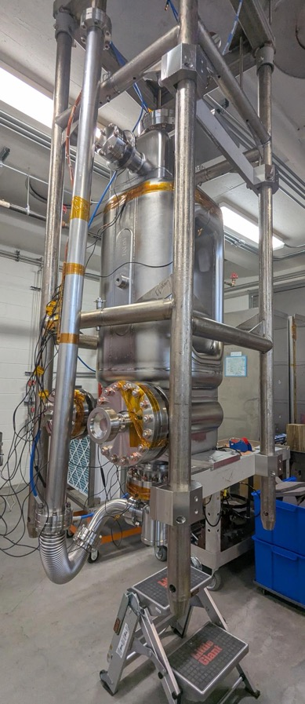
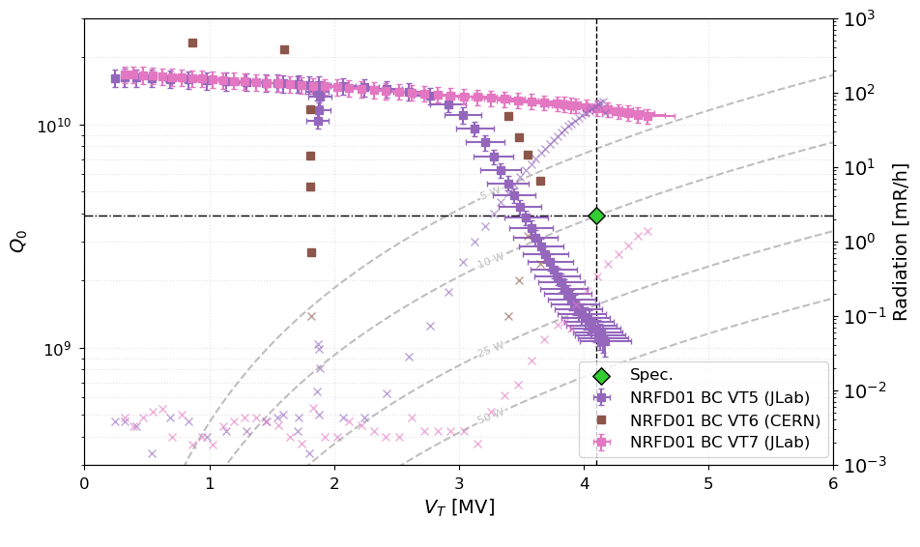
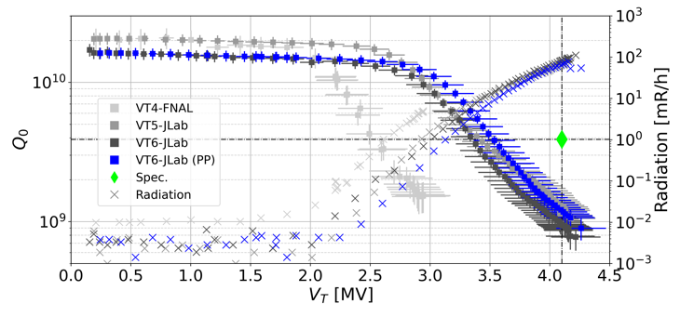
NRFD01 – Qualified With Light BCP by CERN + Test by JLab
NRFD01 underperformed in cold test as received by ZRI, even after several HPRs at JLab.
Shipped to CERN for:
  40µm light BCP → cold testing results cannot be assessed due to multipacting barriers.
  RF processed and qualified at JLab
NRFD01 cold tests as received from ZRI and after multiple HPR at JLab
K. Turaj, N. Valverde (CERN) – A. Castilla (Jlab)
NRFD01 latest cold test results after light BCP

Slide 9
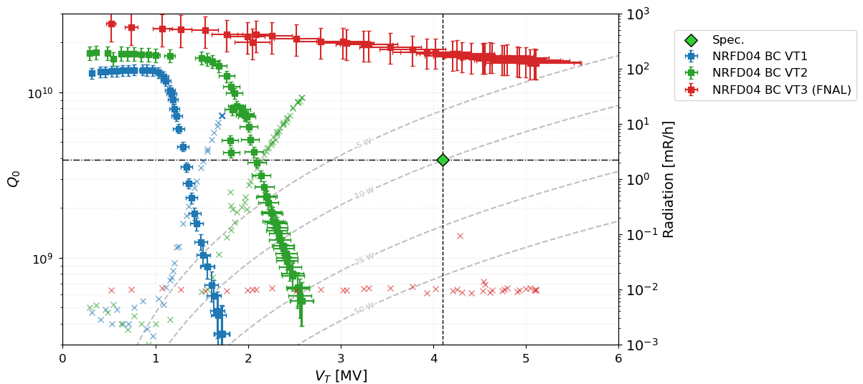
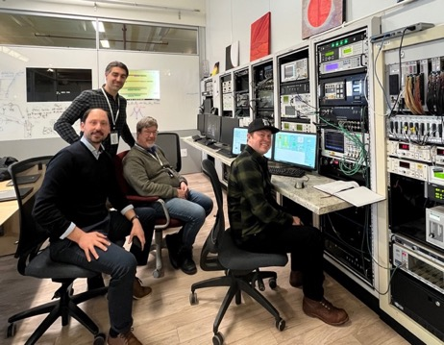
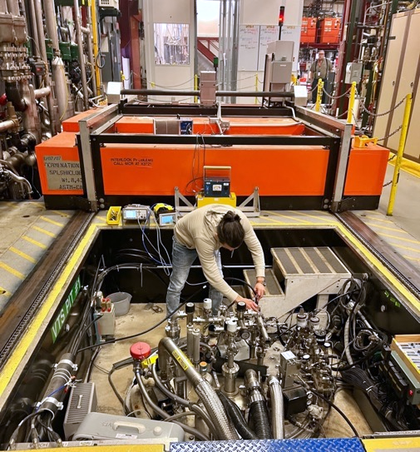
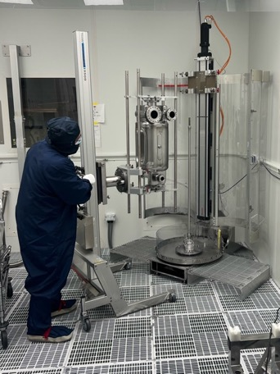
NRFD04 – Qualified With First light BCP at ANL
VT1 (10/30/2025):
  “As received”.
VT2 (11/10/2025):
  HPR + Clean Assy.
VT3 (12/08/2025):
  BCP + preparation (ANL).
After light BCP
FNAL VTS
Cavity as-received had severe FE starting at ~1MV (blue plot).
Re-HPR by JLab provided only marginal improvement with FE onset at ~1.5MV (green plot)
Light-BCP and HPR by ANL allowed exceeding project requirements
  Q₀ at Vt = 4.1 MV ≈ 1.7e+10 (4 times spec)
  V_{t,max} = 5.110 MV with Q₀ = 1.5e+10 (reached admin. limit)
  No FE up to Vt,max = 5.110 MV
  Low-Field Q₀ = 2.61e+10 (highest ever recorded)
ANL HPR
A. Netepenko, D. Bice (FNAL) – A. Castilla (Jlab)

Slide 10
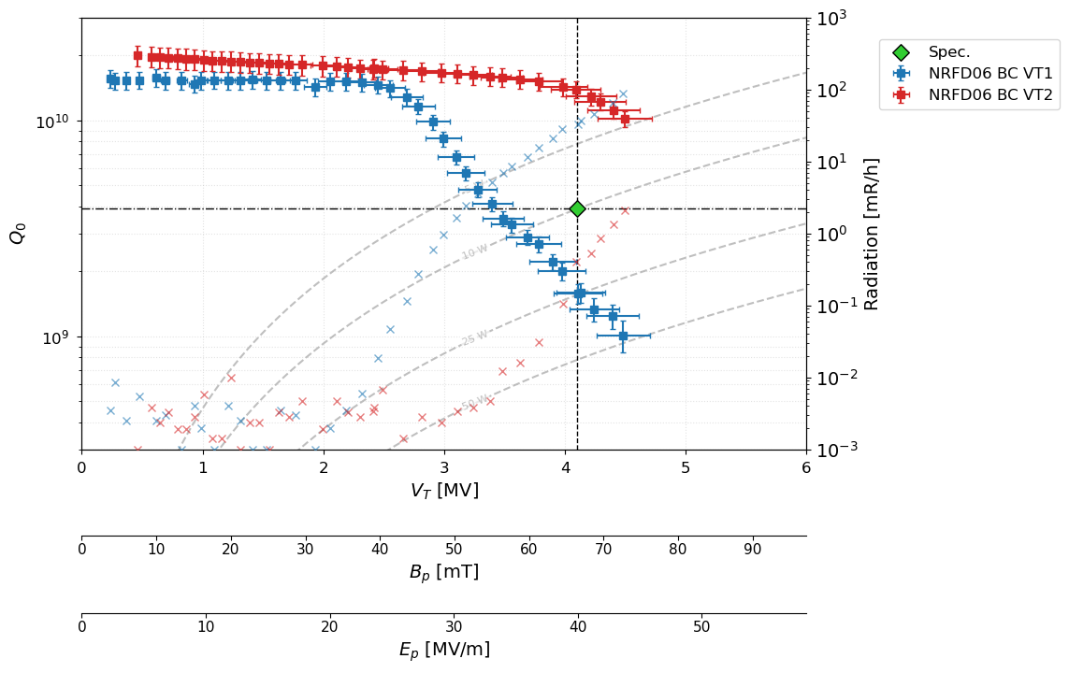
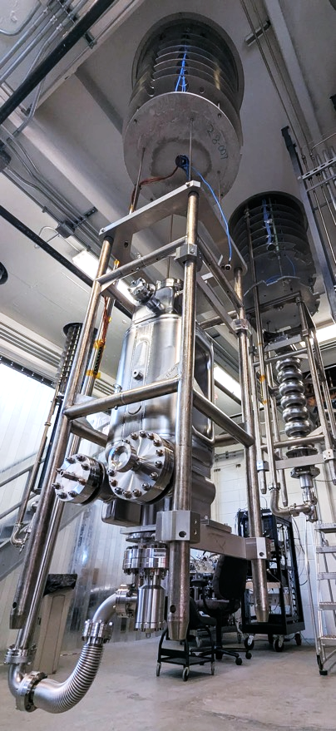
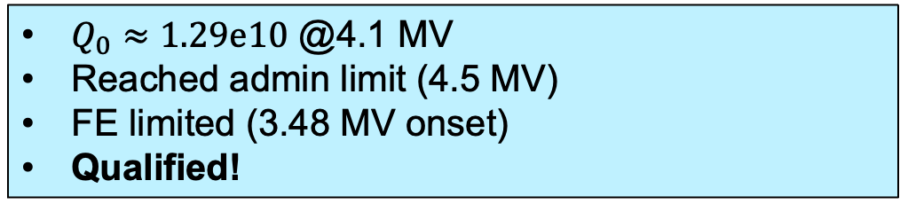
NRFD06 - Qualified after re-HPR by JLab
VT1 (02/03/2026):
  “As received”.
VT2 (02/20/2026):
  HPR + Clean Assy.
$Q_{0}≈1.29e10$ @4.1 MV
Reached admin limit (4.5 MV)
FE limited (3.48 MV onset)
Qualified!
A. Castilla (Jlab)
10

Slide 11
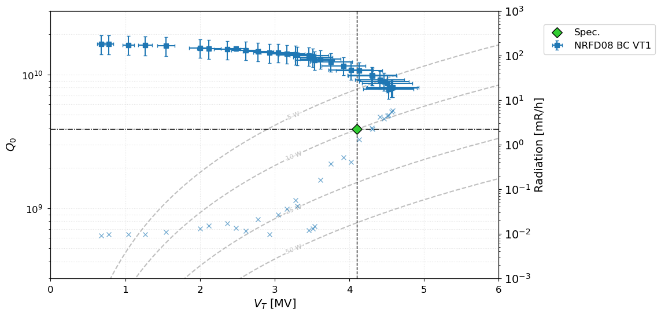
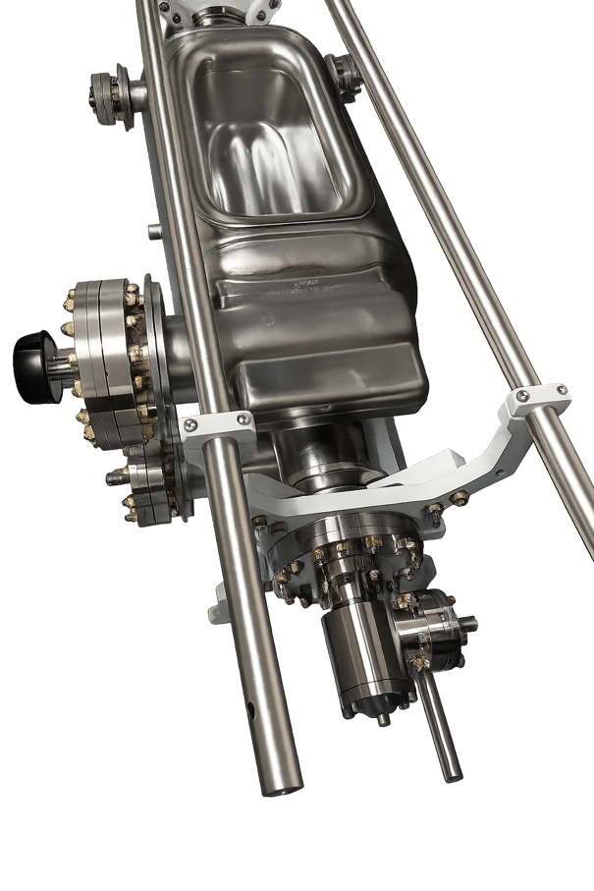
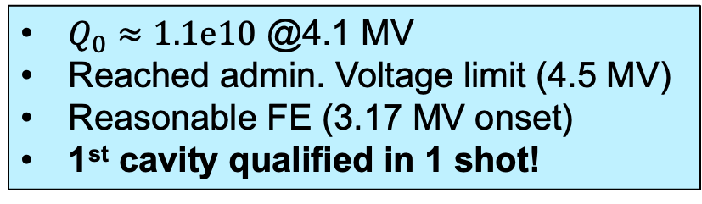
NRFD08 – Qualified 1st Pass Full Processing by ANL
$Q_{0}≈1.1e10$ @4.1 MV
Reached admin. Voltage limit (4.5 MV)
Reasonable FE (3.17 MV onset)
1st cavity qualified in 1 shot!
VT1 (05/29/2026):
  Full surface processing, cleaning and assy. @ANL
  Test @FNAL
A. Netepenko, D. Bice (FNAL) & P. Berutti (BNL)
11

Slide 12
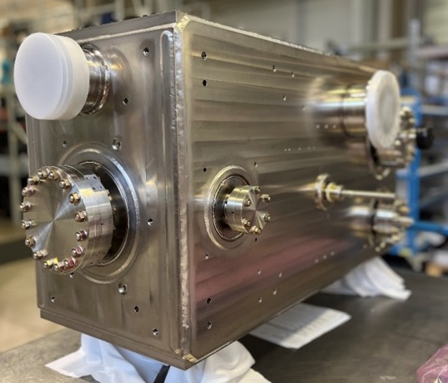
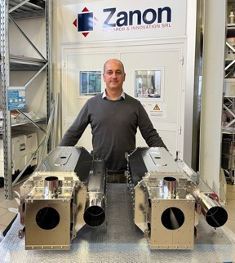
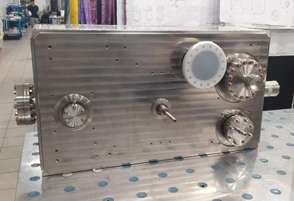
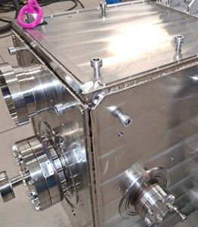
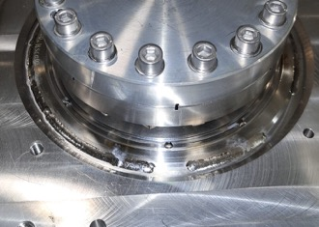

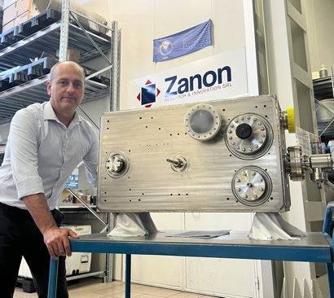
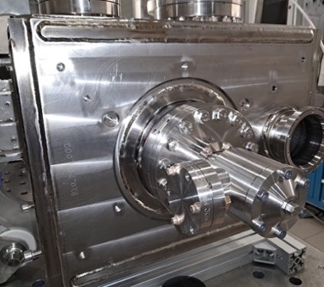
Installation of Magnetic Shields and Helium Tank
Installation of cold magnetic shields, custom rings and titanium plates w/o issues at ZRI.
Multiple Ti Gr 23 vented bolts and Schnorr washers required for assembly of He Tank.
Final TIG welding, for leak tightness only, performed in custom-designed glove box.
Negligible frequency shift of < 10 kHz.
The total time spent welding inside the glove-box is ~2 weeks.
Welding of plates
Welding of flange interfaces
“Dry” Assembly completed
Cold (internal) Magnetic Shields
Jacketing Completed
Welding of fastener covers

Slide 13
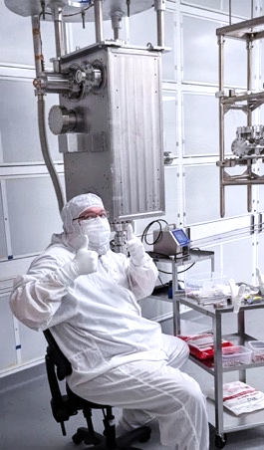
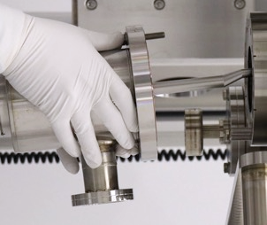







Cold Tests 1st Deliverable
First Deliverable Exceeded Performance Requirements at Jlab and at TRIUMF
TRIUMF
JLab
TRIUMF
TRIUMF
N. Huque, A. Castilla (Jlab) – B. Laxdal, Z. Yao (TRIUMF)

Slide 14
Thank You for your attention
U.S. RFD Teams
Fermilab
Management, Processing, Cold Tests
  Giorgio Apollinari, Vito Lombardo, Leonardo Ristori
  Manuele Narduzzi, Sasha Netepenko, Damon Bice, Colin Narug
Jefferson Lab
HOM Dampers Fabrication and Dressed Cavity Preparations and Tests
Naeem Huque, Alex Castilla, Peter Owen, Ashely Mitchell
Old Dominium University
General Oversight and RF measurements
  Jean Delayen, Subashini De Silva
SLAC National Accelerator Laboratory
RF Simulations
Zenghai Li

