Slide 1
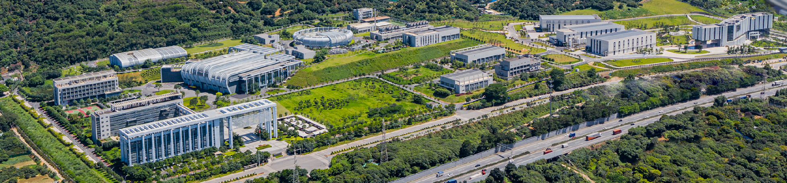



Report of Dongguan Branch
Progress about CSNS-II superconducting cavities
Wenzhong Zhou, Cong Zhang
Institute of High Energy Physics of Chinese Academy of Sciences
TTC 2026 Meeting, CEA-CNRS-Université Paris Saclay, 9-12 June 2026, Gif sur Yvette, France

Slide 2

Outline
Introduction of CSNS-II
Current Status of Double Spoke Cavity Cryomodule
Current Status of Elliptical Cavity Cryomodule
Summary
2

Slide 3
Introduction of CSNS-II
3

Slide 4
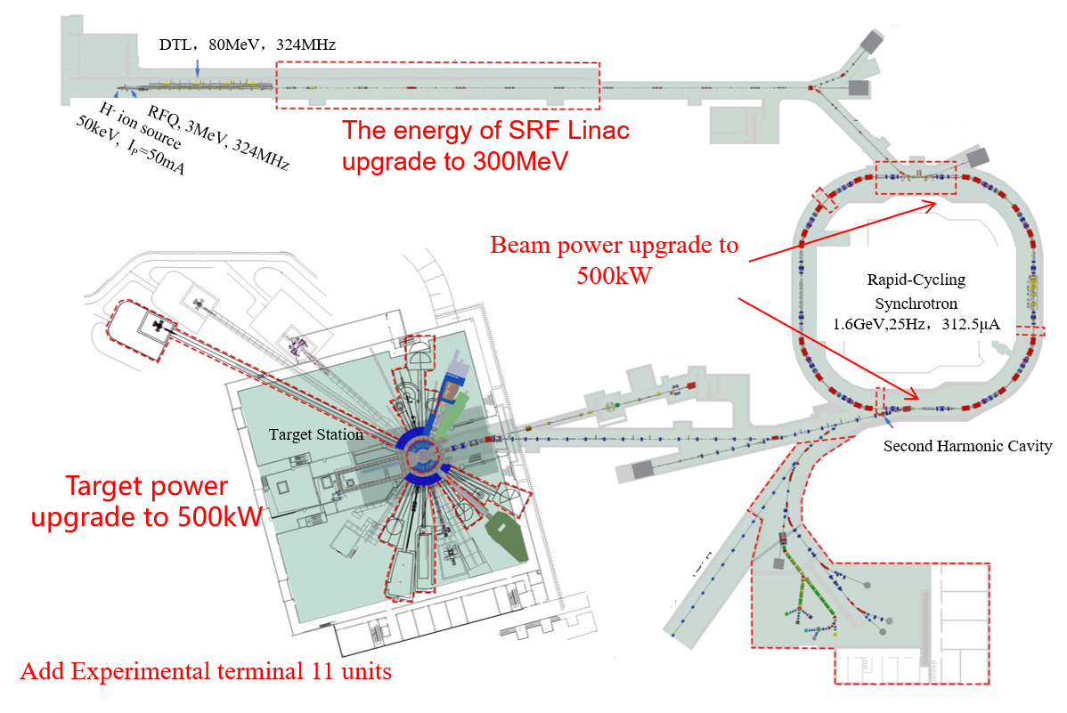
Upgrade scheme of CSNS-II
In the planned upgrade of the China Spallation Neutron Source Phase II (CSNS-II)，the following aspects are included:
A superconducting Linac composed of double-spoke cavities and elliptical cavities will be installed after the existing room temperature Drift Tube Linac (DTL). The beam energy of the Linac will be increased from 80 MeV to 300 MeV, and the peak beam current will be raised from 15 mA to 50 mA.
RCS will add magneticalloy cavities. The proton beam power will rise from 100 kW to 500 kW and the average beam current will in-crease from 62.5 μA to 315 μA.
The proton beam will be directed to the target station, which will have 11 additional beam lines for different experiments.
4

Slide 5
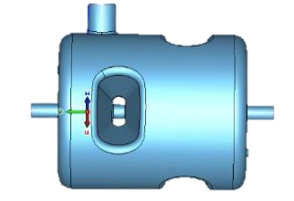
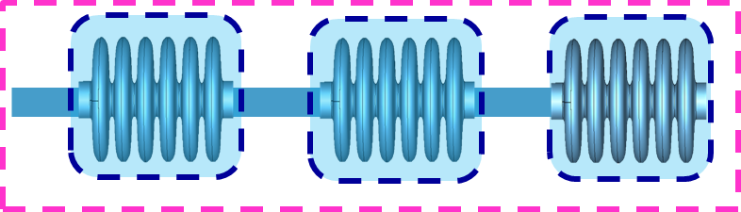
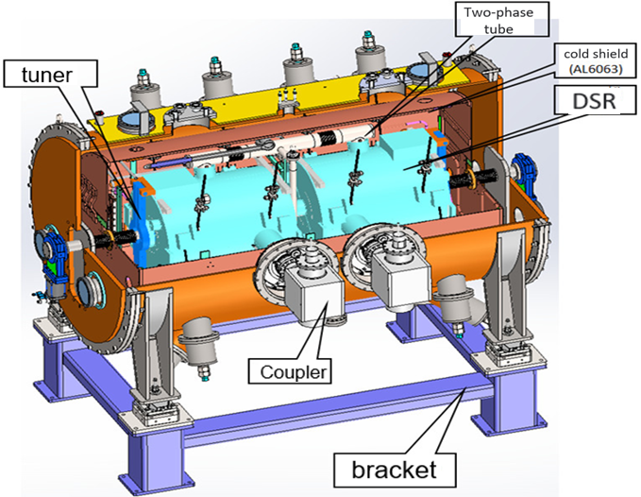
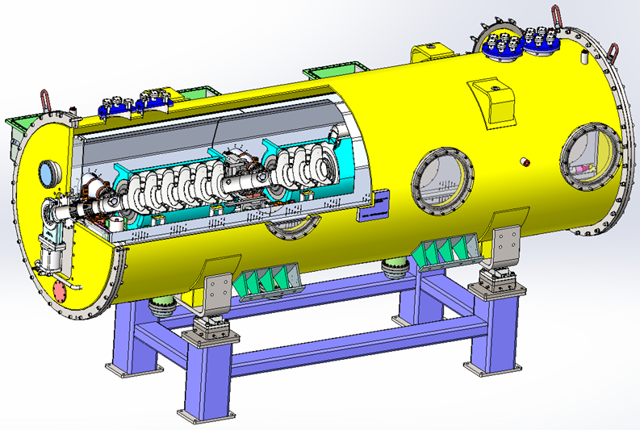
Upgrade scheme of Linac for CSNS-II
50keV
3MeV
80MeV
165MeV
300MeV
H⁻
RFQ
MEBT
DTL
Double-Spoke
cavities
Elliptical cavities
LRBT
RCS
β₀=0.5
324MHz
10 cryomodules
2 cav/cryomodule
βg=0.62
648MHz
8 cryomodules
3cav/cryomodule
Х10
Х8
Double-spoke cavity
Elliptical cavity
5

Slide 6
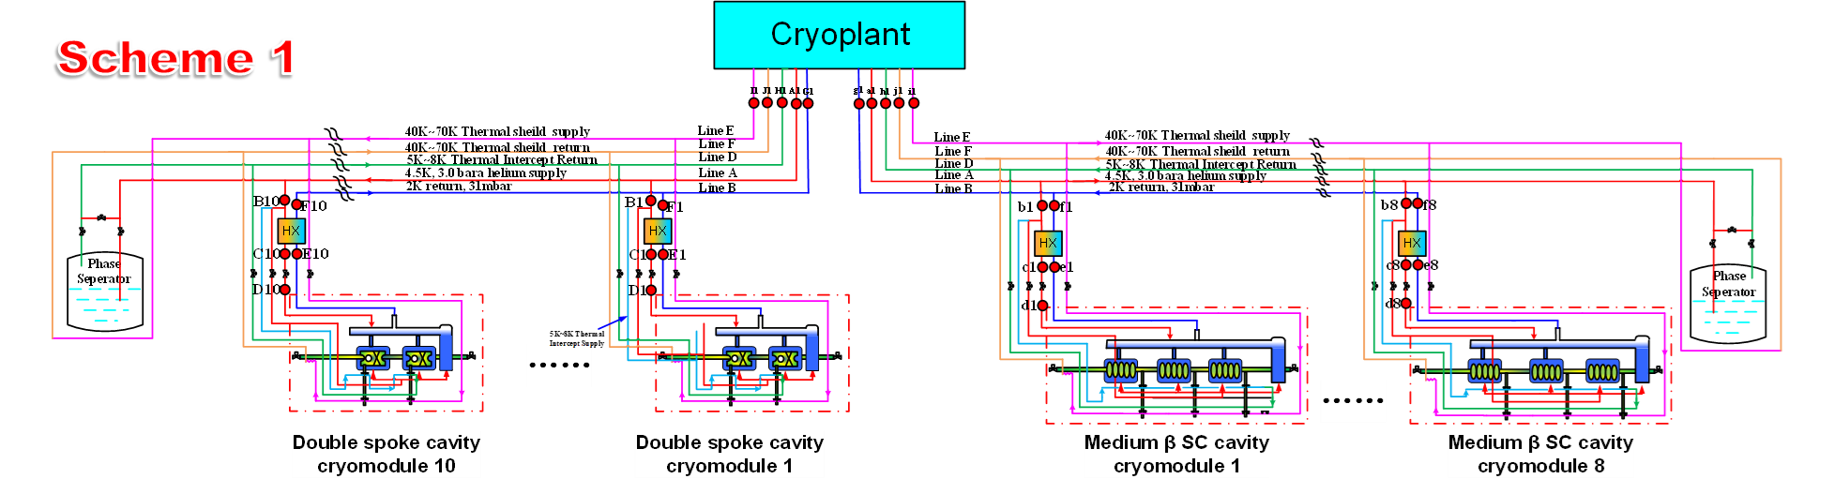
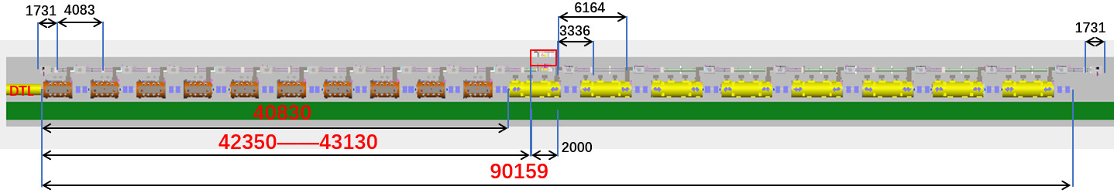
Overall layout of Linac for CSNS-II
6

Slide 7
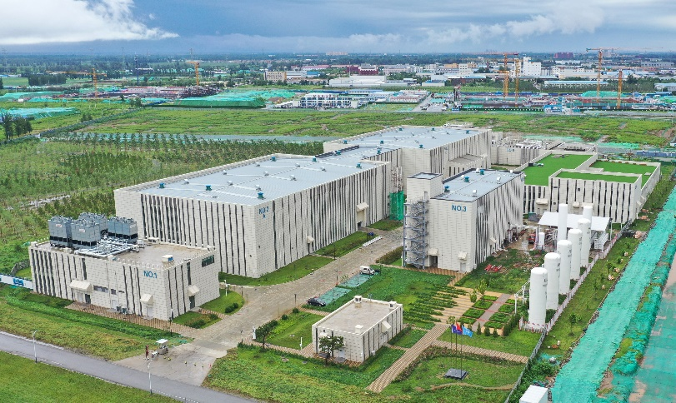
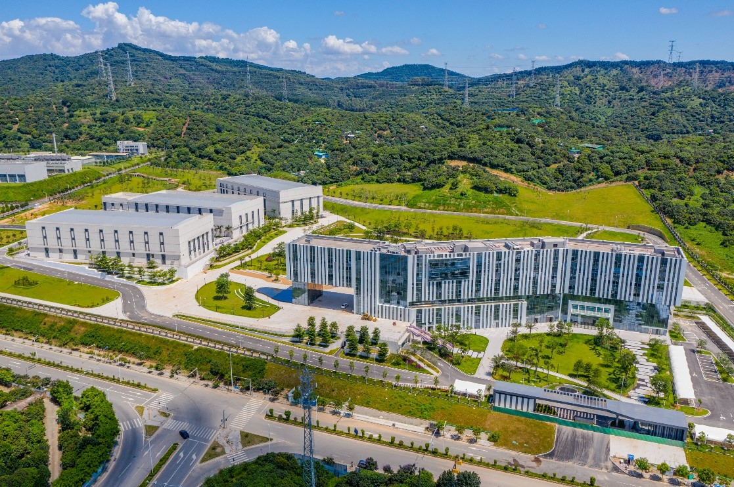
Personnel Composition
Rui Ge
(Person in charge)
Accelerator Division
(Beijing)
High Frequency
Cryogenics
Division of Accelerator Technology (Dongguan )
Linac
cryogenics
Vacuum
Aligment
Mechanics
Vacuum
Aligment
Lianc radiofrequency
PAPS （Beijing,China）
SAPS （Dongguan,China）
7

Slide 8
CSNS-II project schedule
2024 |  |  |  |  |  | 2025 |  |  |  |  |  | 2026 |  |  |  |  |  | 2027 |  |  |  |  |  | 2028 |  |  |  |  |  | 2029
2 | 4 | 6 | 8 | 10 | 12 | 2 | 4 | 6 | 8 | 10 | 12 | 2 | 4 | 6 | 8 | 10 | 12 | 2 | 4 | 6 | 8 | 10 | 12 | 2 | 4 | 6 | 8 | 10 | 12 | 2 | 4 | 6 | 8 | 10 | 12
170kW Beam Commissioning ending
200kW Beam Commissioning in New Injector
Cryogenic System Install beginning
SRF Cavity Tunnel Install beginning
SRF Cavity Tunnel Install ending
T0
1.9
10.11
9.17
7.25
7.1
4.30
12.28
2029
10.9
Linac
Machine Halt for CM Install
300kW Beam Commissioning
Project Acceptance
（5years and 9months）
Civil Engineering beginning
Civil Engineering ending
Linac/RCS Expansion ending
Civil Engineering & Utilities Renovation
2024
8.5
2026
7.20
2026
10.31
9.30
Refrigeration Station Expansion
8

Slide 9
II. Current Status of Double Spoke Cavity Cryomodule
9

Slide 10
Mass production of the double Spoke cavity cryomodule
Double spoke cavity
August 2024 : The niobium supply contract is signed with Ningxia Orient Tantalum Industry Co.,Ltd (OTIC).
December 2024 : The Cryomodule mass production contract has been signed with high-energy running Co., Ltd.
November 2025: the CM1 will be integrated at the end of November.
tuner
Second half of 2024: The batch production of coupler and tuner commenced.
November 2025: Four units have been delivered
May 2026: Fourteen units have been delivered
Coupler
November 2025: Delivery of six high-power conditioned couplers has been completed
May 2026: Fourteen units have been delivered
Cryostat
November 2025: Two sets are delivered
First half of 2025 :The batch production of double-spoke cavity cryomodules commenced.
May 2026: Seven units have been delivered
Horizontal Testing
May 2026 : Completion of the Horizontal Testing of two cryomodule(CM1and CM2)
10

Slide 11
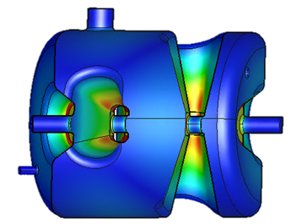
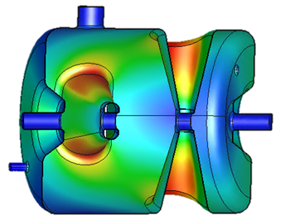
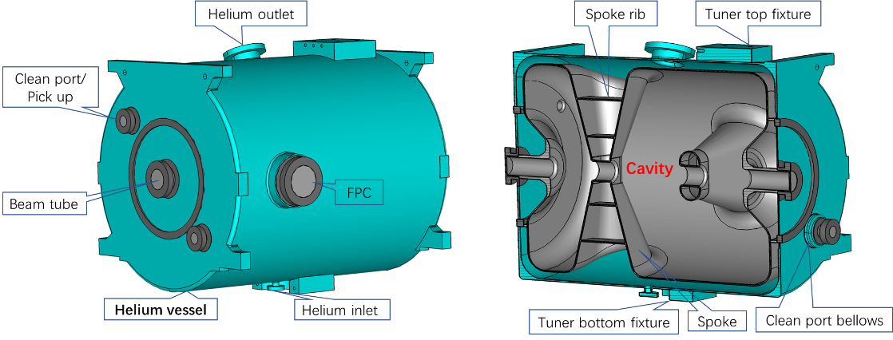
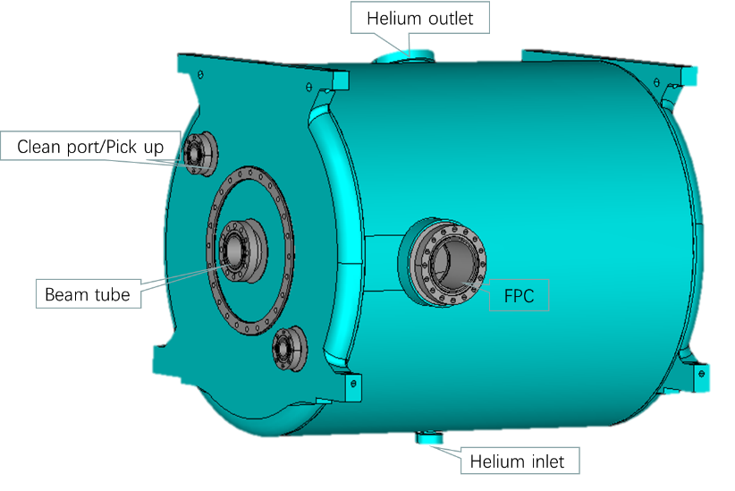
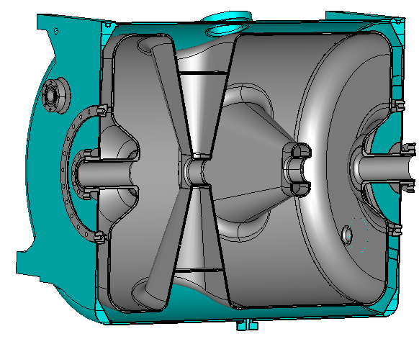
Double spoke cavity - Design
parameter | prototype | improved
Frequency(MHz) | 324 | 324
β_{opt} | 0.5 | 0.5
E_{p}/E_{acc} | 4.1 | 3.44
B_{p}/E_{acc}(mT/(MV/m)) | 9.2 | 8.86
R/Q（Ω） | 410 | 401
G（Ω） | 120 | 118
Beam tube diameter（mm) | 50 | 50
E_{acc}(MV/m) | 7.3 | 9
LFD (Hz/(MV/m)^2) | -10.5 | -4.56
Electric field distribution
Magnetic field distribution
Prototype cavity
Improved cavity
11

Slide 12
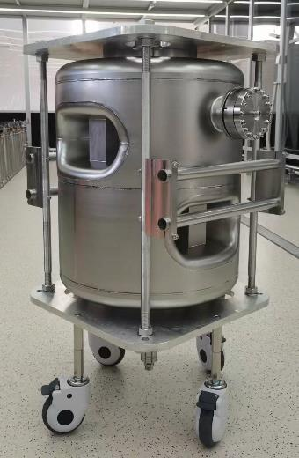
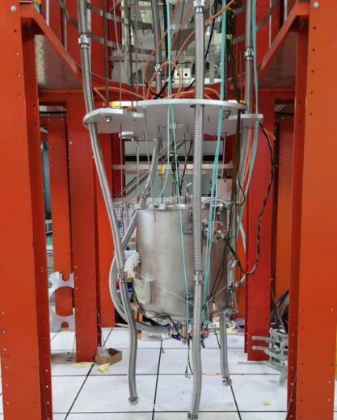
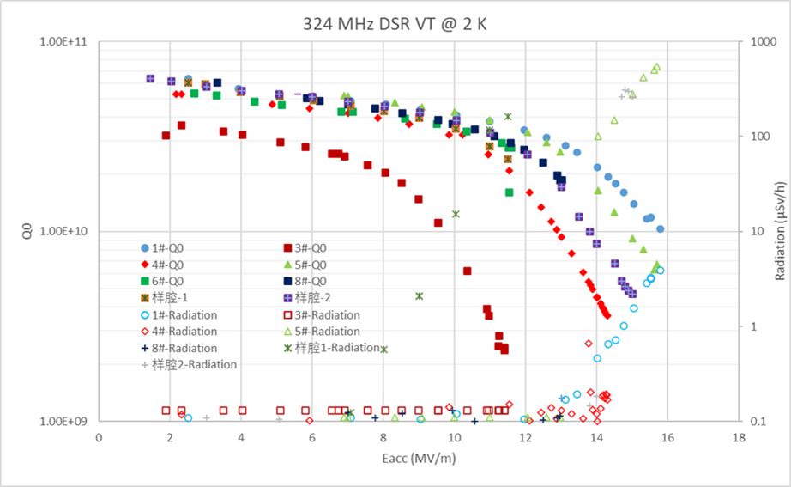
Double spoke cavity – Vertical test
Bare cavity and jacketed cavity
Vertical test data of the six cavities
To date, a total of 11 double-spoke cavities have been fabricated (including the prototype). Two units are undergoing rework to address welding defects; eight have met specifications following vertical testing; and one remains pending evaluation. The maximum accelerating gradient achieved is 15.7 MV/m, with a peak magnetic field (Bp) of 139 mT.
12

Slide 13
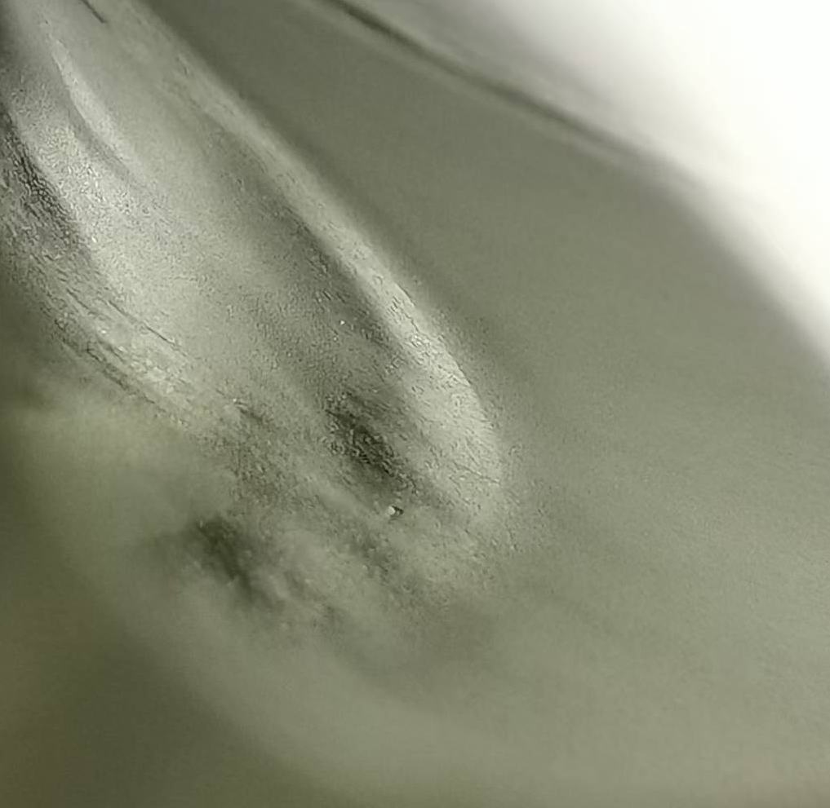
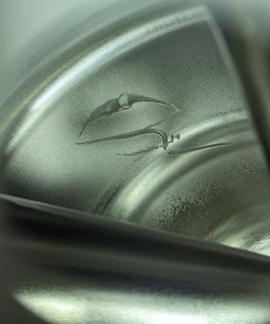
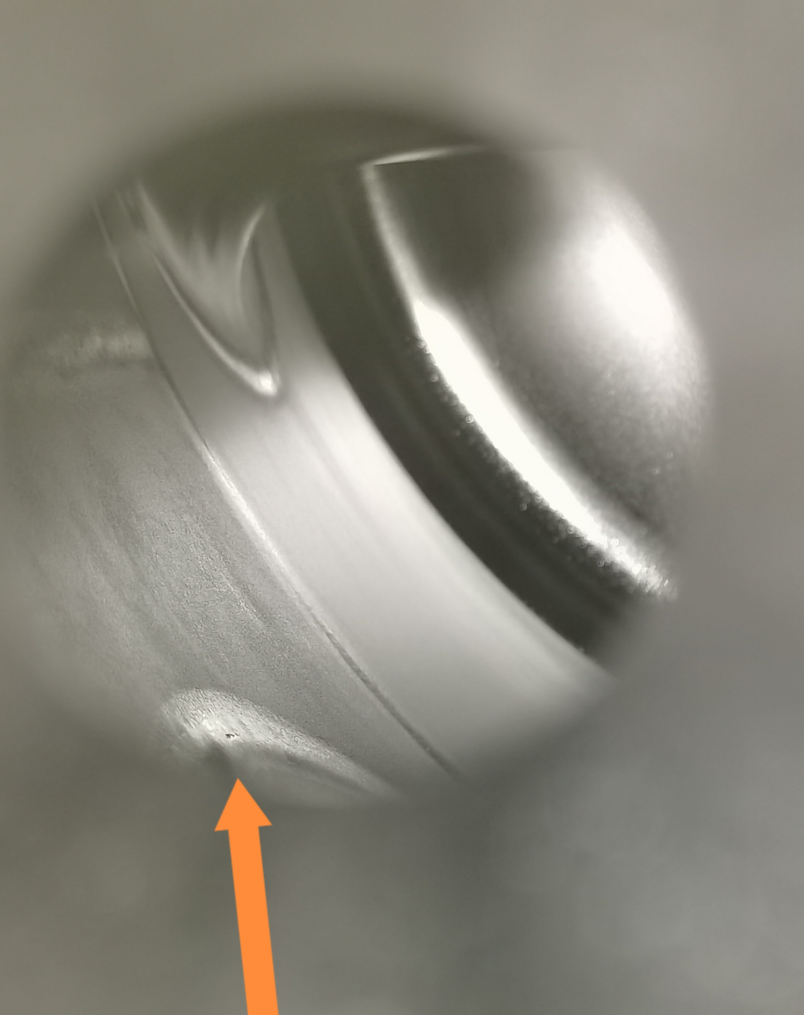
Problems
2#
2#
7#
Two cavities developed latent welding defects that were only revealed after BCP, as they were not detectable after the welding process. Additionally, Serious inner-wall scratches were caused by contact with the nozzle during HPR. Both cavities are currently undergoing rework.
13

Slide 14
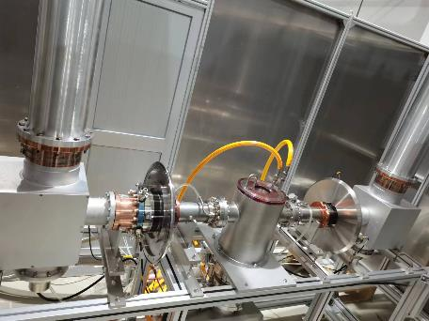
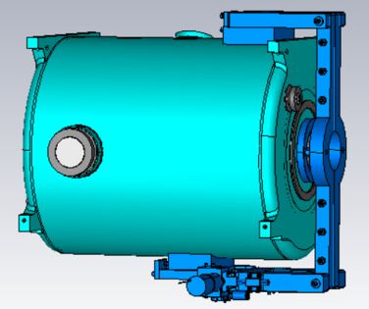
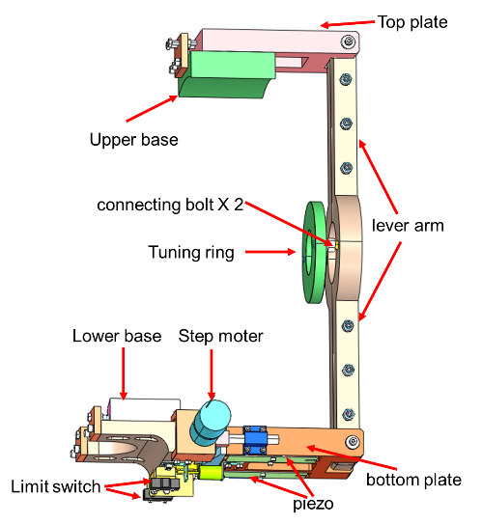
High power coupler
Tuner
Parameter | Value
RF frequency | 324 MHz
Peak RF power | 300 kW
Pulse width | 1.2 ms
Pulse repetition frequency | 25/50Hz
Qext | 4.5E+05
Interface to the cavity | Diameter 80 mm
FPC position | Horizontal to the cavity
Assembly | Clean assembly
FPC type | Coaxial ,single window
Window Type | Coaxial disk with choke
Coupling type | Electric
parameter | value | unit
Slow tuning
Tuning range | 100 | kHz
stroke | ~0.93 | mm
resolution | ＜1 | Hz
stiffness（2K） | ＞20 | N/um
Operate temperature | ~5 | K
Fast tuning will be reserved with space and controller
Tuning Range | ＞1000 | Hz
resolution | ＜1 | Hz
Operate temperature | ~5 | K
Response time | ~1 | ms
A total of 14 sets of couplers have been manufactured and conditioning.
A total of 14 sets of tuners have been manufactured and tested.
14

Slide 15
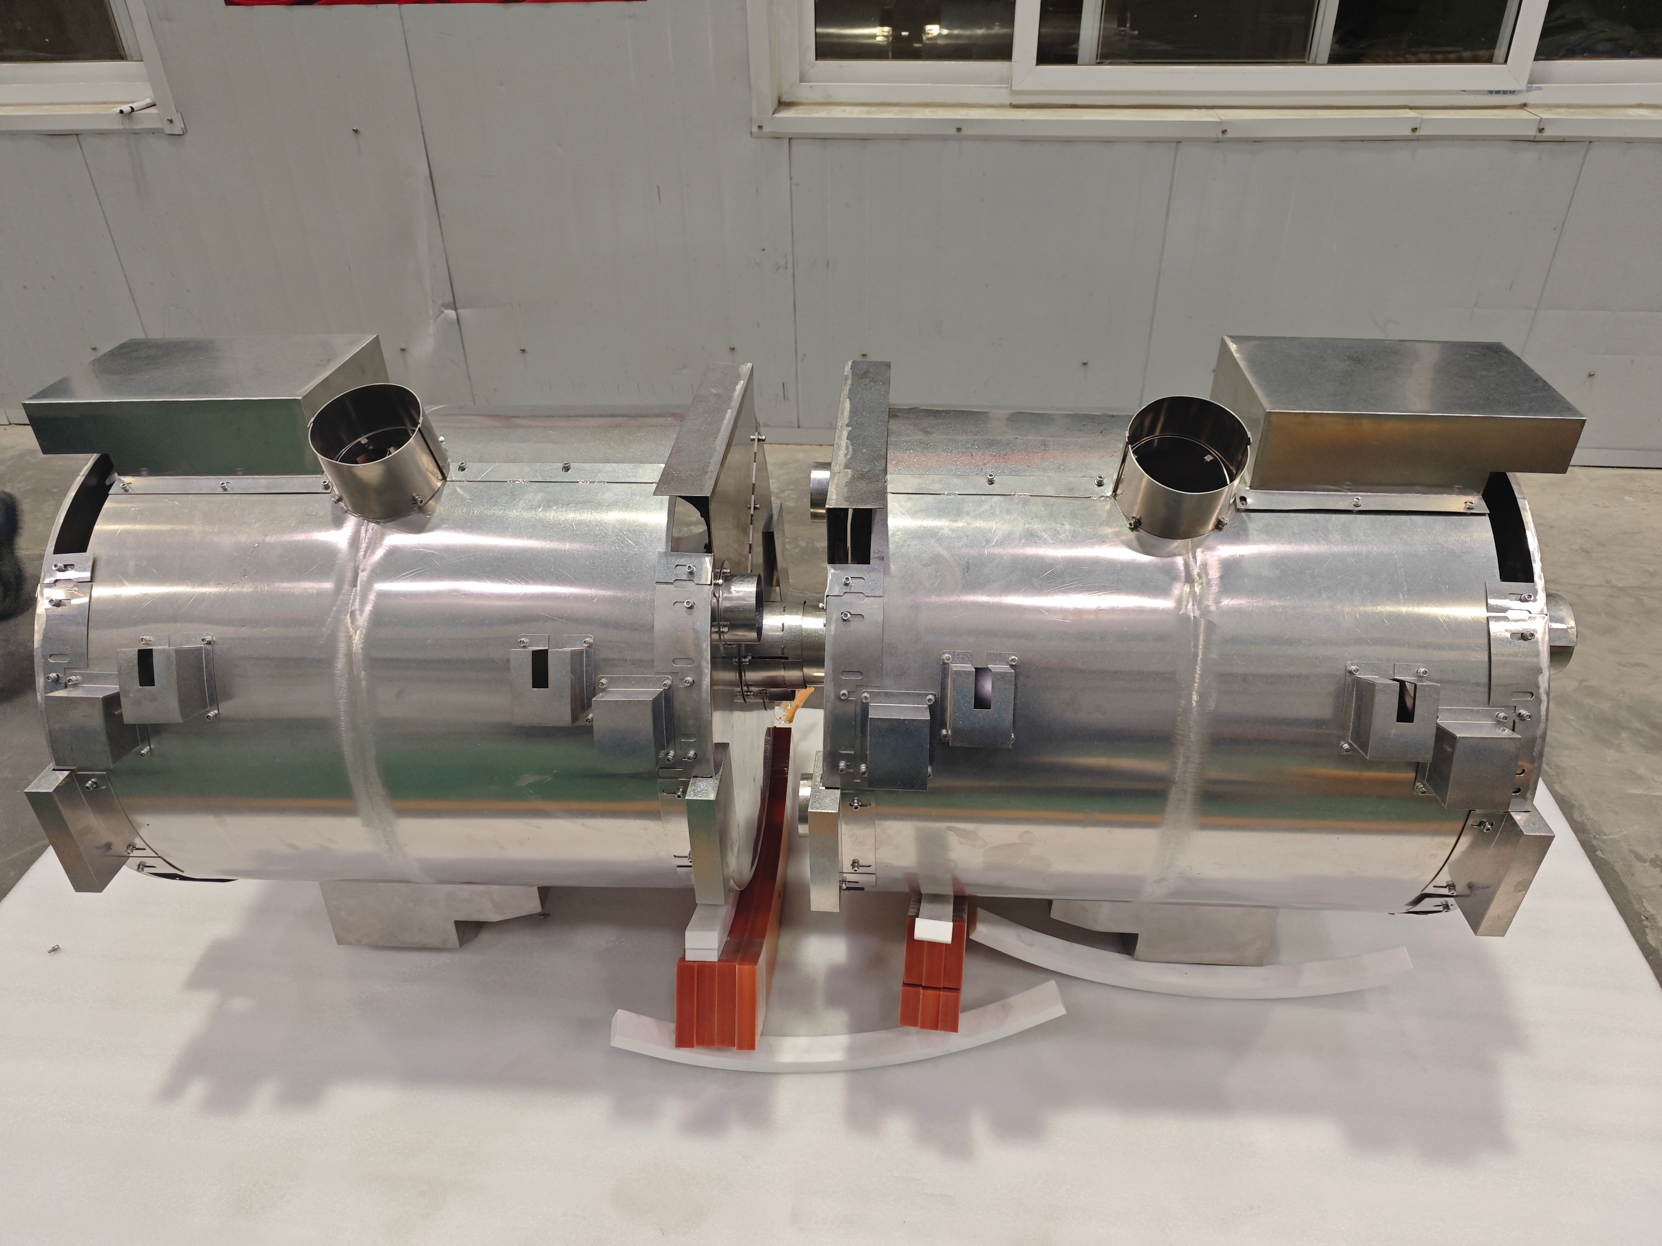
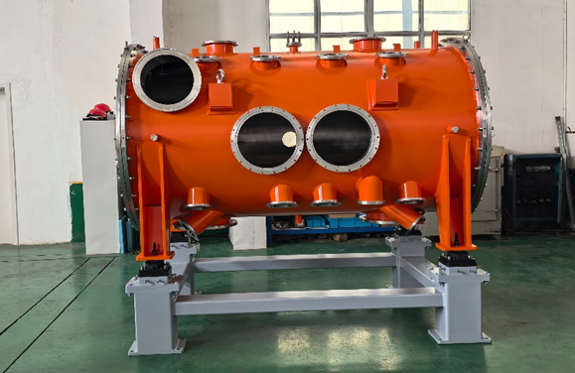
Cryostat and magnetic shield
A total of 10 sets of magentic shield have been manufactured
A total of 7 sets of cryostat have been manufactured
15

Slide 16
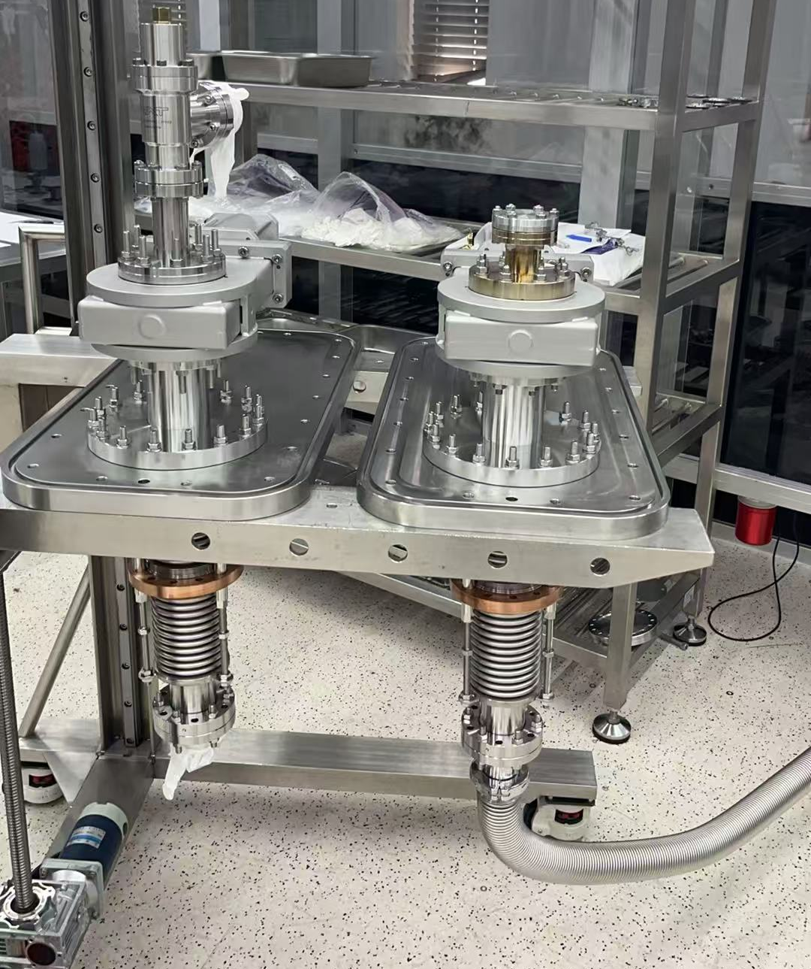
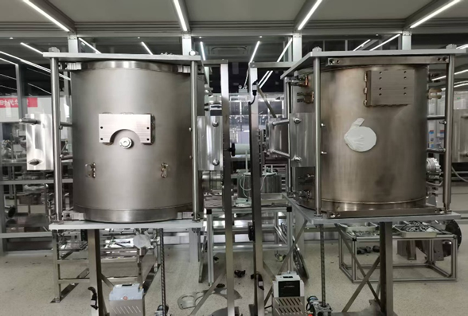
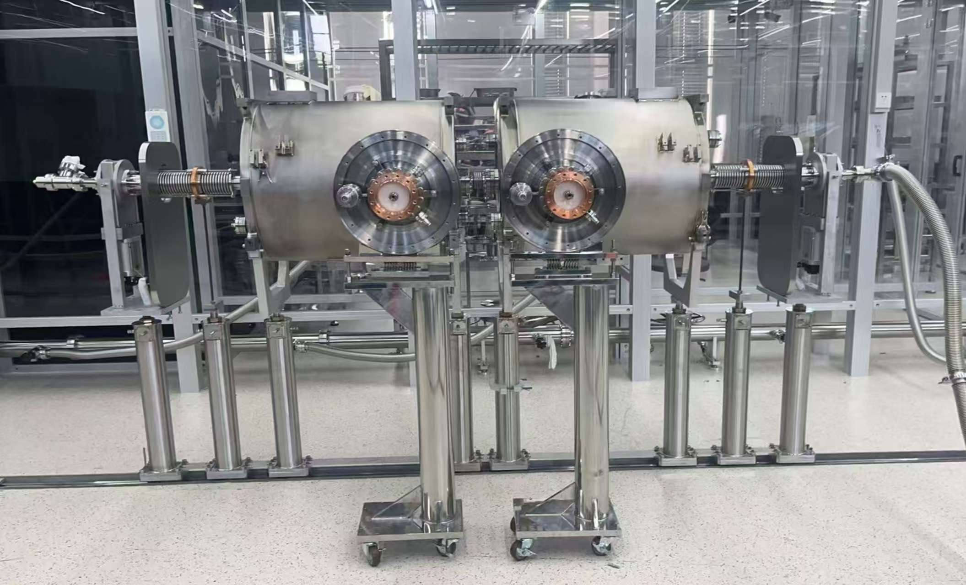
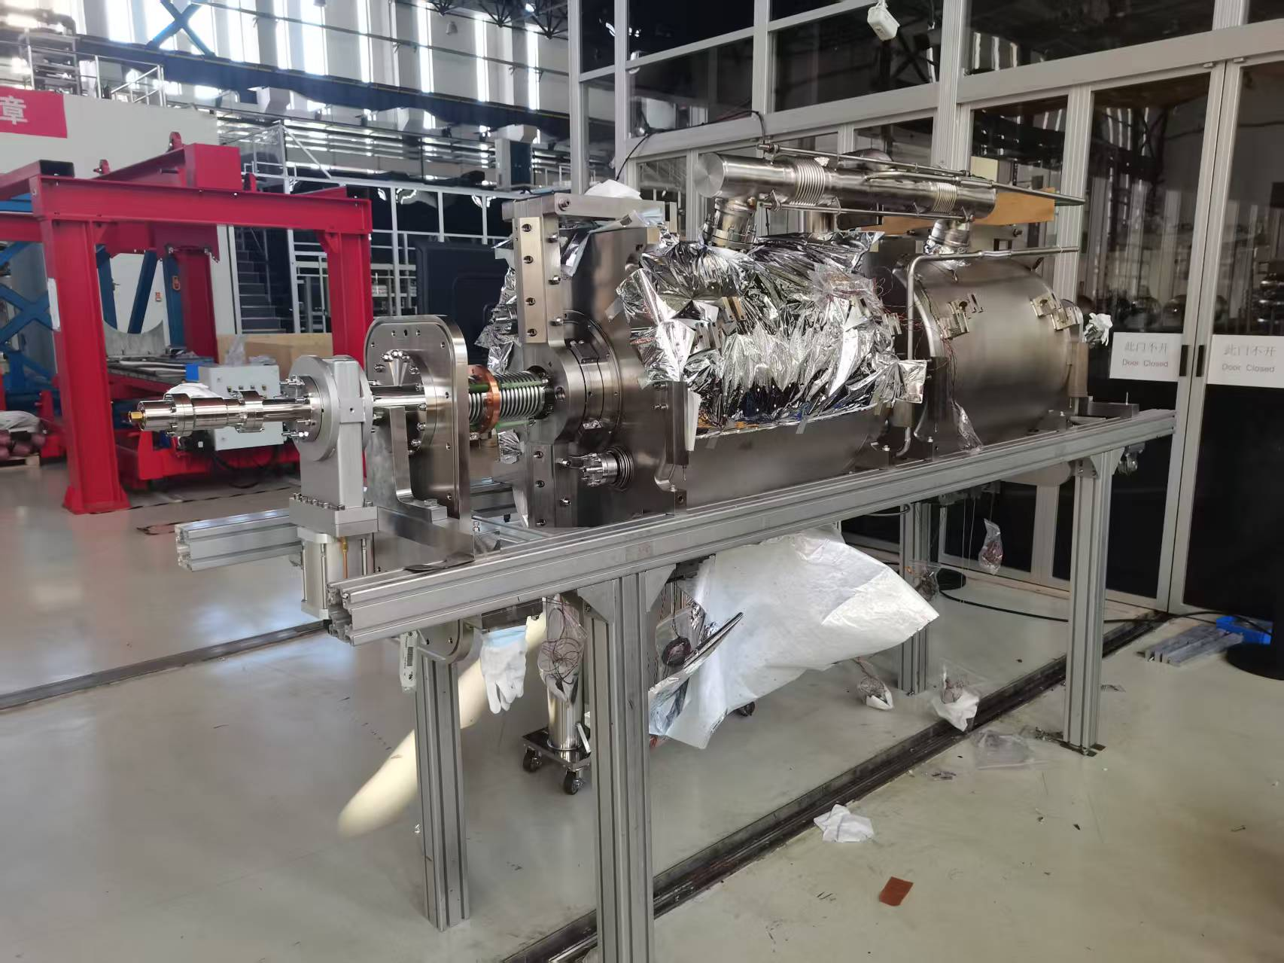
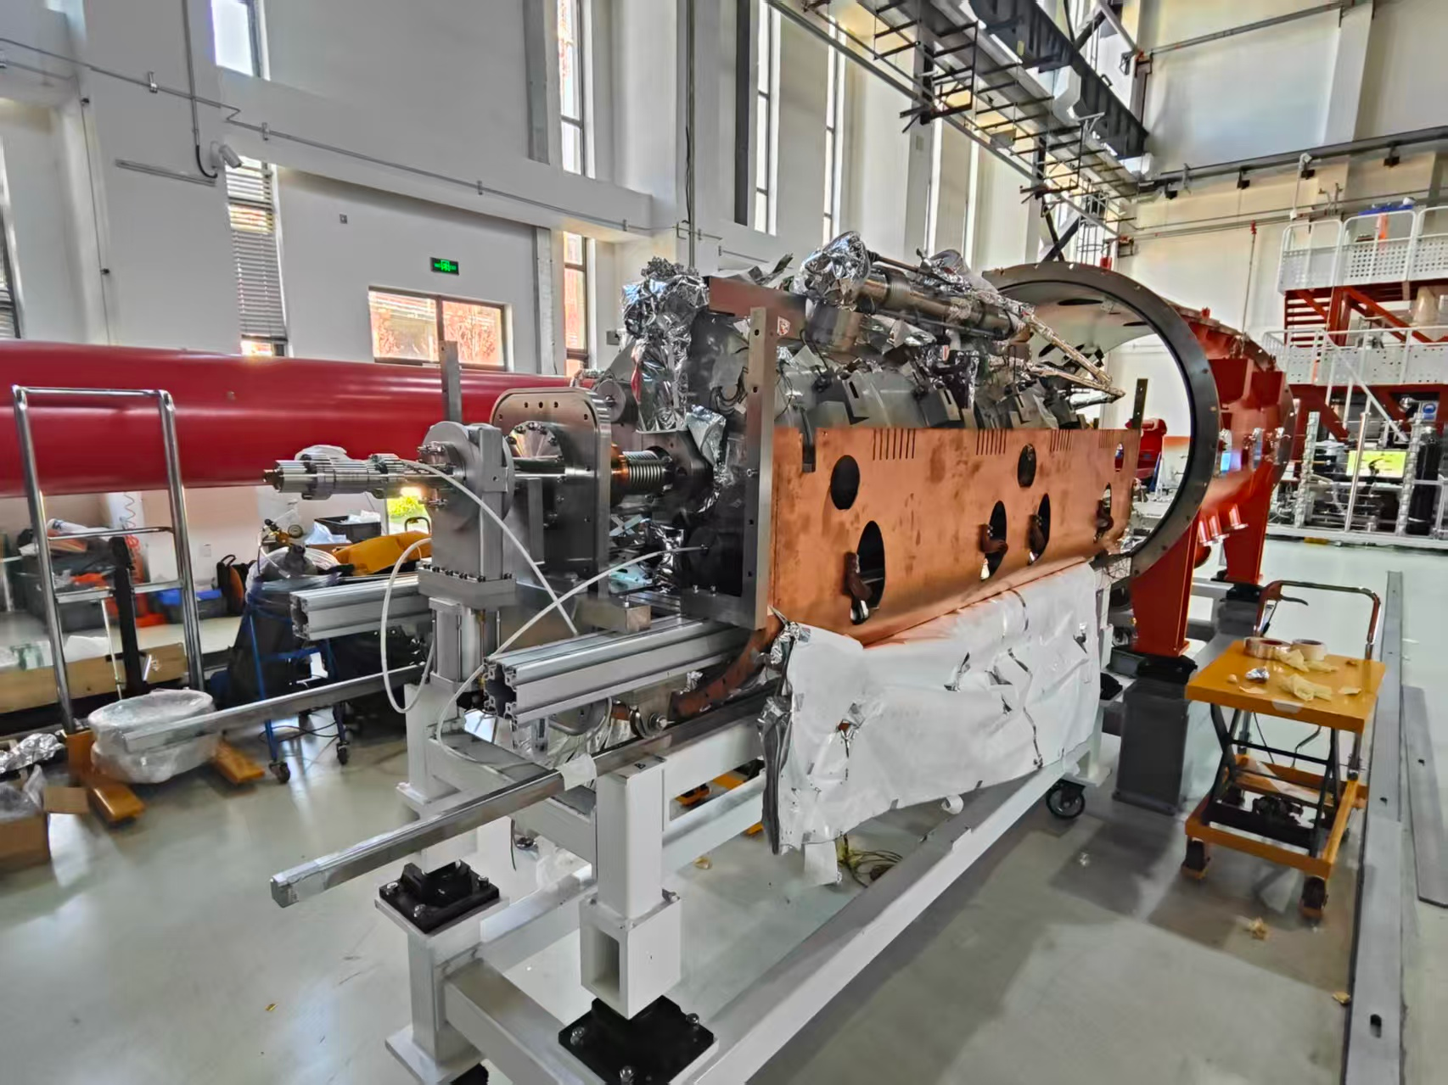
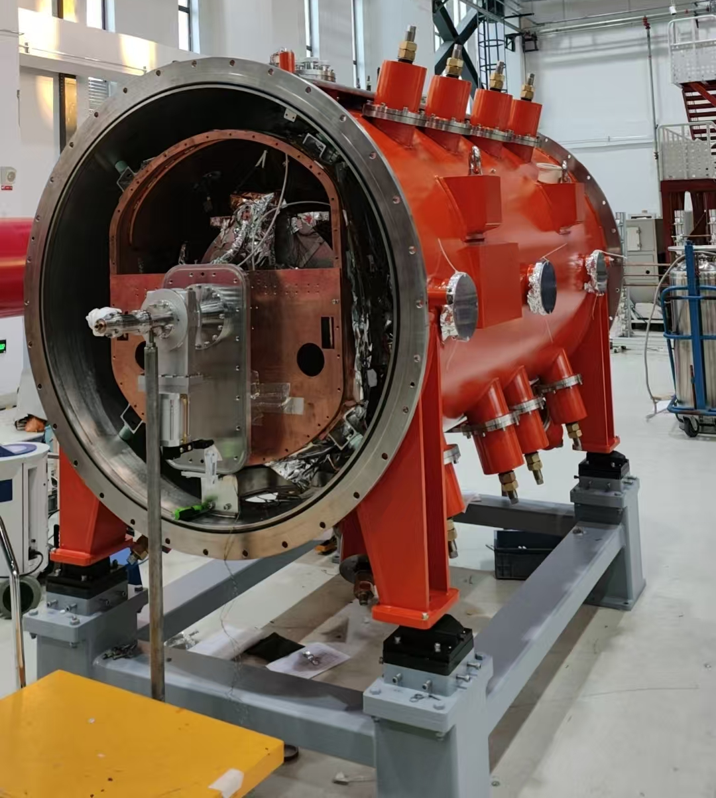
Integration of the cryomodule
Bellows leak detection
DSR
Cavity string
Installation of magnetic shield
The intallation of thermal shield
The cold mass in the cryostat
16

Slide 17
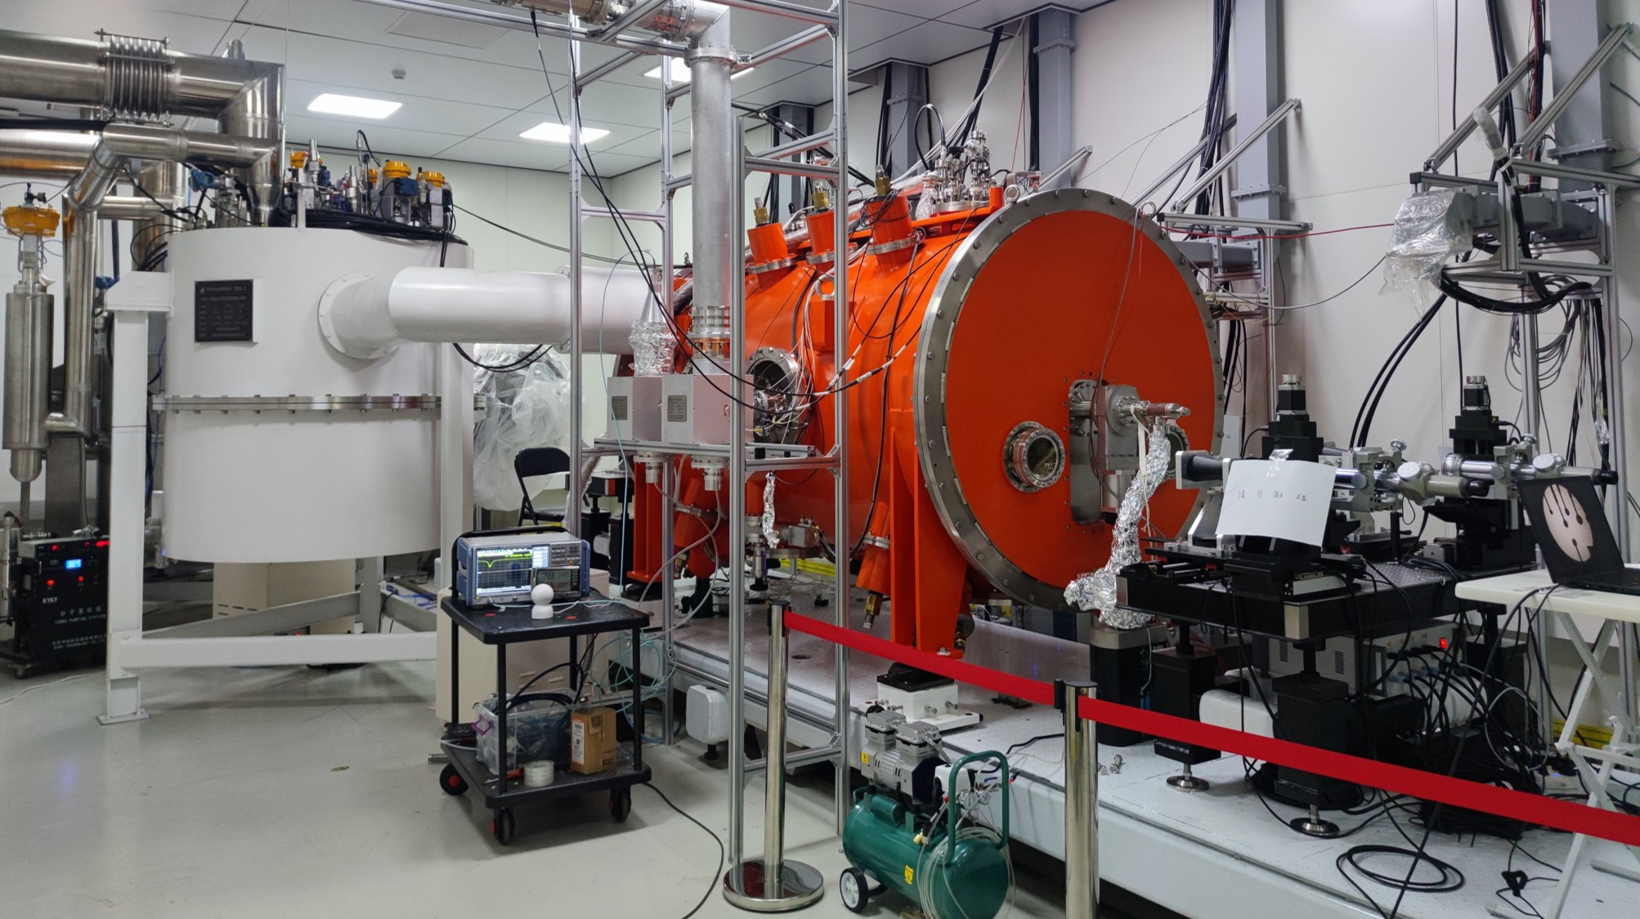
Horizontal test
Cryomodule
Waveguide
Alignment
Valve box
Coupler
Beam pipe
17

Slide 18
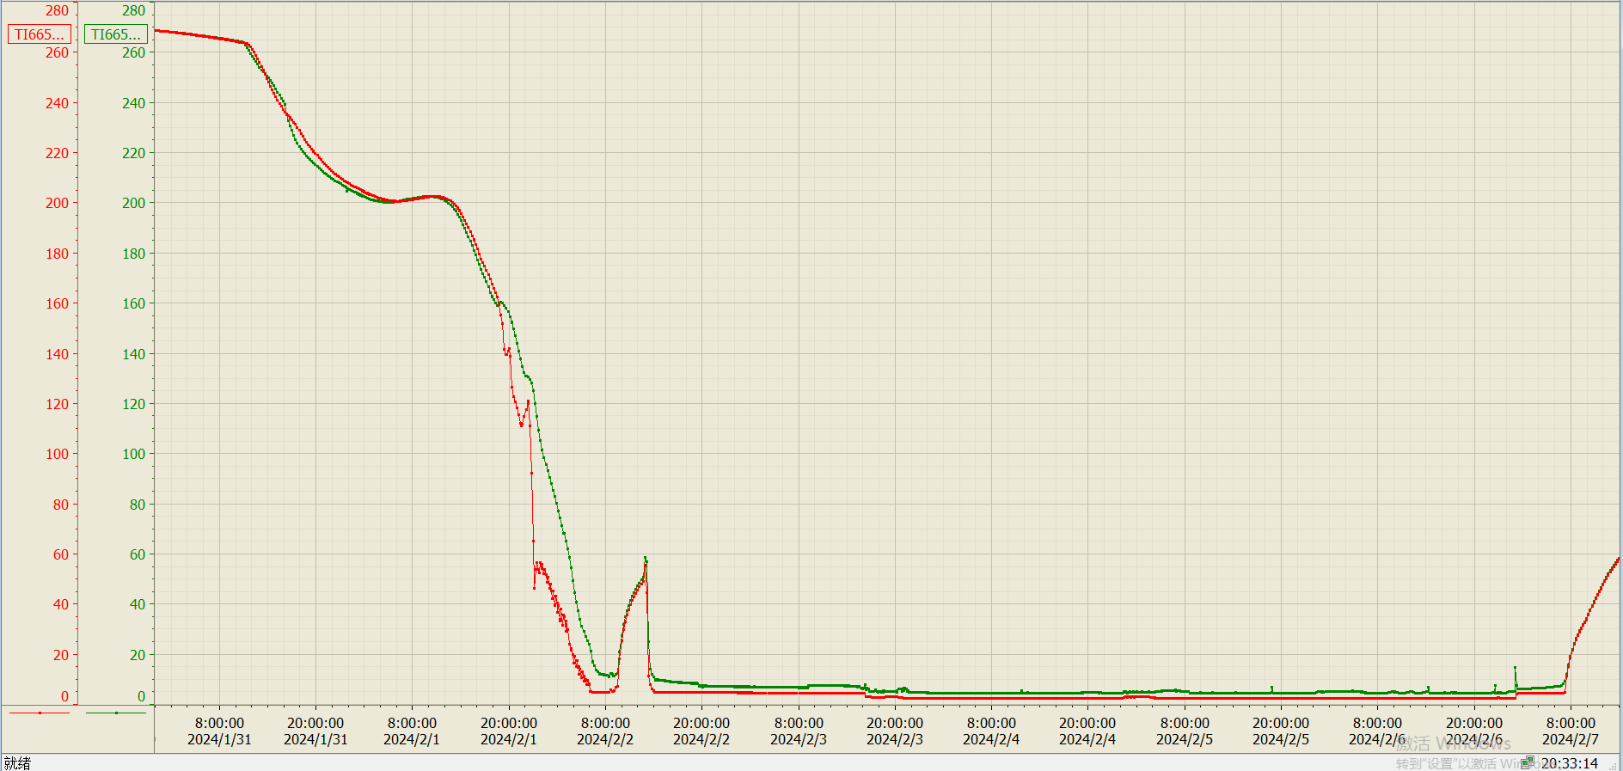
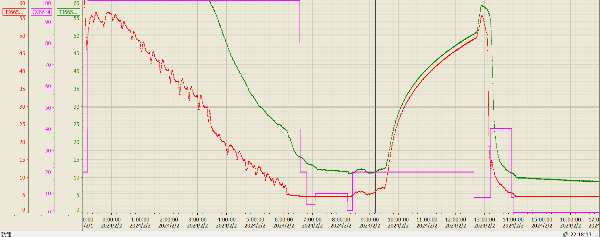
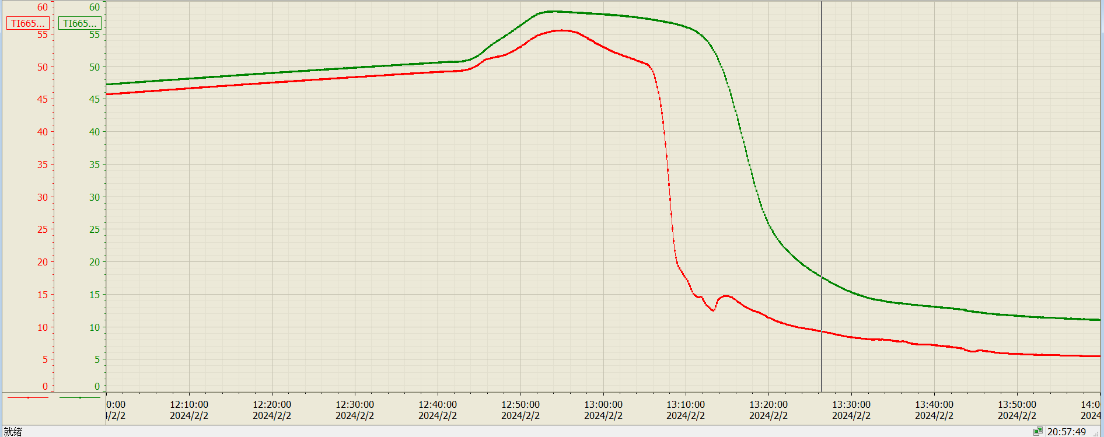
Cooldown process
Phase III
Phase II
Red line is the bottom sensor
Green line is the top sensor
Warm up to 50K. And cooldown again
Phase I
the bottom is 9K, the top is 18K, temperature difference is 9K.
Open 40%
18

Slide 19
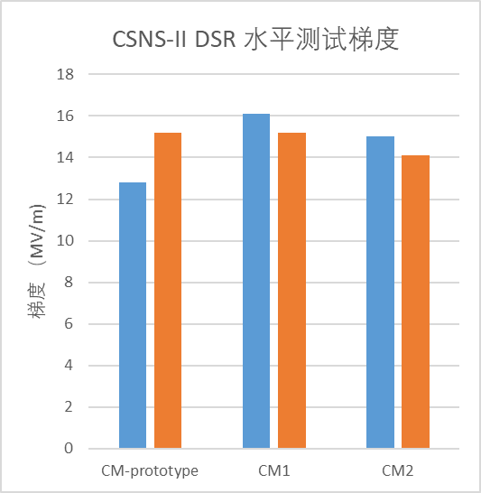
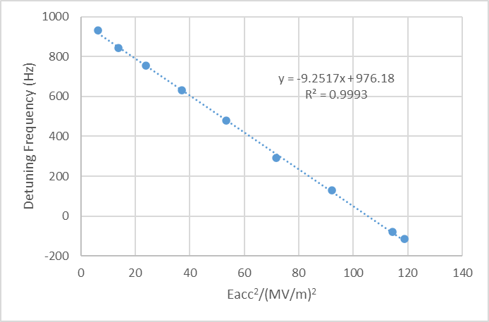
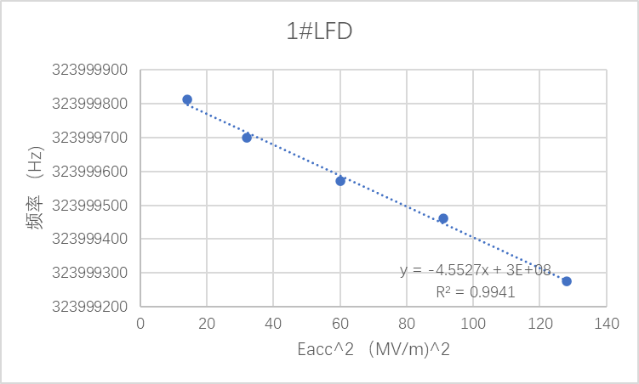
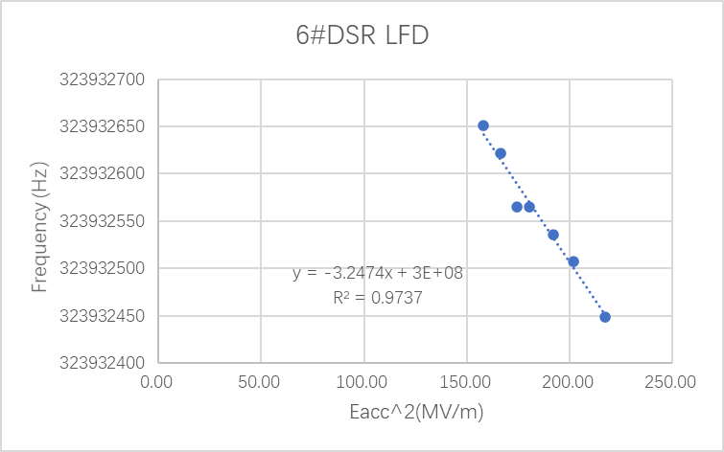

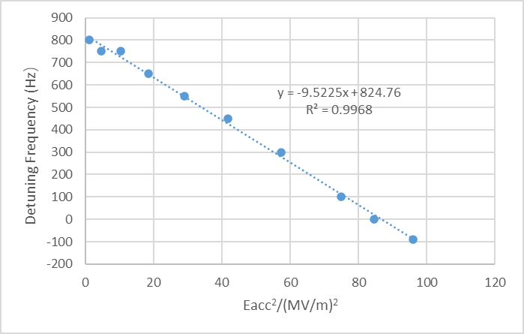
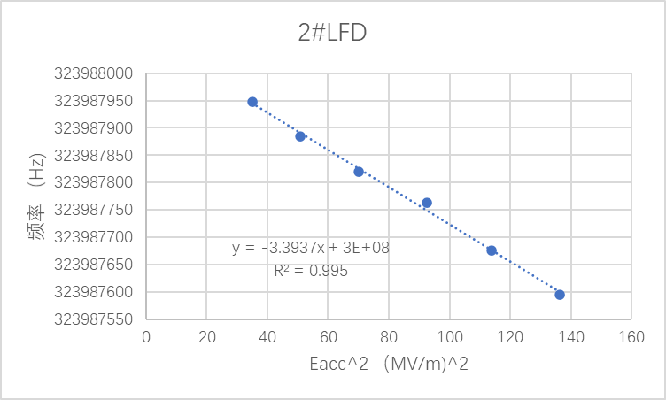
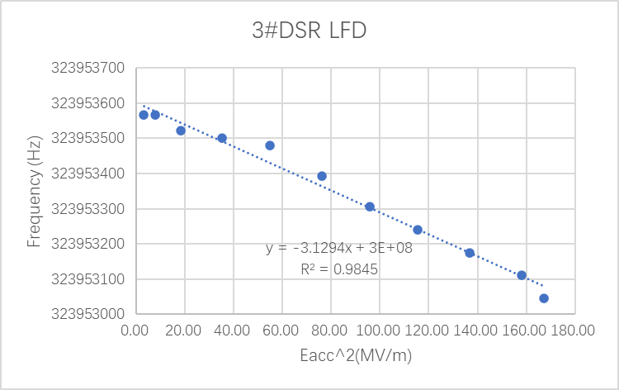
Horizontal test
Accelerating gradient vs. X-ray
DSR cryomodule horizontal test
-9.25 and -9.52 (prototype)
-4.55 and -3.39
CM1
-3.45 and -3.13
CM2
Lorentz force detuning coefficient (Hz/(MV/m)^2)
After testing, the maximum gradient of the cavities reached 16MV/m for 1# and the minimum gradient reached 12.8MV/m; with LFD coefficients decreased about 3 Hz/(MV/m)^2 from 9 Hz/(MV/m)^2 . The static heat leakage of the three cryomodule are 25.8 W, 16.8W and 21.7W. due to a large system error (about 1 W), and the superconducting cavity operates in pulsed mode, dynamic heat leakage could not be accurately measured.
19

Slide 20
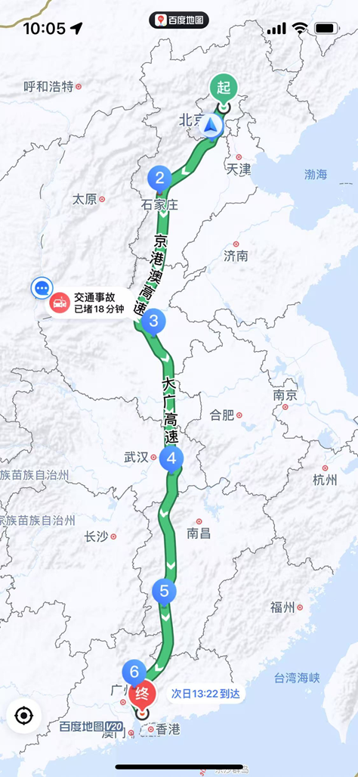
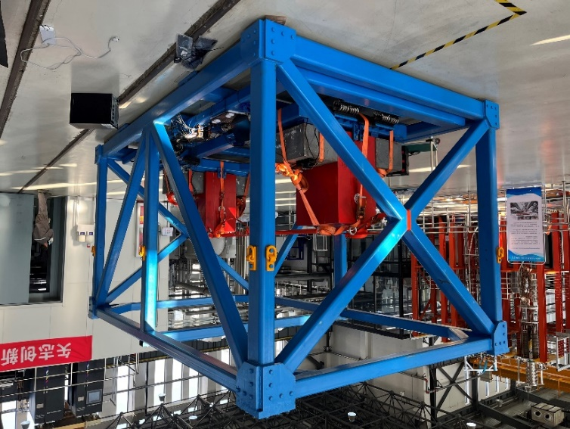
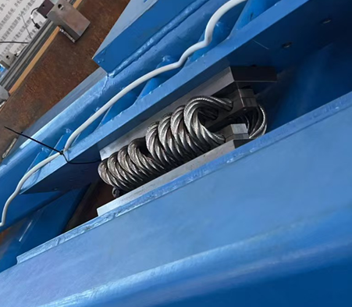
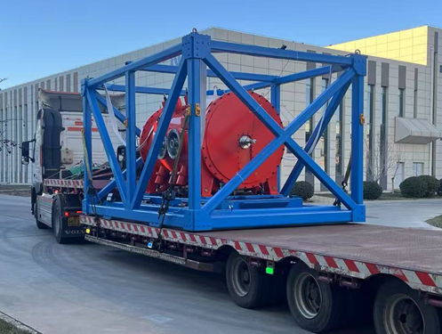
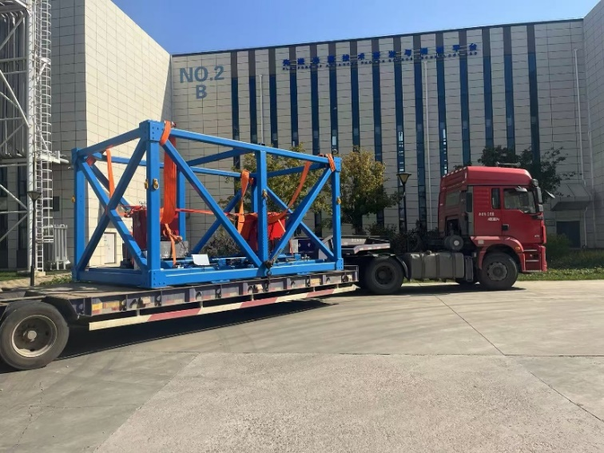
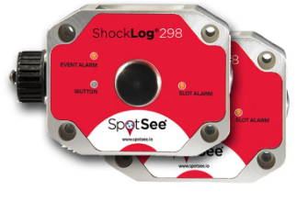
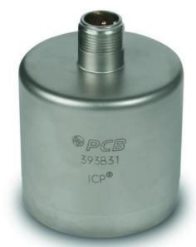



Transportation test
damping frame load-bearing test
selection of damping springs
long-Distance Transportation of False Cavity crymodule (Beijing ←→ Dongguan)
Over 2400 km
safe arrival of true cavity cryomodule transportation
load-bearing road test of damping frame
selection of vibration sensors
20

Slide 21
III. Current Status of 6-cell Elliptical Cavity Cryomodule
21

Slide 22
Development History
The second half of 2024: Mass production has commenced
6-cell Elliptical cavity
August 2024 : The niobium supply contracts are signed with Ningxia Orient Tantalum Industry Co.,Ltd (OTIC) and Northwest Institute for Non-ferrous Metal Researth.
December 2024 : The Cavity mass production contract has been signed with high-energy running Co., Ltd and Ningxia Eastern Superconducting Technology Co., Ltd.
May 2026: Completion of manufacturing for 12 cavities
tuner
March 2024 : The tuner mass production contract has been signed .
May 2026: Ten units have been completed
Coupler
December 2024: : The coupler mass production contract has been signed .
May 2026: Twelve units have been completed
Cryostat
December 2024: The batch production of cavity commenced
May 2026: Three units have been completed
22

Slide 23





6-cell Elliptical cavity - Design
Pick up
FPC
parameter | design
Frequency (MHz) | 648
TTF@βg | 0.7
βg | 0.62
Ep/Eacc | 2.53
Bp/Eacc (mT/(MV/m)） | 5.45
R/Q（Ω） | 309
G（Ω） | 177
Aperture（mm) | 105/120
coupling coefficient（%） | 1.35
LFD (Hz/(MV/m)²) | -1.62
df/dp (Hz/mbar) | 7.45
Tuning (kHz/mm) | 147
Operating gradient (MV/m) | 14
Operating mode | pulsed
Inner reinforcing ribs
Liquid helium inlet
Electric field distribution
1177.1mm
409.6mm
outer reinforcing ribs
Magnetic field distribution
23

Slide 24





6-cell Elliptical cavity -Post-processing measures
Centrifugal Barrel Polishing
To improve the performance of the superconducting cavity, we have decided to use centrifugal barrel polishing (CBP) to enhance the quality of the inner surface for cavity.
24

Slide 25

6-cell Elliptical cavity –Vertical test
Currently, CSNS-II has developed twelve 6-cell elliptical cavities, eight of which have undergone vertical testing, with the remaining four awaiting testing. The maximum gradient achieved is 25.7 MV/m. The gradient and Q-value of all produced cavities meet the operational requirements (14 MV/m @ Q₀ = 5 × 10⁹). the MP is greatly improved, with the MP conditioning completed in 1 minute from 6 to 12 MV/m.
Vertical test
25

Slide 26



High power coupler
Tuner
Parameter | Value
RF frequency | 648 MHz
Peak RF power | 600 kW
Pulse width | 1.2 ms
Pulse repetition frequency | 25/50 Hz
Qext | 9.5E+05
Interface to the cavity | Diameter 80 mm
FPC position | Horizontal to the cavity
Assembly | Clean assembly
FPC type | Coaxial ,single window
Window Type | Coaxial disk
Coupling type | Electric
parameter | value | unit
Slow tuning
Tuning range | >346 | kHz
stroke | ~2.3 | mm
resolution | ＜5 | Hz
stiffness（2K） | ＞20 | N/um
Operate temperature | 5-20 | K
Fast tuning will be reserved with space and controller
Tuning Range | ＞1000 | Hz
resolution | ＜1 | Hz
Operate temperature | 5-20 | K
Response time | ~1 | ms
couplers and conditioning platform
Ten sets of couplers have been completed
Tuner Factory Acceptance Test . 12 sets of couplers have been completed
26

Slide 27



Cryomodule and magnetic shield
Schematic Diagram of the Cryostat Internal Structure
Eight sets of magnetic shielding have been delivered.
Three cryostats have completed factory acceptance.
27

Slide 28






Cryomodule Integration
Coupler-Cavity Mating
The cavity string has been moved out of the cleanroom
Cavities sring
Apply thermal insulation to the cavity string
Install magnetic shielding to the cavity string
Install the thermal shield over the cavity string
28

Slide 29


Cryomodule integration – cold mass assembly
Cryomodule integration complete
Cryomodule to cryogenic valve box connection
29

Slide 30





The horizontal test results
-0.91 Hz/(MV/m)²
-0.60 Hz/(MV/m)²
-0.61 Hz/(MV/m)²
Lorentz force detuning coefficient
The design of LFD为-1.62 Hz/(MV/m)²
Individual Cavity Test
Simultaneous Testing of three Cavities
Static heat load：24W
Dynamic heat load：
4.26W@14MV/m，3W@12MV/m
Q0=1.65E10 @ 14MV/m
Q0=1.72E10 @ 12MV/m
2026.5 CSNS-II First Elliptical Cavity Cryomodule Completed Horizontal Test with Gradients 26.76 MV/m （quench free）、24.57 MV/m （ quench free） 、19.08 MV/m （quench）。The dose decreased from 300 to 100 uSv/h after three days of conditioning at 14 MV/h.
30

Slide 31






The horizontal test results- tuner test
1#
2#
3#
The tuning range exceeds 450kHz；the fast tuning range reachs 2.1kHz. Due to the proven fragility and reliability concerns of piezoelectric fast tuners, a design revision has been approved for the next production batch: fast tuners will be removed. The compensation of microphonics and LFD will be fully managed by the LLRF system’s controls and the RF power source.
31
31

Slide 32
V. Summary

Slide 33
Summary
The mass production of double-spoke cavity cryomodules is now on track.
The first elliptical cavity cryomodule has passed the horizontal test. Its performance basically meets the operational requirements, paving the way for the launch of series production.
The primary challenge facing the project is the production capacity of superconducting cavities. The coming year will be the most demanding period. All project team members are fully committed to tackling this challenge.
33

Slide 34

Thank you for your attention!

