Slide 1
LHC SRF cryomodules: operational experience
K. Turaj on behalf of SY-RF CERN
TTC 2026 Meeting, CEA-CNRS-Universite Paris Saclay, 9-12 June 2026
Notes:
“For operating SRF accelerators the initial performance may have degraded due to gradual decay (field emission, magnetic pollution, poor vacuum, …) or singular perturbations (component failure, vacuum/cryo accidents). Maintaining performance to meet science needs may involve upgrading protocols or developing new mitigation methods but also could dictate upgrades in equipment to retain or boost performance. This working group should concentrate on methods and techniques used in operating SRF accelerators to retain or boost performance through various means such as HPP processing, helium processing, plasma processing and Ozone-gas processing, thermal cycling, reconfiguration, reprocessing. The working group should also include the developments towards the understanding and suppression of sources of degradation”

Slide 2
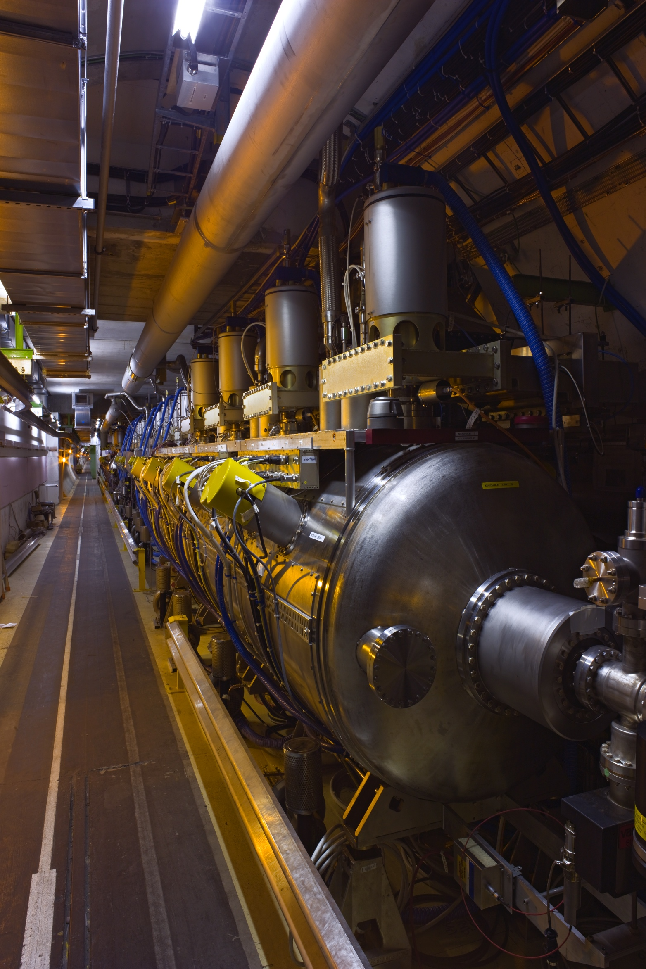
Outline
Introduction & LHC RF cryomodules overview
LHC SRF CM major events
Current operational issues and concerns
Outlook

Slide 3
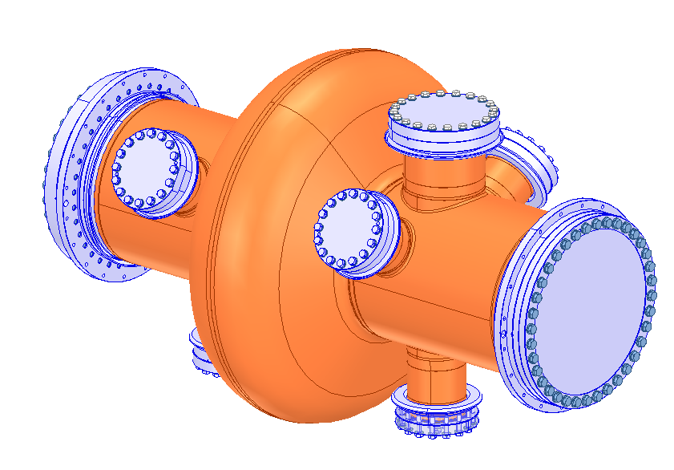
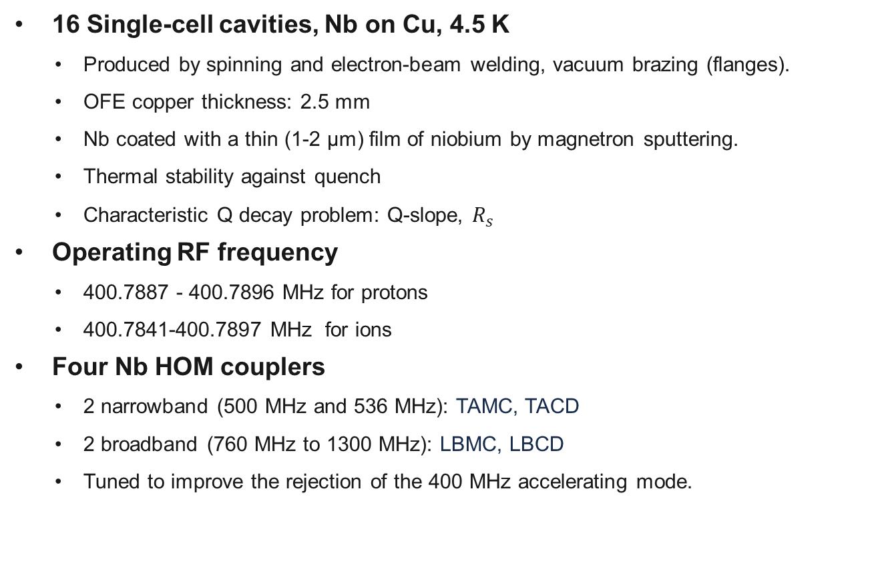
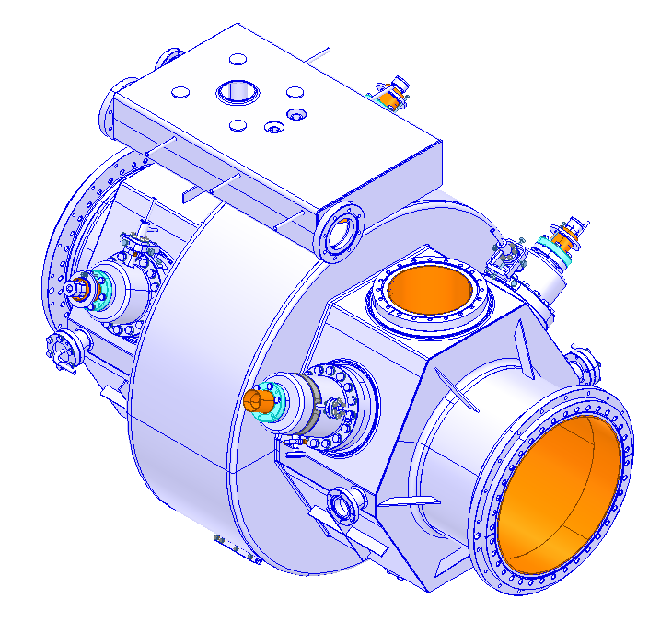
LHC SRF Cavities
Beam aperture: 300mm
Notes:
The copper wall thickness results from a compromise between tuning force and mechanical stability against buckling. With a thickness of 2.8 to 3 mm, the cavity axial spring constant is about 20 kN/mm
Tuning sensitivity 240 [kHz/mm]

Slide 4
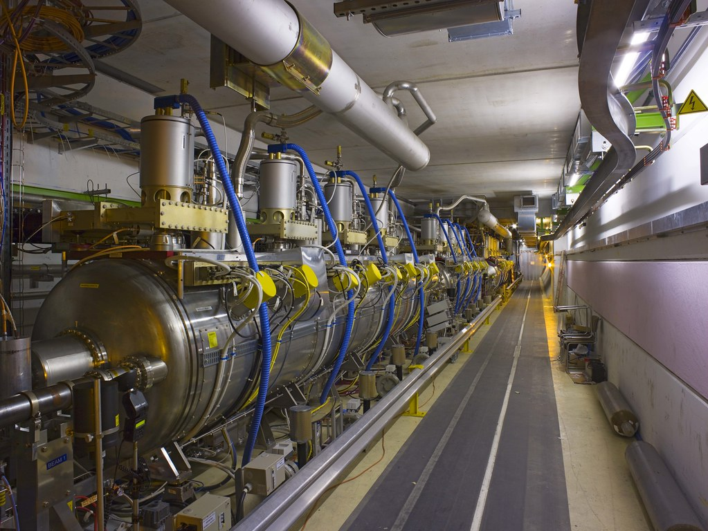

LHC SRF Cryomodules
4 ACS Cryomodules: 2 per beam
  4 cavities per cryomodule
    4 He tanks within CM: interconnected at the liquid and gas levels, common helium feed and gas return.
  Modular cryostat with easy lateral access.
  1 spare cryomodule available (+ 1 jacketed cavity).
Maximum operational voltage: 2 MV/cavity
  Cavities conditioned up to 2.2 MV/cavity
  Proton operation: 1.5 MV/cavity , 2MV/cavity (in HL-LHC).
  Ion operation: 1.75 MV/cavity, 2 MV/cavity in 2024
Stepper-driven mechanical tuner
  Adapts to RF frequency and beam loading
  Tuning range 180 kHz, tuning speed 9 kHz/s
Mobile fundamental power coupler
  Q_{L} ~ 20000 @ injection (450 GeV)
  Q_{L} ~ 60000 @ flat-top (6.8 TeV)
No thermal shield – high static losses: 120W.
RF main couplers
RF waveguides
Cryomodules

Slide 5
LHC SRF cryomodules major events
Voltage limitation on one SRF cryomodule: Run I
C3B2 did not work reliably above 1.2 MV.
SRF cryomodule replaced during LS1
One SRF cryomodule replaced during LS2
Clear signs of contamination observed during the test in SM18, the He processing technique allowed to requalify the cryomodule as a valid spare.
Rupture disks events: 2022/2023
LHC unavailability strongly impacted in 2022 & 2023: Full warm-up and reconditioning, ~4 weeks lost in each case.
C1B1 field antenna measurement issue: Run II
Accidental venting of one cryomodule: LS2
Cabling inside the CM insulation vacuum
3B2 HOM overheating and quenches: since 2023
Origin not yet understood
Problem after LS2, when RD pressure set to correct value with narrow margin

Slide 6
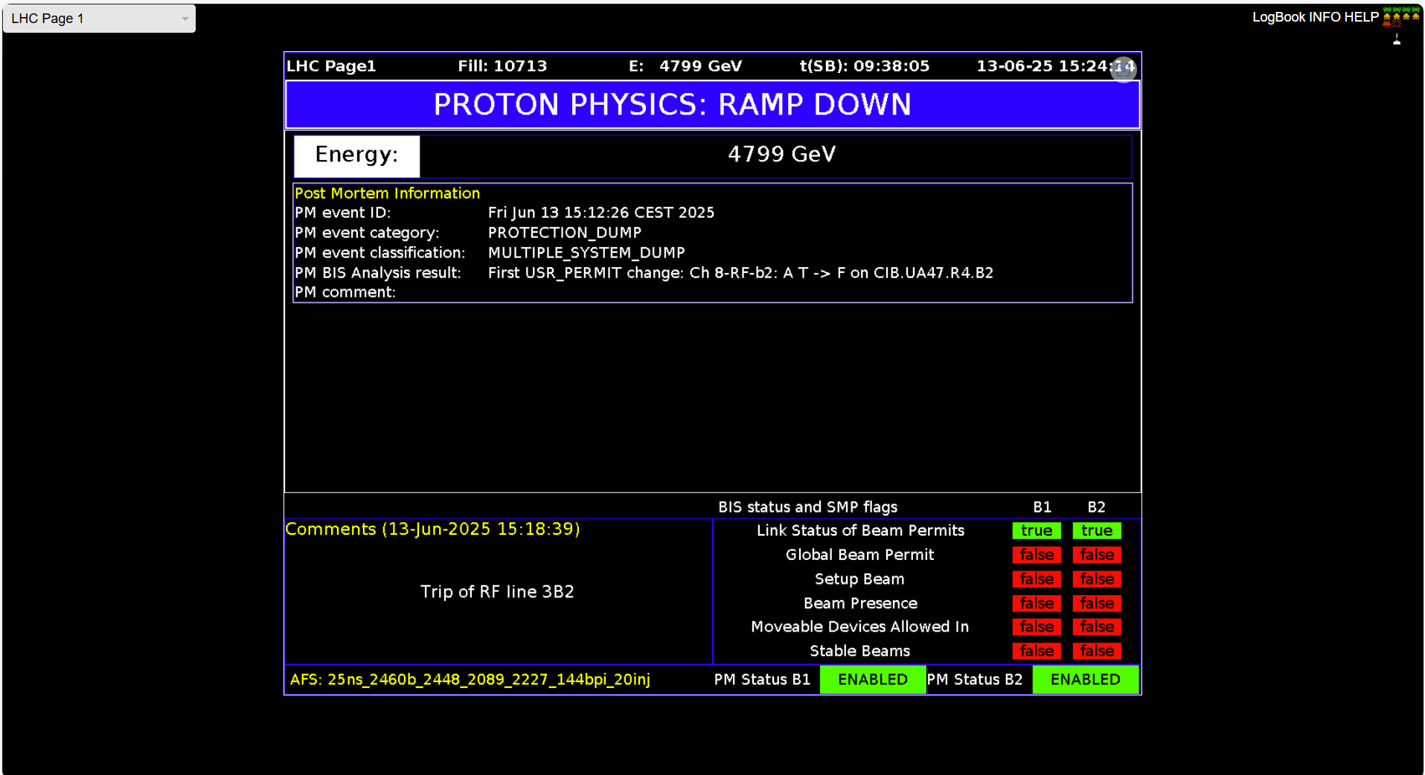
Operational issues and concerns

Slide 7
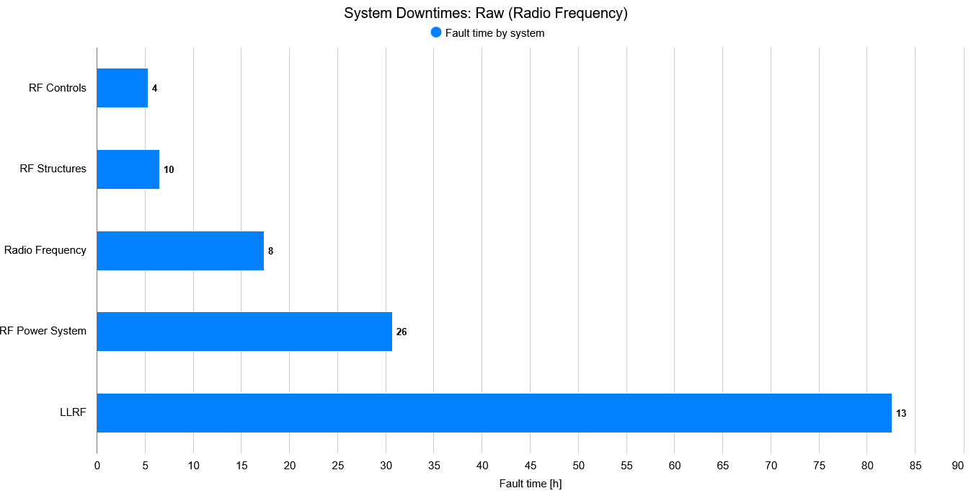
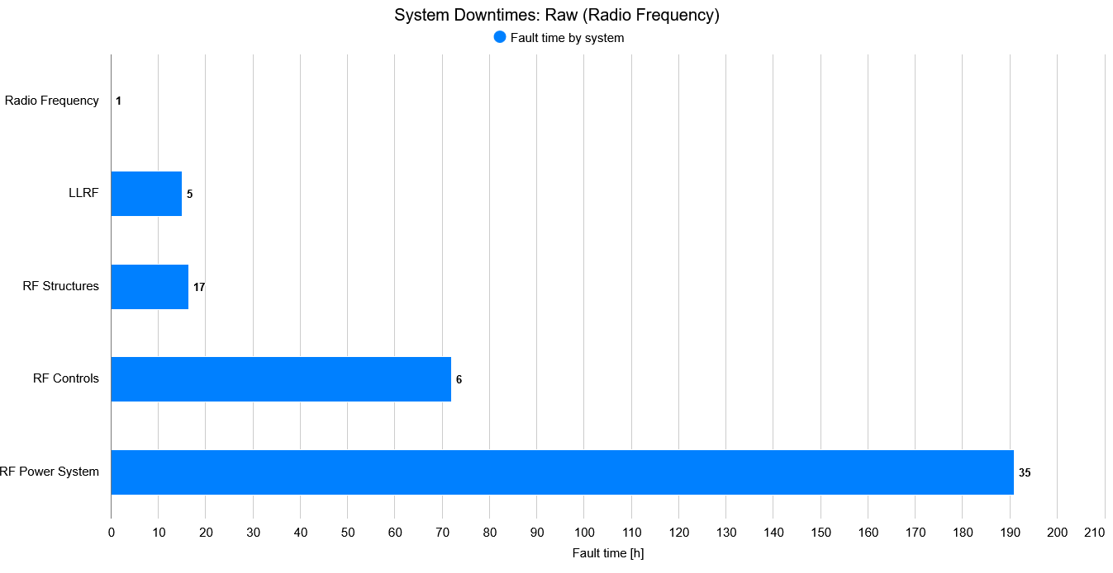
RF System Downtimes
2024
Total RF system downtime: 100 hours of which
RF cryomodules: 6.5 hours
2025
Total RF system downtime: 70,3 hours of which
RF cryomodules: 16,43 hours

Slide 8
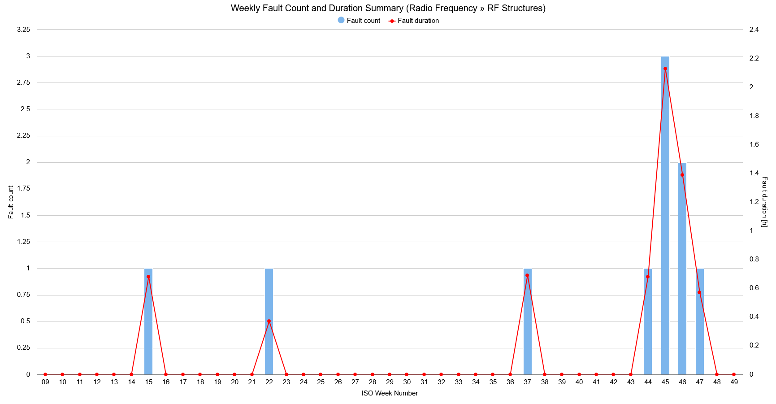
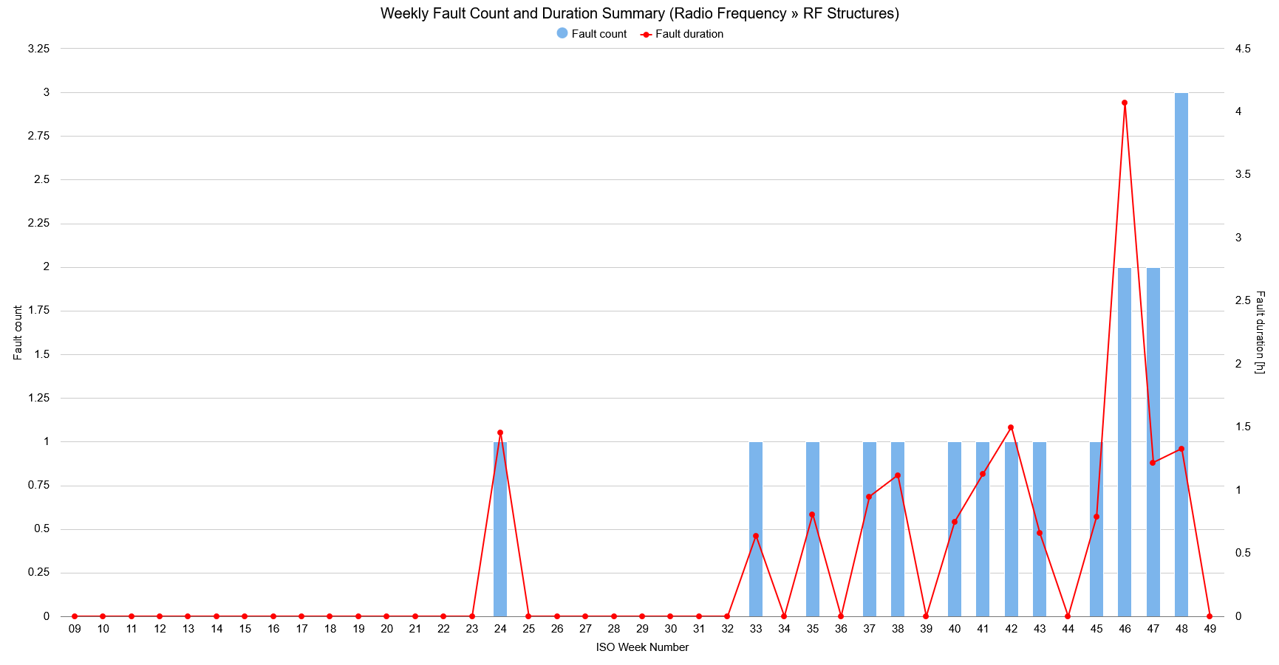
Weekly Fault Count and Duration: RF structures
3B2 voltage reduced from 2MV to 1.5MV, then 1 MV
2024
2025

Slide 9
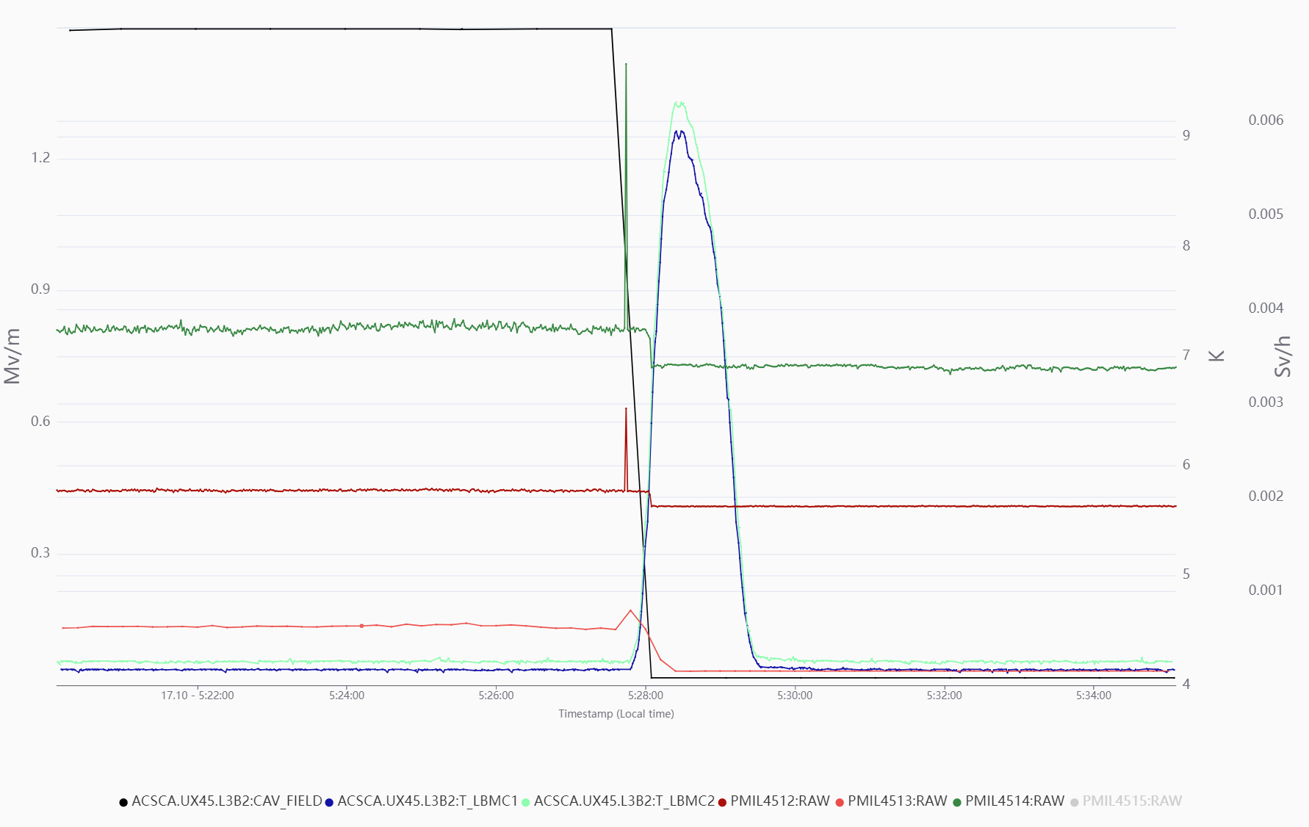
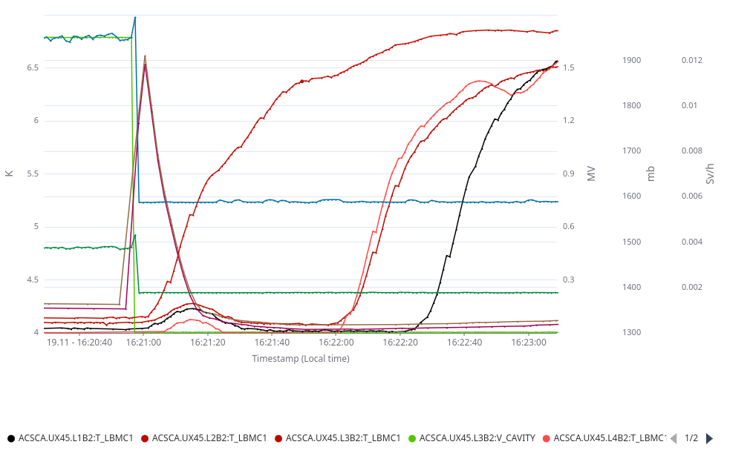
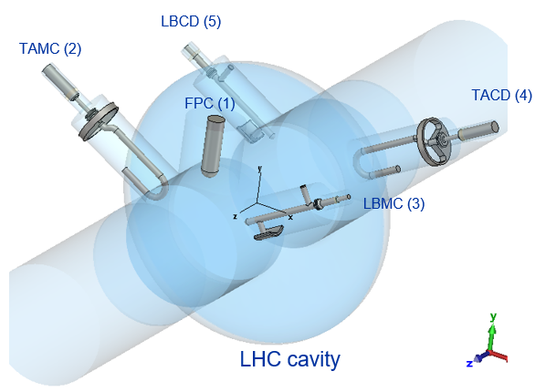
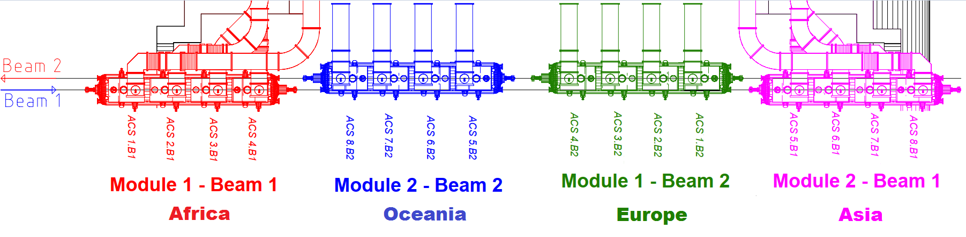
LHC RF Cryomodule Performance
Degraded performance of M1B2, two types of events observed since 2023
  Cavity 3B2 HOM coupler overheating
    HOM temperature interlock: Interlock level at 6K and temperature increases above 9 K.
    ~10 min needed for HOM cool-down.
  M1B2 quenches
    Helium pressure & CRYO OK interlock: Interlock level at 1.5 bara.
    ~30 min each time needed to recover the cryogenic conditions.
→ Events rate increased by ~70%(*): 10 events in 2024 → 17 events in 2025 (6 in 2023 only HOM overheating).
LBMC temperature
Cavity voltage
Temperature increase to 9 K of HOM coupler LBMC
He pressure
X-ray radiation
X-ray radiation
(*) likely underestimated, operational impact mitigated by voltage reduction

Slide 10
LHC RF Cryomodule Performance
Event characteristics:
  Root cause not yet identified.
    Several hypothesis under investigation:
      Emission of electrons from a field emitter.
      Multipacting in HOM coupler or FPC.
      Cooling or RF contact problem.
  Events occur independently of bunch number, beam intensity, beam type, and observed without beam.
  No intrinsic voltage barrier observed; all LHC cavities can achieve 2 MV.

Slide 11
Investigations and Mitigations
Actions taken so far:
  RF measurements confirmed that HOMs (LBMC) is well-tuned.
    In-situ inspection with opening of insulation vacuum performed to verify RF contacts → RF line replaced.
    RF conditioning campaigns with particular focus on M1B2/L3B2.
    Additional diagnostics: radiation sensors and BLMs.
    High-resolution postmortem power signals.
    Increased level of LHe implemented.
  Actions provided additional diagnostic insight, but no immediate in-situ repair solution identified.
Evidence points to cavity 3B2 and HOM coupler as the likely source of the issue.
Voltage of cavity 3B2 lowered to mitigate impact on LHC operation (previously applied ad hoc; baseline for 2026).

Slide 12
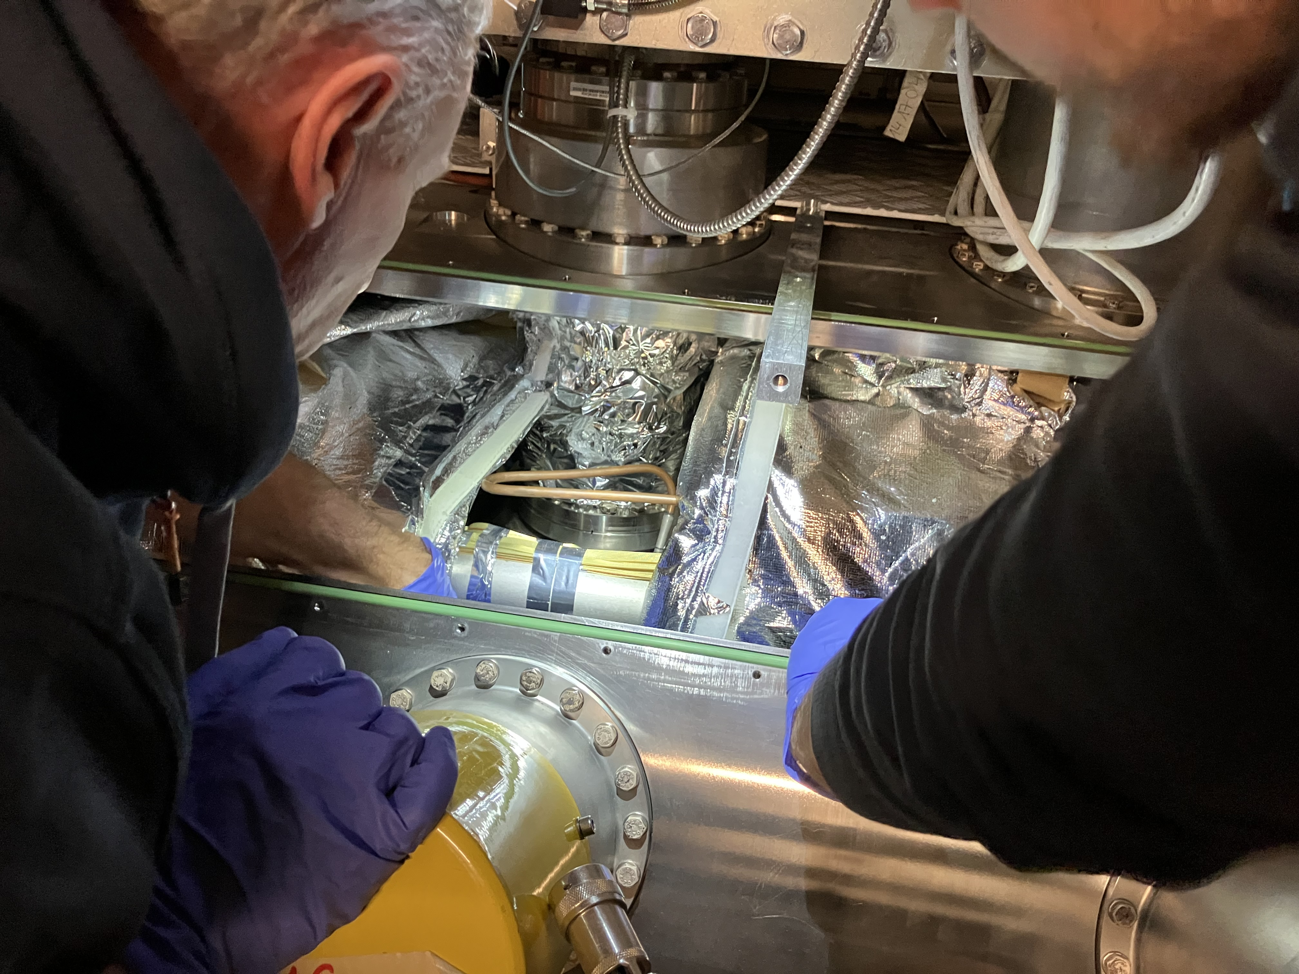
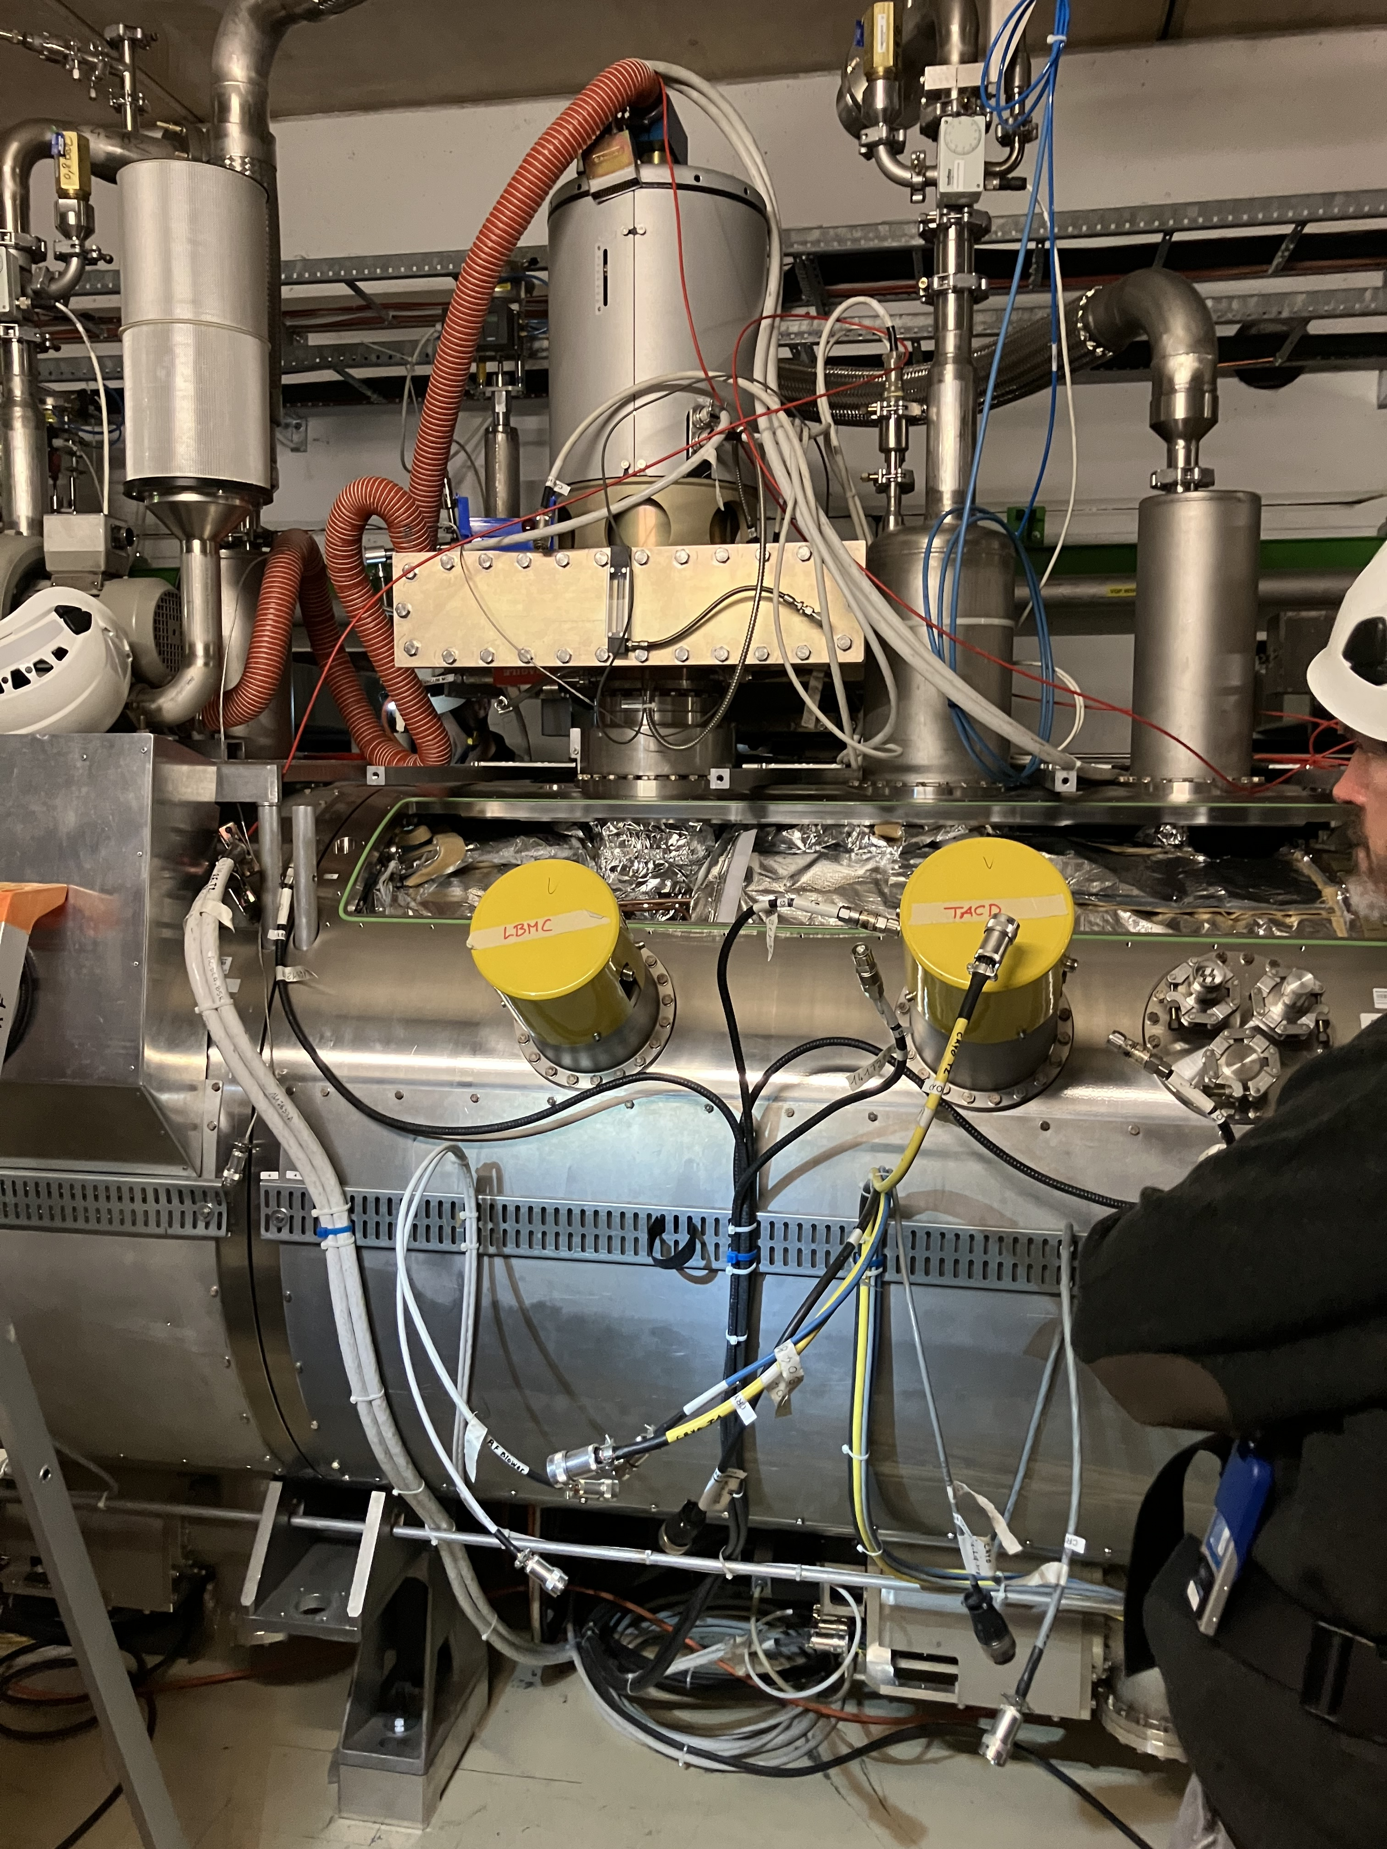
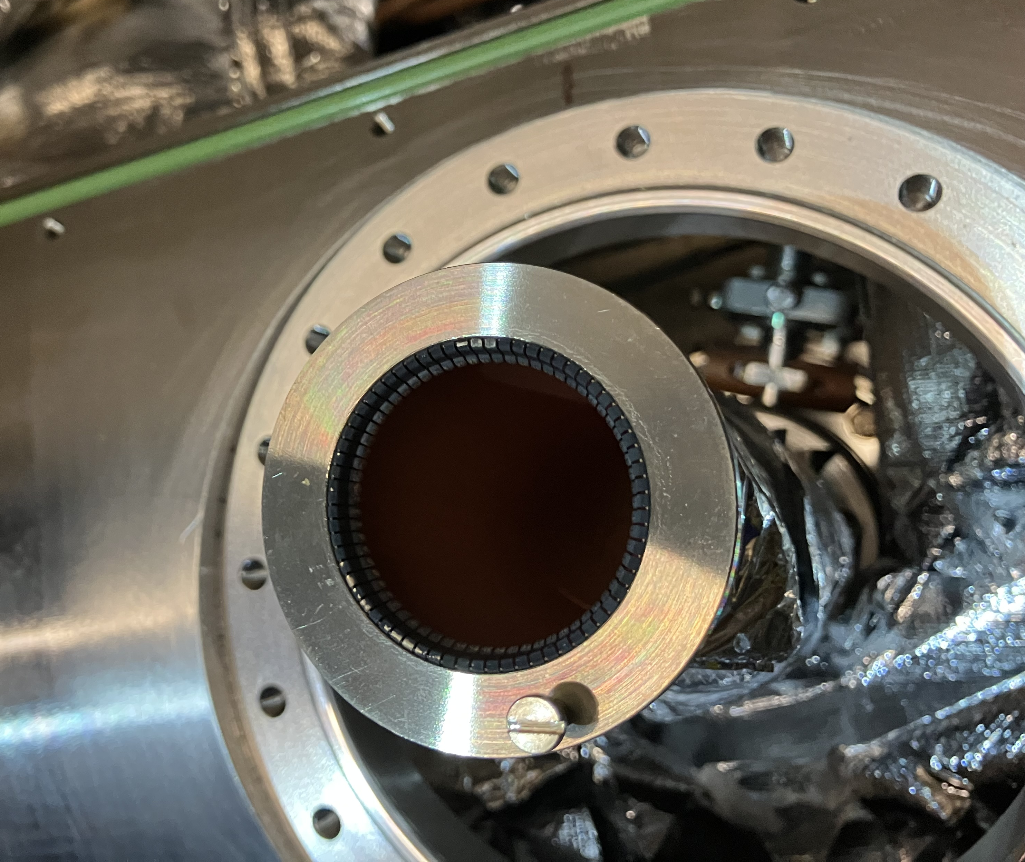
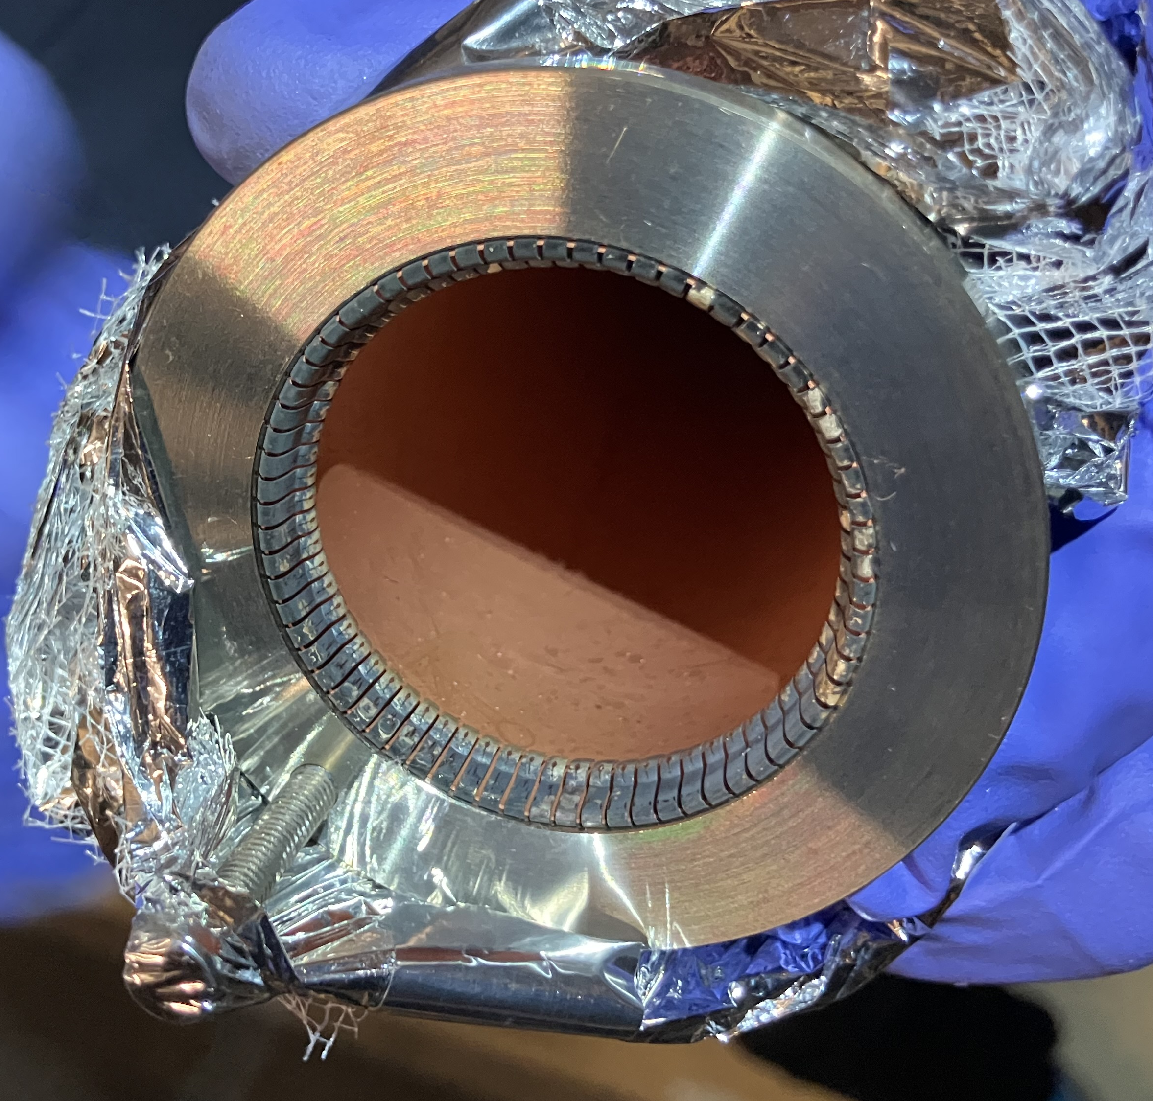
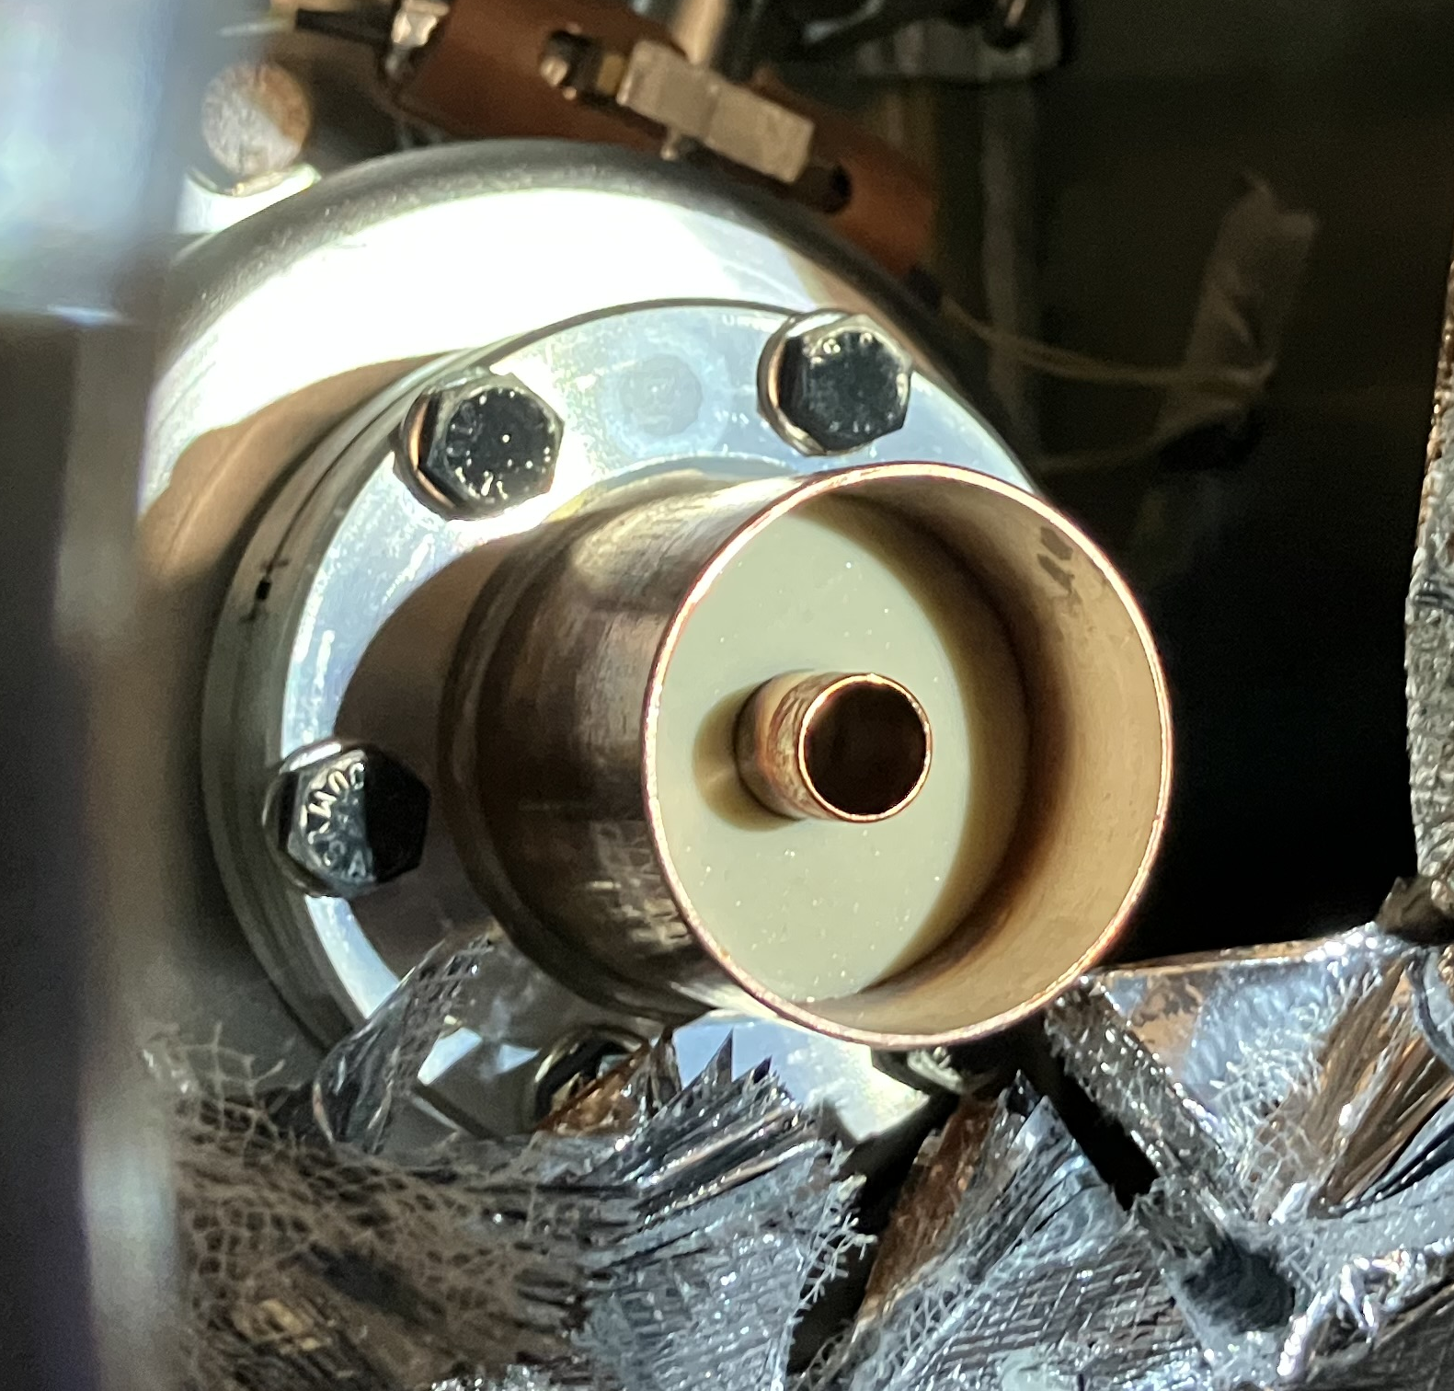
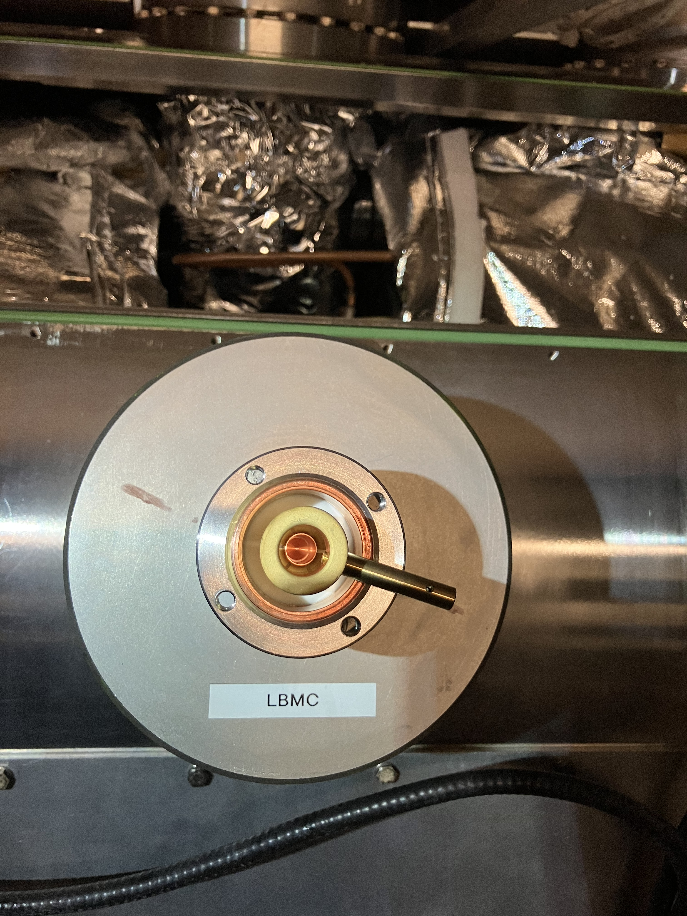
Cavity 3B2 HOM Investigation
In-situ inspection with opening of insulation vacuum: verification of RF contacts
  Signs of burnt/damaged RF fingers observed.
  RF line replaced with clean spare.
  HOM tuning not performed.

Slide 13
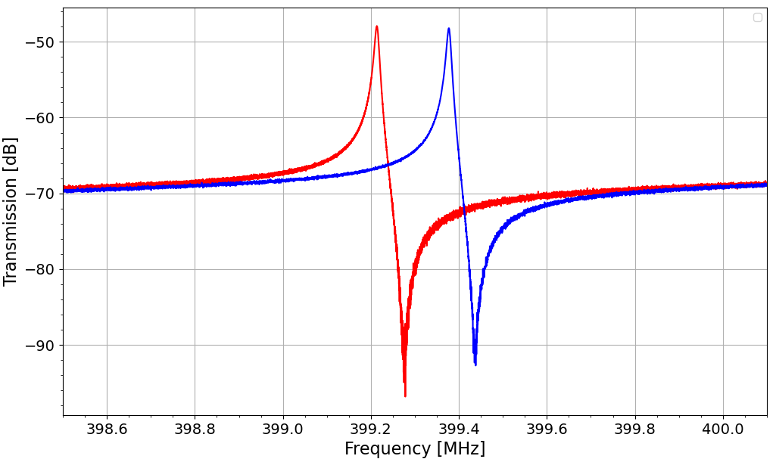
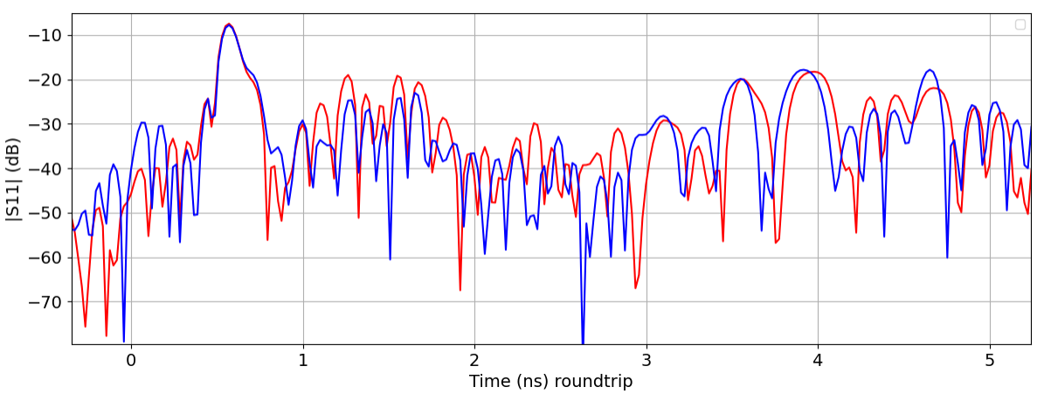
Cavity 3B2 HOM Investigation
Rejection of the fundamental mode in HOM coupler
  Measured with waveguide-to-coax transition mounted on the FPC.
  The RF transmission around 400 MHz below -45 dB and comparable in all cavities: HOM well-tuned.
S21 measurement HOM-Field antenna.
  No obvious problem detected.
TDR of the feedthrough and RF lines.
  10dB less reflection (from -40 dB to -30dB) at the point of RF fingers.
Red: after intervention
Blue: reference
Frequency shift due to pressure change
Red: after intervention
Blue: before intervention

Slide 14
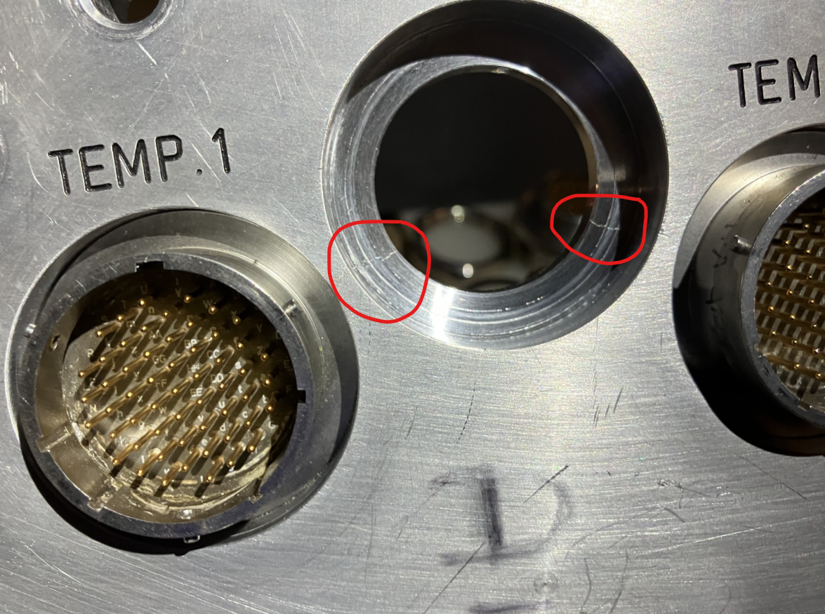
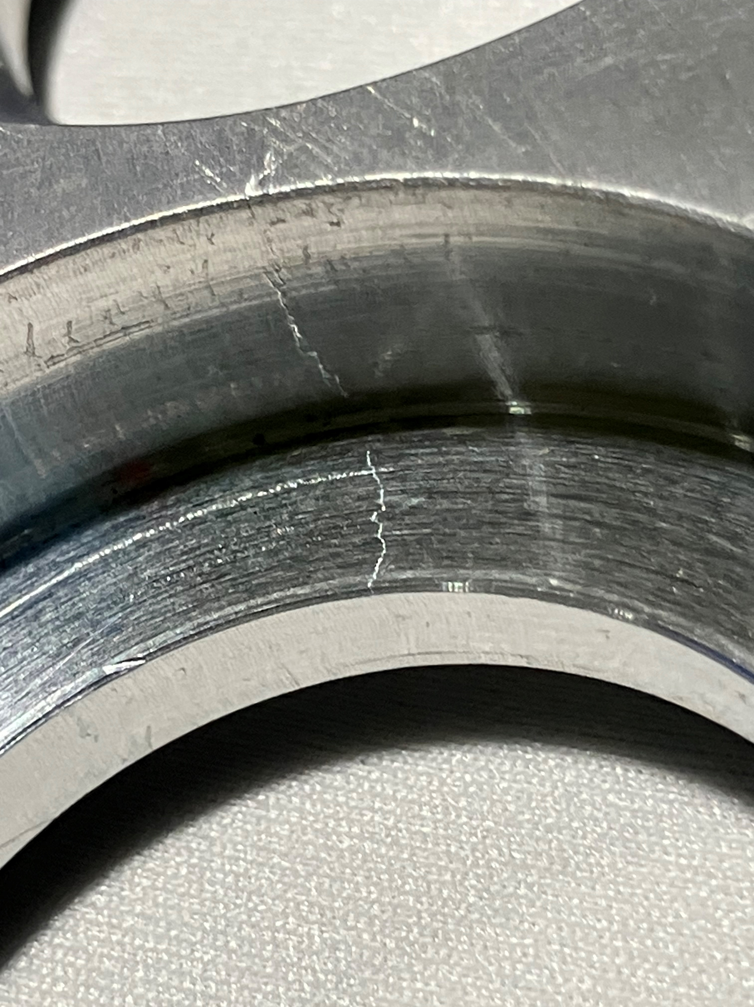
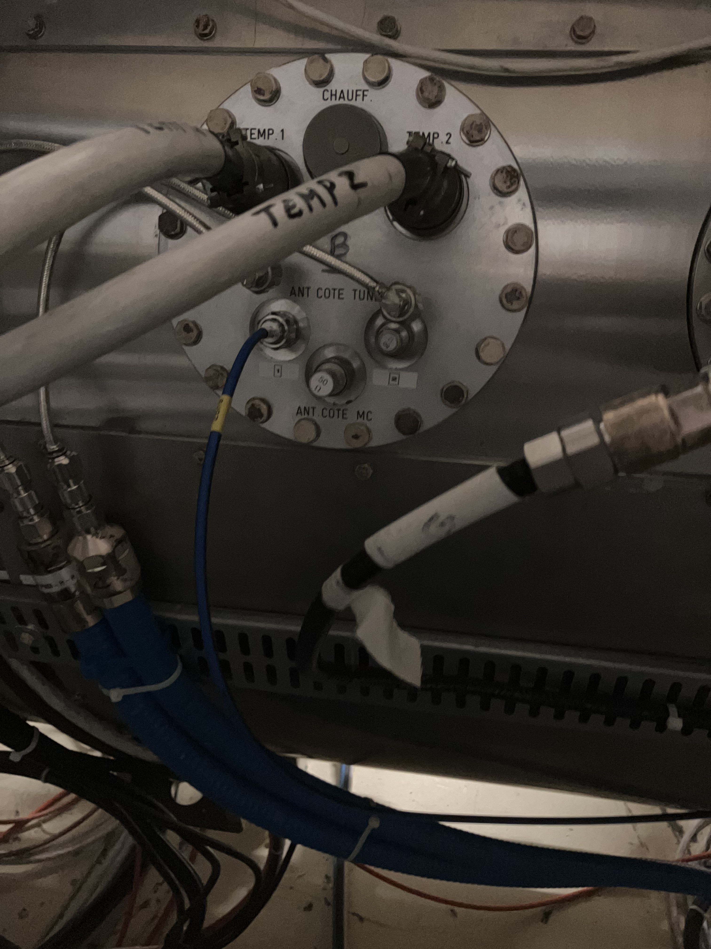
Cracks in Flanges
Leak checks of M1B2 insulation vacuum revealed a problem: cracks in “electric dome” flanges.
  2 leaks at the same place in two different flanges.
“Electric domes” contain feedthroughs for temperature and field antenna signals.
  16 flanges in total (4 per cryomodule).
50% of all flanges (including spare cryomodule) shown signs of cracks
  Sudden loss of insulation vacuum: the cavities might buckle, cryostat rupture discs open, …

Slide 15
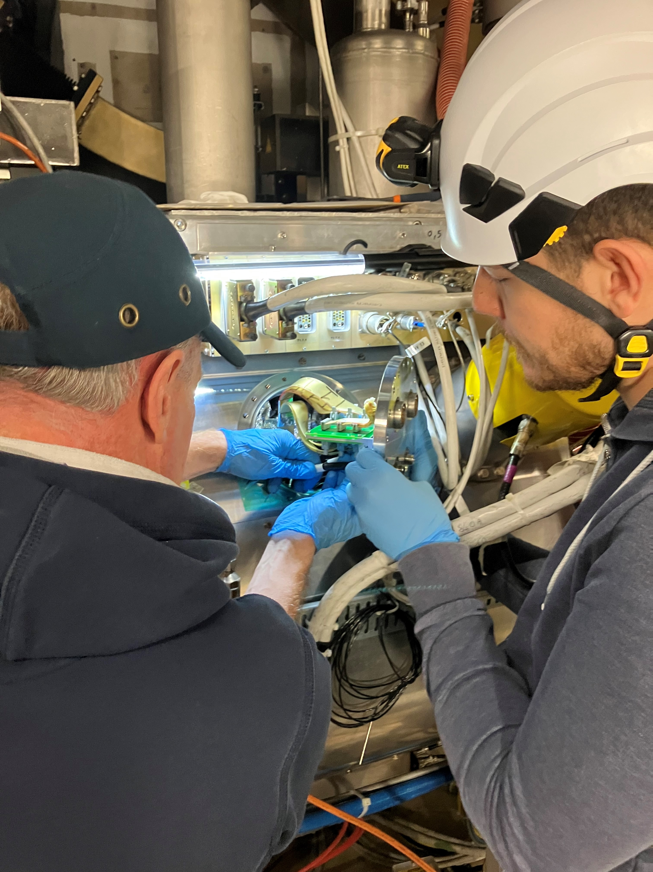
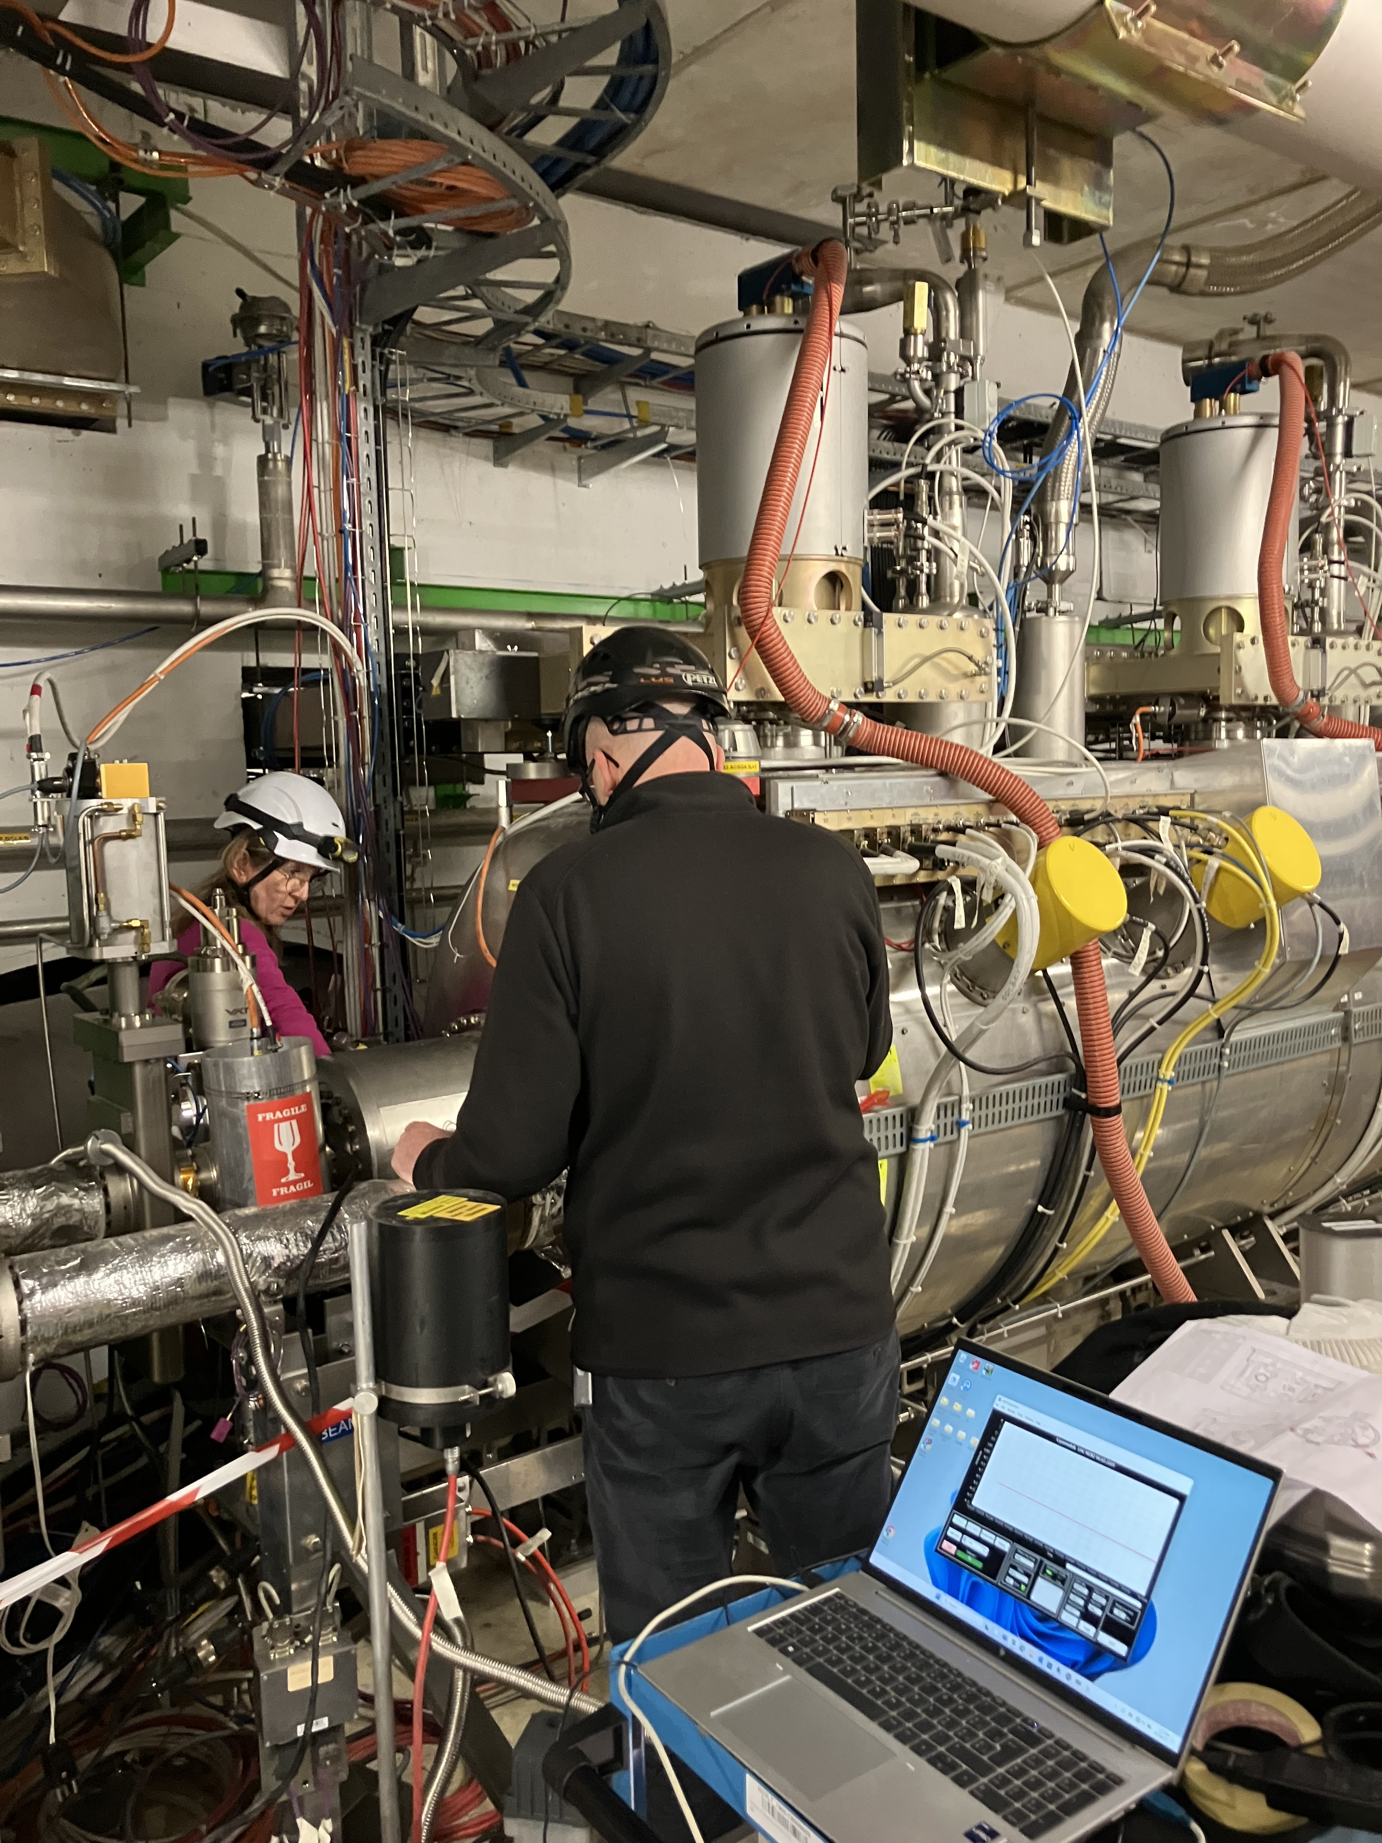
Cracks in Flanges
Urgent studies, production and replacement of all 16 flanges
  Studies and material analysis
    Machining marks and sharp inner fillet radius identified as stress concentrator.
Replacement of all flanges required venting, pumping and leak detection of insulation vacuum of all RF cryomodules.

Slide 16
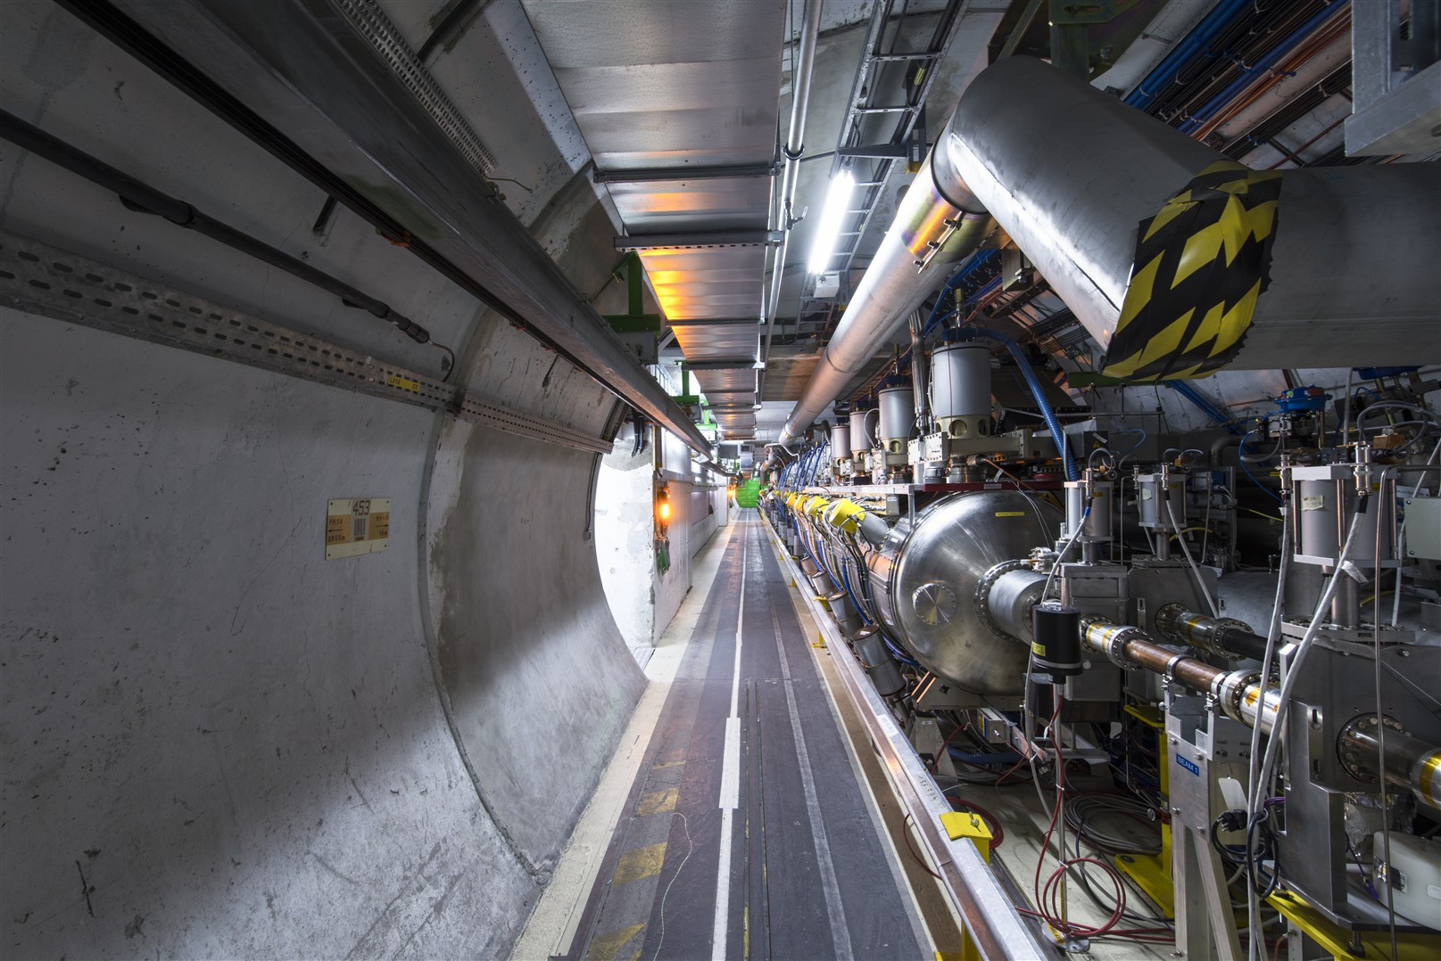
Outlook & Conclusions

Slide 17
Forward Plan: LS3 Strategy
Major concerns: 3B2 HOM overheating and M1B2 cavity “quenches”; understanding the root cause is the highest priority.
A dedicated test window at the end of physic run before Long Shutdown 3 (LS3).
  Operation with four cavities in M1B2 to decouple other cavities contributions and improve localization of the fault source
  Perform aggressive conditioning tests not compatible with routine physics operation.
Replacement of the M1B2 cryomodule with the spare cryomodule at the end of 2026.
  Prevent further performance degradation, potential cavity failure or damage to adjacent equipment.
  Examine the issue and repair M1B2 in SM18 before 2030.
  Previous performance recovery achieved through:
    High-power RF pulse processing (2015)
    Helium processing (2021)
  Future recovery actions may require cryomodule opening, including disassembly, cleaning/rinsing, HOM refurbishment, reassembly and full testing.
  The expected ~18 additional years of LHC operation highlight the importance of developing a robust long-term spare and maintenance strategy for the cryomodules.

Slide 18
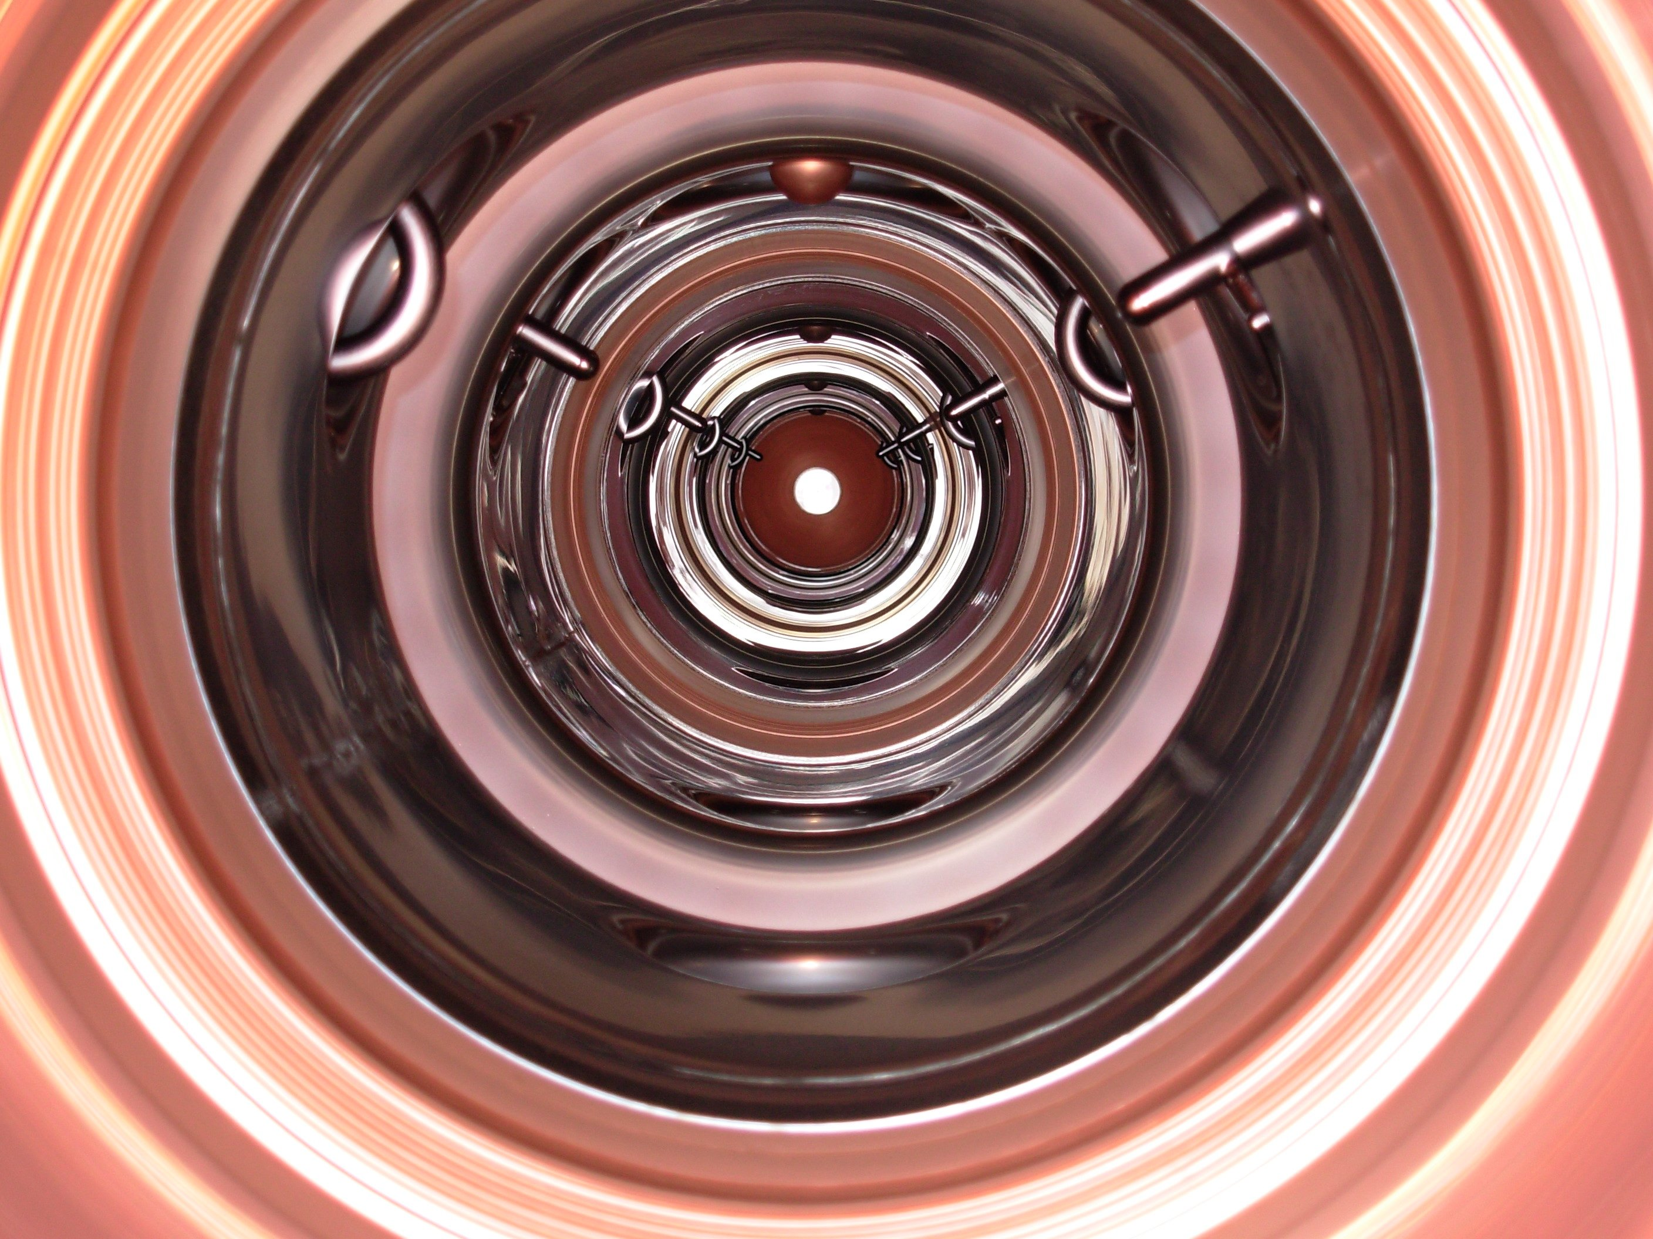
Thank you!

Slide 19
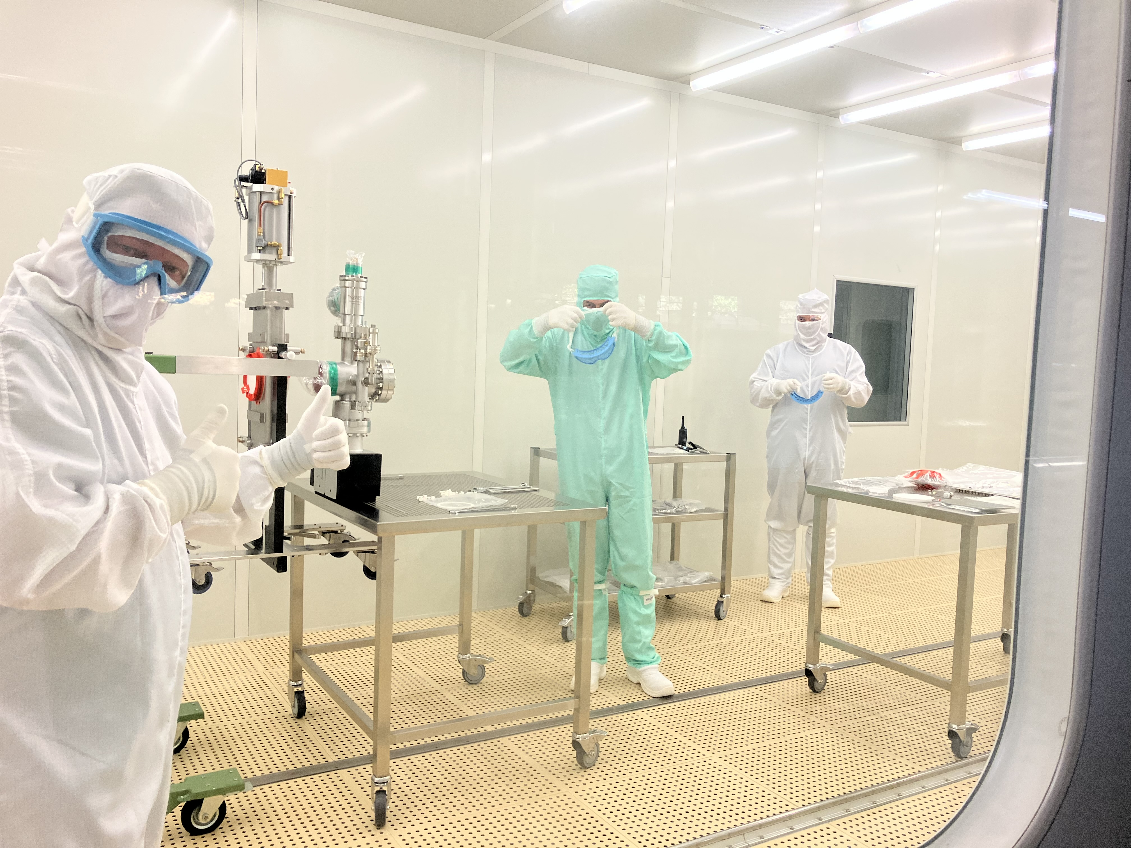
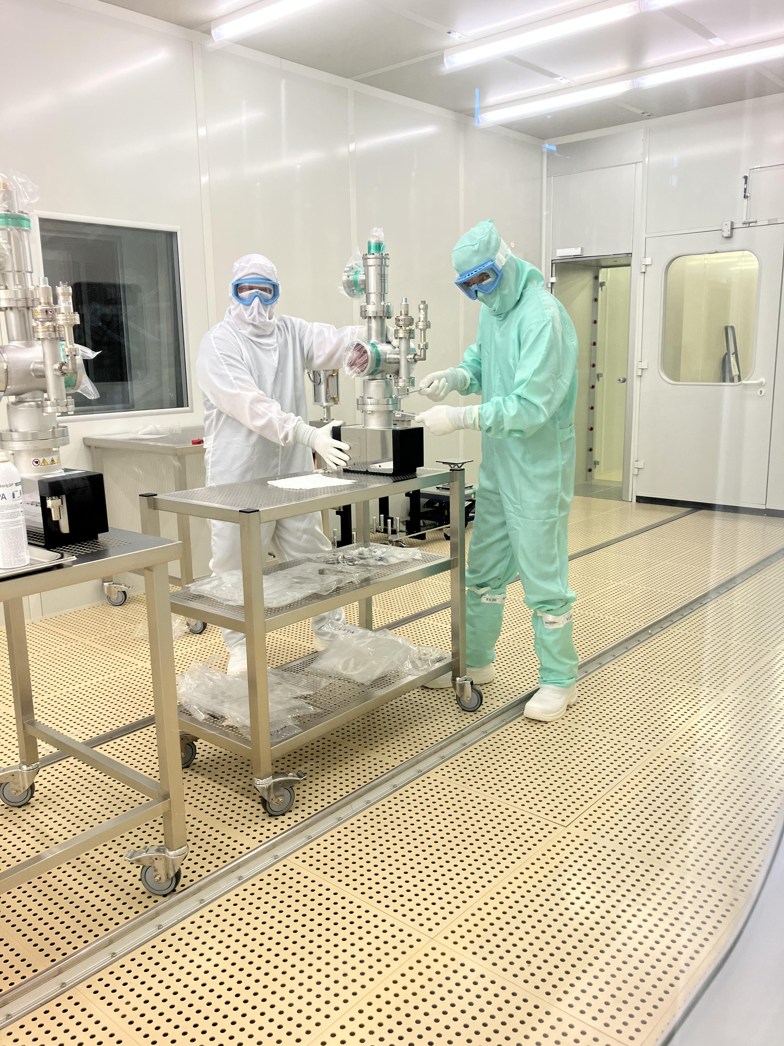
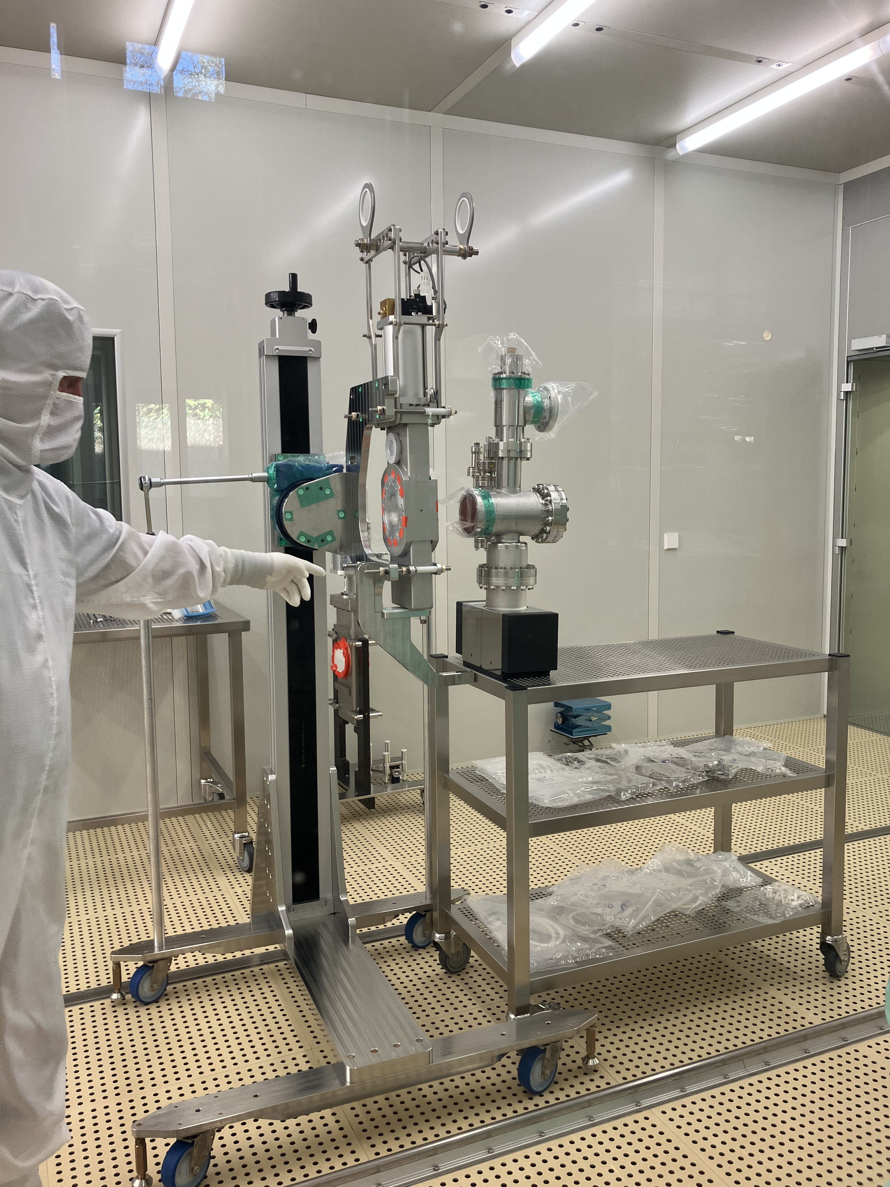
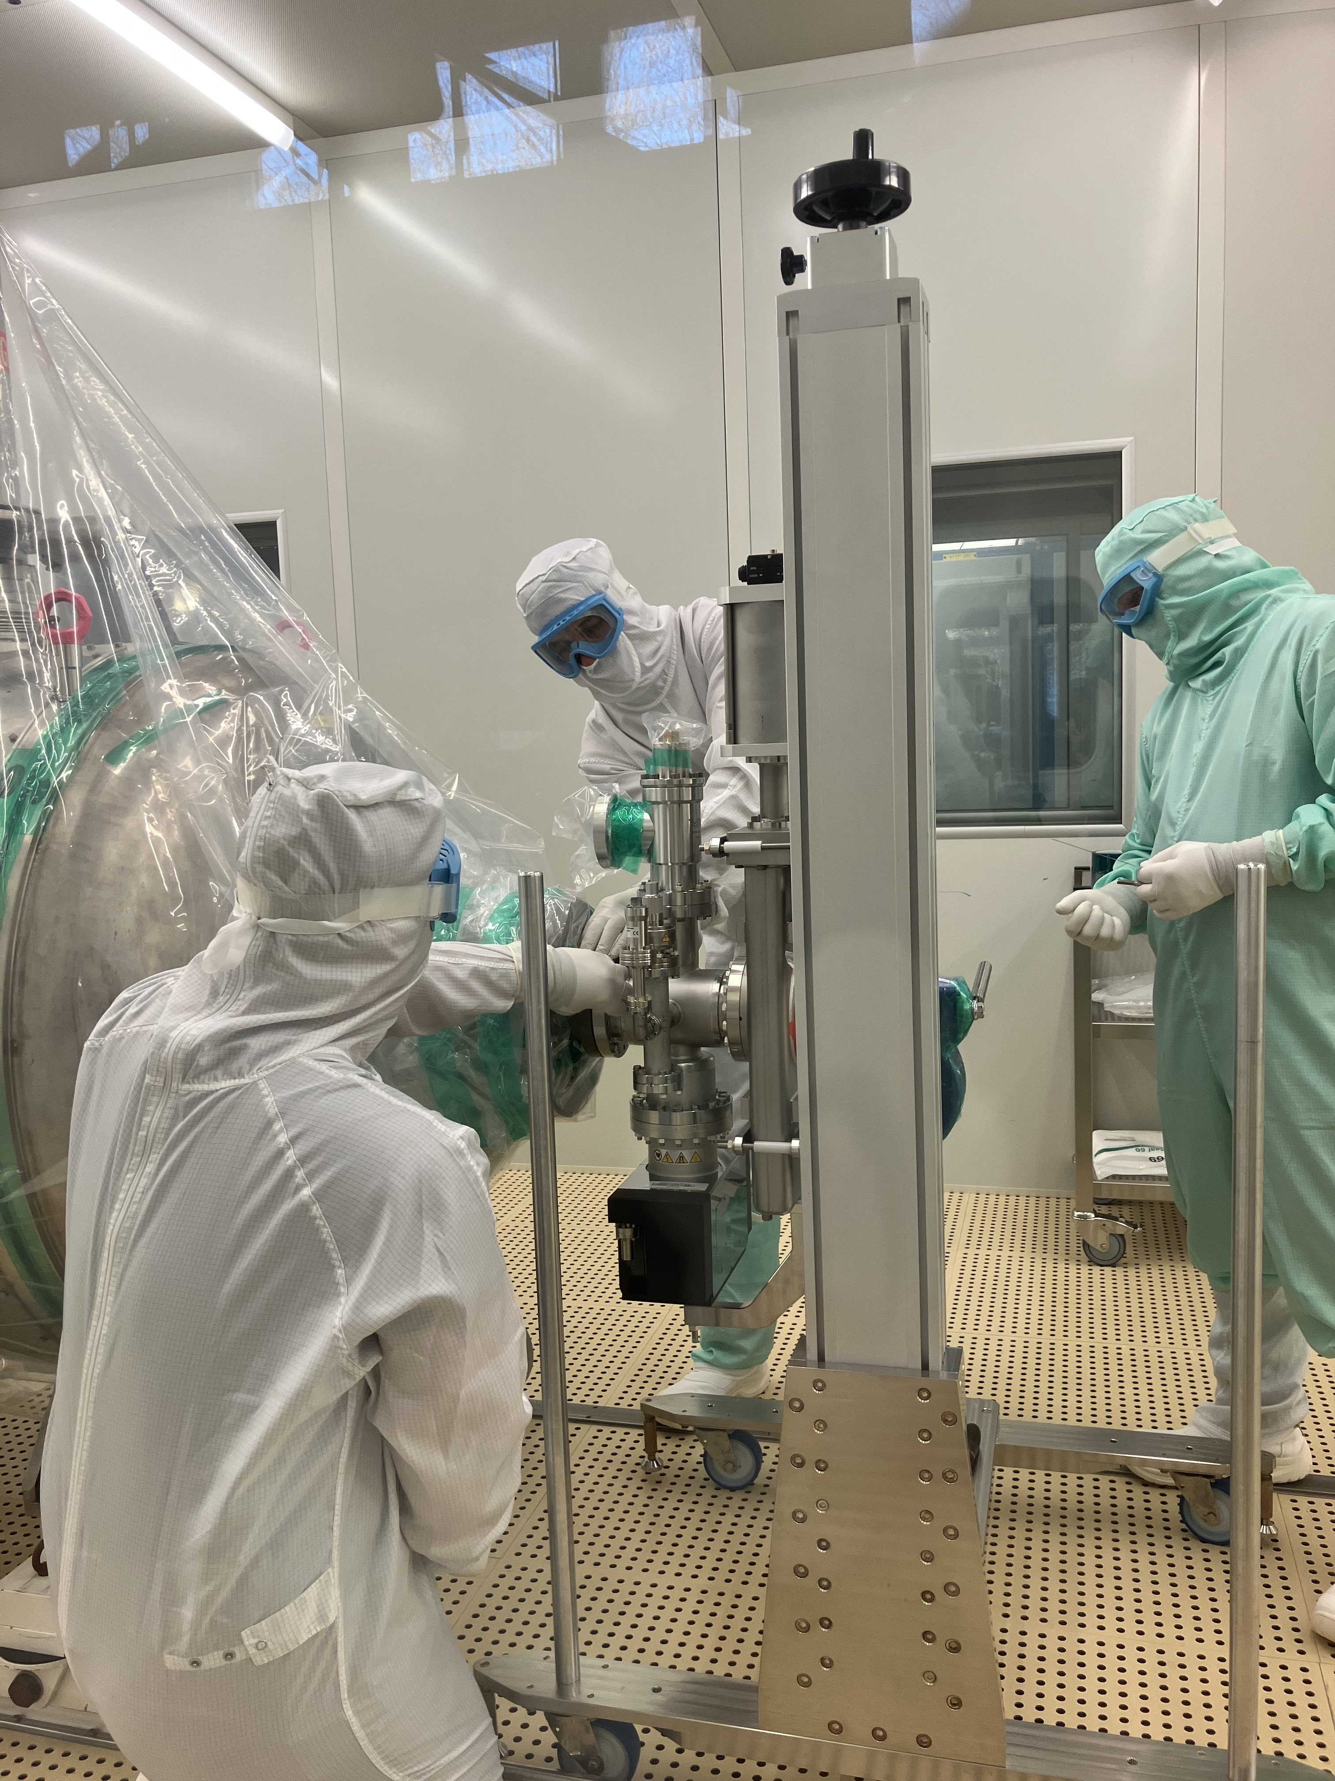
Spare RF Cryomodule
Removed from LHC in 2019 due to the accidental venting.
  RF performance recovered via He processing
  Considered as an operational spare, stored in SM18.
    Equipped with old-type pumping crosses, prone to leaks due to stainless steel corrosion (chlorine residues)
Preparation for cryomodule installation during LS3
  Old pumping crosses replaced with new ones: Leak Test & RGA → OK
  2nd beam line inspection completed
  New electric dome flanges installed and tests

Slide 20
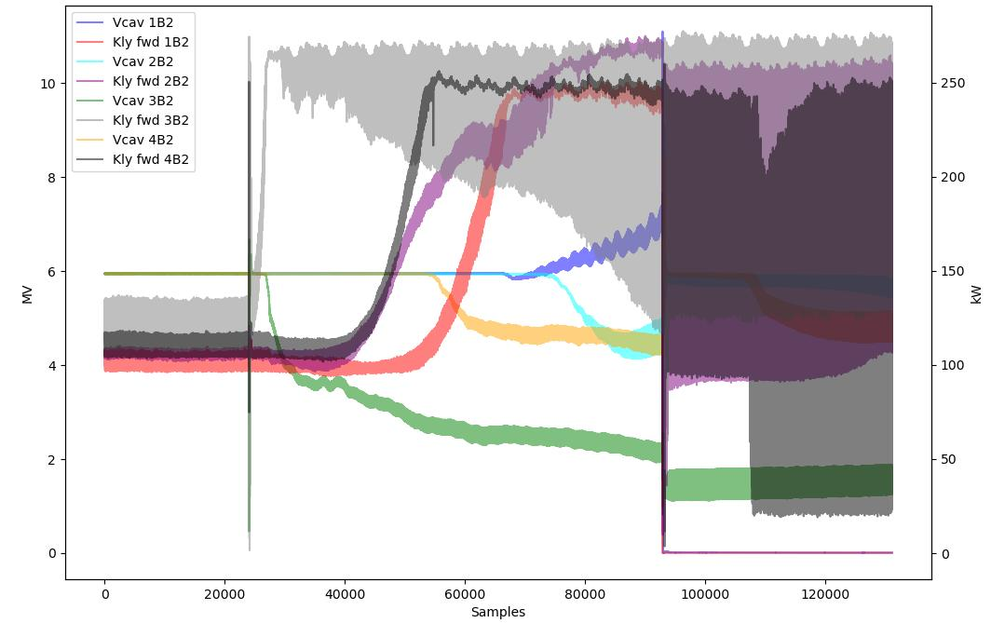
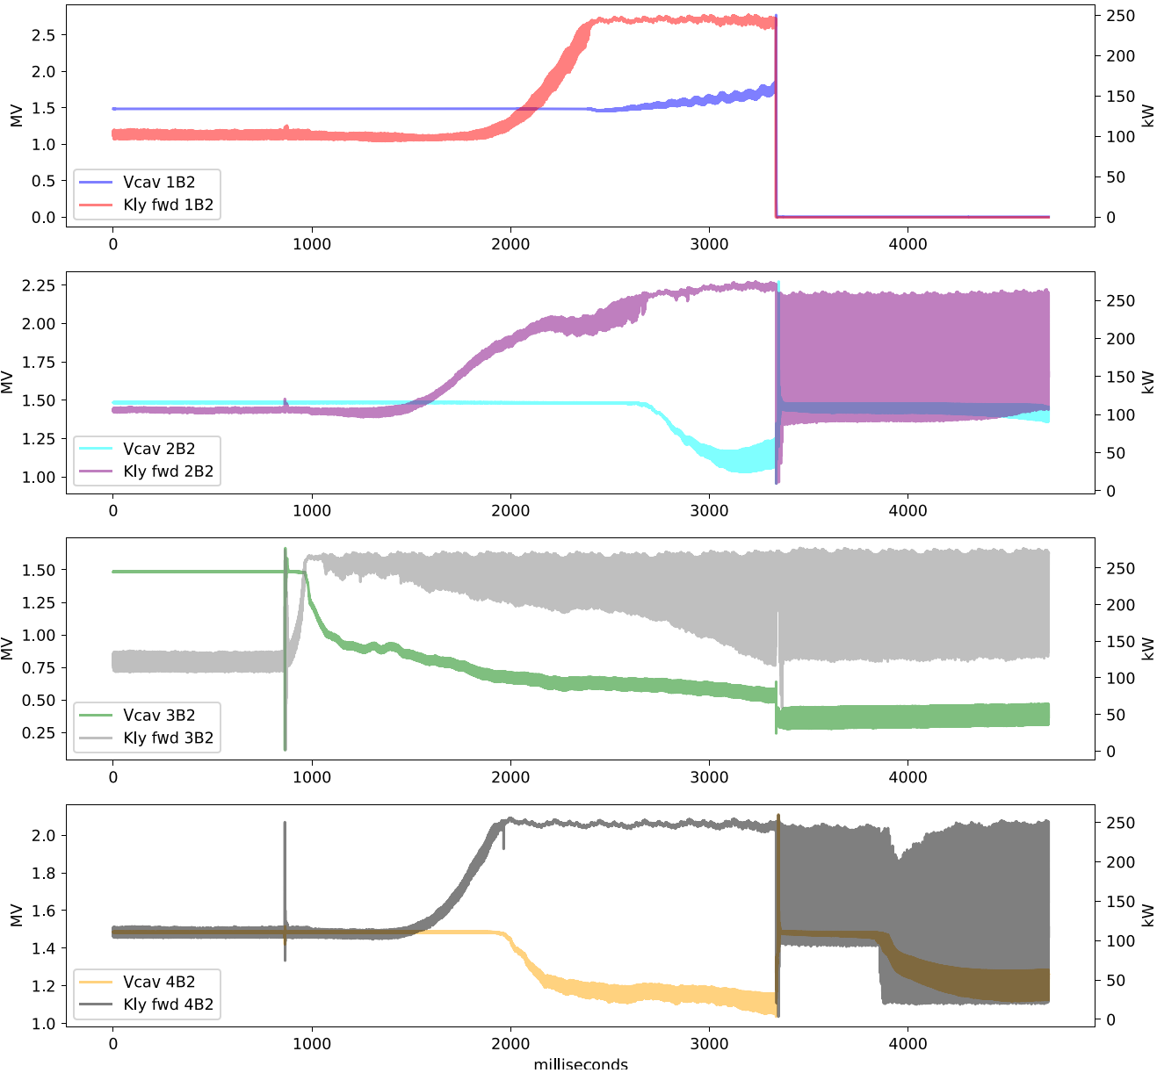
Additional Diagnostics: more data in 2025/2026
More data available during Run 2025
Additional sensors installed
  FE measured near 3B2 higher than elsewhere during the event.
High resolution postmortem power data.
  Initial results suggest that 3B2 may be responsible for M1B2 “quenches”.
Analysis ongoing
Elevated LHe levels not sufficient to prevent events.

Slide 21
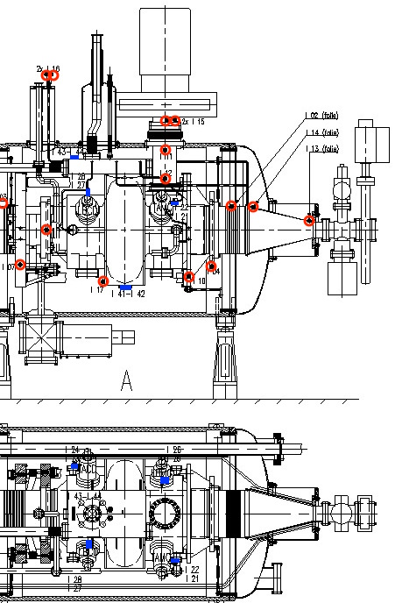
Temperature and Radiation sensors
Temperature sensors
  2 Allan Bradley sensors per coupler
      Interlock level at 6K
  4 CERNOXes (2 top, 2 bottom of the He tank)
Radiation sensors
  5 sensors: at both ends of the modules
RP radiation sensors

