Slide 1
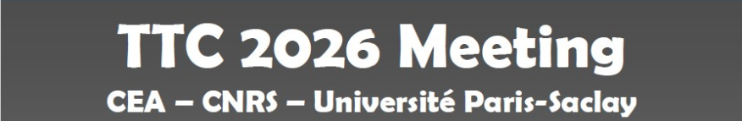
What we learned from the six-year
operation of SRILAC
- Field Emission -
N. Sakamoto, (On behalf of SRF group at RNC)
RIKEN Nishina Center (RNC), Wako, Japan

Slide 2
Table of Contents
RILAC UPGRADE FOR SHE Experiments
SC-QWRs FOR SRILAC
OVERVIEW OF THE SRILAC
OPERATION HISTORY
STATISTICS OF SRILAC OPERATION
SYMPTOM FIELD EMISSION ACTIVATION
EFFECTIVENESS OF HPP
SUMMARY

Slide 3
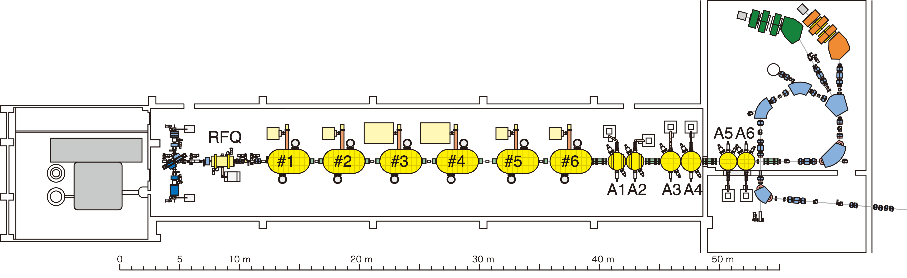


RILAC UPGRADE FOR SHE Experiments
In 2016, RNC commenced a new comprehensive superheavy element (SHE) research program aiming at discovery the new element beyond Z=118 (Oganesson).
For 119 element RNC selected the reaction:
⁵¹V + ²⁴⁸Cm →^{296,295}119 + 3,4n.
This project has collaborated with UTK and ORNL.
⁵¹V¹³⁺ beam with E = 6.2 MeV/u and I = 2.5 puA was required.
Upgrade of the RILAC was performed by replacing in part a superconducting linac, SRILAC, and building a new superconducting electron-cyclotron-resonance ion source, SC-ECR.
H. Sakai et al.,Eur. Phys. J. A,vol.58.pp.238,2022.
T. Nagatomo et al., Rev. Sci. Instrum. 91, 023318 (2020)
T. Nakagawa et al., Rev. Sci. Instrum. 81, 02A320 (2010)
Y. Higurashi et al., Rev. Sci. Instrum. 83, 02A308 (2012)
RILAC
Layout of the RIKEN Heavy-Ion Accelerator
Stable long term operation is the key of this project.
3

Slide 4
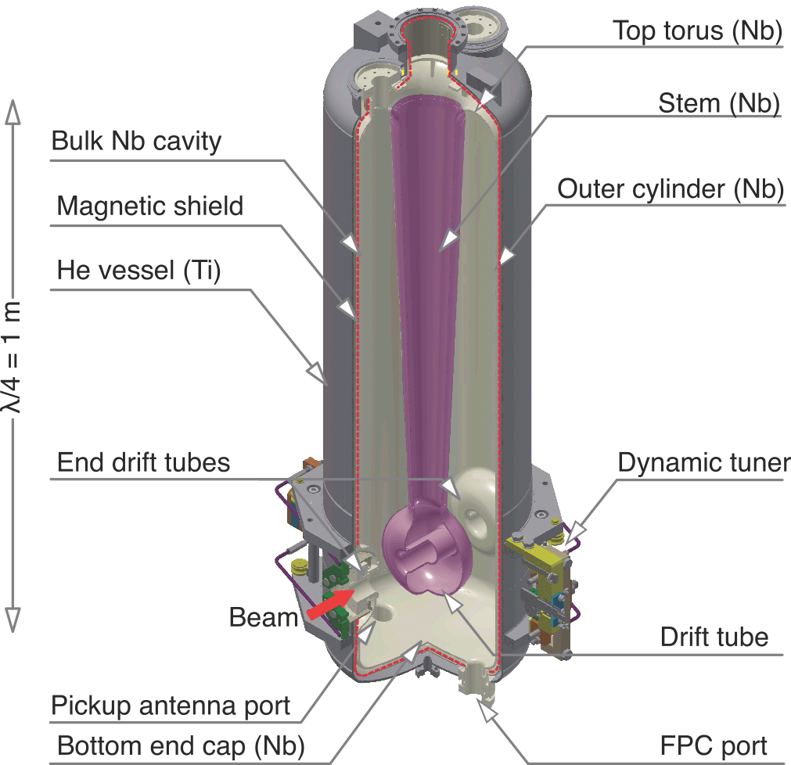
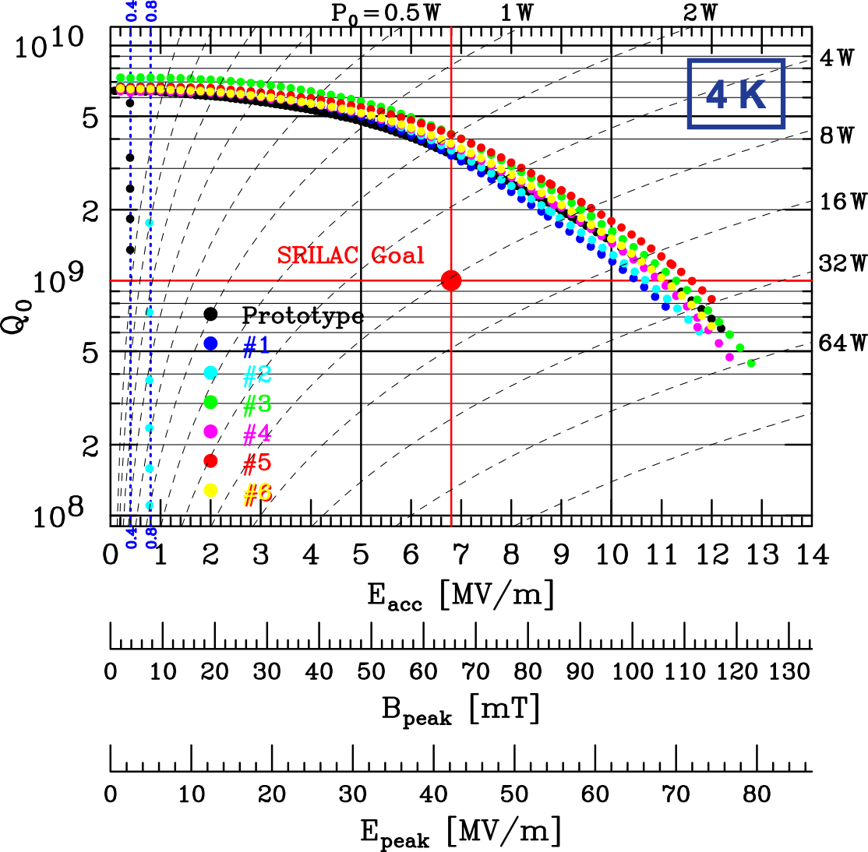
SC-QWRs FOR SRILAC
Bulk Nb (RRR 250:Tokyo Denkai Co.) with BCP based Surface processing
BCP (100 μm)→Annealing (700°C, 3 hr )→BCP (20 μm)→Baking (120°C, 48 hr)
All the cavities had the Q0 exceeding the target value without Field emission.
After assembly, FE appeared at around gap voltage of 1 MV (Eacc = 2.4 MV/m).
Cavities are operated under on-set voltages.
4 MV/m
6.8 MV/m
13.6 MV/m
Parameters
Frequency (MHz) | 73.0 (c.w.)
Optimum β | 0.08
Rsh/Q0 (Ω) | 579
G (=Rsh/Q0) | 22.4
Vacc(MV) | 2.2
Eacc (MV/m) | 6.8
Epeak/Eacc | 6.2
Bpeak/Eacc (mT/(MV/m)) | 9.6
Operating Temperature(K) | 4.5
Target Q0 | 1×10⁹
Operation
Gradient
BCP
Limited by
RF power
RF Characteristics of SC-QWR
Schematic of SC-QWR
Q Measurement of SC-QWR
4

Slide 5
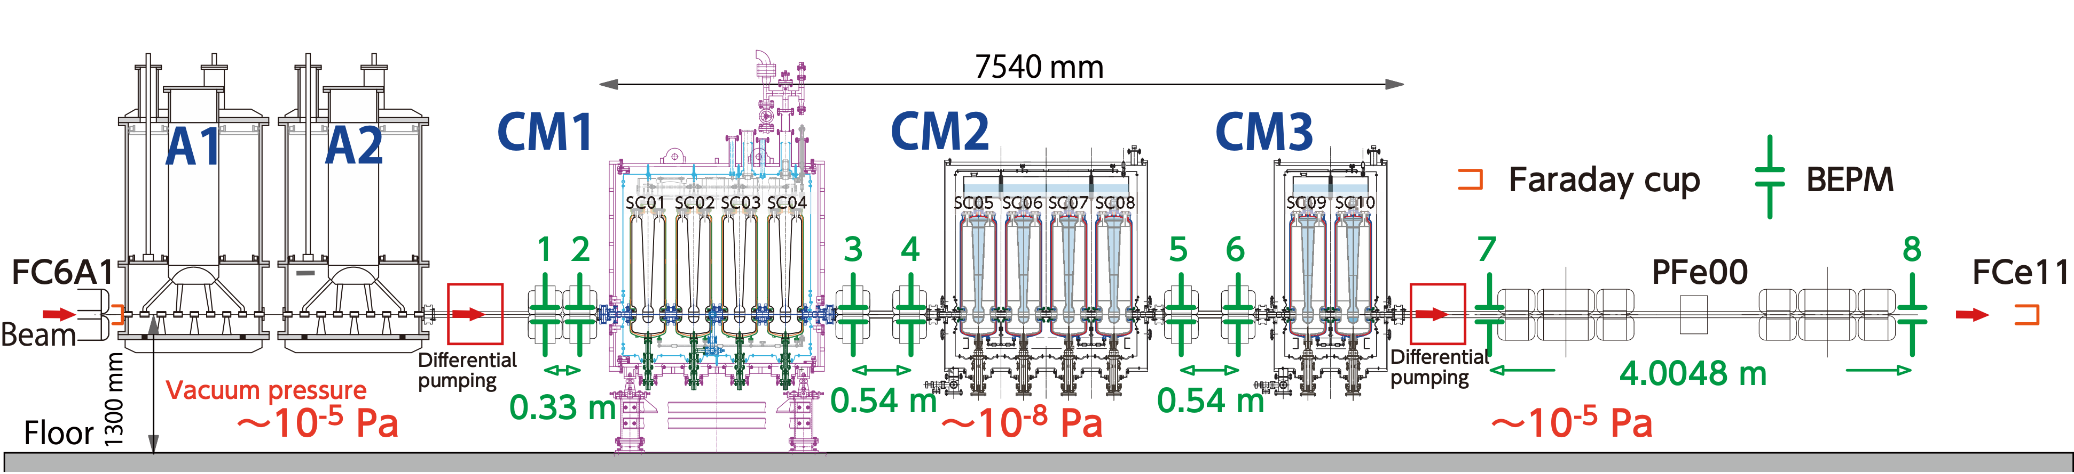
OVERVIEW OF SRILAC
Three Cryomodules host 10 SC-QWRs (CW, 73 MHz) at 4.5 K.
Vacuum pressure of MEBT line is about 1x10⁻⁸ Pa with IP and NEG pumps.
Non-destructive beam monitors at MEBT.
Beam transport to maximize the transmission efficiency from FC-6A1 to FC-e11
Three-stage differential pumping systems (DPS) are introduced at the both end of SRILAC to prevent gas flow from RT section where several x10⁻⁵ Pa.
SC05 and SC06 have got vacuum leak from their coupler windows.
MEBT
MEBT
MEBT
HEBT
-
-
-
Layout of SRILAC
5

Slide 6
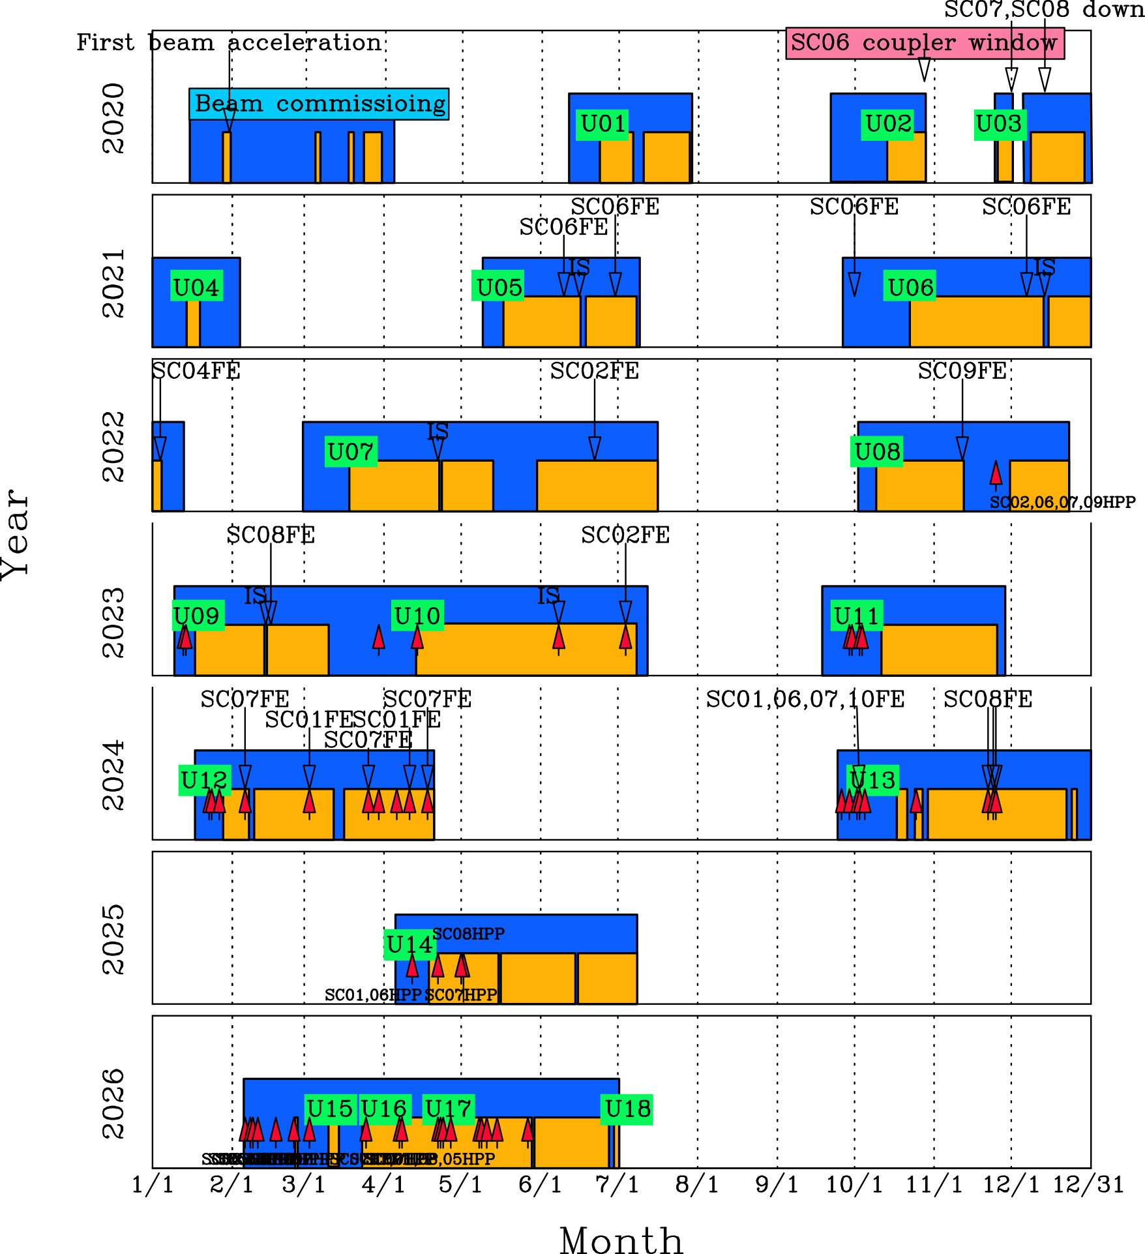

OPERATION HISTORY
Since the beam commissioning, user services were performed for 17 times.
Ions : ⁴⁰Ar¹³⁺, ⁵¹V¹³⁺, ⁴He²⁺
Energy : 4.2 to 6.3 MeV/u (HI), 7.5 MeV/u (α)
Beam Power : < 1.2 kW
1st Beam
FPC
9 cavity-operation
8 cavity-operation
10 cavity-operation
4K
User
Today
Beam
HPP
6

Slide 7


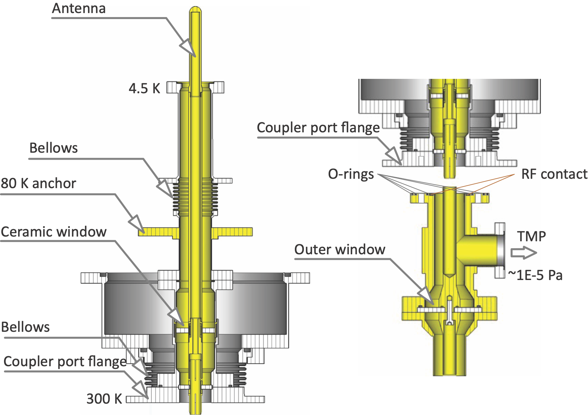
Operation history since the beam commissioning
OPERATION HISTORY
Since the beam commissioning, user services were performed for 17 times.
Ions : ⁴⁰Ar¹³⁺, ⁵¹V¹³⁺, ⁴He²⁺
Energy : 4.2 to 6.3 MeV/u (HI), 7.5 MeV/u (α)
Beam Power : < 1.2 kW
10-cavity operation has been running after the adoption of vacuum port with an additional window to the FPCs.→This has been working very well.
External window
6

Slide 8
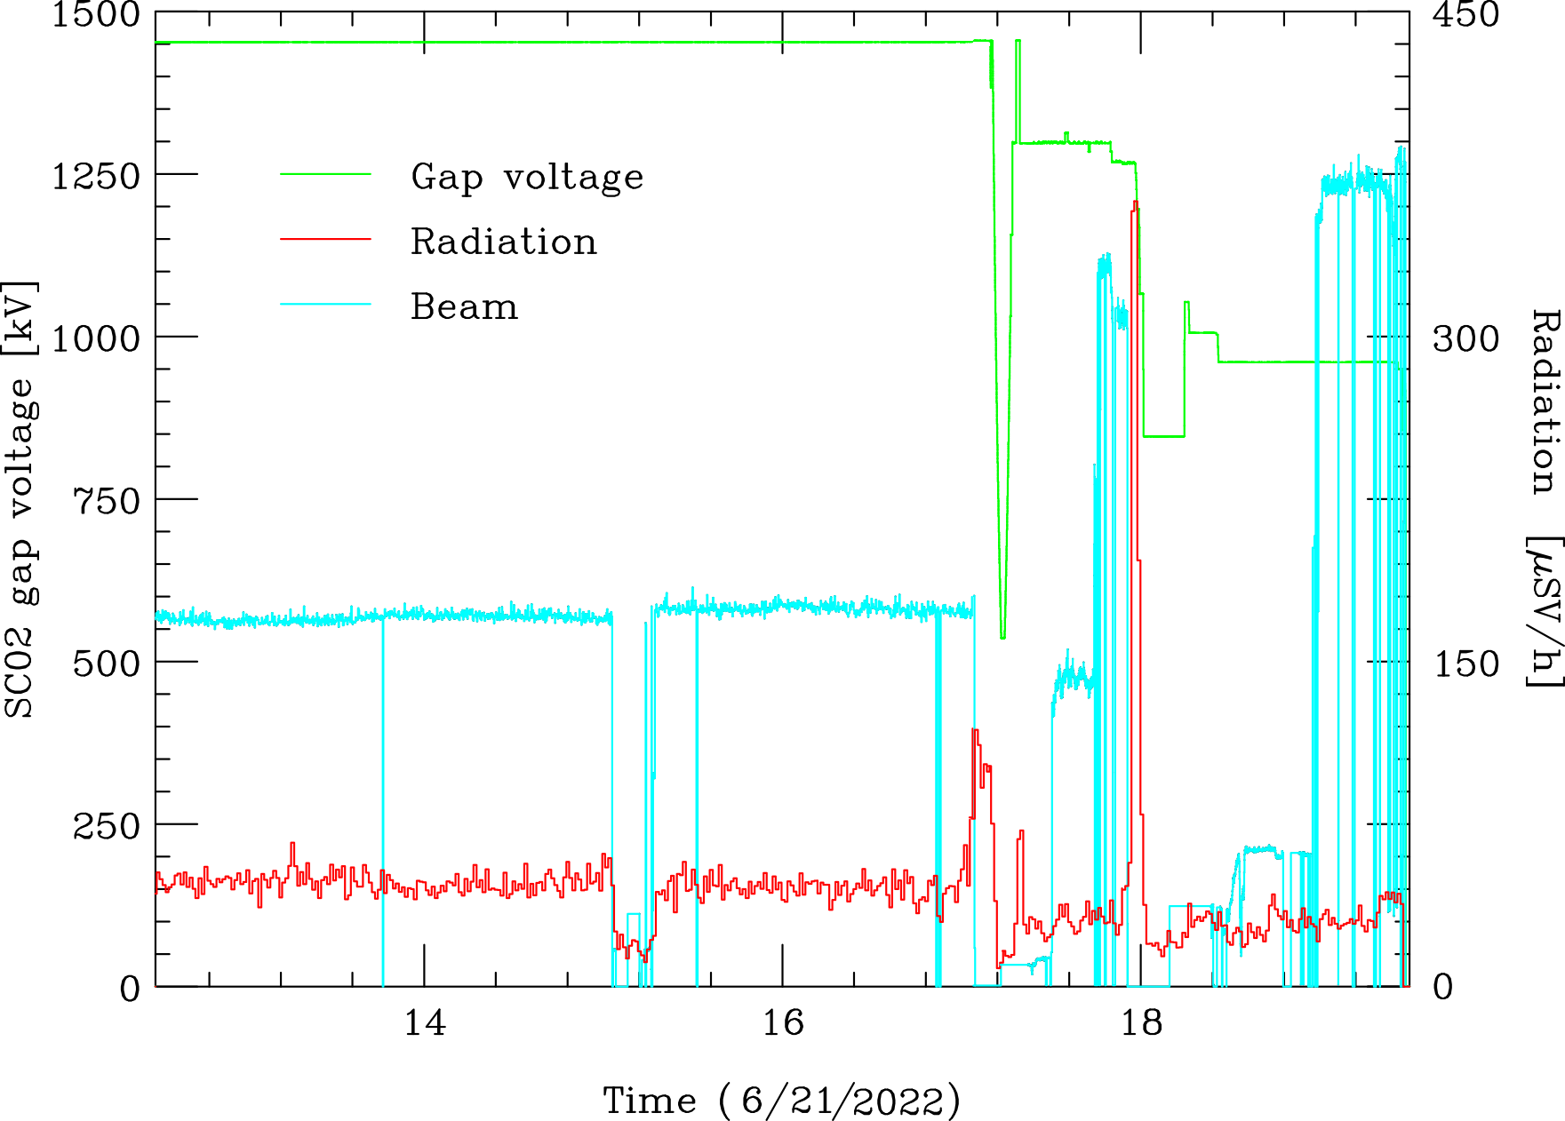
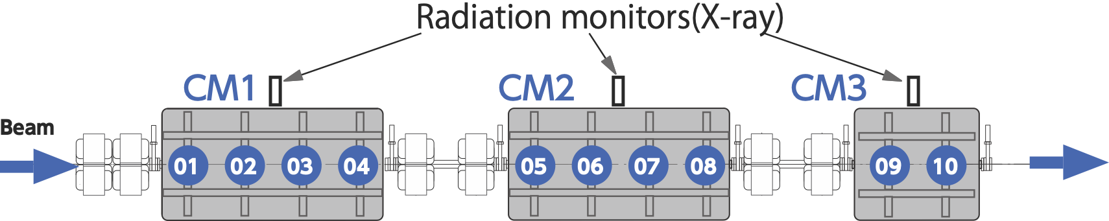
Operation history since the beam commissioning
OPERATION HISTORY
Since the beam commissioning, user services were performed for 17 times.
Ions : ⁴⁰Ar¹³⁺, ⁵¹V¹³⁺, ⁴He²⁺
Energy : 4.2 to 6.3 MeV/u (HI), 7.5 MeV/u (α)
Beam Power : < 1.2 kW
10-cavity operation has been running after the adoption of vacuum port with an additional window to the FPCs.→This has been working very well.
Sudden Field emission/ electronic quench occurred repeatedly during beam service.
6

Slide 9
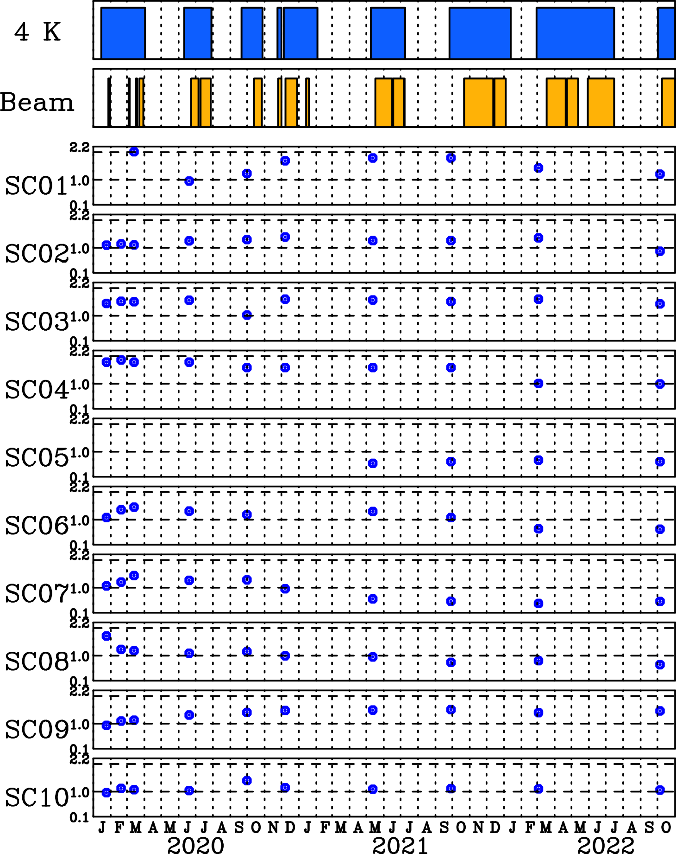

Operation history since the beam commissioning
OPERATION HISTORY
Since the beam commissioning, user services were performed for 17 times.
Ions : ⁴⁰Ar¹³⁺, ⁵¹V¹³⁺, ⁴He²⁺
Energy : 4.2 to 6.3 MeV/u (HI), 7.5 MeV/u (α)
Beam Power : < 1.2 kW
10-cavity operation has been running after the adoption of vacuum port with an additional window to the FPCs.→This has been working very well.
Sudden Field emission/ electronic quench occurred repeatedly during beam service.
Onset gap-voltage (indicated as ●)had been degrading.
6

Slide 10
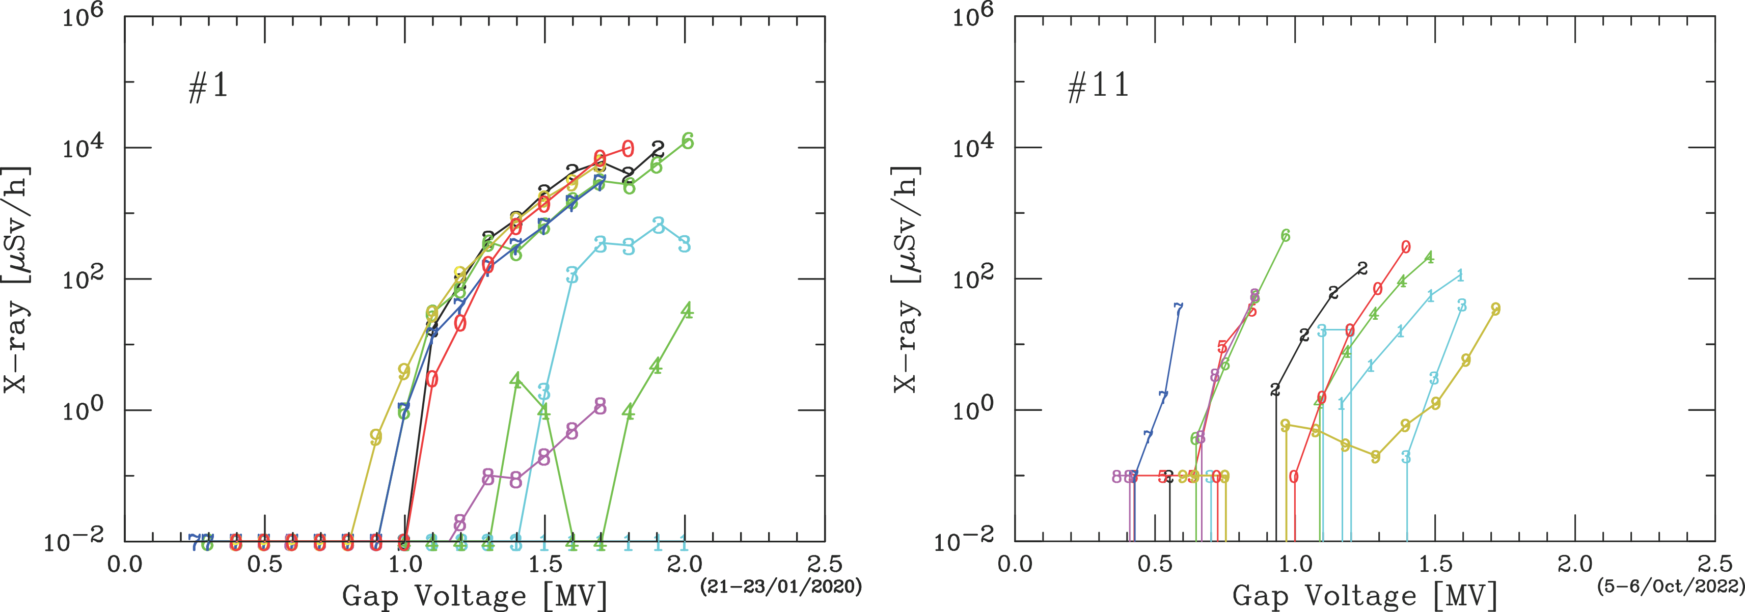
Operation history since the beam commissioning
OPERATION HISTORY
Since the beam commissioning, user services were performed for 17 times.
Ions : ⁴⁰Ar¹³⁺, ⁵¹V¹³⁺, ⁴He²⁺
Energy : 4.2 to 6.3 MeV/u (HI), 7.5 MeV/u (α)
Beam Power : < 1.2 kW
10-cavity operation has been running after the adoption of vacuum port with an additional window to the FPCs.→This has been working very well.
Sudden Field emission/ electronic quench occurred repeatedly during beam service.
Onset gap-voltage (indicated as ●)had been degrading. →(Onset corresponds to Vgap with 1 uSv/h)
1 μSv/h
6

Slide 11
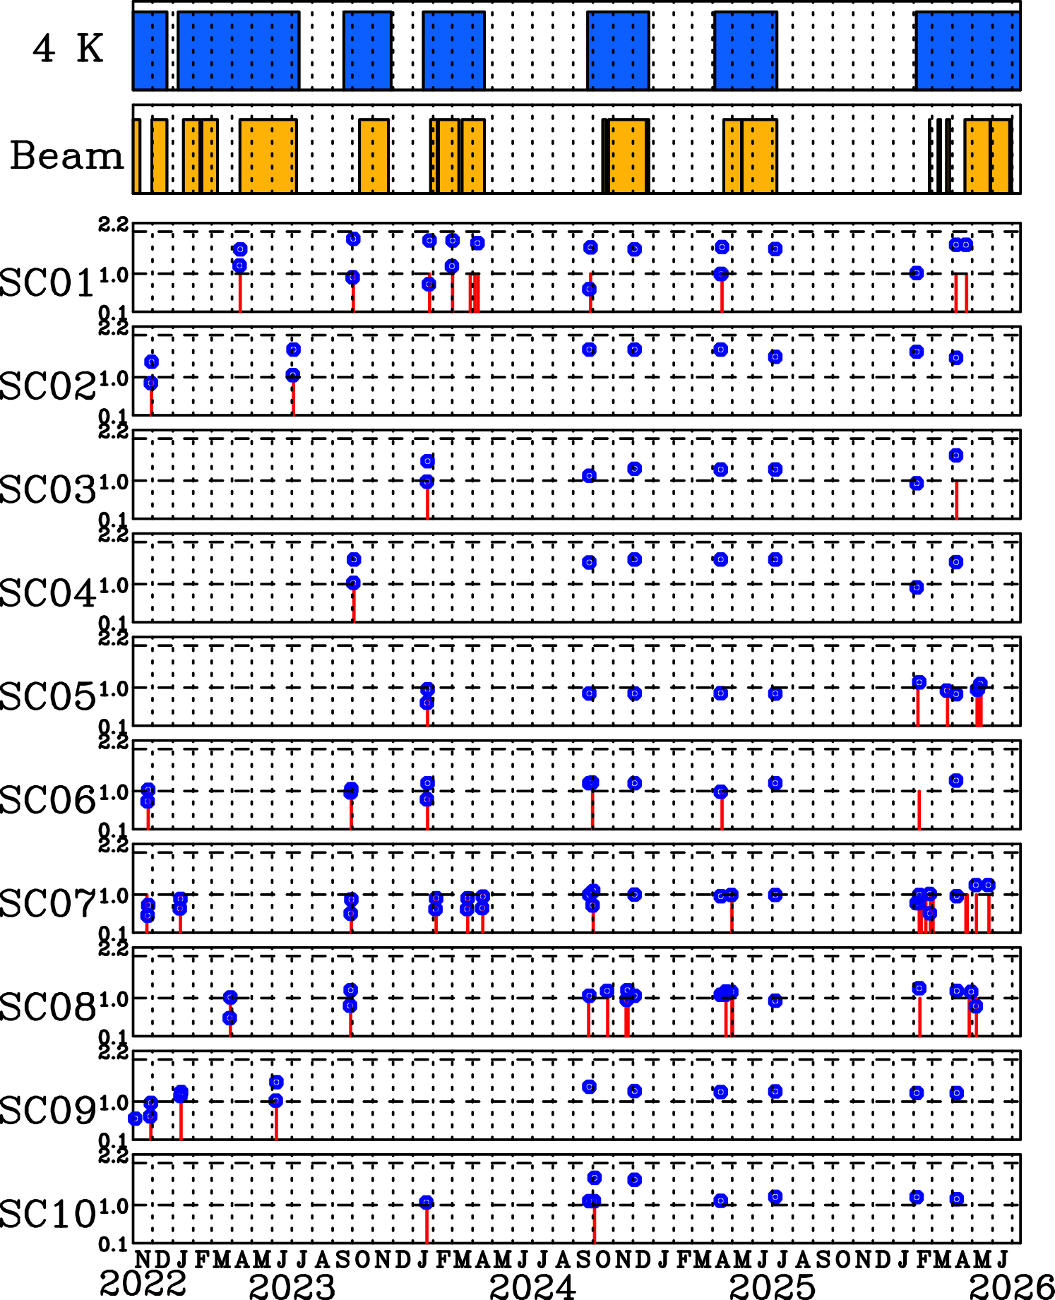
Operation history since the beam commissioning
OPERATION HISTORY
Since the beam commissioning, user services were performed for 17 times.
Ions : ⁴⁰Ar¹³⁺, ⁵¹V¹³⁺, ⁴He²⁺
Energy : 4.2 to 6.3 MeV/u (HI), 7.5 MeV/u (α)
Beam Power : < 1.2 kW
10-cavity operation has been running after the adoption of vacuum port with an additional window to the FPCs.→This has been working very well.
Sudden Field emission/ electronic quench occurred repeatedly during beam service.
Onset gap-voltage (indicated as ●)had been degrading. →(Onset corresponds to Vgap with 1 uSv/h)
High Power RF Processing (HPP, indicated as I ) have been routinely performed and it is still effective to mitigate Field emission/ electronic quench.
6

Slide 12
STATISTICS OF SRILAC OPERATION
4K 1331 days, 14 warm-ups, beam operation 834 days since 2020
GV-open/close
HPP &
Onset
GV-CM1U | GV-CM1D | GV-CM2U | GV-CM2D | GV-CM3U | GV-CM3D
135 | 77 | 55 | 55 | 59 | 177
SCQWR | SC01 | SC02 | SC03 | SC04 | SC05 | SC06 | SC07 | SC08 | SC09 | SC10
HPP | 11 | 2 | 2 | 1 | 6 | 6 | 16 | 14 | 3 | 2
Vonset^{initial} (MV) | (2.2) | 1.1 | 1.4 | 1.8 | 0.6 | 1.1 | 1.1 | 1.7 | 0.9 | 1.0
Vonset²⁰²⁶(MV) | (1.7) | 1.5 | (1.6) | 1.5 | 1.1 | 1.3 | 1.2 | 1.2 | 0.9 | 1.1
() no x-ray observed
GV-CM1U
GV-CM1D
GV-CM2U
GV-CM2D
GV-CM3U
GV-CM3D
7

Slide 13
STATISTICS OF SRILAC OPERATION
4K 1331 days, 14 warm-ups, beam operation 834 days since 2020
GV-open/close
HPP &
Onset
GV-CM1U | GV-CM1D | GV-CM2U | GV-CM2D | GV-CM3U | GV-CM3D
135 | 77 | 55 | 55 | 59 | 177
SCQWR | SC01 | SC02 | SC03 | SC04 | SC05 | SC06 | SC07 | SC08 | SC09 | SC10
HPP | 11 | 2 | 2 | 1 | 6 | 6 | 16 | 14 | 3 | 2
Vonset^{initial} (MV) | (2.2) | 1.1 | 1.4 | 1.8 | 0.6 | 1.1 | 1.1 | 1.7 | 0.9 | 1.0
Vonset²⁰²⁶(MV) | (1.7) | 1.5 | (1.6) | 1.5 | 1.1 | 1.3 | 1.2 | 1.2 | 0.9 | 1.1
() no x-ray observed
GV-CM1U
GV-CM1D
GV-CM2U
GV-CM2D
GV-CM3U
GV-CM3D
5

Slide 14
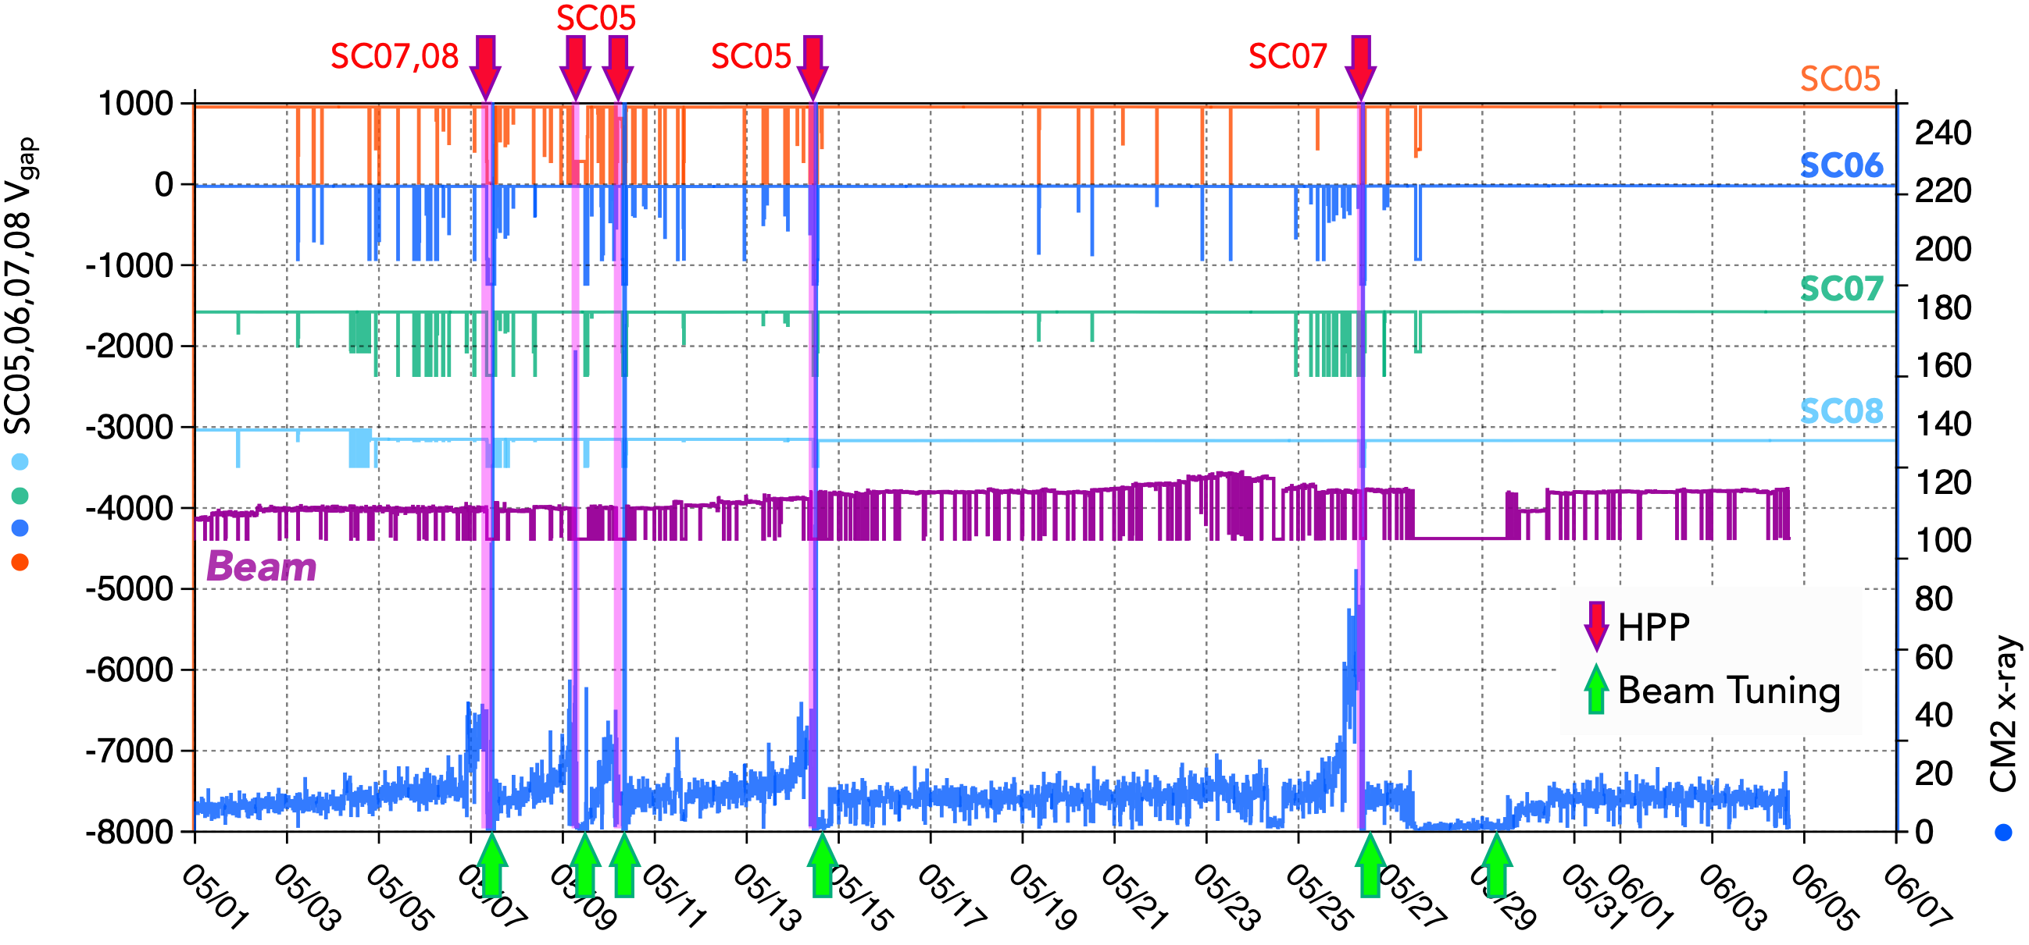
SYMPTOM OF FIELD EMISSION ACTIVATION
Beam tuning has being performed maximizing transmission efficiency from FC-6A1 to FC-e11, minimizing the vacuum level at the room temperature parts between CMs, and minimizing x-ray levels at CMs.
2026
SC05
SC06
SC07
SC08
8

Slide 15
SYMPTOM OF FIELD EMISSION ACTIVATION
Beam tuning has being performed maximizing transmission efficiency from FC-6A1 to FC-e11, minimizing the vacuum level at the room temperature parts between CMs, and minimizing x-ray levels at CMs.
This year SC05,07,08 have been repeatedly processed during beam service.
2026
SC05
SC06
SC07
SC08
8

Slide 16
SYMPTOM OF FIELD EMISSION ACTIVATION
Beam tuning has being performed maximizing transmission efficiency from FC-6A1 to FC-e11, minimizing the vacuum level at the room temperature parts between CMs, and minimizing x-ray levels at CMs.
This year SC05,07,08 have been repeatedly processed during beam service
The region with beam loss looked changing the position according to the beam tuning.
2026
SC05
SC06
SC07
SC08
8

Slide 17
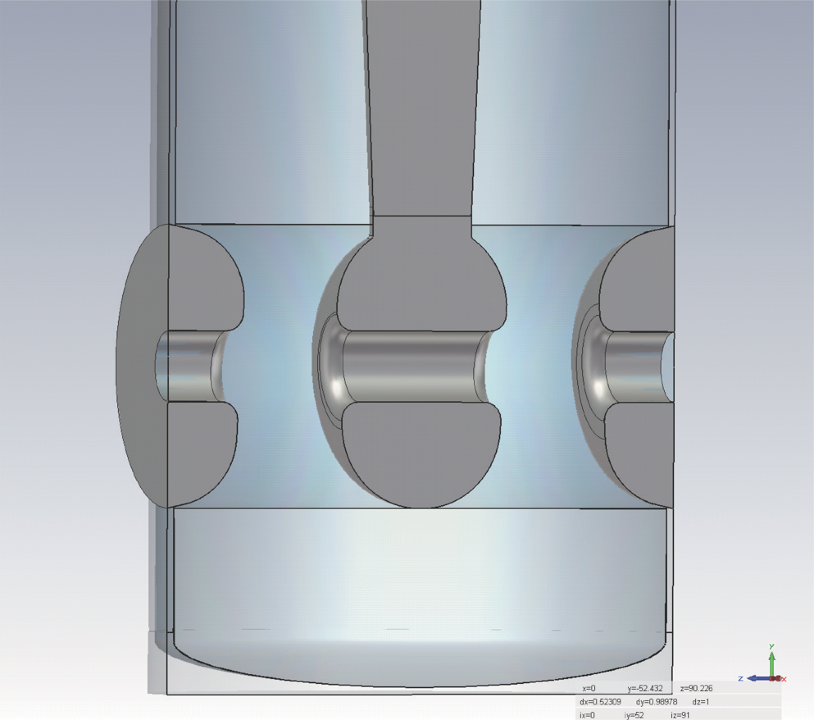

SYMPTOM OF FIELD EMISSION ACTIVATION
Beam tuning has being performed maximizing transmission efficiency from FC-6A1 to FC-e11, minimizing the vacuum level at the room temperature parts between CMs, and minimizing x-ray levels at CMs.
This year SC05,07,08 have been repeatedly processed during beam service
The region with beam loss looked changing the position according to the beam tuning.
e
e
Beam
2026
X-ray
X-ray
Electronic quench by secondary
electron emission w/beam
Electronic quench by E-field
electron emission w/o beam
The power deposited by the impacting ions looks to change the intrinsic properties of the emitter.
8

Slide 18
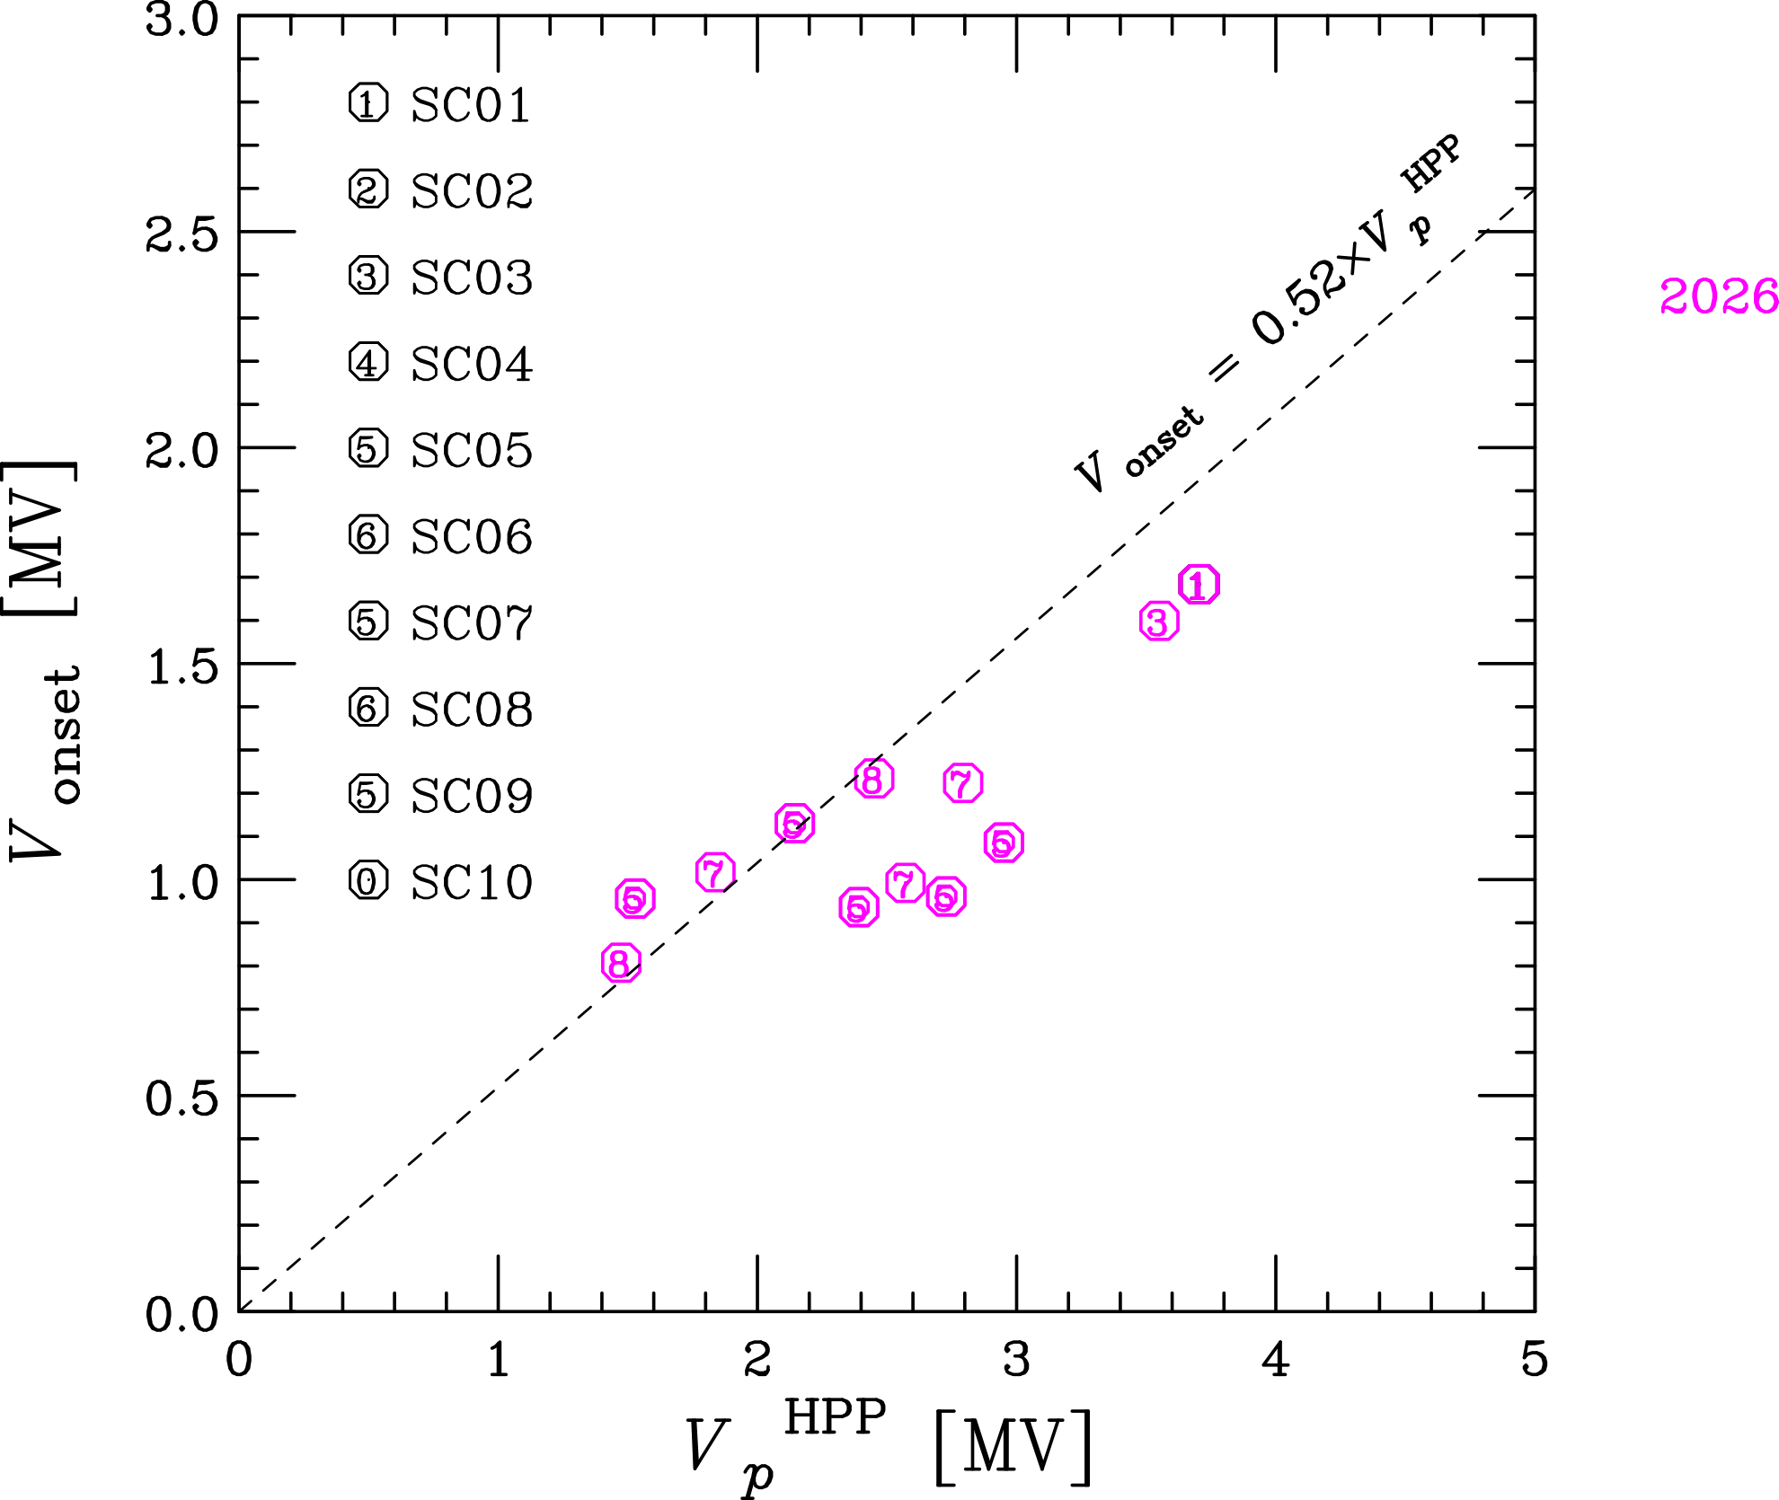
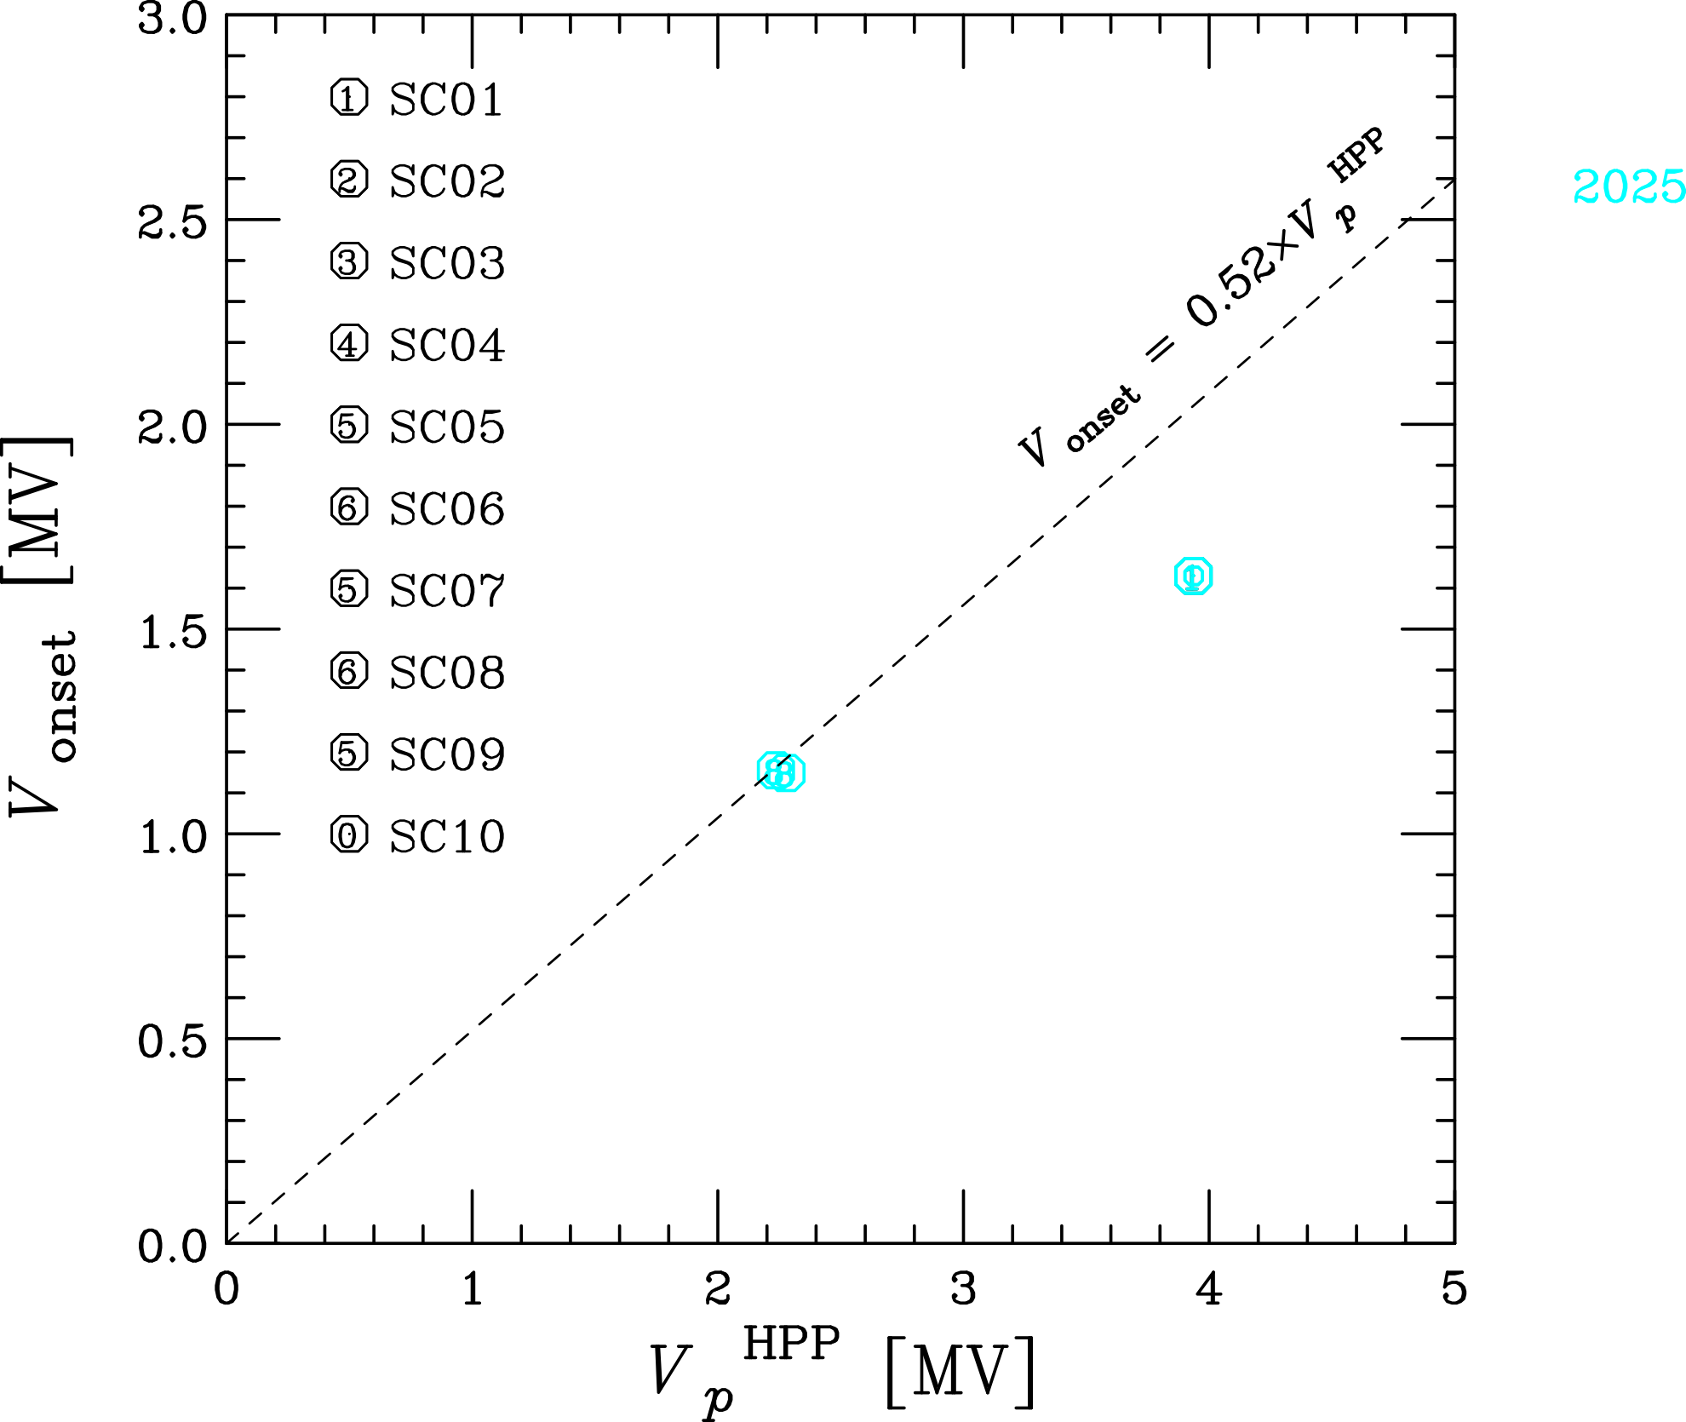
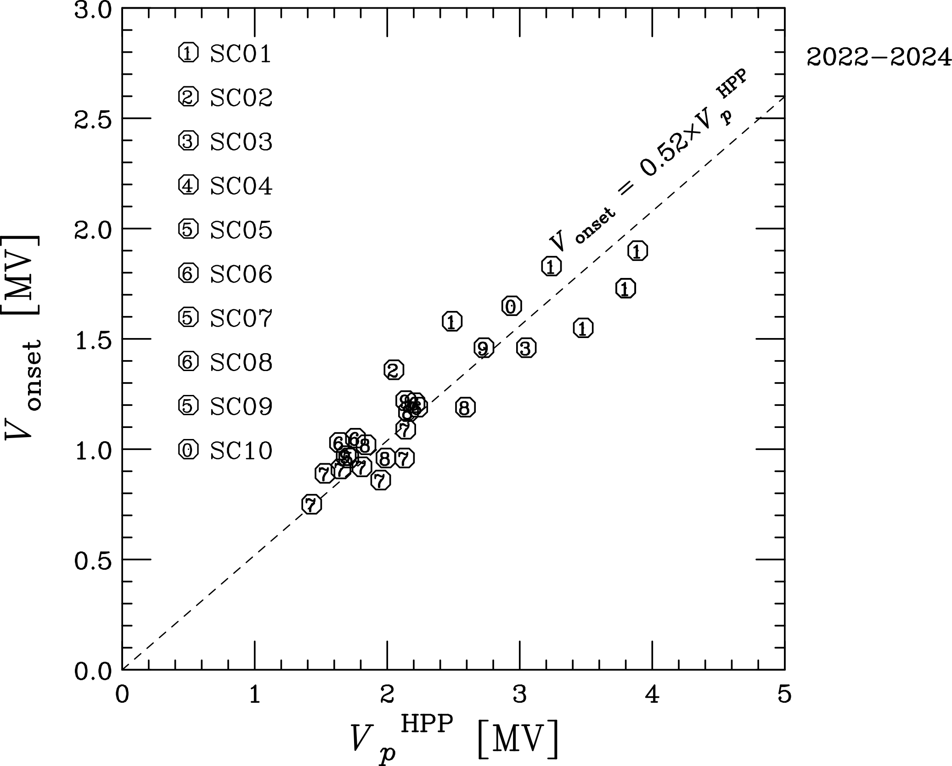
EFFECTIVENESS OF HPP
0.5 Hz and a 1% duty RF pulse with a width of 20 ms was adopted which was sufficient to raise the cavity voltage (Pt) up to 90% with a detuning of 50 Hz.
For HPP from 2022 to 2024, the onset voltage became 52% of the maximum voltage ow the pulsed RF. (indicated with black circles)
In the initial HPPs in 2022, the cavities experienced abrupt decrease of x-ray.
For HPPs in 2025 and 2026, with SC05, SC07, SC08, it looks still effective but the ratios become smaller. (cyan and mageta ones)
Electronic quench levels for CM2 cavites occasionally become lower than those of onset.
9

Slide 19
SUMMARY
RIKEN superconducting linac, SRILAC, has been operating for 6.5 years.
User beam services for experiments of super-heavy element synthesis have been continuously performed.
For SC05 and SC06, external vacuum window work well after the leakage of those couplers.
SC-QWRs suffer from sudden increases in FE during beam service.
Beam loss activates the FE and lowers onset and electronic quench level.
HPP is found effective to reduce field emission irreversibly at a given field level.
Further effectiveness of HPP against FE and is being investigated especially with higher voltage processing so that the target operation gradient 6.8 MV/m might be available without field emission.
All the SC-QWRs continue to function reliably over six years of use!!
This work is partly supported by MS10 Okuno program.
10

Slide 20
Thank you for your attention.

Slide 21
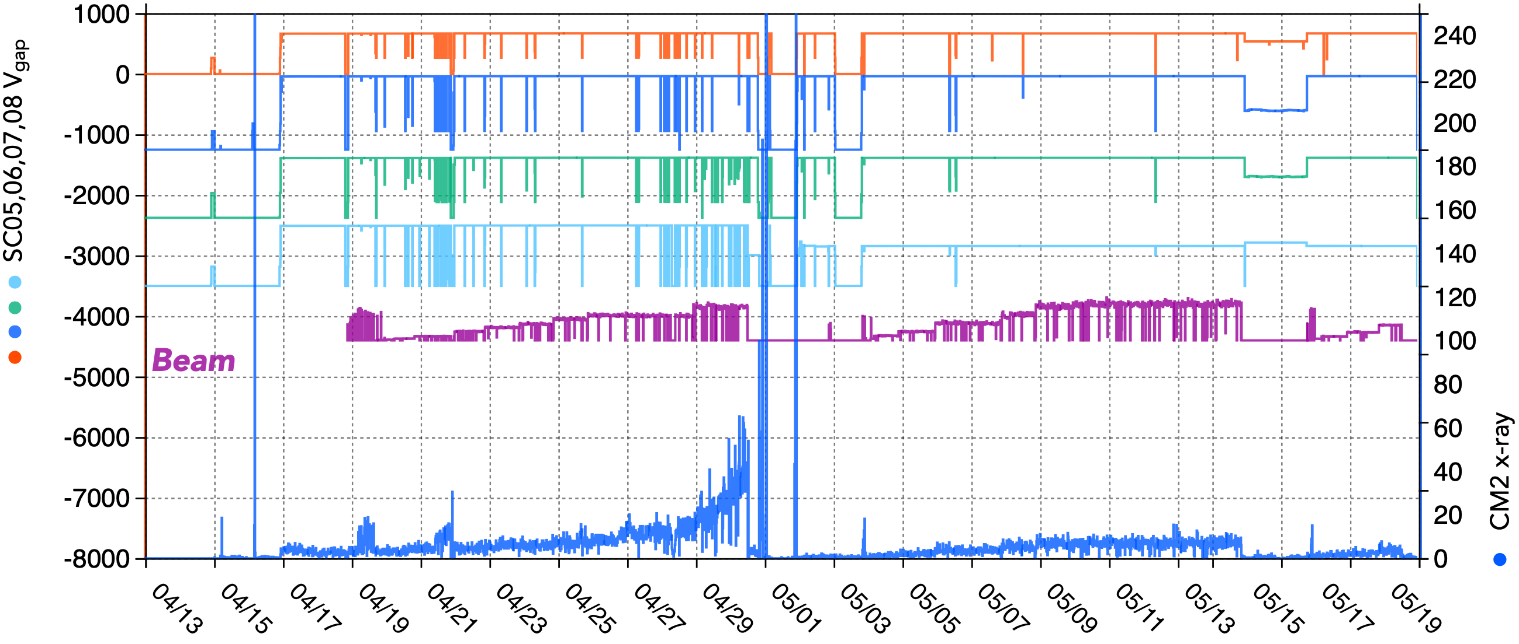
SYMPTOM OF FIELD EMISSION ACTIVATION
Beam tuning has being performed maximizing transmission efficiency from FC-6A1 to FC-e11, minimizing the vacuum level at the room temperature parts between CMs, and minimizing x-ray levels at CMs.
FC-6A1
FC-e11
2025
SC05
SC06
SC07
SC08
8

